Slide 1
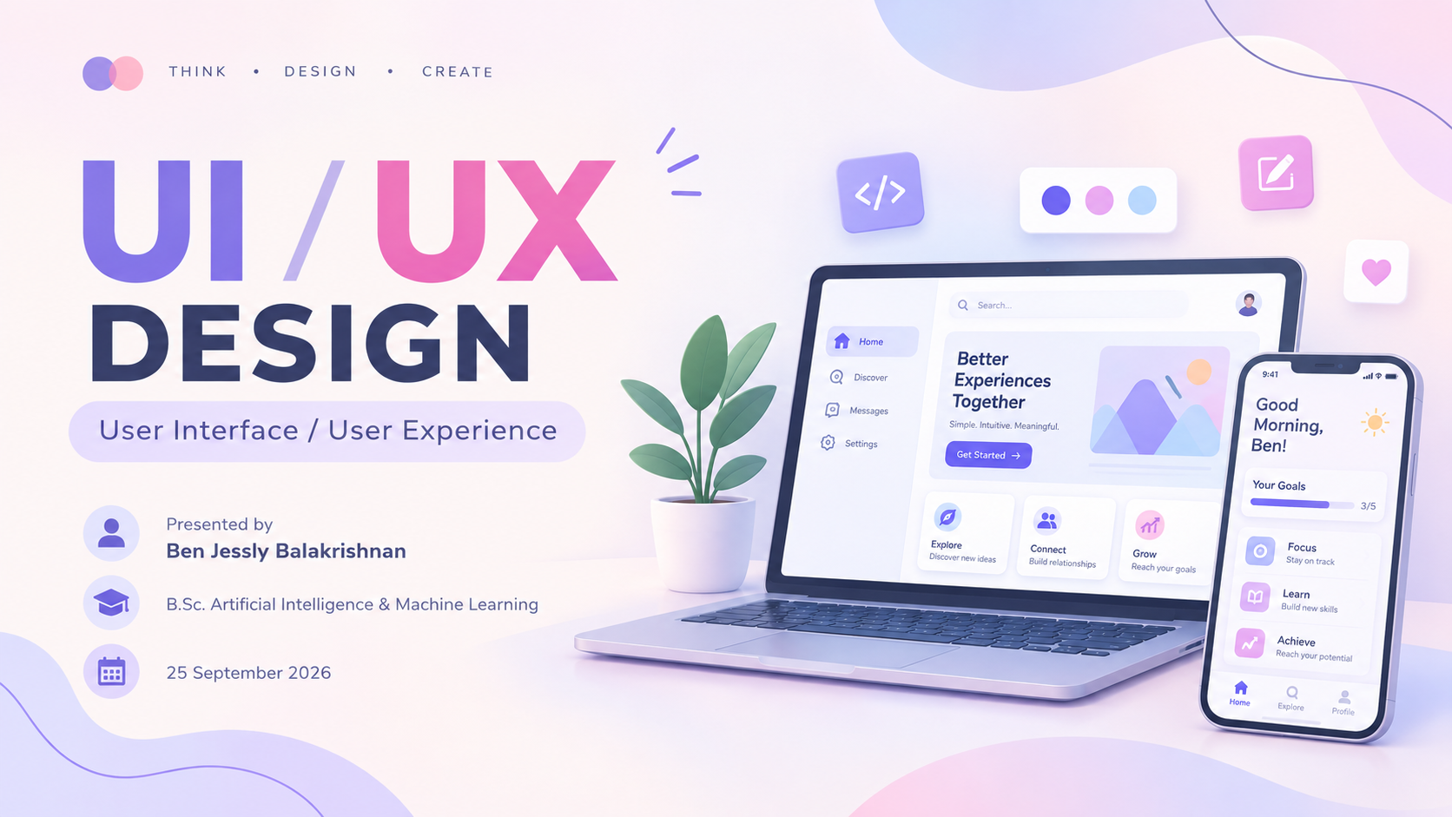

Slide 2



What is UI?
UI = User Interface
The visual and interactive part of a digital product.
Includes buttons, menus, icons, colors, typography, layouts, and screens.
Goal: make the interface clear, attractive, and easy to interact with.

Slide 3
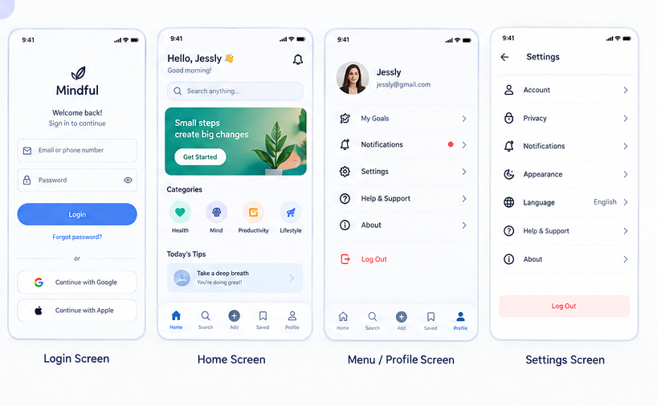
Why is UI Important?
Creates a clear first impression.
Helps users understand what to do and where to click.
Improves readability, consistency, and accessibility.
Supports faster and more comfortable interaction.

Slide 4
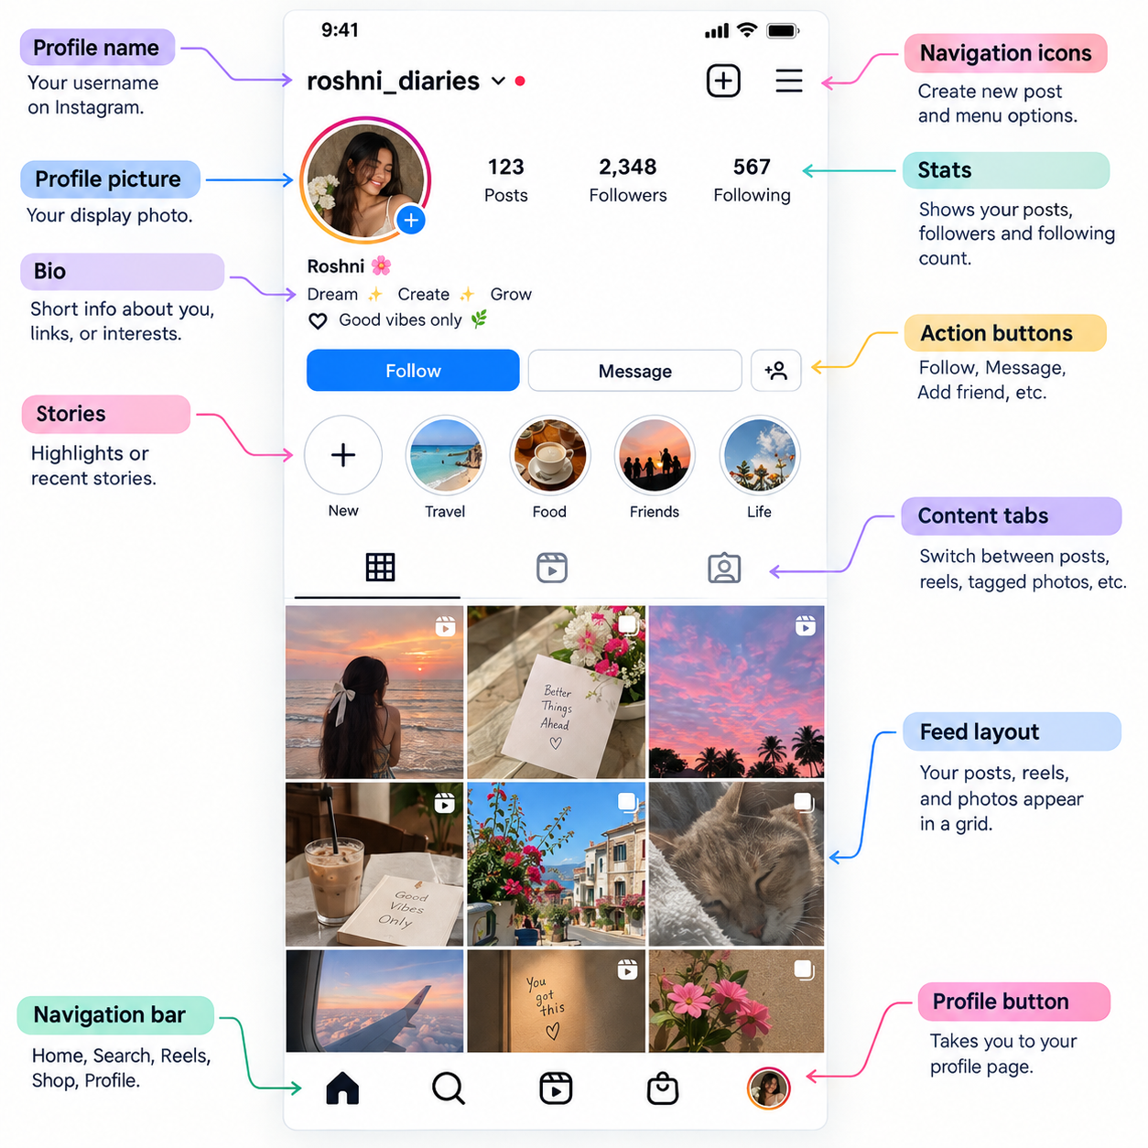
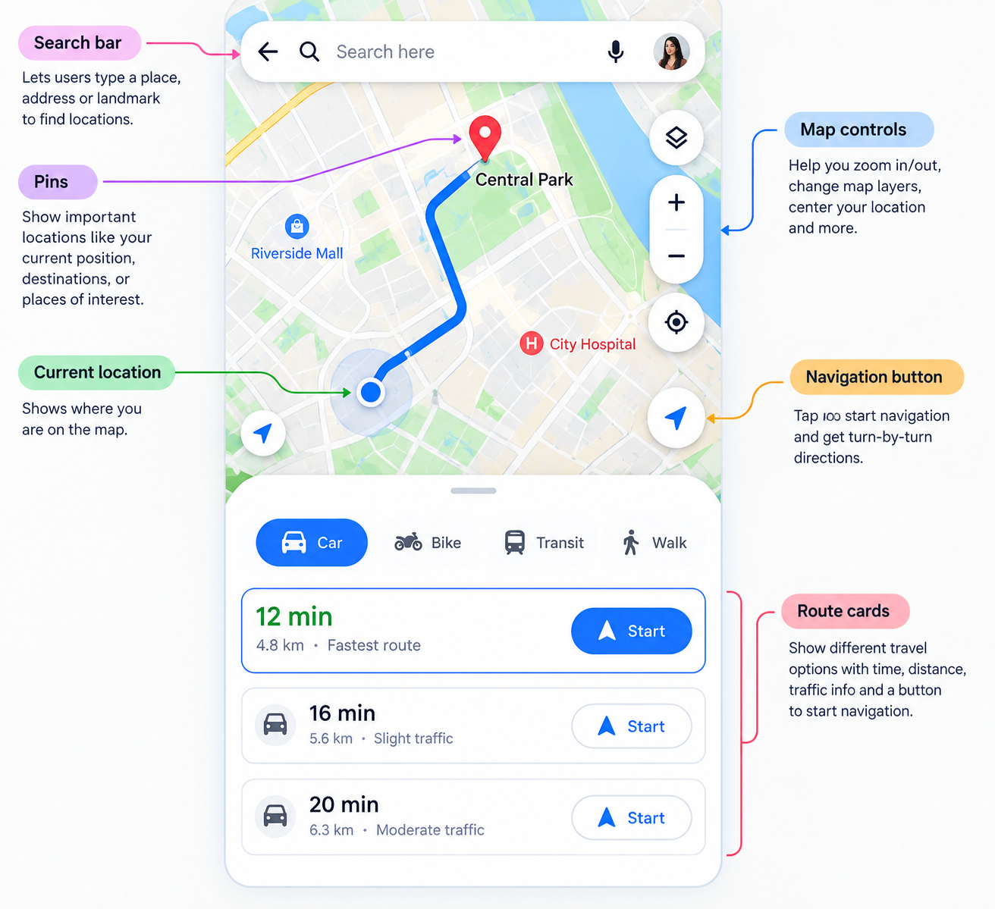
2 Real-Time Examples of UI
Instagram
Google Maps
Profile pages, navigation icons, buttons, stories, and the visual feed layout are UI elements.
Search bar, map controls, pins, navigation buttons, and route cards form the UI.

Slide 5
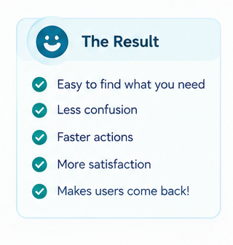
What is UX?
UX = User Experience
The overall experience a person has while using a product or service.
Covers research, user needs, information architecture, interaction flow, and usability.
Goal: make the journey useful, understandable, and satisfying.

Slide 6
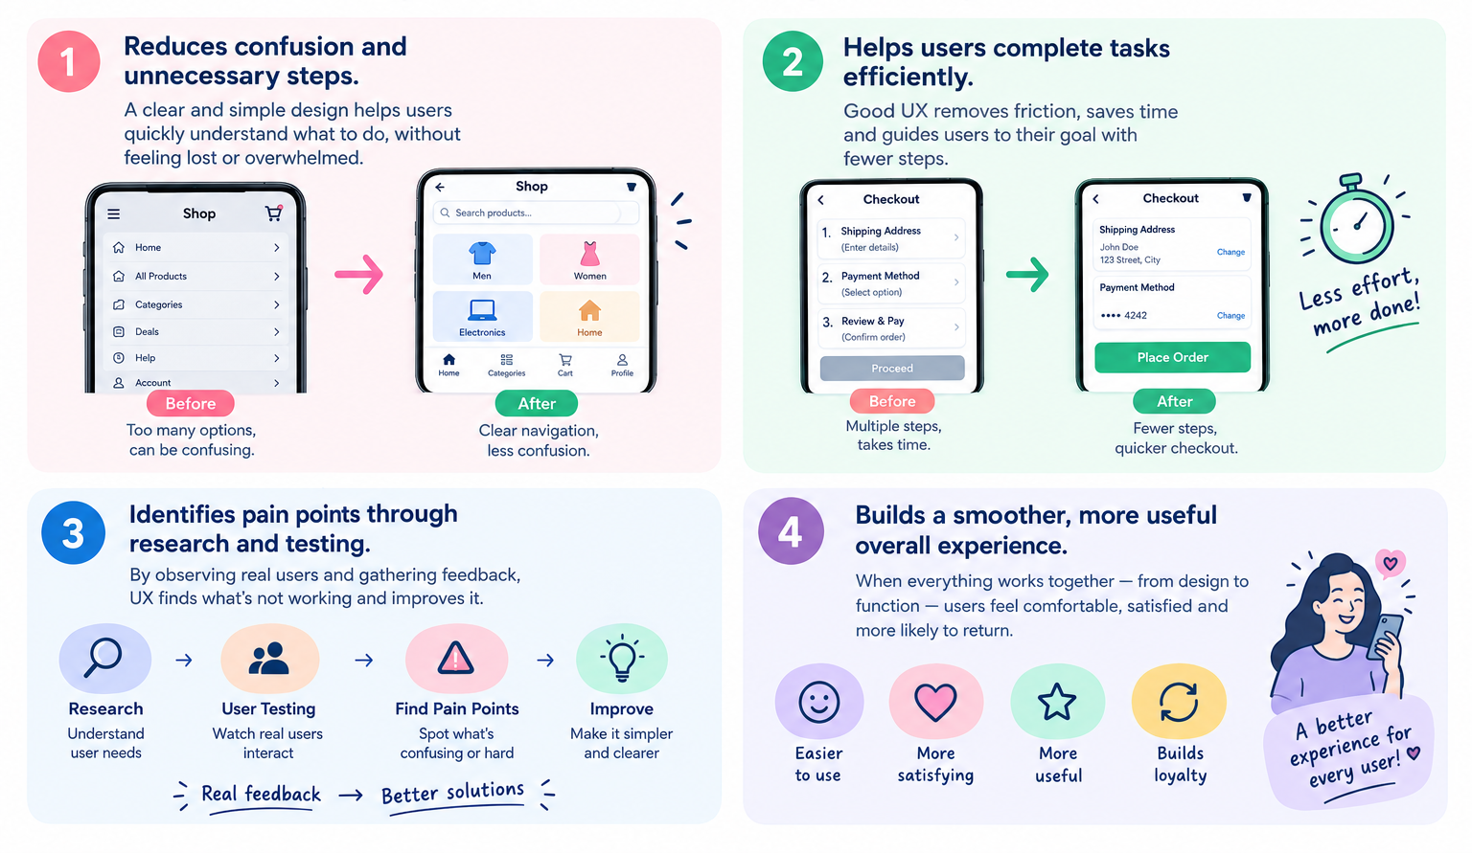
Why is UX Important?
Reduces confusion and unnecessary steps.
Helps users complete tasks efficiently.
Builds a smoother, more useful overall experience.

Slide 7
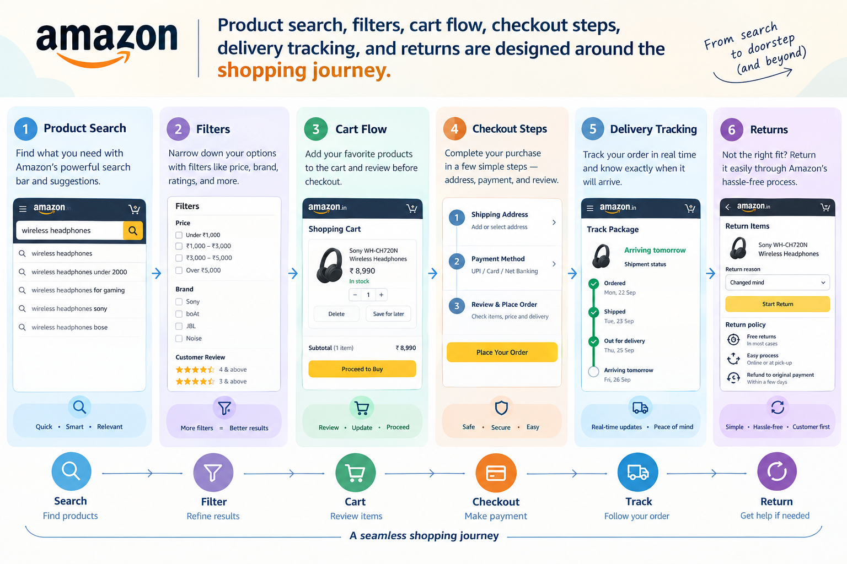
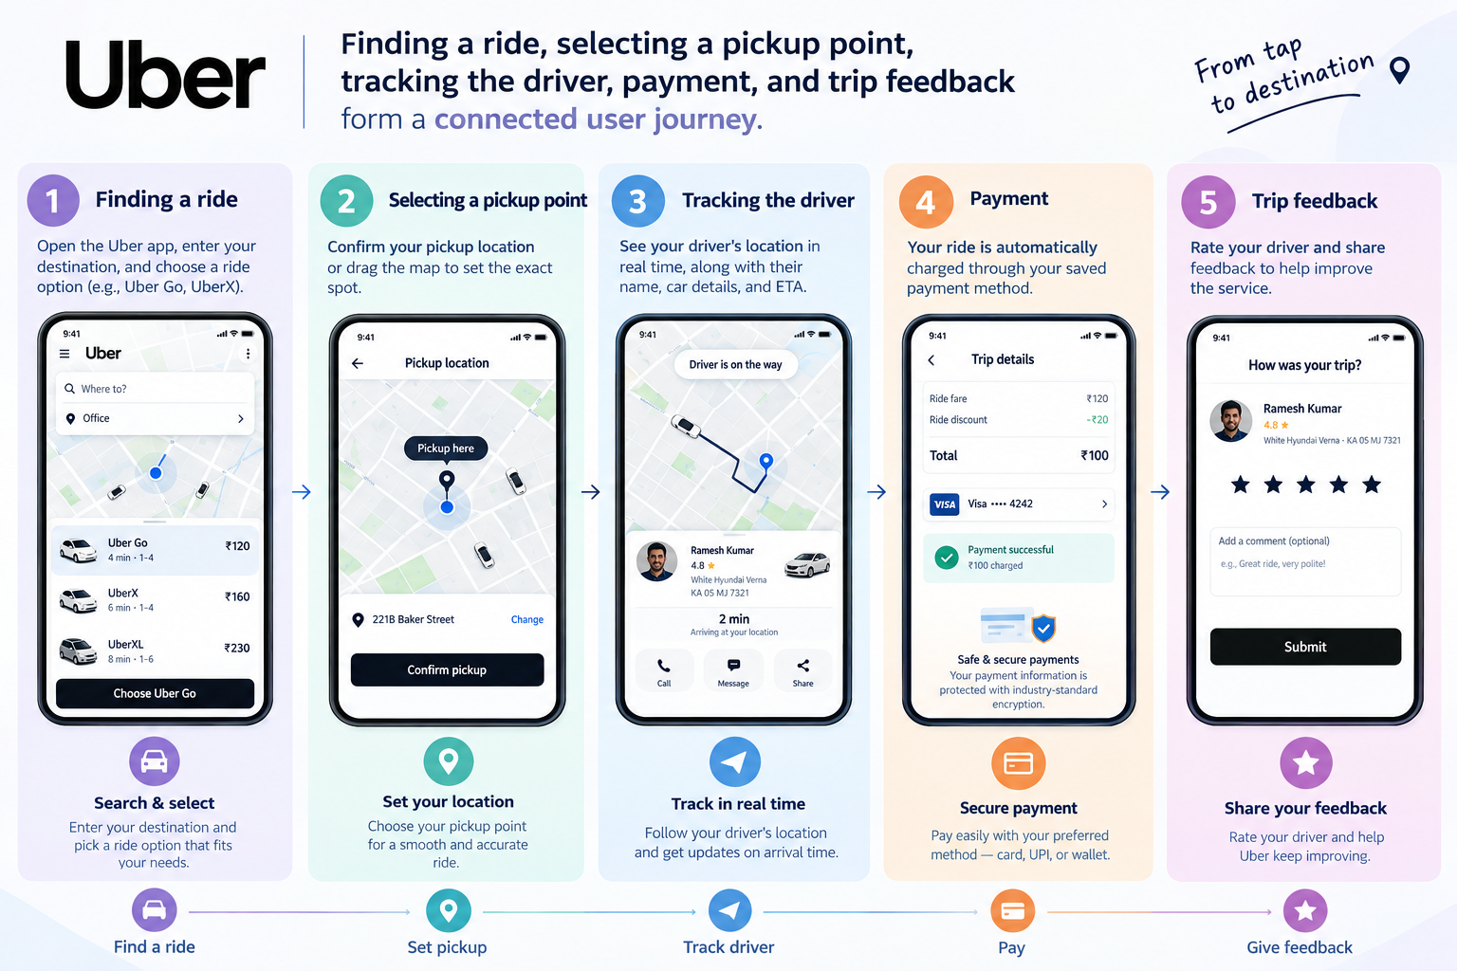
2 Real-Time Examples of UX
Amazon Shopping
Uber / Ride Apps
Product search, filters, cart flow, checkout steps, delivery tracking, and returns are designed around the shopping journey.
Finding a ride, selecting a pickup point, tracking the driver, payment, and trip feedback form a connected user journey.

Slide 8
UI vs UX — Key Difference
UI — Interface
UX — Experience
Focus: how the product looks and how controls appear.
Examples: colors, icons, buttons, spacing, typography.
Focus: how the product works and how the journey feels.
Examples: task flow, navigation, usability, research, testing.

Slide 9
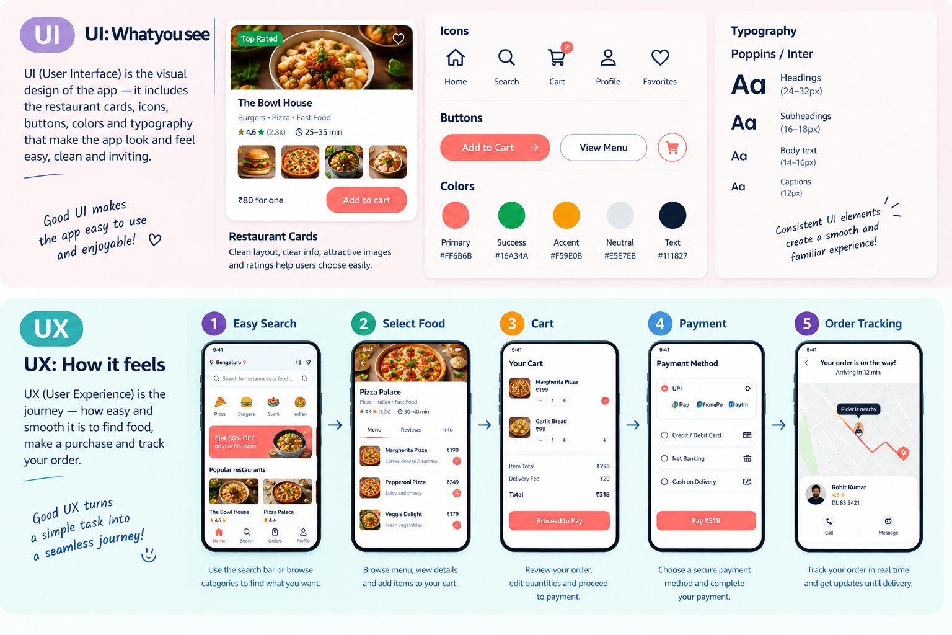
UI and UX with Real-Time Examples

Slide 10
