Slide 1

Example 1

Slide 2
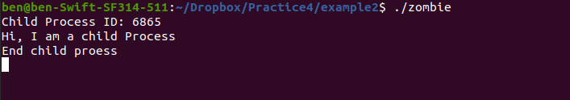
Example 2

Slide 3

Example 3

Slide 4
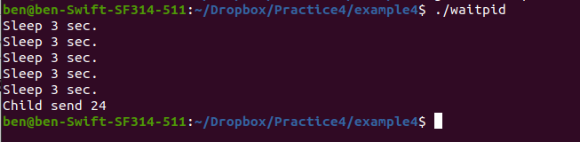
Example 4

Slide 5
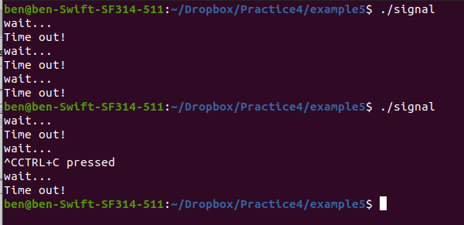
Example 5

Slide 6
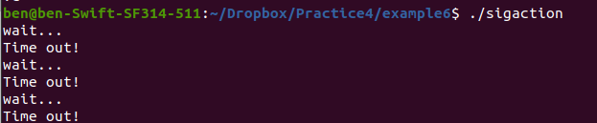
Example 6

Slide 7
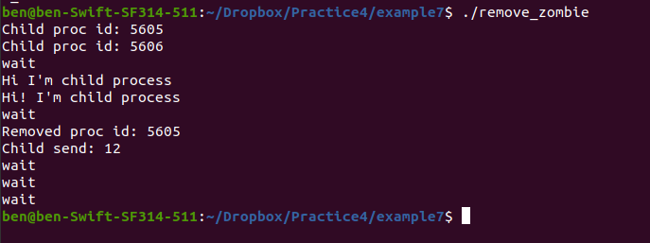
Example 7

Slide 8
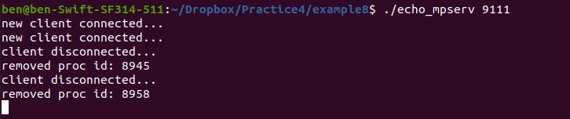
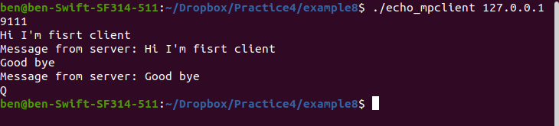
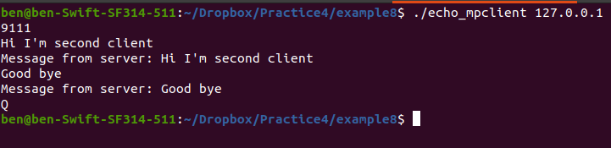
Example 8
Server
Client 1
Client 2

Slide 9
Problem 1
Output
P1
int main(){
if (fork() || fork())
fork();
P1
C1
int main(){
if (fork() || fork())
fork();
int main(){
if (fork() || fork())
fork();
P1
C3
C1
C2
int main(){
if (fork() || fork())
Fork();
printf(1)
int main(){
if (fork() || fork())
Fork();
printf(1);
1
1
1
int main(){
if (fork() || fork())
fork();
C1
C4
int main(){
if (fork() || fork())
Fork();
Printf(1);
1
1

Slide 10
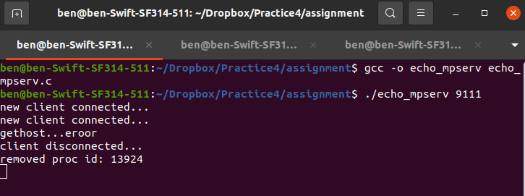
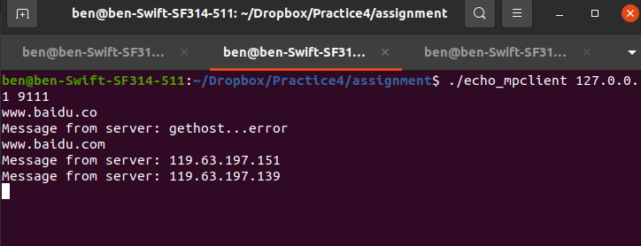
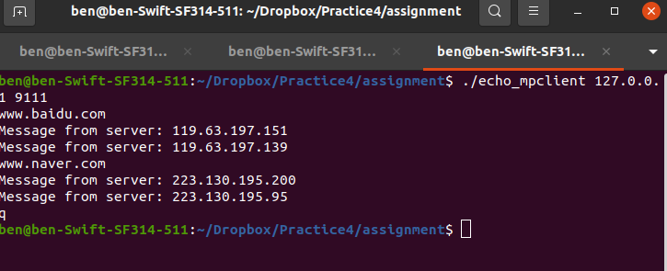
Problem 2
Server
Client 1
Client 2

