Slide 1
Example 1

Slide 2

Example 2

Slide 3
Example 3

Slide 4
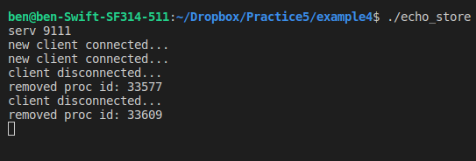
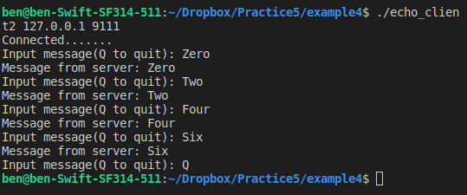
Example 4
Server
Client1
Client2

Slide 5
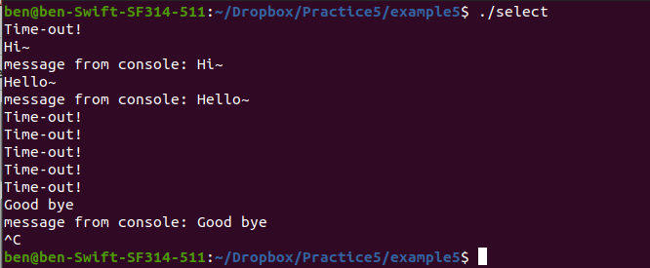
Example 5

Slide 6



Example 6

Slide 7

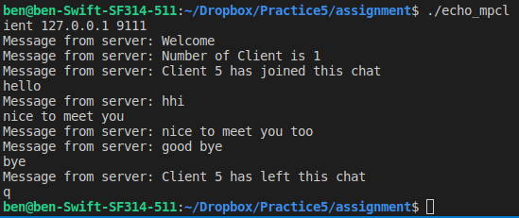
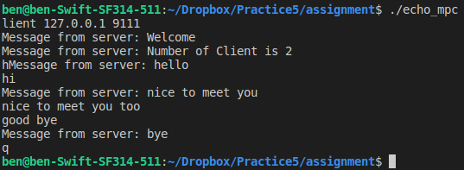
Assignment
Server
Client1
Client2

