Slide 1




Business
THE NATURE OF SMALL BUSINESS
By Group 1

Slide 2
INTRODUCTION
A small business can be defined in two ways: through market share or total assets.
  Under the market share approach, a small business is one that is independently owned, not dominant in its field, and controls less than one percent of the total demand for its products.
  Under the total assets approach, the Magna Carta for Small Enterprises defines small businesses as those with assets between ₱1.5 million and ₱15 million, while those below ₱1.5 million are considered microenterprises.

Slide 3
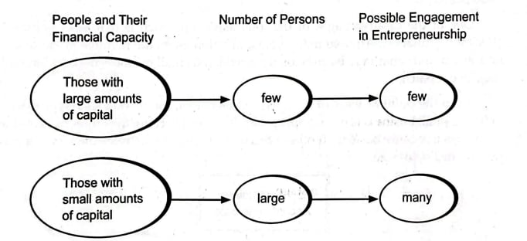
INTRODUCTION

Slide 4


WHAT IS A
SMALL BUSINESS
A small business can be defined in two ways: through market share or total assets.
  Under the market share approach, a small business is one that is independently owned, not dominant in its field, and controls less than one percent of the total demand for its products.
  Under the total assets approach, the Magna Carta for Small Enterprises defines small businesses as those with assets between ₱1.5 million and ₱15 million, while those below ₱1.5 million are considered microenterprises.

Slide 5
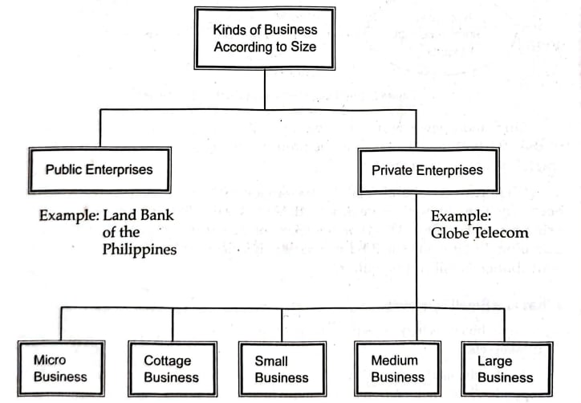
WHAT IS A
SMALL BUSINESS

Slide 6


TYPES OF SMALL BUSINESS
Manufacturing
A manufacturing business is one involved in the conversion of raw materials into products needed by society.
Service
Service businesses are those that provide service in one way or another. They may be further classified into the following:
Business services, Personal services, Repair services, Entertainment and recreation, Hotels and motels, and Education services
Wholesale
Wholesaling refers to the activities of persons or establishments which sell to retailers and other merchants, and/or to industrial, institutional, and commercial users, but who do not sell in large amounts to final consumers.

Slide 7
TYPES OF SMALL BUSINESS
Retailing
Retailing covers all activities involved in the sale of goods and/or services to the final consumers. The bulk of retailing activities are performed by small businesses.
General Construction Firms
General construction firms are those engaged in the construction of buildings whether for private individuals or firms, or for the government. Many of them perform subcontracting jobs for the bigger contractors such as installing electrical facilities and sewerage.

Slide 8


CHARACTERISTICS OF SMALL BUSINESS
Small capital requirement
Independent managemet
Small business requires only small capital and this can be supplied by a single or a few
The owner is also the manager.
Mostly local operation
Small business usually operates in a certain locality although there are cases when the market is not confined to a local area.

Slide 9


ECONOMIC IMPORTANCE OF SMALL BUSINESS
Providers of economic opportunities for entrepreneurs
People who do not feel comfortable as employees have the option of engaging in small business operation.
Providers of products and services to consumers
The production of many products and services is oftentimes not feasible with big and medium business operation. These limited opportunities are naturally fitted for small businesses.
Suppliers of products and services to other businesses
Some businesses require raw materials, semi-finished parts, finished components, or even labor, which they cannot economically produce.

Slide 10
ECONOMIC IMPORTANCE OF SMALL BUSINESS
Distributors of products and services of other businesses
Some manufacturers do not have the ability to distribute their products and services. Many small businesses assume this role for them.
Supporters of government
Small businesses support the government with the taxes they pay, as well as performing other functions.
Providers of employment
A large proportion of the labor force are employed by small businesses.

Slide 11
ADVANTAGES OF OPERATING A SMALL BUSINESS
An individual has various options to improve his economic lot. They are the following:
be a small business operator (SBO)
be an employee
be a professional
An employee enjoys a fixed working schedule like 8:00 A.M. to 5:00 P.M. The pay he receives, however, is limited and dependent to a large extent on industry norms and the financial capability of the company. In some firms, the employee's pay depends on the whims of the owner.

Slide 12
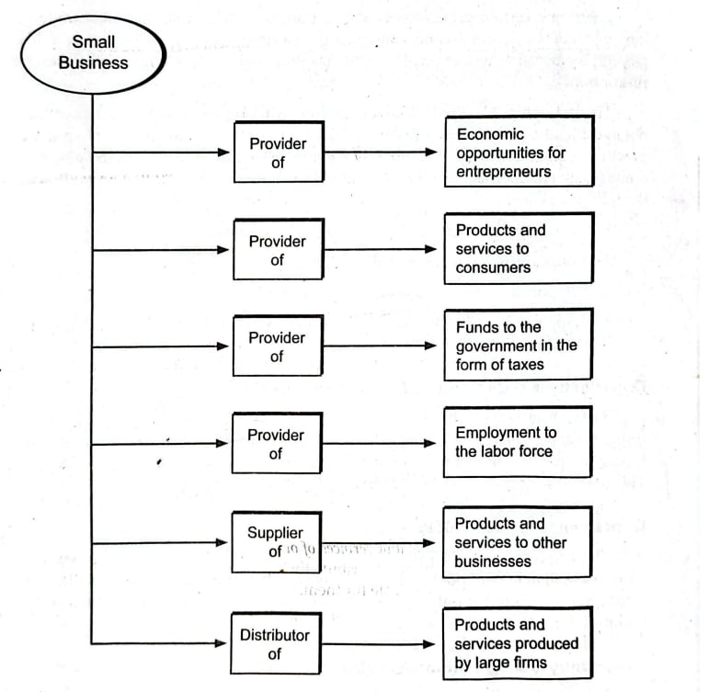
ADVANTAGES OF OPERATING A SMALL BUSINESS

Slide 13

SMALL BUSINESS AND ITS IMPORTANCE TO THE ECONOMY
A professional may earn higher income through the practice of his skills, such as a physician treating patients in a clinic. However, his income is limited by the number of patients he can attend to, and he cannot easily provide employment beyond a few assistants. Employment and professions, in general, are also difficult to pursue because of high job rejection rates and the long years of study and examinations required. The last option, small business operation, may have fewer entry requirements, but it still demands long hours, difficult decision-making, and full responsibility for risks and losses.However, he is afforded the following benefits:
1. opportunity to gain control over his own destiny,
2. opportunity to reach his full potential,
3. opportunity to reap unlimited profits, and
4. opportunity to make a contribution to society and receive recognition for his efforts.

Slide 14
opportunity to gain control over his own destiny
The owner can freely choose, change, or dissolve a business unlike employees or professionals.
opportunity to reach his full potential
Success depends on the operator’s own skills and decisions, not fixed job targets.
opportunity to reap unlimited profits
All earnings belong to the owner, with the chance to increase profits through effort.
opportunity to make a contribution to society and receive recognition for his efforts
Entrepreneurs who innovate gain both social recognition and potential wealth.

Slide 15
DISADVANTAGES OF OPERATING A SMALL BUSINESS
Although certain advantages accrue to the small business operator, there are certain disadvantages that must be considered. These are the following:
1. uncertainty of income
3. lower quality of life until the business gets established
2. risk of losing your entire capital investmen
4. complete responsibility
6. paperwork and other chores
5. having to serve undesirable customers
7. long hours and demanding work condition

Slide 16
DISADVANTAGES OF OPERATING A SMALL BUSINESS
Operating a small business does not guarantee income, unlike employment which provides fixed monthly salaries. Independence in decision-making also carries risks, as errors in judgment can lead to business failure or even loss of investment. At the start, income and profits are uncertain, and the owner may endure a lower quality of life while waiting for returns. The small business operator takes full responsibility for all outcomes, including legal liabilities and customer satisfaction, even when faced with difficult clients. Unlike large companies that can delegate tasks, small business owners often handle paperwork and other demanding duties themselves. Finally, maintaining long working hours is common, since limited production and sales force the operator to personally manage many business functions.

Slide 17
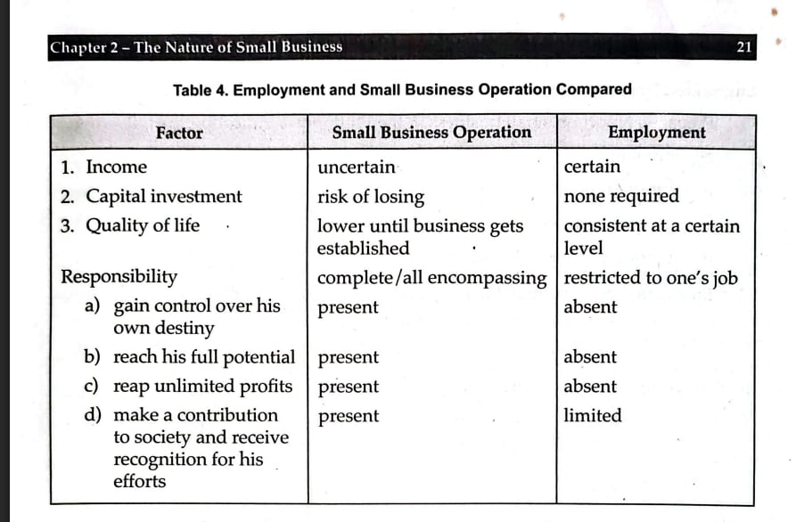
DISADVANTAGES OF OPERATING A SMALL BUSINESS

Slide 18
SUMMARY
  Businesses, especially small enterprises, are important segments of our society.
  A small business is one which is independently owned and which is not domi-nant in its field of operation. Small business may be classified as manufacturing, service, wholesaling, retail-ing, and general construction firms.
  Small businesses are characterized by the following: independent management, small capital requirements, and mostly local operation.
  Small businesses play an important role in the development of our economy. They provide economic opportunities for entrepreneurs, products and services to consum-ers and industrial users, services to other firms by way of distributing their products and services, payment of taxes to the government, and employment.

Slide 19

THANK YOU

