Slide 1
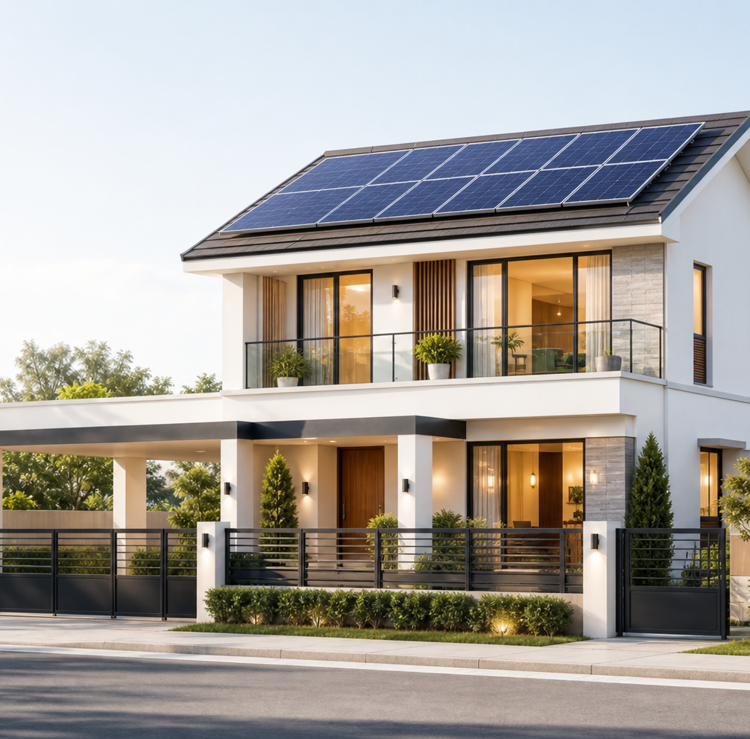
COFOUNDER ALIGNMENT
MACC SYSTEMS & ENGINEERING INC.
SOLAR CITY FOUNDER STRATEGY
Paano tayo makakakuha
ng first repeatable sale
Costing · positioning · pricing · marketing · branding · culture · product–market fit · MVP
Working strategy para sa founder decisions — hindi pa ibig sabihin proven na ang market.
MACC SYSTEMS & ENGINEERING INC. · SOLAR CITY · JULY 2026
01

Slide 2
NORTH STAR
Isang outcome ang basehan ng lahat ng decisions
MISSION
Bawat activity dapat ilapit ang buyer sa next commitment
5
paid installs at ₱99,500
1
Homeowner story
Ano ang ginawa at binayaran dati
Nasa banko ang deposit — hindi pangako lang — by 9 October 2026.
2
Qualified lead
Fit, bill, roof, lugar, at alternative
Ano ang totoong evidence
3
Site survey
Nag-commit ng oras sa real assessment
Counted: lead form · booked survey · paid deposit · signed contract
Hindi counted: likes · comments · compliments · “may kakilala akong interested”
4
Paid deposit
Pinakamalakas na pre-install evidence
Ledger gap: wala pa ang ops/status.md, kaya hypotheses pa ang planning figures.
MACC SYSTEMS & ENGINEERING INC. · SOLAR CITY · JULY 2026
02

Slide 3
COMPANY STRATEGY
Model B muna ang kikita para ma-fund ang Model A
MODEL B · REVENUE ENGINE · NGAYON
MODEL A · LONG-TERM MOAT · MAY GATE
SOURCE + INSTALL
GUMAWA NG SARILING PANELS
Bumili ng certified panels, inverters, at batteries. I-standardize ang design, safe installation, at customer experience.
Trabaho ngayon: matutong magbenta, mag-quote, mag-deliver, at kumita sa fixed package.
Mag-local manufacturing lang kapag may advantage sa local warranty, mabilis na service, PH field data, at customer trust.
Trabaho later: gawing manufacturing moat ang proven sales volume at margin.
MAG-UNLOCK LANG KAPAG
5 paid installs + ₱400k banked gross margin mula Model B
Hangga’t hindi pa pasado ang gate: trainer work lang — one founder-day/week, ≤40 cells, ≤₱20k bawat item.
MACC SYSTEMS & ENGINEERING INC. · SOLAR CITY · JULY 2026
03

Slide 4
FOUNDER TEAM
Four careers, isang strong founder team
Magkakakilala tayo since college. Ngayon, kombinado ang experience natin sa product, electrical delivery, SaaS operations, at automation.
BENJIE
JUNDHEL
JETHRO
DENVER
PRODUCT + DIGITAL SYSTEMS
TECHNICAL DELIVERY
CUSTOMER + COMMERCIAL
OPERATIONS + AUTOMATION
Software engineer · CTO, Channel Automation · nasa Australia until December
Electrical engineer
SaaS owner · POS system
SaaS owner · POS system · software engineer
Lead sa funnel, calculator, CRM, measurement, at remote-to-Philippines transition plan.
Lead sa electrical design, safety, site-survey standards, install quality, at technical supplier checks.
Lead sa customer conversations, sales process, pricing tests, at channel or partner operations.
Lead sa unit-economics reporting, workflow automation, operating data, at internal tools.
Advantage ang shared history kung malinaw ang roles, decisions, at disagreements. Starting accountabilities ito — hindi permanent titles.
MACC SYSTEMS & ENGINEERING INC. · SOLAR CITY · JULY 2026
04

Slide 5
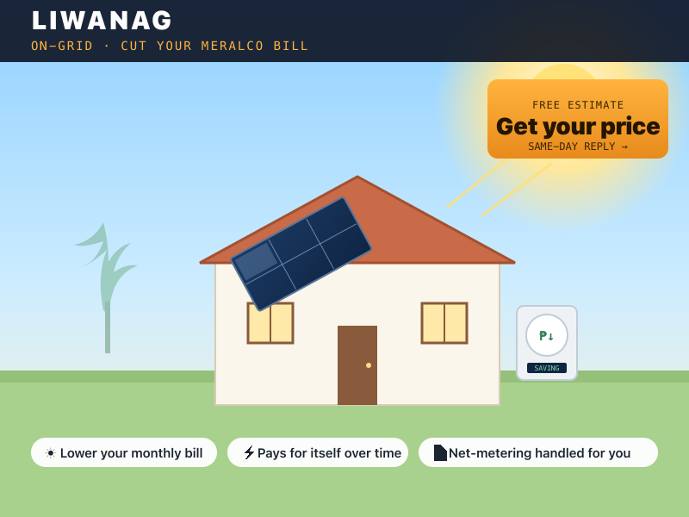
MVP-ING THE FIRST PRODUCT
Unang MVP: LIWANAG — isang buyer, isang offer, isang outcome
RECOMMENDED NA FIRST TEST
Best-fit buyer
Owner-occupied home · stable grid · around ₱8k–₱15k monthly bill · nasa chosen launch area
Fixed offer
~2.3 kWp grid-tied system · certified hardware · standard BOM at scope · planning price na ₱99,500 installed
Customer outcome
Bawasan ang daytime grid purchases; ipakita ang projected peso savings gamit ang real bill at usage pattern.
Dapat malinaw: walang power ang LIWANAG kapag brownout; automatic itong nagshu-shut off dahil sa anti-islanding.
MACC SYSTEMS & ENGINEERING INC. · SOLAR CITY · JULY 2026
05

Slide 6
COSTING
Sa costing, price at target margin ang nauuna
Test price
→
Target margin
→
Maximum total cost
→
BOM + scope decisions
₱99,500
₱69,650
₱74,000
Test price
Max target cost
Estimated cost ngayon
Ito ang price na makikita ng market
Para maka-hit ng 30% gross margin
Current default sa Founder Lab
₱4,350
cost gap na kailangang isara para maging credible ang 30% gross margin
Mag-negotiate, mag-simplify, o magbawas ng scope — huwag itago sa quote.
Planning hypothesis pa ito: palitan ng current supplier, freight, labor, permit, contingency, at warranty-reserve quotes bago gamitin sa customer.
MACC SYSTEMS & ENGINEERING INC. · SOLAR CITY · JULY 2026
06

Slide 7
PRICING
Ang pricing ay market decision muna, saka design constraint
1. Hanapin ang price corridor
2. I-set ang test price
3. Protektahan ang signal
I-compare sa binabayaran o tinitiis na ng customer:
• tuloy lang sa Meralco
• genset / UPS plus running cost
• established installer at ₱150k+
• marketplace kit + freelance electrician
I-test ang ₱99,500 sa loob ng ₱80k–₱100k corridor. Katabi ng price dapat ang outcome: projected monthly savings ng LIWANAG.
Bakit mas mababa: fixed package, standard BOM, walang showroom.
Humingi ng totoong commitment sa totoong price. Kapag paulit-ulit ang stall, i-review muna ang positioning bago mag-discount.
Walang front-end discount hangga’t hindi proven ang back-end path at pre-registered ang test.
Price muna → target margin → maximum cost → package design. Baligtad ang strategy kapag cost-plus.
MACC SYSTEMS & ENGINEERING INC. · SOLAR CITY · JULY 2026
07

Slide 8
POSITIONING
Positioning ang dahilan kung bakit credible ang lower price
PARA KANINO
homeowners sa chosen areas, stable ang grid, at around ₱8k–₱15k ang bill
ANO TAYO
fixed-price, installed home-solar package sa ₱80k–₱100k window
BAKIT TAYO
standard ang scope at BOM, walang showroom overhead, at documented bawat milestone.
Ano talaga ang alternatives ng buyer
Ano dapat malinaw sa market
Do nothing / Meralco
→
Ipakita ang malinaw na bill-based outcome
CATEGORY
Fixed-price installed home solar
Genset or UPS
→
Malinaw: bill pain ang LIWANAG, hindi backup
DIFFERENCE
Established installer
→
Ipaliwanag ang fixed package at no-showroom model
Malinaw + standardized + local accountability
→
Manalo sa safety, permits, warranty, accountability
WHY NOW
DIY marketplace kit
Tumataas ang bills at pagod na ang market sa scams — pero ipaintindi muna kung ano ang offer.
MACC SYSTEMS & ENGINEERING INC. · SOLAR CITY · JULY 2026
08

Slide 9
BLUE OCEAN / ERRC
Blue Ocean: baguhin ang value curve, hindi lang ang presyo
ELIMINATE
REDUCE
Nakakalitong menus
Hidden extras
Unverified savings claims
Spec-first selling
Custom engineering bago qualified ang lead
Showroom overhead
Sobrang daming inventory
Sobrang lawak na area
RAISE
CREATE
Malinaw na price at scope
Documentation
Engineered safety
Local service accountability
Same-day bill / roof estimate
Fixed-scope package
Milestone updates
Malinaw na brownout disclosure
HINDI PUWEDENG BAWASAN: certified hardware · honored warranty · typhoon-rated mounting · permits · electrical safety
MACC SYSTEMS & ENGINEERING INC. · SOLAR CITY · JULY 2026
09

Slide 10

BRANDING
Brand = pangakong kaya nating patunayan palagi
COMPANY
Apat na pangako
Huwag kailanman i-claim
01 Honest ang scope at numbers
02 Engineered ang safety
03 May local accountability
04 Malinaw ang progress: survey hanggang energized
• fake testimonials o install counts
• may backup ang LIWANAG sa brownout
• savings na walang bill-based estimate
• “all-in” pero may tinatagong exclusions
CUSTOMER OFFER
SOLAR CITY
PACKAGES
LIWANAG · ILAW
SANDIGAN
Madaling tandaan ang job ng bawat package — LIWANAG: lower bills · ILAW: essential backup · SANDIGAN: hybrid resilience
MACC SYSTEMS & ENGINEERING INC. · SOLAR CITY · JULY 2026
10

Slide 11
MARKETING
Marketing = measured path hanggang paid deposit
Gayahin ang proven channel mechanics; iba dapat ang promise. I-track bawat handoff.
01
→
02
→
03
→
04
→
05
→
06
VIEW
CALCULATOR
LEAD
REPLY
SURVEY
DEPOSIT
Magsimula kung saan visible ang trust
Maliit at measurable na channel tests
• three named subdivisions / barangays at exact Facebook groups
• direct founder selling at Messenger follow-up
• HOA / barangay demo events
• photographed handovers at neighbor referrals
Max 3 sabay na tests · ≤₱12k · ≤3 weeks · may pre-registered score.
Walang ad spend hangga’t hindi gumagana ang lead delivery, UTM, at stage events. Huwag mag-scale hangga’t walang 2 real deposits sa real price.
MACC SYSTEMS & ENGINEERING INC. · SOLAR CITY · JULY 2026
11

Slide 12
PRODUCT–MARKET FIT
PMF = paulit-ulit na paid behavior na may healthy economics
Hindi pa natin claim na may PMF. Pattern ang hinahanap natin — hindi feeling.
STAGE 1
STAGE 2
STAGE 3
SEARCH
SIGNAL
PATTERN
Makinig ang founders sa real homeowner stories, alamin ang totoong alternatives, at hanapin ang paulit-ulit na pain sa isang narrow segment.
Ang best-fit buyers ay nagbu-book ng survey at nagbabayad ng deposit sa real ₱99,500 test price. Kaya ring ma-hit ang target cost nang walang tagong scope o safety shortcut.
Nauulit ang sales, installs, at referrals nang walang sobrang customization. Pareho ang value na sinasabi ng buyers at healthy ang channel economics.
NOT PMF
comments · compliments · cheap leads · isang custom sale · magandang deck o app
MACC SYSTEMS & ENGINEERING INC. · SOLAR CITY · JULY 2026
12

Slide 13
CREATING CULTURE
Friendship gives trust; malinaw na rules ang protection
CUSTOMER TRUTH
SAFETY + HONESTY
Tanungin ang past behavior. Count commitments. Isulat ang interviews within 24 hours.
Walang fake proof, hidden scope, legal shortcuts, o backup claim para sa LIWANAG.
SPEED WITH GATES
OWNERSHIP WITHOUT EGO
I-launch agad ang reversible tests. Huminto sa safety, legal, cash, at evidence gates.
May named owner, public T5T, honest postmortems, at company-first decisions.
WEEKLY CADENCE
≥1 customer action + ≥1 homeowner story · Friday T5T + traction/product hours · Analyze → Ask → Act sa isang metric
MACC SYSTEMS & ENGINEERING INC. · SOLAR CITY · JULY 2026
13

Slide 14
FOUNDER ACTION PLAN
Sa next 30 days, evidence ang dapat dumami — hindi documents
WEEK 1
WEEK 2
WEEK 3
WEEK 4
ALIGN + INSTRUMENT
DISCOVER + SOURCE
FIRE THE OFFER
LEARN + AIM
→
→
→
Piliin ang launch area at owners. I-check ang lead delivery, UTM, at funnel events. Buksan ang operating ledger.
Mag-record ng three past-specific homeowner stories. Palitan ang planning costs ng current supplier at installer quotes.
Mag-pre-register ng one channel test. I-offer ang LIWANAG sa real price sa real homeowners. Mag-book ng surveys.
Tanungin ang lost leads kung bakit. I-report ang stage conversions at deposits. Isang variable lang ang baguhin.
TATLONG DECISIONS BAGO MATAPOS ANG MEETING
1 Launch subdivision / group 2 Minimum gross margin 3 Owners: customer · offer/pricing · install/technical
MACC SYSTEMS & ENGINEERING INC. · SOLAR CITY · JULY 2026
14

Slide 15
DECISION
MACC SYSTEMS & ENGINEERING INC.
Four founders. One test.
Iharap natin sa real
homeowners.
5
PAID INSTALLS
BY 9 OCT 2026
Ang next proof ay hindi bagong page. Ito ay booked survey, paid deposit, at safe install na may viable margin.
MACC SYSTEMS & ENGINEERING INC. · SOLAR CITY · JULY 2026
15

