Slide 1
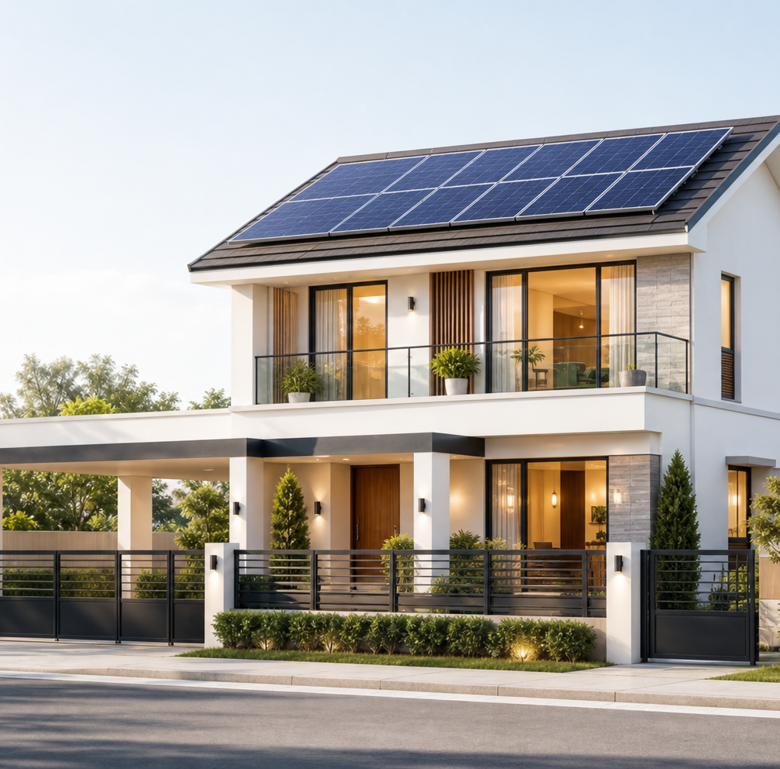
COFOUNDER ALIGNMENT
SOLAR CITY
How we will find
our first repeatable sale
Costing · positioning · pricing · marketing · branding · culture · product–market fit · MVP
Working strategy for founder decisions — not a claim that the market is already proven.
SOLAR CITY · FOUNDER STRATEGY · JULY 2026
01

Slide 2
NORTH STAR
One outcome governs every decision
MISSION
Every activity must move a buyer one step closer
5
paid ₱99,500 installs
1
Homeowner story
Past behavior and prior spend
Deposits banked — not promised — by 9 October 2026.
2
Qualified lead
Fit, bill, roof, location, alternative
The evidence standard
3
Site survey
Time committed to a real assessment
Count: lead submissions · booked surveys · paid deposits · signed contracts
Do not count: likes · comments · compliments · “my friend is interested”
4
Paid deposit
The strongest pre-install evidence
Ledger gap: ops/status.md is missing, so planning figures remain hypotheses.
SOLAR CITY · FOUNDER STRATEGY · JULY 2026
02

Slide 3
COMPANY STRATEGY
Model B earns the right to build Model A
MODEL B · REVENUE ENGINE · NOW
MODEL A · LONG-TERM MOAT · GATED
SOURCE + INSTALL
BUILD OUR OWN MODULES
Buy certified panels, inverters, and batteries. Standardize the design, install safely, and own the customer relationship.
Job now: learn how to sell, quote, deliver, and earn margin on a fixed package.
Develop local manufacturing only where local warranty, service turnaround, Philippine field data, and trust create a defensible value network.
Job later: convert proven volume and margin into a manufacturing moat.
UNLOCK ONLY AFTER
5 paid installs + ₱400k banked Model B gross margin
Until then: Model A stays inside the trainer cap — one founder-day/week, ≤40 cells, ≤₱20k per item.
SOLAR CITY · FOUNDER STRATEGY · JULY 2026
03

Slide 4
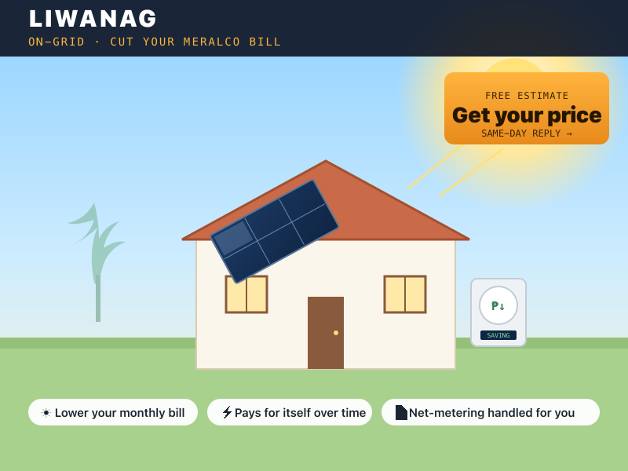
MVP-ING THE FIRST PRODUCT
The first MVP is LIWANAG — one buyer, one offer, one outcome
RECOMMENDED FIRST TEST
Best-fit buyer
Owner-occupied home · stable grid · roughly ₱8k–₱15k monthly bill · inside a named launch area
Fixed offer
~2.3 kWp grid-tied system · purchased certified hardware · standardized BOM and scope · installed at a planning price of ₱99,500
Customer outcome
Reduce daytime grid purchases; show projected peso savings based on the homeowner’s real bill and usage pattern.
Explicit exclusion: LIWANAG does not provide power during a brownout; anti-islanding shuts the system off.
SOLAR CITY · FOUNDER STRATEGY · JULY 2026
04

Slide 5
COSTING
Costing starts with the margin ceiling, not supplier totals
Strategic price
→
Target margin
→
Maximum delivered cost
→
BOM + scope choices
₱99,500
₱69,650
₱74,000
Planning price
Target cost ceiling
Expected cost today
The market-facing constraint
At 30% target gross margin
Current Founder Lab default
₱4,350
cost gap to close before a 30% gross-margin target is credible
Negotiate, simplify, or re-scope — do not hide the gap in the quote.
Planning hypothesis: replace every cost with current supplier, freight, labor, permit, contingency, and warranty-reserve quotes before customer use.
SOLAR CITY · FOUNDER STRATEGY · JULY 2026
05

Slide 6
PRICING
Pricing is a market decision — then a design constraint
1. Find the corridor
2. Set the strategic price
3. Protect the signal
Anchor against what customers already pay or tolerate:
• keep paying Meralco
• genset / UPS plus running cost
• established installer at ₱150k+
• marketplace kit + freelance electrician
Use ₱99,500 as a test inside the ₱80k–₱100k mass corridor. Every price appears beside the outcome: projected monthly savings for LIWANAG.
Reason why we cost less: fixed package, standardized BOM, no showroom.
Ask for a real commitment at the real price. Repeated stalls trigger a positioning review before a discount.
A front-end discount is not allowed until a back-end path is evidenced and the test is pre-registered.
Price first → target margin → maximum cost → package design. Cost-plus reverses the strategy.
SOLAR CITY · FOUNDER STRATEGY · JULY 2026
06

Slide 7
POSITIONING
Positioning makes a lower price credible, not suspicious
FOR
homeowners in named areas with stable grid and roughly ₱8k–₱15k bills
SOLAR CITY IS
a fixed-price, installed home-solar package inside the ₱80k–₱100k window
BECAUSE
we standardize scope and BOM, remove showroom overhead, and document every milestone.
The four real alternatives
What our position must resolve
Do nothing / Meralco
→
Show a transparent bill-based outcome
CATEGORY
Fixed-price installed home solar
Genset or UPS
→
State clearly: LIWANAG solves bill pain, not backup
DIFFERENCE
Established installer
→
Explain the fixed-package, no-showroom model
Clarity + standardization + local accountability
→
Win on safety, permits, warranty, accountability
WHY NOW
DIY marketplace kit
Rising bills and scam fatigue — after the visitor understands the category.
SOLAR CITY · FOUNDER STRATEGY · JULY 2026
07

Slide 8
BLUE OCEAN / ERRC
Blue Ocean means changing the value curve
ELIMINATE
REDUCE
Confusing menus
Hidden extras
Unverified savings claims
Spec-first selling
Custom engineering before qualification
Showroom overhead
Inventory breadth
Geographic sprawl
RAISE
CREATE
Price and scope transparency
Documentation
Engineered safety
Local service accountability
Same-day bill / roof estimate
Fixed-scope package
Milestone updates
Explicit brownout disclosure
TABLE STAKES STAY: certified hardware · honored warranty · typhoon-rated mounting · permits · electrical safety
SOLAR CITY · FOUNDER STRATEGY · JULY 2026
08

Slide 9

BRANDING
The brand is the promise we can consistently prove
Four promises
Never claim
01 Honest scope and numbers
02 Engineered safety
03 Local accountability
04 Clear progress from survey to energized
• fabricated testimonials or install counts
• LIWANAG backup during brownouts
• savings without a bill-based estimate
• “all-in” while hiding exclusions
SOLAR CITY
A practical home-energy offer from a locally accountable engineering company.
Package names translate jobs — LIWANAG: lower bills · ILAW: essential backup · SANDIGAN: hybrid resilience
SOLAR CITY · FOUNDER STRATEGY · JULY 2026
09

Slide 10
MARKETING
Marketing is a measured path to a deposit
Copy the proven channel mechanics; diverge on the promise. Instrument every handoff.
01
→
02
→
03
→
04
→
05
→
06
VIEW
CALCULATOR
LEAD
REPLY
SURVEY
DEPOSIT
Start where trust is visible
Run bounded channel tests
• three named subdivisions / barangays and their exact Facebook groups
• direct founder selling and Messenger follow-up
• HOA / barangay demo events
• photographed handovers and neighbor referrals
Max 3 concurrent tests · ≤₱12k · ≤3 weeks · pre-registered score.
No ad peso until lead delivery, UTM attribution, and stage events work. Do not scale until at least 2 leads pay a real deposit at the real price.
SOLAR CITY · FOUNDER STRATEGY · JULY 2026
10

Slide 11
PRODUCT–MARKET FIT
Product–market fit is repeated paid behavior with viable economics
We do not claim PMF yet. We look for a pattern, not a feeling.
STAGE 1
STAGE 2
STAGE 3
SEARCH
SIGNAL
PATTERN
Founders hear past-specific homeowner stories, learn the real alternatives, and map the same recurring pain in a narrow segment.
Best-fit buyers book surveys and pay deposits at the real ₱99,500 test price. The target cost is reachable without hiding scope or safety.
Sales, installs, and referrals repeat without heroic customization. Buyers describe the same value, and the channel economics remain healthy.
NOT PMF
comments · compliments · cheap leads · one customized sale · a beautiful deck or app
SOLAR CITY · FOUNDER STRATEGY · JULY 2026
11

Slide 12
CREATING CULTURE
Culture is the operating system we use under pressure
CUSTOMER TRUTH
SAFETY + HONESTY
Ask about the past. Count commitments. Write interviews within 24 hours.
No fabricated proof, hidden scope, legal shortcuts, or backup claims for LIWANAG.
SPEED WITH GATES
OWNERSHIP WITHOUT EGO
Fire reversible tests quickly. Stop at safety, legal, cash, and evidence gates.
Named pilot, public T5T, blunt postmortems, and company-first decisions.
WEEKLY CADENCE
≥1 customer-facing action + ≥1 homeowner story · Friday T5T + traction/product hours · Analyze → Ask → Act on one metric
SOLAR CITY · FOUNDER STRATEGY · JULY 2026
12

Slide 13
FOUNDER ACTION PLAN
The next 30 days should produce evidence, not more documents
WEEK 1
WEEK 2
WEEK 3
WEEK 4
ALIGN + INSTRUMENT
DISCOVER + SOURCE
FIRE THE OFFER
LEARN + AIM
→
→
→
Choose launch area and owners. Verify lead delivery, UTM, and funnel events. Open the operating ledger.
Record three past-specific homeowner stories. Replace planning costs with current supplier and installer quotes.
Pre-register one channel test. Put LIWANAG at the real price in front of real homeowners. Book surveys.
Ask lost leads why. Report stage conversions and deposits. Change exactly one message, scope, or channel variable.
THREE DECISIONS TO LEAVE THIS MEETING WITH
1 Launch subdivision / group 2 Target gross-margin floor 3 Owners: customer · offer/pricing · install/technical
SOLAR CITY · FOUNDER STRATEGY · JULY 2026
13

Slide 14
DECISION
SOLAR CITY
Align on the test.
Then put it in front
of homeowners.
5
PAID INSTALLS
BY 9 OCT 2026
The next proof is not another page. It is a booked survey, a paid deposit, and a safe install at viable margin.
SOLAR CITY · FOUNDER STRATEGY · JULY 2026
14

