Slide 1
FIN1209 Technical Analysis in Investment
Chapter 7
Bar Chart Analysis
A price bar records the opening, highest, lowest and closing prices in one interval. Learn to read those four prices first, then ask whether a bar formation may continue or reverse.
Faculty of Economics University
Notes:
- Open with what the chapter is about: reading price bars, the most basic skill in technical analysis, as Lim puts it on p. 209.
- Say the route in one breath: one bar, then formations, then named reversal patterns, then breakouts.

Slide 2
What this chapter will teach you to do
Bar chart analysis is the study of bar chart patterns. Lim calls it the basis of pure price action analysis and the most fundamental skill every technician should have (p. 209).
By the end of the chapter you should be able to explain how bar patterns help us forecast potential tops and bottoms, and recognise early signs that a trend may be about to change (p. 209).
Everything here is read from price bars, one bar at a time.
Chapter 7 - Opening
Lim (2016), p. 209, the chapter's learning objectives.
Notes:
- Start with what bar chart analysis is and why it matters: Lim calls it the most fundamental skill a technician should have (p. 209).
- Keep the word potential. The chapter teaches warnings to weigh, not certainty.

Slide 3
What this chapter will teach you to do, continued
You should also be able to pick out buy and sell signals from single, double, triple and multiple bar formations, both bullish and bearish (p. 209).
And you should be able to read bar behaviour more carefully with Lim's 16 price and volume reversal characteristics, which we met in Chapter 5 (p. 209).
Each pattern is evidence to weigh, not a promise about the next price.
Chapter 7 - Opening
Lim (2016), p. 209, the chapter's learning objectives.
Notes:
- These are the book's last two objectives, in plain words.
- Chapter 5 taught the 16 characteristics; this chapter uses them again to read bars, rather than teaching them from the start.

Slide 4
We will read the chapter in four parts
Part 1 starts with one price bar: the four prices it keeps, and the three ways Lim sorts a group of bars into a formation.
Part 2 asks when a formation suggests the trend will carry on and when it warns of a reversal, and reads the book's generic patterns.
Part 3 covers the popular named reversal patterns, such as the key reversal and the pin bar. Part 4 reads the volatility-based breakout patterns that close the chapter.
We start where the book starts: what one price bar records.
Chapter 7 - Opening
Lim (2016), Chapter 7, sections 7.1 to 7.4.
Notes:
- Say the four parts as one route: from one bar, to formations, to named patterns, to breakouts.
- Part 1 starts where the book starts, with what one price bar records.

Slide 5
A price bar keeps four prices from one interval
Every pattern here is read from price bars. Lim's bar keeps four prices from one interval: open (O), high (H), low (L) and close (C), or OHLC (p. 209).
In Figure 7.1, five minutes of price become one bar: open (1), high (2), low (3), close (4). Lim's caption calls it four pieces of information.
FIGURE 7.1
Figure 7.1: five minutes of price action on the left are summarized by one bar on the right, which keeps only its open, high, low and close.
2
1
4
3
The drawing has no prices; its close ends below its open.
Figure 7.1 - Lim, The Handbook of Technical Analysis (Wiley, 2016)
Part 1 of 4 - 7.1 Price bar | 1 of 22
Lim (2016), pp. 209 to 210, Figure 7.1. The marks are ours, added for teaching.
Notes:
- Start with why: every pattern in this chapter is read from price bars, so first we need to know what one bar keeps.
- Point to the four marks on Lim's bar: gold 1 the open, red 2 the high, blue 3 the low, purple 4 the close.
- The book's drawing has no price scale. Say only what it shows by position; the prices come on the next slide, on our own chart.

Slide 6

Reading one bar of ours, price by price
Now the same four prices with numbers. This bar of ours opens at PHP 50.00 (1), rises as high as PHP 52.40 (2), dips as low as PHP 49.60 (3) and closes at PHP 51.10 (4). Lim calls the distance from the high to the low the range of the bar, |H - L| (p. 209). For this bar it is 52.40 - 49.60 = PHP 2.80.
2
4
1
3
Chart J - FIN1209 teaching chart, drawn for this course. Illustrative data, not a real instrument.
Part 1 of 4 - 7.1 Price bar | 2 of 22
FIN1209 teaching chart J. The PHP values are invented for teaching.
Notes:
- Read the numbers from the chart itself: gold 1 the open at 50.00, red 2 the high at 52.40, blue 3 the low at 49.60, purple 4 the close at 51.10.
- Then work the range out loud: high minus low, 52.40 minus 49.60, is PHP 2.80.
- The prices are ours and the bar is possible: the low is the lowest price and the high the highest.

Slide 7
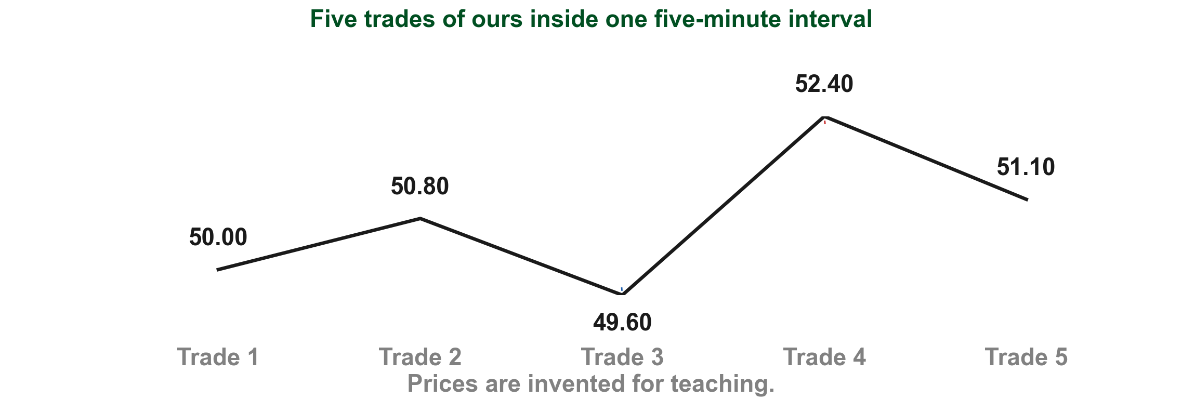
Five minutes of trades become one price bar
Why only four prices? As Chapter 3 put it, the open and close are the prices at the start and end of the interval, and the high and low are its extremes; every other trade drops out. Here are five trades of ours inside one five-minute interval. The first trade, PHP 50.00 (1), becomes the open. The highest, PHP 52.40 (2), is the high, and the lowest, PHP 49.60 (3), is the low.
2
4
1
3
Chart P - FIN1209 teaching chart, drawn for this course. Illustrative data, not a real instrument.
Part 1 of 4 - 7.1 Price bar | 3 of 22
FIN1209 teaching chart P. The PHP values are invented for teaching.
Notes:
- Walk the five trades left to right: 50.00, 50.80, 49.60, 52.40, 51.10.
- Gold 1 is the first trade and becomes the open; red 2 is the highest and blue 3 the lowest; purple 4 is the last and becomes the close.
- Ask the class what happened to the trade at 50.80. It is real trading, but the bar does not keep it.

Slide 8
Five minutes of trades become one price bar
The last, PHP 51.10 (4), becomes the close. The trade at PHP 50.80 leaves no mark on the bar. So this interval's bar is open 50.00, high 52.40, low 49.60 and close 51.10.
2
4
1
3
Chart P - FIN1209 teaching chart, drawn for this course. Illustrative data, not a real instrument.
Part 1 of 4 - 7.1 Price bar | 4 of 22
FIN1209 teaching chart P. The PHP values are invented for teaching.
Notes:
- Walk the five trades left to right: 50.00, 50.80, 49.60, 52.40, 51.10.
- Gold 1 is the first trade and becomes the open; red 2 is the highest and blue 3 the lowest; purple 4 is the last and becomes the close.
- Ask the class what happened to the trade at 50.80. It is real trading, but the bar does not keep it.

Slide 9
CHECK 1 OF 33
Building a price bar
Q1
Q2
In one interval, which trade supplies the bar's close?
What is the range when H is PHP 52.40 and L is PHP 49.60?
A. The first trade
B. The highest trade
C. The lowest trade
D. The last trade
A. PHP 1.40
B. PHP 2.80
C. PHP 3.80
D. PHP 102.00
Part 1 of 4 - 7.1 Price bar | Check 1
Notes:
- Answer from the five trades and the range sentence before advancing.
- The second question is the range of the same bar.

Slide 10
ANSWERS
Building a price bar
Q1 In one interval, which trade supplies the bar's close?
D. The last trade
As Chapter 3 put it, the price at the end of the interval is the close; the first trade is the open, and the highest and lowest are the high and low.
Q2 What is the range when H is PHP 52.40 and L is PHP 49.60?
B. PHP 2.80
The range is the high minus the low: 52.40 - 49.60 = PHP 2.80 (Lim, p. 209).
Part 1 of 4 - 7.1 Price bar | Check 1
Notes:
- Answer from the five trades and the range sentence before advancing.
- The second question is the range of the same bar.

Slide 11
Three five-minute bars can make one 15-minute bar
One bar for a longer stretch is a higher timeframe bar (Lim, p. 210).
It keeps the first interval's open (1), the highest high (2), the lowest low (3) and the last interval's close (4) (p. 209). Dashed lines carry each to the 15-minute bar.
FIGURE 7.2
Figure 7.2: three five-minute intervals on the left are summarized by one 15-minute bar on the right, which keeps the first open, the highest high, the lowest low and the last close.
2
1
4
The drawing has no prices; its 15-minute bar closes below its open.
3
Figure 7.2 - Lim, The Handbook of Technical Analysis (Wiley, 2016)
Part 1 of 4 - 7.1 Price bar | 5 of 22
Lim (2016), pp. 209 to 210, Figure 7.2. The marks are ours, added for teaching.
Notes:
- Move from one interval to a longer stretch: a 15-minute bar built from three five-minute intervals.
- Point to the marks on the five-minute trace: gold 1 where the first interval opens, red 2 the highest high, blue 3 the lowest low, purple 4 where the last interval closes. Then follow each dashed line across to the 15-minute bar.
- Again the drawing has no prices; our own numbers come on the next slide.

Slide 12
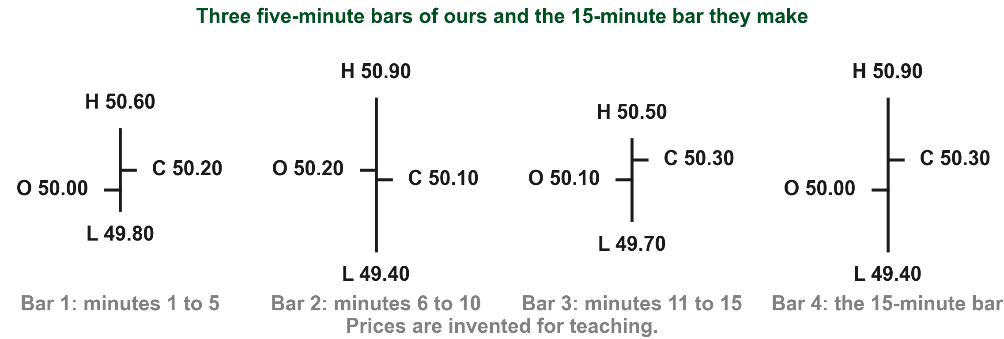
Building a 15-minute bar from our own prices
Here is the same rule with prices of ours. Bars 1 to 3 are three five-minute bars in a row, and bar 4 is the 15-minute bar they make. Bar 4 opens where bar 1 opened, PHP 50.00 (1). Its high is the highest high, PHP 50.90 from bar 2 (2), and its low the lowest low, PHP 49.40, also from bar 2 (3). It closes where bar 3 closed, PHP 50.30 (4). The opens and closes in between drop out.
2
4
1
3
Chart R - FIN1209 teaching chart, drawn for this course. Illustrative data, not a real instrument.
Part 1 of 4 - 7.1 Price bar | 6 of 22
FIN1209 teaching chart R. The PHP values are invented for teaching.
Notes:
- Read each mark from the bar it comes from: gold 1 is bar 1 open, red 2 and blue 3 are both on bar 2, purple 4 is bar 3 close.
- Then show that bar 4 carries exactly those four numbers: 50.00, 50.90, 49.40 and 50.30.
- Every bar is possible: each low is its lowest price and each high its highest.

Slide 13
CHECK 2 OF 33
Reading a higher timeframe bar
Q1
Q2
Which open survives when three five-minute bars become one 15-minute bar?
Which high survives in the 15-minute bar?
A. The first five-minute open
B. The second open
C. The highest high
D. The last close
A. The first high
B. The highest high
C. The last close
D. Every intermediate high
Part 1 of 4 - 7.1 Price bar | Check 2
Notes:
- Both answers come from the rule on the Figure 7.2 slide: first open, highest high, lowest low, last close.
- Ask which prices drop out before revealing the answers.

Slide 14
ANSWERS
Reading a higher timeframe bar
Q1 Which open survives when three five-minute bars become one 15-minute bar?
A. The first five-minute open
It keeps the first interval's open (Lim, p. 209).
Q2 Which high survives in the 15-minute bar?
B. The highest high
It keeps the highest high of the whole stretch (Lim, p. 209).
Part 1 of 4 - 7.1 Price bar | Check 2
Notes:
- Both answers come from the rule on the Figure 7.2 slide: first open, highest high, lowest low, last close.
- Ask which prices drop out before revealing the answers.

Slide 15
Figure 7.3 follows price through several intervals
Many patterns use more than one bar, so Lim next follows price through a run of five-minute intervals (p. 210). This crop shows the first two of the figure's eight.
Take interval 1. Price opens at O (1), climbs to its high H (2), drops to its low L (3) and ends the interval at C (4).
FIGURE 7.3
Figure 7.3, cropped to the price trace of its first two five-minute intervals. Each interval has its own open, high, low and close.
2
4
1
Each interval is read on its own, just like one bar.
3
Figure 7.3 - Lim, The Handbook of Technical Analysis (Wiley, 2016)
Part 1 of 4 - 7.1 Price bar | 7 of 22
Lim (2016), pp. 210 to 211, Figure 7.3. The crop and marks are ours, added for teaching.
Notes:
- Many patterns use several bars in a row, so the book now follows price through several intervals.
- Trace interval 1 with your finger: gold 1 where it opens, red 2 its high, blue 3 its low, purple 4 where it ends.
- The full figure has eight intervals; this crop shows the first two so the letters can be read.

Slide 16
Below each interval, Lim draws the bar it becomes
Under the price trace, Figure 7.3 draws one OHLC bar for each interval, directly below it (p. 210). This crop shows the bars for intervals 1 to 4.
Bar 1 keeps interval 1's open (1), high (2), low (3) and close (4). Its open and close ticks sit level, because interval 1 ended about where it began.
FIGURE 7.3
Figure 7.3, cropped to the price bars drawn under its first four intervals. Each interval becomes one OHLC bar directly below it.
2
1
4
3
Read every interval as a bar first; only then name the pattern.
Figure 7.3 - Lim, The Handbook of Technical Analysis (Wiley, 2016)
Part 1 of 4 - 7.1 Price bar | 8 of 22
Lim (2016), pp. 210 to 211, Figure 7.3. The crop and marks are ours, added for teaching.
Notes:
- The same figure, lower half: under each interval Lim draws the bar it becomes.
- Bar 1 keeps the four prices of interval 1: gold 1 open, red 2 high, blue 3 low, purple 4 close.
- Its open and close ticks are level because interval 1 ended about where it began.

Slide 17
The first way to sort a formation: count its bars
Now we can name patterns. Lim never defines formation; here it means the bar, or group of bars, read as one pattern.
Lim sorts formations in three ways, and the first is the number of bars that make it up (p. 210). One bar is a single formation, two a double and three a triple.
Longer groups are multiple formations; Lim does not say where multiple begins.
The count describes shape only; it does not make a formation bullish or bearish.
Part 1 of 4 - 7.1 Price bar | 9 of 22
Lim (2016), p. 210.
Notes:
- This is the first of Lim's three ways to classify a formation, on p. 210.
- Say plainly that the book never says where multiple begins, so we do not set a number for it.
- A count describes shape only; it predicts nothing by itself.

Slide 18
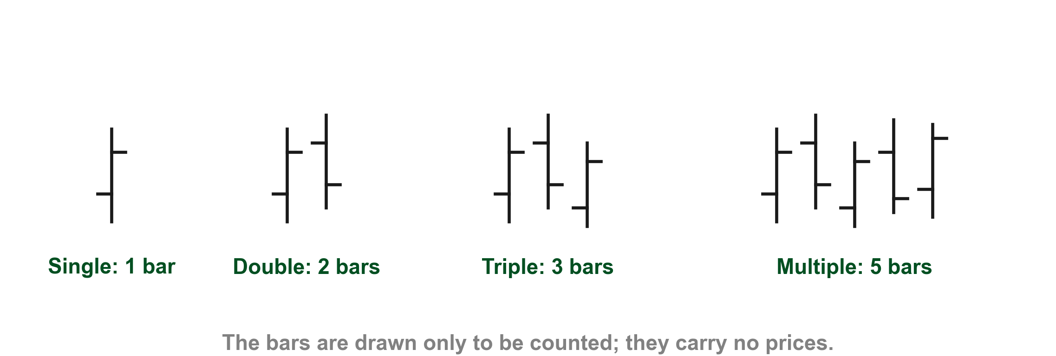
What single, double, triple and multiple look like
Here is what those names look like, drawn by us. One bar on its own (1) is a single formation, two bars (2) a double and three bars (3) a triple. We drew five bars (4) for a multiple formation, since Lim does not say where multiple begins. The bars carry no prices: only how many there are matters here.
1
2
3
4
Chart G - FIN1209 teaching chart, drawn for this course. Illustrative data, not a real instrument.
Part 1 of 4 - 7.1 Price bar | 10 of 22
FIN1209 teaching chart G, drawn to show the four counts; Lim, p. 210.
Notes:
- Count each group aloud: gold 1 has one bar, red 2 two, blue 3 three and purple 4 five.
- The shapes are only for counting. Whether a group leans bullish or bearish is the next question, not this one.
- Lim gives no number at which multiple begins; five is simply our example.

Slide 19
CHECK 3 OF 33
Counting bars in a formation
Q1
Q2
Which formation uses three bars?
Does the number of bars by itself make a formation bullish?
A. Single
B. Double
C. Triple
D. Multiple
A. No, the count only describes the shape
B. Yes, always
C. Only in an uptrend
D. Only with high volume
Part 1 of 4 - 7.1 Price bar | Check 3
Notes:
- Ask the class to name the count before discussing direction.
- The second question separates shape from sentiment.

Slide 20
ANSWERS
Counting bars in a formation
Q1 Which formation uses three bars?
C. Triple
Three bars make a triple formation (Lim, p. 210).
Q2 Does the number of bars by itself make a formation bullish?
A. No, the count only describes the shape
The count sorts formations by size only; whether a formation leans bullish or bearish is a separate question (Lim, p. 210).
Part 1 of 4 - 7.1 Price bar | Check 3
Notes:
- Ask the class to name the count before discussing direction.
- The second question separates shape from sentiment.

Slide 21
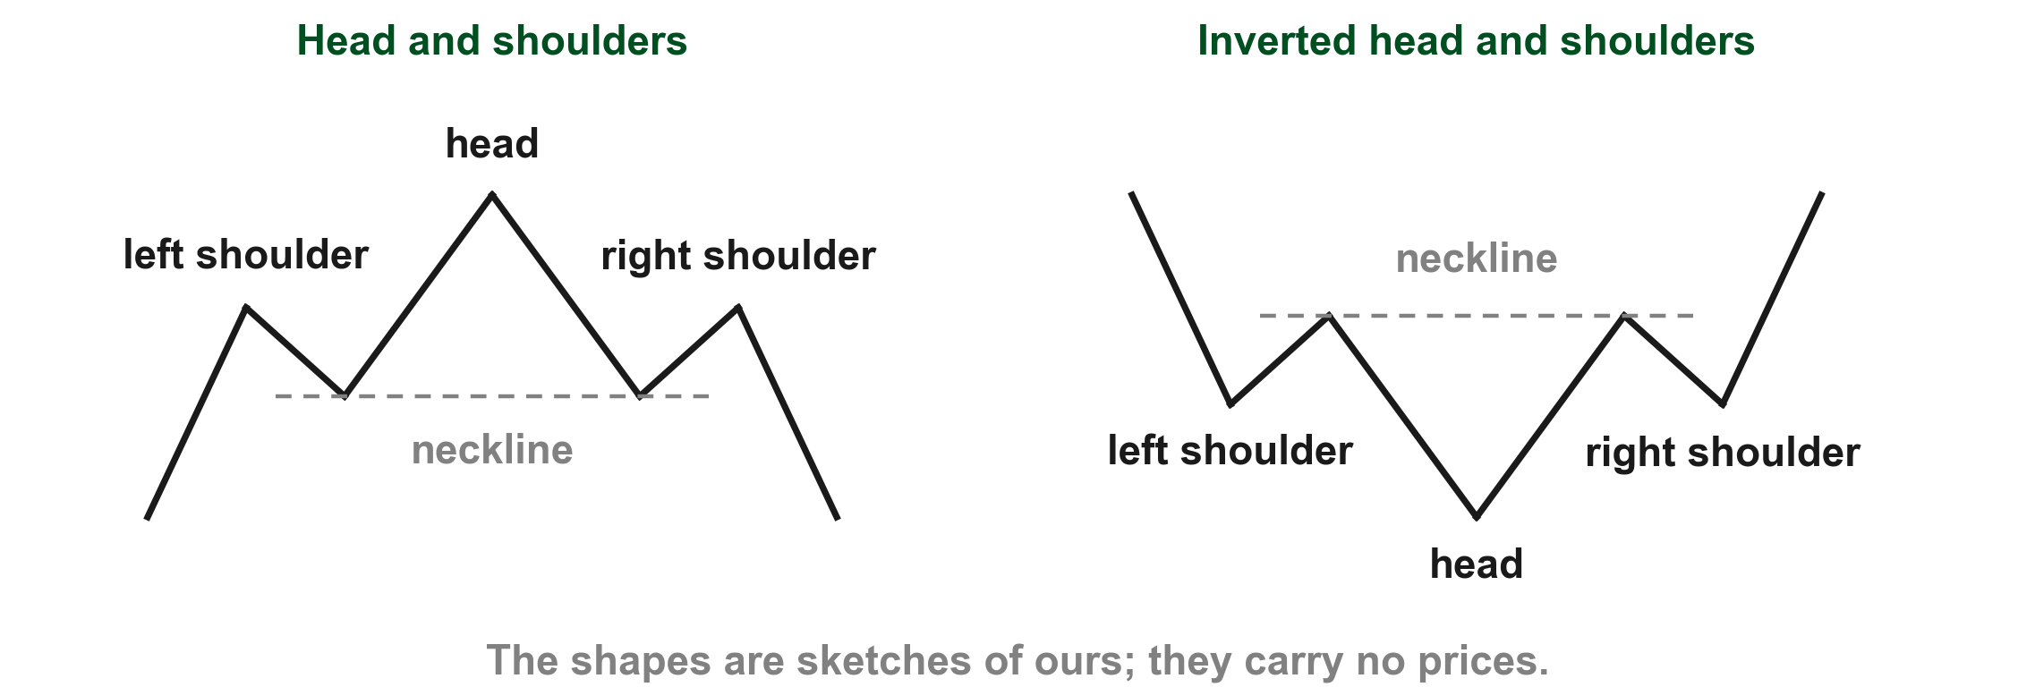
The second way: the formation's own lean
Lim's second way of sorting is the intrinsic bias or sentiment of a formation: whether the formation itself leans bullish or bearish (pp. 210 to 211). Chapter 4 called this intrinsic bias. His example: a standard head and shoulders (1) is intrinsically bearish, and an inverted head and shoulders (2) is intrinsically bullish (p. 211).
1
2
Chart HS - FIN1209 teaching chart, drawn for this course. Illustrative data, not a real instrument.
Part 1 of 4 - 7.1 Price bar | 11 of 22
Our own sketch of the two shapes Lim names on p. 211.
Notes:
- Gold 1 boxes the standard head and shoulders: a left shoulder, a higher head and a right shoulder. Lim calls it intrinsically bearish.
- Red 2 boxes the inverted head and shoulders, the same shape turned over. Lim calls it intrinsically bullish.
- The sketches carry no prices; they only show the two shapes.

Slide 22
The second way: the formation's own lean
The lean belongs to the formation, so it stays the same whichever trend the formation appears in. Intrinsic sentiment is about the formation, not the trend around it.
1
2
Chart HS - FIN1209 teaching chart, drawn for this course. Illustrative data, not a real instrument.
Part 1 of 4 - 7.1 Price bar | 12 of 22
Our own sketch of the two shapes Lim names on p. 211.
Notes:
- Gold 1 boxes the standard head and shoulders: a left shoulder, a higher head and a right shoulder. Lim calls it intrinsically bearish.
- Red 2 boxes the inverted head and shoulders, the same shape turned over. Lim calls it intrinsically bullish.
- The sketches carry no prices; they only show the two shapes.

Slide 23
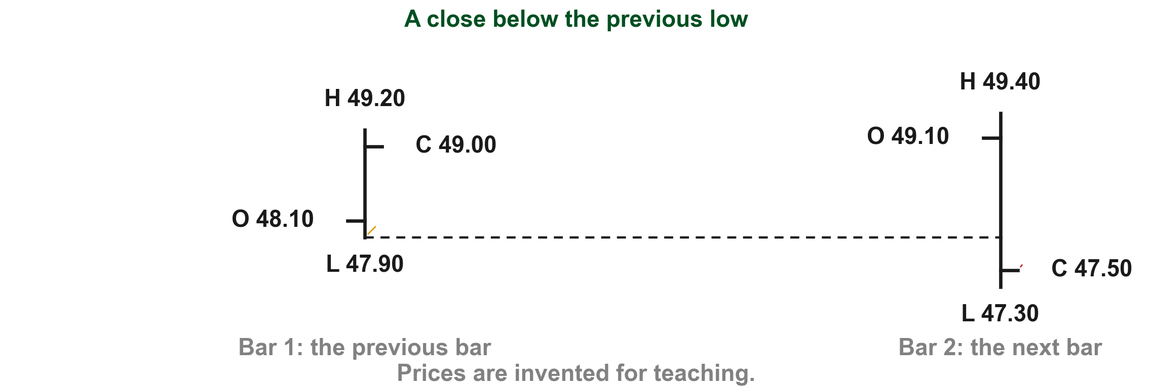
A close below the previous low leans bearish
How do we see that lean in plain bars? Lim gives a general rule: a close below the previous bar's close or low is considered bearish, and a close above the previous bar's close or high is considered bullish (p. 212). For example, with prices of ours: one bar has a low of PHP 47.90 (1) and the next bar closes at PHP 47.50 (2).
1
2
Chart LW - FIN1209 teaching chart, drawn for this course. Illustrative data, not a real instrument.
Part 1 of 4 - 7.1 Price bar | 13 of 22
FIN1209 teaching chart. The PHP values are invented for teaching.
Notes:
- Gold 1 is the previous bar's low at 47.90, carried across on the dashed line.
- Red 2 is the next bar's close at 47.50, below that line, so the formation leans bearish.

Slide 24
A close below the previous low leans bearish
The close is below the previous low, so this two-bar formation leans bearish. Lim calls it a general rule, so treat it as a clue, not a certainty.
1
2
Chart LW - FIN1209 teaching chart, drawn for this course. Illustrative data, not a real instrument.
Part 1 of 4 - 7.1 Price bar | 14 of 22
FIN1209 teaching chart. The PHP values are invented for teaching.
Notes:
- Gold 1 is the previous bar's low at 47.90, carried across on the dashed line.
- Red 2 is the next bar's close at 47.50, below that line, so the formation leans bearish.

Slide 25
CHECK 4 OF 33
Reading intrinsic sentiment
Q1
Q2
What does intrinsic sentiment describe?
One bar has a low of PHP 61.20 and the next bar closes at PHP 60.80. By Lim's general rule, how does this two-bar formation lean?
A. The formation's own bullish or bearish lean
B. The direction of the surrounding trend
C. The trading volume
D. The number of bars
A. Bullish
B. Neither; only volume decides
C. Bearish
D. It depends on the number of bars
Part 1 of 4 - 7.1 Price bar | Check 4
Notes:
- Keep the formation's own lean separate from the trend around it.
- The second question applies the p. 212 rule to new prices.

Slide 26
ANSWERS
Reading intrinsic sentiment
Q1 What does intrinsic sentiment describe?
A. The formation's own bullish or bearish lean
Intrinsic sentiment is the bullish or bearish lean of the formation itself (Lim, p. 211).
Q2 One bar has a low of PHP 61.20 and the next bar closes at PHP 60.80. By Lim's general rule, how does this two-bar formation lean?
C. Bearish
The close of PHP 60.80 is below the previous low of PHP 61.20, and Lim considers a close below the previous low bearish (p. 212).
Part 1 of 4 - 7.1 Price bar | Check 4
Notes:
- Keep the formation's own lean separate from the trend around it.
- The second question applies the p. 212 rule to new prices.

Slide 27
The third way: will the trend continue or reverse?
Lim's third way of sorting is the directional expectation: does the formation suggest the trend will carry on, a continuation, or turn, a reversal (p. 211)?
To decide, compare its intrinsic sentiment with the trend sentiment, which is bullish in an uptrend and bearish in a downtrend (p. 211).
If the two agree, Lim considers it a continuation; if they disagree, a reversal (p. 211), an early sign of the potential trend change the chapter promised (p. 209).
Compare the two sentiments to get the expectation.
Part 1 of 4 - 7.1 Price bar | 15 of 22
Lim (2016), p. 211.
Notes:
- The third classification is the directional expectation: continuation or reversal. It is not trend sentiment.
- Trend sentiment and intrinsic sentiment are the two inputs; the expectation is the result.
- Keep the word potential on a reversal: the book calls these patterns, not promises.

Slide 28
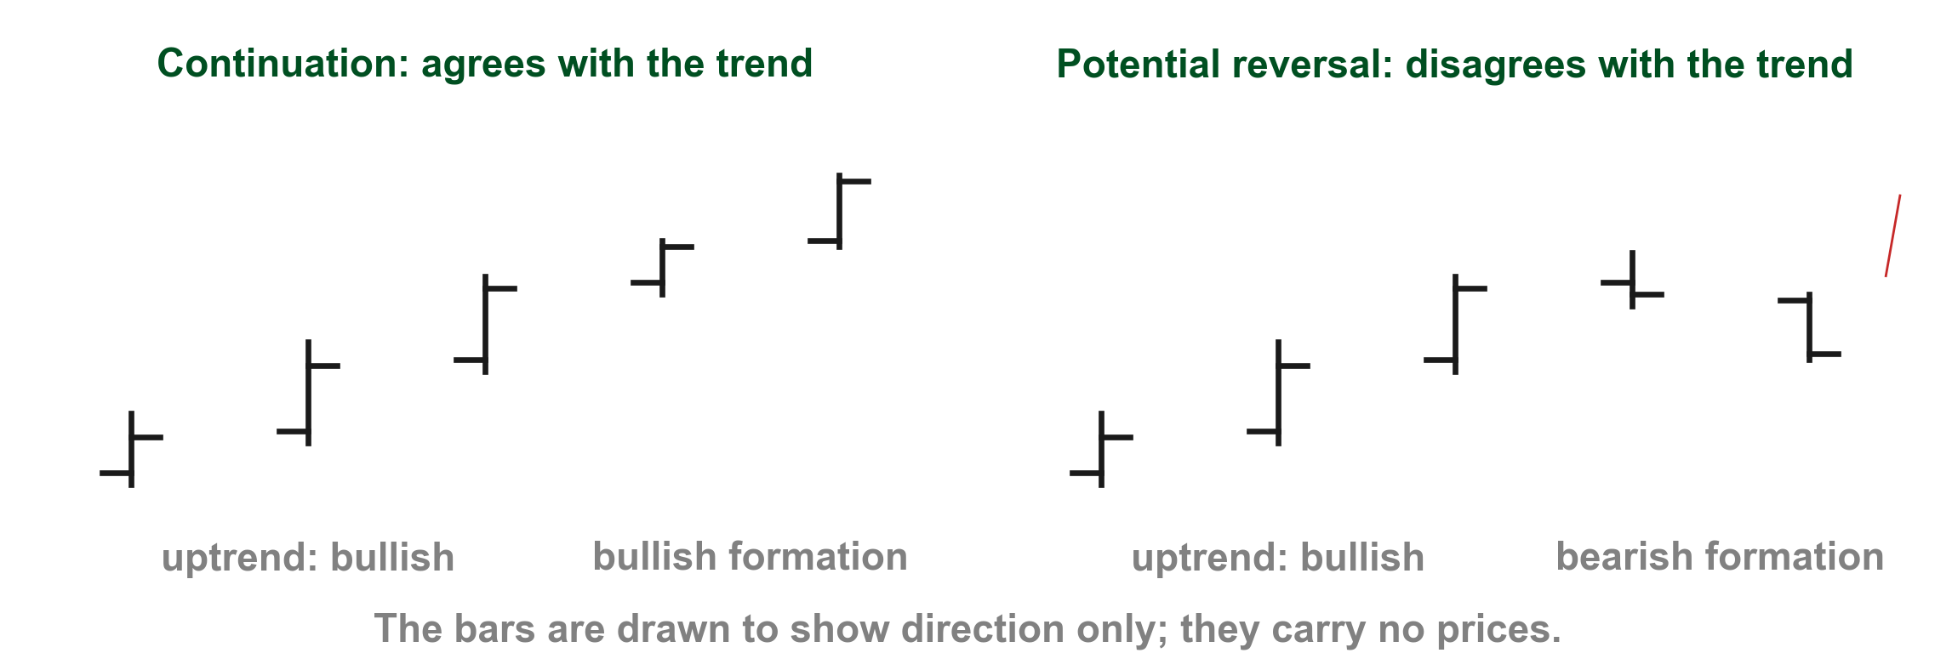
The same uptrend with two different formations
Here is the comparison drawn. In both panels prices have been rising, so the trend sentiment is bullish. A bullish formation (1) agrees with it, so Lim considers it a continuation. A bearish formation (2) disagrees, so it is a reversal (p. 211).
2
1
Chart EX - FIN1209 teaching chart, drawn for this course. Illustrative data, not a real instrument.
Part 1 of 4 - 7.1 Price bar | 16 of 22
Our own sketches of Lim's rule, p. 211.
Notes:
- Gold 1 boxes a bullish formation after the uptrend: it agrees, a continuation.
- Red 2 boxes a bearish formation after the same uptrend: it disagrees, a potential reversal.

Slide 29
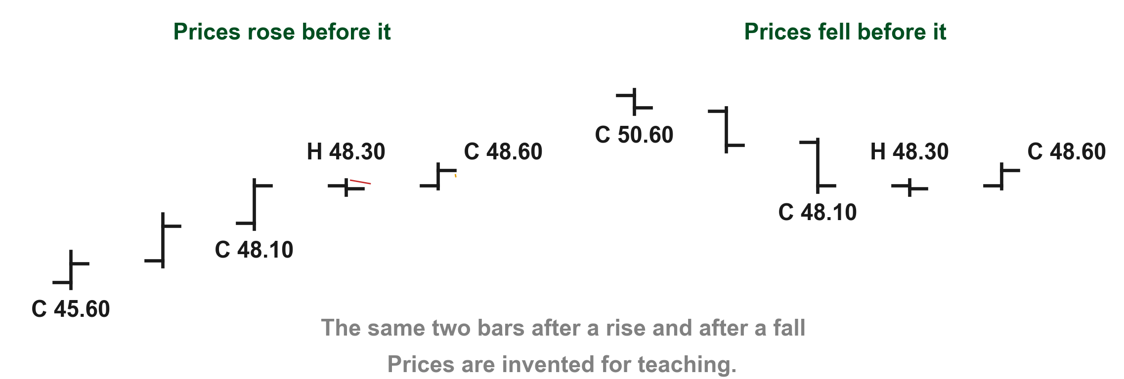
One bullish formation in two different trends
Here is why we keep the two sentiments apart. In a formation of ours the second bar closes at PHP 48.60 (1), above the first bar's high of PHP 48.30 (2), so it is intrinsically bullish. Suppose prices rose (3) from PHP 45.60 to PHP 48.10 before it. Trend sentiment is bullish, the two agree, and the expectation is continuation.
4
2
1
3
Chart TT - FIN1209 teaching chart, drawn for this course. Illustrative data, not a real instrument.
Part 1 of 4 - 7.1 Price bar | 17 of 22
FIN1209 teaching chart. The PHP values are invented for teaching.
Notes:
- Gold 1 and red 2 read the formation: the second bar closes at 48.60, above the first bar's high of 48.30.
- Blue 3 boxes the rise before the left copy, closes 45.60 to 48.10; purple 4 boxes the fall before the right copy, 50.60 to 48.10.
- The two bars are identical in both panels; only the trend before them differs.

Slide 30
One bullish formation in two different trends
Now suppose prices fell (4) from PHP 50.60 to PHP 48.10 before it. Trend sentiment is bearish, the two disagree, and the expectation is a potential reversal. The formation never changed; only the trend around it did.
4
2
1
3
Chart TT - FIN1209 teaching chart, drawn for this course. Illustrative data, not a real instrument.
Part 1 of 4 - 7.1 Price bar | 18 of 22
FIN1209 teaching chart. The PHP values are invented for teaching.
Notes:
- Gold 1 and red 2 read the formation: the second bar closes at 48.60, above the first bar's high of 48.30.
- Blue 3 boxes the rise before the left copy, closes 45.60 to 48.10; purple 4 boxes the fall before the right copy, 50.60 to 48.10.
- The two bars are identical in both panels; only the trend before them differs.

Slide 31
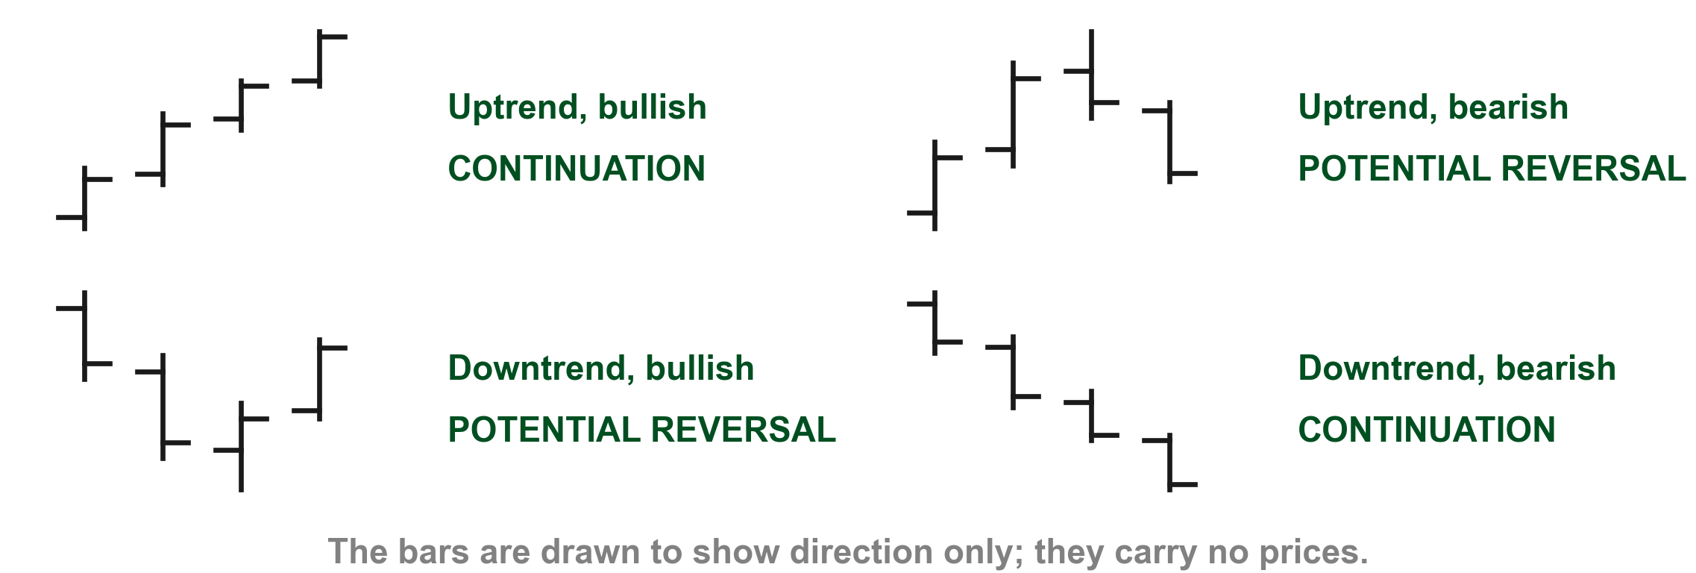
Lim's rule gives four combinations
Put the two sentiments together and there are four cases (p. 211). In an uptrend, a bullish formation (1) agrees with the trend, so Lim considers it a continuation. A bearish formation (2) disagrees, so it is a potential reversal. In a downtrend, a bullish formation (3) disagrees, so it is a potential reversal. A bearish formation (4) agrees, so it is a continuation.
1
2
3
4
Chart FC - FIN1209 teaching chart, drawn for this course. Illustrative data, not a real instrument.
Part 1 of 4 - 7.1 Price bar | 19 of 22
Our own sketches of Lim's four combinations, p. 211.
Notes:
- Four small panels, one for each combination of trend and formation.
- Gold 1 and red 2 are the uptrend cases; blue 3 and purple 4 are the downtrend cases.
- Agreement is a continuation; disagreement is a potential reversal.

Slide 32
Lim's rule gives four combinations
Agreement suggests continuation; disagreement suggests a potential reversal.
1
2
3
4
Chart FC - FIN1209 teaching chart, drawn for this course. Illustrative data, not a real instrument.
Part 1 of 4 - 7.1 Price bar | 20 of 22
Our own sketches of Lim's four combinations, p. 211.
Notes:
- Four small panels, one for each combination of trend and formation.
- Gold 1 and red 2 are the uptrend cases; blue 3 and purple 4 are the downtrend cases.
- Agreement is a continuation; disagreement is a potential reversal.

Slide 33
CHECK 5 OF 33
Comparing the two sentiments
Q1
Q2
What does trend sentiment describe?
A bullish formation appears after prices fell from PHP 72.00 to PHP 66.50. What is the expectation?
A. The formation's own lean
B. Whether the surrounding trend is up or down
C. The bar's range
D. The number of bars
A. Continuation
B. A higher timeframe bar
C. A wider range
D. A potential reversal
Part 1 of 4 - 7.1 Price bar | Check 5
Notes:
- Trend sentiment describes the surrounding trend, not the formation.
- The second question applies the rule to new prices: a bullish formation after a fall.

Slide 34
ANSWERS
Comparing the two sentiments
Q1 What does trend sentiment describe?
B. Whether the surrounding trend is up or down
Trend sentiment is bullish in an uptrend and bearish in a downtrend, so it describes the surrounding trend (Lim, p. 211).
Q2 A bullish formation appears after prices fell from PHP 72.00 to PHP 66.50. What is the expectation?
D. A potential reversal
The fall gives bearish trend sentiment and the formation is bullish. They disagree, so it is a potential reversal (Lim, p. 211).
Part 1 of 4 - 7.1 Price bar | Check 5
Notes:
- Trend sentiment describes the surrounding trend, not the formation.
- The second question applies the rule to new prices: a bullish formation after a fall.

Slide 35
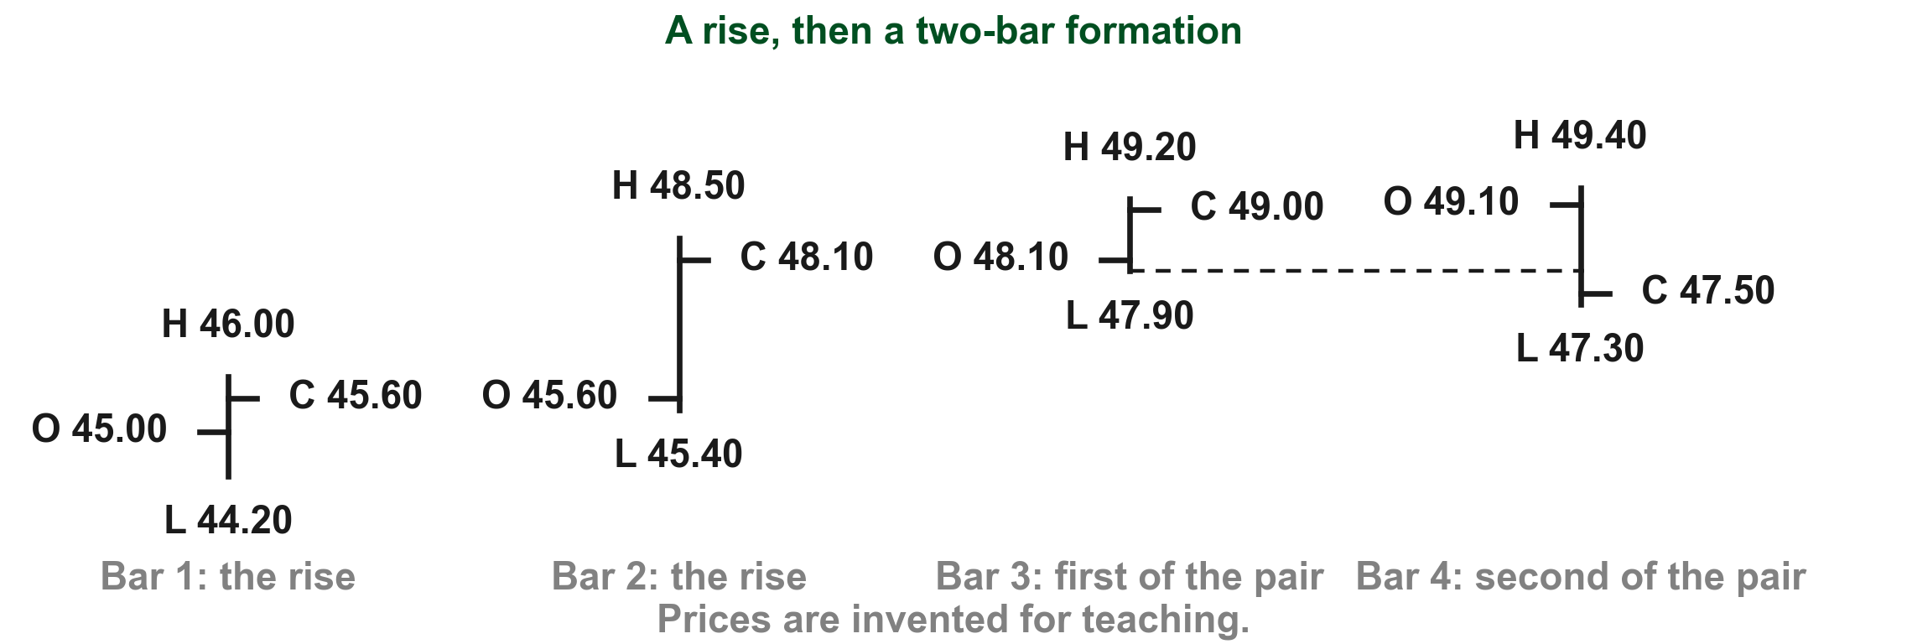
Using all three questions on one example
Now we use all three questions together on an example of ours. First the trend: the closes rose from PHP 45.60 (1) to PHP 48.10 (2), so trend sentiment is bullish. Next the count: the last two bars make a double formation (3). Then the lean: bar 4 closes at PHP 47.50 (4), below bar 3's low of PHP 47.90 on the dashed line, so by Lim's rule the formation leans bearish (p. 212).
4
3
2
1
Chart S - FIN1209 teaching chart, drawn for this course. Illustrative data, not a real instrument.
Part 1 of 4 - 7.1 Price bar | 21 of 22
FIN1209 teaching chart S. The PHP values are invented for teaching.
Notes:
- Take the three questions in order: the closes rise from gold 1 at 45.60 to red 2 at 48.10, so trend sentiment is bullish; blue 3 boxes the double formation.
- Purple 4: bar 4 closes at 47.50, below the dashed line at bar 3's low of 47.90, so the formation leans bearish.
- Bullish against bearish disagree, so the reading is a potential reversal. Every bar is possible: each low is its lowest price.

Slide 36
Using all three questions on one example
Bullish trend sentiment against bearish intrinsic sentiment: they disagree, so this is a potential reversal (p. 211). Part 2 reads the book's own reversal patterns the same way.
4
3
2
1
Chart S - FIN1209 teaching chart, drawn for this course. Illustrative data, not a real instrument.
Part 1 of 4 - 7.1 Price bar | 22 of 22
FIN1209 teaching chart S. The PHP values are invented for teaching.
Notes:
- Take the three questions in order: the closes rise from gold 1 at 45.60 to red 2 at 48.10, so trend sentiment is bullish; blue 3 boxes the double formation.
- Purple 4: bar 4 closes at 47.50, below the dashed line at bar 3's low of 47.90, so the formation leans bearish.
- Bullish against bearish disagree, so the reading is a potential reversal. Every bar is possible: each low is its lowest price.

Slide 37
CHECK 6 OF 33
The three classifications
Q1
Q2
What do single, double, triple and multiple measure?
When does Lim consider a formation a reversal pattern?
A. The trend direction
B. The intrinsic sentiment
C. The number of bars in the formation
D. The size of the range
A. When it has three bars
B. When its range is wide
C. When it closes where it opened
D. When its intrinsic sentiment disagrees with the trend sentiment
Part 1 of 4 - 7.1 Price bar | Check 6
Notes:
- This closes Part 1: all three ways of sorting a formation.
- Both answers come from the classification slides, not from any one chart.

Slide 38
ANSWERS
The three classifications
Q1 What do single, double, triple and multiple measure?
C. The number of bars in the formation
They are the first of Lim's three classifications: the number of bars that make up the formation (p. 210).
Q2 When does Lim consider a formation a reversal pattern?
D. When its intrinsic sentiment disagrees with the trend sentiment
When intrinsic and trend sentiment disagree, Lim considers the pattern a reversal (p. 211).
Part 1 of 4 - 7.1 Price bar | Check 6
Notes:
- This closes Part 1: all three ways of sorting a formation.
- Both answers come from the classification slides, not from any one chart.

Slide 39
Section 7.2 reads each bar pattern against the trend around it
In Part 1 every formation had two sentiments. Its intrinsic sentiment is its own bullish or bearish lean; the trend sentiment is bullish in an uptrend and bearish in a downtrend (p. 211).
Section 7.2 puts the two together. When they agree, Lim calls the pattern a continuation pattern; when they disagree, he calls it a reversal pattern (p. 211).
So the same pattern can mean different things in different trends: read the trend first.
Part 2 of 4 - 7.2 Pattern reading | 1 of 88
Lim (2016), p. 211.
Notes:
- Recall Part 1 in one breath: two sentiments, then the agreement rule.
- Stress that the trend is read first; the same pattern changes meaning with it.

Slide 40
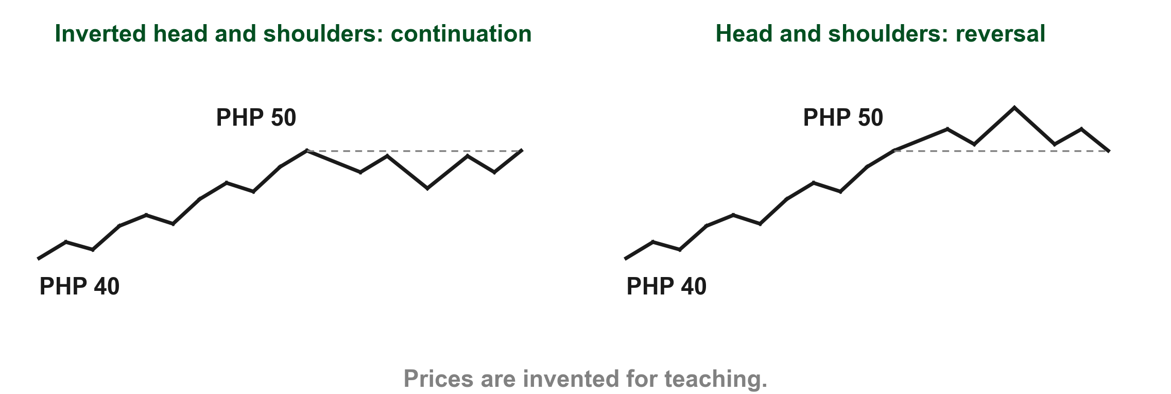
Lim's own example is the head and shoulders
A head and shoulders has bearish intrinsic sentiment and an inverted head and shoulders bullish, as Chapter 4's "Intrinsic bias" explains (p. 211). Let us put invented prices on it. A stock climbs from PHP 40 to PHP 50 (1) over ten days, so the trend sentiment is bullish. An inverted head and shoulders (2) at PHP 50 agrees with that trend, so Lim calls it a continuation pattern.
1
3
2
Chart HN - FIN1209 teaching chart, drawn for this course. Illustrative data, not a real instrument.
Part 2 of 4 - 7.2 Pattern reading | 2 of 88
Our own sketch. The prices are invented for teaching.
Notes:
- Gold 1 boxes the ten day climb from 40 to 50, so trend sentiment is bullish.
- Red 2 boxes the inverted head and shoulders at 50: bullish, agreeing with the trend, so a continuation pattern.
- Blue 3 boxes the head and shoulders in the same place: bearish, disagreeing, so a reversal pattern.

Slide 41
Lim's own example is the head and shoulders
A head and shoulders (3) in the same place disagrees, so it is a reversal pattern.
1
3
2
Chart HN - FIN1209 teaching chart, drawn for this course. Illustrative data, not a real instrument.
Part 2 of 4 - 7.2 Pattern reading | 3 of 88
Our own sketch. The prices are invented for teaching.
Notes:
- Gold 1 boxes the ten day climb from 40 to 50, so trend sentiment is bullish.
- Red 2 boxes the inverted head and shoulders at 50: bullish, agreeing with the trend, so a continuation pattern.
- Blue 3 boxes the head and shoulders in the same place: bearish, disagreeing, so a reversal pattern.

Slide 42
CHECK 7 OF 33
Continuation or reversal
Q1
Q2
A stock climbs from PHP 40 to PHP 50, and then a bearish pattern forms. What does Lim call it?
Why is an inverted head and shoulders in an uptrend a continuation pattern?
A. A continuation pattern
B. A reversal pattern
C. A higher timeframe bar
D. A neutral pattern
A. It has three peaks
B. Its volume is high
C. Both sentiments are bullish
D. The trend is down
Part 2 of 4 - 7.2 Pattern reading | Check 7
Notes:
- Both answers come from the two slides before. Do not reveal them on the question slide.

Slide 43
ANSWERS
Continuation or reversal
Q1 A stock climbs from PHP 40 to PHP 50, and then a bearish pattern forms. What does Lim call it?
B. A reversal pattern
The uptrend's trend sentiment is bullish and the pattern's intrinsic sentiment is bearish. They disagree, so it is a reversal pattern (p. 211).
Q2 Why is an inverted head and shoulders in an uptrend a continuation pattern?
C. Both sentiments are bullish
Its intrinsic sentiment is bullish and the uptrend makes the trend sentiment bullish too, so they agree (p. 211).
Part 2 of 4 - 7.2 Pattern reading | Check 7
Notes:
- Both answers come from the two slides before. Do not reveal them on the question slide.

Slide 44
So Lim draws each bearish reversal at the top of an uptrend
A reversal needs the two sentiments to disagree. So when Lim draws bearish reversal patterns he assumes the existing trend is up, and for bullish ones he assumes it is down (pp. 211 to 212). The book actually prints "bearish" twice in that sentence; the second must mean bullish, as his bullish drawings show.
In each drawing that follows, an arrow labelled "Existing uptrend" leads into a bearish pattern, and "Existing downtrend" into a bullish one.
We start with the smallest patterns, made of one or two bars.
The arrow in each drawing is the trend the pattern has to fight.
Part 2 of 4 - 7.2 Pattern reading | 4 of 88
Lim (2016), pp. 211 to 212.
Notes:
- Point ahead: every drawing from Figure 7.4 to 7.11 carries this arrow.
- Students should say the trend before they name the pattern.

Slide 45
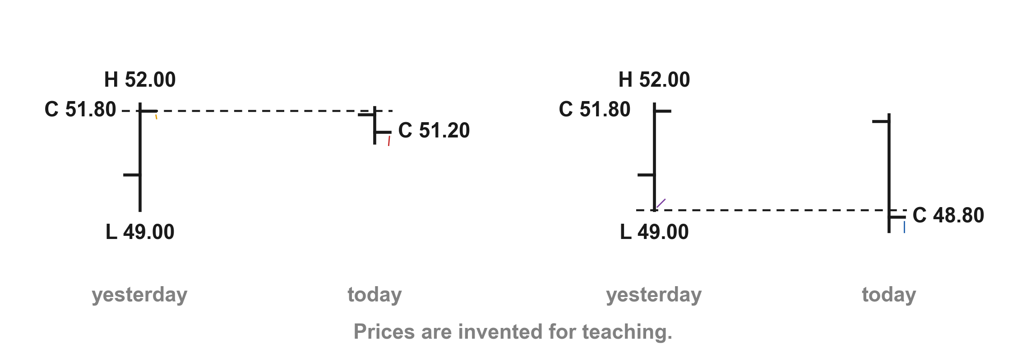
A close below the previous bar is Lim's basic bearish clue
For one-bar and two-bar patterns in an uptrend, Lim's general rule is that a close below the previous bar's close or low is bearish, especially when that previous bar is large or wide-ranging (p. 212). Here it is with invented prices. Yesterday's bar ran from PHP 49.00 to PHP 52.00 and closed at PHP 51.80 (1).
1
2
4
3
Chart PU - FIN1209 teaching chart, drawn for this course. Illustrative data, not a real instrument.
Part 2 of 4 - 7.2 Pattern reading | 5 of 88
FIN1209 teaching chart. The prices are invented for teaching.
Notes:
- Gold 1 is yesterday's close at 51.80; red 2 is today's close at 51.20, below it.
- Blue 3 is a close at 48.80, below yesterday's low at 49.00 marked purple 4.

Slide 46
A close below the previous bar is Lim's basic bearish clue
A close today at PHP 51.20 (2) is below yesterday's close; a close at PHP 48.80 (3) is below yesterday's low (4) as well. Yesterday's PHP 3.00 range is wide, the case Lim says counts for more.
1
2
4
3
Chart PU - FIN1209 teaching chart, drawn for this course. Illustrative data, not a real instrument.
Part 2 of 4 - 7.2 Pattern reading | 6 of 88
FIN1209 teaching chart. The prices are invented for teaching.
Notes:
- Gold 1 is yesterday's close at 51.80; red 2 is today's close at 51.20, below it.
- Blue 3 is a close at 48.80, below yesterday's low at 49.00 marked purple 4.

Slide 47
Lim draws seven of these bearish forms in Figure 7.4
Figure 7.4 collects the seven basic bearish single and double bar reversal patterns of uptrending markets (p. 212). Here is the first drawing, cut out and drawn large.
Each form sits on an existing uptrend (1) and carries a number (2); the next seven slides take them one at a time, each quoting its label.
FIGURE 7.4
Figure 7.4, form 1: the drawing on its arrow, with its number.
1
2
Figure 7.4 - Lim, The Handbook of Technical Analysis (Wiley, 2016)
Part 2 of 4 - 7.2 Pattern reading | 7 of 88
Lim (2016), p. 212, Figure 7.4.
Notes:
- Show the whole sheet once so students see the family; every later slide crops one drawing.
- Point at the arrow and the label under form 1.

Slide 48
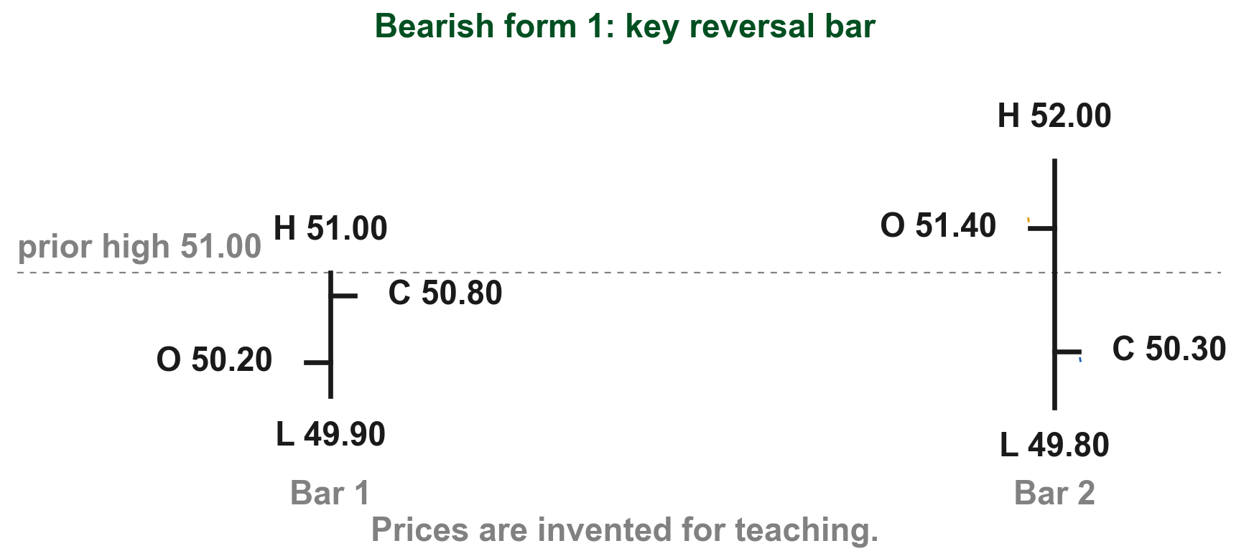
Form 1, the key reversal bar: it opens high and closes low
Lim's label for form 1: "A large bar opening above a previous high and closing near or below a previous close," a key reversal bar (Figure 7.4, p. 212). Let us put invented prices on it. The previous bar reached PHP 51.00 and closed at PHP 50.80. Form 1 opens at PHP 51.40, above that high (1), swings through PHP 2.20 (2), and closes at PHP 50.30, below the previous close (3).
FIGURE 7.4
Figure 7.4, form 1: a key reversal bar after an uptrend.
1
2
3
Figure 7.4, Lim (2016)
Chart BA - FIN1209 teaching chart, drawn for this course. Illustrative data, not a real instrument.
Part 2 of 4 - 7.2 Pattern reading | 8 of 88
Lim (2016), p. 212, Figure 7.4. The prices are invented for teaching.
Notes:
- Read the label, then walk the three marks in order.
- Part 3 comes back to the key reversal bar with the book's real charts.

Slide 49
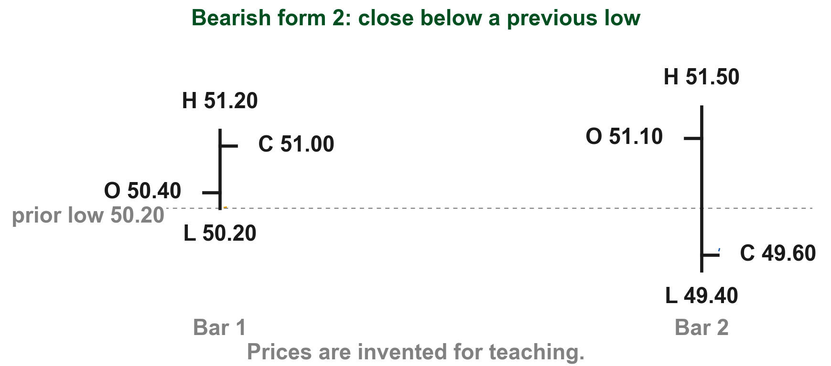
Form 2 closes near or below the previous low
Lim's label for form 2: "A large bar closing near or below a previous low" (Figure 7.4, p. 212). By the close, price has fallen through everything the previous bar traded. Here it is with invented prices. The previous bar's low is PHP 50.20 (1). Form 2 is a large bar with a PHP 2.10 range (2) that closes at PHP 49.60, below that low (3).
FIGURE 7.4
Figure 7.4, form 2: a large bar closing below the previous low.
2
1
3
Figure 7.4, Lim (2016)
Chart BB - FIN1209 teaching chart, drawn for this course. Illustrative data, not a real instrument.
Part 2 of 4 - 7.2 Pattern reading | 9 of 88
Lim (2016), p. 212, Figure 7.4. The prices are invented for teaching.
Notes:
- Compare with form 1: here the close goes below the previous low, not just the previous close.

Slide 50
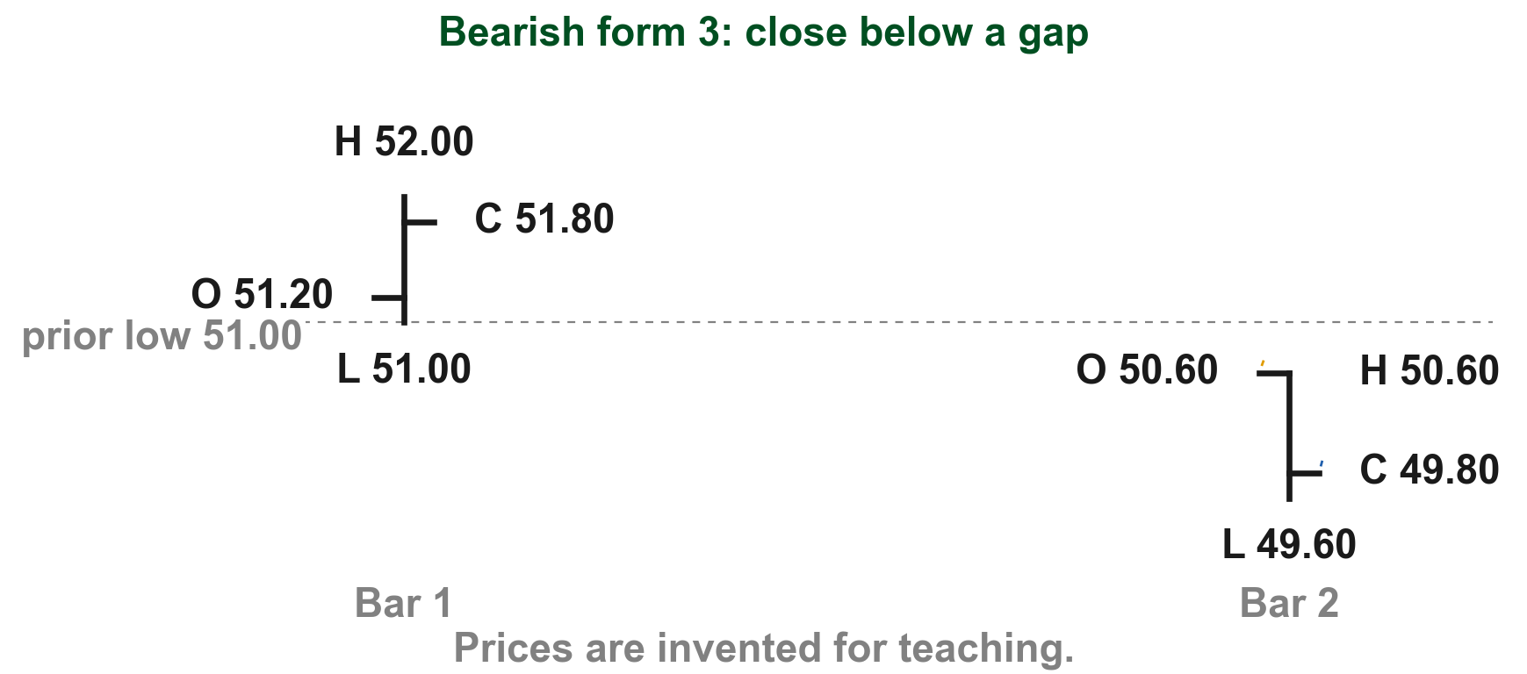
Form 3 closes below a gap
Lim's label for form 3: "A bar closing below a gap formed between the current bar's open and a previous bar's low" (Figure 7.4, p. 212). Chapter 3's "Gap" is a range of prices where no trading took place. Say the previous low is PHP 51.00. Form 3 opens at PHP 50.60 (1), leaving a PHP 0.40 gap above its open (2), and closes at PHP 49.80, below the gap (3).
FIGURE 7.4
Figure 7.4, form 3: a bar closing below a gap.
2
1
3
Figure 7.4, Lim (2016)
Chart BC - FIN1209 teaching chart, drawn for this course. Illustrative data, not a real instrument.
Part 2 of 4 - 7.2 Pattern reading | 10 of 88
Lim (2016), p. 212, Figure 7.4; Chapter 3, "Gap". The prices are invented for teaching.
Notes:
- Chapter 3 would call a gap measured from the previous low to the open a Type 2 gap.
- The gap is open price space: nothing traded between 50.60 and 51.00.

Slide 51
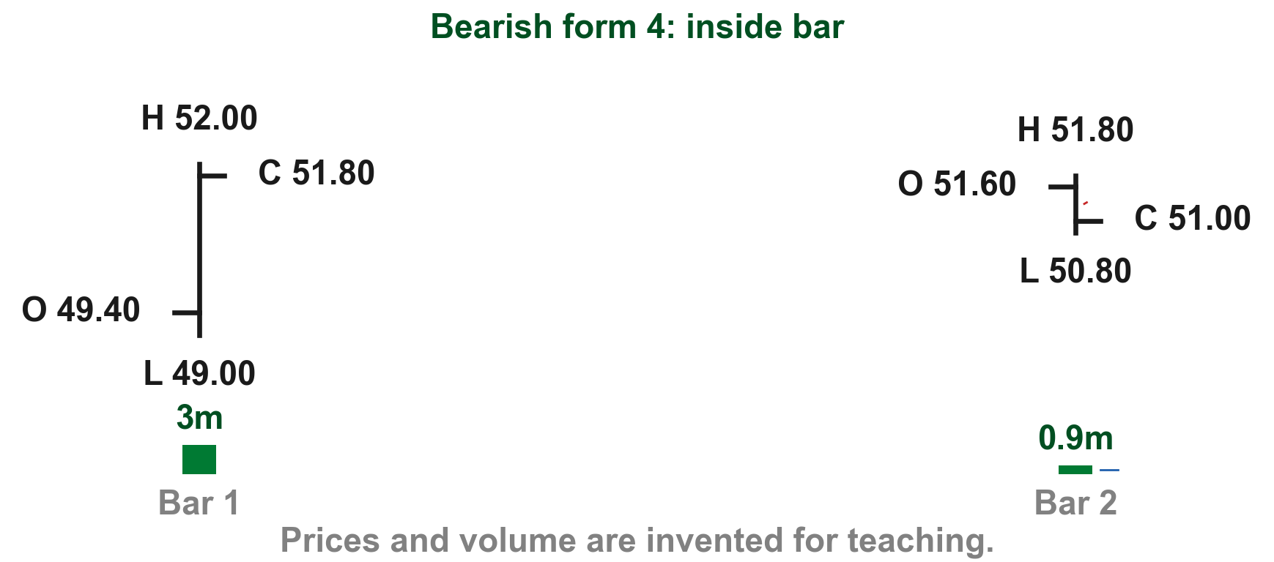
Form 4 is the inside bar: a narrow bar inside a larger one
Lim's label for form 4: "Narrow range bar closing within a larger previous bar's range," an inside bar (Figure 7.4, p. 212). Say the previous bar ranges PHP 3.00 (1); the inside bar ranges only PHP 1.00 (2), on 0.9 million shares against 3.0 million (3). Lim says such narrow bars should generally form on low volume, showing uncertainty in an uptrend (p. 212).
FIGURE 7.4
Figure 7.4, form 4: a narrow inside bar after a large bar.
2
1
3
Figure 7.4, Lim (2016)
Chart BD - FIN1209 teaching chart, drawn for this course. Illustrative data, not a real instrument.
Part 2 of 4 - 7.2 Pattern reading | 11 of 88
Lim (2016), p. 212, Figure 7.4. Prices and volume are invented for teaching.
Notes:
- The bearish clue is the sudden hesitation after a strong up bar.
- Part 3 returns to inside bars and compares them with the Harami.

Slide 52
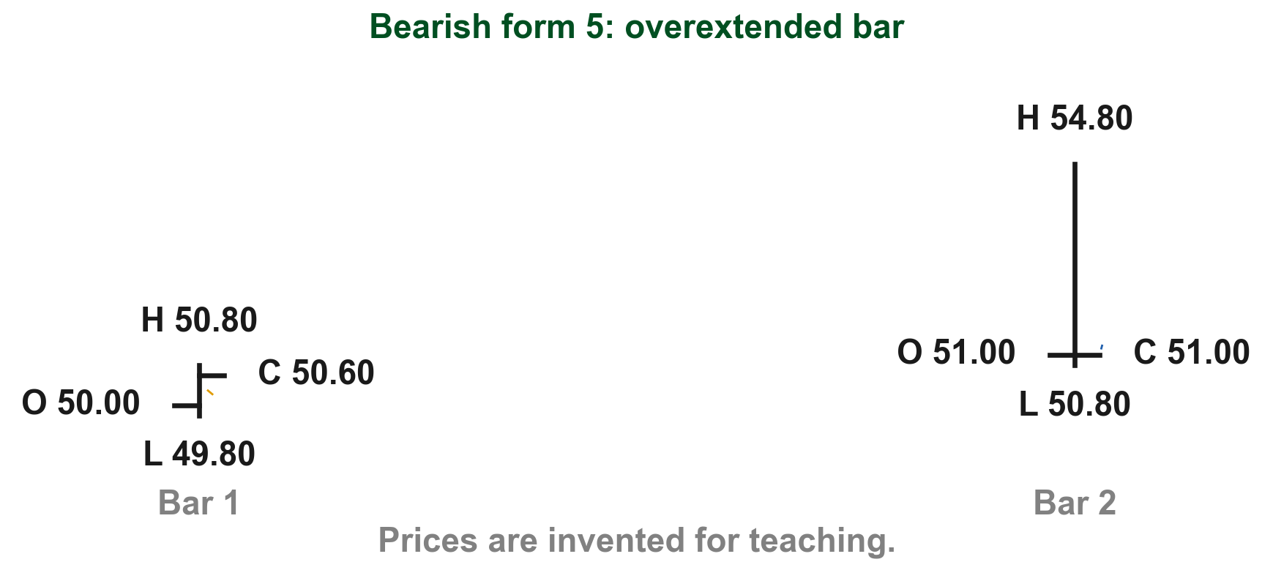
Form 5 is one overextended bar that closes near its low
Lim's label: "An overextended bar closes at or near its low" (Figure 7.4, p. 212). He gives no size; we read "overextended" as unusually long compared with the bars before it, and closing near its low is a separate part. His only other use is beyond a Bollinger band (pp. 217 to 218). Beside an ordinary PHP 1.00 bar (1), form 5 ranges PHP 4.00 (2) and closes near its low (3).
FIGURE 7.4
Figure 7.4, form 5: one overextended bar closing near its low.
2
3
1
Figure 7.4, Lim (2016)
Chart BE - FIN1209 teaching chart, drawn for this course. Illustrative data, not a real instrument.
Part 2 of 4 - 7.2 Pattern reading | 12 of 88
Lim (2016), p. 212, Figure 7.4. The prices are invented for teaching.
Notes:
- Overextended: much longer than the bars before it. Closing near the low is a second, separate condition.

Slide 53
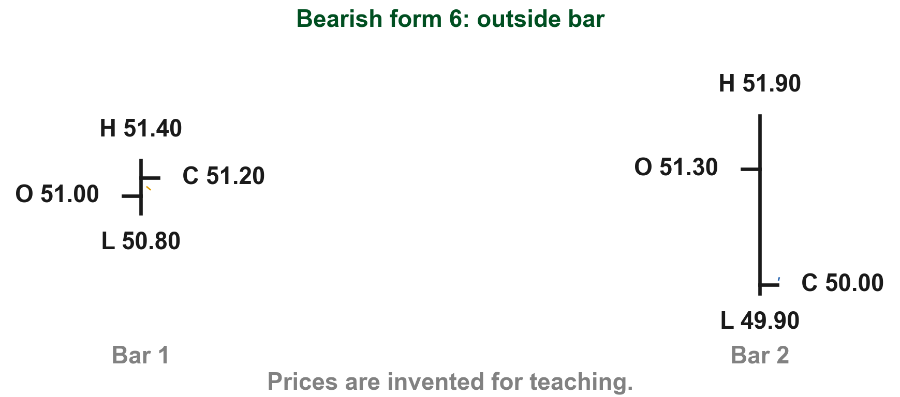
Form 6 is the outside bar: it engulfs the bar before it
Lim's label for form 6: "Bar engulfing a previous narrow range bar and closing near or at its low," which he calls an outside bar (Figure 7.4, p. 212). Let us put invented prices on it. The previous bar is narrow, from PHP 50.80 to PHP 51.40 (1). The outside bar runs from PHP 49.90 to PHP 51.90 (2), beyond both ends, and closes at PHP 50.00, near its low (3).
FIGURE 7.4
Figure 7.4, form 6: an outside bar engulfing a narrow bar.
1
2
3
Figure 7.4, Lim (2016)
Chart BF - FIN1209 teaching chart, drawn for this course. Illustrative data, not a real instrument.
Part 2 of 4 - 7.2 Pattern reading | 13 of 88
Lim (2016), p. 212, Figure 7.4. The prices are invented for teaching.
Notes:
- Form 4 sits inside the previous bar; form 6 reaches beyond both ends of it.
- Part 3 reads outside bars on real charts.

Slide 54
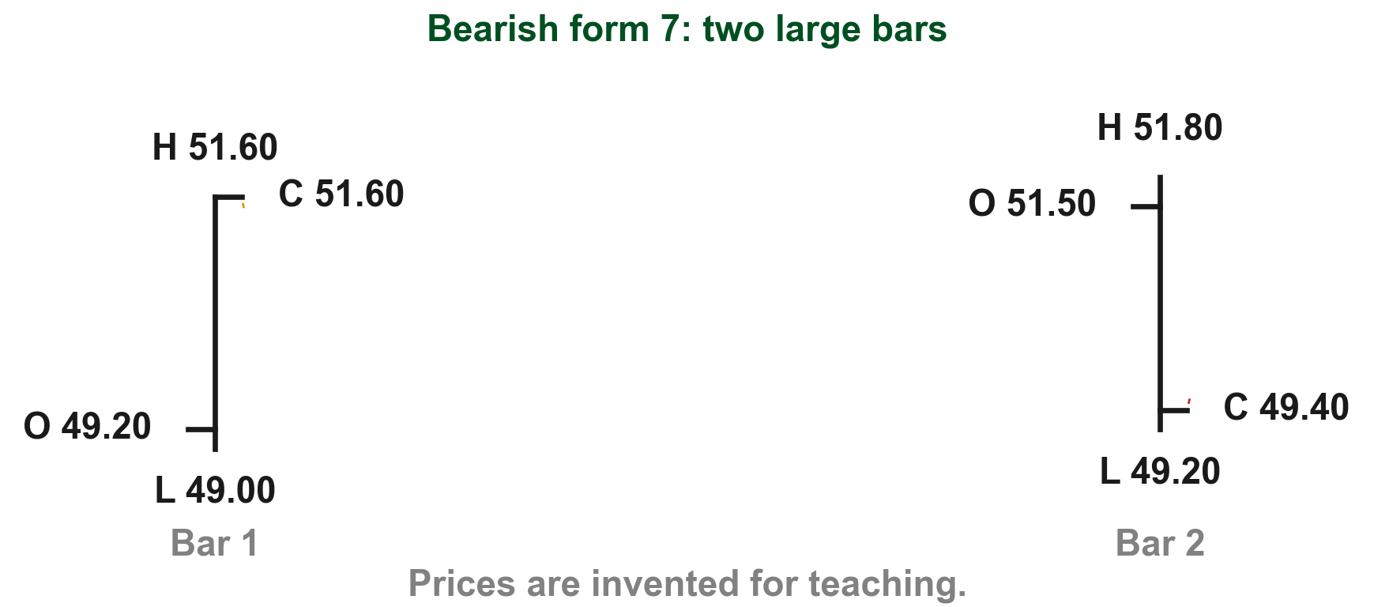
Form 7 is two large bars that close at opposite ends
Lim's label for form 7: "1st large bar closing at its high followed by a large bar closing at or near its low" (Figure 7.4, p. 212). The buyers' strong finish is undone by the very next bar. Here it is with invented prices. The first bar closes at PHP 51.60, right at its high (1). The second bar, just as large, closes at PHP 49.40, only PHP 0.20 above its low (2).
FIGURE 7.4
Figure 7.4, form 7: two large bars closing at opposite ends.
1
2
Figure 7.4, Lim (2016)
Chart BG - FIN1209 teaching chart, drawn for this course. Illustrative data, not a real instrument.
Part 2 of 4 - 7.2 Pattern reading | 14 of 88
Lim (2016), p. 212, Figure 7.4. The prices are invented for teaching.
Notes:
- Ask which close matters more: the second, because it is the most recent word on the trend.

Slide 55
Volume tells us how much weight a bearish pattern gets
Lim adds two volume habits. Narrow range bars in a two-bar pattern should generally form on low volume, showing uncertainty in an uptrend (p. 212).
Large bars closing at or near their lows should generally form on high volume in an uptrend (p. 212).
He also notes that some practitioners treat these same patterns as continuation patterns when they occur in a downtrend (p. 212).
Quiet narrow bars show doubt; heavy large bars show conviction.
Part 2 of 4 - 7.2 Pattern reading | 15 of 88
Lim (2016), p. 212.
Notes:
- These are the volume habits behind the seven drawings.
- Keep Lim's caveat: some practitioners read them as continuations in a downtrend.

Slide 56
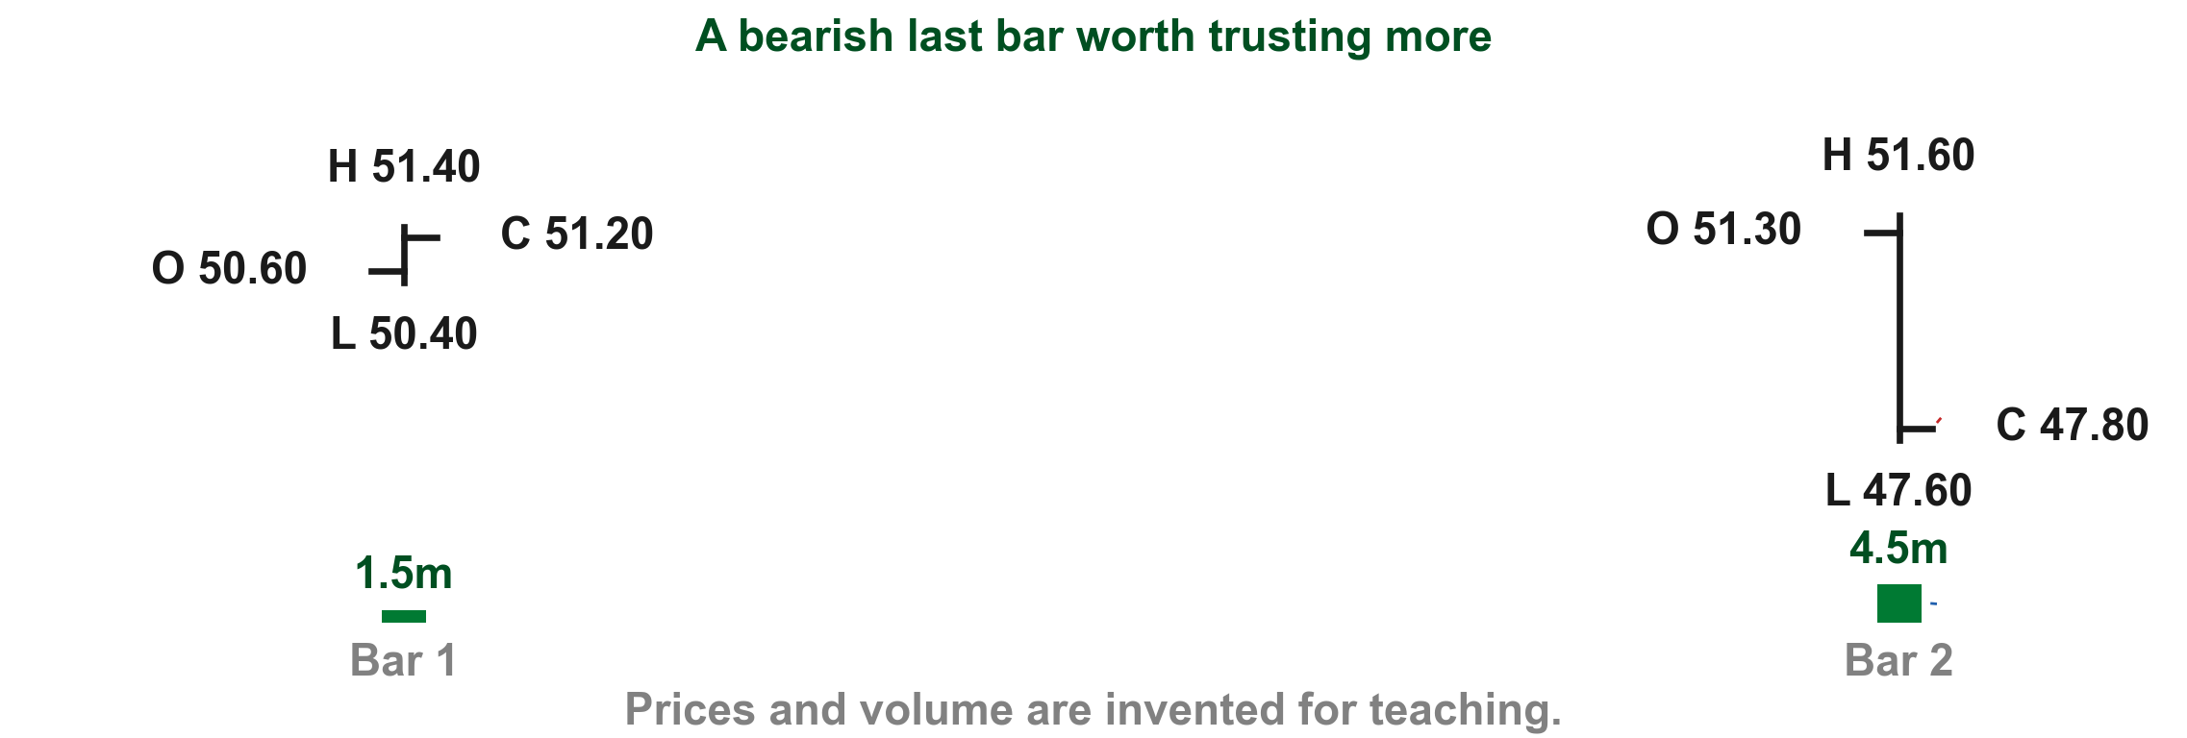
A bearish last bar we can trust more
Lim says a bearish two-bar pattern is potentially more reliable if the last bar is an overextended bar that closes at or near its low on high volume (p. 212). Let us put invented prices on it. The last bar stretches PHP 4.00 against PHP 1.00 before it (1), closes at PHP 47.80, near its low of PHP 47.60 (2), and trades 4.5 million shares against 1.5 million (3).
1
2
3
Chart RL - FIN1209 teaching chart, drawn for this course. Illustrative data, not a real instrument.
Part 2 of 4 - 7.2 Pattern reading | 16 of 88
Lim (2016), p. 212. Prices and volume are invented for teaching.
Notes:
- All three conditions together; any one alone is weaker.
- Potentially more reliable, never certain.

Slide 57
CHECK 8 OF 33
Bearish single and double bar patterns
Q1
Q2
Which last bar makes a bearish two-bar pattern potentially more reliable?
In an uptrend, what does a narrow range bar on low volume within a two-bar pattern show?
A. A narrow bar closing near its high
B. Any bar on low volume
C. A bar that gaps up and closes high
D. An overextended bar closing near its low on high volume
A. A guaranteed reversal
B. Uncertainty
C. A continuation
D. A wider range
Part 2 of 4 - 7.2 Pattern reading | Check 8
Notes:
- Both answers were stated in the body text of the last two slides.

Slide 58
ANSWERS
Bearish single and double bar patterns
Q1 Which last bar makes a bearish two-bar pattern potentially more reliable?
D. An overextended bar closing near its low on high volume
Lim says the pattern is potentially more reliable if the last bar is overextended and closes at or near its low on high volume (p. 212).
Q2 In an uptrend, what does a narrow range bar on low volume within a two-bar pattern show?
B. Uncertainty
Lim says such narrow range bars should generally form on low volume, indicating uncertainty in an uptrend (p. 212).
Part 2 of 4 - 7.2 Pattern reading | Check 8
Notes:
- Both answers were stated in the body text of the last two slides.

Slide 59
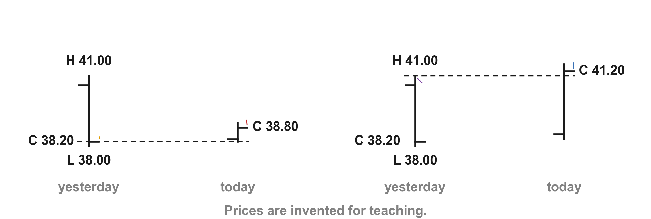
In a downtrend Lim's close rule turns around
In a downtrend Lim's general rule is the mirror image: a close above the previous bar's close or high is bullish, especially if the previous bar is large or wide-ranging (p. 212). Here it is with invented prices. Yesterday's bar ran from PHP 38.00 to PHP 41.00 and closed at PHP 38.20 (1).
3
4
2
1
Chart PD - FIN1209 teaching chart, drawn for this course. Illustrative data, not a real instrument.
Part 2 of 4 - 7.2 Pattern reading | 17 of 88
FIN1209 teaching chart. The prices are invented for teaching.
Notes:
- Gold 1 is yesterday's close at 38.20; red 2 is today's close at 38.80, above it.
- Blue 3 is a close at 41.20, above yesterday's high at 41.00 marked purple 4.

Slide 60
In a downtrend Lim's close rule turns around
A close today at PHP 38.80 (2) is above yesterday's close; a close at PHP 41.20 (3) is above yesterday's high (4) as well. Now the close has to climb past yesterday's bar.
3
4
2
1
Chart PD - FIN1209 teaching chart, drawn for this course. Illustrative data, not a real instrument.
Part 2 of 4 - 7.2 Pattern reading | 18 of 88
FIN1209 teaching chart. The prices are invented for teaching.
Notes:
- Gold 1 is yesterday's close at 38.20; red 2 is today's close at 38.80, above it.
- Blue 3 is a close at 41.20, above yesterday's high at 41.00 marked purple 4.

Slide 61
Lim draws the seven bullish forms in Figure 7.5
Figure 7.5 draws the seven basic bullish single and double bar reversal patterns in a downtrend (p. 213). Here is the first drawing, cut out and drawn large.
Each form sits under an existing downtrend (1) and carries a number (2); the next seven slides take them one at a time, each quoting its label.
2
1
FIGURE 7.5
Figure 7.5, form 1: the number, its arrow and the drawing.
Figure 7.5 - Lim, The Handbook of Technical Analysis (Wiley, 2016)
Part 2 of 4 - 7.2 Pattern reading | 19 of 88
Lim (2016), p. 213, Figure 7.5.
Notes:
- Show the whole sheet once; every later slide crops one drawing.

Slide 62
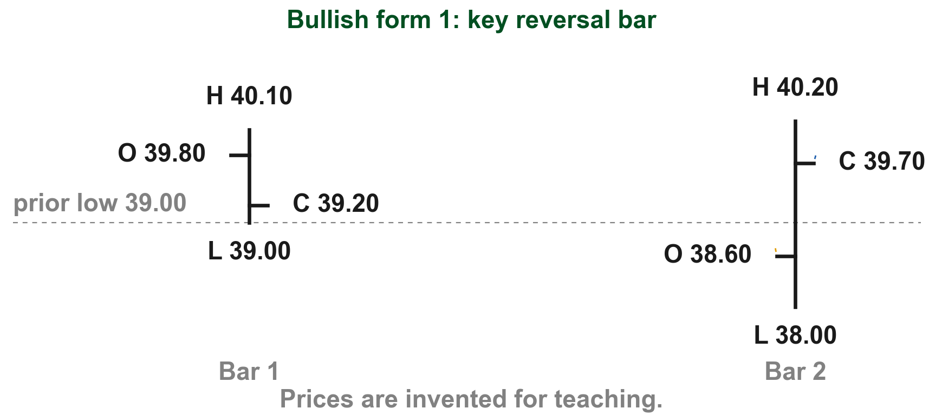
Bullish form 1 opens below the previous low and closes back up
Lim's label: "A large bar opening below a previous low and closing near or above a previous close," again a key reversal bar (Figure 7.5, p. 213). Here it is with invented prices. The previous bar fell to PHP 39.00 and closed at PHP 39.20. Form 1 opens at PHP 38.60 (1), swings through PHP 2.20 (2), and closes at PHP 39.70, above the previous close (3).
FIGURE 7.5
Figure 7.5, form 1: a bullish key reversal bar after a downtrend.
3
2
1
Figure 7.5, Lim (2016)
Chart UA - FIN1209 teaching chart, drawn for this course. Illustrative data, not a real instrument.
Part 2 of 4 - 7.2 Pattern reading | 20 of 88
Lim (2016), p. 213, Figure 7.5. The prices are invented for teaching.
Notes:
- Mirror of bearish form 1: sellers open it weakly, buyers win the day.

Slide 63
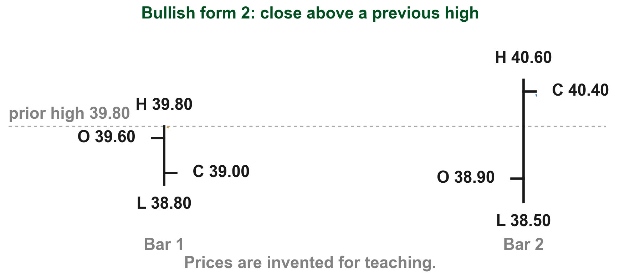
Bullish form 2 closes near or above the previous high
Lim's label: "A large bar closing near or above a previous high" (Figure 7.5, p. 213). Let us put invented prices on it. The previous bar's high is PHP 39.80 (1). Form 2 is a large bar with a PHP 2.10 range (2) that closes at PHP 40.40, above that high (3).
FIGURE 7.5
Figure 7.5, form 2: a large bar closing above the previous high.
3
1
2
Figure 7.5, Lim (2016)
Chart UB - FIN1209 teaching chart, drawn for this course. Illustrative data, not a real instrument.
Part 2 of 4 - 7.2 Pattern reading | 21 of 88
Lim (2016), p. 213, Figure 7.5. The prices are invented for teaching.
Notes:
- Mirror of bearish form 2.

Slide 64
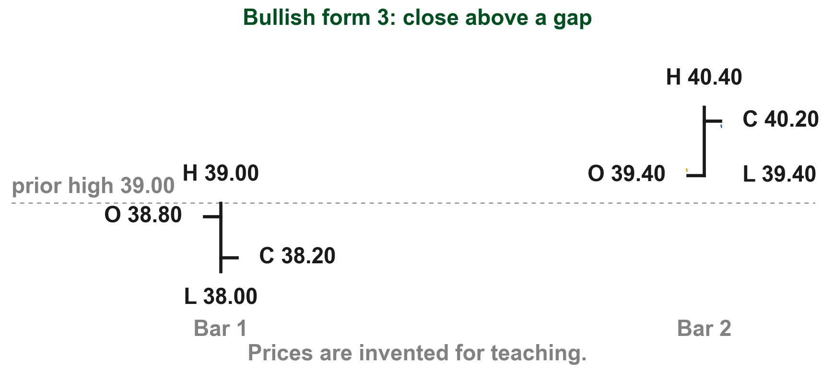
Bullish form 3 closes above a gap
Lim's label: "A bar closing above a gap formed between the current bar's open and a previous bar's high" (Figure 7.5, p. 213). Here it is with invented prices. The previous high is PHP 39.00. Form 3 opens at PHP 39.40 (1), leaving a PHP 0.40 gap below its open (2), and closes at PHP 40.20, above the gap (3).
FIGURE 7.5
Figure 7.5, form 3: a bar closing above a gap.
3
1
2
Figure 7.5, Lim (2016)
Chart UC - FIN1209 teaching chart, drawn for this course. Illustrative data, not a real instrument.
Part 2 of 4 - 7.2 Pattern reading | 22 of 88
Lim (2016), p. 213, Figure 7.5; Chapter 3, "Gap". The prices are invented for teaching.
Notes:
- Mirror of bearish form 3: nothing traded between 39.00 and 39.40.

Slide 65
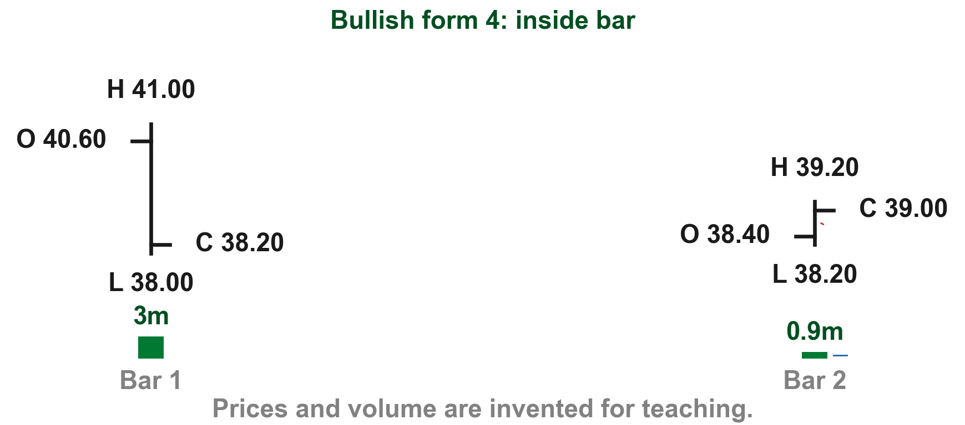
Bullish form 4 is the inside bar after a large down bar
Lim's label: "Narrow range bar closing within a larger previous bar's range," again an inside bar (Figure 7.5, p. 213). Say the previous bar ranges PHP 3.00 (1); the inside bar ranges only PHP 1.00 (2), on 0.9 million shares against 3.0 million (3). Lim says such narrow bars should generally form on low volume, showing uncertainty in a downtrend (p. 212).
FIGURE 7.5
Figure 7.5, form 4: a narrow inside bar after a large bar.
1
2
3
Figure 7.5, Lim (2016)
Chart UD - FIN1209 teaching chart, drawn for this course. Illustrative data, not a real instrument.
Part 2 of 4 - 7.2 Pattern reading | 23 of 88
Lim (2016), pp. 212 to 213, Figure 7.5. Prices and volume are invented for teaching.
Notes:
- Same shape as bearish form 4; the trend before it is what changes.

Slide 66
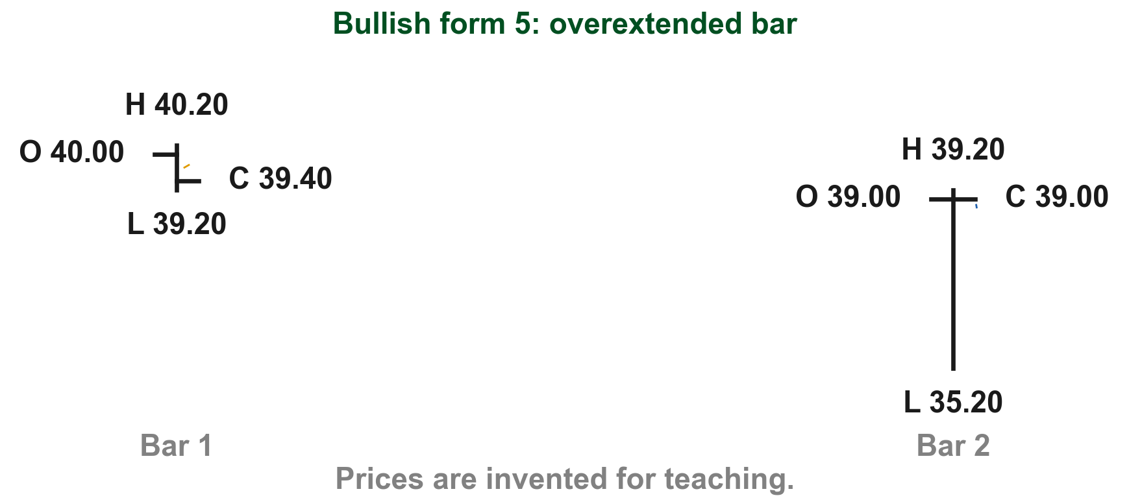
Bullish form 5 is one overextended bar that closes near its high
Lim's label: "An overextended bar closes at or near its high" (Figure 7.5, p. 213). As on the bearish side, we read "overextended" as unusually long compared with the bars before it, and closing near its high is a separate part. Beside an ordinary PHP 1.00 bar (1), form 5 ranges PHP 4.00 (2) and closes near its high (3).
FIGURE 7.5
Figure 7.5, form 5: one overextended bar closing near its high.
1
3
2
Figure 7.5, Lim (2016)
Chart UE - FIN1209 teaching chart, drawn for this course. Illustrative data, not a real instrument.
Part 2 of 4 - 7.2 Pattern reading | 24 of 88
Lim (2016), p. 213, Figure 7.5. The prices are invented for teaching.
Notes:
- Mirror of bearish form 5.

Slide 67
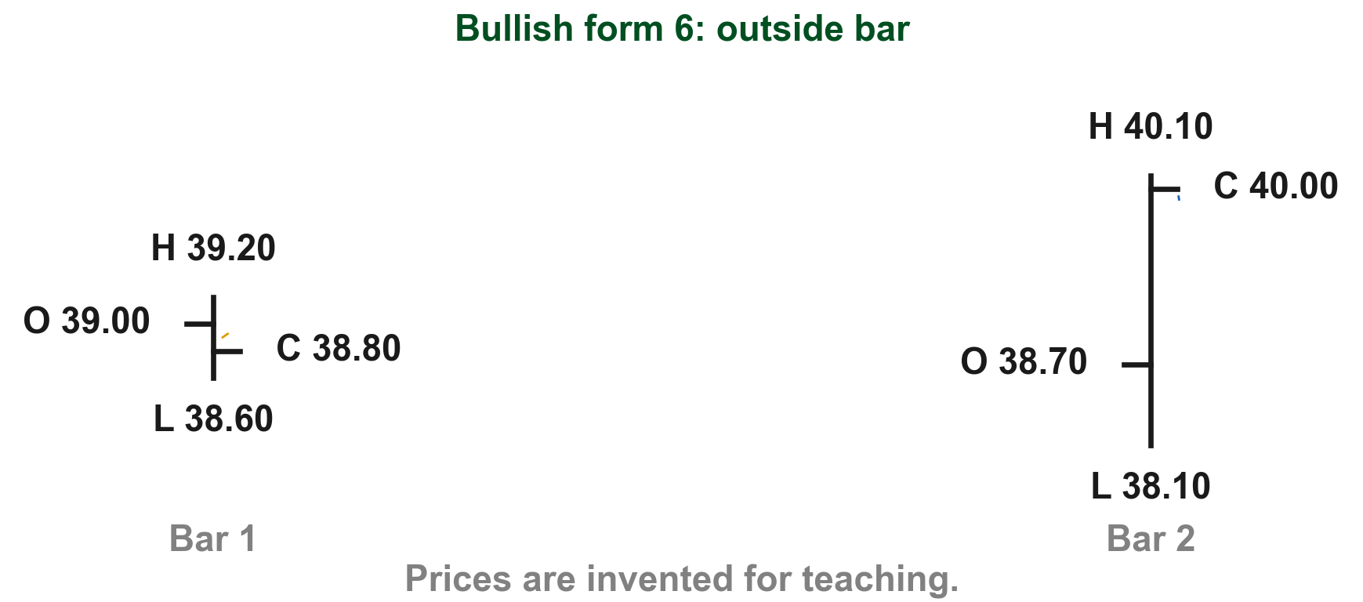
Bullish form 6 is the outside bar that closes near its high
Lim's label: "Bar engulfing a previous narrow range bar and closing near or at its high," again called an outside bar (Figure 7.5, p. 213). Here it is with invented prices. The previous bar is narrow, from PHP 38.60 to PHP 39.20 (1). The outside bar runs from PHP 38.10 to PHP 40.10 (2), beyond both ends, and closes at PHP 40.00, near its high (3).
FIGURE 7.5
Figure 7.5, form 6: an outside bar engulfing a narrow bar.
3
1
2
Figure 7.5, Lim (2016)
Chart UF - FIN1209 teaching chart, drawn for this course. Illustrative data, not a real instrument.
Part 2 of 4 - 7.2 Pattern reading | 25 of 88
Lim (2016), p. 213, Figure 7.5. The prices are invented for teaching.
Notes:
- Mirror of bearish form 6.

Slide 68
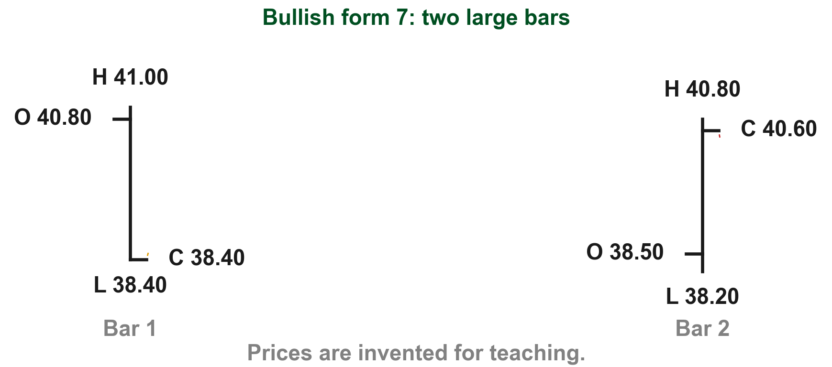
Bullish form 7 is two large bars, the second closing high
Lim's label: "1st large bar closing at its low followed by a large bar closing at or near its high" (Figure 7.5, p. 213). Let us put invented prices on it. The first bar closes at PHP 38.40, right at its low (1). The second bar, just as large, closes at PHP 40.60, only PHP 0.20 below its high (2).
FIGURE 7.5
Figure 7.5, form 7: two large bars closing at opposite ends.
2
1
Figure 7.5, Lim (2016)
Chart UG - FIN1209 teaching chart, drawn for this course. Illustrative data, not a real instrument.
Part 2 of 4 - 7.2 Pattern reading | 26 of 88
Lim (2016), p. 213, Figure 7.5. The prices are invented for teaching.
Notes:
- Mirror of bearish form 7.

Slide 69
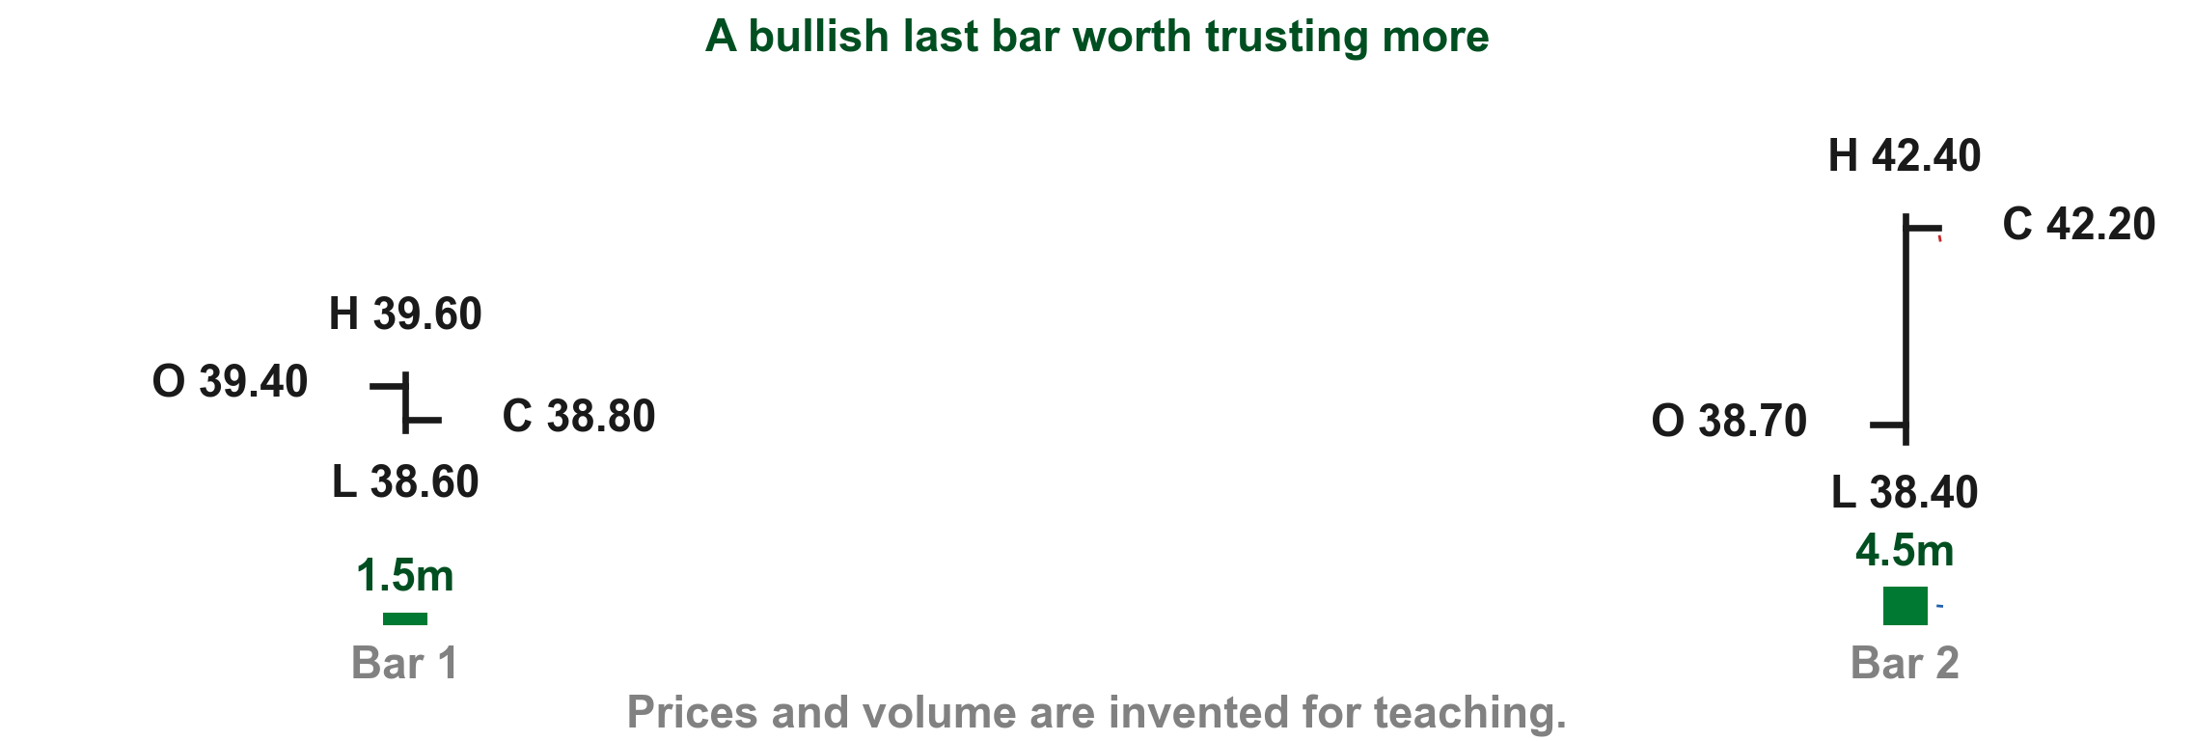
A bullish last bar we can trust more
In most cases, Lim says, a bullish two-bar pattern is potentially more reliable if the last bar is overextended and closes at or near its high on high volume (p. 212). Here it is with invented prices. The last bar stretches PHP 4.00 against PHP 1.00 (1), closes at PHP 42.20, near its PHP 42.40 high (2), on 4.5 million shares against 1.5 million (3).
2
1
3
Chart RM - FIN1209 teaching chart, drawn for this course. Illustrative data, not a real instrument.
Part 2 of 4 - 7.2 Pattern reading | 27 of 88
Lim (2016), p. 212. Prices and volume are invented for teaching.
Notes:
- Note Lim's words: in most cases, and potentially.

Slide 70
CHECK 9 OF 33
Bullish single and double bar patterns
Q1
Q2
In a downtrend, which close does Lim's general rule treat as bullish?
What does Lim call a bar that engulfs a previous narrow range bar and closes near its high?
A. A close above the previous bar's close or high
B. A close below the previous bar's low
C. A close inside the previous range
D. A close at the open
A. An inside bar
B. A key reversal bar
C. An outside bar
D. An overextended bar
Part 2 of 4 - 7.2 Pattern reading | Check 9
Notes:
- Both answers were stated in the body text of the bullish slides.

Slide 71
ANSWERS
Bullish single and double bar patterns
Q1 In a downtrend, which close does Lim's general rule treat as bullish?
A. A close above the previous bar's close or high
Lim's rule: a close above a previous bar's close or high is considered bullish, especially after a large or wide-ranging bar (p. 212).
Q2 What does Lim call a bar that engulfs a previous narrow range bar and closes near its high?
C. An outside bar
That is bullish form 6, which Lim's label calls an outside bar (p. 213).
Part 2 of 4 - 7.2 Pattern reading | Check 9
Notes:
- Both answers were stated in the body text of the bullish slides.

Slide 72
Six bearish triple forms, at the top of an uptrend
Now we go from two bars to three. Lim draws six basic triple bar bearish reversal patterns in Figures 7.6 and 7.7, and each one forms at the top of an uptrend (p. 213).
What is new compared with the double bars is a middle bar: every triple pattern has a first bar, a middle bar and a last bar.
Much of the logic will look familiar from the double bar forms, and we will point out where. That link is our reading, not Lim's.
Part 2 of 4 - 7.2 Pattern reading | 28 of 88
Lim (2016), pp. 213 to 214, Figures 7.6 and 7.7.
Notes:
- From two bars to three: the new thing is the middle bar.
- Say uptrend and middle bar out loud before the first form.

Slide 73
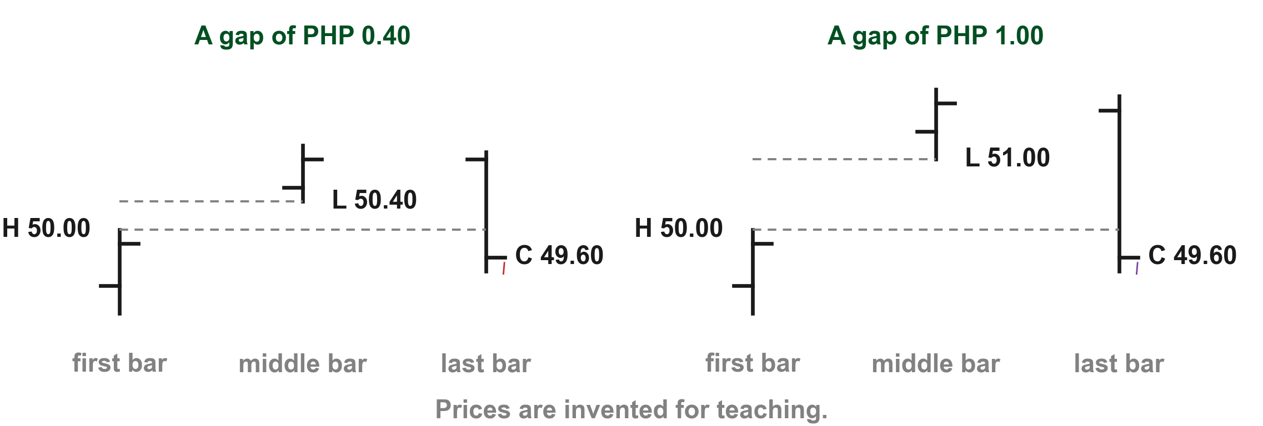
Larger gaps make a completed triple pattern more bearish
Lim's first rule for these patterns is about gaps: the larger the gaps, the more bearish the pattern once it is complete (p. 213). Let us put invented prices on it. If the first bar's high is PHP 50.00 and the middle bar's low is PHP 50.40, the gap is PHP 0.40 (1). The last bar then closes at PHP 49.60, back below the gap (2), and the pattern is complete.
3
1
2
4
Chart GP - FIN1209 teaching chart, drawn for this course. Illustrative data, not a real instrument.
Part 2 of 4 - 7.2 Pattern reading | 29 of 88
FIN1209 teaching chart. The prices are invented for teaching.
Notes:
- Gold 1 boxes the PHP 0.40 gap between the first bar's high of 50.00 and the middle bar's low of 50.40.
- Red 2 is the last bar's close at 49.60, back below the gap.
- Blue 3 boxes the PHP 1.00 gap when the middle bar's low is 51.00; purple 4 is the last bar's close at 49.60 again. The larger gap reads as more bearish.

Slide 74
Larger gaps make a completed triple pattern more bearish
Now take a bigger gap: a middle bar whose low is PHP 51.00 leaves a PHP 1.00 gap (3). The last bar again closes at PHP 49.60, below the gap (4). Both patterns are complete, and Lim would read this one as more bearish because its gap is larger.
3
1
2
4
Chart GP - FIN1209 teaching chart, drawn for this course. Illustrative data, not a real instrument.
Part 2 of 4 - 7.2 Pattern reading | 30 of 88
FIN1209 teaching chart. The prices are invented for teaching.
Notes:
- Gold 1 boxes the PHP 0.40 gap between the first bar's high of 50.00 and the middle bar's low of 50.40.
- Red 2 is the last bar's close at 49.60, back below the gap.
- Blue 3 boxes the PHP 1.00 gap when the middle bar's low is 51.00; purple 4 is the last bar's close at 49.60 again. The larger gap reads as more bearish.

Slide 75
The outer bars should be wide and the middle bar quiet
The larger the range of the first and third bars, the more reliable the reversal pattern, Lim says (p. 213).
For most triple patterns the middle bar usually trades on low volume. Pattern 1 is possibly the exception: there larger middle volume is also considered more bearish, because the buyers failed to keep the close near or above the middle of the bar (p. 213).
As before, the pattern is generally more reliable if the last bar is overextended (unusually long compared with the bars before it) and closes at or near its low on high volume (pp. 213 to 214).
Part 2 of 4 - 7.2 Pattern reading | 31 of 88
Lim (2016), pp. 213 to 214.
Notes:
- Pattern 1 is the one exception to the quiet middle.
- Lim gives the reason: the buyers could not hold the close near the bar's midpoint.

Slide 76
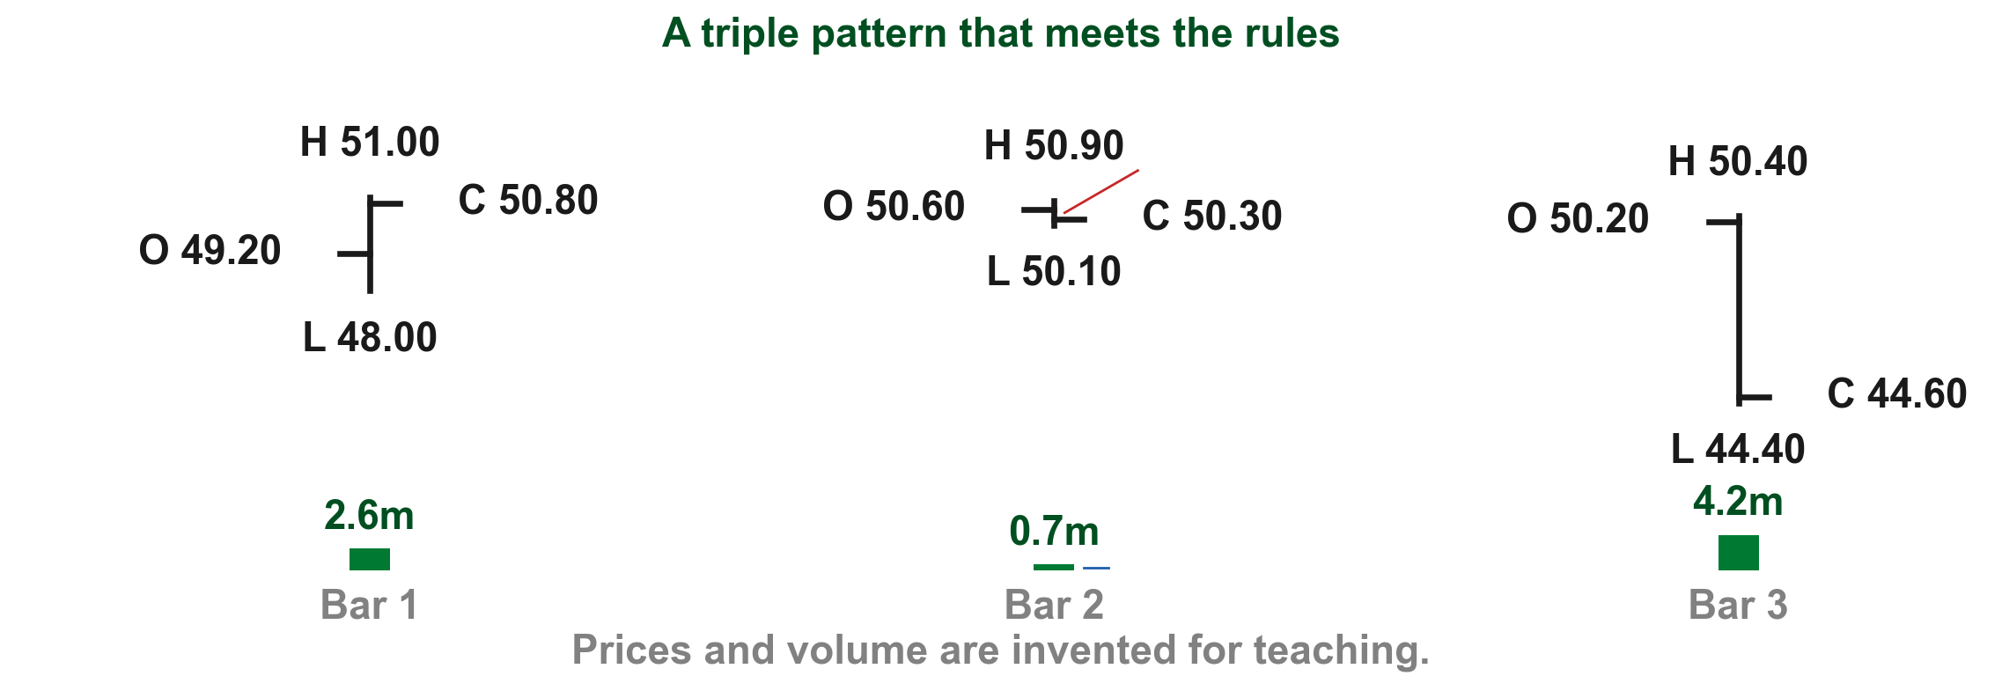
Here is a triple pattern that meets those rules
Let us put invented prices on it. Bar 1 spans PHP 3.00 (1); the middle bar spans only PHP 0.80 (2) on 0.7 million shares (3); and bar 3 spans PHP 6.00 (4), twice as much as bar 1 and far more than the middle bar. Bar 3 also closes at PHP 44.60, near its PHP 44.40 low, on 4.2 million shares: the overextended, near-low, high-volume last bar Lim prefers.
2
1
4
3
Chart TR - FIN1209 teaching chart, drawn for this course. Illustrative data, not a real instrument.
Part 2 of 4 - 7.2 Pattern reading | 32 of 88
Lim (2016), pp. 213 to 214. Prices and volume are invented for teaching.
Notes:
- Wide outer bars, a quiet middle, a heavy last bar: every rule on the slide before.

Slide 77
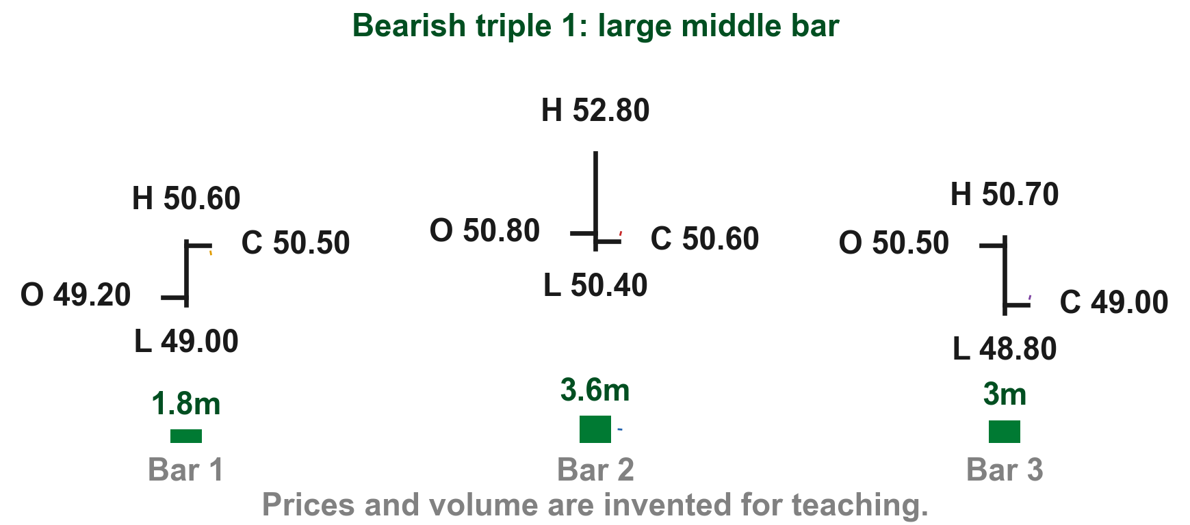
Triple form 1: a large middle bar that closes near its low
After an uptrend, Lim's label: "1st bar closes near its high followed by a large middle bar closing near its low. The 3rd bar closes at or near its low" (Figure 7.6, p. 213). Bar 1 closes at PHP 50.50 (1); the large middle bar at PHP 50.60, near its low (2), on 3.6 million shares (3); bar 3 at PHP 49.00 (4). Our reading, not Lim's: new, not built from a two-bar form.
FIGURE 7.6
Figure 7.6, form 1: three bars with a large middle bar.
2
1
4
3
Figure 7.6, Lim (2016)
Chart TA - FIN1209 teaching chart, drawn for this course. Illustrative data, not a real instrument.
Part 2 of 4 - 7.2 Pattern reading | 33 of 88
Lim (2016), p. 213, Figure 7.6. Prices and volume are invented for teaching.
Notes:
- This is the pattern where heavy middle volume is more bearish, not less.

Slide 78
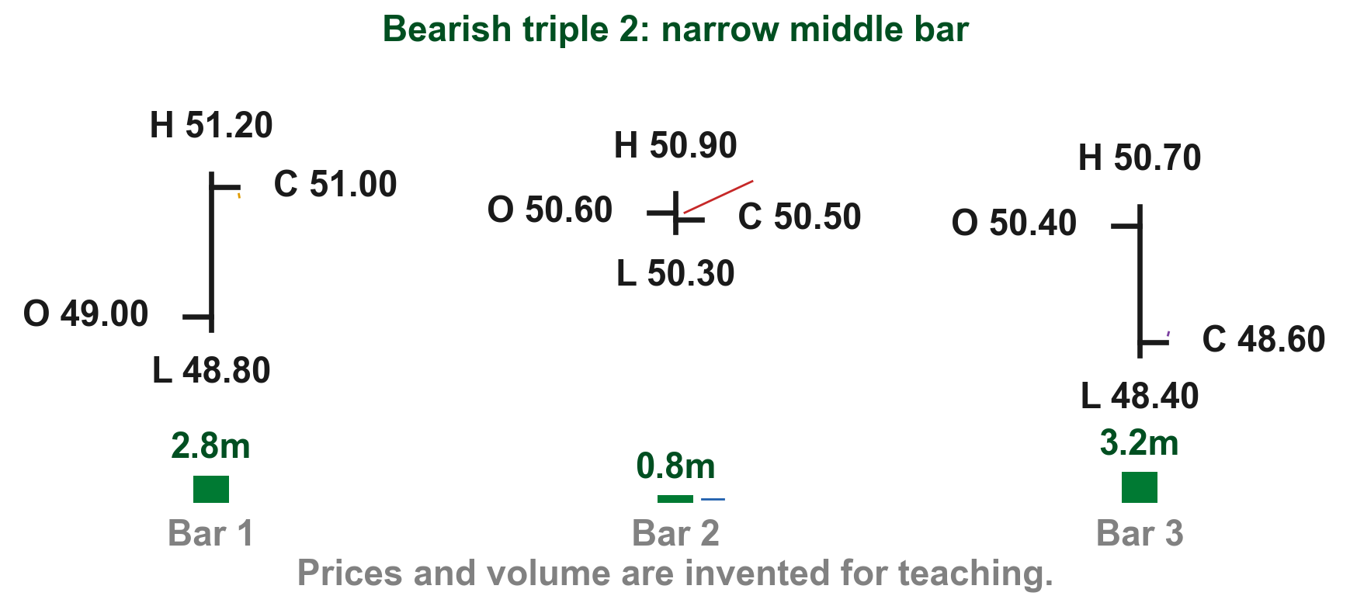
Triple form 2: a narrow, quiet middle bar
After an uptrend, Lim's label: "1st bar closes near its high followed by a narrow range middle bar closing within its range on low volume. The 3rd bar closes at or near its low" (Figure 7.6, p. 213). Bar 1 closes at PHP 51.00 (1); the middle bar spans PHP 0.60 inside it (2), on 0.8 million shares (3); bar 3 at PHP 48.60 (4). Our reading, not Lim's: built from two-bar form 4.
FIGURE 7.6
Figure 7.6, form 2: a narrow middle bar inside the first.
2
1
4
3
Figure 7.6, Lim (2016)
Chart TB - FIN1209 teaching chart, drawn for this course. Illustrative data, not a real instrument.
Part 2 of 4 - 7.2 Pattern reading | 34 of 88
Lim (2016), p. 213, Figure 7.6. Prices and volume are invented for teaching.
Notes:
- This is the usual quiet middle bar.

Slide 79
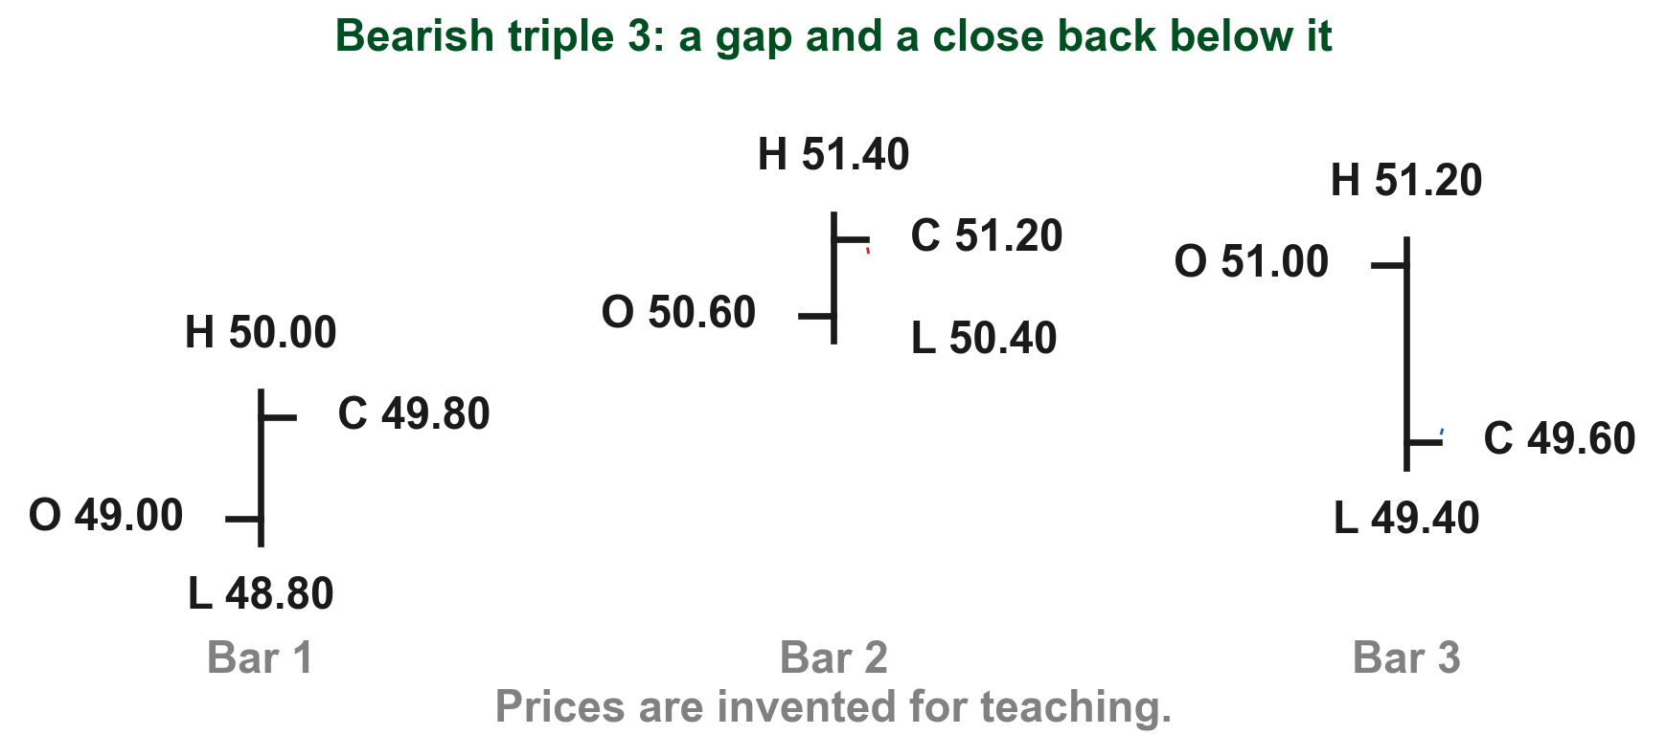
Triple form 3: a gap up, then a close back below it
After an uptrend, Lim's label: "2nd bar gaps up and closes above the gap. The 3rd bar closes below the gap" (Figure 7.6, p. 213). Bar 1 tops out at PHP 50.00 and bar 2's low is PHP 50.40, leaving a PHP 0.40 gap (1); bar 2 closes above it at PHP 51.20 (2); bar 3 closes at PHP 49.60, below the gap (3). Our reading, not Lim's: built from two-bar form 2.
FIGURE 7.6
Figure 7.6, form 3: a gap up, then a close below it.
2
1
3
Figure 7.6, Lim (2016)
Chart TC - FIN1209 teaching chart, drawn for this course. Illustrative data, not a real instrument.
Part 2 of 4 - 7.2 Pattern reading | 35 of 88
Lim (2016), p. 213, Figure 7.6. The prices are invented for teaching.
Notes:
- The gap that held the buyers up is given back by bar 3.

Slide 80
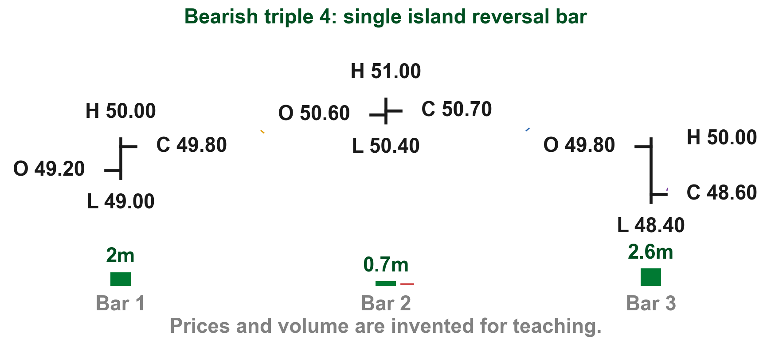
Triple form 4: a single island reversal bar
After an uptrend, Lim's label: "2nd bar gaps up on low volume. The 3rd bar gaps down and closes at or near its low. Also referred to as a single island reversal bar" (Figure 7.7, p. 214). Bar 2 gaps up PHP 0.40 (1) on 0.7 million shares (2); bar 3 gaps down PHP 0.40 below it (3) and closes at PHP 48.60 (4). Our reading, not Lim's: built from two-bar form 3.
FIGURE 7.7
Figure 7.7, form 4: a single island reversal bar.
3
1
4
2
Figure 7.7, Lim (2016)
Chart TD - FIN1209 teaching chart, drawn for this course. Illustrative data, not a real instrument.
Part 2 of 4 - 7.2 Pattern reading | 36 of 88
Lim (2016), p. 214, Figure 7.7. Prices and volume are invented for teaching.
Notes:
- Two gaps leave bar 2 alone on an island. Part 3 reads island reversals on real charts.

Slide 81
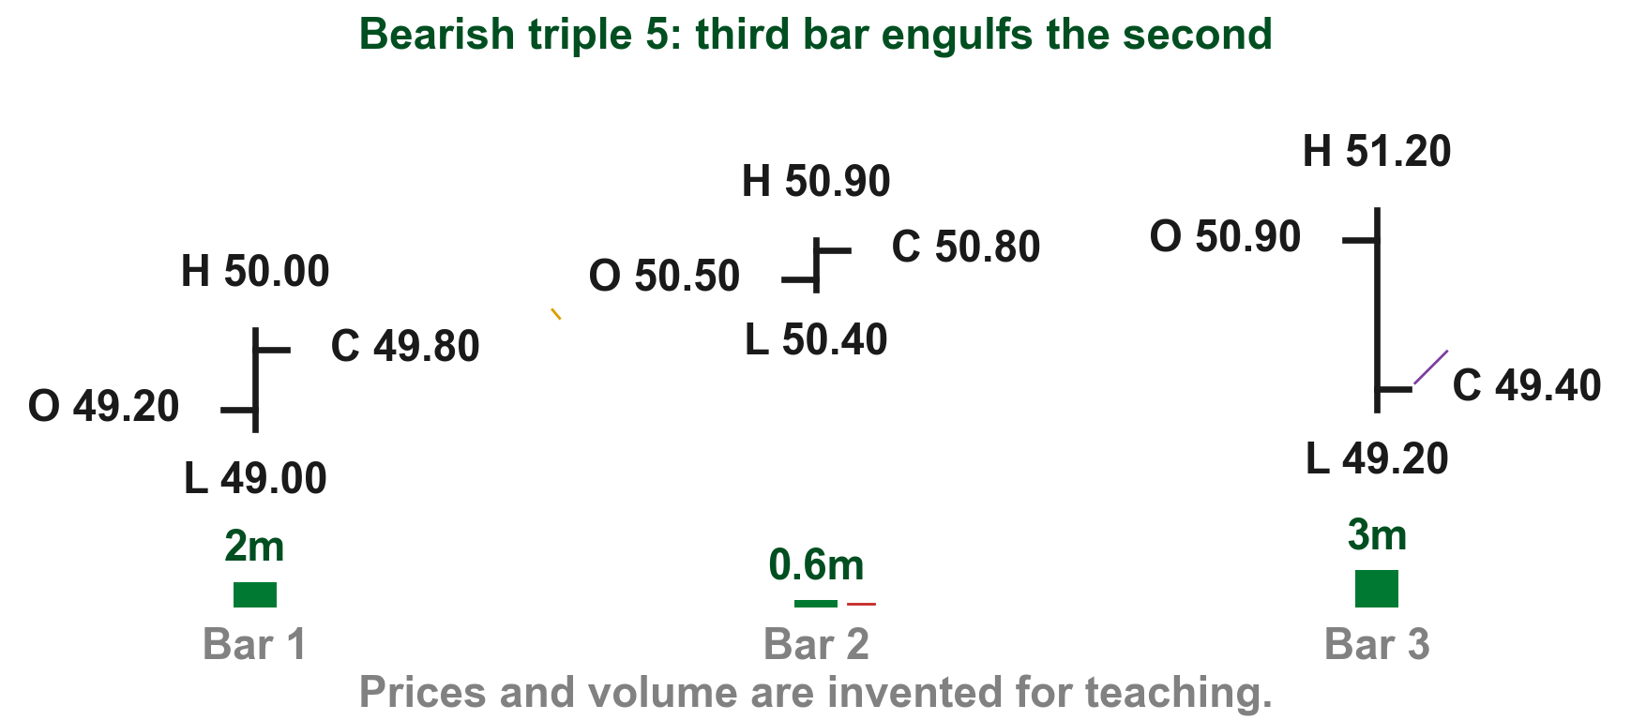
Triple form 5: the third bar engulfs the second
After an uptrend, Lim's label: "2nd bar gaps up on low volume. The 3rd bar engulfs the 2nd bar and closes below the gap" (Figure 7.7, p. 214). Bar 2 gaps up above PHP 50.00 (1) on 0.6 million shares (2); bar 3 runs from PHP 49.20 to PHP 51.20, beyond both ends of bar 2 (3), and closes at PHP 49.40 (4). Our reading, not Lim's: built from two-bar form 6.
FIGURE 7.7
Figure 7.7, form 5: a third bar engulfing the second.
3
4
1
2
Figure 7.7, Lim (2016)
Chart TE - FIN1209 teaching chart, drawn for this course. Illustrative data, not a real instrument.
Part 2 of 4 - 7.2 Pattern reading | 37 of 88
Lim (2016), p. 214, Figure 7.7. Prices and volume are invented for teaching.
Notes:
- Engulfs means the third bar trades beyond both the high and the low of the second.

Slide 82
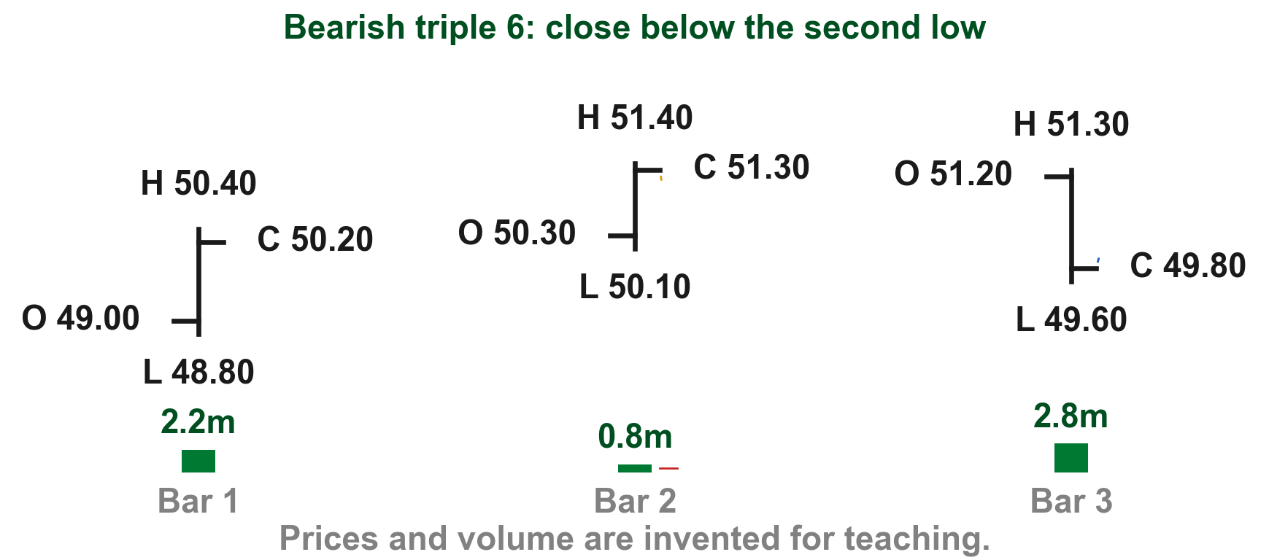
Triple form 6: a close below the middle bar's low
After an uptrend, Lim's label: the 2nd bar "closes at or near its high on low volume followed by a 3rd bar closing below the low of the 2nd bar (and preferably below the close of the 1st bar as well)" (Figure 7.7, p. 214). Bar 2 closes at PHP 51.30 (1) on 0.8 million shares (2); bar 3 at PHP 49.80 (3), under bar 2's PHP 50.10 low. Our reading, not Lim's: built from two-bar form 2.
FIGURE 7.7
Figure 7.7, form 6: a close below the middle bar.
1
3
2
Figure 7.7, Lim (2016)
Chart TF - FIN1209 teaching chart, drawn for this course. Illustrative data, not a real instrument.
Part 2 of 4 - 7.2 Pattern reading | 38 of 88
Lim (2016), p. 214, Figure 7.7. Prices and volume are invented for teaching.
Notes:
- The preferred case closes below both levels, as here.

Slide 83
CHECK 10 OF 33
Bearish triple bar patterns
Q1
Q2
What does Lim say larger gaps do to a triple bearish pattern?
In which triple pattern can larger middle-bar volume count as more bearish?
A. Make it a continuation pattern
B. Make no difference
C. Make it more bearish once complete
D. Make the middle bar quieter
A. Pattern 1
B. Pattern 2
C. Pattern 4
D. None of them
Part 2 of 4 - 7.2 Pattern reading | Check 10
Notes:
- Both answers are in the two rule slides that opened the triple patterns.

Slide 84
ANSWERS
Bearish triple bar patterns
Q1 What does Lim say larger gaps do to a triple bearish pattern?
C. Make it more bearish once complete
The larger the gaps, the more bearish the pattern upon completion (p. 213).
Q2 In which triple pattern can larger middle-bar volume count as more bearish?
A. Pattern 1
The middle bar usually trades on low volume, except possibly in pattern 1, where larger volume is also considered more bearish (p. 213).
Part 2 of 4 - 7.2 Pattern reading | Check 10
Notes:
- Both answers are in the two rule slides that opened the triple patterns.

Slide 85
The six bullish triple forms mirror them in a downtrend
Lim draws six basic triple bar bullish reversal patterns in a downtrend (p. 214).
Lim's reliability rule turns around: a bullish three-bar pattern is potentially more reliable if the last bar is overextended (unusually long compared with the bars before it) and closes at or near its high on high volume (p. 214).
Our six charts are the bearish ones turned upside down about PHP 45, so a close at PHP 50.50 becomes PHP 39.50.
Part 2 of 4 - 7.2 Pattern reading | 39 of 88
Lim (2016), p. 214. The prices are invented for teaching.
Notes:
- Same six shapes, turned over, at the bottom of a downtrend.

Slide 86
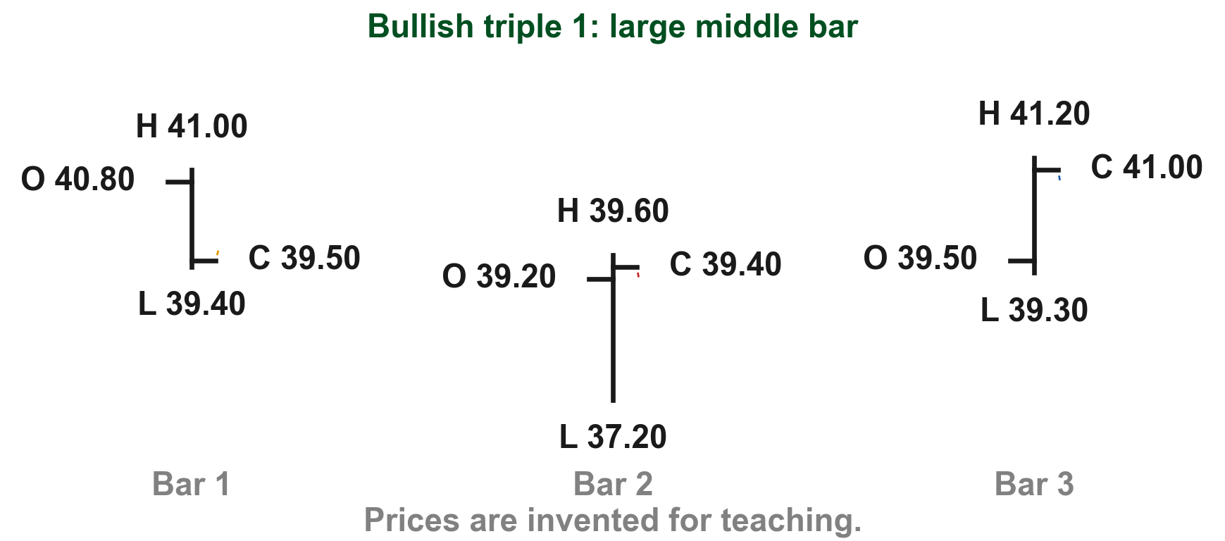
Bullish triple form 1: a large middle bar that closes near its high
In a downtrend, Lim's label: "1st bar closes near its low followed by a large middle bar closing near its high. The 3rd bar closes at or near its high" (Figure 7.8, p. 214). Bar 1 closes at PHP 39.50, near its low (1); the large middle bar closes at PHP 39.40, near its high (2); bar 3 closes at PHP 41.00 (3). Our reading, not Lim's: new, not built from a two-bar form.
FIGURE 7.8
Figure 7.8, form 1: three bars with a large middle bar.
3
1
2
Figure 7.8, Lim (2016)
Chart TG - FIN1209 teaching chart, drawn for this course. Illustrative data, not a real instrument.
Part 2 of 4 - 7.2 Pattern reading | 40 of 88
Lim (2016), p. 214, Figure 7.8. The prices are invented for teaching.
Notes:
- Mirror of bearish triple form 1.

Slide 87
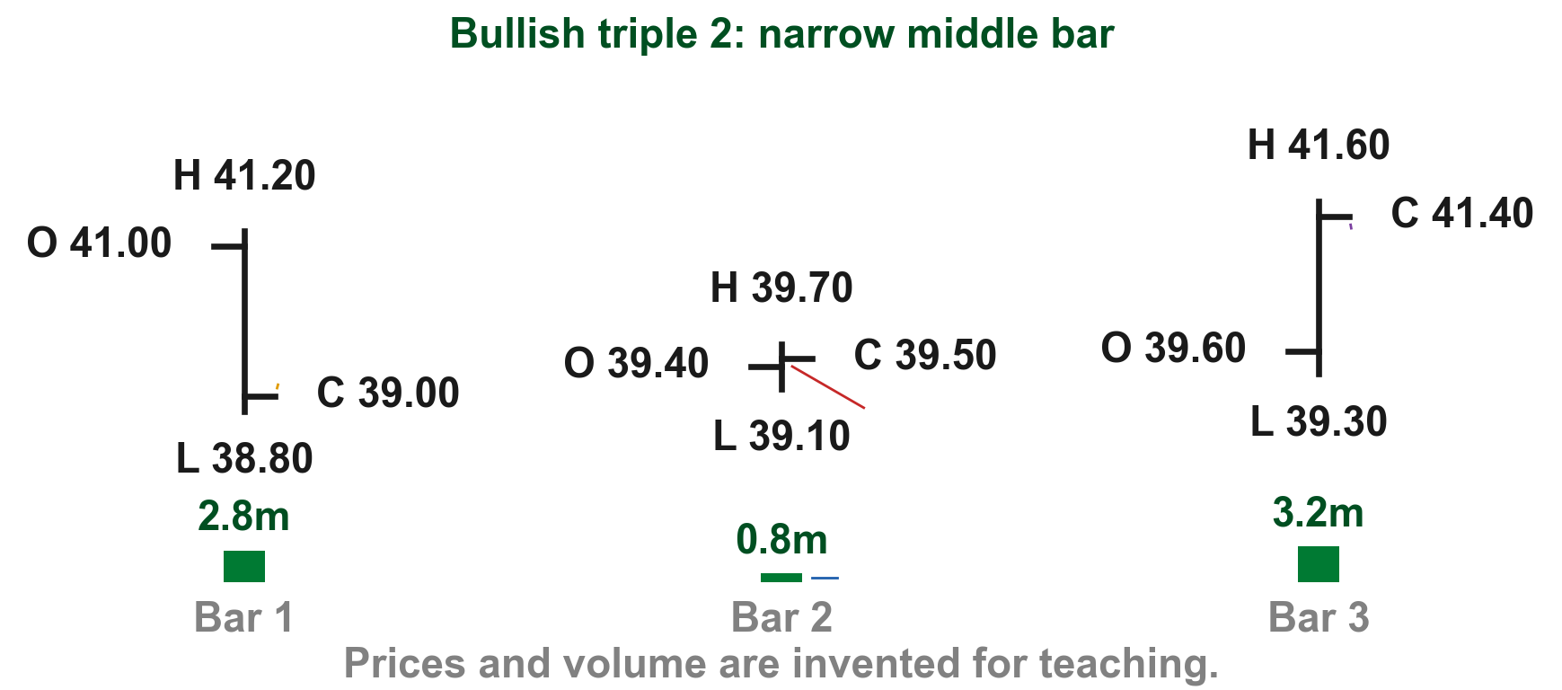
Bullish triple form 2: a narrow, quiet middle bar
In a downtrend, Lim's label: "1st bar closes near its low followed by a narrow range middle bar closing within its range on low volume. The 3rd bar closes at or near its high" (Figure 7.8, p. 214). Bar 1 closes at PHP 39.00 (1); the middle bar spans PHP 0.60 inside it (2), on 0.8 million shares (3); bar 3 at PHP 41.40 (4). Our reading, not Lim's: built from bullish two-bar form 4.
FIGURE 7.8
Figure 7.8, form 2: a narrow middle bar inside the first.
4
1
2
3
Figure 7.8, Lim (2016)
Chart TH - FIN1209 teaching chart, drawn for this course. Illustrative data, not a real instrument.
Part 2 of 4 - 7.2 Pattern reading | 41 of 88
Lim (2016), p. 214, Figure 7.8. Prices and volume are invented for teaching.
Notes:
- Mirror of bearish triple form 2.

Slide 88
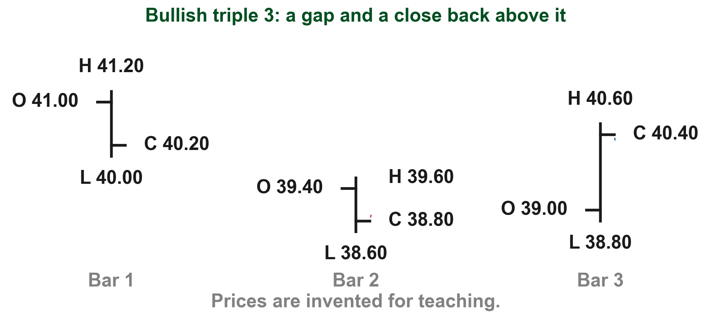
Bullish triple form 3: a gap down, then a close back above it
In a downtrend, Lim's label: "2nd bar gaps down and closes below the gap. The 3rd bar closes above the gap" (Figure 7.8, p. 214). Bar 1's low is PHP 40.00 and bar 2's high only PHP 39.60, leaving a PHP 0.40 gap (1); bar 2 closes below it at PHP 38.80 (2); bar 3 closes at PHP 40.40, above the gap (3). Our reading, not Lim's: built from bullish two-bar form 2.
FIGURE 7.8
Figure 7.8, form 3: a gap down, then a close above it.
3
1
2
Figure 7.8, Lim (2016)
Chart TI - FIN1209 teaching chart, drawn for this course. Illustrative data, not a real instrument.
Part 2 of 4 - 7.2 Pattern reading | 42 of 88
Lim (2016), p. 214, Figure 7.8. The prices are invented for teaching.
Notes:
- Mirror of bearish triple form 3.

Slide 89
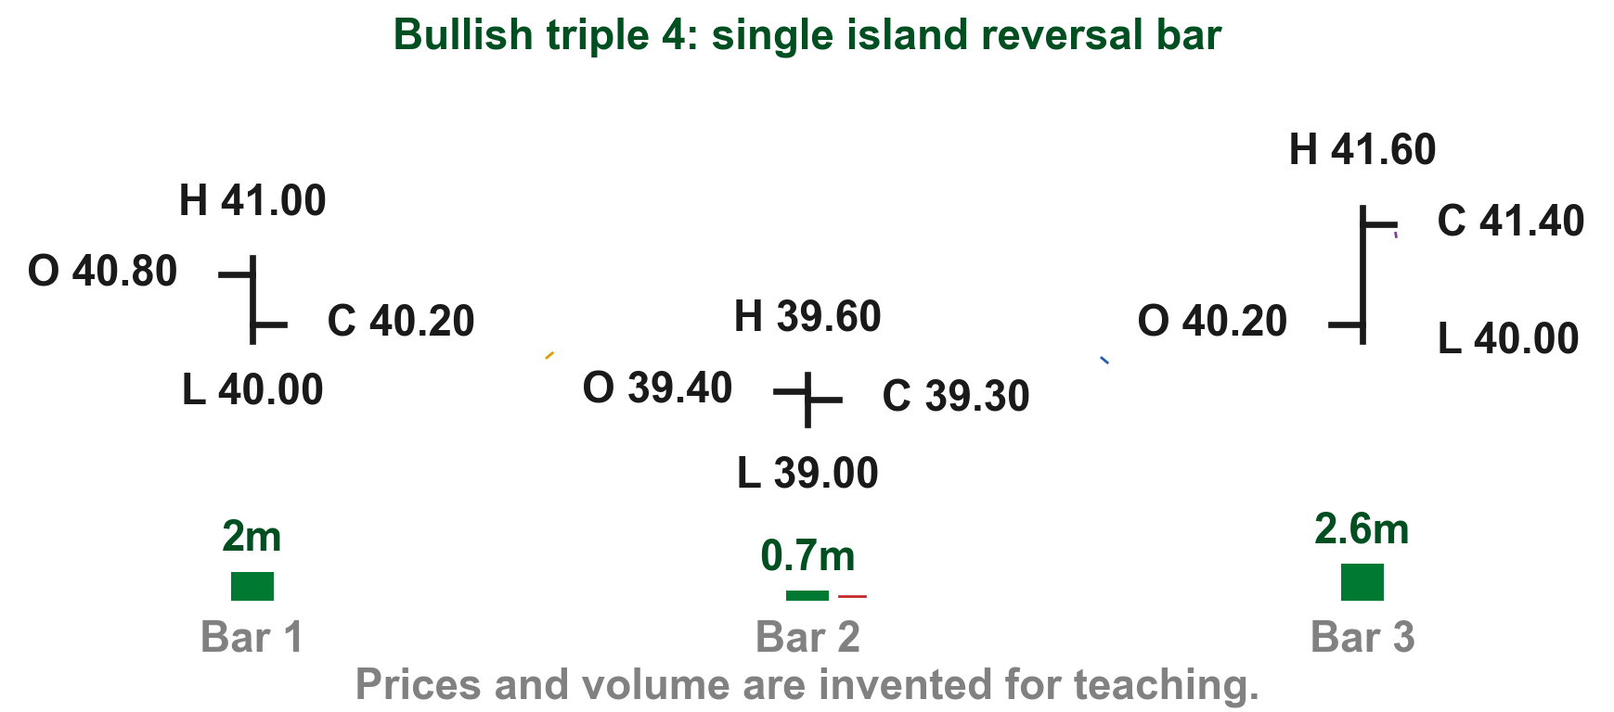
Bullish triple form 4: a single island reversal bar
In a downtrend, Lim's label: "2nd bar gaps down on low volume. The 3rd bar gaps up and closes at or near its high. Also referred to as a single island reversal bar" (Figure 7.9, p. 215). Bar 2 gaps down PHP 0.40 (1) on 0.7 million shares (2); bar 3 gaps up PHP 0.40 above it (3) and closes at PHP 41.40 (4). Our reading, not Lim's: built from bullish two-bar form 3.
FIGURE 7.9
Figure 7.9, form 4: a single island reversal bar.
4
1
3
2
Figure 7.9, Lim (2016)
Chart TJ - FIN1209 teaching chart, drawn for this course. Illustrative data, not a real instrument.
Part 2 of 4 - 7.2 Pattern reading | 43 of 88
Lim (2016), p. 215, Figure 7.9. Prices and volume are invented for teaching.
Notes:
- Mirror of bearish triple form 4.

Slide 90
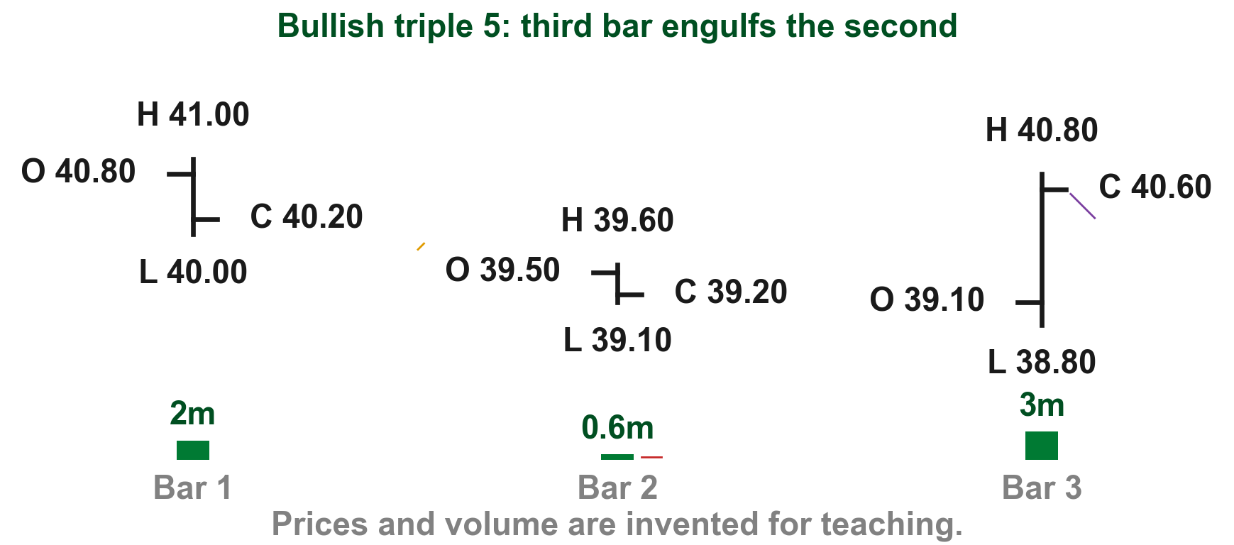
Bullish triple form 5: the third bar engulfs the second
In a downtrend, Lim's label: "2nd bar gaps down on low volume. The 3rd bar engulfs the 2nd bar and closes above the gap" (Figure 7.9, p. 215). Bar 2 gaps down below PHP 40.00 (1) on 0.6 million shares (2); bar 3 runs from PHP 38.80 to PHP 40.80, beyond both ends of bar 2 (3), and closes at PHP 40.60 (4). Our reading, not Lim's: built from bullish two-bar form 6.
FIGURE 7.9
Figure 7.9, form 5: a third bar engulfing the second.
1
3
4
2
Figure 7.9, Lim (2016)
Chart TK - FIN1209 teaching chart, drawn for this course. Illustrative data, not a real instrument.
Part 2 of 4 - 7.2 Pattern reading | 44 of 88
Lim (2016), p. 215, Figure 7.9. Prices and volume are invented for teaching.
Notes:
- Mirror of bearish triple form 5.

Slide 91
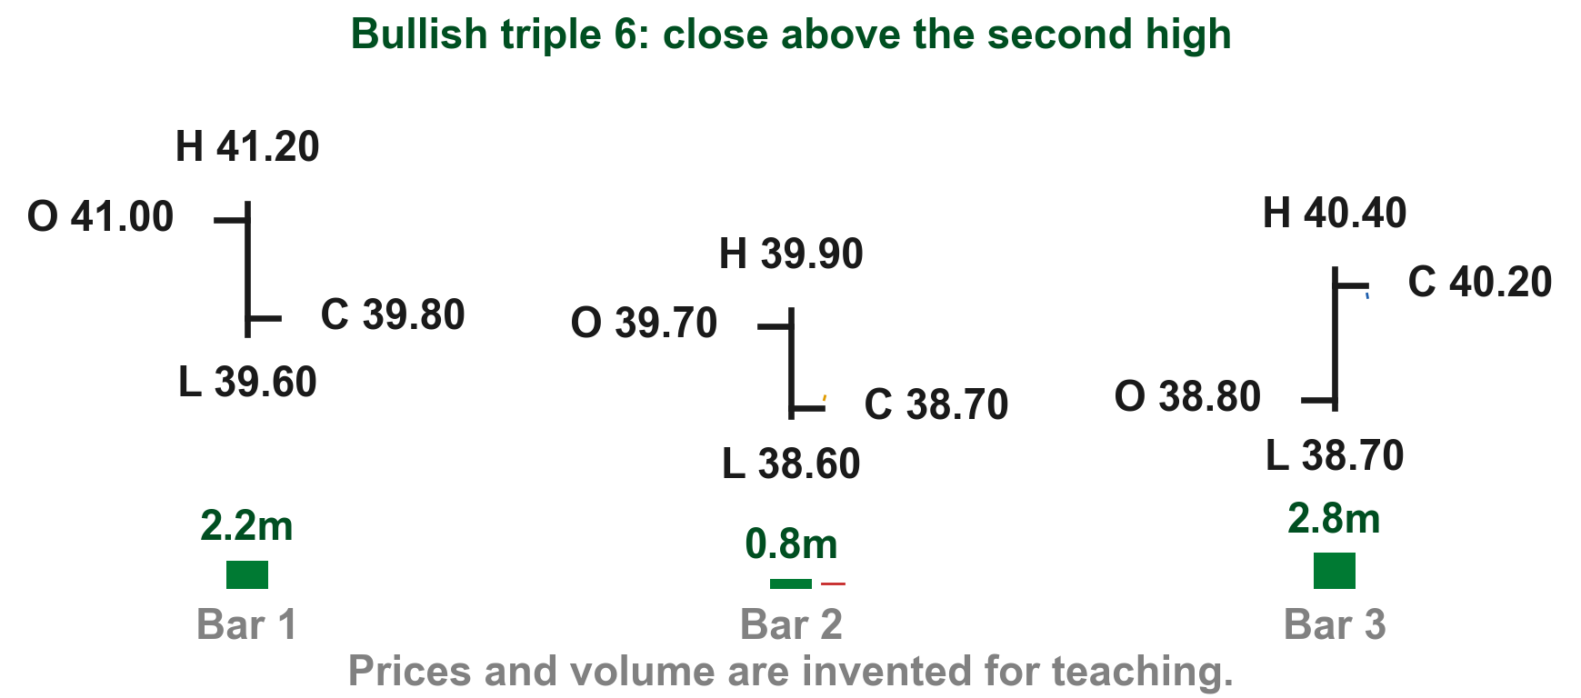
Bullish triple form 6: a close above the middle bar's high
In a downtrend, Lim's label: the 2nd bar "closes at or near its low on low volume followed by a 3rd bar closing above the high of the 2nd bar (and preferably above the close of the 1st bar as well)" (Figure 7.9, p. 215). Bar 2 closes at PHP 38.70 (1) on 0.8 million shares (2); bar 3 at PHP 40.20 (3), over bar 2's high. Our reading, not Lim's: built from bullish two-bar form 2.
FIGURE 7.9
Figure 7.9, form 6: a close above the middle bar.
3
1
2
Figure 7.9, Lim (2016)
Chart TL - FIN1209 teaching chart, drawn for this course. Illustrative data, not a real instrument.
Part 2 of 4 - 7.2 Pattern reading | 45 of 88
Lim (2016), p. 215, Figure 7.9. Prices and volume are invented for teaching.
Notes:
- Mirror of bearish triple form 6.

Slide 92
CHECK 11 OF 33
Bullish triple bar patterns
Q1
Q2
Which last bar makes a bullish three-bar pattern potentially more reliable?
What does Lim call bullish triple pattern 4?
A. A narrow bar on low volume
B. A bar that gaps down
C. A bar closing near its low
D. An overextended bar closing near its high on high volume
A. An inside bar
B. A single island reversal bar
C. A key reversal bar
D. An outside bar
Part 2 of 4 - 7.2 Pattern reading | Check 11
Notes:
- Both answers are in the bullish triple slides.

Slide 93
ANSWERS
Bullish triple bar patterns
Q1 Which last bar makes a bullish three-bar pattern potentially more reliable?
D. An overextended bar closing near its high on high volume
Lim says a bullish three-bar pattern is potentially more reliable if the last bar is overextended and closes at or near its high on high volume (p. 214).
Q2 What does Lim call bullish triple pattern 4?
B. A single island reversal bar
Its label ends "Also referred to as a single island reversal bar" (p. 215).
Part 2 of 4 - 7.2 Pattern reading | Check 11
Notes:
- Both answers are in the bullish triple slides.

Slide 94
Multiple bar patterns stretch the middle across several bars
Lim draws four basic multiple bar bearish reversal patterns in an uptrend (p. 214). Between the first and the last bar sit several bars, where a triple pattern had one.
The gap rule carries over: the larger the gaps, the more bearish the pattern. And the bars between the first and last should generally trade on low volume (p. 214).
The last bar matters most again: an overextended last bar (unusually long compared with the bars before it) closing near or at its low on high volume makes the pattern potentially more reliable (p. 215).
Part 2 of 4 - 7.2 Pattern reading | 46 of 88
Lim (2016), pp. 214 to 215.
Notes:
- Multiple means several bars between the first and the last.
- Our charts draw two middle bars so every price stays readable.

Slide 95
Pattern 2 is possibly the exception; either extreme warns
In pattern 2 the middle bars are wide, each closing near its low. There, Lim says, high volume is possibly also bearish: the sellers are working to keep each close near the low (pp. 214 to 215).
Low volume on those wide bars is bearish too: it shows they are not supported by enough demand (p. 215).
Lim sums it up: extremely high or low volume on the wide middle bars indicates bearishness in an uptrend (p. 215). So 3.8 million or 0.4 million shares, against an ordinary 2.0 million, would both warn.
Part 2 of 4 - 7.2 Pattern reading | 47 of 88
Lim (2016), pp. 214 to 215. The volumes are invented for teaching.
Notes:
- Read Lim's summary sentence slowly: extremely high OR low volume, on the wide bars.
- This is the one place where both high and low volume point the same way.

Slide 96
Multiple form 1: narrow bars hold near the first high
Lim's label: "1st bar closes near its high followed by multiple narrow range bars closing near the 1st bar's high. The last bar closes at or near its low" (Figure 7.10, p. 215).
In the drawing, (1) is the first bar, (2) the narrow bars and (3) the last bar.
FIGURE 7.10
Figure 7.10, form 1: narrow bars near the first high, then a low close.
2
1
3
Figure 7.10 - Lim, The Handbook of Technical Analysis (Wiley, 2016)
Part 2 of 4 - 7.2 Pattern reading | 48 of 88
Lim (2016), p. 215, Figure 7.10.
Notes:
- Read the drawing left to right: first, middle, last.

Slide 97
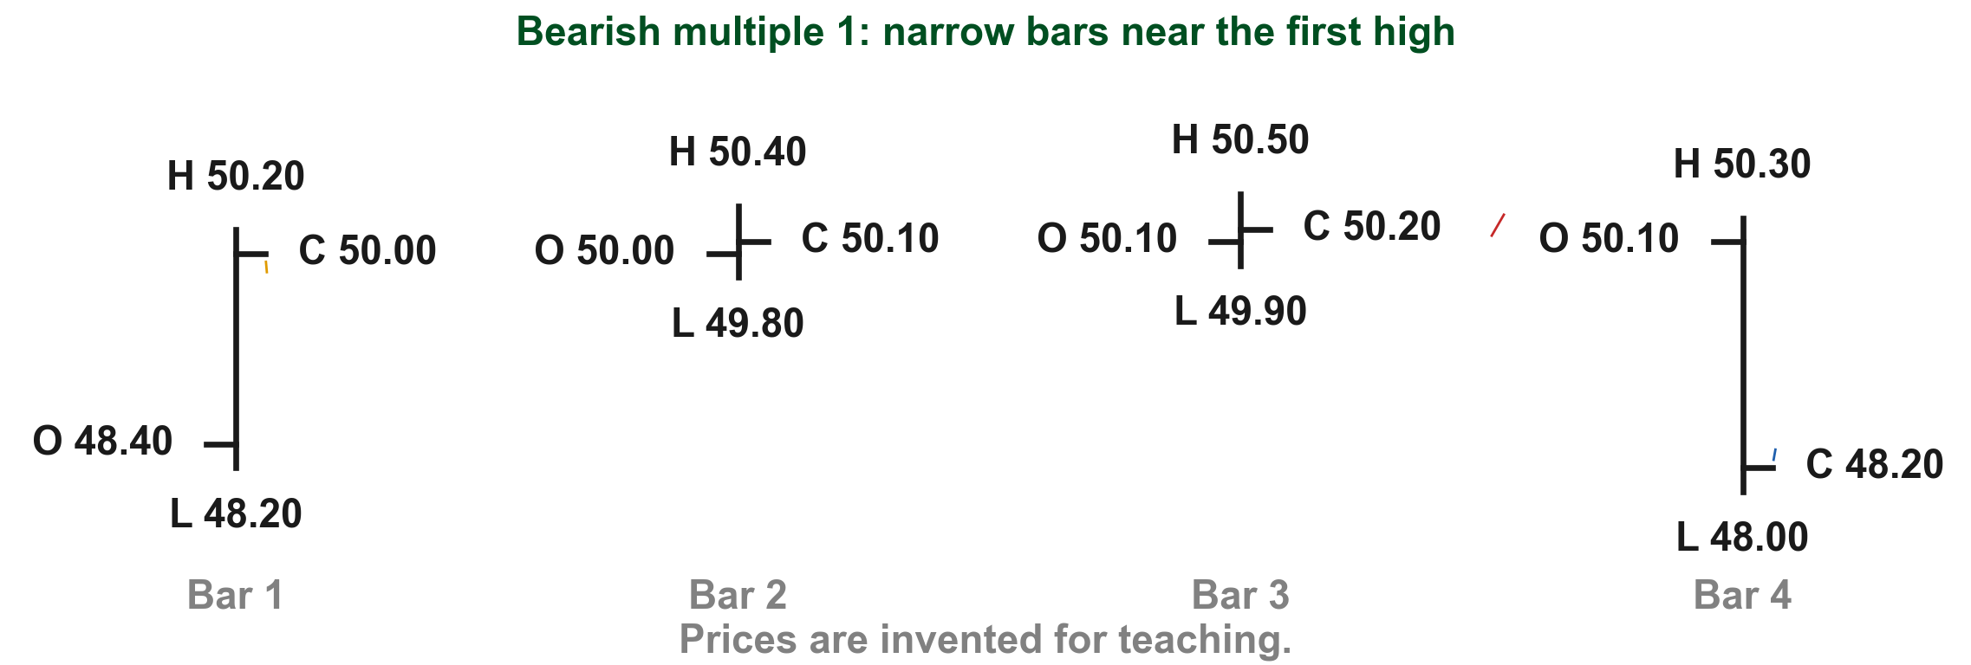
Here is multiple form 1 with simple prices
Lim draws several narrow bars; our chart uses two so every price stays readable. Bar 1 closes at PHP 50.00, near its high (1). The narrow bars (2) close at PHP 50.10 and PHP 50.20, still near that high. The last bar closes at PHP 48.20, near its PHP 48.00 low (3).
2
1
3
Chart XA - FIN1209 teaching chart, drawn for this course. Illustrative data, not a real instrument.
Part 2 of 4 - 7.2 Pattern reading | 49 of 88
Lim (2016), p. 215, Figure 7.10. The prices are invented for teaching.
Notes:
- The buyers hold the price up for a while, then lose it in one bar.

Slide 98
Multiple form 2: wide bars that all close near their lows
Lim's label: "1st bar closes near its high followed by multiple wide range bars, all closing near their lows. The last bar closes at or near its low" (Figure 7.10, p. 215).
In the drawing, (1) is the first bar, (2) the wide bars and (3) the last bar.
2
FIGURE 7.10
Figure 7.10, form 2: wide middle bars closing near their lows.
1
3
Figure 7.10 - Lim, The Handbook of Technical Analysis (Wiley, 2016)
Part 2 of 4 - 7.2 Pattern reading | 50 of 88
Lim (2016), pp. 214 to 215, Figure 7.10.
Notes:
- This is the drawing for the volume exception.

Slide 99
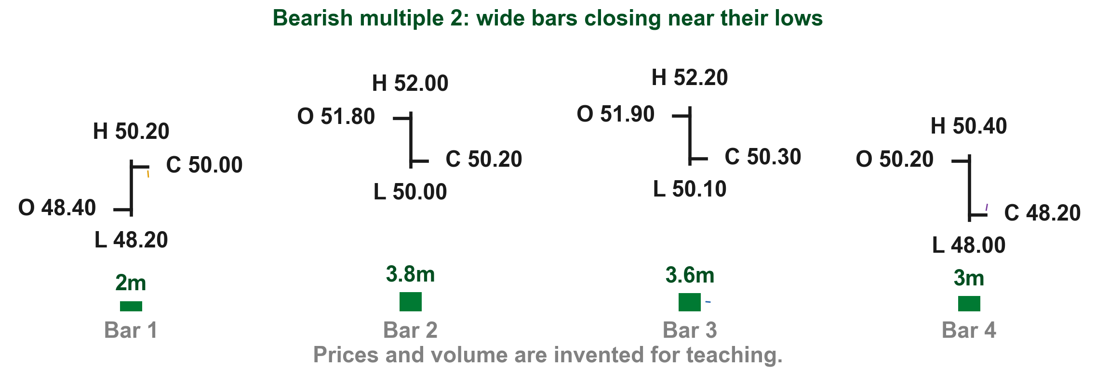
Here is multiple form 2 with simple prices
Bar 1 closes at PHP 50.00, near its high (1). The two wide bars (2) each span about PHP 2.00 and close near their lows, at PHP 50.20 and PHP 50.30, on 3.8 and 3.6 million shares (3). The last bar closes at PHP 48.20, near its low (4). That heavy middle volume is possibly the pattern 2 exception: sellers pressing every close down (pp. 214 to 215).
2
1
4
3
Chart XB - FIN1209 teaching chart, drawn for this course. Illustrative data, not a real instrument.
Part 2 of 4 - 7.2 Pattern reading | 51 of 88
Lim (2016), pp. 214 to 215, Figure 7.10. Prices and volume are invented for teaching.
Notes:
- Ask: what would 0.4 million on the wide bars mean? Also bearish (p. 215).

Slide 100
Multiple form 3: narrow bars stay inside the first bar's range
Lim's label: "1st bar closes near its high followed by multiple narrow range bars closing within its range. The last bar closes at or near its low" (Figure 7.10, p. 215).
In the drawing, (1) is the first bar, (2) the narrow bars and (3) the last bar.
FIGURE 7.10
Figure 7.10, form 3: narrow bars inside the first bar.
1
3
2
Figure 7.10 - Lim, The Handbook of Technical Analysis (Wiley, 2016)
Part 2 of 4 - 7.2 Pattern reading | 52 of 88
Lim (2016), p. 215, Figure 7.10.
Notes:
- Compare with form 1: here the narrow bars sit inside the first bar, not up at its high.

Slide 101
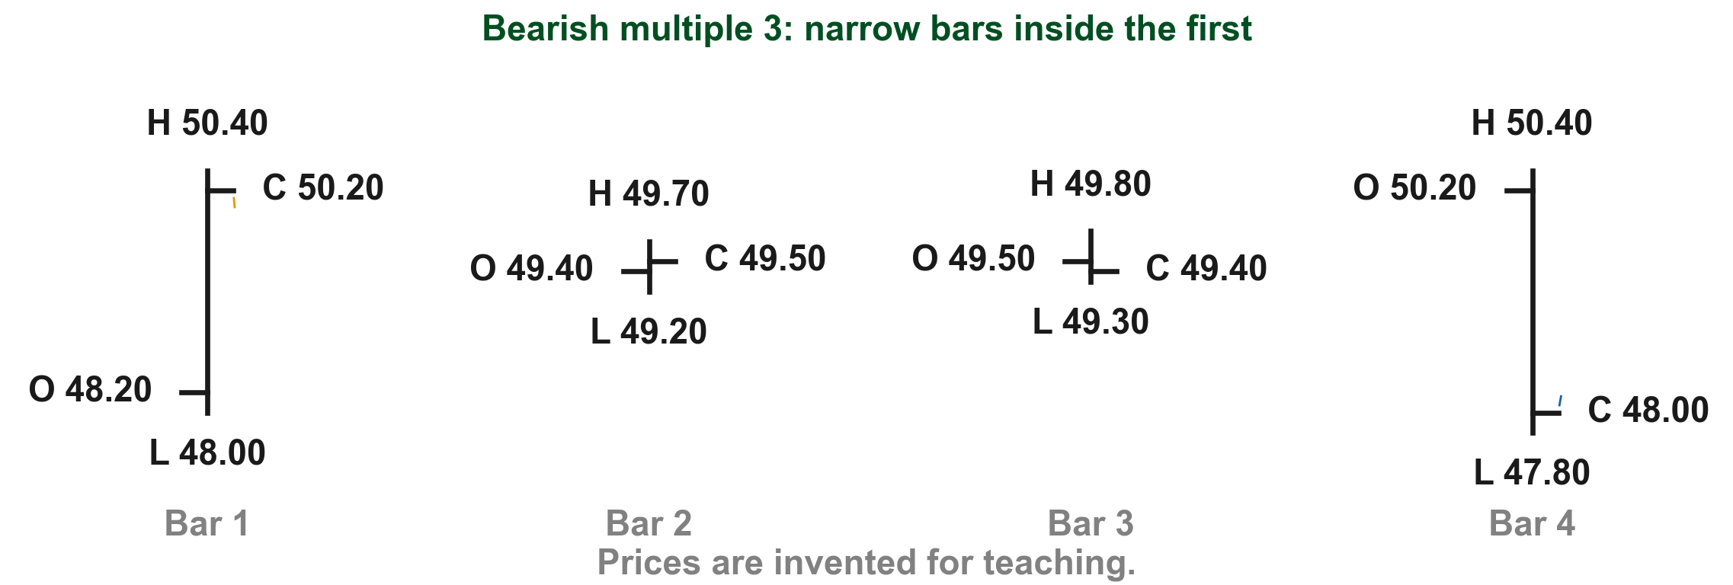
Here is multiple form 3 with simple prices
Bar 1 runs from PHP 48.00 to PHP 50.40 and closes at PHP 50.20 (1). The narrow bars (2) stay inside that range, between PHP 49.20 and PHP 49.80. The last bar closes at PHP 48.00, near its PHP 47.80 low (3).
1
2
3
Chart XC - FIN1209 teaching chart, drawn for this course. Illustrative data, not a real instrument.
Part 2 of 4 - 7.2 Pattern reading | 53 of 88
Lim (2016), p. 215, Figure 7.10. The prices are invented for teaching.
Notes:
- Inside the first bar: the same containment idea as an inside bar, stretched over several bars.

Slide 102
Multiple form 4: an island reversal formation
Lim's label: "1st bar closes near its high followed by multiple bars forming above a gap. The last bar gaps down and closes at or near its low. Referred to as an island reversal formation" (Figure 7.10, p. 215).
In the drawing, (1) is the first bar, (2) the bars above the gap and (3) the last bar.
2
FIGURE 7.10
Figure 7.10, form 4: an island reversal formation.
1
3
Figure 7.10 - Lim, The Handbook of Technical Analysis (Wiley, 2016)
Part 2 of 4 - 7.2 Pattern reading | 54 of 88
Lim (2016), p. 215, Figure 7.10; Chapter 3, "Gap".
Notes:
- Two gaps isolate the middle group, the same island idea as triple form 4.

Slide 103
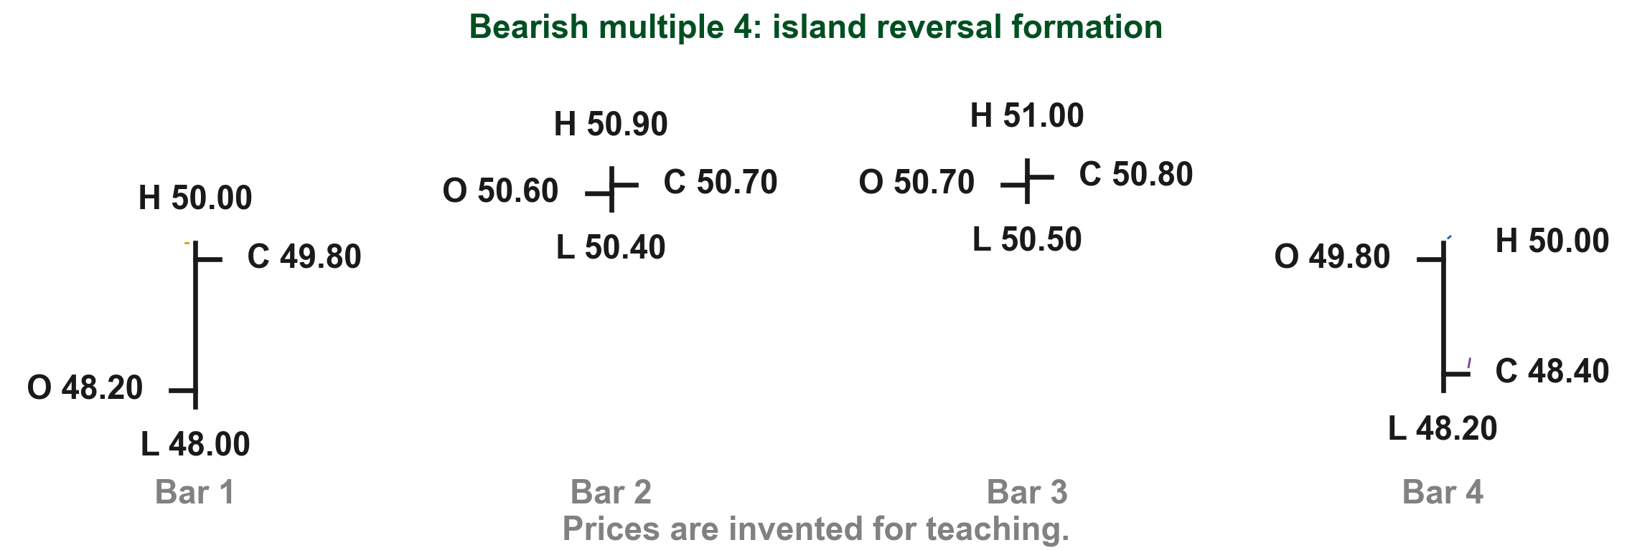
Here is multiple form 4 with simple prices
Bar 1 tops out at PHP 50.00 (1), and the isolated bars (2) trade above a gap, between PHP 50.40 and PHP 51.00. The last bar tops out at PHP 50.00 (3), so it gaps down below them, and closes at PHP 48.40, near its PHP 48.20 low (4).
2
1
3
4
Chart XD - FIN1209 teaching chart, drawn for this course. Illustrative data, not a real instrument.
Part 2 of 4 - 7.2 Pattern reading | 55 of 88
Lim (2016), p. 215, Figure 7.10. The prices are invented for teaching.
Notes:
- Two gaps, as in triple form 4; only the middle is longer.

Slide 104
The four bullish multiple forms mirror the bearish ones
Lim draws four basic multiple bar bullish reversal patterns in a downtrend (p. 215).
In pattern 2 the wide middle bars can occur on high or above average volume, indicating bullishness. Narrow middle bars on low volume are also a sign of potential bullishness (p. 216).
And a bullish pattern is potentially more reliable if the last bar is overextended (unusually long compared with the bars before it) and closes near or at its high on high volume (p. 216).
Part 2 of 4 - 7.2 Pattern reading | 56 of 88
Lim (2016), pp. 215 to 216.
Notes:
- The bullish side keeps both volume readings, now pointing up.

Slide 105
Bullish multiple form 1: narrow bars hold near the first low
Lim's label: "1st bar closes near its low followed by multiple narrow range bars closing near the 1st bar's low. The last bar closes at or near its high" (Figure 7.11, p. 216).
In the drawing, (1) is the first bar, (2) the narrow bars and (3) the last bar.
FIGURE 7.11
Figure 7.11, form 1: narrow bars near the first low, then a high close.
1
3
2
Figure 7.11 - Lim, The Handbook of Technical Analysis (Wiley, 2016)
Part 2 of 4 - 7.2 Pattern reading | 57 of 88
Lim (2016), p. 216, Figure 7.11.
Notes:
- Mirror of bearish multiple form 1.

Slide 106
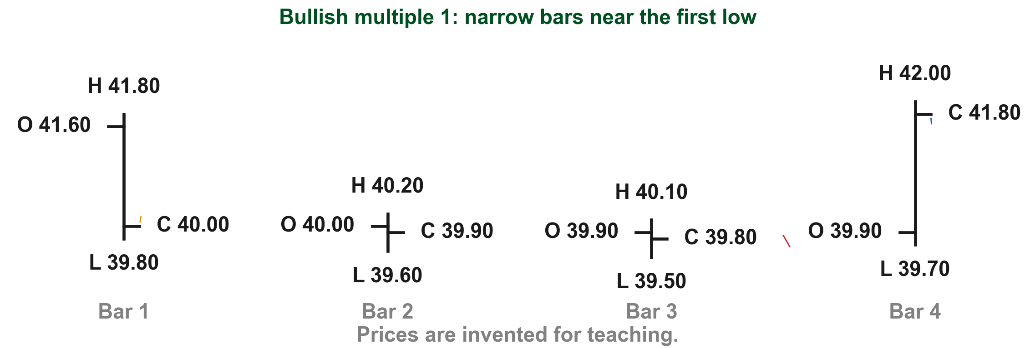
Here is bullish multiple form 1 with simple prices
Bar 1 closes at PHP 40.00, near its low (1). The narrow bars (2) close at PHP 39.90 and PHP 39.80, still near that low. The last bar closes at PHP 41.80, near its PHP 42.00 high (3).
3
1
2
Chart XE - FIN1209 teaching chart, drawn for this course. Illustrative data, not a real instrument.
Part 2 of 4 - 7.2 Pattern reading | 58 of 88
Lim (2016), p. 216, Figure 7.11. The prices are invented for teaching.
Notes:
- The sellers hold the price down for a while, then lose it in one bar.

Slide 107
Bullish multiple form 2: wide bars closing near their highs
Lim's label: "1st bar closes near its low followed by multiple wide range bars, all closing near their highs. The last bar closes at or near its high" (Figure 7.11, p. 216).
In the drawing, (1) is the first bar, (2) the wide bars and (3) the last bar.
FIGURE 7.11
Figure 7.11, form 2: wide middle bars closing near their highs.
1
3
2
Figure 7.11 - Lim, The Handbook of Technical Analysis (Wiley, 2016)
Part 2 of 4 - 7.2 Pattern reading | 59 of 88
Lim (2016), p. 216, Figure 7.11.
Notes:
- Mirror of bearish multiple form 2.

Slide 108
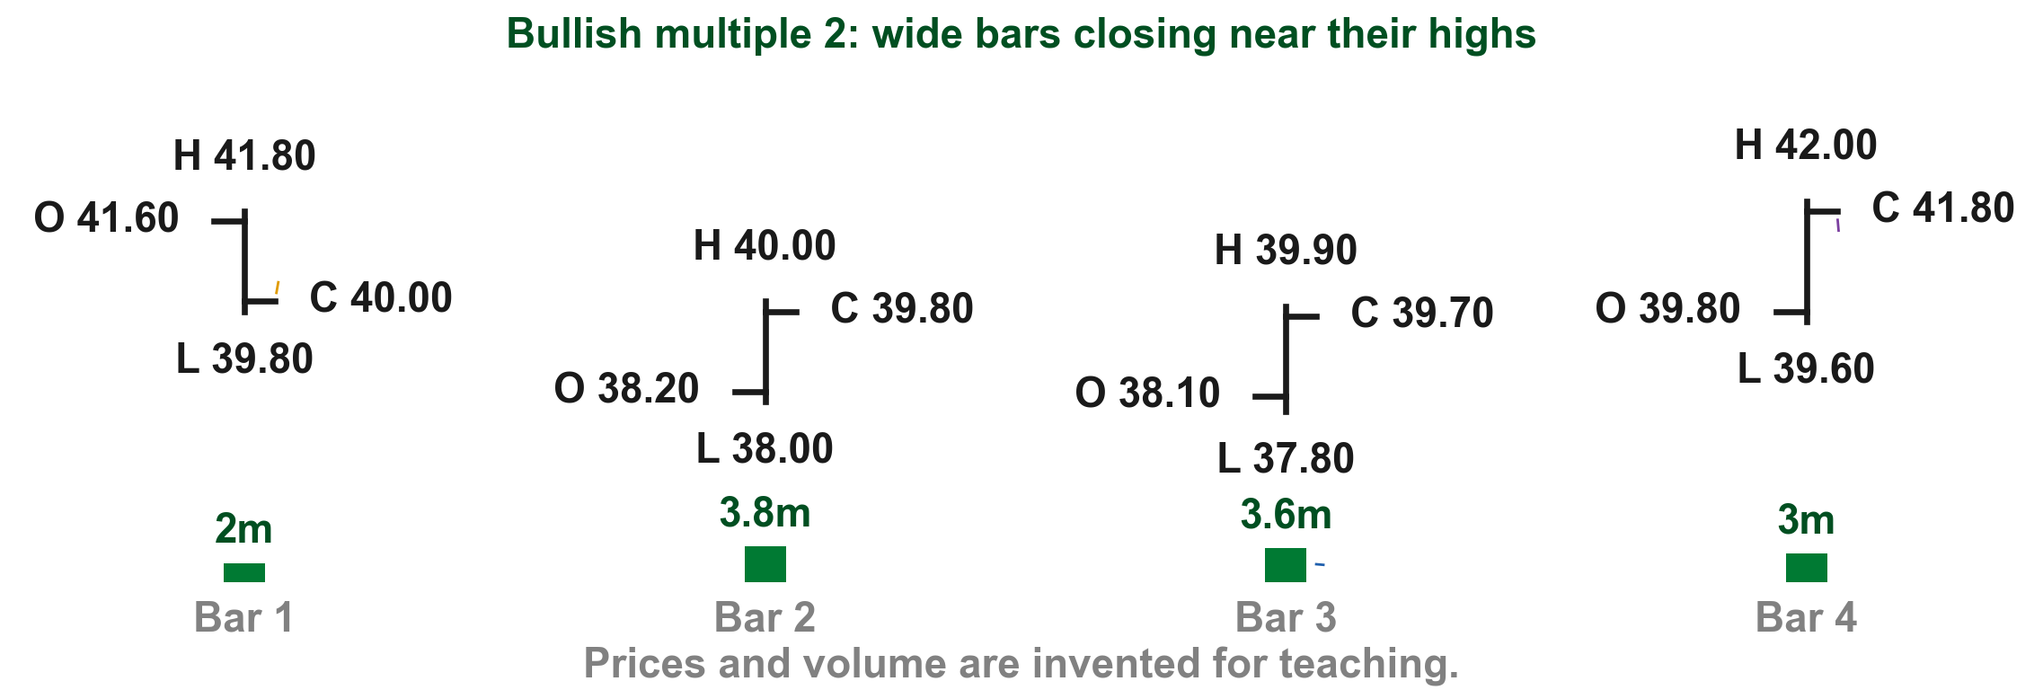
Here is bullish multiple form 2 with simple prices
Bar 1 closes at PHP 40.00, near its low (1). The two wide bars (2) close near their highs, at PHP 39.80 and PHP 39.70, on 3.8 and 3.6 million shares (3). The last bar closes at PHP 41.80, near its high (4). High volume on these wide bars indicates bullishness here (p. 216).
1
4
2
3
Chart XF - FIN1209 teaching chart, drawn for this course. Illustrative data, not a real instrument.
Part 2 of 4 - 7.2 Pattern reading | 60 of 88
Lim (2016), p. 216, Figure 7.11. Prices and volume are invented for teaching.
Notes:
- Same volume as the bearish form 2, now read the other way because the closes sit at the highs.

Slide 109
Bullish multiple form 3: narrow bars inside the first bar
Lim's label: "1st bar closes near its low followed by multiple narrow range bars closing within its range. The last bar closes at or near its high" (Figure 7.11, p. 216).
In the drawing, (1) is the first bar, (2) the narrow bars and (3) the last bar.
FIGURE 7.11
Figure 7.11, form 3: narrow bars inside the first bar.
1
3
2
Figure 7.11 - Lim, The Handbook of Technical Analysis (Wiley, 2016)
Part 2 of 4 - 7.2 Pattern reading | 61 of 88
Lim (2016), p. 216, Figure 7.11.
Notes:
- Mirror of bearish multiple form 3.

Slide 110
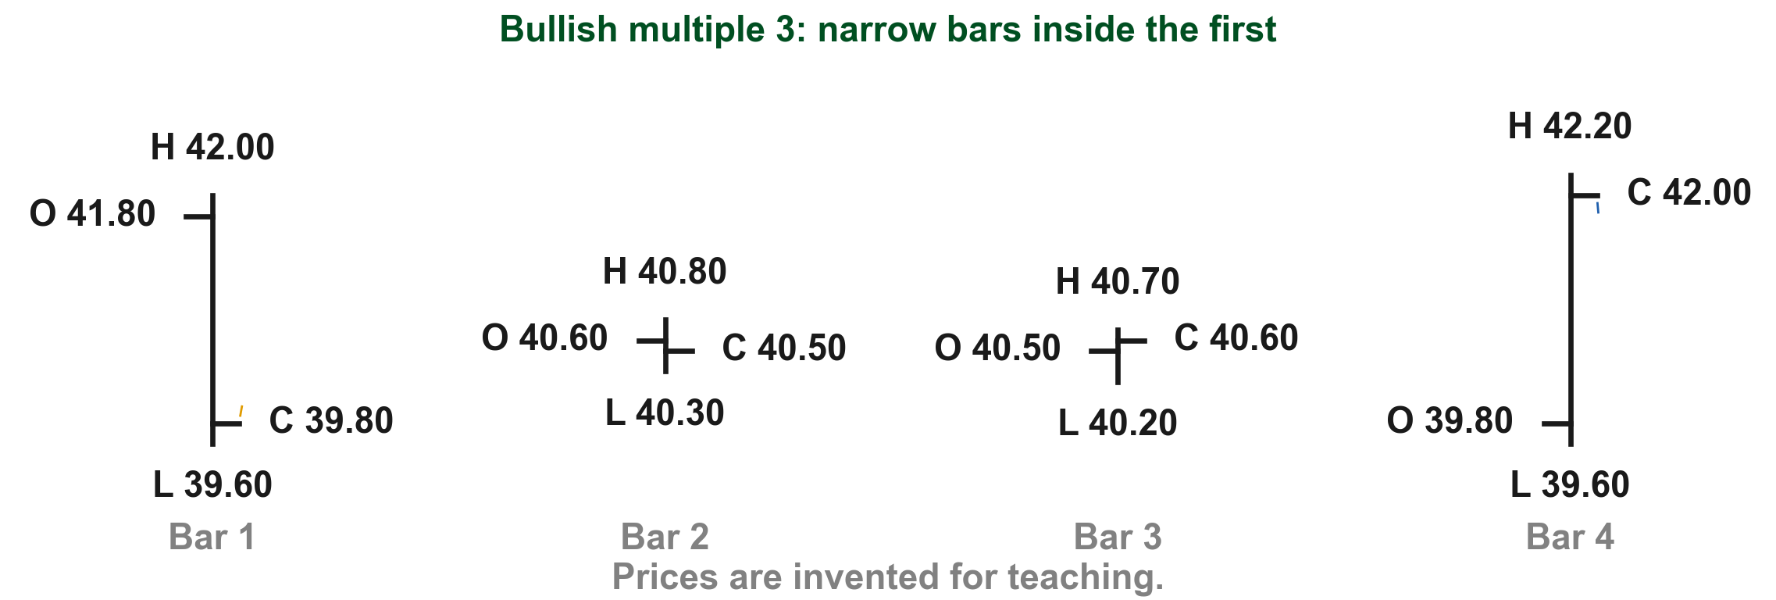
Here is bullish multiple form 3 with simple prices
Bar 1 runs from PHP 39.60 to PHP 42.00 and closes at PHP 39.80 (1). The narrow bars (2) stay inside that range, between PHP 40.20 and PHP 40.80. The last bar closes at PHP 42.00, near its PHP 42.20 high (3).
3
2
1
Chart XG - FIN1209 teaching chart, drawn for this course. Illustrative data, not a real instrument.
Part 2 of 4 - 7.2 Pattern reading | 62 of 88
Lim (2016), p. 216, Figure 7.11. The prices are invented for teaching.
Notes:
- Mirror of bearish multiple form 3.

Slide 111
Bullish multiple form 4: an island reversal formation
Lim's label: "1st bar closes near its low followed by multiple bars forming below a gap. The last bar gaps up and closes at or near its high. Referred to as an island reversal formation" (Figure 7.11, p. 216).
In the drawing, (1) is the first bar, (2) the bars below the gap and (3) the last bar at the right edge of Lim's drawing. Our chart on the next slide draws it with prices.
FIGURE 7.11
Figure 7.11, form 4: bars isolated below a gap.
1
3
2
Figure 7.11 - Lim, The Handbook of Technical Analysis (Wiley, 2016)
Part 2 of 4 - 7.2 Pattern reading | 63 of 88
Lim (2016), p. 216, Figure 7.11.
Notes:
- Say it plainly: the book's last bar is off the page. Our chart supplies it.

Slide 112
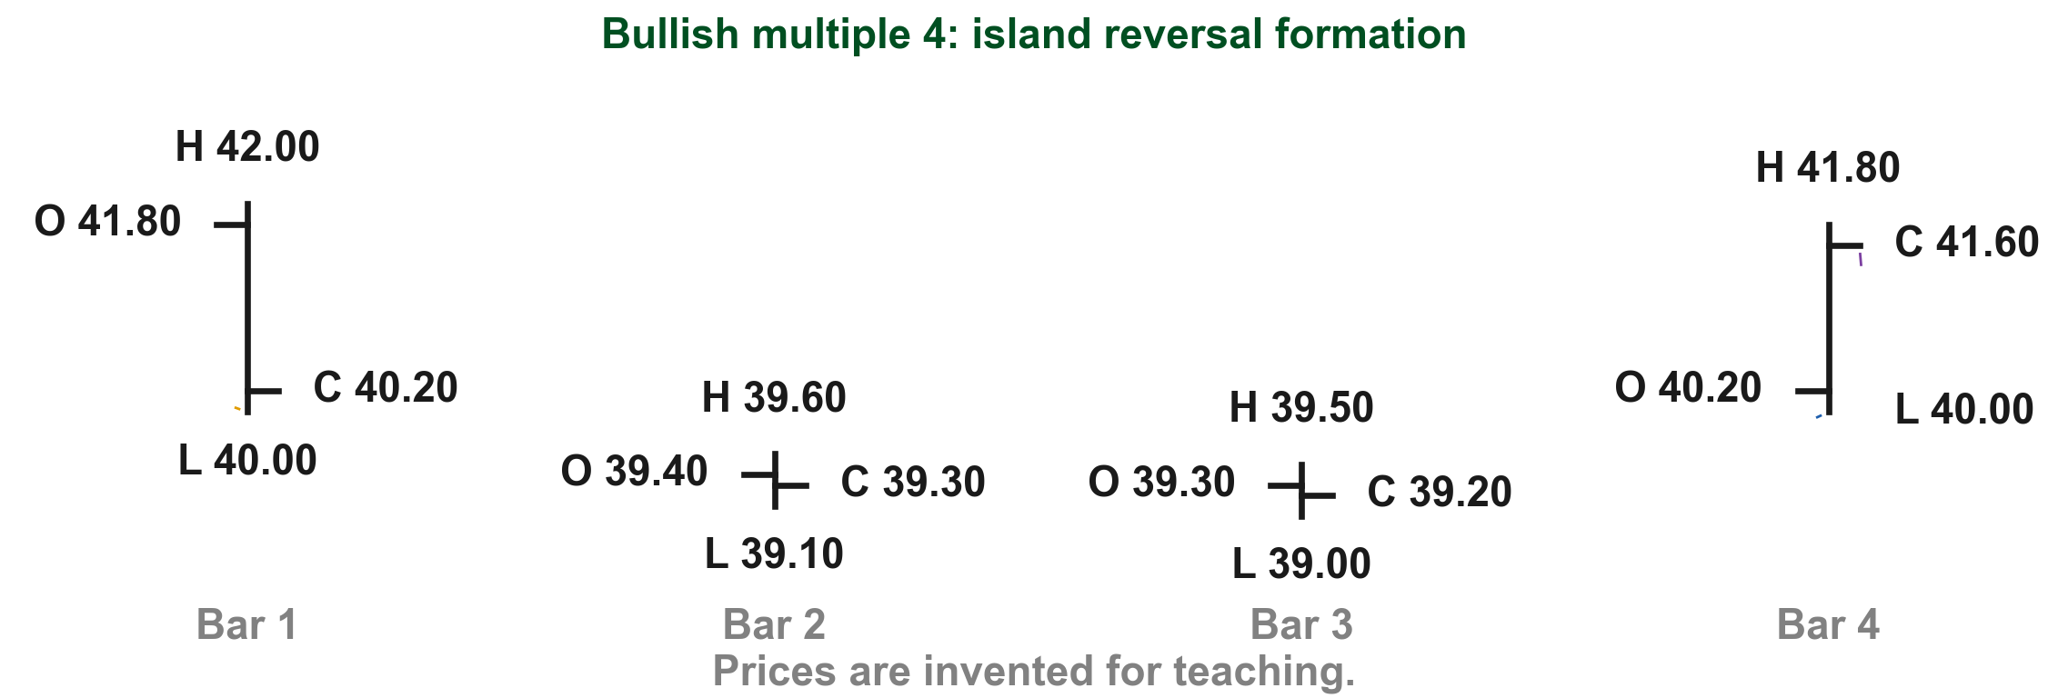
Here is bullish multiple form 4 with simple prices
Bar 1's low is PHP 40.00 (1), and the isolated bars (2) trade below a gap, between PHP 39.00 and PHP 39.60. The last bar's low is PHP 40.00 (3), so it gaps up above them, and closes at PHP 41.60, near its PHP 41.80 high (4).
4
1
3
2
Chart XH - FIN1209 teaching chart, drawn for this course. Illustrative data, not a real instrument.
Part 2 of 4 - 7.2 Pattern reading | 64 of 88
Lim (2016), p. 216, Figure 7.11. The prices are invented for teaching.
Notes:
- Mirror of bearish multiple form 4.

Slide 113
CHECK 12 OF 33
Multiple bar patterns
Q1
Q2
In a bearish multiple pattern, what volume does Lim generally expect on the bars between the first and the last?
In bullish multiple pattern 2, what can high volume on the wide middle bars indicate?
A. Low volume
B. Steadily rising volume
C. The same volume as the first bar
D. Volume does not matter
A. Bearishness
B. Bullishness
C. A continuation pattern
D. Nothing at all
Part 2 of 4 - 7.2 Pattern reading | Check 12
Notes:
- Both answers are in the multiple pattern rule slides.

Slide 114
ANSWERS
Multiple bar patterns
Q1 In a bearish multiple pattern, what volume does Lim generally expect on the bars between the first and the last?
A. Low volume
The numerous bars between the first and last bars should generally occur on low volume, with pattern 2 possibly the exception (p. 214).
Q2 In bullish multiple pattern 2, what can high volume on the wide middle bars indicate?
B. Bullishness
Wide-ranging bars between the first and last bar in pattern 2 can occur on high or above average volume, indicating bullishness (p. 216).
Part 2 of 4 - 7.2 Pattern reading | Check 12
Notes:
- Both answers are in the multiple pattern rule slides.

Slide 115
Continuation bars show the trend is still strong
So far every pattern disagreed with its trend. Lim also draws two patterns where a bullish continuation is expected instead: bullish bars inside an uptrend (p. 216).
Lim adds that large volume on a bullish second bar indicates the trend may still be potentially strong (p. 216).
For bearish continuation bars he says only that the reverse applies (p. 217); he draws no bearish example.
Part 2 of 4 - 7.2 Pattern reading | 65 of 88
Lim (2016), pp. 216 to 217.
Notes:
- Continuation is agreement: a bullish pattern inside an uptrend.

Slide 116

Continuation pattern 1: the second bar breaks the previous high
Lim: "the second bar breaches the high of the previous bar on high volume" (p. 217); his label adds that it closes at or near its high (Figure 7.12, p. 216). Here it is with invented prices. The previous high is PHP 51.00 (1). Bar 2 reaches PHP 53.40 and closes at PHP 53.20, near its high (2), on 4.0 million shares against 2.0 million (3).
FIGURE 7.12
Figure 7.12, pattern 1: a second bar closing near its high.
2
1
3
Figure 7.12, Lim (2016)
Chart CA - FIN1209 teaching chart, drawn for this course. Illustrative data, not a real instrument.
Part 2 of 4 - 7.2 Pattern reading | 66 of 88
Lim (2016), pp. 216 to 217, Figure 7.12. Prices and volume are invented for teaching.
Notes:
- Breach means trade above. Here the close is above the old high as well.

Slide 117

Continuation pattern 2: a halfway retrace, then a breach
Lim: "price retraces to the 50 percent level of the previous bar and subsequently rebounds on high volume, breaching the previous bar's high" (p. 217). Say bar 1 runs from PHP 48.00 to PHP 52.00, so its 50 percent level is (48.00 + 52.00) / 2 = PHP 50.00. Bar 2 dips to PHP 50.00 (1), then rebounds to PHP 52.80, above the old high (2), on 4.2 million shares (3).
FIGURE 7.12
Figure 7.12, pattern 2: a retrace to the midpoint, then a rebound.
2
1
3
Figure 7.12, Lim (2016)
Chart CB - FIN1209 teaching chart, drawn for this course. Illustrative data, not a real instrument.
Part 2 of 4 - 7.2 Pattern reading | 67 of 88
Lim (2016), pp. 216 to 217, Figure 7.12. Prices and volume are invented for teaching.
Notes:
- The retrace looks weak; the rebound through the old high on volume is what matters.

Slide 118
CHECK 13 OF 33
Continuation bars
Q1
Q2
In continuation pattern 1, what does the second bar do?
A first bar runs from PHP 48.00 to PHP 52.00. To what level does pattern 2 retrace?
A. Gaps down below the first bar
B. Breaches the previous high on high volume
C. Closes near its low
D. Stays inside the first bar
A. PHP 49.00
B. PHP 51.00
C. PHP 52.00
D. PHP 50.00
Part 2 of 4 - 7.2 Pattern reading | Check 13
Notes:
- Both answers are in the two continuation slides.

Slide 119
ANSWERS
Continuation bars
Q1 In continuation pattern 1, what does the second bar do?
B. Breaches the previous high on high volume
In pattern 1 the second bar breaches the high of the previous bar on high volume (p. 217).
Q2 A first bar runs from PHP 48.00 to PHP 52.00. To what level does pattern 2 retrace?
D. PHP 50.00
Pattern 2 retraces to the 50 percent level of the previous bar: (48.00 + 52.00) / 2 = PHP 50.00 (p. 217).
Part 2 of 4 - 7.2 Pattern reading | Check 13
Notes:
- Both answers are in the two continuation slides.

Slide 120
Every pattern is read against the 16 reversal characteristics
Besides each pattern's own behaviour, Lim asks us to watch 16 basic price and volume characteristics that indicate a potential reversal (p. 217).
They apply equally to Japanese candlestick analysis (Chapter 3, "Japanese candlestick"). Lim calls them strong indications of a potential change in trend or a price retracement, and refers us to Chapter 5 for the detail (p. 217).
We met all 16 in Chapter 5. The next eleven slides recall them in the book's own words and order, each with invented numbers to show the change.
Part 2 of 4 - 7.2 Pattern reading | 68 of 88
Lim (2016), p. 217; Chapter 3, "Japanese candlestick"; Chapter 5.
Notes:
- These are Chapter 5 terms. Recall each by its slide name; do not re-teach the formulas.

Slide 121

Characteristics 1 and 2: the swings get smaller and shorter
Characteristic 1, decrease in price cycle amplitude: each swing covers less ground, say rises of 40 points (1) shrinking to 30 (2) (Chapter 5, "1 Cycle amplitude"). Characteristic 2, decrease in price cycle period: each swing takes less time, say 20 bars (3) falling to 12 (4) (Chapter 5, "2 Cycle period").
2
4
1
3
Chart K1 - FIN1209 teaching chart, drawn for this course. Illustrative data, not a real instrument.
Part 2 of 4 - 7.2 Pattern reading | 69 of 88
Our own sketches, from the numbers on the slide. Lim (2016), p. 217.
Notes:
- Gold 1 and red 2 mark the first sketch's before and after; blue 3 and purple 4 mark the second's.
- Each sketch is drawn from the numbers in the sentence beside it; they are invented for teaching.

Slide 122

Characteristics 3 and 4: pullbacks change and bars shrink
Characteristic 3, change in bar retracement symmetry: pullbacks that took 6 (1), 6 and 5 bars suddenly take 2 (2) (Chapter 5, "3 Bar retracement symmetry"). Characteristic 4, decrease in average bar range: bars that averaged PHP 3.00 (3) from low to high now average PHP 2.00 (4) (Chapter 5, "4 Average bar range").
2
4
1
3
Chart K3 - FIN1209 teaching chart, drawn for this course. Illustrative data, not a real instrument.
Part 2 of 4 - 7.2 Pattern reading | 70 of 88
Our own sketches, from the numbers on the slide. Lim (2016), p. 217.
Notes:
- Gold 1 and red 2 mark the first sketch's before and after; blue 3 and purple 4 mark the second's.
- Each sketch is drawn from the numbers in the sentence beside it; they are invented for teaching.

Slide 123

Characteristics 5 and 6: the bars lose their quality
Characteristic 5, lack of the quality of price persistence: small, even bars of about PHP 1.00 (1) give way to uneven ones of PHP 0.40, 2.50 and 0.80 (2) (Chapter 5, "5 Price persistence"). Characteristic 6, decrease in average bar stochastic ratio: on average, closes sit lower inside their bars, say 0.80 (3) falling to 0.40 (4) (Chapter 5, "6 The average bar stochastic ratio").
4
1
2
3
Chart K5 - FIN1209 teaching chart, drawn for this course. Illustrative data, not a real instrument.
Part 2 of 4 - 7.2 Pattern reading | 71 of 88
Our own sketches, from the numbers on the slide. Lim (2016), p. 217.
Notes:
- Gold 1 and red 2 mark the first sketch's before and after; blue 3 and purple 4 mark the second's.
- Each sketch is drawn from the numbers in the sentence beside it; they are invented for teaching.

Slide 124

Characteristics 7 and 8: bodies shrink and the angle changes
Characteristic 7, decrease in average candlestick real body to range ratio: on average the bodies shrink inside their bars, say 0.60 (1) falling to 0.25 (2) (Chapter 5, "7 Real body to range ratio, BRR"). Characteristic 8, changes in angular symmetry and momentum: the trend's angle changes, say from 20 (3) to 35 degrees (4).
4
2
1
3
Chart K7 - FIN1209 teaching chart, drawn for this course. Illustrative data, not a real instrument.
Part 2 of 4 - 7.2 Pattern reading | 72 of 88
Our own sketches, from the numbers on the slide. Lim (2016), p. 217.
Notes:
- Gold 1 and red 2 mark the first sketch's before and after; blue 3 and purple 4 mark the second's.
- Each sketch is drawn from the numbers in the sentence beside it; they are invented for teaching.

Slide 125
Characteristics 7 and 8: bodies shrink and the angle changes
Chapter 5 said a steeper climb is generally bullish; Lim adds that a sudden parabolic jump is usually unsustainable and so potentially bearish (p. 218). He gives no cutoff angle (Chapter 5, "8 Angular symmetry and momentum").
4
2
1
3
Chart K7 - FIN1209 teaching chart, drawn for this course. Illustrative data, not a real instrument.
Part 2 of 4 - 7.2 Pattern reading | 73 of 88
Our own sketches, from the numbers on the slide. Lim (2016), p. 217.
Notes:
- Gold 1 and red 2 mark the first sketch's before and after; blue 3 and purple 4 mark the second's.
- Each sketch is drawn from the numbers in the sentence beside it; they are invented for teaching.

Slide 126

Characteristics 9 and 10: a barrier is near and the dips fade
Characteristic 9, proximity to a price barrier: price is near a strong support or resistance, say at PHP 59 (1) under resistance at PHP 60 (2) (Chapter 5, "9 Barrier proximity").
2
1
4
3
Chart K9 - FIN1209 teaching chart, drawn for this course. Illustrative data, not a real instrument.
Part 2 of 4 - 7.2 Pattern reading | 74 of 88
Our own sketches, from the numbers on the slide. Lim (2016), p. 217.
Notes:
- Gold 1 and red 2 mark the first sketch's before and after; blue 3 and purple 4 mark the second's.
- Each sketch is drawn from the numbers in the sentence beside it; they are invented for teaching.

Slide 127
Characteristics 9 and 10: a barrier is near and the dips fade
Characteristic 10, reduction in frequency and decrease in depth of trend-based oscillations: six dips of about 3 points (3) become two dips of 1 point (4) (Chapter 5, "10 Frequency and depth of oscillations").
2
1
4
3
Chart K9 - FIN1209 teaching chart, drawn for this course. Illustrative data, not a real instrument.
Part 2 of 4 - 7.2 Pattern reading | 75 of 88
Our own sketches, from the numbers on the slide. Lim (2016), p. 217.
Notes:
- Gold 1 and red 2 mark the first sketch's before and after; blue 3 and purple 4 mark the second's.
- Each sketch is drawn from the numbers in the sentence beside it; they are invented for teaching.

Slide 128

Characteristics 11 and 12: longer pauses and a third gap
Characteristic 11, appearance of relatively larger and longer lasting consolidations: pauses of 3 bars (1) give way to one of 12 bars (2) (Chapter 5, "11 Size and duration of a consolidation"). Characteristic 12, appearance of an exhaustion gap: a third gap in the trend, say of PHP 0.80 (3), after two earlier ones (4) (Chapter 5, "12 Third gap exhaustion").
2
3
1
4
Chart K11 - FIN1209 teaching chart, drawn for this course. Illustrative data, not a real instrument.
Part 2 of 4 - 7.2 Pattern reading | 76 of 88
Our own sketches, from the numbers on the slide. Lim (2016), p. 217.
Notes:
- Gold 1 and red 2 mark the first sketch's before and after; blue 3 and purple 4 mark the second's.
- Each sketch is drawn from the numbers in the sentence beside it; they are invented for teaching.

Slide 129

Characteristics 13 and 14: the range is spent, price overshoots
Characteristic 13, completion of the average range for the period under observation: the day has already travelled its whole average range (1), say all PHP 3.00 of it (2) (Chapter 5, "13 Average period range").
3
4
2
1
Chart K13 - FIN1209 teaching chart, drawn for this course. Illustrative data, not a real instrument.
Part 2 of 4 - 7.2 Pattern reading | 77 of 88
Our own sketches, from the numbers on the slide. Lim (2016), p. 217.
Notes:
- Gold 1 and red 2 mark the first sketch's before and after; blue 3 and purple 4 mark the second's.
- Each sketch is drawn from the numbers in the sentence beside it; they are invented for teaching.

Slide 130
Characteristics 13 and 14: the range is spent, price overshoots
Characteristic 14, overextended price action with respect to a price barrier: price spikes to PHP 61 (3) above an uptrending overlay line at PHP 60 (4), or above an upper band, as Figure 7.13 shows two slides on (Chapter 5, "14 Overextension past an overlay barrier").
3
4
2
1
Chart K13 - FIN1209 teaching chart, drawn for this course. Illustrative data, not a real instrument.
Part 2 of 4 - 7.2 Pattern reading | 78 of 88
Our own sketches, from the numbers on the slide. Lim (2016), p. 217.
Notes:
- Gold 1 and red 2 mark the first sketch's before and after; blue 3 and purple 4 mark the second's.
- Each sketch is drawn from the numbers in the sentence beside it; they are invented for teaching.

Slide 131

Characteristics 15 and 16: extreme volume and divergence
Characteristic 15, price accompanied by extremely high or low volume: say 5.0 million shares (1) against an average of 1.2 million (2) (Chapter 5, "15 Volume spread action"). Characteristic 16, standard divergences between price, volume, and oscillators: price makes a higher high while volume falls from 3.0 (3) to 1.8 million (4) (Chapter 5, "16 Volume and oscillator divergence").
1
3
4
2
Chart K15 - FIN1209 teaching chart, drawn for this course. Illustrative data, not a real instrument.
Part 2 of 4 - 7.2 Pattern reading | 79 of 88
Our own sketches, from the numbers on the slide. Lim (2016), p. 217.
Notes:
- Gold 1 and red 2 mark the first sketch's before and after; blue 3 and purple 4 mark the second's.
- Each sketch is drawn from the numbers in the sentence beside it; they are invented for teaching.

Slide 132
Figure 7.13 shows three of the characteristics on one chart
Figure 7.13, a daily chart of the National Bank of Greece, shows three at once (pp. 217 to 218).
(1) The run-up's last days climb far more steeply: characteristic 8, angular momentum.
(2) Through the run-up price barely dips: characteristic 10, oscillations.
(3) The overextended bar pokes above the upper band: characteristic 14.
3
FIGURE 7.13
Figure 7.13: a parabolic run-up in price ending in an overextended bar above the upper band.
1
2
Figure 7.13 - Lim, The Handbook of Technical Analysis (Wiley, 2016)
Part 2 of 4 - 7.2 Pattern reading | 80 of 88
Lim (2016), pp. 217 to 218, Figure 7.13.
Notes:
- Walk the three marks in time order: the run-up, then the top.
- Red sits on the run-up, before the top, where Lim says the oscillations are missing.

Slide 133

Why those three marks are warnings
Lim says such rapid increases (1) are usually unsustainable, so potentially bearish (p. 218). A lack of oscillations (2) is potentially bearish because there is little healthy profit-taking (p. 218). The overextended price (3) is stretched past a volatility barrier, the Bollinger upper band, and would be even more bearish with extreme volume (p. 217).
3
1
2
Chart WA - FIN1209 teaching chart, drawn for this course. Illustrative data, not a real instrument.
Part 2 of 4 - 7.2 Pattern reading | 81 of 88
Lim (2016), pp. 217 to 218. The prices and the band are invented for teaching.
Notes:
- Gold 1 is the late jump, red 2 the shallow dips and blue 3 the final bar over the band, on our invented climb.

Slide 134
Why those three marks are warnings
Chapter 7 names the Bollinger upper band but does not define it; read it as the overlay barrier from Chapter 5, "14 Overextension past an overlay barrier", and take no formula from this chapter.
3
1
2
Chart WA - FIN1209 teaching chart, drawn for this course. Illustrative data, not a real instrument.
Part 2 of 4 - 7.2 Pattern reading | 82 of 88
Lim (2016), pp. 217 to 218. The prices and the band are invented for teaching.
Notes:
- Gold 1 is the late jump, red 2 the shallow dips and blue 3 the final bar over the band, on our invented climb.

Slide 135
Here are the same three warnings with simple prices
Our invented price climbs from PHP 40 to PHP 80 in twelve bars. Early bars rise about PHP 1 each; late ones jump PHP 8, to PHP 66 (1), and then PHP 14: a change in angular momentum. The only dips are one point each, the last to PHP 52 (2). The final PHP 80 sits PHP 3 above an invented upper band at PHP 77 (3).
3
1
2
Chart WA - FIN1209 teaching chart, drawn for this course. Illustrative data, not a real instrument.
Part 2 of 4 - 7.2 Pattern reading | 83 of 88
Lim (2016), pp. 217 to 218. The prices and the band are invented for teaching.
Notes:
- Numbers make the three warnings concrete; none of them is a sell signal on its own.

Slide 136
Barrier proximity ranks among the most important
Lim calls barrier proximity, item 9, one of the most important reversal characteristics: reversal patterns are most reliable at significant price barriers (p. 217).
His examples: a bearish key reversal day is more reliable at a significant resistance level, and a bullish exhaustion bar at a significant support level (p. 217). The exhaustion bar is a Part 3 pattern; for now, read it as a bullish bar at support.
So he advises reading every bar formation against all 16 characteristics (p. 218).
Part 2 of 4 - 7.2 Pattern reading | 84 of 88
Lim (2016), p. 217; Chapter 5, "9 Barrier proximity".
Notes:
- This is the one Lim singles out.

Slide 137

A key reversal bar at resistance is more reliable
Here is a key reversal bar where Lim says it counts most. Resistance sits at PHP 60.00 (1). The bar opens at PHP 60.20, pushes up to PHP 60.60 into that barrier (2), then closes at PHP 59.00, below the previous close of PHP 59.60 (3).
2
1
3
Chart RA - FIN1209 teaching chart, drawn for this course. Illustrative data, not a real instrument.
Part 2 of 4 - 7.2 Pattern reading | 85 of 88
Lim (2016), p. 217. The prices are invented for teaching.
Notes:
- Same bar shape as form 1 of Figure 7.4; the barrier is what adds weight.

Slide 138

The same bar with no barrier nearby is less reliable
Now the identical two bars with no resistance anywhere near: the bar still reaches PHP 60.60 (1) and still closes at PHP 59.00 (2). The pattern is the same; only its location changed. By Lim's rule this one is the less reliable reading, though neither is a certainty.
1
2
Chart RB - FIN1209 teaching chart, drawn for this course. Illustrative data, not a real instrument.
Part 2 of 4 - 7.2 Pattern reading | 86 of 88
Lim (2016), p. 217. The prices are invented for teaching.
Notes:
- Ask the room which of the last two bars they would trust more, and why.

Slide 139

The rule works the other way at support
Lim's second example is a bullish exhaustion bar at support, a bar Part 3 teaches. The same rule covers the bullish key reversal of Figure 7.5. With support at PHP 40.00 (1), the bar dips to PHP 39.40 (2) and closes at PHP 41.00, above the previous close of PHP 40.40 (3).
3
1
2
Chart RC - FIN1209 teaching chart, drawn for this course. Illustrative data, not a real instrument.
Part 2 of 4 - 7.2 Pattern reading | 87 of 88
Lim (2016), p. 217. The prices are invented for teaching.
Notes:
- Part 3 begins with key reversal bars on real charts, where this barrier idea returns.

Slide 140
CHECK 14 OF 33
The 16 characteristics on Figure 7.13
Q1
Which characteristic is mark 3?
3
FIGURE 7.13
Figure 7.13: a parabolic run-up in price ending in an overextended bar above the upper band.
A. 8, momentum
B. 10, oscillations
C. 14, overextension
D. 12, exhaustion gap
1
2
Q2
Why are few oscillations in a run-up bearish?
A. Low volume
B. Little profit-taking
C. No band formula
D. A downtrend
Figure 7.13 - Lim, The Handbook of Technical Analysis (Wiley, 2016)
Part 2 of 4 - 7.2 Pattern reading | Check 14
Notes:
- Both answers are on the Figure 7.13 slides. The figure is on the question and the answer.

Slide 141
ANSWERS
The 16 characteristics on Figure 7.13
Q1 Which characteristic is mark 3?
3
FIGURE 7.13
Figure 7.13: a parabolic run-up in price ending in an overextended bar above the upper band.
C. 14, overextension
The overextended bar above the band is characteristic 14 (p. 217).
1
2
Q2 Why are few oscillations in a run-up bearish?
B. Little profit-taking
Lim: a lack of healthy profit-taking makes it potentially bearish (p. 218).
Figure 7.13 - Lim, The Handbook of Technical Analysis (Wiley, 2016)
Part 2 of 4 - 7.2 Pattern reading | Check 14
Notes:
- Both answers are on the Figure 7.13 slides. The figure is on the question and the answer.

Slide 142
CHECK 15 OF 33
Barrier proximity
Q1
Q2
Where does Lim say reversal patterns are most reliable?
Two identical key reversal bars: one at resistance, one far from any barrier. Which reading is more reliable?
A. At significant price barriers
B. Far from any barrier
C. Only on low volume
D. Only in a downtrend
A. The one far from a barrier
B. They are equally reliable
C. Neither can be read
D. The one at resistance
Part 2 of 4 - 7.2 Pattern reading | Check 15
Notes:
- Both answers are on the barrier proximity slides.

Slide 143
ANSWERS
Barrier proximity
Q1 Where does Lim say reversal patterns are most reliable?
A. At significant price barriers
Reversal patterns are most reliable at significant price barriers (p. 217).
Q2 Two identical key reversal bars: one at resistance, one far from any barrier. Which reading is more reliable?
D. The one at resistance
A bearish key reversal day is more reliable when it occurs at a significant resistance level (p. 217).
Part 2 of 4 - 7.2 Pattern reading | Check 15
Notes:
- Both answers are on the barrier proximity slides.

Slide 144
Part 2 in one breath, and where Part 3 begins
Read the trend first; a pattern that disagrees with it is a potential reversal. Lim drew seven one- and two-bar forms, six three-bar forms and four multiple-bar forms, each in both directions.
The last bar, its volume and the gaps decide how much weight a reading gets, and the 16 characteristics, above all barrier proximity, decide the rest.
Part 3 starts with the first form we drew, the key reversal bar, now on the book's real charts.
Part 2 of 4 - 7.2 Pattern reading | 88 of 88
Lim (2016), pp. 211 to 218.
Notes:
- Close Part 2 and open Part 3 by name.

Slide 145
The key reversal is when a strong move suddenly turns
In an uptrend, buyers push price higher. A bearish key reversal breaks that habit: it makes a new high, then closes near or below the previous close.
Lim defines it this way: "A bearish key reversal bar forms a higher high than the previous bar and closes near or below the close of the previous bar" (p. 218).
Why it matters: it warns an uptrend may be running out of buyers. Lim says a wider bar may improve follow-through, but it is not a promise (p. 218).
FIGURE 7.15
The Apple daily chart, cropped to the key reversal day and its surrounding bars. The marked day opens above the previous high, forms a new high, closes below the previous close, and has above average volume.
Figure 7.15 - Lim, The Handbook of Technical Analysis (Wiley, 2016)
Part 3 of 4 - 7.3 Popular reversals | 1 of 65
Lim (2016), pp. 218 to 219, Figure 7.15. The crop is for teaching; no invented example is on this slide.
Notes:
- Use this unmarked chart while introducing the key reversal. The next worked reading identifies the same features with teaching marks.

Slide 146

Walking through one key reversal, price by price
Here is the same pattern with simple prices, so you can see each step. Yesterday the stock reached 52.00 and closed at 51.10. Today it opens higher, at 52.30, already above yesterday's high (1). Buyers push it to 53.20, a new high (2). Then the selling starts, and by the close it has fallen to 50.80, below yesterday's close (3).
1
2
3
4
Chart K - FIN1209 teaching chart, drawn for this course. Illustrative data, not a real instrument.
Part 3 of 4 - 7.3 Popular reversals | 2 of 65
Notes:
- Two invented PHP bars with every OHLC value and volume value labelled. Marks 1 to 4 show the opening price above the previous high, the new high, the close below the previous close, and the volume increase.

Slide 147
Walking through one key reversal, price by price
Volume more than doubles, from 2.0 to 4.2 million shares (4), so many traders took part in that turn.
1
2
3
4
Chart K - FIN1209 teaching chart, drawn for this course. Illustrative data, not a real instrument.
Part 3 of 4 - 7.3 Popular reversals | 3 of 65
Notes:
- Two invented PHP bars with every OHLC value and volume value labelled. Marks 1 to 4 show the opening price above the previous high, the new high, the close below the previous close, and the volume increase.

Slide 148
The bullish key reversal is the same rule in the opposite direction
In a downtrend, a bullish key reversal makes a new low, then closes near or above the previous close.
With simple invented prices: yesterday's low was 41.00 and its close 41.50. Today it falls to a new low of 40.50 (1), then closes at 43.20 (2), above yesterday's close of 41.50, on 4.0 million shares (3).
In Lim's chart price then rebounds rapidly, but that is not a promise (p. 218).
FIGURE 7.14
Apple daily chart. The marked bar makes a new low, closes above the previous close, and is followed by a rapid rebound on high volume.
2
1
3
Figure 7.14 - Lim, The Handbook of Technical Analysis (Wiley, 2016)
Lim (2016), p. 218, Figure 7.14. The figure shows the book's bullish converse.
Part 3 of 4 - 7.3 Popular reversals | 4 of 65
Lim (2016), p. 218, Figure 7.14. The worked PHP values are ours, invented to show the converse.
Notes:
- This is the exact converse: a new low, then a close above the previous close, in a downtrend.
- The book says the bullish key reversal occurs on high volume and price rebounds rapidly in this example.

Slide 149
Figure 7.15 shows the key reversal on the book's chart
The book's chart shows the same rule: a higher high, then a close near or below the prior close (p. 218).
Gold (1) marks the previous bar's high. Red (2) marks the key reversal day's higher high. Blue (3) marks its close, below the previous close. Purple (4) marks the above-average volume beneath it.
Why it matters: a key reversal is a warning, not a promise. In the book's example, the market drifts sideways before it falls.
2
FIGURE 7.15
The Apple daily chart, cropped to the key reversal day and its surrounding bars. The marked day opens above the previous high, forms a new high, closes below the previous close, and has above average volume.
1
3
4
Figure 7.15 - Lim, The Handbook of Technical Analysis (Wiley, 2016)
Part 3 of 4 - 7.3 Popular reversals | 5 of 65
Lim (2016), pp. 218 to 219, Figure 7.15. The crop and marks are for teaching; no invented example is on this slide.
Notes:
- Read the book's definition first, then explain marks 1 to 4 in the same order: previous high, new high and opening area, close, and above-average volume.
- The figure shows consolidation before the later decline. Keep the word potentially: this is a warning, not a promise.

Slide 150
CHECK 16 OF 33
From the key reversal slides
Q1
A bearish key reversal makes a higher high, then:
2
FIGURE 7.15
The Apple daily chart, cropped to the key reversal day and its surrounding bars. The marked bar opens above the previous high, forms a new high, and closes below the previous close.
1
A. Near or below prior close
B. Above prior high
C. Below prior low
D. On low volume only
3
Q2
On Figure 7.15, blue mark 3 identifies:
4
A. Prior close
B. New high
C. Close below prior close
D. Later bars
Figure 7.15 - Lim, The Handbook of Technical Analysis (Wiley, 2016)
Part 3 of 4 - 7.3 Popular reversals | Check 16
Notes:
- Let the room answer from the earlier marked slide. Do not reveal the answers on this question slide.

Slide 151
ANSWERS
From the key reversal slides
Q1 A bearish key reversal makes a higher high, then:
2
FIGURE 7.15
The Apple daily chart, cropped to the key reversal day and its surrounding bars. The marked bar opens above the previous high, forms a new high, and closes below the previous close.
1
A. Near or below prior close
Lim defines the bearish pattern as a higher high followed by a close near or below the previous close.
3
Q2 On Figure 7.15, blue mark 3 identifies:
4
C. Close below prior close
The preceding slide maps blue mark 3 to the close below the previous close (Lim, p. 218).
Figure 7.15 - Lim, The Handbook of Technical Analysis (Wiley, 2016)
Part 3 of 4 - 7.3 Popular reversals | Check 16
Notes:
- Let the room answer from the earlier marked slide. Do not reveal the answers on this question slide.

Slide 152
CHECK 17 OF 33
From the key reversal slides
Q1
A wider key reversal bar makes downside follow-through:
2
FIGURE 7.15
The Apple daily chart, cropped to the key reversal day and its surrounding bars. The marked bar opens above the previous high, forms a new high, and closes below the previous close.
1
A. Impossible
B. Always certain
C. Unrelated
D. Potentially more reliable
3
Q2
The bullish converse is read in a:
A. Monthly chart only
B. Downtrend
C. Flat market only
D. Volume panel
4
Figure 7.15 - Lim, The Handbook of Technical Analysis (Wiley, 2016)
Part 3 of 4 - 7.3 Popular reversals | Check 17
Notes:
- Use this second two-item check so the foundation build keeps a balanced answer key.

Slide 153
ANSWERS
From the key reversal slides
Q1 A wider key reversal bar makes downside follow-through:
2
FIGURE 7.15
The Apple daily chart, cropped to the key reversal day and its surrounding bars. The marked bar opens above the previous high, forms a new high, and closes below the previous close.
1
D. Potentially more reliable
The book says a wider bar makes follow-through potentially more reliable.
3
4
Q2 The bullish converse is read in a:
B. Downtrend
The bullish key reversal is the converse in a downtrend.
Figure 7.15 - Lim, The Handbook of Technical Analysis (Wiley, 2016)
Part 3 of 4 - 7.3 Popular reversals | Check 17
Notes:
- Use this second two-item check so the foundation build keeps a balanced answer key.

Slide 154
A key reversal can warn early without starting an immediate fall
A key reversal is a warning about changing pressure, not a promise that price will fall at once.
Lim's Figure 7.15 shows the market hovering near the key bar (1) before the later decline (2) (p. 218).
1
FIGURE 7.15
The Apple daily chart, cropped to the key reversal day and the later consolidation and decline.
2
A wide bar may make follow-through more reliable, but it does not guarantee it.
Figure 7.15 - Lim, The Handbook of Technical Analysis (Wiley, 2016)
Part 3 of 4 - 7.3 Popular reversals | 6 of 65
Lim (2016), p. 218, Figure 7.15. The crop and marks are for teaching.
Notes:
- Point to mark 1 for the hover and mark 2 for the later decline. The book's point is delayed follow-through.
- Separate the pattern definition from the later price path. The latter is a caveat, not part of the definition.

Slide 155
Figure 7.14 shows what happened after the bullish reversal
Here is the bullish key reversal on the book's chart. Gold (1) marks the day's new low, red (2) its close above the previous close, and blue (3) the high volume beneath it. After that bar, price rebounds rapidly.
Lim presents that rebound as this chart's outcome, not a promise for every bullish key reversal (p. 218).
A reversal warns about changing pressure; timing belongs to later price action.
FIGURE 7.14
Apple daily chart. The marked bar makes a new low, closes above the previous close, and is followed by a rapid rebound on high volume.
2
1
3
Figure 7.14 - Lim, The Handbook of Technical Analysis (Wiley, 2016)
Part 3 of 4 - 7.3 Popular reversals | 7 of 65
Lim (2016), p. 218, Figure 7.14. The crop and marks are for teaching.
Notes:
- Walk the converse from the new low to the close above the previous close before reading the figure.
- The rapid rebound is the book's observation in Figure 7.14, not a promise for every bullish key reversal.

Slide 156
Figure 7.16: context can strengthen the warning
Figure 7.16 shows a bullish key reversal with some of the 16 reversal characteristics around it (p. 219).
The bar forms below the lower Bollinger band (1), which Lim reads as an overextended or oversold condition. It closes near its high (2).
The book draws Bollinger Bands but does not teach them in this chapter, so we read the band as a label, not a formula.
FIGURE 7.16
The ITC Holdings daily chart, cropped to the price panel: the bullish key reversal bar forms below the lower Bollinger band and closes near its high.
2
1
Figure 7.16 - Lim, The Handbook of Technical Analysis (Wiley, 2016)
Part 3 of 4 - 7.3 Popular reversals | 8 of 65
Lim (2016), pp. 219 to 220, Figure 7.16. Bollinger Bands and StochRSI are shown by the book but not defined here.
Notes:
- Mark 1 is the key reversal bar's low, below the lower band. Mark 2 is its close near the high.
- Lim calls these conditions greater potential, not certainty.

Slide 157
Figure 7.16: StochRSI and volume add to the warning
The lower panels of the same figure add two more warnings. StochRSI is at oversold (3), and the key reversal bar trades on extreme volume (4) (p. 219).
Lim says these conditions point to a greater potential for a bullish reversal, and a close near the high on extreme volume suggests a selling climax (p. 219).
FIGURE 7.16
The ITC Holdings daily chart, cropped to the StochRSI and volume panels: StochRSI is oversold and the key reversal bar has extreme volume.
3
4
Figure 7.16 - Lim, The Handbook of Technical Analysis (Wiley, 2016)
Part 3 of 4 - 7.3 Popular reversals | 9 of 65
Lim (2016), pp. 219 to 220, Figure 7.16. Bollinger Bands and StochRSI are shown by the book but not defined here.
Notes:
- Mark 3 is the oversold StochRSI label. Mark 4 is the extreme volume under the key reversal bar.
- Lim calls the close near the high on extreme volume indicative of a selling climax.

Slide 158

A two-day reversal compares the two closing positions
A bearish two-day reversal uses two closing positions: first near the high, second near the low. With simple invented prices, the first closes at PHP 51.80 near its high (1), and the second at PHP 49.60 near its low (2). Lim prefers wider ranges for both bars. The pair is a potential warning, not a guarantee (p. 219).
1
2
Chart L - FIN1209 teaching chart, drawn for this course. Illustrative data, not a real instrument.
Part 3 of 4 - 7.3 Popular reversals | 10 of 65
Notes:
- Two invented PHP bars with OHLC values, closing positions and million-share volume labelled. Mark 1 is the first close near the high and mark 2 the second near the low.

Slide 159
Figure 7.17: the book adds CCI divergence
Gold (1) marks the first close near its high, and red (2) the second close near its low.
The book says wider ranges would be preferable and labels bearish divergence with the commodity channel index (CCI) oscillator (3) (p. 221).
CCI is not defined in Chapter 7. Treat it as the book's supporting label, not a formula to calculate.
1
FIGURE 7.17
The TSX Composite daily chart: the first bar closes near its high, the second near its low, and the lower panel labels bearish CCI divergence.
2
3
Figure 7.17 - Lim, The Handbook of Technical Analysis (Wiley, 2016)
Part 3 of 4 - 7.3 Popular reversals | 11 of 65
Lim (2016), pp. 219 to 221, Figure 7.17. The CCI label is reproduced as the book's observation, not taught as a formula.
Notes:
- Read marks 1 and 2 as the two closing positions. The book prefers wider ranges for both bars.
- CCI is a label in Lim's figure. Chapter 7 does not define its formula, so do not infer one.

Slide 160

Here is a bearish three-bar reversal with simple prices
Here is a bearish three-bar reversal with simple prices. Bar 1 runs from PHP 49.00 to PHP 52.20 and closes near its high, at PHP 52.00 (1). Bar 2 is small: it stays between PHP 51.40 and PHP 52.40 and closes at PHP 51.70 (2). Bar 3 falls from PHP 52.10 to PHP 48.70 and closes near its low, at PHP 48.80 (3).
1
2
3
Chart LK - FIN1209 teaching chart, drawn for this course. Illustrative data, not a real instrument.
Part 3 of 4 - 7.3 Popular reversals | 12 of 65
Notes:
- Three invented PHP bars: the first closes near its high, the second is small, and the third closes near its low.

Slide 161
Here is a bearish three-bar reversal with simple prices
A first close near the high and a third close near the low is the pattern Lim describes (p. 221).
1
2
3
Chart LK - FIN1209 teaching chart, drawn for this course. Illustrative data, not a real instrument.
Part 3 of 4 - 7.3 Popular reversals | 13 of 65
Notes:
- Three invented PHP bars: the first closes near its high, the second is small, and the third closes near its low.

Slide 162
The bearish three-bar reversal changes from a strong close to a weak one
A bearish three-bar reversal appears in a clear uptrend when the first bar closes near its high and the third near its low.
Gold (1), red (2) and blue (3) mark the first, middle and third price bars. Purple (4) marks bearish +DM divergence, a book label not defined here.
The pattern can warn of changing pressure; the later decline is not guaranteed (p. 221).
FIGURE 7.18
The Apple daily chart in a clear, strong uptrend: the first of three bars closes near its high, the third near its low, and the lower panel labels bearish +DM divergence.
1
2
3
4
Figure 7.18 - Lim, The Handbook of Technical Analysis (Wiley, 2016)
Part 3 of 4 - 7.3 Popular reversals | 14 of 65
Lim (2016), p. 221, Figure 7.18. +DM is shown as a book label and is not defined in this chapter.
Notes:
- Marks 1, 2 and 3 identify the first, middle and third bars. The first closes near its high and the third near its low.
- The figure also labels bearish +DM divergence and shows rapid later decline, not a guaranteed result.

Slide 163

A bullish three-bar reversal can show uncertainty in the middle
The bullish three-bar reversal is the converse of the bearish one, at the end of a downtrend, and Lim adds a point about volume (p. 221). With invented values, volume is 4.0m on the first bar (1), 0.6m on the middle (2), and 4.2m on the third (3). A quiet middle supports the reversal reading, but guarantees nothing (pp. 221 to 223).
1
2
3
Chart M - FIN1209 teaching chart, drawn for this course. Illustrative data, not a real instrument.
Part 3 of 4 - 7.3 Popular reversals | 15 of 65
Notes:
- Three invented PHP bars with OHLC values and volumes labelled. Marks 1, 2 and 3 identify the first, middle and third volume readings.

Slide 164
The bullish three-bar examples use stronger outer volume
In Figure 7.19 the middle bar (2) trades on below-average volume, while the first (1) and third (3) bars close on high volume (p. 221).
That is the same quiet middle between busier outer bars as our worked example. It is an observation about this chart, not a guarantee.
FIGURE 7.19
The ITC Holdings daily chart: a three-bar bottom reversal with high-volume outer bars and a below-average-volume middle bar.
1
2
3
Figure 7.19 - Lim, The Handbook of Technical Analysis (Wiley, 2016)
Part 3 of 4 - 7.3 Popular reversals | 16 of 65
Lim (2016), p. 221, Figure 7.19. Volume labels are the book's observations.
Notes:
- Mark 1 is the first outer volume bar, mark 2 is the quiet middle volume bar, and mark 3 is the final outer bar.
- The volume relationship is the book's clue. It does not make the reversal certain.

Slide 165
Context can strengthen a bullish three-bar reversal
Figure 7.20 shows a bullish three-bar reversal (1) on the daily chart of ITC Holdings (p. 222).
Lim notes that the last bar closes between the Bollinger bands (2), which is bullish, and that the pattern matches pattern 5 in Figure 7.9, which Part 2 called bullish triple form 5: the third bar engulfs the second (p. 222).
FIGURE 7.20
The ITC Holdings daily chart, cropped to the price panel: the three-bar bottom reversal and its last bar closing above the lower Bollinger band.
2
1
Figure 7.20 - Lim, The Handbook of Technical Analysis (Wiley, 2016)
Part 3 of 4 - 7.3 Popular reversals | 17 of 65
Lim (2016), p. 222, Figure 7.20. StochRSI and Bollinger Bands are shown but not defined in Chapter 7.
Notes:
- Mark 1 boxes the three-bar group. Mark 2 is the last bar, which closes above the lower band.
- The formulas are not taught here.

Slide 166
The whole three-bar pattern forms while StochRSI is oversold
The panel under the same chart shows that the entire pattern occurs on an oversold condition on the StochRSI (3) (p. 222).
The book gives no formula for StochRSI in this chapter, so this is context rather than a method to calculate.
FIGURE 7.20
The ITC Holdings daily chart, cropped to the StochRSI panel: the oversold reading under the three-bar reversal.
3
Figure 7.20 - Lim, The Handbook of Technical Analysis (Wiley, 2016)
Part 3 of 4 - 7.3 Popular reversals | 18 of 65
Lim (2016), p. 222, Figure 7.20. StochRSI and Bollinger Bands are shown but not defined in Chapter 7.
Notes:
- Mark 3 is the oversold StochRSI reading under the pattern.
- The book gives no StochRSI formula in this chapter.

Slide 167
A later outside day is a separate event
Figure 7.21 first shows a bullish three-bar reversal (1), whose large third bar closes near its high (2).
Later, a separate outside day engulfs four preceding bars (4) and closes near its low (3).
Keep the two apart: the outside day is a new event, not part of the three-bar count (p. 222).
4
FIGURE 7.21
The Newmont Mining daily chart: a three-bar bottom reversal, then a separate outside day engulfing four preceding bars, with high volume under the outside bar.
3
2
1
Figure 7.21 - Lim, The Handbook of Technical Analysis (Wiley, 2016)
Part 3 of 4 - 7.3 Popular reversals | 19 of 65
Lim (2016), p. 222, Figure 7.21. The outside day and volume are the book's observations.
Notes:
- Mark 1 keeps the first three-bar reversal separate. Mark 2 identifies its large third bar near its high.
- Mark 3 boxes the later outside day and its close near the low. Lim says the third bar adds bullishness, not certainty.

Slide 168
Figure 7.22 links this volume arrangement to pattern 6
The figure shows a bullish three-bar reversal with a large middle-bar range (2) and middle-bar volume (3) lower than the first bar (1).
Lim links this arrangement to pattern 6 in Figure 7.9, Part 2's bullish triple form 6: a close above the middle bar's high (p. 223).
That link recalls the generic pattern; it does not add a new trading rule or formula.
FIGURE 7.22
The TSX Composite daily chart: a bullish three-bar reversal whose large middle bar has lower volume than the first bar.
2
1
3
Figure 7.22 - Lim, The Handbook of Technical Analysis (Wiley, 2016)
Part 3 of 4 - 7.3 Popular reversals | 20 of 65
Lim (2016), p. 223, Figure 7.22. The reference to pattern 6 is Lim's cross-reference.
Notes:
- Mark 1 boxes the first bar, mark 2 identifies the lower-volume middle bar, and mark 3 identifies the third bar.
- Lim links this arrangement to pattern 6 in Figure 7.9. That link recalls the earlier generic pattern; it adds no new formula.

Slide 169
CHECK 18 OF 33
From the two-day and three-bar reversal readings
Q1
In the bearish three-bar reversal, the outer closes are:
FIGURE 7.18
The Apple daily chart in a clear, strong uptrend: the first of three bars closes near its high, the third near its low, and the lower panel labels bearish +DM divergence.
A. Both near the middle
B. First near high, third near low
C. First near low, third near high
D. Both at the exact high
1
2
3
Q2
In the bullish three-bar examples, the middle bar can support the reading when it has:
4
A. The highest volume
B. A new all-time high
C. No price range
D. Below-average volume between stronger outer bars
Figure 7.18 - Lim, The Handbook of Technical Analysis (Wiley, 2016)
Part 3 of 4 - 7.3 Popular reversals | Check 18
Notes:
- Let students use the marked Figure 7.18 and the prior body text, not speaker cues.
- Reveal the close positions first, then explain that the middle bar's low volume signals uncertainty in the bullish examples.

Slide 170
ANSWERS
From the two-day and three-bar reversal readings
Q1 In the bearish three-bar reversal, the outer closes are:
FIGURE 7.18
The Apple daily chart in a clear, strong uptrend: the first of three bars closes near its high, the third near its low, and the lower panel labels bearish +DM divergence.
B. First near high, third near low
First near high; third near low (Lim, p. 221).
1
2
3
Q2 In the bullish three-bar examples, the middle bar can support the reading when it has:
4
D. Below-average volume between stronger outer bars
Lim describes a below-average-volume middle bar between high-volume outer bars (pp. 221 to 223).
Figure 7.18 - Lim, The Handbook of Technical Analysis (Wiley, 2016)
Part 3 of 4 - 7.3 Popular reversals | Check 18
Notes:
- Let students use the marked Figure 7.18 and the prior body text, not speaker cues.
- Reveal the close positions first, then explain that the middle bar's low volume signals uncertainty in the bullish examples.

Slide 171

An island reversal is isolated by two gaps
An island reversal is a group of bars separated from surrounding price action by a gap up and a gap down. With simple invented prices, price gaps up from PHP 50.00 to PHP 50.80 (1), forms the isolated bars (2), then gaps down to PHP 49.40 (3). The two gaps create a potential warning. Gap terminology follows Chapter 3.
1
2
3
Chart N - FIN1209 teaching chart, drawn for this course. Illustrative data, not a real instrument.
Part 3 of 4 - 7.3 Popular reversals | 21 of 65
Notes:
- Four invented PHP bars with the prior high, gap-up open, isolated bars, gap-down open and volume values labelled. Marks 1, 2 and 3 identify the two gaps and the island.

Slide 172
Figure 7.23 shows the gap up, the island, and the gap down
An island reversal is a group of bars cut off from the rest of the chart by two gaps.
In Figure 7.23 the gap up (1) comes first, then the isolated island (2), then the gap down (3) (p. 223). Together the two gaps leave the island standing on its own.
FIGURE 7.23
The Direxion Gold Miners daily chart, cropped to the price panel: a gap up, an isolated group of bars, and a gap down.
2
3
1
Figure 7.23 - Lim, The Handbook of Technical Analysis (Wiley, 2016)
Part 3 of 4 - 7.3 Popular reversals | 22 of 65
Lim (2016), pp. 223 to 224, Figure 7.23. Gap meaning points back to Chapter 3; stochastic is shown but not defined here.
Notes:
- An island is isolated by two gaps: mark 1 is the gap up and mark 3 the gap down.
- Mark 2 is the isolated formation.

Slide 173
Figure 7.23 adds volume and stochastic context
Lim notes that the whole island forms on low volume (4), which shows a lack of conviction by market participants, and on overbought conditions on the stochastic oscillator (5) (p. 223).
No stochastic method is given in this chapter, so these labels are context, and the island remains a potential warning.
FIGURE 7.23
The Direxion Gold Miners daily chart, cropped to the volume and stochastic panels: low volume under the island and an overbought stochastic reading.
4
5
Figure 7.23 - Lim, The Handbook of Technical Analysis (Wiley, 2016)
Part 3 of 4 - 7.3 Popular reversals | 23 of 65
Lim (2016), pp. 223 to 224, Figure 7.23. Gap meaning points back to Chapter 3; stochastic is shown but not defined here.
Notes:
- Mark 4 is the low volume under the island. Mark 5 is the overbought stochastic label.
- No stochastic formula is taught here.

Slide 174
CHECK 19 OF 33
From the island reversal reading
Q1
What isolates an island reversal?
FIGURE 7.23
The Direxion Gold Miners daily chart: a gap up, an isolated group of bars, a gap down, low volume, and an overbought stochastic label.
A. A gap up followed by a gap down
B. A single wide bar
C. A high-volume middle bar
D. A trendline only
2
3
Q2
1
How does Chapter 7 treat the overbought stochastic label beside the island?
A. As the island definition
B. As a formula taught in this chapter
C. As supporting context; Chapter 7 gives no method
D. As a guaranteed reversal signal
Figure 7.23 - Lim, The Handbook of Technical Analysis (Wiley, 2016)
Part 3 of 4 - 7.3 Popular reversals | Check 19
Notes:
- Let students answer from the preceding island slides. The two gaps define the formation; the stochastic label is not a Chapter 7 formula.

Slide 175
ANSWERS
From the island reversal reading
Q1 What isolates an island reversal?
FIGURE 7.23
The Direxion Gold Miners daily chart: a gap up, an isolated group of bars, a gap down, low volume, and an overbought stochastic label.
A. A gap up followed by a gap down
Figure 7.23 shows a gap up before and a gap down after the island.
2
3
1
Q2 How does Chapter 7 treat the overbought stochastic label beside the island?
Figure 7.23 - Lim, The Handbook of Technical Analysis (Wiley, 2016)
C. As supporting context; Chapter 7 gives no method
Lim shows it as supporting context, and Chapter 7 gives no stochastic method (p. 223).
Part 3 of 4 - 7.3 Popular reversals | Check 19
Notes:
- Let students answer from the preceding island slides. The two gaps define the formation; the stochastic label is not a Chapter 7 formula.

Slide 176
An outside bar takes over the whole recent range
We now turn from the island reversal, which gaps cut off from the chart, to outside bars. An outside bar engulfs one or more preceding bars, so its range tells us that the recent balance has been broken.
Lim says a larger range, more contained bars, a close near an edge, and high volume can make the reading more reliable (pp. 223 to 224).
The close also matters for direction: a bearish close near the low can support a reversal, while a close with the trend can support continuation (p. 223).
First see the outside range. Then read its close and context.
Part 3 of 4 - 7.3 Popular reversals | 24 of 65
Lim (2016), pp. 223 to 224.
Notes:
- Name the formation and its purpose before showing the invented prices.
- Keep Lim's generally and can qualifiers.

Slide 177

Here is an outside bar with simple prices
Here is an outside bar with simple prices. The first two bars stay between PHP 48.00 and PHP 52.00. The third bar opens at PHP 52.00, runs up to PHP 53.00 (2) and down to PHP 47.00, so its range (1) covers both earlier bars. It closes at PHP 47.50 (3), near its low. Lim says an outside bar that closes at or near its low gives a more reliable reversal (p. 223).
2
1
3
Chart LA - FIN1209 teaching chart, drawn for this course. Illustrative data, not a real instrument.
Part 3 of 4 - 7.3 Popular reversals | 25 of 65
Course chart LA: invented PHP bars and million-share volume.
Notes:
- The first two bars run from PHP 48.00 to PHP 52.00. The outside bar runs from PHP 47.00 to PHP 53.00 and closes at PHP 47.50.
- Its 5.0 million volume is invented to show the book's high-volume reliability condition.

Slide 178
Figure 7.24 shows the outside bar taking control
Lim defines it this way: “Outside bars are bars that engulf one or more preceding bars” (p. 223).
Gold (1) marks the 11 bars inside the outside range, red (2) the outside bar's full range, and blue (3) its close near the low.
The book's caption calls this an inside day reversal, but its text and the figure's own label describe an outside bar engulfing 11 bars, so we follow the text.
1
FIGURE 7.24
ITC Holdings daily chart. The marked outside bar contains 11 preceding bars, breaks the uptrend line, and closes near its low.
2
3
Figure 7.24 - Lim, The Handbook of Technical Analysis (Wiley, 2016)
Part 3 of 4 - 7.3 Popular reversals | 26 of 65
Lim (2016), p. 224, Figure 7.24. The crop and marks are for teaching.
Notes:
- Point first to the 11 contained bars, then to the outside high and low.
- The book says a trendline violation with the bearish breakout should be a reliable short-entry signal.

Slide 179
The outside bar matters more when the surrounding trend breaks too
The same figure keeps the context visible because a bar pattern is read with the trend around it.
Gold (1) marks the contained bars. Red (2) marks the trendline violation at the outside-bar break.
Blue (3) marks the bearish close near the low. Read the trendline break and the close together, not either mark alone.
1
FIGURE 7.24
ITC Holdings daily chart. The marked outside bar contains 11 preceding bars, breaks the uptrend line, and closes near its low.
2
3
Figure 7.24 - Lim, The Handbook of Technical Analysis (Wiley, 2016)
Part 3 of 4 - 7.3 Popular reversals | 27 of 65
Lim (2016), p. 224, Figure 7.24. The crop and marks are for teaching.
Notes:
- Gold [1] marks the 11 preceding bars contained in the outside range.
- Red [2] marks the trendline violation at the outside-bar break. Blue [3] marks the bearish close near the low.

Slide 180
CHECK 20 OF 33
From outside bars
Q1
1
What must a bearish outside bar's range contain?
FIGURE 7.24
ITC Holdings daily chart. The marked outside bar contains 11 preceding bars, breaks the uptrend line, and closes near its low.
2
A. Only the current bar's body
B. One or more prior bars
C. A gap on both sides
D. Only the volume bars
3
Q2
Which close is more reliable for a bearish outside-bar reading?
A. A close near the low
B. A close near the middle
C. A close near the high
D. The close does not matter
Figure 7.24 - Lim, The Handbook of Technical Analysis (Wiley, 2016)
Part 3 of 4 - 7.3 Popular reversals | Check 20
Notes:
- Answer from the preceding outside-bar definition and marked figure.

Slide 181
ANSWERS
From outside bars
Q1 What must a bearish outside bar's range contain?
1
FIGURE 7.24
ITC Holdings daily chart. The marked outside bar contains 11 preceding bars, breaks the uptrend line, and closes near its low.
2
B. One or more prior bars
It engulfs preceding bars (Lim, p. 223).
3
Q2 Which close is more reliable for a bearish outside-bar reading?
A. A close near the low
Lim says closes near the low are generally more reliable for the bearish reading (p. 223).
Figure 7.24 - Lim, The Handbook of Technical Analysis (Wiley, 2016)
Part 3 of 4 - 7.3 Popular reversals | Check 20
Notes:
- Answer from the preceding outside-bar definition and marked figure.

Slide 182
An inside bar pauses inside the previous range
The outside bar expanded the range. An inside bar does the opposite: its high and low stay within the preceding bar's range, so price is pausing inside it.
Lim treats inside bars as reversal bars. The reversal is more reliable when the first bar is wide on high volume and the second is narrow on very low volume (p. 224).
Inside means contained, not engulfing. We will compare the names after this example.
Part 3 of 4 - 7.3 Popular reversals | 28 of 65
Lim (2016), p. 224.
Notes:
- Define inside bar before giving its invented values.
- Keep the first wide and high-volume, second narrow and very-low-volume condition.

Slide 183

Here is an inside bar with simple prices
Here is an inside bar with simple prices. The first bar (1) is wide: it runs from PHP 48.00 to PHP 53.00 on 4.5 million shares. The second bar (2) is narrow, from PHP 49.20 to PHP 52.50 on only 0.5 million shares, so it stays inside the first. The first bar also tests resistance at PHP 53.00 (3).
3
1
2
Chart LB - FIN1209 teaching chart, drawn for this course. Illustrative data, not a real instrument.
Part 3 of 4 - 7.3 Popular reversals | 29 of 65
Course chart LB: invented PHP bars and million-share volume.
Notes:
- The first bar is O 50.00, H 53.00, L 48.00, C 52.40 on 4.5 million shares.
- The second is O 51.80, H 52.50, L 49.20, C 50.10 on 0.5 million shares. It stays inside the first range.

Slide 184
Here is an inside bar with simple prices
A wide, busy first bar and a narrow, quiet second bar is the relationship Lim says makes the reversal more reliable (p. 224).
3
1
2
Chart LB - FIN1209 teaching chart, drawn for this course. Illustrative data, not a real instrument.
Part 3 of 4 - 7.3 Popular reversals | 30 of 65
Course chart LB: invented PHP bars and million-share volume.
Notes:
- The first bar is O 50.00, H 53.00, L 48.00, C 52.40 on 4.5 million shares.
- The second is O 51.80, H 52.50, L 49.20, C 50.10 on 0.5 million shares. It stays inside the first range.

Slide 185
Figure 7.25 shows inside bars testing resistance
In Lim's Figure 7.25 the two inside bars test the same resistance level (p. 224). Gold (1) and red (2) mark those two inside-bar reversals.
Blue (3) marks the figure's bearish StochRSI divergence. Chapter 7 does not define the oscillator formula, so treat it as context shown by Lim.
Repeated failure at resistance warns of a possible reversal; it is not a promise.
FIGURE 7.25
ITC Holdings daily chart. Two inside-bar reversals test the same resistance; the lower panel labels bearish StochRSI divergence.
1
2
3
Figure 7.25 - Lim, The Handbook of Technical Analysis (Wiley, 2016)
Part 3 of 4 - 7.3 Popular reversals | 31 of 65
Lim (2016), p. 225, Figure 7.25. The crop and marks are for teaching.
Notes:
- The two dark bars are the inside-bar reversals at the same resistance.
- The figure labels the oscillator as StochRSI and shows bearish divergence; this deck does not define its formula.

Slide 186
What makes an inside-bar reversal more reliable
Lim says the first bar should be as wide as possible on high volume, the second as narrow as possible on very low volume (p. 224).
This crop shows no volume. Gold (1) and red (2) are the two inside bars at one resistance.
Both highs poke above the upper Bollinger band but close below it, a sign of price exhaustion. Blue (3) is the bearish StochRSI divergence (p. 225).
FIGURE 7.25
ITC Holdings daily chart. Two inside-bar reversals test the same resistance; the lower panel labels bearish StochRSI divergence.
1
2
3
Figure 7.25 - Lim, The Handbook of Technical Analysis (Wiley, 2016)
Part 3 of 4 - 7.3 Popular reversals | 32 of 65
Lim (2016), p. 225, Figure 7.25. The crop and marks are for teaching.
Notes:
- The two dark bars are the inside-bar reversals at the same resistance.
- The figure labels the oscillator as StochRSI and shows bearish divergence; this deck does not define its formula.

Slide 187
CHECK 21 OF 33
From ideal inside bars
Q1
Which bar should be wide in an ideal inside reversal?
FIGURE 7.25
ITC Holdings daily chart. Two inside-bar reversals test the same resistance; the lower panel labels bearish StochRSI divergence.
A. The first bar
B. The second bar
C. Neither bar
D. Only the volume bar
1
2
Q2
Which bar should have very low volume?
A. The first bar
B. The second bar
C. Both bars
D. The resistance line
3
Figure 7.25 - Lim, The Handbook of Technical Analysis (Wiley, 2016)
Part 3 of 4 - 7.3 Popular reversals | Check 21
Notes:
- Keep the marked two tests visible while the room answers.

Slide 188
ANSWERS
From ideal inside bars
Q1 Which bar should be wide in an ideal inside reversal?
FIGURE 7.25
ITC Holdings daily chart. Two inside-bar reversals test the same resistance; the lower panel labels bearish StochRSI divergence.
A. The first bar
Lim says the first bar should be wide (p. 224).
1
2
Q2 Which bar should have very low volume?
3
B. The second bar
Lim says the second bar should be narrow on very low volume (p. 224).
Figure 7.25 - Lim, The Handbook of Technical Analysis (Wiley, 2016)
Part 3 of 4 - 7.3 Popular reversals | Check 21
Notes:
- Keep the marked two tests visible while the room answers.

Slide 189
Lower inside bars can add an exhaustion warning
Figure 7.26 shows three successively lower inside bars (1), each below the Bollinger band. Lim reads that as potential price exhaustion, more so on bearish volume (p. 225).
Later a bearish outside bar forms (2), and prices decline (p. 225).
The figure shows no volume, so read this as a warning, not a promise.
FIGURE 7.26
Silver Wheaton daily chart. Three successively lower inside bars form below the lower band, followed by a bearish outside bar.
2
1
Figure 7.26 - Lim, The Handbook of Technical Analysis (Wiley, 2016)
Part 3 of 4 - 7.3 Popular reversals | 33 of 65
Lim (2016), p. 225, Figure 7.26. The crop and marks are for teaching.
Notes:
- Read the three nested bars from left to right, then the later outside bar.
- The book says the exhaustion reading is especially strong when the declines also have bearish volume.

Slide 190
These three formations are related, but they are not the same
This figure puts three reversal families beside one another. Gold (1) is an inside-bar reversal, red (2) an outside-bar reversal, and blue (3) a three-bar reversal.
Lim notes that these bullish and bearish patterns line up with the stochastic oscillator's overbought and oversold readings (p. 225). Chapter 7 gives no stochastic method, so read them as context.
FIGURE 7.27
Alacer Gold daily chart. The marked examples show inside, outside, and three-bar reversals aligned with stochastic overbought or oversold readings.
2
1
3
Figure 7.27 - Lim, The Handbook of Technical Analysis (Wiley, 2016)
Part 3 of 4 - 7.3 Popular reversals | 34 of 65
Lim (2016), p. 226, Figure 7.27. The crop and marks are for teaching.
Notes:
- The figure places three named reversal families on one chart.
- This slide names the three price-bar families; the indicator panels are outside this slide's scope.

Slide 191
An inside bar is not automatically a Harami
Lim says the inside bar's Japanese candlestick equivalent is the Harami pattern (p. 225): a narrow candle inside the larger candle before it. Lim keeps the two rules separate.
Lim's rule is that the narrow bar's range is no more than one-fourth to one-third of the larger bar's (pp. 225 to 226). A 6.0 point bar allows only 1.5 to 2.0.
An inside bar has no such limit. Check the proportion before you say Harami.
The names are related, not interchangeable.
Part 3 of 4 - 7.3 Popular reversals | 35 of 65
Lim (2016), pp. 225 to 226. The 6.0-point example is ours, invented.
Notes:
- State the proportion arithmetic after naming the distinction.
- Do not rename every inside bar as Harami.

Slide 192
CHECK 22 OF 33
From the reversal families
Q1
Is every inside bar a Harami?
FIGURE 7.27
Alacer Gold daily chart. The marked examples show inside, outside, and three-bar reversals aligned with stochastic overbought or oversold readings.
A. No; Harami has a stricter one-fourth to one-third proportion
B. Yes; the terms are identical
C. Only on high volume
D. Only below support
2
1
Q2
3
How small must a Harami's narrow bar be?
A. One-half to two-thirds
B. One-fourth to one-third
C. One to two points
D. No proportion
Figure 7.27 - Lim, The Handbook of Technical Analysis (Wiley, 2016)
Part 3 of 4 - 7.3 Popular reversals | Check 22
Notes:
- The figure stays visible while the check tests the stricter Harami distinction.

Slide 193
ANSWERS
From the reversal families
Q1 Is every inside bar a Harami?
FIGURE 7.27
Alacer Gold daily chart. The marked examples show inside, outside, and three-bar reversals aligned with stochastic overbought or oversold readings.
A. No; Harami has a stricter one-fourth to one-third proportion
Lim keeps inside bar and Harami rules separate; Harami has the stricter proportion (pp. 225 to 226).
2
1
3
Q2 How small must a Harami's narrow bar be?
Figure 7.27 - Lim, The Handbook of Technical Analysis (Wiley, 2016)
B. One-fourth to one-third
No more than one-fourth to one-third of the larger bar's range (pp. 225 to 226).
Part 3 of 4 - 7.3 Popular reversals | Check 22
Notes:
- The figure stays visible while the check tests the stricter Harami distinction.

Slide 194
An exhaustion bar shows a trend running out of force
We now move from containment to exhaustion. In an uptrend, an exhaustion bar opens above the previous high, is large in context, and closes near its low.
The next bar does not gap away from it. Lim uses those observations together to describe a reversal warning (p. 226).
The bullish converse appears at the bottom of a downtrend. It is a warning, not certainty.
Read trend, size, close, and the next-bar gap together.
Part 3 of 4 - 7.3 Popular reversals | 36 of 65
Lim (2016), p. 226. The transition wording is ours.
Notes:
- Name the pattern and why the next-bar gap matters before the example.
- The invented chart will walk through each condition.

Slide 195

Here is the exhaustion rule, price by price
Here is an exhaustion bar with simple prices. The previous bar reached a high of PHP 65.00 (1). The exhaustion bar (2) opens above it at PHP 65.40 and reaches PHP 66.20, then falls to close near its low at PHP 60.50. The next bar opens at PHP 60.20 (3), inside that range, so there is no gap (p. 226).
1
2
3
Chart LC - FIN1209 teaching chart, drawn for this course. Illustrative data, not a real instrument.
Part 3 of 4 - 7.3 Popular reversals | 37 of 65
Course chart LC: invented PHP bars and million-share volume.
Notes:
- The prior high is PHP 65.00. The exhaustion bar opens at 65.40, reaches 66.20, falls to 60.00, and closes at 60.50.
- The next bar opens at 60.20, inside the exhaustion bar's range, so there is no following gap.

Slide 196
Figure 7.28 shows the bullish converse at a downtrend bottom
The book's bullish exhaustion case is in a downtrend. Gold (1) marks the gap before the bar, red (2) the exhaustion bar, and blue (3) the later rebound.
The bar closes near its high, which is the bullish converse of the uptrend example. The larger bar still matters in trend context.
The prior gap is visible, but Lim's rule concerns the absence of a gap after the exhaustion bar (p. 226).
FIGURE 7.28
J.P. Morgan Chase daily chart. The marked exhaustion bar forms a bottom; the preceding gap and later rebound show the context.
3
1
2
Figure 7.28 - Lim, The Handbook of Technical Analysis (Wiley, 2016)
Part 3 of 4 - 7.3 Popular reversals | 38 of 65
Lim (2016), p. 226, Figure 7.28. The crop and marks are for teaching.
Notes:
- The marked bar is the bullish converse of the uptrend case: it closes near its high in a downtrend.
- There is a gap before the marked bar in this figure, but the book's rule concerns no gap between an exhaustion bar and the subsequent bar.

Slide 197
CHECK 23 OF 33
From the exhaustion figure
Q1
What does the next bar help distinguish in an exhaustion reading?
FIGURE 7.28
J.P. Morgan Chase daily chart. The marked exhaustion bar forms a bottom; the preceding gap and later rebound show the context.
3
A. Whether the next bar gaps away
B. Whether volume is absent
C. Whether resistance is horizontal
D. Whether the bar is an inside bar
1
2
Q2
Where does the bullish exhaustion converse appear?
Figure 7.28 - Lim, The Handbook of Technical Analysis (Wiley, 2016)
A. At the top of a downtrend
B. Only in a flat market
C. Only above resistance
D. At the bottom of a downtrend
Part 3 of 4 - 7.3 Popular reversals | Check 23
Notes:
- Keep the gap and later rebound marks visible while the room answers.

Slide 198
ANSWERS
From the exhaustion figure
Q1 What does the next bar help distinguish in an exhaustion reading?
FIGURE 7.28
J.P. Morgan Chase daily chart. The marked exhaustion bar forms a bottom; the preceding gap and later rebound show the context.
3
A. Whether the next bar gaps away
Lim requires no gap between the exhaustion bar and the subsequent bar (p. 226).
1
2
Figure 7.28 - Lim, The Handbook of Technical Analysis (Wiley, 2016)
Q2 Where does the bullish exhaustion converse appear?
D. At the bottom of a downtrend
Lim says the reverse is true in a downtrend; Figure 7.28 shows it forming a bottom (p. 226).
Part 3 of 4 - 7.3 Popular reversals | Check 23
Notes:
- Keep the gap and later rebound marks visible while the room answers.

Slide 199
An emotion spike is read through range and volume
Exhaustion uses trend, bar shape, and the next-bar gap. The next idea, an emotion spike, is recognised by an unusually wide range and unusually high volume.
Lim says the spike belongs to an emotional market and can appear with a reversal pattern. The invented chart shows the comparison, not a prediction (p. 227).
Range and volume together tell us why the bar is called a spike.
Part 3 of 4 - 7.3 Popular reversals | 39 of 65
Transition wording is ours; the next chart is invented.
Notes:
- Make the shift explicit: this pattern is about range and volume, not the next-bar gap.

Slide 200

Here is an emotion spike with simple prices
Here is an emotion spike with simple prices. Bars 1, 2 and 4 are ordinary: each spans 3.0 points and trades 1.5 million shares. Bar 3 is the spike. It runs from PHP 62.00 to PHP 70.00, a range of 8.0 points (1), and it trades 6.0 million shares (2), four times the ordinary volume. A wide range on high volume is exactly how Lim describes a price spike in an emotional market (p. 227).
1
2
Chart LD - FIN1209 teaching chart, drawn for this course. Illustrative data, not a real instrument.
Part 3 of 4 - 7.3 Popular reversals | 40 of 65
Course chart LD: invented PHP bars and million-share volume.
Notes:
- The ordinary bars have a PHP 3.0 range and 1.5 million shares. The spike has an 8.0 range and 6.0 million shares.
- The numbers are invented to make Lim's wide-range and high-volume description visible.

Slide 201
Figure 7.29 shows the wide bar and the volume behind it
In an emotional market, a price spike is usually wide-ranging and accompanied by high volume (p. 227).
Gold (1) marks the wide spike, red (2) its high volume, and blue (3) the three-bar bearish reversal at the top.
The wide range and high volume explain the name. The reversal context is a warning, not a prediction.
FIGURE 7.29
Mad Catz Interactive daily chart. A wide price spike occurs on high volume and a three-bar bearish reversal forms near the top.
1
3
2
Figure 7.29 - Lim, The Handbook of Technical Analysis (Wiley, 2016)
Part 3 of 4 - 7.3 Popular reversals | 41 of 65
Lim (2016), p. 227, Figure 7.29. The crop and marks are for teaching.
Notes:
- The price panel shows the wide spike; the lower panel shows its high volume.
- Lim also identifies a typical three-bar bearish reversal at the top of the move.

Slide 202
A pin bar makes a barrier break look more convincing than it is
We now add a barrier test. Lim calls a pin bar a single-bar misrepresentation of strength or weakness: price penetrates a moving average, support, resistance, or trendline, then rapidly retraces (p. 227).
Pin bars usually form on low volume. The barrier break can fool a trader, so wait for the return before treating the move as a real breakout.
The false barrier impression separates a pin bar from an exhaustion bar.
Part 3 of 4 - 7.3 Popular reversals | 42 of 65
Lim (2016), p. 227.
Notes:
- Define the pin bar before showing the invented prices.
- Keep the named barriers and low-volume tendency tied to Lim's wording.

Slide 203

Here is a pin bar with simple prices
Here is a pin bar with simple prices. Support sits at PHP 40.00 (1). The pin bar trades down through it to PHP 38.80 (2), then closes back above it at PHP 40.60 (3), on only 0.8 million shares. The return above support is the clue that the break was false (p. 227).
3
1
2
Chart LJ - FIN1209 teaching chart, drawn for this course. Illustrative data, not a real instrument.
Part 3 of 4 - 7.3 Popular reversals | 43 of 65
Notes:
- Read the support line first, then the penetration and the close back above it.

Slide 204
Figure 7.30 shows the barrier, the penetration, and the return
Lim calls pin bars “single bar misrepresentations of market strength or weakness” (p. 227).
Gold (1) marks support, red (2) the intra-period penetration, and blue (3) the close back above support.
The breach can look like a breakout, but the rapid retrace says that first impression was false. Lim also says pin bars usually form on low volume.
FIGURE 7.30
Micron Technology daily chart. The marked pin bar penetrates support and then retraces above the level.
3
1
2
Figure 7.30 - Lim, The Handbook of Technical Analysis (Wiley, 2016)
Part 3 of 4 - 7.3 Popular reversals | 44 of 65
Lim (2016), pp. 227 to 228, Figure 7.30. The crop and marks are for teaching.
Notes:
- Mark 1 is the support barrier, mark 2 the penetration, and mark 3 the rapid retrace.
- The book says pin bars are usually breakouts formed on low volume.

Slide 205
CHECK 24 OF 33
From the pin-bar figure
Q1
What does a pin bar penetrate during the interval?
FIGURE 7.30
Micron Technology daily chart. The marked pin bar penetrates support and then retraces above the level.
A. A volume average
B. A prior close only
C. A stochastic formula
D. A barrier such as support or resistance
3
1
Q2
2
What does the rapid retrace imply?
A. The barrier break is certain
B. The apparent breakout may be false
C. The trend must continue
D. The volume is high
Figure 7.30 - Lim, The Handbook of Technical Analysis (Wiley, 2016)
Part 3 of 4 - 7.3 Popular reversals | Check 24
Notes:
- Keep support, penetration, and close-back-above marks visible.

Slide 206
ANSWERS
From the pin-bar figure
Q1 What does a pin bar penetrate during the interval?
FIGURE 7.30
Micron Technology daily chart. The marked pin bar penetrates support and then retraces above the level.
D. A barrier such as support or resistance
Lim describes a pin bar as penetrating a barrier and then retracing (p. 227).
3
1
2
Q2 What does the rapid retrace imply?
Figure 7.30 - Lim, The Handbook of Technical Analysis (Wiley, 2016)
B. The apparent breakout may be false
The retrace shows that the initial impression of breaking the barrier was false (p. 227).
Part 3 of 4 - 7.3 Popular reversals | Check 24
Notes:
- Keep support, penetration, and close-back-above marks visible.

Slide 207

An exhaustion bar ends a long run
An exhaustion bar comes at the end of a run. It opens above the previous high (1), pushes to a new high (2), then gives most of it back, and the next bar opens without a gap (3) (p. 226).
1
2
3
Chart A - FIN1209 teaching chart, drawn for this course. Illustrative data, not a real instrument.
Part 3 of 4 - 7.3 Popular reversals | 45 of 65
Lim (2016), pp. 226 to 227. Chart A is ours, with invented PHP bars and volume to answer review question 1.
Notes:
- Read the upper example first. The exhaustion bar opens beyond the previous high, but its distinction is the absence of a following gap.
- The pin bar gives a false impression of breaking support, then retraces back above it. Its volume is low in the invented example.
- The book's difference is the false barrier penetration, not the size of the bar alone.

Slide 208

A pin bar pierces support and then snaps back inside
A pin bar pokes through support (1) and then closes back above it (2), on low volume (3). Lim calls pin bars "single bar misrepresentations of market strength or weakness" (p. 227). So ask whether the bar ended a tiring run, or broke a level and came straight back.
2
1
3
Chart A - FIN1209 teaching chart, drawn for this course. Illustrative data, not a real instrument.
Part 3 of 4 - 7.3 Popular reversals | 46 of 65
Lim (2016), pp. 226 to 227. Chart A is ours, with invented PHP bars and volume to answer review question 1.
Notes:
- Read the upper example first. The exhaustion bar opens beyond the previous high, but its distinction is the absence of a following gap.
- The pin bar gives a false impression of breaking support, then retraces back above it. Its volume is low in the invented example.
- The book's difference is the false barrier penetration, not the size of the bar alone.

Slide 209
CHECK 25 OF 33
From exhaustion and pin bars
Q1
What separates an exhaustion bar from a pin bar?
FIGURE 7.28
J.P. Morgan Chase daily chart. The crop keeps the bullish exhaustion bar and its following bar readable for the comparison.
3
A. Exhaustion uses no trend context
B. A pin bar gives a false barrier-penetration impression
C. A pin bar must gap from the next bar
D. Exhaustion is always narrow
1
2
Q2
Figure 7.28 - Lim, The Handbook of Technical Analysis (Wiley, 2016)
Pin bars usually form on:
A. High volume
B. The same volume as the prior bar
C. Low volume
D. No volume data
Part 3 of 4 - 7.3 Popular reversals | Check 25
Notes:
- The key difference is the false impression of breaking a barrier. The pin-bar volume tendency is a separate book statement.

Slide 210
ANSWERS
From exhaustion and pin bars
Q1 What separates an exhaustion bar from a pin bar?
FIGURE 7.28
J.P. Morgan Chase daily chart. The crop keeps the bullish exhaustion bar and its following bar readable for the comparison.
3
B. A pin bar gives a false barrier-penetration impression
Lim says exhaustion bars do not usually provide a false impression of penetrating a barrier, while pin bars do (p. 227).
1
2
Figure 7.28 - Lim, The Handbook of Technical Analysis (Wiley, 2016)
Q2 Pin bars usually form on:
C. Low volume
Lim says pin bars are usually breakouts that form on low volume (p. 227).
Part 3 of 4 - 7.3 Popular reversals | Check 25
Notes:
- The key difference is the false impression of breaking a barrier. The pin-bar volume tendency is a separate book statement.

Slide 211
False breakouts apply the pin-bar warning to a whole barrier
A pin bar gives a false impression within one bar. A false breakout applies the same warning to a support or resistance break: price crosses the level, then returns through it.
The next chart shows both directions with invented prices. The return is the evidence that the first break may have failed (p. 228).
Wait for the return before choosing the opposite direction.
Part 3 of 4 - 7.3 Popular reversals | 47 of 65
Transition wording is ours; the next chart is invented.
Notes:
- Connect false breakouts to the pin-bar barrier idea before showing both directions.

Slide 212

False upside breakout
A false breakout goes through a barrier and then comes back inside it. In the upside case, price rises through PHP 60.00 resistance to a false high of PHP 62.00 (1), then closes back below it at PHP 59.40 (2).
1
2
Chart LE - FIN1209 teaching chart, drawn for this course. Illustrative data, not a real instrument.
Part 3 of 4 - 7.3 Popular reversals | 48 of 65
Course chart LE: invented PHP barriers and closes.
Notes:
- The upper barrier is resistance at PHP 60.00; the false high is PHP 62.00 and the short close is PHP 59.40.
- The lower barrier is support at PHP 40.00; the false low is PHP 38.50 and the long close is PHP 40.60.

Slide 213

False downside breakout
In the downside case, price falls through PHP 40.00 support to a false low of PHP 38.50 (1), then closes back above it at PHP 40.60 (2) (p. 228).
2
1
Chart LE - FIN1209 teaching chart, drawn for this course. Illustrative data, not a real instrument.
Part 3 of 4 - 7.3 Popular reversals | 49 of 65
Course chart LE: invented PHP barriers and closes.
Notes:
- The upper barrier is resistance at PHP 60.00; the false high is PHP 62.00 and the short close is PHP 59.40.
- The lower barrier is support at PHP 40.00; the false low is PHP 38.50 and the long close is PHP 40.60.

Slide 214

Where the short goes in, and where the stop goes
Lim says the short is taken once price falls back below resistance, with the stoploss just above the high of the breakout (p. 228). Here is that trade with simple prices. Resistance sits at PHP 60.00 (1). Price breaks above it to a high of PHP 62.00 (2), then closes back below it at PHP 59.40 (3), and that close is the short.
4
2
1
3
Chart LF - FIN1209 teaching chart, drawn for this course. Illustrative data, not a real instrument.
Part 3 of 4 - 7.3 Popular reversals | 50 of 65
Course chart LF: invented PHP values; the book's drawing is shown separately.
Notes:
- The course drawing labels resistance PHP 60.00, high PHP 62.00, close PHP 59.40, and stop PHP 62.50.
- The book's drawing follows on its own slide.

Slide 215
Where the short goes in, and where the stop goes
The stoploss goes just above the breakout high, at PHP 62.50 (4).
4
2
1
3
Chart LF - FIN1209 teaching chart, drawn for this course. Illustrative data, not a real instrument.
Part 3 of 4 - 7.3 Popular reversals | 51 of 65
Course chart LF: invented PHP values; the book's drawing is shown separately.
Notes:
- The course drawing labels resistance PHP 60.00, high PHP 62.00, close PHP 59.40, and stop PHP 62.50.
- The book's drawing follows on its own slide.

Slide 216
Figure 7.31 shows the bearish entry after a false upside break
Lim calls this a non-failure swing and Sperandeo's 2B entry, but defines neither name (p. 228). For us the pattern is a break above resistance that closes back below it.
Gold (1) marks resistance, red (2) the false high, blue (3) the close back below, and purple (4) the stop above the high.
4
FIGURE 7.31
Bearish non-failure swing. Price breaks above resistance, returns below it, and creates a short entry with a stop above the breakout high.
3
1
2
Figure 7.31 - Lim, The Handbook of Technical Analysis (Wiley, 2016)
Part 3 of 4 - 7.3 Popular reversals | 52 of 65
Lim (2016), p. 228, Figure 7.31. The crop and marks are for teaching.
Notes:
- Lim calls this a non-failure swing and attributes the setup to a 2B entry.
- The short begins after the close returns below resistance; the stop sits just above the breakout high.

Slide 217
Figure 7.32 shows the same failed-break idea in both directions
Gold (1) is the false upside high and red (2) the false downside low. Blue (3) is the close back below resistance; purple (4) the close back above support.
In our example, the closes return to PHP 59.40 under PHP 60.00 resistance and PHP 40.60 over PHP 40.00 support.
That return supports a short after the false upside break or a long after the false downside break (p. 228).
FIGURE 7.32
Silver daily chart. The marked examples return through resistance for shorts or through support for longs.
1
3
4
2
Figure 7.32 - Lim, The Handbook of Technical Analysis (Wiley, 2016)
Part 3 of 4 - 7.3 Popular reversals | 53 of 65
Lim (2016), pp. 228 to 229, Figure 7.32. The crop and marks are for teaching; the PHP prices in the text are ours, invented.
Notes:
- Read the two directions separately: short below resistance after a false upside break, long above support after a false downside break.
- The book does not give a complete trade plan beyond these entry and stop descriptions.

Slide 218
CHECK 26 OF 33
From false breakouts
Q1
After a false upside breakout, the bearish entry is:
FIGURE 7.32
Silver daily chart. The marked examples return through resistance for shorts or through support for longs.
1
A. At a close below resistance
B. At the new high
C. Only after a gap down
D. Above support
3
4
2
Q2
After a false downside breakout, the bullish entry is:
A. Below support
B. At the false low
C. Only after a gap up
D. At a close above support
Figure 7.32 - Lim, The Handbook of Technical Analysis (Wiley, 2016)
Part 3 of 4 - 7.3 Popular reversals | Check 26
Notes:
- Keep both barrier directions visible; the question asks for the returned closes.

Slide 219
ANSWERS
From false breakouts
Q1 After a false upside breakout, the bearish entry is:
FIGURE 7.32
Silver daily chart. The marked examples return through resistance for shorts or through support for longs.
1
A. At a close below resistance
The short is normally initiated when price closes below resistance after the false upside breakout (p. 228).
3
4
2
Q2 After a false downside breakout, the bullish entry is:
Figure 7.32 - Lim, The Handbook of Technical Analysis (Wiley, 2016)
D. At a close above support
The opposite entry is taken when price closes back above support after the false downside breakout (p. 228).
Part 3 of 4 - 7.3 Popular reversals | Check 26
Notes:
- Keep both barrier directions visible; the question asks for the returned closes.

Slide 220
Double Repo names two crossings of a moving average
Joe DiNapoli's Double Repo is a topping pattern. In an uptrend, price closes above and below a three-day simple moving average (SMA) twice, and that gives a sell signal (p. 229).
The SMA is forward shifted by three days. DiNapoli also asks for at least eight to ten days of bullish price action first, and a top of no more than eight to ten bars.
First the bullish run, then two closes below the line inside a short top.
Part 3 of 4 - 7.3 Popular reversals | 54 of 65
Lim (2016), p. 229.
Notes:
- Do not import a formula beyond the book's wording.
- Lim gives only the short version and sends readers to DiNapoli for the rest.

Slide 221

Here is a Double Repo with simple closes
Here is a Double Repo with simple closes. The dashed line is the three-day SMA shifted three days forward: each point is the average of the three closes that ended three bars earlier, so the line starts at bar 6. For ten bars every close is higher than the one before, from PHP 45.00 up to PHP 50.70 (1), well above the line. That is the bullish run DiNapoli asks for first.
1
Chart LG - FIN1209 teaching chart, drawn for this course. Illustrative data, not a real instrument.
Part 3 of 4 - 7.3 Popular reversals | 55 of 65
Course chart LG: invented PHP closes and a three-day SMA.
Notes:
- Each SMA value is the average of the three closes ending three bars earlier: bar 13 uses bars 8 to 10, (49.50 + 50.10 + 50.70) / 3 = 50.10.
- The book says the full method belongs in DiNapoli's original text, so this chart teaches only the named Chapter 7 structure.

Slide 222

Here is a Double Repo with simple closes
Then the top forms. At bar 13 price closes at PHP 49.20, below the line at PHP 50.10 (2). At bar 14 it closes back above, at PHP 50.70 against PHP 50.40 (3). At bar 15 it closes below again, at PHP 49.40 against PHP 50.30 (4). That second close below is the sell signal, five bars into the top, and the next bar falls to PHP 48.30.
3
2
4
Chart LG - FIN1209 teaching chart, drawn for this course. Illustrative data, not a real instrument.
Part 3 of 4 - 7.3 Popular reversals | 56 of 65
Course chart LG: invented PHP closes and a three-day SMA.
Notes:
- Each SMA value is the average of the three closes ending three bars earlier: bar 13 uses bars 8 to 10, (49.50 + 50.10 + 50.70) / 3 = 50.10.
- The book says the full method belongs in DiNapoli's original text, so this chart teaches only the named Chapter 7 structure.

Slide 223
Figure 7.33 shows the Double Repo reversal in the book's chart
Gold (1) marks a close above the forward-shifted three-day SMA and red (2) the first close below it, inside the topping block. Blue (3) marks the later decline.
Lim presents a bearish reversal in an uptrend. The converse applies in a downtrend, but the book sends readers to DiNapoli for the complete method.
Read the two crossings as the named structure, not as a complete trading system.
1
FIGURE 7.33
Continuous daily sugar chart. The marked sequence crosses a forward-shifted three-day SMA twice before the rapid decline.
2
3
Figure 7.33 - Lim, The Handbook of Technical Analysis (Wiley, 2016)
Part 3 of 4 - 7.3 Popular reversals | 57 of 65
Lim (2016), p. 229, Figure 7.33. The crop and marks are for teaching.
Notes:
- The two crossings are the pattern's named structure; the later decline is the observed follow-through.
- Lim directs readers to DiNapoli's original text for a complete discussion.

Slide 224
The Double Repo also has timing limits
Gold (1) marks the forward-shifted three-day SMA. Red (2) marks the required 8 to 10 bullish days before the pattern.
Blue (3) marks the topping formation. Lim says it should not exceed 8 to 10 bars (p. 229).
Count both limits before treating the two crossings as the named sell signal.
FIGURE 7.33
Continuous daily sugar chart. The marked sequence crosses a forward-shifted three-day SMA twice before the rapid decline.
3
1
2
Figure 7.33 - Lim, The Handbook of Technical Analysis (Wiley, 2016)
Part 3 of 4 - 7.3 Popular reversals | 58 of 65
Lim (2016), p. 229, Figure 7.33. The crop and marks are for teaching.
Notes:
- Gold [1] marks the forward-shifted three-day SMA. Red [2] marks the long bullish run before the pattern.
- Blue [3] marks the topping formation, which the book limits to eight to ten bars.

Slide 225
CHECK 27 OF 33
From Double Repo limits
Q1
How many crossing pairs generate the named Double Repo sell signal?
3
FIGURE 7.33
Continuous daily sugar chart. The marked sequence crosses a forward-shifted three-day SMA twice before the rapid decline.
1
A. One pair
B. Three pairs
C. Two pairs
D. No pairs
2
Q2
Where does Lim place the complete Double Repo method?
Figure 7.33 - Lim, The Handbook of Technical Analysis (Wiley, 2016)
A. DiNapoli's original text
B. The volume panel
C. The Hikkake figure
D. No source
Part 3 of 4 - 7.3 Popular reversals | Check 27
Notes:
- Keep the SMA, bullish-day run, and topping formation marks visible.

Slide 226
ANSWERS
From Double Repo limits
Q1 How many crossing pairs generate the named Double Repo sell signal?
3
FIGURE 7.33
Continuous daily sugar chart. The marked sequence crosses a forward-shifted three-day SMA twice before the rapid decline.
1
C. Two pairs
The named bearish Double Repo has two closes above and below the forward-shifted SMA (p. 229).
2
Q2 Where does Lim place the complete Double Repo method?
Figure 7.33 - Lim, The Handbook of Technical Analysis (Wiley, 2016)
A. DiNapoli's original text
Lim sends readers to DiNapoli's original text for the detailed method (p. 229).
Part 3 of 4 - 7.3 Popular reversals | Check 27
Notes:
- Keep the SMA, bullish-day run, and topping formation marks visible.

Slide 227
Hikkake is an inside-bar trap followed by the opposite entry
We finish with the Hikkake. Lim says the word means to trap or ensnare: price breaks out of an inside bar, the breakout fails, and the traders who followed it are caught (p. 230).
So we take the entry only in the opposite direction of the failed breakout, once price breaks the other side of the inside bar. Lim says that breakout should come within three bars of the failed one (p. 230).
Lim prints the Hikkake at the start of section 7.4, but it is a failed-breakout reversal, so we finish Part 3 with it.
Part 3 of 4 - 7.3 Popular reversals | 59 of 65
Lim (2016), p. 230.
Notes:
- Define Hikkake before showing the invented levels.
- Keep the failed direction separate from the opposite entry.

Slide 228

Here is a bearish Hikkake with simple prices
Here is a bearish Hikkake with simple prices. Bar 2 is the inside bar (1): it stays inside bar 1, between PHP 49.00 and PHP 52.00. Bar 3 breaks above the inside high to PHP 53.00 (2) and closes at PHP 52.50, so it looks like an upside breakout. Bar 4 falls back and closes at PHP 48.70, below the inside low (3).
2
1
3
Chart LH - FIN1209 teaching chart, drawn for this course. Illustrative data, not a real instrument.
Part 3 of 4 - 7.3 Popular reversals | 60 of 65
Course chart LH: invented PHP levels and entries.
Notes:
- Bar 2 is inside bar 1. Bar 3 breaks above the inside high of 52.00 and fails; bar 4 closes at 48.70, below the inside low of 49.00.
- The short comes one bar after the failed breakout, inside the three-bar window.

Slide 229
Here is a bearish Hikkake with simple prices
That close is the short entry: the opposite direction of the failed breakout, one bar after it (p. 230).
2
1
3
Chart LH - FIN1209 teaching chart, drawn for this course. Illustrative data, not a real instrument.
Part 3 of 4 - 7.3 Popular reversals | 61 of 65
Course chart LH: invented PHP levels and entries.
Notes:
- Bar 2 is inside bar 1. Bar 3 breaks above the inside high of 52.00 and fails; bar 4 closes at 48.70, below the inside low of 49.00.
- The short comes one bar after the failed breakout, inside the three-bar window.

Slide 230

Bullish Hikkake
In the bullish case, the inside bar (1) runs from PHP 40.00 to PHP 43.00. Bar 3 breaks below it to a false low of PHP 39.00 (2), then bar 4 closes at PHP 43.40, above the inside high, and that is the long (3).
3
1
2
Chart LI - FIN1209 teaching chart, drawn for this course. Illustrative data, not a real instrument.
Part 3 of 4 - 7.3 Popular reversals | 62 of 65
Course chart LI: invented PHP values; the book's drawing is shown separately.
Notes:
- Bullish: inside bar 40.00 to 43.00, false low 39.00, long when bar 4 closes at 43.40, above 43.00.
- This mirrors the bearish example on the previous slides.

Slide 231
Figure 7.34 shows the bullish Hikkake sequence
Gold (1) marks the inside bar, red (2) the failed downside breakout, and blue (3) the re-entry above the inside high.
The entry is taken only in the opposite direction and within three bars (Lim, p. 230).
FIGURE 7.34
The bullish schematic: an inside bar, a failed downside breakout, and the opposite re-entry above the inside high.
1
3
2
Figure 7.34 - Lim, The Handbook of Technical Analysis (Wiley, 2016)
Part 3 of 4 - 7.3 Popular reversals | 63 of 65
Lim (2016), p. 230, Figure 7.34. The crop and marks are for teaching.
Notes:
- Gold [1] marks the inside bar, red [2] the failed downside breakout, and blue [3] the bullish re-entry above the inside high.
- Only the opposite re-entry is taken, and it must occur within three bars.

Slide 232
The bearish Hikkake is the same trap in reverse
Gold (1) marks the inside bar, red (2) the failed upside breakout, and blue (3) the re-entry below the inside low.
The failed upside direction is not the entry. The bearish entry is the opposite re-entry within three bars (Lim, p. 230).
FIGURE 7.34
The bearish schematic: an inside bar, a failed upside breakout, and the opposite re-entry below the inside low.
2
1
3
Figure 7.34 - Lim, The Handbook of Technical Analysis (Wiley, 2016)
Part 3 of 4 - 7.3 Popular reversals | 64 of 65
Lim (2016), p. 230, Figure 7.34. The crop and marks are for teaching.
Notes:
- Gold [1] marks the inside bar, red [2] the failed upside breakout, and blue [3] the bearish re-entry below the inside low.
- Only the opposite re-entry is taken, and it must occur within three bars.

Slide 233
Figure 7.35 places a bullish Hikkake at a bottom
Gold (1) marks the Hikkake formation at the channel bottom, red (2) its failed downside breakout, and blue (3) the upside re-entry.
Lim notes the pattern forms on high volume, a selling climax, with stochastics oversold (pp. 230 to 231). The book draws the linear regression channel but does not teach it in this chapter.
FIGURE 7.35
iShares Emerging Markets daily chart. A bullish Hikkake forms at a linear regression channel bottom.
3
1
2
Figure 7.35 - Lim, The Handbook of Technical Analysis (Wiley, 2016)
Part 3 of 4 - 7.3 Popular reversals | 65 of 65
Lim (2016), pp. 230 to 231, Figure 7.35. The crop and marks are for teaching.
Notes:
- The figure includes indicator panels, but this slide does not interpret their formulas.
- Read the formation, failed downside breakout, and upside re-entry only.

Slide 234
CHECK 28 OF 33
From the Hikkake example
Q1
Within how many bars must the opposite Hikkake re-entry occur?
FIGURE 7.35
iShares Emerging Markets daily chart. A bullish Hikkake forms at a linear regression channel bottom.
A. One bar
B. Three bars
C. Eight bars
D. Ten bars
3
1
2
Q2
Which direction is taken after the initial Hikkake failure?
A. The failed direction
B. No direction
C. The opposite direction
D. Only the trend direction
Figure 7.35 - Lim, The Handbook of Technical Analysis (Wiley, 2016)
Part 3 of 4 - 7.3 Popular reversals | Check 28
Notes:
- Keep the marked formation, failed downside breakout, and upside re-entry visible.

Slide 235
ANSWERS
From the Hikkake example
Q1 Within how many bars must the opposite Hikkake re-entry occur?
FIGURE 7.35
iShares Emerging Markets daily chart. A bullish Hikkake forms at a linear regression channel bottom.
B. Three bars
Lim says the breakout must occur within three bars of the initial failed breakout (p. 230).
3
1
2
Q2 Which direction is taken after the initial Hikkake failure?
C. The opposite direction
Hikkake takes the opposite re-entry after the inside-bar breakout fails (p. 230).
Figure 7.35 - Lim, The Handbook of Technical Analysis (Wiley, 2016)
Part 3 of 4 - 7.3 Popular reversals | Check 28
Notes:
- Keep the marked formation, failed downside breakout, and upside re-entry visible.

Slide 236
CHECK 29 OF 33
From false breakouts and Hikkake
Q1
After a false upside breakout, the bearish entry is:
FIGURE 7.34
The bearish schematic: an inside bar, a failed upside breakout, and the opposite re-entry below the inside low.
2
A. At the new high
B. Above support
C. Only after a gap down
D. At a close below resistance
1
Q2
A Hikkake opposite re-entry must occur within:
3
A. One bar
B. Two bars
C. Three bars
D. Ten bars
Figure 7.34 - Lim, The Handbook of Technical Analysis (Wiley, 2016)
Part 3 of 4 - 7.3 Popular reversals | Check 29
Notes:
- Read the two directions separately, then reveal the timing rule.

Slide 237
ANSWERS
From false breakouts and Hikkake
Q1 After a false upside breakout, the bearish entry is:
FIGURE 7.34
The bearish schematic: an inside bar, a failed upside breakout, and the opposite re-entry below the inside low.
2
D. At a close below resistance
The book says a short is normally initiated when price closes below resistance after the false upside breakout (p. 228).
1
Q2 A Hikkake opposite re-entry must occur within:
3
C. Three bars
Lim says the breakout must occur within three bars of the initial failed breakout (p. 230).
Figure 7.34 - Lim, The Handbook of Technical Analysis (Wiley, 2016)
Part 3 of 4 - 7.3 Popular reversals | Check 29
Notes:
- Read the two directions separately, then reveal the timing rule.

Slide 238
Part 4 turns to Lim's volatility-based breakouts
Part 4 covers the last section of Chapter 7, which Lim calls volatility-based breakout patterns (p. 230). It opens with the Hikkake, which we read at the end of Part 3; now we read the other two, Larry Williams' Oops entry and the inside day narrow range pattern.
The Oops uses three orders from Chapter 5. A sell-stop waits below the market and is filled only if price falls to it, and a buy-stop waits above the market and is filled only if price rises to it. A stoploss closes a position that moves against us.
Part 4 of 4 - 7.4 Volatility breakouts | 1 of 20
Lim (2016), p. 230, with Chapter 5's stop orders.
Notes:
- Name the section first: Lim's 7.4 is volatility-based breakout patterns. It opens with the Hikkake, already read at the end of Part 3.
- Recall Chapter 5 before any number: a sell-stop fills only if price falls to it, a buy-stop only if price rises to it, and a stoploss closes a position that moves against us.

Slide 239
Williams' Oops trades against a gap that fails
Williams' Oops starts with a bar that opens beyond the range of the previous bar (p. 231). If the new bar opens above the previous bar's high, Lim places a sell-stop entry order at the previous bar's high and a stoploss at the new bar's high.
That gap-up case is the bearish Oops: we sell. The trade is taken only if price falls back to the previous high, against the gap, and the stoploss at the new high limits the loss if the gap keeps going.
The Oops waits for the gap to fail before it acts.
Part 4 of 4 - 7.4 Volatility breakouts | 2 of 20
Lim (2016), p. 231.
Notes:
- Define the Oops in the book's words, then name the gap-up case: it is the bearish Oops.
- The point: the order fills only if price comes back against the gap.

Slide 240

Here is a bearish Oops with simple prices
Here are two bars of ours. Bar 1 is the previous bar, with a high of PHP 52.00. Bar 2 opens at PHP 53.00 (1), above that high, so as it opens we place a sell-stop at PHP 52.00 (2) and a stoploss at bar 2's high. Bar 2 climbs to a high of PHP 54.00 (3), so that is where the stoploss sits.
3
1
2
Chart N - FIN1209 teaching chart, drawn for this course. Illustrative data, not a real instrument.
Part 4 of 4 - 7.4 Volatility breakouts | 3 of 20
Chart N is ours, with invented PHP values to show Lim (2016), p. 231.
Notes:
- Walk the bars in time order: the open first, then the high, then the fall.
- Gold 1 is the open above bar 1, red 2 the sell-stop at 52.00, blue 3 the new high where the stoploss sits.
- Then say the stop and reverse in words: once short, close the short and go long.

Slide 241
Here is a bearish Oops with simple prices
Then price falls to PHP 50.50, through the sell-stop at PHP 52.00 (2), and the order is filled: we are now short. Once we are short, if price turned back up through the stoploss at PHP 54.00 (3), the stoploss would close the short. Lim adds that a stop and reverse order is initiated at the stoploss level (p. 231), so we would also go long there.
3
2
Chart N - FIN1209 teaching chart, drawn for this course. Illustrative data, not a real instrument.
Part 4 of 4 - 7.4 Volatility breakouts | 4 of 20
Chart N is ours, with invented PHP values to show Lim (2016), p. 231.
Notes:
- Walk the bars in time order: the open first, then the high, then the fall.
- Gold 1 is the open above bar 1, red 2 the sell-stop at 52.00, blue 3 the new high where the stoploss sits.
- Then say the stop and reverse in words: once short, close the short and go long.

Slide 242
Figure 7.36 draws both Oops setups
Lim draws both setups in Figure 7.36 (p. 231). On the right is the bearish one: the bar gaps up (1), the sell-stop sits at the previous high (2), and the stop and reverse level is at the new high (3).
On the left is the bullish mirror image: the bar gaps down (4), the buy-stop waits at the previous low (5), and the stop and reverse level is at the new low (6).
FIGURE 7.36
The book's two Williams' Oops drawings: a gap down with a buy-stop at the previous low, and a gap up with a sell-stop at the previous high; each stop and reverse level is at the new bar's extreme.
3
1
2
5
4
6
Figure 7.36 - Lim, The Handbook of Technical Analysis (Wiley, 2016)
Part 4 of 4 - 7.4 Volatility breakouts | 5 of 20
Lim (2016), p. 231, Figure 7.36. The marks are ours, added for teaching.
Notes:
- Start on the right-hand drawing, the sell setup: gold 1 the gap-up open, red 2 the sell-stop level, blue 3 the stop and reverse level.
- Then the left-hand drawing, the buy setup: purple 4 the gap down, red 5 the buy-stop at the previous low, blue 6 the stop and reverse level at the new low.

Slide 243

The bullish Oops is the same rule after a gap down
The bullish Oops is the mirror image. If the new bar opens below the previous bar's low, Lim places a buy-stop entry order at the previous bar's low and a stoploss at the new bar's low (p. 231). Here are prices of ours, and bar 1's low is PHP 48.00. Bar 2 opens at PHP 47.00 (1), below bar 1's low, so as it opens we place a buy-stop at PHP 48.00 (2) and a stoploss at bar 2's low.
2
1
Chart V - FIN1209 teaching chart, drawn for this course. Illustrative data, not a real instrument.
Part 4 of 4 - 7.4 Volatility breakouts | 6 of 20
Chart V is ours, with invented PHP values to show Lim (2016), p. 231.
Notes:
- The bullish Oops is the mirror image: gap down, buy-stop at the previous low, stoploss at the new low.
- Gold 1 the open below bar 1, red 2 the buy-stop at 48.00, blue 3 the new low where the stoploss sits.

Slide 244
The bullish Oops is the same rule after a gap down
Bar 2 dips to PHP 46.00 (3), where the stoploss now sits, then rises to PHP 49.00, through PHP 48.00, so the buy-stop is filled and we are long. Once we are long, if price fell back through the stoploss at PHP 46.00 (3), the stoploss would close the long and the stop and reverse order would go short.
3
Chart V - FIN1209 teaching chart, drawn for this course. Illustrative data, not a real instrument.
Part 4 of 4 - 7.4 Volatility breakouts | 7 of 20
Chart V is ours, with invented PHP values to show Lim (2016), p. 231.
Notes:
- The bullish Oops is the mirror image: gap down, buy-stop at the previous low, stoploss at the new low.
- Gold 1 the open below bar 1, red 2 the buy-stop at 48.00, blue 3 the new low where the stoploss sits.

Slide 245
CHECK 30 OF 33
From the two Oops setups
Q1
Q2
After a gap down, where does Lim place the Williams' Oops buy-stop?
A bearish Oops sell-stop has filled. What does Lim say happens if price then rises through the stoploss?
A. At the new bar's low
B. At the previous bar's high
C. At the previous bar's low
D. At the new bar's open
A. Nothing; we hold the short
B. A stop and reverse order is initiated there
C. We add to the short
D. We move the stoploss higher
Part 4 of 4 - 7.4 Volatility breakouts | Check 30
Notes:
- Both answers are on the Oops slides: the buy-stop at the previous low, and stop and reverse once the entry has filled.

Slide 246
ANSWERS
From the two Oops setups
Q1 After a gap down, where does Lim place the Williams' Oops buy-stop?
C. At the previous bar's low
If the new bar opens below the previous bar's low, Lim places the buy-stop at the previous bar's low; the stoploss goes at the new bar's low (p. 231).
Q2 A bearish Oops sell-stop has filled. What does Lim say happens if price then rises through the stoploss?
B. A stop and reverse order is initiated there
If price reverses, a stop and reverse order is initiated at the stoploss level (p. 231): the short is closed and a long is opened.
Part 4 of 4 - 7.4 Volatility breakouts | Check 30
Notes:
- Both answers are on the Oops slides: the buy-stop at the previous low, and stop and reverse once the entry has filled.

Slide 247
Figure 7.37 shows a bearish Oops on a real chart
Figure 7.37 is Lim's bearish Oops on the daily chart of Dynegy Inc. (p. 231). The marked bar (1) opens above the previous bar's high.
The book puts the sell-stop at the previous bar's high (2) and the stop and reverse buy-stop at the current bar's high (3). The bar closes below the sell-stop, and the book's arrow shows the expected downside move.
FIGURE 7.37
The right side of the book's daily Dynegy chart: the bearish Oops bar, the sell-stop at the previous bar's high, the stop and reverse buy-stop at the current bar's high, and the expected downside move.
1
3
2
This is Lim's example, not a promise that every Oops works.
Figure 7.37 - Lim, The Handbook of Technical Analysis (Wiley, 2016)
Part 4 of 4 - 7.4 Volatility breakouts | 8 of 20
Lim (2016), p. 231, Figure 7.37. The crop and marks are ours, added for teaching.
Notes:
- This is the book's own bearish Oops. Gold 1 is the Oops bar, which opens above the previous bar's high.
- Red 2 is the sell-stop at the previous high and blue 3 the stop and reverse buy-stop at the current bar's high, both as the book labels them.
- Keep it honest: the arrow is the expected move in this example, not a promise.

Slide 248
Lim looks for each Oops in the direction of the trend
Lim adds when to look: a bullish Oops in an uptrend and a bearish Oops in a downtrend (p. 231).
In Figure 7.37, Dynegy falls steeply (1), then drifts sideways, so the bearish Oops (2) comes after a fall.
Lim says the morning and evening star, piercing line and dark cloud cover candlesticks can help find setups; Chapter 7 does not define them.
FIGURE 7.37
The book's whole daily Dynegy chart: a steep fall, a sideways stretch, and the bearish Oops bar.
1
2
Figure 7.37 - Lim, The Handbook of Technical Analysis (Wiley, 2016)
Part 4 of 4 - 7.4 Volatility breakouts | 9 of 20
Lim (2016), p. 231, Figure 7.37. The marks are ours, added for teaching.
Notes:
- Lim says where to look: a bullish Oops in an uptrend, a bearish Oops in a downtrend.
- Gold 1 is the steep fall at the start of the chart; red 2 is the bearish Oops bar.
- The four candlestick names are only named in Chapter 7. Do not define them.

Slide 249
ID/NR looks for the quietest bar, sitting inside the one before
The second pattern is the Inside Day Narrow Range pattern, or ID/NR. Lim calls it a volatility breakout pattern and says an ID/NR n pattern is an inside day breakout from the narrowest bar over the last n days (p. 232).
It joins two ideas we already have. An inside day is a bar whose high and low stay within the previous bar's range, the inside bar of Part 3. Narrow range uses Part 1's range, the high minus the low: the bar must be the narrowest of the last n bars.
Part 4 of 4 - 7.4 Volatility breakouts | 10 of 20
Lim (2016), p. 232, with the inside bar from Part 3 and the range from Part 1.
Notes:
- Name the pattern and its two parts before any number: an inside day, and the narrowest range of the last n bars.
- Both parts are already known: the inside bar from Part 3 and the range from Part 1.

Slide 250
Why Lim calls ID/NR a volatility breakout
Lim names ID/NR a volatility breakout pattern but gives no further reason. Our plain reading is that the narrowest bar in a while is the quietest one, so the breakout comes out of low volatility.
He does say the pattern has no bearish or bullish sentiment associated with it: the breakout can occur in either direction (p. 232).
ID/NR tells us when to watch, not which way price will go.
Part 4 of 4 - 7.4 Volatility breakouts | 11 of 20
Lim (2016), p. 232.
Notes:
- Lim gives the name but no reason; say plainly that the plain reading is ours.
- Neutrality is in the book: no bearish or bullish sentiment.

Slide 251

Here is an ID/NR6 with prices of ours
Here are six daily bars of ours, with each range, the high minus the low, written under its bar. The ranges are 4.0, 3.2, 2.8, 2.1, 1.6 and 1.2, so each bar is quieter than the one before. Bar 6's range of 1.2 is the narrowest of all six (1), and its high of 54.60 and low of 53.40 stay inside bar 5's range, 53.20 to 54.80.
1
Chart O - FIN1209 teaching chart, drawn for this course. Illustrative data, not a real instrument.
Part 4 of 4 - 7.4 Volatility breakouts | 12 of 20
Chart O is ours, with invented PHP ranges to show Lim (2016), p. 232.
Notes:
- Read the six ranges first: each bar is quieter than the one before.
- Gold 1 is bar 6's range, inside bar 5. Red 2 and blue 3 are bar 5's high and low, the two trigger levels, as the book's drawing on the next slide places them.

Slide 252
Here is an ID/NR6 with prices of ours
That makes bar 6 an inside day and the narrowest of the last six bars (1): an ID/NR6. We set the trigger levels where Lim's drawing on the next slide puts them, at the bar that holds the inside bar: a long trigger at bar 5's high, PHP 54.80 (2), and a short trigger at its low, PHP 53.20 (3). A break above 54.80 points up; a break below 53.20 points down.
2
1
3
Chart O - FIN1209 teaching chart, drawn for this course. Illustrative data, not a real instrument.
Part 4 of 4 - 7.4 Volatility breakouts | 13 of 20
Chart O is ours, with invented PHP ranges to show Lim (2016), p. 232.
Notes:
- Read the six ranges first: each bar is quieter than the one before.
- Gold 1 is bar 6's range, inside bar 5. Red 2 and blue 3 are bar 5's high and low, the two trigger levels, as the book's drawing on the next slide places them.

Slide 253
Figure 7.38 is Lim's drawing of an ID/NR6
Figure 7.38 is Lim's ID/NR6 (p. 232). Count back six bars, 2 to 7 (1). The book's arrow points to bar 7 and calls it an inside bar that has the narrowest range of the last six bars: it sits within bar 6 (2).
The two dotted lines are the book's long trigger level (3) and short trigger level (4). They run from the high and low of bar 6, the bar that holds the inside bar.
FIGURE 7.38
The book's ID/NR6 drawing: seven numbered bars, bar 7 labelled as the inside bar with the narrowest range of the last six, and long and short trigger levels at bar 6's high and low.
Six bars counted, one inside bar, and two triggers waiting.
3
2
4
1
Figure 7.38 - Lim, The Handbook of Technical Analysis (Wiley, 2016)
Part 4 of 4 - 7.4 Volatility breakouts | 14 of 20
Lim (2016), p. 232, Figure 7.38. The marks are ours, added for teaching.
Notes:
- Gold 1 counts the six bars, 2 to 7. Red 2 holds bars 6 and 7: the book's arrow names bar 7 the inside bar with the narrowest range.
- Blue 3 and purple 4 are the book's long and short trigger levels, drawn from bar 6's high and low.

Slide 254

The number in ID/NR says how many bars to count
The n in ID/NR n is how many bars we count back, the last bar included. The book's heading runs from ID/NR4 to ID/NR7 (p. 232). The table counts back from bar 7 through seven bars of ours with ranges 1.0, 4.0, 3.2, 2.8, 2.1, 1.6 and 1.2. Counting four, five or six bars back, bar 7's range of 1.2 is the narrowest, so bar 7 is an NR4, an NR5 and an NR6 at once (1).
1
Chart T - FIN1209 teaching chart, drawn for this course. Illustrative data, not a real instrument.
Part 4 of 4 - 7.4 Volatility breakouts | 15 of 20
Chart T is ours, with invented ranges to show Lim (2016), p. 232.
Notes:
- The n is how many bars we count back, the inside bar included.
- Gold 1: counting four, five or six bars, bar 7 is the narrowest. Red 2: counting seven brings in bar 1's 1.0, so not an NR7.
- Say the point: one bar can carry several NR numbers at once.

Slide 255
The number in ID/NR says how many bars to count
Counting seven bars brings in bar 1's range of 1.0, so bar 7 is not an NR7 (2). The number says how far back the bar is the narrowest.
2
Chart T - FIN1209 teaching chart, drawn for this course. Illustrative data, not a real instrument.
Part 4 of 4 - 7.4 Volatility breakouts | 16 of 20
Chart T is ours, with invented ranges to show Lim (2016), p. 232.
Notes:
- The n is how many bars we count back, the inside bar included.
- Gold 1: counting four, five or six bars, bar 7 is the narrowest. Red 2: counting seven brings in bar 1's 1.0, so not an NR7.
- Say the point: one bar can carry several NR numbers at once.

Slide 256
CHECK 31 OF 33
Counting an ID/NR pattern
Q1
Q2
What does the 6 in ID/NR6 count?
Does an ID/NR pattern carry bullish sentiment?
A. Six inside days in a row
B. Six days of rising volume
C. Six bars after the breakout
D. The last six bars, the inside bar included
A. No; Lim says it has no bearish or bullish sentiment
B. Yes; it always breaks upward
C. Only in an uptrend
D. Only on monthly bars
Part 4 of 4 - 7.4 Volatility breakouts | Check 31
Notes:
- Both answers are in the body text: the n counts the last n bars, and Lim gives ID/NR no sentiment.

Slide 257
ANSWERS
Counting an ID/NR pattern
Q1 What does the 6 in ID/NR6 count?
D. The last six bars, the inside bar included
An ID/NR n pattern is an inside day breakout from the narrowest bar over the last n days, so ID/NR6 counts the last six bars (p. 232).
Q2 Does an ID/NR pattern carry bullish sentiment?
A. No; Lim says it has no bearish or bullish sentiment
Lim says the pattern has no bearish or bullish sentiment associated with it; the breakout can occur in either direction (p. 232).
Part 4 of 4 - 7.4 Volatility breakouts | Check 31
Notes:
- Both answers are in the body text: the n counts the last n bars, and Lim gives ID/NR no sentiment.

Slide 258
ID/NR has no direction until price breaks a trigger
Lim says the ID/NR pattern has no bearish or bullish sentiment associated with it, and the breakout can occur in either direction (p. 232).
That is why Figure 7.38 draws two triggers. A break above the long trigger level (1) would point up, and a break below the short trigger level (2) would point down. In this drawing the tall arrow from bar 7 (3) points down through the short trigger.
So we count the bars, confirm the inside bar, and then wait to see which trigger price breaks.
FIGURE 7.38
Figure 7.38's ID/NR6 drawing, with its long and short trigger levels and the long arrow from bar 7 running down through the short trigger.
1
2
Figure 7.38 - Lim, The Handbook of Technical Analysis (Wiley, 2016)
3
Part 4 of 4 - 7.4 Volatility breakouts | 17 of 20
Lim (2016), p. 232, Figure 7.38. The marks are ours, added for teaching.
Notes:
- Lim: no bearish or bullish sentiment, and the breakout can go either way.
- Gold 1 and red 2 are the two triggers. Blue 3 is the tall arrow in this drawing, which points down through the short trigger.
- The practical rule: count, confirm the inside bar, then wait.

Slide 259

The same pattern works on monthly bars
Lim also applies the pattern to monthly bars, where he calls it Inside Month/NR5 (p. 232). Here are six monthly bars of ours, one bar a month. The first five have ranges of 12, 10, 9, 7 and 5. Bar 5's range of 5 is the narrowest of the five (1), and its high of 30.00 and low of 25.00 stay inside bar 4's range, 24.00 to 31.00.
1
Chart W - FIN1209 teaching chart, drawn for this course. Illustrative data, not a real instrument.
Part 4 of 4 - 7.4 Volatility breakouts | 18 of 20
Chart W is ours, with invented monthly PHP values to show Lim (2016), p. 232.
Notes:
- Same rule, one bar a month. Gold 1 is bar 5, the inside month and the narrowest of five.
- Red 2 is bar 5's high, PHP 30.00; blue 3 is bar 6's close, PHP 36.00, after the upward breakout.

Slide 260
The same pattern works on monthly bars
That makes bar 5 an inside month and the narrowest of the last five (1): an Inside Month/NR5. Bar 6 then breaks out upward: it rises through bar 5's high of PHP 30.00 (2) and bar 4's high of PHP 31.00, and closes at PHP 36.00 (3), PHP 8.00 above bar 5's close of PHP 28.00.
3
2
1
Chart W - FIN1209 teaching chart, drawn for this course. Illustrative data, not a real instrument.
Part 4 of 4 - 7.4 Volatility breakouts | 19 of 20
Chart W is ours, with invented monthly PHP values to show Lim (2016), p. 232.
Notes:
- Same rule, one bar a month. Gold 1 is bar 5, the inside month and the narrowest of five.
- Red 2 is bar 5's high, PHP 30.00; blue 3 is bar 6's close, PHP 36.00, after the upward breakout.

Slide 261
Figure 7.39 shows an Inside Month/NR5 breakout
Figure 7.39 is Lim's Inside Month/NR5 on Dynegy's monthly chart (p. 232). February (1) sits inside January and is the narrowest of the five months from October to February (2).
Its dotted lines sit at February's own high and low, while Figure 7.38 drew them from the bar before the inside bar; Lim's text does not say which to use. Here March (3) rises above both, so the breakout is upward either way.
FIGURE 7.39
The left part of the book's monthly Dynegy chart, September to May: February inside January, the five months October to February, and March's upside breakout.
3
2
1
Figure 7.39 - Lim, The Handbook of Technical Analysis (Wiley, 2016)
Part 4 of 4 - 7.4 Volatility breakouts | 20 of 20
Lim (2016), p. 232, Figure 7.39. The crop and marks are ours, added for teaching.
Notes:
- Gold 1 is February, inside January and the narrowest of the five months in red 2, October to February.
- Blue 3 is March, the upside breakout the book labels.
- Say plainly that the two figures draw the trigger lines in different places and the text does not settle it; here March clears both.

Slide 262
CHECK 32 OF 33
From Inside Month/NR5
Q1
Q2
What changes when ID/NR is read as Inside Month/NR5?
What stays the same in Inside Month/NR5?
A. The pattern turns bullish
B. Volume replaces range
C. Each bar is one month
D. The inside bar must be the widest
A. The breakout must be upward
B. The count is always seven bars
C. Every bar must close higher
D. The bar must sit inside the one before and be the narrowest of the last n
Part 4 of 4 - 7.4 Volatility breakouts | Check 32
Notes:
- Both answers are in the body text of the monthly slides: the timeframe changes, the inside-and-narrowest rule stays.

Slide 263
ANSWERS
From Inside Month/NR5
Q1 What changes when ID/NR is read as Inside Month/NR5?
C. Each bar is one month
Lim applies the same pattern to monthly bars, so each bar is one month (p. 232).
Q2 What stays the same in Inside Month/NR5?
D. The bar must sit inside the one before and be the narrowest of the last n
The monthly pattern still needs an inside bar that is the narrowest of the last n bars, here five (p. 232).
Part 4 of 4 - 7.4 Volatility breakouts | Check 32
Notes:
- Both answers are in the body text of the monthly slides: the timeframe changes, the inside-and-narrowest rule stays.

Slide 264
CHECK 33 OF 33
From Williams' Oops and ID/NR
Q1
Q2
FIGURE 7.38
A crop of the book's ID/NR6 drawing around bars 5 to 7, with bar 7, the inside bar the book's arrow names, marked.
After a gap up, the Williams' Oops sell-stop is placed at:
Why is ID/NR7 a volatility breakout pattern, like the inside bar (1) in Figure 7.38?
A. The previous bar's high
B. The new bar's high
C. The previous bar's low
D. The midpoint of both bars
A. It always breaks upward
B. It is an inside day breaking out from the narrowest bar of the last seven
C. It counts volume
D. It needs seven up closes
1
Figure 7.38 - Lim, The Handbook of Technical Analysis (Wiley, 2016)
Part 4 of 4 - 7.4 Volatility breakouts | Check 33
Notes:
- Both answers come from the body of the Part 4 slides: the Oops order rule and the ID/NR definition.
- Do not reveal the answers here; the next slide gives the reasons.

Slide 265
ANSWERS
From Williams' Oops and ID/NR
Q1 After a gap up, the Williams' Oops sell-stop is placed at:
FIGURE 7.38
A crop of the book's ID/NR6 drawing around bars 5 to 7, with bar 7, the inside bar the book's arrow names, marked.
A. The previous bar's high
Lim places the sell-stop at the previous bar's high; the new bar's high is the stoploss (p. 231).
Q2 Why is ID/NR7 a volatility breakout pattern, like the inside bar (1) in Figure 7.38?
1
B. It is an inside day breaking out from the narrowest bar of the last seven
Lim calls ID/NR a volatility breakout pattern and defines ID/NR n as an inside day breakout from the narrowest bar over the last n days (p. 232). He gives no other reason. Reading the narrowest bar as the quietest is ours, not his.
Figure 7.38 - Lim, The Handbook of Technical Analysis (Wiley, 2016)
Part 4 of 4 - 7.4 Volatility breakouts | Check 33
Notes:
- Both answers come from the body of the Part 4 slides: the Oops order rule and the ID/NR definition.
- Do not reveal the answers here; the next slide gives the reasons.

Slide 266
Here is the chapter's reading habit
Bar, indicator, and volume action may indicate future price activity.
Chapter 7 reads OHLC, formation count, trend and intrinsic sentiment, gaps, barriers, volume, and 16 reversal characteristics.
Breakout patterns may catch continuations or reversals, but every reading remains potential. Chapter 8 teaches the oscillator method.
This is a reading habit, not a complete trade plan.
Chapter 7 - Wrap up
Lim (2016), p. 233. The chapter summary is paraphrased for teaching.
Notes:
- Read the book's summary on p. 233 as the scope of the chapter.
- Emphasise that potential evidence is not a guarantee or a complete trading system.

Slide 267
Review question 1 starts with the exhaustion bar
Review question 1 asks how exhaustion bars and pin bars differ (p. 233). In an uptrend an exhaustion bar opens above the previous bar's high and should close at or near its low, and no gap follows it.
In a downtrend the reverse is true, as in Figure 7.28's bullish exhaustion bar (1) at a bottom (p. 226).
Its Gap label is the opening gap from the previous bar; the rule is that no gap follows the exhaustion bar.
FIGURE 7.28
A crop of Figure 7.28 around the bullish exhaustion bar the book labels, with the gap before it and the bars after it.
1
Lim regards it as a reversal bar (p. 226).
Figure 7.28 - Lim, The Handbook of Technical Analysis (Wiley, 2016)
Chapter 7 - Wrap up
Lim (2016), pp. 226 and 233, Figure 7.28. The crop and mark are ours, added for teaching.
Notes:
- Read the question first, then answer it in two halves: the exhaustion bar on this slide, the pin bar and the difference on the next.
- Gold 1 is the bullish exhaustion bar the book labels in Figure 7.28.

Slide 268
Review question 1: how a pin bar differs
A pin bar, or Pinocchio bar, pokes through a barrier and then rapidly retraces back inside it (p. 227). In Figure 7.30, Micron's pin bar (1) breaches support (2), and price comes straight back above it (p. 228).
So the difference is this. A pin bar gives a false impression of price breaking through a barrier, and pin bars usually form on low volume. Exhaustion bars do not usually give that false impression (p. 227).
FIGURE 7.30
A crop of Figure 7.30 around the pin bar: its long tail below the dotted support line and the bars that recover above it.
2
1
Figure 7.30 - Lim, The Handbook of Technical Analysis (Wiley, 2016)
Chapter 7 - Wrap up
Lim (2016), pp. 227 to 228, Figure 7.30. The crop and marks are ours, added for teaching.
Notes:
- Gold 1 is the pin bar's tail below support; red 2 is the support line it breaches.
- Then give Lim's own answer to the question, from p. 227: the false impression and the low volume.

Slide 269
Review question 2: why ID/NR7 is a volatility breakout
Review question 2 asks why the ID/NR7 pattern is called a volatility breakout pattern (p. 233). Lim names it one and defines ID/NR n as an inside day breakout from the narrowest bar over the last n days; for ID/NR7, the narrowest of the last seven (p. 232).
He gives no further reason. Our plain reading: the narrowest bar is the quietest in a while, like the inside bar the book's arrow names in Figure 7.38 (1), so the breakout comes out of low volatility.
FIGURE 7.38
A crop of Figure 7.38 around bars 4 to 7, the inside bar the book's arrow names, and the two trigger levels.
1
Figure 7.38 - Lim, The Handbook of Technical Analysis (Wiley, 2016)
Chapter 7 - Wrap up
Lim (2016), pp. 232 to 233, Figure 7.38. The crop and mark are ours, added for teaching.
Notes:
- Lim gives the name and the definition but no further reason; say plainly which sentence is our reading.
- Gold 1 is the inside bar the book's arrow names in Figure 7.38.

Slide 270
Review question 3: the key reversal day
Review question 3 asks for the main characteristics of a key reversal day (p. 233). A bearish key reversal bar forms a higher high than the previous bar and closes near or below the close of the previous bar (p. 218).
It may open with a large gap up and close on high volume, and the wider the bar, the more reliable the follow-through (p. 218). Figure 7.15 marks Apple's key reversal day (1) on above-average volume (2). A bullish key reversal is the converse, in a downtrend.
1
FIGURE 7.15
A crop of Figure 7.15: Apple's key reversal day after the uptrend, and its volume bar above the 20-day average.
2
Figure 7.15 - Lim, The Handbook of Technical Analysis (Wiley, 2016)
Chapter 7 - Wrap up
Lim (2016), pp. 218 to 219 and 233, Figure 7.15. The crop and marks are ours, added for teaching.
Notes:
- Gold 1 is Apple's key reversal day; red 2 is its above-average volume bar.
- Keep the follow-through honest: the book says the market may hover before it falls.

Slide 271
Review answer 4: the first eight characteristics
Review question 4 asks us to describe the 16 price and volume reversal characteristics (p. 233). Lim lists them on p. 217 as signs of a potential reversal, and Chapter 5 discusses each one.
The first eight are a decrease in price cycle amplitude, a decrease in price cycle period, a change in bar retracement symmetry, a decrease in average bar range, a lack of the quality of price persistence, a decrease in average bar stochastic ratio, a decrease in average candlestick real body to range ratio, and changes in angular symmetry and momentum.
Chapter 7 - Wrap up
Lim (2016), pp. 217 and 233; the 16 names follow the book's order.
Notes:
- Read the first eight as names; Chapter 5 gave the detail.
- Read every name as evidence of a potential reversal, not certainty.

Slide 272
Review answer 4: the last eight characteristics
The next four are proximity to a price barrier, a reduction in frequency and decrease in depth of trend-based oscillations, the appearance of relatively larger and longer lasting consolidations, and the appearance of an exhaustion gap.
The last four are completion of the average range for the period under observation, overextended price action with respect to a price barrier, price accompanied by extremely high or low volume, and standard divergences between price, volume and oscillators.
Lim singles out barrier proximity as one of the most important.
Chapter 7 - Wrap up
Lim (2016), p. 217; the 16 names follow the book's order.
Notes:
- Finish the list, then stress barrier proximity, which Lim singles out.
- These are clues to a potential reversal, not guarantees.

Slide 273
Review answer 5: what volume adds to a pattern
Review question 5 asks how volume affects bar chart pattern analysis (p. 233).
In a two-bar pattern, a narrow range bar should generally form on low volume, indicating uncertainty, and a large bar closing at or near its low should generally form on high volume in an uptrend (p. 212).
Lim also calls a bearish pattern potentially more reliable when its last bar is an overextended bar that closes at or near its low on high volume (pp. 212 to 214).
Volume adds weight to a reading; it does not guarantee the result.
Chapter 7 - Wrap up
Lim (2016), pp. 212 to 214 and 233.
Notes:
- Answer from the book's volume sentences on pp. 212 to 214.
- Keep the qualification: volume adds weight, it does not guarantee.

Slide 274
Review question 6: two triple-bar bearish patterns
Review question 6 asks for two triple-bar bearish patterns and how to trade them (p. 233). Figure 7.6 draws them (p. 213).
In pattern 1 (1), the first bar closes near its high, a large middle bar closes near its low, and the third bar closes at or near its low. In pattern 2 (2), a narrow range middle bar closes within its range on low volume, and the third bar closes at or near its low.
On trading, Lim gives only what makes the pattern more reliable: larger gaps, wider first and third bars, and a last bar closing near its low on high volume (pp. 213 to 214). He gives no entry or exit rule.
1
FIGURE 7.6
Figure 7.6 cropped to the bars of its first two bearish triple-bar patterns.
2
Figure 7.6 - Lim, The Handbook of Technical Analysis (Wiley, 2016)
Chapter 7 - Wrap up
Lim (2016), pp. 213 to 214 and 233, Figure 7.6. The crop and marks are ours, added for teaching.
Notes:
- Gold 1 is pattern 1, red 2 is pattern 2; read the book's captions for each.
- For the trading half, say honestly that Chapter 7 gives reliability conditions, not entry and exit rules.

Slide 275
Review question 7: the ideal inside-bar reversal
Review question 7 asks for the ideal conditions for an inside bar reversal (p. 233). Lim says the first bar should be as wide as possible on high volume, and the second as narrow as possible on very low volume (p. 224).
Figure 7.25 shows two inside bars, 1 (1) and 2 (2), each within a wider bar at the same resistance level (pp. 224 to 225). It has no volume panel, so the volume half of the rule comes from the text.
FIGURE 7.25
The price panel of Figure 7.25 around the two inside bars the book numbers 1 and 2, both at the same resistance level.
1
2
Figure 7.25 - Lim, The Handbook of Technical Analysis (Wiley, 2016)
Chapter 7 - Wrap up
Lim (2016), pp. 224 to 225 and 233, Figure 7.25. The crop and marks are ours, added for teaching.
Notes:
- Gold 1 and red 2 are the book's two inside bars, each with the wider bar that holds it, both at resistance.
- The figure has no volume panel, so the volume half of the rule is read from the text, not the picture.

Slide 276
Review question 8 points ahead to Chapter 8
Review question 8 asks how we would use oscillators to gauge how bearish or bullish a bar reversal pattern is (p. 233). Chapter 7 shows only that they can agree.
In Figure 7.25, the book labels a bearish divergence (2) between the oscillator panel, StochRSI, and inside bar 2 (1) (p. 225): the oscillator falls while price makes inside bar 2 at resistance, so it agrees with the bearish reversal reading. Lim also lists divergences between price, volume and oscillators as the 16th reversal characteristic (p. 217).
How to read the oscillators themselves is Chapter 8, so for now we treat their agreement as extra evidence, not a method.
FIGURE 7.25
The right part of Figure 7.25: inside bar 2 at resistance and, below it, the StochRSI panel with the book's bearish divergence line.
1
2
Figure 7.25 - Lim, The Handbook of Technical Analysis (Wiley, 2016)
Chapter 7 - Wrap up
Lim (2016), pp. 217, 225 and 233, Figure 7.25. The crop and marks are ours, added for teaching.
Notes:
- Answer only what Chapter 7 shows: oscillators agreeing with a bar reversal. The method is Chapter 8.
- Gold 1 is inside bar 2; red 2 is the bearish divergence the book labels in the oscillator panel.

Slide 277
What to carry forward from Chapter 7
A potential reversal is a reading, not a guarantee. Define the bar, show the numbers, and read the figure.
Then check the 16 reversal characteristics and name what the book leaves open.
Chapter 7 does not provide a complete trade plan, and its figures alone do not supply one.
Read potential evidence honestly; it is not a promise.
Chapter 7 - Wrap up
Lim (2016), Chapter 7.
Notes:
- Use this as the final synthesis, not as a new method.
- Close by naming the chapter's boundary: a reading is not a complete trade plan.

