Slide 1
FIN1209 Technical Analysis in Investment
Chapter 1
Introduction to the Art and Science of Technical Analysis
Institute of Accounts, Business and Finance | Far Eastern University Manila
Benjamin C. Sotelo

Slide 2
What you will be able to do
Understand the key concepts underlying technical analysis.
Identify the different forms of chart analysis.
Describe the objectives of technical analysis.
Understand what subjectivity means in technical analysis.
Chapter 1 - Learning objectives

Slide 3
What you will be able to do, continued
Recognize the strengths and weaknesses of technical analysis.
Categorize market participants by style and time in markets.
Identify the various styles and approaches in technical analysis.
Chapter 1 - Learning objectives

Slide 4
How today is laid out
Part 1 Why anybody analyzes a market
Part 2 Three ways to forecast a price
Part 3 Classifying technical analysis
Part 4 Subjectivity
Part 5 The assumptions underneath everything
Part 6 Who is in the market
Six parts, and a clean stop at every boundary.
Chapter 1 - Roadmap

Slide 5
Part 1 of 6
Why Anybody Analyzes a Market
Where the urge to make a profit actually comes from.
The one rule every trade in the world is trying to satisfy.
The two jobs technical analysis does, and the four words for a trade.
About 25 minutes

Slide 6
Markets run on three instincts
1. The instinct to survive.
2. The instinct for comfort.
3. The instinct to propagate.
Survival is the strongest of the three. It usually comes first.
Part 1 of 6 - Why we analyze | 1 of 26

Slide 7
What the survival instinct contains
Stay alive.
Satisfy hunger.
Seek safety, which means staying with the group or herd.
Avoid danger, through natural fears of fire, loud noise, heights.
Notice the third one. Herding will come back on almost every chart we read.
Part 1 of 6 - Why we analyze | 2 of 26

Slide 8
To make a profit, something has to change
You cannot profit from something that never moves.
You need a variable of change: something you own whose value shifts.
It could be a house, a sack of rice, a currency, or a share.
Markets exist because value moves. Analysis exists because we want to know which way.
Part 1 of 6 - Why we analyze | 3 of 26

Slide 9
NEW TERM
Price
IN PLAIN WORDS
Price is the most convenient variable of change we have. It is visible, it is public, and it updates constantly.
FOR EXAMPLE
Jollibee shares closed at 240 pesos yesterday and 244 pesos today. You did not need anyone's permission to see that.
THE FORMAL DEFINITION
Price is the observable variable of change on which market participants act, and the primary data of technical analysis.
Part 1 of 6 - Why we analyze | 4 of 26

Slide 10
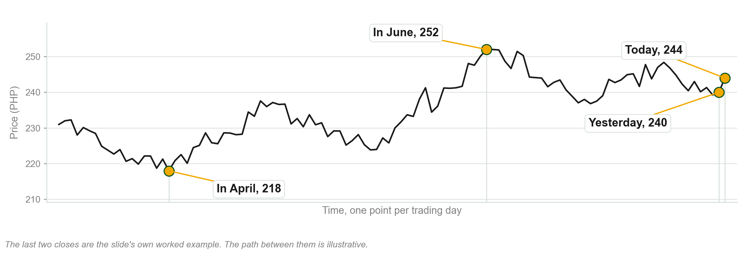
Price is a number that will not sit still
Chart A - FIN1209 teaching chart, drawn for this course. Illustrative data, not a real instrument.
Part 1 of 6 - Why we analyze | 5 of 26

Slide 11
NEW TERM
The buy low, sell high principle
IN PLAIN WORDS
A simple mechanical rule that would guarantee a profit every single time: buy when the price is low and sell when it is higher.
FOR EXAMPLE
Buy at 40 pesos, sell at 52 pesos, keep 12 pesos a share. Nothing clever happened.
THE FORMAL DEFINITION
The buy low, sell high principle is the mechanical rule that profit is realized by acquiring at a lower price and disposing at a higher one.
Part 1 of 6 - Why we analyze | 6 of 26

Slide 12
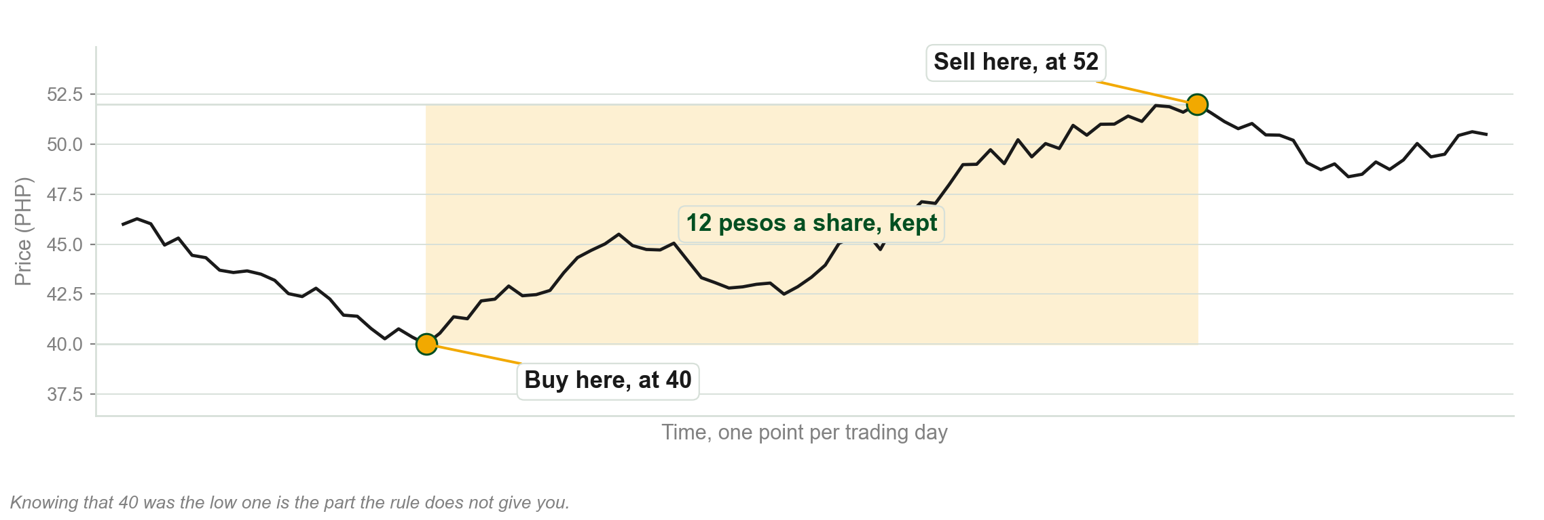
Buy low, sell high, drawn once
Chart B - FIN1209 teaching chart, drawn for this course. Illustrative data, not a real instrument.
Part 1 of 6 - Why we analyze | 7 of 26

Slide 13
The rule is easy. Obeying it is not.
To buy low you must first know that today's price is low.
To sell high you must know that today's price is high.
Both of those are statements about the future, not the present.
This is where chance enters, and this is why the subject exists.
Part 1 of 6 - Why we analyze | 8 of 26

Slide 14
NEW TERM
The price-time chart
IN PLAIN WORDS
A picture with price up the side and time along the bottom. It is how traders keep track of two things at once.
FOR EXAMPLE
Any chart on your trading app. The vertical axis is pesos, the horizontal axis is days.
THE FORMAL DEFINITION
A price-time chart is a two dimensional visualization that plots price on the vertical axis against time on the horizontal axis.
Part 1 of 6 - Why we analyze | 9 of 26

Slide 15
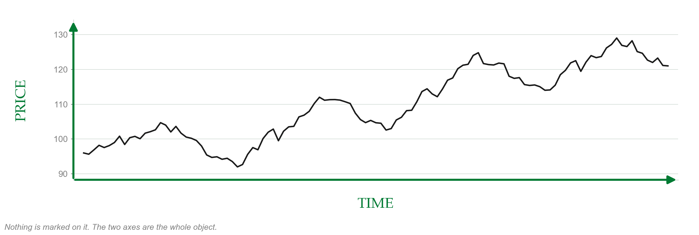
The two axes, drawn
Chart C - FIN1209 teaching chart, drawn for this course. Illustrative data, not a real instrument.
Part 1 of 6 - Why we analyze | 10 of 26

Slide 16
Technical analysis does exactly two jobs
Job one: it identifies and describes what already happened.
Job two: it forecasts what might happen next.
Everything in this course is one of those two jobs.
This is called the dual function of technical analysis.
Part 1 of 6 - Why we analyze | 11 of 26

Slide 17
NEW TERM
Identification
IN PLAIN WORDS
The record keeping job. The chart tells you what the market has already done, with no opinion attached.
FOR EXAMPLE
From a five year chart you can read the highest price ever paid, the calmest month, and the days that gapped.
THE FORMAL DEFINITION
Identification is the descriptive function of technical analysis: it records and describes past and present price and market action.
Part 1 of 6 - Why we analyze | 12 of 26

Slide 18
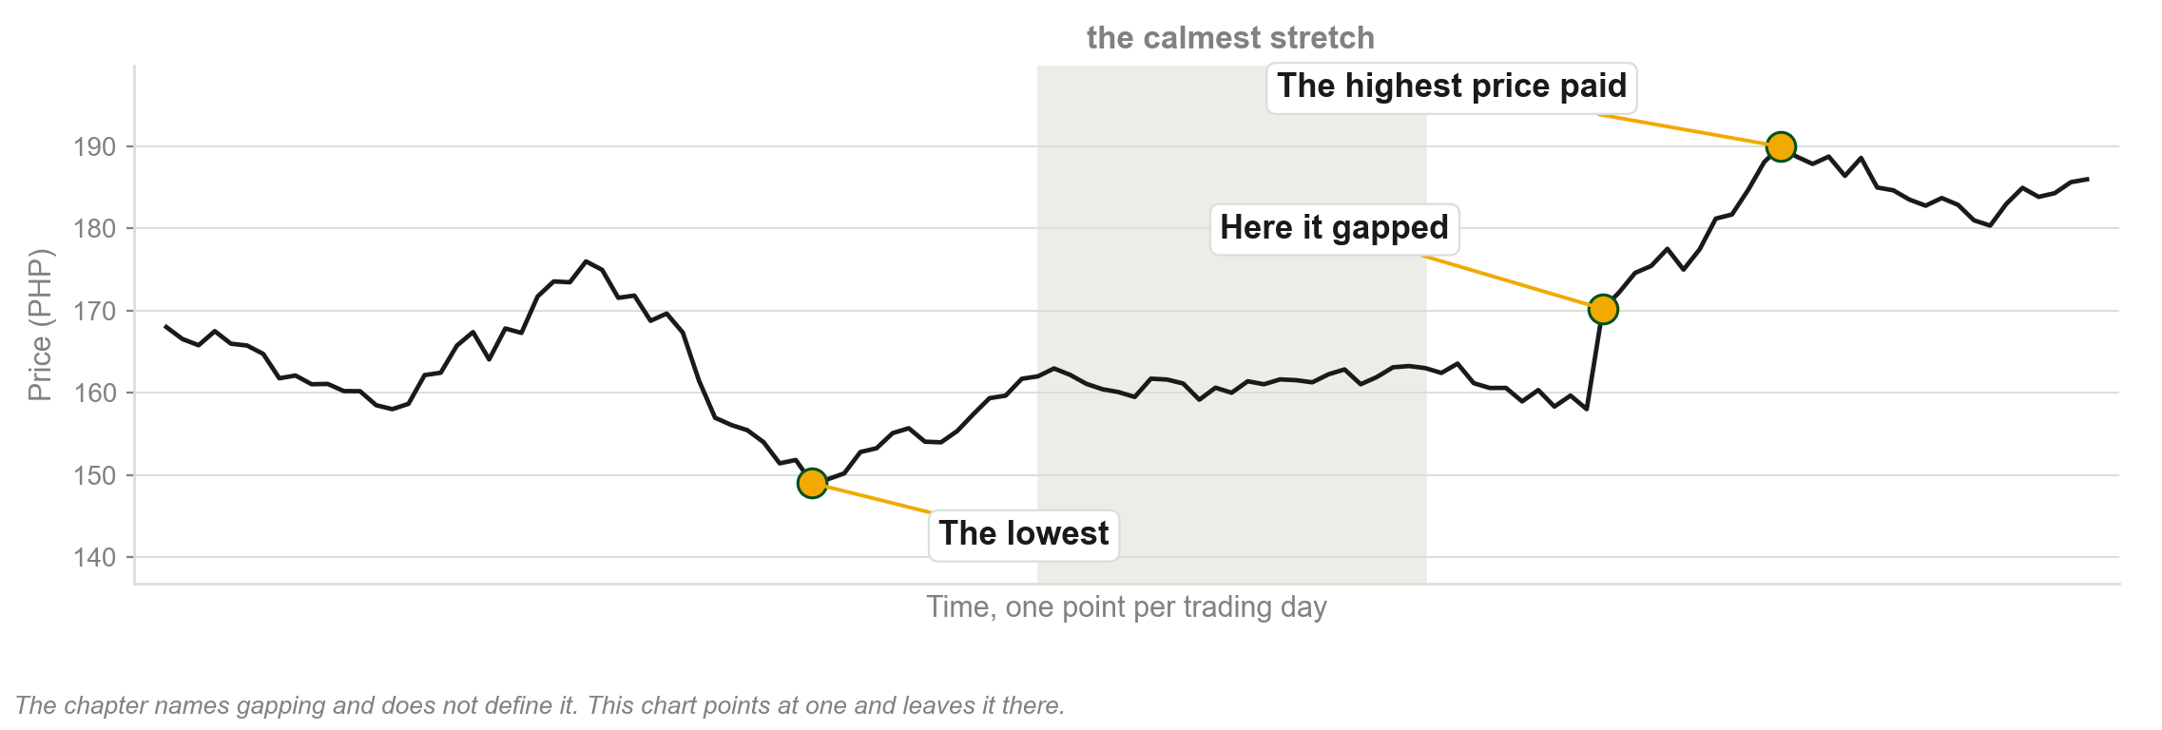
Four facts, and not one of them is an opinion
Chart D - FIN1209 teaching chart, drawn for this course. Illustrative data, not a real instrument.
Part 1 of 6 - Why we analyze | 13 of 26

Slide 19
NEW TERM
Forecasting
IN PLAIN WORDS
The opinion job. You take what the chart recorded and make a claim about what comes next, and the claim worth most is where a new trend begins.
FOR EXAMPLE
Prices bounced off 100 pesos four times, so you expect buyers to show up there again.
THE FORMAL DEFINITION
Forecasting is the inferential function of technical analysis: it interprets identified market action to infer potential future price behavior, especially the start of a new trend.
Part 1 of 6 - Why we analyze | 14 of 26

Slide 20
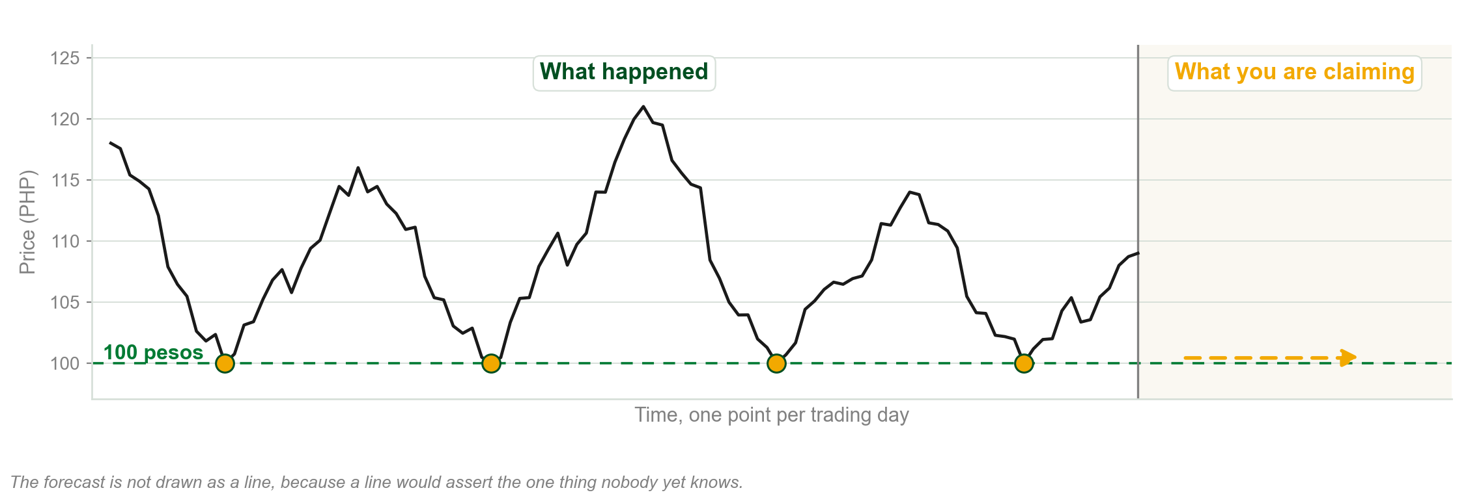
Four bounces are the record. A fifth is the claim.
Chart E - FIN1209 teaching chart, drawn for this course. Illustrative data, not a real instrument.
Part 1 of 6 - Why we analyze | 15 of 26

Slide 21
What identification hands you before you risk a peso
The average size of a normal day's move.
The highest and lowest prices ever paid.
Where the market usually stalls and goes sideways.
How much trading actually happens, and how often price gaps.
This is the homework you do before any trade, and it is free.
Part 1 of 6 - Why we analyze | 16 of 26

Slide 22
NEW TERM
To go long
IN PLAIN WORDS
To buy in order to open a new position. You now own it and you want the price to rise.
FOR EXAMPLE
You buy 1,000 shares of Ayala at 620 pesos. You are long Ayala.
THE FORMAL DEFINITION
To go long means to buy to open a new position.
Part 1 of 6 - Why we analyze | 17 of 26

Slide 23
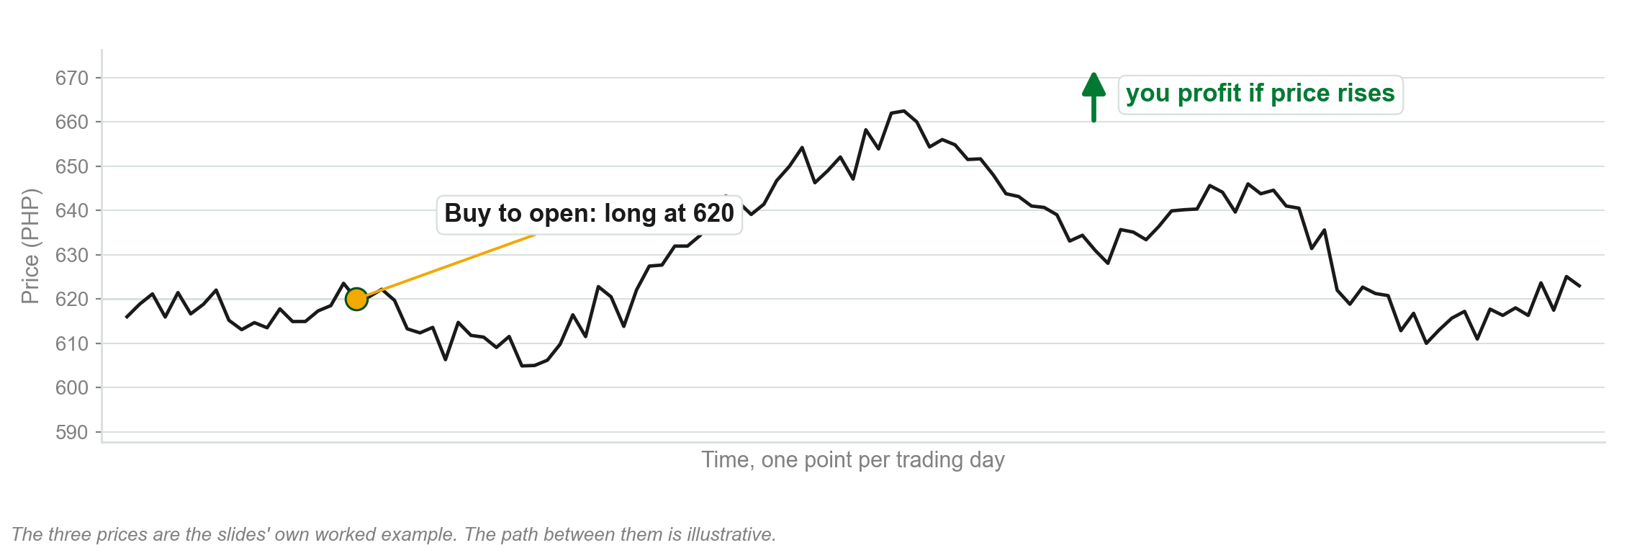
Going long: a buy that opens
Chart F - FIN1209 teaching chart, drawn for this course. Illustrative data, not a real instrument.
Part 1 of 6 - Why we analyze | 18 of 26

Slide 24
NEW TERM
To liquidate
IN PLAIN WORDS
To sell in order to close a position you already held. It is the exit from a long.
FOR EXAMPLE
You sell those 1,000 Ayala shares at 660 pesos. You have liquidated.
THE FORMAL DEFINITION
To liquidate means to sell to close a position previously held.
Part 1 of 6 - Why we analyze | 19 of 26

Slide 25
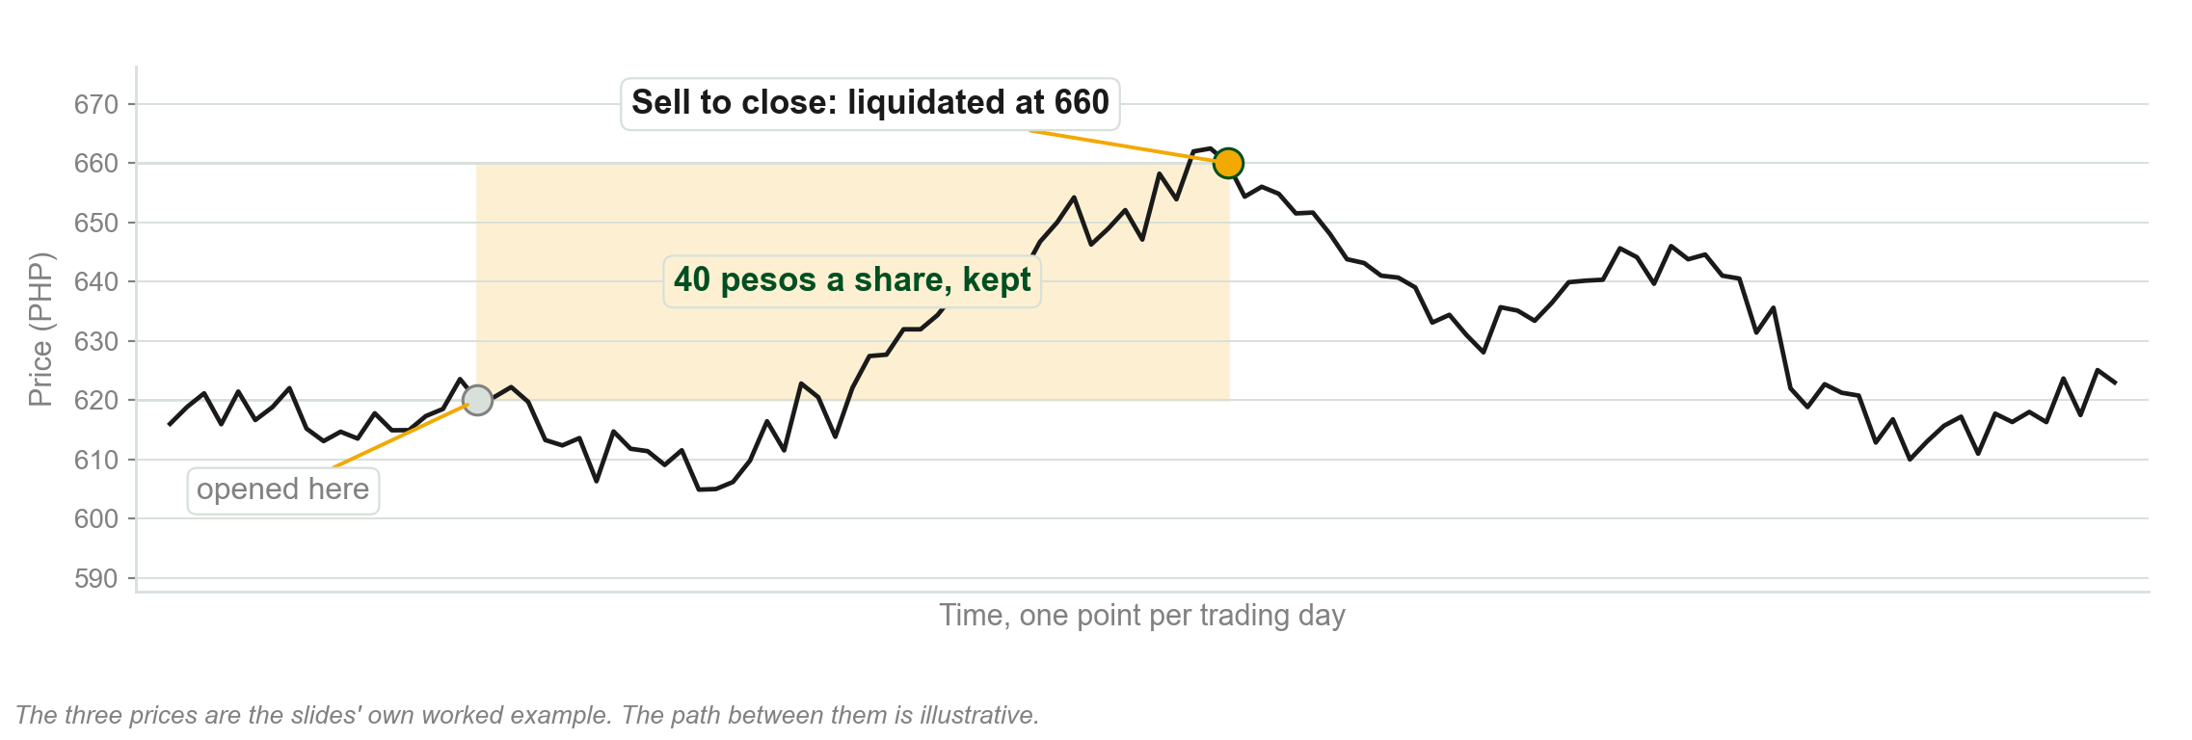
Liquidating: a sell that closes the long
Chart G - FIN1209 teaching chart, drawn for this course. Illustrative data, not a real instrument.
Part 1 of 6 - Why we analyze | 20 of 26

Slide 26
NEW TERM
To go short
IN PLAIN WORDS
To sell in order to open a new position, before you own it. You want the price to fall.
FOR EXAMPLE
You sell 1,000 borrowed shares at 660 pesos hoping to buy them back cheaper.
THE FORMAL DEFINITION
To go short means to sell to open a new position.
Part 1 of 6 - Why we analyze | 21 of 26

Slide 27
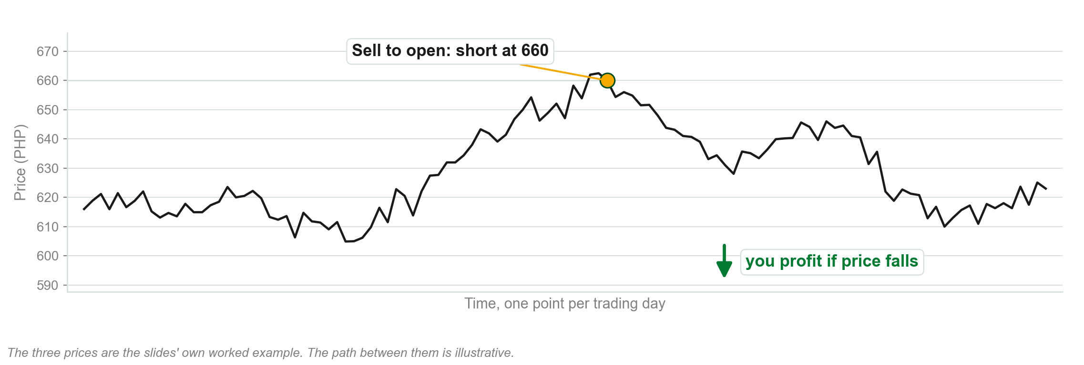
Going short: a sell that opens
Chart H - FIN1209 teaching chart, drawn for this course. Illustrative data, not a real instrument.
Part 1 of 6 - Why we analyze | 22 of 26

Slide 28
NEW TERM
To cover
IN PLAIN WORDS
To buy in order to close a position you had shorted. It is the exit from a short.
FOR EXAMPLE
You buy back those 1,000 shares at 610 pesos and return them. You have covered.
THE FORMAL DEFINITION
To cover means to buy to close a position previously shorted.
Part 1 of 6 - Why we analyze | 23 of 26

Slide 29
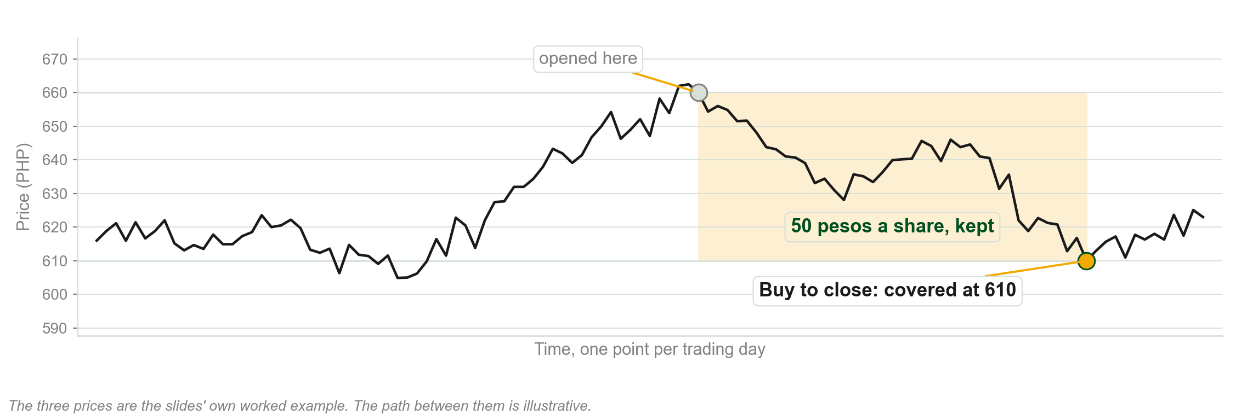
Covering: a buy that closes the short
Chart I - FIN1209 teaching chart, drawn for this course. Illustrative data, not a real instrument.
Part 1 of 6 - Why we analyze | 24 of 26

Slide 30
The four ways a trade actually makes money
1. Long at a low price, liquidate at a higher price.
2. Long at a high price, liquidate at an even higher price.
3. Short at a high price, cover at a lower price.
4. Short at a relatively low price, cover at an even lower price.
Buy low, sell high is only scenario 1. Three other ways exist.
The department's quiz has asked which of these count as buy low, sell high. Read them carefully.
Part 1 of 6 - Why we analyze | 25 of 26

Slide 31
The mechanics of profiting from a change
FIGURE 1.1
The two ways to profit side by side: buy low then sell high, or sell high then buy back low, with the jargon and the demand or supply behind each.
The artwork is copyrighted and is not in the public repository. Build with assets/figures/ present to place it here.
Figure 1.1 - Lim, The Handbook of Technical Analysis (Wiley, 2016)
Part 1 of 6 - Why we analyze | 26 of 26

Slide 32
You now know
▪ The three motivational instincts, and why survival leads
▪ Variable of change
▪ Price
▪ The buy low, sell high principle
▪ The price-time chart
▪ The dual function of technical analysis
▪ Identification
▪ Forecasting
▪ To go long, and to liquidate
▪ To go short, and to cover
▪ The four profitable trade scenarios
Part 1 of 6 - Why we analyze | recap

Slide 33
Part 2 of 6
Three Ways to Forecast a Price
Fundamental analysis, information analysis, and technical analysis.
Six definitions of technical analysis worth memorizing.
What each approach can and cannot tell you about timing.
About 30 minutes

Slide 34
Three approaches, one question
1. Fundamental analysis: what is this thing worth?
2. Information analysis: what does the news say?
3. Technical analysis: what is the market itself doing?
All three are trying to answer the same question: where does price go next?
Part 2 of 6 - Forecasting | 1 of 30

Slide 35
The three approaches on one page
FIGURE 1.2
Fundamental analysis using intrinsic value, technical analysis using price, volume and sentiment, information analysis using public and non-public information.
The artwork is copyrighted and is not in the public repository. Build with assets/figures/ present to place it here.
Figure 1.2 - Lim, The Handbook of Technical Analysis (Wiley, 2016)
Part 2 of 6 - Forecasting | 2 of 30

Slide 36
NEW TERM
Fundamental analysis
IN PLAIN WORDS
Working out what a company is really worth by reading its financial statements, then comparing that to the price.
FOR EXAMPLE
You read San Miguel's annual report, decide the business is worth 130 pesos a share, and see it trading at 98 pesos.
THE FORMAL DEFINITION
Fundamental analysis estimates the value of a security from its financial performance and position, in order to judge whether the current price is justified.
Part 2 of 6 - Forecasting | 3 of 30

Slide 37
NEW TERM
Intrinsic value
IN PLAIN WORDS
What the security is genuinely worth once you account for everything the business owns, owes, and earns.
FOR EXAMPLE
Holdings, debt, earnings, dividends, income, balance sheet activity and cash flow, all reduced to one number per share.
THE FORMAL DEFINITION
Intrinsic value is the worth of a security in light of all its holdings, debt, earnings, dividends, income, balance sheet activity, and cash flow.
Part 2 of 6 - Forecasting | 4 of 30

Slide 38
Undervalued and overvalued
Price below intrinsic value means undervalued. Buyers should appear, creating demand.
Price above intrinsic value means overvalued. Sellers should appear, creating supply.
Undervalued means cheap relative to worth. It does not mean the price will rise today.
The department's quiz has reversed this pair to catch inattentive students.
Part 2 of 6 - Forecasting | 5 of 30

Slide 39
Undervalued: price below intrinsic value
FIGURE 1.3
Intrinsic value of 25 dollars against a current price of 20 dollars, so the stock is underpriced and the expected reaction is potential demand.
The artwork is copyrighted and is not in the public repository. Build with assets/figures/ present to place it here.
Figure 1.3 - Lim, The Handbook of Technical Analysis (Wiley, 2016)
Part 2 of 6 - Forecasting | 6 of 30

Slide 40
Overvalued: price above intrinsic value
FIGURE 1.4
The same diagram inverted: a current price of 25 dollars against intrinsic value of 20 dollars, so the stock is overpriced and the expected reaction is potential supply.
The artwork is copyrighted and is not in the public repository. Build with assets/figures/ present to place it here.
Figure 1.4 - Lim, The Handbook of Technical Analysis (Wiley, 2016)
Part 2 of 6 - Forecasting | 7 of 30

Slide 41
How a fundamentalist turns accounts into a number
Price to earnings, or P/E. Price to earnings growth, or PEG.
Price to book, and price to sales.
Debt to equity, and earnings per share.
Asset pricing models like the capital asset pricing model, or CAPM.
CAPM seeks the best balance between risk and expected returns over a risk free rate.
None of this tells you what to do at 9:31 tomorrow morning.
Part 2 of 6 - Forecasting | 8 of 30

Slide 42
NEW TERM
The top-down approach
IN PLAIN WORDS
Start with the big picture, then narrow down. Pick the strong sector first, then the best company inside it.
FOR EXAMPLE
You decide banking will do well this year, then you compare BDO, BPI and Metrobank.
THE FORMAL DEFINITION
A top-down approach studies broad market factors and sector rotation models in order to select stocks within a strengthening industry or sector.
Part 2 of 6 - Forecasting | 9 of 30

Slide 43
NEW TERM
The bottom-up approach
IN PLAIN WORDS
Start with the company. If the business is excellent, you buy it whatever the sector is doing.
FOR EXAMPLE
You like one shipping firm's balance sheet and buy it even though shipping as a whole is weak.
THE FORMAL DEFINITION
A bottom-up approach relies primarily on a specific company's own fundamental performance rather than on sector or market conditions.
Part 2 of 6 - Forecasting | 10 of 30

Slide 44
Where fundamental analysis runs out of road
Accounts can be dressed up, misreported, or outright falsified.
By the time an audited report is published, the information is already old.
It never gives you a precise price or a precise moment to act.
Fundamental data suits long term investment. It is poor at short term timing.
Part 2 of 6 - Forecasting | 11 of 30

Slide 45
When a policy decision becomes a price level
Interest rate announcements and central bank policy move supply and demand too.
The Swiss National Bank held a ceiling on the franc: EURCHF at or above 1.2000.
That decision created a technical demand for the euro right at 1.2000.
Traders bought each time the rate neared it, with stops a reasonable distance below.
A policy decision, read off a chart as a price level.
The ceiling holds only for as long as the bank defends it.
Part 2 of 6 - Forecasting | 12 of 30

Slide 46
The ceiling, drawn as a line
FIGURE 1.5
A long term EURCHF chart with a horizontal line at 1.2000 labeled the SNB exchange rate ceiling on the CHF, and the shaded period from September 2011 in which price sits above that line.
The artwork is copyrighted and is not in the public repository. Build with assets/figures/ present to place it here.
Figure 1.5 - Lim, The Handbook of Technical Analysis (Wiley, 2016)
Part 2 of 6 - Forecasting | 13 of 30

Slide 47
NEW TERM
Information analysis
IN PLAIN WORDS
Forecasting from what you read: newspapers, bulletins, online reports, company announcements.
FOR EXAMPLE
A quarterly result beats expectations, so you expect the share to open higher tomorrow.
THE FORMAL DEFINITION
Information analysis forms an opinion about potential market action from information gleaned from public sources.
Part 2 of 6 - Forecasting | 14 of 30

Slide 48
Why public information is usually late
Those with non-public material information have already moved the market.
By the time it is public, only an inconsequential amount of the move is left.
Acting on non-public material information is insider trading, and it is illegal.
The technical analyst sees the move on the chart and acts, without waiting for the reason.
In unregulated over the counter markets, brokers front running large client orders is the same problem wearing a different name.
Part 2 of 6 - Forecasting | 15 of 30

Slide 49
NEW TERM
Technical analysis
IN PLAIN WORDS
Reading the market's own behavior, mainly price, volume and open interest, to work out what it is likely to do next.
FOR EXAMPLE
You do not know why the buyers came. You only know they came at 250 pesos, three times.
THE FORMAL DEFINITION
Technical analysis is the identification and forecasting of potential market behavior based largely on the action and dynamics of the market itself.
Part 2 of 6 - Forecasting | 16 of 30

Slide 50
A definition worth writing down
"Technical analysis is the study of market action, primarily through the use of charts, for the purpose of forecasting future price trends."
John Murphy, Technical Analysis of the Financial Markets (NYIF, 1999)
What it tells us
Charting is the main tool, and the target is future price trends.
Part 2 of 6 - Forecasting | 17 of 30

Slide 51
A definition worth writing down
"Technical analysis is the science of recording, usually in graphic form, the actual history of trading ... then deducing from that pictured history the probable future trend."
Edwards and Magee, Technical Analysis of Stock Trends (AMACOM, 2007)
What it tells us
Past information, recorded as a picture, is what the forecast is built from.
Part 2 of 6 - Forecasting | 18 of 30

Slide 52
A definition worth writing down
"It refers to the study of the action of the market itself as opposed to the study of the goods in which the market deals."
Edwards and Magee, Technical Analysis of Stock Trends (AMACOM, 2007)
What it tells us
You study the market, not the product the market trades.
Part 2 of 6 - Forecasting | 19 of 30

Slide 53
A definition worth writing down
"The art of technical analysis, for it is an art, is to identify a trend reversal at a relatively early stage and ride on that trend until the weight of the evidence shows or proves that the trend has reversed."
Martin Pring, Technical Analysis Explained, 4th Edition (McGraw-Hill, 2002)
What it tells us
The goal is to catch a reversal early, and then to stay until the evidence turns.
Part 2 of 6 - Forecasting | 20 of 30

Slide 54
A definition worth writing down
"Technical analysis deals in probabilities, never in certainties."
Martin Pring, Technical Analysis Explained, 4th Edition (McGraw-Hill, 2002)
What it tells us
This is the definition that keeps you solvent. Weigh risk against return, every time.
Part 2 of 6 - Forecasting | 21 of 30

Slide 55
A definition worth writing down
"Technical analysis is based on the assumption that people will continue to make the same mistakes they have made in the past."
Martin Pring, Technical Analysis Explained, 4th Edition (McGraw-Hill, 2002)
What it tells us
This is the behavioral reason the whole subject works at all.
Part 2 of 6 - Forecasting | 22 of 30

Slide 56
A definition worth writing down
"Market price tends to lead the known fundamentals ... Market price acts as a leading indicator of the fundamentals."
John Murphy, Technical Analysis of the Financial Markets (NYIF, 1999)
What it tells us
Price often moves before the news explains why. That is the timing advantage.
Part 2 of 6 - Forecasting | 23 of 30

Slide 57
What technically based timing gives you
Precise entry and exit prices, and the precise time of entry and exit.
Real time bullish and bearish signals, and real time price triggers.
The ability to scale in and out at significant price levels.
Entries and exits timed to volatility behavior and to market order flow.
Notice how many of these contain the word precise.
A precise entry level is not a predicted reversal price. It says where you will act, not where the market will turn.
Part 2 of 6 - Forecasting | 24 of 30

Slide 58
What technically based timing gives you, continued
Exit an extended trend at a technically significant reversal level.
Define risk as a percentage, in terms of real price levels.
Use volume and open interest to gauge the strength of a move.
Use market breadth and sentiment to gauge that strength more broadly.
Forecast peaks and troughs through cycle and seasonality analysis.
Every one of these is a technique we will build over the semester.
Part 2 of 6 - Forecasting | 25 of 30

Slide 59
What fundamentally based timing gives you
Undervalued stocks that could appreciate, with no precise price or time to go long.
Overvalued stocks that could depreciate, with no precise price or time to go short.
Fundamentally strong stocks to rotate into, again with no precise price or time.
Read the ending of all three lines. The gap is always timing.
Part 2 of 6 - Forecasting | 26 of 30

Slide 60
The fundamentalist, in four lines
Mainly concerned with intrinsic value.
Strives to understand the underlying cause of a market move.
Focused on which company to participate in.
Can tell you which company to buy, but not the best moment to start.
Cause, company, value.
Part 2 of 6 - Forecasting | 27 of 30

Slide 61
The technical analyst, in four lines
Mainly concerned with the structure and dynamics of price and market action.
More concerned with the effects of a move than with its cause.
Usually cannot determine intrinsic value or whether a stock is under or overvalued.
Can determine precisely when to start, purely from price performance.
Effect, price, timing.
Neither column is complete on its own. Most professionals use both.
Part 2 of 6 - Forecasting | 28 of 30

Slide 62
The six streams of market action
Price action, and volume action.
Open interest action.
Sentiment, and market breadth.
Flow of funds.
Price is the most important, followed closely by volume.
Flow of funds includes things like margin debt. The department has quizzed exactly that.
Part 2 of 6 - Forecasting | 29 of 30

Slide 63
NEW TERM
OHLC
IN PLAIN WORDS
The four numbers that describe any single bar on a chart: where it opened, its high, its low, and where it closed.
FOR EXAMPLE
A daily bar for Globe: opened 1,800, high 1,845, low 1,792, closed 1,838.
THE FORMAL DEFINITION
OHLC denotes the opening, high, low, and closing prices of a bar over any chosen interval, from one minute to one year.
Part 2 of 6 - Forecasting | 30 of 30

Slide 64
You now know
▪ Fundamental, information and technical analysis
▪ Intrinsic value
▪ Undervalued and overvalued
▪ Top-down and bottom-up approaches
▪ Non-public material information and insider trading
▪ Murphy: study of market action through charts
▪ Edwards and Magee: recording history, deducing the probable trend
▪ Edwards and Magee: the market itself, not the goods
▪ Pring: an art, catching a reversal early
▪ Pring: probabilities, never certainties
▪ Pring: people repeat their mistakes
▪ Murphy: price leads the known fundamentals
▪ Technically and fundamentally based market timing
▪ The fundamentalist and the technical analyst
▪ The six streams of market action, and OHLC
Part 2 of 6 - Forecasting | recap

Slide 65
Part 3 of 6
Classifying Technical Analysis
The four branches every technique in this course belongs to.
The two opposite bets a trader can make about price.
The honest advantages and disadvantages of the whole method.
About 25 minutes

Slide 66
Four branches, one subject
1. Classical technical analysis.
2. Statistical analysis.
3. Sentiment analysis.
4. Behavioral analysis.
Whatever branch you use, you still interpret it through your own biases.
Part 3 of 6 - Classifications | 1 of 19

Slide 67
The four branches on one page
FIGURE 1.6
Classical, statistical, sentiment and behavioral analysis, each with its own list of studies, all funnelling into one line at the bottom.
The artwork is copyrighted and is not in the public repository. Build with assets/figures/ present to place it here.
Figure 1.6 - Lim, The Handbook of Technical Analysis (Wiley, 2016)
Part 3 of 6 - Classifications | 2 of 19

Slide 68
NEW TERM
Classical technical analysis
IN PLAIN WORDS
The traditional, visual, hand-drawn kind. Patterns on charts, and indicators drawn over or under the price.
FOR EXAMPLE
Bar and candlestick patterns, support and resistance, oscillators, market breadth, cycle analysis.
THE FORMAL DEFINITION
Classical technical analysis uses conventional bar, chart and candlestick patterns, oscillator and overlay indicators, market breadth, relative strength, and cycle analysis.
Part 3 of 6 - Classifications | 3 of 19

Slide 69
NEW TERM
Statistical analysis
IN PLAIN WORDS
The mathematical kind. Instead of looking at a shape you compute a number and test it.
FOR EXAMPLE
Volatility, linear regression, correlation, time series analysis, hypothesis testing.
THE FORMAL DEFINITION
Statistical analysis is the quantitative branch, studying dispersion, central tendency, skewness, volatility, regression, hypothesis testing, correlation and covariance.
Part 3 of 6 - Classifications | 4 of 19

Slide 70
NEW TERM
Sentiment analysis
IN PLAIN WORDS
Measuring the mood of the crowd. How optimistic or pessimistic are participants right now?
FOR EXAMPLE
Put to call ratios, short interest, margin debt, bullish percent readings, opinion polls of professionals.
THE FORMAL DEFINITION
Sentiment analysis studies the psychology of market participants through polls and surveys, flow of funds, and the positions taken by large institutions and hedgers.
Part 3 of 6 - Classifications | 5 of 19

Slide 71
NEW TERM
Behavioral analysis
IN PLAIN WORDS
Studying how participants actually react, including their biases and their bad habits.
FOR EXAMPLE
Herd behavior, loss aversion, confirmation bias, overconfidence, the gambler's fallacy.
THE FORMAL DEFINITION
Behavioral analysis studies how market participants react to news, to profits and losses, to the actions of others, and to their own psychological and emotional biases.
Part 3 of 6 - Classifications | 6 of 19

Slide 72
Two opposite bets about price
Bet one: price has gone far enough and will come back.
Bet two: price is going somewhere and will keep going.
Almost every strategy you will ever meet is one of these two.
The technical studies you choose follow directly from which bet you are making.
Part 3 of 6 - Classifications | 7 of 19

Slide 73
Mean reverting against non-mean reverting
FIGURE 1.7
The two camps compared column by column: their study preferences, their order types, where each one enters, and the rationale behind each.
The artwork is copyrighted and is not in the public repository. Build with assets/figures/ present to place it here.
Figure 1.7 - Lim, The Handbook of Technical Analysis (Wiley, 2016)
Part 3 of 6 - Classifications | 8 of 19

Slide 74
NEW TERM
The mean reverting or contrarian approach
IN PLAIN WORDS
You expect price to snap back to an average. You do not expect it to travel far.
FOR EXAMPLE
You buy at support and short at resistance, using divergence, regression lines, moving average bands and Bollinger bands.
THE FORMAL DEFINITION
A mean reverting approach expects price to return to an average or to a balance between supply and demand, enters at cycle extremes, and acts on the overbought and oversold conditions its studies pinpoint.
Part 3 of 6 - Classifications | 9 of 19

Slide 75
NEW TERM
The non-mean reverting or momentum approach
IN PLAIN WORDS
You expect price to keep travelling. Demand creates more demand, supply creates more supply.
FOR EXAMPLE
You buy the breakout of a chart pattern, a moving average, a Darvas Box or a Donchian channel.
THE FORMAL DEFINITION
A non-mean reverting approach expects trends to continue through a positive feedback cycle, enters at cycle midpoints, and acts on the crossover of the oscillator equilibrium level.
Part 3 of 6 - Classifications | 10 of 19

Slide 76
NEW TERM
Limit and stop entry orders
IN PLAIN WORDS
A limit order buys only at your price or better. A stop order buys only once price has pushed through a level.
FOR EXAMPLE
Contrarians prefer limit orders, because they want a good price. Momentum traders prefer stop orders, because they want confirmation.
THE FORMAL DEFINITION
Limit entry orders execute at a specified price or better; stop entry orders trigger once price trades through a specified level.
Part 3 of 6 - Classifications | 11 of 19

Slide 77
What technical analysis is genuinely good at
It works the same way on every market, instrument and timeframe.
You do not need to learn a new company to trade a new stock.
It is visual, so market risk and volatility are easy to see.
One skill, applied everywhere. That is the strongest practical argument for it.
Part 3 of 6 - Classifications | 12 of 19

Slide 78
What technical analysis is genuinely good at, continued
It gives timely, precise entry and exit levels.
Those levels arrive with a signal, bullish or bearish, before the move.
When many participants act on the same obvious level, the reaction is more reliable.
That last advantage has a name, and it is also a criticism. We meet it shortly.
Part 3 of 6 - Classifications | 13 of 19

Slide 79
The honest disadvantages
It is subjective. The same pattern can be read several ways.
The repeating tendency can be disrupted by shocks, or by algorithmic and high frequency trading.
Reading a chart takes practice; inferring from it takes much more.
Every bullish reading has an equal and opposite bearish reading.
Part 3 of 6 - Classifications | 14 of 19

Slide 80
The three big objections
Random walk: prices are pure chance, so patterns mean nothing.
The strong form of the Efficient Market Hypothesis: price already reflects everything.
The self-fulfilling prophecy: signals work only because everyone watches them.
We take the first two apart in Part 5. We take the third apart right now.
Part 3 of 6 - Classifications | 15 of 19

Slide 81
NEW TERM
The self-fulfilling prophecy
IN PLAIN WORDS
The claim that a technical signal works not because it is meaningful, but because enough people act on it at the same moment.
FOR EXAMPLE
A trendline breaks and thousands of traders buy on the break, so price rises, so the trendline looks like it worked.
THE FORMAL DEFINITION
The self-fulfilling prophecy holds that prices react to technical signals because of the concerted action of participants acting on those signals rather than because of the signals themselves.
Part 3 of 6 - Classifications | 16 of 19

Slide 82
The self-fulfilling prophecy cycle, stages one to three
1. A clear and obvious signal attracts participants.
2. Their concerted action creates reliable price reactions.
3. Reliable reactions attract even more participants.
These three stages are the advantage. This is when the signal is worth trading.
Part 3 of 6 - Classifications | 17 of 19

Slide 83
The cycle, stages four to six
4. Participants start to preempt each other for better fills.
5. Reactions drift from expected entry levels and participants abandon the signal.
6. With preempting gone, reliable reactions begin to appear again.
Then the process repeats. The signal is never permanently dead or permanently alive.
Part 3 of 6 - Classifications | 18 of 19

Slide 84
The six stages as one loop
FIGURE 1.8
The self-fulfilling prophecy cycle drawn as a circle, with stages one to three bracketed as advantageous entries and stages four to six as disadvantageous.
The artwork is copyrighted and is not in the public repository. Build with assets/figures/ present to place it here.
Figure 1.8 - Lim, The Handbook of Technical Analysis (Wiley, 2016)
Part 3 of 6 - Classifications | 19 of 19

Slide 85
You now know
▪ Classical technical analysis
▪ Statistical analysis
▪ Sentiment analysis
▪ Behavioral analysis
▪ The mean reverting or contrarian approach
▪ The non-mean reverting or momentum approach
▪ Limit entry orders and stop entry orders
▪ Darvas Box and Donchian channel breakouts
▪ The advantages of technical analysis
▪ The disadvantages of technical analysis
▪ The self-fulfilling prophecy
▪ The six stage prophecy cycle, and preempting
Part 3 of 6 - Classifications | recap

Slide 86
Part 4 of 6
Subjectivity
Which half of technical analysis is objective, and which half is not.
Why two honest analysts read the same chart differently.
How to resolve conflicting signals instead of freezing.
About 35 minutes

Slide 87
Objective and subjective at the same time
The chart is objective. It is a historical record and it does not argue.
The analysis is subjective. It happens inside a human being.
The data is not the problem. The reader is.
Part 4 of 6 - Subjectivity | 1 of 36

Slide 88
Analysis is three separate activities
1. Identifying price and indicator patterns.
2. Interpreting what the data means.
3. Inferring what price might do next.
Subjectivity enters at every one of the three, not just the last.
Part 4 of 6 - Subjectivity | 2 of 36

Slide 89
NEW TERM
Subjectivity
IN PLAIN WORDS
Two competent analysts, given exactly the same chart, can reach different and equally defensible conclusions.
FOR EXAMPLE
One reads an overbought oscillator as a strong trend continuing. Another reads it as a market about to reverse.
THE FORMAL DEFINITION
Subjectivity is the dependence of analysis on behavioral traits, filters and biases unique to each analyst or observer.
Part 4 of 6 - Subjectivity | 3 of 36

Slide 90
The problem is twofold
First: which form of analysis should be applied to this chart at all?
Second: which indicators should be applied to it?
Neither question has a correct answer. Both have consequences.
One plain chart can carry trendlines, moving averages, chart patterns, regression bands, divergence, volatility bands and volume study.
Part 4 of 6 - Subjectivity | 4 of 36

Slide 91
One chart, reading one: nothing on it
FIGURE 1.9
A plain price chart with no analysis drawn on it at all, the raw record before anybody has interpreted it.
The artwork is copyrighted and is not in the public repository. Build with assets/figures/ present to place it here.
Figure 1.9 - Lim, The Handbook of Technical Analysis (Wiley, 2016)
Part 4 of 6 - Subjectivity | 5 of 36

Slide 92
Reading two: trendlines
FIGURE 1.10
The same chart with a short-term downtrend line, a longer-term uptrend line, an uptrend line and a downtrend line drawn across it.
The artwork is copyrighted and is not in the public repository. Build with assets/figures/ present to place it here.
Figure 1.10 - Lim, The Handbook of Technical Analysis (Wiley, 2016)
Part 4 of 6 - Subjectivity | 6 of 36

Slide 93
Reading three: moving averages
FIGURE 1.11
The same chart with a moving average through it, marked where it acts as support with buy points and where it acts as resistance with a short.
The artwork is copyrighted and is not in the public repository. Build with assets/figures/ present to place it here.
Figure 1.11 - Lim, The Handbook of Technical Analysis (Wiley, 2016)
Part 4 of 6 - Subjectivity | 7 of 36

Slide 94
Reading four: chart patterns
FIGURE 1.12
The same chart annotated with an ascending triangle, a head and shoulders, a parabolic move, a symmetrical triangle breakout and a channel retest.
The artwork is copyrighted and is not in the public repository. Build with assets/figures/ present to place it here.
Figure 1.12 - Lim, The Handbook of Technical Analysis (Wiley, 2016)
Part 4 of 6 - Subjectivity | 8 of 36

Slide 95
Reading five: regression and divergence
FIGURE 1.13
The same chart with regression lines showing higher highs in price while the CCI panel below makes lower highs, marked standard bearish divergence.
The artwork is copyrighted and is not in the public repository. Build with assets/figures/ present to place it here.
Figure 1.13 - Lim, The Handbook of Technical Analysis (Wiley, 2016)
Part 4 of 6 - Subjectivity | 9 of 36

Slide 96
Reading six: regression with volume
FIGURE 1.14
The same chart with regression lines and a volume panel underneath, marking a parabolic buying climax with a volume spike at the blow off.
The artwork is copyrighted and is not in the public repository. Build with assets/figures/ present to place it here.
Figure 1.14 - Lim, The Handbook of Technical Analysis (Wiley, 2016)
Part 4 of 6 - Subjectivity | 10 of 36

Slide 97
Reading seven: volatility bands, volume and MACD
FIGURE 1.15
The same chart again with volatility bands, price exceeding the upper band, the volume spike, and MACD at a historically overbought level.
The artwork is copyrighted and is not in the public repository. Build with assets/figures/ present to place it here.
Figure 1.15 - Lim, The Handbook of Technical Analysis (Wiley, 2016)
Part 4 of 6 - Subjectivity | 11 of 36

Slide 98
NEW TERM
Contradictory signals
IN PLAIN WORDS
Two indicators point in opposite directions at the same moment.
FOR EXAMPLE
The MACD says the market is strengthening while the stochastic says it is exhausted.
THE FORMAL DEFINITION
Contradictory signals are indications from two or more studies that are in clear and direct opposition to one another.
Part 4 of 6 - Subjectivity | 12 of 36

Slide 99
NEW TERM
Confirmatory signals
IN PLAIN WORDS
Two indicators agree, so your confidence in the reading goes up.
FOR EXAMPLE
A chart pattern breaks upward and volume expands on the same bar.
THE FORMAL DEFINITION
Confirmatory signals are indications from separate studies that agree with and reinforce the same conclusion.
Part 4 of 6 - Subjectivity | 13 of 36

Slide 100
NEW TERM
Complementary signals
IN PLAIN WORDS
Two signals look contradictory but are actually describing different time horizons, and together they say more than either alone.
FOR EXAMPLE
A 20 period reading says slightly overbought while a 100 period reading says slightly oversold: cheap for the long term, stretched for the short term.
THE FORMAL DEFINITION
Complementary signals are apparently opposing indications that, once their differing time horizons are recognized, combine into a fuller reading of the market.
Part 4 of 6 - Subjectivity | 14 of 36

Slide 101
Why indicators disagree in the first place
The mathematics behind each indicator is different.
Each one tracks a different time horizon.
Data may be missing on one charting platform.
Data quality, accuracy and type vary between platforms.
Two identical indicators on two platforms can honestly disagree.
Tick volume, which counts transactions regardless of size, is one common source of the difference.
Part 4 of 6 - Subjectivity | 15 of 36

Slide 102
Two oscillators, one chart, opposite answers
FIGURE 1.16
A daily Alcoa chart with two oscillators below it: the faster one reads overbought at the same moment the slower one reads oversold.
The artwork is copyrighted and is not in the public repository. Build with assets/figures/ present to place it here.
Figure 1.16 - Lim, The Handbook of Technical Analysis (Wiley, 2016)
Part 4 of 6 - Subjectivity | 16 of 36

Slide 103
Resolving conflicting chart patterns
First, measure the size of each pattern.
The sentiment of the larger formation takes precedence.
Larger patterns speak for the longer term, smaller ones for the short term.
A bullish ascending triangle that contains a bearish head and shoulders stays bullish until the neckline breaks.
This one rule removes a large slice of the subjectivity in reading chart formations.
Part 4 of 6 - Subjectivity | 17 of 36

Slide 104
Conflicting patterns in one formation
FIGURE 1.17
An ascending triangle marked bullish, a symmetrical triangle marked neutral, and a complex head and shoulders marked bearish, all in the same stretch of price.
The artwork is copyrighted and is not in the public repository. Build with assets/figures/ present to place it here.
Figure 1.17 - Lim, The Handbook of Technical Analysis (Wiley, 2016)
Part 4 of 6 - Subjectivity | 18 of 36

Slide 105
Patterns that agree
FIGURE 1.18
A larger descending triangle and a smaller descending triangle, both bearish, over a complex head and shoulders that is also bearish.
The artwork is copyrighted and is not in the public repository. Build with assets/figures/ present to place it here.
Figure 1.18 - Lim, The Handbook of Technical Analysis (Wiley, 2016)
Part 4 of 6 - Subjectivity | 19 of 36

Slide 106
The same fact, read two ways
Oil rises sharply. One analyst calls it bearish: costs go up across the economy.
Another calls it bullish: demand is rising, so the economy is healthy.
Both are reading the identical fact.
For every bullish interpretation there is an equal and opposite bearish one.
Notice that both of those analysts are fundamentalists. Subjectivity is not a technical problem.
Part 4 of 6 - Subjectivity | 20 of 36

Slide 107
NEW TERM
Selective perception
IN PLAIN WORDS
Quietly ignoring the signals that disagree with the view you already hold.
FOR EXAMPLE
You use three oscillators. Two are bullish, one is not, so you decide the third one is unreliable today.
THE FORMAL DEFINITION
Selective perception is the tendency to heed only those signals that support a preconceived view of the market, discarding those that conflict with it.
Part 4 of 6 - Subjectivity | 21 of 36

Slide 108
Selective perception, drawn
FIGURE 1.19
A head and shoulders in price with three oscillators below it. MACD is bullish and is crossed out with the word ignore written across it; RSI and stochastics are bearish.
The artwork is copyrighted and is not in the public repository. Build with assets/figures/ present to place it here.
Figure 1.19 - Lim, The Handbook of Technical Analysis (Wiley, 2016)
Part 4 of 6 - Subjectivity | 22 of 36

Slide 109
Even the entry point is subjective
A trendline break looks like a hard, objective fact.
But you chose which two troughs to connect, and another analyst chose differently.
Each act of identification is objective. The choice between them is not.
Individually objective, collectively subjective.
The same is true of automated trading: the moment a parameter can be adjusted, subjectivity returns.
Part 4 of 6 - Subjectivity | 23 of 36

Slide 110
Which trendline calls the reversal?
FIGURE 1.20
One market top with two different uptrend lines drawn under it, A and B, each penetrated at a different price and a different moment.
The artwork is copyrighted and is not in the public repository. Build with assets/figures/ present to place it here.
Figure 1.20 - Lim, The Handbook of Technical Analysis (Wiley, 2016)
Part 4 of 6 - Subjectivity | 24 of 36

Slide 111
NEW TERM
The price filter
IN PLAIN WORDS
You require price to move a set distance past the level before you accept the breakout.
FOR EXAMPLE
A fixed peso excursion, a percentage of the breakout price, or a multiple of average true range.
THE FORMAL DEFINITION
A price-based filter validates a breakout by requiring a specified absolute, relative, or volatility-scaled price excursion beyond the trigger level.
Part 4 of 6 - Subjectivity | 25 of 36

Slide 112
NEW TERM
The time filter
IN PLAIN WORDS
You require the market to hold beyond the level for a set amount of time before you accept it.
FOR EXAMPLE
Wait for a set number of bars to close beyond the trendline before entering.
THE FORMAL DEFINITION
A time-based filter validates a breakout by requiring the market to sustain the excursion for a specified duration or number of closed bars.
Part 4 of 6 - Subjectivity | 26 of 36

Slide 113
NEW TERM
The algorithmic filter
IN PLAIN WORDS
You require a specific sequence of events, not just a distance or a delay.
FOR EXAMPLE
A particular sequence of closed bars, or a sequence of new peaks or troughs, or a retest of the barrier after the break.
THE FORMAL DEFINITION
An algorithmic filter validates a breakout by requiring a defined sequence of price events, such as bar sequences, successive peaks or troughs, or a barrier retest.
Part 4 of 6 - Subjectivity | 27 of 36

Slide 114
The three filter families beside the trade
FIGURE 1.21
A trendline penetration on the left with a question mark on the entry, and on the right the full list: price-based, time-based and event-based filters.
The artwork is copyrighted and is not in the public repository. Build with assets/figures/ present to place it here.
Figure 1.21 - Lim, The Handbook of Technical Analysis (Wiley, 2016)
Part 4 of 6 - Subjectivity | 28 of 36

Slide 115
An exercise: read the chart yourself
1. You get a plain four hourly chart of USDCAD with nothing drawn on it.
2. Draw the trendlines you think mark the trend changes.
3. Compare with the person beside you, then compare with the book.
No marks and no right answer. The differences are the lesson.
This is the book's own exercise, on printed pages 27 to 29. You can run it again at home.
Part 4 of 6 - Subjectivity | 29 of 36

Slide 116
The chart. Draw your trendlines now.
FIGURE 1.22
A plain four hourly bar chart of USDCAD with no lines, no indicators and no annotations, captioned a basic bar chart and asking what the technical analyst can see.
The artwork is copyrighted and is not in the public repository. Build with assets/figures/ present to place it here.
Figure 1.22 - Lim, The Handbook of Technical Analysis (Wiley, 2016)
Part 4 of 6 - Subjectivity | 30 of 36

Slide 117
Now compare with the person beside you
Put the two charts side by side.
Find one trendline you both drew, and one that only one of you drew.
Neither of you has made a mistake.
Two honest analysts, one chart, two readings. You have just produced the argument of this part.
Part 4 of 6 - Subjectivity | 31 of 36

Slide 118
Now compare with the book
FIGURE 1.23
The same four hourly USDCAD chart carrying the book's own trendline analysis: a rising line under the first advance, a falling line from the high, a second rising line, and a final falling line down the right hand side.
The artwork is copyrighted and is not in the public repository. Build with assets/figures/ present to place it here.
Figure 1.23 - Lim, The Handbook of Technical Analysis (Wiley, 2016)
Part 4 of 6 - Subjectivity | 32 of 36

Slide 119
Second pass: find the chart patterns
Go back to your own chart, the one with no lines on it.
Mark any chart pattern you can name.
If you cannot name any yet, that is expected. We learn them properly later in the course.
Two minutes, then we compare again.
Part 4 of 6 - Subjectivity | 33 of 36

Slide 120
The book's patterns, for comparison
FIGURE 1.24
The same USDCAD chart with six named formations marked: an expanding triangle for uncertainty, a bearish rising wedge, two bearish downtrending channels, a bullish inverted head and shoulders, and a bearish symmetrical triangle at a resistance zone.
The artwork is copyrighted and is not in the public repository. Build with assets/figures/ present to place it here.
Figure 1.24 - Lim, The Handbook of Technical Analysis (Wiley, 2016)
Part 4 of 6 - Subjectivity | 34 of 36

Slide 121
Were there differences? Good.
The book's own answer is that differences here are not errors.
They are merely a consequence of subjectivity.
The fact that you can draw alternate trendlines at all is where subjectivity enters.
You have just watched identification, interpretation and inference happen to one chart, twice.
Homework 1 is this exercise on a live platform: find charts showing different trends, draw the trendlines, interpret them.
Part 4 of 6 - Subjectivity | 35 of 36

Slide 122
Subjectivity shrinks with practice
A novice cannot see the trendlines, the patterns or the angles at first.
With enough chart hours, the same formations become obvious.
The subjectivity never reaches zero, but it falls a long way.
Nothing on this slide can be achieved by reading. Only by looking at charts.
Run the exercise again in a month. Your lines will change. The chart will not.
Part 4 of 6 - Subjectivity | 36 of 36

Slide 123
You now know
▪ Objective chart, subjective analysis
▪ Identifying, interpreting, inferring
▪ Subjectivity in the choice of analysis and studies
▪ Contradictory signals
▪ Confirmatory signals
▪ Complementary signals
▪ Why indicators disagree, and tick volume
▪ The larger formation takes precedence
▪ Equal and opposite interpretations
▪ Selective perception
▪ Individually objective, collectively subjective
▪ Price, time and algorithmic filters
▪ Your own trendlines, against a classmate's and against the book's
Part 4 of 6 - Subjectivity | recap

Slide 124
Part 5 of 6
The Assumptions Underneath Everything
The three assumptions that make technical analysis possible.
Market discounting, the Efficient Market Hypothesis, and random walk.
The four assumptions you apply at the chart.
About 30 minutes

Slide 125
Three assumptions hold the subject up
1. The market discounts everything.
2. Market behavior tends to repeat itself.
3. The market tends to move in trends.
Remove any one of these and technical analysis stops making sense.
Part 5 of 6 - Assumptions | 1 of 33

Slide 126
NEW TERM
Market discounting
IN PLAIN WORDS
The price you see already contains everything the market knows and expects. You do not need to hunt for the reason.
FOR EXAMPLE
A share drifts up for two weeks before good news is announced. The market was already discounting it.
THE FORMAL DEFINITION
Market discounting is the assumption that market action, including price action, reflects all known information in the markets.
Part 5 of 6 - Assumptions | 2 of 33

Slide 127
What the market can and cannot discount
It CAN discount known information.
It CAN discount expectations about known information.
It CAN discount expectations about potential events.
It CANNOT discount unexpected events.
It CANNOT discount unknown information.
Insider activity counts as known information, because the insider's buying moves the price.
Part 5 of 6 - Assumptions | 3 of 33

Slide 128
What the market is really discounting
Information about actual events.
Expectation about actual events.
Information about expected events.
Expectation about expected events.
Expectation about the possibility of unexpected events.
Not the news alone, but what everyone expects about it.
This is why a company can beat expectations and still fall. The good result was already priced.
Part 5 of 6 - Assumptions | 4 of 33

Slide 129
A semi-efficient market absorbing news
FIGURE 1.28
Three data releases on a price and time axis, with dashed curves showing price adjusting gradually rather than instantly at each one.
The artwork is copyrighted and is not in the public repository. Build with assets/figures/ present to place it here.
Figure 1.28 - Lim, The Handbook of Technical Analysis (Wiley, 2016)
Part 5 of 6 - Assumptions | 5 of 33

Slide 130
The same thing, on a real chart
FIGURE 1.29
A EURUSD chart around the non-farm payrolls release of 2 August 2013, annotated with the range before the data, the breakout, the traders buying the news and the early traders exiting into it.
The artwork is copyrighted and is not in the public repository. Build with assets/figures/ present to place it here.
Figure 1.29 - Lim, The Handbook of Technical Analysis (Wiley, 2016)
Part 5 of 6 - Assumptions | 6 of 33

Slide 131
NEW TERM
The Efficient Market Hypothesis
IN PLAIN WORDS
A rival theory saying the market prices everything so perfectly and so fast that no analysis can beat it.
FOR EXAMPLE
If EMH held completely, reading a chart or an annual report would both be a waste of an afternoon.
THE FORMAL DEFINITION
The Efficient Market Hypothesis states that for a market to efficiently discount and reflect all information perfectly, all participants must act on all information in the same rational manner instantaneously.
Part 5 of 6 - Assumptions | 7 of 33

Slide 132
Efficient, under EMH, means two things
1. Participants react instantaneously to all market information.
2. Participants react rationally to all market information.
Both conditions must hold. Failing either one is enough to break the hypothesis.
Technical analysis needs neither condition. It only assumes the market discounts what becomes known to it.
Part 5 of 6 - Assumptions | 8 of 33

Slide 133
What a perfectly efficient market would look like
FIGURE 1.27
The same three data releases, but price jumps vertically at each one with the time taken to adjust marked as zero.
The artwork is copyrighted and is not in the public repository. Build with assets/figures/ present to place it here.
Figure 1.27 - Lim, The Handbook of Technical Analysis (Wiley, 2016)
Part 5 of 6 - Assumptions | 9 of 33

Slide 134
Why perfect efficiency cannot happen
Not everyone reacts the same way. Some trade against the news.
Not everyone reacts at the same time. Some act early, some act late.
Not everyone can access the information, and information is never free.
Ask a hundred people to clap the instant a bell rings. You will not get one sound.
Part 5 of 6 - Assumptions | 10 of 33

Slide 135
NEW TERM
The semi-efficient market
IN PLAIN WORDS
The realistic middle ground. The market does absorb new information, just gradually and imperfectly.
FOR EXAMPLE
After a jobs report, price swings back and forth for an hour as traders compete for fills, then settles.
THE FORMAL DEFINITION
A semi-efficient market discounts new information at a slower rate, adjusting gradually as participants compete with one another for the best fills.
Part 5 of 6 - Assumptions | 11 of 33

Slide 136
NEW TERM
The weak form of EMH
IN PLAIN WORDS
Current prices already reflect all past price information, so past prices cannot help you.
FOR EXAMPLE
If it were true, no chart pattern, trendline or moving average could ever have value.
THE FORMAL DEFINITION
The weak form of EMH suggests that all current prices have already fully discounted all past price information and therefore cannot impact future prices.
Part 5 of 6 - Assumptions | 12 of 33

Slide 137
NEW TERM
The semi-strong form of EMH
IN PLAIN WORDS
Once information is public it is already in the price, so public information is useless too.
FOR EXAMPLE
Reading the annual report the day it is published gains you nothing.
THE FORMAL DEFINITION
The semi-strong form of EMH suggests that all information, once public, is already reflected in price, making its use unprofitable and pointless.
Part 5 of 6 - Assumptions | 13 of 33

Slide 138
NEW TERM
The strong form of EMH
IN PLAIN WORDS
Everything is in the price, public or private. Nothing anyone knows can help.
FOR EXAMPLE
Even an insider with genuinely secret information could not profit from it.
THE FORMAL DEFINITION
The strong form of EMH suggests that all information, whether public or private, is already fully reflected in current price, so all forms of analysis and forecasting are pointless.
Part 5 of 6 - Assumptions | 14 of 33

Slide 139
NEW TERM
Random walk
IN PLAIN WORDS
The claim that prices move purely by chance, so nothing that happened before tells you anything. Its second half, that current price has no influence over future price, is the Markovian condition.
FOR EXAMPLE
Flipping a coin every minute and plotting the running total. It will look like a chart, and it will mean nothing.
THE FORMAL DEFINITION
Random walk suggests that prices move in a purely random manner, that past prices do not influence current price, and that current price does not influence future price.
Part 5 of 6 - Assumptions | 15 of 33

Slide 140
Random walk, EMH, and what they would imply
FIGURE 1.30
Random walk feeding into the three forms of EMH, and both feeding a box listing the consequences: no technical, fundamental or behavioral analysis, no active investing, nobody beats the market.
The artwork is copyrighted and is not in the public repository. Build with assets/figures/ present to place it here.
Figure 1.30 - Lim, The Handbook of Technical Analysis (Wiley, 2016)
Part 5 of 6 - Assumptions | 16 of 33

Slide 141
Random walk is not the same as EMH
Under EMH, prices do adjust, they just adjust instantly to new information.
Under random walk, prices do not adjust to anything. The motion is purely random.
Markets are driven by perception and expectation, not by random acts of buying and selling.
Watch how precisely price reacts at a round number or an old high. Chance does not aim.
Part 5 of 6 - Assumptions | 17 of 33

Slide 142
What actually happens in the real world
Insiders accumulate before the announcement, so price starts moving early.
The public joins after the news is published.
More participants join the now obvious move, and the market overreacts.
The insiders sell into that enthusiasm, and a top forms.
This is herding, and it is the survival instinct from Part 1 doing its work.
Part 5 of 6 - Assumptions | 18 of 33

Slide 143
Insider activity moving price before the news
FIGURE 1.31
Accumulation curving up ahead of each bullish release and distribution curving down ahead of the bearish one, in every case before the announcement.
The artwork is copyrighted and is not in the public repository. Build with assets/figures/ present to place it here.
Figure 1.31 - Lim, The Handbook of Technical Analysis (Wiley, 2016)
Part 5 of 6 - Assumptions | 19 of 33

Slide 144
Market inertia, and the overreaction
FIGURE 1.32
The same releases again, with herd behavior carrying price past the level it should have settled at, then inefficient discounting pulling it back.
The artwork is copyrighted and is not in the public repository. Build with assets/figures/ present to place it here.
Figure 1.32 - Lim, The Handbook of Technical Analysis (Wiley, 2016)
Part 5 of 6 - Assumptions | 20 of 33

Slide 145
Price is not the same as value
A stock valued at 10 pesos can trade at 30 pesos with no change in its fundamentals.
What is being traded is expectation, not absolute worth.
Current price is the result of expectations about future price and value.
Market action is the collective expectation of all its participants.
Part 5 of 6 - Assumptions | 21 of 33

Slide 146
Assumption two: behavior repeats
Past price and chart patterns give a reasonable basis for forecasting.
The reason is human psychology, which changes very slowly.
Fear, greed, hope, anger and regret do not get software updates.
Patterns repeat because people repeat.
Every other forecasting method also uses past data: accounting, regression, behavioral finance.
Part 5 of 6 - Assumptions | 22 of 33

Slide 147
Repetition you can see: angular symmetries
FIGURE 1.25
A four-hourly USDCAD bar chart with a shallow angle of ascent and a steeper one marked, and the correction that followed each.
The artwork is copyrighted and is not in the public repository. Build with assets/figures/ present to place it here.
Figure 1.25 - Lim, The Handbook of Technical Analysis (Wiley, 2016)
Part 5 of 6 - Assumptions | 23 of 33

Slide 148
The underlying ordered structure of price
FIGURE 1.26
The same USDCAD chart overlaid with a converging channel and a lattice of symmetry lines, labeled visual evidence of the semi-random nature of price behavior.
The artwork is copyrighted and is not in the public repository. Build with assets/figures/ present to place it here.
Figure 1.26 - Lim, The Handbook of Technical Analysis (Wiley, 2016)
Part 5 of 6 - Assumptions | 24 of 33

Slide 149
Three things that erode repeatability
Preempting: traders outbid each other ahead of the trigger, from the self-fulfilling prophecy.
Program trading: machines trade in ways humans cannot replicate.
New participants: each new cohort brings a slightly different approach.
The assumption is reasonable, not guaranteed. That is why Pring said probabilities.
Part 5 of 6 - Assumptions | 25 of 33

Slide 150
Assumption three: the market moves in trends
Trends give the largest profit over the shortest time in the market.
That is why trend based methods dominate the field.
But what exactly is a trend, and when does it stop being one?
Successively higher or lower peaks and troughs is the most widely accepted definition.
A trend on one timeframe can be a sideways market on another. Chapter 5 settles the definitions.
Part 5 of 6 - Assumptions | 26 of 33

Slide 151
Trend following is not free
Poor performance in ranging markets, and whipsaws during consolidation.
Low winning percentages, which means large drawdowns.
Trend changes are hard to identify early, and fast markets produce slippage.
Too many trend systems chasing the same move produce inefficient fills.
Every method in this course has a cost. Know the cost before you use the method.
Part 5 of 6 - Assumptions | 27 of 33

Slide 152
Four assumptions you apply at the chart
1. Price behavior persists until there is evidence to the contrary.
2. Every bullish reading has an equal and opposite bearish reading.
3. Extreme bullishness is potentially bearish, and the reverse.
4. A technical tool matters only because participants say it does.
These four are applied assumptions. They govern what you do, not what you believe.
Part 5 of 6 - Assumptions | 28 of 33

Slide 153
NEW TERM
Applied assumption one: persistence
IN PLAIN WORDS
Whatever the market is currently doing, assume it keeps doing it until something proves otherwise.
FOR EXAMPLE
A trend is assumed to continue, a consolidation is assumed to keep ranging, a cycle is assumed to hold until it clearly fails.
THE FORMAL DEFINITION
Price behavior is expected to persist until there is evidence to the contrary. Persistence is the assumed status quo.
Part 5 of 6 - Assumptions | 29 of 33

Slide 154
NEW TERM
Applied assumption two: equal and opposite
IN PLAIN WORDS
Any signal you can read as bullish, someone competent can read as bearish, from the same data.
FOR EXAMPLE
Rising oil prices as evidence of a recovering economy, or as evidence of rising costs.
THE FORMAL DEFINITION
For every bullish indication or interpretation, there exists an equal and opposite bearish indication or interpretation for the same price behavior.
Part 5 of 6 - Assumptions | 30 of 33

Slide 155
NEW TERM
Applied assumption three: extremes invert
IN PLAIN WORDS
A reading that is extremely bullish is also a warning, because the market may be exhausted.
FOR EXAMPLE
A stochastic reading of 100 percent is explicitly bullish and implicitly bearish at the same time.
THE FORMAL DEFINITION
Extreme bullishness is potentially bearish, and extreme bearishness is potentially bullish, because extremes indicate overextension or exhaustion.
Part 5 of 6 - Assumptions | 31 of 33

Slide 156
NEW TERM
Applied assumption four: significance is attributed
IN PLAIN WORDS
An indicator has no power of its own. It has exactly as much power as the number of people acting on it.
FOR EXAMPLE
A famous trendline produces a big penetration bar because it is famous, not because the line is magic.
THE FORMAL DEFINITION
A technical tool or indicator has no real significance except that attributed to it by market participants.
Part 5 of 6 - Assumptions | 32 of 33

Slide 157
Where technical analysis works best
On long timeframes, fundamental analysis carries a lot of the forecasting load.
On very short timeframes, fundamental analysis is nearly useless.
The smaller your stop, the more the forecast depends on technical work.
This is why technical analysis is generally more reliable at lower timeframes.
Part 5 of 6 - Assumptions | 33 of 33

Slide 158
You now know
▪ Market discounting, and what it cannot discount
▪ What markets are really discounting
▪ The Efficient Market Hypothesis
▪ Instantaneous and rational reaction
▪ The semi-efficient market
▪ The weak, semi-strong and strong forms
▪ Random walk and the Markovian condition
▪ Real world discounting, insiders and overreaction
▪ Price versus value, and expected value
▪ Behavior repeats, and what erodes it
▪ The market moves in trends, and what that costs
▪ The four assumptions in application
Part 5 of 6 - Assumptions | recap

Slide 159
Part 6 of 6
Who Is In The Market
The eight categories of market participant.
Two other ways to sort them: by time, and by method.
The main markets, and the instruments derived from them.
About 25 minutes

Slide 160
The cast of a market
Average investors and traders. Financial institutions.
Commercial banks and central banks. Hedgers and arbitrageurs.
Brokers, hedge funds, mutual funds and pension funds.
Every price you see is one of these people disagreeing with another one.
Part 6 of 6 - Participants | 1 of 14

Slide 161
NEW TERM
Retail and institutional participants
IN PLAIN WORDS
Retail means individuals trading their own money. Institutional means organizations trading other people's money at scale.
FOR EXAMPLE
You with a 20,000 peso account are retail. A pension fund moving 200 million pesos is institutional.
THE FORMAL DEFINITION
Retail participants trade their own capital in comparatively small size; institutional participants deploy pooled or corporate capital in size sufficient to move markets.
Part 6 of 6 - Participants | 2 of 14

Slide 162
NEW TERM
Speculators and investors
IN PLAIN WORDS
A speculator is paid for taking on price risk over a shorter horizon. An investor holds for the longer term return.
FOR EXAMPLE
A speculator buys expecting a move this month. An investor buys expecting dividends and growth for a decade.
THE FORMAL DEFINITION
Speculators assume price risk in pursuit of gain from price movement; investors commit capital for longer term return from the asset itself.
Part 6 of 6 - Participants | 3 of 14

Slide 163
NEW TERM
Supply side and demand side
IN PLAIN WORDS
The book lists both of these among its eight categories of market participant, and then defines neither of them anywhere in the book.
FOR EXAMPLE
Aside, not examinable. Two readings circulate outside the text. One makes the supply side the providers of the market service, brokers, exchanges, market makers and data vendors, and the demand side the funds and traders who use them. The other makes the supply side producers hedging their output and the demand side consumers hedging their input.
Part 6 of 6 - Participants | 4 of 14

Slide 164
NEW TERM
Professionals and novices
IN PLAIN WORDS
A professional does this for a living, with a process. A novice is still building one.
FOR EXAMPLE
Everyone in this room is a novice today. That is the correct and useful answer.
THE FORMAL DEFINITION
Professionals participate as an occupation, with defined process and risk control; novices participate without established process or experience.
Part 6 of 6 - Participants | 5 of 14

Slide 165
NEW TERM
Discretionary and nondiscretionary traders
IN PLAIN WORDS
A discretionary trader decides each trade themselves. A nondiscretionary trader follows a fixed system without overriding it.
FOR EXAMPLE
Reading the chart and deciding is discretionary. Letting a coded rule fire the order is nondiscretionary.
THE FORMAL DEFINITION
Discretionary traders exercise judgement on each decision; nondiscretionary traders execute a predefined rule set without discretionary intervention.
Part 6 of 6 - Participants | 6 of 14

Slide 166
Sorted by time spent in the market
Scalpers: in and out within seconds or minutes.
Day traders: every trade closed within the same trading day.
Swing traders: technical reversals lasting a few days to a week.
Position traders: a few months up to a year.
Investors: buy and hold.
Same market, five completely different jobs.
Part 6 of 6 - Participants | 7 of 14

Slide 167
Participants by time in the market
FIGURE 1.33
Scalpers, day traders, swing traders, position traders and investors laid out left to right, from seconds at one end to buy and hold at the other.
The artwork is copyrighted and is not in the public repository. Build with assets/figures/ present to place it here.
Figure 1.33 - Lim, The Handbook of Technical Analysis (Wiley, 2016)
Part 6 of 6 - Participants | 8 of 14

Slide 168
Sorted by method
Scalpers: very rapid long and short trades, buying the bid and selling the ask.
Trend traders: catching trends and trailing the position.
Reversal traders: catching key levels, often through mean reversion.
Scale traders: averaging against price until it turns.
Investors: buy and hold.
The same two bets from Part 3, wearing different clothes.
Scale trading is the highest risk method on this list. Averaging into a loss is how accounts end.
Part 6 of 6 - Participants | 9 of 14

Slide 169
Participants by trading methodology
FIGURE 1.34
The same five columns re-sorted by method: scalpers, trend traders, reversal traders, scale traders and investors, each with what it is attempting to do.
The artwork is copyrighted and is not in the public repository. Build with assets/figures/ present to place it here.
Figure 1.34 - Lim, The Handbook of Technical Analysis (Wiley, 2016)
Part 6 of 6 - Participants | 10 of 14

Slide 170
The main markets
Stocks. Fixed income.
Foreign exchange. Commodities.
Real estate.
These are the underlying markets. Everything else is built on top of them.
Part 6 of 6 - Participants | 11 of 14

Slide 171
The markets, and the instruments built on them
FIGURE 1.35
Five underlying markets on the right, stocks through real estate, and five derivative instruments on the left, options through exchange traded funds.
The artwork is copyrighted and is not in the public repository. Build with assets/figures/ present to place it here.
Figure 1.35 - Lim, The Handbook of Technical Analysis (Wiley, 2016)
Part 6 of 6 - Participants | 12 of 14

Slide 172
NEW TERM
Derivative
IN PLAIN WORDS
An instrument whose value comes from something else. You get exposure to the thing without owning the thing.
FOR EXAMPLE
Options, futures, contracts for difference, spread betting, and exchange traded funds.
THE FORMAL DEFINITION
A derivative is an instrument that provides access to an underlying market, deriving its value from that underlying.
Part 6 of 6 - Participants | 13 of 14

Slide 173
Five ways to own gold
Buy physical gold. That is the main market.
Buy or sell a gold futures contract. Derivative.
Buy or sell a gold options contract. Derivative.
Buy shares in a gold backed exchange traded fund. Derivative.
Trade gold through a contract for difference. Derivative.
One underlying, five different instruments, five different risk profiles.
Part 6 of 6 - Participants | 14 of 14

Slide 174
You now know
▪ The eight categories of market participant
▪ Retail and institutional
▪ Speculator and investor
▪ Supply side and demand side
▪ Professional and novice
▪ Discretionary and nondiscretionary traders
▪ Sorted by time: scalper to investor
▪ Sorted by method: scalper to investor
▪ The five main markets
▪ Derivatives and the five instruments
▪ Five ways to participate in gold
Part 6 of 6 - Participants | recap

Slide 175
Chapter 1 in five sentences
Technical analysis is the study of market action.
It identifies what has happened, and it forecasts what might.
It rests on discounting, repetition, and trends.
It is subjective, and so is every other kind of analysis.
It deals in probabilities, never in certainties.
If you remember the last line, you will make fewer expensive mistakes than most people.
Chapter 1 - Wrap up

Slide 176
The review questions to prepare
What is a good definition of technical analysis?
List as many advantages and disadvantages of technical analysis as you can.
What are the challenges to technical analysis?
How does market discounting differ from EMH, and what are its three levels?
How are conflicting signals resolved, and why is a trend change subjective?
Is random walk a true reflection of the markets?
All eight of the book's review questions, answered today.
Chapter 1 - Wrap up

Slide 177
Next: Dow Theory
Chapter 2 gives us the six tenets that modern technical analysis is built on.
Bring the four trading verbs and the three assumptions with you. You will need them.
Before then: open any chart, draw your trendlines, and compare with a classmate.
FIN1209 Technical Analysis in Investment | Institute of Accounts, Business and Finance

