Slide 1
FIN1209 Technical Analysis in Investment
Chapter 4
Market Phase Analysis
Institute of Accounts, Business and Finance | Far Eastern University Manila
Benjamin C. Sotelo

Slide 2
What you will be able to do
Understand the structural and functional characteristics of the three market phases.
Forecast market phase accurately via its behavioral and cyclical properties.
Identify potential market regime changes via volume action.
Describe the inertial and momentum characteristics for each market phase.
Identify specific price pattern formations associated with each phase.
Compare and contrast Eastern and Western approaches to interpreting market phases.
Chapter 4 - Opening

Slide 3
How this chapter is laid out
4.1 Dow: the phases, who is on each side, and when a consolidation is over.
4.2 Chart patterns: which pattern belongs to which phase, and why.
4.3 to 4.6 Volume, moving averages, divergence and sentiment.
4.7 Sakata: the Japanese five phase model.
4.8 and 4.9 Elliott waves and cycles.
One question runs through all nine: which phase is the market in?
Chapter 4 - Opening

Slide 4
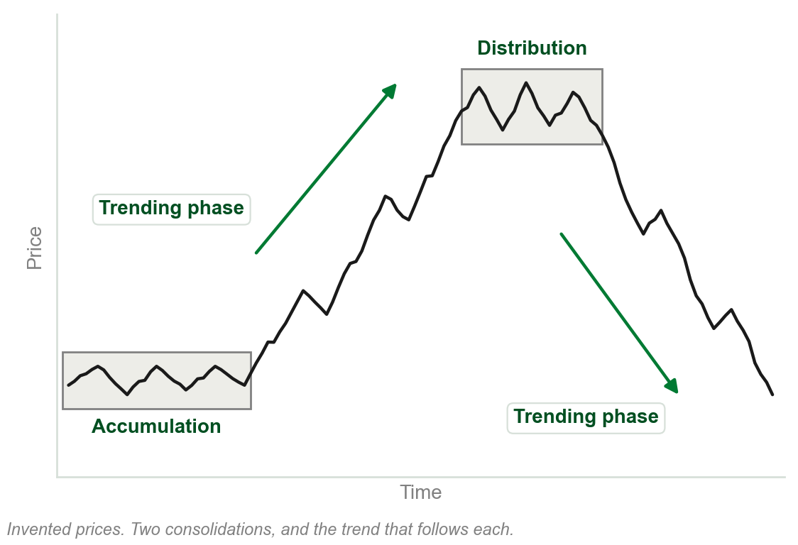
4.1 Markets move in phases
Dow Theory, in Chapter 2: a primary trend has three phases. Accumulation, trending, distribution.
That description is now regarded as the basic underlying characteristic of market action.
Phase analysis applies across all time frames.
Not recognizing the phases and their transitions greatly disadvantages the practitioner.
Chart A - FIN1209 teaching chart, drawn for this course. Illustrative data, not a real instrument.
Part 1 of 9 - 4.1 Dow | 1 of 14

Slide 5
NEW TERM
Consolidation phase
IN PLAIN WORDS
The sideways stretch. Price ranges, or makes small corrective moves, instead of trending.
FIGURE 4.1
A tree: market phase splits into consolidation and trend, and consolidation splits again into accumulation and distribution.
The artwork is copyrighted and is not in the public repository. Build with assets/figures/ present to place it here.
FOR EXAMPLE
A share that swings between PHP 40 and PHP 44 for four months, going nowhere, is consolidating.
THE FORMAL DEFINITION
One of only two basic phases, the other being the trending phase. A market consolidates, when expressing indecision, rest or exhaustion, by ranging or by making relatively small corrective moves. It subdivides into accumulation and distribution.
Figure 4.1 - Lim, The Handbook of Technical Analysis (Wiley, 2016)
Part 1 of 9 - 4.1 Dow | 2 of 14

Slide 6
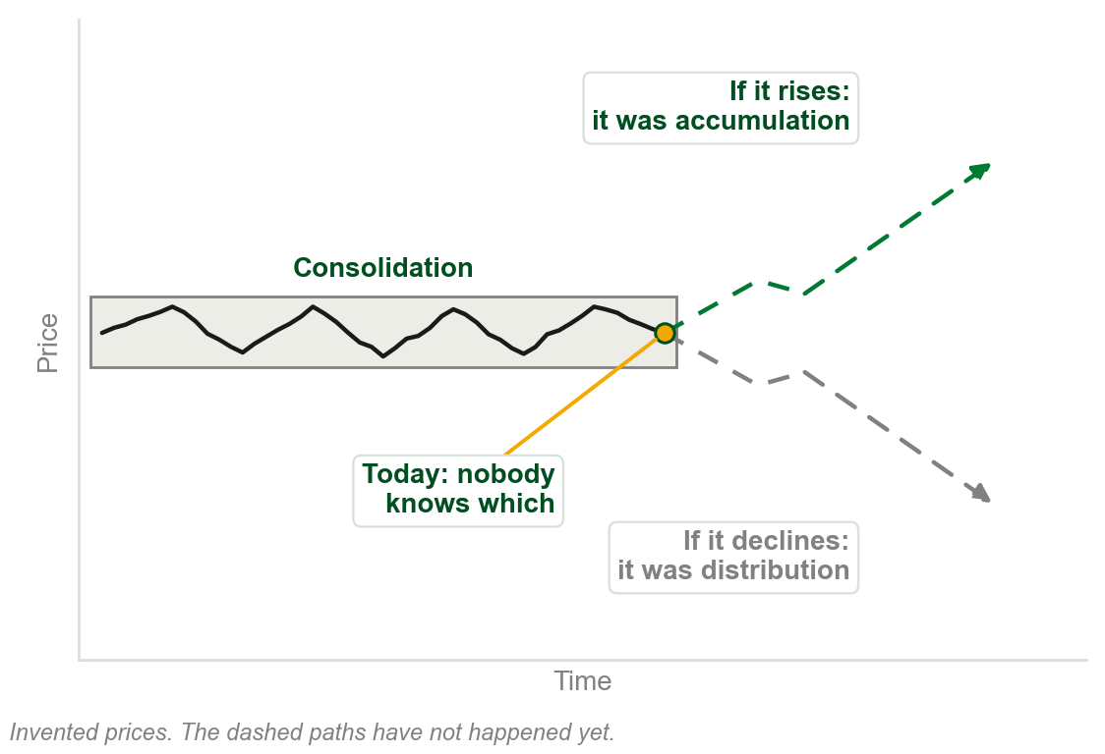
Accumulation or distribution? Known only afterwards
If the market rises after consolidating, the consolidation was accumulation: buying activity.
If it declines after consolidating, it was distribution: selling activity.
Which one it is can only be ascertained after the fact.
One objective of technical analysis is to look for evidence of which is taking place.
Chart B - FIN1209 teaching chart, drawn for this course. Illustrative data, not a real instrument.
Part 1 of 9 - 4.1 Dow | 3 of 14

Slide 7
The first evidence: volume in a consolidation
Volume normally declines gradually during a consolidation.
Very low volume is a strong sign the consolidation may be ending, and a trend starting.
On a daily chart a consolidation normally lasts about three to six months, or longer.
FIGURE 4.2
The daily Dow Jones Industrial Average with its accumulation, trending and distribution phases boxed and named, a last box named only consolidation, and a volume panel below with the decline in volume through each consolidation drawn in.
The artwork is copyrighted and is not in the public repository. Build with assets/figures/ present to place it here.
The last box on the chart says only consolidation. What follows was not yet known.
Figure 4.2 - Lim, The Handbook of Technical Analysis (Wiley, 2016)
Part 1 of 9 - 4.1 Dow | 4 of 14

Slide 8
The same phases at every time scale
A primary trend typically spans months to years in the equity markets.
In commodity futures it tends to be shorter: high leverage induces greater volatility.
Dow described the equity markets, but the phases are found across all markets.
FIGURE 4.3
A 15 minute EURUSD chart with distribution, trend and accumulation phases boxed one after another, titled micro phase action.
The artwork is copyrighted and is not in the public repository. Build with assets/figures/ present to place it here.
They show on sub-hourly charts too: micro phase action, shaped by the macro phase behavior around it.
Figure 4.3 - Lim, The Handbook of Technical Analysis (Wiley, 2016)
Part 1 of 9 - 4.1 Dow | 5 of 14

Slide 9
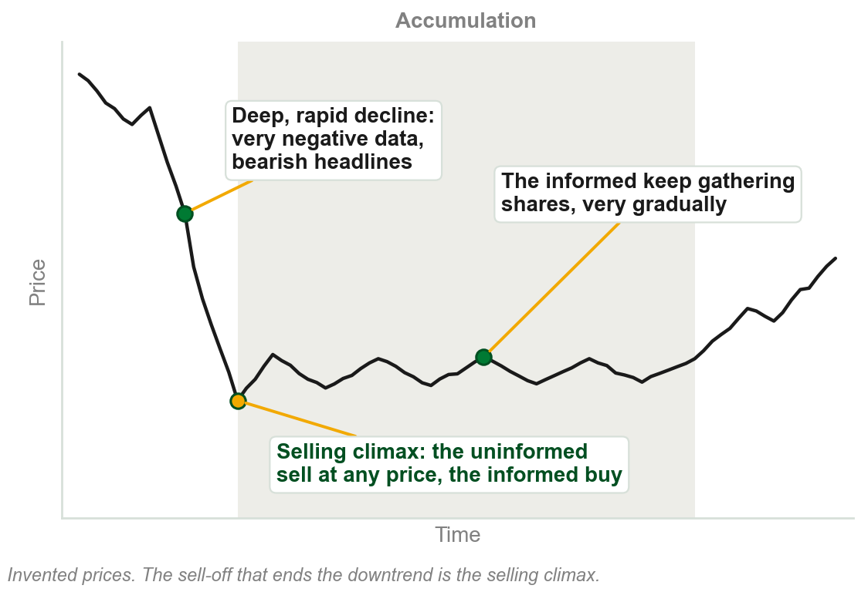
Accumulation: the informed buy from the frightened
It normally follows a deep and rapid decline, on very negative data and bearish headlines.
The uninformed are extremely bearish and sell at whatever price is available.
The informed buy from them: a contrarian approach that needs deep pockets.
They gather shares very gradually, careful not to drive prices up too fast.
The sell-off that ends the downtrend is called a selling climax.
Chart C - FIN1209 teaching chart, drawn for this course. Illustrative data, not a real instrument.
Part 1 of 9 - 4.1 Dow | 6 of 14

Slide 10
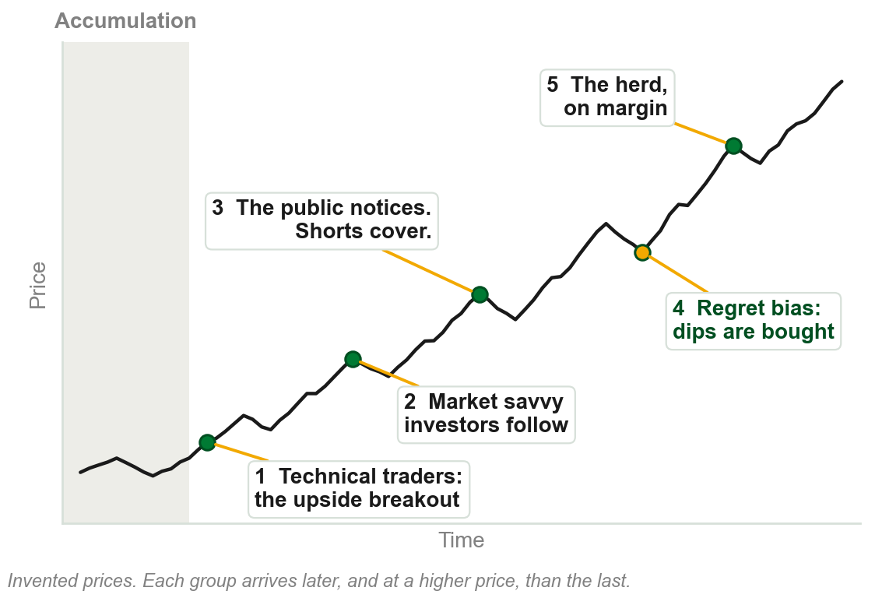
The uptrend feeds on itself
Technical traders get in early, on a clear upside breakout. Market savvy investors follow.
As the uptrend becomes obvious the public is drawn in, and the bears cover their shorts.
Regret bias: those who missed out, or sold too early, buy at every dip.
At even higher prices the herd uses more margin, even borrowing to invest.
A vicious positive feedback cycle.
Chart D - FIN1209 teaching chart, drawn for this course. Illustrative data, not a real instrument.
Part 1 of 9 - 4.1 Dow | 7 of 14

Slide 11
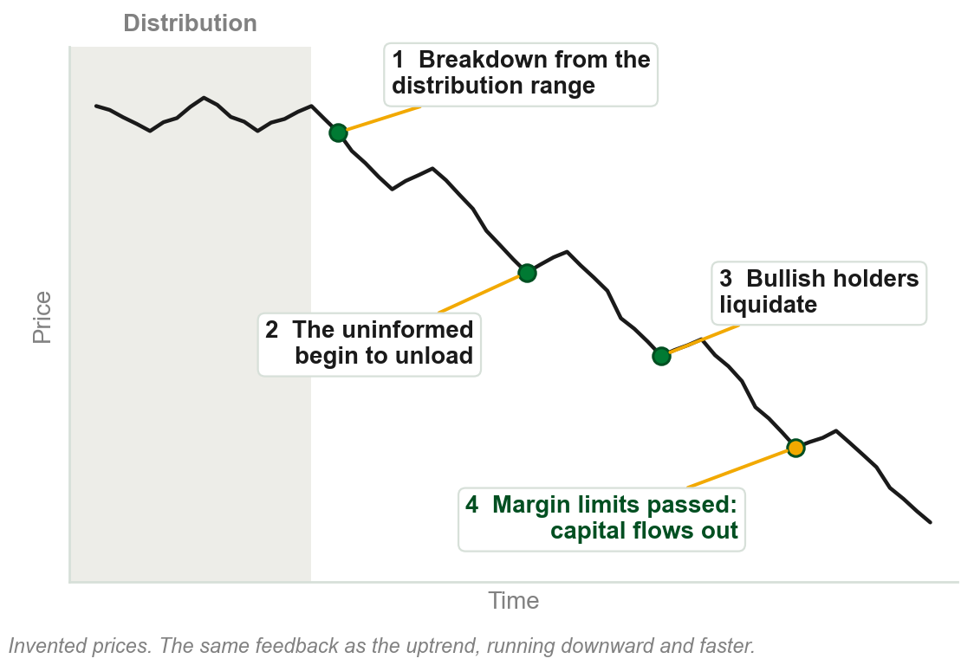
The downtrend: the same cycle, downward
It begins with a breakdown from a distribution range, on increasingly bearish data.
The uninformed begin to unload, and previously bullish participants liquidate.
Past the threshold of pain and the margin limits, capital flows out of the market.
Bearish sentiment intensifies as prices sink: the same vicious feedback cycle.
Chart E - FIN1209 teaching chart, drawn for this course. Illustrative data, not a real instrument.
Part 1 of 9 - 4.1 Dow | 8 of 14

Slide 12
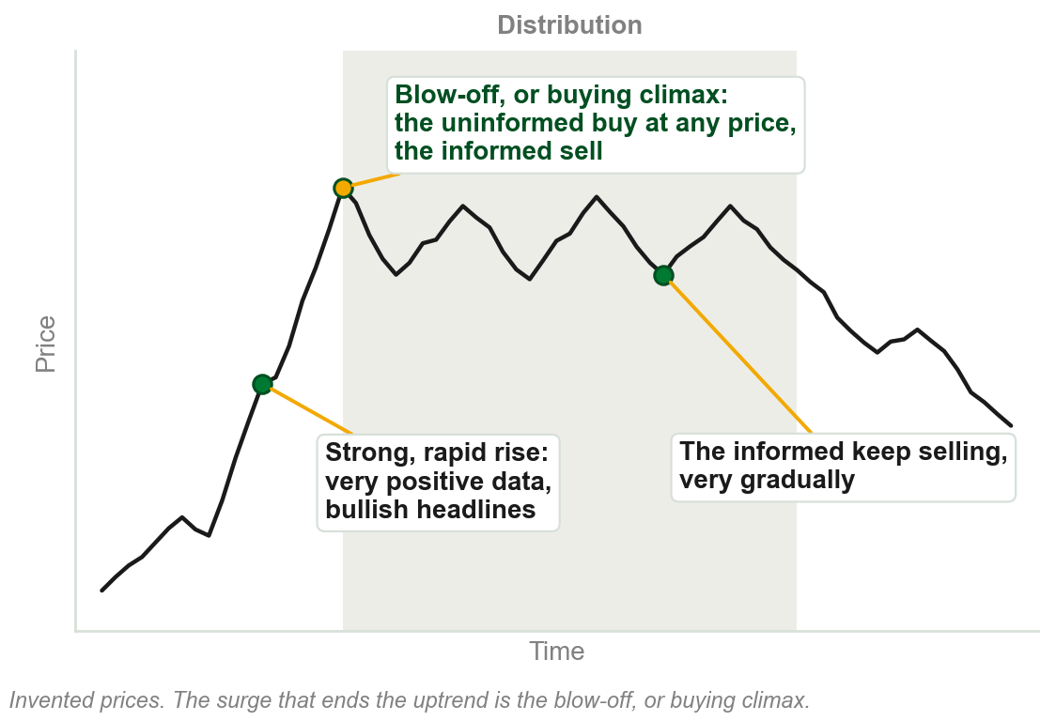
Distribution: the same story upside down
It normally follows a strong and rapid rise, on very positive data and the most bullish headlines.
The uninformed buy at whatever price is available: irrational exuberance. Margin debt is skyrocketing.
The informed sell to them very gradually, careful not to drive prices down too rapidly.
The surge that ends the uptrend is called a blow-off, or buying climax.
Chart F - FIN1209 teaching chart, drawn for this course. Illustrative data, not a real instrument.
Part 1 of 9 - 4.1 Dow | 9 of 14

Slide 13
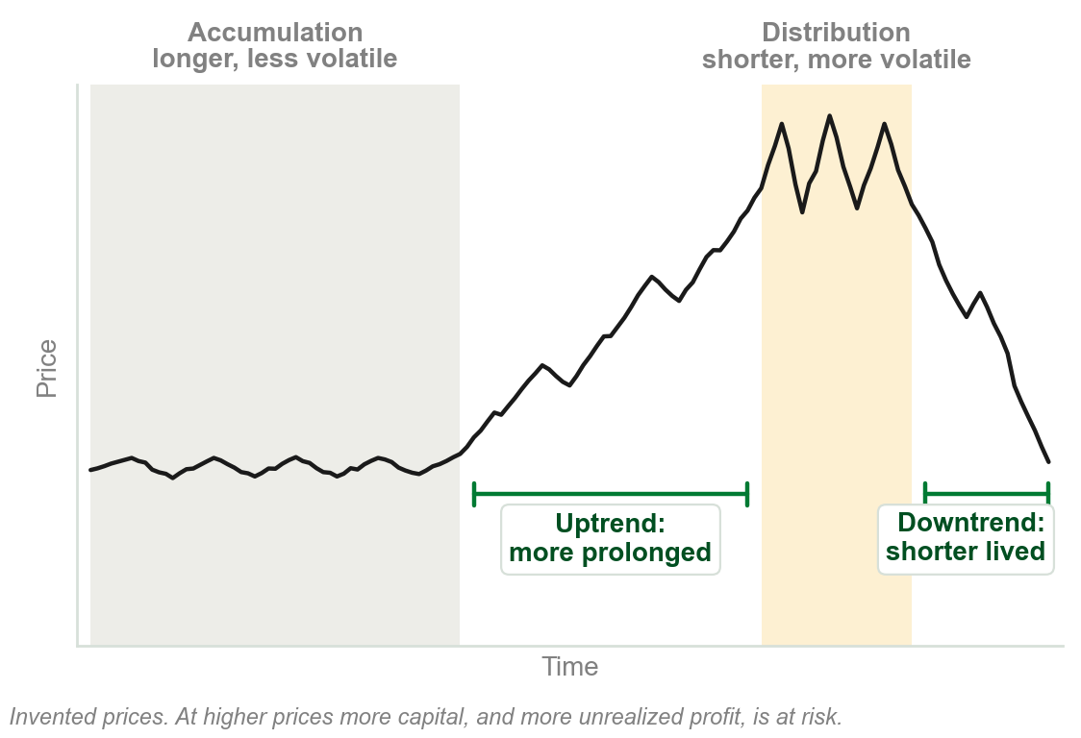
Why tops are shorter and rougher than bottoms
Accumulation normally lasts longer than distribution.
The uptrend tends to be more prolonged than the downtrend.
Distributions tend to be much more volatile than accumulations.
One reason covers all three: at higher prices more capital, and more unrealized profit, is at risk.
Chart G - FIN1209 teaching chart, drawn for this course. Illustrative data, not a real instrument.
Part 1 of 9 - 4.1 Dow | 10 of 14

Slide 14
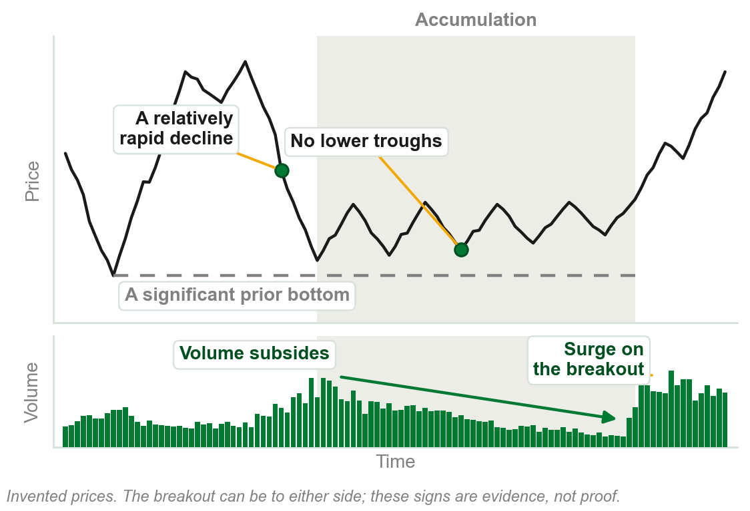
The signs of an accumulation
It comes after a relatively rapid decline, ideally near a significant prior bottom.
There is no evidence of lower troughs being formed.
Volume begins to subside as a potential upside breakout approaches.
The longer it lasts, the more powerful the breakout, typically on a surge in volume.
It starts a new primary bull market, or a shorter-term uptrend.
Chart H - FIN1209 teaching chart, drawn for this course. Illustrative data, not a real instrument.
Part 1 of 9 - 4.1 Dow | 11 of 14

Slide 15
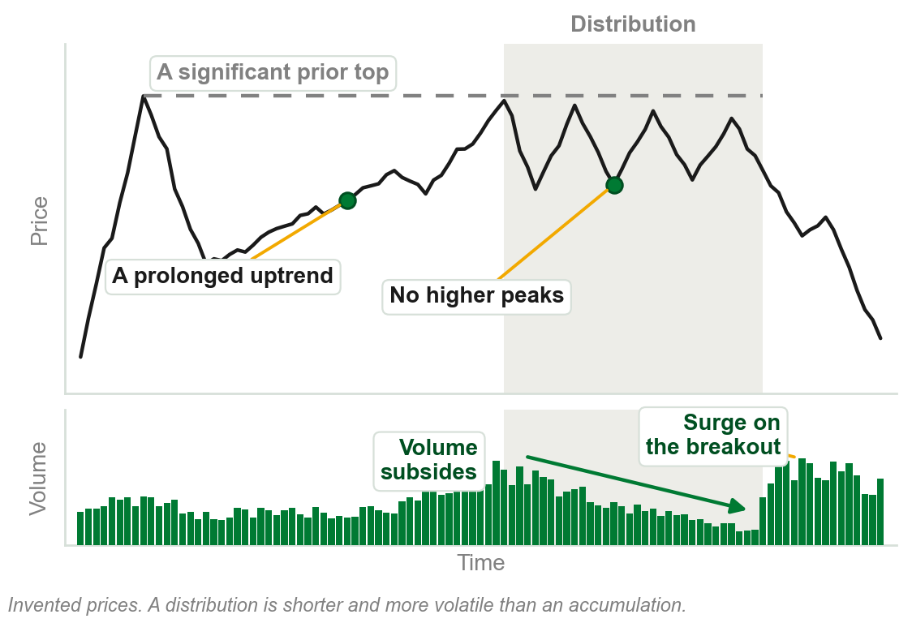
The signs of a distribution
It comes after a prolonged uptrend, ideally near a significant prior top.
Signs of market exhaustion show, and no higher peaks form.
Volume begins to subside as a potential downside breakout approaches.
The longer it lasts, the more powerful the breakout, typically on a surge in volume.
It starts a new primary bear market, or a shorter-term downtrend.
Chart I - FIN1209 teaching chart, drawn for this course. Illustrative data, not a real instrument.
Part 1 of 9 - 4.1 Dow | 12 of 14

Slide 16
When is a consolidation over?
There is no absolute consensus on the exact point where a consolidation ends.
Some look for a 3 to 5 percent rise above the highest peak of the range.
Some wait for the minimum measuring objective to be met.
Most look for a clear and simple technical breakout from the range.
FIGURE 4.4
A consolidation range with the three popular completion levels marked above it: a technical breakout, a 3 to 5 percent rise above the highest peak, and a one to one minimum target projection of the range.
The artwork is copyrighted and is not in the public repository. Build with assets/figures/ present to place it here.
Even then, where the breakout occurs depends on the price filter used.
Figure 4.4 - Lim, The Handbook of Technical Analysis (Wiley, 2016)
Part 1 of 9 - 4.1 Dow | 13 of 14

Slide 17
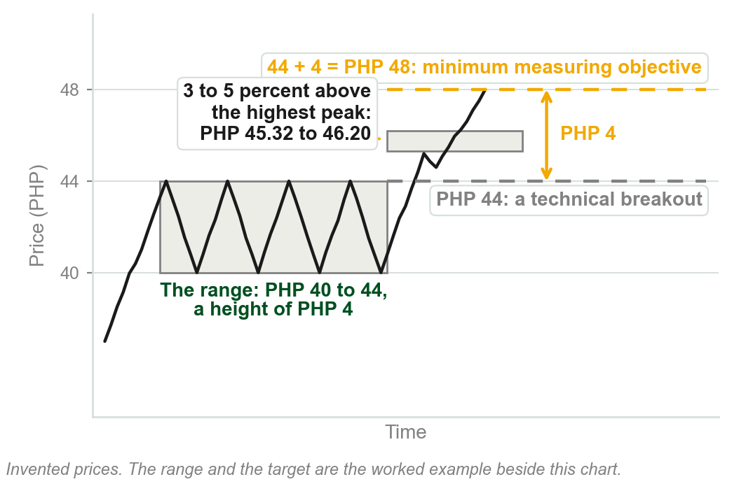
NEW TERM
Minimum measuring objective
IN PLAIN WORDS
The least a breakout is expected to travel: usually the height of the range it broke out of.
FOR EXAMPLE
A share ranges between PHP 40 and PHP 44, a height of PHP 4. On an upside breakout the minimum target is 44 + 4 = PHP 48.
THE FORMAL DEFINITION
The expected minimum price target, which is usually a price excursion equal to the range or height of the consolidation.
Chart J - FIN1209 teaching chart, drawn for this course. Illustrative data, not a real instrument.
Part 1 of 9 - 4.1 Dow | 14 of 14

Slide 18
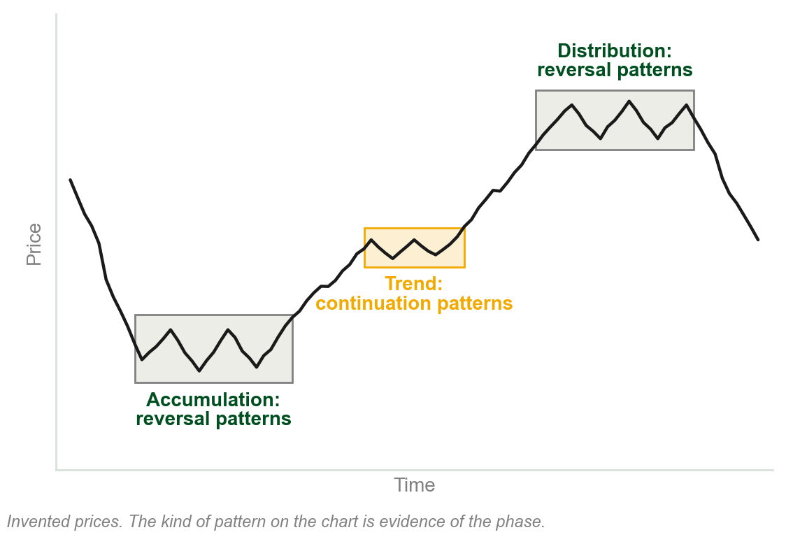
4.2 Chart patterns show the phase
Market phase can also be identified by the type of chart pattern at each stage.
Most chart patterns belong to one of two groups: reversal or continuation.
Accumulation and distribution tend to hold reversal patterns. Continuation patterns form within the trend.
So the kind of pattern on the chart is evidence of the phase the market is in.
Chart K - FIN1209 teaching chart, drawn for this course. Illustrative data, not a real instrument.
Part 2 of 9 - 4.2 Chart patterns | 1 of 16

Slide 19
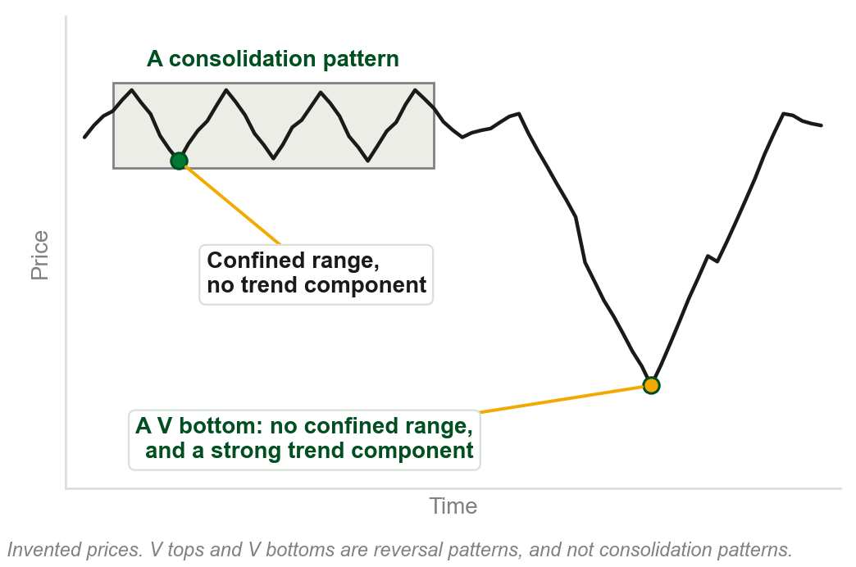
NEW TERM
Consolidation pattern
IN PLAIN WORDS
A pattern that stays inside a range and is not trending anywhere.
FOR EXAMPLE
A share drifts between PHP 40 and PHP 44 for six weeks as a triangle forms.
THE FORMAL DEFINITION
A chart pattern is usually regarded as a consolidation pattern if it unfolds within a relatively confined and well defined price range, and lacks any significant trend component.
Chart L - FIN1209 teaching chart, drawn for this course. Illustrative data, not a real instrument.
Part 2 of 9 - 4.2 Chart patterns | 2 of 16

Slide 20
Most patterns consolidate. V reversals do not.
A market in indecision, rest or exhaustion ranges, or makes small corrective moves.
So most reversal and continuation patterns are also consolidation patterns.
V tops and V bottoms are the exception: no confined range, a strong trend component.
FIGURE 4.8
A 4 hour USDCAD chart: a head and shoulders distribution labelled intrinsically bearish, a decline into a sharp V bottom labelled a rapid accumulation phase, and a new consolidation after the rise.
The artwork is copyrighted and is not in the public repository. Build with assets/figures/ present to place it here.
V reversals are the hardest to forecast: seen only in hindsight.
They occur more often during distributions than accumulations.
Figure 4.8 - Lim, The Handbook of Technical Analysis (Wiley, 2016)
Part 2 of 9 - 4.2 Chart patterns | 3 of 16

Slide 21
NEW TERM
Intrinsic bias
IN PLAIN WORDS
The bullish or bearish lean a pattern carries in itself, wherever it appears.
FIGURE 4.6
A EURUSD chart with an inverted head and shoulders boxed at the bottom of a decline, labelled an intrinsically bullish pattern and a reversal pattern, and the trend phase rising out of it.
The artwork is copyrighted and is not in the public repository. Build with assets/figures/ present to place it here.
FOR EXAMPLE
An ascending triangle is intrinsically bullish. Wherever it occurs, it is inherently a bullish indication.
THE FORMAL DEFINITION
The inherent bullish or bearish sentiment associated with a chart pattern that is independent of location, where sentiment is strictly based on the nature of the pattern.
Figure 4.6 - Lim, The Handbook of Technical Analysis (Wiley, 2016)
Part 2 of 9 - 4.2 Chart patterns | 4 of 16

Slide 22
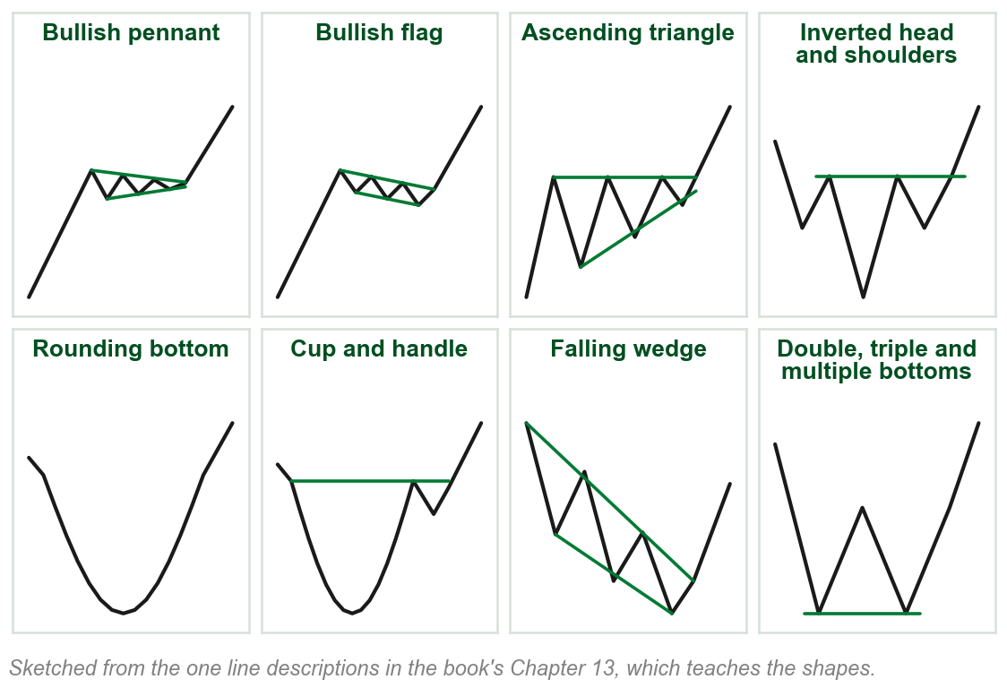
Intrinsically bullish: the book's eight
Bullish pennants, and bullish flags.
Ascending triangles, and inverted head and shoulders.
Rounding bottoms, and cup and handles.
Falling wedges, and double, triple and multiple bottoms.
Wherever one of these forms, it is inherently a bullish indication.
Review question 2 asks for these eight.
Chart M - FIN1209 teaching chart, drawn for this course. Illustrative data, not a real instrument.
Part 2 of 9 - 4.2 Chart patterns | 5 of 16

Slide 23
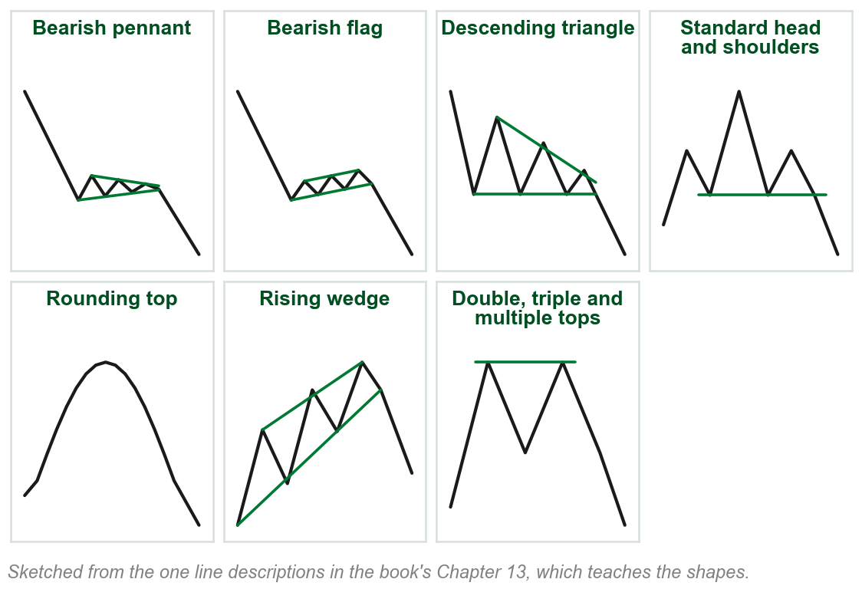
Intrinsically bearish: the book's seven
Bearish pennants, and bearish flags.
Descending triangles, and standard head and shoulders.
Rounding tops, and rising wedges.
Double, triple and multiple tops.
Each is a bullish pattern turned upside down.
The cup and handle is on the bullish list and has no twin on this one.
Chart N - FIN1209 teaching chart, drawn for this course. Illustrative data, not a real instrument.
Part 2 of 9 - 4.2 Chart patterns | 6 of 16

Slide 24
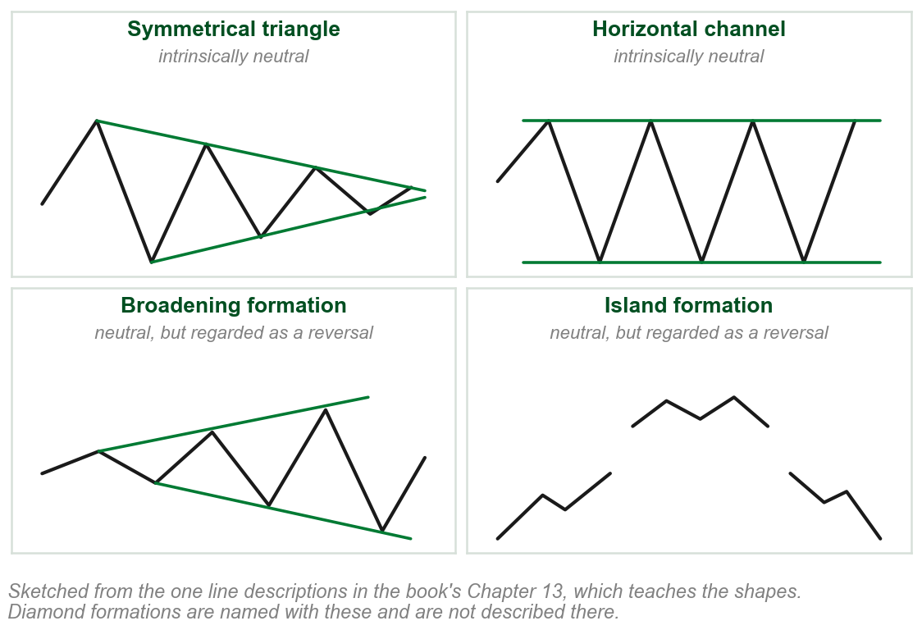
Intrinsically neutral patterns
Symmetrical triangles and horizontal channels have no obvious bias in sentiment.
Some authors classify them as continuation patterns, others as reversal patterns.
Broadening, diamond and island formations are also neutral, but are regarded as reversal formations.
Whether a neutral pattern reverses or continues is decided beyond the pattern itself.
Chart O - FIN1209 teaching chart, drawn for this course. Illustrative data, not a real instrument.
Part 2 of 9 - 4.2 Chart patterns | 7 of 16

Slide 25
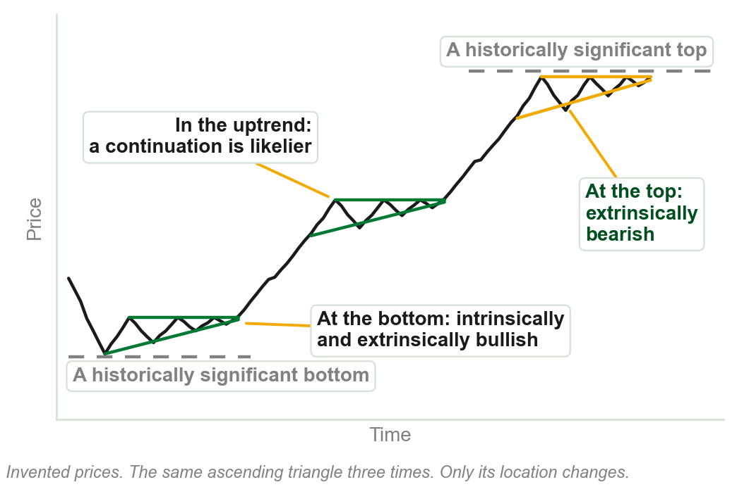
NEW TERM
Extrinsic bias
IN PLAIN WORDS
The lean a pattern takes from where it sits, not from its shape.
FOR EXAMPLE
An ascending triangle at the price level of a historically significant market top is extrinsically bearish: it sits at a significant resistance.
THE FORMAL DEFINITION
Location-based sentiment: sentiment that is dependent on factors that are external, or extrinsic, to the pattern.
Chart P - FIN1209 teaching chart, drawn for this course. Illustrative data, not a real instrument.
Part 2 of 9 - 4.2 Chart patterns | 8 of 16

Slide 26
What sets the extrinsic bias
The direction of the preceding trend.
Location with respect to historical extremes in price.
Location with respect to the phase of an underlying market cycle.
Location with respect to other supportive and resistive overlay barriers.
Bullish or bearish divergent formations.
FIGURE 4.12
The daily gold chart: a symmetrical triangle labelled extrinsically bullish, forming on a strong accumulation zone tested by multiple bottoms, beside a downtrend line acting as support, all inside a larger consolidation that contains smaller distributions and accumulations.
The artwork is copyrighted and is not in the public repository. Build with assets/figures/ present to place it here.
Figure 4.12: a neutral triangle on a well tested accumulation zone, beside trendline support, is extrinsically bullish.
Figure 4.12 - Lim, The Handbook of Technical Analysis (Wiley, 2016)
Part 2 of 9 - 4.2 Chart patterns | 9 of 16

Slide 27
When the biases agree
Intrinsic and extrinsic bias agree: a reversal at a top or bottom is more reliable.
Intrinsic bias in agreement with the trend sentiment, the direction of the trend: a continuation is more likely.
Any disagreement: the reversal or continuation may be inherently weak.
FIGURE 4.13
A 15 minute EURUSD chart with an ascending triangle, a flat top and a rising lower line, forming partway up an uptrend and labelled as continuation in a trend phase.
The artwork is copyrighted and is not in the public repository. Build with assets/figures/ present to place it here.
An ascending triangle in an uptrend: bullish pattern, bullish trend.
Figure 4.13 - Lim, The Handbook of Technical Analysis (Wiley, 2016)
Part 2 of 9 - 4.2 Chart patterns | 10 of 16

Slide 28
Continuation patterns agree with the trend
Bullish with respect to an uptrend: bullish pennants and flags, ascending triangles, inverted head and shoulders, rounding bottoms, cup and handles, falling wedges.
Bearish with respect to a downtrend: bearish pennants and flags, descending triangles, standard head and shoulders, rising wedges.
FIGURE 4.10
A 15 minute EURUSD chart: a distribution, a downside breakout, then a bear flag labelled intrinsically bearish and as continuation, with prices consolidating in a diagonally constrained manner before the trend resumes.
The artwork is copyrighted and is not in the public repository. Build with assets/figures/ present to place it here.
A continuation pattern's bias should agree with the trend sentiment.
Figure 4.10: a bear flag, confirmed once price violates the pattern.
Figure 4.10 - Lim, The Handbook of Technical Analysis (Wiley, 2016)
Part 2 of 9 - 4.2 Chart patterns | 11 of 16

Slide 29
A rounding bottom, or cup and handle, as continuation
FIGURE 4.14
A 4 hour EURUSD chart with a rounding bottom, or cup and handle, forming partway up an uptrend and labelled as continuation in a trend phase.
The artwork is copyrighted and is not in the public repository. Build with assets/figures/ present to place it here.
Figure 4.14 - Lim, The Handbook of Technical Analysis (Wiley, 2016)
Part 2 of 9 - 4.2 Chart patterns | 12 of 16

Slide 30
Reversal patterns disagree with the trend
As a general guide, intrinsic bias and trend sentiment disagree for reversal patterns.
A standard head and shoulders, intrinsically bearish, ends an uptrend as distribution.
An inverted one, intrinsically bullish, ends a downtrend as accumulation.
FIGURE 4.7
A 15 minute EURUSD chart with a head and shoulders boxed as a consolidation range and labelled as distribution, a breakdown through its neckline, and a new consolidation forming at the projected target below.
The artwork is copyrighted and is not in the public repository. Build with assets/figures/ present to place it here.
Figure 4.7: at the minimum price objective a new consolidation forms.
The objective is a 1:1 projection of the pattern's height from the neckline breakout.
Figure 4.7 - Lim, The Handbook of Technical Analysis (Wiley, 2016)
Part 2 of 9 - 4.2 Chart patterns | 13 of 16

Slide 31
Figure 4.5: the reversal patterns, by phase
Accumulation based, in downtrends: inverted head and shoulders, cup and handles, rounding bottoms, falling wedges, ascending triangles, and double, triple and multiple bottoms.
Distribution based, in uptrends: standard head and shoulders, rounding tops, rising wedges, descending triangles, and double, triple and multiple tops.
FIGURE 4.5
The book's summary diagram, Phase-Based Chart Patterns: three lists, accumulation based, distribution based and continuation based, with the first two marked as reversal patterns whose intrinsic and trend sentiment disagree, and the third as patterns whose intrinsic and trend sentiment should agree.
The artwork is copyrighted and is not in the public repository. Build with assets/figures/ present to place it here.
Bullish in a downtrend, bearish in an uptrend: bias and trend disagree.
Both lists add broadening, island and diamond formations. V bottoms and V tops are reversals too.
Figure 4.5 - Lim, The Handbook of Technical Analysis (Wiley, 2016)
Part 2 of 9 - 4.2 Chart patterns | 14 of 16

Slide 32
Neutral patterns borrow their bias
A neutral formation's extrinsic bias is derived from the trend sentiment.
A symmetrical triangle is extrinsically bullish in an uptrend, bearish in a downtrend.
Broadening, diamond and island formations are reversals: their bias opposes the trend.
FIGURE 4.9
A 15 minute EURUSD chart with a symmetrical triangle forming partway up an uptrend, prices consolidating in a convergent manner, labelled intrinsically neutral, extrinsically bullish, and as continuation.
The artwork is copyrighted and is not in the public repository. Build with assets/figures/ present to place it here.
A neutral pattern has no lean of its own. Its surroundings supply one.
One list in the book files broadening formations with the trend; its next paragraph and Figure 4.5, as reversals.
Figure 4.9 - Lim, The Handbook of Technical Analysis (Wiley, 2016)
Part 2 of 9 - 4.2 Chart patterns | 15 of 16

Slide 33
Probabilities, never certainties
Two ascending triangles form the accumulation, and price breaks out on a large upside gap.
After the trend a third ascending triangle forms, then breaks down instead.
Trend sentiment and intrinsic bias agreed perfectly, and the pattern still failed.
FIGURE 4.11
The daily iShares Silver Trust chart: two ascending triangles as accumulation, the second labelled intrinsically and extrinsically bullish, a gap up into the trend phase, then a new ascending triangle that breaks down unexpectedly, with volume declining into each breakout.
The artwork is copyrighted and is not in the public repository. Build with assets/figures/ present to place it here.
Technical forecasting is based on probabilities, and never on certainties.
Failed patterns often lead to a more powerful reaction.
Figure 4.11 - Lim, The Handbook of Technical Analysis (Wiley, 2016)
Part 2 of 9 - 4.2 Chart patterns | 16 of 16

Slide 34
4.3 Volume falls before the phase changes
Each phase has its typical volume action: down through a consolidation, up through a trend.
Volume tends to decline to relatively low levels just before a phase transition.
So volume can be used as a timing indicator for potential phase transitions.
FIGURE 4.15
A schematic cycle of accumulation, trend, distribution, trend and accumulation, with volume marked down through each consolidation and up through each trend.
The artwork is copyrighted and is not in the public repository. Build with assets/figures/ present to place it here.
Very low volume says a consolidation may be ending. It does not say which way.
Figure 4.15 - Lim, The Handbook of Technical Analysis (Wiley, 2016)
Part 3 of 9 - 4.3 Volume | 1 of 5

Slide 35
A trend that loses volume is running out
If an uptrend or downtrend is inherently weak, volume falls off during the trend phase.
That is a sign of trend exhaustion.
It signals a potentially earlier onset of a distribution or accumulation phase.
FIGURE 4.16
The same schematic cycle with volume turning down partway through each trend, the turn circled and labelled trend exhaustion.
The artwork is copyrighted and is not in the public repository. Build with assets/figures/ present to place it here.
Volume should rise through a trend. When it turns down partway, expect the consolidation sooner.
Figure 4.16 - Lim, The Handbook of Technical Analysis (Wiley, 2016)
Part 3 of 9 - 4.3 Volume | 2 of 5

Slide 36
Open interest: watch for disagreement
For the most part, open interest action correlates fairly closely with volume action.
It is when the two diverge significantly that open interest adds evidence.
If open interest increases during a consolidation instead of decreasing, the breakout and the trend after it tend to be much more rapid and extended.
FIGURE 4.17
The schematic cycle with open interest rising through the distribution instead of falling, and the downside breakout that follows labelled strong.
The artwork is copyrighted and is not in the public repository. Build with assets/figures/ present to place it here.
Open interest is used here and taught in Chapter 6.
Figure 4.17 - Lim, The Handbook of Technical Analysis (Wiley, 2016)
Part 3 of 9 - 4.3 Volume | 3 of 5

Slide 37
Volume and phase on a real chart
The extended distribution is violated by a downside gap, on high volume.
The trend phase follows, with bullish volume divergence, and passes into an accumulation.
Volume gradually decreases as the accumulation progresses.
FIGURE 4.18
An intraday Isis Pharmaceuticals chart: a long distribution phase broken by a downside gap, a trend phase curving down into an accumulation phase, and a volume panel labelled bullish volume divergence under the trend and again under the accumulation.
The artwork is copyrighted and is not in the public repository. Build with assets/figures/ present to place it here.
Falling volume signals a potentially imminent breakout, to the upside or the downside.
Figure 4.18 - Lim, The Handbook of Technical Analysis (Wiley, 2016)
Part 3 of 9 - 4.3 Volume | 4 of 5

Slide 38
Heavy volume marks a top or a bottom
Higher than normal volume at the start of an accumulation or distribution strongly indicates a bottom or top has formed.
In Figure 4.19 large price-based volume coincides with the distribution and accumulation zones.
FIGURE 4.19
An hourly Facebook chart with horizontal volume bars drawn against price levels: the largest coincide with a distribution zone and an accumulation zone, with order flow marked seeking out additional liquidity at the edges of each.
The artwork is copyrighted and is not in the public repository. Build with assets/figures/ present to place it here.
Price levels with historically high volume are potential levels of accumulation or distribution.
Price-based volume, as opposed to time-based volume, is used here and not explained.
Figure 4.19 - Lim, The Handbook of Technical Analysis (Wiley, 2016)
Part 3 of 9 - 4.3 Volume | 5 of 5

Slide 39
4.4 A moving average across the phases
Market phase can also be identified by the behavior of moving averages.
During a trending phase a moving average shows the minimum incidence of whipsaws.
During a consolidation, whipsaw action increases significantly.
FIGURE 4.20
One simple moving average under a rising price, labelled as containing the trend with fewer whipsaws, then flattening inside a boxed consolidation where price crosses it again and again, labelled whipsaws during the consolidation phase.
The artwork is copyrighted and is not in the public repository. Build with assets/figures/ present to place it here.
The cause is the flattening-out effect of averages in a sideways or ranging market.
The book uses whipsaw without defining it; Figure 4.20 points at them. Moving averages are Chapter 11.
Figure 4.20 - Lim, The Handbook of Technical Analysis (Wiley, 2016)
Part 4 of 9 - 4.4 Moving averages | 1 of 2

Slide 40
Several averages: spread in a trend, tangle in a range
In a trend, multiple moving average lines start to diverge from each other.
The greater the divergence, the stronger the ensuing trend.
When the lines begin to converge, that is an early indication of a potential consolidation.
FIGURE 4.21
A daily chart with four moving averages, 20, 50, 100 and 200 day: the lines overlap through an accumulation phase, fan apart through the trend phase, where they also act as support, and overlap again in the consolidation that follows.
The artwork is copyrighted and is not in the public repository. Build with assets/figures/ present to place it here.
Overlapping lines: consolidation. Diverging lines: a strong trend in place.
Figure 4.21 - Lim, The Handbook of Technical Analysis (Wiley, 2016)
Part 4 of 9 - 4.4 Moving averages | 2 of 2

Slide 41
4.5 Divergence tracks momentum
Divergence may be used to track the changes in price momentum.
That makes it extremely useful for identifying potential consolidations, and the strength of a trend.
Once divergence is observed, look for a slowing of the trend.
FIGURE 4.22
An hourly EURUSD chart: price makes a higher peak inside a distribution while the MACD below it makes a lower one, labelled standard bearish divergence and momentum turning before price.
The artwork is copyrighted and is not in the public repository. Build with assets/figures/ present to place it here.
In Figure 4.22 price makes a higher peak while the MACD makes a lower one: standard bearish divergence.
The chapter uses divergence, MACD and RSI without defining them. Divergence is Chapter 9.
Figure 4.22 - Lim, The Handbook of Technical Analysis (Wiley, 2016)
Part 5 of 9 - 4.5 Divergence | 1 of 3

Slide 42
Bullish divergence supports an accumulation
The accumulation takes the form of an inverted head and shoulders pattern.
It is further supported by standard bullish divergence on the MACD.
The left shoulder, head and right shoulder coincide with the projected cycle lows.
FIGURE 4.23
The daily 3M chart: an accumulation in the form of an inverted head and shoulders, with standard bullish divergence marked on the MACD below it and vertical lines marking consistent cycle lows at the shoulders and the head.
The artwork is copyrighted and is not in the public repository. Build with assets/figures/ present to place it here.
This bullish confluence within the accumulation greatly increases the probability of a strong upside move.
Figure 4.23 - Lim, The Handbook of Technical Analysis (Wiley, 2016)
Part 5 of 9 - 4.5 Divergence | 2 of 3

Slide 43
Momentum turns before price
Volume, MACD and RSI all show bullish divergence with price in the accumulation.
The MACD and the RSI are both momentum-based indicators.
At the tail end of a trend, a sign that a consolidation may be forming helps a trader anticipate an early entry.
FIGURE 4.24
A 5 minute GBPUSD chart: a downtrend into an accumulation, with bullish divergence marked on volume, on the MACD and on the RSI inside the accumulation, and a new trend rising out of it.
The artwork is copyrighted and is not in the public repository. Build with assets/figures/ present to place it here.
We see momentum turning before price.
For bullish divergence in volume, falling prices must be accompanied by decreasing volume.
Figure 4.24 - Lim, The Handbook of Technical Analysis (Wiley, 2016)
Part 5 of 9 - 4.5 Divergence | 3 of 3

Slide 44
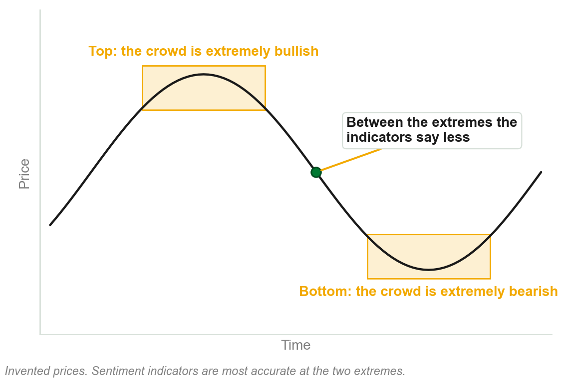
4.6 Sentiment is clearest at the extremes
Participants swing between fear, greed and hope, responding to news and each other.
Identifiable patterns repeat fairly consistently, especially at market extremes.
Sentiment indicators track participants' aggregate sentiment, emotions and psychology.
They are most accurate at extremes of optimism or pessimism.
Chart Q - FIN1209 teaching chart, drawn for this course. Illustrative data, not a real instrument.
Part 6 of 9 - 4.6 Sentiment | 1 of 3

Slide 45
Thirteen sentiment indicators, by name
Put-call ratios, Arm's Index, and odd lot sales.
Margin debt, the COT report, and the VIX.
The short interest ratio, the cash asset ratio, and the advance-decline line.
New highs minus new lows, up volume minus down volume, Market Vane reports, and the Bullish Sentiment Index.
The book gives these as examples and explains none of them here.
Chapter 23 is the detailed discussion. How any one of them is built is not examined from this chapter.
Part 6 of 9 - 4.6 Sentiment | 2 of 3

Slide 46
What the indicators read at a top and a bottom
At distribution the put/call ratio and the VIX are low, but starting to increase.
A/D, margin debt, new highs minus new lows and the Bullish Percent Index are high, but starting to decrease.
At accumulation every one of those readings is reversed.
FIGURE 4.25
A price curve from a distribution at the top to an accumulation at the bottom, with six sentiment readings listed beside each: put/call ratio, A/D, VIX, margin debt, new highs minus new lows and the Bullish Percent Index.
The artwork is copyrighted and is not in the public repository. Build with assets/figures/ present to place it here.
Each reading is at an extreme and has just started to turn.
The figure says Bullish Percent Index, the list Bullish Sentiment Index. The book does not say if they are the same.
Figure 4.25 - Lim, The Handbook of Technical Analysis (Wiley, 2016)
Part 6 of 9 - 4.6 Sentiment | 3 of 3

Slide 47
NEW TERM
4.7 Sakata's Five Methods
IN PLAIN WORDS
A Japanese way of reading the market that divides it into five phases, not Dow's three.
FIGURE 4.26
Two panels side by side: Sakata's five market phases, with San Sen at the bottom, San Pei, San Poh and San Ku through the rise and San Zan at the top, beside Elliott's 5-3 wave structure.
The artwork is copyrighted and is not in the public repository. Build with assets/figures/ present to place it here.
FOR EXAMPLE
In the left panel: three bottoms, three thrusts with a correction after each, then three tops.
THE FORMAL DEFINITION
A unique Japanese approach for interpreting and understanding the markets, which originated with Munehisa Honma. The market is divided into five distinct phases, as opposed to the conventional three-phase model by Dow.
Figure 4.26 - Lim, The Handbook of Technical Analysis (Wiley, 2016)
Part 7 of 9 - 4.7 Sakata | 1 of 3

Slide 48
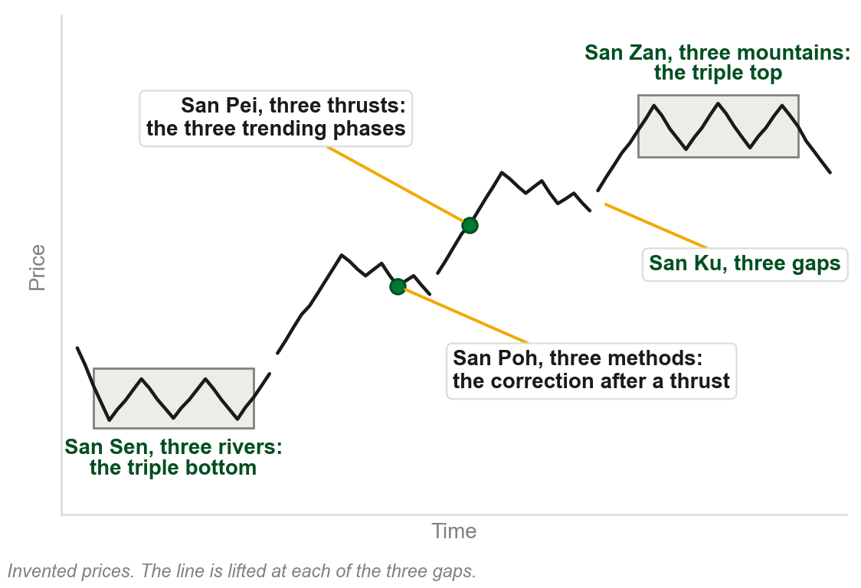
The five methods, by name
San Zan, three mountains: the Western triple top. The distribution phase.
San Sen, three rivers: the Western triple bottom. The accumulation phase.
San Ku, three gaps: the breakaway, runaway and exhaustion gaps of the trend.
San Pei, three thrusts: the three trending phases between the two.
San Poh, three methods: the three corrections, one after each thrust.
Chart R - FIN1209 teaching chart, drawn for this course. Illustrative data, not a real instrument.
Part 7 of 9 - 4.7 Sakata | 2 of 3

Slide 49
Five phases inside three
Dow's three phases may seem inconsistent with Sakata's five, and with Elliott's waves.
Simple chart patterns show the models need not be viewed as distinct.
A triple bottom, thrusts with bullish flags and gaps between them, then a triple top.
FIGURE 4.27
Dow's three-phase market drawn with Sakata's pieces: a triple bottom as the accumulation phase, a rising channel of thrusts, bullish flags and the breakaway, runaway and exhaustion gaps as the trend phase, and a triple top as the distribution phase.
The artwork is copyrighted and is not in the public repository. Build with assets/figures/ present to place it here.
A plausible resolution between Eastern and Western approaches.
Figure 4.27 - Lim, The Handbook of Technical Analysis (Wiley, 2016)
Part 7 of 9 - 4.7 Sakata | 3 of 3

Slide 50
4.8 Elliott: five waves up, three waves down
Elliott described markets as an impulsive five-wave up, then a corrective three-wave down.
The trending phase is impulse waves 1, 3 and 5.
The accumulation phase is corrective waves 2 and 4. Distribution is usually the abc correction.
FIGURE 4.28
Elliott's wave structure: five numbered motive waves rising, with waves 1, 3 and 5 marked impulsive, then three lettered corrective waves a, b and c falling. Eight waves of one degree.
The artwork is copyrighted and is not in the public repository. Build with assets/figures/ present to place it here.
Sakata's San Pei closely resembles waves 1, 3 and 5. San Poh somewhat resembles waves a, b and c.
The book also places the abc correction under accumulation, 'in most cases'. Elliott's waves have specific rules; Sakata's model is less rigid.
Figure 4.28 - Lim, The Handbook of Technical Analysis (Wiley, 2016)
Part 8 of 9 - 4.8 Elliott | 1 of 2

Slide 51
Elliott's waves on the gold chart
Primary waves 1 and 2 sit in the accumulation, the powerful wave 3 in the trend.
Volume gradually decreases over each significant consolidation.
Volume peaks around the top of wave 5, within a new area of consolidation.
FIGURE 4.29
The weekly gold chart from 2000 to 2012 with an Elliott wave count on log scaling: an accumulation phase, two trend phases with a consolidation between them, a potential distribution phase at the top, and volume marked falling across three consolidations.
The artwork is copyrighted and is not in the public repository. Build with assets/figures/ present to place it here.
Fibonacci price and time projections help gauge where each wave ends.
Fibonacci projection is not taught here. Elliott waves: Chapter 18.
Figure 4.29 - Lim, The Handbook of Technical Analysis (Wiley, 2016)
Part 8 of 9 - 4.8 Elliott | 2 of 2

Slide 52
4.9 Where in the cycle decides what the pattern is
Whether a formation reverses or continues depends on where in the cycle it unfolds.
Between cycle extremes, formations tend to be continuations.
At cycle peaks they tend to be distributions. At cycle troughs, accumulations.
FIGURE 4.30
A price cycle with four formations boxed on it: a reversal as accumulation at each cycle trough, a continuation between the extremes, and a reversal as distribution at the cycle peak.
The artwork is copyrighted and is not in the public repository. Build with assets/figures/ present to place it here.
If the intrinsic and extrinsic biases agree as well, it is potentially more reliable.
For formations on the same cycle degree. Finding the cycle period is Chapter 20.
Figure 4.30 - Lim, The Handbook of Technical Analysis (Wiley, 2016)
Part 9 of 9 - 4.9 Cycles | 1 of 3

Slide 53
One triangle, three roles
The intrinsically neutral symmetrical triangle takes three distinct roles.
Accumulation at the bottom of the cycle, continuation between the top and the bottom, distribution at the top.
It adopts a bullish extrinsic bias at cycle troughs, and a bearish one at cycle peaks.
FIGURE 4.31
A price cycle with the same symmetrical triangle drawn at four places: as accumulation at each cycle trough, as continuation between the extremes, and as distribution at the cycle peak.
The artwork is copyrighted and is not in the public repository. Build with assets/figures/ present to place it here.
Between the extremes it adopts the preexisting trend sentiment.
Figure 4.31 - Lim, The Handbook of Technical Analysis (Wiley, 2016)
Part 9 of 9 - 4.9 Cycles | 2 of 3

Slide 54
The same in a price channel
In a rising channel the triangle is accumulation at the bottom, continuation in the middle, distribution at the top.
Had the pattern been an inverted head and shoulders, a reversal at the bottom or a continuation in the middle would be more probable.
FIGURE 4.32
An uptrending price channel with the symmetrical triangle drawn as accumulation at the bottom of the channel, as continuation in the middle, and as distribution at the top, headed look for supportive and resistive confluences.
The artwork is copyrighted and is not in the public repository. Build with assets/figures/ present to place it here.
Confluences with other overlay barriers, such as Fibonacci levels, give more reliable forecasts of where price may react.
Figure 4.32 - Lim, The Handbook of Technical Analysis (Wiley, 2016)
Part 9 of 9 - 4.9 Cycles | 3 of 3

Slide 55
Chapter 4 in five sentences
Markets consolidate or trend; a consolidation is accumulation or distribution.
Which one it was is known only afterwards, so the analyst gathers evidence.
Chart patterns are evidence: their intrinsic and extrinsic bias should agree.
Volume, moving averages, divergence, sentiment and cycles each add evidence.
Sakata's five phases and Elliott's waves fit inside Dow's three.
Recognizing a phase transition tells you which technical tool or setup to use.
Chapter 4 - Wrap up

Slide 56
The review questions to prepare
Define the term consolidation, and explain why most chart patterns are consolidation patterns.
List eight chart patterns that are intrinsically bullish.
Describe how you would determine if accumulation is taking place.
Which sentiment indicators best describe distributions?
How would you use moving averages, and a cycle, to gauge market phase?
How do you use divergence to identify potential consolidations?
All eight of the book's questions, on six lines. Each is answered on a slide in this deck.
Chapter 4 - Wrap up

Slide 57
What this chapter uses and does not teach
The shapes of the chart patterns: Chapter 13. Open interest: Chapter 6.
Moving averages and whipsaws: Chapter 11. Divergence, MACD and RSI: Chapter 9.
The thirteen sentiment indicators: Chapter 23. Elliott's rules: Chapter 18. Cycles: Chapter 20.
The objectives promise inertial characteristics; the text never uses the word.
From this chapter, only what each tool says about market phase is examinable.
Do not fill these from outside the book. Each comes back in its own chapter.
Chapter 4 - Wrap up

