Slide 1
FIN1209 Technical Analysis in Investment
Chapter 6
Volume and Open Interest
Institute of Accounts, Business and Finance | Far Eastern University Manila
Benjamin C. Sotelo
Notes:
- Greet the room, then say what today buys them: how to read volume and open interest against price, and the indicators built from them.
- Say every idea today has a picture beside it. Where the book drew one it is the book's; the rest are ours.

Slide 2
What you will be able to do
Understand volume action and its implications for market action.
Recognize early trend weakness via volume and open interest divergence.
Identify bullish and bearish signals on volume and open interest indicators.
Forecast potential reversals and corrections via volume cycles.
Set up effective volume filtering, for better timed entries and exits.
Read volume across successive contract months in futures markets.
The last is not taught in this chapter's text. Chapter 3 read volume across contract months.
Chapter 6 - Opening
Book p.173: its six learning objectives, nearly word for word.
Notes:
- These are the book's six learning objectives. Say the first and the fifth, and that every one is examinable.
- Be straight about the sixth: the chapter's text never comes back to contract months. Chapter 3's rollover slides are where it was taught.

Slide 3
How this chapter is laid out
Part 1 Confirmation and divergence. Part 2 Timing, the VWMA, climaxes.
Part 3 Price barriers and filtering. Part 4 Open interest, tick volume, the TRIN.
Part 5 Bar range and volume cycles. Part 6 The volume oscillators, section 6.2.
Parts 1 to 5 are the book's section 6.1, in its order.
Bottom right of every teaching slide: the book page it comes from, and whose the numbers are. Lettered charts are ours, invented, drawn where the book gives only words, a sketch or a dense chart. Peso amounts are our examples.
Chapter 6 - Opening
The parts are the book's own sub-sections, pp.173 to 208, grouped in its order.
Notes:
- Section 6.1 is thirty pages with twenty sub-headings, so it is five parts here. The marker at the bottom left of every slide says which one we are in.
- Say the checks carry no marks. Each question slide is followed by its answers on a slide of their own.

Slide 4
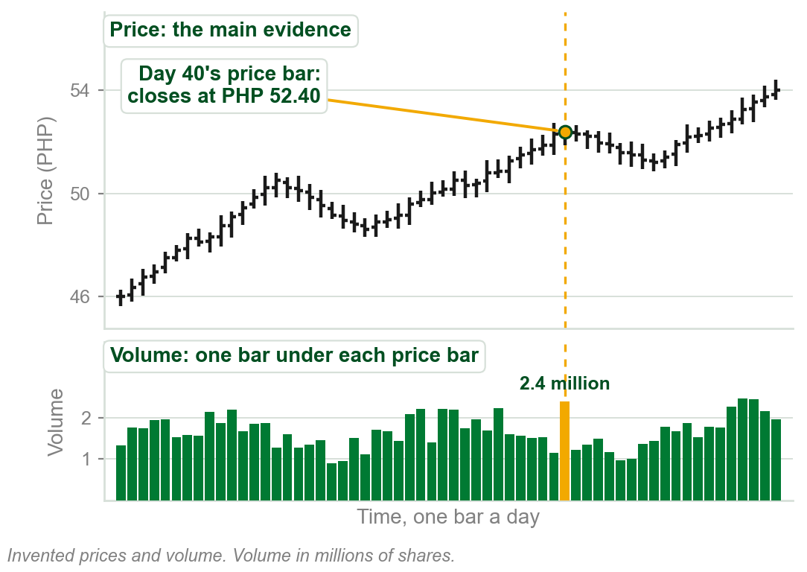
6.1 Price first: volume and open interest as evidence
Price is regarded as the best indicator of potential future price behavior.
Volume and open interest offer additional evidence to corroborate bullish or bearish setups.
They can show underlying weakness, and work as timing indicators for potential breakouts.
Many novices misread declining volume as a weakness in a consolidation.
Why that is a misreading: Part 2. Volume is defined two slides on, open interest in Part 4.
Chart A - FIN1209 teaching chart, drawn for this course. Illustrative data, not a real instrument.
Part 1 of 6 - 6.1 Confirmation | 1 of 18
Book p.173, the chapter's opening paragraph. The chart is ours, on invented prices, to show how the book's figures draw volume.
Notes:
- The book's opening paragraph, and the shape of every figure today: price on top, volume underneath, one volume bar under each price bar.
- Point at the gold day. The price bar says where it traded; the volume bar under it says how much traded. Every figure in the chapter is read that way.
- The novice error in the gold line is answered in Part 2: falling volume inside a consolidation is normal, and it times the breakout.

Slide 5
Chapter 2's tenet: volume confirms the trend
Chapter 2: under Dow Theory, volume should expand in the direction of the trend.
Uptrend: volume rises as price rises and falls in downside retracements: bullish volume action.
Downtrend: volume rises as price declines and falls in upside retracements: bearish volume action.
FIGURE 6.1
Two sketches of volume confirming a trend. Top: a rising price with volume bars that grow on the rise and shrink in the downside retracement, labelled bullish volume action in an uptrend. Bottom: a falling price with volume that grows on the fall and shrinks in the upside retracement, labelled bearish volume action in a downtrend.
The artwork is copyrighted and is not in the public repository. Build with assets/figures/ present to place it here.
Volume is a supporting, or secondary, indicator.
Volume action contrary to this: an uptrend may potentially be bearish, a downtrend bullish.
Figure 6.1 - Lim, The Handbook of Technical Analysis (Wiley, 2016)
Part 1 of 6 - 6.1 Confirmation | 2 of 18
Book pp.173-174 and Figure 6.1. The tenet was a Chapter 2 term, Volume must confirm the trend.
Notes:
- A recall: Chapter 2 gave this as its sixth tenet, with the same four conditions. Nothing in it changes.
- Read the figure's two halves. In each, the tall volume bars sit under the move that goes with the trend, and the short ones under the retracement.
- What is new today is the vocabulary on the next slides: volume is bullish or bearish, and it confirms or diverges.

Slide 6
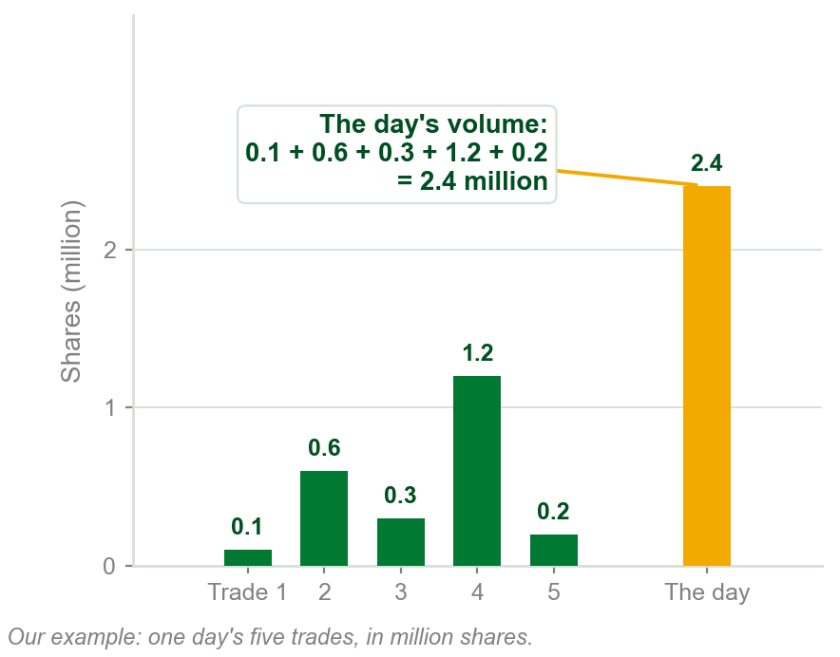
NEW TERM
Volume
IN PLAIN WORDS
How much was traded in one period: the bar under each price bar. Used since Chapter 1, first defined here.
FOR EXAMPLE
Five trades in one day: 0.1, 0.6, 0.3, 1.2 and 0.2 million shares. That day's volume is 2.4 million shares.
THE FORMAL DEFINITION
Volume is an indication of market participation. It is the total number of shares or contracts traded over a specific time interval.
Chart B - FIN1209 teaching chart, drawn for this course. Illustrative data, not a real instrument.
Part 1 of 6 - 6.1 Confirmation | 3 of 18
Book p.174 gives the definition. The trades and the share counts in the example and on the chart are ours.
Notes:
- The word has been on our charts since Chapter 1, and Chapter 2 made a tenet of it, but this is the first slide that defines it.
- Shares for a stock, contracts for a futures market. The interval is whatever the chart's bar is: a day, an hour, five minutes.
- Keep the five trades in mind: in Part 4 the same five trades give a tick volume of five.

Slide 7
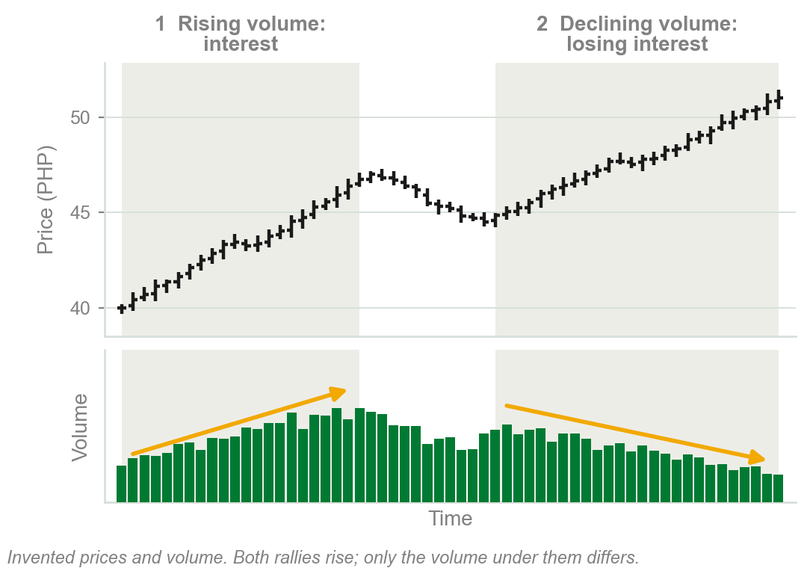
Two principles: rising and declining volume
1 Rising volume: participants want to see price go higher in an uptrend, lower in a downtrend, and will buy higher or sell lower to take part.
2 Declining volume: they are losing interest, would rather buy lower in an uptrend or sell higher in a downtrend, if not exiting.
Volume measures participation: how many want to take part in the move.
Chart C - FIN1209 teaching chart, drawn for this course. Illustrative data, not a real instrument.
Part 1 of 6 - 6.1 Confirmation | 4 of 18
Book p.174: its two basic principles, nearly word for word. The chart is ours, on invented prices.
Notes:
- The book says to remember these two whenever volume is studied. Every reading later in the chapter comes back to them.
- On the chart, 1 is a rally the market wants: volume grows as price rises. 2 is a rally fewer want: price still rises, on shrinking volume.

Slide 8
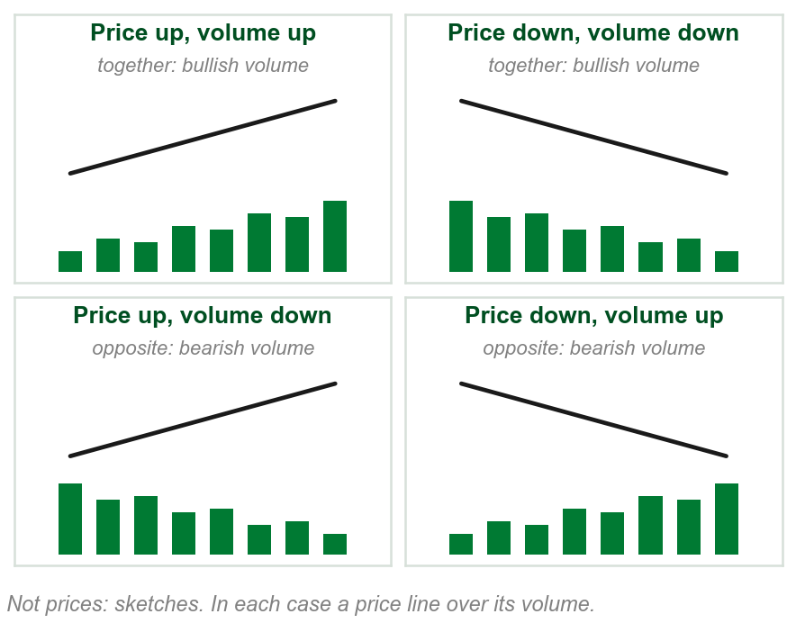
NEW TERM
Bullish volume and bearish volume
IN PLAIN WORDS
Bullish volume moves with price. Bearish volume moves against it.
FOR EXAMPLE
A share rallies on rising volume and dips on falling volume: bullish both times. Falling on rising volume, bouncing on falling volume: bearish.
THE FORMAL DEFINITION
Both rising and declining volume are regarded as bullish volume if volume and price rise and decline together, and as bearish volume if they move in opposite directions.
Chart D - FIN1209 teaching chart, drawn for this course. Illustrative data, not a real instrument.
Part 1 of 6 - 6.1 Confirmation | 5 of 18
Book pp.174-175 states it for an uptrend, then a downtrend. Joined into one line here: our summary of its four sentences.
Notes:
- The book says it four times, trend by trend. Every one of the four is the same rule: together is bullish, opposite is bearish.
- So the same falling volume is bullish under a falling price and bearish under a rising one. Volume alone says nothing until price's direction is known.
- This answers review question 2, describe bullish and bearish volume.

Slide 9
Rising volume is not always bullish
Declining volume does not necessarily imply bearishness. Rising volume does not imply bullishness.
The bullish or bearish sentiment of volume depends on the direction of the price.
Figure 6.2: volume expands with gold's primary bull trend and declines in the retracement. Bullish, both times.
FIGURE 6.2
The continuous daily chart of gold from 1989 to 2013: a primary bull trend from 2001, its volume expanding in the direction of the trend, and volume declining in the retracement at the end, labelled bullish.
The artwork is copyrighted and is not in the public repository. Build with assets/figures/ present to place it here.
The book calls the opposite reading a simple mistake many novices make.
Figure 6.2 - Lim, The Handbook of Technical Analysis (Wiley, 2016)
Part 1 of 6 - 6.1 Confirmation | 6 of 18
Book p.175 and Figure 6.2.
Notes:
- Point at the end of the chart: price falls and volume falls with it. That is bullish volume in an uptrend, not a warning.
- The mistake is reading volume alone: falling equals bad. Ask the room which way price was going first.

Slide 10
Volume that does not confirm the trend
Uptrend: volume decreases as price rises and increases in downside retracements. Bearish volume: a potentially weak or bearish uptrend.
Downtrend: volume decreases as price falls and increases in upside retracements. Bullish volume: a potentially bullish downtrend.
FIGURE 6.3
Two sketches of volume not confirming a trend. Top: a rising price whose volume shrinks on the rise and grows in the retracement, labelled bearish volume action in an uptrend. Bottom: a falling price whose volume shrinks on the fall and grows in the upside retracement, labelled bullish volume action in a downtrend.
The artwork is copyrighted and is not in the public repository. Build with assets/figures/ present to place it here.
The trend goes one way and its volume says the other.
Figure 6.3 - Lim, The Handbook of Technical Analysis (Wiley, 2016)
Part 1 of 6 - 6.1 Confirmation | 7 of 18
Book p.175 and Figure 6.3.
Notes:
- Set this beside Figure 6.1. The prices are the same shapes; only the volume is swapped.
- Not confirming is still only a potential: the book says weak or bearish uptrend, not a reversal.

Slide 11
CHECK 1 OF 19
Bullish and bearish volume
Q1
Q2
In an uptrend, price dips in a retracement and volume declines during the dip. That volume is:
Volume rises while price declines in a preexisting downtrend. The book calls this:
A. Bearish volume, because volume is falling
B. Bullish volume, because price and volume fall together
C. Neither, because the trend is up
D. Volume not confirming the uptrend
A. Bullish volume action
B. A potentially bullish downtrend
C. Volume that does not confirm the trend
D. Bearish volume action, confirming the downtrend
Part 1 of 6 - 6.1 Confirmation | Check 1
Notes:
- Read Q1 aloud, then Q2. Give them sixty seconds and no discussion.
- Ask for a show of hands on each option before you advance.
- This is for reading the room, not for marks. Say so if anyone tenses up.

Slide 12
ANSWERS
Bullish and bearish volume
Q1 In an uptrend, price dips in a retracement and volume declines during the dip. That volume is:
B. Bullish volume, because price and volume fall together
Volume and price declining together is bullish volume, whatever the volume does on its own.
Q2 Volume rises while price declines in a preexisting downtrend. The book calls this:
D. Bearish volume action, confirming the downtrend
Volume expanding in the direction of a downtrend is bearish volume action: it confirms the trend.
Part 1 of 6 - 6.1 Confirmation | Check 1
Notes:
- Reveal one at a time. Say the reason out loud, not just the letter.
- If more than a third of the room missed one, step back and reteach it.

Slide 13
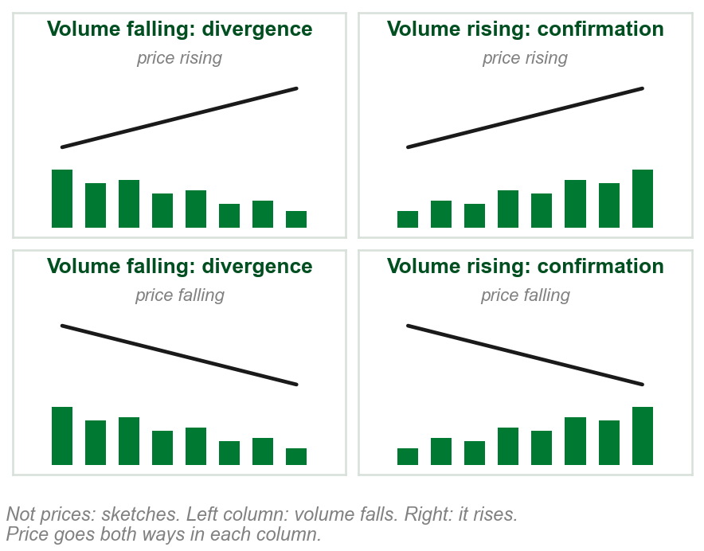
NEW TERM
Volume divergence and volume confirmation
IN PLAIN WORDS
Volume falling is divergence. Volume rising is confirmation, also called convergence.
FOR EXAMPLE
Price rises from PHP 40 to PHP 46 as volume shrinks from 3 to 1 million a day: divergence. Had it grown to 5 million: confirmation.
THE FORMAL DEFINITION
Volume divergence occurs whenever volume declines, irrespective of the direction of price. Volume convergence or confirmation occurs whenever volume rises, irrespective of the direction of price.
Chart E - FIN1209 teaching chart, drawn for this course. Illustrative data, not a real instrument.
Part 1 of 6 - 6.1 Confirmation | 8 of 18
Book p.175 defines both. The chart is ours: sketches, not prices.
Notes:
- Read the columns of the chart, not the rows: each column is one volume direction, with price going both ways.
- Bullish or bearish volume needs price. Divergence or confirmation does not: it is volume's direction alone.

Slide 14
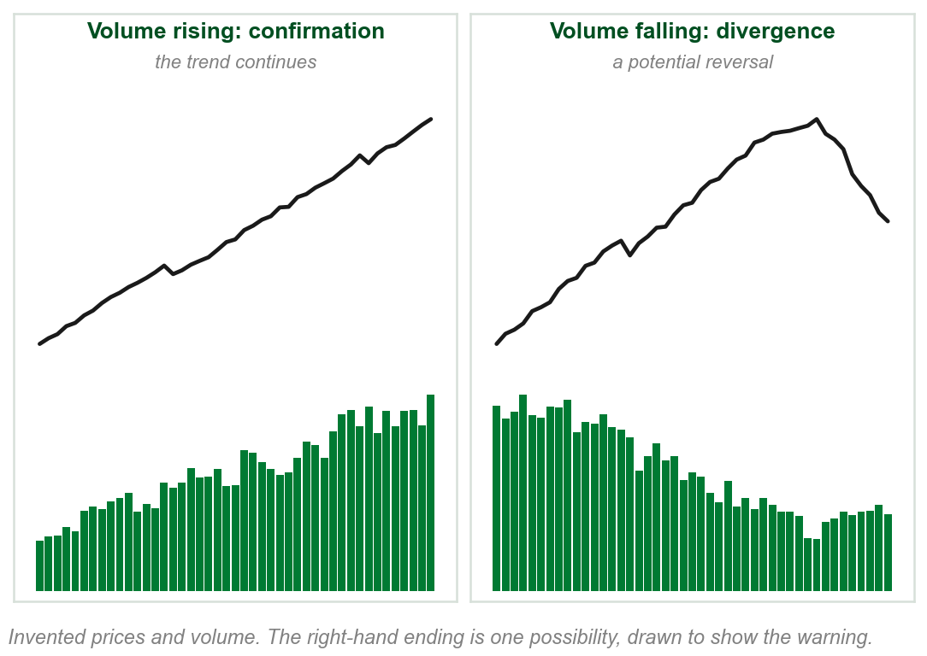
What divergence and confirmation say
Divergence: participants are not interested in seeing price go further. Bearish for an uptrend, bullish for a downtrend.
Confirmation: they are interested in taking part in the move. Bullish for an uptrend, bearish for a downtrend.
Confirmation is an early indication of a potential continuation; divergence, of a potential reversal.
The book: divergence always indicates potential weakness in an existing trend, confirmation always potential strength.
Chart F - FIN1209 teaching chart, drawn for this course. Illustrative data, not a real instrument.
Part 1 of 6 - 6.1 Confirmation | 9 of 18
Book pp.175-176. The chart is ours, on invented prices.
Notes:
- Confirmation is called convergence too: price and volume coming together in one direction. Both words mean volume rising.
- The right-hand chart is one possible ending, drawn to show what potential reversal means. Divergence is an early warning, not a certainty.

Slide 15
NEW TERM
Bullish and bearish divergence and confirmation
IN PLAIN WORDS
Four names: is volume falling or rising, and does it move with price or against it?
FIGURE 6.4
Four columns, each a price path over a supporting series. Bearish divergence: price rising, the supporting series falling. Bullish confirmation: both rising. Bearish confirmation: price falling, the supporting series rising. Bullish divergence: both falling. The supporting series is listed as volume bars, a volume moving average, open interest, and the ATR in brackets.
The artwork is copyrighted and is not in the public repository. Build with assets/figures/ present to place it here.
FOR EXAMPLE
Both falling: bullish divergence. Both rising: bullish confirmation. Volume down, price up: bearish divergence. Volume up, price down: bearish confirmation.
THE FORMAL DEFINITION
Bullish divergence can only occur in a downtrend, a potential upside reversal; bearish divergence only in an uptrend, a potential downside reversal.
Figure 6.4 - Lim, The Handbook of Technical Analysis (Wiley, 2016)
Part 1 of 6 - 6.1 Confirmation | 10 of 18
Book pp.176-178 and Figure 6.4. The four names are its p.178 summary. The ATR on the figure is in no sentence of the text.
Notes:
- The example row is the book's own summary of all four scenarios, page 178. The formal row is its two sentences on where each divergence can occur.
- Bullish or bearish comes from the last slide but one: together or apart. Divergence or confirmation from the last slide: volume down or up.
- The figure lists four kinds of supporting series. Volume, its moving average and open interest are all in the text; the ATR is not mentioned anywhere in it.

Slide 16
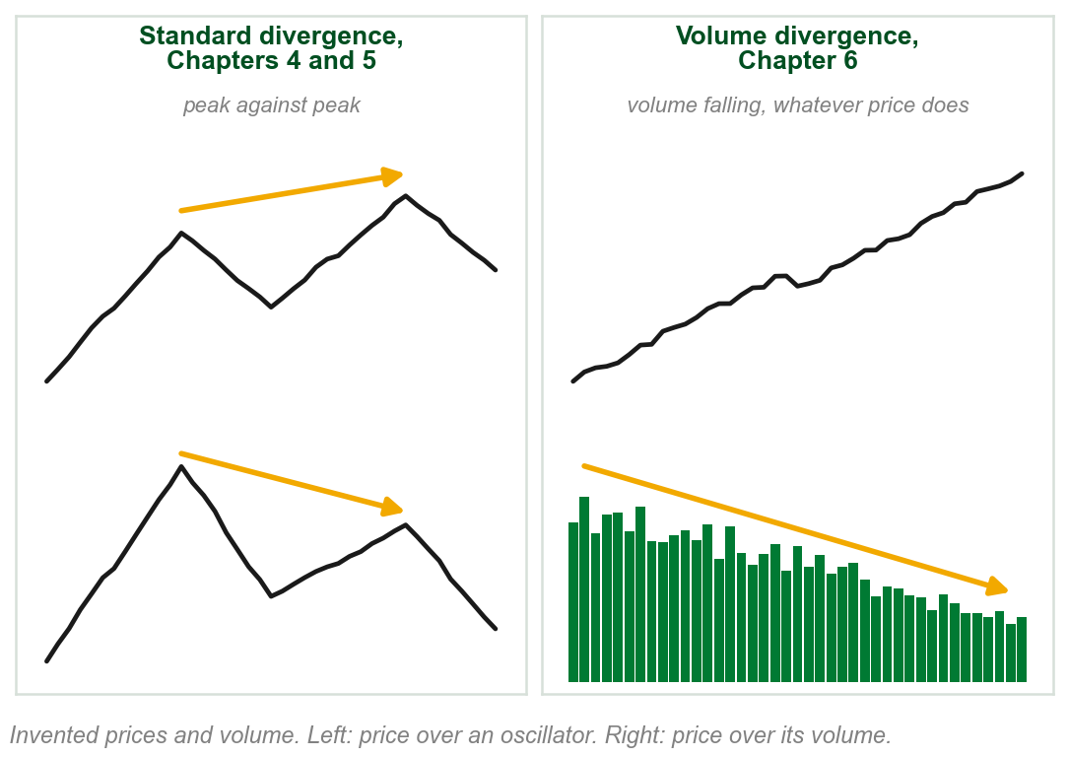
Not the divergence Chapters 4 and 5 drew
Chapters 4 and 5: standard divergence. Price makes a higher peak while an oscillator, the MACD or the bar stochastic, makes a lower one.
Volume divergence is volume declining, whatever price does.
Price's direction still decides bullish or bearish.
Volume has no reverse divergence classification.
Chapter 4 gave the volume case: falling price on decreasing volume. Reverse divergence: Chapter 9.
Chart G - FIN1209 teaching chart, drawn for this course. Illustrative data, not a real instrument.
Part 1 of 6 - 6.1 Confirmation | 11 of 18
A recall of this course's Chapters 4 and 5, against the book's p.176. The chart is ours, on invented prices.
Notes:
- Same word, different test. Standard divergence compares two peaks on two lines. Volume divergence asks one question: is volume falling?
- This answers review question 3, how volume divergence differs from standard oscillator divergence.
- Reverse divergence was named in Chapter 5 and left to Chapter 9. The book says there is no such classification for volume.

Slide 17
Bullish volume divergence: Isis Pharmaceuticals
Isis Pharmaceuticals traces out a bullish rounding bottom.
As price falls, volume falls with it, twice: bullish volume divergence.
FIGURE 6.5
An intraday chart of Isis Pharmaceuticals: price falls steeply and curves into a larger rounding bottom pattern, and the volume panel under it carries two dashed lines falling to the right, each labelled bullish volume divergence.
The artwork is copyrighted and is not in the public repository. Build with assets/figures/ present to place it here.
Divergence provides additional evidence of a bullish chart formation.
The chart's own note: Isis penetrated the previous day's close though the Dow Jones Industrial Average fell 219 points.
Figure 6.5 - Lim, The Handbook of Technical Analysis (Wiley, 2016)
Part 1 of 6 - 6.1 Confirmation | 12 of 18
Book p.177 and Figure 6.5. Rounding bottom: named in Chapter 4. Chapter 4's Figure 4.18 was an intraday chart of this stock too.
Notes:
- Price falling and volume falling together: bullish divergence, by the last slides. Point at the two dashed lines in the volume panel.
- Evidence, not a signal: the pattern is the setup and the volume corroborates it, which is the chapter's first sentence again.

Slide 18
Ten periods of bullish volume: gold
Periods 1, 3, 7 and 9: bullish confirmation. 4 and 6: bullish divergence. 5: volume flat.
2, 8 and 10: volume declines in a consolidation, timing the breakout (why: Part 2).
FIGURE 6.6
The SPDR Gold Trust over about four years, split by dashed lines into ten numbered periods, with arrows on the volume panel showing volume rising or falling in each, under the label volume expanding in the direction of the existing trend.
The artwork is copyrighted and is not in the public repository. Build with assets/figures/ present to place it here.
At the end of 2, 8 and 10, price breaks out as volume reaches its minimum.
The book says bullish divergence occurs only in a downtrend; 4 and 6 are dips in this uptrend. Our reading, price falling for any stretch: no check rests on it.
Figure 6.6 - Lim, The Handbook of Technical Analysis (Wiley, 2016)
Part 1 of 6 - 6.1 Confirmation | 13 of 18
Book p.178 and Figure 6.6. Its caption says a daily chart; the chart itself is labelled weekly.
Notes:
- Go period by period with the arrows on the volume panel. Up arrows with price rising: confirmation. Down arrows with price dipping: divergence.
- The breakout timing in 2, 8 and 10 is Part 2's subject. Here it is enough that a consolidation's falling volume is not divergence.
- Be plain about the gap: the book's sentence says downtrend, its figure says inside an uptrend. The slide gives our reading and says it is ours.

Slide 19
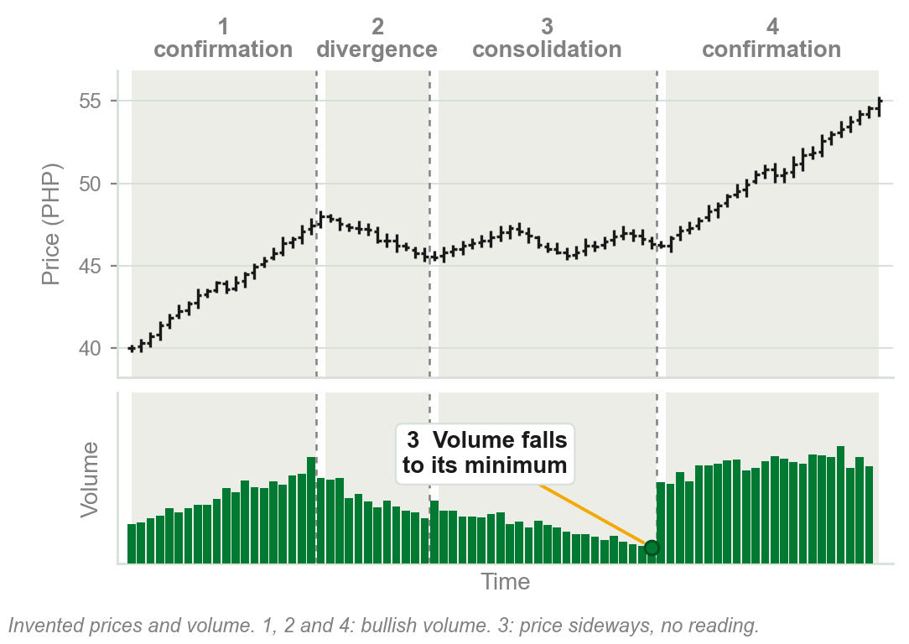
Our example: one uptrend, period by period
1 Price rises, volume rises: bullish confirmation.
2 Price dips, volume falls: bullish divergence.
3 Price moves sideways, volume falls to its minimum: a consolidation.
4 Price breaks out and rises, volume rises: bullish confirmation.
1, 2 and 4 are bullish volume. In 3 price moves sideways: no reading, Part 2.
Chart H - FIN1209 teaching chart, drawn for this course. Illustrative data, not a real instrument.
Part 1 of 6 - 6.1 Confirmation | 14 of 18
Ours: Figure 6.6's readings on one invented uptrend, so each period can be seen. The periods' lengths and volumes are ours.
Notes:
- The book's figure has ten periods on a real chart and they are hard to see. Here are four, one of each kind it names.
- Ask the room for each period before reading the label: which way is price, which way is volume, together or apart.

Slide 20
CHECK 2 OF 19
Divergence and confirmation
Q1
Q2
Price and volume are declining together. By the book's summary this is:
Which statement about volume divergence is the book's?
A. Bearish confirmation
B. Bearish divergence
C. Bullish divergence
D. Bullish confirmation
A. It occurs whenever volume declines, irrespective of the direction of price
B. It needs price to make a higher peak while volume makes a lower one
C. It has a reverse divergence classification
D. It always indicates potential strength in a trend
Part 1 of 6 - 6.1 Confirmation | Check 2
Notes:
- Read Q1 aloud, then Q2. Give them sixty seconds and no discussion.
- Ask for a show of hands on each option before you advance.
- This is for reading the room, not for marks. Say so if anyone tenses up.

Slide 21
ANSWERS
Divergence and confirmation
Q1 Price and volume are declining together. By the book's summary this is:
C. Bullish divergence
Volume declining is divergence, and volume moving with price is bullish: bullish divergence.
Q2 Which statement about volume divergence is the book's?
A. It occurs whenever volume declines, irrespective of the direction of price
Volume divergence is volume declining, whatever price does. No reverse classification, and it indicates weakness.
Part 1 of 6 - 6.1 Confirmation | Check 2
Notes:
- Reveal one at a time. Say the reason out loud, not just the letter.
- If more than a third of the room missed one, step back and reteach it.

Slide 22
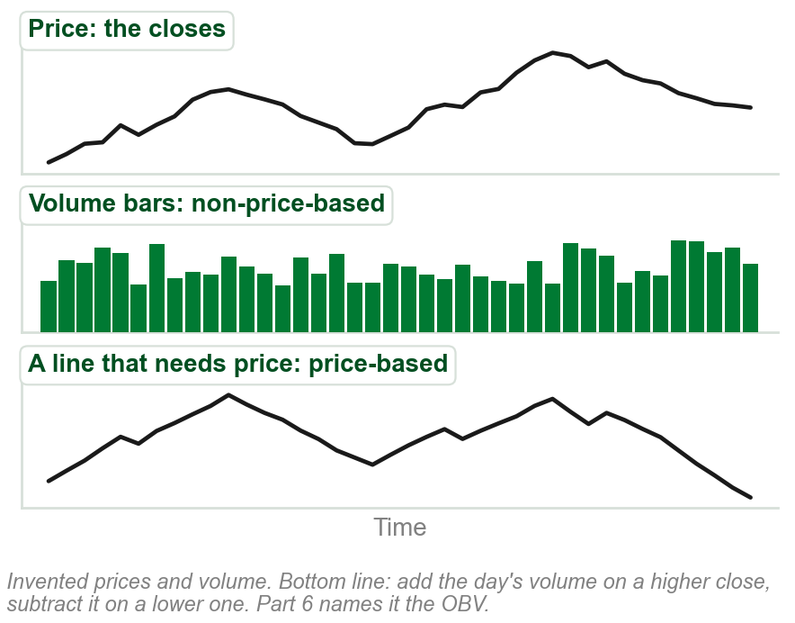
NEW TERM
Price-based and non-price-based volume oscillators
IN PLAIN WORDS
Oscillator: an indicator in a panel under price. Non-price-based: volume only. Price-based: price built in.
FOR EXAMPLE
Volume bars count shares. A line adding volume on up closes, subtracting on down closes, uses price.
THE FORMAL DEFINITION
Price-based volume oscillators incorporate price data in their construction, whereas non-price-based volume oscillators only incorporate volume data in their construction.
Chart I - FIN1209 teaching chart, drawn for this course. Illustrative data, not a real instrument.
Part 1 of 6 - 6.1 Confirmation | 15 of 18
Book pp.178-179 defines both. The chart is ours, on invented prices; its OBV line is computed by the rule taught in Part 6.
Notes:
- Oscillator is the book's word for any indicator drawn in its own panel under the price. Chapter 8 is oscillators; nothing more about them is needed today.
- The bottom line on the chart is the On Balance Volume, taught in Part 6. Here it only shows what price-based means: the close decides the sign.
- Volume bars are on the book's non-price-based list, so plain volume counts as one of these oscillators.

Slide 23
The book's two lists
Price-based: On Balance Volume (OBV), Accumulation/Distribution Line (ADL), Chaikin Money Flow, Chaikin Oscillator, Demand Index, Herrick Payoff Index.
Non-price-based: standard volume bars, smoothed volume, detrended volume, rate of change of volume (ROC volume), percentage volume oscillator (PVO).
Reading divergence on one kind differs from reading it on the other.
Taught later: OBV, ADL, the two Chaikin indicators and the Herrick index in Part 6, smoothed volume in Part 3. The Demand Index, detrended volume, ROC volume and the PVO are named and never explained.
Part 1 of 6 - 6.1 Confirmation | 16 of 18
Book p.179: its two lists, as printed. Where each is taught is this course's note.
Notes:
- The book gives these as two lists and no figure, so this slide has no picture. The next two slides show how the two kinds are read.
- Do not explain the four the book never explains. Say they are names only.

Slide 24
Reading divergence on the two kinds
Bearish divergence and bullish confirmation are read the same way on both kinds.
Bullish divergence: price falls. Volume falls on a non-price-based one; a price-based one rises.
Bearish confirmation: price falls. Volume rises on a non-price-based one; a price-based one falls.
FIGURE 6.7
Eight pairs of arrows, a price arrow over a volume arrow, in four boxes: divergence and confirmation, each for non-price-based and price-based volume oscillators. The two kinds differ only in bullish divergence and bearish confirmation, where the price-based volume arrow points the other way.
The artwork is copyrighted and is not in the public repository. Build with assets/figures/ present to place it here.
A price-based oscillator diverges by moving against price; plain volume, by falling.
Figure 6.7 - Lim, The Handbook of Technical Analysis (Wiley, 2016)
Part 1 of 6 - 6.1 Confirmation | 17 of 18
Book p.179 and Figure 6.7. The last line is our summary of the figure's eight arrows.
Notes:
- Go box by box. Top left and top right differ only in the bullish divergence pair; bottom left and bottom right only in the bearish confirmation pair.
- Why the price-based one differs: price is built into it, so when price falls it would fall too, unless buying is underneath. Ours, not the book's words: the book gives the figure and no reason.

Slide 25
Both kinds on one chart
Volume and smoothed volume, non-price-based: bearish divergence as the euro trust rises.
The detrended PVO, non-price-based: bearish divergence too.
The ADL, price-based: bullish confirmation, rising with price.
FIGURE 6.8
A daily chart of the Currency Shares Euro Trust rising, with three panels under it: volume with a smoothed line, labelled bearish divergence; a detrended volume oscillator, the PVO, also labelled bearish divergence; and the accumulation distribution line, labelled bullish confirmation.
The artwork is copyrighted and is not in the public repository. Build with assets/figures/ present to place it here.
The same rise, read two ways: each kind by its own rule.
Figure 6.8 - Lim, The Handbook of Technical Analysis (Wiley, 2016)
Part 1 of 6 - 6.1 Confirmation | 18 of 18
Book p.180 and Figure 6.8. PVO and detrending are on the figure and not explained by the book.
Notes:
- Price rises across the arrow at the top. Two volume panels fall under it, bearish divergence; the ADL rises with it, bullish confirmation.
- Do not resolve the disagreement. The book shows the figure to show each kind read by its own rule; it does not say which to believe.

Slide 26
CHECK 3 OF 19
The two kinds of volume oscillator
Q1
Q2
Which of these is a non-price-based volume oscillator?
Price falls while a price-based volume oscillator rises. On the book's reading this is:
A. On Balance Volume
B. Chaikin Money Flow
C. Smoothed volume
D. Accumulation/Distribution Line
A. Bearish confirmation
B. Bullish divergence
C. Bearish divergence
D. Bullish confirmation
Part 1 of 6 - 6.1 Confirmation | Check 3
Notes:
- Read Q1 aloud, then Q2. Give them sixty seconds and no discussion.
- Ask for a show of hands on each option before you advance.
- This is for reading the room, not for marks. Say so if anyone tenses up.

Slide 27
ANSWERS
The two kinds of volume oscillator
Q1 Which of these is a non-price-based volume oscillator?
C. Smoothed volume
Smoothed volume uses volume data only. The other three incorporate price.
Q2 Price falls while a price-based volume oscillator rises. On the book's reading this is:
B. Bullish divergence
On a price-based oscillator, bullish divergence is price falling while the oscillator rises.
Part 1 of 6 - 6.1 Confirmation | Check 3
Notes:
- Reveal one at a time. Say the reason out loud, not just the letter.
- If more than a third of the room missed one, step back and reteach it.

Slide 28
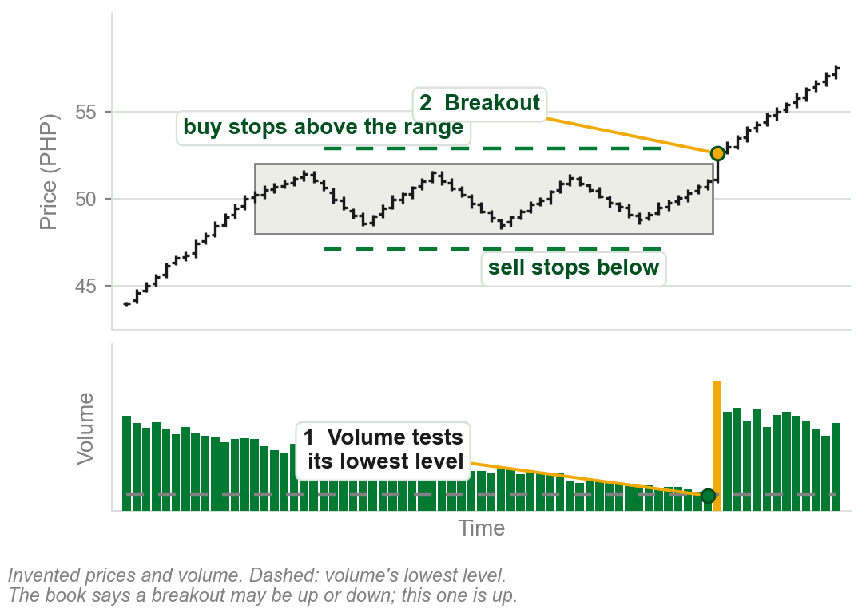
6.1 Volume as a timing indicator
When volume nears its lowest historical level, a breakout from the consolidation is expected.
Why: most who wanted to buy have bought; most who wanted to sell have sold.
Stop orders build up above and below the range: once triggered, the catalyst.
No divergence reading in a range: price moves sideways.
So falling volume in a range is not weakness. Breakout here: out of a range, as in Chapters 2 and 4.
Chart J - FIN1209 teaching chart, drawn for this course. Illustrative data, not a real instrument.
Part 2 of 6 - 6.1 Timing | 1 of 17
Book p.180: the reason is the book's. Stop orders: Chapters 1 and 5. The chart is ours, on invented prices; where the stops sit is our drawing of the book's sentence.
Notes:
- This answers the novice error from the first slide. Sideways price cannot diverge from anything, so shrinking volume inside a range is not a warning: it is the clock running down.
- The stops are stop orders, Chapter 1 and Chapter 5: buy stops above the range, sell stops below it. Whichever side is hit first starts the move.
- The book says either an upside or a downside breakout. Low volume does not say which way.

Slide 29
NEW TERM
Low volume breakout signal
IN PLAIN WORDS
Volume sinks to its lowest level inside a range: expect price to leave the range soon, either way.
FIGURE 6.9
A daily Apple chart with a low volume level drawn across its volume panel. Circles mark two low volume reversals at time lines 1 and 2, a bearish divergence and a bearish confirmation, and later an accumulation box that price leaves on a low volume breakout signal.
The artwork is copyrighted and is not in the public repository. Build with assets/figures/ present to place it here.
FOR EXAMPLE
Figure 6.9: Apple ranges in an accumulation, the box, while volume falls to its lowest level. Price then breaks out of the box, upward.
THE FORMAL DEFINITION
Whenever the volume is testing a significant minimum or its lowest historical levels, a breakout is expected. We refer to this as a low volume breakout signal.
Figure 6.9 - Lim, The Handbook of Technical Analysis (Wiley, 2016)
Part 2 of 6 - 6.1 Timing | 2 of 17
Book pp.180-181 and Figure 6.9.
Notes:
- Find the box at the bottom right of the price panel, then the circle under it where volume sits on the low volume level. The breakout follows.
- The figure also labels a bearish divergence into the top and a bearish confirmation on the fall: Part 1's names on a real chart. The two circles at 1 and 2 are the next slide.

Slide 30
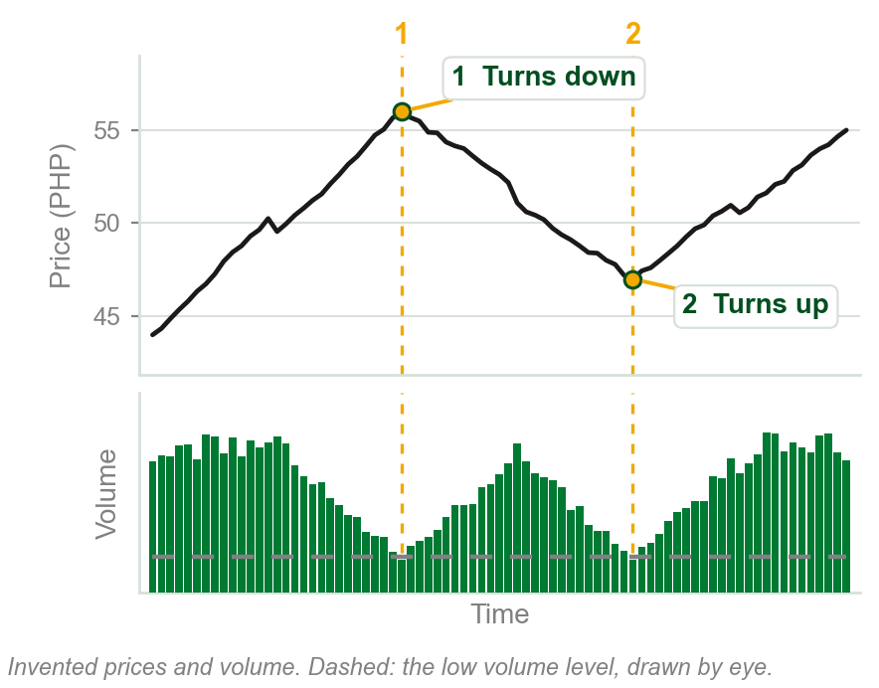
NEW TERM
Low volume reversal
IN PLAIN WORDS
Price turns while volume sits at its minimum.
FOR EXAMPLE
Figure 6.9 turns twice on low volume, at time lines 1 and 2. On our chart: at 1 a peak, at 2 a trough, each as volume touches its low level.
THE FORMAL DEFINITION
There is a tendency for price to reverse when volume is at its minimum or lowest historical levels. We refer to such reversals as low volume reversals.
Chart K - FIN1209 teaching chart, drawn for this course. Illustrative data, not a real instrument.
Part 2 of 6 - 6.1 Timing | 3 of 17
Book p.180 gives the term; Figure 6.9 (p.181) has two. The chart is ours, on invented prices, because that figure is dense.
Notes:
- Two uses of the same low volume: in a range it times a breakout, in a trend it marks a turn.
- The book gives a tendency and no rule for where the low volume level goes. Figure 6.9 draws it by eye, and so does this chart.

Slide 31
Breakouts at the lowest volume: silver
Three consolidation breakouts, each as the lowest or minimum volume level is tested.
Volume increases on the breakout bars, bars 1, 2 and 3.
FIGURE 6.10
The daily iShares Silver Trust with three consolidations boxed and a low volume threshold drawn across the volume panel. Dotted arrows show volume falling to the threshold in each box, and the breakouts at bars 1, 2 and 3 follow, with volume rising on each breakout bar.
The artwork is copyrighted and is not in the public repository. Build with assets/figures/ present to place it here.
Volume falls into the breakout, then surges on it.
Figure 6.10 - Lim, The Handbook of Technical Analysis (Wiley, 2016)
Part 2 of 6 - 6.1 Timing | 4 of 17
Book p.181 and Figure 6.10.
Notes:
- The figure shows the signal three times: an accumulation breakout up at 1, distribution breakouts down at 2 and 3. Each comes as volume touches the line.
- Notice the breakout bars themselves carry more volume than the bars before them.

Slide 32
CHECK 4 OF 19
Volume as a timing indicator
Q1
Q2
Inside a consolidation, volume falls to its lowest level in a year. The book expects:
Why is there no divergence reading during a consolidation?
A. A breakout, to the upside or the downside
B. An upside breakout only
C. Bearish divergence, so a decline
D. The consolidation to last longer
A. Volume is always flat in a consolidation
B. Divergence needs open interest
C. Consolidations only occur on low volume
D. Price is moving sideways, so neither direction can be read
Part 2 of 6 - 6.1 Timing | Check 4
Notes:
- Read Q1 aloud, then Q2. Give them sixty seconds and no discussion.
- Ask for a show of hands on each option before you advance.
- This is for reading the room, not for marks. Say so if anyone tenses up.

Slide 33
ANSWERS
Volume as a timing indicator
Q1 Inside a consolidation, volume falls to its lowest level in a year. The book expects:
A. A breakout, to the upside or the downside
Volume testing its lowest historical level in a consolidation is a low volume breakout signal, either way.
Q2 Why is there no divergence reading during a consolidation?
D. Price is moving sideways, so neither direction can be read
With price moving sideways it is not possible to tell divergence from convergence, let alone bullish from bearish.
Part 2 of 6 - 6.1 Timing | Check 4
Notes:
- Reveal one at a time. Say the reason out loud, not just the letter.
- If more than a third of the room missed one, step back and reteach it.

Slide 34
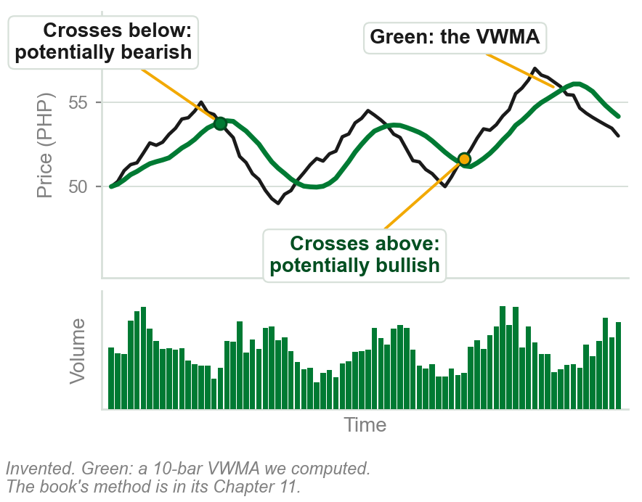
NEW TERM
Volume-weighted moving average, VWMA
IN PLAIN WORDS
A line of average price on the chart, weighted by volume as its name says. Chapter 11 says how.
FOR EXAMPLE
A share at PHP 52, above its VWMA at PHP 50: potentially bullish. At PHP 48, below it: potentially bearish.
THE FORMAL DEFINITION
A VWMA may be created to track overvalued and undervalued stock. Typically, price is considered potentially bullish when it is above the VWMA, and bearish when below it.
Chart L - FIN1209 teaching chart, drawn for this course. Illustrative data, not a real instrument.
Part 2 of 6 - 6.1 Timing | 5 of 17
Book p.181. It defers the calculation to Chapter 11. The chart is ours, on invented prices; its line is a 10-bar VWMA we computed.
Notes:
- The book's heading is Volume-Weighted Average Price/Moving Average, and its figure says VWAP. It treats the two names as one line here.
- How the average is weighted is Chapter 11. Today it is a line over price, and what matters is which side of it price is on.
- Moving averages were met in Chapters 4 and 5 and are taught in Chapter 11.

Slide 35
The VWMA on a chart
Price rises decisively every time it crosses above the VWMA, and declines in a similar manner when it crosses below.
The crossovers occur at the daily volume cycle peaks.
The figure also marks the line acting as support and resistance.
FIGURE 6.11
A 10-minute chart of the S&P 500 SPDR over four days with a dashed volume weighted average price line, labelled price above it bullish and below it bearish, and the line marked as support and as resistance. Circles on the volume panel mark the daily volume cycle peaks, with arrows from them to the crossovers.
The artwork is copyrighted and is not in the public repository. Build with assets/figures/ present to place it here.
Above the line, bullish. Below it, bearish.
Volume cycles, and their peaks: Part 5.
Figure 6.11 - Lim, The Handbook of Technical Analysis (Wiley, 2016)
Part 2 of 6 - 6.1 Timing | 6 of 17
Book p.181 and Figure 6.11. The figure is labelled VWAP on a 10-minute chart; the caption says VWMA, daily.
Notes:
- Follow each dashed arrow from a circled volume peak up to a crossover. That is the book's point about timing.
- Name the mismatch and move on: the caption says VWMA and daily, the figure says VWAP and 10 minutes.

Slide 36
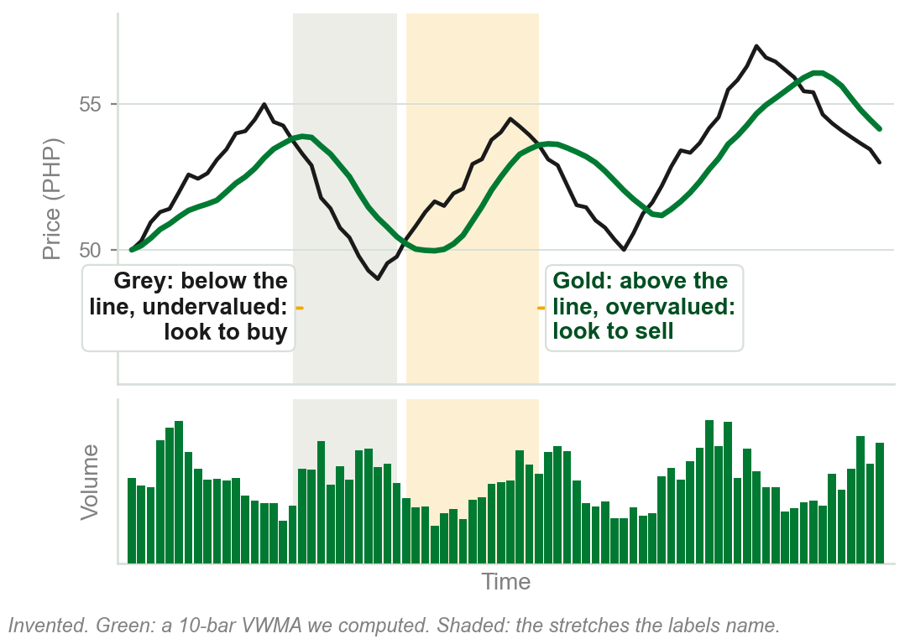
Undervalued below, overvalued above
The book also calls a stock undervalued below the VWMA and overvalued above it.
Many institutional traders look for buy signals only when it is undervalued, and sell signals only when it is above.
So above the line is potentially bullish, and also where institutions look to sell.
Two readings of one line, both the book's.
Know both. The book leaves the tension between them unresolved, and so does this slide.
Chart M - FIN1209 teaching chart, drawn for this course. Illustrative data, not a real instrument.
Part 2 of 6 - 6.1 Timing | 7 of 17
Book p.181. Both readings are the book's, a paragraph apart; it does not reconcile them. The chart is ours, on invented prices.
Notes:
- Read both sentences from the book. One says above the line is bullish; the next says above the line is overvalued, where institutions sell.
- Do not invent a reconciliation. If a student asks, the answer is that the book gives both and the course teaches both.

Slide 37
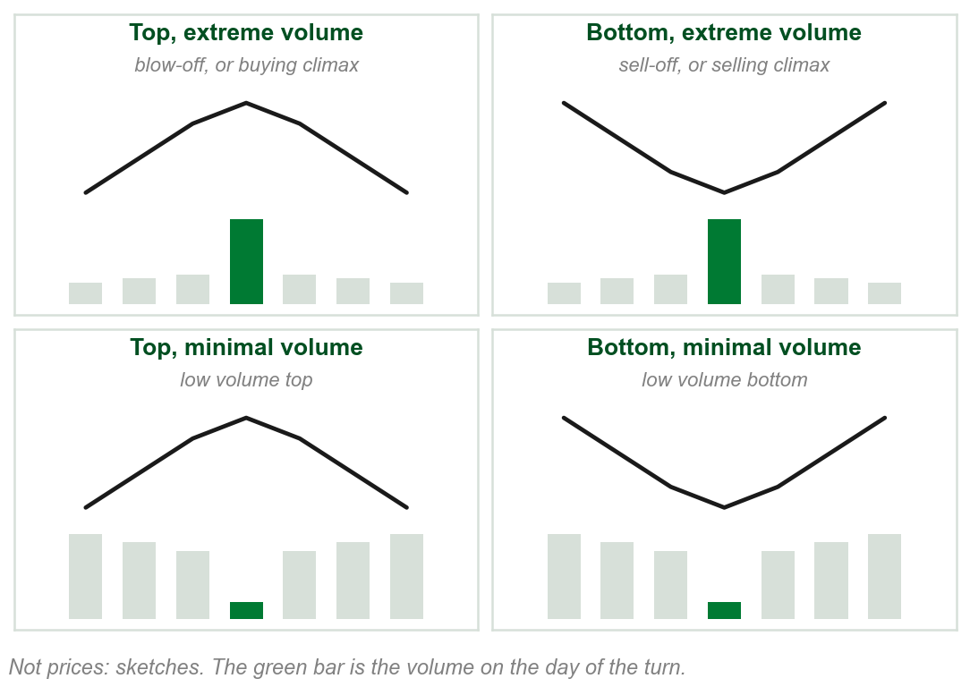
Tops and bottoms: volume at the extremes
A top or bottom usually comes on relatively large or extreme volume, or on relatively low or minimal volume.
Extreme volume: a top is a blow-off or buying climax, a bottom a sell-off or selling climax.
Extremely low volume: a low volume top, or a low volume bottom.
Four turns, named by place and by volume.
Chapter 4 named the climaxes that end a trend. Chapter 6 adds their extreme volume.
Chart N - FIN1209 teaching chart, drawn for this course. Illustrative data, not a real instrument.
Part 2 of 6 - 6.1 Timing | 8 of 17
Book pp.182-183, its four scenarios. Chapter 4 named the climaxes by who trades. The chart is ours: sketches, not prices.
Notes:
- The climaxes are a recall: Chapter 4 told who buys and sells in them. What is new is the volume, and the two low volume names.
- The low volume top and bottom get their own slide after the climax figures, in the book's order.

Slide 38
NEW TERM
Upper and lower overextended volume levels
IN PLAIN WORDS
A line across the volume panel that only extreme volume reaches. A lower one catches smaller turns.
FIGURE 6.12
The daily chart of Exxon Mobil from 2006 to 2013: an ellipse around a market bottom made by two selling climaxes, with arrows down to two volume spikes. Across the volume panel run two lines, upper level volume overextension and lower level volume overextension.
The artwork is copyrighted and is not in the public repository. Build with assets/figures/ present to place it here.
FOR EXAMPLE
Figure 6.12: Exxon Mobil bottoms on two selling climaxes, and both spikes reach the upper level.
THE FORMAL DEFINITION
The extreme volume level is the upper overextended volume level, a signal for potential bottoms or tops. A lower overextended volume level forecasts less significant corrections.
Figure 6.12 - Lim, The Handbook of Technical Analysis (Wiley, 2016)
Part 2 of 6 - 6.1 Timing | 9 of 17
Book p.183 and Figure 6.12. Exxon Mobil is spelt Exxon Mobile by the book.
Notes:
- Point at the two spikes under the ellipse: each is a selling climax, and each reaches the upper line.
- Upper for the big turns, lower for the corrections. Where to draw them is the slide after next.

Slide 39
Blow-offs: buying climaxes
A couple of blow-offs, or buying climaxes, at relatively high volume.
Each is a market top on a volume spike, and price falls after it.
FIGURE 6.13
The daily chart of the E-TRACS UBS Bloomberg CMCI Food ETN with two circled volume spikes labelled blow-off, each under a market top.
The artwork is copyrighted and is not in the public repository. Build with assets/figures/ present to place it here.
The same overextension that marks a selling climax marks a buying one.
Figure 6.13 - Lim, The Handbook of Technical Analysis (Wiley, 2016)
Part 2 of 6 - 6.1 Timing | 10 of 17
Book p.183 and Figure 6.13.
Notes:
- The mirror of the last figure: tops this time. Follow each arrow from BLOW-OFF to its spike and up to its top.
- The second blow-off is on a much smaller spike than the first in absolute terms. Compare it with the volume around it, not with the first.

Slide 40
Where to set the overextension level
Set by visual inspection, where only the most significant tops or bottoms are found.
Set lower, it signals more often, at less significant tops and bottoms.
Figure 6.14: the spikes are all above the rolling 100-day 2-sigma level; one breaks a significant support.
FIGURE 6.14
The daily SPDR Gold Trust: a dashed volume overextension line across the volume panel with circled spikes above it, and a dashed support line on the price that is broken at the right on extreme volume, labelled above the rolling 100-day 2-sigma level.
The artwork is copyrighted and is not in the public repository. Build with assets/figures/ present to place it here.
Higher level, fewer and bigger turns.
Figure 6.14 - Lim, The Handbook of Technical Analysis (Wiley, 2016)
Part 2 of 6 - 6.1 Timing | 11 of 17
Book pp.183-184 and Figure 6.14. Sigma, a standard deviation, is taught in Part 3.
Notes:
- By eye is the book's method: there is no formula for the line. The 2-sigma level is a second, computed line, and Part 3 builds one.
- Find the support break at the far right: price falls through a significant level on extreme volume.

Slide 41
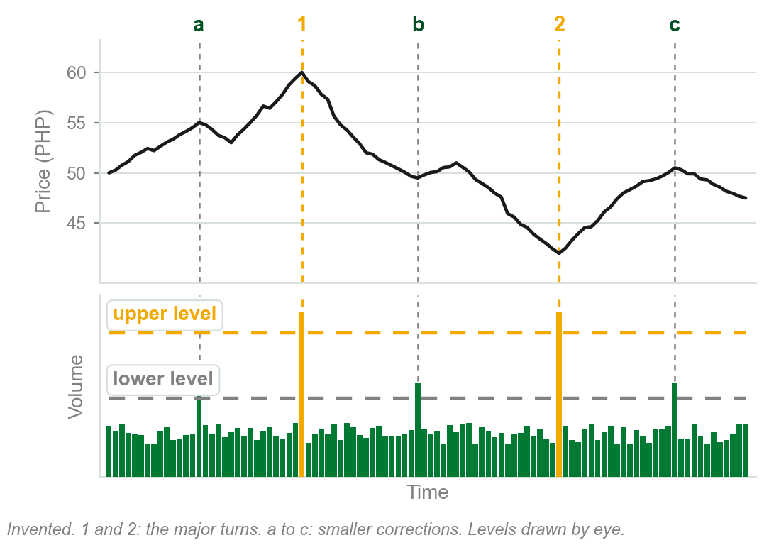
Our example: a higher level and a lower one
Upper level: only two spikes reach it, at the two major turns, 1 and 2.
Lower level: three more spikes reach it, at smaller corrections, a, b and c.
Where the line goes decides which turns it signals.
Chart O - FIN1209 teaching chart, drawn for this course. Illustrative data, not a real instrument.
Part 2 of 6 - 6.1 Timing | 12 of 17
Ours, drawing the book's p.183 rule on one invented chart. Both levels and every price are ours.
Notes:
- The numbers are the big turns and the letters the small ones. Ask the room which line they would draw to trade only the big ones.
- Both lines were placed by eye, the way the book says to.

Slide 42
Volatility spikes at the same turns
A Bollinger Bandwidth oscillator times volatility in silver.
The volatility spikes coincide with the volume overextensions, signaling tops and bottoms.
FIGURE 6.15
The continuous daily chart of silver with an upper and a lower volume overextension line, and under it a bandwidth oscillator labelled volatility, with its own historical volatility level. Thin lines join circled volatility spikes to volume overextensions and to a top at 1 and a bottom at 2.
The artwork is copyrighted and is not in the public repository. Build with assets/figures/ present to place it here.
Many practitioners filter out volatility below a threshold and regard it as noise.
Bandwidth and Bollinger Bands are named and not explained in this chapter.
Figure 6.15 - Lim, The Handbook of Technical Analysis (Wiley, 2016)
Part 2 of 6 - 6.1 Timing | 13 of 17
Book p.184 and Figure 6.15. The book does not explain the Bollinger Bandwidth here.
Notes:
- Two kinds of evidence agree at 1 and 2: volume overextended, and volatility spiking. The lower, wavy stretch is what the book calls noise.
- Do not teach the bandwidth. Say it is a measure of volatility the book uses here and explains elsewhere.

Slide 43
CHECK 5 OF 19
Climaxes and overextension
Q1
Q2
A market top forms on extreme volume. The book calls it:
A trader lowers the volume overextension level on a chart. The signals will be:
A. A low volume top
B. A selling climax
C. A low volume breakout signal
D. A blow-off or buying climax
A. Fewer, at more significant tops and bottoms
B. More frequent, at less significant tops and bottoms
C. Unchanged, because the level is set by eye
D. Limited to selling climaxes
Part 2 of 6 - 6.1 Timing | Check 5
Notes:
- Read Q1 aloud, then Q2. Give them sixty seconds and no discussion.
- Ask for a show of hands on each option before you advance.
- This is for reading the room, not for marks. Say so if anyone tenses up.

Slide 44
ANSWERS
Climaxes and overextension
Q1 A market top forms on extreme volume. The book calls it:
D. A blow-off or buying climax
A market top associated with extreme volume is a blow-off or buying climax.
Q2 A trader lowers the volume overextension level on a chart. The signals will be:
B. More frequent, at less significant tops and bottoms
Setting the level lower tends to signal less significant tops or bottoms more frequently.
Part 2 of 6 - 6.1 Timing | Check 5
Notes:
- Reveal one at a time. Say the reason out loud, not just the letter.
- If more than a third of the room missed one, step back and reteach it.

Slide 45
NEW TERM
Low volume top and low volume bottom
IN PLAIN WORDS
A top, or a bottom, made on very little volume.
FIGURE 6.16
A daily Apple chart with a low volume threshold drawn across its volume panel and circled wherever volume tests it. Dashed time lines run up from each circle to a top or a bottom in price, labelled low volume reversals.
The artwork is copyrighted and is not in the public repository. Build with assets/figures/ present to place it here.
FOR EXAMPLE
Figure 6.16: Apple turns at seven time lines, each where volume tests a lower volume threshold, circled. Some are tops and some are bottoms.
THE FORMAL DEFINITION
A market top associated with extremely low or minimal volume is called a low volume top. A market bottom associated with extremely low volume is called a low volume bottom.
Figure 6.16 - Lim, The Handbook of Technical Analysis (Wiley, 2016)
Part 2 of 6 - 6.1 Timing | 14 of 17
Book pp.183, 185 and Figure 6.16.
Notes:
- These are the low volume reversals of the part's start, now named by where they turn: at a top or at a bottom.
- The threshold is again drawn by eye, and the circles are where volume tests it.

Slide 46
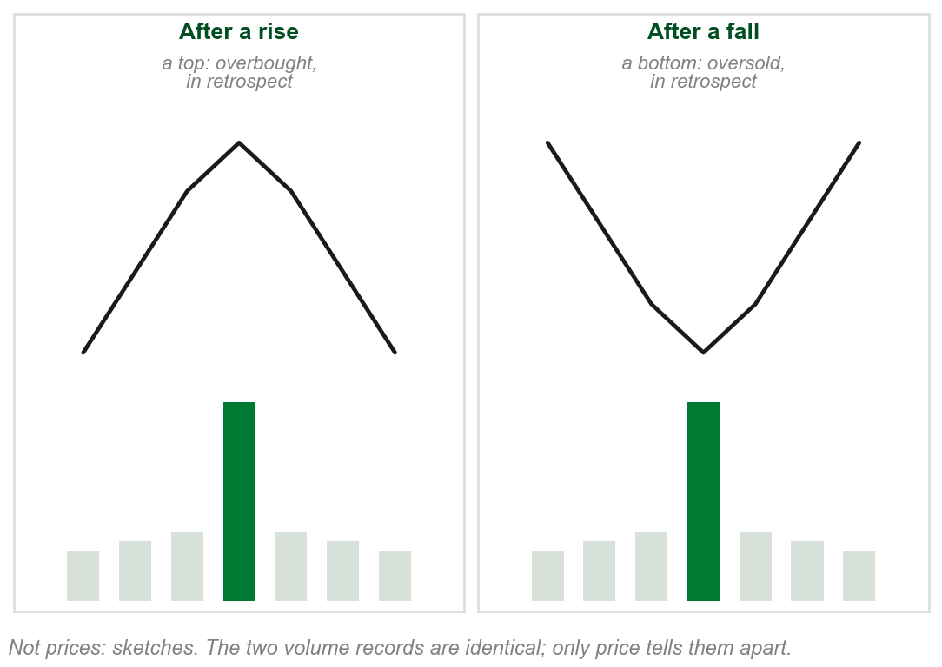
Overbought or oversold? Only afterwards
Overextended volume can signal either a top or a bottom: extreme buying and selling both generate volume.
So a volume extreme is not overbought or oversold until it is tied to a top or a bottom.
We can pinpoint the overextension now. Overbought or oversold, only in retrospect.
Overbought and oversold: met in Chapters 1 and 5, never defined there or here. Oscillators are Chapter 8.
Chart P - FIN1209 teaching chart, drawn for this course. Illustrative data, not a real instrument.
Part 2 of 6 - 6.1 Timing | 15 of 17
Book p.186. The chart is ours: sketches, not prices. Overbought and oversold are used and not defined in this chapter.
Notes:
- The two volume bars are identical. Only what price did next tells you which one it was.
- That is the book's reason for not calling volume overbought or oversold in advance.

Slide 47
Lower timeframes are more sensitive
The same gold volume, on five timeframes: daily, weekly, monthly, quarterly, yearly.
Daily and weekly volume peak in 2013. Monthly and higher peak in 2011.
Lower timeframe charts are more sensitive to volume action.
FIGURE 6.17
The continuous chart of gold with five volume panels under it: daily, weekly, monthly, quarterly and yearly. Lines over each mark where its volume peaks: in 2013 on the daily and weekly panels, in 2011 on the monthly, quarterly and yearly ones.
The artwork is copyrighted and is not in the public repository. Build with assets/figures/ present to place it here.
At higher timeframes, the overall trend or behavior of volume is more obvious.
Figure 6.17 - Lim, The Handbook of Technical Analysis (Wiley, 2016)
Part 2 of 6 - 6.1 Timing | 16 of 17
Book p.186 and Figure 6.17.
Notes:
- Find the circled spike in 2013 on the daily and weekly panels. Then find where monthly and above peak: 2011.
- One day's spike dominates a daily panel. Added into a month or a year, it is outweighed by the busy months around it.

Slide 48
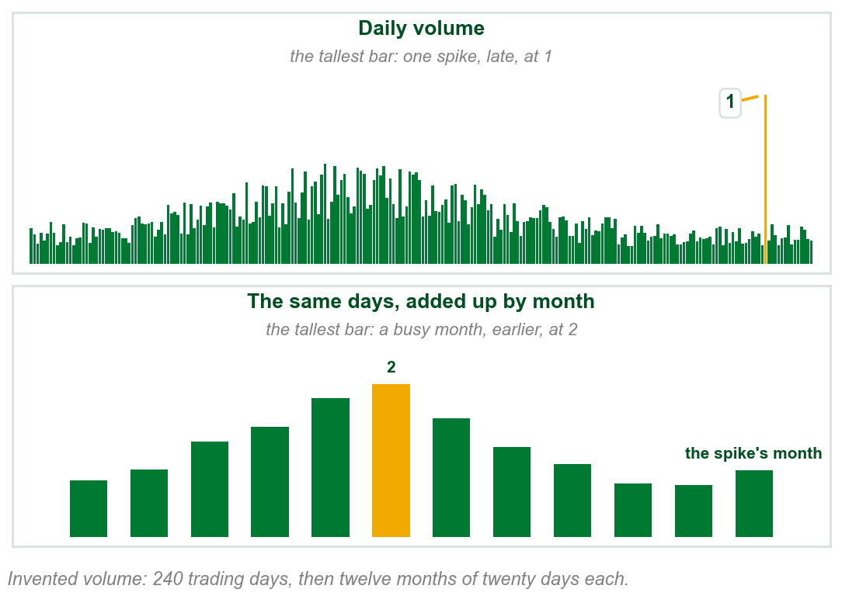
Our example: one record, two timeframes
Daily: the tallest bar is one spike, late in the record, at 1.
Monthly: the same days added up by month. The busiest month, 2, comes earlier.
One volume record, two different peaks: it depends on the timeframe.
Chart Q - FIN1209 teaching chart, drawn for this course. Illustrative data, not a real instrument.
Part 2 of 6 - 6.1 Timing | 17 of 17
Ours: the book's p.186 point on one invented volume record. The days, the spike and the months are ours.
Notes:
- Nothing changes between the two panels but the length of the bar: the same shares, added up by day or by month.
- So the daily chart reacts to one day; the monthly chart shows the broad shape of participation.

Slide 49
CHECK 6 OF 19
Low volume turns and timeframes
Q1
Q2
A market bottom forms on extremely low volume. The book calls it:
Why does the book say volume extremes can be called overbought or oversold only in retrospect?
A. A sell-off
B. A low volume bottom
C. A selling climax
D. An upper overextended volume level
A. Volume is not an oscillator
B. Volume extremes only occur at bottoms
C. An overextension can signal either a top or a bottom
D. Overbought levels are set by eye
Part 2 of 6 - 6.1 Timing | Check 6
Notes:
- Read Q1 aloud, then Q2. Give them sixty seconds and no discussion.
- Ask for a show of hands on each option before you advance.
- This is for reading the room, not for marks. Say so if anyone tenses up.

Slide 50
ANSWERS
Low volume turns and timeframes
Q1 A market bottom forms on extremely low volume. The book calls it:
B. A low volume bottom
A market bottom associated with extremely low volume is a low volume bottom.
Q2 Why does the book say volume extremes can be called overbought or oversold only in retrospect?
C. An overextension can signal either a top or a bottom
Extreme buying and selling both generate volume, so only the top or bottom that follows tells which it was.
Part 2 of 6 - 6.1 Timing | Check 6
Notes:
- Reveal one at a time. Say the reason out loud, not just the letter.
- If more than a third of the room missed one, step back and reteach it.

Slide 51
6.1 Volume and the strength of a price barrier
Barrier (Chapter 5): a resistance above price stops a rise; a support below price stops a fall.
Retest (Chapter 5): price coming back later to a barrier it touched before.
Volume peak: the tallest bar comes at the touch, the bar where price meets the barrier. Resistance 1, Support 1.
Volume dip or trough: the shortest bar comes at the touch. Resistance 2, Support 2.
FIGURE 6.18
Four sketches under the question which price barrier is more reliable. Resistance 1 and Support 1 are each touched as volume peaks; Resistance 2 and Support 2 are each touched as volume dips to its lowest.
The artwork is copyrighted and is not in the public repository. Build with assets/figures/ present to place it here.
The book: the peak is the most reliable.
Figure 6.18 - Lim, The Handbook of Technical Analysis (Wiley, 2016)
Part 3 of 6 - 6.1 Filtering | 1 of 21
Book p.187 and Figure 6.18. Barrier and retest: Chapter 5's words. The book gives no volume number for a peak or a dip.
Notes:
- Ask the question on the figure before answering it. Point at the touch in each sketch, then at the volume bar under it: tallest in the top row, shortest in the bottom row.
- Barrier is Chapter 5's word, from barrier proximity: a support below price or a resistance above it. Retest was Chapter 5's too, price returning to a level it touched before.
- Why the peak wins comes on the next slide, with numbers.

Slide 52
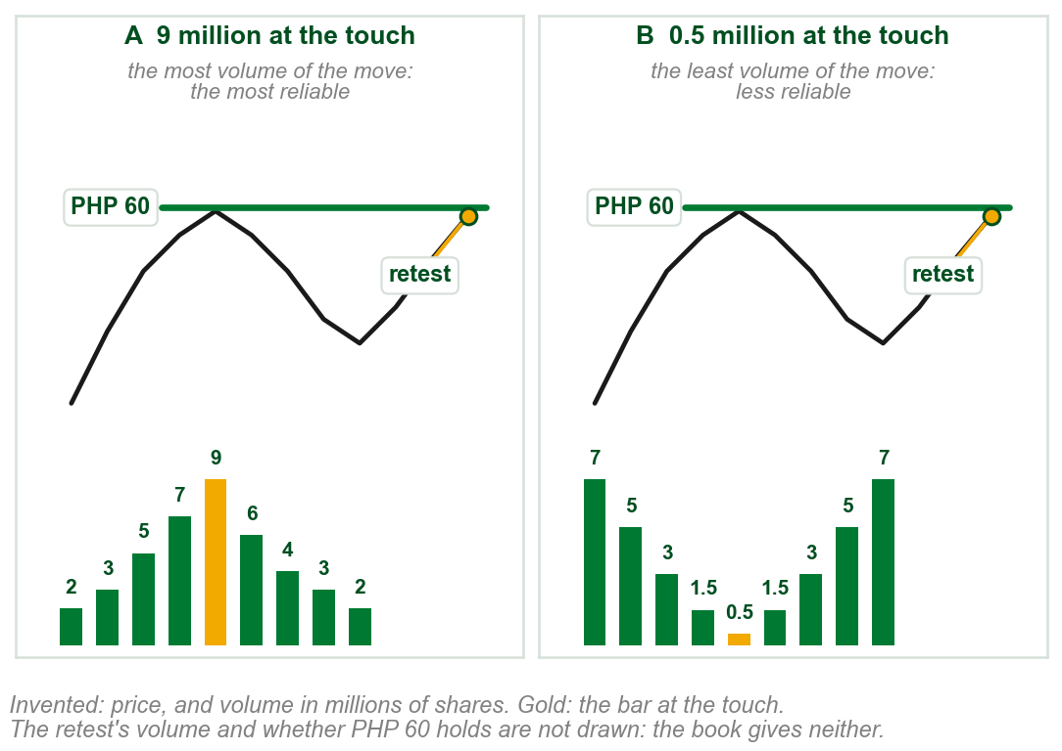
Why a volume peak makes the stronger barrier
Ours: twice, price rises to PHP 60 and turns down. Volume in millions of shares.
A: 9 million at the touch, more than any other bar. Even that surge could not get through, so traders expect PHP 60 to hold.
B: 0.5 million at the touch, less than any other bar. It held only for lack of buying: hardly anyone tried.
On a retest, A is the stronger barrier.
The book: since expectation is everything in the market, that confidence goes a long way.
Chart RA - FIN1209 teaching chart, drawn for this course. Illustrative data, not a real instrument.
Part 3 of 6 - 6.1 Filtering | 2 of 21
Book p.187: the reasons are the book's. Ours: PHP 60 and every volume number, invented to show the two shapes.
Notes:
- Read A first: the biggest push of the move hit PHP 60 and still failed. Then B: nobody pushed, so the level was never really tested.
- The chart does not draw what happens at the retest. The book says only which barrier is more reliable, not that B will break.

Slide 53
Five kinds of volume action at a barrier
Across: the bars before, at and after the touch, which the dashed arrow marks. Only the volume differs between sketches.
1 Increasing: each bar taller. 2 Decreasing: each shorter. 3 Peaking: tallest at the touch.
4 Bottoming: shortest at the touch. 5 Flatlining: all alike.
FIGURE 6.19
Ten sketches in two rows, five at a resistance and five at a support, each with volume bars under the turn: increasing, decreasing, peaking, bottoming and flatlining across the barrier.
The artwork is copyrighted and is not in the public repository. Build with assets/figures/ present to place it here.
Top: resistance. Bottom: support.
The book: increasing or decreasing volume there signifies a change in sentiment, the crowd's mood (Chapter 1).
Figure 6.19 - Lim, The Handbook of Technical Analysis (Wiley, 2016)
Part 3 of 6 - 6.1 Filtering | 3 of 21
Book pp.187-188 and Figure 6.19. Across: the book does not define it; this reading is ours, from the figure.
Notes:
- Peaking and bottoming are the two cases of Figure 6.18. Increasing, decreasing and flatlining are new.
- In every sketch the price curve is the same; only the volume bars change. Read the bars left to right.

Slide 54
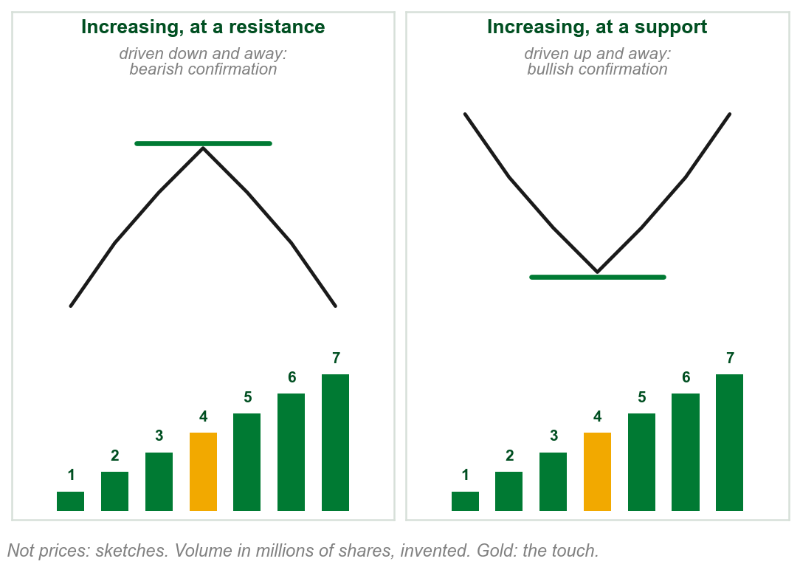
Increasing volume: price driven away
Increasing, ours: 1, 2, 3 million on the way in, 4 at the touch, 5, 6, 7 on the way out.
The book: rising volume on the way in looks strong enough to break through. Instead price turns, and the rising volume drives it away.
At a resistance price falls as volume rises: Part 1's bearish confirmation. At a support both rise: bullish confirmation.
Rising volume across a barrier confirms the turn away from it.
Chart R - FIN1209 teaching chart, drawn for this course. Illustrative data, not a real instrument.
Part 3 of 6 - 6.1 Filtering | 4 of 21
Book p.188. Confirmation, bullish and bearish: Part 1. The chart is ours: sketches and invented volume.
Notes:
- The book's sentences on increasing and decreasing volume are hard going. This slide takes increasing alone: what volume does, then what price does next.
- Price down with volume up is bearish confirmation, Part 1's name for it: at a resistance the rising volume is the selling that drives price down.

Slide 55
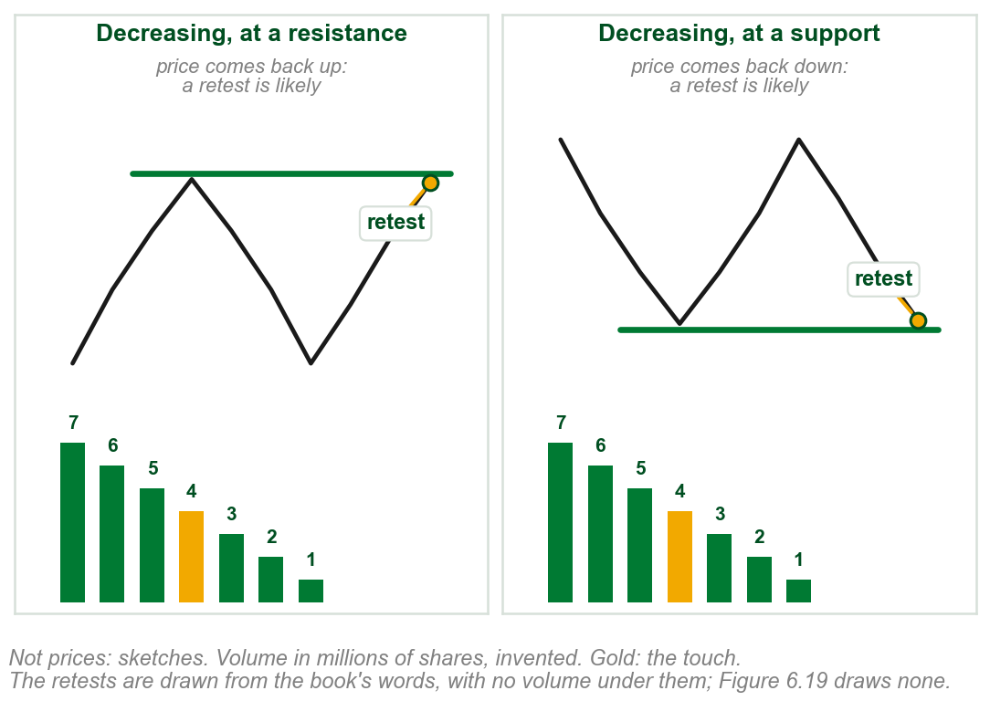
Decreasing volume: a retest is likely
Decreasing, ours: 7, 6, 5 million on the way in, 4 at the touch, 3, 2, 1 on the way out.
The book: falling volume on the way in looks like too little force to take price through.
Price turns, and volume falls even further: little force is driving price away.
So a retest is likely; in extreme cases price goes through, a penetration (Chapter 2).
Falling volume across a barrier invites a retest.
Chart RB - FIN1209 teaching chart, drawn for this course. Illustrative data, not a real instrument.
Part 3 of 6 - 6.1 Filtering | 5 of 21
Book p.188. Penetration: Chapter 2. The chart is ours: sketches and invented volume, its retests drawn from the book's words.
Notes:
- Decreasing volume across the barrier is the one to watch: the book says it tends to see a retest, and in more extreme circumstances price may return to penetrate it.
- Figure 6.19 draws price turning cleanly in every case. The retests on our chart are drawn from the book's words, and the chart gives them no volume because the book gives none.

Slide 56
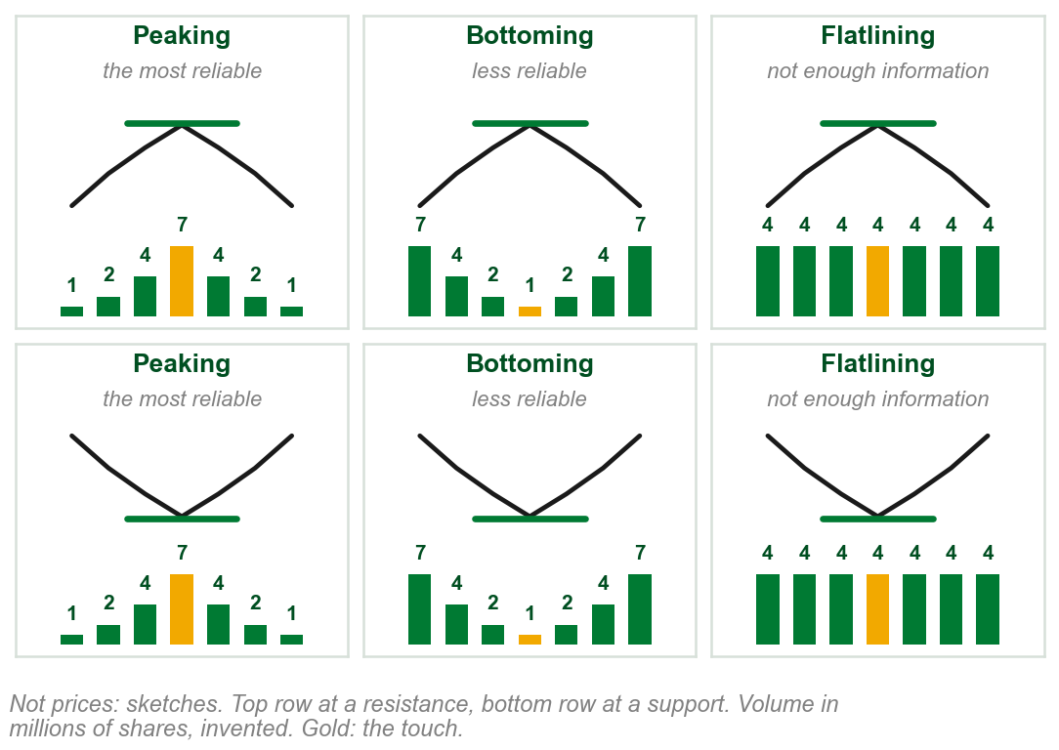
Peaking, bottoming and flatlining
Peaking, ours: 1, 2, 4, 7 at the touch, 4, 2, 1. Figure 6.18's peak: most reliable.
Bottoming: 7, 4, 2, 1 at the touch, 2, 4, 7. Figure 6.18's dip: less reliable.
Flatlining: 4 on every bar. The book: not enough information about price's next move.
The other two: increasing confirms the turn, decreasing invites a retest.
A peak is the most reliable; the book does not rank it against increasing.
Chart RC - FIN1209 teaching chart, drawn for this course. Illustrative data, not a real instrument.
Part 3 of 6 - 6.1 Filtering | 6 of 21
Book pp.187-188. The chart is ours: sketches and invented volume.
Notes:
- Peaking and bottoming are the volume peak and the volume dip of Figure 6.18, now with numbers. Flatlining is the only new one.
- Flatlining is not a weak barrier or a strong one. The book says it gives too little information to tell.

Slide 57
CHECK 7 OF 19
Volume at a price barrier
Q1
Q2
Which support is regarded as the most reliable barrier to future retests?
Volume decreases across a support as price touches it and turns. The book says this tends to see:
A. One formed at a volume peak
B. One formed across a volume trough
C. One formed on flatlining volume
D. One formed on decreasing volume
A. Price driven away with bullish confirmation
B. Not enough information to say
C. The strongest possible barrier
D. A retest of the barrier, or even a penetration
Part 3 of 6 - 6.1 Filtering | Check 7
Notes:
- Read Q1 aloud, then Q2. Give them sixty seconds and no discussion.
- Ask for a show of hands on each option before you advance.
- This is for reading the room, not for marks. Say so if anyone tenses up.

Slide 58
ANSWERS
Volume at a price barrier
Q1 Which support is regarded as the most reliable barrier to future retests?
A. One formed at a volume peak
Support formed at a volume peak held against a large surge in volume, so traders expect it to hold.
Q2 Volume decreases across a support as price touches it and turns. The book says this tends to see:
D. A retest of the barrier, or even a penetration
Decreasing volume across support or resistance tends to see a retest, and in extreme cases a penetration.
Part 3 of 6 - 6.1 Filtering | Check 7
Notes:
- Reveal one at a time. Say the reason out loud, not just the letter.
- If more than a third of the room missed one, step back and reteach it.

Slide 59
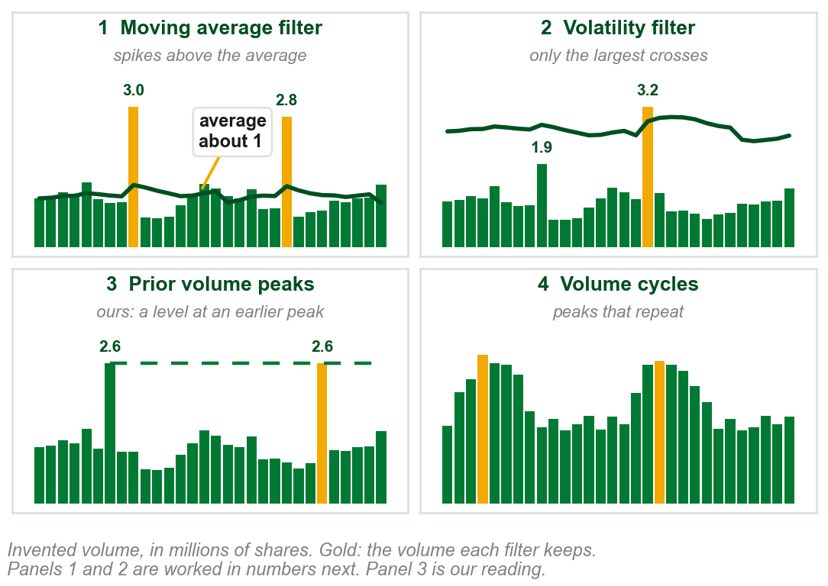
Filtering volume action: four ways
Filtering picks out the most significant volume: what may lead to a top or bottom.
Four of the book's numerous ways: 1 a moving average filter, which it calls the smoothed volume filter, 2 a volatility filter, 3 prior volume peaks, 4 volume cycles.
1 and 2 are worked next. 3 is named and never explained. 4 comes in Part 5.
Gold: the volume each filter keeps.
Panel 3 is our reading, not examinable: like Part 2's upper overextended volume level, set at earlier climax volume.
Chart S - FIN1209 teaching chart, drawn for this course. Illustrative data, not a real instrument.
Part 3 of 6 - 6.1 Filtering | 7 of 21
Book pp.188-189: the four are the book's, from among numerous ways. Prior volume peaks: named on p.188 only. The chart is ours, on invented volume.
Notes:
- This answers review question 5, the modes of volume filtering. Four ways, and the book explains two of them in this passage: the smoothed volume filter, then the two- or three-sigma filter.
- Prior volume peaks: the book names them on p.188 and never explains them. Part 2's upper overextended volume level was set at the volume of earlier climaxes, which is the nearest the book comes; that reading is ours and is not examinable.

Slide 60
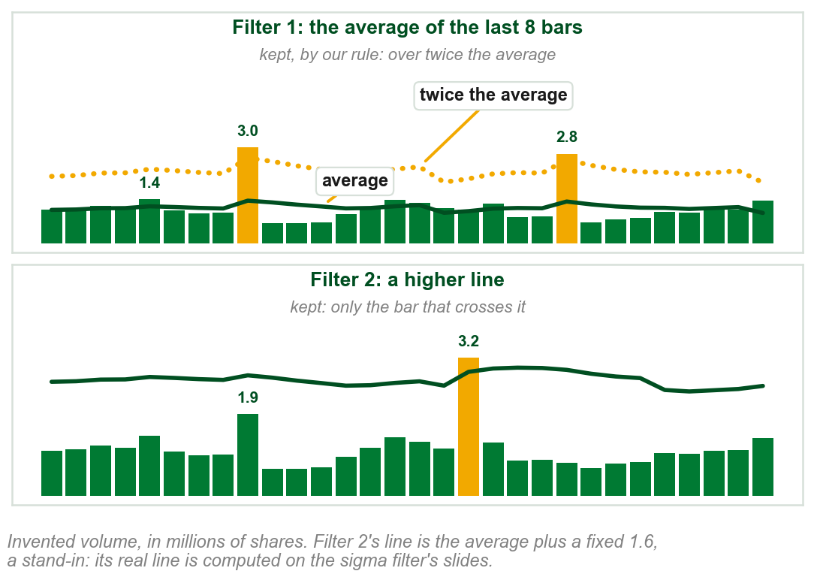
Filters 1 and 2 in numbers
Ours, filter 1: the line is the average of the last 8 bars, about 1 million.
How far above counts? The book gives no measure. Our rule: over twice the average.
1.4 million is just over the line: ordinary. The 3.0 and 2.8 million spikes: kept.
Filter 2: only the 3.2 bar crosses its higher line; the 1.9 bar is dropped.
Filter 1 is the book's smoothed volume filter: next.
Chart SA - FIN1209 teaching chart, drawn for this course. Illustrative data, not a real instrument.
Part 3 of 6 - 6.1 Filtering | 8 of 21
Book pp.188-189: a spike above the line is significant; no measure of how far. Ours: the volume, the 8 bars, the twice rule and filter 2's stand-in line.
Notes:
- The twice rule is ours, to make the reading concrete. The book says only that a spike above the line is significant, and its own Figure 6.20 marks only the tallest spikes.
- Filter 2's line here is a stand-in, the average plus a fixed amount. The real line, the two- or three-sigma filter, is computed on its own slides after the smoothed volume filter.

Slide 61
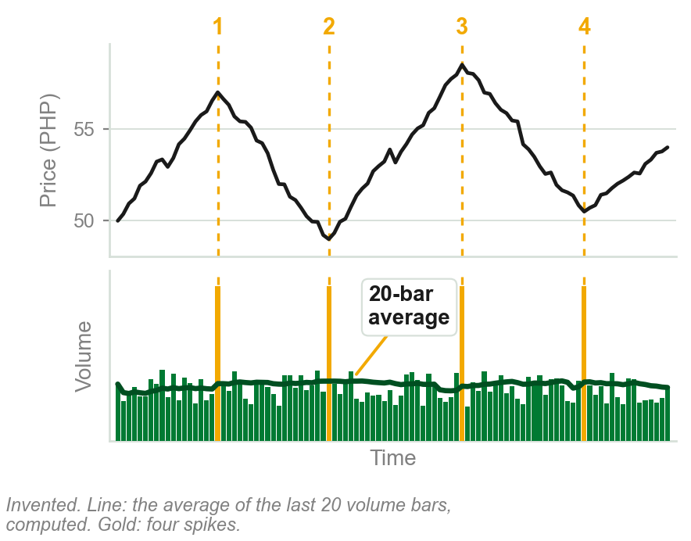
NEW TERM
Smoothed volume filter
IN PLAIN WORDS
An average of recent volume, drawn over the volume bars. A spike well above it stands out.
FOR EXAMPLE
Our chart: each point is the average of the last 20 volume bars. Four spikes stand well above it.
THE FORMAL DEFINITION
A smoothed volume filter is simply a moving average based on volume, instead of price. Volume spiking above this overextended moving average line is considered significant, and may lead to a top or bottom.
Chart T - FIN1209 teaching chart, drawn for this course. Illustrative data, not a real instrument.
Part 3 of 6 - 6.1 Filtering | 9 of 21
Book p.188. The chart is ours, on invented volume; its line is a 20-bar simple average of volume we computed.
Notes:
- A moving average is met again: Chapters 4 and 5 used them, Chapter 11 teaches them. Here it is an average of volume, not of price.
- The book says a spike above the line is significant and gives no measure of how far above. On its own Figure 6.20 the arrows mark only the tallest spikes, and so does this chart.

Slide 62
Choosing the average's length
The average is slide 57's smoothed volume filter, over the last N bars. N, the lookback, is how many bars go into it.
Short N, 5 bars say: hugs the bars closely, ordinary ones cross it too, many false signals.
Long N, 100 bars say: slow and flat, only huge spikes cross it, few signals, some turns missed.
FIGURE 6.20
The daily USDJPY chart with a smoothed volume line across its volume panel, labelled moving average overextension threshold. Dotted arrows rise from the overextensions in volume to tops and bottoms in price.
The artwork is copyrighted and is not in the public repository. Build with assets/figures/ present to place it here.
The right N sits in between. How to find it: next slide.
Figure 6.20: each dotted arrow runs from a spike crossing the line up to a top or a bottom.
Figure 6.20 - Lim, The Handbook of Technical Analysis (Wiley, 2016)
Part 3 of 6 - 6.1 Filtering | 10 of 21
Book pp.188-189 and Figure 6.20.
Notes:
- Lookback is the number of bars averaged. A longer one smooths more.
- Follow two or three of the dotted arrows from a spike to a turn in price.

Slide 63
Choosing the length, continued
Backtest: run the filter on past prices with a few different N, and see which one actually caught the real tops and bottoms. Keep that N.
Rule of thumb: set N to the dominant trading cycle period, or half of it. Ours, invented: swings about 40 bars peak to peak give N = 40, or N = 20.
The book gives no fixed N. Not that any N works: the right N is found for each market, by backtest or by this rule of thumb.
No universal lookback. A method for finding one, for this market.
Part 3 of 6 - 6.1 Filtering | 11 of 21
Book pp.188-189. Ours: the worked cycle number and the actionable backtest description.
Notes:
- This slide has no picture: it works through the book's two rules of thumb, not a new reading of a chart. Figure 6.20 was the last slide's.
- Walk the backtest sentence slowly: try N = 10, 20 and 50 on last year's chart, and see which flagged the real turns.

Slide 64
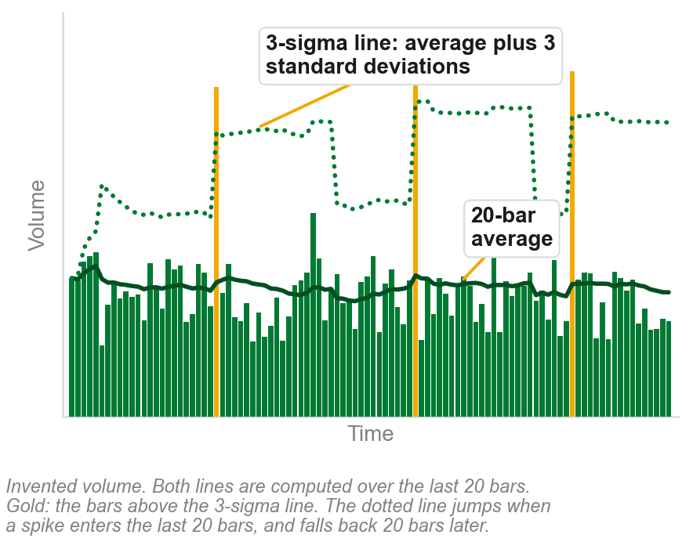
NEW TERM
Two- or three-sigma volume filter
IN PLAIN WORDS
Sigma is the standard deviation: how far volume typically strays from its own mean, over the same N bars. The line: Upper = mean + k x sigma, k = 3 here, or 2.
FOR EXAMPLE
Worked, ours: the last 20 bars average 10 million shares, sigma 2 million. 3-sigma line = 10 + 3x2 = 16 million: 12 million does not cross, 18 million does. 2-sigma line = 14 million, so it flags more bars.
THE FORMAL DEFINITION
A 2- or 3-sigma filter, also a volatility filter, keeps only the most significant surges: a Bollinger Band on volume, lines a set number of standard deviations above and below a moving average, upper band only, since only surges matter here.
Chart U - FIN1209 teaching chart, drawn for this course. Illustrative data, not a real instrument.
Part 3 of 6 - 6.1 Filtering | 12 of 21
Book p.189. Chart: ours, computed; divisor and window read from build/charts_chapter06.py, not guessed.
Notes:
- Sigma is the Greek letter for a standard deviation: how far values typically spread from their average.
- Bollinger Bands were named in Chapter 1, in the mean reverting approach, and are not explained there either. All this filter needs is the upper line.
- Three sigma is stricter than two: fewer bars cross it.

Slide 65
How the dotted line is drawn, bar by bar
At each bar: take its last 20 volume bars, this one included. Mean, then sigma. Plot mean + 3 x sigma. Move forward one bar, repeat.
That is why it jumps: a spike entering the window raises both at once, so the line leaps up, staying high until the spike leaves 20 bars later.
The book never says if sigma divides by 20 or 19, or if the bar sits in its own window. Our code divides by 20 and includes the bar.
Recomputed from nothing at every bar: no memory beyond its window.
Part 3 of 6 - 6.1 Filtering | 13 of 21
Book p.189 gives only the words. Ours: how build/charts_chapter06.py actually computes it, read from the code, not guessed.
Notes:
- This closes the two gaps the review found: the divisor and the window. Both are read straight from the code that drew the chart.
- The jump explanation matches the chart's own footnote, here given as the reason instead of just the fact.

Slide 66
A three-sigma filter on USDJPY
Stepped line: the three-sigma filter, on daily USDJPY. The book marks three surges over it, arrows up to price.
Figure 6.20, same market, marked six. Stricter, this line skips the April 2011 top, the highest price, that 6.20 caught.
The two lower lines are drawn and not named by the book; only the top one is the filter.
FIGURE 6.21
The daily USDJPY chart with a stepped line across its volume panel labelled 3-sigma volume overextension threshold, and dotted arrows from the few overextensions in volume above it to tops and bottoms in price.
The artwork is copyrighted and is not in the public repository. Build with assets/figures/ present to place it here.
The book: such surges tend to come at the most significant tops and bottoms.
Figure 6.21 - Lim, The Handbook of Technical Analysis (Wiley, 2016)
Part 3 of 6 - 6.1 Filtering | 14 of 21
Book p.189 and Figure 6.21. Ours: the counts of arrows and the April top, read off Figures 6.20 and 6.21.
Notes:
- Compare with Figure 6.20, the same market. The threshold here is higher, so only the largest surges cross it.
- Follow each of the three arrows down to the surge under it. Then find the April 2011 top: a dotted upright, and no arrow.

Slide 67
Why the book draws the line on the bars
The book also names a standard deviation oscillator: an indicator in its own panel, as Part 1 used the word. It does not describe or draw one.
It is less useful, the book says, because it gives no overlay: a line drawn over the volume bars themselves, so a bar can be seen crossing it.
Figure 6.21's line stays high for months after the March spike, far beyond our 20 bars. The book never gives its N.
What to do: pick N as for the smoothed filter, then draw the 3-sigma line over the bars. A bar above it may mark a top or bottom.
Part 3 of 6 - 6.1 Filtering | 15 of 21
Book p.189. It names the oscillator and does not describe it.
Notes:
- No picture: this slide reads the book's one sentence on the oscillator, beside the two figures already shown.
- Oscillator is Part 1's word: an indicator in a panel under price.

Slide 68
CHECK 8 OF 19
Filtering volume
Q1
Q2
A smoothed volume filter is:
In a two- or three-sigma volume filter, which part of the Bollinger Band is used?
A. A Bollinger Band on price
B. A moving average based on volume, instead of price
C. The lowest historical volume level
D. A count of trades
A. The lower band only
B. Both bands
C. The upper band only
D. The middle line only
Part 3 of 6 - 6.1 Filtering | Check 8
Notes:
- Read Q1 aloud, then Q2. Give them sixty seconds and no discussion.
- Ask for a show of hands on each option before you advance.
- This is for reading the room, not for marks. Say so if anyone tenses up.

Slide 69
ANSWERS
Filtering volume
Q1 A smoothed volume filter is:
B. A moving average based on volume, instead of price
The book: a smoothed volume filter is simply a moving average based on volume, instead of price.
Q2 In a two- or three-sigma volume filter, which part of the Bollinger Band is used?
C. The upper band only
Only the Bollinger upper band is used: the filter keeps the most significant surges.
Part 3 of 6 - 6.1 Filtering | Check 8
Notes:
- Reveal one at a time. Say the reason out loud, not just the letter.
- If more than a third of the room missed one, step back and reteach it.

Slide 70
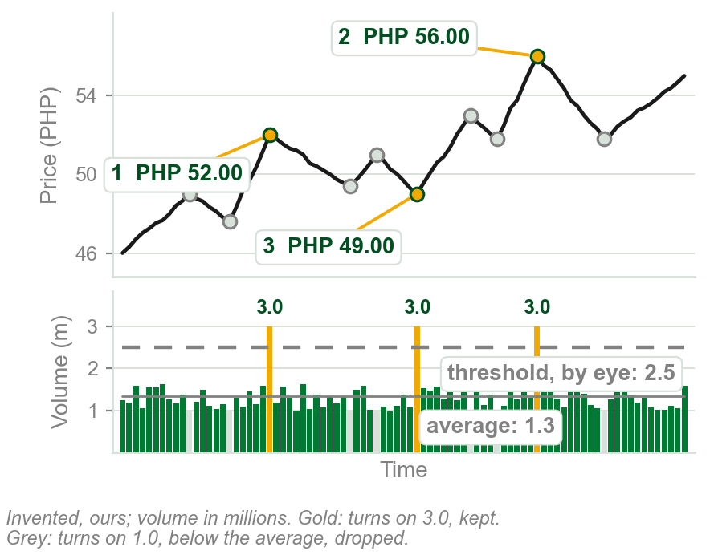
NEW TERM
Volume filtered inflection points
IN PLAIN WORDS
Only peaks and troughs (Chapter 5's inflection points) that came on heavy volume are used to draw lines.
FOR EXAMPLE
Ours, in millions: 1, 2, 3 came on 3.0, above our 2.5 line. Seven grey turns came on 1.0: dropped.
THE FORMAL DEFINITION
Many practitioners use only peaks and troughs that are considered significant, that is, associated with above average volume, to construct trendlines and channels.
Chart V - FIN1209 teaching chart, drawn for this course. Illustrative data, not a real instrument.
Part 3 of 6 - 6.1 Filtering | 16 of 21
Book p.189. Inflection point: Chapter 5. The chart is ours, invented.
Notes:
- Trendlines and channels were Chapter 5, and so were inflection points. This adds one rule for which points to use: only the heavily traded ones.
- The grey turns are real peaks and troughs too. They are skipped because too little traded at them.

Slide 71
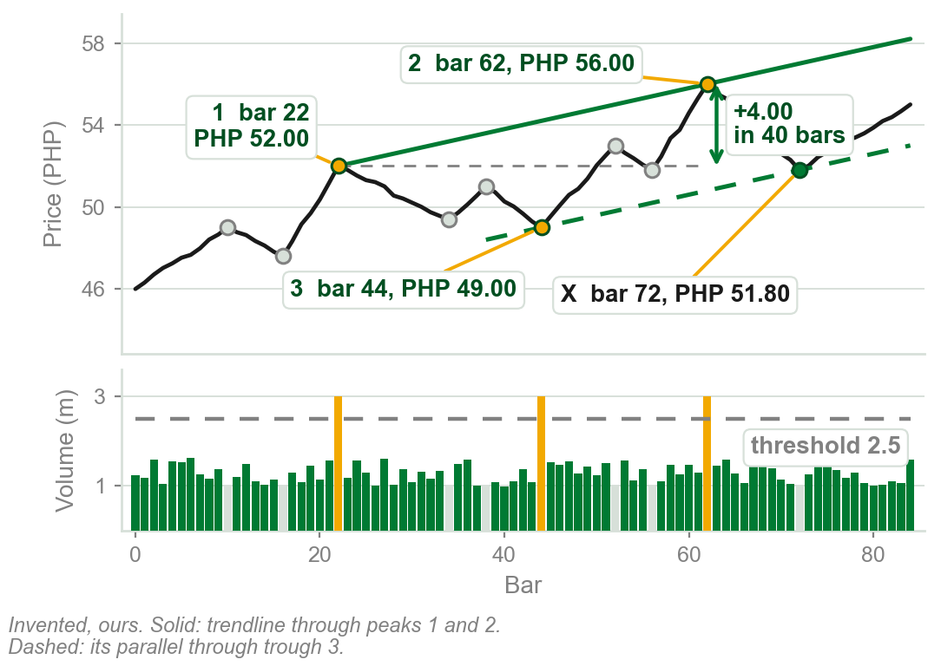
Drawing a volume filtered channel, step by step
Step 1. Mark every peak and trough.
Step 2. The book's rule: above average volume, 1.3 here. Its example draws a higher line by eye, and it never says which governs. Ours: 2.5. Only 1, 2, 3 reach it.
Step 3. Join peaks 1 (bar 22, PHP 52.00) and 2 (bar 62, PHP 56.00): PHP 4.00 in 40 bars, 0.10 a bar.
Step 4. The same slope through trough 3 (bar 44, PHP 49.00): the channel.
Chart VA - FIN1209 teaching chart, drawn for this course. Illustrative data, not a real instrument.
Part 3 of 6 - 6.1 Filtering | 17 of 21
Ours: the steps and every number, invented. The method and both rules for the threshold are the book's, p.189.
Notes:
- Read the steps against the chart: each bar number and price is printed on it.
- A turn on 2.0 million would pass the book's definition and fail its example's line. The book does not settle that, and neither do we: our chart has no turn in between.

Slide 72
A channel from filtered points: silver
The book's example: daily silver, with tick volume, the number of trades (Part 4).
A threshold drawn by visual inspection, so only the most significant peaks reach it. The oval rings July to August.
Two arrows: under Points 1 and 3, days apart, and under 2. Trendline 1 to 2, parallel from 3.
FIGURE 6.22
The daily silver chart, XAGUSD, with a tick volume overextension threshold across its volume panel. Arrows rise from the circled tick volume peaks to points 1, 2 and 3; a channel is drawn from 1 and 2 with a parallel from 3, and price reacts at X.
The artwork is copyrighted and is not in the public repository. Build with assets/figures/ present to place it here.
At X price bounces off the lower line, a short-term buy, then falls through it.
Figure 6.22 - Lim, The Handbook of Technical Analysis (Wiley, 2016)
Part 3 of 6 - 6.1 Filtering | 18 of 21
Book p.189 and Figure 6.22.
Notes:
- Follow the two arrows from the oval up to points 1 and 3, then 2. Those are the only points used.
- Falls through it: the book says the market reversed downward, violating the rising channel.

Slide 73
What the channel is for, and what the book leaves open
Ours: X is bar 72, 28 bars after trough 3 at bar 44. The lower line is there at 49.00 + 28 x 0.10 = PHP 51.80; price touches it and turns up.
Silver's April bars (labelled High tick volume level) and late September bars reach the line too; the channel uses only July to August, unexplained.
Chapter 5's uptrend line joined troughs; here the book joins two peaks and gives no reason. Either way, two parallels make the channel.
What to do: at the lower line, look for a short-term buy, as at silver's X. Falling through it violates the channel.
Part 3 of 6 - 6.1 Filtering | 19 of 21
Book pp.189-190 and Figure 6.22. Ours: the arithmetic at X, and what the figure's volume panel shows.
Notes:
- 28 is the number of bars from trough 3, bar 44, to X, bar 72, on the step by step chart.
- Why only heavily traded turns? The book says only that it shows the importance of significant inflection points; the next figure's slide quotes it. Part 3's first rule, a barrier formed at a volume peak is the most reliable, fits, and that link is ours.

Slide 74
More channels from filtered points
Points numbered afresh. Ovals ring heavy volume under 1, under 3 and 2, under 5 and 6.
Trendline 1 to 2, parallel from 3: a large bearish candlestick, closing far below its open, breaks it.
A parallel from 4, carried back, meets the trough at X, January 2011: valid, the book says, with no third touch (Chapter 5).
Parallels from 5 and 6: a new channel.
FIGURE 6.23
The same silver chart with more volume filtered points, numbered 1 to 6 and X. Several parallel rising lines are drawn through them, each from a point that came on overextended volume, forming channels that contain price.
The artwork is copyrighted and is not in the public repository. Build with assets/figures/ present to place it here.
Every line runs parallel to 1 to 2.
Figure 6.23 - Lim, The Handbook of Technical Analysis (Wiley, 2016)
Part 3 of 6 - 6.1 Filtering | 20 of 21
Book pp.189-190 and Figure 6.23. Candlestick and valid: Chapters 3 and 5.
Notes:
- Count the parallels: five lines, every one at the slope of the line from 1 to 2.
- The book admits the line through X was found looking back. It still calls the channel valid.

Slide 75
What Figure 6.23 shows, and two things it leaves open
Every line has the slope of trendline 1 to 2, January to November 2011: one steady angle, which the book calls near perfect angular symmetry (Chapter 5).
The 5 and 6 channel: resistance at its top, support at its bottom. The book's lesson: build patterns on significant inflection points.
Open: the text calls it the same chart of USDJPY; caption and chart say silver.
Open: the figure rings no heavy volume under 4 or X, though both anchor lines.
Draw from heavily traded turns; watch the parallels for resistance and support.
Part 3 of 6 - 6.1 Filtering | 21 of 21
Book pp.189-190 and Figure 6.23. Angular symmetry: Chapter 5. Ours: what the figure rings and what it does not.
Notes:
- No picture of its own: it reads Figure 6.23, on the slide before, as a whole.
- Look at the three ovals on the volume panel: they sit under 1, under 2 and 3, and under 5 and 6.

Slide 76
CHECK 9 OF 19
Filtered inflection points
Q1
Q2
Which peaks and troughs are used to construct volume filtered trendlines and channels?
On Figure 6.22, how is the volume threshold drawn?
A. Every peak and trough on the chart
B. Only those associated with above average volume
C. Only those formed on minimal volume
D. Only those within a consolidation
A. By visual inspection, so only the most significant peaks reach it
B. As a 100-day moving average
C. At three standard deviations
D. At the lowest historical volume
Part 3 of 6 - 6.1 Filtering | Check 9
Notes:
- Read Q1 aloud, then Q2. Give them sixty seconds and no discussion.
- Ask for a show of hands on each option before you advance.
- This is for reading the room, not for marks. Say so if anyone tenses up.

Slide 77
ANSWERS
Filtered inflection points
Q1 Which peaks and troughs are used to construct volume filtered trendlines and channels?
B. Only those associated with above average volume
Only significant inflection points are used: those associated with above average volume.
Q2 On Figure 6.22, how is the volume threshold drawn?
A. By visual inspection, so only the most significant peaks reach it
The book draws a simple tick volume overextension level by visual inspection.
Part 3 of 6 - 6.1 Filtering | Check 9
Notes:
- Reveal one at a time. Say the reason out loud, not just the letter.
- If more than a third of the room missed one, step back and reteach it.

Slide 78
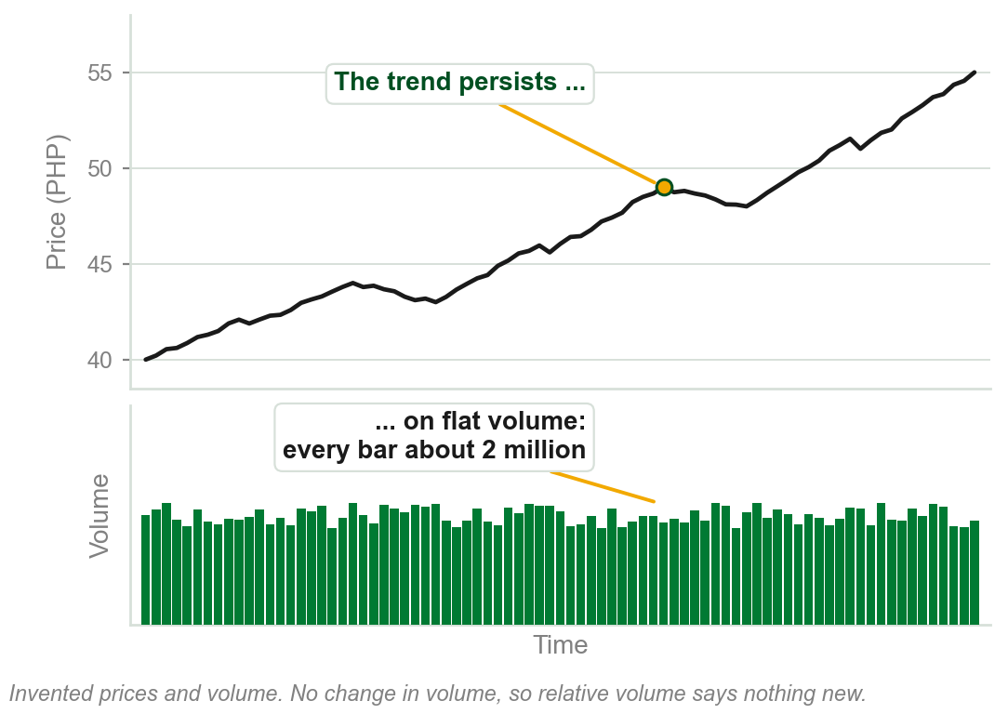
6.1 Relative and absolute volume
Absolute volume is the raw count: today, 3 million shares traded.
Relative volume compares it with its own past: 3 million against a usual 1.5 million is double.
The book: absolute volume is not as important as relative. The change in volume tells the most about price.
Yet a trend can persist for long periods on flat volume.
Chart W - FIN1209 teaching chart, drawn for this course. Illustrative data, not a real instrument.
Part 4 of 6 - 6.1 Open interest | 1 of 26
Book pp.190-191. It never defines the two names; these readings are ours, from its contrast. The share counts and the chart are ours, on invented prices.
Notes:
- Work the double out loud: 3 million today, 1.5 million usually, so twice the usual. That comparison is relative volume.
- This is review question 7, which is more useful. The book's answer: relative, for reading trends; absolute has the uses two slides on.
- The chart is the warning in the gold line: no change in volume, and the trend goes on anyway.

Slide 79
What the change in volume tells
Rising and falling volume show interest at each price. Part 1's tests: rising is confirmation, falling divergence; with price bullish, against bearish.
Past extremes, Part 2's overextended levels, are a reference. Ours: busiest day 9 million, quietest 0.4 million; volume reaching either again warns of a top or bottom.
Flat volume is no sign a trend is ending; the book gives no rule for it.
Read the change in volume for the trend, and past extremes for the turns.
Part 4 of 6 - 6.1 Open interest | 2 of 26
Book p.191. The share counts in the example are ours.
Notes:
- This slide has no picture: it ties the book's two sentences to Parts 1 and 2, which drew them.
- Peaks and troughs both count: the book says historical volume peaks and troughs give the reference level.

Slide 80
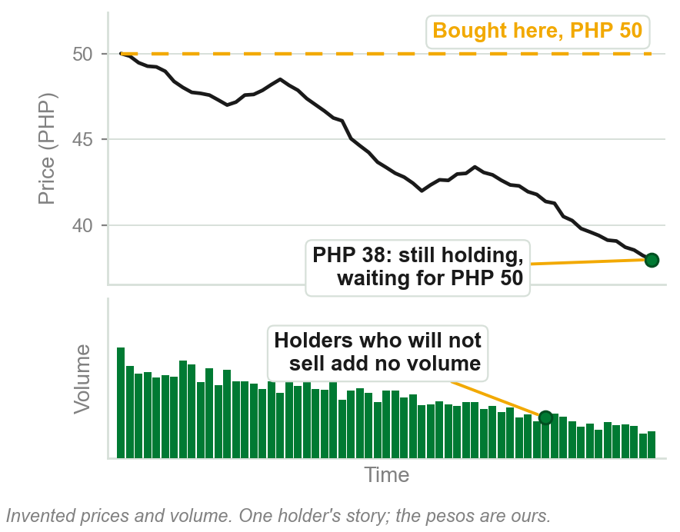
NEW TERM
Loss aversion bias
IN PLAIN WORDS
Holding a losing position rather than selling at a loss, hoping it comes back. Holding is not trading: it adds no volume.
FOR EXAMPLE
Bought at PHP 50, now PHP 38: an unrealized loss of PHP 12, on paper only, as you have not sold. You hold for breakeven, PHP 50.
THE FORMAL DEFINITION
Many investors hold on to losing positions in a falling market, hoping they rebound to breakeven or profitability, believing unrealized losses are not real losses: loss aversion bias.
Chart X - FIN1209 teaching chart, drawn for this course. Illustrative data, not a real instrument.
Part 4 of 6 - 6.1 Open interest | 3 of 26
Book p.191 names the bias. The pesos, the share and the chart are ours, on invented prices.
Notes:
- Chapter 1 listed loss aversion among behavioral biases in one line. This is the first slide that says what it is.
- The book says many investors treat a paper loss as no loss, and so they hold. Breakeven is the price at which you neither gain nor lose.
- Why it is in a chapter on volume: holding is not trading, so a bear market trades less. That is the next slide.

Slide 81
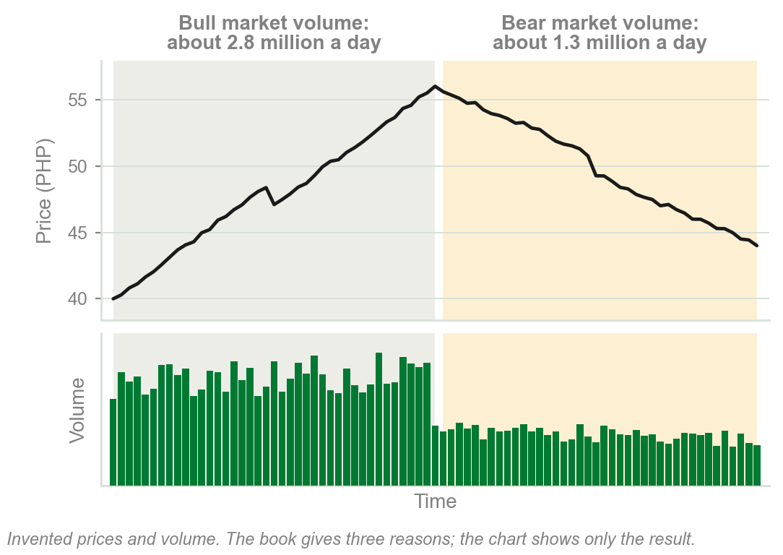
Bull market volume outweighs bear market volume
1 Loss aversion: losing positions held in a falling, bear market add nothing to its trading.
2 In a rising, bull market, traders can fund new positions with house money: profit already made.
3 More investment funds market their services in a bull market, drawing in investors.
So bull market volume tends to outweigh bear market volume. Ours: 2.8 million shares a day rising, 1.3 million falling.
A few of the book's reasons; it draws no trading rule from them.
Chart Y - FIN1209 teaching chart, drawn for this course. Illustrative data, not a real instrument.
Part 4 of 6 - 6.1 Open interest | 4 of 26
Book p.191: its three reasons, nearly word for word. The chart and its share counts are ours, on invented prices.
Notes:
- The book says a variety of reasons, a few being these three. They are its list, not a complete one.
- House money is the book's phrase for profit already made, spent again.

Slide 82
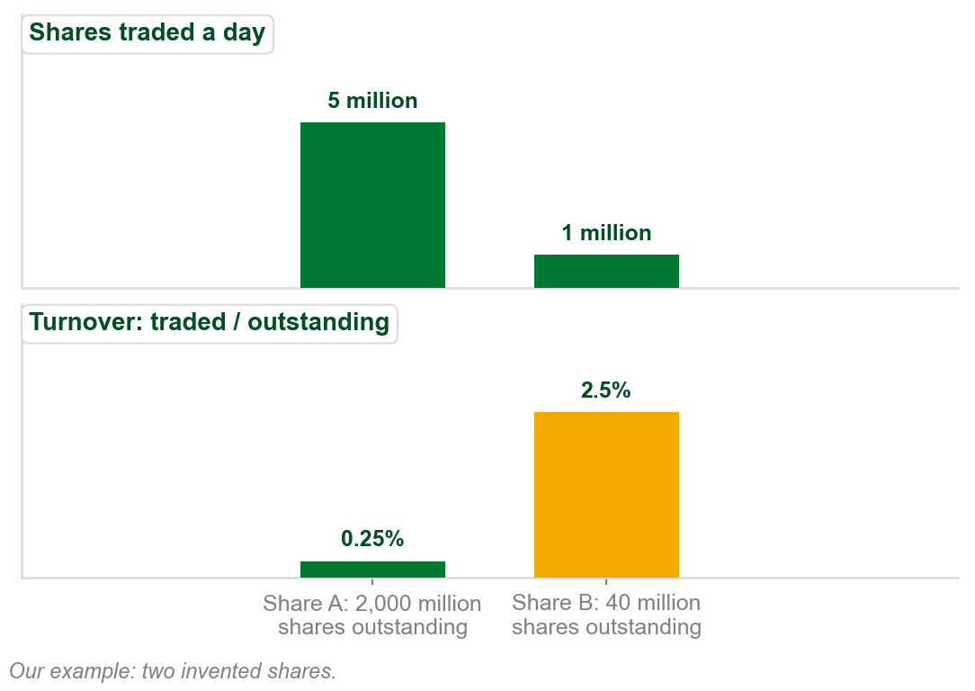
What absolute volume is good for
1 Price rejection levels, Chapter 3: prices the market was pushed back from. The book gives no method.
2 Comparing participation in stocks, sectors or commodities, seeking liquidity: the book's word, not defined.
3 Turnover: shares traded / shares outstanding, all the company's shares. A: 5m / 2,000m = 0.25%. B: 1m / 40m = 2.5%.
A trades five times the shares; B has ten times the participation.
Chart Z - FIN1209 teaching chart, drawn for this course. Illustrative data, not a real instrument.
Part 4 of 6 - 6.1 Open interest | 5 of 26
Book p.191. The two shares, their volumes and their shares outstanding are ours: a share-count example of turnover.
Notes:
- Absolute volume is the raw count of the first slide of this part. Work the turnover out loud: 5 million of 2,000 million is a quarter of one percent; 1 million of 40 million is two and a half percent.
- Liquidity is the book's word, used here and not defined in this chapter. Do not define it for them.

Slide 83
Volume distortions
A surge in arbitrage, program trading and high frequency trading (HFT) may distort volume's traditional meaning: traders' interest in a rise or fall.
Chapter 1: program trading is machines trading in ways humans cannot replicate. Chapter 1 named arbitrage and HFT without defining them; so does this chapter.
Ours: a day trades 4 million shares, 3 million of them program trades. The bar reads 4 million; traders taking part in the move traded 1 million.
So a volume bar may count machine trades as well as interest: here only 1 of 4 million. The book gives no way to separate them.
Part 4 of 6 - 6.1 Open interest | 6 of 26
Book p.192. Chapter 1 named arbitrage, program trading and HFT. The share counts in the example are ours.
Notes:
- The book gives two sentences and no figure, so this slide has no picture.
- The example is ours and only shows the size of the problem: the bar counts every share, whoever traded it.

Slide 84
CHECK 10 OF 19
Relative and absolute volume
Q1
Q2
According to the book, which gives the most information about potential price action?
An investor holds a losing share, believing an unrealized loss is not a real loss. The book calls this:
A. Absolute volume
B. The change in volume
C. Turnover against shares outstanding
D. Tick volume
A. House money
B. A low volume reversal
C. A volume distortion
D. Loss aversion bias
Part 4 of 6 - 6.1 Open interest | Check 10
Notes:
- Read Q1 aloud, then Q2. Give them sixty seconds and no discussion.
- Ask for a show of hands on each option before you advance.
- This is for reading the room, not for marks. Say so if anyone tenses up.

Slide 85
ANSWERS
Relative and absolute volume
Q1 According to the book, which gives the most information about potential price action?
B. The change in volume
Absolute volume is not as important as relative volume: it is the change in volume that gives the most information.
Q2 An investor holds a losing share, believing an unrealized loss is not a real loss. The book calls this:
D. Loss aversion bias
Holding losing positions in hope of breakeven, treating unrealized losses as not real, is loss aversion bias.
Part 4 of 6 - 6.1 Open interest | Check 10
Notes:
- Reveal one at a time. Say the reason out loud, not just the letter.
- If more than a third of the room missed one, step back and reteach it.

Slide 86
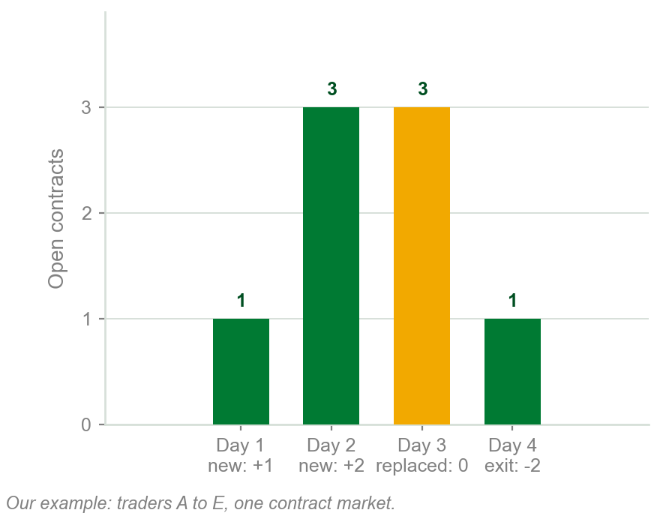
NEW TERM
Open interest
IN PLAIN WORDS
Every futures or options contract has a buyer, the long, and a seller, the short. Open interest counts the contracts still open.
FOR EXAMPLE
Plus 1 a contract when a new long and short both open; minus 1 when both close; no change when one side is replaced. Worked: next slide.
THE FORMAL DEFINITION
The total amount of outstanding contracts in the futures and options markets. It increases when a new long and short are initiated, decreases when both exit, and is unchanged when one is replaced.
Chart AA - FIN1209 teaching chart, drawn for this course. Illustrative data, not a real instrument.
Part 4 of 6 - 6.1 Open interest | 7 of 26
Book p.192 gives the definition and the three rules. The traders and contract counts are ours.
Notes:
- Chapter 3 listed open interest as transaction data and Chapter 4 used it in a consolidation. This is the first slide that defines it.
- Each contract is one long and one short, so a contract is open until both sides are out. Long and short are Chapter 1's go long and go short.
- The chart is the next slide's four days, one column a day. Read its labels against the three rules in the example row.

Slide 87
Open interest, day by day
Day 1: A buys 1 from B, both new, A long and B short: plus 1. Open interest 1.
Day 2: C buys 2 from D, both new: plus 2. Open interest 3.
Day 3: A sells that 1 to E, the new long; B is still short: no change. Still 3.
Day 4: D buys back 2 from C: D's short and C's long close: minus 2. Now 1.
Only both sides opening, or both closing, moves the count.
The book's reason to count: unlike stocks, all futures and options contracts eventually expire.
Part 4 of 6 - 6.1 Open interest | 8 of 26
Book p.192 gives the three rules and the reason. The traders and contract counts are ours.
Notes:
- This slide has no picture of its own: the chart beside the term is these four days, one column each.
- On day 4, D buying back is covering and C selling is liquidating: Chapter 1's words for closing a short and a long.

Slide 88
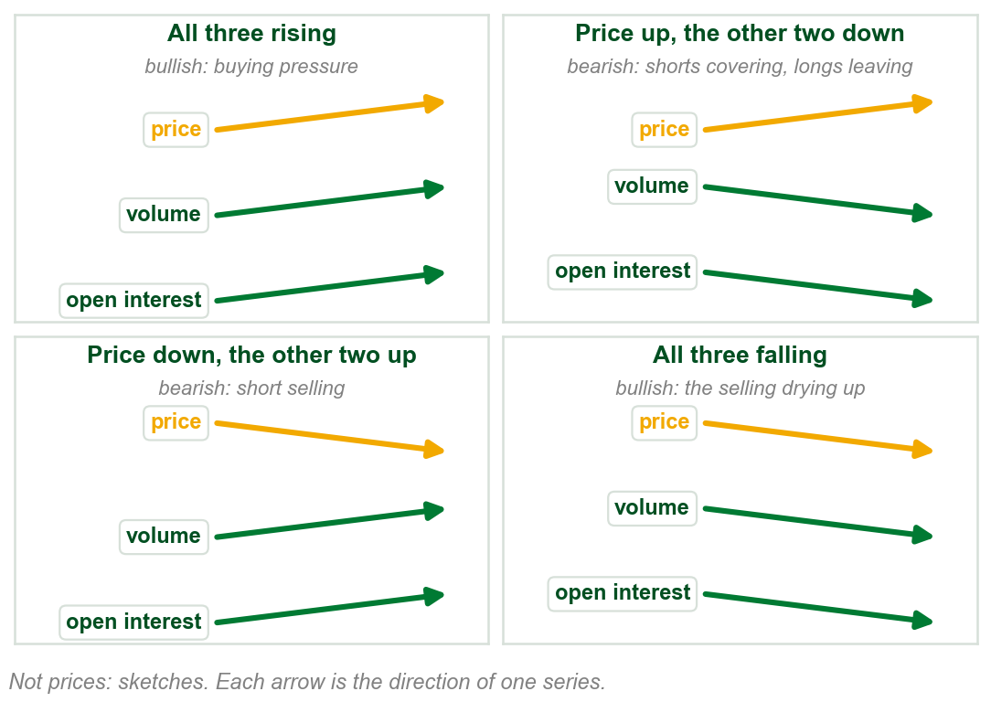
Open interest is read like volume
Like volume, open interest shows interest in seeing price rise or fall. With price: bullish. Against: bearish.
Price rising. Both rising: bullish, buying pressure. Both falling: bearish, shorts covering (buying back) and longs leaving.
Price falling. Both rising: bearish, short selling. Both falling: bullish, fewer longs liquidating, fewer new shorts.
Rising is confirmation, falling is divergence: as for non-price-based volume.
Chart AB - FIN1209 teaching chart, drawn for this course. Illustrative data, not a real instrument.
Part 4 of 6 - 6.1 Open interest | 9 of 26
Book p.192: the reading and its reasons are the book's. The chart is ours: arrows, not prices.
Notes:
- The same rule as Part 1's bullish and bearish volume, with open interest moving alongside volume. Both words, both rules: the book says open interest divergence is read as for non-price-based volume oscillators.
- The book's reason for the last case: participants are less interested in seeing the market decline further.
- This is review question 6, the relationship between volume, open interest and price.

Slide 89
The four readings, worked
Ours: a futures contract rises from PHP 100 to PHP 110.
Open interest 50,000 to 60,000 contracts, volume 8,000 to 12,000 a day: both rise with price. Bullish confirmation, buying pressure.
Open interest 50,000 to 40,000, volume 8,000 to 5,000: both fall as price rises. Bearish divergence: shorts covering, longs leaving.
Falling from PHP 110 to PHP 100 instead: both rising is bearish confirmation, short selling; both falling, bullish divergence.
Same price move, opposite readings: volume and open interest decide.
Part 4 of 6 - 6.1 Open interest | 10 of 26
Book p.192 gives the four readings and their reasons. The contract, its prices and its counts are ours, invented.
Notes:
- This slide has no picture: it puts numbers on the four sketches of the last slide. The names are Part 1's: bullish or bearish, confirmation or divergence.
- Ask the room to name the case before you read the answer: price up, open interest down, volume down.

Slide 90
What a trader does with the four
All three rising, bullish: look for buy signals.
Price rising, open interest and volume falling, bearish: look to exit, liquidating (selling) your longs.
Price falling, both rising, bearish: look to go short. Once both start to fall together, bullish: rapidly cover (buy back) all shorts.
FIGURE 6.24
The continuous daily chart of silver rising from A to B, with an open interest panel showing a lower peak at 2, labelled bearish divergence, and a volume panel showing a higher peak at 1, labelled bullish confirmation.
The artwork is copyrighted and is not in the public repository. Build with assets/figures/ present to place it here.
Figure 6.24, silver, A to B: volume peaks higher at 1, bullish confirmation; open interest peaks lower at 2, bearish divergence. They disagree; the book reads open interest: longs liquidating, early. Silver then fell from about $49 to under $30.
Figure 6.24 - Lim, The Handbook of Technical Analysis (Wiley, 2016)
Part 4 of 6 - 6.1 Open interest | 11 of 26
Book p.192 and Figure 6.24; the prices are read off the figure by eye. Go long, liquidate, go short and cover are Chapter 1 terms.
Notes:
- The four actions are the four cases of the last slide, turned into what to do.
- On the figure, volume and open interest disagree at the top: volume peaks at the highest price, open interest does not. The book reads the open interest: longs leaving.

Slide 91
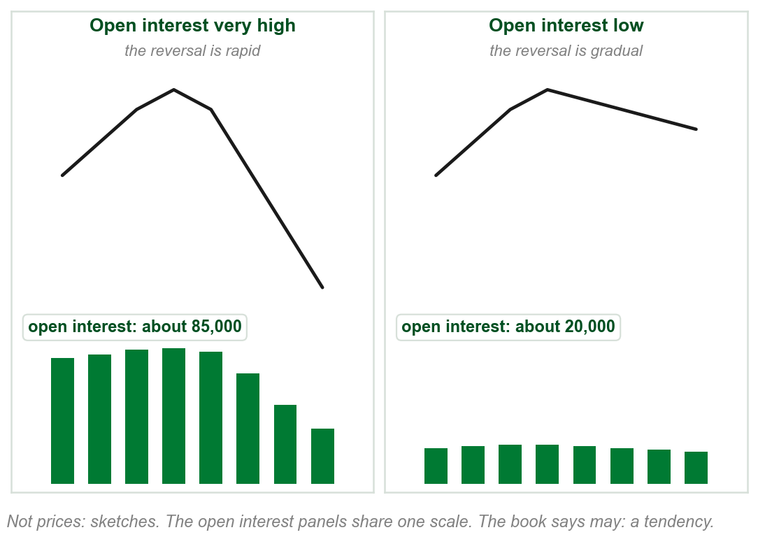
Very high open interest: a faster reversal
The level of open interest may indicate the nature of a reversal or breakout: here, its speed.
If open interest is very high, the reversal may be significantly more rapid.
Ours: about 85,000 open contracts against 20,000. After the same top, the first falls steeply.
The reason: many open contracts liquidating and covering at once.
Liquidating: longs selling to close. Covering: shorts buying back. The book sets no number for very high.
Chart AC - FIN1209 teaching chart, drawn for this course. Illustrative data, not a real instrument.
Part 4 of 6 - 6.1 Open interest | 12 of 26
Book p.192: one sentence and its reason. The chart is ours: two invented reversals, the open interest in each made up to show the point.
Notes:
- Chapter 4 said rising open interest in a consolidation makes the breakout more rapid. This is the same idea at a reversal.
- May be, says the book: a tendency, not a rule.

Slide 92
CHECK 11 OF 19
Open interest
Q1
Q2
A trader with a long futures contract sells it to a new buyer, who takes over the long. Open interest:
Prices are rising while volume and open interest are both declining. The book reads this as:
A. Increases by one
B. Decreases by one
C. Stays unchanged
D. Doubles
A. Bearish: shorts covering and longs leaving the market
B. Bullish: buying pressure
C. Bearish: short selling
D. Bullish: liquidation drying up
Part 4 of 6 - 6.1 Open interest | Check 11
Notes:
- Read Q1 aloud, then Q2. Give them sixty seconds and no discussion.
- Ask for a show of hands on each option before you advance.
- This is for reading the room, not for marks. Say so if anyone tenses up.

Slide 93
ANSWERS
Open interest
Q1 A trader with a long futures contract sells it to a new buyer, who takes over the long. Open interest:
C. Stays unchanged
Open interest is unchanged when one side is replaced by a new position, but not both.
Q2 Prices are rising while volume and open interest are both declining. The book reads this as:
A. Bearish: shorts covering and longs leaving the market
Rising prices on declining volume and open interest are bearish, driven by shorts covering and longs leaving.
Part 4 of 6 - 6.1 Open interest | Check 11
Notes:
- Reveal one at a time. Say the reason out loud, not just the letter.
- If more than a third of the room missed one, step back and reteach it.

Slide 94
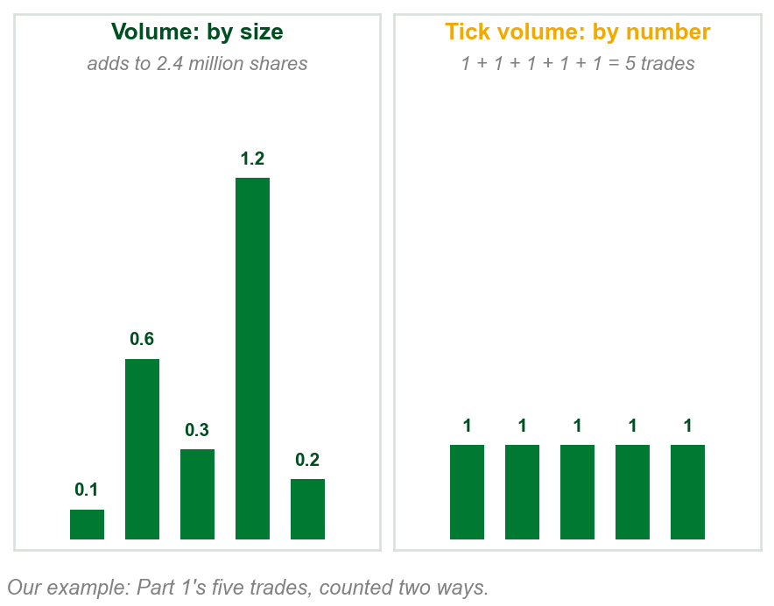
NEW TERM
Tick volume
IN PLAIN WORDS
A count of trades, not shares: one tick is one trade, of any size. Met in Chapter 1's caption and Chapter 3's tick chart.
FOR EXAMPLE
Part 1's five trades of 0.1, 0.6, 0.3, 1.2 and 0.2 million shares: volume 2.4 million shares, tick volume 5.
THE FORMAL DEFINITION
One tick represents one trade: tick volume is transaction volume. Many OTC fx brokers offer it instead of actual volume; strongly correlated with it, it may be used as a proxy.
Chart AD - FIN1209 teaching chart, drawn for this course. Illustrative data, not a real instrument.
Part 4 of 6 - 6.1 Open interest | 13 of 26
Book pp.192-193. OTC fx is the book's over the counter foreign exchange market. The five trades are Part 1's, ours. Chapter 3's tick chart counts trades the same way.
Notes:
- This is review question 1: volume counts what was traded, tick volume counts how many trades. One trade may be 1 contract or 1,000.
- OTC fx and proxy are spelled out on the next slide.

Slide 95
Tick volume as a stand-in for volume
Where: the over the counter (OTC) foreign exchange (fx) market, where many brokers offer tick volume instead of actual volume. The book does not say why.
Strongly correlated: the two rise and fall together. Ours: a busy hour, 900 trades and 60 million in currency; a quiet hour, 200 trades and 14 million.
So tick volume may be a proxy, a stand-in, for actual volume, for comparing relative levels of overbought and oversold: Part 2's words, never defined.
Compare tick volume with its own past: 900 trades does not say how much changed hands.
Part 4 of 6 - 6.1 Open interest | 14 of 26
Book pp.192-193. The trade counts and amounts in the example are ours, invented.
Notes:
- This slide has no picture: the chart beside the term already counts the same trades both ways.
- Relative levels is the book's phrase: higher or lower than before, as on the first slide of this part.

Slide 96
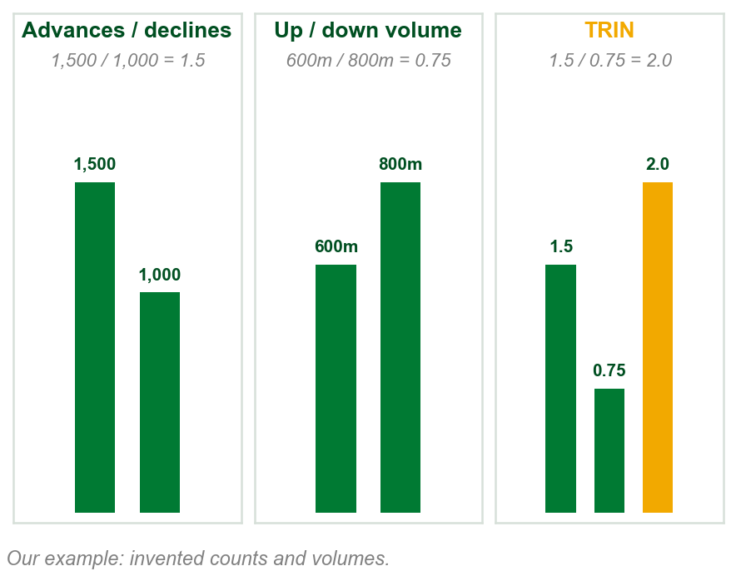
NEW TERM
The Arms Index, or TRIN
IN PLAIN WORDS
Breadth: advances, stocks that rose, over declines, stocks that fell. Divided by up volume over down volume, the shares each side traded. Our readings.
FOR EXAMPLE
1,500 advances / 1,000 declines = 1.5. Up volume 600 million / down volume 800 million = 0.75. TRIN = 1.5 / 0.75 = 2.0.
THE FORMAL DEFINITION
The Arms Index, or TRIN, incorporates breadth volume, advances and declines: TRIN = (advances / declines) / (up volume / down volume).
Chart AE - FIN1209 teaching chart, drawn for this course. Illustrative data, not a real instrument.
Part 4 of 6 - 6.1 Open interest | 15 of 26
Book p.193 gives the ratio. The counts and volumes in the example are ours. Advances and declines: Chapter 3's breadth data, never defined.
Notes:
- Advances and declines were listed in Chapter 3 as breadth data and never defined. The plain row reads them as the number of stocks rising and falling; that reading is ours.
- Up volume and down volume: the volume in the rising stocks and in the falling ones, again our reading of the names.
- Work the arithmetic slowly. The TRIN is a ratio of two ratios.

Slide 97
The TRIN, step by step
1 Advances / declines = 1,500 / 1,000 = 1.5 rising stocks for each falling one.
2 Up volume / down volume = 600m / 800m = 0.75: the falling stocks traded more shares.
3 TRIN = 1.5 / 0.75 = 2.0. Rearranged: down volume per falling stock, 800m / 1,000 = 0.8m, over up volume per rising stock, 600m / 1,500 = 0.4m.
A TRIN of 2.0: each falling stock traded, on average, twice the volume of each rising stock.
Step 3 and the gold line are our arithmetic; the book never reads one value such as 2.0.
Part 4 of 6 - 6.1 Open interest | 16 of 26
Book p.193 gives the ratio. It names breadth volume, advances, declines, up and down volume and never defines them; our readings. The numbers are ours.
Notes:
- This slide has no picture: the chart beside the term is these three steps as columns.
- Step 3 is only the same division rearranged. Check it on the board: 0.8 / 0.4 = 2.0.

Slide 98
Reading the tick and the TRIN
The tick: the book never says what it measures. On Figure 6.25 it goes below zero, so it is not tick volume, a count of trades.
Short term, the book's rule: tick rising but not overbought, TRIN falling but not oversold: bullish, look for a long entry.
Figure 6.25 shows something else: tick down to about -1,000, TRIN up to about 2.2, both at levels it labels oversold. The index then rose.
FIGURE 6.25
A 1-minute chart of the S&P 500 index falling and then rising, with a $TICK panel and a $TRIN panel under it. A box around the low marks both labelled oversold, with the note that short-term bullishness was predicated on the confluence of oversold signals.
The artwork is copyrighted and is not in the public repository. Build with assets/figures/ present to place it here.
Both at the labelled oversold extremes: the book reads short-term bullish, look for a long entry.
The book does not say why its figure departs from its short-term rule.
Figure 6.25 - Lim, The Handbook of Technical Analysis (Wiley, 2016)
Part 4 of 6 - 6.1 Open interest | 17 of 26
Book p.193 and Figure 6.25; the levels are read off the figure by eye. The caption says daily; the chart and the text say 1-minute.
Notes:
- Read the short-term rule, then point at the box: the tick dips and the TRIN rises, the opposite of the rule's bullish case. Say so; do not reconcile it.
- The converse, the longer-term rule and the book's gaps are the next slide.

Slide 99
The longer-term rule, and the book's gaps
Short term, the converse: tick falling but not oversold, TRIN rising but not overbought: bearish, look for a short entry.
Longer term: tick oversold, above its weekly two-sigma level, and TRIN overbought, near or above 3.0 daily: bullish, long. Reverse: bearish, short.
Two sigma: Part 3's line, k = 2. Ours: weekly tick mean 200, sigma 300, line 200 + 2 x 300 = 800; above it, oversold. A daily TRIN of 3.2: overbought.
Bullish TRIN: overbought in the text, oversold in Figure 6.25.
No reasons for either rule. Figure 6.25's oversold tick sits at its low, not above two sigma.
Part 4 of 6 - 6.1 Open interest | 18 of 26
Book p.193 and Figure 6.25. The weekly tick numbers are ours, in invented units; the book never says what the tick measures.
Notes:
- This slide has no picture: it finishes the book's rules from the last slide's figure. Do not settle the gaps; name them.
- No check rests on these rules. The check after this part tests only tick volume and the TRIN's arithmetic.

Slide 100
A bearish day on the tick and the TRIN
Figure 6.26: the S&P 500 falls all afternoon. The boxed TRIN rises from about 0.9 to 1.34: bearish, by the short-term rule.
1:45 to 2:45 p.m.: the text says largely absent of activity; the figure says absent of uptick action. In its shaded box the tick barely rises above zero and twice drops to about -1,000, circled as extreme bearish ticks.
FIGURE 6.26
A 1-minute chart of the S&P 500 index on an intraday decline, with a $TICK panel showing stretches marked bearish and balanced tick action, and a $TRIN panel whose last stretch is boxed and labelled rising TRIN, bearish.
The artwork is copyrighted and is not in the public repository. Build with assets/figures/ present to place it here.
Together, a short-term bearish signal: look for a short entry.
The book gives no reason this is bearish, and does not define uptick.
Figure 6.26 - Lim, The Handbook of Technical Analysis (Wiley, 2016)
Part 4 of 6 - 6.1 Open interest | 19 of 26
Book p.194 and Figure 6.26; the TRIN values are read off the figure. Its caption says daily; the times show a 1-minute chart.
Notes:
- A rising TRIN is bearish, by the short-term rule two slides back. Point at the boxed stretch, then at the shaded tick stretch labelled bearish after 1:45.
- Uptick is the figure's word and is not defined by the book. Read it only as the label on the figure.

Slide 101
CHECK 12 OF 19
Tick volume and the TRIN
Q1
Q2
One trade of 1,000 contracts and one trade of 1 contract are made. Tick volume is:
Advances 1,200, declines 800, up volume 900 million, down volume 600 million. The TRIN is:
A. 1,001
B. 1,000
C. 1
D. 2
A. 1.0
B. 1.5
C. 2.25
D. 0.67
Part 4 of 6 - 6.1 Open interest | Check 12
Notes:
- Read Q1 aloud, then Q2. Give them sixty seconds and no discussion.
- Ask for a show of hands on each option before you advance.
- This is for reading the room, not for marks. Say so if anyone tenses up.

Slide 102
ANSWERS
Tick volume and the TRIN
Q1 One trade of 1,000 contracts and one trade of 1 contract are made. Tick volume is:
D. 2
One tick represents one trade, whatever its size: two trades, a tick volume of 2.
Q2 Advances 1,200, declines 800, up volume 900 million, down volume 600 million. The TRIN is:
A. 1.0
(1,200 / 800) / (900 / 600) = 1.5 / 1.5 = 1.0.
Part 4 of 6 - 6.1 Open interest | Check 12
Notes:
- Reveal one at a time. Say the reason out loud, not just the letter.
- If more than a third of the room missed one, step back and reteach it.

Slide 103
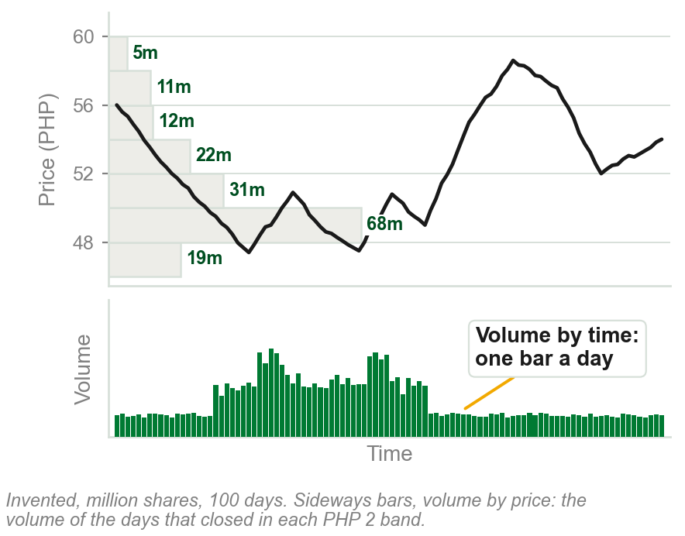
NEW TERM
Volume by price and volume by time
IN PLAIN WORDS
One volume record added up two ways. By time: the usual bars, one a day. By price: sideways bars, one per price band.
FOR EXAMPLE
Our chart, 100 days: 68 million shares at PHP 48 to 50, the longest sideways bar; 12 million at PHP 54 to 56. Five days worked: next slide.
THE FORMAL DEFINITION
Volume by time represents the total volume traded over a specified time interval or period. Volume by price identifies the total volume traded at each price level.
Chart AF - FIN1209 teaching chart, drawn for this course. Illustrative data, not a real instrument.
Part 4 of 6 - 6.1 Open interest | 20 of 26
Book p.194 defines both. The chart is ours: the volume by price is added up from its own invented bars and volume.
Notes:
- The same trades, added up two ways: by when they happened, and by the price they happened at.
- Each sideways bar on the chart is the total of every day's volume while price sat in that band.

Slide 104
Adding up volume by price, worked
Ours, five days: closes of PHP 49.10, 49.80, 51.20, 48.60 and 50.50, on 2, 3, 1, 4 and 2 million shares.
By time: one bar a day, 2, 3, 1, 4, 2 million: the usual volume panel.
By price: each day's volume goes in the band of its close. PHP 48 to 50: 2 + 3 + 4 = 9 million. PHP 50 to 52: 1 + 2 = 3 million.
The same 12 million shares: most traded between PHP 48 and 50. Using both splits: two-dimensional volume analysis.
The book does not say how a day's volume is split across its prices; ours puts it all at the close.
Part 4 of 6 - 6.1 Open interest | 21 of 26
Book p.194 defines both. The five days, their closes and their volumes are ours, invented.
Notes:
- This slide has no picture: the chart beside the term is the same sum done over 100 days.
- Do the sum on the board: which days closed between 48 and 50? Days 1, 2 and 4.

Slide 105
Volume by price marks a support: silver
Figure 6.27, iShares Silver Trust: sideways bars longest around $17. The book's volume turnover here is shares traded, not the turnover ratio.
So $17 represents a significant support: a floor where a fall may stop. The figure: significant capital commitment.
Also marked: high volume at about $35, a new consolidation level, not in the text.
FIGURE 6.27
The daily iShares Silver Trust with volume by price drawn as horizontal bars from the left edge. The longest bars sit around the $17 level, labelled significant capital commitment, strong support, and another cluster at the newer consolidation level higher up.
The artwork is copyrighted and is not in the public repository. Build with assets/figures/ present to place it here.
Ordinary volume bars show when, not at what price.
Chapter 4's price-based volume; not Part 1's oscillators.
Figure 6.27 - Lim, The Handbook of Technical Analysis (Wiley, 2016)
Part 4 of 6 - 6.1 Open interest | 22 of 26
Book p.194 and Figure 6.27. Chapter 4's Figure 4.19 showed the same thing and called it price-based volume.
Notes:
- Find the longest sideways bars, near $17, and then find price returning to that level.
- Clear up the word: Chapter 4's price-based volume is this, volume by price. Part 1's price-based oscillators are a different thing.

Slide 106
The most traded range: 3M
Figure 6.28, 3M: the longest sideways bars, bracketed, $77 to $86: the most traded range, more shares than at any other price.
With 3M last at about $88, $77 to $86 lies below: potential support, the figure's label. $90 to $92 above: some resistance, says the book, not how it was found.
Volume panel lines, Part 1's names: bearish confirmation, price falling on rising volume; bearish divergence, price rising on falling volume.
FIGURE 6.28
The daily chart of 3M with volume by price as horizontal bars, the longest bracketed between about $77 and $86 and labelled maximum capital commitment in this range, an important support zone in the future.
The artwork is copyrighted and is not in the public repository. Build with assets/figures/ present to place it here.
These price ranges are potential future support and resistance levels.
Figure 6.28 - Lim, The Handbook of Technical Analysis (Wiley, 2016)
Part 4 of 6 - 6.1 Open interest | 23 of 26
Book p.194 and Figure 6.28.
Notes:
- The bracket on the figure is the $77 to $86 range. Price later falls through it and returns.
- The figure's own labels also mark bearish confirmation and bearish divergence on the volume panel: Part 1's names again.

Slide 107
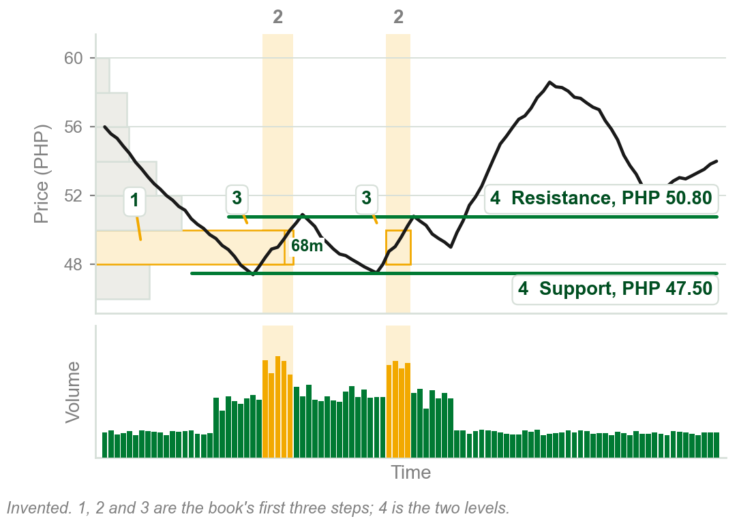
Support and resistance in four steps
1 Largest volume by price range: ours, PHP 48 to 50.
2 Largest volume by time intervals: ours, two bursts of 3.4 to 4.1 million a day.
3 Intersection, the boxes: most shares at one price, step 1's band, in one stretch, step 2's days.
4 Closest peak above the intersection: resistance, PHP 50.80. Closest trough below: support, PHP 47.50.
Potentially the most significant and reliable support and resistance.
No reason given; largest is picked by eye.
Chart AG - FIN1209 teaching chart, drawn for this course. Illustrative data, not a real instrument.
Part 4 of 6 - 6.1 Open interest | 24 of 26
Book pp.196-197, its steps. The chart is ours, on invented prices, with the steps numbered in the book's order.
Notes:
- Follow the numbers on the chart in order. The band is step 1, the shaded columns step 2, the boxes step 3, the two lines step 4.
- The book takes the nearest turn either side of the intersection. The next slide says what our two levels then did.

Slide 108
What the two levels did on our chart
Support at PHP 47.50: price turned up near it twice, at PHP 47.40 and PHP 47.50.
Resistance at PHP 50.80: price turned down near it twice, at PHP 50.90 and PHP 50.80, then broke above it and rose to about PHP 58.60.
The book says potentially: likely levels, not certain ones. It does not say what a break through one means.
A level from the four steps is potential: ours held twice, then broke.
Part 4 of 6 - 6.1 Open interest | 25 of 26
Book pp.196-197. The prices are our chart's, read from the series that drew it.
Notes:
- This slide has no picture: it reads the two lines of the chart on the last slide, after the step 4 prices were found.
- Do not add a rule for the break. The book gives none.

Slide 109
The four steps on 3M
1 $74 to $80: the book's largest volume by price range, the dark sideways bars.
2 and 3 The dark columns, where volume reaches the dotted overextended volume level (Part 2), cross it in two white boxes.
4 Closest peak above, about $80: resistance. Closest trough below, about $72.50: support.
FIGURE 6.29
The daily chart of 3M with the $74 to $80 volume by price band and two dark time columns over the high volume intervals; where they cross are two white boxes. Dashed lines mark the closest resistance above and the closest support below, and an overextended volume level runs across the volume panel.
The artwork is copyrighted and is not in the public repository. Build with assets/figures/ present to place it here.
Both act as effective barriers to price on the daily chart of 3M.
Figure 6.28 gave 3M's most traded range as $77 to $86. The book does not say why they differ.
Figure 6.29 - Lim, The Handbook of Technical Analysis (Wiley, 2016)
Part 4 of 6 - 6.1 Open interest | 26 of 26
Book pp.196-197 and Figure 6.29; the two levels are read off the figure by eye.
Notes:
- Read the figure with the last slide's numbers. The two white boxes are step 3.
- The dashed arrows mark the two levels of step 4: resistance at about $80, at the top of the zone, and support at about $72.50, below it. The overextended volume level on the volume panel is Part 2's.

Slide 110
CHECK 13 OF 19
Two-dimensional volume
Q1
Q2
Volume by price identifies:
In the book's two-dimensional method, the most significant resistance is:
A. The total volume over a time interval
B. The number of trades at each price
C. The total volume traded at each price level
D. The open interest at each price
A. The highest price on the chart
B. The top of the largest volume by price range
C. The level of the largest volume by time bar
D. The closest peak above the area of intersection
Part 4 of 6 - 6.1 Open interest | Check 13
Notes:
- Read Q1 aloud, then Q2. Give them sixty seconds and no discussion.
- Ask for a show of hands on each option before you advance.
- This is for reading the room, not for marks. Say so if anyone tenses up.

Slide 111
ANSWERS
Two-dimensional volume
Q1 Volume by price identifies:
C. The total volume traded at each price level
Volume by price identifies the total volume traded at each price level.
Q2 In the book's two-dimensional method, the most significant resistance is:
D. The closest peak above the area of intersection
Locate the intersection of the largest volume by price and by time; the closest peak above it is the resistance.
Part 4 of 6 - 6.1 Open interest | Check 13
Notes:
- Reveal one at a time. Say the reason out loud, not just the letter.
- If more than a third of the room missed one, step back and reteach it.

Slide 112
6.1 Volume and bar range: Chapter 5's four cases
Chapter 5's characteristic 15, volume spread action, set bar range against volume four ways.
Here the book uses the four to forecast potential breakouts and reversals, and names each bar.
Spread means bar range, as in Chapter 5: not Chapter 3's bid-ask spread.
FIGURE 6.30
Four numbered pairs, each an empty box for the bar range above a black box for the volume: 1 a short range on low volume, 2 a short range on high volume, 3 a tall range on low volume, 4 a tall range on high volume.
The artwork is copyrighted and is not in the public repository. Build with assets/figures/ present to place it here.
Chapter 5's squat bar is the High Volume Reversal Bar.
Chapter 6 reads two cases more strongly: both reversal bars. Chapter 5 called the large range on low volume only trend inhibiting.
Figure 6.30 - Lim, The Handbook of Technical Analysis (Wiley, 2016)
Part 5 of 6 - 6.1 Bar range | 1 of 14
Book p.197 and Figure 6.30, against this course's Chapter 5, characteristic 15. Spread is the book's word for bar range here.
Notes:
- A recall first: Chapter 5 drew these four as Chart R and called the second one the squat bar.
- The figure is the book's whole picture of them: a box for the range, a box for the volume. The next slides put each in a trend.

Slide 113
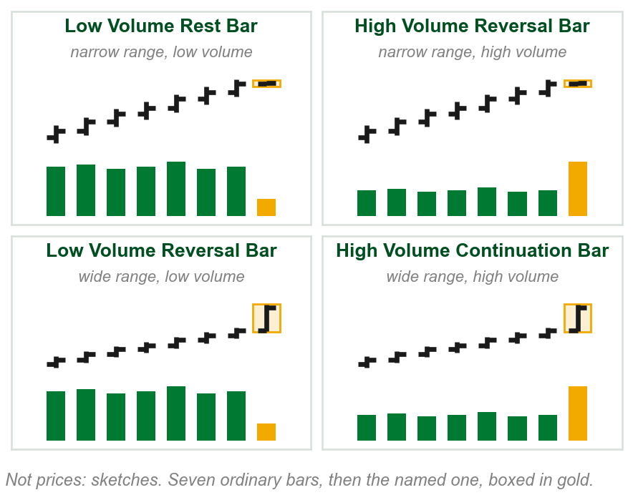
NEW TERM
Rest, reversal and continuation bars
IN PLAIN WORDS
Four names for a bar's range against its volume: narrow or wide, on low or high volume.
FOR EXAMPLE
A fast uptrend's usual bar is PHP 1.00 on 2 million shares. A PHP 0.20 bar on 5 million: narrow range on high volume.
THE FORMAL DEFINITION
Narrow range on low volume: Low Volume Rest Bar. Narrow, high volume: High Volume Reversal Bar. Wide, low volume: Low Volume Reversal Bar. Wide, high volume: High Volume Continuation Bar.
Chart AH - FIN1209 teaching chart, drawn for this course. Illustrative data, not a real instrument.
Part 5 of 6 - 6.1 Bar range | 2 of 14
Book p.197: the four names. The pesos and share counts in the example are ours. The chart is ours: sketches, not prices.
Notes:
- The example is the second of the four, the high volume reversal bar: Chapter 5's squat bar, now with a name.
- Narrow and wide are against the trend's usual bars, as low and high are against its usual volume. The book gives no number for either.

Slide 114
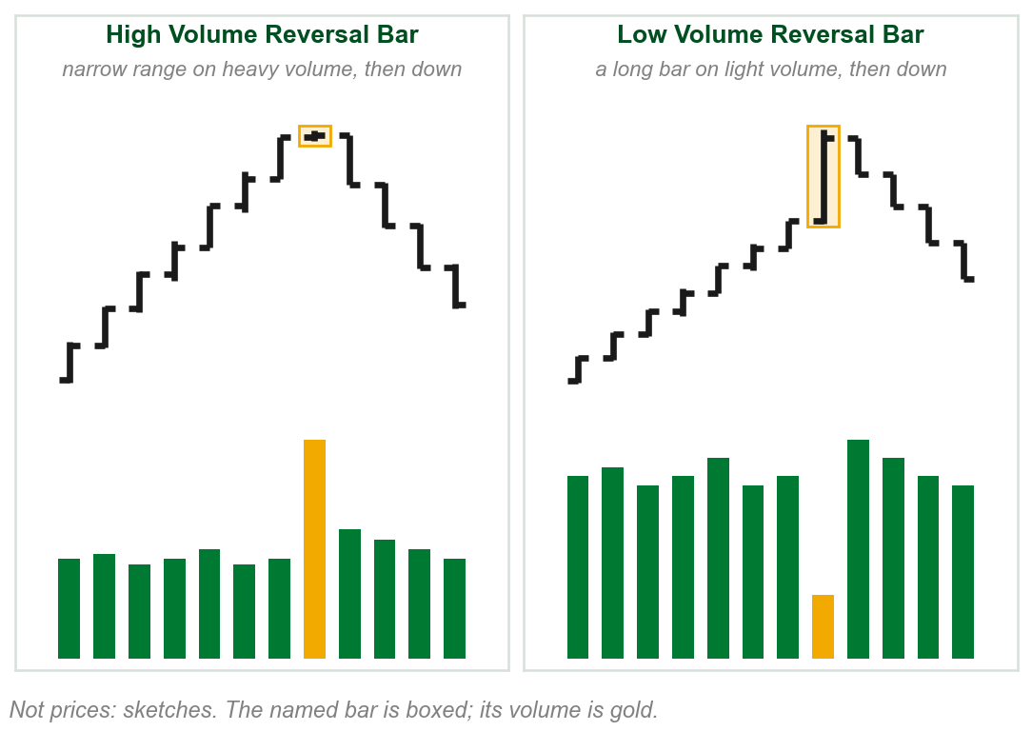
The two reversal bars
High Volume Reversal Bar: strong reversal potential. Were the volume buying, the range would be wider: sellers are in control. Bearish in an uptrend, the converse in a downtrend.
Low Volume Reversal Bar: a big move on little participation. The longer the bar, the more bearish in an uptrend, bullish in a downtrend.
Too little movement for the volume, or too little volume for the move.
Chapter 5 called a large range on low volume only trend inhibiting.
Chart AI - FIN1209 teaching chart, drawn for this course. Illustrative data, not a real instrument.
Part 5 of 6 - 6.1 Bar range | 3 of 14
Book p.197: the readings and reasons are the book's. The chart is ours: sketches, not prices.
Notes:
- The book's reasoning for the first: in an uptrend, heavy buying would push the range wide. A narrow range on heavy volume means someone was selling into it.
- The gold line is our one-line summary of the two, not the book's words.

Slide 115
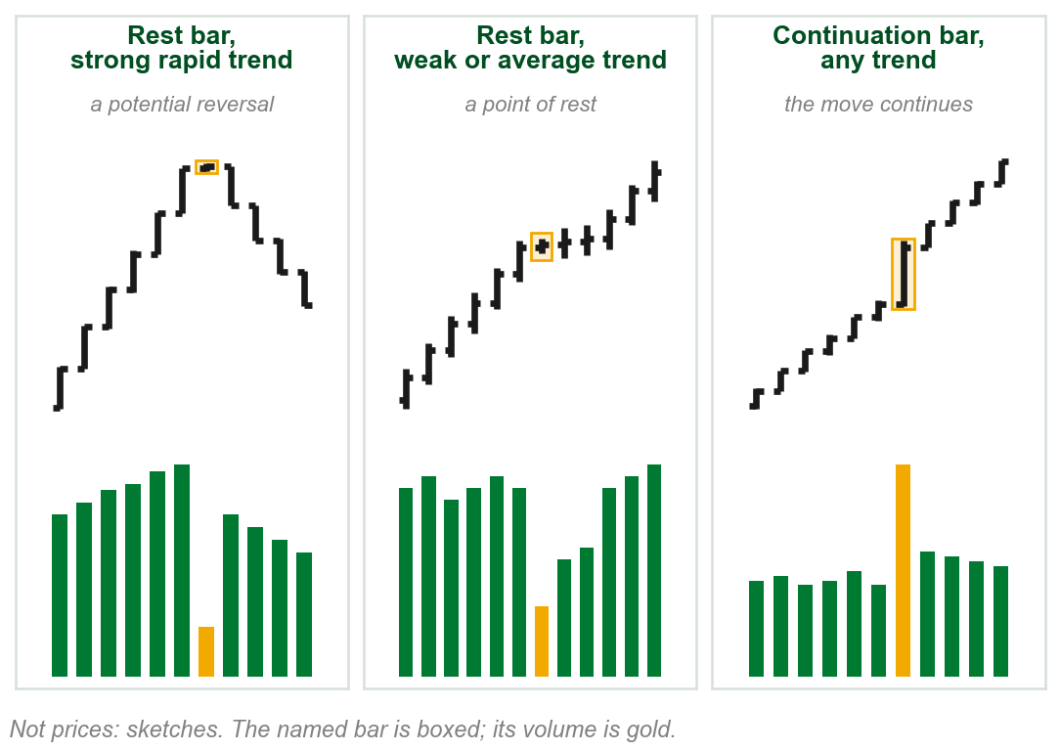
The rest bar and the continuation bar
Low Volume Rest Bar: a lack of participation. In a strong, rapid trend, a potential reversal; in a weak to average one, a point of rest.
High Volume Continuation Bar: a big move on very large participation. Bullish in an uptrend, bearish in a downtrend.
The rest bar's meaning depends on the trend's speed; the continuation bar continues whichever trend it is in.
Chapter 5: small range, low volume, trend inhibiting; large range, large volume, trend promoting.
Chart AJ - FIN1209 teaching chart, drawn for this course. Illustrative data, not a real instrument.
Part 5 of 6 - 6.1 Bar range | 4 of 14
Book p.197: the readings and reasons are the book's. The chart is ours: sketches, not prices.
Notes:
- The first two cells are the same bar in two trends. The book's point is that the trend decides what it means.
- The continuation bar is Chapter 5's trend promoting case, named.

Slide 116
CHECK 14 OF 19
Bar range and volume
Q1
Q2
In an uptrend, a bar has a narrow range on very large volume. The book calls it:
A Low Volume Rest Bar appears in a weak to average trend. It tends to indicate:
A. A High Volume Continuation Bar
B. A Low Volume Rest Bar
C. A High Volume Reversal Bar
D. A Low Volume Reversal Bar
A. A point of rest
B. A strong reversal
C. A continuation on heavy buying
D. A selling climax
Part 5 of 6 - 6.1 Bar range | Check 14
Notes:
- Read Q1 aloud, then Q2. Give them sixty seconds and no discussion.
- Ask for a show of hands on each option before you advance.
- This is for reading the room, not for marks. Say so if anyone tenses up.

Slide 117
ANSWERS
Bar range and volume
Q1 In an uptrend, a bar has a narrow range on very large volume. The book calls it:
C. A High Volume Reversal Bar
Narrow range on high volume is the High Volume Reversal Bar: sellers taking control, bearish in an uptrend.
Q2 A Low Volume Rest Bar appears in a weak to average trend. It tends to indicate:
A. A point of rest
In weak to average trends the rest bar tends to indicate a point of rest; in strong, rapid trends, a potential reversal.
Part 5 of 6 - 6.1 Bar range | Check 14
Notes:
- Reveal one at a time. Say the reason out loud, not just the letter.
- If more than a third of the room missed one, step back and reteach it.

Slide 118
High volume reversal bars: a dollar fund
Two narrow range candlesticks on high volume, at Points 1 and 2.
After each, price reverses rapidly.
Also: in August a low volume breakout signal at a descending triangle's apex, then a volume surge.
FIGURE 6.31
The daily PowerShares DB U.S. Dollar Bullish Fund. Narrow range candlesticks on high volume are circled at 1, near a low, and at 2, near a high, with lines down to their tall volume bars. At the left a triangle narrows into a low volume breakout signal.
The artwork is copyrighted and is not in the public repository. Build with assets/figures/ present to place it here.
Narrow bar, heavy volume, rapid reversal.
Apex: where the triangle's lines meet. The curved lines are Bollinger Bands, not discussed. After Point 2 the reversal runs past the chart's edge.
Figure 6.31 - Lim, The Handbook of Technical Analysis (Wiley, 2016)
Part 5 of 6 - 6.1 Bar range | 5 of 14
Book p.198 and Figure 6.31. Descending triangle: named in Chapter 4; its shape is in the book's Chapter 13.
Notes:
- Point 1 is a reversal bar at a bottom, so the converse applies: bullish. Point 2 is at a top.
- The triangle on the left is Part 2's low volume breakout signal again: volume falling into the apex, then surging.

Slide 119
A reversal bar at a bottom
A narrow range candlestick on high volume, around the beginning of November.
It led to a significant rebound in price.
FIGURE 6.32
The daily PowerShares DB U.S. Dollar Bullish Fund with a narrow range candlestick on high volume circled at a low at the start of November, followed by a strong rise.
The artwork is copyrighted and is not in the public repository. Build with assets/figures/ present to place it here.
The converse case: a high volume reversal bar in a decline is bullish.
Figure 6.32 - Lim, The Handbook of Technical Analysis (Wiley, 2016)
Part 5 of 6 - 6.1 Bar range | 6 of 14
Book p.198 and Figure 6.32.
Notes:
- Find the circle at the low. The volume bar under it is one of the tallest on the chart.
- Converse is the book's word: in a downtrend the same bar means buyers taking control.

Slide 120
More reliable inside the larger trend
A high volume reversal bar around May 23, 2011, after bearish divergence in volume and on the MACD.
It is potentially more reliable because it formed within a larger downtrend.
At Point X, a high volume continuation bar. Continuation bars too are more reliable in the direction of the predominant trend.
FIGURE 6.33
The daily PowerShares DB U.S. Dollar Bullish Fund in a long decline under its moving averages, with a circled high volume reversal bar at a short rally's top in late May, a falling line over volume and the MACD leading up to it, and a high volume continuation bar marked X.
The artwork is copyrighted and is not in the public repository. Build with assets/figures/ present to place it here.
A bar that agrees with the larger trend is the more reliable.
Figure 6.33 - Lim, The Handbook of Technical Analysis (Wiley, 2016)
Part 5 of 6 - 6.1 Bar range | 7 of 14
Book p.199 and Figure 6.33. The MACD is used here and not taught; Chapter 4 met it. The figure's RSI panel and two moving averages are not discussed.
Notes:
- Bearish divergence in volume is Part 1's: price rising into the bar while volume falls.
- The MACD is an oscillator the book has not taught. Point at its falling line and leave it there.

Slide 121
A reversal bar at an overextended level
A high volume reversal bar around the end of October 2011.
It occurred at a historically overextended volume level, drawn on the chart.
FIGURE 6.34
The daily PowerShares DB U.S. Dollar Bullish Fund with a line across the volume panel labelled historically overextended volume level, and a circled reversal bar at the end of October whose volume reaches that line.
The artwork is copyrighted and is not in the public repository. Build with assets/figures/ present to place it here.
Two signals agree: the reversal bar, and Part 2's overextended volume.
Figure 6.34 - Lim, The Handbook of Technical Analysis (Wiley, 2016)
Part 5 of 6 - 6.1 Bar range | 8 of 14
Book p.199 and Figure 6.34.
Notes:
- The overextended level is Part 2's upper overextended volume level, drawn by eye.
- Two independent pieces of evidence at one bar is what the book keeps pointing to.

Slide 122
Constant volume charts find reversal bars
Chapter 3: a constant volume chart draws a new bar once a set volume has traded.
Volume is fixed per bar, so a reversal bar is found from its range and height alone.
Figure 6.35: a narrow bar, bearish, sellers in control; a tall bar, no interest in the rise.
FIGURE 6.35
Two sketches of a constant volume bar chart, every volume bar the same height. Left: a rise topped by a narrow range bar on relatively high volume, bearish. Right: a rise topped by one overextended, very tall bar on relatively low volume, bearish.
The artwork is copyrighted and is not in the public repository. Build with assets/figures/ present to place it here.
Especially useful for reversal bars on high or low volume.
High and low against the range: a narrow bar packs the fixed volume into little movement, a tall bar spreads it over a big one.
Figure 6.35 - Lim, The Handbook of Technical Analysis (Wiley, 2016)
Part 5 of 6 - 6.1 Bar range | 9 of 14
Book p.199 and Figure 6.35. The constant volume chart was a Chapter 3 term.
Notes:
- Every bar holds the same volume, so a narrow bar is a lot of volume for the price moved, and a tall bar is little volume for it.
- That is the last part's two reversal bars, read off a chart where volume never changes.

Slide 123
CHECK 15 OF 19
Reversal bars on charts
Q1
Q2
Why is the high volume reversal bar of Figure 6.33 regarded as potentially more reliable?
On a constant volume chart, potential reversal bars are found from:
A. It formed on a constant volume chart
B. It formed within a larger downtrend
C. Its volume was the lowest of the year
D. It formed on flat volume
A. The volume bars alone
B. The time axis
C. The open interest
D. The bar range alone and its height against the rest
Part 5 of 6 - 6.1 Bar range | Check 15
Notes:
- Read Q1 aloud, then Q2. Give them sixty seconds and no discussion.
- Ask for a show of hands on each option before you advance.
- This is for reading the room, not for marks. Say so if anyone tenses up.

Slide 124
ANSWERS
Reversal bars on charts
Q1 Why is the high volume reversal bar of Figure 6.33 regarded as potentially more reliable?
B. It formed within a larger downtrend
The bearish reversal bar occurred within a larger downtrend, the direction of the predominant trend.
Q2 On a constant volume chart, potential reversal bars are found from:
D. The bar range alone and its height against the rest
Volume is fixed for each bar, so reversal bars are identified by bar range and height alone.
Part 5 of 6 - 6.1 Bar range | Check 15
Notes:
- Reveal one at a time. Say the reason out loud, not just the letter.
- If more than a third of the room missed one, step back and reteach it.

Slide 125
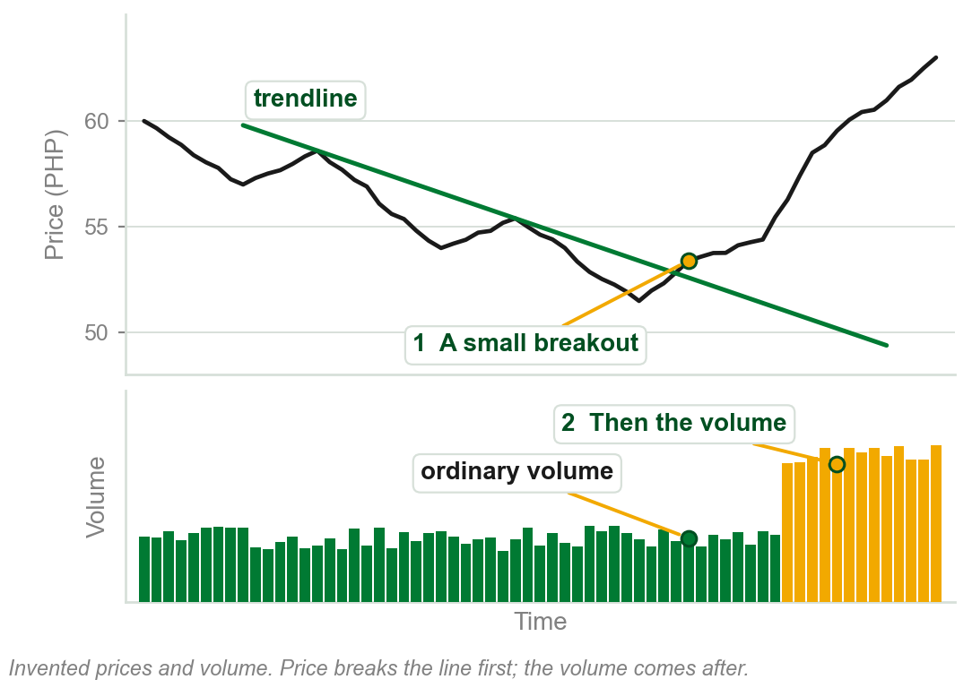
Volume leading price, or price leading volume
Most practitioners agree that without participation, volume, price cannot move significantly.
Yet buy and sell signals need not have much volume to appear on the chart.
A small breakout of a very significant trendline may set off a larger one, inviting tremendous volume.
Then price leads volume: more often now, the book says.
Chart AK - FIN1209 teaching chart, drawn for this course. Illustrative data, not a real instrument.
Part 5 of 6 - 6.1 Bar range | 10 of 14
Book p.200. The chart is ours, on invented prices. Breakout of a trendline: Chapter 5's use of the word.
Notes:
- The book asks the question, does volume lead price, and answers both ways.
- On the chart, the breakout at 1 comes first and the volume at 2 after it. That order is what price leading volume means.

Slide 126
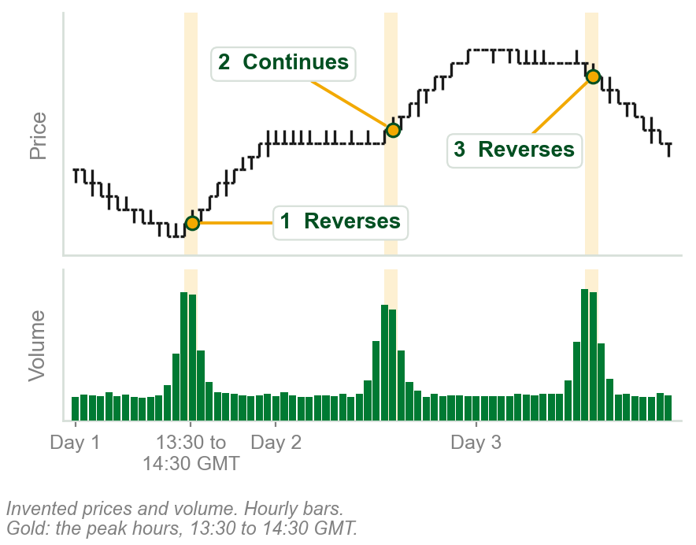
NEW TERM
Intraday volume cycle
IN PLAIN WORDS
Volume rises and falls on a daily rhythm, peaking at about the same hour each day.
FOR EXAMPLE
1:30 to 2:30 p.m. GMT is 9:30 to 10:30 p.m. in Manila. On our chart, price turns or breaks away at each peak.
THE FORMAL DEFINITION
The intraday volume cycle normally peaks around 1:30 p.m. to 2:30 p.m. GMT. At these volume peaks, price will either reverse or continue, but very rarely remain unchanged.
Chart AL - FIN1209 teaching chart, drawn for this course. Illustrative data, not a real instrument.
Part 5 of 6 - 6.1 Bar range | 11 of 14
Book p.200. The hours are the book's; its examples are EURUSD. The chart and the Manila time are ours.
Notes:
- This is review question 8: volume cycles, and where you find them. The book's answer is intraday, with the peak at that hour.
- The book does not say the hour holds for every market; its examples are the euro against the dollar.
- Reverse or continue: the peak does not say which. It says something is about to happen.

Slide 127
Volume cycle peaks at support and resistance
Almost every reversal on the 30-minute EURUSD comes at an intraday tick volume peak.
Especially useful when price retests a previous support or resistance level.
Many use a bidirectional, or straddle, entry at the peak, since price rarely stays unchanged.
FIGURE 6.36
A 30-minute EURUSD chart over several weeks with support and resistance lines, a triangle and a channel, and daily volume cycles in the volume panel; price reverses at the volume peaks.
The artwork is copyrighted and is not in the public repository. Build with assets/figures/ present to place it here.
Know when the peak comes; catch price either way.
Chapter 5's bidirectional entry: a trade either way, depending on the breakout.
Figure 6.36 - Lim, The Handbook of Technical Analysis (Wiley, 2016)
Part 5 of 6 - 6.1 Bar range | 12 of 14
Book pp.200-201 and Figure 6.36. Bidirectional entry: a Chapter 5 term.
Notes:
- Straddle is the book's second name for the bidirectional entry: orders above and below, so either move is caught.
- The daily spikes in the volume panel are the cycle. Line a few of them up with turns in price.

Slide 128
Trendline retests at volume peaks
On hourly EURUSD, price rebounds off trendline retests at Points 1, 4 and 5, each during a tick volume cycle peak.
A cycle-tuned stochastic oscillator showed oversold conditions there too.
At Points 2 and 3 the trendline failed. There the stochastic showed no clear oversold condition, at X and Y.
FIGURE 6.37
An hourly EURUSD chart with three rising trendlines, retests marked at 1 to 5, a volume panel with daily volume cycles, and a stochastic panel whose oversold readings are marked under 1, 4 and 5, with circles at X and Y where it was not clearly oversold.
The artwork is copyrighted and is not in the public repository. Build with assets/figures/ present to place it here.
The volume peak times the retest; the oscillator confirms it.
Figure 6.37 - Lim, The Handbook of Technical Analysis (Wiley, 2016)
Part 5 of 6 - 6.1 Bar range | 13 of 14
Book pp.201-202 and Figure 6.37. The cycle-tuned stochastic: named in Chapter 5; oscillators are Chapter 8.
Notes:
- Match each number to the shaded marks in the bottom panel. The successful retests had the oscillator oversold; the failures did not.
- Do not teach the stochastic. Oversold is used as in Part 2: named, not defined here.

Slide 129
Volume on non-constant time charts
Point and figure, Renko and three line break charts, Chapter 3: the time axis is not plotted in a linear fashion.
That affects the angle of trendlines, channels and chart patterns.
Equivolume charts are unique: constant time bars, but bar width varies with volume, so the time axis is non-linear too.
FIGURE 6.38
Two daily Apple charts of the same months, a standard chart with a linear time axis above and an equivolume chart with a non-linear time axis below. The same rising trendline is drawn on both, and circles mark where each is violated, at different places.
The artwork is copyrighted and is not in the public repository. Build with assets/figures/ present to place it here.
Figure 6.38: the same trendline is violated at different points on the two charts.
Figure 6.38 - Lim, The Handbook of Technical Analysis (Wiley, 2016)
Part 5 of 6 - 6.1 Bar range | 14 of 14
Book p.202 and Figure 6.38. Point and figure, Renko, three line break and equivolume charts were Chapter 3 terms.
Notes:
- Chapter 3 built these charts. The point here is only what a non-linear time axis does to a line drawn across it.
- Wide bars on heavy days stretch the axis, so the line's angle changes and so does where price crosses it.

Slide 130
CHECK 16 OF 19
Volume cycles and the time axis
Q1
Q2
The book says the intraday volume cycle normally peaks around:
Why may a trendline be violated at a different point on an equivolume chart than on a standard chart?
A. The market open
B. 1:30 p.m. to 2:30 p.m. GMT
C. The market close
D. Midnight GMT
A. Equivolume charts ignore volume
B. Equivolume charts use closing prices only
C. Bar width varies with volume, so the time axis is non-linear
D. Equivolume charts are not constant time
Part 5 of 6 - 6.1 Bar range | Check 16
Notes:
- Read Q1 aloud, then Q2. Give them sixty seconds and no discussion.
- Ask for a show of hands on each option before you advance.
- This is for reading the room, not for marks. Say so if anyone tenses up.

Slide 131
ANSWERS
Volume cycles and the time axis
Q1 The book says the intraday volume cycle normally peaks around:
B. 1:30 p.m. to 2:30 p.m. GMT
The intraday volume cycle normally peaks around 1:30 p.m. to 2:30 p.m. GMT.
Q2 Why may a trendline be violated at a different point on an equivolume chart than on a standard chart?
C. Bar width varies with volume, so the time axis is non-linear
Bars are constant time but their width varies with volume, so the time axis is non-linear and a line's angle changes.
Part 5 of 6 - 6.1 Bar range | Check 16
Notes:
- Reveal one at a time. Say the reason out loud, not just the letter.
- If more than a third of the room missed one, step back and reteach it.

Slide 132
6.2 Volume oscillators, and how they are read
The book's eight: the VWMA, the Accumulation Distribution Line (ADL),
On Balance Volume (OBV), the Chaikin Money Flow and Chaikin Oscillator,
the Demand Index, the Herrick Payoff Index, the NYSE Up/Down Volume Line.
Each is read by eight standard methods. Here: mostly divergence, plus oversold levels and trendlines on the indicator.
The eight methods, Chapter 8: 1 OBOS overextended levels, 2 equilibrium and zero line crossovers, 3 signal line crossovers, 4 price-oscillator divergence, 5 to 7 geometrically, numerically and horizontally based oscillator pattern analysis, 8 oscillator-on-oscillator analysis. OBOS: overbought and oversold. The VWMA was Part 2; the Demand Index is never explained.
Part 6 of 6 - 6.2 Oscillators | 1 of 14
Book p.203: both lists, as printed. It refers the eight methods to Chapter 8.
Notes:
- Two lists the book gives without a figure, so this slide has no picture. Say the names, and that Chapter 8 teaches the methods.
- Divergence on a volume oscillator was Part 1: price-based ones read like standard divergence.

Slide 133
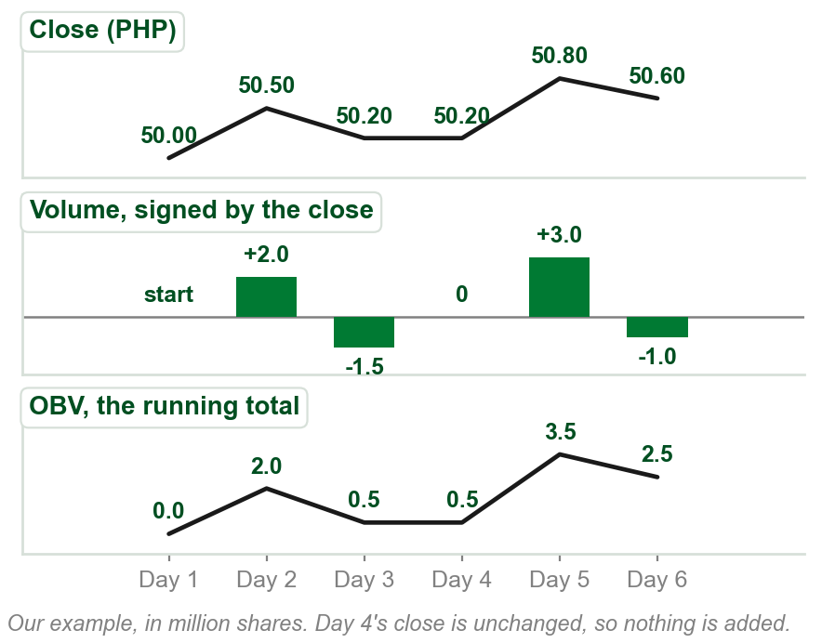
NEW TERM
On Balance Volume, OBV
IN PLAIN WORDS
A running total of volume: add the day's volume if the close rose, subtract it if the close fell.
FOR EXAMPLE
Closes PHP 50.00, 50.50, 50.20, 50.20, 50.80, 50.60; volumes after day 1: 2.0, 1.5, 1.0, 3.0, 1.0 million. OBV: 0, 2.0, 0.5, 0.5, 3.5, 2.5.
THE FORMAL DEFINITION
A cumulative running total of each period's volume: added if the close is higher than the preceding close, subtracted if lower, and nothing if unchanged.
Chart AM - FIN1209 teaching chart, drawn for this course. Illustrative data, not a real instrument.
Part 6 of 6 - 6.2 Oscillators | 2 of 14
Book p.203 gives the rule. The closes and volumes in the example and on the chart are ours.
Notes:
- Work it with the room: day 2 closes up, add 2.0; day 3 down, take away 1.5; day 4 unchanged, nothing; day 5 up, add 3.0; day 6 down, take away 1.0.
- Only the direction of the close matters, not how far it moved. That is the weakness on the next slide.

Slide 134
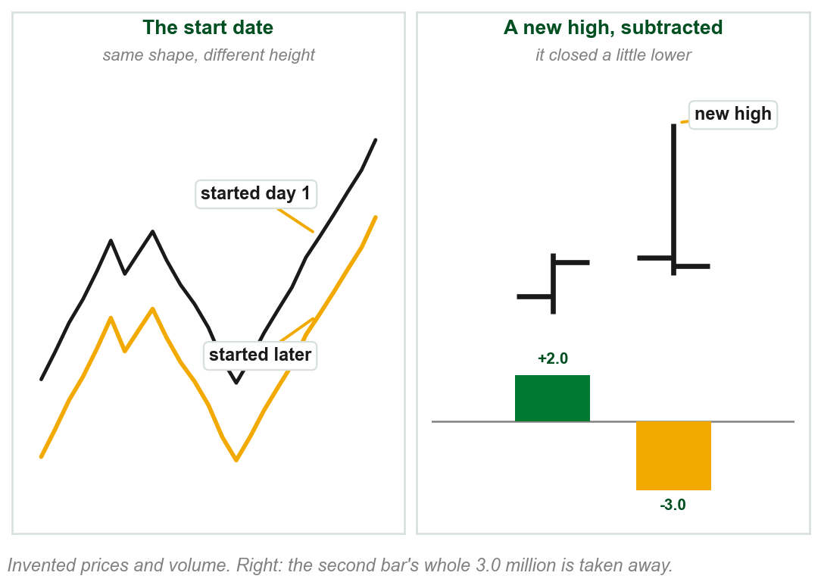
The OBV: a disadvantage and a weakness
Disadvantage: its absolute value depends on the start date. Its relative changes do not, so the eight methods still work.
Weakness: volume is added or subtracted regardless of the bar's own behavior.
A bar closing just below the last close is subtracted, even after a new high far above the last bar's.
To redress it, many prefer the ADL or the two Chaikin indicators.
Chart AN - FIN1209 teaching chart, drawn for this course. Illustrative data, not a real instrument.
Part 6 of 6 - 6.2 Oscillators | 3 of 14
Book pp.203-204: the disadvantage, the weakness and its example are the book's. The chart is ours, on invented bars.
Notes:
- Left cell: shift the start and the whole line moves up or down, but every rise and fall stays the same. Divergence reads the rises and falls.
- Right cell: the second bar went far higher and still counts as a down day, because it closed a little lower.

Slide 135
OBV bullish divergence: Citigroup
Citigroup's price falls to a lower low while the OBV makes a higher one.
Prices rebound strongly thereafter.
FIGURE 6.39
The daily chart of Citigroup with an On Balance Volume panel under it. A falling line marks price's lower lows in August to October 2011, and a rising line under the OBV, labelled bullish divergence, marks its higher lows.
The artwork is copyrighted and is not in the public repository. Build with assets/figures/ present to place it here.
The OBV is price-based: bullish divergence is price falling while it rises.
Figure 6.39 - Lim, The Handbook of Technical Analysis (Wiley, 2016)
Part 6 of 6 - 6.2 Oscillators | 4 of 14
Book p.204 and Figure 6.39.
Notes:
- Part 1's rule for a price-based oscillator: bullish divergence is price falling while the oscillator rises. Point at the two lines.
- Compare with plain volume, where bullish divergence is volume falling with price.

Slide 136
OBV bearish divergence: copper
Copper's price rises, twice, while the OBV falls.
Prices fell strongly thereafter.
FIGURE 6.40
The daily chart of copper with an On Balance Volume panel under it. Two arrows mark price rising to higher peaks in 2011 while two arrows under the OBV fall, labelled bearish divergence.
The artwork is copyrighted and is not in the public repository. Build with assets/figures/ present to place it here.
Bearish divergence reads the same on both kinds: price up, the indicator down.
Figure 6.40 - Lim, The Handbook of Technical Analysis (Wiley, 2016)
Part 6 of 6 - 6.2 Oscillators | 5 of 14
Book p.204 and Figure 6.40.
Notes:
- Two divergences, each an arrow up on price and an arrow down on the OBV.
- After the second one, copper fell from about 4.5 to about 3.0.

Slide 137
CHECK 17 OF 19
On Balance Volume
Q1
Q2
Today's close is lower than yesterday's, on volume of 3 million shares. The OBV:
The book's disadvantage of the OBV is that:
A. Is unchanged
B. Rises by 3 million
C. Rises by part of 3 million
D. Falls by 3 million
A. Its absolute value depends on the start date
B. It cannot show divergence
C. It uses open interest
D. It ignores volume
Part 6 of 6 - 6.2 Oscillators | Check 17
Notes:
- Read Q1 aloud, then Q2. Give them sixty seconds and no discussion.
- Ask for a show of hands on each option before you advance.
- This is for reading the room, not for marks. Say so if anyone tenses up.

Slide 138
ANSWERS
On Balance Volume
Q1 Today's close is lower than yesterday's, on volume of 3 million shares. The OBV:
D. Falls by 3 million
If the close is lower than the preceding close, the period's whole volume is subtracted from the running total.
Q2 The book's disadvantage of the OBV is that:
A. Its absolute value depends on the start date
Its absolute reading depends on the start date; its relative changes do not, so the eight methods still work.
Part 6 of 6 - 6.2 Oscillators | Check 17
Notes:
- Reveal one at a time. Say the reason out loud, not just the letter.
- If more than a third of the room missed one, step back and reteach it.

Slide 139
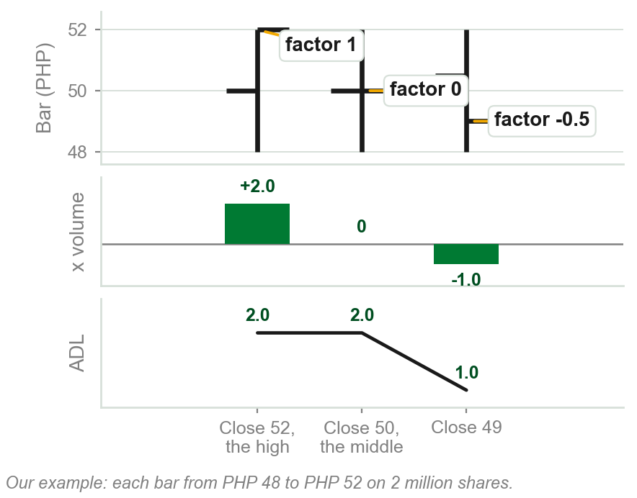
NEW TERM
Accumulation Distribution Line, ADL
IN PLAIN WORDS
A running total of volume, each bar adding or subtracting a share of its volume by where it closed.
FOR EXAMPLE
High PHP 52, low PHP 48, 2 million shares. Close 52: add 2.0 million. Close 50, the middle: add nothing. Close 49: subtract 1.0 million.
THE FORMAL DEFINITION
Calculate the multiplying factor [(C - L) - (H - C)] / (H - L) times the period's volume, and add it to its running total: the ADL.
Chart AO - FIN1209 teaching chart, drawn for this course. Illustrative data, not a real instrument.
Part 6 of 6 - 6.2 Oscillators | 6 of 14
Book pp.204-205 gives the calculation. C, H and L: the close, high and low of the bar, Chapter 1's OHLC. The bars and their volume are ours.
Notes:
- C, H and L are the close, high and low: the OHLC of Chapter 1. Work the 49 close: (49 - 48) - (52 - 49) is 1 - 3, minus 2; over the range of 4, minus one half.
- The name echoes the accumulation and distribution phases of Chapters 2 and 4. The book does not connect the two.

Slide 140
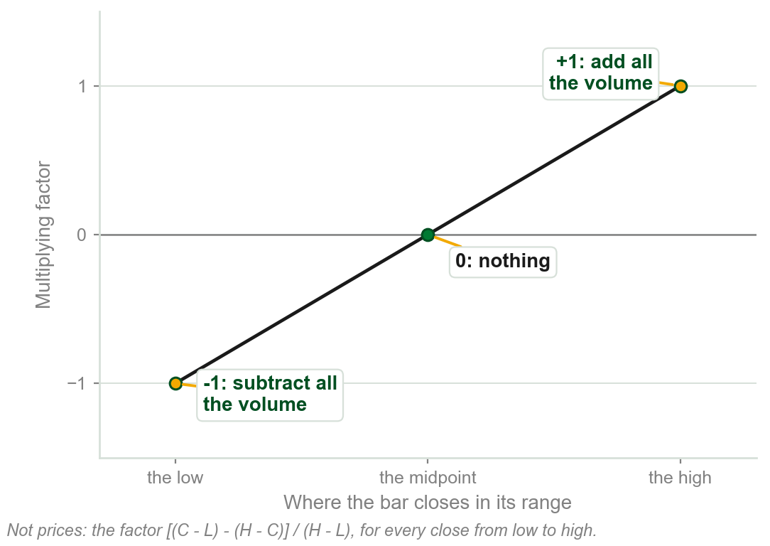
How the ADL redresses the OBV
A close at the midpoint adds nothing: if C - L = H - C, then C = (H + L) / 2.
The further above the midpoint price closes, the more volume is added; below, the more subtracted.
At most the day's total volume is added: a close at the high makes the factor exactly 1.
The ADL accounts for the current bar's price action. The OBV does not.
Chart AP - FIN1209 teaching chart, drawn for this course. Illustrative data, not a real instrument.
Part 6 of 6 - 6.2 Oscillators | 7 of 14
Book p.205: the algebra is the book's. The chart is ours: the factor drawn against where the close sits.
Notes:
- The line is the whole idea: the factor slides from minus one to plus one as the close moves from the low to the high.
- No matter how wide the range, the maximum is the day's volume, not some multiple of it: the book's words.

Slide 141
The ADL confirms, volume diverges: EURUSD
The ADL shows bullish confirmation, rising with price.
The volume bars show bearish divergence: an underlying weakness in the uptrend.
FIGURE 6.41
An hourly EURUSD chart rising to a top, with an A/D line panel rising alongside it, labelled bullish confirmation, and a volume panel falling, labelled bearish divergence, under the heading divergence between volume and ADL.
The artwork is copyrighted and is not in the public repository. Build with assets/figures/ present to place it here.
The trader should wait for price confirmation of a reversal before taking part.
Figure 6.41 - Lim, The Handbook of Technical Analysis (Wiley, 2016)
Part 6 of 6 - 6.2 Oscillators | 8 of 14
Book p.205 and Figure 6.41.
Notes:
- The two kinds again, disagreeing: the price-based ADL rises with price, plain volume falls.
- The book does not pick one. It says wait for price to confirm before acting.

Slide 142
OBV and ADL together: trend or range
When the OBV and the ADL rise or fall together, price trends in a decisive manner.
When they move in opposite directions, price tends to range or consolidate.
Useful for gauging behavioral or regime changes in the market.
FIGURE 6.42
The daily chart of Exxon Mobil with OBV and ADL panels. On the left the two move apart, non-confirmation, under an erratic and volatile price; on the right they rise together, confirmation, under a pronounced trend.
The artwork is copyrighted and is not in the public repository. Build with assets/figures/ present to place it here.
It may help decide between a trend-following and a range-bound strategy.
Figure 6.42 - Lim, The Handbook of Technical Analysis (Wiley, 2016)
Part 6 of 6 - 6.2 Oscillators | 9 of 14
Book pp.205-206 and Figure 6.42.
Notes:
- Left ellipse: the OBV falls while the ADL rises, and price goes nowhere. Right ellipse: both rise, and price trends.
- Regime is the book's word for the market's mode: trending or ranging, as in Chapter 4's phases.

Slide 143
CHECK 18 OF 19
The ADL
Q1
Q2
A bar closes exactly at the midpoint of its range. What does it add to the ADL?
The OBV and the ADL move in opposite directions. Price tends to:
A. Its whole volume
B. Half its volume
C. Nothing
D. Minus its whole volume
A. Trend decisively
B. Range or consolidate
C. Make a buying climax
D. Gap
Part 6 of 6 - 6.2 Oscillators | Check 18
Notes:
- Read Q1 aloud, then Q2. Give them sixty seconds and no discussion.
- Ask for a show of hands on each option before you advance.
- This is for reading the room, not for marks. Say so if anyone tenses up.

Slide 144
ANSWERS
The ADL
Q1 A bar closes exactly at the midpoint of its range. What does it add to the ADL?
C. Nothing
When C = (H + L) / 2, the factor (C - L) - (H - C) is zero, so nothing is added or subtracted.
Q2 The OBV and the ADL move in opposite directions. Price tends to:
B. Range or consolidate
When the two move in opposite directions there is a tendency for price to range or consolidate.
Part 6 of 6 - 6.2 Oscillators | Check 18
Notes:
- Reveal one at a time. Say the reason out loud, not just the letter.
- If more than a third of the room missed one, step back and reteach it.

Slide 145
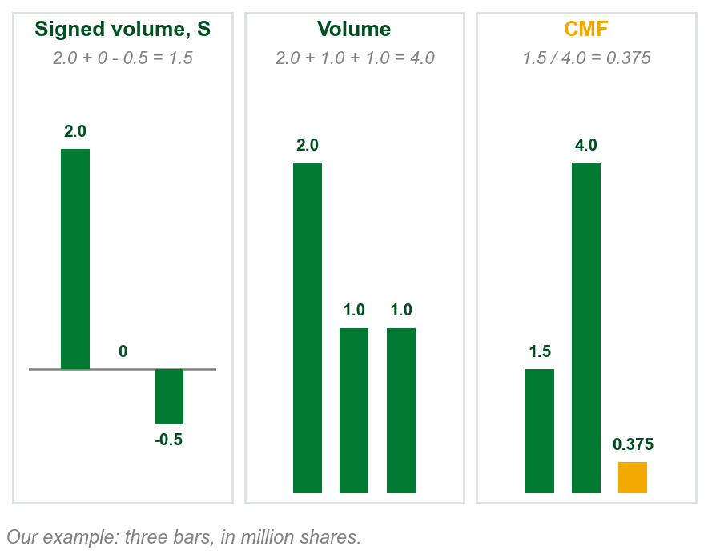
NEW TERM
Chaikin Money Flow and Chaikin Oscillator
IN PLAIN WORDS
CMF: the ADL's signed volume over N bars, over their volume. The oscillator: two averages of its running total.
FOR EXAMPLE
Signed volumes 2.0, 0 and -0.5 million on volumes 2.0, 1.0 and 1.0 million: CMF = 1.5 / 4.0 = 0.375.
THE FORMAL DEFINITION
S is the multiplying factor times volume. N-period CMF: the N-period sum of S over the N-period sum of volume. Chaikin oscillator: a shorter-term EMA less a longer-term EMA of the CMF's running total.
Chart AQ - FIN1209 teaching chart, drawn for this course. Illustrative data, not a real instrument.
Part 6 of 6 - 6.2 Oscillators | 10 of 14
Book p.206 gives the calculation, not the two EMA lengths. EMA: an exponential moving average, Chapter 11. N: a number of periods. The bars and volumes are ours.
Notes:
- S is the same signed volume as the ADL's. The CMF divides its total over N bars by the volume of those bars, so it stays between minus one and one.
- The book says to make a running total of the CMF, as for the ADL, and take the oscillator from that. It gives no lengths for the two EMAs; its figure prints 3 and 10.
- EMA is an exponential moving average: named here, taught in Chapter 11. N is the number of periods, as in Chapter 5.

Slide 146
The Chaikin pair on copper
The sell, or bearish, signal: each breaks the rising line drawn under it. The Chaikin oscillator breaks first, the CMF later.
Oversold levels on both point to a potential market bottom in copper around October 2011.
FIGURE 6.43
The daily chart of copper with a Chaikin oscillator panel and a Chaikin Money Flow panel. Rising lines mark both before a top in August, with dashed arrows to the top, and both panels carry a line labelled oversold that both touch near the October low.
The artwork is copyrighted and is not in the public repository. Build with assets/figures/ present to place it here.
The Chaikin oscillator gives the earlier signal.
Figure 6.43 - Lim, The Handbook of Technical Analysis (Wiley, 2016)
Part 6 of 6 - 6.2 Oscillators | 11 of 14
Book p.206 and Figure 6.43. The figure prints CMF(20) and ChiOsc(3,10); the text gives no settings.
Notes:
- Follow the dashed arrows from each panel up to the top: the oscillator's arrow comes first.
- Oversold again: used, not defined, as in Part 2.

Slide 147
NEW TERM
NYSE Up/Down Volume
IN PLAIN WORDS
Volume in the NYSE's rising stocks set against volume in its falling ones.
FIGURE 6.44
Two daily panels, 2009 to 2011: the NYSE Advance-Decline Volume line above, labelled cumulative, breaking its rising trendline at a point marked early bearish signal; and the NYSE Composite Index below, breaking its own trendline later, circled as price confirmation.
The artwork is copyrighted and is not in the public repository. Build with assets/figures/ present to place it here.
FOR EXAMPLE
Figure 6.44: the indicator breaks its rising trendline first, an early bearish signal; the NYSE Composite breaks later.
THE FORMAL DEFINITION
The ratio of advancing volume over declining volume. Being non-price-based, its divergence is read like volume bars and smoothed and detrended volume.
Figure 6.44 - Lim, The Handbook of Technical Analysis (Wiley, 2016)
Part 6 of 6 - 6.2 Oscillators | 12 of 14
Book p.206 and Figure 6.44. Its line is labelled cumulative and runs below zero, which a ratio cannot; the book does not explain.
Notes:
- Read it as the book does: the volume indicator breaks first, price confirms later.
- Say the gap plainly: the text says ratio; the figure's line is cumulative and goes negative. The book does not reconcile them.

Slide 148
NEW TERM
Herrick Payoff Index
IN PLAIN WORDS
A price-based volume oscillator that also uses open interest, so it can only be used where there is open interest: futures and options.
FOR EXAMPLE
On a gold futures chart it can be read. On a PSE share, which has no open interest, it cannot.
THE FORMAL DEFINITION
The Herrick Payoff Index uses open interest in its calculations, so it may only be used with futures and options. It incorporates price, so its divergence is read as for all price-based volume oscillators. Bearish signals: money flowing out; bullish signals: money flowing in.
Part 6 of 6 - 6.2 Oscillators | 13 of 14
Book pp.207-208. The book gives no formula and no figure for it, so this slide has no picture.
Notes:
- Open interest was Part 4: only futures and options have it, which is why this index is limited to them.
- It may be read with any or all of the eight methods of the part's first slide.

Slide 149
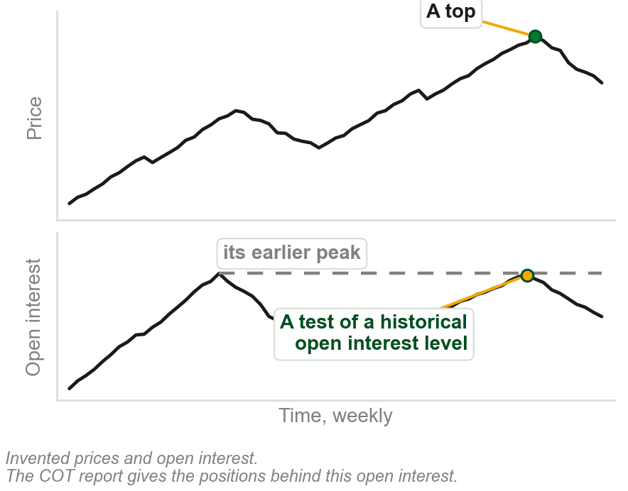
NEW TERM
Commitment of Traders, COT, report
IN PLAIN WORDS
A weekly report of who holds the open positions in a futures market, group by group.
FOR EXAMPLE
Traders look for changes in the net commercial or non-commercial positions, and for a test of a significant or historical open interest level.
THE FORMAL DEFINITION
Released every Friday, it reports all open positions held by commercials (hedgers, non-cash positions), non-commercials (hedge funds, financial institutions, large traders) and, in aggregate, small traders.
Chart AR - FIN1209 teaching chart, drawn for this course. Illustrative data, not a real instrument.
Part 6 of 6 - 6.2 Oscillators | 14 of 14
Book p.208 gives the report and its two uses; it does not define net. The chart is ours, on invented prices and open interest.
Notes:
- Traders use it to find potential tops and bottoms. The book says net position and does not define net; do not supply a formula.
- Hedgers were named in Chapter 1 among the participants. Commercial and non-commercial are the report's own groups.

Slide 150
CHECK 19 OF 19
The other volume oscillators
Q1
Q2
Why may the Herrick Payoff Index only be used with futures and options?
On the Chaikin Money Flow, three bars have signed volumes of 3.0, 1.0 and -2.0 million on volumes of 4.0, 2.0 and 2.0 million. The CMF is:
A. It uses tick volume
B. It is non-price-based
C. It uses open interest in its calculations
D. It is released every Friday
A. 0.25
B. 2.0
C. 0.5
D. -2.0
Part 6 of 6 - 6.2 Oscillators | Check 19
Notes:
- Read Q1 aloud, then Q2. Give them sixty seconds and no discussion.
- Ask for a show of hands on each option before you advance.
- This is for reading the room, not for marks. Say so if anyone tenses up.

Slide 151
ANSWERS
The other volume oscillators
Q1 Why may the Herrick Payoff Index only be used with futures and options?
C. It uses open interest in its calculations
The Herrick Payoff Index uses open interest, which only futures and options have.
Q2 On the Chaikin Money Flow, three bars have signed volumes of 3.0, 1.0 and -2.0 million on volumes of 4.0, 2.0 and 2.0 million. The CMF is:
A. 0.25
The sum of S, 2.0, divided by the sum of volume, 8.0, is 0.25.
Part 6 of 6 - 6.2 Oscillators | Check 19
Notes:
- Reveal one at a time. Say the reason out loud, not just the letter.
- If more than a third of the room missed one, step back and reteach it.

Slide 152
Chapter 6 in five sentences
Volume is participation: moving with price, bullish; against it, bearish.
Volume falling is divergence, rising is confirmation, whatever price does.
Minimum volume times breakouts and reversals; extreme volume, climaxes.
Barriers, filters and volume by price pick out the volume that matters.
Open interest reads like volume; the OBV, ADL and Chaikin pair use price.
The book's summary: price-based volume oscillators read differently.
Chapter 6 - Wrap up
Book p.208: its summary is three sentences. These five are ours, of the whole chapter.
Notes:
- Read all five slowly. This is the summary to copy down.
- The book's summary adds that volume divergence and filtering are used throughout the rest of the book.

Slide 153
The review questions to prepare
Volume against tick volume? Bearish and bullish volume?
How is volume divergence distinct from standard oscillator divergence?
How would you use volume as a timing indicator?
The various modes of volume filtering?
The relationship between volume, open interest and price?
Absolute or relative volume? Volume cycles: their use, and where?
The book's eight questions, on six lines: the first and last lines carry two each.
Chapter 6 - Wrap up
Book p.208.
Notes:
- Say where each answer sits, line by line: Parts 4 and 1, Part 1, Part 2, Part 3, Part 4, then Parts 4 and 5.
- Question 3 is the one most likely to be answered wrongly: volume divergence ignores price's direction.

Slide 154
What the book uses, and where it says two things
Used, not explained: overbought, oversold, Bollinger Bands and Bandwidth, MACD, EMA, the tick, the cycle-tuned stochastic.
Named only: the Demand Index, detrended volume, ROC volume, the PVO.
Sent ahead, by chapter: oscillators 8, divergence 9, moving averages and the VWMA's calculation 11.
Two answers: above the VWMA, bullish or overvalued; a bullish TRIN, overbought or oversold; the up/down line, ratio or cumulative.
Where the book disagrees with itself, the slide says so.
Chapter 6 - Wrap up
This course's own list, drawn from the chapter's slides. The numbers after Sent ahead are the book's chapters.
Notes:
- Be straight with them: this chapter leans on oscillators the book teaches in Chapter 8.
- Next is Chapter 7, Bar Chart Analysis.

