Slide 1
FIN1209 Technical Analysis in Investment
Chapter 5
Trend Analysis
Institute of Accounts, Business and Finance | Far Eastern University Manila
Benjamin C. Sotelo
Notes:
- Greet the room, then say what today buys them: what a trend is, how to judge its quality, and how to get in and out of one.
- Say every idea today has a picture beside it. Where the book drew one it is the book's; the rest are ours.

Slide 2
What you will be able to do
Understand the significance of a market trend and its underlying characteristics.
Recognize the limitations of defining trend and market action.
Identify early indications of a potential market reversal.
Read the markets in terms of wave cycles of various degrees.
Set up effective price filtering, and calculate the optimum tradesize for breakout trades.
Use channels, trendlines, fan lines and Drummond geometry to track the market.
Chapter 5 - Opening
Book p.125: its seven learning objectives, on six lines.
Notes:
- These are the book's seven learning objectives, trimmed to six lines. The fifth line joins its fifth and sixth.
- Do not read all of them aloud. Say the first and the last, and that every one is examinable.

Slide 3
How this chapter is laid out
5.1 What a trend is, and where any definition runs out.
5.2 Sixteen price characteristics that show the quality of a trend.
5.3 to 5.5 Filters, orders, entries, stops and tradesize.
5.6 Trendlines, channels and fan lines.
5.7 to 5.11 Retracements, gaps, directionality, Drummond, reversal signs.
Eleven sections, the book's own. Two of them are long: 5.2 and 5.6.
Bottom right of every teaching slide: the book page it comes from, and whose the numbers are. Lettered charts are ours, invented, drawn where the book gives only words or a sketch. Peso amounts are our examples.
Chapter 5 - Opening
The sections are the book's own, pp.125 to 170.
Notes:
- The parts are the book's own sections. The marker at the bottom left of every slide says which one we are in.
- Say the checks carry no marks. Each question slide is followed by its answers on a slide of their own.

Slide 4
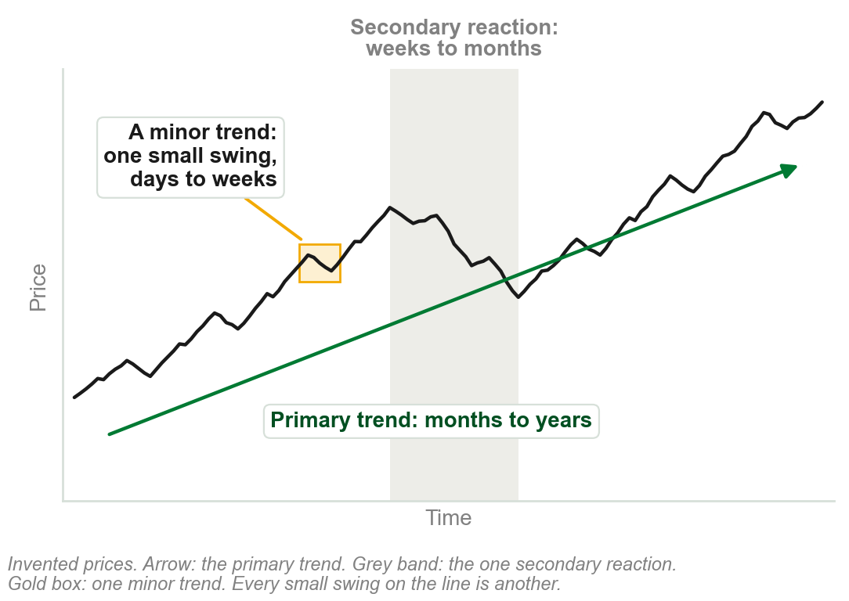
5.1 Dow sorts trends by how long they last
Primary, or major, trends are longer term: months to years.
Secondary trends, or reactions, are medium term: weeks to months.
Minor trends are shorter term: days to weeks.
Dow sorts the three by duration and extent: how long a trend lasts, and how far it runs.
Chapter 2 taught all three, with one extent: a secondary reaction retraces a third to two thirds. Here the book lists durations only.
Chart A - FIN1209 teaching chart, drawn for this course. Illustrative data, not a real instrument.
Part 1 of 11 - 5.1 Definitions | 1 of 21
Book p.125: 'classified and defined by their duration and extent'. The chart is ours, on invented prices: this chapter has no figure of the three together.
Notes:
- Link back to Chapter 2: the same three trends. Today's question is what a trend is, and how to tell a healthy one.
- Point at the chart: the long rise is the primary trend, the fall inside it a secondary reaction, the small swings minor trends.

Slide 5
An uptrend: higher highs and higher lows
An uptrend is a series of successively higher highs, the peaks, and higher lows, the troughs.
HH: a rally carries above the last peak. HL: a dip holds above the last trough.
Right of the figure: the highs and lows stop rising. By the definition, the uptrend has technically ended.
FIGURE 5.1
A rising bar chart with every peak marked HH and every trough HL, labelled an uptrend as a sequence of higher highs and higher lows, and a flat stretch at the end where the uptrend has technically ended.
The artwork is copyrighted and is not in the public repository. Build with assets/figures/ present to place it here.
The same definition as Chapter 2: Dow's peak and trough analysis.
A share peaks at PHP 50, dips to 46, peaks at 54, dips to 49: higher highs and higher lows.
Figure 5.1 - Lim, The Handbook of Technical Analysis (Wiley, 2016)
Part 1 of 11 - 5.1 Definitions | 2 of 21
Book p.126 and Figure 5.1. The pesos in the small print are our example.
Notes:
- A recall, not a new term: Chapter 2 defined the uptrend the same way. This is review question 1, what is a trend.
- HH is a higher high and HL a higher low. Where the sequence stops, the figure says the uptrend has technically ended.

Slide 6
A downtrend: lower highs and lower lows
A downtrend is represented by a series of successively lower highs and lows. The figure starts from a first peak, H, and a first trough, L.
Each rally stops below the last peak: a lower high, LH.
Each decline carries below the last trough: a lower low, LL.
FIGURE 5.2
A falling bar chart labelled a downtrend unfolding, with its first peak marked H, its first trough L, and after them three lower highs marked LH and three lower lows marked LL.
The artwork is copyrighted and is not in the public repository. Build with assets/figures/ present to place it here.
Peak and trough analysis is the most popular definition of a trend.
Figure 5.2 - Lim, The Handbook of Technical Analysis (Wiley, 2016)
Part 1 of 11 - 5.1 Definitions | 3 of 21
Book p.126 and Figure 5.2.
Notes:
- Read the labels left to right: H, L, then LH and LL three times over.
- The definition asks for both, lower highs and lower lows, one after another.

Slide 7
Where the definition runs out
Scenarios 1 and 2 show higher highs and higher lows: uptrends under Dow.
Scenario 3 has one high, H, and one low, L, then runs to B: no second peak or trough to compare. Scenario 4 never turns.
Under the definition neither is an uptrend. Yet in all four, price went from A to B.
FIGURE 5.3
Four paths from a point A up to a point B. The first two zigzag through higher highs and higher lows and are labelled uptrend. The third has one high and one low, the fourth is a straight line, and both are labelled uptrend with a question mark.
The artwork is copyrighted and is not in the public repository. Build with assets/figures/ present to place it here.
All definitions impose limitations: an actual trend may go unrecognized.
So many practitioners prefer an absolute measure: the distance traversed, not how price behaved on the way.
Figure 5.3 - Lim, The Handbook of Technical Analysis (Wiley, 2016)
Part 1 of 11 - 5.1 Definitions | 4 of 21
Book pp.126-127 and Figure 5.3.
Notes:
- This is review question 2: the disadvantages of defining market and price action. The book adds that erratic or chaotic price action can make peaks and troughs extremely hard to identify.
- Ask the room: do we deny that scenarios 3 and 4 were trends? The book leaves it as a question.

Slide 8
Three other ways to call a trend intact
Left: price stays above an overlay indicator: here a trendline. A moving average is another.
Middle: price stays above an arbitrarily chosen price level.
Right: no reversal of a specified amount. Each grey box is one such amount, as on a Point and Figure or Renko chart.
FIGURE 5.4
Three rising prices, each labelled trend still intact: one remaining above a dotted trendline, one remaining above a chosen level, and one climbing through stacked boxes with the minimum reversal amount not breached.
The artwork is copyrighted and is not in the public repository. Build with assets/figures/ present to place it here.
While the condition holds, the trend is still intact.
For a downtrend, below. Trendlines: 5.6. Moving averages, met in Chapter 4: Chapter 11. Point and Figure, Renko: Chapter 3.
Figure 5.4 - Lim, The Handbook of Technical Analysis (Wiley, 2016)
Part 1 of 11 - 5.1 Definitions | 5 of 21
Book pp.127-128 and Figure 5.4.
Notes:
- Left to right in the figure: above a trendline, above a chosen level, no reversal of the minimum amount. The converse holds for downtrends.
- Other overlays the book names: the lower Bollinger, linear regression and moving average band, and the lower boundary of a chart pattern.
- The chosen level is often a historically significant support, whose violation implies a very high probability of the trend reversing.

Slide 9
CHECK 1 OF 21
What a trend is
Q1
Q2
Under Dow's peak and trough definition, an uptrend is a series of successively:
Price rises from A to B in one straight move, with no peaks or troughs at all. Under Dow's definition this is:
A. Higher highs and lower lows
B. Higher highs and higher lows
C. Lower highs and lower lows
D. Higher closes only
A. A primary uptrend
B. A secondary reaction
C. A downtrend
D. Not classified as an uptrend
Part 1 of 11 - 5.1 Definitions | Check 1
Notes:
- Read Q1 aloud, then Q2. Give them sixty seconds and no discussion.
- Ask for a show of hands on each option before you advance.
- This is for reading the room, not for marks. Say so if anyone tenses up.

Slide 10
ANSWERS
What a trend is
Q1 Under Dow's peak and trough definition, an uptrend is a series of successively:
B. Higher highs and higher lows
An uptrend is successively higher highs, the peaks, and higher lows, the troughs.
Q2 Price rises from A to B in one straight move, with no peaks or troughs at all. Under Dow's definition this is:
D. Not classified as an uptrend
With no higher highs or lows there is nothing for the definition to recognize, even though price travelled from A to B.
Part 1 of 11 - 5.1 Definitions | Check 1
Notes:
- Reveal one at a time. Say the reason out loud, not just the letter.
- If more than a third of the room missed one, step back and reteach it.

Slide 11
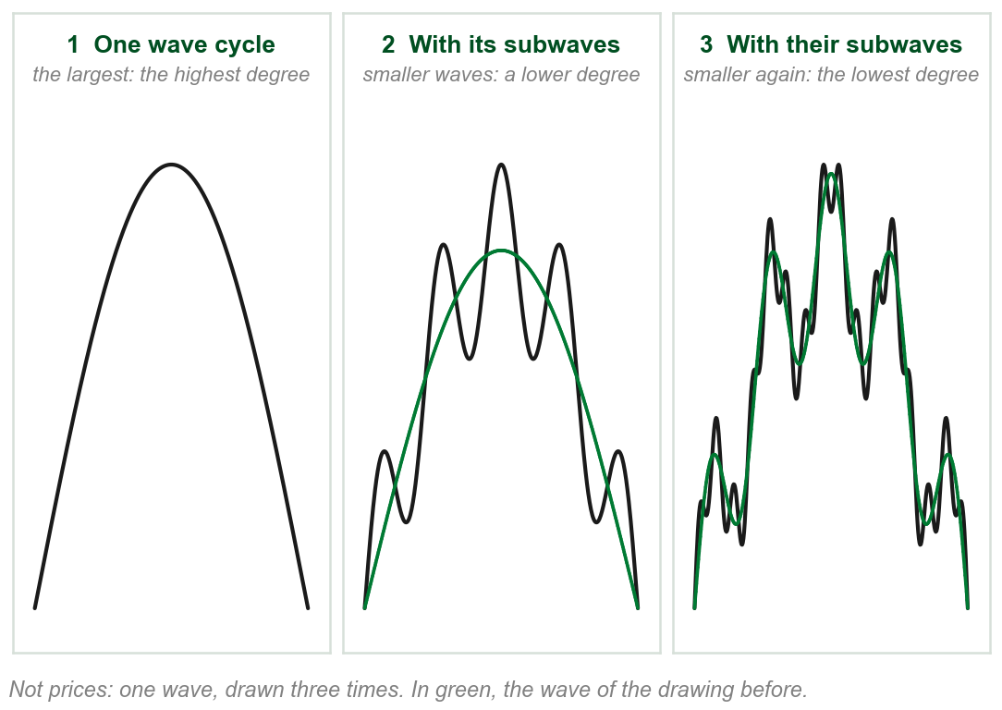
What a wave degree is
Price swings up and back down. A run of swings of one size is a wave: the book's wave cycle.
Small swings ride inside bigger ones. The smaller wave is a subwave of the bigger.
Degree is the rank of a wave by size: the bigger wave is of a higher degree, its subwaves of a lower one.
The book: any trend or consolidation can be described in wave cycles, at various wave degrees.
Chapters 3 and 4 said wave cycle and cycle degree in passing. The book defines neither; this reading is from its figures.
Chart B - FIN1209 teaching chart, drawn for this course. Illustrative data, not a real instrument.
Part 1 of 11 - 5.1 Definitions | 6 of 21
Book p.128 says wave cycle, wave degree and subwave and defines none of them. The reading and the chart are ours, from its Figures 5.5 to 5.9.
Notes:
- Teach this slide before anything is named. Left drawing: one wave. Middle: the same wave, in green, with smaller waves riding along it. Right: smaller ones again riding along those.
- Each added wave is a subwave of the one it rides on, and one degree lower. Two drawings are two degrees, three are three.
- A degree is not an angle and not a fixed size: it only says which of two waves is the bigger. The reading rests on the book's figures and its words larger, smaller and subwave; Chapters 3 and 4 used the words and explained neither.

Slide 12
NEW TERM
Wave cycles: HWC, MWC and LWC
IN PLAIN WORDS
Three wave degrees on one chart, named by size against each other.
FIGURE 5.5
A wave of three degrees: one thick line rising and falling, the higher wave cycle; a dotted line weaving around it, the medium wave cycle; and a thin jagged line weaving around that, the lower wave cycle.
The artwork is copyrighted and is not in the public repository. Build with assets/figures/ present to place it here.
FOR EXAMPLE
In the figure: HWC thick, MWC dotted, LWC thin. Three degrees here; the minimum in any trend is two.
THE FORMAL DEFINITION
HWC, the higher wave cycle: the highest wave degree. MWC, the medium wave cycle: a subwave of the HWC, of a lower degree. LWC, the lower wave cycle: a subwave of both, at the lowest degree.
Figure 5.5 - Lim, The Handbook of Technical Analysis (Wiley, 2016)
Part 1 of 11 - 5.1 Definitions | 7 of 21
Book pp.128-129 and Figure 5.5. It gives the minimum of two degrees as a note, with no reason.
Notes:
- Three wave cycles laid over one another: the thick line is the HWC, the dotted line the MWC, the thin line the LWC.
- Higher, medium and lower are relative to each other. The book fixes no size or duration for any of them.
- It gives the minimum of two degrees as a note, with no reason. Do not supply one.

Slide 13
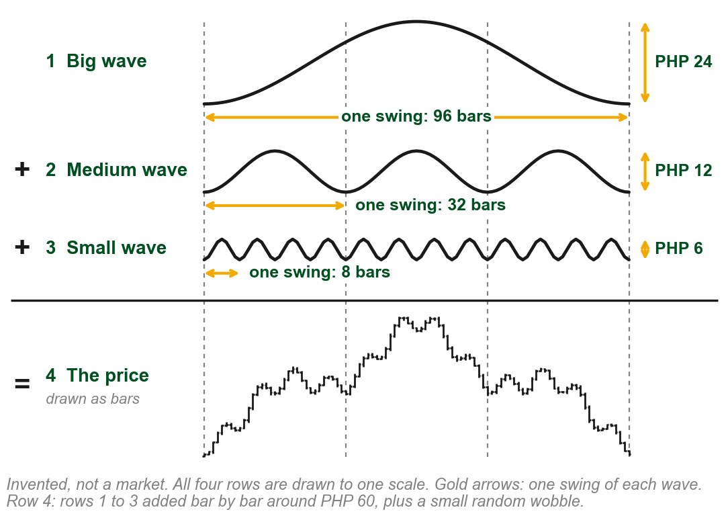
Our example: one price, built from three waves
Figure 5.5 is a sketch with no prices. To see wave cycles on price bars, we built a price.
Rows 1 to 3: a big, a medium and a small wave. Gold arrows measure one swing of each, up and back down.
Row 4: at every bar the three are added, around PHP 60, plus a small wobble: the price.
The sizes are ours. A real chart carries none.
Why these sizes: so that three medium swings fit in the big one, and four small swings in each medium one.
Chart C - FIN1209 teaching chart, drawn for this course. Illustrative data, not a real instrument.
Part 1 of 11 - 5.1 Definitions | 8 of 21
Ours, to put the book's Figure 5.5 (p.129) on a price chart. Every number here is one we chose; none is the book's or a market's.
Notes:
- Say plainly that this price is made up, and how. Nothing on the next slides is a measurement of a market; it is a price we built so that the three cycles can be seen.
- Read the chart like a sum in arithmetic, top to bottom: big, plus medium, plus small, equals the price. All four rows are to one scale, so the small wave really is that small.
- The gold arrows are one swing of each wave: how long it takes and how tall it is. The dashed uprights show three medium swings inside the big one and four small swings inside each medium one. Any clearly different sizes would have done.

Slide 14
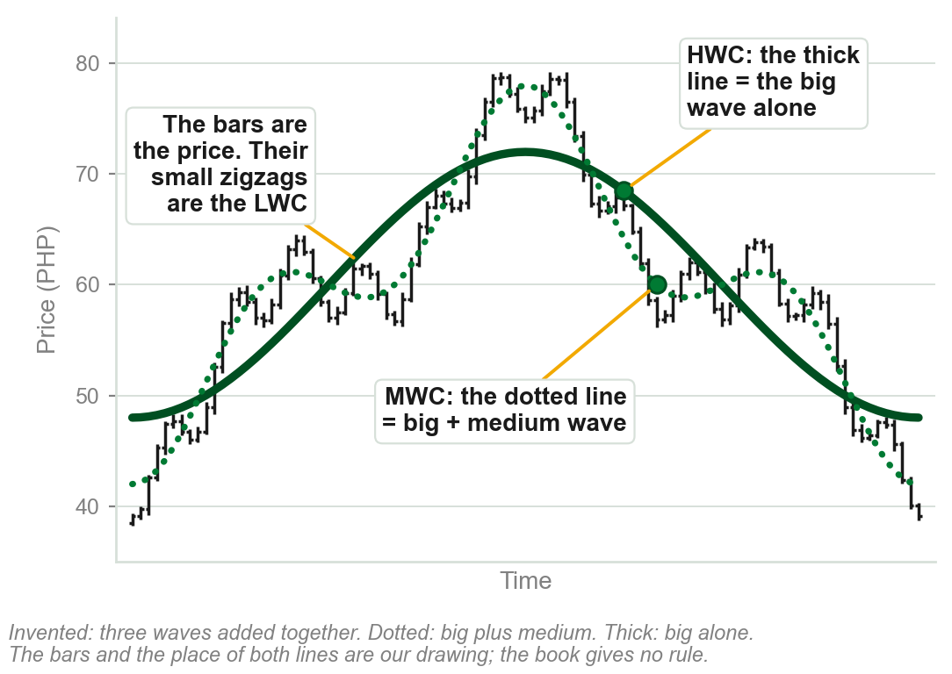
How the three cycles are drawn
LWC: the small zigzags of the price bars.
MWC: the dotted line, the big wave plus the medium, through the middle of the zigzags.
HWC: the thick line, the big wave alone, through the middle of the dotted line's swings.
The book gives no rule for placing either line. We can place ours because we built the price.
They look like moving averages. The book does not say they are.
Moving averages: met in Chapter 4, taught in Chapter 11.
Chart D - FIN1209 teaching chart, drawn for this course. Illustrative data, not a real instrument.
Part 1 of 11 - 5.1 Definitions | 9 of 21
The book's (pp.128-129, Figure 5.5): thin, dotted and thick lines, and no formula, indicator or number of bars. Ours: the bars, and where both lines sit.
Notes:
- The question a student asks of the book's figure is what the three lines are. The thin one is price. The other two are drawn over price to show its bigger swings.
- Why draw them at all: the book calls it critical that a trader be able to visualize price cycles on the chart. Its figures are freehand sketches, with no bars and no price axis.
- Be plain that the book stops there. It names no indicator and gives no length, so do not say the lines are moving averages of any period. Moving averages are Chapter 11.

Slide 15
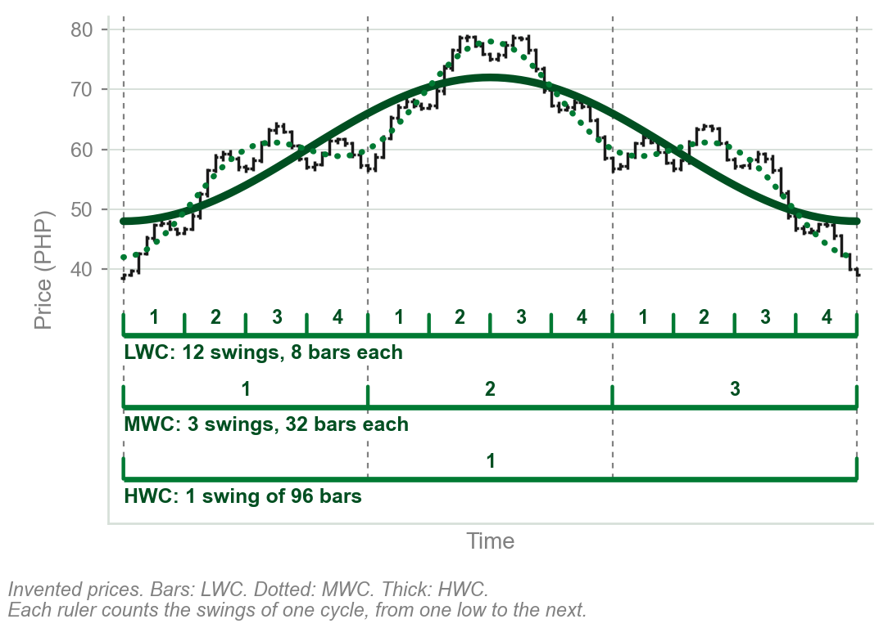
Telling the three cycles apart
Each ruler counts the swings of one wave cycle, low to low.
Four LWC swings fit inside each MWC swing, and three MWC swings inside the HWC swing. That is what subwave means.
A real chart gives no sizes and the book fixes none. So compare: the smallest swings in view are the LWC, the swings they ride on the MWC, the biggest the HWC.
A degree is a rank, never a fixed size.
Four and three are this chart's numbers, not a rule.
Chart E - FIN1209 teaching chart, drawn for this course. Illustrative data, not a real instrument.
Part 1 of 11 - 5.1 Definitions | 10 of 21
Ours, on the book's pp.128-129, which fix no size, duration or timeframe for a wave cycle. The counts are of our invented chart.
Notes:
- Read the three rulers from the top. Every fourth small low is also a medium low, and the first and last lows are lows of all three: that is the nesting.
- Each degree also has its own average size of swing. The book's words are the average wave amplitude and volatility associated with that particular wave degree, and they come up with breakouts in a moment.
- Chapter 9 comes back to wave degrees and says the relationship between them is relative. Chapter 18 gives Elliott's named degrees. Neither is needed here.

Slide 16
Know which wave cycle you are trading
Without knowing which wave cycle is traded, a trader may be unable to:
select consistent breakout levels or effective stoploss levels, or apply effective stopsizing;
tell trend from consolidation mode, or find the direction of the predominant trend.
The figure labels one rise three ways: [1] on the HWC, 1 to 3 on the MWC, i to v and a to c on the LWC.
FIGURE 5.6
One rise labelled at three wave degrees: i to v and a to c at the lowest degree, 1 to 3 at the medium degree, and [1] at the highest, under the heading Elliott wave in terms of wave degrees.
The artwork is copyrighted and is not in the public repository. Build with assets/figures/ present to place it here.
The labels, question marks included, are Elliott's, Chapter 18: not needed here. Stoploss, a stop loss order: 5.4. Stopsizing: 5.5.
Figure 5.6 - Lim, The Handbook of Technical Analysis (Wiley, 2016)
Part 1 of 11 - 5.1 Definitions | 11 of 21
Book p.129 and Figure 5.6. The book lists the five with no reasons; p.130 explains modes and breakout levels, which follow here.
Notes:
- The book calls it critical that a trader be able to visualize price cycles on the chart. Its five inabilities sit on two lines here.
- The figure labels one rise three ways. Point at the three sets of labels and do not teach the count: that is Chapter 18.

Slide 17
Trending and consolidating at once
Chapter 4: a market is either trending or consolidating.
Chapter 5 adds: it may be both at once, depending on the wave cycle being observed.
Figure: the LWC climbs swing after swing, then falls: trend mode. The MWC swings across one level: ranging. The HWC is flat: flatline.
FIGURE 5.7
A flat thick arrow, the higher wave cycle in flatline mode; a dashed wave swinging above and below it, the medium wave cycle in ranging mode; and a thin jagged line climbing each swing, the lower wave cycle in trend mode.
The artwork is copyrighted and is not in the public repository. Build with assets/figures/ present to place it here.
Ask at which wave degree before asking whether it is trending.
Ranging and flatline are the figure's words; the text says only trend and consolidation mode. Both are consolidation.
Figure 5.7 - Lim, The Handbook of Technical Analysis (Wiley, 2016)
Part 1 of 11 - 5.1 Definitions | 12 of 21
Book p.130 and Figure 5.7. The Chapter 4 line is this course's Chapter 4 deck.
Notes:
- Three answers to one question on one chart: flat, ranging, trending. Ranging and flatline are the figure's labels; the text says only trend and consolidation, and says mode where Chapter 4 said phase.
- Chapter 4's consolidation phase was the sideways stretch, one of only two basic phases. Nothing there is withdrawn; this chapter adds that the phase depends on the wave being read.

Slide 18
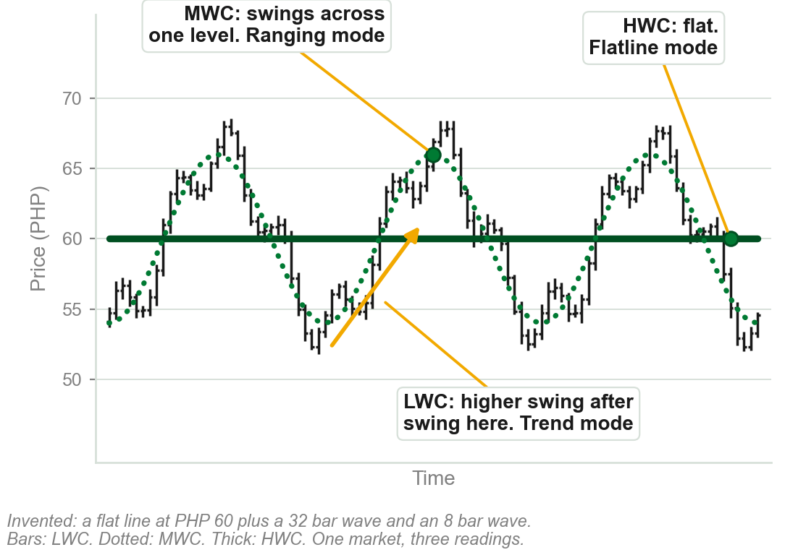
One market, three modes, on price bars
LWC, the small zigzags of the bars: swing after swing they climb, then fall. Trend mode, up and then down.
The dotted MWC swings between about PHP 54 and PHP 66 and gets nowhere: ranging mode.
The thick HWC stays at PHP 60: flatline mode.
One chart. Whether it is trending depends on which wave is read.
The three modes are the book's. The bars and the pesos are our invented chart.
Chart F - FIN1209 teaching chart, drawn for this course. Illustrative data, not a real instrument.
Part 1 of 11 - 5.1 Definitions | 13 of 21
Ours: the book's Figure 5.7 (p.130) on price bars. Built from a flat line at PHP 60, a 32 bar wave PHP 12 tall and an 8 bar wave PHP 4 tall, so each mode shows.
Notes:
- The same idea as the book's sketch, on bars. Point at the gold arrow first: along it every small swing ends higher than the last, an uptrend to anyone trading the bars.
- Then the dotted line: up to 66, down to 54, three times over. To the trader of that wave nothing has happened.
- Then the thick line. Three traders, one chart, three true answers.

Slide 19
CHECK 2 OF 21
Wave cycles
Q1
Q2
Of the three wave cycles, the one that is a subwave of both of the others is the:
A market's lower wave cycle is rising while its medium wave cycle moves sideways. The market is in:
A. Higher wave cycle, HWC
B. Lower wave cycle, LWC
C. Medium wave cycle, MWC
D. None: each is a subwave of only one
A. Trend mode only
B. Consolidation mode only
C. Both, depending on the wave cycle observed
D. Neither, until a breakout occurs
Part 1 of 11 - 5.1 Definitions | Check 2
Notes:
- Read Q1 aloud, then Q2. Give them sixty seconds and no discussion.
- Ask for a show of hands on each option before you advance.
- This is for reading the room, not for marks. Say so if anyone tenses up.

Slide 20
ANSWERS
Wave cycles
Q1 Of the three wave cycles, the one that is a subwave of both of the others is the:
B. Lower wave cycle, LWC
The LWC is a subwave of both the HWC and the MWC, at the lowest wave degree. The MWC is a subwave of the HWC only.
Q2 A market's lower wave cycle is rising while its medium wave cycle moves sideways. The market is in:
C. Both, depending on the wave cycle observed
A market may be in trend and consolidation modes at the same time, depending on the wave cycle being observed.
Part 1 of 11 - 5.1 Definitions | Check 2
Notes:
- Reveal one at a time. Say the reason out loud, not just the letter.
- If more than a third of the room missed one, step back and reteach it.

Slide 21
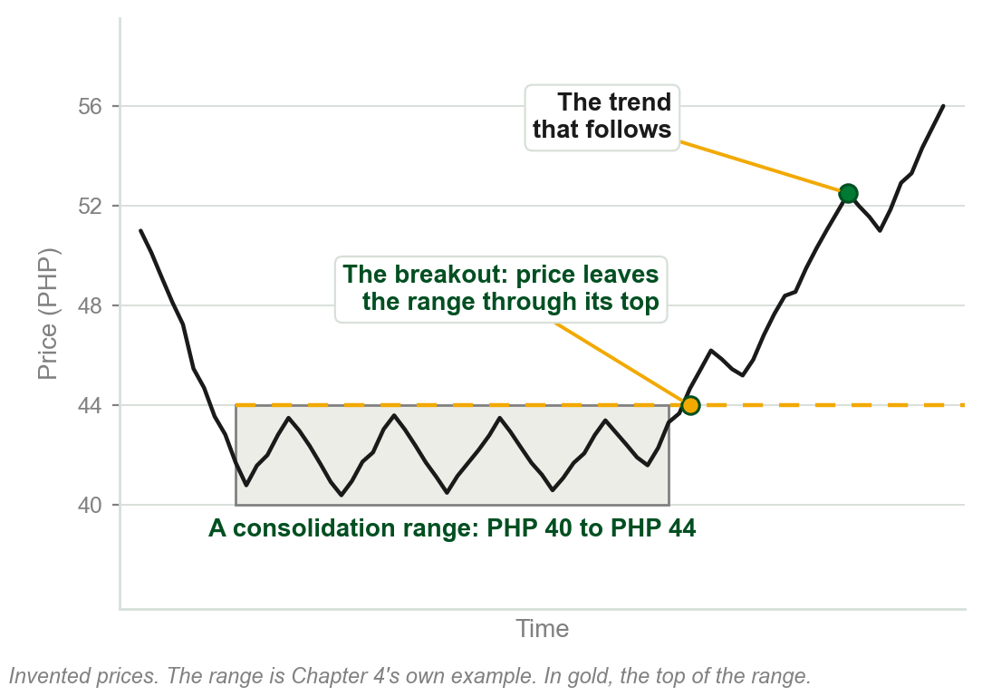
Breakout, as Chapters 2 and 4 used it
Chapter 2: a line, a narrow sideways range, usually results in a strong breakout.
Chapter 4: most call a consolidation over on a clear breakout from the range. The trend phase follows.
In both, price leaves a sideways range through its top or its bottom.
The breakout taught so far: price getting out of a range.
Earlier chapters also said breakout, in passing, of a pattern, a neckline and a level. None defined it.
Chart G - FIN1209 teaching chart, drawn for this course. Illustrative data, not a real instrument.
Part 1 of 11 - 5.1 Definitions | 14 of 21
A recall of this course's Chapters 2 and 4. The chart is Chapter 4's own example, a range from PHP 40 to PHP 44.
Notes:
- A recall, not a new term, and it is here because the word is about to be used more widely. Chapter 2's line and Chapter 4's consolidation both ended in a breakout from a range.
- The chart is Chapter 4's own example again: a share ranging between PHP 40 and PHP 44. The gold line is the top of the range, and the breakout is where price gets through it.
- Ask the room what the breakout was a breakout of. The answer to hold on to is a level: the top of the range.

Slide 22
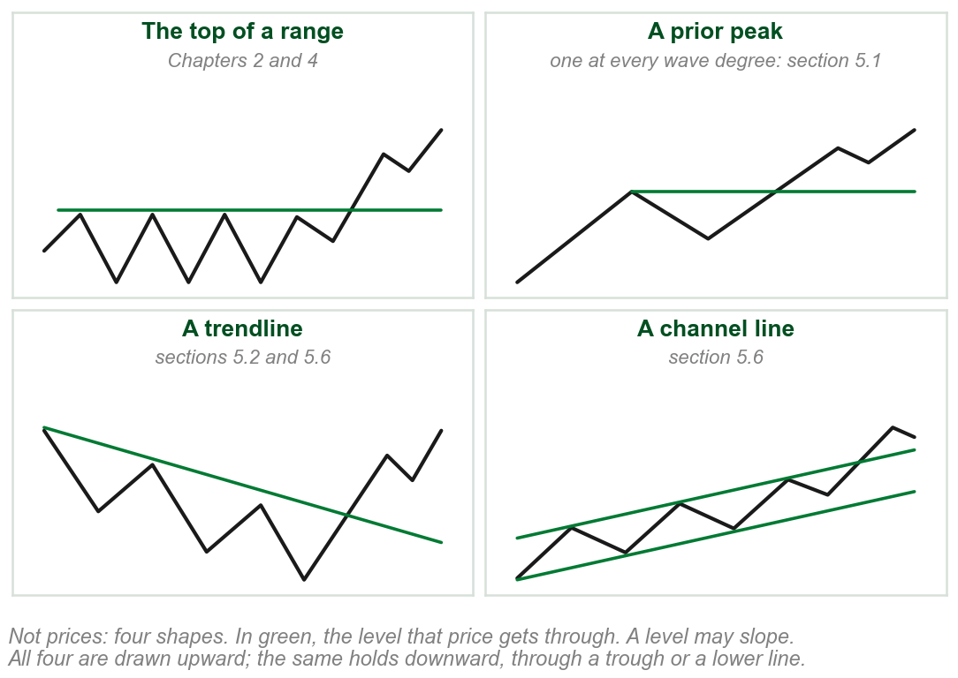
Chapter 5: a breakout is through a level
The edge of a range is one kind of level. Chapter 5 uses breakout of every kind:
a prior peak or trough, a trendline, a channel line, any overlay such as a moving average.
Each time, a level holds price and then price gets through it. A level may slope, as a trendline does.
One word for all of them: the level need not be the edge of a range.
The book never defines breakout. Chapter 2 called price going through a previous peak or trough a penetration.
Chart H - FIN1209 teaching chart, drawn for this course. Illustrative data, not a real instrument.
Part 1 of 11 - 5.1 Definitions | 15 of 21
Our reading of how the book uses the word: pp.130, 143, 148, 158 to 161. It defines breakout nowhere.
Notes:
- This is the slide that reconciles the two uses. A breakout is price getting through a level that was holding it. The top of a range is such a level, and so is a prior peak, a trendline or a channel line.
- It is not new to this chapter either. Chapter 1's price filter asked price to move a set distance past the level, and Chapter 3's breakout level was 10.00.
- Be straight that the definition is ours, from use. The book says breakout, penetration, violation and breach of a level and never sets one against another; in Chapter 2 it wrote inflection point breakouts for what it had called penetration.

Slide 23
A breakout for every wave degree
Breakouts can be defined by wave degree: the level depends on the degree traded.
Each B/OUT LEVEL in the figure sits on a prior peak: five peaks, five levels.
Knowing the degree, a trader can size the stoploss to its average wave amplitude and volatility.
FIGURE 5.8
One price path with breakout levels drawn at three sizes: short LWC breakout levels on the small swings, two MWC breakout levels on the medium swings, and one HWC breakout level across the top of the whole move.
The artwork is copyrighted and is not in the public repository. Build with assets/figures/ present to place it here.
Volatility at one wave degree may not manifest at a higher or lower degree.
Our words: a stop sized for the thin line's zigzags is too small for the thick line's one swing. Amplitude: 5.2. Stop sizing: 5.5.
Figure 5.8 - Lim, The Handbook of Technical Analysis (Wiley, 2016)
Part 1 of 11 - 5.1 Definitions | 16 of 21
Book p.130 and Figure 5.8. The gold line is the only reason the book gives for sizing the stoploss by degree.
Notes:
- Count the levels in the figure: several small ones, two medium, one large. Each is a horizontal line across a peak, and each is a breakout to somebody.
- Each wave cycle has peaks of its own, so each has levels of its own. That is read off the figure; the three lines are the book's sentences.
- Stopsizing comes back in section 5.5. For now: a stop sized for one degree is the wrong size for another.

Slide 24
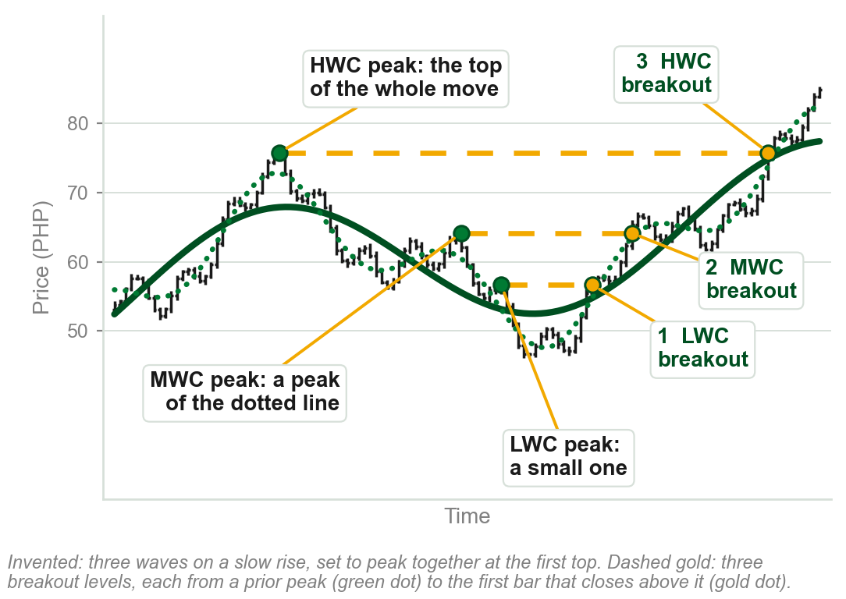
One price passes three breakout levels
Each dashed gold line is a breakout level: the highest price at a prior peak.
1 LWC breakout: past a small peak, about PHP 57.
2 MWC breakout: past a peak of the dotted line, about PHP 64.
3 HWC breakout: past the top of the whole move, about PHP 76.
One price, three breakouts: one for each wave degree.
Chart I - FIN1209 teaching chart, drawn for this course. Illustrative data, not a real instrument.
Part 1 of 11 - 5.1 Definitions | 17 of 21
Ours: the book's Figure 5.8 (p.130) on price bars. Each level is the highest bar at a peak, where price was, not the height of the smooth line.
Notes:
- Three traders watch one price. Each is waiting for a different gold line, and each calls a different bar the breakout.
- Read each gold line from its left end, the prior peak, to its right end, the bar that closes above it. The numbers are the order in which the three breakouts happen.
- Nothing taught in Chapters 2 and 4 is withdrawn. A breakout from a range is a breakout through a level: the edge of the range.

Slide 25
NEW TERM
Wave-degree convergence
IN PLAIN WORDS
When the biggest wave turns, every smaller wave turns with it. That is why bigger turning points matter more.
FIGURE 5.9
The three wave cycles rising to one peak and turning down together, with the peak labelled all subwaves reversing in sync with the highest wave degree.
The artwork is copyrighted and is not in the public repository. Build with assets/figures/ present to place it here.
FOR EXAMPLE
At a major top the HWC, the MWC and the LWC all turn down together.
THE FORMAL DEFINITION
When a large wave cycle reverses, all the wave cycles of lower degrees reverse in sync with it. Waves of higher degrees need not reverse when waves of lower degrees reverse.
Figure 5.9 - Lim, The Handbook of Technical Analysis (Wiley, 2016)
Part 1 of 11 - 5.1 Definitions | 18 of 21
Book p.130, and Figure 5.9 on p.131. The book states this as a rule and gives no reason for it.
Notes:
- The arrow at the top of the figure marks the one moment all three degrees turn at once.
- It runs one way only: the small waves reverse many times on the way up without the large one turning.

Slide 26
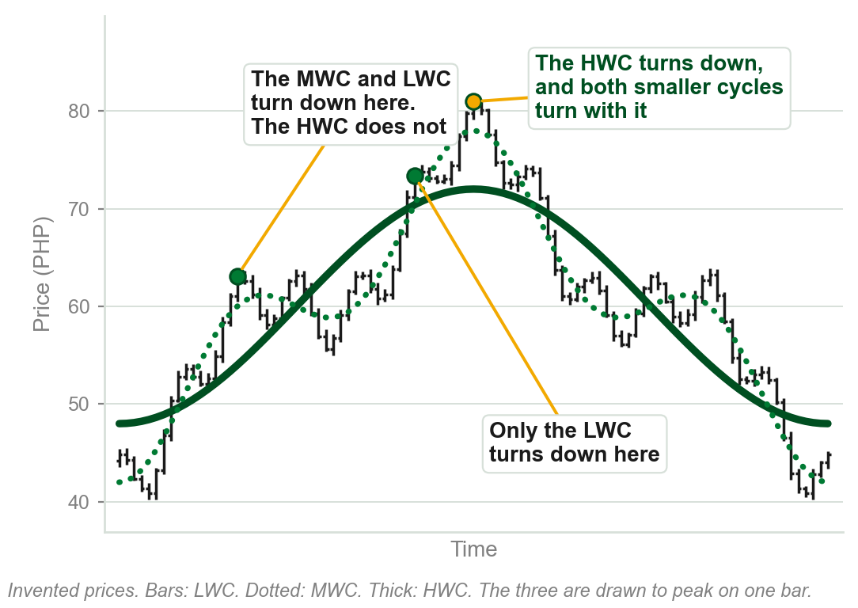
Lower degrees turn alone. The highest does not.
On the way up the LWC turns down again and again, and the rise goes on.
The MWC turns down as well, with the LWC, and the HWC still rises.
At the top the HWC turns down, and the MWC and the LWC turn with it.
A turn of the largest wave is a turn of every wave: the significant one.
The book gives no reason. Our waves are set to peak on one bar. Chapter 3's convergence, futures meeting spot, was a different thing.
Chart J - FIN1209 teaching chart, drawn for this course. Illustrative data, not a real instrument.
Part 1 of 11 - 5.1 Definitions | 19 of 21
Ours: the book's Figure 5.9 (pp.130-131) on price bars. The three invented waves are set to peak on one bar, so the one turn shows.
Notes:
- The book's two sentences, one after the other on the same bars: all subwaves of the largest wave reverse together, and waves of higher degrees need not reverse when waves of lower degrees do.
- Left mark: the dotted line and the bars turn down and the thick line keeps rising. Middle mark: only the bars turn. Gold mark: all three.
- Chapter 3 used convergence for futures and spot prices at expiry. Same word, a different thing, and the caption says so.

Slide 27
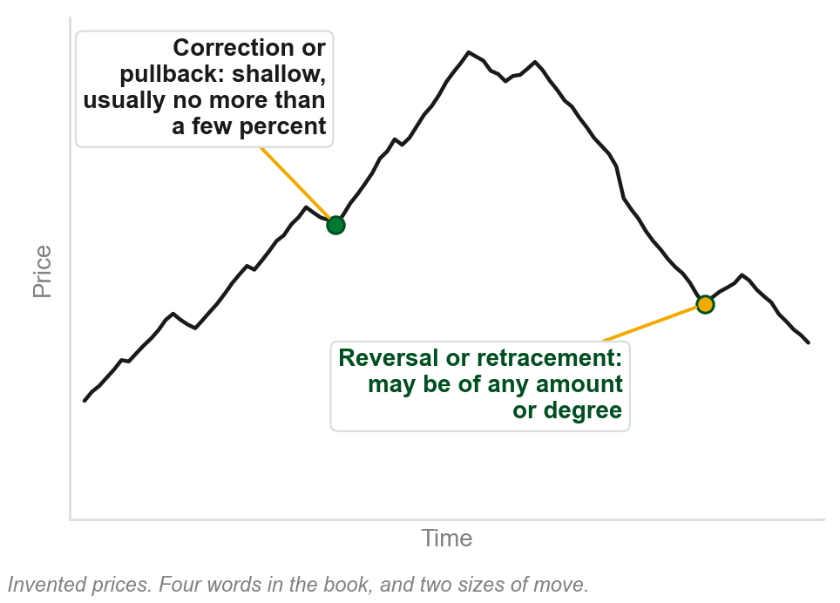
NEW TERM
Correction and pullback
IN PLAIN WORDS
A small move against the trend: shallow, usually no more than a few percent.
FOR EXAMPLE
A share at PHP 50 dips to PHP 49: 2 percent of its price. A correction, or pullback.
THE FORMAL DEFINITION
Reversals and retracements imply a turnaround in prices, and may be of any amount or degree. Corrections and pullbacks tend to imply a more shallow reversal or retracement, usually no more than a few percent.
Chart K - FIN1209 teaching chart, drawn for this course. Illustrative data, not a real instrument.
Part 1 of 11 - 5.1 Definitions | 20 of 21
Book p.131. It puts no number on 'a few percent' and does not say percent of what; our example measures against the price. The chart is ours.
Notes:
- Reversal and retracement have been in use since Chapter 2, and correction has appeared in passing. This slide is where correction and pullback get their meaning: the small case.
- The book uses all four words through the rest of the chapter. This is the one place it says how they differ.

Slide 28
A trend in the highs, the lows or the closes
Trend may also be defined on individual open, high, low and close data.
Top row: the same bars are an uptrend in their highs and a downtrend in their lows.
Middle: the bars' highs and lows stay level, yet the closes rise bar after bar. An uptrend in the closes: Chapter 3's line chart.
Bottom: the mark at the middle of each bar stays level. By that mark, no trend.
FIGURE 5.10
Three rows of bars under the heading OHLC-based trend: bar highs rising while bar lows fall, bar closes rising steadily and labelled equivalent to a line chart, and flatline action based on typical and midprices.
The artwork is copyrighted and is not in the public repository. Build with assets/figures/ present to place it here.
The figure calls that mark the mid or typical price. The book defines neither here, nor the pivot point moving average, the CCI or Floor Trader's Pivot Points.
Figure 5.10 - Lim, The Handbook of Technical Analysis (Wiley, 2016)
Part 1 of 11 - 5.1 Definitions | 21 of 21
Book pp.131-132 and Figure 5.10.
Notes:
- Top row of the figure: the highs rise and the lows fall together, an uptrend by one measure and a downtrend by the other.
- Typical price is named and not defined in this chapter. Do not supply a formula.

Slide 29
CHECK 3 OF 21
Wave degrees and reversals
Q1
Q2
Turning points of larger wave cycles are more significant than those of smaller ones because:
A correction or pullback, as opposed to a reversal or retracement, tends to imply a move that is:
A. Larger cycles always carry more volume
B. Smaller cycles never reverse
C. Larger cycles are easier to see
D. Lower degree cycles all reverse with them
A. Shallow, usually no more than a few percent
B. Of any amount or degree
C. At least half of the prior trend
D. Always followed by a new trend
Part 1 of 11 - 5.1 Definitions | Check 3
Notes:
- Read Q1 aloud, then Q2. Give them sixty seconds and no discussion.
- Ask for a show of hands on each option before you advance.
- This is for reading the room, not for marks. Say so if anyone tenses up.

Slide 30
ANSWERS
Wave degrees and reversals
Q1 Turning points of larger wave cycles are more significant than those of smaller ones because:
D. Lower degree cycles all reverse with them
Wave-degree convergence: when a large wave cycle reverses, all the wave cycles of lower degrees reverse with it.
Q2 A correction or pullback, as opposed to a reversal or retracement, tends to imply a move that is:
A. Shallow, usually no more than a few percent
Reversals and retracements may be of any amount. Corrections and pullbacks tend to be shallow, usually no more than a few percent.
Part 1 of 11 - 5.1 Definitions | Check 3
Notes:
- Reveal one at a time. Say the reason out loud, not just the letter.
- If more than a third of the room missed one, step back and reteach it.

Slide 31
5.2 Sixteen price characteristics
1 Cycle amplitude. 2 Cycle period. 3 Bar retracement symmetry.
4 Average bar range. 5 Price persistence. 6 Average bar stochastic ratio.
7 Real body to range ratio. 8 Angular symmetry and momentum.
9 Barrier proximity. 10 Frequency and depth of oscillations.
11 Size and duration of a consolidation. 12 Third gap exhaustion.
13 Average period range. 14 Overextension. 15 Volume spread. 16 Divergence.
Each is taught in this order on the slides that follow. Variations in these may impact future price activity. The book calls reading pure price action the highest skill any trader can aspire to.
Part 2 of 11 - 5.2 Quality of trend | 1 of 28
Book p.132. For most of the sixteen the book states what a change signals and gives no reason. Where it gives one, the slide gives it.
Notes:
- Do not teach from this slide. It is the map of this part: say that each number gets a slide and a picture of its own.
- Price is regarded as the most important indicator of potential future price action. That is why the list is about price.
- Review question 4 asks for 12 ways price action may be understood. The section lists 16. Teach the 16.

Slide 32
NEW TERM
1 Cycle amplitude
IN PLAIN WORDS
The height of each leg of a swing, as the figure marks it.
FIGURE 5.11
A rising wave between two converging dashed lines, each swing smaller than the last, with the up cycle amplitudes and the down cycle amplitudes measured by vertical arrows, labelled gradually decreasing up and down cycle amplitudes.
The artwork is copyrighted and is not in the public repository. Build with assets/figures/ present to place it here.
FOR EXAMPLE
Rallies of PHP 6, then 4, then 2: decreasing amplitude.
THE FORMAL DEFINITION
Decreasing cycle amplitude is an early indication of potential underlying weakness in an uptrend, and a bullish indication in a downtrend. In an uptrend the up cycle amplitudes must, on average, be larger than the down ones; the converse in a downtrend. The change in successive amplitudes matters most.
Figure 5.11 - Lim, The Handbook of Technical Analysis (Wiley, 2016)
Part 2 of 11 - 5.2 Quality of trend | 2 of 28
Book p.132 and Figure 5.11. It gives no reason why a shrinking amplitude means weakness. The pesos are our example.
Notes:
- In the figure the long arrows are up cycle amplitudes and the short ones down cycle amplitudes. Both shrink, swing after swing.
- The book never defines cycle amplitude in words. The plain line is how Figure 5.11 measures it, and the pesos are ours.
- The pattern for all sixteen: a variation in something, and what that variation says about the trend.

Slide 33
Contracting, even and expanding amplitude
Contracting formations are bearish in an uptrend and bullish in a downtrend.
Expanding formations, with both boundary lines pointing upward, are generally bullish in an uptrend; the converse in a downtrend.
Steady, consistent amplitude is bullish in an uptrend and bearish in a downtrend.
FIGURE 5.12
Three idealized uptrends side by side: contracting price action between converging lines, labelled bearish; even price action between parallel lines, labelled neutral or bullish; and expanding price action between diverging lines, labelled bullish or volatile.
The artwork is copyrighted and is not in the public repository. Build with assets/figures/ present to place it here.
The steady trend is regarded as the most reliable in extent and duration.
The figure labels even Neutral / Bullish and expanding Bullish / Volatile; the book does not reconcile them.
Figure 5.12 - Lim, The Handbook of Technical Analysis (Wiley, 2016)
Part 2 of 11 - 5.2 Quality of trend | 3 of 28
Book p.133 and Figure 5.12. The book states these readings and gives no reason for them.
Notes:
- The figure's three labels are bearish, neutral or bullish, and bullish or volatile. The text calls the even one bullish in an uptrend.
- For expanding formations in a downtrend the book says only that the converse applies.

Slide 34
NEW TERM
2 Cycle period
IN PLAIN WORDS
How long each swing takes, as the figure marks it: across, from one peak to the next.
FIGURE 5.13
A rising wave between two converging lines whose peaks come closer and closer together, with the horizontal distance between peaks marked by arrows that shorten, labelled gradually decreasing cycle periods.
The artwork is copyrighted and is not in the public repository. Build with assets/figures/ present to place it here.
FOR EXAMPLE
An uptrend's peaks come 30 bars apart, then 20, then 12: a decreasing cycle period.
THE FORMAL DEFINITION
Decreasing cycle periods are also an early indication of potential weakness in a trend. A gradual reduction in the cycle period during an uptrend: there may be underlying weakness in the uptrend. During a downtrend: a bullish indication.
Figure 5.13 - Lim, The Handbook of Technical Analysis (Wiley, 2016)
Part 2 of 11 - 5.2 Quality of trend | 4 of 28
Book p.133 and Figure 5.13. It gives no reason. The bar counts 30, 20 and 12 are our example.
Notes:
- Same reading as amplitude, with the swings measured sideways: each one takes less time than the one before.
- The book defines neither word. The two figures do it by where they put their arrows.
- Chapter 4 named the cycle period once, as the business of Chapter 20. This is the first time it is read.

Slide 35
NEW TERM
3 Bar retracement symmetry
IN PLAIN WORDS
In a strong trend each retracement takes about the same number of bars. Count them.
FIGURE 5.14
A rising channel in which three retracements of 28, 30 and 26 bars are labelled consistent symmetry indicates strong trend action, then a retracement of only 14 bars circled as symmetry broken, a trend behavior change, before price leaves the channel upward at a point A.
The artwork is copyrighted and is not in the public repository. Build with assets/figures/ present to place it here.
FOR EXAMPLE
In the figure three retracements take 28, 30 and 26 bars: consistent symmetry. The next takes 14: symmetry broken, and a strong upside move follows, at A.
THE FORMAL DEFINITION
A change in the number of bars in a retracement is an early indication of a potential change in trend behavior.
Figure 5.14 - Lim, The Handbook of Technical Analysis (Wiley, 2016)
Part 2 of 11 - 5.2 Quality of trend | 5 of 28
Book p.134 and Figure 5.14: the bar counts 28, 30, 26 and 14 are printed on the figure. It gives no reason.
Notes:
- Consistent symmetry indicates strong trend action: that is the figure's own label.
- The same figure comes back with channels: here price also fails to reach the lower channel line before it breaks out.

Slide 36
CHECK 4 OF 21
Amplitude and symmetry
Q1
Q2
In an uptrend, the cycle amplitude decreases swing after swing. This is:
Retracements in an uptrend have taken 28, 30 and 26 bars. The next one takes 14. This suggests:
A. A sign that the trend is strengthening
B. A bullish indication
C. An early indication of potential weakness
D. Of no significance
A. A potential change in trend behavior
B. Nothing, because the trend is still up
C. An increase in cycle amplitude
D. That a downtrend has begun
Part 2 of 11 - 5.2 Quality of trend | Check 4
Notes:
- Read Q1 aloud, then Q2. Give them sixty seconds and no discussion.
- Ask for a show of hands on each option before you advance.
- This is for reading the room, not for marks. Say so if anyone tenses up.

Slide 37
ANSWERS
Amplitude and symmetry
Q1 In an uptrend, the cycle amplitude decreases swing after swing. This is:
C. An early indication of potential weakness
Decreasing cycle amplitude in an uptrend is an early indication of potential underlying weakness. In a downtrend it would be bullish.
Q2 Retracements in an uptrend have taken 28, 30 and 26 bars. The next one takes 14. This suggests:
A. A potential change in trend behavior
A change in the number of bars in a retracement is an early indication of a potential change in trend behavior.
Part 2 of 11 - 5.2 Quality of trend | Check 4
Notes:
- Reveal one at a time. Say the reason out loud, not just the letter.
- If more than a third of the room missed one, step back and reteach it.

Slide 38
NEW TERM
4 Average bar range
IN PLAIN WORDS
The average height of the bars, low to high.
FIGURE 5.15
A rising run of candlesticks, each shorter than the one before, labelled gradually decreasing bar range, over a lower panel in which the ATR declines.
The artwork is copyrighted and is not in the public repository. Build with assets/figures/ present to place it here.
FOR EXAMPLE
Daily ranges average PHP 3.00 one month, 2.40 the next, 1.80 the next: a decreasing average bar range.
THE FORMAL DEFINITION
A decrease in the average bar range is an early indication of potential weakness in an uptrend, and a bullish indication in a downtrend. The bar range can be tracked using the average true range, ATR.
Figure 5.15 - Lim, The Handbook of Technical Analysis (Wiley, 2016)
Part 2 of 11 - 5.2 Quality of trend | 6 of 28
Book p.134, Figure 5.15, whose lower panel is the ATR: next slide. Its text fixes no number of bars to average; its real charts print ATR(14) unexplained. Pesos ours.
Notes:
- Same shape of rule as the first two: something shrinking in an uptrend is weakness, in a downtrend it is bullish.
- The ATR in the figure's lower panel gets the next slide to itself: what a true range is, from Chapter 3, and why the book prefers it.

Slide 39
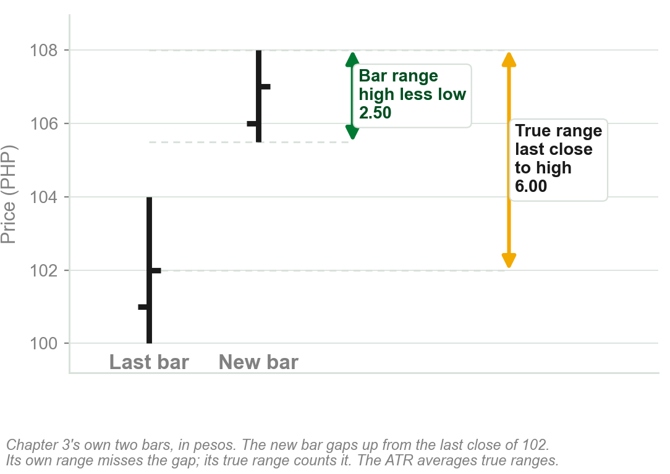
The ATR: a bar range that counts the gaps
Chapter 3: a bar's true range is the greater of its own range and the distance from the last close to its high or low.
On Chapter 3's two bars: bar range 2.50, true range 6.00.
The ATR is the average of the true ranges.
Unlike average bar range, the ATR accounts for gaps between the bars as well.
Chapter 3 met it with the Type 4 gap. The book calls the ATR an oscillator: that, and how it is averaged, is Chapter 8.
Chart L - FIN1209 teaching chart, drawn for this course. Illustrative data, not a real instrument.
Part 2 of 11 - 5.2 Quality of trend | 7 of 28
Book p.134: the gold sentence is the book's own; counting gaps is its only given reason. Recall: Chapter 3's slide "The true range, and the Type 4 gap". The chart is ours.
Notes:
- A recall first: Chapter 3 gave the true range beside the Type 4 gap, which is also measured from the last close. Chapter 3's own numbers are on the chart.
- Then the one thing Chapter 5 adds: the book tracks the bar range with the ATR, because the ATR also sees the gaps between bars.
- How the true range is averaged into the ATR is Chapter 8. Do not supply a formula or a number of bars.

Slide 40
A declining ATR in a steady uptrend
GLD, the SPDR Gold Trust Shares, weekly: a steady uptrend, the figure's strong uptrend, while the ATR in the bottom panel declines.
Volume, the bars under the price, rises: bullish. But the ATR is indicating otherwise.
FIGURE 5.16
The weekly GLD chart in three panels: price in a strong uptrend to a circled pair of candlesticks at the top, volume increasing beneath it, and the ATR declining all the way up before turning.
The artwork is copyrighted and is not in the public repository. Build with assets/figures/ present to place it here.
Price declined after the volume climax.
Volume climax: the book's phrase, undefined here; the burst of volume near the top. It adds that a large bearish candlestick, circled at the top, completes the picture: too small to see here, and not needed. The ATR's turn up at the end goes without comment.
Figure 5.16 - Lim, The Handbook of Technical Analysis (Wiley, 2016)
Part 2 of 11 - 5.2 Quality of trend | 8 of 28
Book pp.134-135 and Figure 5.16.
Notes:
- Three panels: price, volume, ATR. Price and volume rise together while the ATR falls the whole way up.
- One characteristic disagreed with everything else on the chart, and it was the one that was right.

Slide 41
5 Price persistence
A trend persists for longer when price is of high quality: relatively small, and approximately equal, bar ranges.
Price then moves predictably. Trends and reversals are clear and decisive, and volatility is relatively low.
Left box: long, clean moves, greater persistence. Right box: short, choppy moves, lesser persistence.
FIGURE 5.17
An hourly GBPJPY chart with two boxes: higher quality price action with greater persistence, where the swings are long and clean, and lower quality price action with lesser persistence, where they are short and choppy.
The artwork is copyrighted and is not in the public repository. Build with assets/figures/ present to place it here.
Persistence, Chapter 1: price behavior persists. Low volatility here: small bars, not small moves, in our reading. The bars are too small to see: the next slide draws them.
Figure 5.17 - Lim, The Handbook of Technical Analysis (Wiley, 2016)
Part 2 of 11 - 5.2 Quality of trend | 9 of 28
Book pp.135-136, Figure 5.17: hourly GBPJPY. The book does not say what low volatility is measured by, or name the curved bands.
Notes:
- A recall, not a new term: persistence was Chapter 1's first applied assumption. Here the book says which kind of price persists.
- Two tests for high quality price, both about the bars: small ranges, and ranges about equal to each other.
- Left box against right box: the same market, a week apart, easy to track and then hard to track.

Slide 42
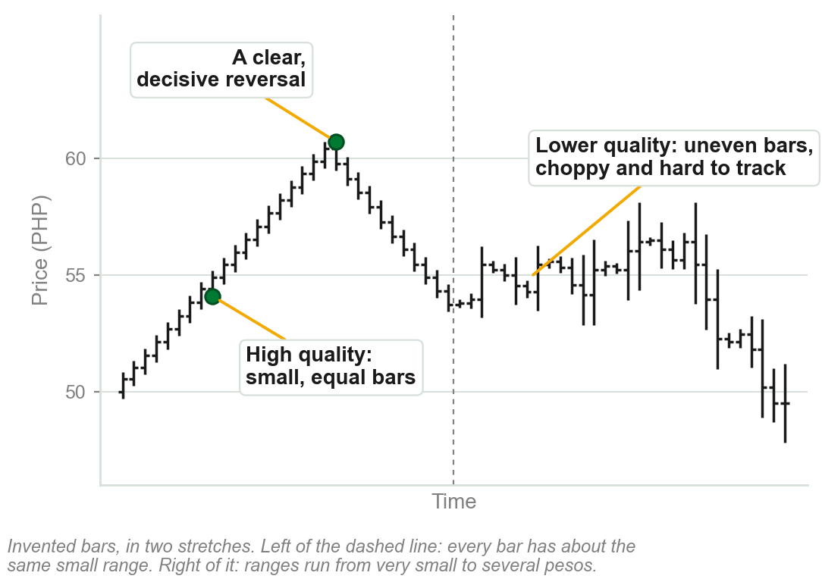
High and lower quality price, on bars
Left, high quality: every bar's range is relatively small, and about equal to the last.
Price moves predictably: a clean trend up, and a clear, decisive reversal.
Right, lower quality: bar ranges uneven, small then large. Moves are short and choppy, and hard to track.
Small, equal bars: the trend persists.
Characteristic 4 watched the bar range shrink. This one asks whether the bars are small and alike. The book does not relate the two.
Chart M - FIN1209 teaching chart, drawn for this course. Illustrative data, not a real instrument.
Part 2 of 11 - 5.2 Quality of trend | 10 of 28
Ours: the book's two tests for high quality price (p.135) on invented bars, because the bars of its Figure 5.17 cannot be seen. It gives no reason for either test.
Notes:
- The book's Figure 5.17 shows the result, long clean moves against short choppy ones, at a size where no bar can be seen. This chart shows the cause the book names: the bar ranges.
- Point at the left stretch first: the bars are all about one height. Then the right: no two alike.
- Do not turn it into a rule the book does not give. It says only that prices tend to persist for longer when these two qualities are present.

Slide 43
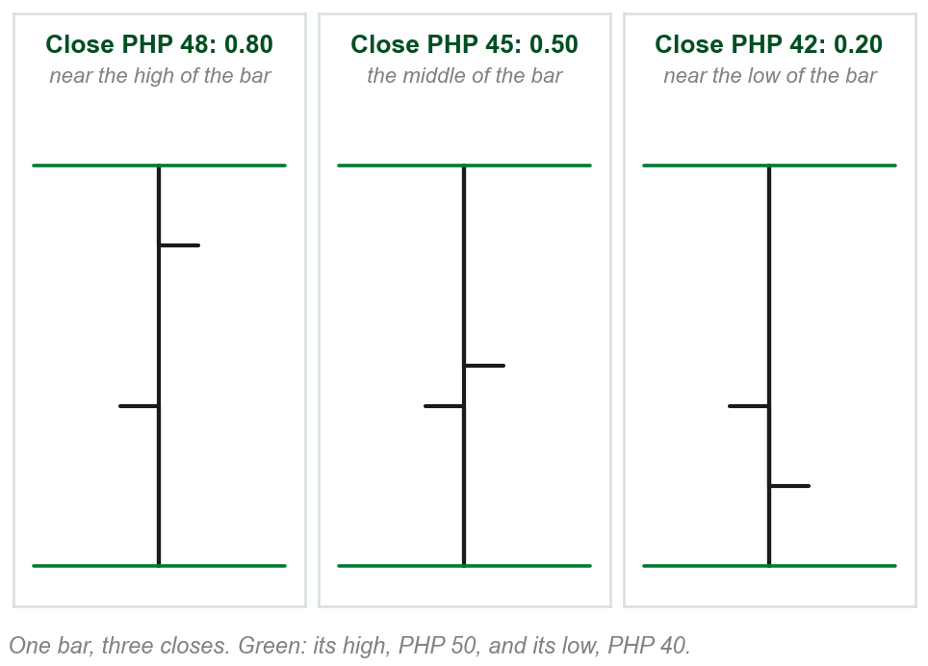
NEW TERM
Bar stochastic
IN PLAIN WORDS
Where a bar closed inside its own range: near the top, the middle or the bottom.
FOR EXAMPLE
A bar with a low of PHP 40, a high of PHP 50 and a close of PHP 48: (48 - 40) / (50 - 40) = 0.80. It closed near its high.
THE FORMAL DEFINITION
The relative position of the closing price within the bar itself, measured as a ratio: (C - L) / (H - L). The book calls it essentially a one-period %K, and does not explain %K here.
Chart N - FIN1209 teaching chart, drawn for this course. Illustrative data, not a real instrument.
Part 2 of 11 - 5.2 Quality of trend | 11 of 28
Book p.135; the formula is printed on its Figure 5.18 (p.136). The pesos and the chart are ours, picked to give 0.80, 0.50 and 0.20.
Notes:
- The text gives the words and the book's next figure prints the formula. The pesos are ours.
- Read the three bars left to right. The bar is the same height each time; only the right tick, the close, moves down it, and the ratio falls from 0.80 to 0.20.
- The standard stochastic oscillator compares the close with the last N periods. This one looks inside a single bar. %K is named, not taught.

Slide 44
6 The average bar stochastic ratio
In an uptrend, a gradual decline in closes with respect to the bar is an early indication of potential weakness.
In a downtrend, a gradual increase is an early indication of potential bullishness.
FIGURE 5.18
A rising run of bars whose closes sit lower and lower within each bar, labelled declining closing prices with respect to the bar range, with the formula bar stochastic = (C - L) / (H - L) and a lower panel in which the bar stochastic declines.
The artwork is copyrighted and is not in the public repository. Build with assets/figures/ present to place it here.
In the figure the bars climb while each close sits lower within its bar.
Average: the ratio is watched through a moving average of it, on the next slide.
Figure 5.18 - Lim, The Handbook of Technical Analysis (Wiley, 2016)
Part 2 of 11 - 5.2 Quality of trend | 12 of 28
Book p.135, and Figure 5.18 on p.136. It gives no reason for the sign.
Notes:
- Price keeps rising while the closes sink within their bars. That is the characteristic: the ratio falling in an uptrend.
- The lower panel is the ratio itself, bar by bar, sliding down.

Slide 45
The ratio, averaged, on a real chart
The ratio is monitored with a simple moving average, SMA. Lower panel: a 3-period SMA, the average of the last three bars' ratios.
The book: it accurately identifies bearish divergences in uptrends and bullish ones in downtrends, which the figure labels.
The panel cannot be read at this size. The next slide draws one bearish divergence.
FIGURE 5.19
A weekly EURUSD chart over a lower panel carrying a 3-period SMA of the bar stochastic, with three tops labelled bearish divergence and three bottoms labelled bullish divergence.
The artwork is copyrighted and is not in the public repository. Build with assets/figures/ present to place it here.
Weekly EURUSD. Moving averages: Chapter 11. Divergence, bullish and bearish: Chapter 9.
Figure 5.19 - Lim, The Handbook of Technical Analysis (Wiley, 2016)
Part 2 of 11 - 5.2 Quality of trend | 13 of 28
Book pp.136-137 and Figure 5.19. It does not say why the average is of three periods.
Notes:
- Read the figure's labels and stop. Chapter 4 showed one divergence and did not define it. What divergence is, formally, waits for Chapter 9.
- A simple moving average is used here and not built. Moving averages are Chapter 11.

Slide 46
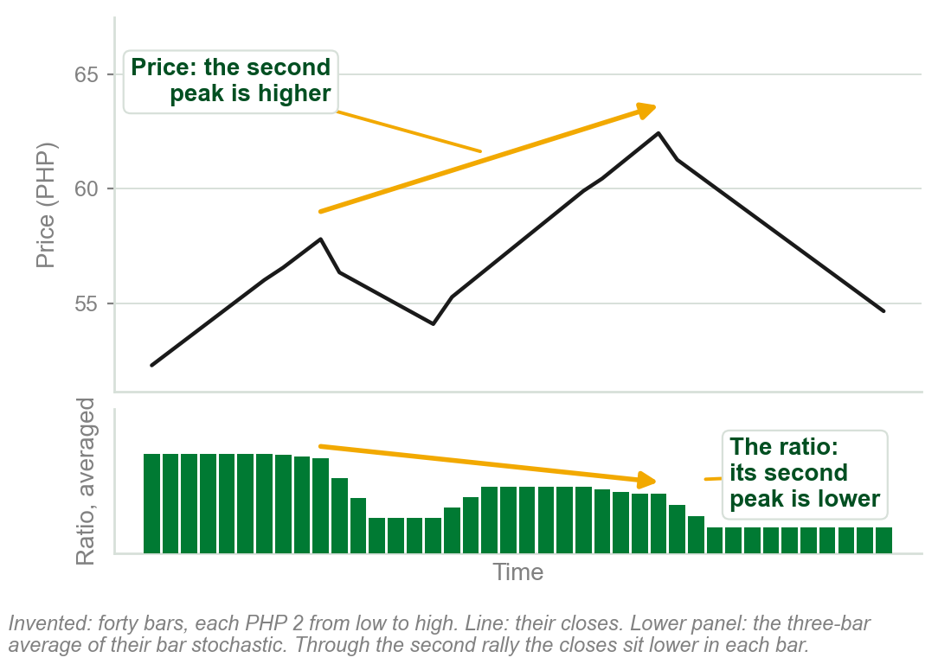
One bearish divergence, drawn
Top: price makes a peak, pulls back, then makes a higher peak.
Bottom: the three-bar average of the bar stochastic. Its second peak is lower.
Price higher, ratio lower: bearish divergence. In the second rally each bar closed lower in its range.
Closes sinking within their bars while price still rises.
Chapter 4 showed the same shape on the MACD. Bullish divergence, at bottoms, is left to Chapter 9.
Chart O - FIN1209 teaching chart, drawn for this course. Illustrative data, not a real instrument.
Part 2 of 11 - 5.2 Quality of trend | 14 of 28
Ours: one of Figure 5.19's bearish divergences (book p.136) on invented bars. Divergence as Chapter 4 showed it; the book explains it in Chapter 9.
Notes:
- The book's figure labels six divergences on a real chart, in a panel too fine to read. This is one of the bearish ones, drawn from bars we invented.
- Two arrows: the one on price rises, the one on the averaged ratio falls. They diverge, and that is all the word means on this slide.
- Do not go further than Chapter 4 did. Standard, reverse, bullish and bearish divergence are Chapter 9.

Slide 47
NEW TERM
7 Real body to range ratio, BRR
IN PLAIN WORDS
How much of a candlestick is real body: the open-to-close move as a share of the whole bar.
FIGURE 5.20
A rising run of candlesticks whose real bodies shrink while their ranges do not, labelled declining BRR, with the formula body to range ratio (BRR) = (C - O) / (H - L) and a lower panel in which the BRR declines.
The artwork is copyrighted and is not in the public repository. Build with assets/figures/ present to place it here.
FOR EXAMPLE
Open 42, close 48, low 40 and high 50, in pesos: (48 - 42) / (50 - 40) = 0.60.
THE FORMAL DEFINITION
BRR = (C - O) / (H - L). A gradual decrease in the real body to candlestick range is an early indication of potential weakness in an uptrend, and a bullish indicator in a downtrend. A simple moving average of the ratio is used to monitor it.
Figure 5.20 - Lim, The Handbook of Technical Analysis (Wiley, 2016)
Part 2 of 11 - 5.2 Quality of trend | 15 of 28
Book p.136; the formula is printed on Figure 5.20 (p.137). It gives no reason, and does not say how to treat a falling candle, where C - O is negative. The pesos are ours.
Notes:
- The formula is printed on Figure 5.20 and the pesos are ours. The real body was Chapter 3: the boxed space between the open and the close.
- Bar stochastic asks where the bar closed. This one asks how much of the bar the open-to-close move covered.

Slide 48
CHECK 5 OF 21
Bar range, and where the bar closes
Q1
Q2
A bar has a low of PHP 20, a high of PHP 30 and a close of PHP 22. Its bar stochastic is:
Unlike the average bar range, the average true range (ATR) oscillator:
A. 0.20
B. 0.50
C. 0.80
D. 2.00
A. Ignores the closing price
B. Accounts for gaps between the bars
C. Works only in uptrends
D. Measures volume, and not price
Part 2 of 11 - 5.2 Quality of trend | Check 5
Notes:
- Read Q1 aloud, then Q2. Give them sixty seconds and no discussion.
- Ask for a show of hands on each option before you advance.
- This is for reading the room, not for marks. Say so if anyone tenses up.

Slide 49
ANSWERS
Bar range, and where the bar closes
Q1 A bar has a low of PHP 20, a high of PHP 30 and a close of PHP 22. Its bar stochastic is:
A. 0.20
(C - L) / (H - L) = (22 - 20) / (30 - 20) = 0.20. The bar closed near its low.
Q2 Unlike the average bar range, the average true range (ATR) oscillator:
B. Accounts for gaps between the bars
The ATR will account for gaps between the bars as well, which a plain average of bar ranges does not.
Part 2 of 11 - 5.2 Quality of trend | Check 5
Notes:
- Reveal one at a time. Say the reason out loud, not just the letter.
- If more than a third of the room missed one, step back and reteach it.

Slide 50
NEW TERM
8 Angular symmetry and momentum
IN PLAIN WORDS
A trend rising or falling at a steady angle.
FIGURE 5.21
A three year chart of 3M Co. with many trendlines, labelled all lines are rising at the same angle and underlying angular symmetry in 3M Co., two of them dotted and numbered 1 and 2, a point 3 above the second, and a box marked bullish indication.
The artwork is copyrighted and is not in the public repository. Build with assets/figures/ present to place it here.
FOR EXAMPLE
3M Co.: every long line rises at one angle, consistent angular symmetry. Dotted lines 1 and 2 are parallel to each other: a strong predictor of bullishness.
THE FORMAL DEFINITION
Any change in angular symmetry is an early indication of potential bullishness or bearishness. Generally an increase in the angle of ascent is bullish, and a decrease bearish.
Figure 5.21 - Lim, The Handbook of Technical Analysis (Wiley, 2016)
Part 2 of 11 - 5.2 Quality of trend | 16 of 28
Book pp.137-138, Fig. 5.21. Its reason: line 1 was followed by a steady rise. Point 3: where it expects a minor correction first. Momentum is never explained.
Notes:
- Trendline 1 was followed by a steady rise, so the book expects the same after trendline 2, following a minor correction at point 3.
- It says 3M went on to rise above $140, which the chart does not show. The caption says hourly; the chart itself is daily.
- Chapter 1's Figure 1.25 showed angular symmetries on a chart and did not say how to read them. This is where the book does.

Slide 51
Acceleration and deceleration
Upside acceleration in price is bullish. Upside deceleration is bearish.
Downside acceleration is bearish. Downside deceleration is bullish.
Upside and downside acceleration is normally parabolic in nature.
FIGURE 5.22
Four curves. Uptrends: one bending upward, upside acceleration, bullish; one flattening, upside deceleration, bearish. Downtrends: one bending downward, downside acceleration, bearish; one flattening, downside deceleration, bullish.
The artwork is copyrighted and is not in the public repository. Build with assets/figures/ present to place it here.
An uptrend may not be self-sustaining if its rate of ascent was excessive.
Such rises usually end in a blow-off or buying climax, Chapter 4; downside acceleration may end in a selling climax. The book gives no measure of excessive.
Figure 5.22 - Lim, The Handbook of Technical Analysis (Wiley, 2016)
Part 2 of 11 - 5.2 Quality of trend | 17 of 28
Book p.138 and Figure 5.22.
Notes:
- Speeding up is with the trend, slowing down is against it. Four cases, one rule.
- After a blow-off or buying climax prices subsequently collapse, the book says. Both climaxes came up in Chapter 4.

Slide 52
Deceleration with a diminishing bar range
An even more potentially bearish scenario in an uptrend.
Two characteristics at once: a deceleration in price, and a diminishing bar range.
FIGURE 5.23
A run of candlesticks rising along a curve that flattens out, each candlestick shorter than the last, labelled gradually decreasing bar range and flattening out action.
The artwork is copyrighted and is not in the public repository. Build with assets/figures/ present to place it here.
The trend flattens out, and each bar covers less ground than the last.
Figure 5.23 - Lim, The Handbook of Technical Analysis (Wiley, 2016)
Part 2 of 11 - 5.2 Quality of trend | 18 of 28
Book pp.138-139 and Figure 5.23.
Notes:
- Characteristic 4 and characteristic 8 on one chart. Two warnings agreeing is worth more than either alone.
- The book's caption calls it diminishing angular momentum.

Slide 53
A change in the trend rate
Trend rate: dollars risen per day along a leg. Gold's is consistent, leg after leg.
Once the rate changes, the market enters a new regime: greater volatility, larger swings.
The new rate of $10.30 a day may be unsustainable over the longer term.
FIGURE 5.24
A daily Gold chart headed trend rate analysis on Gold: five rising legs each drawn at an uptrend rate of $3.80 a day, labelled previous market behavior, then steeper legs at $10.30 a day, an approximately 270 percent increase, labelled new market behavior, more volatile.
The artwork is copyrighted and is not in the public repository. Build with assets/figures/ present to place it here.
Gold in fact declined rapidly thereafter, not shown on the chart.
The old rate is about $3.30 a day in the book's text, $3.80 on its figure. $10.30 is 2.7 times $3.80, a rise of about 170 percent; the figure prints 'approx. 270% increase'.
Figure 5.24 - Lim, The Handbook of Technical Analysis (Wiley, 2016)
Part 2 of 11 - 5.2 Quality of trend | 19 of 28
Book p.139 and Figure 5.24. The dollar rates are the book's, and it does not show how they were measured.
Notes:
- The five parallel strokes on the left are the same angle: angular symmetry again, stated as dollars per day.
- Two slips in the book on this one figure: the two old rates, and the caption printed under 5.24, which is Figure 5.25's. Say them once, plainly, and teach the idea: a change of rate is a change of regime.

Slide 54
NEW TERM
9 Barrier proximity
IN PLAIN WORDS
How near a trend is to a strong price barrier: a support below or a resistance above. The nearer, the likelier a turn.
FIGURE 5.25
A daily chart of iShares MSCI Emerging Markets: a strong downtrend falls to a support barrier drawn from an earlier low and price rebounds, with the cycle-tuned stochastic below circled at oversold.
The artwork is copyrighted and is not in the public repository. Build with assets/figures/ present to place it here.
FOR EXAMPLE
iShares MSCI Emerging Markets rebounds at strong support, a line across an earlier low, with the oscillator below at its low: oversold.
THE FORMAL DEFINITION
There is always a high probability that a trend may reverse as it approaches a strong and significant price barrier.
Figure 5.25 - Lim, The Handbook of Technical Analysis (Wiley, 2016)
Part 2 of 11 - 5.2 Quality of trend | 20 of 28
Book pp.139-140, Figure 5.25. No measure of strong is given. What support and resistance are, and why they hold: 5.6. The cycle-tuned stochastic, oversold: Chapter 8.
Notes:
- The barrier here is a support level set by an earlier low. A strong downtrend meets it and turns.
- Say overbought and oversold as the figure does. The oscillator itself is Chapter 8.

Slide 55
CHECK 6 OF 21
Acceleration and barriers
Q1
Q2
Upside deceleration in an uptrend is regarded as:
A strong downtrend approaches a strong and significant support level. The probability of a reversal is:
A. Bullish
B. Bearish
C. Neutral
D. A buying climax
A. Low, because the trend is strong
B. Unchanged by the level
C. Zero until volume rises
D. High, because of barrier proximity
Part 2 of 11 - 5.2 Quality of trend | Check 6
Notes:
- Read Q1 aloud, then Q2. Give them sixty seconds and no discussion.
- Ask for a show of hands on each option before you advance.
- This is for reading the room, not for marks. Say so if anyone tenses up.

Slide 56
ANSWERS
Acceleration and barriers
Q1 Upside deceleration in an uptrend is regarded as:
B. Bearish
Upside acceleration is bullish and upside deceleration is bearish. For downtrends the two are reversed.
Q2 A strong downtrend approaches a strong and significant support level. The probability of a reversal is:
D. High, because of barrier proximity
There is always a high probability that a trend may reverse as it approaches a strong and significant price barrier.
Part 2 of 11 - 5.2 Quality of trend | Check 6
Notes:
- Reveal one at a time. Say the reason out loud, not just the letter.
- If more than a third of the room missed one, step back and reteach it.

Slide 57
10 Frequency and depth of oscillations
An uptrend is more reliable with a reasonable number of oscillations, its dips and rallies: fairly frequent, not too shallow or too deep.
That indicates healthy profit taking. With little profit taken, more unrealized profit is at risk, and traders exit rapidly at the slightest hint of bearishness.
FIGURE 5.26
Two uptrends. On the left a large number of deep price oscillations, with less chance of a severe retracement because more profit is taken along the way. On the right a smaller number of shallow oscillations, with a high probability of a more severe retracement.
The artwork is copyrighted and is not in the public repository. Build with assets/figures/ present to place it here.
Few oscillations: a trend potentially more bearish at higher prices.
The figure calls the healthy trend's oscillations deep. The book does not say how deep is too deep.
Figure 5.26 - Lim, The Handbook of Technical Analysis (Wiley, 2016)
Part 2 of 11 - 5.2 Quality of trend | 21 of 28
Book pp.140-141 and Figure 5.26. The reason on the slide, profit taking, is the book's.
Notes:
- With some profit taken off the table, traders react less emotionally at higher prices. That is the book's reason.
- The grey boxes in the figure say it in full: pent-up profit and emotions create more fear of losing capital and profit.

Slide 58
Oscillations on the Apple chart
Apple first oscillates in a steady, rising channel: the two parallel dotted lines (5.6).
Then price rises rapidly, with the minimum of oscillations and little profit taking.
Between time lines 1 and 2 the ATR declines as prices rise: a bearish indication, which the figure labels bearish divergence.
FIGURE 5.27
A daily Apple chart: a relatively healthy trend with deep oscillations inside a rising channel, then a rapidly rising trend with little price oscillation, an eventual sell-off, and an ATR panel displaying bearish divergence between two dotted time lines.
The artwork is copyrighted and is not in the public repository. Build with assets/figures/ present to place it here.
Apple prices decline substantially thereafter.
Profit-taking oscillations also occur at various wave degrees within a trend.
Figure 5.27 - Lim, The Handbook of Technical Analysis (Wiley, 2016)
Part 2 of 11 - 5.2 Quality of trend | 22 of 28
Book p.141 and Figure 5.27.
Notes:
- Two of the sixteen on one stock: few oscillations, characteristic 10, and a falling ATR, characteristic 4.
- The second rise toward the historical high has a similar rate and as little profit taking as the first.

Slide 59
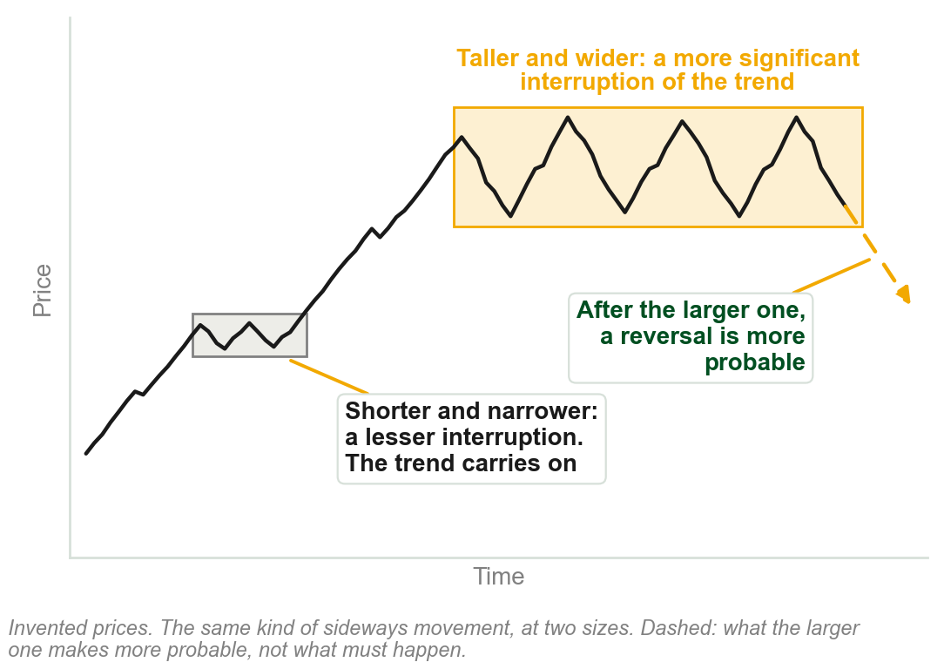
11 Size and duration of a consolidation
A trend interruption, Chapter 4's consolidation, is more significant the greater its magnitude, a taller chart pattern, and the longer it takes, a wider one.
Larger trend interruptions normally lead to a greater probability of a reversal.
In short, size takes precedence over form.
Form: which pattern. A larger head and shoulders is more bearish in an uptrend; a larger rounding bottom more bullish in a downtrend.
Chart P - FIN1209 teaching chart, drawn for this course. Illustrative data, not a real instrument.
Part 2 of 11 - 5.2 Quality of trend | 23 of 28
Book p.141. The chart is ours, on invented prices: the book has no figure for this point.
Notes:
- The longer a consolidation takes to unfold, the greater its disruptive power with respect to the trend, should a reversal occur.
- The two boxes on the chart hold the same kind of sideways movement. Only their size differs.

Slide 60
NEW TERM
12 Third gap exhaustion
IN PLAIN WORDS
Count the gaps in a trend. Watch the third.
FIGURE 5.28
A daily chart of the SPDR Dow Jones Industrial Average ETF: a breakaway, a runaway and an exhaustion gap numbered 1, 2 and 3 on the way up, the same three numbered on the way down, and a cycle-tuned stochastic indicating overextension at both third gaps.
The artwork is copyrighted and is not in the public repository. Build with assets/figures/ present to place it here.
FOR EXAMPLE
The SPDR Dow Jones Industrial Average ETF tops after gap 3 of its uptrend, and bottoms after gap 3 of the downtrend that follows. The oscillator in the lower panel is at its high, overbought, at the top, and at its low, oversold, at the bottom.
THE FORMAL DEFINITION
The appearance of a third gap in a trend is an indication of potential trend exhaustion and a possible reversal.
Figure 5.28 - Lim, The Handbook of Technical Analysis (Wiley, 2016)
Part 2 of 11 - 5.2 Quality of trend | 24 of 28
Book pp.141-142 and Figure 5.28. It gives no reason why the third, and does not say which gaps to count; the figure numbers the three that 5.8 names.
Notes:
- The figure names the three gaps breakaway, runaway and exhaustion. Section 5.8 defines them.
- Chapter 4 met the same three as Sakata's San Ku, three gaps.

Slide 61
CHECK 7 OF 21
Oscillations and size
Q1
Q2
An uptrend rises rapidly with very few oscillations. Compared with an uptrend that oscillates frequently, it is:
Two head and shoulders formations appear in strong uptrends. The larger of the two is deemed:
A. More reliable, because nothing interrupts it
B. Certain to continue
C. Potentially more bearish at higher prices
D. Free of unrealized profit
A. Less bearish than the smaller one
B. More bearish than the smaller one
C. Bullish
D. Equally bearish, because the form is the same
Part 2 of 11 - 5.2 Quality of trend | Check 7
Notes:
- Read Q1 aloud, then Q2. Give them sixty seconds and no discussion.
- Ask for a show of hands on each option before you advance.
- This is for reading the room, not for marks. Say so if anyone tenses up.

Slide 62
ANSWERS
Oscillations and size
Q1 An uptrend rises rapidly with very few oscillations. Compared with an uptrend that oscillates frequently, it is:
C. Potentially more bearish at higher prices
Little profit taking leaves more pent-up and unrealized profit at risk, so traders exit rapidly at the slightest hint of bearishness.
Q2 Two head and shoulders formations appear in strong uptrends. The larger of the two is deemed:
B. More bearish than the smaller one
Larger trend interruptions normally lead to a greater probability of a reversal. Size takes precedence over form.
Part 2 of 11 - 5.2 Quality of trend | Check 7
Notes:
- Reveal one at a time. Say the reason out loud, not just the letter.
- If more than a third of the room missed one, step back and reteach it.

Slide 63
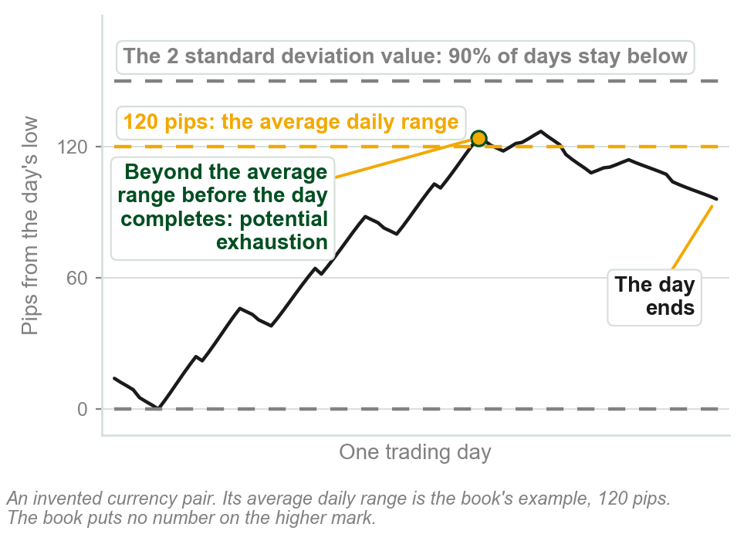
NEW TERM
13 Average period range
IN PLAIN WORDS
The usual range of price in one period.
FOR EXAMPLE
A foreign exchange (FOREX) pair averages 120 pips a day, a pip being the smallest price step a forex quote moves in. Price beyond that, either way, before the day completes: potential exhaustion.
THE FORMAL DEFINITION
One of the most reliable characteristics of price activity. The average is found with the ATR. A higher mark, the 2 standard deviation value of bar range (twice how far ranges typically spread from that average): ninety percent of period ranges stay below it.
Chart Q - FIN1209 teaching chart, drawn for this course. Illustrative data, not a real instrument.
Part 2 of 11 - 5.2 Quality of trend | 25 of 28
Book p.142: 120 pips and ninety percent are its numbers. A breach of the higher mark is a greater overextension.
Notes:
- The period can be any chosen duration of observation. The book's example is a day.
- When looking for the reversal, pay special attention to supportive and resistive confluences.
- The book advises a simple backtest to find the most reliable lookback period for either method.

Slide 64
14 Overextension past an overlay barrier
A price penetration above an uptrending line, or below a downtrending one, is generally regarded as a potential sign of exhaustion, with a reversal expected.
Short term penetrations below an uptrending line, or above a downtrending one, are usually regarded as false breakouts.
FIGURE 5.29
Four small charts. Top: price spiking above an uptrending line, and price spiking below a downtrending line, each circled as price exhaustion. Bottom: price dipping below an uptrending line, and price poking above a downtrending line, each circled as a false breakout.
The artwork is copyrighted and is not in the public repository. Build with assets/figures/ present to place it here.
With the line's slope: exhaustion. Against it: a false breakout.
The line is the heading's overlay barrier: a line drawn over price (5.6). False breakout, in the figure: price pokes through and comes straight back.
Figure 5.29 - Lim, The Handbook of Technical Analysis (Wiley, 2016)
Part 2 of 11 - 5.2 Quality of trend | 26 of 28
Book pp.142-143 and Figure 5.29. It gives no reason for either reading, and does not say how short is short term.
Notes:
- Top row of the figure is overextension, bottom row is the false breakout. The lines are the same; the side differs.
- The book's caption for this figure is simply price exhaustion.

Slide 65
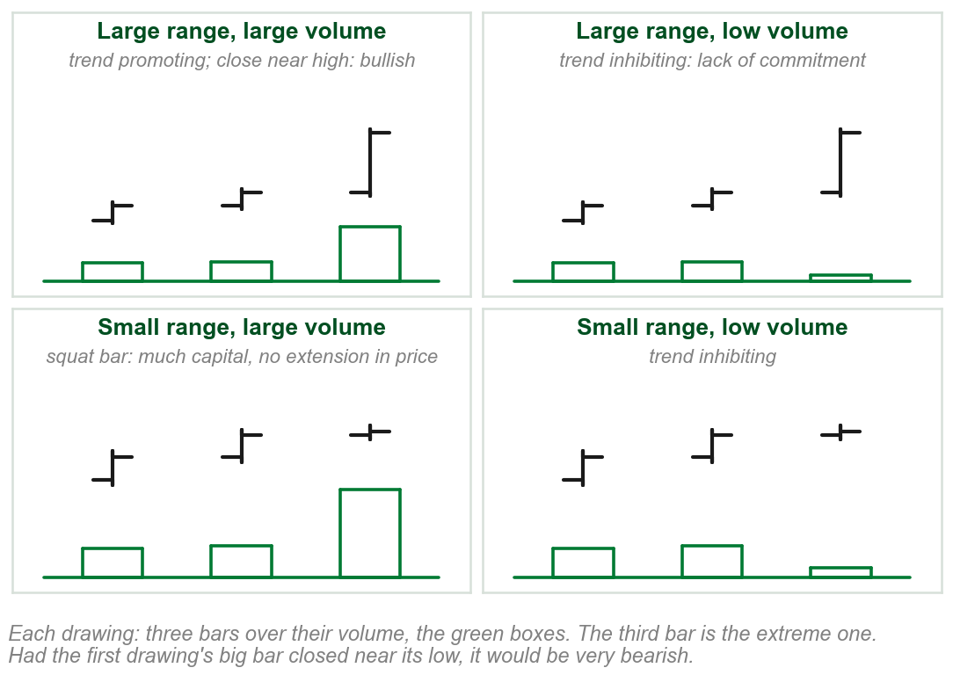
15 Volume spread action
Large range, large volume: trend promoting. Close near the high: bullish. Near the low: very bearish.
Large range, low volume: trend inhibiting. A lack of commitment.
Small range, large volume, the squat bar: inhibiting, and a much stronger reversal sign.
Small range, low volume: trend inhibiting.
Price and volume matter most together when both are extreme.
Chart R - FIN1209 teaching chart, drawn for this course. Illustrative data, not a real instrument.
Part 2 of 11 - 5.2 Quality of trend | 27 of 28
Book p.143; the chart is ours. The heading says spread, the text says bar range: not Chapter 3's bid-ask spread. The squat bar's reason is on the chart.
Notes:
- The book says very large and very small, very large and very low, each time. The slide drops the word very to fit.
- Only the squat bar is called a significantly stronger indication of reversal: a large commitment of capital and no further extension in price.
- The two low volume cases are trend inhibiting, though not necessarily a reversal.

Slide 66
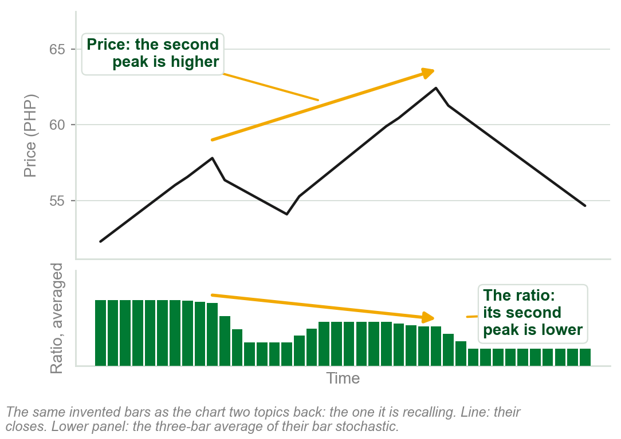
16 Volume and oscillator divergence
Standard divergence, price and volume or price and any oscillator, may signal a potential reversal or continuation.
As Chapter 4 showed: price makes a higher peak while the MACD makes a lower one. Recalled on the right, characteristic 6's own example.
The book names a second kind, reverse divergence, but gives it no sentence of its own here.
Reverse divergence, and how either kind signals a continuation, are left to Chapter 9.
Chart S - FIN1209 teaching chart, drawn for this course. Illustrative data, not a real instrument.
Part 2 of 11 - 5.2 Quality of trend | 28 of 28
Book p.143, one sentence, then Chapter 9. MACD: Chapter 4. Chart recalls Chart O, a few slides back.
Notes:
- This slide recalls the picture rather than drawing a new one: the book gives divergence one sentence here and sends the reader to Chapter 9 for the rest.
- Two of this chapter's figures have already labelled divergences, and Chapter 4 showed one on the MACD. That is as far as the book has taken it.

Slide 67
CHECK 8 OF 21
Exhaustion and volume
Q1
Q2
A currency pair has an average daily range of 120 pips. By midday it has already moved 130 pips. This is regarded as:
A very small bar range on very large volume, the squat bar, is regarded as:
A. A breakaway gap
B. A potential sign of exhaustion
C. Proof that the trend will continue
D. A decrease in cycle period
A. Trend promoting
B. A sign of weak commitment only
C. Of no significance
D. A significantly stronger indication of a potential reversal
Part 2 of 11 - 5.2 Quality of trend | Check 8
Notes:
- Read Q1 aloud, then Q2. Give them sixty seconds and no discussion.
- Ask for a show of hands on each option before you advance.
- This is for reading the room, not for marks. Say so if anyone tenses up.

Slide 68
ANSWERS
Exhaustion and volume
Q1 A currency pair has an average daily range of 120 pips. By midday it has already moved 130 pips. This is regarded as:
B. A potential sign of exhaustion
Price activity beyond the average range before the trading day completes is a potential sign of exhaustion.
Q2 A very small bar range on very large volume, the squat bar, is regarded as:
D. A significantly stronger indication of a potential reversal
Trend inhibiting, and a much stronger sign of a potential reversal: much capital committed, and no further extension in price.
Part 2 of 11 - 5.2 Quality of trend | Check 8
Notes:
- Reveal one at a time. Say the reason out loud, not just the letter.
- If more than a third of the room missed one, step back and reteach it.

Slide 69
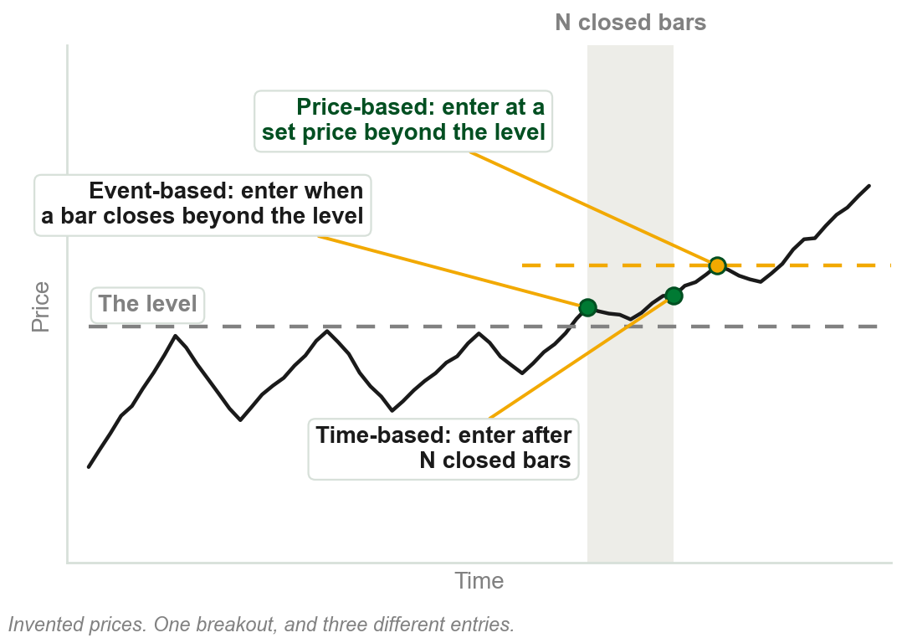
5.3 Three categories of filter
Price-based filters indicate the exact price of entry, but not when.
Time-based filters indicate the exact time of entry, but not the price.
Event-based filters indicate neither, until an event has occurred.
The type of filter, and the extent to which it is employed, sets the exact point of entry and exit.
Chapter 1: filters validate breakouts. Unfiltered, they cannot be backtested, run against past prices to see how they would have performed, the book says.
Chart T - FIN1209 teaching chart, drawn for this course. Illustrative data, not a real instrument.
Part 3 of 11 - 5.3 Filters | 1 of 3
Book p.144; backtest glossed in the caption, ours. The chart is ours: the book's own figure lists the filters and does not show the three entries.
Notes:
- Chapter 1 taught the price, time and algorithmic filters as terms. This section sorts them by what each one pins down: the price, the time, or neither.
- Without a filter a profitable performance is unrepeatable, the book says, because it cannot be backtested.

Slide 70
The filters, one level down
Price-based. Absolute: a fixed price excursion. Relative: a percentage of the breakout price. Volatility: multiples of ATR or of standard deviation, how far a bar's range typically varies.
Time-based: a duration of N closed bars, N being however many the trader chooses.
Event-based. Algorithmic: a specific sequence of closed bars, several in a row closing the same way, or of new highs or lows. Event-based measure: a closing violation, or a retest, price returning to touch a broken level.
FIGURE 5.30
A price falling through an uptrend line after a failure swing, with a question mark on how far below the line it must go, beside the full list: (A) price-based filters, absolute, relative and volatility measures; (B) time-based filters; (C) event-based filters, algorithmic filters and event-based measures.
The artwork is copyrighted and is not in the public repository. Build with assets/figures/ present to place it here.
How far past the line, the ?, before the break counts? Chapter 1 calls the third family algorithmic; here it is a branch of event-based.
Figure 5.30 - Lim, The Handbook of Technical Analysis (Wiley, 2016)
Part 3 of 11 - 5.3 Filters | 2 of 3
Book pp.144-145, Figure 5.30. N, a sequence, a retest and standard deviation are glossed in one line each; the book gives no number for any of them.
Notes:
- The figure is the same list beside a trendline penetration: how far through the line must price go before it counts?
- Chapter 1's prose called the third family algorithmic and its Figure 1.21 called it event-based. This chapter's list settles it one way and its review question the other.

Slide 71
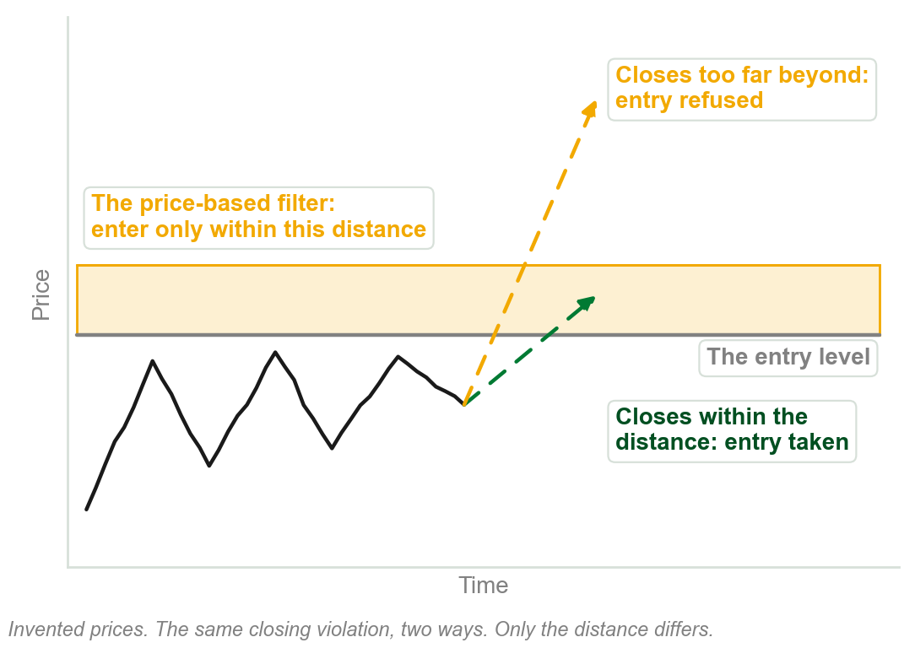
Two-stage filtering
Stage one: a closing violation triggers entry. But price may close too far beyond the entry level.
Stage two: a price-based filter limits entry to within a set distance: a maximum here, where Chapter 1's was a minimum.
Time and event filters do not specify the entry price, so controlling risk is ineffective, if not impossible.
So price-based filters are preferred.
Chart U - FIN1209 teaching chart, drawn for this course. Illustrative data, not a real instrument.
Part 3 of 11 - 5.3 Filters | 3 of 3
Book pp.144-145; the chart is ours. Its reason: with no cap on the risk of a single trade a system may meet risk of ruin, a phrase it does not define.
Notes:
- This is review question 8: a price-based filter names the price, so the risk on the trade is known before it is taken.
- The closing violation is still the trigger. The price filter is only there to limit risk should the violation be overextended.

Slide 72
CHECK 9 OF 21
Filters
Q1
Q2
A filter that indicates the exact price of entry, but not when the entry will be initiated, is:
A trader enters on a closing violation and adds a price-based filter. The second filter is there to:
A. Time-based
B. Event-based
C. Price-based
D. Algorithmic
A. Limit entry to within a specified distance
B. Delay the entry by N closed bars
C. Confirm the trend with volume
D. Replace the closing violation
Part 3 of 11 - 5.3 Filters | Check 9
Notes:
- Read Q1 aloud, then Q2. Give them sixty seconds and no discussion.
- Ask for a show of hands on each option before you advance.
- This is for reading the room, not for marks. Say so if anyone tenses up.

Slide 73
ANSWERS
Filters
Q1 A filter that indicates the exact price of entry, but not when the entry will be initiated, is:
C. Price-based
Price-based filters give the exact price and not the time. Time-based filters give the time and not the price.
Q2 A trader enters on a closing violation and adds a price-based filter. The second filter is there to:
A. Limit entry to within a specified distance
Prices may close too far beyond the entry level. The price-based filter limits entry to within a specified distance.
Part 3 of 11 - 5.3 Filters | Check 9
Notes:
- Reveal one at a time. Say the reason out loud, not just the letter.
- If more than a third of the room missed one, step back and reteach it.

Slide 74
5.4 Four ways into and out of the market
To go long: buying to open a new position.
To go short: selling to open a new position.
To liquidate: selling to close an old long position.
To cover: buying to close an old short position.
FIGURE 5.31
One price swing with the four orders marked on it: go long, buy to open at a low price of $50; liquidate, sell to close at a higher price of $70; go short, sell to open at a high price of $70; cover, buy to close at a lower price of $40. A box works out the long profit as $20 and the short profit as $30.
The artwork is copyrighted and is not in the public repository. Build with assets/figures/ present to place it here.
In the figure: long from $50 to $70 is $20. Short from $70 to $40 is $30.
Chapter 1's four terms. In cash: no open positions. To square: to exit. To hedge: equal and opposite positions.
Figure 5.31 - Lim, The Handbook of Technical Analysis (Wiley, 2016)
Part 4 of 11 - 5.4 Participation | 1 of 9
Book pp.145-146 and Figure 5.31: the dollar amounts are printed on the figure.
Notes:
- Two words open a position and two close one. Liquidate belongs to a long, cover belongs to a short.
- Work the box in the figure aloud: 70 less 50, then 70 less 40. The short made more because it sold high and bought back lower.

Slide 75
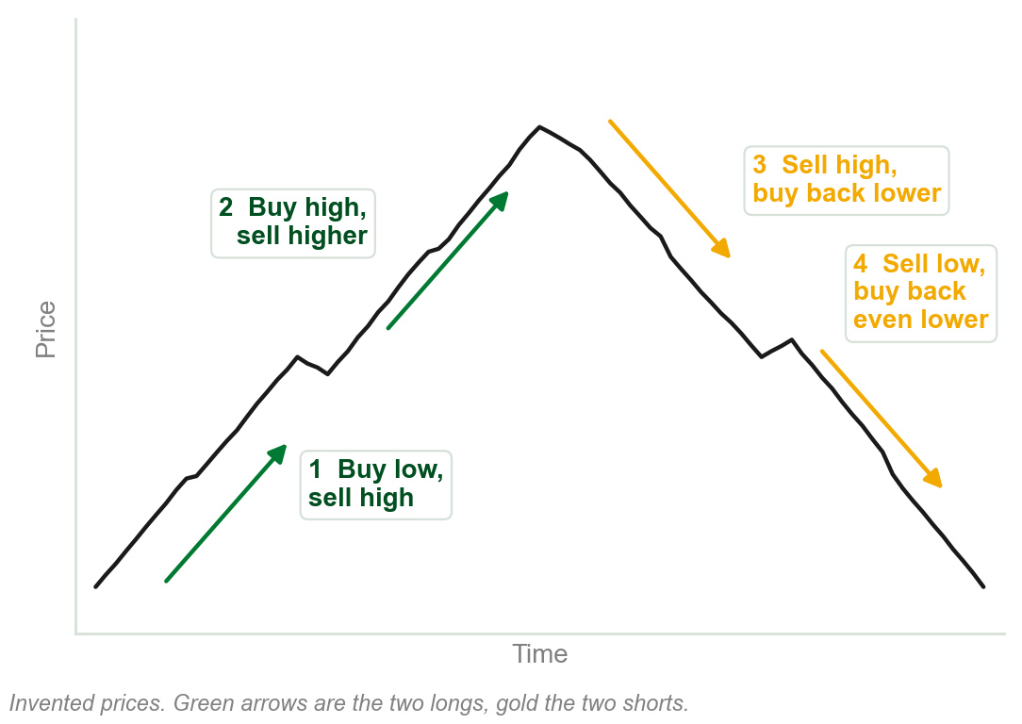
Four scenarios, one principle
1 Buying low and selling high.
2 Buying high and selling higher.
3 Selling high and buying back lower.
4 Selling low and buying back even lower.
Two longs, two shorts. In every one, the selling price is above the buying price.
The book here files all four under 'the principle of buying low and selling high'. By name only the first is buy low, sell high, as Chapter 1 said.
Chart V - FIN1209 teaching chart, drawn for this course. Illustrative data, not a real instrument.
Part 4 of 11 - 5.4 Participation | 2 of 9
Book pp.145-146. The chart is ours, on invented prices.
Notes:
- The book lists these four as what the principle of buying low and selling high involves.
- Follow the numbers on the chart: trades 1 and 2 ride the rise, trades 3 and 4 ride the fall.

Slide 76
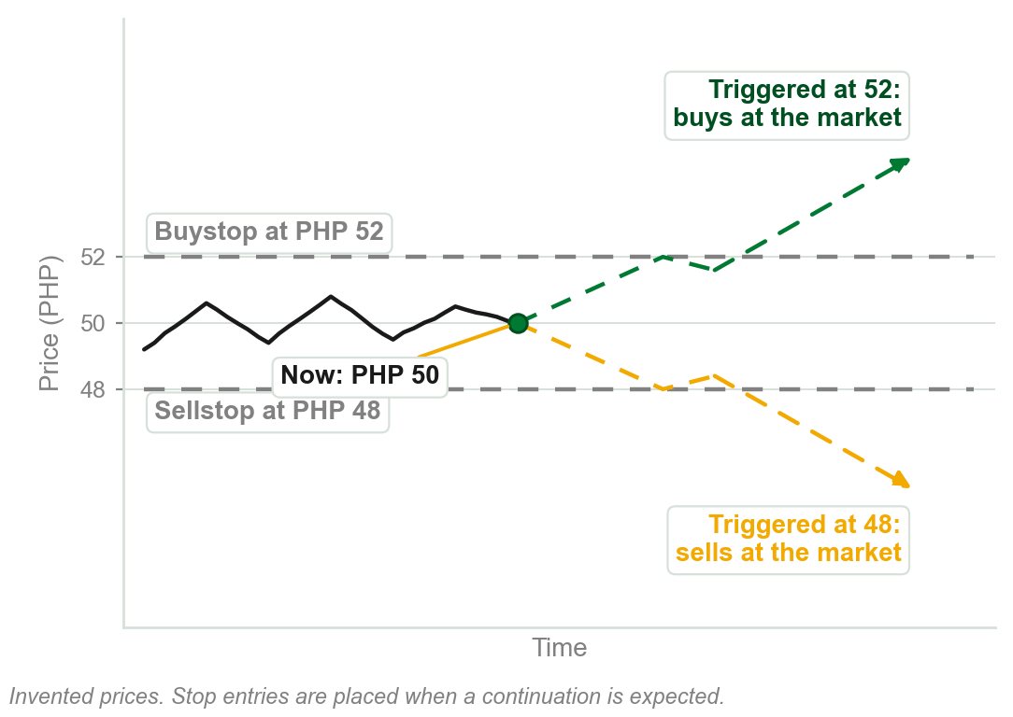
Stop orders: execution, but not the price
A stop order waits at a set price. Once triggered there, it turns into a market order: enter or exit immediately, at any price.
A buystop or sellstop entry is placed when a continuation in price is expected.
A stop exit closes a position that moves adversely: the stoploss order.
It can guarantee execution, but not the fill price.
Chapter 1 taught stop and limit entries. New: the exits, and that a gap can fill a stop away from its price.
Chart W - FIN1209 teaching chart, drawn for this course. Illustrative data, not a real instrument.
Part 4 of 11 - 5.4 Participation | 3 of 9
Book p.146. The chart is ours, on invented prices.
Notes:
- A recall, not a new term: Chapter 1 taught limit and stop entry orders. New today: the exits, and what each order can guarantee.
- The book's sentence reads 'cannot guarantee that an order will be executed, or filled at the specified price, but it can guarantee execution'. Its later sentences settle it: execution yes, price no.
- Stop orders may wait as pending, or working, orders. For entry: a buystop or a sellstop. To exit a position that moves adversely: a stoploss.

Slide 77
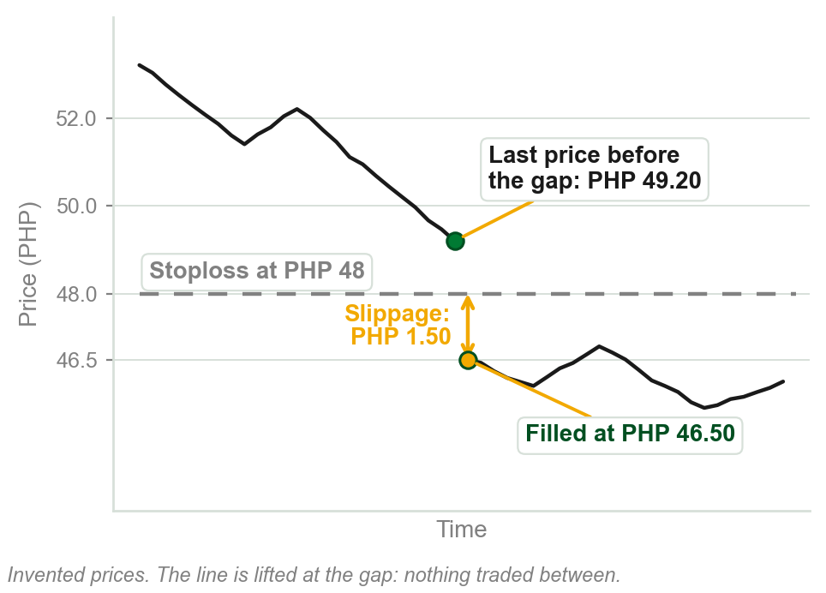
NEW TERM
Slippage
IN PLAIN WORDS
Filled at a price other than the one you asked for. Negative: worse for you. Positive: better.
FOR EXAMPLE
A stoploss waits at PHP 48. Price gaps down and the order is filled at PHP 46.50: negative slippage of PHP 1.50 a share.
THE FORMAL DEFINITION
The difference between the specified order price and the actual filled price. Stoploss orders may experience additional loss under gapping price action, due to negative slippage.
Chart X - FIN1209 teaching chart, drawn for this course. Illustrative data, not a real instrument.
Part 4 of 11 - 5.4 Participation | 4 of 9
Book p.146. The pesos and the chart are our example: PHP 48.00 less PHP 46.50 is PHP 1.50.
Notes:
- A stop becomes a market order, and the market had no price between 48 and 46.50 to give.
- Slippage can be positive too. The next slide is the order that only ever gets the positive kind.
- Chapters 1 and 3 used the word slippage without saying what it is. This is its definition.

Slide 78
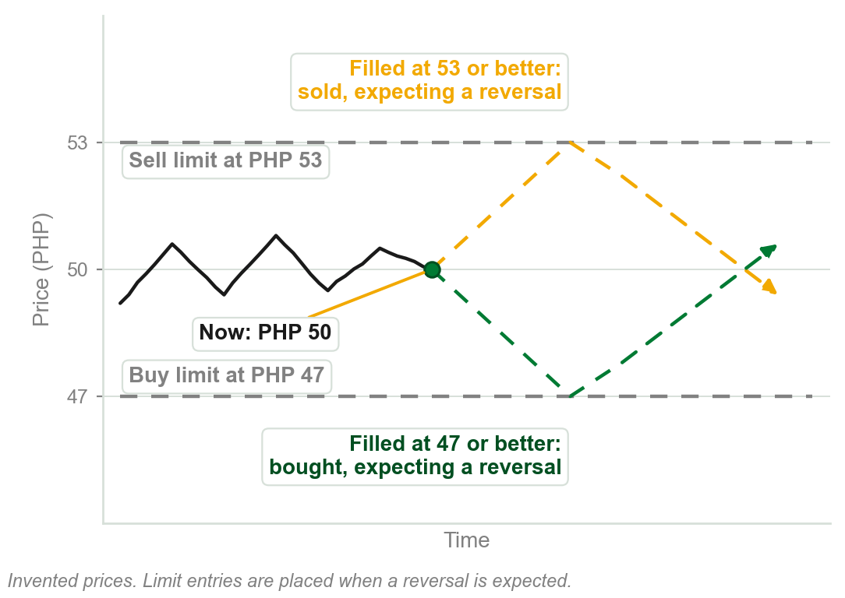
Limit orders: the price, but not execution
Instructions to enter or exit a market at a specified price, or better.
If the broker cannot fill it at that price or better, it is not executed.
A buy limit or sell limit entry is placed when a reversal in price is expected.
Placed only as a pending order. Only positive slippage is possible.
It can guarantee the intended price or better, but not execution.
Chart Y - FIN1209 teaching chart, drawn for this course. Illustrative data, not a real instrument.
Part 4 of 11 - 5.4 Participation | 5 of 9
Book pp.146-147. The chart is ours, on invented prices.
Notes:
- Also a recall from Chapter 1, and the mirror of the stop order: the price is guaranteed and the execution is not.
- A share trades at PHP 50 and a buy limit waits at PHP 47. If it cannot be filled at 47 or better, nothing happens.
- Limit orders can only be placed as pending, or working, orders, never instantaneously. Only positive slippage is possible with them.

Slide 79
CHECK 10 OF 21
Stop orders, limit orders and slippage
Q1
Q2
Which order can guarantee execution, but not the price at which it is filled?
A long position has its stoploss at PHP 30. Price gaps down, and the order is filled at PHP 28.80. The slippage is:
A. A limit order
B. A sell limit order
C. A stop order
D. A buy limit order
A. PHP 1.20, positive
B. PHP 1.20, negative
C. PHP 28.80
D. Zero, because the order was filled
Part 4 of 11 - 5.4 Participation | Check 10
Notes:
- Read Q1 aloud, then Q2. Give them sixty seconds and no discussion.
- Ask for a show of hands on each option before you advance.
- This is for reading the room, not for marks. Say so if anyone tenses up.

Slide 80
ANSWERS
Stop orders, limit orders and slippage
Q1 Which order can guarantee execution, but not the price at which it is filled?
C. A stop order
Once triggered a stop order turns into a market order: it is executed, at whatever price the market gives.
Q2 A long position has its stoploss at PHP 30. Price gaps down, and the order is filled at PHP 28.80. The slippage is:
B. PHP 1.20, negative
Slippage is the difference between the specified order price and the actual filled price: 30.00 - 28.80 = 1.20, against the trader.
Part 4 of 11 - 5.4 Participation | Check 10
Notes:
- Reveal one at a time. Say the reason out loud, not just the letter.
- If more than a third of the room missed one, step back and reteach it.

Slide 81
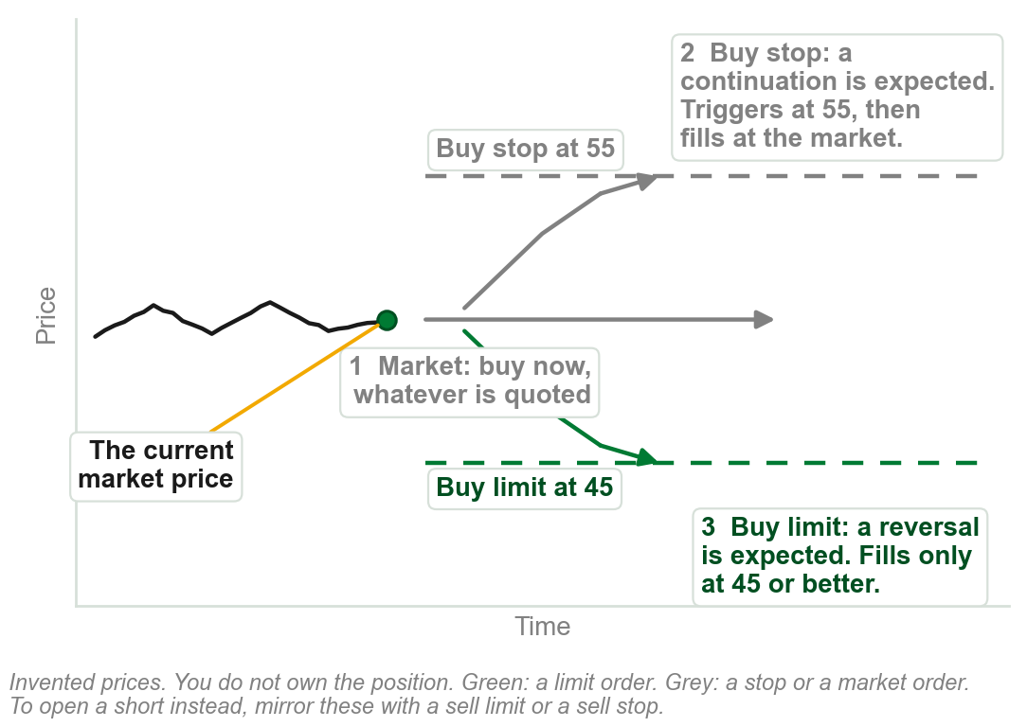
You do not own it: orders to enter
A market order: buy now, at whatever price is quoted. Instant, but the price is not guaranteed.
A buy stop: buy at a set price or higher, placed when a continuation up is expected.
A buy limit: buy at a set price or lower, placed when a reversal down is expected.
To open a short instead, the mirror is a sell limit or a sell stop; this pp.146-148 stretch works only the buy side.
Going short itself was taught earlier, in 5.4 Trend Participation; the book does not pair it with these orders here.
Chart Z - FIN1209 teaching chart, drawn for this course. Illustrative data, not a real instrument.
Part 4 of 11 - 5.4 Participation | 6 of 9
Book pp.146-147. The chart is ours, recalling the stop and limit entry slides before, numbered to its own arrows.
Notes:
- The question to ask before anything else: am I flat, or already in the position? This slide answers it for flat.
- A buy stop turns into a market order once triggered: the price it fills at after that is not guaranteed.
- A buy limit never fills worse than its price. It may not fill at all.

Slide 82
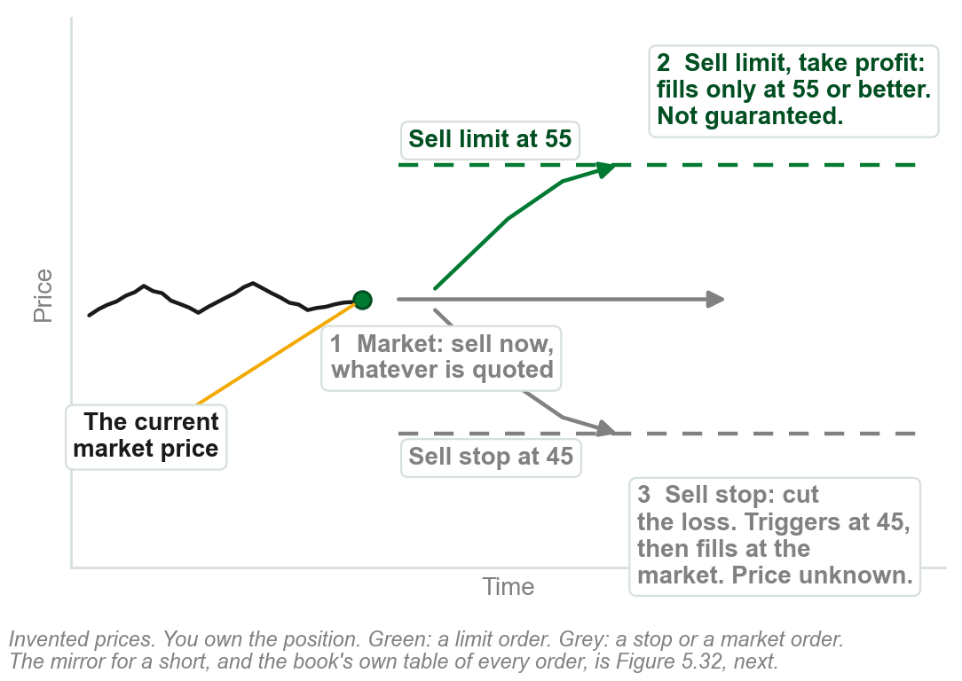
You own it: orders to exit
A market order: sell now, at whatever price is quoted. Instant, but the price is not guaranteed.
A sell limit: the profit-take order, above the market. Fills only at that price or better.
A sell stop: the stoploss, below the market. Triggers there, then fills at the market, price unknown.
A limit exit is not guaranteed. A stop exit is guaranteed, but not its price.
The book says 'or better, that is, higher' of every limit order; for a buy limit on the other slide, better reads lower.
Chart AA - FIN1209 teaching chart, drawn for this course. Illustrative data, not a real instrument.
Part 4 of 11 - 5.4 Participation | 7 of 9
Book pp.147-148. The chart is ours, numbered the same way as the entry slide before it.
Notes:
- Profit is taken with a limit and a loss is cut with a stop, on either side of the market, the same pairing as entries.
- The limit exit is the profit-take order. Under gapping price action it can sometimes exit with greater profit.
- Negative slippage can occur on the stoploss if price gaps through it; Chapter 5's own slippage term, a few slides back.

Slide 83
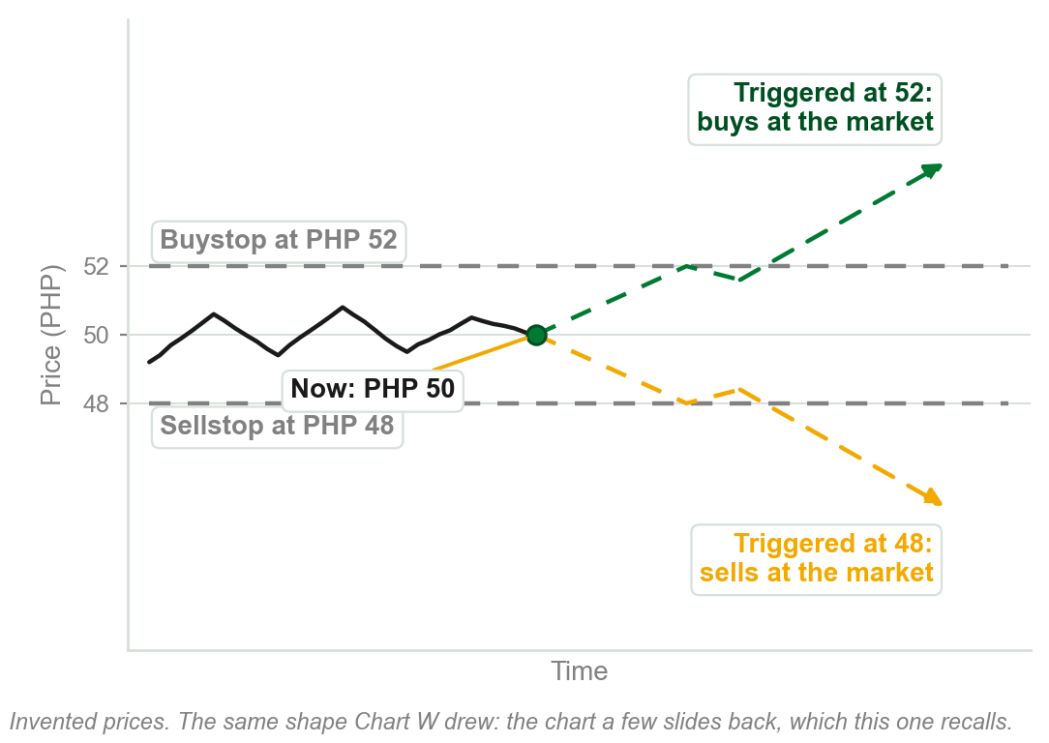
Other orders the book names
Market if Touched, MIT: sells above the market, buys below it, with a stop order. Same shape as the recall, right.
Day orders stay pending only until the end of the trading day.
Good till Cancelled orders stay active until further notice.
Market on Close orders fill in the last minutes, at or near the close.
OCO places two opposite orders and cancels whichever does not fill. OTO places a second order once a first fills.
Chart AB - FIN1209 teaching chart, drawn for this course. Illustrative data, not a real instrument.
Part 4 of 11 - 5.4 Participation | 8 of 9
Book pp.147-148. The chart recalls Chart W, a few slides back: the same shape an MIT order uses.
Notes:
- The picture recalls Chart W rather than drawing a new one: an MIT is the same waiting-order shape, just named for its use as a profit exit or an any-price entry.
- MIT sits in Figure 5.32 as a profit exit, or an entry at any price. The book describes it as shorting above the market using a stop order.

Slide 84
The book's table: orders above and below the market
FIGURE 5.32
A table around the current market price. Orders allowable above the market: buy stop or limit entry, sell limit entry, MIT sell, buy stop to exit a loss, sell limit to exit with profit. Orders allowable under the market: sell stop or limit entry, buy limit entry, MIT buy, sell stop to exit a loss, buy limit to exit with profit.
The artwork is copyrighted and is not in the public repository. Build with assets/figures/ present to place it here.
Figure 5.32 - Lim, The Handbook of Technical Analysis (Wiley, 2016)
Part 4 of 11 - 5.4 Participation | 9 of 9
Book p.148, Figure 5.32. 'Stop /limit entry' is the figure's own wording: the book's text places a buystop above and a sellstop below, and explains no stop/limit order.
Notes:
- The book's summary of the section. Read the top row, then the bottom row as its mirror.
- Entries above the market: a buystop if prices are expected to rise higher, a sell limit if they are expected to reverse there.
- Entries below: a sellstop if prices are expected to continue to decline, a buy limit if they are expected to reverse.

Slide 85
CHECK 11 OF 21
Placing orders
Q1
Q2
A trader is long and wants to take profit if price rises to a level above the market. The order to place is:
An order that stays pending only until the end of the trading day is a:
A. A buystop
B. A sellstop
C. A buy limit
D. A sell limit
A. Day order
B. Good till Cancelled order
C. Market on Close order
D. Contingent order
Part 4 of 11 - 5.4 Participation | Check 11
Notes:
- Read Q1 aloud, then Q2. Give them sixty seconds and no discussion.
- Ask for a show of hands on each option before you advance.
- This is for reading the room, not for marks. Say so if anyone tenses up.

Slide 86
ANSWERS
Placing orders
Q1 A trader is long and wants to take profit if price rises to a level above the market. The order to place is:
D. A sell limit
Profit taking above the market is a sell limit, normally referred to as a profit-take order.
Q2 An order that stays pending only until the end of the trading day is a:
A. Day order
Day orders instruct the broker to keep an order pending only until the end of the trading day.
Part 4 of 11 - 5.4 Participation | Check 11
Notes:
- Reveal one at a time. Say the reason out loud, not just the letter.
- If more than a third of the room missed one, step back and reteach it.

Slide 87
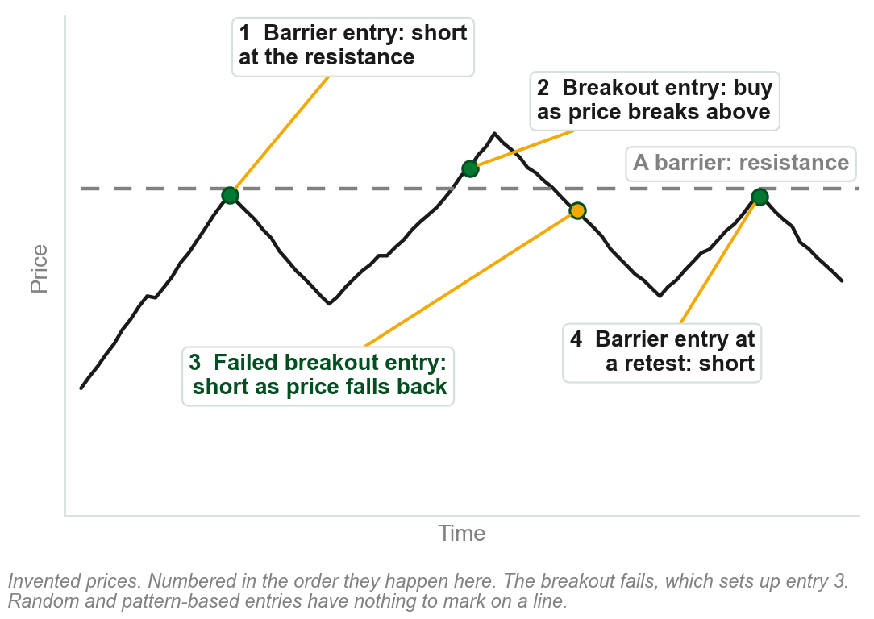
5.5 Ways of initiating an entry
Overlay breakout entries: on an upside or downside breakout of a price overlay.
Overlay barrier entries: buy at support, short at resistance, or at a retest of the barrier.
Failed breakout entries: in the opposite direction, after a failed breakout.
Random entries, and pattern or sequence-based entries.
The book announces four ways and lists five, each with or against the trend. Failed breakout: 5.2's false breakout. Pattern entries follow a set sequence of bars or a completed pattern; a random entry is taken with no technical signal at all, usually only to benchmark a strategy against chance.
Chart AC - FIN1209 teaching chart, drawn for this course. Illustrative data, not a real instrument.
Part 5 of 11 - 5.5 Inflection points | 1 of 13
Book pp.148-149; the chart is ours. Overlays it names: channels and trendlines (5.6), pivot points and price envelopes (not taught here).
Notes:
- The chart shows the first three. A random entry and a pattern entry have nothing to mark on one line.
- Pattern or sequence-based entries follow a particular sequence of bars, or a completed pattern. The book's examples are DeMark Sequential and Japanese candlestick entries.

Slide 88
Three variations of a top and a bottom
Failure swing: the second peak fails to penetrate the previous peak.
Double top: the second peak matches the level of the previous peak.
Non-failure swing: the second peak succeeds in penetrating the previous peak.
Bottoms are the mirror: a failure swing, a double bottom and a non-failure swing, read on the second trough.
FIGURE 5.33
Two rows of three drawings. Three basic variations of a top reversal: failure swing, double top and non-failure swing, each with its second peak and its sell signal marked. Three basic variations of a bottom reversal: the same three on the second trough, each with its buy signal.
The artwork is copyrighted and is not in the public repository. Build with assets/figures/ present to place it here.
All three were Chapter 2 terms, unchanged. More complex: a head and shoulders, a broadening formation, an island, a diamond, a rounding top or bottom.
Figure 5.33 - Lim, The Handbook of Technical Analysis (Wiley, 2016)
Part 5 of 11 - 5.5 Inflection points | 2 of 13
Book p.149 and Figure 5.33. The book says 'as we learned in Chapter 4'; in this course they were Chapter 2's terms.
Notes:
- A recall: all three were Chapter 2 terms in this course, under Dow Theory. The book's own sentence here says Chapter 4.
- In each drawing the signal is marked where price breaks the level between the two peaks, or the two troughs.

Slide 89
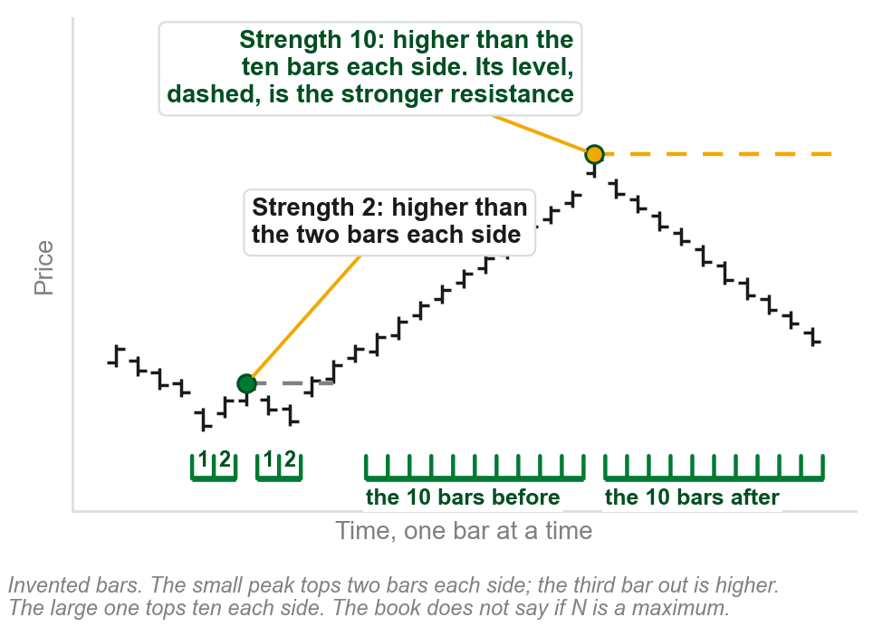
NEW TERM
Inflection point of strength N
IN PLAIN WORDS
An inflection point, a peak or trough, counts for more the more bars flank it. A peak acts as resistance, stopping a rally; a trough acts as support, stopping a decline.
FOR EXAMPLE
A peak whose highest bar is higher than the ten bars on either side is of strength 10. One that tops only two bars each side is of strength 2.
THE FORMAL DEFINITION
N bars on either side of the highest peak or lowest trough is an inflection point of strength N. More bars: a more significant peak or trough, and a stronger resistance or support level.
Chart AD - FIN1209 teaching chart, drawn for this course. Illustrative data, not a real instrument.
Part 5 of 11 - 5.5 Inflection points | 3 of 13
Book pp.149-150. It gives no reason, and does not say whether N is the most bars a peak tops. On the chart the small peak fails at the third bar. Strengths 2 and 10 are ours.
Notes:
- The book's other name for an inflection point is a swing point. Peaks give resistance levels and troughs give support levels.
- Fewer flanking bars: the level is considered less significant and less reliable.
- Chapters 2 and 3 used the words inflection point in passing. Its strength, and the definition, are new today.

Slide 90
NEW TERM
Support and resistance role reversal
IN PLAIN WORDS
A breached barrier changes sides.
FIGURE 5.34
Four drawings in two columns, resistance turning into support and support turning into resistance: the top pair on horizontal levels, the bottom pair on a downtrend line and an uptrend line.
The artwork is copyrighted and is not in the public repository. Build with assets/figures/ present to place it here.
FOR EXAMPLE
A share holds at PHP 40, then falls through it. On the next rally PHP 40 stops it.
THE FORMAL DEFINITION
Price barriers change roles once breached: support turns into future resistance, and resistance into future support. All overlay barriers: channels, trendlines (5.6), pivot points and price envelopes, the last two not built in this course, named only as the book's others.
Figure 5.34 - Lim, The Handbook of Technical Analysis (Wiley, 2016)
Part 5 of 11 - 5.5 Inflection points | 4 of 13
Book p.150, Figure 5.34: top row flat levels, bottom row trendlines (5.6). No reason given here; pesos ours. Support and resistance: the slide just before this one.
Notes:
- Top row of the figure: horizontal levels. Bottom row: the same thing on sloping trendlines.
- Follow one drawing through: price is stopped by the line, breaks it, comes back, and is held from the other side.

Slide 91
Role reversal in a trend
In a downtrend, support turns into resistance, level after level.
In an uptrend, resistance turns into support, level after level.
FIGURE 5.35
A price chart falling and then rising, with short horizontal lines at the levels where support turned into resistance in the downtrend and where resistance turned into support in the uptrend.
The artwork is copyrighted and is not in the public repository. Build with assets/figures/ present to place it here.
Each horizontal line in the figure is one level, met first from one side and then from the other.
Figure 5.35 - Lim, The Handbook of Technical Analysis (Wiley, 2016)
Part 5 of 11 - 5.5 Inflection points | 5 of 13
Book p.150, Figure 5.35. The book gives this figure no sentence of its own.
Notes:
- The book gives this figure no sentence of its own. Its two labels are the two lines on the slide.
- Count the levels on the way down, then on the way up. Every one was used twice.

Slide 92
Prior peaks, prior troughs and a channel
EURUSD, 30 minutes: support and resistance at prior peaks and troughs, and on the rising channel.
Resistance turning into support, again and again, in an uptrend.
FIGURE 5.36
A 30 minute EURUSD chart headed resistance turning into support in an uptrend: horizontal levels each marked resistance and then support, a rising channel around them, and a cycle-tuned stochastic below with arrows from its lows up to the support levels.
The artwork is copyrighted and is not in the public repository. Build with assets/figures/ present to place it here.
The same role reversal as the last two slides, on a real chart instead of an invented one.
The figure's lower panel carries an oscillator, the cycle-tuned stochastic, Chapter 8, too small to read here; this slide keeps only what the price panel itself shows.
Figure 5.36 - Lim, The Handbook of Technical Analysis (Wiley, 2016)
Part 5 of 11 - 5.5 Inflection points | 6 of 13
Book p.151 and Figure 5.36.
Notes:
- Horizontal levels and the channel's sloping lines are both barriers, and both change roles.
- The book reads the lower panel as confirming oversold at each support; it cannot be verified at this size, so the slide does not assert it.

Slide 93
CHECK 12 OF 21
Tops, bottoms and role reversal
Q1
Q2
At a market top, the second peak fails to penetrate the previous peak. This variation is called a:
A support level is breached. In technical analysis it is now expected to act as:
A. Double top
B. Failure swing
C. Non-failure swing
D. Rounding top
A. Stronger support
B. A runaway gap
C. Future resistance
D. Nothing: a breached level is discarded
Part 5 of 11 - 5.5 Inflection points | Check 12
Notes:
- Read Q1 aloud, then Q2. Give them sixty seconds and no discussion.
- Ask for a show of hands on each option before you advance.
- This is for reading the room, not for marks. Say so if anyone tenses up.

Slide 94
ANSWERS
Tops, bottoms and role reversal
Q1 At a market top, the second peak fails to penetrate the previous peak. This variation is called a:
B. Failure swing
A failure swing fails to penetrate. A double top matches the previous peak, and a non-failure swing succeeds in penetrating it.
Q2 A support level is breached. In technical analysis it is now expected to act as:
C. Future resistance
Price barriers change roles once breached: support turns into future resistance, and resistance into future support.
Part 5 of 11 - 5.5 Inflection points | Check 12
Notes:
- Reveal one at a time. Say the reason out loud, not just the letter.
- If more than a third of the room missed one, step back and reteach it.

Slide 95
Trade in the direction of the trend
It means to buy in an uptrend and short in a downtrend. It is generally easier and safer.
Buying dips and selling rallies gets positions at the most advantageous prices, with the smallest stopsizes: the stop goes just beyond the dip or rally, close to the entry.
Positions taken with the trend can be held, and so extract greater profit from the markets.
FIGURE 5.37
Two drawings: buying dips in an uptrend, with arrows at each trough along a rising dotted trendline, and selling into rallies in a downtrend, with arrows at each peak along a falling one.
The artwork is copyrighted and is not in the public repository. Build with assets/figures/ present to place it here.
Buying a dip and selling a rally are retracement entries in the direction of the existing trend.
Stopsize: the distance from entry to stop. Trendlines or channels (5.6) time the entries; a cycle-tuned oscillator (Chapter 8) fine-tunes them.
Figure 5.37 - Lim, The Handbook of Technical Analysis (Wiley, 2016)
Part 5 of 11 - 5.5 Inflection points | 7 of 13
Book pp.151-152 and Figure 5.37. Both reasons on the slide are the book's.
Notes:
- The book gives two of its reasons. Both are about where the entry sits: near the trendline, so the stop is small.
- In the figure every entry is at the trendline. That is a barrier entry from the first slide of this part.

Slide 96
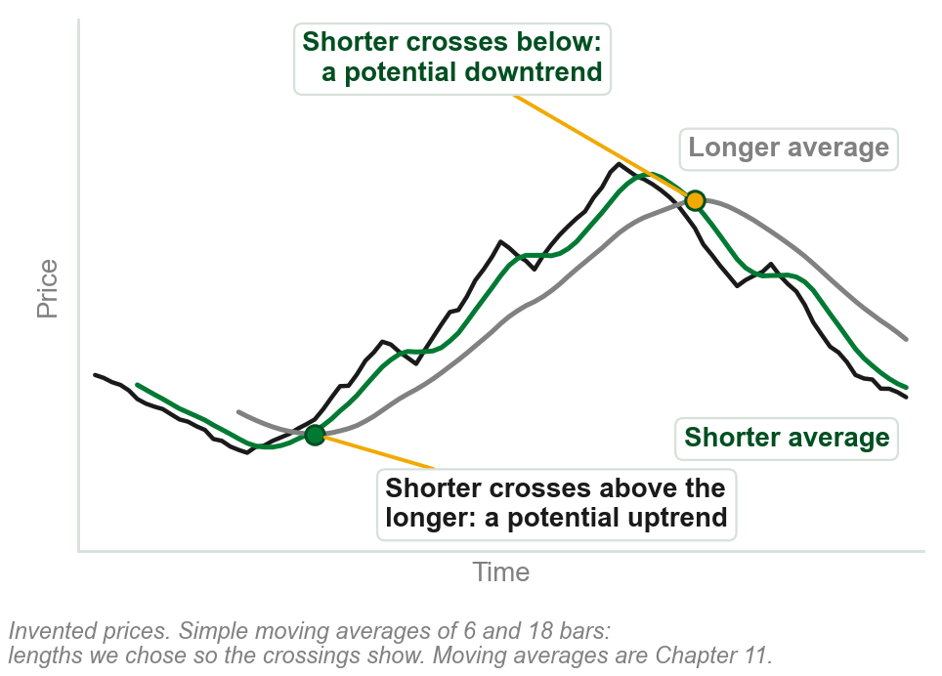
NEW TERM
Trend filter
IN PLAIN WORDS
Says whether a trend is on. Not 5.3's filters.
FOR EXAMPLE
A moving average: the average of a bar's own close and a set number before it, moving ahead one bar at a time. A double crossover compares a shorter one against a longer: shorter above, a potential uptrend; shorter below, a potential downtrend.
THE FORMAL DEFINITION
It helps to identify a trend amidst the market noise and price volatility. How a moving average is built in general is Chapter 11; this is only its crossing read. Two more: an oscillator crossing its signal line, and price contained above or below an overlay barrier.
Chart AE - FIN1209 teaching chart, drawn for this course. Illustrative data, not a real instrument.
Part 5 of 11 - 5.5 Inflection points | 8 of 13
Book p.152. No reason given for the crossover; signal line is not explained here. The chart is ours: 6 and 18 bar moving averages, chosen so the crossings show.
Notes:
- For the oscillator filter: crossing above its signal line signifies potential longer-term bullishness, crossing below potential bearishness.
- For containment: price staying above the moving average or trendline signifies an uptrend still intact. That was section 5.1.
- Three popular filters, which the book says is by no means exhaustive. Moving averages are Chapter 11: the chart draws two and explains neither.

Slide 97
A filter and a trigger together
Bottom: the MACD, the filter, says which way. Middle: the stochastic, the trigger, says when.
Long: the stochastic crosses above its signal line with the MACD above zero. Short: the reverse.
Stops: below the previous trough for a long, trailing up to each higher trough. A short: the mirror.
FIGURE 5.38
A EURUSD chart with long entries, short entries and trailing stops marked on price, a stochastic panel with the entry crossovers circled, and a MACD panel with three divergences drawn on it.
The artwork is copyrighted and is not in the public repository. Build with assets/figures/ present to place it here.
Preview only, not examinable: the MACD, the stochastic and signal lines are not taught in this course until later chapters.
An illustration of one tool for direction, one for timing, shown here only because the book places it in this section. Nothing on this slide is assumed known or tested.
Figure 5.38 - Lim, The Handbook of Technical Analysis (Wiley, 2016)
Part 5 of 11 - 5.5 Inflection points | 9 of 13
Book pp.152-153 and Figure 5.38.
Notes:
- Trailing: the stop advances to the next higher trough in an uptrend, and to the next lower peak in a downtrend.
- Read the figure top down: where the trades were, what triggered them, what filtered them.

Slide 98
CHECK 13 OF 21
With the trend
Q1
Q2
Buying on a dip in an uptrend is an example of:
In a double moving average crossover, the start of a potential uptrend is signified by:
A. A failed breakout entry
B. A random entry
C. A breakout entry against the trend
D. A retracement entry in the direction of the existing trend
A. The shorter average crossing above the longer
B. The longer average crossing above the shorter
C. Price touching either average
D. Both averages turning flat
Part 5 of 11 - 5.5 Inflection points | Check 13
Notes:
- Read Q1 aloud, then Q2. Give them sixty seconds and no discussion.
- Ask for a show of hands on each option before you advance.
- This is for reading the room, not for marks. Say so if anyone tenses up.

Slide 99
ANSWERS
With the trend
Q1 Buying on a dip in an uptrend is an example of:
D. A retracement entry in the direction of the existing trend
Buying on a dip and selling into a rally are retracement entries taken in the direction of the existing trend.
Q2 In a double moving average crossover, the start of a potential uptrend is signified by:
A. The shorter average crossing above the longer
The shorter crossing above the longer signifies the start of a potential uptrend. Crossing below it, a potential downtrend.
Part 5 of 11 - 5.5 Inflection points | Check 13
Notes:
- Reveal one at a time. Say the reason out loud, not just the letter.
- If more than a third of the room missed one, step back and reteach it.

Slide 100
Where the stop goes, and how big it is
A stop is usually placed just below significant troughs for longs, just above significant peaks for shorts.
Entry too far from one: a stop some multiple of ATR or standard deviations away. A qualitative rule only; the book gives no actual multiple.
Barrier entries: stopsizes always about the same. The peak or trough is usually the point of entry itself.
Breakout entries: stopsizes vary. The peak or trough may be any distance from the entry.
FIGURE 5.39
Two columns. Breakout entries: go long at a breakout with the stoploss just below the trough, where the stopsize will vary with each entry. Barrier entries: go long at support with the stoploss just below the barrier, where the stopsize need not vary with each entry. Each is shown on a level and on a trendline.
The artwork is copyrighted and is not in the public repository. Build with assets/figures/ present to place it here.
Stopsize: the distance from entry to stop, the figure's brackets.
Figure 5.39 - Lim, The Handbook of Technical Analysis (Wiley, 2016)
Part 5 of 11 - 5.5 Inflection points | 10 of 13
Book pp.153-154 and Figure 5.39, which says only that a barrier entry's stopsize need not vary with each entry.
Notes:
- The brackets in the figure are the stopsizes: wide and changing on the left, narrow and steady on the right.
- For a barrier entry the significant peak or trough is usually the point of entry itself. That is why its stop is always close.

Slide 101
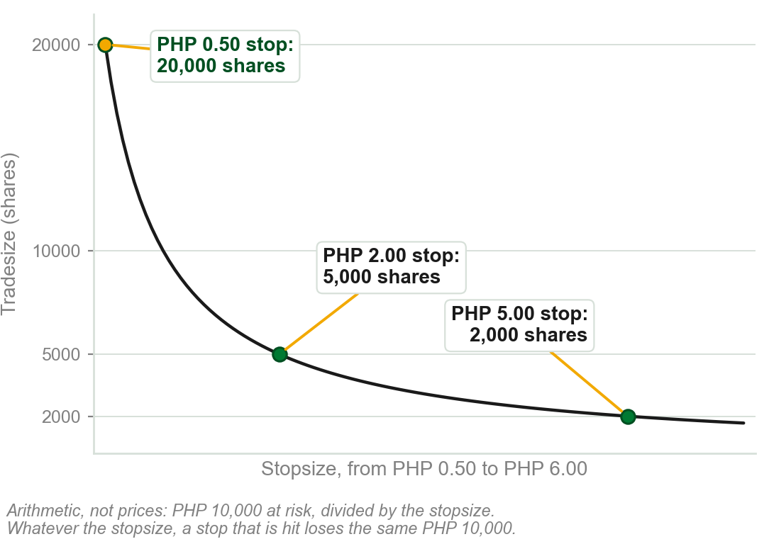
The trouble with a varying stopsize
Tradesize, the number of shares, is the risk per trade divided by the stopsize. So it varies with every stop.
The book's two worst cases: narrow stops taken out frequently, on a fixed percentage of current capital; or wide stops, on a fixed percentage of original capital.
Either way the result is significant loss.
Taken out: the stop is hit. Why each is bad, our reading: a narrow stop on current capital compounds, each loss shrinks the base the next is sized from; a wide stop on original capital stays large even after capital has shrunk.
Chart AF - FIN1209 teaching chart, drawn for this course. Illustrative data, not a real instrument.
Part 5 of 11 - 5.5 Inflection points | 11 of 13
Book p.153: 'risking a fixed percentage or fixed unit size per trade'. The chart is ours, and is arithmetic: PHP 10,000 at risk divided by each stopsize.
Notes:
- The chart is one line of arithmetic: tradesize is the risk per trade divided by the stopsize.
- A narrow stop is hit more often, and with a fixed risk it is hit at full size every time.

Slide 102
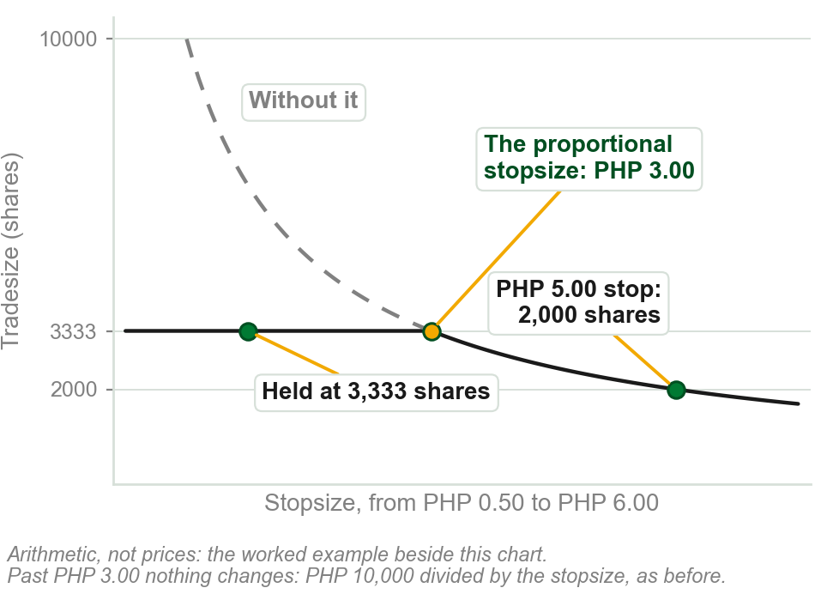
NEW TERM
Proportional stopsizing
IN PLAIN WORDS
One tradesize for every stop up to a threshold. For any wider stop, a smaller one, as before.
FOR EXAMPLE
Proportional stopsize, the threshold: PHP 3.00. Risk per trade PHP 10,000. Stops up to 3.00 trade 3,333 shares; a 5.00 stop, 2,000.
THE FORMAL DEFINITION
It limits the losses in either scenario by allocating a fixed percentage of original capital to narrow stops, and of current capital for stopsizes that exceed a fixed threshold size.
Chart AG - FIN1209 teaching chart, drawn for this course. Illustrative data, not a real instrument.
Part 5 of 11 - 5.5 Inflection points | 12 of 13
Book pp.153-154; pesos ours. Its sentence speaks of original and current capital; its five steps, next slide, use one risk per trade. Learn the steps.
Notes:
- This is review question 7. The advantage: losses are limited whether the stops that get hit are the narrow ones or the wide ones.
- The author says he first introduced it in The Wiley Trading Guide Volume II. Tradesizing gets Chapter 28.

Slide 103
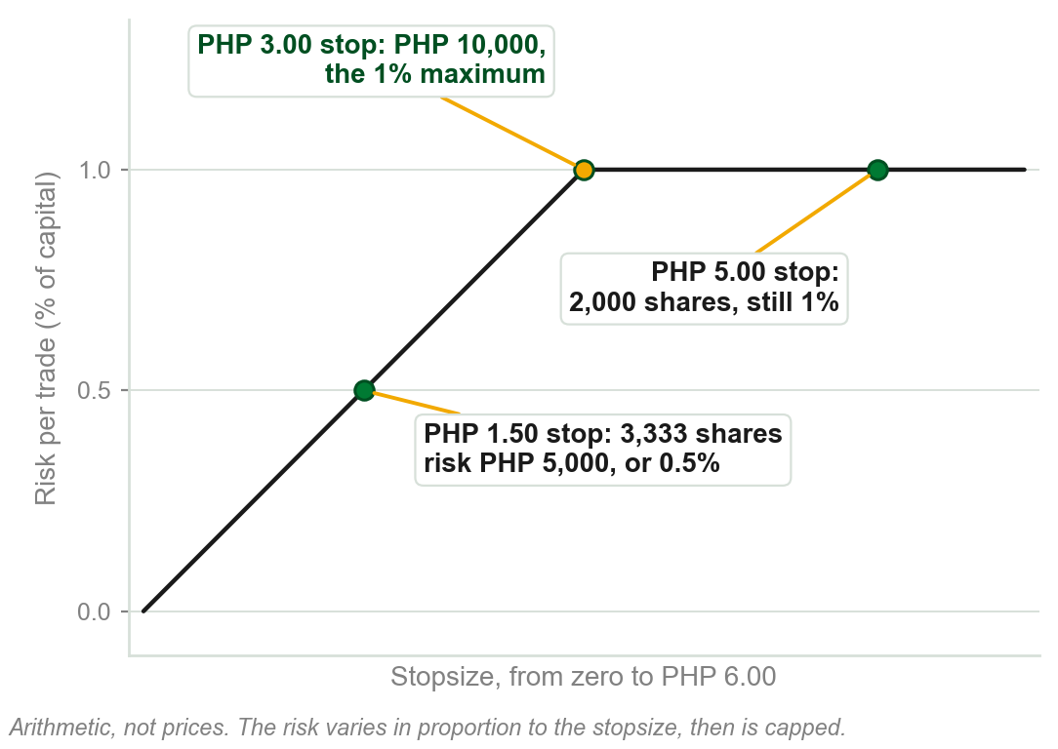
Five steps to the proportional tradesize
1 Backtest, run the system on past trades: the average stopsize of 300 to 500, to average out noise. Say PHP 2.00.
2 Their two standard deviation value: say PHP 1.00, the same cushion as 13's ninety percent mark.
3 Add: the proportional stopsize, PHP 3.00, wide enough for almost every stop seen.
4 Maximum risk per trade: 1 percent of current capital. Say PHP 10,000.
5 10,000 / 3.00 = 3,333 shares, the proportional tradesize.
Chart AH - FIN1209 teaching chart, drawn for this course. Illustrative data, not a real instrument.
Part 5 of 11 - 5.5 Inflection points | 13 of 13
Book p.154. No reason for 300 to 500 trades or step 3, beyond 13's 2 SD case. Backtest: 5.3. Pesos, 1 percent: ours.
Notes:
- This is the chapter objective on calculating the optimum tradesize for breakout trades. The pesos are ours; the five steps are the book's.
- Why proportional: for stops at or below the threshold the percentage risk varies proportionally with the stopsize, and is always capped at the maximum.
- Step 4 is a percentage of current capital. The book says 300 to 500 trades if possible.

Slide 104
CHECK 14 OF 21
Stops and tradesize
Q1
Q2
A backtest gives an average stopsize of PHP 4.00 and a two standard deviation value of PHP 2.00. The risk per trade is PHP 12,000. The proportional tradesize is:
Compared with breakout entries, the stopsizes of barrier entries are:
A. 1,000 shares
B. 2,000 shares
C. 3,000 shares
D. 6,000 shares
A. Always wider
B. Different with every entry
C. Always approximately the same size
D. Not needed at all
Part 5 of 11 - 5.5 Inflection points | Check 14
Notes:
- Read Q1 aloud, then Q2. Give them sixty seconds and no discussion.
- Ask for a show of hands on each option before you advance.
- This is for reading the room, not for marks. Say so if anyone tenses up.

Slide 105
ANSWERS
Stops and tradesize
Q1 A backtest gives an average stopsize of PHP 4.00 and a two standard deviation value of PHP 2.00. The risk per trade is PHP 12,000. The proportional tradesize is:
B. 2,000 shares
The proportional stopsize is 4.00 + 2.00 = PHP 6.00, and 12,000 / 6.00 = 2,000 shares.
Q2 Compared with breakout entries, the stopsizes of barrier entries are:
C. Always approximately the same size
At a barrier the significant peak or trough is usually the point of entry itself, so the stop sits just behind the barrier every time.
Part 5 of 11 - 5.5 Inflection points | Check 14
Notes:
- Reveal one at a time. Say the reason out loud, not just the letter.
- If more than a third of the room missed one, step back and reteach it.

Slide 106
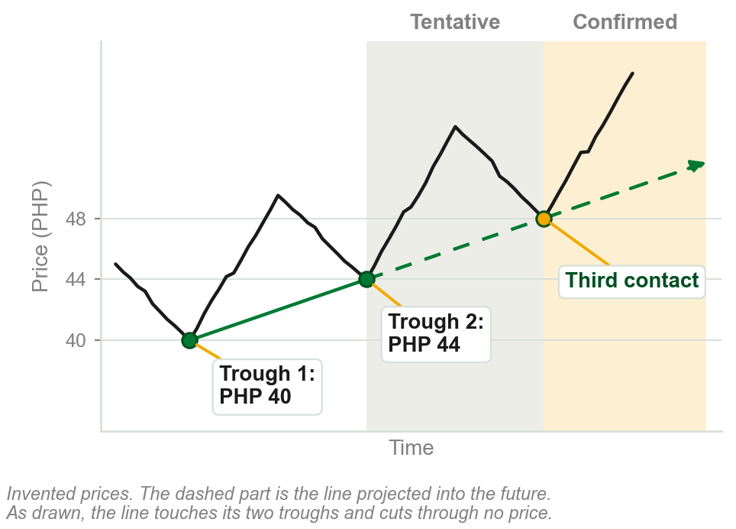
NEW TERM
5.6 Trendline
IN PLAIN WORDS
A straight line through two turning points, carried forward, cutting through no price.
FOR EXAMPLE
Join an uptrend's troughs at PHP 40 and PHP 44 and extend the line. A third touch confirms it.
THE FORMAL DEFINITION
A line projected forward into the future from two significant inflection points: troughs for an uptrend, peaks for a downtrend. Two points only fit a line to the past; a third touch is the first time it predicts, which is why it is tentative until then and confirmed, or valid, after. A line price cuts through has already broken it, so it could not still be holding.
Chart AI - FIN1209 teaching chart, drawn for this course. Illustrative data, not a real instrument.
Part 6 of 11 - 5.6 Trendlines | 1 of 24
Book p.155. No reason given for the third contact or the no-cutting rule beyond our own reading. Price crossing it later is a breach. Pesos and chart ours.
Notes:
- The book's rule is that lines must not cut through any price action at any point along the line. Its other word for tentative is provisionary.
- Tentative and valid apply only to conventional trendlines, and not to fan lines, which come at the end of this part.
- Chapter 1 drew trendlines on its figures and never said how one is made. This is where the book does.

Slide 107
Short, medium and longer-term trendlines
A trendline is short, medium or longer term depending on the amount of price activity it contains above or below it.
Longer-term uptrend lines contain more price activity above them than shorter-term uptrend lines.
The converse is true for downtrend lines.
FIGURE 5.40
One rising price with three dotted uptrend lines fanning out from the same low: a steep short-term line, a medium-term line, and a shallow longer-term line that contains or supports more of the price action.
The artwork is copyrighted and is not in the public repository. Build with assets/figures/ present to place it here.
A longer-term trendline contains, or supports, more of the price action.
Point and Figure's bullish support and bearish resistance lines are drawn from one reference point, not two.
Figure 5.40 - Lim, The Handbook of Technical Analysis (Wiley, 2016)
Part 6 of 11 - 5.6 Trendlines | 2 of 24
Book p.155 and Figure 5.40.
Notes:
- All three lines start at the same trough. The term is set by how much price sits above the line, not by the calendar.
- The Point and Figure lines are the one exception to two inflection points that the book names. Chapter 15 is Point and Figure.

Slide 108
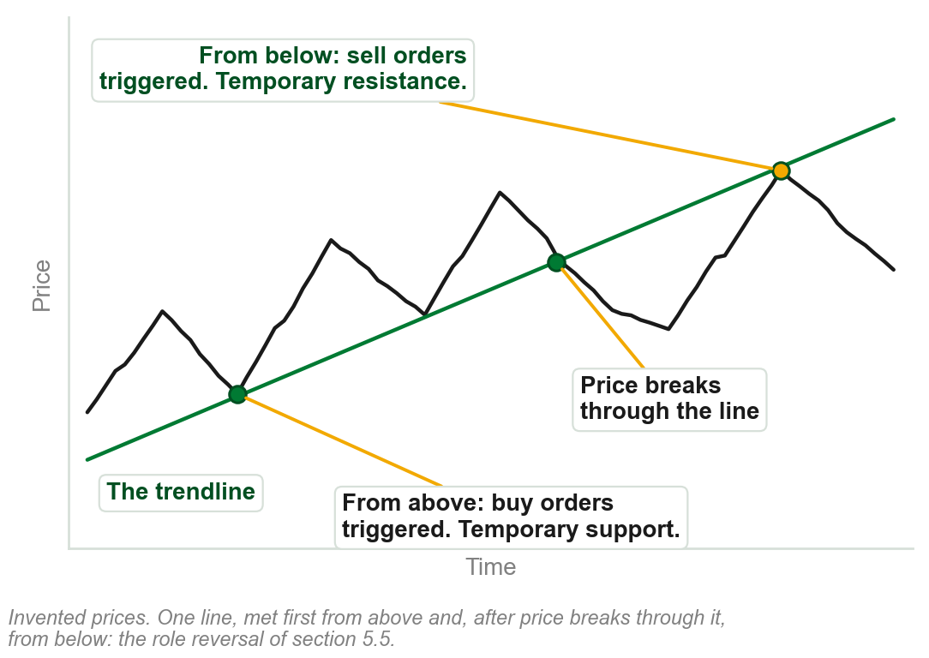
Why a trendline holds: behavior
All price overlays, trendlines included, are barriers. Most participants place buy orders above one and sell orders below it.
From above, price triggers the buy orders: an upside reaction, temporary support.
From below, it triggers the sell orders: a downside reaction, temporary resistance.
Support and resistance are behavioral: human psychology, biases and emotions.
Chapters 2 and 3 pointed here for support and resistance. This is the book's account of them.
Chart AJ - FIN1209 teaching chart, drawn for this course. Illustrative data, not a real instrument.
Part 6 of 11 - 5.6 Trendlines | 3 of 24
Book pp.155-156, reason included. The chart is ours, on invented prices.
Notes:
- The book's words: support and resistance are regarded as behavioral consequences of human psychology, biases and emotions.
- This is the same role reversal as section 5.5, explained: one line, support from above and resistance from below.

Slide 109
NEW TERM
Internal line
IN PLAIN WORDS
A breached trendline: invalid, still usable.
FIGURE 5.41
A 30 minute EURUSD chart following one uptrend line: drawn from two troughs at points 1 and 2, confirmed or validated at its first retest, the third point on the line, then invalidated, and a new uptrend line redrawn between points 1 and 3.
The artwork is copyrighted and is not in the public repository. Build with assets/figures/ present to place it here.
FOR EXAMPLE
Figure: the line through 1 and 2 is confirmed at the circle, then breached: an internal line. A new line runs through 1 and 3.
THE FORMAL DEFINITION
Once breached, a trendline is invalidated and thereafter called an internal line. The new uptrend line runs from the original lower trough to the new significant trough; in a downtrend, from the original higher peak to the new peak.
Figure 5.41 - Lim, The Handbook of Technical Analysis (Wiley, 2016)
Part 6 of 11 - 5.6 Trendlines | 4 of 24
Book p.156, Figure 5.41. Its example of use: a head and shoulders neckline (Chapter 13), very frequently retested after the breach. It does not say why internal.
Notes:
- The figure runs the whole life of a line: drawn, confirmed at the circle, invalidated, redrawn.
- Invalidated does not mean ineffective. Price often comes back to an old line, as it does to a neckline.

Slide 110
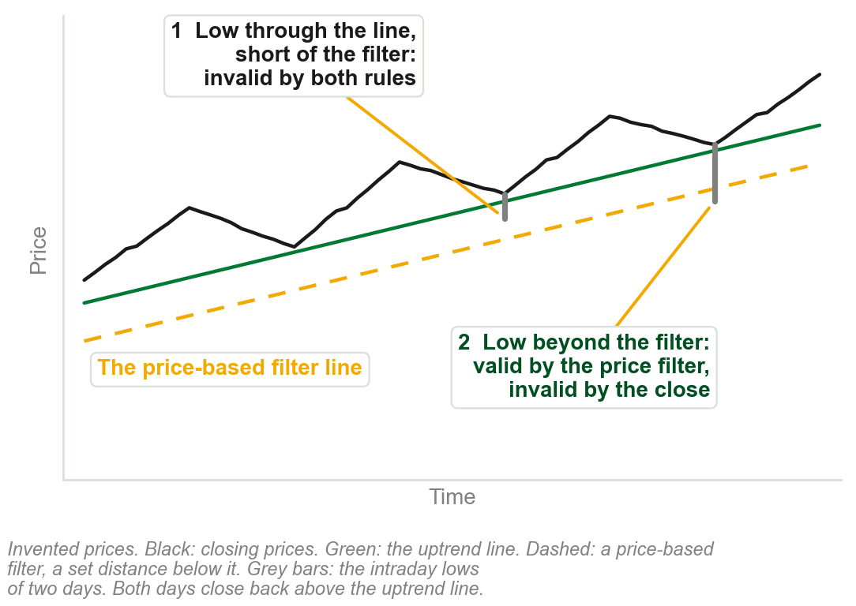
What counts as a valid penetration?
It depends on the filtering employed. Closing filter rule: valid only once price closes beyond the line.
So an intraday low well through an uptrend line, with a close back above it, is significant but invalid.
The book's answer: use a price-based filter. A penetration is then valid once price goes a set distance beyond the line, whatever the close.
With a time or event filter, the book adds the price filter as a second stage. Valid or not, a new trendline may still be drawn.
Chart AK - FIN1209 teaching chart, drawn for this course. Illustrative data, not a real instrument.
Part 6 of 11 - 5.6 Trendlines | 5 of 24
Book pp.156-157. The chart is ours, on invented prices.
Notes:
- The answer depends on the type and extent of filtering. The book: we yet again observe the problems with defining price action.
- A price-based filter lets the trader decide exactly how much price excursion represents a valid penetration.

Slide 111
CHECK 15 OF 21
Drawing and breaking a trendline
Q1
Q2
A trendline drawn from two troughs becomes a confirmed, or valid, trendline when:
Once a trendline has been invalidated, it is thereafter referred to as:
A. It is first drawn
B. Price breaches it
C. Price tests it at a third point of contact
D. Volume rises along it
A. A tentative line
B. A valid line
C. A neckline
D. An internal line
Part 6 of 11 - 5.6 Trendlines | Check 15
Notes:
- Read Q1 aloud, then Q2. Give them sixty seconds and no discussion.
- Ask for a show of hands on each option before you advance.
- This is for reading the room, not for marks. Say so if anyone tenses up.

Slide 112
ANSWERS
Drawing and breaking a trendline
Q1 A trendline drawn from two troughs becomes a confirmed, or valid, trendline when:
C. Price tests it at a third point of contact
A trendline is only provisionary, or tentative, until it is tested for the first time, at the third point of price contact.
Q2 Once a trendline has been invalidated, it is thereafter referred to as:
D. An internal line
A breached trendline is invalidated, but not unusable. It is thereafter referred to as an internal line.
Part 6 of 11 - 5.6 Trendlines | Check 15
Notes:
- Reveal one at a time. Say the reason out loud, not just the letter.
- If more than a third of the room missed one, step back and reteach it.

Slide 113
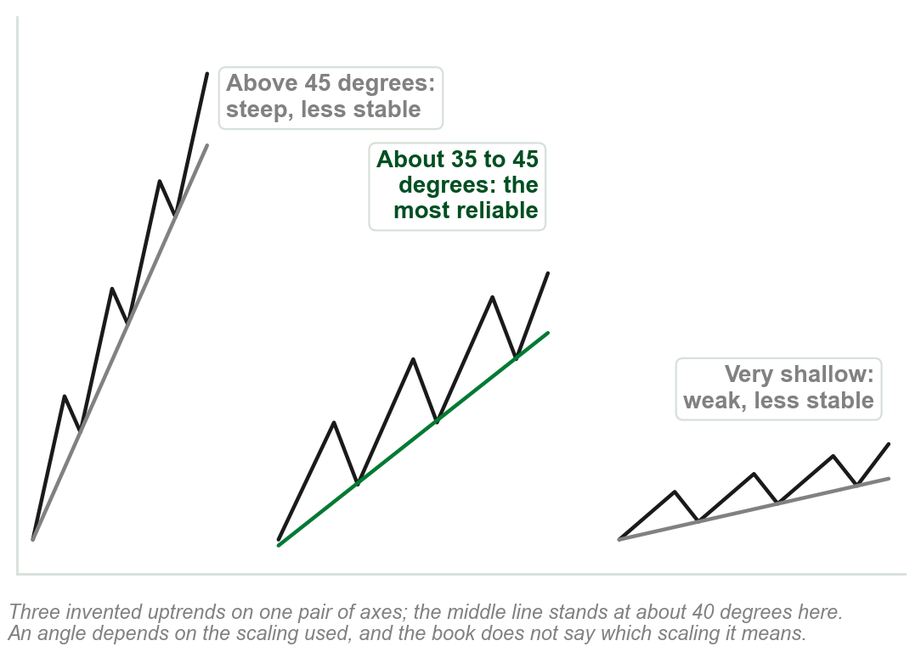
A reliable trendline: angle and duration
A reliable trendline gives consistent support and resistance. A lot of whipsaws, price crossing the line back and forth without a clean break: unreliable.
Angle, read on a linear price scale, Chapter 3: above 45 degrees a steep uptrend is less stable, and may not sustain itself. So is a very shallow one.
The most reliable uptrend line rises at approximately 35 to 45 degrees.
Duration: longer-term trendlines are generally more reliable than shorter-term ones.
A longer-term line is more obvious to all participants and attracts more and larger orders.
Chart AL - FIN1209 teaching chart, drawn for this course. Illustrative data, not a real instrument.
Part 6 of 11 - 5.6 Trendlines | 6 of 24
Book p.157. No reason given for 35 to 45 degrees or the scaling; our reading is linear, Chapter 3. The chart is ours.
Notes:
- This and the next slide are review question 6: the factors that impact trendline reliability. Six of them, two here.
- The steep trend may not be able to sustain itself over the longer term. Chapter 4 said the book uses whipsaw without defining it; this slide gives it a working definition, ours, since the book never does.

Slide 114
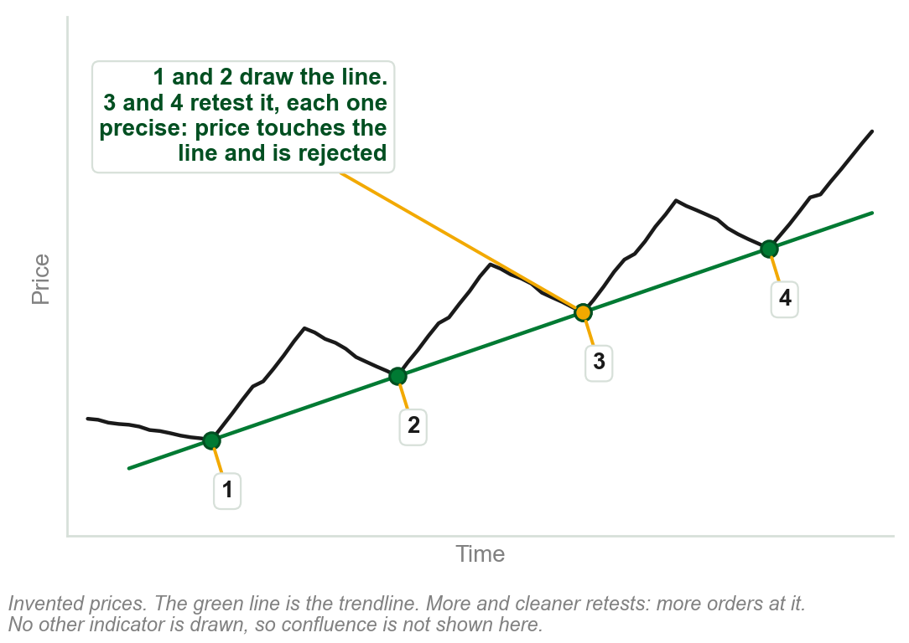
A reliable trendline: the other four
Number of retests: the more a line is retested, the more orders it attracts.
Clarity of the retests: the more precise, the more formidable the barrier.
Confluence: other bullish or bearish indicators agreeing at the point of contact. A stronger rejection of price.
Preceding action: contracting cycle amplitude, cycle period, bar range or body-to-range ratio makes a line suspect.
Retests show that traders are aware of the line and paying attention to it.
Chart AM - FIN1209 teaching chart, drawn for this course. Illustrative data, not a real instrument.
Part 6 of 11 - 5.6 Trendlines | 7 of 24
Book pp.157-158, reasons included. The chart is ours, on invented prices.
Notes:
- The first three share one mechanism: the more visible the line, the more orders gather around it, as on the behavior slide.
- The fourth is section 5.2 again: a line under a weakening trend is unreliable over the longer term.

Slide 115
A trendline's minimum price target
Find the distance that price moved farthest from the trendline.
Apply a one-to-one projection of that distance from the breakout point.
Farthest distance PHP 6, breakout at PHP 50: the minimum target is 50 - 6 = PHP 44.
FIGURE 5.42
A 30 minute EURUSD chart: the maximum distance of price from the uptrend line measured as a vertical arrow, the same height projected one to one down from the breakout point, and profit-taking activity around the minimum target projection.
The artwork is copyrighted and is not in the public repository. Build with assets/figures/ present to place it here.
In the figure prices bottom very close to the minimum projected target.
Chapter 4's minimum measuring objective, from a trendline.
Figure 5.42 - Lim, The Handbook of Technical Analysis (Wiley, 2016)
Part 6 of 11 - 5.6 Trendlines | 8 of 24
Book p.158 and Figure 5.42. The pesos are our example of the one-to-one projection.
Notes:
- The same idea as Chapter 4's minimum measuring objective, measured from a trendline and not from a range.
- The pesos are ours. The figure shows the method on EURUSD: one arrow up, the same arrow down.

Slide 116
Strengths and weaknesses of trendline analysis
Strengths 1 and 2: straight lines catch any trend change, no need to identify price patterns.
Strengths 3 and 4: simple on any timeframe or market, viewable across them all.
Weakness 1: subject to whipsaws, the slide before's term; weaker in erratic markets.
Weakness 2: affected by the scaling used, Chapter 3's ratio or linear.
Weakness 3: a sideways consolidation drifts both ways, crossing a line without a real reversal's break.
Part 6 of 11 - 5.6 Trendlines | 9 of 24
Book pp.158-159: its own list. Weakness 3's reason is our reading.
Notes:
- No picture: this is the book's own list of four strengths and three weaknesses, on five lines.
- The scaling weakness is Chapter 3: a straight line on a linear scale is not straight on a ratio scale.

Slide 117
CHECK 16 OF 21
Reliability and targets
Q1
Q2
The most reliable uptrend line has an angle of ascent of approximately:
Price moved at most PHP 8 away from an uptrend line, then broke below the line at PHP 60. The minimum price target is:
A. 10 to 20 degrees
B. 35 to 45 degrees
C. 50 to 60 degrees
D. 75 to 90 degrees
A. PHP 44
B. PHP 52
C. PHP 60
D. PHP 68
Part 6 of 11 - 5.6 Trendlines | Check 16
Notes:
- Read Q1 aloud, then Q2. Give them sixty seconds and no discussion.
- Ask for a show of hands on each option before you advance.
- This is for reading the room, not for marks. Say so if anyone tenses up.

Slide 118
ANSWERS
Reliability and targets
Q1 The most reliable uptrend line has an angle of ascent of approximately:
B. 35 to 45 degrees
Above 45 degrees a trend is less stable, and so is a very shallow one. Approximately 35 to 45 degrees is the most reliable.
Q2 Price moved at most PHP 8 away from an uptrend line, then broke below the line at PHP 60. The minimum price target is:
B. PHP 52
A one-to-one projection of the farthest distance from the breakout point: 60 - 8 = PHP 52.
Part 6 of 11 - 5.6 Trendlines | Check 16
Notes:
- Reveal one at a time. Say the reason out loud, not just the letter.
- If more than a third of the room missed one, step back and reteach it.

Slide 119
NEW TERM
Continuation and reversal trendlines
IN PLAIN WORDS
Named by the breakout a trendline allows.
FIGURE 5.43
Two existing uptrends. In the first a falling dotted line over a pullback is broken upward: a continuation trendline, with the breakout in the direction of the existing trend. In the second a rising dotted line under the trend is broken downward: a reversal trendline.
The artwork is copyrighted and is not in the public repository. Build with assets/figures/ present to place it here.
FOR EXAMPLE
A falling line over a retracement in an uptrend, broken upward: a continuation trendline. For the retracement itself, a lower degree, a reversal.
THE FORMAL DEFINITION
Trendlines that allow a breakout in the direction of the existing trend are continuation trendlines; in the opposite direction, reversal trendlines. First ascertain which wave degree is being observed.
Figure 5.43 - Lim, The Handbook of Technical Analysis (Wiley, 2016)
Part 6 of 11 - 5.6 Trendlines | 10 of 24
Book p.159 and Figure 5.43. Why the wave degree matters is our reading; the book says only that it must be ascertained.
Notes:
- The left line is a downtrend line of a lower wave degree, drawn inside an uptrend of a higher one. Breaking it continues the larger trend.
- Wave degrees, from section 5.1, are what make one breach a continuation and another a reversal.

Slide 120
NEW TERM
Channel, and its return line
IN PLAIN WORDS
A trendline and a parallel across price.
FIGURE 5.44
A rising channel turning into a falling channel, headed channel transition: an uptrend line through points 1 and 2 with its channel or return line from point 3, then a downtrend line through points 4 and 5 with its channel or return line from point 6.
The artwork is copyrighted and is not in the public repository. Build with assets/figures/ present to place it here.
FOR EXAMPLE
Rising: an uptrend line on troughs 1 and 2, with a parallel from peak 3. Falling: a downtrend line on peaks 4 and 5, with a parallel from trough 6, which violates the uptrend line.
THE FORMAL DEFINITION
A line projected parallel to the trendline from a significant peak or trough is the channel, or return, line. Channels indicate potential entry, profit-taking, price target and stoploss levels.
Figure 5.44 - Lim, The Handbook of Technical Analysis (Wiley, 2016)
Part 6 of 11 - 5.6 Trendlines | 11 of 24
Book pp.159-160 and Figure 5.44.
Notes:
- A channel is a trendline and one parallel to it, on the other side of price. Earlier chapters showed channels and never built one.
- In the figure the rising channel transitions into a falling one. Trough 6 violating the uptrend line may be an early indication of a potential trend change.
- For alternative approaches to constructing a channel the book refers to Chapter 13.

Slide 121
NEW TERM
Nested channels
IN PLAIN WORDS
Channels inside a bigger channel.
FIGURE 5.45
A 4 hour Silver chart with one larger falling channel drawn across it and many smaller channels, rising and falling, nested within the larger one.
The artwork is copyrighted and is not in the public repository. Build with assets/figures/ present to place it here.
FOR EXAMPLE
Silver, 4 hour: price moves through smaller channels, rising and falling, inside one larger falling channel.
THE FORMAL DEFINITION
The smaller channels are contained, or nested, within the larger channel. Nesting can occur at multiple levels, with large channels comprised of ever-decreasing channel sizes. Channel nesting has fractal-like properties.
Figure 5.45 - Lim, The Handbook of Technical Analysis (Wiley, 2016)
Part 6 of 11 - 5.6 Trendlines | 12 of 24
Book p.160, Figure 5.45 (p.161). Fractal-like, unexplained by the book: the same shape at every size. It says nothing of the lines right of the larger channel.
Notes:
- The wave degrees of section 5.1, drawn as channels: a small channel inside a medium one inside a large one.
- Fractal-like is the book's phrase. The same shape repeats at every size.

Slide 122
Nested channels at Fibonacci levels
Nested channeling again, this time on a chart of the USDCAD.
The horizontal lines are Fibonacci retracement levels: set percentages of a prior move.
The book's own page, kept for completeness. Neither the channels nor the levels can be read at this size, so nothing here is asked to be verified from it; the next slide redraws the same idea so it can be.
FIGURE 5.46
A price chart with nested channels drawn in solid and dashed lines over a set of horizontal Fibonacci retracement levels, from 0.0 to 100.0, with the channel turns falling on those levels.
The artwork is copyrighted and is not in the public repository. Build with assets/figures/ present to place it here.
Retracement levels: 5.7, and Chapter 10. The book's printed caption repeats Figure 5.45's and says Silver; its text says USDCAD.
Figure 5.46 - Lim, The Handbook of Technical Analysis (Wiley, 2016)
Part 6 of 11 - 5.6 Trendlines | 13 of 24
Book p.160, and Figure 5.46 on p.161.
Notes:
- Two kinds of barrier on one chart: the sloping channel lines and the horizontal retracement levels.
- Say the slip once: the printed caption belongs to the figure before it.

Slide 123
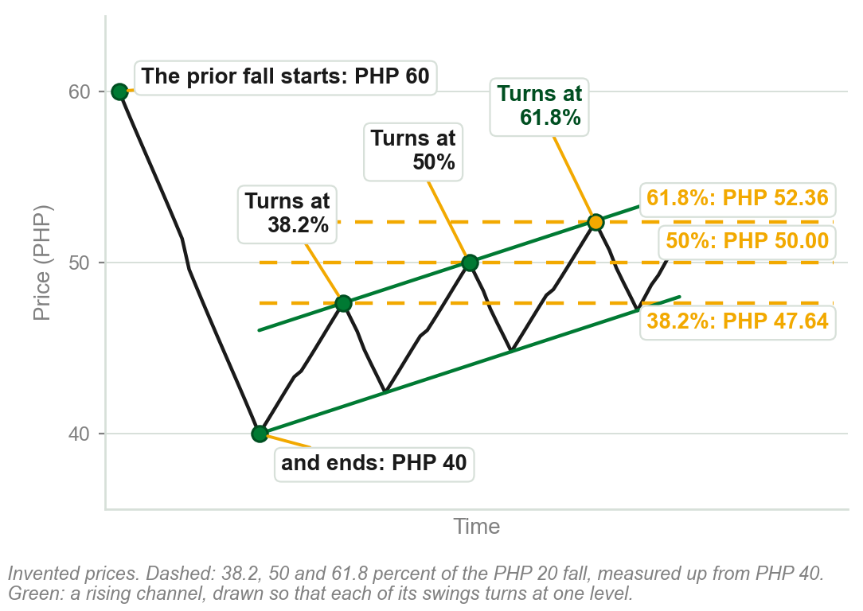
A channel turning at retracement levels
A prior fall: PHP 60 down to PHP 40, PHP 20 in all.
Levels, measured back up from PHP 40: 38.2 percent is PHP 47.64, 50 percent PHP 50.00, 61.8 percent PHP 52.36.
Each swing of the rising channel turns down at one of the levels: the reaction the book says to notice.
Two kinds of barrier: sloping channel lines, flat retracement levels.
Preview only, not examinable: 38.2, 50 and 61.8 percent are borrowed here for the book's channel point; where they come from is 5.7 and Chapter 10, not this slide.
Chart AN - FIN1209 teaching chart, drawn for this course. Illustrative data, not a real instrument.
Part 6 of 11 - 5.6 Trendlines | 14 of 24
Ours: what the book says of its Figure 5.46 (p.160), on invented prices, because the figure's levels cannot be read. Drawn so that each swing turns at a level.
Notes:
- The book's figure makes this point on a real chart at a size where neither the levels nor a single reaction can be made out. This is the same point, drawn so it can be.
- Work one level aloud: 38.2 percent of PHP 20 is PHP 7.64, and 40 plus 7.64 is 47.64.
- Say plainly that the chart was drawn to turn at the levels. It shows what reacting at a level looks like, not that price must.

Slide 124
Projecting a price target with a channel
The return line of a channel is a possible price target, providing resistance to price.
Solid: an uptrend line through troughs 1 and 2, and its parallel from peak 3, channel projection 1. Price meets it at 5.
Dotted: a new, steeper line from trough 2 to trough 4, and its parallel from 5, channel projection 2. Price meets it at 6.
FIGURE 5.47
A EURUSD chart: a rising line through troughs 1 and 2 carried on to trough 4, channel projection 1 drawn parallel to it from peak 3 and met by price at point 5, and channel projection 2 carried on to point 6.
The artwork is copyrighted and is not in the public repository. Build with assets/figures/ present to place it here.
The targets at 5 and 6 were forecast accurately.
The line slopes: the target price depends on when price arrives.
Figure 5.47 - Lim, The Handbook of Technical Analysis (Wiley, 2016)
Part 6 of 11 - 5.6 Trendlines | 15 of 24
Book p.160, and Figure 5.47 on p.162. The point by point reading of the figure is ours; the book gives it one sentence.
Notes:
- Channel projection 1 runs from point 3 and was met at point 5. Projection 2 was met at point 6.
- This is review question 5: a channel pinpoints where a move may stop before price gets there.

Slide 125
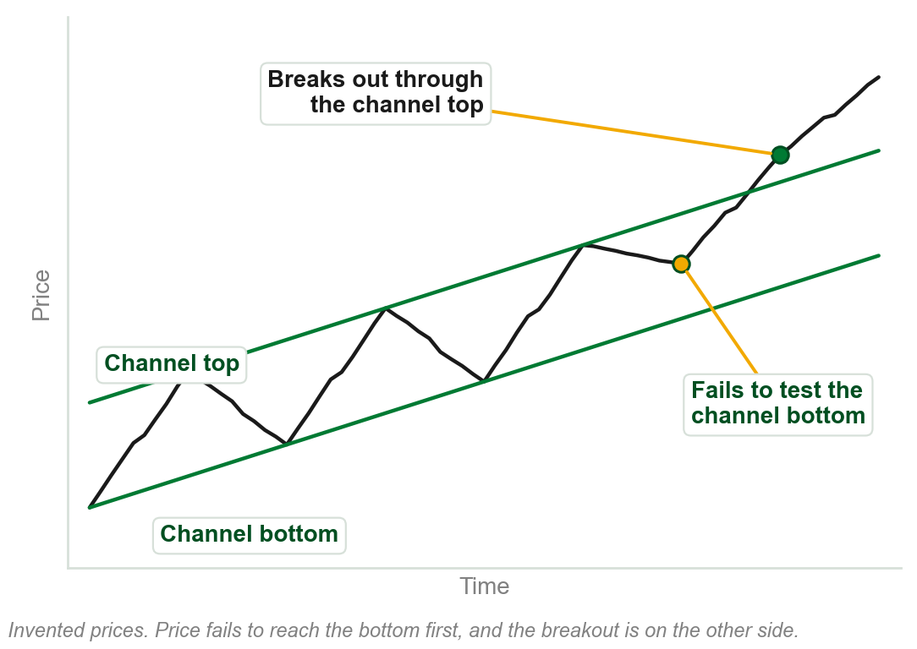
Anticipating a channel breakout
Price failing to test one of the channel boundaries may be an early indication of a breakout in the opposite direction.
A failure to test a channel bottom in an uptrend, or a channel top in a downtrend, is even stronger evidence of a continuation of the existing trend.
Especially so if the channel breakout bar is accompanied by large volume.
Not the same case as 5.2's single trendline, where piercing the line itself was exhaustion: here price never even reaches the near boundary, then clears the far one, which 5.2 never addressed.
Chart AO - FIN1209 teaching chart, drawn for this course. Illustrative data, not a real instrument.
Part 6 of 11 - 5.6 Trendlines | 16 of 24
Book pp.160-161. The chart is ours: the book makes the point on its Figure 5.14. Reconciled with 5.2's single-line exhaustion rule below, our reading.
Notes:
- The other half of review question 5: a failed test of one boundary points at a breakout through the other.
- The chart is ours. The book makes the point on the figure it used for bar retracement symmetry.

Slide 126
CHECK 17 OF 21
Channels
Q1
Q2
In a rising channel, the line projected parallel to the uptrend line from a significant peak is called the:
In an uptrend, price fails to test the bottom of its rising channel. This is evidence of:
A. Channel, or return, line
B. Internal line
C. Neckline
D. Reversal trendline
A. A reversal to the downside
B. A failure swing
C. A potential continuation of the existing uptrend
D. An invalid trendline
Part 6 of 11 - 5.6 Trendlines | Check 17
Notes:
- Read Q1 aloud, then Q2. Give them sixty seconds and no discussion.
- Ask for a show of hands on each option before you advance.
- This is for reading the room, not for marks. Say so if anyone tenses up.

Slide 127
ANSWERS
Channels
Q1 In a rising channel, the line projected parallel to the uptrend line from a significant peak is called the:
A. Channel, or return, line
The uptrend line is drawn on two significant troughs, and the parallel from a significant peak is the channel or return line.
Q2 In an uptrend, price fails to test the bottom of its rising channel. This is evidence of:
C. A potential continuation of the existing uptrend
A failure to test one boundary points to a breakout through the other. The bottom went untested, so the top: a continuation.
Part 6 of 11 - 5.6 Trendlines | Check 17
Notes:
- Reveal one at a time. Say the reason out loud, not just the letter.
- If more than a third of the room missed one, step back and reteach it.

Slide 128
NEW TERM
Sperandeo trendlines
IN PLAIN WORDS
Sperandeo's rule for which two points to join: a minor trough or peak is a small one, smaller than the move it sits inside.
FIGURE 5.48
Two drawings. A Sperandeo uptrend line from the lowest trough through the highest minor trough preceding the highest peak, and a Sperandeo downtrend line from the highest peak through the lowest minor peak preceding the lowest trough.
The artwork is copyrighted and is not in the public repository. Build with assets/figures/ present to place it here.
FOR EXAMPLE
An uptrend's lowest trough is PHP 40, and its highest minor trough before the PHP 60 peak is PHP 55: the line runs from the first through the second.
THE FORMAL DEFINITION
Uptrend line: from the lowest trough to the highest minor trough preceding the highest peak. Downtrend line: the mirror. The rule anchors the line on the most recent higher low before the top, as close under price as the rally allows. From Victor Sperandeo's Trader Vic: Methods of a Wall Street Master.
Figure 5.48 - Lim, The Handbook of Technical Analysis (Wiley, 2016)
Part 6 of 11 - 5.6 Trendlines | 17 of 24
Book p.162, Figure 5.48 (p.163). No reason given for the rule itself. It advises reading Sperandeo's book. Pesos ours.
Notes:
- Find the extreme first, the highest peak, then walk back to the last minor trough before it. The line joins that to the lowest trough.
- The author writes that there is no way he can do justice to the approach here, and advises reading Sperandeo's book. The pesos are ours.

Slide 129
NEW TERM
DeMark trendlines
IN PLAIN WORDS
DeMark's rule: join the two newest points.
FIGURE 5.49
A rising candlestick chart with three uptrend lines drawn from different pairs of troughs: the one through the two most recent troughs is marked correct and the two drawn from older troughs are marked wrong.
The artwork is copyrighted and is not in the public repository. Build with assets/figures/ present to place it here.
FOR EXAMPLE
Of three uptrend lines in the figure, only the one through the two most recent troughs is marked Correct.
THE FORMAL DEFINITION
Uptrend line: from the two most recent qualified troughs. Downtrend line: from the two most recent qualified peaks. From Thomas DeMark's The New Science of Technical Analysis, where the book sends the reader for how a point qualifies.
Figure 5.49 - Lim, The Handbook of Technical Analysis (Wiley, 2016)
Part 6 of 11 - 5.6 Trendlines | 18 of 24
Book p.162, Fig. 5.49. It calls the approach more responsive, not saying than what, or how a point qualifies. The troughs cannot be told apart here: next slide.
Notes:
- A conventional trendline starts from the oldest troughs. DeMark's starts from the newest, which is why it is more responsive.
- Do not teach the pivot selection process. The book sends the reader to DeMark for it.

Slide 130
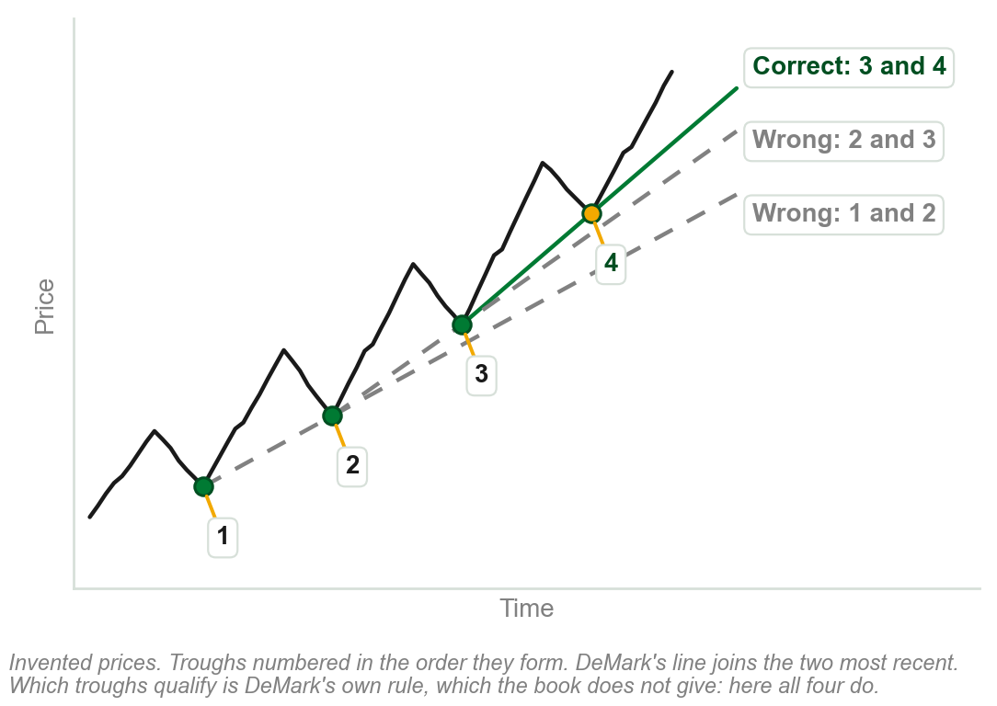
DeMark's line, on numbered troughs
An uptrend with four troughs, numbered in the order they form.
Correct, DeMark's line: through the two most recent troughs, 3 and 4.
Wrong: the lines through 2 and 3, and through 1 and 2. They use older troughs.
Only the two most recent troughs give DeMark's line.
Which troughs qualify is DeMark's own rule; the book sends the reader to his book for it. Here all four are taken to qualify.
Chart AP - FIN1209 teaching chart, drawn for this course. Illustrative data, not a real instrument.
Part 6 of 11 - 5.6 Trendlines | 19 of 24
Ours: the book's Figure 5.49 (p.163) redrawn on invented prices with the troughs numbered, because they cannot be told apart on it.
Notes:
- The book's figure draws three lines on a real chart and marks one Correct. Which troughs each line joins cannot be seen on it, so this is the same picture with the troughs numbered.
- The line through 3 and 4 is the steepest of the three here, and the closest to the latest price. The book's word for the approach is more responsive.
- Do not teach the pivot selection process. The book sends the reader to DeMark for it.

Slide 131
NEW TERM
Standard fan lines
IN PLAIN WORDS
Three trendlines fanning out from one point, each flatter than the last.
FIGURE 5.50
Two drawings: decelerating fan lines, three uptrend lines fanning out from one trough and numbered 1st, 2nd and 3rd as they flatten, and accelerating fan lines, three downtrend lines fanning out from one peak.
The artwork is copyrighted and is not in the public repository. Build with assets/figures/ present to place it here.
FOR EXAMPLE
Decelerating: from one significant trough, three uptrend lines to later troughs. Accelerating: three downtrend lines, from one peak.
THE FORMAL DEFINITION
They indicate a change in trend: violation of the third fan line is strong confirmation. They provide support and resistance, change roles when breached, and trade like any trendline.
Figure 5.50 - Lim, The Handbook of Technical Analysis (Wiley, 2016)
Part 6 of 11 - 5.6 Trendlines | 20 of 24
Book p.163, Fig. 5.50. No reason for three or the names. Its troughs and peaks are too small to read; the next slide redraws them.
Notes:
- All three lines share one starting point: a trough for the decelerating set, a peak for the accelerating one.
- Tentative and valid do not apply to fan lines. A fan line uses two inflection points but only one is at a peak or trough.
- The troughs and peaks are too small to read here, so the next slide redraws the idea on an invented chart.

Slide 132
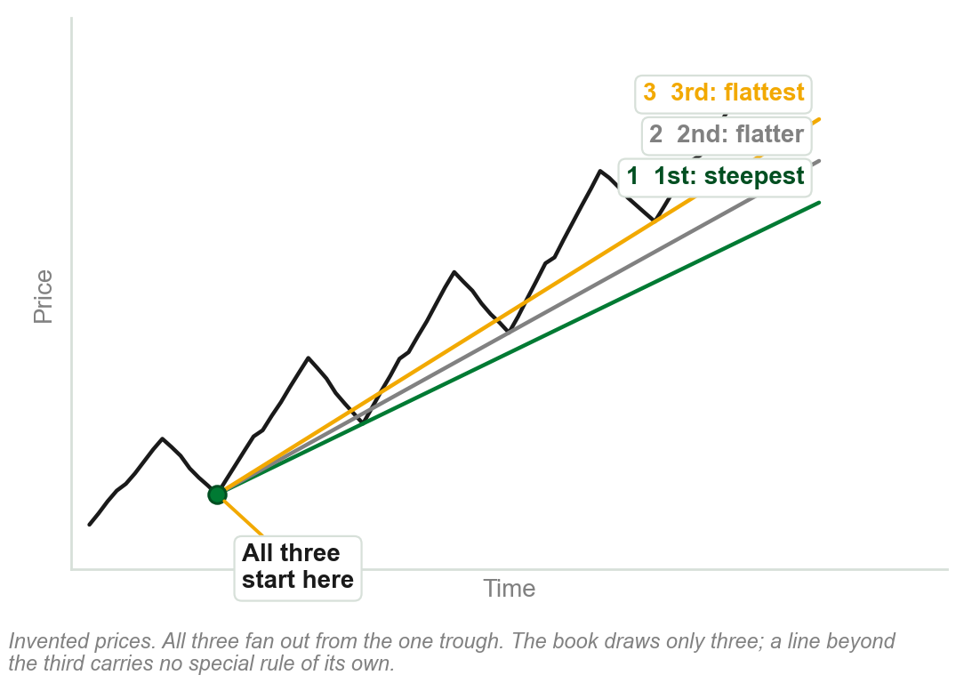
Standard fan lines, numbered
An uptrend, with three fan lines all starting from its first trough.
1st, steepest: to the next trough. 2nd, flatter: to the one after. 3rd, flattest: to the last.
Accelerating fan lines, from a peak instead, are the same shape mirrored down.
Each line is numbered in the order the book draws it.
The book says to draw only three of either; a line beyond the third carries no rule of its own.
Chart AQ - FIN1209 teaching chart, drawn for this course. Illustrative data, not a real instrument.
Part 6 of 11 - 5.6 Trendlines | 21 of 24
Ours: the book's Figure 5.50 (p.163) redrawn on invented prices, because its troughs and peaks are too small to read on it.
Notes:
- Accelerating fan lines run from a significant higher peak to gradually rising lower peaks. The book says to draw only three of either.

Slide 133
NEW TERM
Fibonacci fan lines
IN PLAIN WORDS
Fan lines through three Fibonacci levels.
FIGURE 5.51
A rise from a trough to a peak with a vertical line dropped from the peak to the base, divided at 38.2, 50.0 and 61.8 percent, and three lines projected from the trough through those three points.
The artwork is copyrighted and is not in the public repository. Build with assets/figures/ present to place it here.
FOR EXAMPLE
A rise from PHP 40 to PHP 60: the vertical line is PHP 20 tall. Measured down from the peak, the three marks are PHP 52.36, 50.00 and 47.64.
THE FORMAL DEFINITION
Bearish: identify a significant Fibonacci retracement range. Draw a vertical line from its peak to the trough's price level. Divide it at 38.2, 50 and 61.8 percent. Project three lines from the trough through those levels.
Figure 5.51 - Lim, The Handbook of Technical Analysis (Wiley, 2016)
Part 6 of 11 - 5.6 Trendlines | 22 of 24
Book p.164, Figure 5.51. It calls this one bearish and does not say why. The percentages are given, not derived: Fibonacci is Chapter 10, retracements 5.7. Pesos ours.
Notes:
- This is the fan line whose second point is not a peak or trough: it sits along a predetermined vertical axis.
- Fibonacci ratios are Chapter 10. Today the three percentages are given, not derived. The pesos are ours.

Slide 134
NEW TERM
Speed lines
IN PLAIN WORDS
Fibonacci fan lines, drawn with thirds.
FIGURE 5.52
A rise from a trough to a peak with a vertical line dropped from the peak to the base and divided into three thirds, and two lines projected from the trough through the division points: the 1/3 speed line and the 2/3 speed line.
The artwork is copyrighted and is not in the public repository. Build with assets/figures/ present to place it here.
FOR EXAMPLE
The same vertical line, divided into thirds: a 1/3 speed line and a 2/3 speed line.
THE FORMAL DEFINITION
Edson Gould's speed lines track the progress of a trend as it attempts to bottom or top. They are created in exactly the same way as Fibonacci fan lines, except that the retracement ratios are one-third and two-thirds.
Figure 5.52 - Lim, The Handbook of Technical Analysis (Wiley, 2016)
Part 6 of 11 - 5.6 Trendlines | 23 of 24
Book p.164, Figure 5.52 (p.165). No reason for thirds. What they are read for: as with all fan lines, support and resistance (p.163).
Notes:
- One construction, two sets of ratios: Fibonacci's three percentages, or Gould's two thirds.
- One-third and two-thirds are also the retracements Dow watched, which is the next section.

Slide 135
NEW TERM
Andrew's Pitchfork
IN PLAIN WORDS
Three parallel lines drawn from three points.
FIGURE 5.53
A daily Silver chart with a falling pitchfork: a significant peak, a retracement trough and a retracement peak, three parallel falling lines, and labels where prices react at the median line and tag the upper band.
The artwork is copyrighted and is not in the public repository. Build with assets/figures/ present to place it here.
FOR EXAMPLE
Daily Silver, in a downtrend: prices react at the median line and tag the upper band.
THE FORMAL DEFINITION
Bearish: find a significant peak, then an upside retracement that does not exceed it. The median line runs from the peak through the midpoint between the retracement trough and peak; parallels run from both. The lines give support and resistance. Bullish: the converse.
Figure 5.53 - Lim, The Handbook of Technical Analysis (Wiley, 2016)
Part 6 of 11 - 5.6 Trendlines | 24 of 24
Book p.165, Figure 5.53. No reason given. Its text calls both reactions support; at the upper band the figure shows price turning down, which is resistance.
Notes:
- Three points make it: the significant peak, the retracement trough, the retracement peak. The middle line is called the median.
- It is a channel with a centre line, drawn from three points and not two.

Slide 136
CHECK 18 OF 21
Other trendlines and fan lines
Q1
Q2
DeMark trendlines in an uptrend are constructed from:
Speed lines differ from Fibonacci fan lines in that their retracement ratios are:
A. The lowest trough and the highest peak
B. The two most recent qualified troughs
C. The two oldest troughs on the chart
D. The lowest trough and the highest minor trough
A. 38.2, 50 and 61.8 percent
B. One-eighth and one-quarter
C. 25, 50 and 75 percent
D. One-third and two-thirds
Part 6 of 11 - 5.6 Trendlines | Check 18
Notes:
- Read Q1 aloud, then Q2. Give them sixty seconds and no discussion.
- Ask for a show of hands on each option before you advance.
- This is for reading the room, not for marks. Say so if anyone tenses up.

Slide 137
ANSWERS
Other trendlines and fan lines
Q1 DeMark trendlines in an uptrend are constructed from:
B. The two most recent qualified troughs
DeMark uses the two most recent qualified troughs in an uptrend, and the two most recent qualified peaks in a downtrend.
Q2 Speed lines differ from Fibonacci fan lines in that their retracement ratios are:
D. One-third and two-thirds
Speed lines are created in exactly the same way as Fibonacci fan lines, except the ratios are one-third and two-thirds.
Part 6 of 11 - 5.6 Trendlines | Check 18
Notes:
- Reveal one at a time. Say the reason out loud, not just the letter.
- If more than a third of the room missed one, step back and reteach it.

Slide 138
5.7 Three ways to measure a retracement
Fibonacci retracements are based on ratios related to the Fibonacci Phi ratio: Chapter 10. Only the percentages matter here.
Dow paid particular attention to the one-third and two-thirds retracements. Gann employed one-third and one-eighth retracement ranges.
FIGURE 5.54
A table of retracement percentages in three columns. Fibonacci: 23.6, 38.2, 50 in brackets, 61.8 and 78.6. Dow: 33, 50 and 66. Gann: 12.5, 25.0, 37.5, 50.0, 62.5, 75.0 and 87.5.
The artwork is copyrighted and is not in the public repository. Build with assets/figures/ present to place it here.
Gann and Dow both regarded 50 percent as the most significant, with most major tops and bottoms forming around it.
Each is a percentage of the move retraced, as in Chapter 2. The table's Gann column is in eighths only, and it brackets Fibonacci's 50; the book explains neither.
Figure 5.54 - Lim, The Handbook of Technical Analysis (Wiley, 2016)
Part 7 of 11 - 5.7 Retracements | 1 of 2
Book p.166 and Figure 5.54. Nothing is derived here: the book leaves that to 'a subsequent chapter', unnamed. Its Chapter 10 is Fibonacci, its Chapter 19 Gann.
Notes:
- A retracement percentage is a share of the move being retraced, as in Chapter 2. Read the table across, not down: each row is one zone and three ways of naming it.
- The Gann column is in eighths: 12.5 percent is one-eighth. Nothing here is derived; that waits for the later chapters.

Slide 139
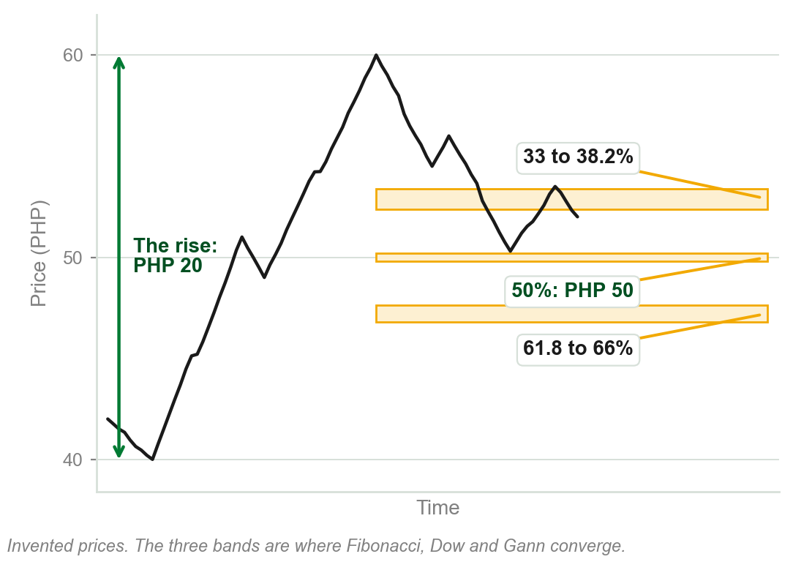
Where the three approaches agree
Set side by side, the retracement percentages converge strongly around specific ranges.
Between 33 and 38.2 percent.
At 50 percent.
Between 61.8 and 66 percent.
Probably the most important retracement percentage of all is the 50 percent level.
Chart AR - FIN1209 teaching chart, drawn for this course. Illustrative data, not a real instrument.
Part 7 of 11 - 5.7 Retracements | 2 of 2
Book p.166. The chart is ours: a rise from PHP 40 to PHP 60, chosen so that 50 percent falls on PHP 50.
Notes:
- The rise on the chart is PHP 20, so a 50 percent retracement gives back PHP 10 and stands at PHP 50.
- Three people measuring three ways still watch the same three zones. That is what convergence buys.

Slide 140
NEW TERM
5.8 Common, breakaway, runaway and exhaustion gaps
IN PLAIN WORDS
Each is named for where it opens: in a range, or early, midway or late in a trend.
FIGURE 5.55
A weekly Wheat chart with each kind of gap boxed and named: common gaps inside the consolidation, then a breakaway gap, a runaway gap and an exhaustion gap up the trend, with arrows from the three trend gaps to later levels of support.
The artwork is copyrighted and is not in the public repository. Build with assets/figures/ present to place it here.
FOR EXAMPLE
Weekly Wheat shows all four.
THE FORMAL DEFINITION
Common: within a trading range, considered insignificant. Breakaway: as price breaks away from a consolidation or chart pattern. Runaway, measuring, midway or continuation: in a strong trend phase; there may be more than one. Exhaustion: at the end of a trend, before a consolidation or reversal.
Figure 5.55 - Lim, The Handbook of Technical Analysis (Wiley, 2016)
Part 8 of 11 - 5.8 Gaps | 1 of 4
Book p.166, Figure 5.55 (p.167), whose Support arrows mark the support each gap later gives. Chapter 3 named the four and left their meanings to this chapter.
Notes:
- Chapter 3 defined a gap and named these four for later, and Chapter 4 met three of them as San Ku. This is where the book says what each one is.
- Runaway, measuring, midway and continuation are four names for one gap. On the Wheat chart: common gaps inside the consolidation, then the three trend gaps.
- Prices top after the third gap, the exhaustion gap: characteristic 12 from section 5.2.

Slide 141
Gaps forecasting trend exhaustion
Weekly Wheat: common gaps within the consolidation, then the trend-related gaps.
Prices top after the third gap: potential trend exhaustion.
The exhaustion is at a significant resistance level, created by a strong price rejection.
FIGURE 5.56
A weekly Wheat chart: a strong price rejection at an early high, a dashed line carrying that level across as prior resistance, an accumulation box holding a common gap, then a breakaway gap, a midway gap and an exhaustion gap rising into a distribution box at the resistance.
The artwork is copyrighted and is not in the public repository. Build with assets/figures/ present to place it here.
Gaps define the stages within a trend, indicating potential tops and bottoms.
Midway gap: the runaway gap by another name. The rejection is at a very bearish shooting star, a candlestick pattern: Chapter 14.
Figure 5.56 - Lim, The Handbook of Technical Analysis (Wiley, 2016)
Part 8 of 11 - 5.8 Gaps | 2 of 4
Book pp.166-167 and Figure 5.56.
Notes:
- Chapter 4's phases, located by gaps: common gaps in the accumulation, the exhaustion gap opening the distribution.
- Two signs agree at the top: a third gap, and a significant resistance level. Barrier proximity again.

Slide 142
Gaps become support and resistance
On the Wheat chart the gaps gave rise to later levels of support.
On this 15 minute chart of GLD, gaps give rise to areas of both support and resistance: the horizontal lines drawn from each gap.
FIGURE 5.57
A 15 minute chart of the SPDR Gold Trust Shares headed gaps as support and resistance: horizontal lines drawn from each gap, parallel dashed lines showing angular symmetry in GLD, and a cycle-tuned stochastic below with its extremes circled.
The artwork is copyrighted and is not in the public repository. Build with assets/figures/ present to place it here.
Gaps tend to create areas of potential support and resistance.
The gaps, and the figure's other two labels (angular symmetry in GLD, a cycle-tuned stochastic, both characteristics for a different chapter), cannot be read at this size, so nothing here is asked to be verified from them; the next slide draws the gap claim so it can be.
Figure 5.57 - Lim, The Handbook of Technical Analysis (Wiley, 2016)
Part 8 of 11 - 5.8 Gaps | 3 of 4
Book pp.167-168, Figure 5.57, kept for completeness; no reason given why a gap becomes a barrier.
Notes:
- A gap is a price range nobody traded in. Its edges are levels, and levels act as barriers.
- The figure also marks angular symmetry in GLD and a cycle-tuned stochastic; neither is legible here and neither is this chapter's to explain.

Slide 143
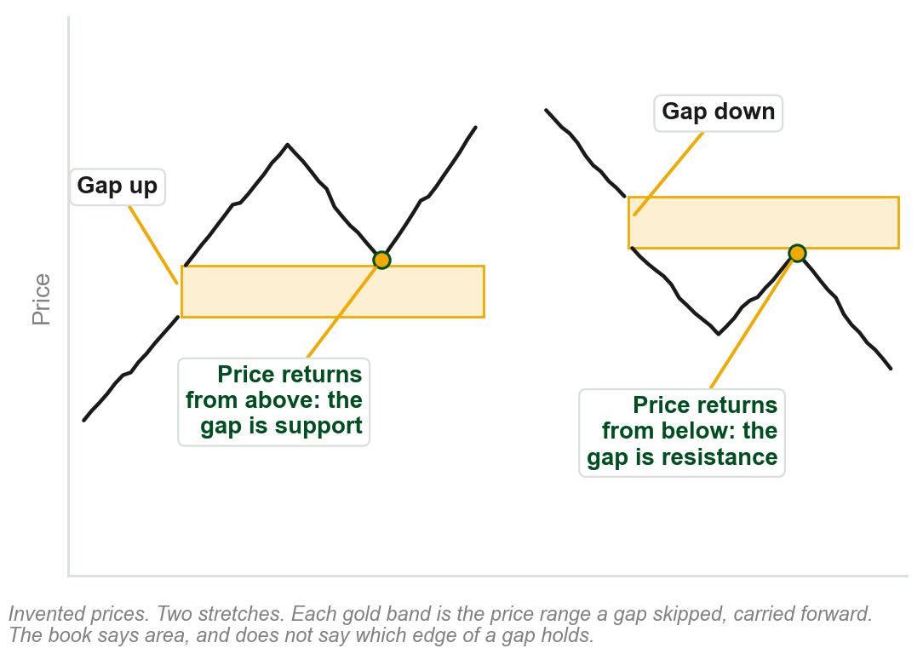
A gap as support, and a gap as resistance
Each gold band is the price range a gap skipped, carried forward in time.
Left: price gaps up and climbs. When it returns from above, the gap area holds it: support.
Right: price gaps down and falls. When it returns from below, the gap area stops it: resistance.
From above, a gap is support. From below, resistance.
The book says area, and does not say which edge of the gap holds.
Chart AS - FIN1209 teaching chart, drawn for this course. Illustrative data, not a real instrument.
Part 8 of 11 - 5.8 Gaps | 4 of 4
Ours: the book's sentence (p.167) on invented prices, because the gaps on its Figure 5.57 are too small to see. It gives no reason why a gap holds.
Notes:
- A gap is a range of prices nobody traded in. The band is that range, carried to the right.
- Left stretch first: the return from above stops at the band. Then the right stretch, its mirror.
- This is role by side, the same as any barrier: support from above, resistance from below.

Slide 144
CHECK 19 OF 21
Retracements and gaps
Q1
Q2
Both Gann and Dow regarded which retracement percentage as the most significant?
A gap created as price leaves a consolidation or chart pattern is a:
A. 33 percent
B. 38.2 percent
C. 50 percent
D. 61.8 percent
A. Breakaway gap
B. Common gap
C. Runaway gap
D. Exhaustion gap
Part 8 of 11 - 5.8 Gaps | Check 19
Notes:
- Read Q1 aloud, then Q2. Give them sixty seconds and no discussion.
- Ask for a show of hands on each option before you advance.
- This is for reading the room, not for marks. Say so if anyone tenses up.

Slide 145
ANSWERS
Retracements and gaps
Q1 Both Gann and Dow regarded which retracement percentage as the most significant?
C. 50 percent
Both regarded 50 percent as the most significant, with most major tops and bottoms forming around that level.
Q2 A gap created as price leaves a consolidation or chart pattern is a:
A. Breakaway gap
Common gaps sit within a range, runaway gaps in a strong trend phase, and exhaustion gaps at the end of a trend.
Part 8 of 11 - 5.8 Gaps | Check 19
Notes:
- Reveal one at a time. Say the reason out loud, not just the letter.
- If more than a third of the room missed one, step back and reteach it.

Slide 146
NEW TERM
5.9 Unidirectional and bidirectional entries
IN PLAIN WORDS
With the trend only, or whichever way price breaks.
FIGURE 5.58
A price rising and falling between two levels, with longs marked only on the way up and shorts only on the way down, labelled micro-unidirectional entries, over the words equivalent to a macro-bidirectional mechanism: a buy-sell straddle, buying above one line and selling below the other.
The artwork is copyrighted and is not in the public repository. Build with assets/figures/ present to place it here.
FOR EXAMPLE
A trader takes only breakouts with the trend: long in an uptrend, short in a downtrend. Trends turn, so over time that is trading both ways, if no called-for trade is skipped.
THE FORMAL DEFINITION
A unidirectional entry is a trade taken only in the direction of the existing trend, up or down. A bidirectional entry is a trade taken in either direction, depending on which way the breakout occurs.
Figure 5.58 - Lim, The Handbook of Technical Analysis (Wiley, 2016)
Part 9 of 11 - 5.9 Directionality | 1 of 1
Book pp.168-169, Fig. 5.58. Top: each swing traded with its short-term (micro) trend. Bottom: the same seen longer-term (macro): buy above, sell below, its straddle.
Notes:
- Micro means very short-term and macro means longer-term. The trader only ever trades one way at any one time.
- The figure's lower half is the bidirectional trader: one buy level above, one sell level below, whichever breaks.

Slide 147
NEW TERM
5.10 Drummond geometry
IN PLAIN WORDS
A way to stay on the right side of the market.
FIGURE 5.59
A weekly EURUSD chart with a short moving average hugging price, labelled PLdot approximated by a 3-period SMA of typical price: price above the SMA is bullish, price below it is bearish, and buy when the SMA turns up and sell when it turns down.
The artwork is copyrighted and is not in the public repository. Build with assets/figures/ present to place it here.
FOR EXAMPLE
Price above the PLdot line: bullish. Below: bearish. Some buy when it turns up, sell when it turns down.
THE FORMAL DEFINITION
Charles Drummond's: a short-term moving average, the PLdot line, and inter-bar trendlines, which connect each bar's highs and connect each bar's lows, that forecast support and resistance. The PLdot is a simple three-period moving average of typical price, and may be forward shifted by one period.
Figure 5.59 - Lim, The Handbook of Technical Analysis (Wiley, 2016)
Part 10 of 11 - 5.10 Drummond | 1 of 2
Book p.169, Fig. 5.59, where the line hugs the bars too closely to see: next slide. Not explained: typical price, why three periods.
Notes:
- For a detailed look the book refers the reader to The Ultimate Trading Guide, by Hill, Pruitt and Hill.
- Typical price is named and not defined in this chapter. The forward shift is there to give an early prognostication of market sentiment.
- The inter-bar trendlines connect the highs and the lows.

Slide 148
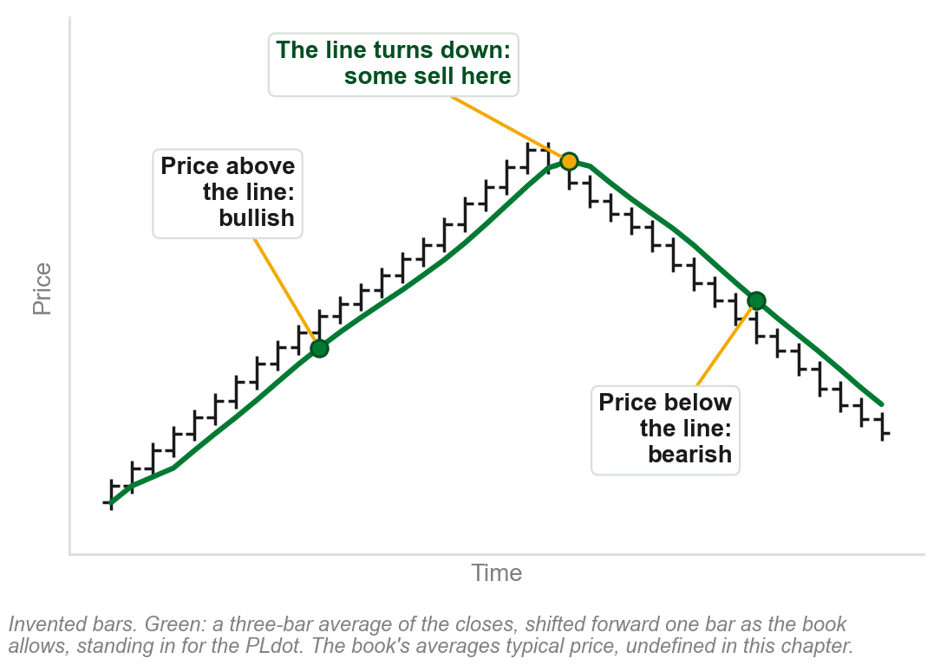
Reading a PLdot line
The green line is a three-bar moving average: at each bar, the average of the last three.
Price above the line: the market is regarded as bullish. Below it: bearish.
Some buy when the line turns up, and sell when it turns down.
It helps keep the trader on the right side of the market.
Ours averages closes, shifted forward one bar. The book's PLdot averages typical price, which this chapter does not define. Moving averages: Chapter 11.
Chart AT - FIN1209 teaching chart, drawn for this course. Illustrative data, not a real instrument.
Part 10 of 11 - 5.10 Drummond | 2 of 2
Ours: the book's three readings of the PLdot (p.169) on invented bars, because the line cannot be seen on its Figure 5.59.
Notes:
- The book's figure draws the same thing on EURUSD, where the line sits on the bars and cannot be picked out.
- Three readings, all on the chart: above the line, below the line, and the turn.
- Our line averages closing prices because typical price is not defined in this chapter. Do not supply a formula for it.

Slide 149
CHECK 20 OF 21
Directionality and Drummond
Q1
Q2
A trade taken in either direction, depending on which way the breakout occurs, is a:
In Drummond geometry, price above the PLdot line means the market is regarded as:
A. Unidirectional entry
B. Barrier entry
C. Retracement entry
D. Bidirectional entry
A. Bearish
B. Bullish
C. Overbought
D. In consolidation
Part 10 of 11 - 5.10 Drummond | Check 20
Notes:
- Read Q1 aloud, then Q2. Give them sixty seconds and no discussion.
- Ask for a show of hands on each option before you advance.
- This is for reading the room, not for marks. Say so if anyone tenses up.

Slide 150
ANSWERS
Directionality and Drummond
Q1 A trade taken in either direction, depending on which way the breakout occurs, is a:
D. Bidirectional entry
A unidirectional entry is taken only in the direction of the existing trend. A bidirectional one goes whichever way the breakout does.
Q2 In Drummond geometry, price above the PLdot line means the market is regarded as:
B. Bullish
When price is above the PLdot the market is regarded as bullish, and when it is below, bearish.
Part 10 of 11 - 5.10 Drummond | Check 20
Notes:
- Reveal one at a time. Say the reason out loud, not just the letter.
- If more than a third of the room missed one, step back and reteach it.

Slide 151
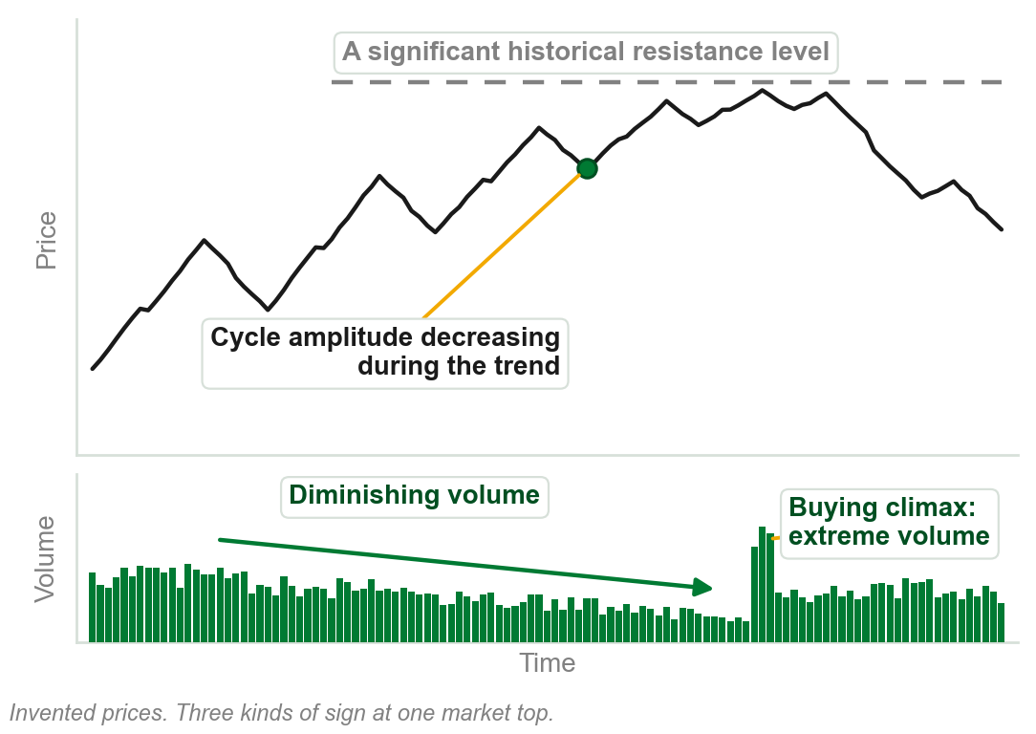
5.11 Signs that a trend may reverse
Volume: diminishing volume in a trend, or extreme volume in a buying or selling climax.
Chart patterns: bearish after a strong, prolonged uptrend, bullish after a downtrend.
Cycles: peaks at tops, troughs at bottoms, or decreasing cycle amplitude or period in a trend.
Tops at significant historical resistance levels, bottoms at significant historical support levels.
Also a chart pattern sign: the appearance of a large broadening, diamond or island formation.
Chart AU - FIN1209 teaching chart, drawn for this course. Illustrative data, not a real instrument.
Part 11 of 11 - 5.11 Reversals | 1 of 2
Book p.170. The chart is ours, on invented prices.
Notes:
- The book calls this section a summary. These four are the ones this chapter and the last have already taught.
- Diminishing volume indicates potential weakness in the trend. Extreme volume is indicative of market tops and bottoms.

Slide 152
Reversal signs from tools taught later
Oscillators, Chapter 8: give overbought and oversold readings at tops and bottoms, by a method this chapter does not give.
Divergence, Chapter 9: bearish divergence with price at tops, bullish at bottoms.
Candlesticks, Chapter 14: bearish formations at tops, bullish at bottoms.
Intermarket, no chapter named: a reversal confirmed by what related or broader markets are doing at the same time, by a method this chapter does not give.
A summary, the book says: it explains none of these tools here. Know the names; the first three come with their own chapters. Signal line, equilibrium line and intermarket relationship: used here by name only, defined in none of this course's chapters, and added to the next slide's used-not-taught list for that reason.
Part 11 of 11 - 5.11 Reversals | 2 of 2
Book p.170. It does not say here what a signal line, an equilibrium line or an intermarket relationship is; this slide names each tool without claiming how it works.
Notes:
- No picture: each of these needs a tool the book has not taught yet. Oscillators are Chapter 8, divergence Chapter 9, candlesticks Chapter 14.
- With the last slide these are the book's seven headings, a to g. Together they answer review question 3.

Slide 153
CHECK 21 OF 21
Forecasting reversals
Q1
Q2
Which volume behavior tends to accompany a potential market reversal?
Potential market tops tend to form at:
A. Steady, average volume throughout
B. Volume rising in step with the trend
C. Diminishing volume, or extreme volume
D. None: volume has no bearing on reversals
A. Significant historical resistance levels
B. Significant historical support levels
C. Cycle troughs
D. Oversold oscillator signals
Part 11 of 11 - 5.11 Reversals | Check 21
Notes:
- Read Q1 aloud, then Q2. Give them sixty seconds and no discussion.
- Ask for a show of hands on each option before you advance.
- This is for reading the room, not for marks. Say so if anyone tenses up.

Slide 154
ANSWERS
Forecasting reversals
Q1 Which volume behavior tends to accompany a potential market reversal?
C. Diminishing volume, or extreme volume
Diminishing volume indicates potential weakness in the trend, and buying or selling climaxes are indicative of market tops and bottoms.
Q2 Potential market tops tend to form at:
A. Significant historical resistance levels
Tops tend to form at significant historical resistance levels, and bottoms at significant historical support levels.
Part 11 of 11 - 5.11 Reversals | Check 21
Notes:
- Reveal one at a time. Say the reason out loud, not just the letter.
- If more than a third of the room missed one, step back and reteach it.

Slide 155
Chapter 5 in five sentences
Dow defines a trend by its peaks and troughs, and every definition has limits.
Sixteen price characteristics show a trend's quality: watch each for a change.
Filters, orders, stops and tradesize settle how a trend is entered and exited.
Trendlines, channels and fan lines are barriers: support, resistance, targets.
Retracement levels, gaps and the signs in 5.11 help locate a reversal.
The book's own summary: pay particular attention to the 16 characteristics.
Chapter 5 - Wrap up
Book p.171: its summary is three sentences. These five are ours, of the whole chapter.
Notes:
- Read all five slowly. This is the summary to copy down.
- The book's summary is three sentences long. Its one piece of advice is the gold line.

Slide 156
The review questions to prepare
What is a trend? Explain the disadvantages of defining market and price action.
What are the early indications of a potential reversal?
Briefly describe the ways in which price action may be understood.
How can channel analysis help pinpoint potential reversals and continuations?
What are the factors that impact trendline reliability?
The advantages of proportional sizing? Of price-based over time and algorithmic filters?
The book's eight questions, on six lines. Its question 4, line three here, says 12 ways; 5.2 lists 16.
Chapter 5 - Wrap up
Book p.171.
Notes:
- Lines one and six each carry two of the book's eight questions.
- Say where each answer sits: 5.1, 5.11, 5.2, 5.6, 5.6, then 5.5 and 5.3.

Slide 157
What the book uses, and where it says two things
Never defined here: breakout, wave cycle, wave degree, stopsize.
Used, not taught: typical price, overbought, oversold, signal line, equilibrium line, intermarket relationship, MACD.
Sent ahead, by chapter: oscillators 8, divergence 9, Fibonacci 10, moving averages 11, candlesticks 14, Elliott 18, Gann 19.
Two answers: 16 characteristics, taught, or 12; 5 ways to enter, listed, or 4; Gold's rate, $3.30 or $3.80.
Where the book disagrees with itself, the slide says so.
Chapter 5 - Wrap up
This course's own list of the main ones, drawn from the chapter's slides. The numbers after Sent ahead are the book's chapters.
Notes:
- Be straight with them: this chapter leans on oscillators and candlesticks the book has not taught yet.
- Next is Chapter 6, Volume and Open Interest.

