Slide 1
FIN1209 Technical Analysis in Investment
Chapter 8
Window Oscillators and Overlay Indicators
Institute of Accounts, Business and Finance | Far Eastern University Manila
Benjamin C. Sotelo
Notes:
- Chapter 8 is where the oscillators used since Chapter 4 are finally taught.
- The first class reads them and classifies indicators; the second class builds them one by one.

Slide 2
What this chapter lets you do
Lim's four objectives for Chapter 8 (p. 235): understand why oscillators and indicators matter and how to use them to forecast reversals and breakouts in the market; describe the difference between overlay indicators and window oscillators; identify the types of overlay indicator and understand how chart scaling affects each; and set up multiple timeframe charts to better observe price and indicator action.
Chapter 8 - Opening
Lim (2016), p. 235.
Notes:
- Four objectives, in Lim's words.
- Say them plainly; each one is a part of today or of the second class.

Slide 3
The route through Chapter 8
The chapter has two halves for two class meetings. The first class is sections 8.1 and 8.2: what indicators are, the kinds of overlay and oscillator, and eight ways to read an oscillator. The second class is sections 8.3 to 8.8: tuning an oscillator, other timeframes, input data, trading with the trend, the main oscillators one by one, and pivot points.
Chapter 8 - Opening
Lim (2016), pp. 235 to 266.
Notes:
- The first class is today; the second class is the next meeting.
- Say which half each section belongs to.

Slide 4
Part 1 of 8
Defining Indicators and Oscillators
indicator
overlay
window oscillator
bounded
scale invariant
about 70 minutes
Notes:
- Say we are starting Part 1 of 8.
- Read the five terms, then move. Do not linger here.

Slide 5
Indicators show strength and weakness that price alone hides
Up to now we have mostly read price itself: bars, patterns and trends. The book has also kept using indicators such as the MACD, the RSI and the stochastic without explaining them, and Chapter 6 told you Chapter 8 is where oscillators get taught. This is that chapter.
Why bother? Lim says oscillators and indicators can reveal underlying strengths and weaknesses of price action that would not have been obvious otherwise, which helps us forecast potential reversals and breakouts (p. 235).
Indicators can show you strength or weakness you would not have spotted from price alone.
Part 1 of 8 - 8.1 Indicators | 1 of 53
Lim (2016), p. 235; Chapter 6. The chart on the next slide is ours.
Notes:
- Open by saying what the chapter is: the place where the oscillators used since Chapter 4 finally get taught.
- Then show one picture of the claim: price alone looks strong, the indicator under it does not.

Slide 6
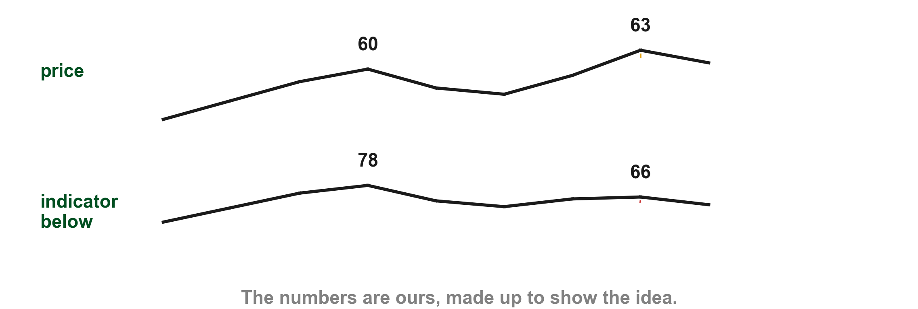
Here is what an indicator can show that price alone does not
Here is one example of ours of what that can look like: price makes a higher peak (1) while the indicator under it makes a lower one (2). Price alone shows only strength. Lim calls this divergence, and we meet it later in this chapter (pp. 240, 244).
1
2
Chart H - FIN1209 teaching chart, drawn for this course. Illustrative data, not a real instrument.
Part 1 of 8 - 8.1 Indicators | 2 of 53
FIN1209 teaching chart H. The numbers are invented for teaching.
Notes:
- Gold 1 the second price peak, higher than the first, 63 against 60. Red 2 the second indicator peak, lower, 66 against 78.
- This is our example of what Lim means; the next slides say what the indicator is.

Slide 7
Indicators come in two kinds: overlays and window oscillators
Lim sorts indicators, the word for the whole family here, into two categories (p. 235). An overlay indicator is plotted on the same chart as price, or on an oscillator, where it acts as a barrier, that is, support and resistance (p. 235).
A window oscillator is a mathematically derived indicator, normally based on open, high, low and close, volume and open interest (p. 236). On Lim's charts it sits in its own window under price (p. 238).
An overlay goes on top of price or an oscillator. A window oscillator gets a window of its own.
Part 1 of 8 - 8.1 Indicators | 3 of 53
Lim (2016), pp. 235, 236 and 238.
Notes:
- Two names to learn: overlay indicator and window oscillator. The next slide shows both on one chart.

Slide 8
Figure 8.1 puts both kinds of indicator on one chart
The top part is price, with overlay indicators drawn on it (1). Under it sit three window oscillators: the relative strength index or RSI (2), the stochastics (3) and the moving average convergence divergence or MACD (4).
Inside the MACD window (4), see Lim's label "Overlays on oscillators": he draws overlays there as well.
1
FIGURE 8.1
Figure 8.1: a price chart with overlays on it, and under it the RSI and the stochastics, both bounded 0 to 100 percent, and the MACD, which is unbounded.
2
3
Price and its overlays on top. Oscillators in their own windows below.
4
Figure 8.1 - Lim, The Handbook of Technical Analysis (Wiley, 2016)
Part 1 of 8 - 8.1 Indicators | 4 of 53
Lim (2016), p. 238, Figure 8.1. The marks are ours, added for teaching.
Notes:
- Walk the four boxes top to bottom: gold 1 price with overlays, red 2 the RSI, blue 3 the stochastics, purple 4 the MACD.
- Point out the label at the bottom of the MACD window: Lim draws overlays on oscillators too.

Slide 9
The oscillators you will meet before we build them (1 of 3)
Bounded, 0 to 100 percent: the relative strength index or RSI (1) tracks a stock's strength through its average gain and loss over the last n periods, n being the lookback (p. 262). The stochastic (2) is the position of the latest close in the recent price range (p. 259). The StochRSI (3) is the stochastic calculation applied to RSI values (p. 251). Lim's chart prints the StochRSI (3) from 0 to 1 instead of 0 to 100: 0.8 there is 80 percent. That reading is ours.
FIGURE 8.17
Figure 8.17, cropped to its three oscillator windows. From the top: the StochRSI, the slow stochastic and the RSI, each under the Dow Jones price chart.
3
2
1
Figure 8.17 - Lim, The Handbook of Technical Analysis (Wiley, 2016)
Part 1 of 8 - 8.1 Indicators | 5 of 53
Lim (2016), pp. 251, 254, 259 and 262, Figure 8.17. The marks are ours, added for teaching.
Notes:
- The bounded oscillators, read on Lim's own chart. The second class builds each one.

Slide 10
Overbought, oversold and equilibrium on one oscillator
Overbought and oversold are the high and low ends of an oscillator's readings (pp. 236, 241). Lim calls them overextensions. That is not Chapter 7's overextended bar: here the word describes an oscillator's reading. Equilibrium is the central value it swings around (p. 244).
Part 1 of 8 - 8.1 Indicators | 6 of 53
Lim (2016), pp. 236, 241 and 244. The chart on the next slide is ours.
Notes:
- Overbought, oversold and equilibrium, drawn on one oscillator of ours.

Slide 11
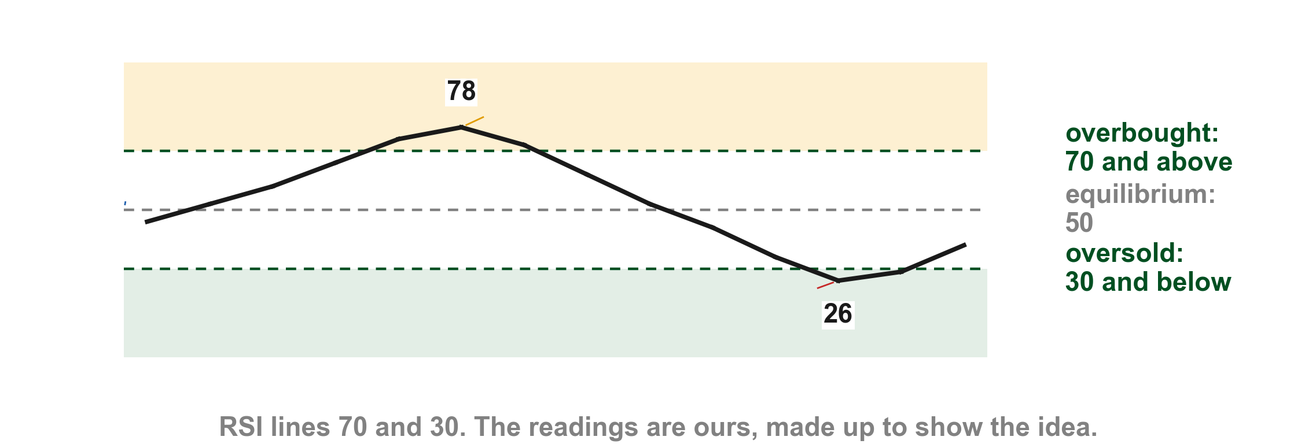
Here they are on one oscillator of ours
Lim says overbought is usually at or above 70 or 80 percent and oversold at or below 20 or 30, depending on the oscillator (p. 241). Our chart uses the RSI's 70 and 30. On our oscillator the reading of 78 is overbought (1), the 26 is oversold (2), and 50 is the equilibrium (3).
1
3
2
Chart G - FIN1209 teaching chart, drawn for this course. Illustrative data, not a real instrument.
Part 1 of 8 - 8.1 Indicators | 7 of 53
FIN1209 teaching chart G. The numbers are invented for teaching.
Notes:
- Gold 1 the overbought reading of 78, red 2 the oversold reading of 26, blue 3 the equilibrium line at 50.
- The 70 and 30 lines are the RSI defaults Lim gives on p. 241; the readings are ours.

Slide 12
The oscillators you will meet before we build them (2 of 3)
Unbounded, no top or bottom: the moving average convergence divergence or MACD (1) is the 12-period exponential moving average (EMA) minus the 26-period EMA (p. 257). The rate of change or ROC (2) is the percent change in price over n periods, and momentum or MOM is the price difference over n periods (p. 256).
Lim's chart draws the MACD and the ROC; the MOM is drawn later. The top window is the RSI; the lines and arrows Lim draws on it belong to a later topic.
FIGURE 8.8
Figure 8.8, cropped to its three oscillator windows. From the top: the RSI, the MACD and the ROC, each under the Apple price chart.
1
2
Figure 8.8 - Lim, The Handbook of Technical Analysis (Wiley, 2016)
Part 1 of 8 - 8.1 Indicators | 8 of 53
Lim (2016), pp. 245, 256 and 257, Figure 8.8. The marks are ours, added for teaching.
Notes:
- The unbounded ones. The second class builds the MACD, ROC and MOM; the CCI is on the next slide.

Slide 13
The oscillators you will meet before we build them (3 of 3)
The CCI, the commodity channel index (1), gets an overbought level of plus 100 and an oversold level of minus 100 (pp. 242, 244). This chapter gives no calculation for it. On Lim's chart the plus 100 level is the solid line (2) and the minus 100 level the solid line (3). The zero line crossovers marked there come later.
The first class only reads these oscillators on Lim's charts; the second class builds them. Where you meet one before the second class builds it, the slide says what you need and no more.
FIGURE 8.7
Figure 8.7, cropped to its lower half: the RSI window and, under it, the CCI window with its plus 100 and minus 100 lines and its zero line.
1
2
3
Figure 8.7 - Lim, The Handbook of Technical Analysis (Wiley, 2016)
Part 1 of 8 - 8.1 Indicators | 9 of 53
Lim (2016), pp. 242 and 244, Figure 8.7. The marks are ours, added for teaching.
Notes:
- The CCI has no calculation in this chapter. Its zero line is drawn on Lim's chart.

Slide 14
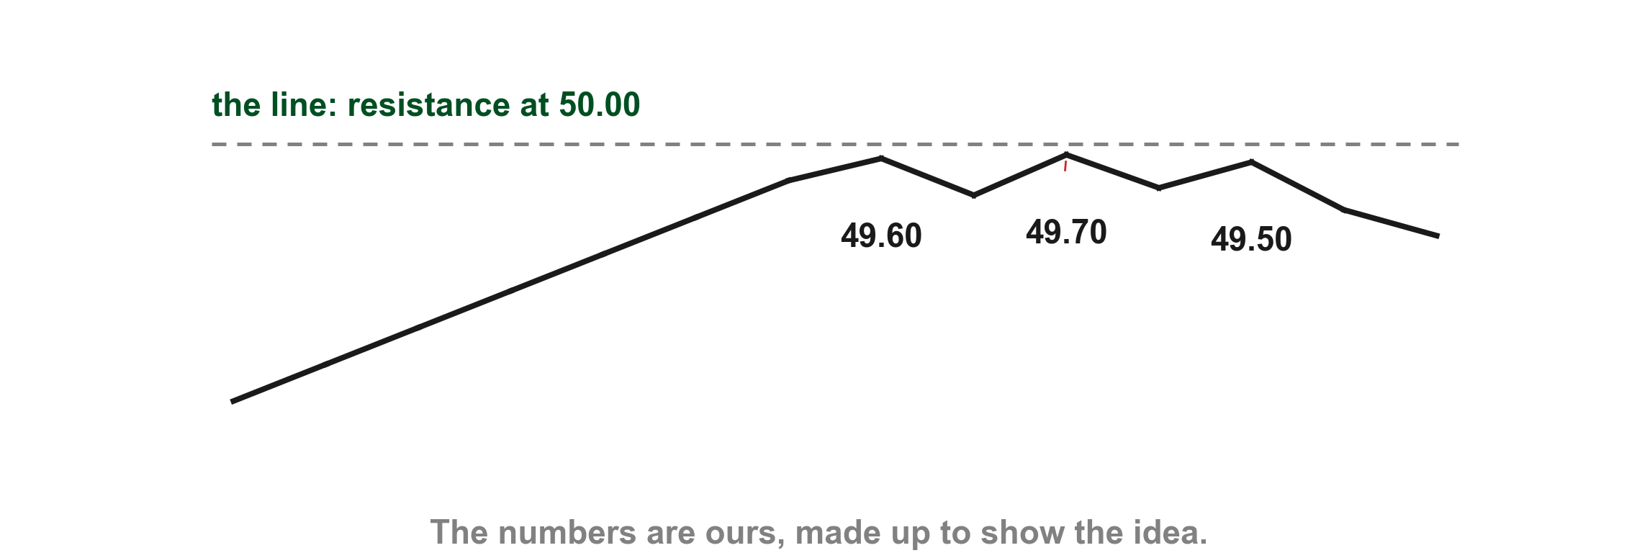
An overlay is a barrier the price runs into
Lim says an overlay indicator acts as a barrier to price, that is, as support or resistance (p. 235). Chapter 2 gave us the idea: until a level is breached, nothing has happened. On our chart price climbs to a line at 50.00 (1) and stalls under it (2).
1
2
Chart I - FIN1209 teaching chart, drawn for this course. Illustrative data, not a real instrument.
Part 1 of 8 - 8.1 Indicators | 10 of 53
FIN1209 teaching chart I. The numbers are invented for teaching.
Notes:
- Gold 1 the resistance line at 50.00. Red 2 one of the stalls, 49.70.

Slide 15
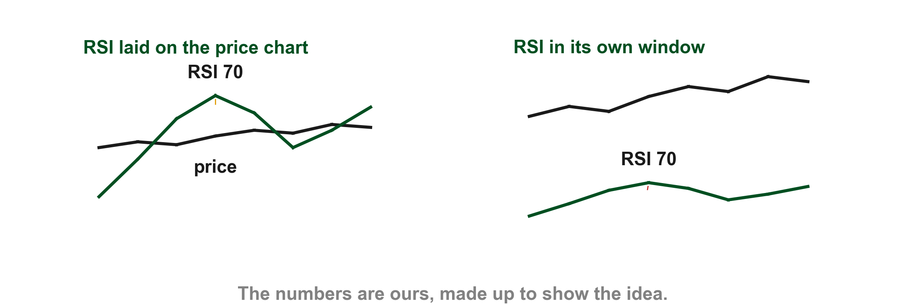
An oscillator drawn on top of price tells us nothing
Lim warns that a window oscillator laid on the price chart is not a meaningful overlay. A MACD or RSI drawn on the price chart itself "will not interact with price in any meaningful way" (p. 236); the book gives no further reason. On our chart the RSI is drawn over price on the left (1) and sits in its own window on the right (2).
1
2
Chart J - FIN1209 teaching chart, drawn for this course. Illustrative data, not a real instrument.
Part 1 of 8 - 8.1 Indicators | 11 of 53
FIN1209 teaching chart J. The numbers are invented for teaching.
Notes:
- Gold 1 the RSI laid over the price; red 2 the same RSI in its own window.

Slide 16
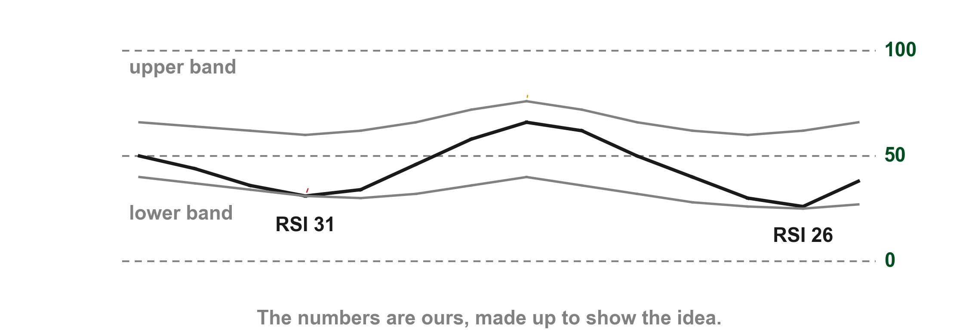
An overlay drawn on an oscillator does work
The reverse is fine: an overlay drawn on a window oscillator is a valid barrier for the oscillator. Lim's example is a Bollinger band on an RSI, which marks overbought and oversold levels in the RSI (p. 236); this chapter does not say how the band is built. On our chart a band surrounds an RSI (1) and the RSI finds support at its lower edge (2).
1
2
Chart K - FIN1209 teaching chart, drawn for this course. Illustrative data, not a real instrument.
Part 1 of 8 - 8.1 Indicators | 12 of 53
FIN1209 teaching chart K. The numbers are invented for teaching.
Notes:
- Gold 1 the band; red 2 a touch of its lower edge.

Slide 17
Four kinds of overlay, side by side
The oscillators we just met have a window of their own. Overlays do not, and Lim sorts them into four kinds by how they forecast a barrier (p. 236): numerically based, horizontally based, geometrically based and algorithmically based.
Each kind gets a slide and a chart of its own next. Lim's flow chart draws all four together a little later.
Four kinds: a formula, a level, a line, a rule about bars.
Part 1 of 8 - 8.1 Indicators | 13 of 53
Lim (2016), p. 236. The chart on the next slide is ours.
Notes:
- Name the four kinds together, then one slide each.

Slide 18
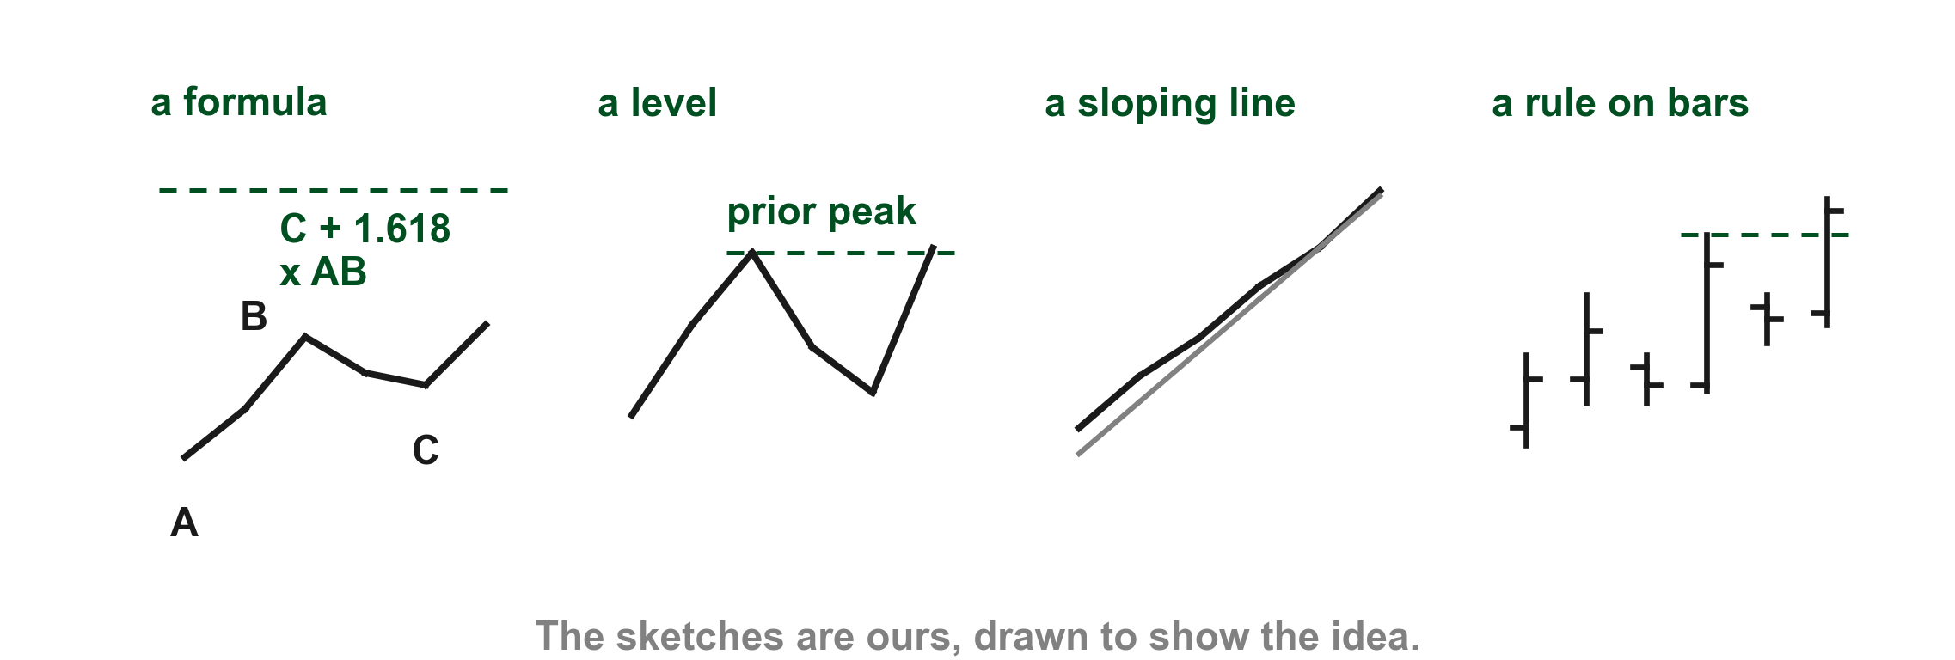
Here are the four kinds in one small sketch each
In our sketch the numerically based overlay is a target from a formula, with the points A, B and C (1), the horizontally based one a level from the past, a prior peak (2), the geometrically based one a sloping line (3) and the algorithmically based one a high over a few bars (4).
1
2
3
4
Chart AB - FIN1209 teaching chart, drawn for this course. Illustrative data, not a real instrument.
Part 1 of 8 - 8.1 Indicators | 14 of 53
FIN1209 teaching chart AB. The numbers are invented for teaching.
Notes:
- Gold 1 the formula target, red 2 the flat level, blue 3 the sloping line, purple 4 the high of a few bars.

Slide 19
Numerically based overlays are worked out from a formula
A numerically based overlay forecasts a future price barrier mathematically, from a formula (p. 236).
If you can calculate the level, it is numerically based.
Part 1 of 8 - 8.1 Indicators | 15 of 53
Lim (2016), p. 236. The chart is on the next slide and is ours.
Notes:
- Numerically based: a formula.

Slide 20
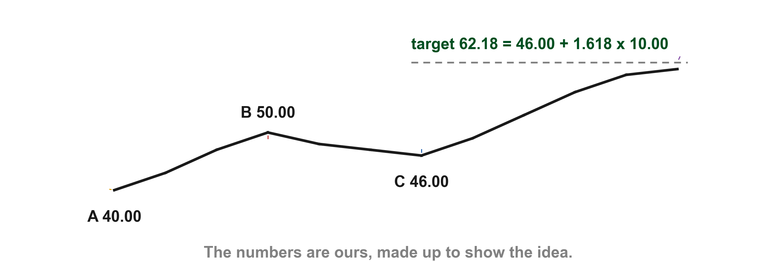
A Fibonacci target is the one formula Lim gives
Lim's example is a Fibonacci upside target from a 161.8 percent expansion of the range AB, measured from C: target = C + (1.618 x AB) (p. 236). He gives only the letters and does not say which points A, B and C are; we take A as the low, B as the high and C as the pullback low. On our chart A is 40.00 (1), B is 50.00 (2), so AB is 10.00, and C is 46.00 (3).
2
3
1
Chart L - FIN1209 teaching chart, drawn for this course. Illustrative data, not a real instrument.
Part 1 of 8 - 8.1 Indicators | 16 of 53
FIN1209 teaching chart L. The numbers are invented for teaching.
Notes:
- A 40.00 gold, B 50.00 red, C 46.00 blue, the target 62.18 purple.

Slide 21
A Fibonacci target is the one formula Lim gives
The target is 46.00 + 16.18 = 62.18 (4). Lim adds that a Fibonacci level, once worked out, may also be classed as horizontally based, which is how Chapter 3 listed it; a moving average may not (p. 236). Here we keep it numerically based, because it comes from a formula.
4
Chart L - FIN1209 teaching chart, drawn for this course. Illustrative data, not a real instrument.
Part 1 of 8 - 8.1 Indicators | 17 of 53
FIN1209 teaching chart L. The numbers are invented for teaching.
Notes:
- A 40.00 gold, B 50.00 red, C 46.00 blue, the target 62.18 purple.

Slide 22
Horizontally based overlays are levels from the past
A horizontally based overlay forecasts a barrier from a prior resistance or support level. The forecast does not depend on time, but Lim warns that the level can still be invalidated, especially when it has been breached many times (p. 236).
A level from the past is the same price whatever the day.
Part 1 of 8 - 8.1 Indicators | 18 of 53
Lim (2016), p. 236. The chart on the next slide is ours.
Notes:
- Horizontally based: levels from the past.

Slide 23
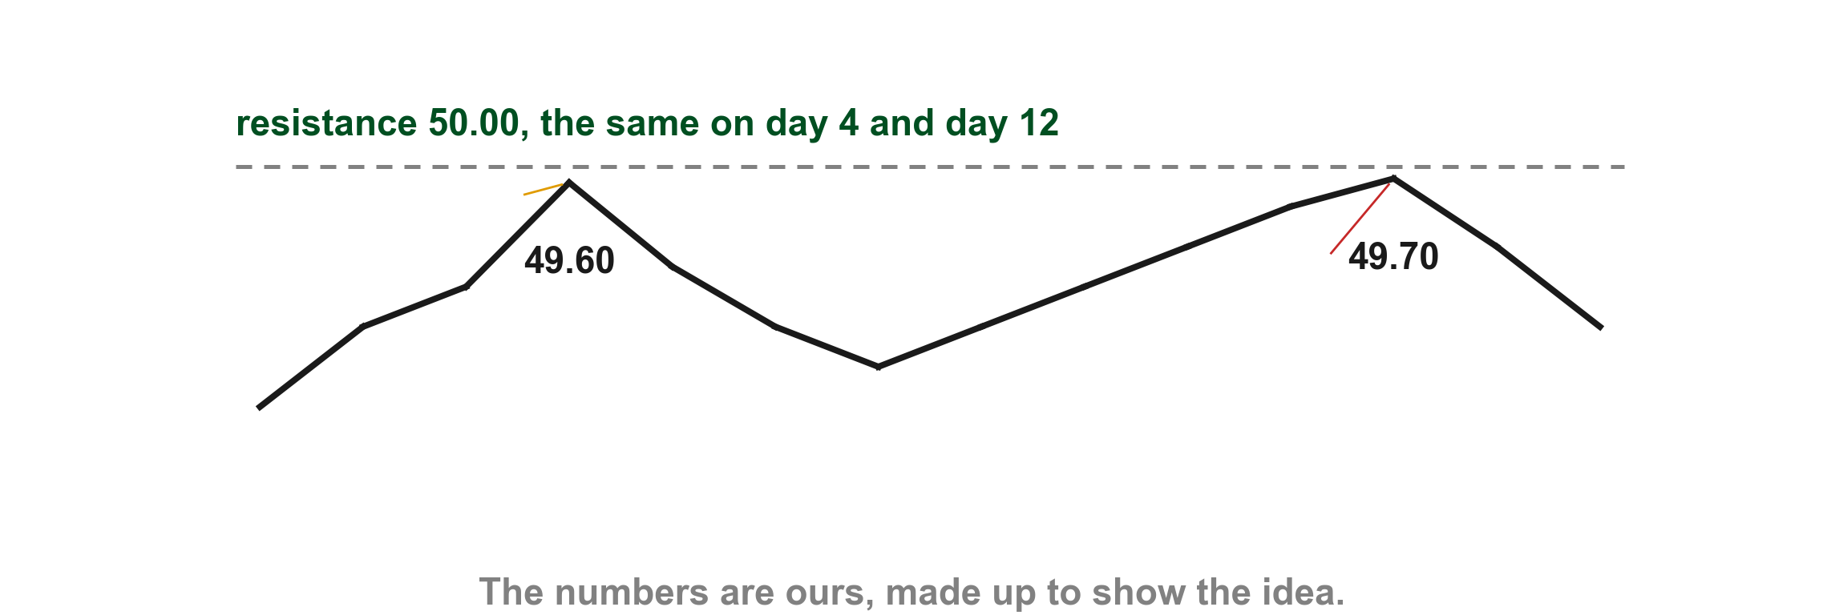
A horizontal level is the same price on any day
Our resistance is 50.00. Price tests it on day 4 (1), reaching 49.60, and again on day 12 (2), reaching 49.70. The level is the same price both times.
1
2
Chart M - FIN1209 teaching chart, drawn for this course. Illustrative data, not a real instrument.
Part 1 of 8 - 8.1 Indicators | 19 of 53
FIN1209 teaching chart M. The numbers are invented for teaching.
Notes:
- Gold 1 the test on day 4, red 2 the test on day 12.

Slide 24
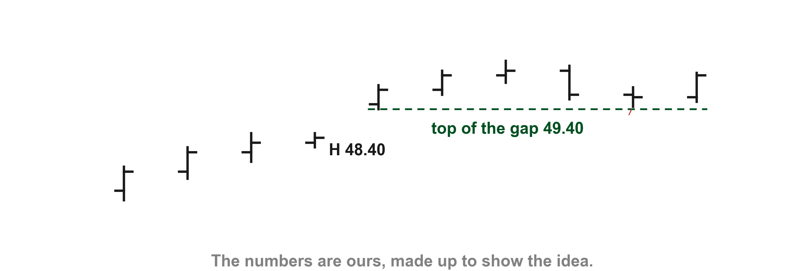
A gap is also a horizontal overlay
Lim also lists price gaps, which he calls rising and falling windows, as horizontal overlays (p. 236). Here window means gap, not the window an oscillator sits in, so we say gap. Chapter 3 taught that this kind of gap is called a window. On our chart there is a gap between a high of 48.40 and a low of 49.40 (1), and later price comes back to its top edge and holds (2).
2
1
Chart N - FIN1209 teaching chart, drawn for this course. Illustrative data, not a real instrument.
Part 1 of 8 - 8.1 Indicators | 20 of 53
FIN1209 teaching chart N. The numbers are invented for teaching.
Notes:
- Gold 1 the gap from 48.40 to 49.40, red 2 the later bar holding at 49.40.

Slide 25
Geometrically based overlays are lines drawn from peaks and troughs
A geometrically based overlay is a diagonal line, such as a trendline, drawn from peaks and troughs (p. 236). Chapter 5 taught the trendline. Because the line slopes, the barrier it forecasts depends on when price tests it.
Part 1 of 8 - 8.1 Indicators | 21 of 53
Lim (2016), p. 236; Chapter 5, trendlines. The chart on the next slide is ours.
Notes:
- Geometrically based: lines drawn from peaks and troughs.

Slide 26
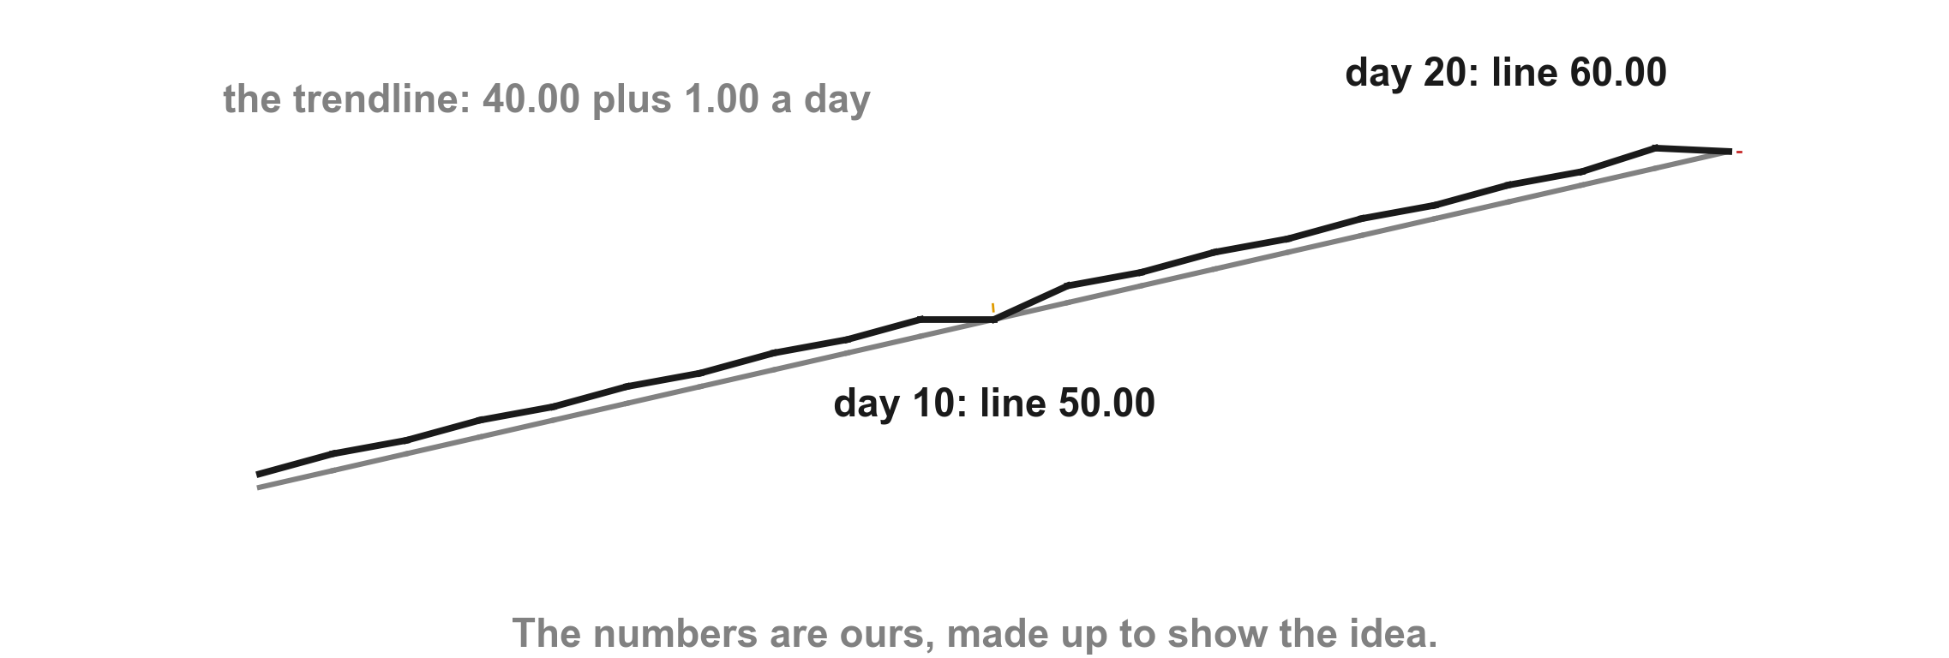
A trendline is a different price on a different day
Our trendline rises 1.00 a day from 40.00. Price tests it on day 10 (1), when the line is at 50.00, and again on day 20 (2), when it is at 60.00.
2
1
Chart O - FIN1209 teaching chart, drawn for this course. Illustrative data, not a real instrument.
Part 1 of 8 - 8.1 Indicators | 22 of 53
FIN1209 teaching chart O. The numbers are invented for teaching.
Notes:
- Gold 1 the test on day 10, red 2 the test on day 20.

Slide 27
Algorithmically based overlays follow a rule about bars
An algorithmically based overlay forecasts a barrier or breakout level from a specific sequence of bar or candlestick action. Lim names two-bar breakouts, Guppy's count back line and DeMark's TD sequential (p. 236); we only name them.
Part 1 of 8 - 8.1 Indicators | 23 of 53
Lim (2016), p. 236. The chart on the next slide is ours.
Notes:
- Algorithmically based: a rule about a sequence of bars.

Slide 28
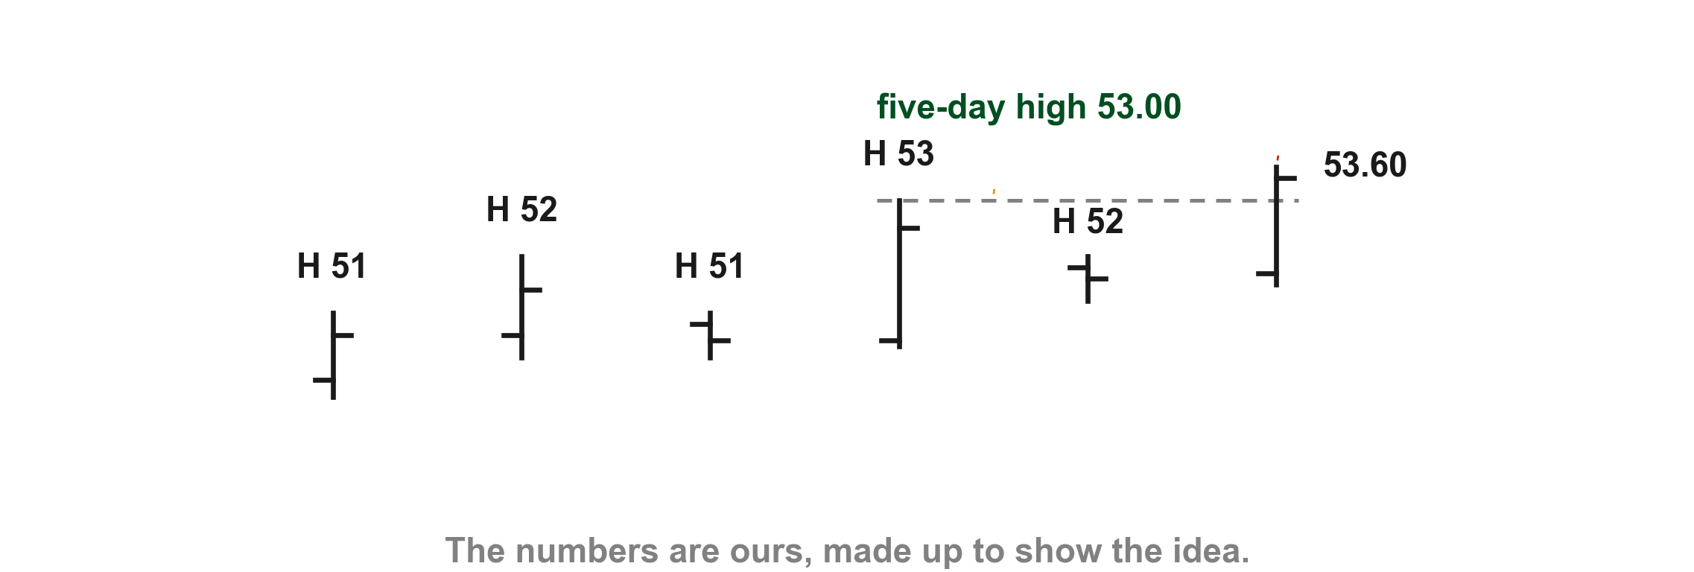
A five-day high is one such rule
Lim's own example is to buy at the breach of a five-day high (p. 237). On our chart the five highs are 51, 52, 51, 53 and 52, so the five-day high is 53.00 (1). A sixth bar then trades through it, up to 53.60 (2).
2
1
Chart P - FIN1209 teaching chart, drawn for this course. Illustrative data, not a real instrument.
Part 1 of 8 - 8.1 Indicators | 24 of 53
FIN1209 teaching chart P. The numbers are invented for teaching.
Notes:
- Gold 1 the five-day high at 53.00, red 2 the breach at 53.60.

Slide 29
CHECK 1 OF 11
The four kinds of overlay
Q1
Q2
Which kind of overlay forecasts a barrier from a formula?
A trendline gives a different price on a different day. Which kind of overlay is it?
A. Horizontally based
B. Numerically based
C. Geometrically based
D. Algorithmically based
A. Numerically based
B. Horizontally based
C. Algorithmically based
D. Geometrically based
Part 1 of 8 - 8.1 Indicators | Check 1
Notes:
- Both answers come from the overlay slides before.

Slide 30
ANSWERS
The four kinds of overlay
Q1 Which kind of overlay forecasts a barrier from a formula?
B. Numerically based
A numerically based overlay forecasts price barriers mathematically; Lim's example is the Fibonacci target, C + (1.618 x AB) (p. 236).
Q2 A trendline gives a different price on a different day. Which kind of overlay is it?
D. Geometrically based
A trendline is a geometrically based overlay: it is a sloping line, so the barrier depends on when price tests it (p. 236).
Part 1 of 8 - 8.1 Indicators | Check 1
Notes:
- Both answers come from the overlay slides before.

Slide 31
Figure 8.2 sorts the window oscillators
Lim's flow chart puts the window oscillators in three boxes: bounded (1), semi bounded (2) and fully unbounded (3), each with his list of examples (p. 238). The text names only two kinds, bounded and unbounded; the semi bounded box holds the unbounded ones that stop at zero (pp. 236 to 237).
FIGURE 8.2
Figure 8.2, left half: Lim's flow chart with the window oscillators in three boxes, bounded, semi bounded and fully unbounded, each with his list of examples. The three header boxes are marked.
1
2
3
We only read the lists for now. The names are Lim's.
Figure 8.2 - Lim, The Handbook of Technical Analysis (Wiley, 2016)
Part 1 of 8 - 8.1 Indicators | 25 of 53
Lim (2016), p. 238, Figure 8.2. The marks are ours, added for teaching.
Notes:
- Gold 1 bounded, red 2 semi bounded, blue 3 fully unbounded. The names in the lists are Lim's.

Slide 32
Figure 8.2 sorts the overlays
The overlays are in four boxes: numerically based (1), geometrically based (2), algorithmically based (3) and horizontally based (4), each with his list (p. 238). Inside each box Lim writes scale invariant or scale sensitive; we meet those words a few slides on. First the oscillator side, in detail.
FIGURE 8.2
Figure 8.2, right half: Lim's flow chart with the overlay indicators in four boxes, numerically, geometrically, algorithmically and horizontally based, with his lists and his scale labels. The four header boxes are marked.
2
1
3
4
Figure 8.2 - Lim, The Handbook of Technical Analysis (Wiley, 2016)
Part 1 of 8 - 8.1 Indicators | 26 of 53
Lim (2016), p. 238, Figure 8.2. The marks are ours, added for teaching.
Notes:
- Numerical, geometric, algorithmic, horizontal. The scale labels come in a few slides.

Slide 33
A bounded oscillator stays between 0 and 100 percent
A bounded oscillator's readings run from 0 to 100 percent; Lim says the oscillator has been normalized (p. 236). The RSI and the stochastic from our list are bounded; the second class builds them.
The advantage is that the same scale lets us compare relative overextension, that is, overbought and oversold, between different stocks or markets over the same number of periods (p. 236).
Same scale, so two stocks can be compared.
Part 1 of 8 - 8.1 Indicators | 27 of 53
Lim (2016), p. 236. The chart on the next slide is ours.
Notes:
- Bounded: 0 to 100 percent.

Slide 34
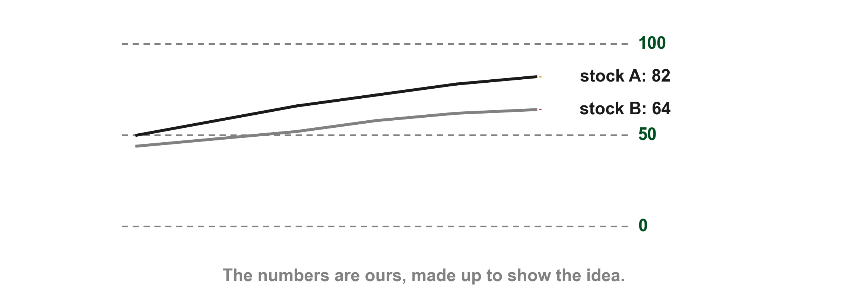
Here are two stocks on the same 0 to 100 scale
On our chart stock A ends at 82 (1) and stock B at 64 (2), on the same scale over the same number of periods, so we can say stock A is the more overextended.
1
2
Chart Q - FIN1209 teaching chart, drawn for this course. Illustrative data, not a real instrument.
Part 1 of 8 - 8.1 Indicators | 28 of 53
FIN1209 teaching chart Q. The numbers are invented for teaching.
Notes:
- Gold 1 stock A at 82, red 2 stock B at 64.

Slide 35
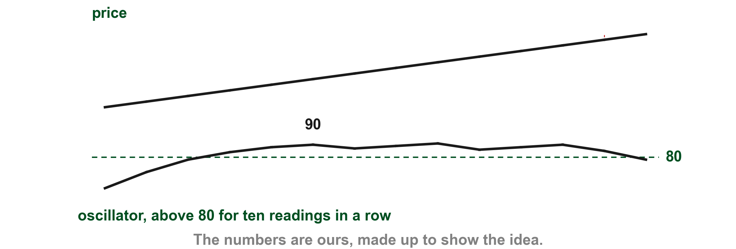
In a strong trend a bounded oscillator stays at the top
The disadvantage is that in a strong trend the readings tend to stay overbought or oversold for long, which tells us little more than that a strong trend is in effect (pp. 236 to 237). On our chart the oscillator sits above 80 for ten readings in a row (1) while price rises steadily (2).
2
1
Chart R - FIN1209 teaching chart, drawn for this course. Illustrative data, not a real instrument.
Part 1 of 8 - 8.1 Indicators | 29 of 53
FIN1209 teaching chart R. The numbers are invented for teaching.
Notes:
- Gold 1 the ten readings above 80, red 2 the steady rise in price.

Slide 36
An unbounded oscillator has no top or bottom
An unbounded oscillator has no upper or lower limit (p. 237). The MACD, the ROC and the CCI from our list are unbounded.
The advantage is that it gives historical levels of overbought and oversold, specific to one stock or market and one timeframe (p. 237).
Part 1 of 8 - 8.1 Indicators | 30 of 53
Lim (2016), p. 237. The chart on the next slide is ours.
Notes:
- Unbounded: no top or bottom.

Slide 37
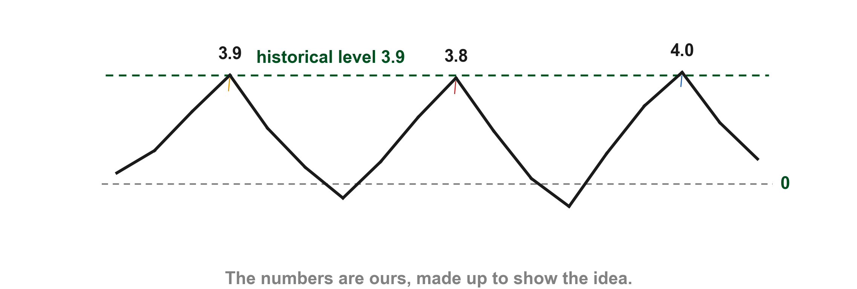
Its overbought level comes from its own history
On our chart the oscillator turned down at 3.9 (1), at 3.8 (2) and at 4.0 (3). Past peaks at about the same height give a historical overbought level, near 3.9. Lim says such levels are specific to a particular stock or market at a selected timeframe (p. 237).
1
2
3
Chart S - FIN1209 teaching chart, drawn for this course. Illustrative data, not a real instrument.
Part 1 of 8 - 8.1 Indicators | 31 of 53
FIN1209 teaching chart S. The numbers are invented for teaching.
Notes:
- Gold 1, red 2 and blue 3 the three peaks near 3.9.

Slide 38
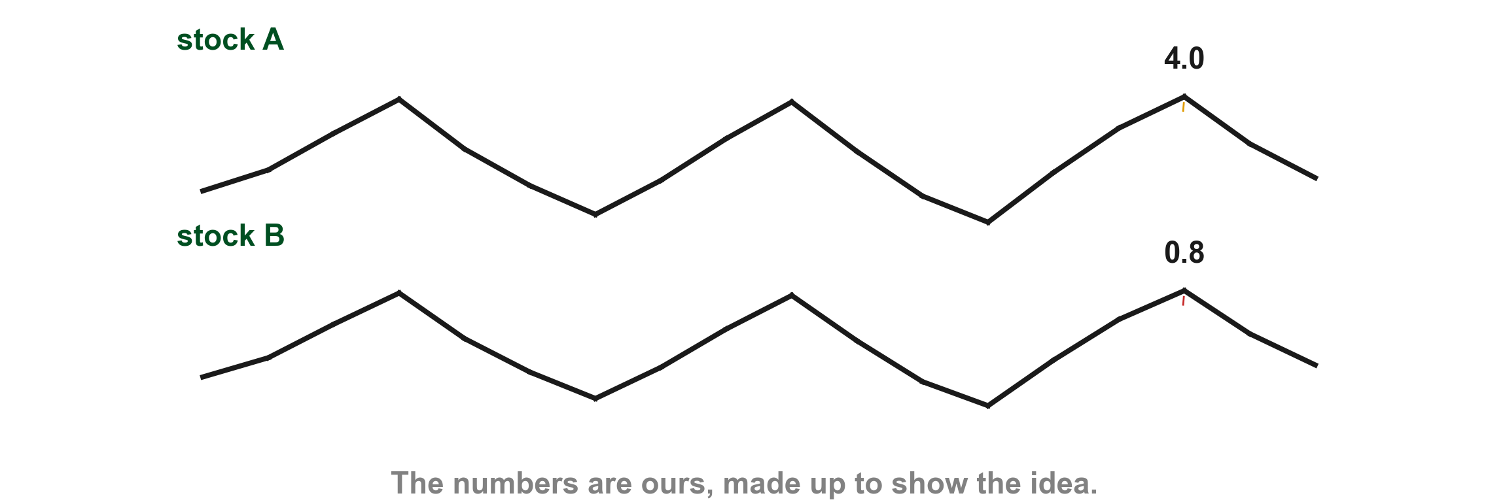
Be careful comparing unbounded oscillators between stocks
Lim adds a care: because the levels are specific to one stock or market, take care when comparing the degree of overextension between different stocks or markets (p. 237). Our stock A peaks at 4.0 (1) and our stock B at 0.8 (2), yet the two lines have the same shape. So stock A at 4.0 is no more overextended than stock B at 0.8.
1
2
Chart T - FIN1209 teaching chart, drawn for this course. Illustrative data, not a real instrument.
Part 1 of 8 - 8.1 Indicators | 32 of 53
FIN1209 teaching chart T. The numbers are invented for teaching.
Notes:
- Gold 1 stock A's peak, 4.0; red 2 stock B's peak, 0.8.

Slide 39
Be careful comparing unbounded oscillators between stocks
Read each stock against its own history, never against another stock's numbers. A bounded oscillator is different: every stock sits on the same 0 to 100 scale, so there the comparison is fair (p. 236).
Chart T - FIN1209 teaching chart, drawn for this course. Illustrative data, not a real instrument.
Part 1 of 8 - 8.1 Indicators | 33 of 53
FIN1209 teaching chart T. The numbers are invented for teaching.
Notes:
- Gold 1 stock A's peak, 4.0; red 2 stock B's peak, 0.8.

Slide 40
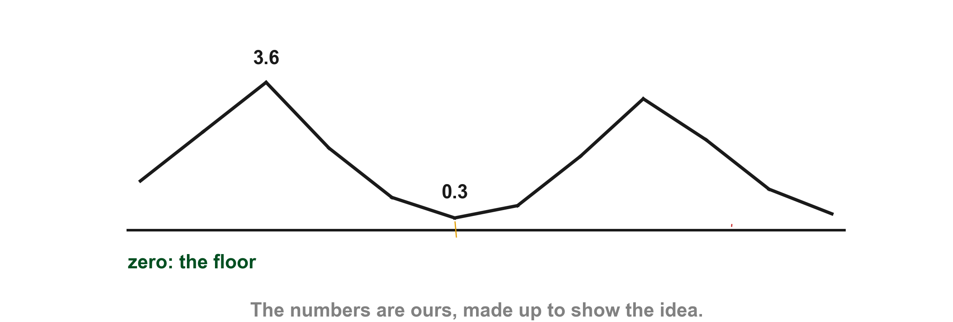
Some unbounded oscillators stop at zero
Some unbounded oscillators do have a lower limit of zero: Lim names volume, the average directional index (ADX), Bollinger Bandwidth and the average true range (ATR) from Chapter 3, and calls them semi bounded (p. 237). Lim spells out the ADX only later in this chapter (p. 255); neither the ADX nor Bollinger Bandwidth is built here, we only name them.
Chart U - FIN1209 teaching chart, drawn for this course. Illustrative data, not a real instrument.
Part 1 of 8 - 8.1 Indicators | 34 of 53
FIN1209 teaching chart U. The numbers are invented for teaching.
Notes:
- Gold 1 a low of 0.3, red 2 the zero floor.

Slide 41
Some unbounded oscillators stop at zero
Our volume-like line dips to 0.3 (1) but cannot go below the zero floor (2).
2
1
Chart U - FIN1209 teaching chart, drawn for this course. Illustrative data, not a real instrument.
Part 1 of 8 - 8.1 Indicators | 35 of 53
FIN1209 teaching chart U. The numbers are invented for teaching.
Notes:
- Gold 1 a low of 0.3, red 2 the zero floor.

Slide 42
Normalization can turn one kind into the other
Lim says an unbounded oscillator "may sometimes" be converted into a bounded one by normalization, which confines its readings between 0 and 100 percent. In the next sentence he says normalization "will always" convert a point-based oscillator such as the MACD, the MOM, the CCI, the ATR or the ADX into a percentage scaled one (p. 237). The book does not say when it fails. Point-based means the readings are not on a 0 to 100 percent scale; Lim does not define it, so that reading is ours. We read the two sentences together: the oscillators he names can always be rescaled, and he does not name any that cannot.
Part 1 of 8 - 8.1 Indicators | 36 of 53
Lim (2016), p. 237. The chart on the next slide is ours.
Notes:
- Quote both of Lim's sentences and say the book does not reconcile them.

Slide 43
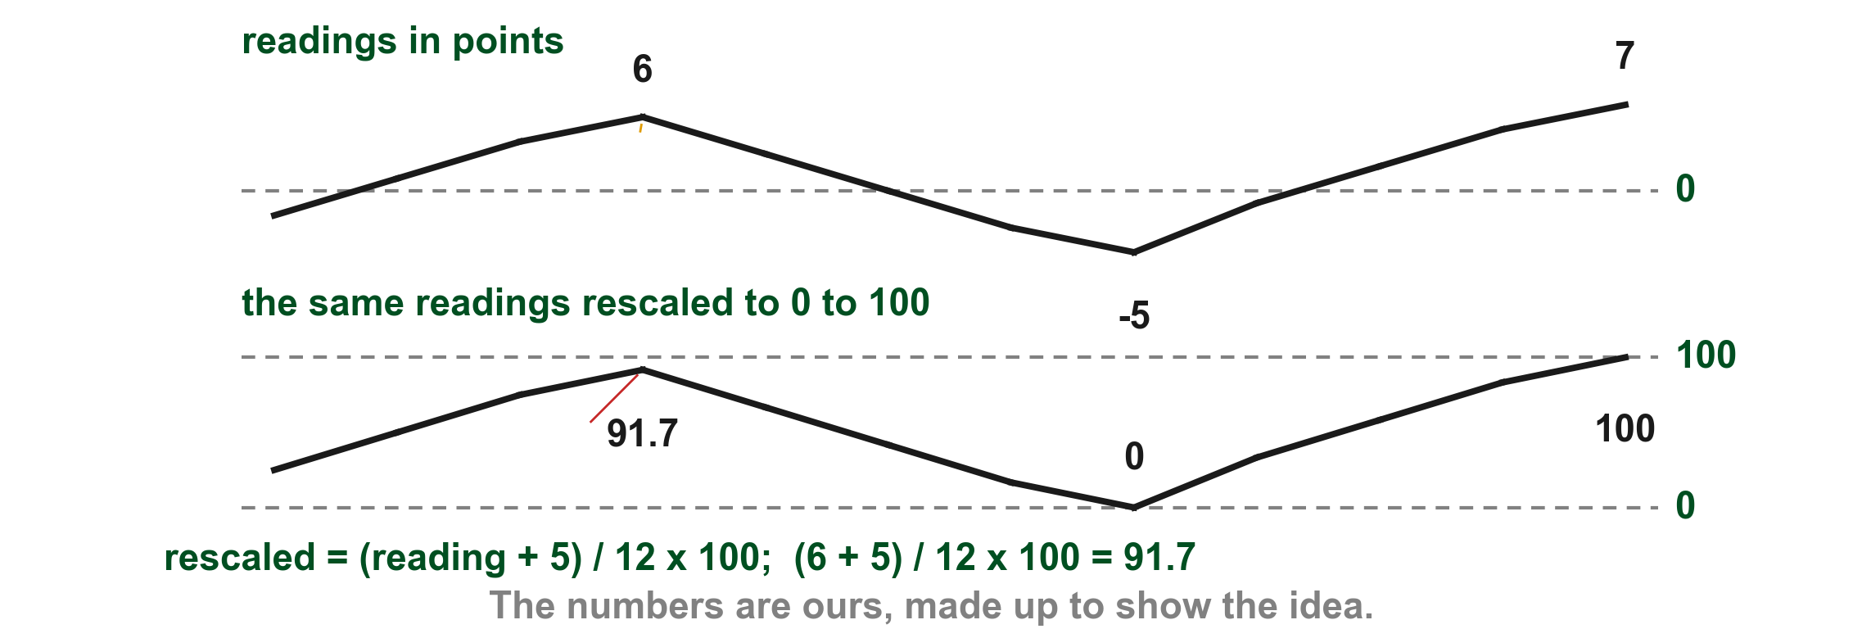
Here is one set of readings rescaled to 0 to 100
Lim gives no method here, so this is our own simple rescaling. The readings run from -5 to 7 points. Our rescaling takes each reading's distance above the lowest and divides by the whole range: (6 - (-5)) / (7 - (-5)) x 100 = 11 / 12 x 100 = 91.7. So the reading of 6 (1) becomes 91.7 (2), the lowest, -5, becomes 0 and the highest, 7, becomes 100.
1
2
Chart V - FIN1209 teaching chart, drawn for this course. Illustrative data, not a real instrument.
Part 1 of 8 - 8.1 Indicators | 37 of 53
FIN1209 teaching chart V. The numbers are invented for teaching.
Notes:
- Gold 1 the reading of 6 points, red 2 the same reading rescaled, 91.7.

Slide 44
Some call unbounded oscillators indicators, not oscillators
Some practitioners call unbounded oscillators window indicators rather than oscillators, because an unbounded one need not revert to its central or equilibrium value; its values can rise or fall indefinitely (p. 237). Lim's examples are the cumulative ones, such as the Net Advance Decline Line and the OBV from Chapter 6, which tend to trend. This is a second use of the word. Earlier, indicator meant the whole family, overlays and oscillators together (p. 235). Here some practitioners use it only for unbounded oscillators that trend (p. 237). In this deck indicator keeps the first meaning.
Part 1 of 8 - 8.1 Indicators | 38 of 53
Lim (2016), p. 237; Chapter 6, OBV. The chart on the next slide is ours.
Notes:
- Some practitioners say window indicator.

Slide 45
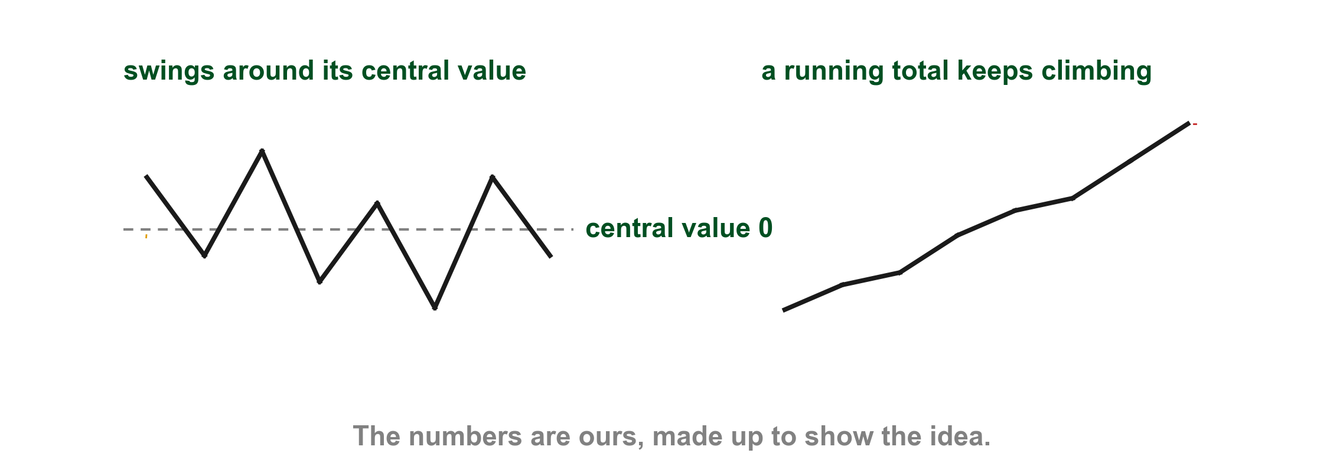
Here is one that oscillates and one that trends
On our chart the line on the left swings around its central value, zero (1), which is what an oscillator does. The running total on the right keeps climbing (2), so many practitioners would call it an indicator instead.
2
1
Chart W - FIN1209 teaching chart, drawn for this course. Illustrative data, not a real instrument.
Part 1 of 8 - 8.1 Indicators | 39 of 53
FIN1209 teaching chart W. The numbers are invented for teaching.
Notes:
- Gold 1 the line swinging around its centre, red 2 the running total.

Slide 46
CHECK 2 OF 11
Bounded and unbounded
Q1
Q2
Why can a bounded oscillator be compared between stocks?
In a strong trend, what does a bounded oscillator tend to do?
A. Its readings run on the same 0 to 100 scale
B. It never becomes overbought
C. It uses only volume
D. Its levels come from each stock's own history
A. Fall to zero
B. Stay overbought or oversold for long
C. Cross its equilibrium every day
D. Become unbounded
Part 1 of 8 - 8.1 Indicators | Check 2
Notes:
- Both answers come from the bounded and unbounded slides.

Slide 47
ANSWERS
Bounded and unbounded
Q1 Why can a bounded oscillator be compared between stocks?
A. Its readings run on the same 0 to 100 scale
The same 0 to 100 scale lets us compare overextension between stocks or markets over the same number of periods (p. 236).
Q2 In a strong trend, what does a bounded oscillator tend to do?
B. Stay overbought or oversold for long
It tends to remain overbought or oversold for extended periods, which says little more than that a strong trend is in effect (pp. 236 to 237).
Part 1 of 8 - 8.1 Indicators | Check 2
Notes:
- Both answers come from the bounded and unbounded slides.

Slide 48
Scaling changes some indicators and not others
Chapter 2 showed an arithmetic (linear) scale and a logarithmic (ratio) scale. Lim says scaling affects only the geometrically based indicators. An indicator that scaling does not change is scale invariant (p. 237), and he counts the numerical, horizontal and algorithmic overlays among them. Scaling does not change window oscillators either, because their values are calculated (p. 237). Chapter 3 named the geometric, numerical and horizontal kinds; the algorithmic kind is new here, and it is scale invariant too. Lim's flow chart of indicators calls the geometric kind scale sensitive.
Part 1 of 8 - 8.1 Indicators | 40 of 53
Lim (2016), pp. 237 to 238; Chapter 2, scaling; Chapter 3, "What scaling changes, and what it does not". The chart on the next slide is ours.
Notes:
- Scale invariant: unchanged by the scale.

Slide 49
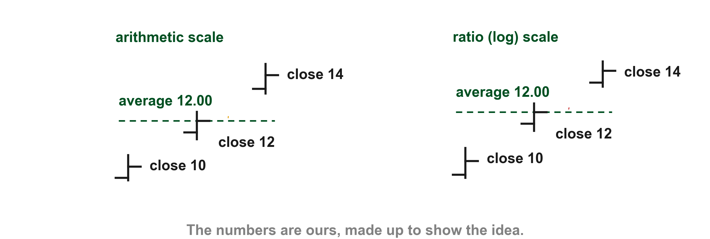
A moving average is the same on either scale
A simple moving average is the average of the closing prices of the last N periods, so the scale cannot change it (p. 237). On our chart three closes of 10, 12 and 14 average 12.00 on the arithmetic scale (1) and on the ratio scale (2).
1
2
Chart X - FIN1209 teaching chart, drawn for this course. Illustrative data, not a real instrument.
Part 1 of 8 - 8.1 Indicators | 41 of 53
FIN1209 teaching chart X. The numbers are invented for teaching.
Notes:
- Gold 1 the average on the arithmetic scale, red 2 the same average on the ratio scale.

Slide 50
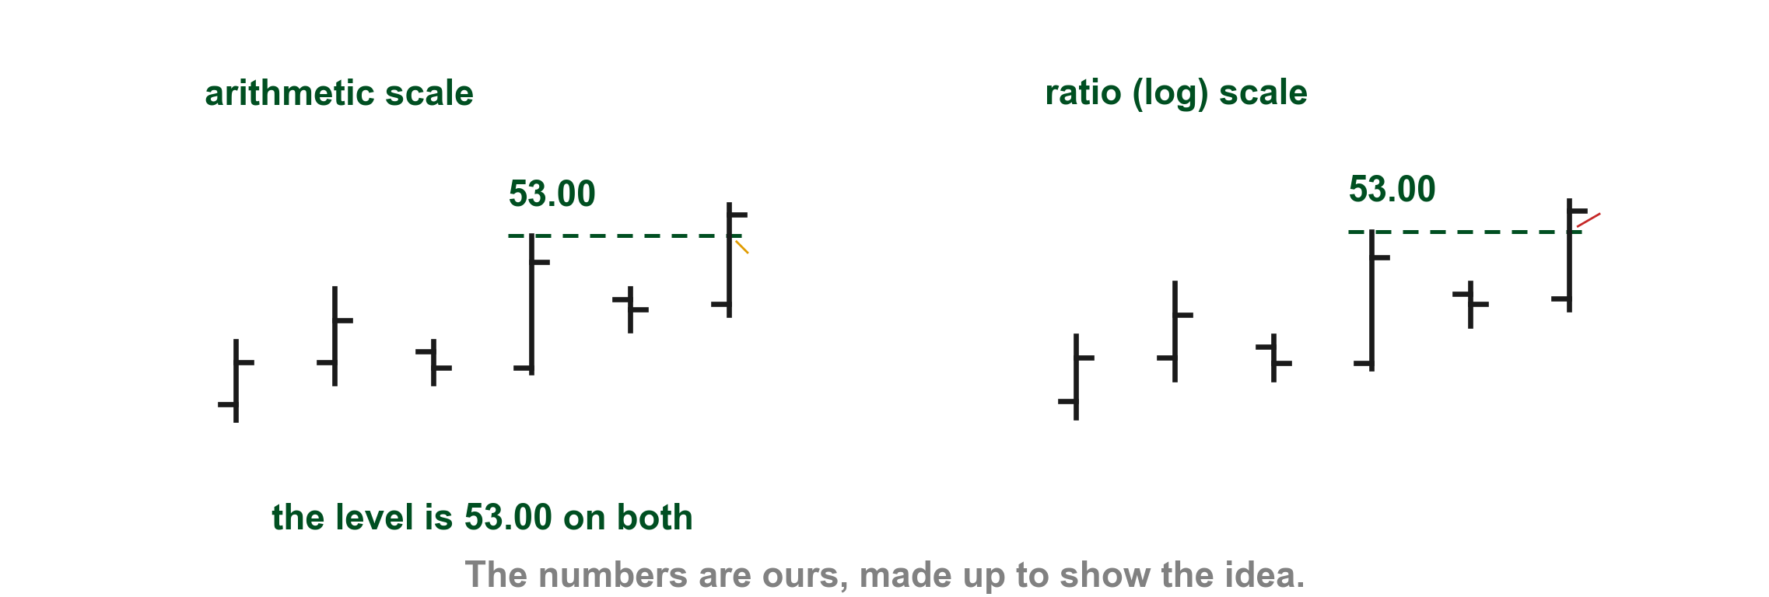
A five-day high does not move either
The algorithmic example is also scale invariant: the high prices keep the same values whatever the scale, so the five-day high is still 53.00 (pp. 237 to 238). The 53.00 line on both scales is a flat price level, and Lim says horizontal overlays such as support and resistance are scale invariant too, because they depend only on the price axis (p. 238).
Chart Y - FIN1209 teaching chart, drawn for this course. Illustrative data, not a real instrument.
Part 1 of 8 - 8.1 Indicators | 42 of 53
FIN1209 teaching chart Y. The numbers are invented for teaching.
Notes:
- Gold 1 the five-day high on the arithmetic scale, red 2 the same high on the ratio scale.

Slide 51
A five-day high does not move either
Our five bars and the sixth that breaks them give 53.00 on the arithmetic scale (1) and on the ratio scale (2).
2
1
Chart Y - FIN1209 teaching chart, drawn for this course. Illustrative data, not a real instrument.
Part 1 of 8 - 8.1 Indicators | 43 of 53
FIN1209 teaching chart Y. The numbers are invented for teaching.
Notes:
- Gold 1 the five-day high on the arithmetic scale, red 2 the same high on the ratio scale.

Slide 52
Trendlines are the ones that change
Trendlines are geometrically based, and Lim calls them the only group that is not scale invariant. On his ratio scaled chart the uptrend line (1) is penetrated early (2); the same line on a linear scale is penetrated later (p. 239).
FIGURE 8.3
Figure 8.3, top chart: the Nasdaq 100 on a ratio scale with an uptrend line, and the price breaking through it early.
2
1
The linear version is on the next slide.
Figure 8.3 - Lim, The Handbook of Technical Analysis (Wiley, 2016)
Part 1 of 8 - 8.1 Indicators | 44 of 53
Lim (2016), p. 239, Figure 8.3. The marks are ours, added for teaching.
Notes:
- Gold 1 the uptrend line, red 2 the early penetration on the ratio scale.

Slide 53
Lim says the same trendline on the linear scale breaks later
Here is the same Nasdaq 100 on a linear scale, its uptrend line (1) and the break Lim labels a late penetration (2). Lim says ratio scaling changes the angle of every trendline and produces earlier penetrations (p. 239). On his two charts the breaks fall close together, near the start of 2001; what the figure shows plainly is the angle: the line (1) is steeper on the ratio chart than here.
FIGURE 8.3
Figure 8.3, bottom chart: the same Nasdaq 100 on a linear scale with its uptrend line, and the price breaking through it later.
2
1
Figure 8.3 - Lim, The Handbook of Technical Analysis (Wiley, 2016)
Part 1 of 8 - 8.1 Indicators | 45 of 53
Lim (2016), p. 239, Figure 8.3. The marks are ours, added for teaching.
Notes:
- Same index, linear scale, later penetration.

Slide 54
Why a trendline depends on time
Lim says the potential support from an uptrend line depends on when price tests it: the more time has elapsed, the higher the support (pp. 238 to 239). On our chart the line is 50.00 when price tests it on day 10 (1) and 60.00 on day 20 (2).
2
1
Chart O - FIN1209 teaching chart, drawn for this course. Illustrative data, not a real instrument.
Part 1 of 8 - 8.1 Indicators | 46 of 53
FIN1209 teaching chart O. The numbers are invented for teaching.
Notes:
- Gold 1 day 10, red 2 day 20.

Slide 55
CHECK 3 OF 11
Scale and trendlines
Q1
FIGURE 8.3
Figure 8.3, top chart: the Nasdaq 100 on a ratio scale with an uptrend line, and the price breaking through it early.
Which kind of overlay is not scale invariant?
2
A. Numerically based
B. Horizontally based
C. Geometrically based
D. Algorithmically based
1
Figure 8.3 - Lim, The Handbook of Technical Analysis (Wiley, 2016)
Q2
Why is a simple moving average scale invariant?
A. It averages N closes, on any scale
B. It is a diagonal line
C. It needs a ratio axis
D. It is a horizontal level
Part 1 of 8 - 8.1 Indicators | Check 3
Notes:
- Both answers come from the scale slides.

Slide 56
ANSWERS
Scale and trendlines
Q1 Which kind of overlay is not scale invariant?
FIGURE 8.3
Figure 8.3, top chart: the Nasdaq 100 on a ratio scale with an uptrend line, and the price breaking through it early.
2
C. Geometrically based
Trendlines and other geometric overlays are the only ones scaling changes (p. 239).
1
Q2 Why is a simple moving average scale invariant?
Figure 8.3 - Lim, The Handbook of Technical Analysis (Wiley, 2016)
A. It averages N closes, on any scale
It is the average of N closes, which scaling does not change (p. 237).
Part 1 of 8 - 8.1 Indicators | Check 3
Notes:
- Both answers come from the scale slides.

Slide 57
Static overlays do not move with time
A static overlay's forecast does not depend on time. Lim says all the horizontally based and algorithmically based overlays are static, and so are many numerically based ones. The forecast level stays where it is unless it is invalidated and a new forecast is needed (p. 239).
Part 1 of 8 - 8.1 Indicators | 47 of 53
Lim (2016), p. 239. The chart on the next slide is ours.
Notes:
- Static overlays do not move with time.

Slide 58
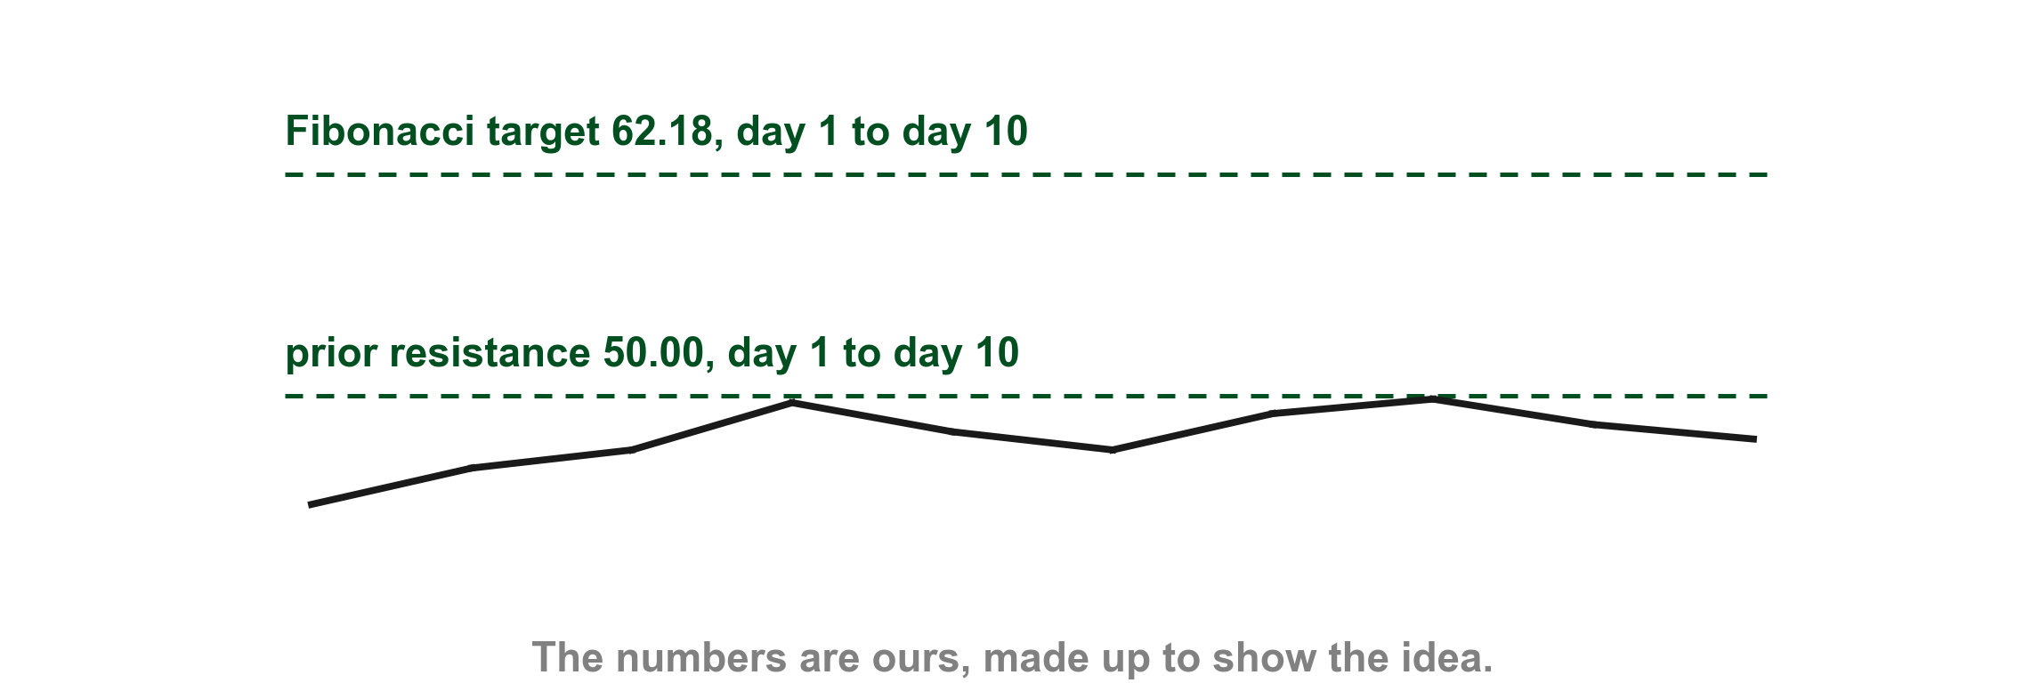
Here are two static levels staying put for ten days
On our chart a prior resistance at 50.00 (1) and a Fibonacci target at 62.18 (2) are the same price on day 1 and on day 10.
2
1
Chart Z - FIN1209 teaching chart, drawn for this course. Illustrative data, not a real instrument.
Part 1 of 8 - 8.1 Indicators | 48 of 53
FIN1209 teaching chart Z. The numbers are invented for teaching.
Notes:
- Gold 1 the prior resistance, red 2 the Fibonacci target.

Slide 59
Lim's list of static overlays
Lim's static overlays are prior support and resistance levels; Fibonacci projection, retracement, extension and expansion levels; Gann Square of Nine and squaring of the high and low projections; Gann's one-third and one-eighth retracements; Floor Trader's Pivot Points; reward-to-risk price targets; Gartley Butterfly projections; Parabolic SAR; Chandelier Exit levels; and horizontal channels (pp. 239 to 240).
We only name these. Pivot points get their own section, 8.7, in the second class.
Part 1 of 8 - 8.1 Indicators | 49 of 53
Lim (2016), pp. 239 to 240.
Notes:
- Lim's list of static overlays; names only.

Slide 60
Dynamic overlays move as time goes by
A dynamic overlay's forecast does depend on time. It includes all the geometrically based overlays and some numerically based ones. The exact level is only known once price tests, or is near, the overlay (p. 240).
Part 1 of 8 - 8.1 Indicators | 50 of 53
Lim (2016), p. 240. The chart on the next slide is ours.
Notes:
- Dynamic overlays move as time goes by.

Slide 61
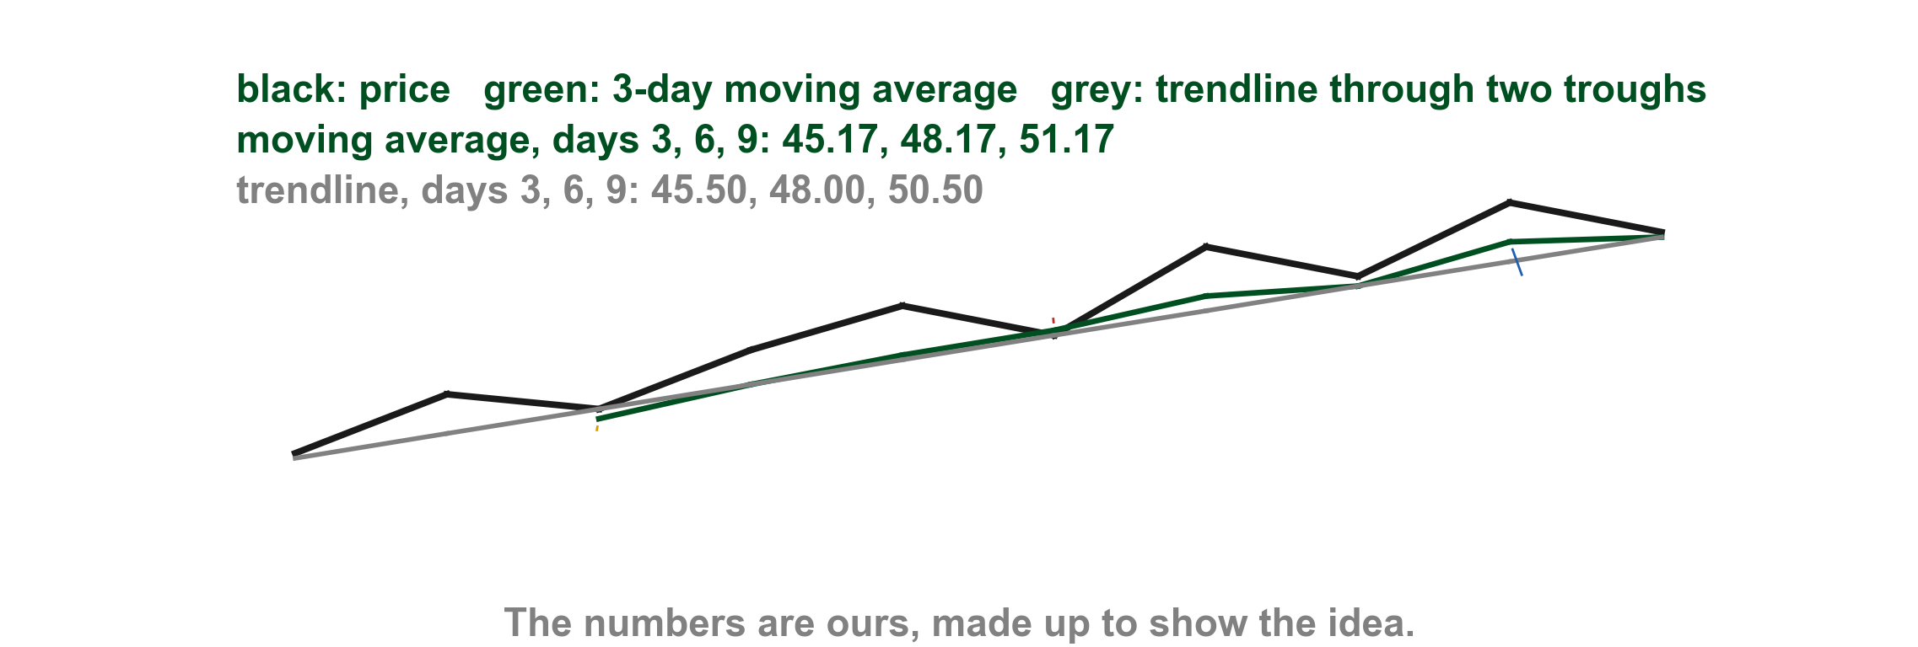
Here are two dynamic levels moving with the days
On our chart a 3-day simple moving average reads 45.17 on day 3 (1), 48.17 on day 6 (2) and 51.17 on day 9 (3). The trendline, drawn through two troughs of the price line, moves too, reading 45.50, 48.00 and 50.50, so each is a different price on a different day.
2
3
1
Chart AA - FIN1209 teaching chart, drawn for this course. Illustrative data, not a real instrument.
Part 1 of 8 - 8.1 Indicators | 51 of 53
FIN1209 teaching chart AA. The numbers are invented for teaching.
Notes:
- Gold 1, red 2 and blue 3 the moving average on days 3, 6 and 9.

Slide 62
Lim's list of dynamic overlays
Lim's dynamic overlays are Bollinger Bands, moving averages, moving average bands, Keltner Bands, STARC Bands, Ichimoku overlays, linear regression bands, Andrew's Pitchfork, trendlines, rising and falling channels, chart patterns and Wolfe Waves (p. 240).
Again we only name them.
Part 1 of 8 - 8.1 Indicators | 52 of 53
Lim (2016), p. 240.
Notes:
- Lim's list of dynamic overlays; names only.

Slide 63
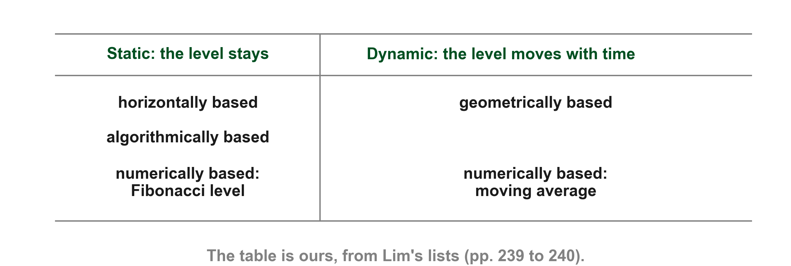
Here are the four kinds sorted into static and dynamic
Horizontally based and algorithmically based overlays are static; geometrically based overlays are dynamic; numerically based overlays can be either (pp. 239 to 240). Lim lists Fibonacci levels among the static overlays and moving averages among the dynamic ones (p. 240), so the numerically based kind sits in both columns.
FIN1209 table, from Lim's lists (pp. 239 to 240).
Part 1 of 8 - 8.1 Indicators | 53 of 53
FIN1209 teaching chart AS. The table is ours, from Lim's lists (pp. 239 to 240).
Notes:
- Static: horizontal, algorithmic, and the Fibonacci level. Dynamic: geometric, and the moving average.

Slide 64
CHECK 4 OF 11
Static or dynamic
Q1
Q2
Which of these is a dynamic overlay?
Which kinds of overlay are all static?
A. A prior resistance level
B. A Fibonacci retracement level
C. A five-day high
D. A moving average
A. Geometrically based
B. Numerically based
C. Horizontally and algorithmically based
D. Chart patterns
Part 1 of 8 - 8.1 Indicators | Check 4
Notes:
- Both answers come from the static and dynamic slides.

Slide 65
ANSWERS
Static or dynamic
Q1 Which of these is a dynamic overlay?
D. A moving average
A moving average is dynamic: its level depends on time. The other three are static (pp. 239 to 240).
Q2 Which kinds of overlay are all static?
C. Horizontally and algorithmically based
Lim says all the horizontally based and algorithmically based overlays are static (p. 239).
Part 1 of 8 - 8.1 Indicators | Check 4
Notes:
- Both answers come from the static and dynamic slides.

Slide 66
Part 2 of 8
Eight Ways to Analyze an Oscillator
overbought
crossover
divergence
confirmation
signal
about 80 minutes
Notes:
- Say we are starting Part 2 of 8.
- Read the five terms, then move. Do not linger here.

Slide 67
Eight ways to read an oscillator
We now know the kinds of indicator; next is how to read an oscillator. Lim lists eight ways to read a window oscillator for potential buy and sell signals (p. 240): overbought and oversold; equilibrium crossovers; signal line crossovers; divergence; geometric, numerical and horizontal pattern analysis; and oscillator on oscillator. Chapter 6 listed all eight and used three of them; now each one is taught.
Lim's Figure 8.4 shows several of the eight on one chart; we mark it as each is taught.
FIGURE 8.4
Figure 8.4: a price chart with an oscillator under it, and Lim's arrows and labels for a crossover, an overbought reading, an oversold reading, a divergence and a chart pattern.
Figure 8.4 - Lim, The Handbook of Technical Analysis (Wiley, 2016)
Part 2 of 8 - 8.2 Eight ways | 1 of 60
Lim (2016), pp. 240 and 242, Figure 8.4. Chapter 6, "Eight ways to read an oscillator; three used here".
Notes:
- Chapter 6 listed eight and used three.

Slide 68
An oscillator gives a signal; price gives the trigger
Many practitioners require price confirmation: price must breach an overlay. An oscillator breaching an overlay is only a signal of potential bullishness or bearishness (p. 241).
The next sentences are Lim's own: the trigger for entry or exit "must always be based on price action" (p. 241), and oscillators "only generate trade signals, not trade triggers" (p. 256). Chapter 5 called a stochastic crossing a trigger; for Lim the trigger is price.
Part 2 of 8 - 8.2 Eight ways | 2 of 60
Lim (2016), pp. 241 and 256; Chapter 5, "A filter and a trigger together". The chart on the next slide is ours.
Notes:
- The signal comes from the oscillator, the trigger from price.

Slide 69
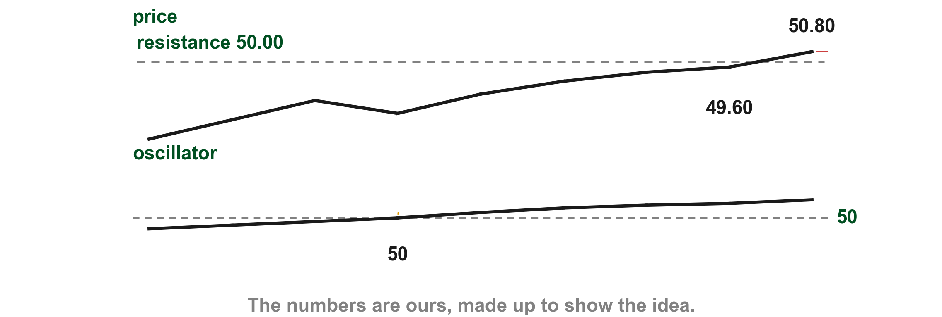
Here is a signal that comes before its trigger
On our chart the oscillator crosses 50 (1), a signal, while price is still under its resistance. The trigger comes later, when price breaches the resistance (2).
2
1
Chart AC - FIN1209 teaching chart, drawn for this course. Illustrative data, not a real instrument.
Part 2 of 8 - 8.2 Eight ways | 3 of 60
FIN1209 teaching chart AC. The numbers are invented for teaching.
Notes:
- Gold 1 the oscillator crossing 50, the signal. Red 2 price breaching 50.00, the trigger.

Slide 70
Which overlays count as price confirmation
For a valid price confirmation, price may breach a numerically, horizontally or geometrically based overlay (p. 241). The most reliable and popular are prior support and resistance levels, simple trendlines, moving averages and chart pattern breakouts or reactions (p. 241). The book does not say why it leaves the algorithmic overlays out.
Part 2 of 8 - 8.2 Eight ways | 4 of 60
Lim (2016), p. 241. The chart on the next slide is ours.
Notes:
- Which overlays count as price confirmation.

Slide 71
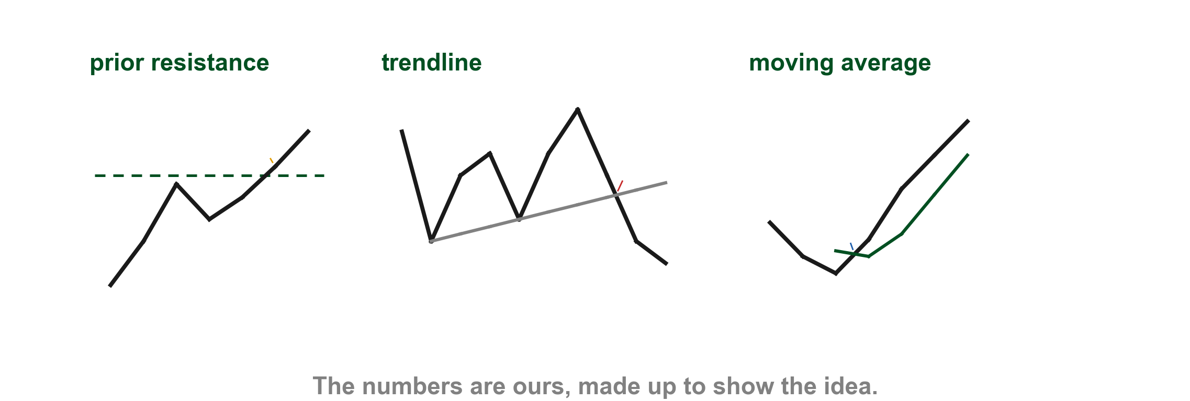
Here is price breaching three of those overlays
On our charts price breaches a prior resistance (1), a trendline through two troughs (2) and a 3-bar moving average (3). Each is a price confirmation, because price, not the oscillator, does the breaching (p. 241).
1
2
3
Chart AU - FIN1209 teaching chart, drawn for this course. Illustrative data, not a real instrument.
Part 2 of 8 - 8.2 Eight ways | 5 of 60
FIN1209 teaching chart AU. The numbers are invented for teaching.
Notes:
- Gold 1 the resistance breach, red 2 the trendline breach, blue 3 the moving average breach.

Slide 72
Overbought and oversold: how far is too far
Overbought and oversold (OBOS) levels on an oscillator are indicative of overextensions in price, where a potential reversal in price is expected (p. 241). Overbought is first and foremost a strong uptrend with a high probability of a bearish reversal; oversold is the mirror, and price confirmation is required (p. 241).
A bounded oscillator can also stay overbought for long in a strong trend (p. 237); price confirmation is what decides. Chapters 5 to 7 used overextended for price past a barrier, for volume and for a long bar; here the overextension is still in price, and the oscillator's overbought or oversold zone is how we see it.
Part 2 of 8 - 8.2 Eight ways | 6 of 60
Lim (2016), pp. 237 and 241; Chapters 5, 6 and 7. The chart on the next slide is ours.
Notes:
- Overbought and oversold: how far is too far.

Slide 73
Here is an oscillator that stays overbought
On our chart the oscillator sits above 80 for ten readings (1) while price keeps rising (2), so the reading alone is not a turn.
2
1
Chart R - FIN1209 teaching chart, drawn for this course. Illustrative data, not a real instrument.
Part 2 of 8 - 8.2 Eight ways | 7 of 60
FIN1209 teaching chart R. The numbers are invented for teaching.
Notes:
- Gold 1 the ten readings above 80, red 2 price still rising.

Slide 74
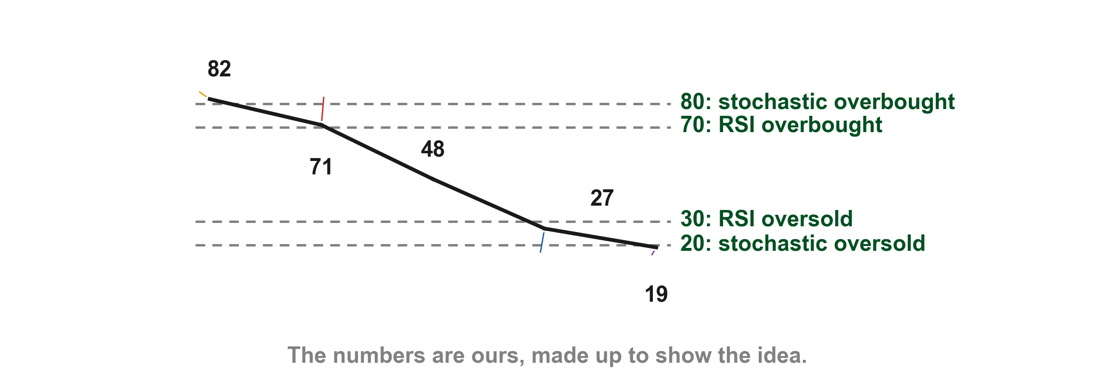
Levels for a bounded oscillator
Lim gives overbought as usually at or above 70 or 80 percent and oversold as usually at or below 20 or 30, depending on the oscillator (p. 241). Our readings: 82 (1) is overbought on either level, 71 (2) only against 70, 48 is neither, 27 (3) is oversold only against 30 and 19 (4) on either.
1
2
3
4
Chart AD - FIN1209 teaching chart, drawn for this course. Illustrative data, not a real instrument.
Part 2 of 8 - 8.2 Eight ways | 8 of 60
FIN1209 teaching chart AD. The numbers are invented for teaching.
Notes:
- Gold 1 the 82, red 2 the 71, blue 3 the 27, purple 4 the 19.

Slide 75
Levels for an unbounded oscillator come from its history
An unbounded oscillator has no fixed percentage. Lim reads overbought as historical or significant peaks and oversold as historical or significant troughs (p. 241). These levels are best found by looking at the chart (p. 242). He gives no number of periods for historical.
Part 2 of 8 - 8.2 Eight ways | 9 of 60
Lim (2016), pp. 241 to 242. The chart on the next slide is ours.
Notes:
- Unbounded: levels come from history.

Slide 76
Here is a historical level on one oscillator of ours
Our unbounded oscillator turned down at 3.9 (1), 3.8 (2) and 4.0 (3). Peaks at about the same height give a historical overbought level, near 3.9.
1
2
3
Chart S - FIN1209 teaching chart, drawn for this course. Illustrative data, not a real instrument.
Part 2 of 8 - 8.2 Eight ways | 10 of 60
FIN1209 teaching chart S. The numbers are invented for teaching.
Notes:
- Gold 1, red 2 and blue 3 the three peaks near 3.9.

Slide 77
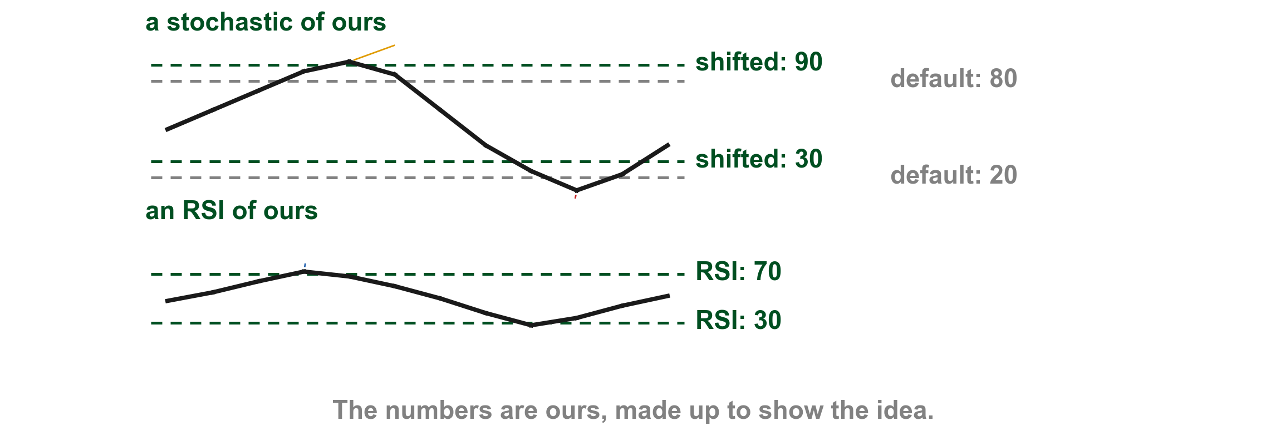
Here are the default levels and the shifted ones
The stochastic's default levels are 80 and 20; the RSI's are 70 and 30 (p. 241). Many practitioners shift the stochastic's up ten points, to 90 and 30, for the upside bias in strong, prolonged uptrends (p. 241). Ours reaches the shifted 90 (1) and dips under 30 and 20 (2); our RSI reaches 70 (3).
1
2
3
Chart AE - FIN1209 teaching chart, drawn for this course. Illustrative data, not a real instrument.
Part 2 of 8 - 8.2 Eight ways | 11 of 60
FIN1209 teaching chart AE. The numbers are invented for teaching.
Notes:
- Gold 1 the stochastic over 90, red 2 under 30, blue 3 the RSI over 70.

Slide 78
CCI and standard deviation oscillator levels
For the CCI Lim gives overbought at plus 100 and oversold at minus 100, and says these are measures of volatility; they coincide well with the Bollinger band's 1 standard deviation values, and plus and minus 200 match its 2 standard deviation bands (p. 242). The standard deviation oscillator uses plus or minus 1 or 2 sigma, the book's other word for standard deviation (p. 242), which Chapter 5 met. Most unbounded oscillators have no widely accepted levels.
Part 2 of 8 - 8.2 Eight ways | 12 of 60
Lim (2016), p. 242; Chapter 5, standard deviation. The chart on the next slide is ours.
Notes:
- CCI and standard deviation levels.

Slide 79
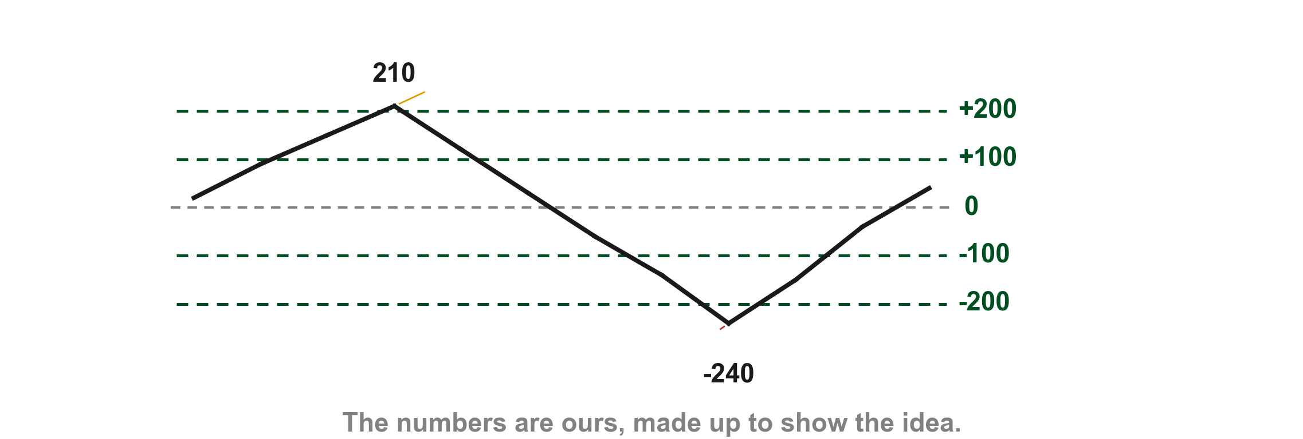
Here are the CCI levels on one oscillator of ours
The CCI's own calculation is not in this chapter. On our unbounded oscillator a reading of 210 (1) is beyond plus 200 and a reading of -240 (2) is beyond minus 200.
1
2
Chart AF - FIN1209 teaching chart, drawn for this course. Illustrative data, not a real instrument.
Part 2 of 8 - 8.2 Eight ways | 13 of 60
FIN1209 teaching chart AF. The numbers are invented for teaching.
Notes:
- Gold 1 a reading beyond plus 200, red 2 a reading beyond minus 200.

Slide 80
Figure 8.4 shows signals on one chart
Lim's chart marks several signals. For now only two matter: the oscillator at an overbought reading (1) and at an oversold reading (2) (p. 242). Its crossover, divergence and chart pattern labels belong to later ways; we come back to them after all eight are taught.
FIGURE 8.4
Figure 8.4: a price chart with an oscillator under it, and Lim's arrows and labels for a crossover, an overbought reading, an oversold reading, a divergence and a chart pattern.
1
2
Figure 8.4 - Lim, The Handbook of Technical Analysis (Wiley, 2016)
Part 2 of 8 - 8.2 Eight ways | 14 of 60
Lim (2016), p. 242, Figure 8.4. The marks are ours, added for teaching.
Notes:
- Gold 1 overbought, red 2 oversold. The other labels come later.

Slide 81
Figure 8.5: a historically overbought MACD
The MACD is an unbounded oscillator, so its overbought level comes from its own history. On Lim's Amazon chart that level is the dotted line in the MACD window (1); the book gives no number. Lim says every time the MACD tests or exceeds it, a reversal or correction in price followed, at his time lines 1 to 6 (2) (p. 242).
FIGURE 8.5
Figure 8.5: Amazon.com with its MACD under it, a dotted overbought level in the MACD window and six dashed time lines numbered 1 to 6 by Lim.
2
1
Figure 8.5 - Lim, The Handbook of Technical Analysis (Wiley, 2016)
Part 2 of 8 - 8.2 Eight ways | 15 of 60
Lim (2016), pp. 242 to 243, Figure 8.5, courtesy of Stockcharts.com. The marks are ours, added for teaching.
Notes:
- Gold 1 the dotted overbought level in the MACD window, red 2 Lim's numbered time lines 1 to 6.

Slide 82
Figure 8.6: oversold on a cycle-tuned stochastic
A cycle-tuned stochastic has its lookback set to the market's cycle; the second class explains that. Lim says its oversold levels (1) coincided perfectly with bottoms in silver, shown by all six up arrows (2) to (7), and he used historical levels in place of 80 and 20 (p. 242). The figure also prints "to confirm the RSI oversold indication"; that is not price confirmation.
FIGURE 8.6
Figure 8.6: silver with a cycle-tuned stochastic under it, its oversold levels, and six up arrows at the bottoms.
4
5
3
6
7
2
1
Figure 8.6 - Lim, The Handbook of Technical Analysis (Wiley, 2016)
Part 2 of 8 - 8.2 Eight ways | 16 of 60
Lim (2016), pp. 242 to 243, Figure 8.6. The marks are ours, added for teaching.
Notes:
- Gold 1 the oversold levels, then the six arrows.

Slide 83
CHECK 5 OF 11
Overbought and oversold
Q1
FIGURE 8.6
Figure 8.6: silver with a cycle-tuned stochastic under it, its oversold levels, and six up arrows at the bottoms.
In Figure 8.6, what do the up arrows (marks 2 to 7) show?
4
5
A. Overbought levels at tops
B. Oversold levels coinciding with bottoms
C. Crossovers of 50
D. Price breaching resistance
3
6
7
2
1
Q2
Figure 8.6 - Lim, The Handbook of Technical Analysis (Wiley, 2016)
Where do the levels for an unbounded oscillator come from?
A. The oscillator's own history
B. A fixed 70 and 30
C. The stochastic's default
D. A fixed 80 and 20
Part 2 of 8 - 8.2 Eight ways | Check 5
Notes:
- Both answers come from the overbought and oversold slides.

Slide 84
ANSWERS
Overbought and oversold
Q1 In Figure 8.6, what do the up arrows (marks 2 to 7) show?
FIGURE 8.6
Figure 8.6: silver with a cycle-tuned stochastic under it, its oversold levels, and six up arrows at the bottoms.
B. Oversold levels coinciding with bottoms
Lim says oversold levels coincided with silver bottoms (p. 242).
4
5
3
6
7
2
1
Q2 Where do the levels for an unbounded oscillator come from?
Figure 8.6 - Lim, The Handbook of Technical Analysis (Wiley, 2016)
A. The oscillator's own history
They are its historical or significant peaks and troughs (p. 241).
Part 2 of 8 - 8.2 Eight ways | Check 5
Notes:
- Both answers come from the overbought and oversold slides.

Slide 85
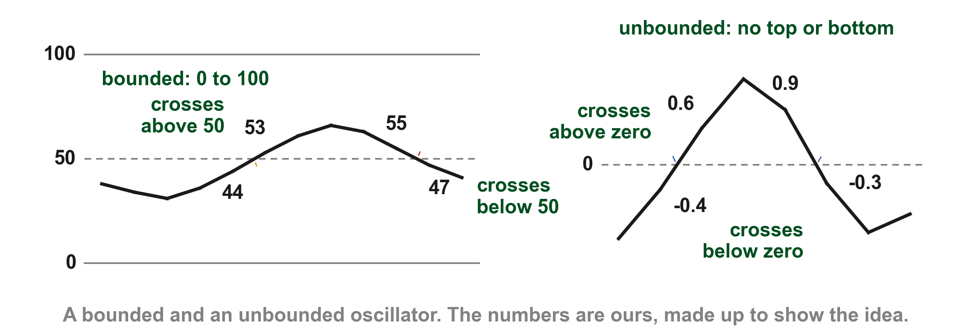
Crossing its equilibrium level is a buy or sell signal
An oscillator can be read by its equilibrium, the central value it swings around: 50 percent for a bounded oscillator and zero for an unbounded one (p. 244). Crossing above it is a buy signal and crossing below it a sell signal (p. 244). On our chart the bounded one crosses above 50 (1) and below 50 (2); the unbounded one crosses above zero (3) and below zero (4).
2
3
4
1
Chart B - FIN1209 teaching chart, drawn for this course. Illustrative data, not a real instrument.
Part 2 of 8 - 8.2 Eight ways | 17 of 60
FIN1209 teaching chart B. The numbers are invented for teaching.
Notes:
- Gold 1 and red 2 on the bounded oscillator at 50, blue 3 and purple 4 on the unbounded one at zero.

Slide 86
Figure 8.7 shows the RSI crossing its 50 percent level
Here is the RSI on Lim's daily chart of Goldman Sachs. It drops below its dashed 50 percent level (1). Follow the vertical line up from there and Lim has marked a sell with an S (2). Later the RSI climbs back above the level (3), and the next vertical line leads up to a buy, marked with a B (4) (p. 244).
FIGURE 8.7
Figure 8.7, cropped to its second pair of crossings: the price chart with Lim's S and B letters, and under it the RSI with its dashed 50 percent level and its axis. Mark 1 is where the RSI drops below 50, mark 2 the S above it, mark 3 where the RSI climbs back above 50, mark 4 the B above it.
2
4
The RSI gives the signal. The trigger to enter still has to come from price (pp. 241, 244).
3
Figure 8.7 - Lim, The Handbook of Technical Analysis (Wiley, 2016)
1
Part 2 of 8 - 8.2 Eight ways | 18 of 60
Lim (2016), p. 244, Figure 8.7. The marks are ours, added for teaching.
Notes:
- The book shows the same idea on a real chart. Gold 1 the RSI dropping below 50, red 2 the S above it, blue 3 the RSI climbing back above 50, purple 4 the B above it.

Slide 87
An oscillator signal is not a trigger
Lim says these crossings are signals and should not be regarded as triggers for entry (p. 244). On our chart the oscillator crosses 50 (1) before price breaks its resistance (2).
2
1
Chart AC - FIN1209 teaching chart, drawn for this course. Illustrative data, not a real instrument.
Part 2 of 8 - 8.2 Eight ways | 19 of 60
FIN1209 teaching chart AC. The numbers are invented for teaching.
Notes:
- Gold 1 the oscillator crossing 50, red 2 price breaching the resistance.

Slide 88
Figure 8.7 again: the CCI crosses its zero line
The CCI is unbounded, so its equilibrium is zero. In the lower half of Lim's chart the CCI crosses zero at (1) and (2), on the same vertical lines where the RSI crosses 50 (3) and (4), so the signals are nearly identical (p. 244).
FIGURE 8.7
Figure 8.7, lower half: the RSI and the CCI with Lim's label for the 50 percent and zero line crossovers.
3
4
2
1
Figure 8.7 - Lim, The Handbook of Technical Analysis (Wiley, 2016)
Part 2 of 8 - 8.2 Eight ways | 20 of 60
Lim (2016), p. 244, Figure 8.7, courtesy of Stockcharts.com. The marks are ours, added for teaching.
Notes:
- Gold 1 and red 2 the CCI zero line crossings at Lim's arrow tips; blue 3 and purple 4 the RSI crossings of 50 above them.

Slide 89
CHECK 6 OF 11
Equilibrium crossovers
Q1
FIGURE 8.7
Figure 8.7, cropped to its second pair of crossings: the price chart with Lim's S and B letters, and under it the RSI with its dashed 50 percent level and its axis. Mark 1 is where the RSI drops below 50, mark 2 the S above it, mark 3 where the RSI climbs back above 50, mark 4 the B above it.
On a bounded oscillator such as the RSI, which level is the equilibrium?
2
4
A. 0 percent
B. 30 percent
C. 50 percent
D. 100 percent
Q2
In the figure, the RSI drops below 50 at mark 1. What does Lim call that?
A. A buy signal
B. A sell signal
C. A trigger for entry
D. A signal line crossover
3
1
Figure 8.7 - Lim, The Handbook of Technical Analysis (Wiley, 2016)
Part 2 of 8 - 8.2 Eight ways | Check 6
Notes:
- Both answers come from the equilibrium crossover slides.

Slide 90
ANSWERS
Equilibrium crossovers
Q1 On a bounded oscillator such as the RSI, which level is the equilibrium?
FIGURE 8.7
Figure 8.7, cropped to its second pair of crossings: the price chart with Lim's S and B letters, and under it the RSI with its dashed 50 percent level and its axis. Mark 1 is where the RSI drops below 50, mark 2 the S above it, mark 3 where the RSI climbs back above 50, mark 4 the B above it.
2
4
C. 50 percent
It runs 0 to 100 percent, so its equilibrium is 50 percent (p. 244).
Q2 In the figure, the RSI drops below 50 at mark 1. What does Lim call that?
B. A sell signal
Crossing below the equilibrium is a sell signal. Lim calls these signals, not triggers for entry (p. 244).
3
1
Figure 8.7 - Lim, The Handbook of Technical Analysis (Wiley, 2016)
Part 2 of 8 - 8.2 Eight ways | Check 6
Notes:
- Both answers come from the equilibrium crossover slides.

Slide 91
Two oscillators that agree may be one oscillator
Many oscillators give the same buy and sell signals because they are highly correlated, being built from the same price data. Lim calls this similarity multicollinearity, and says it creates a false consensus and a false sense of confidence (p. 245). Collinearity provides redundant information.
Part 2 of 8 - 8.2 Eight ways | 21 of 60
Lim (2016), p. 245. The chart on the next slide is ours.
Notes:
- Multicollinearity: two oscillators from the same prices.

Slide 92
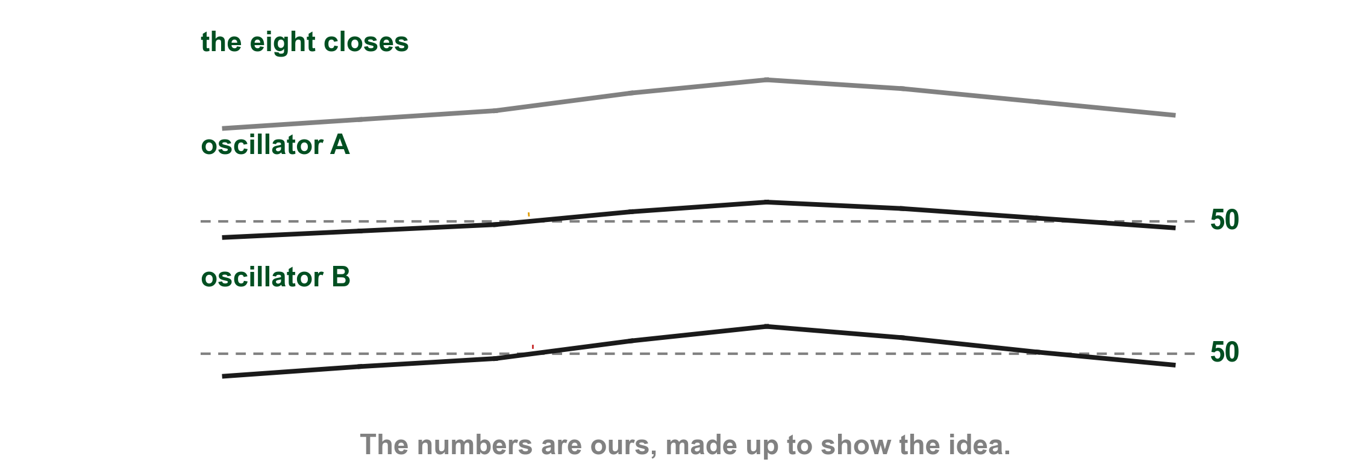
Here are two oscillators from one set of prices
Our two oscillators come from the same eight closes, drawn above them. A crosses 50 (1) at the same reading that B does (2); two lines, one piece of information.
1
2
Chart AG - FIN1209 teaching chart, drawn for this course. Illustrative data, not a real instrument.
Part 2 of 8 - 8.2 Eight ways | 22 of 60
FIN1209 teaching chart AG. The numbers are invented for teaching.
Notes:
- Gold 1 oscillator A crossing 50, red 2 oscillator B crossing 50 at the same reading.

Slide 93
Figure 8.8: RSI, MACD and ROC on one Apple chart
Lim's Apple chart shows the effect: the RSI, MACD and ROC give similar crossover points (1) and similar divergences (2), where price and the oscillator move apart, which Chapters 4 and 5 met and which we teach for oscillators a little later (p. 245). The windows from the top are the RSI (3), the MACD (4) and the ROC (5).
1
FIGURE 8.8
Figure 8.8: Apple with the RSI, MACD and ROC under it. Lim labels similar crossover points on the price chart and similar divergences by arrows.
2
3
4
5
Figure 8.8 - Lim, The Handbook of Technical Analysis (Wiley, 2016)
Part 2 of 8 - 8.2 Eight ways | 23 of 60
Lim (2016), p. 245, Figure 8.8, courtesy of Stockcharts.com. The marks are ours, added for teaching.
Notes:
- Gold 1 the similar crossover points, red 2 the similar divergences, blue 3 the RSI window, purple 4 the MACD window.

Slide 94
How to avoid collinearity
The cure is to use oscillators built from data other than price alone. Lim names a combination of stochastics, Chaikin's money flow index, which uses volume, and sentiment or breadth oscillators such as the McClellan Oscillator and the Put/Call ratio (p. 245). Chapter 6 taught the Chaikin Money Flow; Lim's money flow index may or may not be the same, and he does not say.
Two things Lim does not reconcile. He lists stochastics here and, in the next sentence, among the price-based oscillators novices wrongly stack together (p. 245). And on p. 262 he says many practitioners find a stochastic and RSI agreement more reliable. We give both and no ruling.
Part 2 of 8 - 8.2 Eight ways | 24 of 60
Lim (2016), pp. 245 and 262; Chapter 6, Chaikin Money Flow.
Notes:
- How to avoid collinearity; both readings of the stochastic.

Slide 95
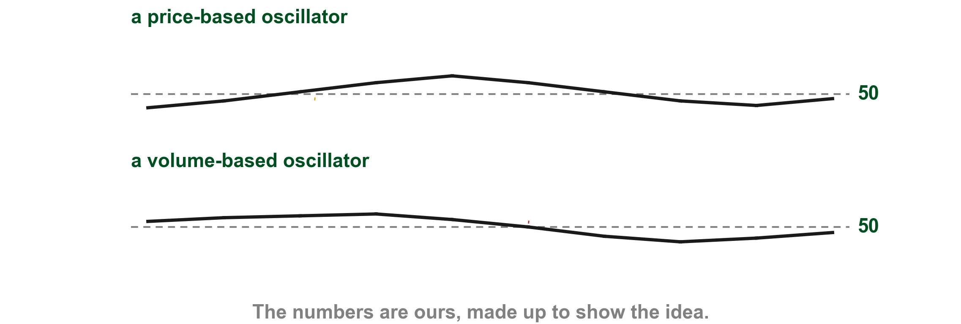
Here are two oscillators built from different data
On our chart one oscillator is built from price and one from volume. They cross their equilibrium at different points (1) (2), and they are built from different data, so the signals are not one signal twice. Breadth, how many stocks are taking part, is another source Lim names.
1
2
Chart AV - FIN1209 teaching chart, drawn for this course. Illustrative data, not a real instrument.
Part 2 of 8 - 8.2 Eight ways | 25 of 60
FIN1209 teaching chart AV. The numbers are invented for teaching.
Notes:
- Gold 1 the price-based crossing, red 2 the volume-based crossing, at different readings.

Slide 96
CHECK 7 OF 11
Collinearity
Q1
1
Why can several price-based oscillators agreeing be misleading?
FIGURE 8.8
Figure 8.8: Apple with the RSI, MACD and ROC under it. Lim labels similar crossover points on the price chart and similar divergences by arrows.
A. They use volume
B. They never cross
C. They have no levels
D. They are built from the same price data
2
Q2
3
In Figure 8.8, marks 1 and 2 show what?
A. Different signals
B. Pivot points
C. Similar crossovers and divergences
D. Volume spikes
4
5
Figure 8.8 - Lim, The Handbook of Technical Analysis (Wiley, 2016)
Part 2 of 8 - 8.2 Eight ways | Check 7
Notes:
- Both answers come from the collinearity slides.

Slide 97
ANSWERS
Collinearity
Q1 Why can several price-based oscillators agreeing be misleading?
1
FIGURE 8.8
Figure 8.8: Apple with the RSI, MACD and ROC under it. Lim labels similar crossover points on the price chart and similar divergences by arrows.
D. They are built from the same price data
Same price data gives a false consensus (p. 245).
2
Q2 In Figure 8.8, marks 1 and 2 show what?
3
C. Similar crossovers and divergences
Lim labels them similar crossovers and divergences (p. 245).
4
5
Figure 8.8 - Lim, The Handbook of Technical Analysis (Wiley, 2016)
Part 2 of 8 - 8.2 Eight ways | Check 7
Notes:
- Both answers come from the collinearity slides.

Slide 98
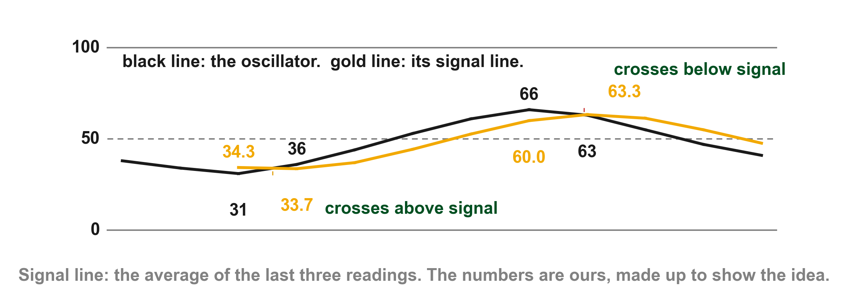
Crossing its own average is a signal line crossover
A signal line is a moving average of the oscillator itself, so it lags it. Crossing above it is a buy signal and crossing below it a sell signal (p. 246). Ours averages the last three readings. The oscillator from our equilibrium chart crosses above it (1) between readings 31 and 36 and below it (2) between 66 and 63.
2
1
Chart C - FIN1209 teaching chart, drawn for this course. Illustrative data, not a real instrument.
Part 2 of 8 - 8.2 Eight ways | 26 of 60
FIN1209 teaching chart C. The numbers are invented for teaching.
Notes:
- Gold 1 the upward crossing of the signal line, red 2 the downward one. The first comes before the oscillator reaches 50.

Slide 99
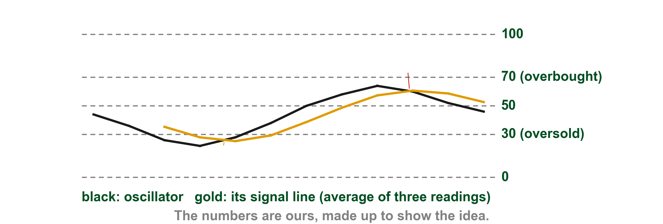
A crossing near oversold counts for more
Many practitioners call an upward crossover more bullish near an oversold level and a downward one more bearish near an overbought level (p. 246). Our oscillator, with a 3-reading average as its signal line, crosses up near the oversold 30 (1), the stronger buy, and down at about 60 (2), far from the overbought 70. The MACD's own signal line is a nine-period EMA (p. 246).
2
1
Chart AH - FIN1209 teaching chart, drawn for this course. Illustrative data, not a real instrument.
Part 2 of 8 - 8.2 Eight ways | 27 of 60
FIN1209 teaching chart AH. The numbers are invented for teaching.
Notes:
- Gold 1 the crossing near oversold, red 2 the crossing at about 60, far from the overbought 70.

Slide 100
Figure 8.9: MACD signal line crossovers
On Lim's Goldman Sachs chart the signal line crossovers (1) are marked at the vertical time lines, with an S for a sell and a B for a buy. The MACD crosses its signal line at (2) and again at (3). The signal line is the smoother of the two lines, since it is an average. Lim finds these fairly effective in forecasting tops and bottoms in the stock (p. 246).
FIGURE 8.9
Figure 8.9: Goldman Sachs with its MACD and signal line under it, vertical time lines, and Lim's label for the signal line crossovers.
1
3
2
Figure 8.9 - Lim, The Handbook of Technical Analysis (Wiley, 2016)
Part 2 of 8 - 8.2 Eight ways | 28 of 60
Lim (2016), p. 246, Figure 8.9, courtesy of Stockcharts.com. The marks are ours, added for teaching.
Notes:
- Gold 1 Lim's label, red 2 an early crossing, blue 3 a later one.

Slide 101
CHECK 8 OF 11
Signal line crossovers
Q1
FIGURE 8.9
Figure 8.9: Goldman Sachs with its MACD and signal line under it, vertical time lines, and Lim's label for the signal line crossovers.
What is a signal line?
1
A. A price trendline
B. A moving average of the oscillator
C. The 50 percent level
D. A volume line
3
2
Q2
Figure 8.9 - Lim, The Handbook of Technical Analysis (Wiley, 2016)
When is an upward crossover of the signal line seen as more bullish?
A. Near an overbought level
B. Above 90
C. Only in a downtrend
D. Near an oversold level
Part 2 of 8 - 8.2 Eight ways | Check 8
Notes:
- Both answers come from the signal line slides.

Slide 102
ANSWERS
Signal line crossovers
Q1 What is a signal line?
FIGURE 8.9
Figure 8.9: Goldman Sachs with its MACD and signal line under it, vertical time lines, and Lim's label for the signal line crossovers.
B. A moving average of the oscillator
It is a moving average of the oscillator, so it lags (p. 246).
1
3
2
Q2 When is an upward crossover of the signal line seen as more bullish?
D. Near an oversold level
Many treat it as more bullish near oversold (p. 246).
Figure 8.9 - Lim, The Handbook of Technical Analysis (Wiley, 2016)
Part 2 of 8 - 8.2 Eight ways | Check 8
Notes:
- Both answers come from the signal line slides.

Slide 103
Divergence: when price and the oscillator disagree
A crossover reads the oscillator against a level or against its own signal line. Divergence compares price with the oscillator (p. 246). Chapter 4 and Chapter 5 met it; Chapter 6's volume divergence is a different measure. Lim said earlier that an equilibrium signal can be misrepresented by divergence, where higher highs in price are accompanied by lower highs in the oscillator (p. 244).
Lim's list opens with divergence indicating potential reversals, yet two of its four kinds expect a continuation. Each kind gets its own slide next.
Part 2 of 8 - 8.2 Eight ways | 29 of 60
Lim (2016), pp. 244 and 246 to 247; Chapter 4, 4.5; Chapter 5, characteristic 16. The charts are on the next slides and are ours.
Notes:
- Divergence: price and the oscillator disagree.

Slide 104
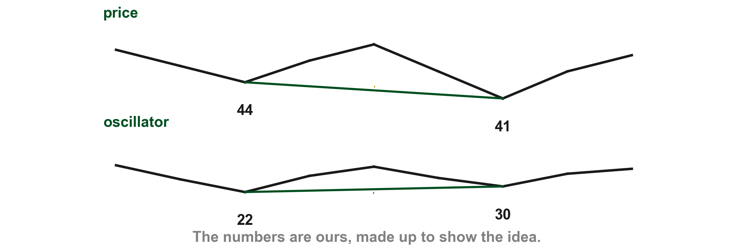
Standard bullish divergence
Standard bullish divergence is a lower trough in price accompanied by a higher trough in the oscillator. It is a bullish setup awaiting price confirmation, and a potential upside reversal is expected (p. 246). On our chart price troughs at 44 then 41 (1) while the oscillator troughs at 22 then 30 (2).
1
2
Chart AI - FIN1209 teaching chart, drawn for this course. Illustrative data, not a real instrument.
Part 2 of 8 - 8.2 Eight ways | 30 of 60
FIN1209 teaching chart AI. The numbers are invented for teaching.
Notes:
- Gold 1 the lower price trough, red 2 the higher oscillator trough.

Slide 105
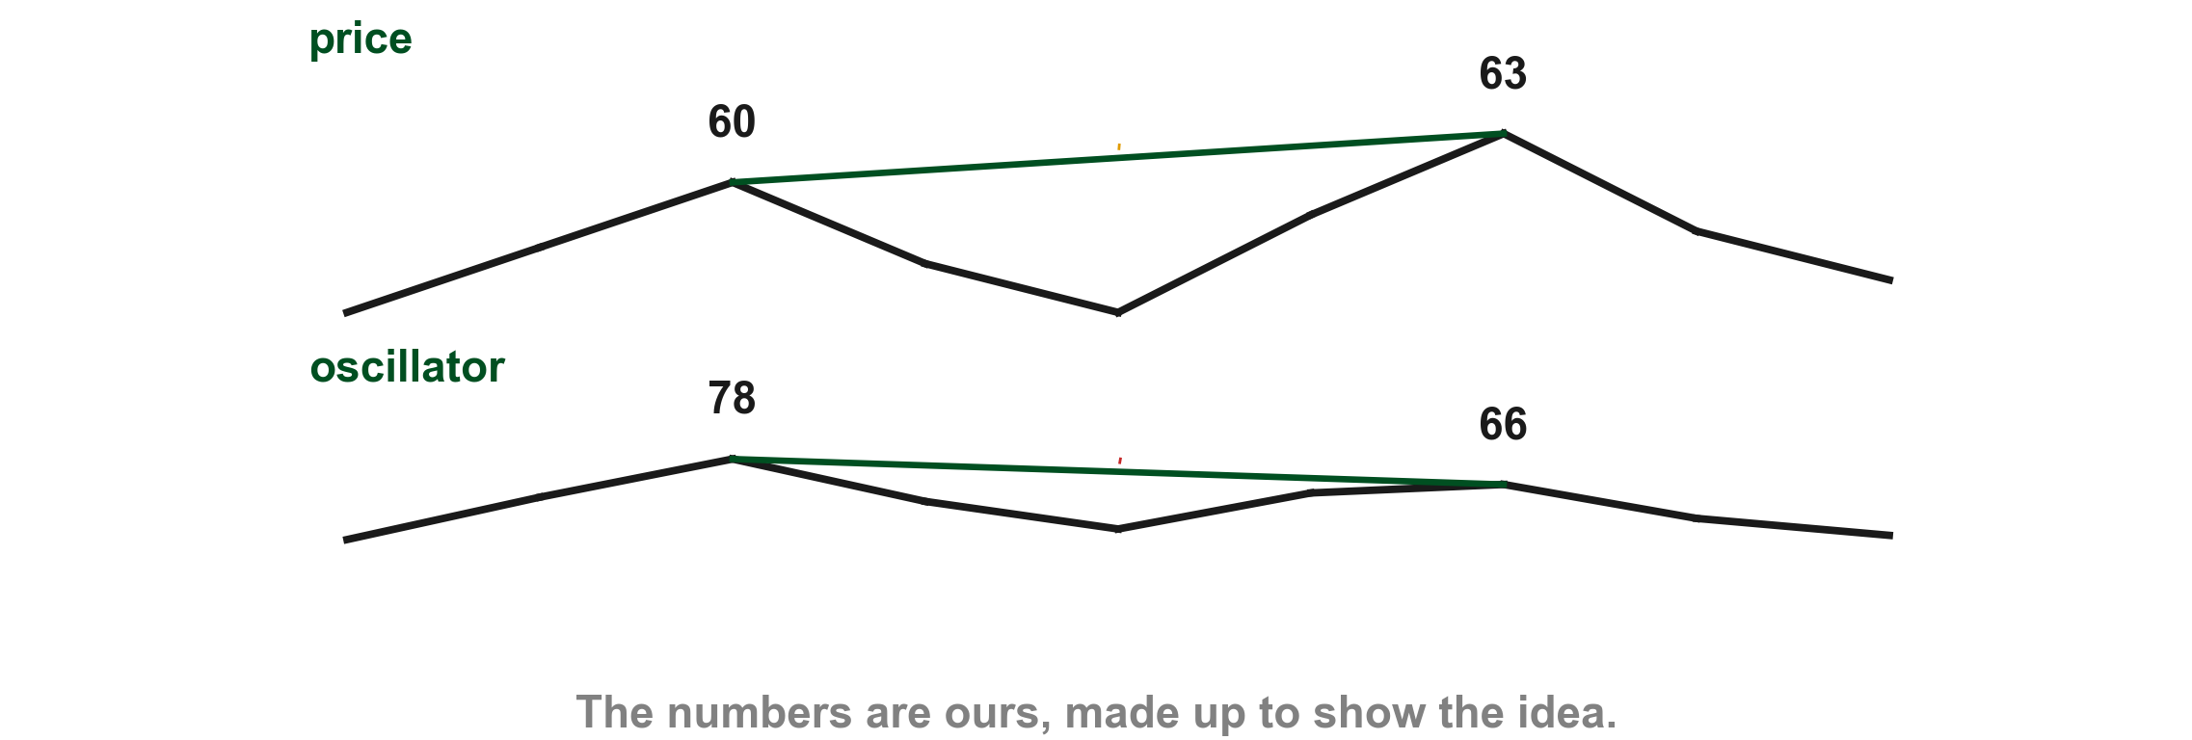
Standard bearish divergence
Standard bearish divergence is a higher peak in price accompanied by a lower peak in the oscillator. It is a bearish setup awaiting price confirmation, and a potential downside reversal is expected (pp. 246 to 247). On our chart price peaks at 60 then 63 (1) while the oscillator peaks at 78 then 66 (2).
1
2
Chart AJ - FIN1209 teaching chart, drawn for this course. Illustrative data, not a real instrument.
Part 2 of 8 - 8.2 Eight ways | 31 of 60
FIN1209 teaching chart AJ. The numbers are invented for teaching.
Notes:
- Gold 1 the higher price peak, red 2 the lower oscillator peak.

Slide 106
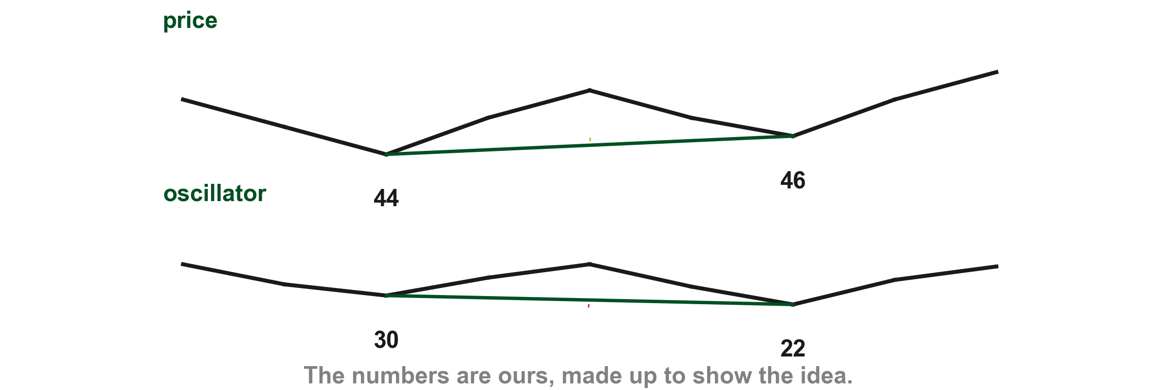
Reverse bullish divergence
Reverse bullish divergence is a higher trough in price accompanied by a lower trough in the oscillator. It is a bullish setup awaiting price confirmation, and a potential upside continuation is expected (p. 247). On our chart price troughs at 44 then 46 (1) while the oscillator troughs at 30 then 22 (2).
1
2
Chart AK - FIN1209 teaching chart, drawn for this course. Illustrative data, not a real instrument.
Part 2 of 8 - 8.2 Eight ways | 32 of 60
FIN1209 teaching chart AK. The numbers are invented for teaching.
Notes:
- Gold 1 the higher price trough, red 2 the lower oscillator trough.

Slide 107
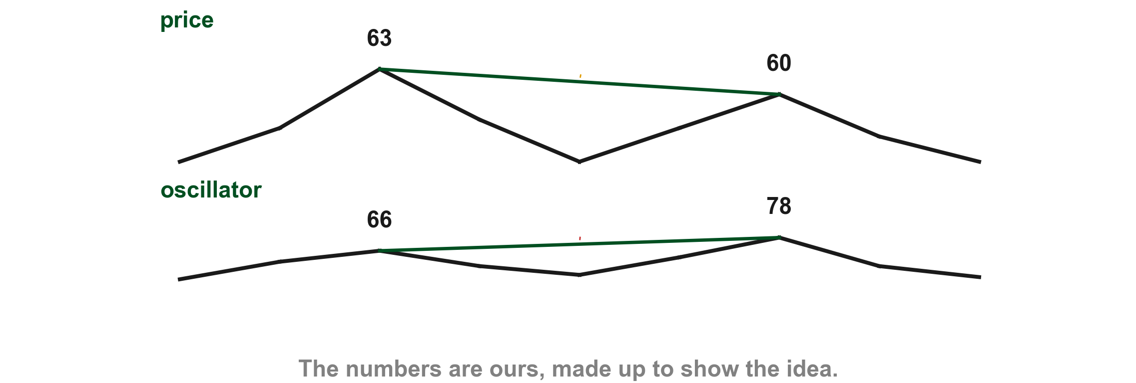
Reverse bearish divergence
Reverse bearish divergence is a lower peak in price accompanied by a higher peak in the oscillator. It is a bearish setup awaiting price confirmation, and a potential downside continuation is expected (p. 247). On our chart price peaks at 63 then 60 (1) while the oscillator peaks at 66 then 78 (2).
1
2
Chart AL - FIN1209 teaching chart, drawn for this course. Illustrative data, not a real instrument.
Part 2 of 8 - 8.2 Eight ways | 33 of 60
FIN1209 teaching chart AL. The numbers are invented for teaching.
Notes:
- Gold 1 the lower price peak, red 2 the higher oscillator peak.

Slide 108
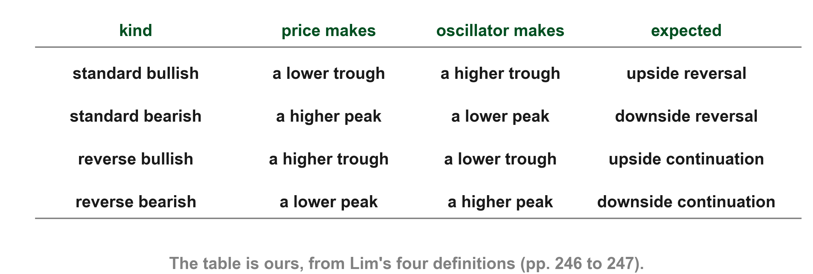
Here are the four kinds in one table
Lim's four definitions side by side: the standard kinds expect a reversal and the reverse kinds a continuation (pp. 246 to 247). Chapter 9 adds more on divergence; these four are in Chapter 8.
FIN1209 table, from Lim's four definitions (pp. 246 to 247).
Part 2 of 8 - 8.2 Eight ways | 34 of 60
FIN1209 table, from Lim's four definitions (pp. 246 to 247).
Notes:
- Standard bullish and bearish expect a reversal; reverse bullish and bearish a continuation.

Slide 109
Figure 8.10: the left half
Lim's GBPUSD chart prints a label on each divergence line. On the left half you can read standard bullish (1), standard bearish (2) and reverse bullish (3) divergence by their printed names (p. 247). The label at the right edge is read on the next slide.
FIGURE 8.10
Figure 8.10, left half: the GBPUSD chart with its MACD and Lim's labelled divergence lines: standard bullish, standard bearish and reverse bullish.
2
3
1
Figure 8.10 - Lim, The Handbook of Technical Analysis (Wiley, 2016)
Part 2 of 8 - 8.2 Eight ways | 35 of 60
Lim (2016), p. 247, Figure 8.10. The marks are ours, added for teaching.
Notes:
- Gold 1 standard bullish, red 2 standard bearish, blue 3 reverse bullish.

Slide 110
Figure 8.10: the right half
On the right half the labels are standard bearish (1), reverse bearish (2), standard bullish (3) and reverse bullish (4). The label at the far right is standard bearish again (5). The kinds are interleaved across the figure, which is why we read it by halves and not by bullish and bearish (p. 247).
FIGURE 8.10
Figure 8.10, right half: Lim's labelled divergence lines: standard bearish, reverse bearish, standard bullish and reverse bullish.
1
2
4
5
3
Figure 8.10 - Lim, The Handbook of Technical Analysis (Wiley, 2016)
Part 2 of 8 - 8.2 Eight ways | 36 of 60
Lim (2016), p. 247, Figure 8.10. The marks are ours, added for teaching.
Notes:
- Gold 1 standard bearish, red 2 reverse bearish, blue 3 standard bullish, purple 4 reverse bullish.

Slide 111
Figure 8.11: the S&P 500 against the Bullish Percent Index
In Lim's S&P 500 chart the arrows are labelled reverse bullish (1), standard bearish (2), standard bullish (3) and, again, reverse bullish (4) divergence. Lim's own large black numbers 1 to 4 mark his time lines; our marks are the coloured badges. The Bullish Percent Index is named in the book, not defined (p. 247).
FIGURE 8.11
Figure 8.11, upper part: the S&P 500 and the whole S&P Bullish Percent Index window, with time lines 1 to 4 and Lim's labels for the reverse bullish, standard bearish and standard bullish divergences.
2
1
4
3
Figure 8.11 - Lim, The Handbook of Technical Analysis (Wiley, 2016)
Part 2 of 8 - 8.2 Eight ways | 37 of 60
Lim (2016), p. 247, Figure 8.11, courtesy of Stockcharts.com. The marks are ours, added for teaching.
Notes:
- Gold 1 reverse bullish, red 2 standard bearish, blue 3 standard bullish, purple 4 reverse bullish.

Slide 112
Figure 8.11: the S&P 500 against the MACD
The lower part of the figure puts the Bullish Percent Index (1) and the MACD (2) under the price chart. Using oscillators based on price and on market breadth is a good way to soften the effects of multicollinearity (p. 247).
FIGURE 8.11
Figure 8.11, lower part: the Bullish Percent Index window and the MACD window with Lim's divergence arrows.
1
2
Figure 8.11 - Lim, The Handbook of Technical Analysis (Wiley, 2016)
Part 2 of 8 - 8.2 Eight ways | 38 of 60
Lim (2016), p. 247, Figure 8.11, courtesy of Stockcharts.com. The marks are ours, added for teaching.
Notes:
- Gold 1 the index window, red 2 the MACD window.

Slide 113
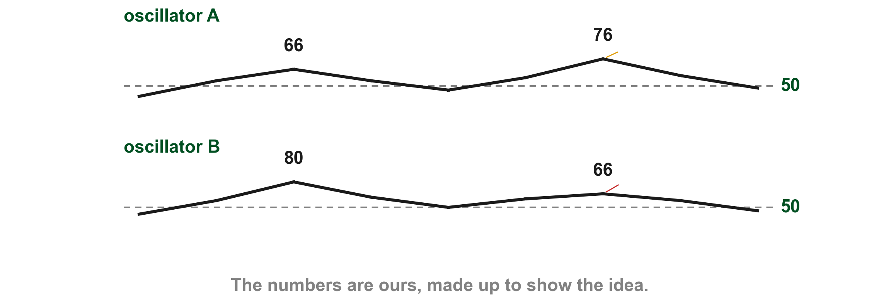
Divergence between two oscillators
On our chart oscillator A makes a higher peak (1) while oscillator B makes a lower one (2). Divergence can be found between two oscillators, but Lim says the divergence between price and an oscillator is the more pertinent (p. 247). He sends the reader to Chapter 9 for more on divergence and for George Lane's setups (p. 247); we teach nothing more than the pointer here.
1
2
Chart AT - FIN1209 teaching chart, drawn for this course. Illustrative data, not a real instrument.
Part 2 of 8 - 8.2 Eight ways | 39 of 60
FIN1209 teaching chart AT. The numbers are invented for teaching.
Notes:
- Gold 1 the higher peak of oscillator A, red 2 the lower peak of oscillator B.

Slide 114
CHECK 9 OF 11
Divergence
Q1
FIGURE 8.10
Figure 8.10, left half: the GBPUSD chart with its MACD and Lim's labelled divergence lines: standard bullish, standard bearish and reverse bullish.
Lower price trough, higher oscillator trough: what is it?
2
A. Reverse bullish
B. Standard bearish
C. Reverse bearish
D. Standard bullish
3
1
Q2
Which kind expects an upside continuation?
A. Reverse bullish
B. Standard bearish
C. Reverse bearish
D. Standard bullish
Figure 8.10 - Lim, The Handbook of Technical Analysis (Wiley, 2016)
Part 2 of 8 - 8.2 Eight ways | Check 9
Notes:
- Both answers come from the divergence slides.

Slide 115
ANSWERS
Divergence
Q1 Lower price trough, higher oscillator trough: what is it?
FIGURE 8.10
Figure 8.10, left half: the GBPUSD chart with its MACD and Lim's labelled divergence lines: standard bullish, standard bearish and reverse bullish.
D. Standard bullish
Lower price troughs, higher oscillator troughs: standard bullish (p. 246).
2
3
Q2 Which kind expects an upside continuation?
1
A. Reverse bullish
Reverse bullish divergence expects an upside continuation (p. 247).
Figure 8.10 - Lim, The Handbook of Technical Analysis (Wiley, 2016)
Part 2 of 8 - 8.2 Eight ways | Check 9
Notes:
- Both answers come from the divergence slides.

Slide 116
Patterns and overlays drawn on an oscillator
The last four ways draw on the oscillator what we draw on price. Geometrically based overlays usually used are trendlines, channels, chart patterns and apex reactions; apex reaction is only named here (p. 248). The signals are four: breaching upward is a buy, testing from below a sell, breaching downward a sell and testing from above a buy (p. 248).
Part 2 of 8 - 8.2 Eight ways | 40 of 60
Lim (2016), pp. 247 to 248. The charts on the next slides are ours.
Notes:
- The last four ways draw on the oscillator what we draw on price.

Slide 117
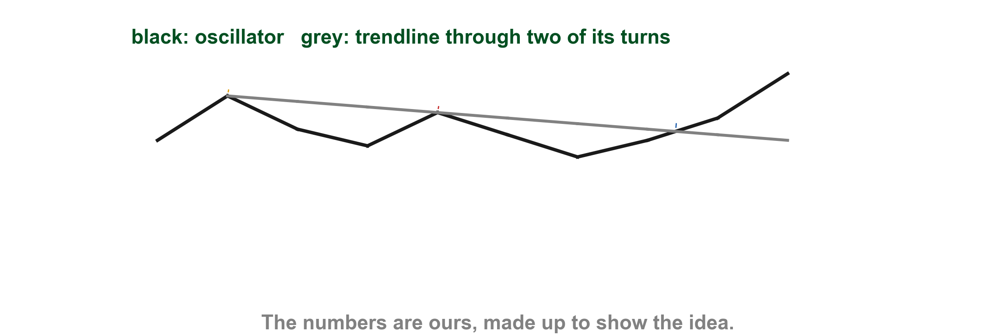
Breach upward is a buy signal
An oscillator breaching a geometrically based overlay to the upside is a buy (bullish) signal (p. 248). On our chart a falling trendline runs through the oscillator's two earlier peaks (1) (2), and the oscillator breaks up through it (3).
1
2
3
Chart AM - FIN1209 teaching chart, drawn for this course. Illustrative data, not a real instrument.
Part 2 of 8 - 8.2 Eight ways | 41 of 60
FIN1209 teaching chart AM. The numbers are invented for teaching.
Notes:
- Gold 1 and red 2 the two earlier peaks, blue 3 the breach upward.

Slide 118
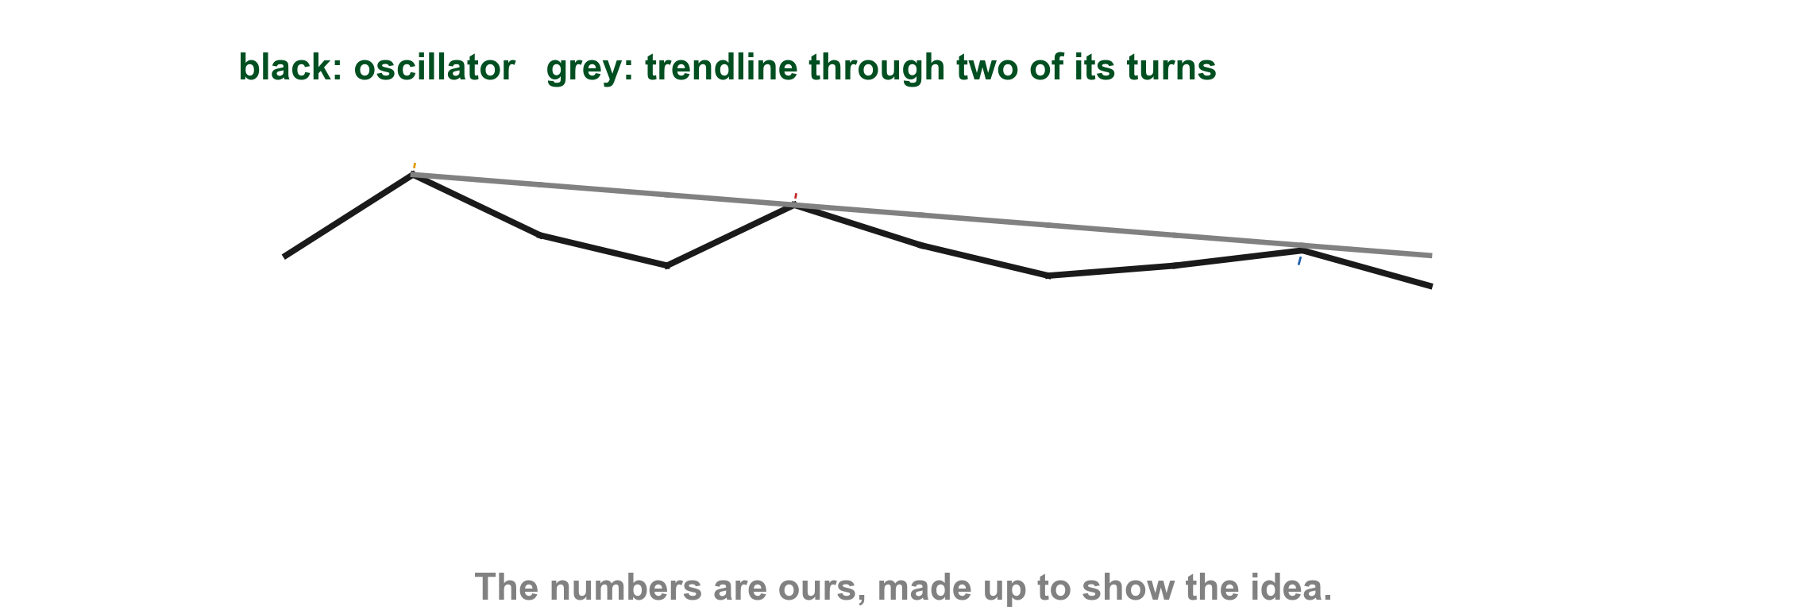
Testing from below is a sell signal
An oscillator testing a geometrically based overlay from below is a sell (bearish) signal (p. 248). Our falling trendline runs through the two earlier peaks (1) (2), and the oscillator rises to it and turns back (3).
1
2
3
Chart AN - FIN1209 teaching chart, drawn for this course. Illustrative data, not a real instrument.
Part 2 of 8 - 8.2 Eight ways | 42 of 60
FIN1209 teaching chart AN. The numbers are invented for teaching.
Notes:
- Gold 1 and red 2 the two earlier peaks, blue 3 the test from below.

Slide 119
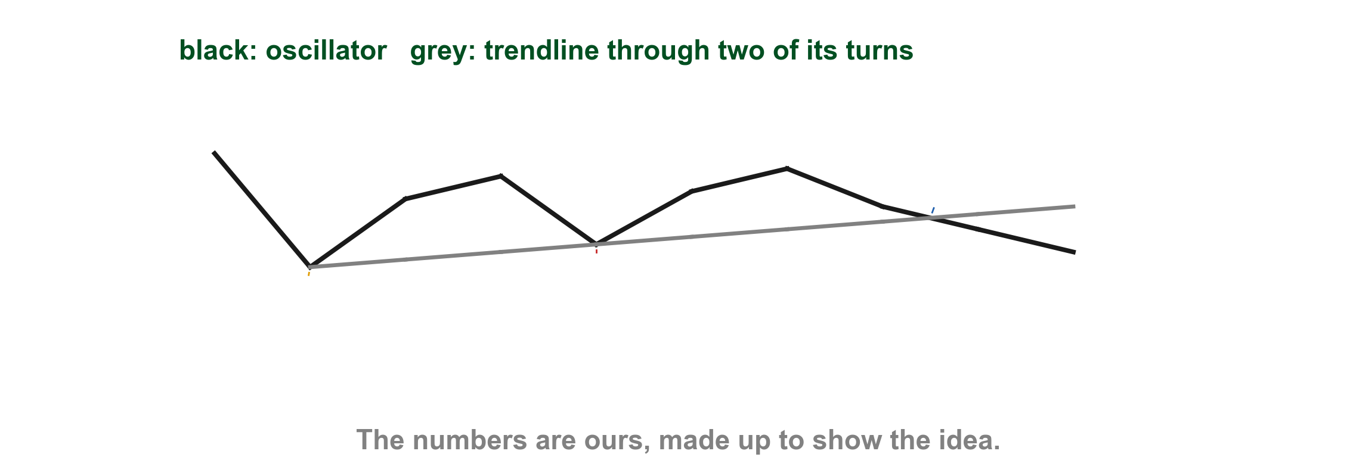
Breach downward is a sell signal
An oscillator breaching a geometrically based overlay to the downside is a sell (bearish) signal (p. 248). Our rising trendline runs through the two earlier troughs (1) (2), and the oscillator falls through it (3).
3
2
1
Chart AO - FIN1209 teaching chart, drawn for this course. Illustrative data, not a real instrument.
Part 2 of 8 - 8.2 Eight ways | 43 of 60
FIN1209 teaching chart AO. The numbers are invented for teaching.
Notes:
- Gold 1 and red 2 the two earlier troughs, blue 3 the breach downward.

Slide 120
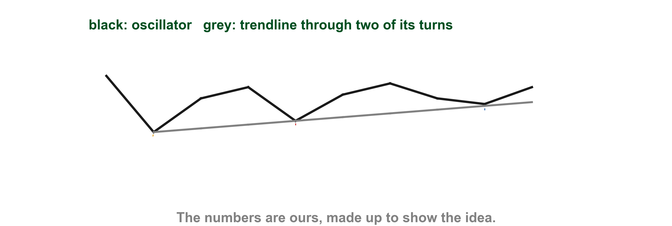
Testing from above is a buy signal
An oscillator testing a geometrically based overlay from above is a buy (bullish) signal (p. 248). Our rising trendline runs through the two earlier troughs (1) (2), and the oscillator falls to it and holds (3).
3
2
1
Chart AP - FIN1209 teaching chart, drawn for this course. Illustrative data, not a real instrument.
Part 2 of 8 - 8.2 Eight ways | 44 of 60
FIN1209 teaching chart AP. The numbers are invented for teaching.
Notes:
- Gold 1 and red 2 the two earlier troughs, blue 3 the test from above.

Slide 121
Figure 8.12: the triangle and the first sell signal
In Lim's 30-minute Nikkei 225 chart the momentum oscillator (MOM) carries a symmetrical triangle breakout (1), and the sell signal under it (2) (pp. 248 to 249).
FIGURE 8.12
Figure 8.12, left half: the 30-minute Nikkei 225 with its momentum oscillator under it, a symmetrical triangle breakout and the sell signal under it.
1
2
Figure 8.12 - Lim, The Handbook of Technical Analysis (Wiley, 2016)
Part 2 of 8 - 8.2 Eight ways | 45 of 60
Lim (2016), p. 249, Figure 8.12. The marks are ours, added for teaching.
Notes:
- Gold 1 the triangle, red 2 the sell signal.

Slide 122
Figure 8.12: the channel, the trendlines and the buy signal
On the right half the oscillator carries a channel (1), trendlines (2) and a buy signal (3). The Sell signal label in the middle of this half (4) is Lim's second sell signal, after the one on the last slide (pp. 248 to 249).
FIGURE 8.12
Figure 8.12, right half: the oscillator channel, the trendlines, a second sell signal and the buy signal.
1
2
4
3
Figure 8.12 - Lim, The Handbook of Technical Analysis (Wiley, 2016)
Part 2 of 8 - 8.2 Eight ways | 46 of 60
Lim (2016), p. 249, Figure 8.12. The marks are ours, added for teaching.
Notes:
- Gold 1 the channel, red 2 the trendlines, blue 3 the buy signal.

Slide 123
Figure 8.12: the projected channel bottom
On the right, the oscillator channel is projected down to its bottom edge (1), where Lim marks a projected channel bottom buy signal (2) (p. 248).
FIGURE 8.12
Figure 8.12, cropped to its oscillator channel on the right and the buy signal at its bottom edge.
2
1
Figure 8.12 - Lim, The Handbook of Technical Analysis (Wiley, 2016)
Part 2 of 8 - 8.2 Eight ways | 47 of 60
Lim (2016), p. 249, Figure 8.12. The marks are ours, added for teaching.
Notes:
- Gold 1 the channel, red 2 the buy signal at its bottom edge.

Slide 124
Numerically based overlays on an oscillator
The numerically based overlays usually employed are Bollinger Bands, moving averages, moving average bands, Fibonacci levels and linear regression bands (p. 249). The four signals are the same: breaching upward is a buy, testing from below a sell, breaching downward a sell and testing from above a buy (p. 249).
Part 2 of 8 - 8.2 Eight ways | 48 of 60
Lim (2016), p. 249. The chart on the next slide is ours.
Notes:
- Numerically based overlays on an oscillator.

Slide 125
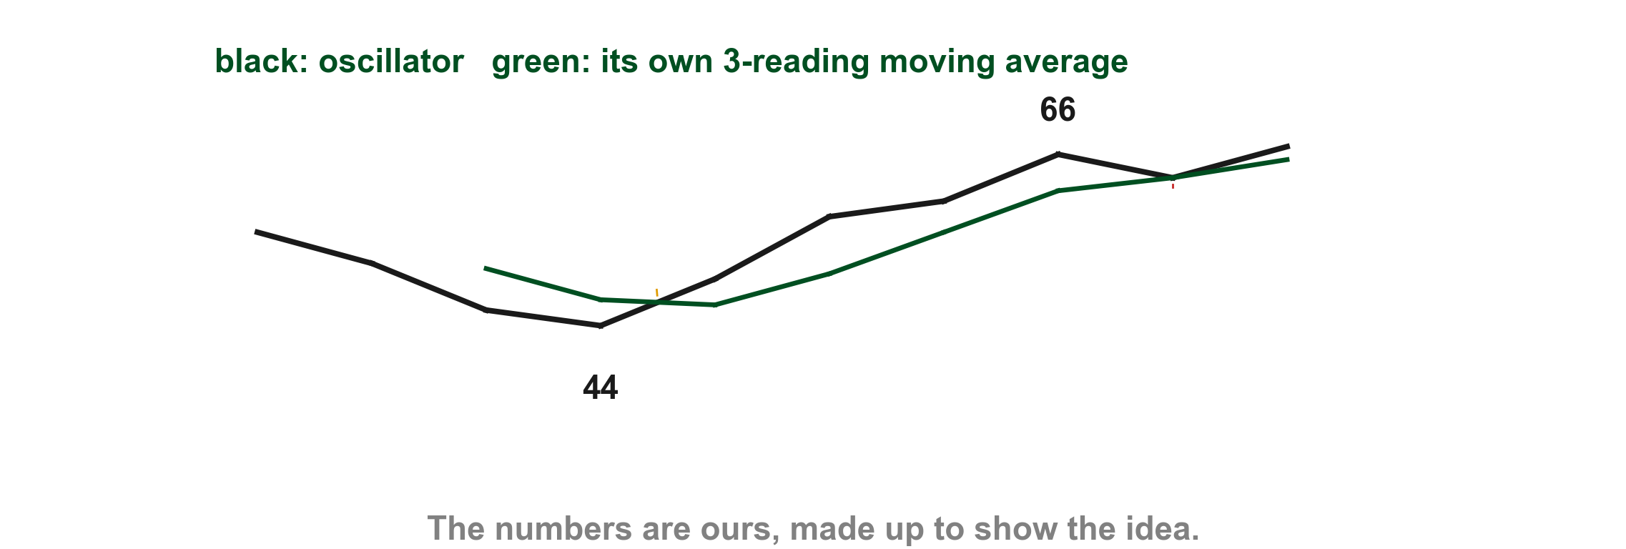
Here is an oscillator against its own moving average
Our oscillator breaks up through its 3-reading moving average at 47 (1), a buy, and later falls back from 66 to touch the average from above at 63 (2), also a buy (p. 249).
2
1
Chart AQ - FIN1209 teaching chart, drawn for this course. Illustrative data, not a real instrument.
Part 2 of 8 - 8.2 Eight ways | 49 of 60
FIN1209 teaching chart AQ. The numbers are invented for teaching.
Notes:
- Gold 1 the breach upward, red 2 the test from above.

Slide 126
Figure 8.13: the RSI finds support at the lower Bollinger band
In Lim's Starbucks chart the Bollinger bands (1) are drawn on the RSI, and the RSI finds support at the lower band at the four arrows (2) to (5). Prices also bottomed each time (p. 249). On p. 250 Lim says the RSI reacted at the upper and lower bands; his figure and his p. 249 text show only the lower band, so we read the lower one.
FIGURE 8.13
Figure 8.13: Starbucks with its RSI and Bollinger bands drawn on the RSI, Lim's overbought and oversold levels, and four arrows labelled RSI at Bollinger lower band.
1
2
3
4
5
Figure 8.13 - Lim, The Handbook of Technical Analysis (Wiley, 2016)
Part 2 of 8 - 8.2 Eight ways | 50 of 60
Lim (2016), pp. 249 to 250, Figure 8.13, courtesy of Stockcharts.com. The marks are ours, added for teaching.
Notes:
- Gold 1 the band, then the four arrows labelled RSI at Bollinger lower band.

Slide 127
Figure 8.13: what oversold means here
Lim says the actual oversold was a fair distance below the Bollinger band oversold levels. His figure labels the line Oversold level (2), and his next sentence calls it the 30 percent oversold line, well below the lower band (1) (p. 249). The method catches bottoms in a rising market without waiting for the RSI to fall to 30.
FIGURE 8.13
Figure 8.13, cropped to the RSI window: the lower Bollinger band, the RSI and Lim's oversold level label.
1
2
Figure 8.13 - Lim, The Handbook of Technical Analysis (Wiley, 2016)
Part 2 of 8 - 8.2 Eight ways | 51 of 60
Lim (2016), p. 249, Figure 8.13, courtesy of Stockcharts.com. The marks are ours, added for teaching.
Notes:
- Gold 1 the lower band, red 2 the Oversold level label.

Slide 128
Horizontally based overlays on an oscillator
Practitioners look for prior support and resistance in the oscillator itself (p. 250). Breaching a resistance level is a buy, displaying resistance at a prior resistance level is a sell, breaching a support level is a sell and displaying support at a prior support level is a buy (p. 250).
Part 2 of 8 - 8.2 Eight ways | 52 of 60
Lim (2016), p. 250. The chart on the next slide is ours.
Notes:
- Horizontally based overlays on an oscillator.

Slide 129
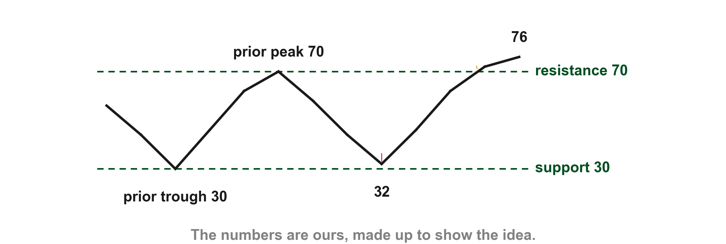
Here are resistance and support in an oscillator
On our oscillator the prior resistance is the earlier peak at 70 and the prior support the earlier trough at 30. It breaks through the resistance (1), a buy, and holds near the support at 32 (2), also a buy.
1
2
Chart AR - FIN1209 teaching chart, drawn for this course. Illustrative data, not a real instrument.
Part 2 of 8 - 8.2 Eight ways | 53 of 60
FIN1209 teaching chart AR. The numbers are invented for teaching.
Notes:
- Gold 1 the breach of resistance, red 2 the hold at support.

Slide 130
Figure 8.14: oscillator support and resistance
On Lim's Nikkei 225 chart the oscillator resistance (1) is drawn, with sell signals where the oscillator shows resistance (2) (p. 251). The support and the buy signals are on the next slide.
FIGURE 8.14
Figure 8.14, left part: the 30-minute Nikkei 225 with its oscillator under it, Lim's oscillator resistance line and his label for sell signals at resistance.
2
1
Figure 8.14 - Lim, The Handbook of Technical Analysis (Wiley, 2016)
Part 2 of 8 - 8.2 Eight ways | 54 of 60
Lim (2016), p. 251, Figure 8.14. The marks are ours, added for teaching.
Notes:
- Gold 1 the resistance line, red 2 the sell signals label.

Slide 131
Figure 8.14: the signals in order
Looking at the right part: the sell signals at the resistance (1) come first, then the buy signals at the support (2), with the oscillator support line (3) under them (p. 251).
FIGURE 8.14
Figure 8.14, right part: the sell signals at the oscillator resistance and the buy signals at the oscillator support.
1
2
3
Figure 8.14 - Lim, The Handbook of Technical Analysis (Wiley, 2016)
Part 2 of 8 - 8.2 Eight ways | 55 of 60
Lim (2016), p. 251, Figure 8.14. The marks are ours, added for teaching.
Notes:
- Gold 1 the sell signals at resistance, red 2 the buy signals at support, blue 3 the support line.

Slide 132
Oscillator on oscillator
Buy and sell signals may also come from the interaction between window oscillators. Lim writes "similarly" (p. 250): the Bollinger band on the Starbucks RSI is indicator on oscillator, and this is oscillator on oscillator. His example is the Stochastic RSI, where the stochastic of RSI values is calculated and plotted (p. 251); the formula comes in 8.4. Any of the earlier seven ways can be applied to it.
Part 2 of 8 - 8.2 Eight ways | 56 of 60
Lim (2016), pp. 250 to 251. The figure is on the next slide.
Notes:
- Oscillator on oscillator: the StochRSI; formula in 8.4.

Slide 133
Figure 8.15: buying dips in an uptrend
On Lim's Apple chart the StochRSI points to potential buying dips, shown by his label Bullish oversold signals (1) and the five dotted lines his label points to, (2) to (6). Lim says these are buying dips in an uptrend (p. 251); the chart draws no trendline, so the uptrend is the rising price. Under the first five dotted lines the StochRSI is below its 0.2 line (7). Its axis runs 0.0 to 1.0, not 0 to 100, because the formula in 8.4, in the second class, has no x 100 (p. 254).
1
FIGURE 8.15
Figure 8.15: Apple with the StochRSI under it, Lim's label Bullish oversold signals and five dotted arrows.
6
2
3
5
4
7
Figure 8.15 - Lim, The Handbook of Technical Analysis (Wiley, 2016)
Part 2 of 8 - 8.2 Eight ways | 57 of 60
Lim (2016), p. 251, Figure 8.15, courtesy of Stockcharts.com. The marks are ours, added for teaching.
Notes:
- Gold 1 Lim's label, then arrowed lines.

Slide 134
CHECK 10 OF 11
Patterns on an oscillator
Q1
FIGURE 8.14
Figure 8.14, right part: the sell signals at the oscillator resistance and the buy signals at the oscillator support.
An oscillator breaks above its own resistance. The signal is:
1
A. A sell signal
B. No signal
C. A buy signal
D. A trigger for entry
2
Q2
3
In Figure 8.14, what do marks 1 and 2 show?
Figure 8.14 - Lim, The Handbook of Technical Analysis (Wiley, 2016)
A. Buy signals at resistance
B. Divergence
C. Pivot points
D. Sell at resistance, buy at support
Part 2 of 8 - 8.2 Eight ways | Check 10
Notes:
- Both answers come from the oscillator pattern slides.

Slide 135
ANSWERS
Patterns on an oscillator
Q1 An oscillator breaks above its own resistance. The signal is:
FIGURE 8.14
Figure 8.14, right part: the sell signals at the oscillator resistance and the buy signals at the oscillator support.
1
C. A buy signal
Breaching a resistance level is a buy signal (p. 250).
2
Q2 In Figure 8.14, what do marks 1 and 2 show?
3
D. Sell at resistance, buy at support
Lim labels sell signals at resistance, buy at support (p. 251).
Figure 8.14 - Lim, The Handbook of Technical Analysis (Wiley, 2016)
Part 2 of 8 - 8.2 Eight ways | Check 10
Notes:
- Both answers come from the oscillator pattern slides.

Slide 136
CHECK 11 OF 11
The eight ways
Q1
Q2
An RSI crosses above 50. Which of the eight ways is that?
A MACD crosses its own moving average. Which way is that?
A. Overbought and oversold
B. Equilibrium crossover
C. Divergence
D. Oscillator on oscillator
A. Equilibrium crossover
B. Overbought and oversold
C. Signal line crossover
D. Horizontally based pattern
Part 2 of 8 - 8.2 Eight ways | Check 11
Notes:
- Each answer names one of the eight ways.

Slide 137
ANSWERS
The eight ways
Q1 An RSI crosses above 50. Which of the eight ways is that?
B. Equilibrium crossover
50 is the equilibrium of a bounded oscillator, so this is an equilibrium crossover (p. 244).
Q2 A MACD crosses its own moving average. Which way is that?
C. Signal line crossover
A signal line is a moving average of the oscillator, so crossing it is a signal line crossover (p. 246).
Part 2 of 8 - 8.2 Eight ways | Check 11
Notes:
- Each answer names one of the eight ways.

Slide 138
Figure 8.4 again, all five signals
Now every label on Lim's chart has been taught. At the oscillator the overbought (1) and oversold (2) readings; the crossover (3) of two lines; the divergence (4) between price and the oscillator; and the chart pattern (5) drawn on the oscillator (p. 242).
FIGURE 8.4
Figure 8.4 again, with all five labels marked: crossover, overbought, oversold, divergence and chart pattern.
4
3
5
1
2
Figure 8.4 - Lim, The Handbook of Technical Analysis (Wiley, 2016)
Part 2 of 8 - 8.2 Eight ways | 58 of 60
Lim (2016), p. 242, Figure 8.4. The marks are ours, added for teaching.
Notes:
- Gold 1 overbought, red 2 oversold, blue 3 crossover, purple 4 divergence, gold 5 chart pattern.

Slide 139
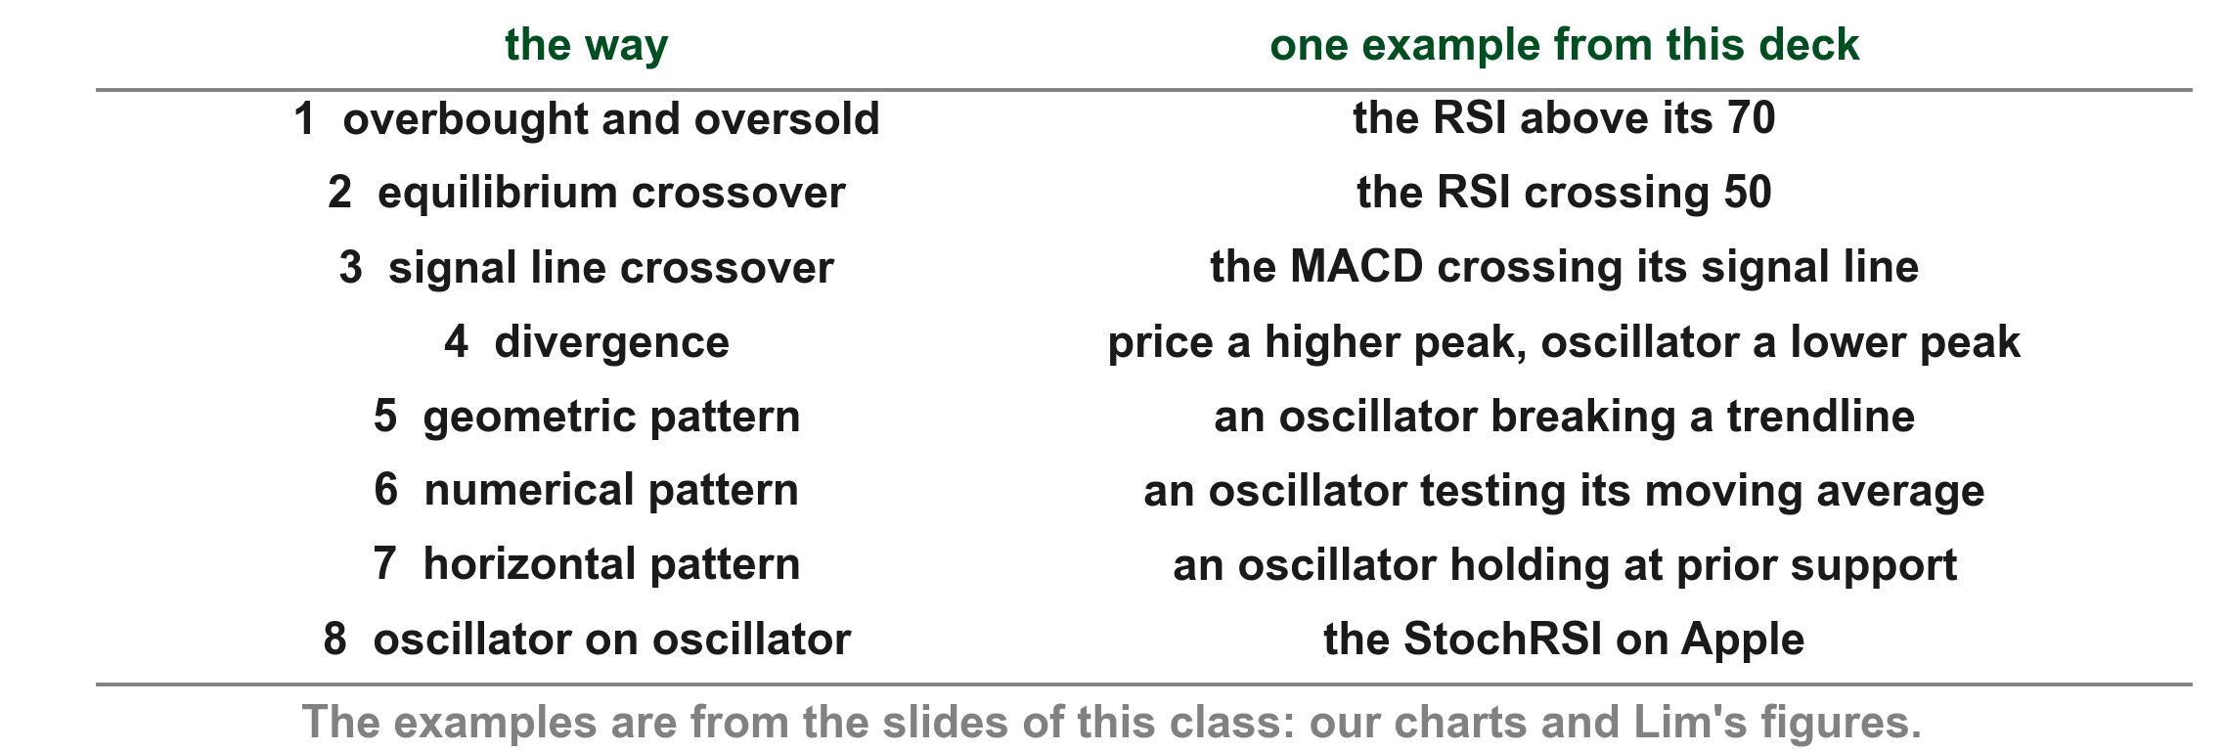
What you can now do after the first class
You can name the four kinds of overlay and the two kinds of window oscillator, and say what scale invariant, static and dynamic mean. You can read an oscillator eight ways, each with one example in the table below.
FIN1209 table: examples from the slides of this class, our charts and Lim's figures.
Part 2 of 8 - 8.2 Eight ways | 59 of 60
FIN1209 table: examples from the slides of this class, our charts and Lim's figures.
Notes:
- One example for each of the eight ways.

Slide 140
What the second class covers
The second class tunes the lookback to the market's cycle and then goes through the main oscillators one by one: the rate of change (ROC), momentum (MOM), the MACD, the average true range (ATR), the stochastic and the RSI, and then pivot points.
Part 2 of 8 - 8.2 Eight ways | 60 of 60
Lim (2016), pp. 252 to 265.
Notes:
- The second class tunes the lookback and builds the oscillators.

