Slide 1
FIN1209 Technical Analysis in Investment
Chapter 6
Volume and Open Interest
Institute of Accounts, Business and Finance | Far Eastern University Manila
Benjamin C. Sotelo

Slide 2
What you will be able to do
Understand volume action and its implications for market action.
Recognize early trend weakness via volume and open interest divergence.
Identify bullish and bearish signals on volume and open interest indicators.
Forecast potential reversals and corrections via volume cycles.
Set up effective volume filtering, for better timed entries and exits.
Read volume across successive contract months in futures markets.
The last is not taught in this chapter's text; Chapter 3 read volume across contract months. Every other idea here gets its own slide when its part comes.
Chapter 6 - Opening
Book p.173: its six learning objectives, nearly word for word.

Slide 3
How this chapter is laid out
Part 1 Confirmation and divergence. Part 2 Timing, the volume-weighted moving average (VWMA), climaxes.
Part 3 Price barriers and filtering. Part 4 Open interest, tick volume, the Arms Index (TRIN).
Part 5 Bar range and volume cycles. Part 6 The volume oscillators, section 6.2.
Parts 1 to 5 are the book's section 6.1, in its order.
Bottom right of every teaching slide: the book page it comes from, and whose the numbers are. Lettered charts are ours, invented, drawn where the book gives only words, a sketch or a dense chart. Peso amounts are our examples.
Chapter 6 - Opening
The parts are the book's own sub-sections, pp.173 to 208, grouped in its order.

Slide 4
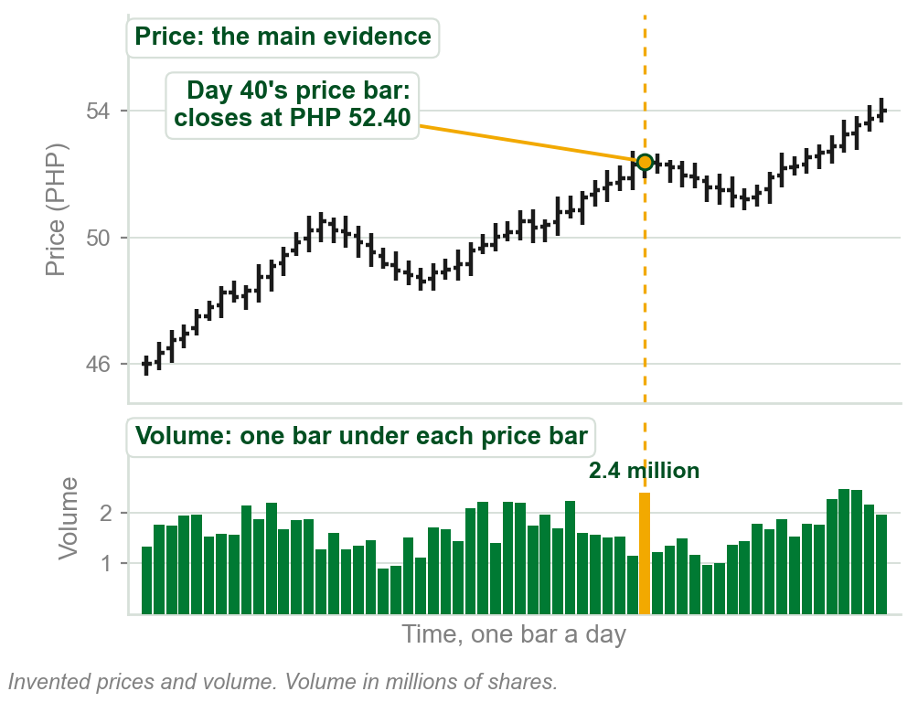
6.1 Price first: volume and open interest as evidence
Price is regarded as the best indicator of future price. Volume and open interest are extra evidence: they back up, or corroborate, a setup, show weakness, time breakouts.
Chart A, ours: every chart today has price bars on top, one volume bar under each. Day 40: PHP 52.40, 2.4 million shares.
Novices misread falling volume in a consolidation as weakness: it times the breakout.
Why: Part 2. Volume: defined below. Open interest: Part 4.
Chart A - FIN1209 teaching chart, drawn for this course. Illustrative data, not a real instrument.
Part 1 of 6 - 6.1 Confirmation | 1 of 29
Book p.173, the chapter's opening paragraph. The chart is ours, on invented prices, to show how the book's figures draw volume.

Slide 5
Chapter 2's tenet: volume confirms the trend
Chapter 2, Dow Theory: volume should expand in the direction of the trend. Big on moves with the trend, small on retracements, the moves against it.
(1) Uptrend: volume rises as price rises, falls on the dips: bullish volume action, the book says.
(2) Downtrend: volume rises as price falls, falls on the bounces: bearish volume action.
FIGURE 6.1
Two sketches of volume confirming a trend. Top: a rising price with volume bars that grow on the rise and shrink in the downside retracement, labelled bullish volume action in an uptrend. Bottom: a falling price with volume that grows on the fall and shrinks in the upside retracement, labelled bearish volume action in a downtrend.
1
Both confirm their trend. Numbers on the next slide.
2
Volume is a supporting, or secondary, indicator. Volume doing the opposite: an uptrend may be bearish, a downtrend bullish.
Figure 6.1 - Lim, The Handbook of Technical Analysis (Wiley, 2016)
Part 1 of 6 - 6.1 Confirmation | 2 of 29
Book pp.173-174 and Figure 6.1. The tenet was a Chapter 2 term, Volume must confirm the trend.

Slide 6
The tenet with numbers
Uptrend, ours: price climbs PHP 40 to 46 as volume grows from 2 to 4 million shares a day, then dips to 44 on 1 million. Confirmed.
Downtrend, ours: price falls PHP 50 to 46 as volume grows from 2 to 4 million a day, then bounces to 48 on 1 million. Confirmed.
Same pattern, big with the trend and small against it, but two names. Uptrend: price and volume move the same way, bullish. Downtrend: opposite ways, bearish.
Bearish here is not a warning. It is volume backing a fall.
Why opposite ways is called bearish: the term Bullish volume and bearish volume, and the slide after it.
Part 1 of 6 - 6.1 Confirmation | 3 of 29
Book pp.173-174 states the tenet and its two names. The prices and share counts are ours.

Slide 7
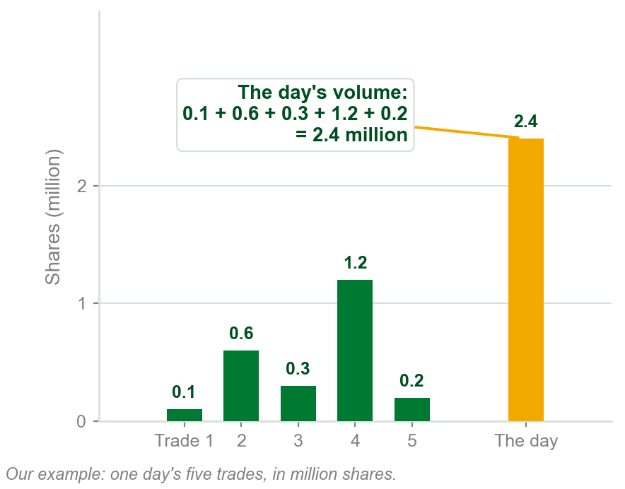
NEW TERM
Volume
IN PLAIN WORDS
How much was traded in one period: the bar under each price bar. Used since Chapter 1, first defined here.
FOR EXAMPLE
Five trades in one day: 0.1, 0.6, 0.3, 1.2 and 0.2 million shares. That day's volume is 2.4 million shares.
THE FORMAL DEFINITION
Volume is an indication of market participation. It is the total number of shares or contracts traded over a specific time interval.
Chart B - FIN1209 teaching chart, drawn for this course. Illustrative data, not a real instrument.
Part 1 of 6 - 6.1 Confirmation | 4 of 29
Book p.174 gives the definition. The trades and the share counts in the example and on the chart are ours.

Slide 8
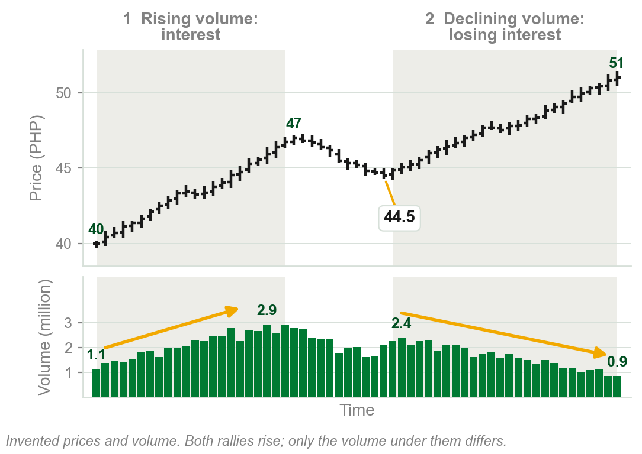
Two principles: rising and declining volume
1 Rising volume: more want price to keep going the trend's way, and will buy higher in an uptrend or sell lower in a downtrend.
2 Declining volume: losing interest. They would rather buy lower in an uptrend, sell higher in a downtrend, or leave.
Chart C: rally 1, PHP 40 to 47, on volume rising 1.1 to 2.9 million. Rally 2, 44.5 to 51, on volume falling 2.4 to 0.9 million.
Volume measures participation.
Chart C - FIN1209 teaching chart, drawn for this course. Illustrative data, not a real instrument.
Part 1 of 6 - 6.1 Confirmation | 5 of 29
Book p.174: its two basic principles, in plainer words. The chart is ours, on invented prices; the numbers are read off it.

Slide 9
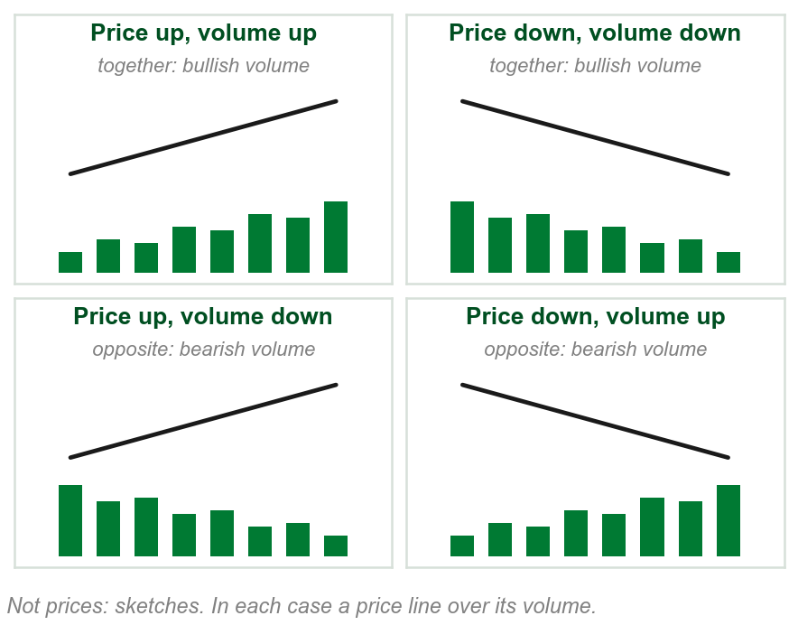
NEW TERM
Bullish volume and bearish volume
IN PLAIN WORDS
Compare price's direction with volume's. Same way: bullish volume. Opposite: bearish volume.
FOR EXAMPLE
Ours: price PHP 50 to 46 as volume grows 2 to 4 million: opposite, bearish. Price 50 to 46 as volume shrinks 4 to 2 million: same way, bullish.
THE FORMAL DEFINITION
Both rising and declining volume are regarded as bullish volume if volume and price rise and decline together, and as bearish volume if they move in opposite directions.
Chart D - FIN1209 teaching chart, drawn for this course. Illustrative data, not a real instrument.
Part 1 of 6 - 6.1 Confirmation | 6 of 29
Book pp.174-175 states it for an uptrend, then a downtrend. Joined into one line here: our summary of its four sentences. The numbers are ours.

Slide 10
Why falling price on rising volume is bearish
Volume counts shares that changed hands. Every share traded has a buyer and a seller, so volume alone never says buyers outnumber sellers.
Principle 1: rising volume is more people taking part in the move. PHP 50 to 46 on 2 to 4 million: more sell lower. The fall has backing: bearish.
Principle 2, the other way: price 50 to 46 on 4 to 2 million shares: fewer willing to sell lower. The fall is losing its backing, so bullish.
Rising volume is not demand. It is more trading in the direction price is already going.
Part 1 of 6 - 6.1 Confirmation | 7 of 29
Book p.174: the definition and the two principles. Ours: the buyer and seller point, which follows from the definition, and the numbers.

Slide 11
Rising volume is not always bullish
The book: declining volume does not imply bearishness, nor rising volume bullishness. PHP 50 to 46 on 2 to 4 million: rising, yet bearish.
Figure 6.2, gold: (1) about 260 in 2001 to 1,900 in 2011 as volume expands (2): bullish. (3) Then to about 1,200 in 2013 as volume declines: bullish too.
3
FIGURE 6.2
The continuous daily chart of gold from 1989 to 2013: a primary bull trend from 2001, its volume expanding in the direction of the trend, and volume declining in the retracement at the end, labelled bullish.
1
2
Read price's direction first, then volume's.
Figure 6.2 - Lim, The Handbook of Technical Analysis (Wiley, 2016)
The book calls reading volume alone, falling means bad, a simple mistake many novices make.
Part 1 of 6 - 6.1 Confirmation | 8 of 29
Book p.175 and Figure 6.2, its prices read off the figure. The peso example is ours.

Slide 12
Volume that does not confirm the trend
Confirming volume is big with the trend, small against it. Not confirming is the reverse.
(1) Uptrend, ours: PHP 40 to 46 as volume shrinks 4 to 2 million, dip to 44 as it grows to 3. Opposite ways: bearish volume, a potentially weak uptrend.
(2) Downtrend, ours: PHP 50 to 46 as volume shrinks 4 to 2 million, bounce to 48 as it grows to 3. Same way: bullish volume, a potentially bullish downtrend.
FIGURE 6.3
Two sketches of volume not confirming a trend. Top: a rising price whose volume shrinks on the rise and grows in the retracement, labelled bearish volume action in an uptrend. Bottom: a falling price whose volume shrinks on the fall and grows in the upside retracement, labelled bullish volume action in a downtrend.
1
2
A warning, not a reversal.
Figure 6.3 - Lim, The Handbook of Technical Analysis (Wiley, 2016)
Part 1 of 6 - 6.1 Confirmation | 9 of 29
Book p.175 and Figure 6.3. The prices and share counts are ours: the tenet's numbers with the volume swapped.

Slide 13
Two questions, asked in order
1 Bullish or bearish volume? Price and volume only, no trend: same direction bullish, opposite bearish.
2 Does it confirm the trend? In an uptrend bullish volume confirms; in a downtrend bearish volume confirms. The other kind does not.
Downtrend, PHP 50 to 46, volume 2 to 4 million: bearish, so it confirms.
Uptrend dip, PHP 46 to 44, volume 1 to 3 million: bearish, so it does not.
Bearish is not the same as not confirming.
Part 1 of 6 - 6.1 Confirmation | 10 of 29
Our summary of the book's pp.174-175, which states both for each trend. The prices and share counts are ours.

Slide 14
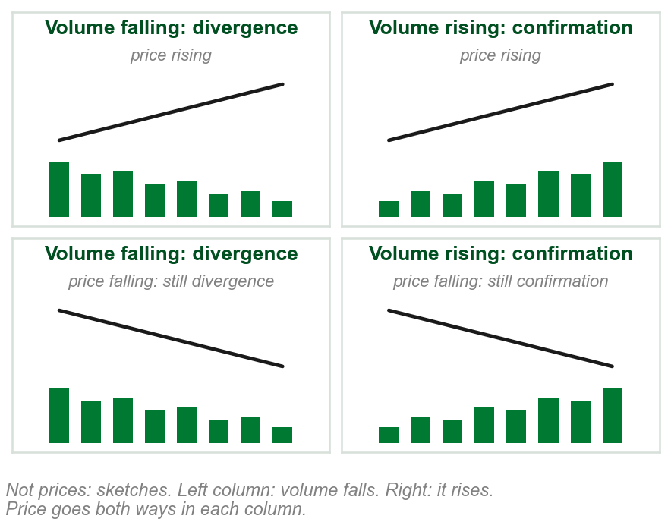
NEW TERM
Volume divergence and volume confirmation
IN PLAIN WORDS
Leave price out. Volume falling: divergence. Volume rising: confirmation, or convergence.
FOR EXAMPLE
Ours: price PHP 40 to 46 as volume shrinks 3 to 1 million: divergence. Volume 3 to 5 million instead: confirmation.
THE FORMAL DEFINITION
Volume divergence occurs whenever volume declines, irrespective of the direction of price. Volume convergence or confirmation occurs whenever volume rises, irrespective of the direction of price.
Chart E - FIN1209 teaching chart, drawn for this course. Illustrative data, not a real instrument.
Part 1 of 6 - 6.1 Confirmation | 11 of 29
Book p.175 defines both. The prices and share counts are ours; the chart is ours, sketches, not prices.

Slide 15
Not bullish and bearish renamed
Bullish or bearish asks about price and volume together. Divergence or confirmation asks about volume alone. Two questions, two answers.
Ours: price PHP 40 to 46 on volume 2 to 4 million. Same way: bullish. Volume up: confirmation. Here the two answers line up.
Price PHP 50 to 46 on volume 2 to 4 million. Opposite ways: bearish. Volume up: still confirmation. Here they do not.
Bullish or bearish needs price. Divergence or confirmation needs only volume.
Part 1 of 6 - 6.1 Confirmation | 12 of 29
Book p.175 defines both pairs. The comparison and the numbers are ours.

Slide 16
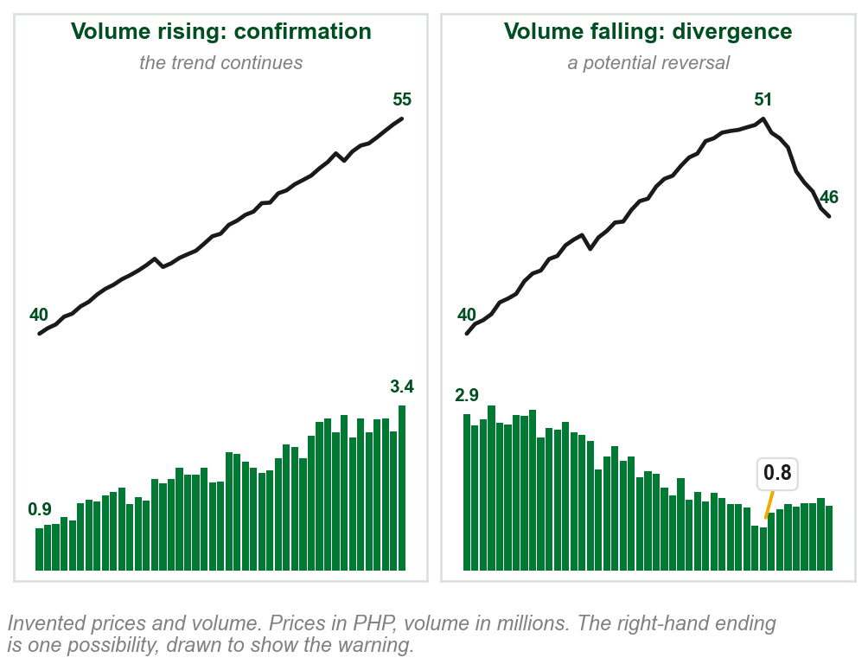
What divergence and confirmation say
Divergence, volume falling: on a rise, fewer will buy higher, bearish for an uptrend; on a fall, fewer will sell lower, bullish for a downtrend.
Confirmation, volume rising: with a rise, bullish for an uptrend; with a fall, bearish for a downtrend.
Chart F: left, PHP 40 to 55, volume 0.9 to 3.4 million: it continues. Right, 40 to 51, volume 2.9 to 0.8: it turns.
Both are early warnings, not certainties.
Chart F - FIN1209 teaching chart, drawn for this course. Illustrative data, not a real instrument.
Part 1 of 6 - 6.1 Confirmation | 13 of 29
Book pp.175-176. The chart is ours, on invented prices; the numbers are read off it.

Slide 17
Confirms the trend, or volume confirmation
Volume confirms the trend (Chapter 2, p.174): over the whole trend, big with it and small against it. It judges the pattern.
Volume confirmation (p.175): on one stretch, volume rising. It judges one leg at a time.
Ours: PHP 40 to 46 on 2 to 4 million, a dip to 44 on 1 million. The trend is confirmed. The dip alone, volume falling with price, is bullish divergence.
One dip can be a bullish divergence inside a confirmed uptrend.
The next slide finds both on the book's own chart.
Part 1 of 6 - 6.1 Confirmation | 14 of 29
Book p.174 (the tenet) and p.175 (volume confirmation). The prices and share counts are the tenet's, ours.

Slide 18
Both on one chart: Figure 6.6
(1) Over the whole rise, volume expands: the trend is confirmed.
(2) and (3) The dips of periods 4 and 6, on falling volume: the book labels each bullish divergence.
FIGURE 6.6
The SPDR Gold Trust over about four years, split by dashed lines into ten numbered periods. Volume expands across the whole uptrend, and periods 4 and 6 are dips on falling volume, labelled bullish divergence by the book.
2
3
A confirmed uptrend with two bullish divergences inside it.
1
Figure 6.6 - Lim, The Handbook of Technical Analysis (Wiley, 2016)
Part 1 of 6 - 6.1 Confirmation | 15 of 29
Book p.178 and Figure 6.6: the book labels the whole trend bullish volume and two of its dips bullish divergence.

Slide 19
NEW TERM
Bullish and bearish divergence and confirmation
IN PLAIN WORDS
One name from two answers: bullish or bearish, then divergence or confirmation.
1
FIGURE 6.4
Four columns, each a price path over a supporting series. Bearish divergence: price rising, the supporting series falling. Bullish confirmation: both rising. Bearish confirmation: price falling, the supporting series rising. Bullish divergence: both falling. The supporting series is listed as volume bars, a volume moving average, open interest, and the ATR in brackets.
FOR EXAMPLE
Ours: PHP 50 to 46, volume 2 to 4 million: opposite, bearish; volume up, confirmation. Figure 6.4's third column (1): price top, volume below.
THE FORMAL DEFINITION
Volume and price declining together: bullish divergence. Rising together: bullish confirmation. Volume declining, price rising: bearish divergence. Volume rising, price declining: bearish confirmation.
Figure 6.4 - Lim, The Handbook of Technical Analysis (Wiley, 2016)
Part 1 of 6 - 6.1 Confirmation | 16 of 29
Book pp.176-178 and Figure 6.4. The formal row is its p.178 summary. The ATR on the figure is in no sentence of the text. The numbers are ours.

Slide 20
What each of the four tells
Bullish divergence, PHP 50 to 46 as volume falls 3 to 1 million: fewer will sell lower. A potential upside reversal.
Bearish divergence, PHP 46 to 50 as volume falls 3 to 1 million: fewer will buy higher. A potential downside reversal.
Bullish or bearish confirmation, volume rising with the move: more are taking part. A potential continuation.
Divergence warns of a turn. Confirmation, of backing.
The book: divergence always indicates potential weakness, confirmation potential strength.
Part 1 of 6 - 6.1 Confirmation | 17 of 29
Book pp.175-177: what each name indicates, from its two principles on p.174.

Slide 21
Where divergence can occur: the book and its figure
The book: bullish divergence can only occur in a downtrend, bearish only in an uptrend (p.176).
(1) Yet on Figure 6.6, price rises from about 42 to about 120, the span on the right: an uptrend.
Inside it, the book labels the dips of periods 4 (2) and 6 (3), price and volume falling together, bullish divergence.
FIGURE 6.6
The SPDR Gold Trust over about four years, rising from about 42 to about 120, split into ten numbered periods. Periods 4 and 6 are dips on falling volume inside that uptrend, labelled bullish divergence by the book.
2
3
1
Our reading: the p.178 summary applies to any stretch, so a dip inside an uptrend can be bullish divergence.
Figure 6.6 - Lim, The Handbook of Technical Analysis (Wiley, 2016)
Part 1 of 6 - 6.1 Confirmation | 18 of 29
Book pp.176-177 for where each can occur, and Figure 6.6 (p.178). Our reading is said to be ours.

Slide 22
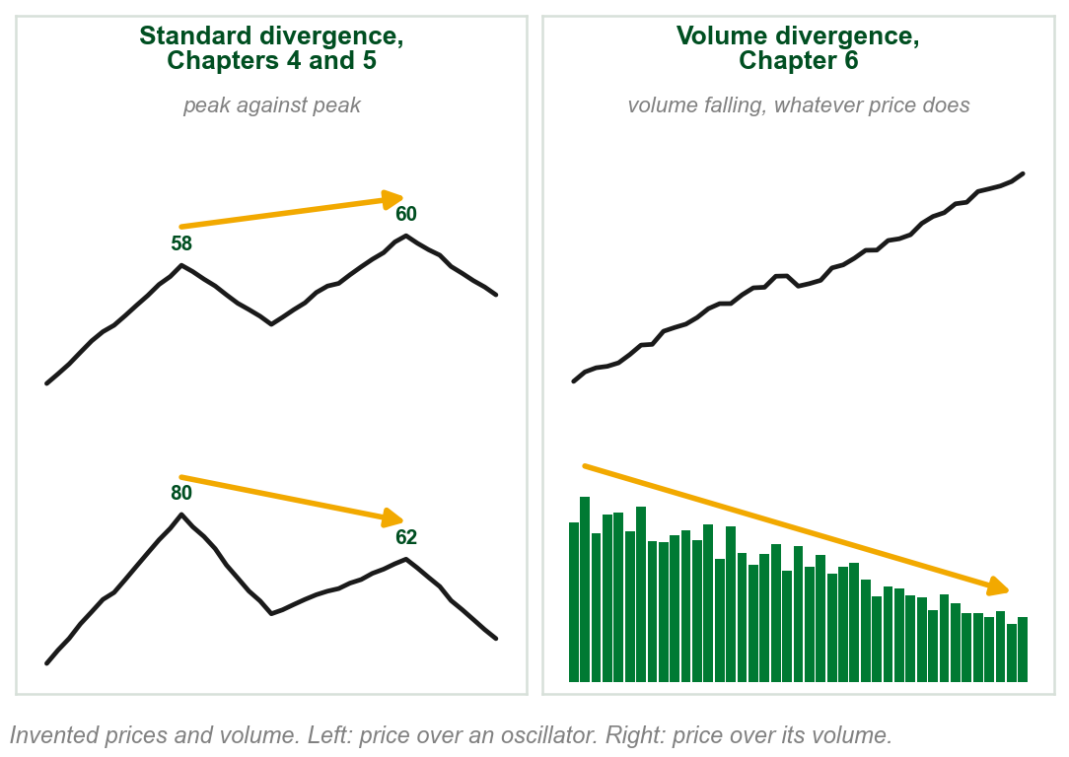
Not the divergence Chapters 4 and 5 drew
Chapters 4 and 5, standard divergence: compare two peaks. Ours: price peaks at PHP 58, then higher at 60; an oscillator peaks at 80, then lower at 62.
Volume divergence compares no peaks: volume declining, whatever price does. Price's direction still decides bullish or bearish.
Volume has no reverse divergence (p.176): one kind only, volume falling.
Chapter 5 only named reverse divergence, left to Chapter 9. Chapter 4: bullish divergence in volume is falling price on decreasing volume.
Chart G - FIN1209 teaching chart, drawn for this course. Illustrative data, not a real instrument.
Part 1 of 6 - 6.1 Confirmation | 19 of 29
A recall of this course's Chapters 4 and 5, against the book's p.176. The chart is ours, on invented prices; its peaks are read off it.

Slide 23
Bullish volume divergence: Isis Pharmaceuticals
(1) Isis Pharmaceuticals falls from about 12 to about 9 and curves into a rounding bottom, a bullish pattern from Chapter 4.
In two stretches, (2) and (3), volume falls as price falls: volume falling, divergence; with price, bullish. Fewer are willing to sell lower.
FIGURE 6.5
An intraday chart of Isis Pharmaceuticals: price falls steeply and curves into a larger rounding bottom pattern, and the volume panel under it carries two dashed lines falling to the right, each labelled bullish volume divergence.
1
Divergence provides additional evidence of a bullish chart formation.
2
3
Figure 6.5 - Lim, The Handbook of Technical Analysis (Wiley, 2016)
The chart's note: Isis rose past the previous day's close though the Dow Jones Industrial Average fell 219 points, a bullish indication.
Part 1 of 6 - 6.1 Confirmation | 20 of 29
Book p.177 and Figure 6.5, its prices read off the figure. Its caption says daily; the chart is labelled 10 min. Rounding bottom: Chapter 4.

Slide 24
Ten periods of bullish volume: gold
1, 3 (1), 7 and 9: price and volume rise, bullish confirmation. 4 (2) and 6 (3): price dips as volume falls, bullish divergence. 5: volume flat, no reading.
2 (4), 8 and 10: volume falls as price moves sideways, a consolidation (Chapter 4). At volume's minimum, price breaks out.
FIGURE 6.6
The SPDR Gold Trust over about four years, split by dashed lines into ten numbered periods, with arrows on the volume panel showing volume rising or falling in each, under the label volume expanding in the direction of the existing trend.
2
3
In a consolidation, volume times the breakout: Part 2.
4 and 6 are dips inside this uptrend, yet the book labels them bullish divergence: its p.178 summary applied to a falling stretch.
4
1
Figure 6.6 - Lim, The Handbook of Technical Analysis (Wiley, 2016)
Part 1 of 6 - 6.1 Confirmation | 21 of 29
Book p.178 and Figure 6.6. Its caption says a daily chart; the chart itself is labelled weekly.

Slide 25
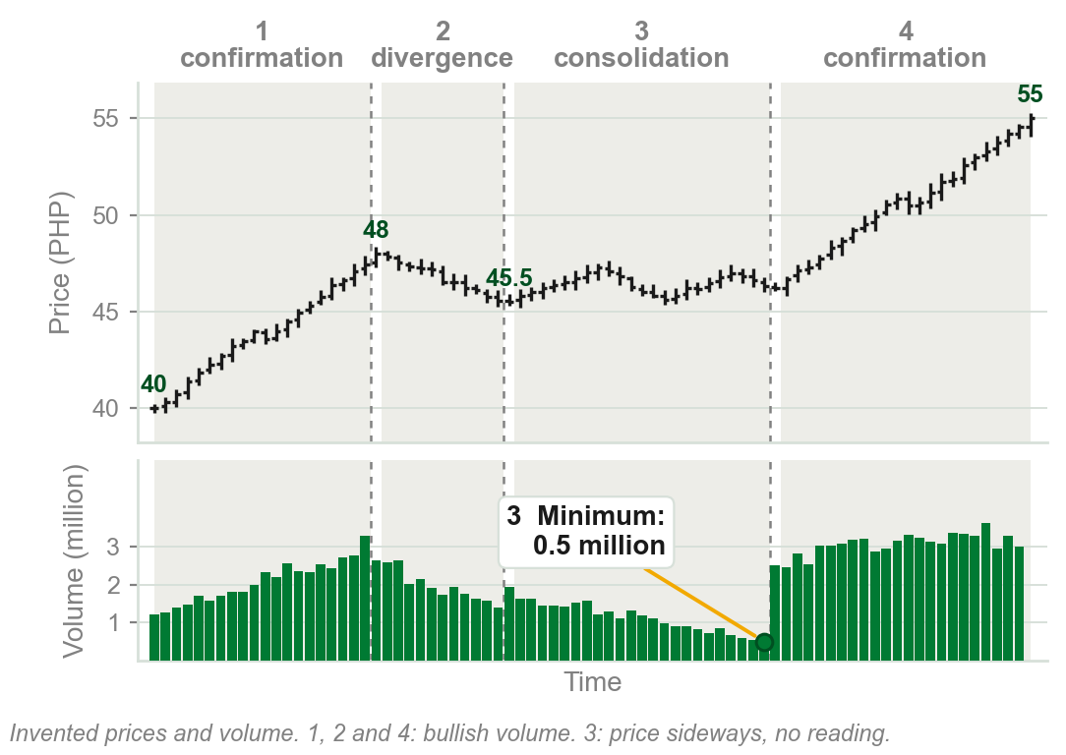
Our example: one uptrend, period by period
1 PHP 40 to 48, volume about 1.2 to 3.3 million: both rise, bullish confirmation.
2 Dip to 45.5, volume about 2.7 to 1.4 million: both fall, bullish divergence. Fewer will sell lower: a weak dip, and 4 resumes the trend.
3 Sideways, 45.5 to 47.3, volume down to 0.5 million: a consolidation.
4 Breakout, 46 to 55, volume about 2.5 to 3 million: bullish confirmation.
3: no direction, no reading (p.180).
Chart H - FIN1209 teaching chart, drawn for this course. Illustrative data, not a real instrument.
Part 1 of 6 - 6.1 Confirmation | 22 of 29
Ours: Figure 6.6's readings on one invented uptrend, so each period can be seen. The periods, prices and volumes are ours, read off the chart.

Slide 26
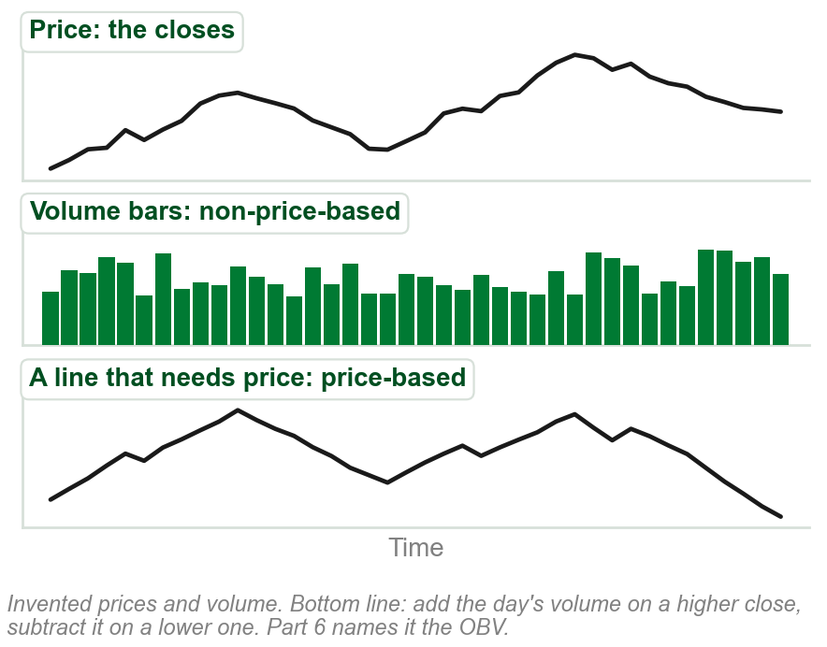
NEW TERM
Price-based and non-price-based volume oscillators
IN PLAIN WORDS
Oscillator: an indicator under price. Price-based: price built in. Non-price-based: volume only.
FOR EXAMPLE
Ours: closes PHP 50, 51, 50.5 on 2, 3, 1 million. Bars: 2, 3, 1. Line: start at 0; 51 is higher, add 3: 3; 50.5 is lower, subtract 1: 2.
THE FORMAL DEFINITION
Price-based volume oscillators incorporate price data in their construction, whereas non-price-based volume oscillators only incorporate volume data in their construction.
Chart I - FIN1209 teaching chart, drawn for this course. Illustrative data, not a real instrument.
Part 1 of 6 - 6.1 Confirmation | 23 of 29
Book pp.178-179 defines both; our gloss of oscillator. The numbers are ours. The chart is ours, on invented prices; its line is the rule taught in Part 6.

Slide 27
The book's two lists
Price-based: On Balance Volume (OBV), Accumulation/Distribution Line (ADL), Chaikin Money Flow, Chaikin Oscillator, Demand Index, Herrick Payoff Index.
Non-price-based: standard volume bars, smoothed volume, detrended volume, rate of change of volume (ROC volume), percentage volume oscillator (PVO).
So plain volume bars count as a non-price-based volume oscillator.
Reading divergence on one kind differs from reading it on the other.
Taught later: OBV, ADL, the two Chaikin indicators and the Herrick index in Part 6, smoothed volume in Part 3. The Demand Index, detrended volume, ROC volume and the PVO are named and never explained.
Part 1 of 6 - 6.1 Confirmation | 24 of 29
Book p.179: its two lists, as printed. Where each is taught is this course's note.

Slide 28
Reading divergence on the two kinds
(1) Non-price-based, plain volume included: bullish if it moves with price, bearish if against. Divergence if it falls, confirmation if it rises.
(2) Price-based, such as the OBV: bullish if it rises, bearish if it falls. Divergence if it moves against price, confirmation if with it.
Figure 6.7: top half divergence, bottom half confirmation; left (1) plain volume, right (2) price-based. Two arrows flip, (3) and (4).
FIGURE 6.7
Eight pairs of arrows, a price arrow over a volume arrow, in four boxes: divergence and confirmation, each for non-price-based and price-based volume oscillators. The two kinds differ only in bullish divergence and bearish confirmation, where the price-based volume arrow points the other way.
3
4
First ask which kind you are reading.
1
2
Figure 6.7 - Lim, The Handbook of Technical Analysis (Wiley, 2016)
Book: only bullish divergence and bearish confirmation differ.
Part 1 of 6 - 6.1 Confirmation | 25 of 29
Book p.179 and Figure 6.7. The two rules are our summary of the figure's eight arrows; the book gives no reason the two kinds differ.

Slide 29
The four names on both kinds, with numbers
Price rising, PHP 46 to 50: both kinds read alike. Volume 3 to 5 million, OBV 5 to 7: bullish confirmation. Both down: bearish divergence.
Price falling, 50 to 46, bullish divergence: volume falls 3 to 1 million, with price; the OBV rises 5 to 7 million, against price.
Price falling, 50 to 46, bearish confirmation: volume rises 3 to 5 million, against price; the OBV falls 5 to 3 million, with price.
Price falling: same names, opposite arrows.
Plain volume: rising is confirmation. A price-based line: moving with price is confirmation.
Part 1 of 6 - 6.1 Confirmation | 26 of 29
Book p.179: the four names on both kinds. The prices and the volume and OBV numbers are ours.

Slide 30
The same four on Figure 6.7's arrows
(1) and (2) Bullish confirmation, price rising: the volume arrows match on both kinds.
(3) and (4) Bullish divergence: plain volume falls with price; the price-based arrow rises.
(5) and (6) Bearish confirmation: plain volume rises; the price-based arrow falls with price.
3
4
FIGURE 6.7
Eight pairs of arrows, a price arrow over a volume arrow, in four boxes. With price rising the two kinds of oscillator match; with price falling, in bullish divergence and bearish confirmation, the price-based volume arrow points the other way.
5
6
Only the two price-falling cases flip.
1
2
Figure 6.7 - Lim, The Handbook of Technical Analysis (Wiley, 2016)
Part 1 of 6 - 6.1 Confirmation | 27 of 29
Book p.179 and Figure 6.7: where the two kinds' arrows match and where they differ.

Slide 31
Both kinds on one chart: price and volume
(1) The trust rises from about 129 to 133, October to January.
(2) Volume and smoothed volume, a 20-day average, non-price-based: falling, against price: bearish divergence.
FIGURE 6.8
The top of Figure 6.8: a daily chart of the Currency Shares Euro Trust rising from about 129 to 133, and under it volume with a smoothed line, labelled bearish divergence.
1
2
Plain volume falling under a rising price: bearish divergence.
Smoothed volume: Part 3. The figure's two lower panels come next.
Figure 6.8 - Lim, The Handbook of Technical Analysis (Wiley, 2016)
Part 1 of 6 - 6.1 Confirmation | 28 of 29
Book p.180 and Figure 6.8, its prices read off the figure. Shown: its price and volume panels.

Slide 32
Both kinds on one chart: the PVO and the ADL
The same months, the same price rising from about 129 to 133.
(1) The PVO, a detrended volume oscillator the book never explains: non-price-based, falling: bearish divergence too.
(2) ADL, price-based: rising, with price: bullish confirmation.
FIGURE 6.8
The bottom of Figure 6.8: a detrended volume oscillator, the PVO, labelled bearish divergence, and under it the accumulation distribution line rising, labelled bullish confirmation.
1
2
Figure 6.8 - Lim, The Handbook of Technical Analysis (Wiley, 2016)
Each kind read by its own rule.
The book gives no rule for which reading to believe.
Part 1 of 6 - 6.1 Confirmation | 29 of 29
Book p.180 and Figure 6.8. Shown: its two lower panels. PVO and detrending are on the figure and not explained by the book.

Slide 33
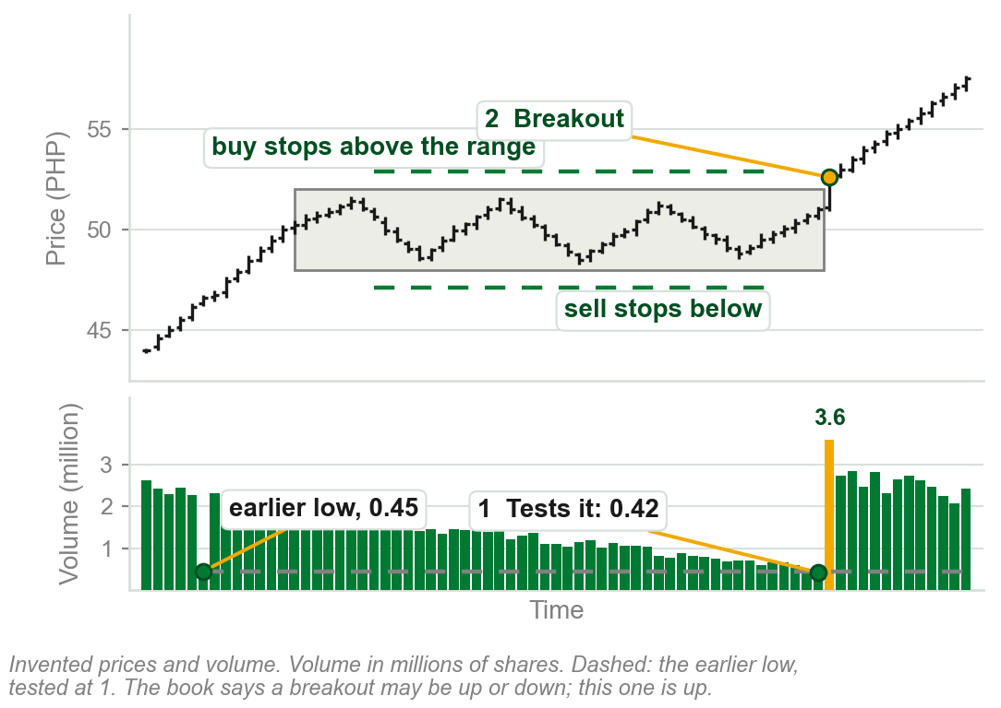
6.1 Volume as a timing indicator
Consolidation: price moving sideways in a range, here PHP 48 to 52.
The book: as volume falls close to its lowest historical level, a breakout from the range is expected.
Ours: an earlier low, 0.45 million, sets the dashed level. Volume falls back to 0.42 at 1, testing it; at 2 price breaks out on 3.6 million.
No divergence reading in a range: price moves sideways.
So falling volume in a range is not weakness. How far back historical reaches, the book does not say.
Chart J - FIN1209 teaching chart, drawn for this course. Illustrative data, not a real instrument.
Part 2 of 6 - 6.1 Timing | 1 of 30
Book p.180. Consolidation and breakout: Chapters 2 and 4. The chart is ours, on invented prices and volume; the numbers are read off it.

Slide 34
Why the lowest volume times the breakout
1 Volume shrinks as each side finishes: most who wanted to buy have bought, most who wanted to sell have sold.
2 Stop orders pile up outside the range: buy stops above PHP 52, sell stops below PHP 48 (Chapter 1: they trade once price pushes through their level).
3 When price reaches one edge, those stops trigger together and push it out: the catalyst.
4 Up or down, the book does not say: let price show the way.
What to do: volume back at an earlier low, expect a breakout.
Part 2 of 6 - 6.1 Timing | 2 of 30
Book p.180: the reasons are the book's. Stop orders: Chapters 1 and 5. The PHP 48 and 52 edges are ours.

Slide 35
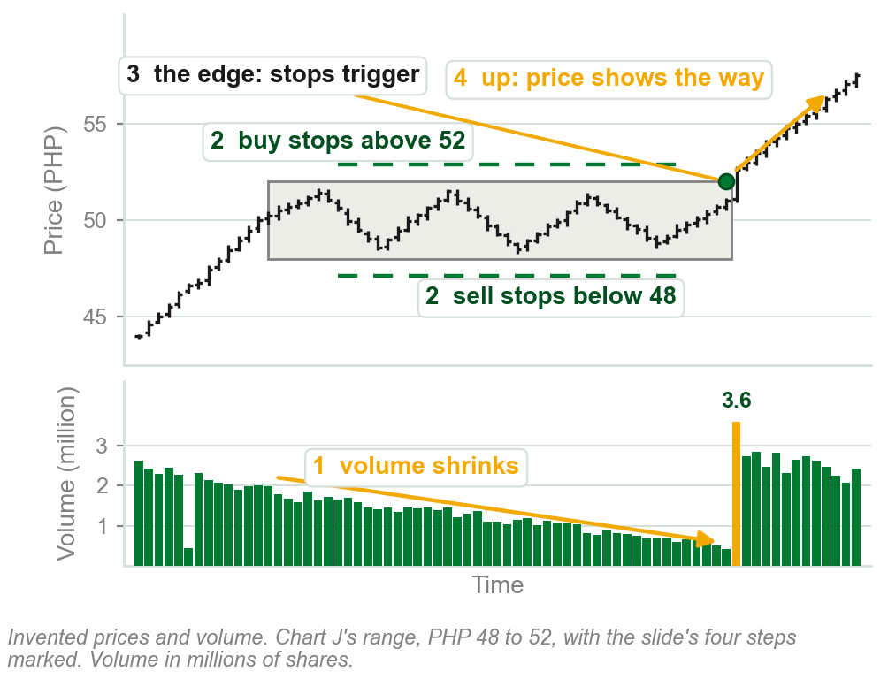
The four steps on one range
1 Volume shrinks, to 0.42 million.
2 Buy stops wait above PHP 52, sell stops below PHP 48.
3 Price reaches the top edge: the buy stops trigger.
4 It breaks out up, on 3.6 million.
The quiet range is where the breakout is loaded.
Chart GA - FIN1209 teaching chart, drawn for this course. Illustrative data, not a real instrument.
Part 2 of 6 - 6.1 Timing | 3 of 30
Book p.180's four reasons, drawn on our invented range, PHP 48 to 52. Every price and volume is ours.

Slide 36
NEW TERM
Low volume breakout signal
IN PLAIN WORDS
A signal, not a trade: in a range, volume falls back to a low it has touched before, testing it. Expect price to leave the range soon, up or down.
FIGURE 6.9
A daily Apple chart with a low volume level drawn across its volume panel. Circles mark two low volume reversals at time lines 1 and 2, a bearish divergence and a bearish confirmation, and later an accumulation box that price leaves on a low volume breakout signal.
2
FOR EXAMPLE
Figure 6.9, Apple: in late March, inside the Accumulation box (2), a buying range (Chapters 2 and 4), volume falls back to the dashed low volume level (1), at (3). In April price breaks out of the top.
THE FORMAL DEFINITION
Whenever the volume is testing a significant minimum or its lowest historical levels, a breakout is expected. We refer to this as a low volume breakout signal.
1
3
Figure 6.9 - Lim, The Handbook of Technical Analysis (Wiley, 2016)
Part 2 of 6 - 6.1 Timing | 4 of 30
Book pp.180-181 and Figure 6.9. Accumulation: Chapters 2 and 4.

Slide 37
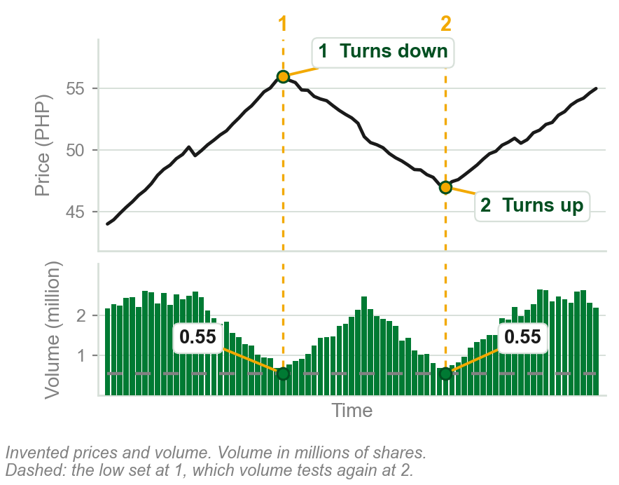
NEW TERM
Low volume reversal
IN PLAIN WORDS
Price turns as volume sits at its minimum. In a trend, volume testing its low says the trend may turn, the book's tendency; price shows which way.
FOR EXAMPLE
Ours: volume shrinks to 0.55 million at 1, the PHP 56 peak, and price turns down. That low is the dashed line. At 2, PHP 47, volume falls back to it and price turns up.
THE FORMAL DEFINITION
There is a tendency for price to reverse when volume is at its minimum or lowest historical levels. We refer to such reversals as low volume reversals.
Chart K - FIN1209 teaching chart, drawn for this course. Illustrative data, not a real instrument.
Part 2 of 6 - 6.1 Timing | 5 of 30
Book p.180 gives the term; Figure 6.9 (p.181) has two. The chart is ours, on invented prices, because that figure is dense. The book does not say how the low is set.

Slide 38
Breakouts at the lowest volume: silver
The three boxes are consolidations. The low volume threshold (1) runs low across the volume panel, near 10 million shares.
Dotted arrows: volume falls to it in each box. Then price breaks out: up at 1, from an accumulation; down at 2 and 3, from distributions, ranges where informed holders sell.
Volume rises on the breakout bars, (2), (3) and (4), under the book's 1, 2 and 3.
FIGURE 6.10
The daily iShares Silver Trust with three consolidations boxed and a low volume threshold drawn across the volume panel. Dotted arrows show volume falling to the threshold in each box, and the breakouts at bars 1, 2 and 3 follow, with volume rising on each breakout bar.
2
3
4
1
One signal, three times: it said when; price chose the way.
Figure 6.10 - Lim, The Handbook of Technical Analysis (Wiley, 2016)
Part 2 of 6 - 6.1 Timing | 6 of 30
Book p.181 and Figure 6.10. Accumulation and distribution: Chapters 2 and 4. The 10 million is read by eye off the figure's scale.

Slide 39
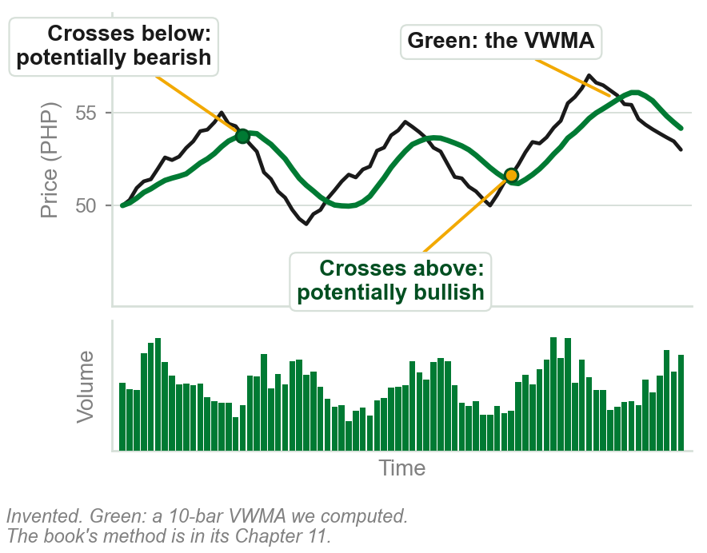
NEW TERM
Volume-weighted moving average, VWMA
IN PLAIN WORDS
A moving average: the average of the last few closes, redone at each new bar. Volume-weighted: each close counts by its volume, so heavy days pull the line toward their price.
FOR EXAMPLE
Line at PHP 50: price at 52, above it, is potentially bullish; at 48, below it, potentially bearish. Our chart: the gold dot crosses above, the green dot below.
THE FORMAL DEFINITION
A VWMA may be created to track overvalued and undervalued stock. Typically, price is considered potentially bullish when it is above the VWMA, and bearish when below it.
Chart L - FIN1209 teaching chart, drawn for this course. Illustrative data, not a real instrument.
Part 2 of 6 - 6.1 Timing | 7 of 30
Book p.181. It defers the calculation to Chapter 11. Moving averages: met in Chapters 4 and 5. The chart is ours; its line is a 10-bar VWMA we computed.

Slide 40
How our VWMA line is computed, with numbers
Ours: three bars close at PHP 50, 52 and 54, on 1, 1 and 2 million shares.
Plain average: (50 + 52 + 54) / 3 = PHP 52. Every bar counts the same.
Volume-weighted: each close times its volume, added up, divided by the total volume: (50 x 1 + 52 x 1 + 54 x 2) / 4 = 210 / 4 = PHP 52.50.
The heavy PHP 54 day pulls the line up toward it. At the next bar, drop the oldest, add the newest, compute again; our charts use 10 bars.
The VWMA: the average price, weighted by how much traded at it.
Part 2 of 6 - 6.1 Timing | 8 of 30
Ours: how our charts compute the line, read from build/charts_chapter06.py, on invented numbers. The book's own calculation is in its Chapter 11.

Slide 41
The VWMA on a chart
A 10-minute chart of the S&P 500 SPDR. Dashed (1): the line labelled VWAP, volume-weighted average price; the book treats VWAP and VWMA as one line here.
(2) Price rises decisively each time it crosses above the line, and falls after crossing below.
(3) The four circles: each day's volume peak, its busiest stretch (Part 5). Dashed arrows run up from each: the crossovers came at those peaks.
FIGURE 6.11
A 10-minute chart of the S&P 500 SPDR over four days with a dashed volume weighted average price line, labelled price above it bullish and below it bearish, and the line marked as support and as resistance. Circles on the volume panel mark the daily volume cycle peaks, with arrows from them to the crossovers.
1
2
3
Above the line, bullish; below it, bearish.
Figure 6.11 - Lim, The Handbook of Technical Analysis (Wiley, 2016)
So watch each day's busiest stretch: the crossovers came there, and the book gives no rule beyond that. The line also acts as support, a floor, and resistance, a ceiling (Chapter 5).
Part 2 of 6 - 6.1 Timing | 9 of 30
Book p.181 and Figure 6.11. The figure is labelled VWAP on a 10-minute chart; the caption says VWMA, daily. Support and resistance: Chapter 5.

Slide 42
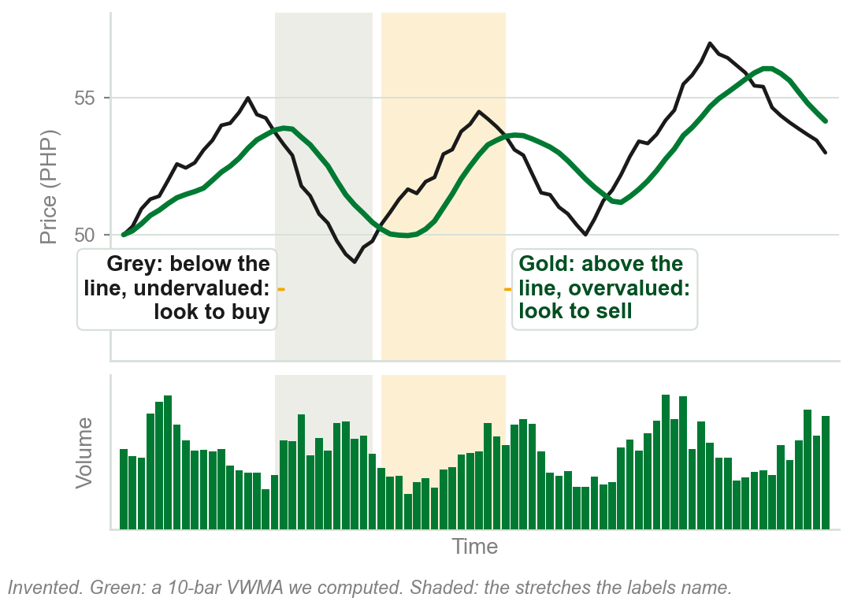
Undervalued below, overvalued above
The book also calls a stock undervalued below the VWMA and overvalued above it.
Its buy signals come from another method, unnamed; the VWMA only decides whether to take one.
Institutions buy only below the line, sell only above. Ours, line at PHP 50: a buy signal at 48, yes; at 52, no.
So above the line is bullish for the trend, yet overvalued: not where institutions buy.
Two readings of one line, both the book's.
Chart M - FIN1209 teaching chart, drawn for this course. Illustrative data, not a real instrument.
Part 2 of 6 - 6.1 Timing | 10 of 30
Book p.181. Both readings are the book's, a paragraph apart; it does not reconcile them. The chart and the PHP 50 example are ours.

Slide 43
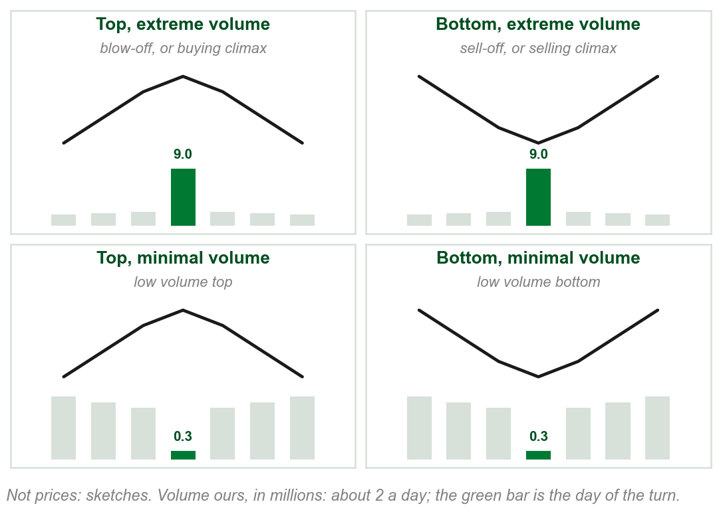
Tops and bottoms: volume at the extremes
Back from the VWMA to volume itself: how much trades on the day a market turns?
The book: tops and bottoms usually come on relatively large or extreme volume, or relatively low or minimal volume.
Ours, usual volume 2 million a day. On 9 million: a top is a blow-off or buying climax; a bottom, a sell-off or selling climax.
On 0.3 million: a low volume top, or a low volume bottom.
Four turns, named by place and by volume.
Chart N - FIN1209 teaching chart, drawn for this course. Illustrative data, not a real instrument.
Part 2 of 6 - 6.1 Timing | 11 of 30
Book pp.182-183, its four scenarios. Chapter 4 named the climaxes by who trades. The chart is ours: sketches, with our invented volumes.

Slide 44
Why the quiet pair matters, and why sell-off
Ours: one peak at PHP 60. On 9 million the rise ends in a frenzy; on 0.3 million it runs out of interest. Watch only spikes and you miss the second.
Every trade has a buyer and a seller; the names say who was rushing.
Selling climax, Chapter 4: a deep fall ends as the uninformed sell at any price and the informed buy from them.
Buying climax, the mirror: a strong rise ends as the uninformed buy at any price and the informed sell to them.
The quiet pair are the low volume reversals: turns on silence.
Part 2 of 6 - 6.1 Timing | 12 of 30
Book pp.182-185. Who trades in each climax: Chapter 4, its accumulation and distribution slides.

Slide 45
NEW TERM
Upper and lower overextended volume levels
IN PLAIN WORDS
Overextended volume: far above usual. The upper level is a line only the most extreme spikes reach; a lower one, still high, is reached more often.
FIGURE 6.12
The daily chart of Exxon Mobil from 2006 to 2013: an ellipse around a market bottom made by two selling climaxes, with arrows down to two volume spikes. Across the volume panel run two lines, upper level volume overextension, near 120 million shares, and lower level volume overextension, near 70 million.
FOR EXAMPLE
Figure 6.12, Exxon Mobil: the extreme volume of two selling climaxes (1), under the ellipse, sets the upper level (2).
2
1
THE FORMAL DEFINITION
The extreme volume level is the upper overextended volume level, a signal for predicting potential bottoms or tops. A lower overextended volume level forecasts less significant corrections.
Figure 6.12 - Lim, The Handbook of Technical Analysis (Wiley, 2016)
Part 2 of 6 - 6.1 Timing | 13 of 30
Book p.183 and Figure 6.12. Exxon Mobil is spelt Exxon Mobile by the book.

Slide 46
Figure 6.12's two levels, read off its scale
(1) Most days trade under 40 million shares.
(2) The lower line: a little under 70 million.
(3) The upper line: a little above 120 million.
(4) and (5) The two spikes that reach it sit under bottoms.
FIGURE 6.12
The daily chart of Exxon Mobil from 2006 to 2013. Most volume bars sit under 40 million shares; a lower overextension line runs near 70 million and an upper one near 120 million, and the two spikes that reach the upper line sit under the market bottom in the ellipse.
3
4
5
2
1
Both lines are far above a usual day.
Figure 6.12 - Lim, The Handbook of Technical Analysis (Wiley, 2016)
Part 2 of 6 - 6.1 Timing | 14 of 30
Book p.183 and Figure 6.12, its scale read by eye.

Slide 47
What the two levels tell you
Both are high volume: lower means less extreme, not low volume.
Upper: potential tops or bottoms, a warning and not a promise. Lower: less significant corrections, smaller moves against the trend.
Exxon's chart shows only bottoms; the book says the same level signals tops too.
Above the line: a potential turn. Which way: price, afterwards.
Part 2 of 6 - 6.1 Timing | 15 of 30
Book p.183. Correction: Chapter 5. Not a promise: the book's word potential, said plainly.

Slide 48
Blow-offs: buying climaxes
A blow-off, or buying climax: a market top on extreme volume, the mirror of Exxon's selling climaxes.
Follow each arrow from BLOW-OFF to its circled volume spike, (1) and (2), then up to the top above it, (3) and (4). Price falls after each.
Relatively high, the book says: the first spike tops 200 thousand shares, the second only about 100 thousand, yet each towers over its neighbours.
4
FIGURE 6.13
The daily chart of the E-TRACS UBS Bloomberg CMCI Food ETN with two circled volume spikes labelled blow-off, each under a market top: the first above 200 thousand shares, the second about 100 thousand.
3
1
2
Figure 6.13 - Lim, The Handbook of Technical Analysis (Wiley, 2016)
Compare a spike with its own neighbours, not with the biggest bar.
Part 2 of 6 - 6.1 Timing | 16 of 30
Book p.183 and Figure 6.13. The volumes are read by eye off the figure's scale.

Slide 49
Where to set the overextension level
By visual inspection, the book says: by eye, no formula. Find the spikes under the most significant tops and bottoms; draw the line just below them.
Set lower, more spikes cross it: more frequent signals, at less significant tops and bottoms.
Figure 6.14, gold: the circled spikes (2) cross the dashed level (1). At the far right price breaks a significant support (3), a level where falls had stopped, on extreme volume.
FIGURE 6.14
The daily SPDR Gold Trust: a dashed volume overextension line across the volume panel with circled spikes above it, a stepped computed line under it, and a dashed support line on the price that is broken at the right on extreme volume, labelled above the rolling 100-day 2-sigma level.
3
2
1
Higher level, fewer and bigger turns.
Figure 6.14 - Lim, The Handbook of Technical Analysis (Wiley, 2016)
The figure's second, computed line: next slide.
Part 2 of 6 - 6.1 Timing | 17 of 30
Book pp.183-184 and Figure 6.14. Support: Chapter 5.

Slide 50
The figure's second line: a rolling 2-sigma level
Rolling 100-day 2-sigma level = 100-day average volume + 2 x sigma. Sigma, the standard deviation: how far volume typically strays from its average.
Ours: average 20 million, sigma 10 million: 20 + 2 x 10 = 40 million. A 35 million day stays under; 55 million crosses.
Rolling: redone daily over the latest 100 days, so the level moves as old days leave the window.
By eye or by formula: only volume above the line counts.
Part 2 of 6 - 6.1 Timing | 18 of 30
Book p.184 names the rolling 100-day 2-sigma level. Ours: the arithmetic and the 20 and 10 million.

Slide 51
The rolling line on Figure 6.14
(1) On Figure 6.14, the solid line under the dashed level is the rolling level.
(2) The August 2011 spikes enter its window: the line steps up.
(3) Some 100 days later they leave, and it drops back.
FIGURE 6.14
The daily SPDR Gold Trust with its volume panel: the solid rolling 100-day 2-sigma line steps up after the August 2011 volume spikes and drops back some 100 days later.
The level follows volume's recent past: what counts as extreme changes over time.
1
2
3
Figure 6.14 - Lim, The Handbook of Technical Analysis (Wiley, 2016)
Part 2 of 6 - 6.1 Timing | 19 of 30
Book p.184 names the rolling line. Ours: why it steps, read by eye off Figure 6.14.

Slide 52
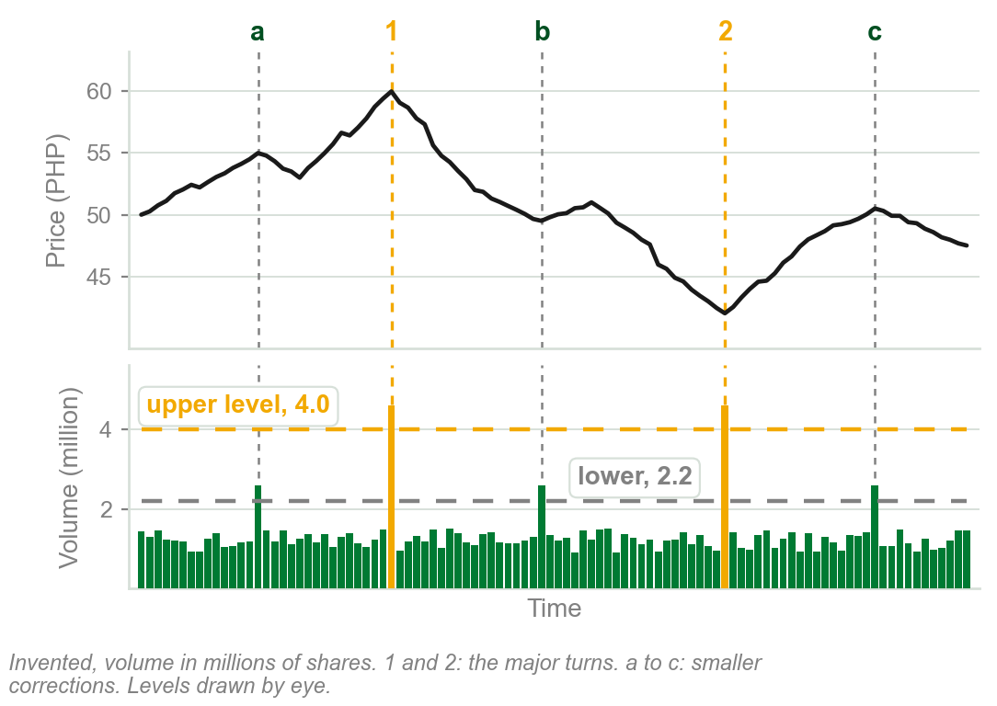
Our example: a higher level and a lower one
Ours: ordinary bars trade 0.9 to 1.5 million shares. Upper level 4.0 million, lower 2.2, both by eye.
Upper: only the spikes of 4.6 million cross it, at 1, the top at PHP 60, and at 2, the bottom at PHP 42. Two signals, both major turns.
Lower: those two, plus spikes of 2.6 million at a, b and c, smaller corrections. Five signals.
Where the line goes decides which turns it signals.
Only the major turns: the upper line. The corrections too: the lower, which flags smaller moves.
Chart O - FIN1209 teaching chart, drawn for this course. Illustrative data, not a real instrument.
Part 2 of 6 - 6.1 Timing | 20 of 30
Ours, drawing the book's p.183 rule on one invented chart. Both levels, every price and every volume are ours.

Slide 53
Volatility spikes at the same turns
Volatility: how widely price swings. The bottom panel, a Bollinger Bandwidth oscillator, is the book's gauge of it here; the chapter does not say how it is calculated.
Thin upright lines join circled volatility spikes (1) to volume crossing the overextension lines (2), and up to turns in price.
At the book's 1 and 2, lows after sharp falls, volume and volatility spike together.
FIGURE 6.15
The continuous daily chart of silver with an upper and a lower volume overextension line, and under it a bandwidth oscillator labelled volatility, with its own historical volatility level. Thin lines join circled volatility spikes to volume overextensions and to two lows after sharp falls, at 1 and 2.
2
1
Figure 6.15 - Lim, The Handbook of Technical Analysis (Wiley, 2016)
Two different measures flag the same turns.
Part 2 of 6 - 6.1 Timing | 21 of 30
Book p.184 and Figure 6.15. The book does not explain the Bollinger Bandwidth. The figure's caption calls 1 and 2 selling climaxes.

Slide 54
Figure 6.15's two volatility lines
(1) The dashed line, near 15: below it is noise, which many practitioners filter out. All four circled spikes clear it.
(2) The historical volatility level, near 40: only the spikes under the book's two lows reach it.
FIGURE 6.15
The continuous daily chart of silver, its volume with two overextension lines, and under it a bandwidth oscillator labelled volatility: a dashed noise line near 15 that four circled spikes clear, and a historical volatility level near 40 that only the two spikes under the book's lows 1 and 2 reach.
2
1
A low line for noise, a high one for the major turns.
Figure 6.15 - Lim, The Handbook of Technical Analysis (Wiley, 2016)
Part 2 of 6 - 6.1 Timing | 22 of 30
Book p.184 and Figure 6.15, its two volatility lines read by eye.

Slide 55
What the volatility spike adds
A second, separate measure, price's swings, agreeing with volume at the same turns: evidence that corroborates, the chapter's first idea.
A spike above the noise line is a real one; a spike at the historical level marks a major turn, as on the volume panel's upper line.
Both crossing together is stronger evidence; the book gives no weighting.
As on volume: a low line for noise, a high one for the major turns.
Part 2 of 6 - 6.1 Timing | 23 of 30
Book p.184. Evidence that corroborates: the chapter's first slide, p.173.

Slide 56
NEW TERM
Low volume top and low volume bottom
IN PLAIN WORDS
A top, or a bottom, made on very little volume. Ours: usual volume 2 million a day; a peak, or a trough, on 0.3 million.
FIGURE 6.16
A daily Apple chart with a low volume threshold drawn across its volume panel and circled wherever volume tests it. Dashed time lines run up from each circle to a top or a bottom in price, labelled low volume reversals.
2
FOR EXAMPLE
Figure 6.16, Apple: seven circles where volume dips to a lower threshold (1), set by a rule the book does not give. Each time line runs up to a turn (2).
THE FORMAL DEFINITION
A market top associated with extremely low or minimal volume is called a low volume top. A market bottom associated with extremely low volume is called a low volume bottom.
1
Figure 6.16 - Lim, The Handbook of Technical Analysis (Wiley, 2016)
Part 2 of 6 - 6.1 Timing | 24 of 30
Book pp.183, 185 and Figure 6.16. The 2 and 0.3 million are ours.

Slide 57
Reading a low volume turn
What it means: when volume falls to its threshold, expect a turn, the book's tendency.
Why, by the book's reason for breakouts: those who wanted to trade have traded, so the move runs out of participants. The book gives that reason for breakouts, not for turns.
Top or bottom: the touch does not say. Wait for price to show which it was.
Volume going quiet says a turn may come; price says which.
Part 2 of 6 - 6.1 Timing | 25 of 30
Book pp.180 and 185. The reason is the book's for breakouts, p.180; it gives none for these turns.

Slide 58
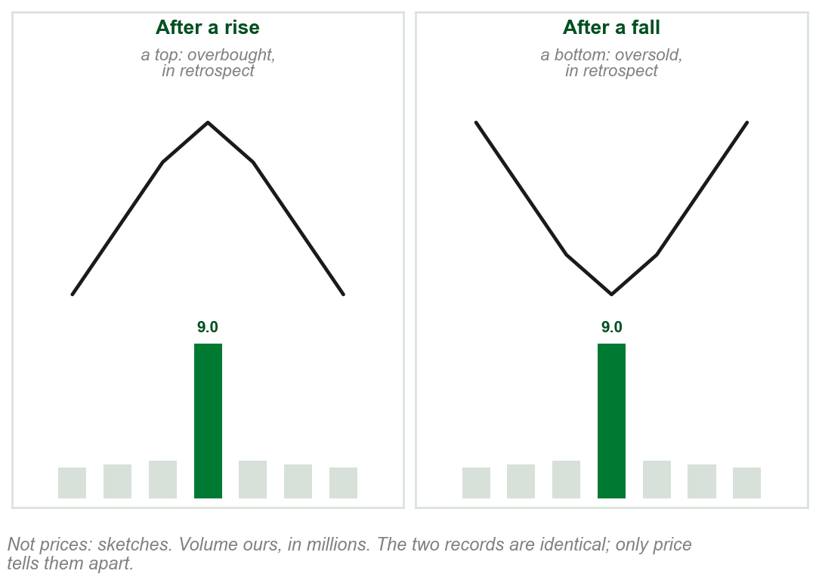
Overbought or oversold? Only afterwards
Back to the spikes, with one caution.
Overextended volume can signal a top or a bottom: extreme buying and selling both generate volume.
Overbought: an extreme tied to a top; oversold, to a bottom: the book's usage. Plain words, ours: risen too far, fallen too far.
Our chart: the same 9 million spike twice. Price rose into it, then fell: a top. Or fell, then rose: a bottom.
Overextension: pinpointed now. Overbought or oversold: only in retrospect.
Chart P - FIN1209 teaching chart, drawn for this course. Illustrative data, not a real instrument.
Part 2 of 6 - 6.1 Timing | 26 of 30
Book p.186. The chart is ours: sketches, with our invented volumes. Overbought and oversold are used and not defined in this chapter.

Slide 59
What the caution teaches
The point: a volume spike tells you something is happening, not what. Volume alone cannot call a market overbought or oversold.
So do not trade the spike alone: name the overextension now, and wait for price to show which way it turned.
It returns to the spikes because the book puts the caution here, p.186.
The book is silent on two things: whether the quiet turns carry it too, and what overbought and oversold mean.
Volume says a turn is likely; price says which kind it was.
Part 2 of 6 - 6.1 Timing | 27 of 30
Book p.186. Where the caution sits is the book's order. That it is silent on the quiet turns is a reading of p.186, which names overextensions only.

Slide 60
Lower timeframes are more sensitive
Timeframe: the time one bar covers. A monthly bar adds up every day of the month.
Figure 6.17, gold: daily and weekly volume peak in 2013 (1); monthly, quarterly and yearly peak in 2011 (2).
1
FIGURE 6.17
The continuous chart of gold with five volume panels under it: daily, weekly, monthly, quarterly and yearly. Lines over each mark where its volume peaks: in 2013 on the daily and weekly panels, in 2011 on the monthly, quarterly and yearly ones.
2
Lower timeframes are more sensitive: one day's burst shows. Higher ones show the overall trend of volume.
Figure 6.17 - Lim, The Handbook of Technical Analysis (Wiley, 2016)
Part 2 of 6 - 6.1 Timing | 28 of 30
Book p.186 and Figure 6.17.

Slide 61
Why the peaks differ: the arithmetic
Ours: a record 2013 day of 10 million, in a month of 19 quiet days of 3 million: 10 + 57 = 67 million for the month.
A 2011 month with no record day, 20 days of 6 million: 20 x 6 = 120 million, the monthly peak.
So the record day tops the daily bars, and the steady month tops the monthly ones.
Daily to spot a single burst; monthly or higher to see the trend in volume.
Part 2 of 6 - 6.1 Timing | 29 of 30
Book p.186's point, worked. The 10, 3 and 6 million are ours, to show the arithmetic.

Slide 62
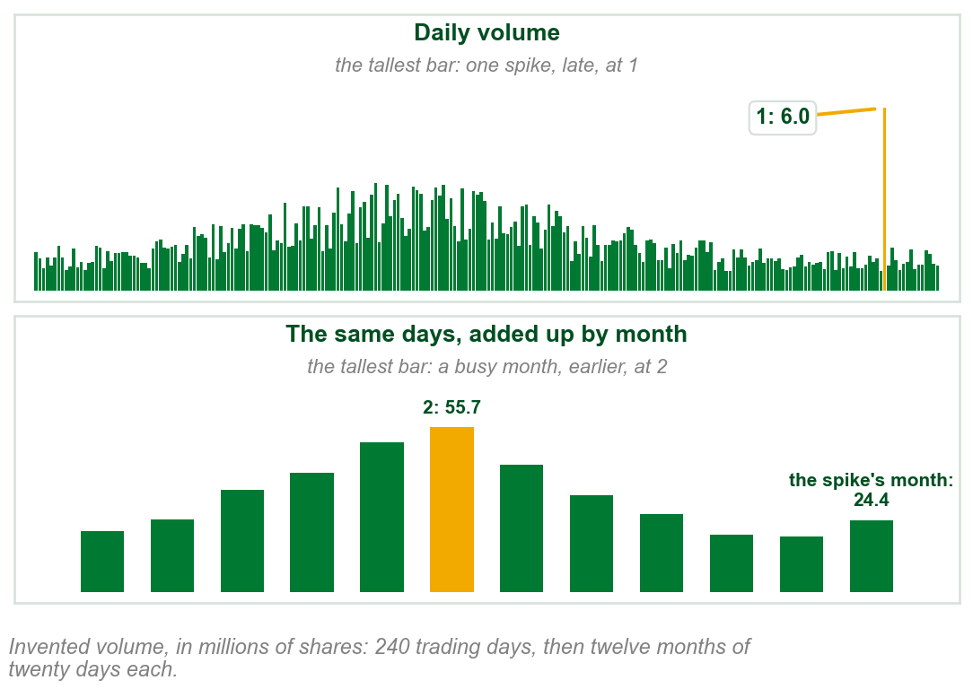
Our example: one record, two timeframes
Daily: the tallest bar is one spike of 6.0 million shares, late in the record, at 1.
Monthly, the same days added twenty at a time: the spike's month comes to only 24.4 million, one big day and nineteen of about 1 million.
The busiest month, 2, comes earlier: no day above 3.5 million, but twenty of them add to 55.7 million.
One volume record, two different peaks: it depends on the timeframe.
Chart Q - FIN1209 teaching chart, drawn for this course. Illustrative data, not a real instrument.
Part 2 of 6 - 6.1 Timing | 30 of 30
Ours: the book's p.186 point on one invented volume record. The days, the spike and the months are ours, and the sums are read from it.

Slide 63
6.1 Volume and the strength of a price barrier
Barrier (Chapter 5): a resistance above price stops a rise; a support below price stops a fall.
Retest (Chapter 5): price coming back later to a barrier it touched before.
Volume peak: the tallest bar comes at the touch, the bar where price meets the barrier. Resistance 1 (1), Support 1 (2).
Volume dip or trough: the shortest bar comes at the touch. Resistance 2 (3), Support 2 (4).
FIGURE 6.18
Four sketches under the question which price barrier is more reliable. Resistance 1 and Support 1 are each touched as volume peaks; Resistance 2 and Support 2 are each touched as volume dips to its lowest.
1
2
3
4
The book: the peak is the most reliable.
Figure 6.18 - Lim, The Handbook of Technical Analysis (Wiley, 2016)
Part 3 of 6 - 6.1 Filtering | 1 of 24
Book p.187 and Figure 6.18. Barrier and retest: Chapter 5's words. The book gives no volume number for a peak or a dip.

Slide 64
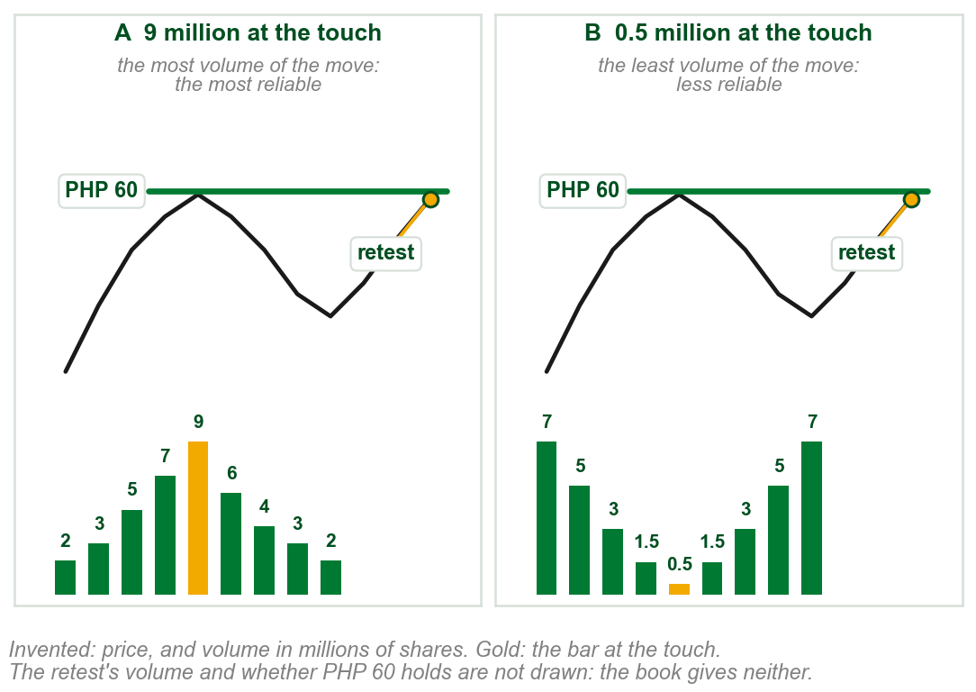
Why a volume peak makes the stronger barrier
Ours: twice, price rises to PHP 60 and turns down. Volume in millions of shares.
A: 9 million at the touch, more than any other bar. Even that surge could not get through, so traders expect PHP 60 to hold.
B: 0.5 million at the touch, less than any other bar. It held only for lack of buying: hardly anyone tried.
On a retest, A is the stronger barrier.
The book: since expectation is everything in the market, that confidence goes a long way.
Chart RA - FIN1209 teaching chart, drawn for this course. Illustrative data, not a real instrument.
Part 3 of 6 - 6.1 Filtering | 2 of 24
Book p.187: the reasons are the book's. Ours: PHP 60 and every volume number, invented to show the two shapes.

Slide 65
Five kinds of volume action at a barrier
Across: the bars before, at and after the touch, which the dashed arrow marks. Only the volume differs between sketches.
(1) Increasing: each bar taller. (2) Decreasing: each shorter. (3) Peaking: tallest at the touch.
(4) Bottoming: shortest at the touch. (5) Flatlining: all alike.
FIGURE 6.19
Ten sketches in two rows, five at a resistance and five at a support, each with volume bars under the turn: increasing, decreasing, peaking, bottoming and flatlining across the barrier.
1
2
3
4
5
Top: resistance. Bottom: support.
The book: increasing or decreasing volume there signifies a change in sentiment, the crowd's mood (Chapter 1).
Figure 6.19 - Lim, The Handbook of Technical Analysis (Wiley, 2016)
Part 3 of 6 - 6.1 Filtering | 3 of 24
Book pp.187-188 and Figure 6.19. Across: the book does not define it; this reading is ours, from the figure.

Slide 66
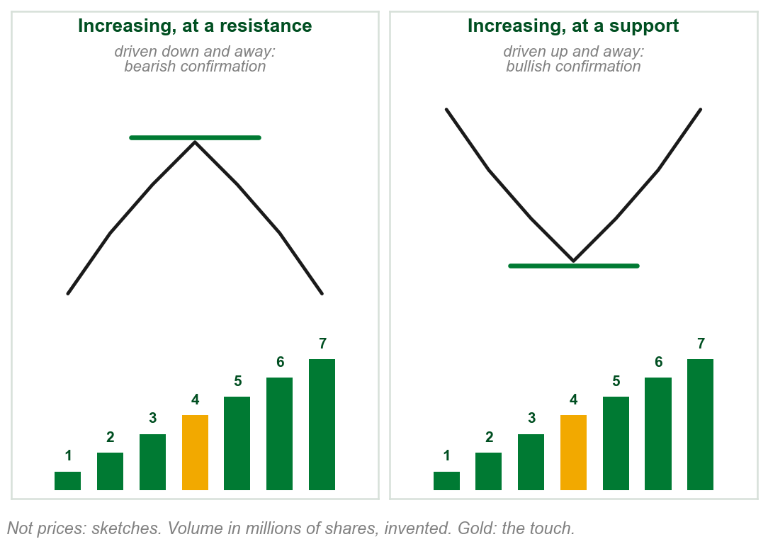
Increasing volume: price driven away
Increasing, ours: 1, 2, 3 million on the way in, 4 at the touch, 5, 6, 7 on the way out.
The book: rising volume on the way in looks strong enough to break through. Instead price turns, and the rising volume drives it away.
At a resistance price falls as volume rises: Part 1's bearish confirmation. At a support both rise: bullish confirmation.
Rising volume across a barrier confirms the turn away from it.
Chart R - FIN1209 teaching chart, drawn for this course. Illustrative data, not a real instrument.
Part 3 of 6 - 6.1 Filtering | 4 of 24
Book p.188. Confirmation, bullish and bearish: Part 1. The chart is ours: sketches and invented volume.

Slide 67
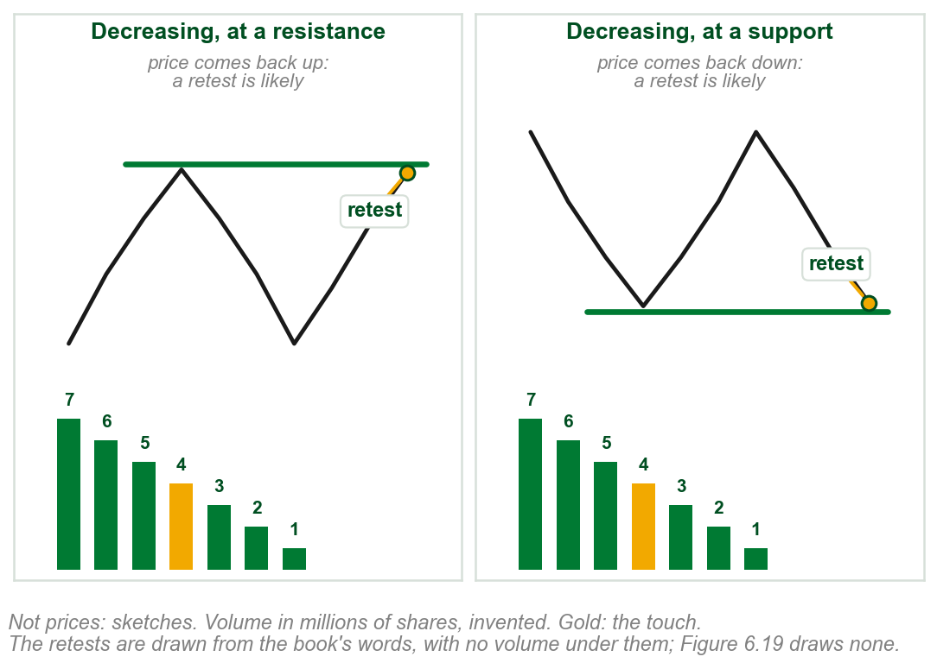
Decreasing volume: a retest is likely
Decreasing, ours: 7, 6, 5 million on the way in, 4 at the touch, 3, 2, 1 on the way out.
The book: falling volume on the way in looks like too little force to take price through.
Price turns, and volume falls even further: little force is driving price away.
So a retest is likely; in extreme cases price goes through, a penetration (Chapter 2).
Falling volume across a barrier invites a retest.
Chart RB - FIN1209 teaching chart, drawn for this course. Illustrative data, not a real instrument.
Part 3 of 6 - 6.1 Filtering | 5 of 24
Book p.188. Penetration: Chapter 2. The chart is ours: sketches and invented volume, its retests drawn from the book's words.

Slide 68
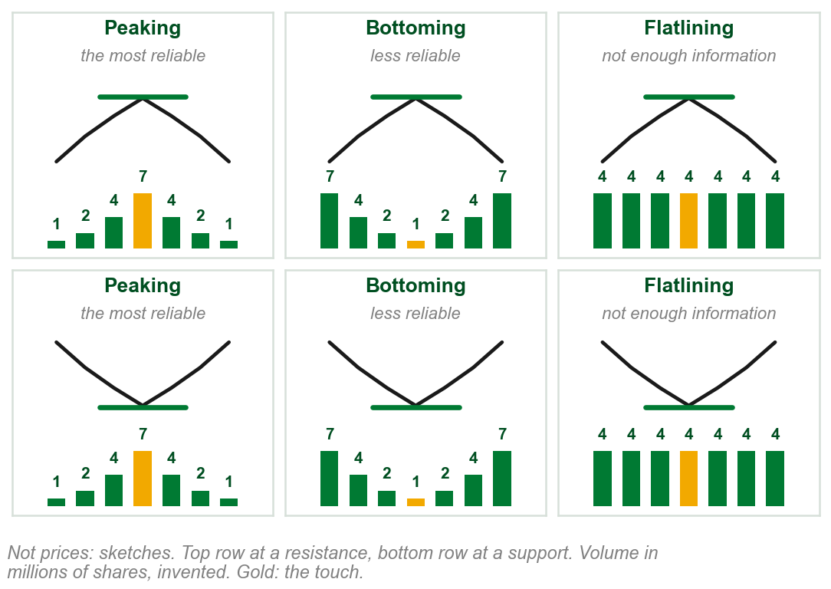
Peaking, bottoming and flatlining
Peaking, ours: 1, 2, 4, 7 at the touch, 4, 2, 1. The book: most reliable.
Bottoming: 7, 4, 2, 1 at the touch, 2, 4, 7. The book: less reliable.
Flatlining: 4 on every bar. The book: not enough information about price's next move.
The other two: increasing confirms the turn, decreasing invites a retest.
A peak is the most reliable; the book does not rank it against increasing.
Chart RC - FIN1209 teaching chart, drawn for this course. Illustrative data, not a real instrument.
Part 3 of 6 - 6.1 Filtering | 6 of 24
Book pp.187-188. The chart is ours: sketches and invented volume.

Slide 69
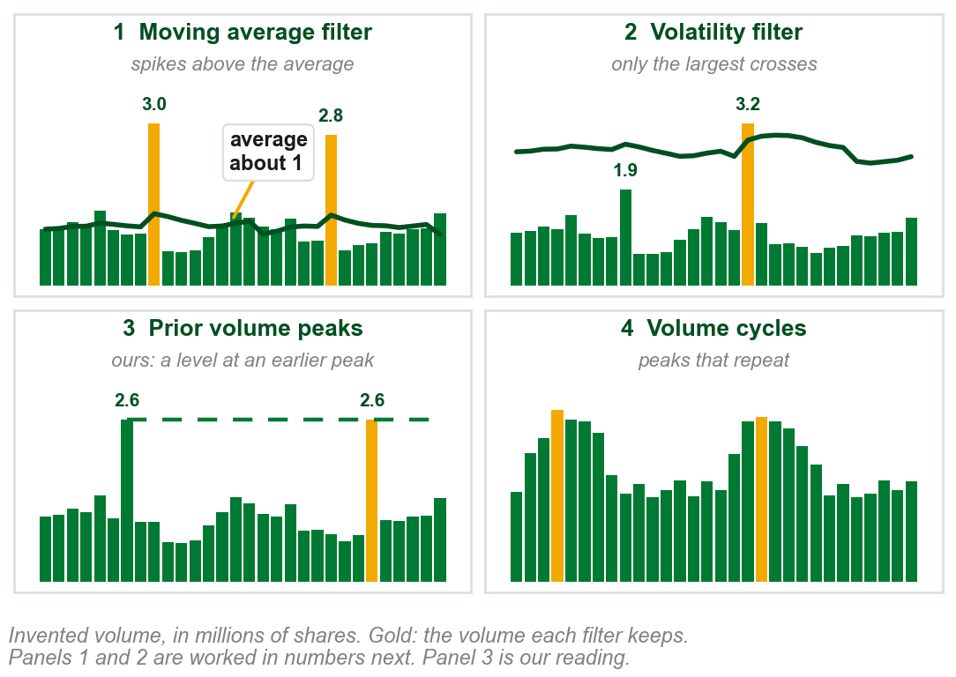
Filtering volume action: four ways
Filtering picks out the most significant volume: what may lead to a top or bottom.
Four of the book's numerous ways: 1 a moving average filter, which it calls the smoothed volume filter, 2 a volatility filter, 3 prior volume peaks, 4 volume cycles.
1 and 2 are worked next. 3 is named and never explained. 4 comes in Part 5.
Gold: the volume each filter keeps.
Panel 3 is our reading, not examinable: like Part 2's upper overextended volume level, set at earlier climax volume.
Chart S - FIN1209 teaching chart, drawn for this course. Illustrative data, not a real instrument.
Part 3 of 6 - 6.1 Filtering | 7 of 24
Book pp.188-189: the four are the book's, from among numerous ways. Prior volume peaks: named on p.188 only. The chart is ours, on invented volume.

Slide 70
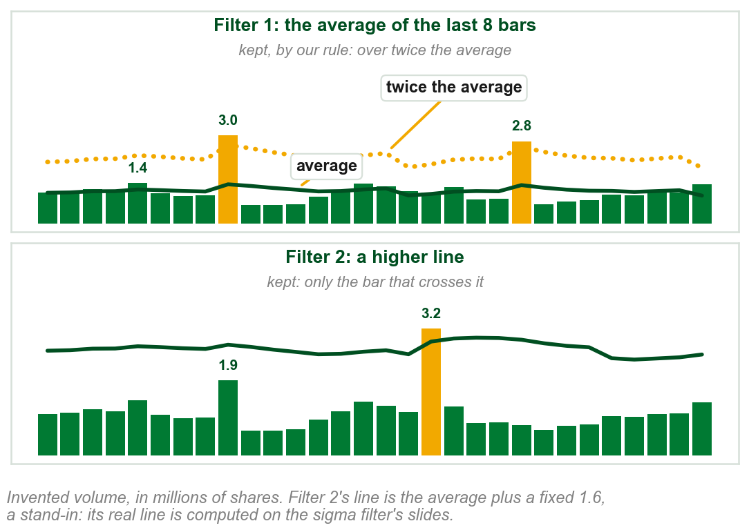
Filters 1 and 2 in numbers
Ours, filter 1: the line is the average of the last 8 bars, about 1 million.
How far above counts? The book gives no measure. Our rule: over twice the average.
1.4 million is just over the line: ordinary. The 3.0 and 2.8 million spikes: kept.
Filter 2: only the 3.2 bar crosses its higher line; the 1.9 bar is dropped.
Filter 1 is the book's smoothed volume filter: next.
Chart SA - FIN1209 teaching chart, drawn for this course. Illustrative data, not a real instrument.
Part 3 of 6 - 6.1 Filtering | 8 of 24
Book pp.188-189: a spike above the line is significant; no measure of how far. Ours: the volume, the 8 bars, the twice rule and filter 2's stand-in line.

Slide 71
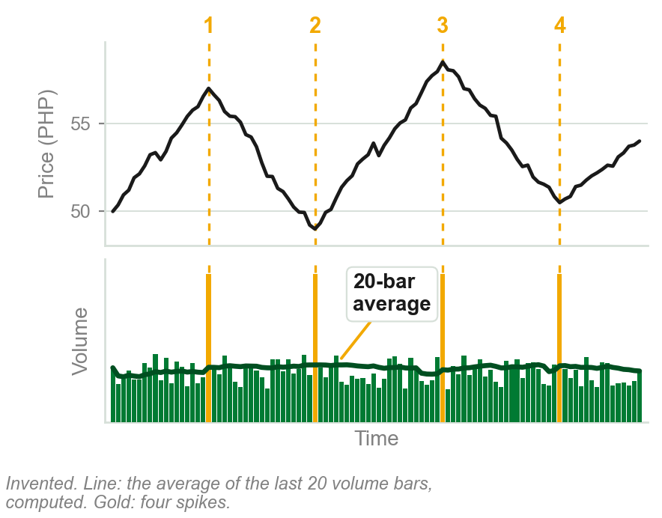
NEW TERM
Smoothed volume filter
IN PLAIN WORDS
An average of recent volume, drawn over the volume bars. A spike well above it stands out.
FOR EXAMPLE
Our chart: each point is the average of the last 20 volume bars. Four spikes stand well above it.
THE FORMAL DEFINITION
A smoothed volume filter is simply a moving average based on volume, instead of price. Volume spiking above this overextended moving average line is considered significant, and may lead to a top or bottom.
Chart T - FIN1209 teaching chart, drawn for this course. Illustrative data, not a real instrument.
Part 3 of 6 - 6.1 Filtering | 9 of 24
Book p.188. The chart is ours, on invented volume; its line is a 20-bar simple average of volume we computed.

Slide 72
Choosing the average's length
The average (1) is the smoothed volume filter of the term slide, over the last N bars. N, the lookback, is how many bars go into it.
Short N, 5 bars say: hugs the bars closely, ordinary ones cross it too, many false signals.
Long N, 100 bars say: slow and flat, only huge spikes cross it, few signals, some turns missed.
FIGURE 6.20
The daily USDJPY chart with a smoothed volume line across its volume panel, labelled moving average overextension threshold. Dotted arrows rise from the overextensions in volume to tops and bottoms in price.
3
2
1
The right N sits in between. How to find it: next slide.
Figure 6.20 - Lim, The Handbook of Technical Analysis (Wiley, 2016)
Figure 6.20: each dotted arrow runs from a spike crossing the line (2) up to a top or a bottom (3).
Part 3 of 6 - 6.1 Filtering | 10 of 24
Book pp.188-189 and Figure 6.20.

Slide 73
Choosing the length, continued
Backtest: run the filter on past prices with a few different N, and see which one actually caught the real tops and bottoms. Keep that N.
Rule of thumb: set N to the dominant trading cycle period, or half of it. Ours, invented: swings about 40 bars peak to peak give N = 40, or N = 20.
The book gives no fixed N. Not that any N works: the right N is found for each market, by backtest or by this rule of thumb.
No universal lookback. A method for finding one, for this market.
Part 3 of 6 - 6.1 Filtering | 11 of 24
Book pp.188-189. Ours: the worked cycle number and the actionable backtest description.

Slide 74
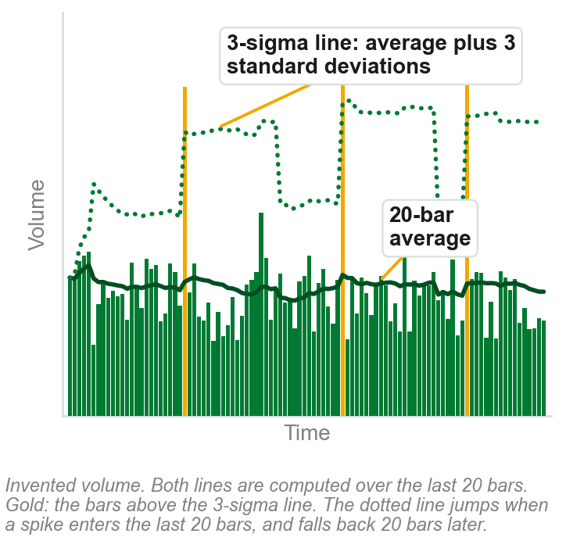
NEW TERM
Two- or three-sigma volume filter
IN PLAIN WORDS
Sigma, the standard deviation: how far volume typically strays from its mean over the same N bars. The line: mean + k x sigma, k = 3 here, or 2.
FOR EXAMPLE
Ours: 20 bars average 10 million, sigma 2 million. 3-sigma line: 10 + 3 x 2 = 16 million; 12 million stays under, 18 million crosses. 2-sigma, 14 million, flags more.
THE FORMAL DEFINITION
A 2- or 3-sigma filter, a volatility filter, keeps only the most significant surges: the upper Bollinger Band of volume, k standard deviations above its average.
Chart U - FIN1209 teaching chart, drawn for this course. Illustrative data, not a real instrument.
Part 3 of 6 - 6.1 Filtering | 12 of 24
Book p.189. Chart: ours, computed; divisor and window read from build/charts_chapter06.py, not guessed.

Slide 75
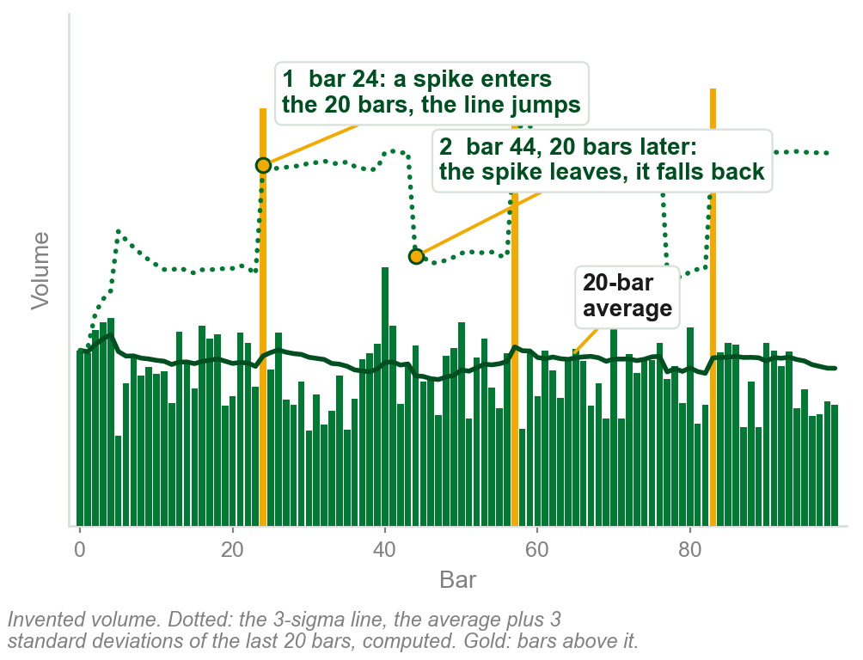
How the dotted line is drawn, bar by bar
At each bar: take its last 20 volume bars, this one included. Mean, then sigma. Plot mean + 3 x sigma. Move forward one bar, repeat.
That is why it jumps, at 1: a spike entering the window raises both at once, so the line leaps up. It stays high until the spike leaves 20 bars later, at 2.
Recomputed from nothing at every bar: no memory beyond its window.
Chart HU - FIN1209 teaching chart, drawn for this course. Illustrative data, not a real instrument.
Part 3 of 6 - 6.1 Filtering | 13 of 24
Book p.189 gives only the words. Ours: how build/charts_chapter06.py actually computes it, read from the code, not guessed.

Slide 76
Two things the book leaves open
The book never says if sigma divides by 20 or by 19.
Nor does it say if the bar sits in its own window of 20.
Our code divides by 20 and includes the bar.
The method is the book's; these two choices are ours.
Part 3 of 6 - 6.1 Filtering | 14 of 24
Book p.189 gives only the words. Ours: how build/charts_chapter06.py computes the line, read from the code.

Slide 77
A three-sigma filter on USDJPY
Daily USDJPY with a three-sigma filter on its volume. Three surges cross the line; the book marks each with an arrow up to price (1) (2) (3).
Stricter than the smoothed filter, this line skips the April 2011 top (4), the highest price on the chart.
4
FIGURE 6.21
The daily USDJPY chart with a stepped line across its volume panel labelled 3-sigma volume overextension threshold, and dotted arrows from the three overextensions in volume above it up to turns in price; the April 2011 top has no arrow.
1
2
3
The book: such surges tend to come at the most significant tops and bottoms.
Figure 6.21 - Lim, The Handbook of Technical Analysis (Wiley, 2016)
Part 3 of 6 - 6.1 Filtering | 15 of 24
Book p.189 and Figure 6.21. Ours: the April top, read off the figure.

Slide 78
The three-sigma line, close up
Stepped line (1): the three-sigma filter, drawn over the volume bars.
Three surges cross it (2) (3) (4), each under an arrow up to price.
It stays high for months after the March spike (2), far beyond our 20 bars. The book never gives its N.
The two lower lines (5) (6) are drawn and not named by the book; only the top one is the filter.
3
4
FIGURE 6.21
The volume panel of the daily USDJPY chart, drawn larger: the stepped 3-sigma volume overextension threshold over the volume bars, the three surges that cross it, and two lower lines the book does not name.
2
1
5
6
Figure 6.21 - Lim, The Handbook of Technical Analysis (Wiley, 2016)
Part 3 of 6 - 6.1 Filtering | 16 of 24
Book p.189 and Figure 6.21, its volume panel. Ours: what the lines do, read off the figure.

Slide 79
Why the book draws the line on the bars
The book also names a standard deviation oscillator: an indicator in its own panel (Part 1). It does not describe or draw one.
It is less useful, the book says, because it gives no overlay: a line drawn over the volume bars themselves, so a bar can be seen crossing it.
What to do: pick N as for the smoothed filter, and draw the 3-sigma line over the bars; a bar above it may mark a top or bottom.
Part 3 of 6 - 6.1 Filtering | 17 of 24
Book p.189. It names the oscillator and does not describe it.

Slide 80
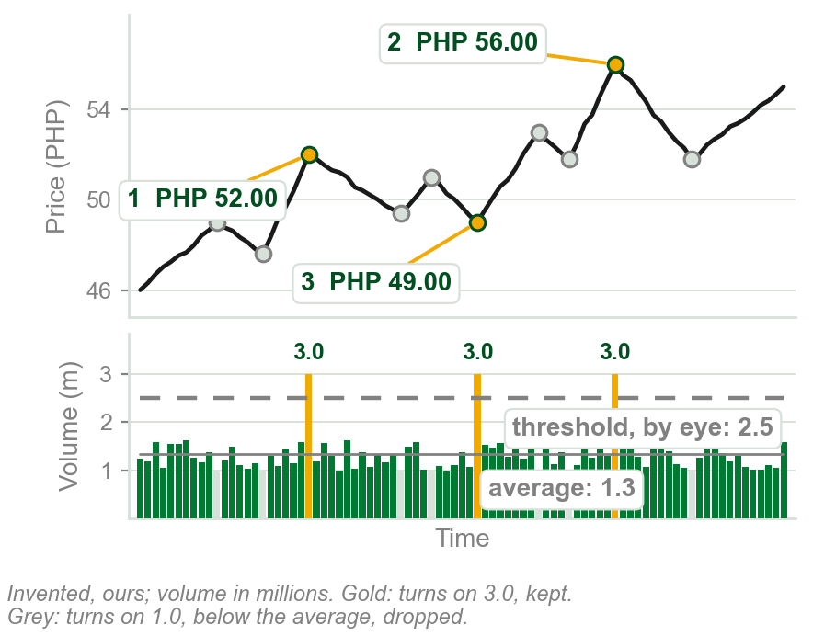
NEW TERM
Volume filtered inflection points
IN PLAIN WORDS
Only peaks and troughs (Chapter 5's inflection points) that came on heavy volume are used to draw lines.
FOR EXAMPLE
Ours, in millions: 1, 2, 3 came on 3.0, above our 2.5 line. Seven grey turns came on 1.0: dropped.
THE FORMAL DEFINITION
Many practitioners use only peaks and troughs that are considered significant, that is, associated with above average volume, to construct trendlines and channels.
Chart V - FIN1209 teaching chart, drawn for this course. Illustrative data, not a real instrument.
Part 3 of 6 - 6.1 Filtering | 18 of 24
Book p.189. Inflection point: Chapter 5. The chart is ours, invented.

Slide 81
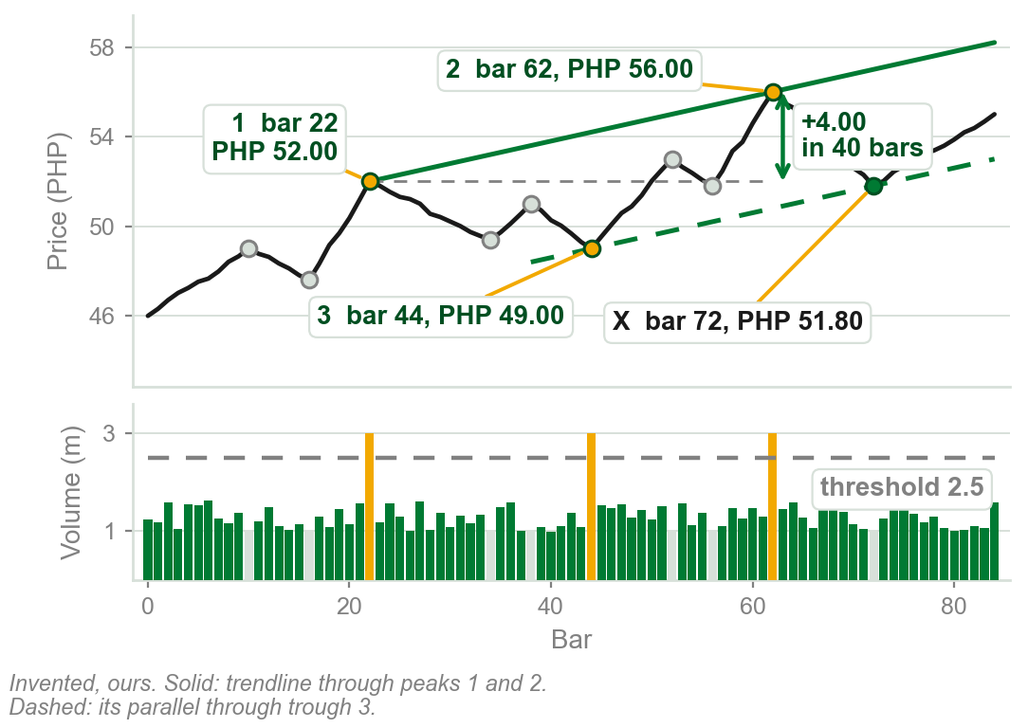
Drawing a volume filtered channel, step by step
Step 1. Mark every peak and trough.
Step 2. The book's rule: above average volume, 1.3 here. Its example draws a higher line by eye, and it never says which governs. Ours: 2.5. Only 1, 2, 3 reach it.
Step 3. Join peaks 1 (bar 22, PHP 52.00) and 2 (bar 62, PHP 56.00): PHP 4.00 in 40 bars, 0.10 a bar.
Step 4. The same slope through trough 3 (bar 44, PHP 49.00): the channel.
Chart VA - FIN1209 teaching chart, drawn for this course. Illustrative data, not a real instrument.
Part 3 of 6 - 6.1 Filtering | 19 of 24
Ours: the steps and every number, invented. The method and both rules for the threshold are the book's, p.189.

Slide 82
A channel from filtered points: silver
The book's example: daily silver, with tick volume, the number of trades (Part 4).
A threshold drawn by visual inspection (1), so only the most significant peaks reach it. The oval (2) rings July to August.
Two arrows: under Points 1 and 3, days apart, and under 2. Trendline 1 to 2, parallel from 3.
FIGURE 6.22
The daily silver chart, XAGUSD, with a tick volume overextension threshold across its volume panel. Arrows rise from the circled tick volume peaks to points 1, 2 and 3; a channel is drawn from 1 and 2 with a parallel from 3, and price reacts at X.
3
4
2
1
At X (3) price bounces off the lower line, a short-term buy, then falls through it (4).
Figure 6.22 - Lim, The Handbook of Technical Analysis (Wiley, 2016)
Part 3 of 6 - 6.1 Filtering | 20 of 24
Book p.189 and Figure 6.22.

Slide 83
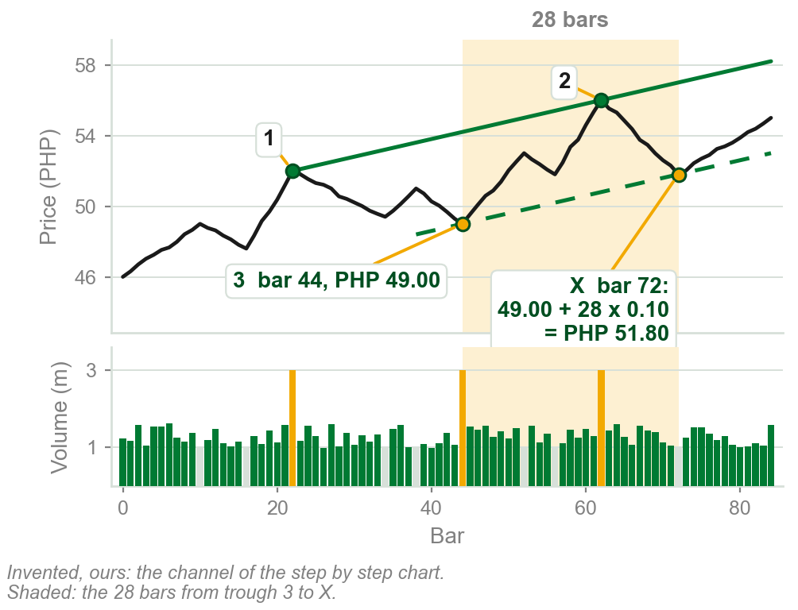
What the channel is for: the lower line at X
Ours: the lower line rises at the slope of peaks 1 to 2: PHP 4.00 in 40 bars, 0.10 a bar.
X is bar 72, 28 bars after trough 3 at bar 44, shaded. The lower line is there at 49.00 + 28 x 0.10 = PHP 51.80; price touches it and turns up.
What to do: at the lower line, look for a short-term buy. Falling through it violates the channel, the book's word.
Chapter 5's uptrend line joined troughs; here the book joins two peaks, 1 and 2, and gives no reason.
Chart HV - FIN1209 teaching chart, drawn for this course. Illustrative data, not a real instrument.
Part 3 of 6 - 6.1 Filtering | 21 of 24
Book pp.189-190. Ours: the channel, its numbers and the arithmetic at X, on the step by step chart's invented prices.

Slide 84
What Figure 6.22 leaves open
The channel uses only the July to August peaks in tick volume (4), under the arrows to Points 1, 2 and 3.
Yet silver's April bars (5), at the line labelled High tick volume level, and late September bars (6), reach the threshold too; the book does not say why it skips them.
FIGURE 6.22
The daily silver chart, XAGUSD, with its tick volume overextension threshold. The July to August tick volume peaks are ringed under Points 1, 2 and 3; the April bars, at the line labelled high tick volume level, and the late September bars also reach the threshold and are not used.
5
4
6
Figure 6.22 - Lim, The Handbook of Technical Analysis (Wiley, 2016)
Use heavily traded turns; which of them is left to the eye.
Part 3 of 6 - 6.1 Filtering | 22 of 24
Book pp.189-190 and Figure 6.22. Ours: what the figure's volume panel shows that the text does not explain.

Slide 85
More channels from filtered points
Points numbered afresh. Ovals ring heavy volume under 1, under 3 and 2, under 5 and 6.
Trendline 1 to 2, parallel from 3: a large bearish candlestick, closing far below its open, breaks it (7).
A parallel from 4, carried back, meets the trough at X (8), January 2011: valid, the book says, with no third touch (Chapter 5).
Parallels from 5 and 6: a new channel (9).
FIGURE 6.23
The same silver chart with more volume filtered points, numbered 1 to 6 and X. Several parallel rising lines are drawn through them, each from a point that came on overextended volume, forming channels that contain price.
7
9
8
Figure 6.23 - Lim, The Handbook of Technical Analysis (Wiley, 2016)
Every line runs parallel to 1 to 2.
Part 3 of 6 - 6.1 Filtering | 23 of 24
Book pp.189-190 and Figure 6.23. Candlestick and valid: Chapters 3 and 5.

Slide 86
What Figure 6.23 shows, and two things it leaves open
Every line has the slope of trendline 1 to 2 (7): one steady angle, the book's near perfect angular symmetry (Chapter 5).
The 5 and 6 channel (8): resistance at its top, support at its bottom.
Open: the text says USDJPY; the chart, silver.
Open: no heavy volume is ringed under 4 (9) or X, yet both anchor lines.
FIGURE 6.23
The same silver chart with volume filtered points 1 to 6 and X. Every line runs parallel to the trendline from 1 to 2; the last channel runs from 5 and 6; the volume panel rings heavy volume under 1, under 3 and 2, and under 5 and 6, and nothing under 4 or X.
7
8
9
Figure 6.23 - Lim, The Handbook of Technical Analysis (Wiley, 2016)
Build lines on heavily traded turns; watch the parallels for resistance and support.
Part 3 of 6 - 6.1 Filtering | 24 of 24
Book pp.189-190 and Figure 6.23. Angular symmetry: Chapter 5. Ours: what the figure rings and what it does not.

Slide 87
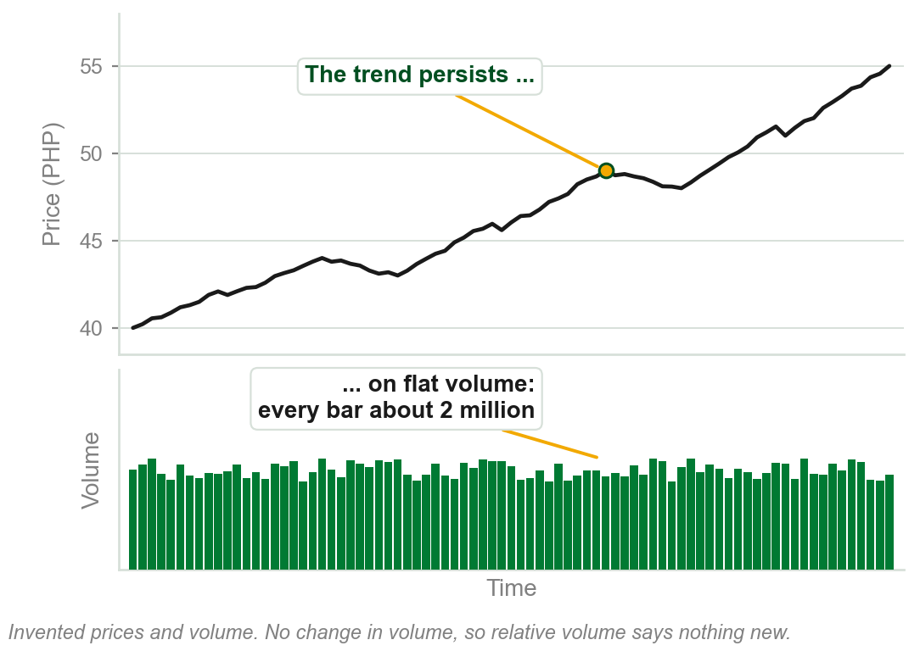
6.1 Relative and absolute volume
Absolute volume is the raw count: today, 3 million shares traded.
Relative volume compares it with its own past: 3 million against a usual 1.5 million is double.
The book: absolute volume is not as important as relative. The change in volume tells the most about price.
Yet a trend can persist for long periods on flat volume.
Chart W - FIN1209 teaching chart, drawn for this course. Illustrative data, not a real instrument.
Part 4 of 6 - 6.1 Open interest | 1 of 29
Book pp.190-191. It never defines the two names; these readings are ours, from its contrast. The share counts and the chart are ours, on invented prices.

Slide 88
What the change in volume tells
Rising and falling volume show interest at each price. Part 1's tests: rising is confirmation, falling divergence; with price bullish, against bearish.
Past extremes, Part 2's overextended levels, are a reference. Ours: busiest day 9 million, quietest 0.4 million; volume reaching either again warns of a top or bottom.
Flat volume is no sign a trend is ending; the book gives no rule for it.
Read the change in volume for the trend, and past extremes for the turns.
Part 4 of 6 - 6.1 Open interest | 2 of 29
Book p.191. The share counts in the example are ours.

Slide 89
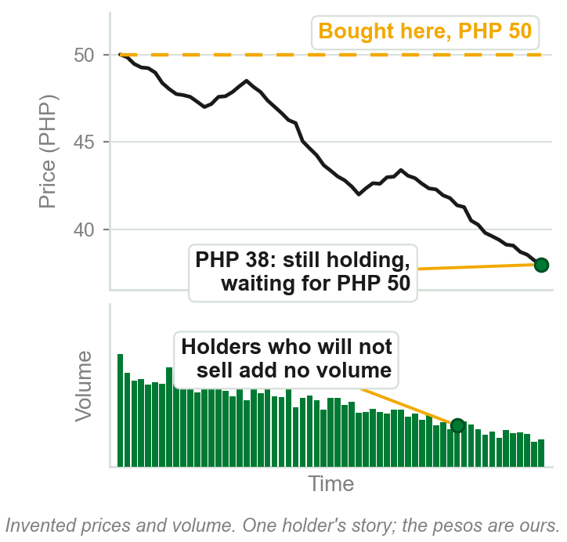
NEW TERM
Loss aversion bias
IN PLAIN WORDS
Holding a losing position, not selling at a loss, hoping it comes back. Holding is not trading: it adds no volume.
FOR EXAMPLE
Bought at PHP 50, now PHP 38: an unrealized loss of PHP 12, on paper only, unsold. You hold for breakeven, PHP 50.
THE FORMAL DEFINITION
Many investors hold on to losing positions in a falling market, hoping they rebound to breakeven or profitability, believing unrealized losses are not real losses: loss aversion bias.
Chart X - FIN1209 teaching chart, drawn for this course. Illustrative data, not a real instrument.
Part 4 of 6 - 6.1 Open interest | 3 of 29
Book p.191 names the bias. The pesos, the share and the chart are ours, on invented prices.

Slide 90
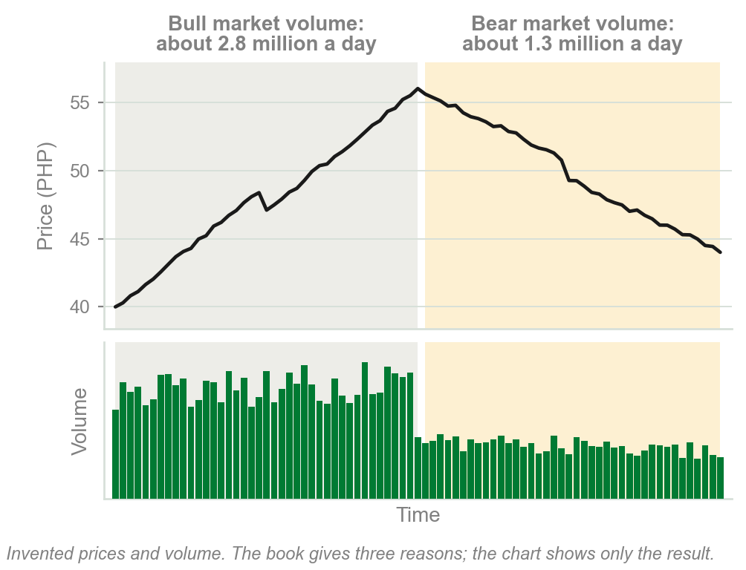
Bull market volume outweighs bear market volume
1 Loss aversion: losing positions held in a falling, bear market add nothing to its trading.
2 In a rising, bull market, traders can fund new positions with house money: profit already made.
3 More investment funds market their services in a bull market, drawing in investors.
So bull market volume tends to outweigh bear market volume. Ours: 2.8 million shares a day rising, 1.3 million falling.
A few of the book's reasons; it draws no trading rule from them.
Chart Y - FIN1209 teaching chart, drawn for this course. Illustrative data, not a real instrument.
Part 4 of 6 - 6.1 Open interest | 4 of 29
Book p.191: its three reasons, nearly word for word. The chart and its share counts are ours, on invented prices.

Slide 91
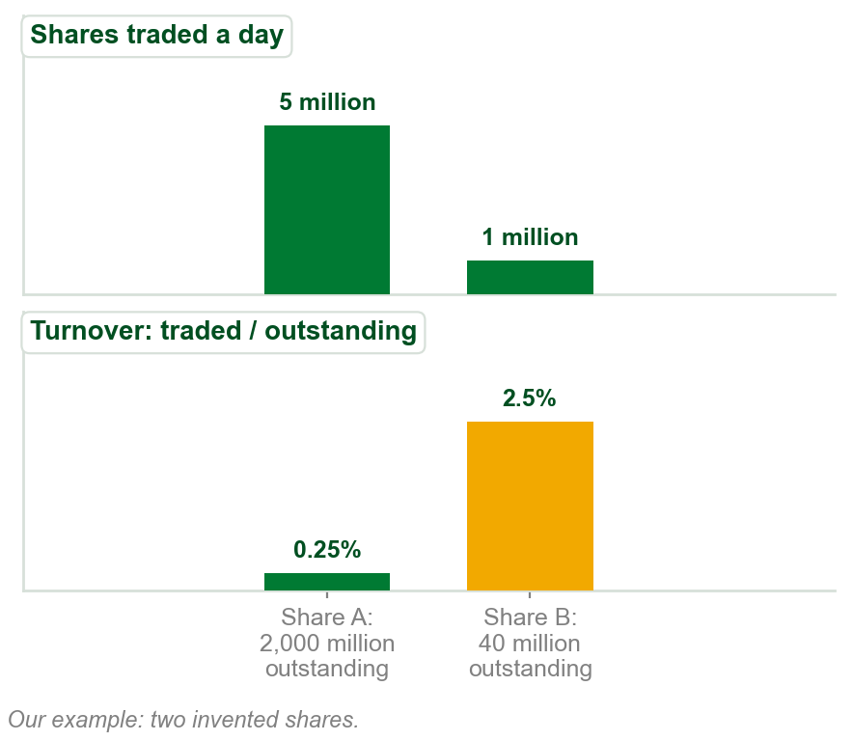
What absolute volume is good for
1 Price rejection levels, Chapter 3: prices the market was pushed back from. The book gives no method.
2 Comparing participation in stocks, sectors or commodities, seeking liquidity: the book's word, not defined.
3 Turnover: shares traded / shares outstanding, all the company's shares. A: 5m / 2,000m = 0.25%. B: 1m / 40m = 2.5%.
A trades five times the shares; B has ten times the participation.
Chart Z - FIN1209 teaching chart, drawn for this course. Illustrative data, not a real instrument.
Part 4 of 6 - 6.1 Open interest | 5 of 29
Book p.191. The two shares, their volumes and their shares outstanding are ours: a share-count example of turnover.

Slide 92
Volume distortions
A surge in arbitrage, program trading and high frequency trading (HFT) may distort volume's traditional meaning: traders' interest in a rise or fall.
Chapter 1: program trading is machines trading in ways humans cannot replicate. Chapter 1 named arbitrage and HFT without defining them; so does this chapter.
Ours: a day trades 4 million shares, 3 million of them program trades. The bar reads 4 million; traders taking part in the move traded 1 million.
So a volume bar may count machine trades as well as interest: here only 1 of 4 million. The book gives no way to separate them.
Part 4 of 6 - 6.1 Open interest | 6 of 29
Book p.192. Chapter 1 named arbitrage, program trading and HFT. The share counts in the example are ours.

Slide 93
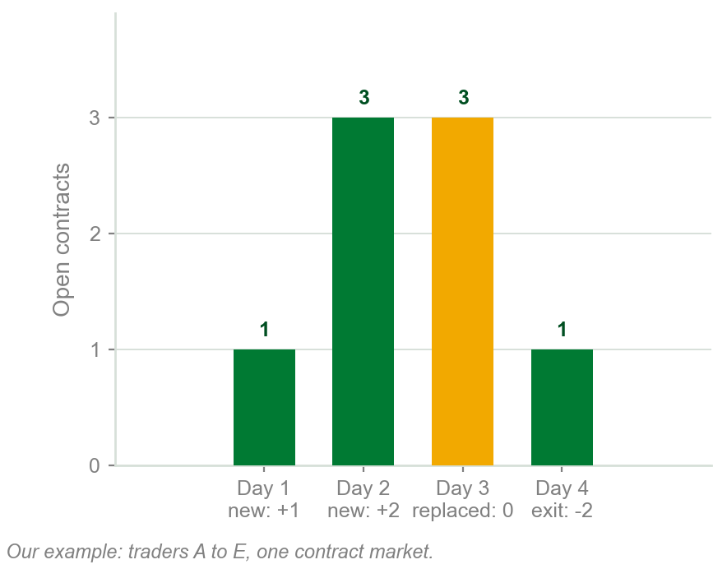
NEW TERM
Open interest
IN PLAIN WORDS
Every futures or options contract has a buyer, the long, and a seller, the short. Open interest counts the contracts still open.
FOR EXAMPLE
Plus 1 when a new long and short both open; minus 1 when both close; no change when one side is replaced.
THE FORMAL DEFINITION
The total amount of outstanding contracts in the futures and options markets. It increases when a new long and short are initiated, decreases when both exit, and is unchanged when one is replaced.
Chart AA - FIN1209 teaching chart, drawn for this course. Illustrative data, not a real instrument.
Part 4 of 6 - 6.1 Open interest | 7 of 29
Book p.192 gives the definition and the three rules. The traders and contract counts are ours.

Slide 94
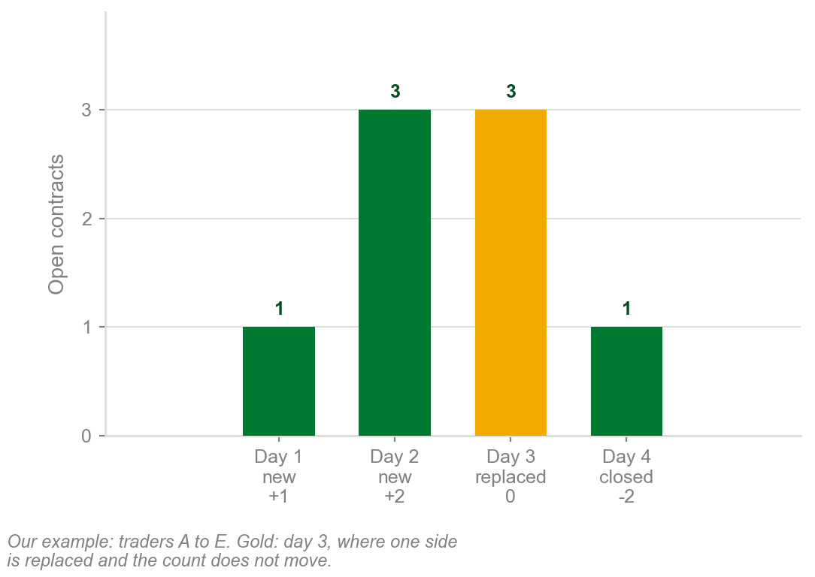
Open interest, day by day
Day 1: A buys 1 from B, both new, A long and B short: plus 1. Open interest 1.
Day 2: C buys 2 from D, both new: plus 2. Open interest 3.
Day 3: A sells that 1 to E, the new long; B is still short: no change. Still 3.
Day 4: D buys back 2 from C: D's short and C's long close: minus 2. Now 1.
Only both sides opening, or both closing, moves the count.
Chart HA - FIN1209 teaching chart, drawn for this course. Illustrative data, not a real instrument.
Part 4 of 6 - 6.1 Open interest | 8 of 29
Book p.192: the rules, and why count: unlike stocks, futures and options contracts expire. Traders and counts: ours.

Slide 95
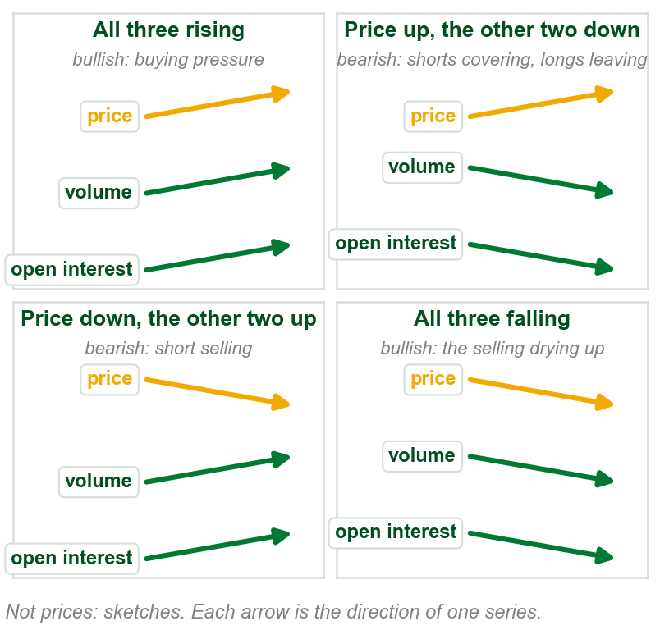
Open interest is read like volume
Like volume, open interest shows interest in seeing price rise or fall. With price: bullish. Against: bearish.
Price rising. Both rising: bullish, buying pressure. Both falling: bearish, shorts covering (buying back) and longs leaving.
Price falling. Both rising: bearish, short selling. Both falling: bullish, fewer longs liquidating, fewer new shorts.
Rising is confirmation, falling is divergence: as for non-price-based volume.
Chart AB - FIN1209 teaching chart, drawn for this course. Illustrative data, not a real instrument.
Part 4 of 6 - 6.1 Open interest | 9 of 29
Book p.192: the reading and its reasons are the book's. The chart is ours: arrows, not prices.

Slide 96
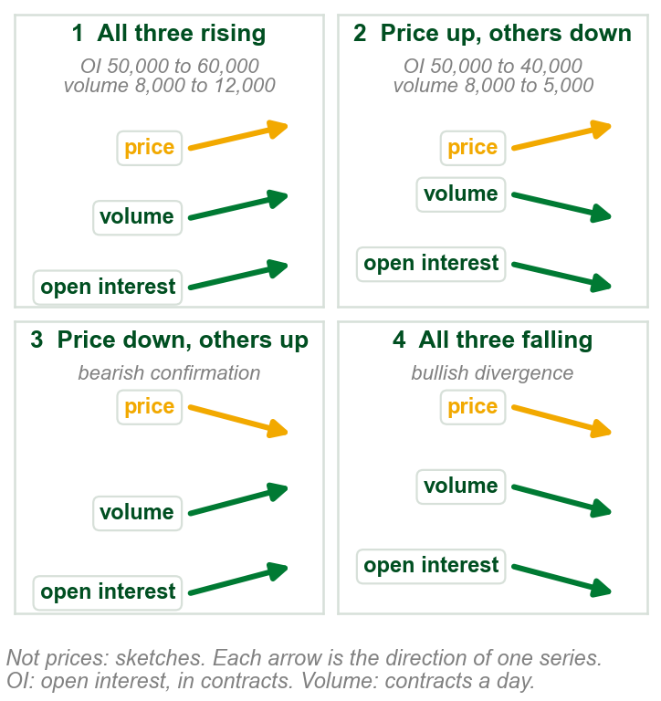
The four readings, worked
1 Ours: a futures contract rises, PHP 100 to 110. Open interest 50,000 to 60,000, volume 8,000 to 12,000 a day: bullish confirmation, buying pressure.
2 Same rise; open interest 50,000 to 40,000, volume 8,000 to 5,000: bearish divergence, shorts covering, longs leaving.
Falling, PHP 110 to 100: 3, both rising, bearish confirmation, short selling; 4, both falling, bullish divergence.
Same price move, opposite readings: volume and open interest decide.
Chart HB - FIN1209 teaching chart, drawn for this course. Illustrative data, not a real instrument.
Part 4 of 6 - 6.1 Open interest | 10 of 29
Book p.192 gives the four readings and their reasons. The contract, its prices and its counts are ours, invented.

Slide 97
What a trader does with the four
All three rising, bullish: look for buy signals.
Price rising, open interest and volume falling, bearish: look to exit, liquidating (selling) your longs.
Price falling, both rising, bearish: look to go short. Once both start to fall together, bullish: rapidly cover (buy back) all shorts.
FIGURE 6.24
The price panel of the continuous daily chart of silver: from A, about $20 in 2008, price rises to B, about $49 in 2011, then falls to under $30.
2
1
Figure 6.24, silver: from A, about $20, price rose to B, about $49 (1), then fell to under $30 (2). Which of the four was it at B? Next slide.
Figure 6.24 - Lim, The Handbook of Technical Analysis (Wiley, 2016)
Part 4 of 6 - 6.1 Open interest | 11 of 29
Book p.192 and Figure 6.24; the prices are read off the figure by eye. Go long, liquidate, go short and cover are Chapter 1 terms.

Slide 98
Figure 6.24: volume and open interest disagree at B
Volume peaks higher at B than at A (1): price and volume rise together, bullish confirmation.
Open interest peaks lower at B than at A (2): price rises as open interest falls, bearish divergence.
They disagree. The book reads the open interest: longs liquidating, early. Silver then fell from about $49 to under $30.
FIGURE 6.24
The open interest and volume panels of the continuous daily chart of silver, from 2005 to 2012. At B, early 2011, volume makes a higher peak than at A, marked 1, labelled bullish confirmation; open interest makes a lower peak, marked 2, labelled bearish divergence.
2
1
When the two disagree, the book reads open interest.
Figure 6.24 - Lim, The Handbook of Technical Analysis (Wiley, 2016)
Part 4 of 6 - 6.1 Open interest | 12 of 29
Book p.192 and Figure 6.24; the prices are read off the figure by eye. Confirmation and divergence: Part 1.

Slide 99
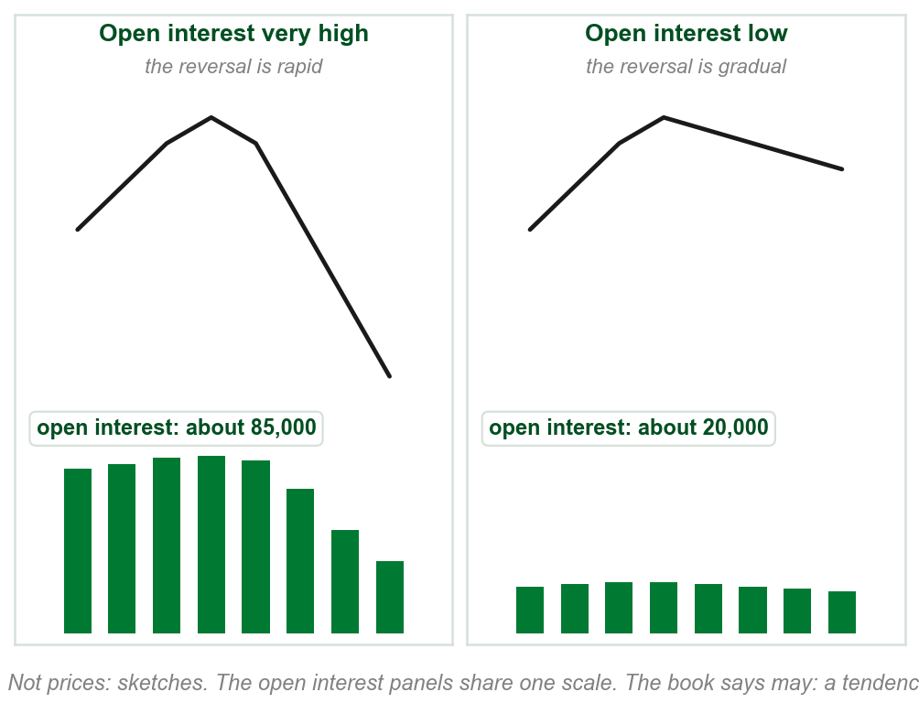
Very high open interest: a faster reversal
The level of open interest may indicate the nature of a reversal or breakout: here, its speed.
If open interest is very high, the reversal may be significantly more rapid.
Ours: about 85,000 open contracts against 20,000. After the same top, the first falls steeply.
The reason: many open contracts liquidating and covering at once.
Liquidating: longs selling to close. Covering: shorts buying back. The book sets no number for very high.
Chart AC - FIN1209 teaching chart, drawn for this course. Illustrative data, not a real instrument.
Part 4 of 6 - 6.1 Open interest | 13 of 29
Book p.192: one sentence and its reason. The chart is ours: two invented reversals, the open interest in each made up to show the point.

Slide 100
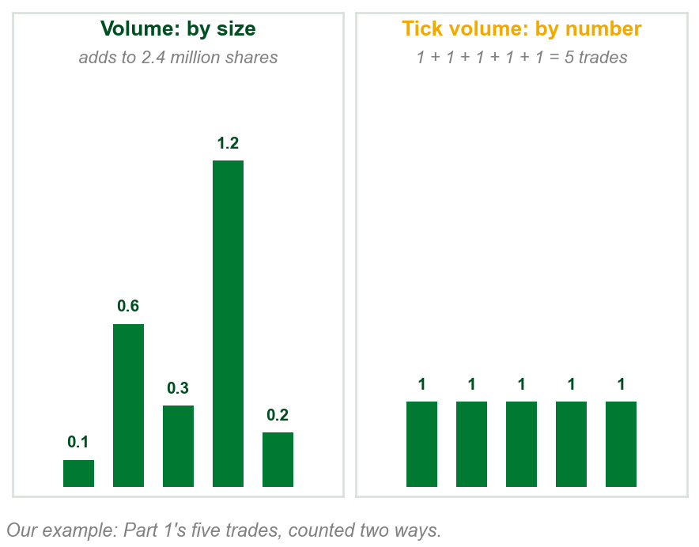
NEW TERM
Tick volume
IN PLAIN WORDS
A count of trades, not shares: one tick is one trade, of any size. Met in Chapters 1 and 3.
FOR EXAMPLE
Part 1's five trades of 0.1, 0.6, 0.3, 1.2 and 0.2 million shares: volume 2.4 million shares, tick volume 5.
THE FORMAL DEFINITION
One tick represents one trade: tick volume is transaction volume. Many OTC fx brokers offer it instead of actual volume; strongly correlated with it, it may be used as a proxy.
Chart AD - FIN1209 teaching chart, drawn for this course. Illustrative data, not a real instrument.
Part 4 of 6 - 6.1 Open interest | 14 of 29
Book pp.192-193. OTC fx is the book's over the counter foreign exchange market. The five trades are Part 1's, ours. Chapter 3 counted trades the same way.

Slide 101
Tick volume as a stand-in for volume
Where: the over the counter (OTC) foreign exchange (fx) market, where many brokers offer tick volume instead of actual volume. The book does not say why.
Strongly correlated: the two rise and fall together. Ours: a busy hour, 900 trades and 60 million in currency; a quiet hour, 200 trades and 14 million.
So tick volume may be a proxy, a stand-in, for actual volume, for comparing relative levels of overbought and oversold: Part 2's words, never defined.
Compare tick volume with its own past: 900 trades does not say how much changed hands.
Part 4 of 6 - 6.1 Open interest | 15 of 29
Book pp.192-193. The trade counts and amounts in the example are ours, invented.

Slide 102
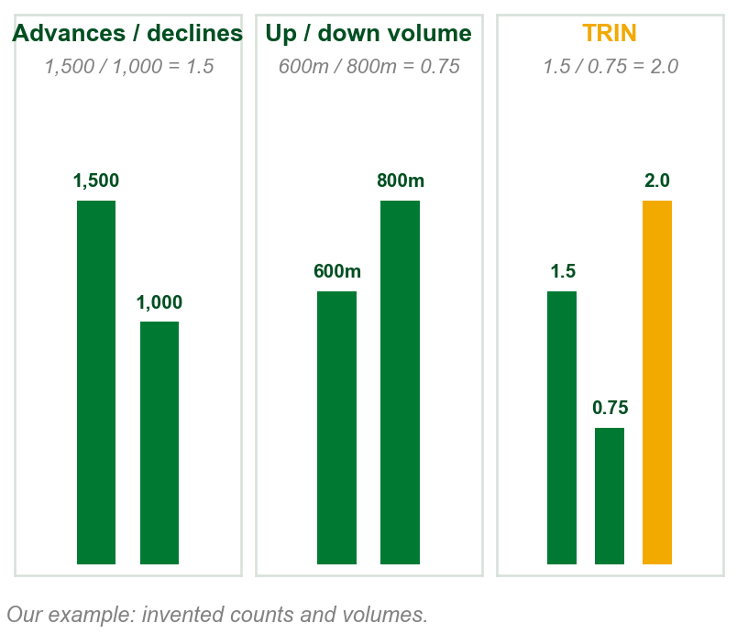
NEW TERM
The Arms Index, or TRIN
IN PLAIN WORDS
Breadth: advances, stocks that rose, over declines, stocks that fell. Divided by up volume over down volume, the shares each side traded. Our readings.
FOR EXAMPLE
1,500 advances / 1,000 declines = 1.5. Up volume 600 million / down volume 800 million = 0.75. TRIN = 1.5 / 0.75 = 2.0.
THE FORMAL DEFINITION
The Arms Index, or TRIN, incorporates breadth volume, advances and declines: TRIN = (advances / declines) / (up volume / down volume).
Chart AE - FIN1209 teaching chart, drawn for this course. Illustrative data, not a real instrument.
Part 4 of 6 - 6.1 Open interest | 16 of 29
Book p.193 gives the ratio. The counts and volumes in the example are ours. Advances and declines: Chapter 3's breadth data, never defined.

Slide 103
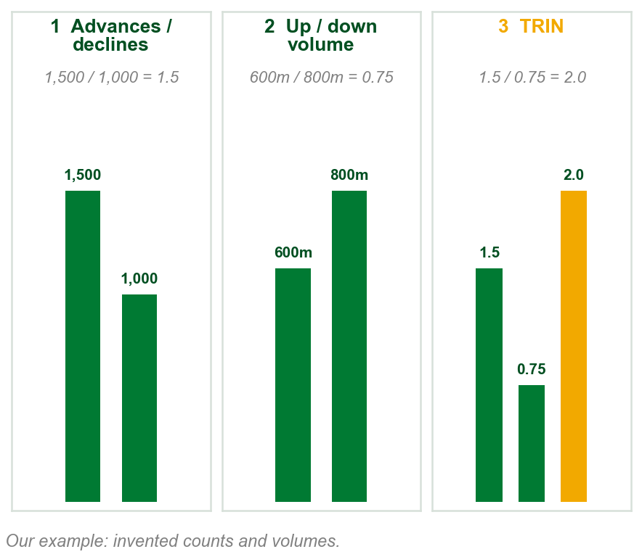
The TRIN, step by step
1 Advances / declines = 1,500 / 1,000 = 1.5 rising stocks for each falling one.
2 Up volume / down volume = 600m / 800m = 0.75: the falling stocks traded more shares.
3 TRIN = 1.5 / 0.75 = 2.0. Rearranged: down volume per falling stock, 800m / 1,000 = 0.8m, over up volume per rising stock, 600m / 1,500 = 0.4m.
A TRIN of 2.0: each falling stock traded, on average, twice the volume of each rising stock.
Step 3 and the gold line are our arithmetic; the book never reads one value such as 2.0.
Chart HE - FIN1209 teaching chart, drawn for this course. Illustrative data, not a real instrument.
Part 4 of 6 - 6.1 Open interest | 17 of 29
Book p.193 gives the ratio. It names breadth volume, advances, declines, up and down volume and never defines them; our readings. The numbers are ours.

Slide 104
Reading the tick and the TRIN
The tick: the book never says what it measures. On Figure 6.25 it goes below zero (1), so it is not tick volume, a count of trades.
Short term, the book's rule: tick rising but not overbought, TRIN falling but not oversold: bullish, look for a long entry.
Figure 6.25 shows something else: tick down to about -1,000 (1), TRIN up to about 2.2 (2), both at levels it labels oversold. The index then rose (3).
FIGURE 6.25
A 1-minute chart of the S&P 500 index falling and then rising, with a $TICK panel and a $TRIN panel under it. A box around the low marks both labelled oversold, with the note that short-term bullishness was predicated on the confluence of oversold signals.
3
1
2
Both at the labelled oversold extremes: the book reads short-term bullish, look for a long entry.
Figure 6.25 - Lim, The Handbook of Technical Analysis (Wiley, 2016)
The book does not say why its figure departs from its short-term rule.
Part 4 of 6 - 6.1 Open interest | 18 of 29
Book p.193 and Figure 6.25; the levels are read off the figure by eye. The caption says daily; the chart and the text say 1-minute.

Slide 105
The longer-term rule, and the book's gaps
Short term, the converse: tick falling but not oversold, TRIN rising but not overbought: bearish, look for a short entry.
Longer term: tick oversold, above its weekly two-sigma level, and TRIN overbought, near or above 3.0 daily: bullish, long. Reverse: bearish, short.
Two sigma: Part 3's line, k = 2. Ours: weekly tick mean 200, sigma 300: 200 + 2 x 300 = 800; above it, oversold. Daily TRIN 3.2: overbought.
The book gives no reason for either rule.
Part 4 of 6 - 6.1 Open interest | 19 of 29
Book p.193. The weekly tick numbers are ours, in invented units; the book never says what the tick measures.

Slide 106
Figure 6.25 against the text's rules
The text calls a bullish TRIN overbought. Figure 6.25 labels its TRIN oversold (2), at the low, before the index rose.
The text's longer-term oversold tick is above a two-sigma level. The figure's oversold tick (1) sits at its low.
FIGURE 6.25
The 1-minute S&P 500 chart of the last slides. In the box at the low, the TRIN reaches about 2.2 at the line the figure labels TRIN oversold, and the tick drops to about -1,000 at the line it labels TICK oversold: both at the bottom of their swing, not above a two-sigma level.
1
The book does not say why its figure and its text differ.
2
Figure 6.25 - Lim, The Handbook of Technical Analysis (Wiley, 2016)
Part 4 of 6 - 6.1 Open interest | 20 of 29
Book p.193 and Figure 6.25; the levels are read off the figure by eye.

Slide 107
A bearish day on the tick and the TRIN
Figure 6.26: the S&P 500 falls all afternoon. The boxed TRIN rises from about 0.9 to 1.34 (1): bearish, by the short-term rule.
1:45 to 2:45 p.m.: the text says largely absent of activity; the figure says absent of uptick action. In its shaded box (2) the tick barely rises above zero and twice drops to about -1,000, circled as extreme bearish ticks (3).
FIGURE 6.26
A 1-minute chart of the S&P 500 index on an intraday decline, with a $TICK panel showing stretches marked bearish and balanced tick action, and a $TRIN panel whose last stretch is boxed and labelled rising TRIN, bearish.
2
3
Together, a short-term bearish signal: look for a short entry.
1
The book gives no reason this is bearish, and does not define uptick.
Figure 6.26 - Lim, The Handbook of Technical Analysis (Wiley, 2016)
Part 4 of 6 - 6.1 Open interest | 21 of 29
Book p.194 and Figure 6.26; the TRIN values are read off the figure. Its caption says daily; the times show a 1-minute chart.

Slide 108
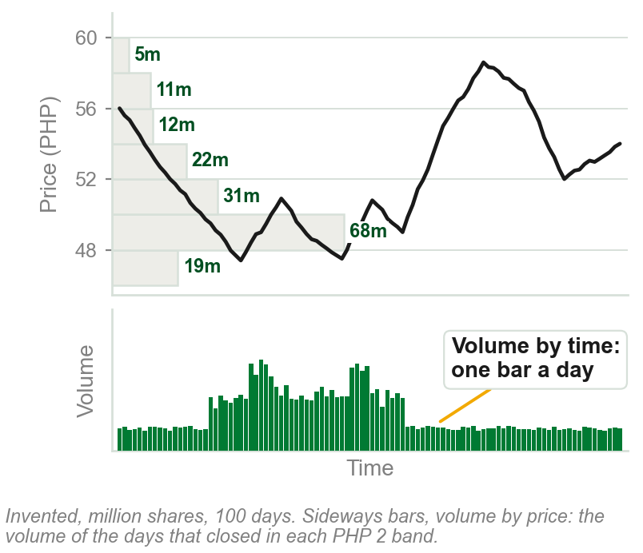
NEW TERM
Volume by price and volume by time
IN PLAIN WORDS
One volume record added up two ways. By time: the usual bars, one a day. By price: sideways bars, one per price band.
FOR EXAMPLE
Our chart, 100 days: 68 million shares at PHP 48 to 50, the longest sideways bar; 12 million at PHP 54 to 56. Five days worked: next slide.
THE FORMAL DEFINITION
Volume by time represents the total volume traded over a specified time interval or period. Volume by price identifies the total volume traded at each price level.
Chart AF - FIN1209 teaching chart, drawn for this course. Illustrative data, not a real instrument.
Part 4 of 6 - 6.1 Open interest | 22 of 29
Book p.194 defines both. The chart is ours: the volume by price is added up from its own invented bars and volume.

Slide 109
Adding up volume by price, worked
Ours, five days: closes of PHP 49.10, 49.80, 51.20, 48.60 and 50.50, on 2, 3, 1, 4 and 2 million shares.
By time: one bar a day, 2, 3, 1, 4, 2 million: the usual volume panel.
By price: each day's volume goes in the band of its close. PHP 48 to 50: 2 + 3 + 4 = 9 million. PHP 50 to 52: 1 + 2 = 3 million.
The same 12 million shares: most traded between PHP 48 and 50. Using both splits: two-dimensional volume analysis.
The book does not say how a day's volume is split across its prices; ours puts it all at the close.
Part 4 of 6 - 6.1 Open interest | 23 of 29
Book p.194 defines both. The five days, their closes and their volumes are ours, invented.

Slide 110
Volume by price marks a support: silver
Figure 6.27, iShares Silver Trust: sideways bars longest around $17 (1). The book's volume turnover here is shares traded, not the turnover ratio.
So $17 (2) represents a significant support: a floor where a fall may stop. The figure: significant capital commitment.
Also marked: high volume at about $35 (3), a new consolidation level, not in the text.
FIGURE 6.27
The daily iShares Silver Trust with volume by price drawn as horizontal bars from the left edge. The longest bars sit around the $17 level, labelled significant capital commitment, strong support, and another cluster at the newer consolidation level higher up.
3
1
2
Ordinary volume bars show when, not at what price.
Figure 6.27 - Lim, The Handbook of Technical Analysis (Wiley, 2016)
Chapter 4's price-based volume; not Part 1's oscillators.
Part 4 of 6 - 6.1 Open interest | 24 of 29
Book p.194 and Figure 6.27. Chapter 4 showed the same thing and called it price-based volume.

Slide 111
The most traded range: 3M
Figure 6.28, 3M: the longest sideways bars, bracketed, $77 to $86 (1): the most traded range, more shares than at any other price.
With 3M last at about $88 (2), $77 to $86 lies below: potential support, the figure's label. $90 to $92 above (3): some resistance, says the book, not how it was found.
3
FIGURE 6.28
The price panel of the daily chart of 3M with volume by price as horizontal bars, the longest bracketed between about $77 and $86 and labelled maximum capital commitment in this range, an important support zone in the future; 3M last at about $88.
1
2
Figure 6.28 - Lim, The Handbook of Technical Analysis (Wiley, 2016)
These price ranges are potential future support and resistance levels.
Part 4 of 6 - 6.1 Open interest | 25 of 29
Book p.194 and Figure 6.28.

Slide 112
The volume panel on 3M
The figure's own lines carry Part 1's names.
Bearish confirmation (4): price falling, May to October, on rising volume.
Bearish divergence (5): price rising, November to February, on falling volume.
FIGURE 6.28
The daily chart of 3M from May 2011 to February 2012: a falling price line with a rising volume line under it, labelled bearish confirmation, then a rising price line with a falling volume line under it, labelled bearish divergence.
5
Volume read against price, as in Part 1, on the same chart.
4
Figure 6.28 - Lim, The Handbook of Technical Analysis (Wiley, 2016)
Part 4 of 6 - 6.1 Open interest | 26 of 29
Book p.194 and Figure 6.28. Confirmation and divergence: Part 1.

Slide 113
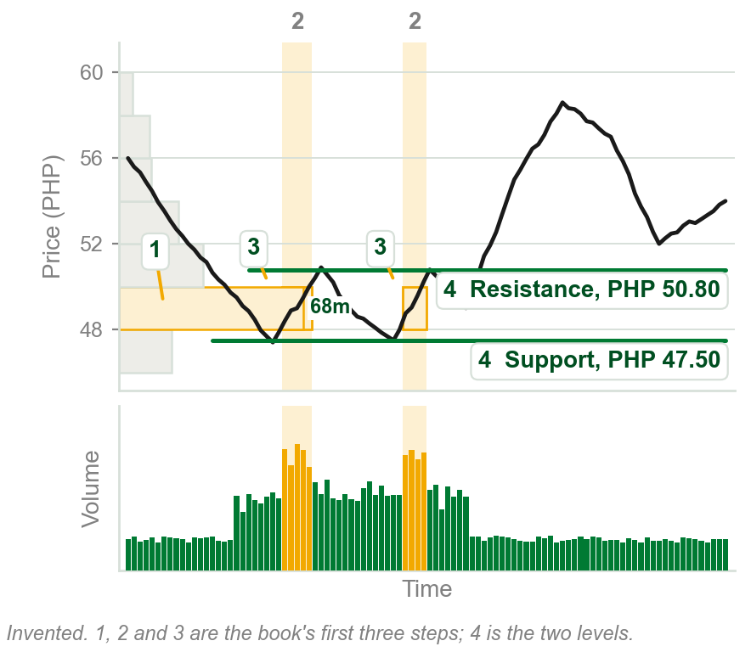
Support and resistance in four steps
1 Largest volume by price range: ours, PHP 48 to 50.
2 Largest volume by time intervals: ours, two bursts of 3.4 to 4.1 million a day.
3 Intersection, the boxes: most shares at one price, step 1's band, in one stretch, step 2's days.
4 Closest peak above the intersection: resistance, PHP 50.80. Closest trough below: support, PHP 47.50.
Potentially the most significant and reliable support and resistance.
No reason given; largest is picked by eye.
Chart AG - FIN1209 teaching chart, drawn for this course. Illustrative data, not a real instrument.
Part 4 of 6 - 6.1 Open interest | 27 of 29
Book pp.196-197, its steps. The chart is ours, on invented prices, with the steps numbered in the book's order.

Slide 114
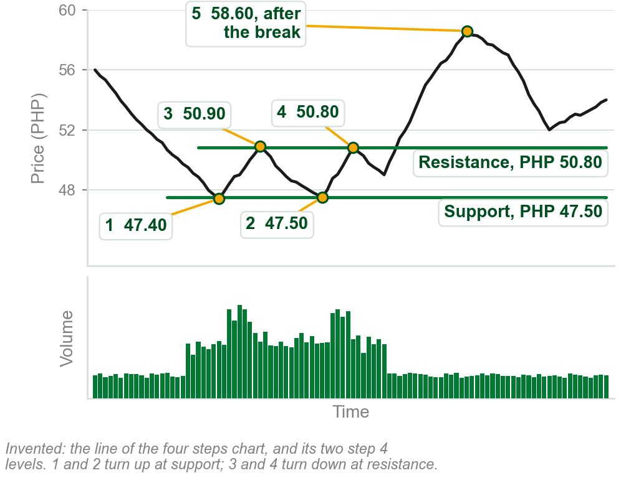
What the two levels did on our chart
Support at PHP 47.50: price turned up near it twice, at 1, PHP 47.40, and 2, PHP 47.50.
Resistance at PHP 50.80: price turned down near it twice, at 3, PHP 50.90, and 4, PHP 50.80, then broke above it and rose to about PHP 58.60, at 5.
Potential levels, the book says, not certain ones: ours held twice, then broke. It does not say what a break means.
Chart HG - FIN1209 teaching chart, drawn for this course. Illustrative data, not a real instrument.
Part 4 of 6 - 6.1 Open interest | 28 of 29
Book pp.196-197. The prices are our chart's, read from the series that drew it.

Slide 115
The four steps on 3M
(1) $74 to $80: the book's largest volume by price range, the dark sideways bars.
(2) The dark columns, where volume reaches the dotted overextended volume level (Part 2), cross it in two white boxes, (3) and (5).
(4) Closest peak above, about $80: resistance. Closest trough below, about $72.50: support.
FIGURE 6.29
The daily chart of 3M with the $74 to $80 volume by price band and two dark time columns over the high volume intervals; where they cross are two white boxes. Dashed lines mark the closest resistance above and the closest support below, and an overextended volume level runs across the volume panel.
1
3
5
4
2
Both act as effective barriers to price on the daily chart of 3M.
Figure 6.29 - Lim, The Handbook of Technical Analysis (Wiley, 2016)
A page earlier the book gave 3M's most traded range as $77 to $86. It does not say why they differ.
Part 4 of 6 - 6.1 Open interest | 29 of 29
Book pp.196-197 and Figure 6.29; the two levels are read off the figure by eye.

Slide 116
6.1 Volume and bar range: Chapter 5's four cases
Bar range, as in Chapter 5: a bar's high minus its low. High PHP 52.00, low PHP 51.20: range PHP 0.80. The book also says spread, not Chapter 3's bid-ask spread.
Set range against volume: four cases. Figure 6.30 draws each as an empty box, the range, over a black box, the volume.
(1) short range, low volume; (2) short, high; (3) tall, low; (4) tall, high. The book uses them to forecast breakouts and reversals.
FIGURE 6.30
Four numbered pairs: an empty box for the bar range over a black box for the volume. 1 short on low, 2 short on high, 3 tall on low, 4 tall on high.
1
2
3
4
Chapter 5's squat bar, a small range on large volume, is case 2.
Figure 6.30 - Lim, The Handbook of Technical Analysis (Wiley, 2016)
Part 5 of 6 - 6.1 Bar range | 1 of 26
Book p.197 and Figure 6.30; Chapter 5, characteristic 15. The pesos are ours. Spread is the book's word for bar range here.

Slide 117
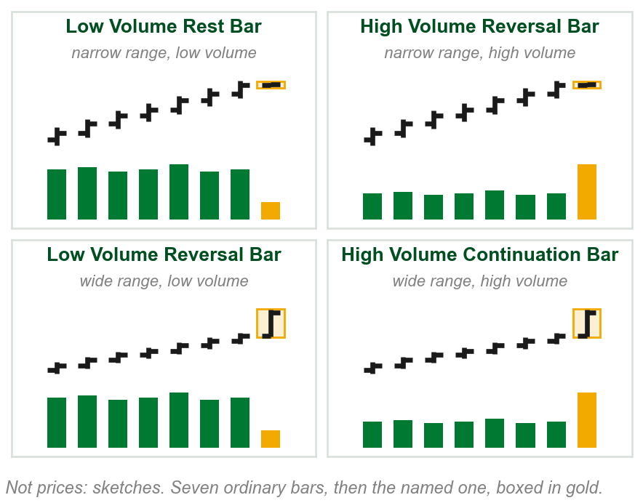
NEW TERM
Rest, reversal and continuation bars
IN PLAIN WORDS
One name for each of four kinds of bar: narrow or wide range, on low or high volume, each judged against the trend's usual bars.
FOR EXAMPLE
Usual bar: PHP 1.00 on 2 million shares. PHP 0.20 on 5 million: narrow, high, a High Volume Reversal Bar.
THE FORMAL DEFINITION
Narrow range on low volume: Low Volume Rest Bar. Narrow, high volume: High Volume Reversal Bar. Wide, low volume: Low Volume Reversal Bar. Wide, high volume: High Volume Continuation Bar.
Chart AH - FIN1209 teaching chart, drawn for this course. Illustrative data, not a real instrument.
Part 5 of 6 - 6.1 Bar range | 2 of 26
Book p.197: the four names. The pesos and share counts in the example are ours. The chart is ours: sketches, not prices.

Slide 118
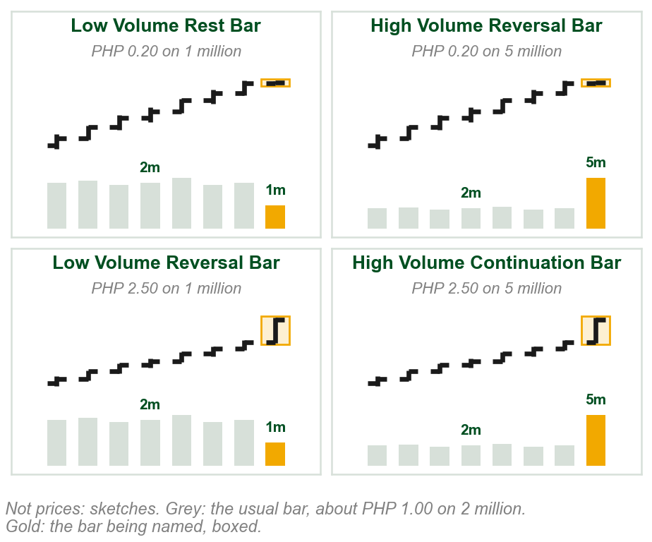
Naming a bar, step by step
Step 1, the usual bar, grey: about PHP 1.00 high to low, on 2 million shares; ours, as the book gives no number.
Step 2, compare. (1) PHP 0.20 on 1 million: narrow, low: Low Volume Rest Bar. (2) PHP 0.20 on 5 million: narrow, high: High Volume Reversal Bar.
(3) PHP 2.50 on 1 million: wide, low: Low Volume Reversal Bar. (4) PHP 2.50 on 5 million: wide, high: High Volume Continuation Bar.
1
2
3
4
Judge each bar against the bars around it.
Chart JA - FIN1209 teaching chart, drawn for this course. Illustrative data, not a real instrument.
Part 5 of 6 - 6.1 Bar range | 3 of 26
Book p.197: the four names. Ours: every number, the comparison with the usual bar, which the book does not put a number on, and the chart: sketches, not prices.

Slide 119
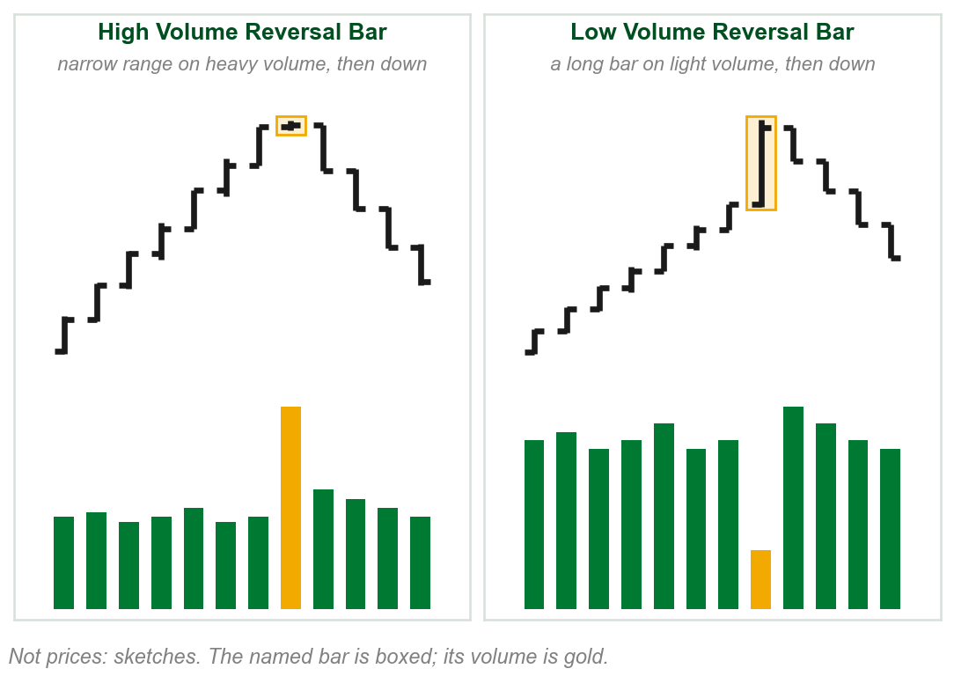
The two reversal bars
(1) High Volume Reversal Bar, narrow on high volume, chart left: a strong potential for reversal. Bearish in an uptrend; the converse, bullish, in a downtrend.
(2) Low Volume Reversal Bar, wide on low volume, right: a potential for reversal. The longer the bar, the more bearish in an uptrend, bullish in a downtrend.
1
2
Too little movement for the volume, or too little volume for the move.
Chart AI - FIN1209 teaching chart, drawn for this course. Illustrative data, not a real instrument.
Part 5 of 6 - 6.1 Bar range | 4 of 26
Book p.197: the readings are the book's; the gold line is our summary. The chart is ours: sketches, not prices.

Slide 120
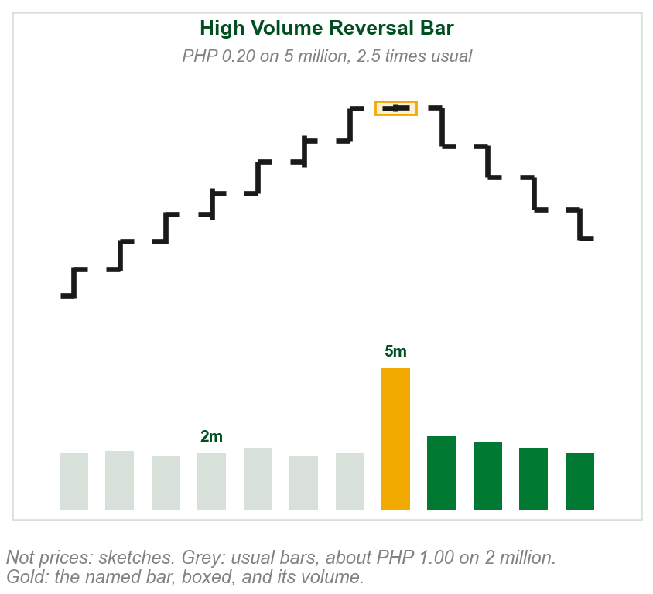
Why the reversal bars warn, with numbers
(1) Ours: the usual bar moves PHP 1.00 on 2 million shares. Today 5 million trade, 2.5 times usual, and price moves only PHP 0.20.
The book: were that volume buying, the range would be much wider. So sellers are attempting to take control. In a downtrend, the converse.
1
A warning of a potential turn, not a certainty: the book gives no entry rule.
Chart JB - FIN1209 teaching chart, drawn for this course. Illustrative data, not a real instrument.
Part 5 of 6 - 6.1 Bar range | 5 of 26
Book p.197: the reason is the book's, and the converse is its word for the downtrend case. Ours: every number, and the chart: a sketch, not prices.

Slide 121
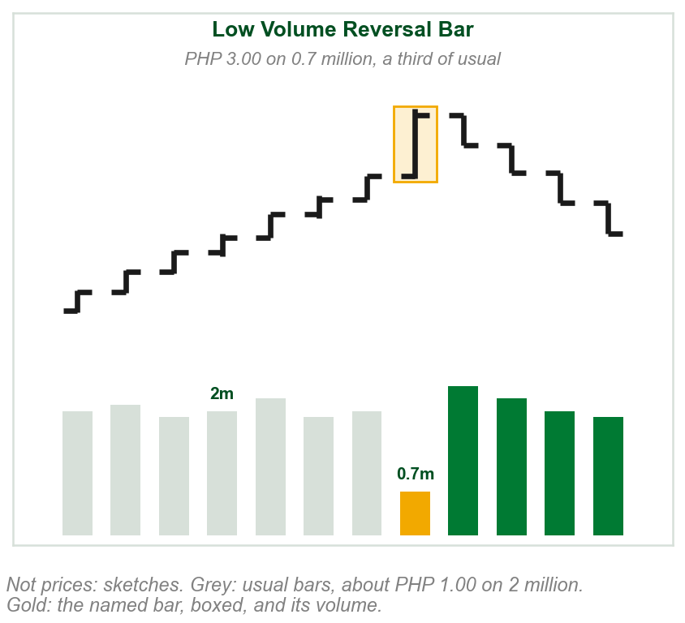
Why the low volume reversal bar warns, with numbers
(1) Ours: price jumps PHP 3.00 on 0.7 million shares, a third of the usual 2 million.
The book: a large move on little participation, its word for volume: a lack of interest. Bearish in an uptrend, bullish in a downtrend.
1
Too little volume for the move: a potential reversal.
Chart JN - FIN1209 teaching chart, drawn for this course. Illustrative data, not a real instrument.
Part 5 of 6 - 6.1 Bar range | 6 of 26
Book p.197: the reason is the book's. Ours: every number, and the chart: a sketch, not prices.

Slide 122

The rest bar and the continuation bar
Low Volume Rest Bar, narrow on low volume: a lack of participation. In a strong, rapid trend (1), a potential reversal; in a weak to average one (2), a point of rest.
(3) High Volume Continuation Bar, wide on high volume: backed by very large participation. Bullish in an uptrend, bearish in a downtrend.
2
3
1
The rest bar reads by the trend's speed; the continuation bar, by its direction.
Chart AJ - FIN1209 teaching chart, drawn for this course. Illustrative data, not a real instrument.
Part 5 of 6 - 6.1 Bar range | 7 of 26
Book p.197: the readings and reasons are the book's. The chart is ours: sketches, not prices.

Slide 123

The rest bar's two readings, with numbers
(1) Ours: a rise of PHP 1.60 a bar stalls on a PHP 0.30 bar with a quarter of the usual volume. That fast, then that quiet: a potential reversal.
(2) The same quiet bar in a rise of PHP 0.45 a bar: a point of rest, a pause before the rise goes on. The book gives no speed for strong and rapid.
Chapter 5 called both low volume bars only trend inhibiting, holding the trend back. Here each can also mark a reversal.
2
1
Read the rest bar with the trend's speed.
Chart JC - FIN1209 teaching chart, drawn for this course. Illustrative data, not a real instrument.
Part 5 of 6 - 6.1 Bar range | 8 of 26
Book p.197; Chapter 5, characteristic 15. Ours: every number, the chart, and a pause as the plain reading of point of rest. The book gives no reason speed matters.

Slide 124
High volume reversal bars: a dollar fund
At (1) and (2): a narrow range candle on one of the tallest volume bars, about 11 to 13 million shares against 5 million most days.
Point 1, late October, at a low: price then rises. Point 2, at the year end, ends a dip from about 22.6 to 22.35: price turns back up to 22.72.
(3) August: volume falls into a triangle's apex, where its lines meet: Part 2's low volume breakout signal. Then a volume surge.
2
FIGURE 6.31
The daily dollar fund: narrow range candlesticks on high volume circled at 1, at a low, and 2, at a dip near the highs, lined to tall volume bars; a triangle at the left.
3
1
Figure 6.31 - Lim, The Handbook of Technical Analysis (Wiley, 2016)
Narrow bar, heavy volume, then a turn.
Part 5 of 6 - 6.1 Bar range | 9 of 26
Book p.198 and Figure 6.31, the PowerShares DB U.S. Dollar Bullish Fund. Ours: volumes read by eye. The curved lines are Bollinger Bands, not discussed.

Slide 125
A reversal bar at a bottom
The dollar fund in 2010: a narrow range candlestick on high volume, circled at a low around the start of November (1).
The volume bars under the circle are among the chart's tallest. Price then rebounds (2), from about 22.0 to about 23.5 within the month.
FIGURE 6.32
The daily PowerShares DB U.S. Dollar Bullish Fund with a narrow range candlestick on high volume circled at a low at the start of November, followed by a strong rise.
2
1
Figure 6.32 - Lim, The Handbook of Technical Analysis (Wiley, 2016)
The converse case: in a decline, a high volume reversal bar is bullish.
Part 5 of 6 - 6.1 Bar range | 10 of 26
Book p.198 and Figure 6.32, the PowerShares DB U.S. Dollar Bullish Fund. Ours: the prices and volumes, read by eye.

Slide 126
More reliable inside the larger trend
The dollar fund, 2011: a larger downtrend (1), about 23.4 in January to 21.0 in May. A short rally ends at a circled high volume reversal bar (2), May 23.
Before it, bearish divergence (3): price rising while volume fell, and the MACD too.
Bearish, the larger trend's way: potentially more reliable, the book says. Prices then fell.
(4) X, early May: a high volume continuation bar.
FIGURE 6.33
The daily dollar fund in a long decline: a circled high volume reversal bar at a short rally's top in late May, falling lines over volume and the MACD before it, and a continuation bar at X.
1
2
4
3
Agreeing with the larger trend: more reliable.
Figure 6.33 - Lim, The Handbook of Technical Analysis (Wiley, 2016)
Part 5 of 6 - 6.1 Bar range | 11 of 26
Book p.199 and Figure 6.33, the dollar fund. Ours: prices read by eye. The MACD: met in Chapter 4, not taught. The RSI panel and the two moving averages are not discussed.

Slide 127
Why the larger trend matters, with numbers
Larger, or predominant, trend: the whole move, our reading, as the book gives none. (1) Here, about 23.4 in January down to 21.0 in May.
(2) The circled high volume reversal bar is bearish, with that fall: potentially more reliable, the book says.
FIGURE 6.33
The daily dollar fund in a long decline from about 23.4 in January to 21.0 in May, with a circled high volume reversal bar at a short rally's top in late May.
1
2
Ask which way the larger trend runs. The book gives no further reason.
Figure 6.33 - Lim, The Handbook of Technical Analysis (Wiley, 2016)
Part 5 of 6 - 6.1 Bar range | 12 of 26
Book p.199 and Figure 6.33. Ours: levels read by eye, and the larger trend read as the whole move. The book does not define the larger trend.

Slide 128
X: a continuation bar against the larger trend
The book: continuation bars, too, are more reliable in the direction of the predominant trend.
(1) X, our reading, as the book does not say: a high volume continuation bar rising against the larger downtrend, so the less reliable kind.
Its rally lasted about two and a half weeks before the fall went on.
FIGURE 6.33
The daily dollar fund in a long decline, with X marking a high volume continuation bar in early May that rises against the decline.
1
With the larger trend: more reliable. Against it: less.
Figure 6.33 - Lim, The Handbook of Technical Analysis (Wiley, 2016)
Part 5 of 6 - 6.1 Bar range | 13 of 26
Book p.199 and Figure 6.33. Ours: the reading of X, and its length read by eye. The book does not discuss X.

Slide 129
A reversal bar at an overextended level
The dollar fund, end of October 2011: a high volume reversal bar, circled (1).
Its volume reaches the line across the volume panel (2), about 13 million: the book's historically overextended volume level, Part 2's upper level.
Historically is not defined; the line runs level with the September peaks, the oval (3). Price had fallen into the bar, and rose after it.
FIGURE 6.34
The daily PowerShares DB U.S. Dollar Bullish Fund with a line across the volume panel labelled historically overextended volume level, and a circled reversal bar at the end of October whose volume reaches that line.
3
1
2
Figure 6.34 - Lim, The Handbook of Technical Analysis (Wiley, 2016)
Two signals agree: the reversal bar, and Part 2's overextended volume.
Part 5 of 6 - 6.1 Bar range | 14 of 26
Book p.199 and Figure 6.34, the dollar fund. Ours: volume and direction read by eye. The book does not say which way price went.

Slide 130
Constant volume charts find reversal bars
Chapter 3: a constant volume chart starts a new bar each time a set volume has traded, so every volume bar is the same height (3).
So the book finds reversal bars from the bar range alone and its height against the rest of the bars.
Figure 6.35: a narrow bar (1), sellers taking control; a very tall bar (2), a lack of interest in the rise. Both bearish.
FIGURE 6.35
Two sketches of a constant volume chart, all volume bars equal. Left: a rise topped by a narrow bar on relatively high volume. Right: by a very tall bar on relatively low volume. Both bearish.
1
2
3
Especially useful for reversal bars on high or low volume.
Figure 6.35 - Lim, The Handbook of Technical Analysis (Wiley, 2016)
Part 5 of 6 - 6.1 Bar range | 15 of 26
Book p.199 and Figure 6.35. The constant volume chart was a Chapter 3 term.

Slide 131
High and low volume when every bar's volume is fixed
Ours: every bar holds 100,000 shares; a usual bar spans PHP 1.00: 100,000 shares a peso of range.
(1) A PHP 0.20 bar: 100,000 shares moved price 20 centavos, 500,000 a peso, five times usual. Figure 6.35's label: relatively high volume.
(2) A PHP 4.00 bar: 100,000 shares over 4 pesos, 25,000 a peso, a quarter of usual. Its label: relatively low volume.
FIGURE 6.35
Two sketches of a constant volume chart, all volume bars equal. 1, left: a rise topped by a narrow bar labelled relatively high volume. 2, right: a rise topped by a very tall bar labelled relatively low volume.
1
2
Volume is fixed, so the range alone says if it was a lot or a little.
Figure 6.35 - Lim, The Handbook of Technical Analysis (Wiley, 2016)
Part 5 of 6 - 6.1 Bar range | 16 of 26
Book p.199 and Figure 6.35, whose labels say relatively high and relatively low volume. Ours: every number, and the per-peso reading.

Slide 132

Volume leading price, or price leading volume
Volume leading price, our reading: volume rises first, price moves after. Most agree price cannot move significantly without volume.
Price leading volume: price breaks first. Signals need little volume to appear. (1) A small trendline breakout on ordinary volume.
As the break becomes obvious it invites tremendous volume. (2) Volume more than doubles.
1
2
Price moved first: price led volume.
Chart AK - FIN1209 teaching chart, drawn for this course. Illustrative data, not a real instrument.
Part 5 of 6 - 6.1 Bar range | 17 of 26
Book p.200. Ours: the reading of leading, and the chart, on invented prices. Breakout of a trendline: Chapter 5's use of the word.

Slide 133

What price leading volume means for a signal
Ours: a usual day trades 1.3 million. (1) Price closes PHP 0.80 above a two-month falling trendline, (2) on 1.3 million: an ordinary day.
By volume alone, nothing happened. But the break shows on every chart: (3) days later, 3 million trade.
Light volume on a break does not cancel it: watch whether volume follows. The book does not say for how long.
1
3
Volume can follow the signal: more often now, the book says, as technical analysis is widely used.
2
Chart JE - FIN1209 teaching chart, drawn for this course. Illustrative data, not a real instrument.
Part 5 of 6 - 6.1 Bar range | 18 of 26
Book p.200, one paragraph. Ours: the numbers and the chart, Chart AK's line with its numbers. The book gives no test for when a light volume signal will draw volume in.

Slide 134

NEW TERM
Intraday volume cycle
IN PLAIN WORDS
Intraday: within one day. Volume swells and fades daily, peaking at about the same hour each day.
3
FOR EXAMPLE
GMT, Greenwich Mean Time: 1:30 to 2:30 p.m. GMT is 9:30 to 10:30 p.m. in Manila. Our chart: reversals at (1) and (3), a continuation at (2).
2
1
THE FORMAL DEFINITION
The intraday volume cycle normally peaks around 1:30 p.m. to 2:30 p.m. GMT. At these volume peaks, price will either reverse or continue, but very rarely remain unchanged.
Chart AL - FIN1209 teaching chart, drawn for this course. Illustrative data, not a real instrument.
Part 5 of 6 - 6.1 Bar range | 19 of 26
Book p.200. The hours are the book's; its examples are EURUSD. The chart and the Manila time are ours.

Slide 135
Using the cycle: when to watch, not which way
The book: the cycle lets us anticipate price action. At the peak hour price will reverse or continue, very rarely stay put.
It does not say which way, so many use a straddle, Chapter 5's bidirectional entry: one order each way.
Ours: EURUSD at 1.3000 before 1:30 p.m. GMT. A buy stop at 1.3020 buys only if price rises to it; a sell stop at 1.2980 sells only if price falls to it.
The book gives no reason for the hour, no distance for the orders, and nothing on the order not filled.
Part 5 of 6 - 6.1 Bar range | 20 of 26
Book pp.200-201. Ours: the EURUSD prices, the timing and the order levels. EURUSD: the euro priced in US dollars. Bidirectional entry: a Chapter 5 term.

Slide 136
Volume cycle peaks at support and resistance
30-minute EURUSD: almost every reversal comes at a peak in tick volume, Part 4's count of trades: the daily spikes in the bottom panel (2).
Follow the solid line down from Market bottom (1): it lands on one of the tallest spikes (4).
Especially useful when price retests a support or resistance level (3): comes back to one it turned at before.
FIGURE 6.36
A 30-minute EURUSD chart over weeks, with support and resistance lines, a triangle and a channel, over daily volume cycles; price turns at the peaks.
3
1
4
2
Figure 6.36 - Lim, The Handbook of Technical Analysis (Wiley, 2016)
Many straddle the peak: catch price either way.
Part 5 of 6 - 6.1 Bar range | 21 of 26
Book pp.200-201 and Figure 6.36. Retest: our plain reading; the book does not define it. The figure's labels and dotted lines are not explained in the text.

Slide 137
Trendline retests at volume peaks
Hourly EURUSD: price rebounds off a rising trendline at the book's 1 (1) and at its 4 and 5 (2), each time at a tick volume peak (3).
At the book's 2 and 3, the trendline failed.
FIGURE 6.37
Hourly EURUSD with rising trendlines and retests 1 to 5, daily volume cycles below, and a stochastic panel: oversold under 1, 4 and 5, not at X and Y.
1
2
3
Retests at a volume peak: the line held three times of five.
Figure 6.37 - Lim, The Handbook of Technical Analysis (Wiley, 2016)
Part 5 of 6 - 6.1 Bar range | 22 of 26
Book pp.201-202 and Figure 6.37. Oversold and the cycle-tuned stochastic are named, not taught: oscillators are the book's Chapter 8. The pip label is not in the text.

Slide 138
Retests and the stochastic
Bottom panel: a cycle-tuned stochastic. At the book's 1, 4 and 5 it read oversold: its line on the lower line, the grey boxes (1).
At 2 and 3 the trendline failed: at circles Y (2) and X (3) the stochastic was still mid-panel, not clearly oversold.
The book never defines oversold.
FIGURE 6.37
The volume and stochastic panels of Figure 6.37, enlarged: grey boxes where its line sits on the lower line, under the book's retests 1, 4 and 5, and circles Y and X where it does not.
2
3
1
Figure 6.37 - Lim, The Handbook of Technical Analysis (Wiley, 2016)
Volume peak and oscillator both: the line held.
Part 5 of 6 - 6.1 Bar range | 23 of 26
Book pp.201-202 and Figure 6.37, its volume and stochastic panels. Oversold and the cycle-tuned stochastic are named, not taught: oscillators are the book's Chapter 8.

Slide 139
Volume on non-constant time charts
Chapter 3: point and figure, Renko and three line break charts are not plotted linearly in time: equal steps along the axis are not equal times.
That changes the angle of trendlines, channels and chart patterns. Figure 6.38, top: Apple on a standard daily chart, with a trendline (2).
FIGURE 6.38
The upper panel of Figure 6.38: Apple on a standard daily chart, a rising trendline under it, and a circle in late May where price stays above the line.
1
2
(1) Circled, late May: on the standard chart, price stays above the line.
Figure 6.38 - Lim, The Handbook of Technical Analysis (Wiley, 2016)
Part 5 of 6 - 6.1 Bar range | 24 of 26
Book p.202 and Figure 6.38, its upper panel. Point and figure, Renko, three line break and equivolume charts were Chapter 3 terms.

Slide 140
The same line on the equivolume chart
Equivolume: each bar covers the same time, but is wider on heavier volume, so its time axis is non-linear too.
Figure 6.38, bottom: the same Apple prices on an equivolume chart, and the same trendline (2).
So the same line meets late May at a different place.
FIGURE 6.38
The lower panel of Figure 6.38: the same Apple prices on an equivolume chart, the same trendline, and a circle in late May where price cuts through the line.
1
2
(1) Circled, late May: on the equivolume chart, price cuts through the line.
Figure 6.38 - Lim, The Handbook of Technical Analysis (Wiley, 2016)
Part 5 of 6 - 6.1 Bar range | 25 of 26
Book p.202 and Figure 6.38, its lower panel: the same prices and the same line as the slide before, on an equivolume chart.

Slide 141

Why the trendline moves, with numbers
Ours: lows of PHP 100 and 110, ten ordinary days apart, one step a day on both charts: the line rises PHP 1.00 a step.
Then five heavy days: (1) one step each on the daily chart, (2) two each on the equivolume one. The lines reach PHP 115 and PHP 120.
That day's low of PHP 117 holds above the daily line and cuts the equivolume one. Equal widths would move nothing.
1
2
The book shows the discrepancy, not which break to trust.
Chart JG - FIN1209 teaching chart, drawn for this course. Illustrative data, not a real instrument.
Part 5 of 6 - 6.1 Bar range | 26 of 26
Book p.202. Ours: every number and the chart. The book says the angle is affected and shows the result in Figure 6.38; it does not work the arithmetic.

Slide 142
6.2 Volume oscillators, and how they are read
An oscillator (Part 1): an indicator in its own panel under price. Section 6.2 names eight built from volume.
Price-based: the OBV, the ADL, the Chaikin Money Flow and Oscillator, the Herrick Payoff Index, the Demand Index (never explained).
Non-price-based: the NYSE Up/Down Volume Line. The eighth, the VWMA (Part 2), is on neither of Part 1's lists.
Plain volume diverges by falling; price-based, against price.
Part 6 of 6 - 6.2 Oscillators | 1 of 25
Book p.203 lists the eight. p.179 sorts the price-based ones and p.206 the NYSE line; the VWMA is on neither list.

Slide 143

Eight ways to read an oscillator; three used here
Eight methods, taught in Chapter 8, listed below. Part 6 uses only three:
A Price, a higher peak; oscillator, a lower one. Against price: divergence. Falling: bearish. Price then falls (method 4).
B A rising line under the oscillator; falling through it is a sell signal (the Chaikin pair, later). No method is named.
C An oversold level (method 1): a potential bottom, the book says (p.206). It never says how it is set.
The eight: 1 OBOS (overbought and oversold) overextended levels, 2 equilibrium and zero line crossovers, 3 signal line crossovers, 4 price-oscillator divergence, 5 to 7 geometric, numeric and horizontal pattern analysis, 8 oscillator on oscillator.
Chart FA - FIN1209 teaching chart, drawn for this course. Illustrative data, not a real instrument.
Part 6 of 6 - 6.2 Oscillators | 2 of 25
Book p.203 lists the eight methods and sends them to Chapter 8; p.206 reads the oversold level. The chart is ours, invented.

Slide 144

NEW TERM
On Balance Volume, OBV
IN PLAIN WORDS
A running total of volume: a close above the day before's adds the day's volume; below, subtracts it; the same, nothing.
FOR EXAMPLE
Ours: day 2 closes up, add 2.0 million: OBV 2.0. Day 3 down, take 1.5: 0.5. Day 4 unchanged: 0.5. Day 5 up, add 3.0: 3.5. Day 6 down, take 1.0: 2.5.
THE FORMAL DEFINITION
A cumulative running total of each period's volume: added if the close is higher than the preceding close, subtracted if lower, and nothing if unchanged.
Chart AM - FIN1209 teaching chart, drawn for this course. Illustrative data, not a real instrument.
Part 6 of 6 - 6.2 Oscillators | 3 of 25
Book p.203 gives the rule. The closes and volumes in the example and on the chart are ours.

Slide 145

What the OBV's number says, and which kind it is
The book sets no start; we start at 0 on day 1, with no day before it. (1) Up days: 2.0 + 3.0 = 5.0 million; (2) down days: 1.5 + 1.0 = 2.5. (3) OBV: 2.5.
Rising OBV: more volume on up closes than down closes. Falling: the reverse.
Price-based, as the close sets the sign. Part 1's two questions: rising (bullish) or falling (bearish)? With price (confirmation) or against it (divergence)?
1
2
3
Read it by rises and falls against price, not by level: next slide.
Chart JH - FIN1209 teaching chart, drawn for this course. Illustrative data, not a real instrument.
Part 6 of 6 - 6.2 Oscillators | 4 of 25
Book p.203 gives the rule and no starting value. The arithmetic and the chart are ours, on Chart AM's six days. The reading rule is Part 1's, Figure 6.7.

Slide 146

The OBV's disadvantage: the start date
Its level, the book's absolute value, depends on the start date. Start our six days on day 3: day 6 reads 2.0 (2), not 2.5 (1).
Its changes, the relative value, do not. From day 3 (3) to day 6, both lines rise 2.0: 0.5 to 2.5, 0 to 2.0.
The book: so all eight methods may still be used. Divergence reads rises and falls.
1
2
3
An OBV reading of 2.5 means nothing alone; a rise or a fall does.
Chart AN - FIN1209 teaching chart, drawn for this course. Illustrative data, not a real instrument.
Part 6 of 6 - 6.2 Oscillators | 5 of 25
Book pp.203-204: the disadvantage and its consequence are the book's. The chart is ours: the OBV's six days, started twice.

Slide 147

The OBV's weakness: only the close counts
Volume is added or subtracted regardless of the bar's own behavior.
Ours: bar 1 has a high of 51.00 and closes 50.80. Bar 2 rallies to a new high of 54.00 (1), far above, and closes 50.70 (2), just under 50.80.
Bar 2 closed lower, so all its 3.0 million is subtracted (3).
1
2
3
To redress it, that is, to put it right, many prefer the ADL or the two Chaikin indicators: next.
Chart FC - FIN1209 teaching chart, drawn for this course. Illustrative data, not a real instrument.
Part 6 of 6 - 6.2 Oscillators | 6 of 25
Book pp.203-204: the weakness and its example are the book's. The two bars and their numbers are ours.

Slide 148
OBV bullish divergence: Citigroup
(1) Price: a lower low, August to October 2011: the falling line.
(2) OBV: a higher low, same weeks: the rising line.
Price-based rule: rising, so bullish; against price, so divergence.
(3) Then, the book: prices rebound strongly, here about 22 to 34 dollars.
FIGURE 6.39
The daily chart of Citigroup with an On Balance Volume panel under it. A falling line marks price's lower lows in August to October 2011, and a rising line under the OBV, labelled bullish divergence, marks its higher lows.
3
1
2
On plain volume, bullish divergence is instead volume falling as price falls.
Figure 6.39 - Lim, The Handbook of Technical Analysis (Wiley, 2016)
Part 6 of 6 - 6.2 Oscillators | 7 of 25
Book p.204 and Figure 6.39. The dollar levels are read off the figure, roughly.

Slide 149
OBV bearish divergence: copper
(1) First arrow, March to April 2011: equal peaks near 4.5; the OBV falls.
(2) Second, June to August: price rises from about 4.1 to 4.5; the OBV falls.
The book calls both bearish divergence: the OBV falls (3) while price holds or rises.
(4) Prices then fell strongly, the book says: here to about 3.0 by October.
FIGURE 6.40
The daily chart of copper with an On Balance Volume panel under it. Two arrows mark price holding level and then rising to a peak in 2011 while two arrows under the OBV fall, labelled bearish divergence.
1
4
2
3
Bearish divergence: price flat or up, the price-based indicator down.
Figure 6.40 - Lim, The Handbook of Technical Analysis (Wiley, 2016)
Part 6 of 6 - 6.2 Oscillators | 8 of 25
Book p.204 and Figure 6.40. The price levels are read off the figure, roughly.

Slide 150

NEW TERM
Accumulation Distribution Line, ADL
IN PLAIN WORDS
Like the OBV, a running total, but each bar adds a share of its volume set by where it closes in its range.
FOR EXAMPLE
Ours: bar PHP 48 to 52, 2 million shares. Close 52: add 2.0. At 50: add 0. At 49: take 1.0.
THE FORMAL DEFINITION
C, H, L: close, high, low. Calculate the multiplying factor [(C - L) - (H - C)] / (H - L) times the period's volume, and add it to its running total: the ADL.
Chart AO - FIN1209 teaching chart, drawn for this course. Illustrative data, not a real instrument.
Part 6 of 6 - 6.2 Oscillators | 9 of 25
Book pp.204-205 gives the calculation. C, H and L are Chapter 1's OHLC. The bars and their volume are ours.

Slide 151

The ADL worked, bar by bar
Each bar: low L = 48, high H = 52, range H - L = 4, volume 2.0 million. C - L: the close's height above the low. H - C: its depth below the high.
(1) Close 52: (4 - 0) / 4 = 1, add 2.0. (2) Close 50: (2 - 2) / 4 = 0, add nothing. (3) Close 49: (1 - 3) / 4 = -0.5, take 1.0.
The running total, bar by bar: 2.0, then 2.0 + 0 = 2.0, then 2.0 - 1.0 = 1.0. That total is the ADL.
1
2
3
The factor scores where the close sits: -1 at the low, 0 at the midpoint, +1 at the high.
Chart JI - FIN1209 teaching chart, drawn for this course. Illustrative data, not a real instrument.
Part 6 of 6 - 6.2 Oscillators | 10 of 25
Book pp.204-205 gives the factor. The bars, volumes, arithmetic and chart are ours, Chart AO's three bars.

Slide 152

How the ADL redresses the OBV
(1) Midpoint, nothing added: if C - L = H - C, then C = (H + L) / 2. For 48 and 52, 50.
Further above it, more is added; below it, more subtracted.
(2) At most the day's volume: at the high, C = H, the factor is (H - L) / (H - L) = 1, however wide the bar.
2
1
The ADL accounts for the current bar's price action. The OBV does not.
Chart AP - FIN1209 teaching chart, drawn for this course. Illustrative data, not a real instrument.
Part 6 of 6 - 6.2 Oscillators | 11 of 25
Book p.205: the algebra and the maximum are the book's. The chart is ours: the factor against where the close sits.

Slide 153

One bar, two answers: the OBV against the ADL
Ours: yesterday closed 50.00. Today runs from 46.00 to 51.00 on 2.0 million shares and closes at 49.75.
(1) OBV: 49.75 is below 50.00, so subtract all 2.0 million.
(2) ADL: C - L = 3.75, H - C = 1.25, range 5. Factor (3.75 - 1.25) / 5 = 0.5: add 1.0 million.
2
1
The OBV sees only yesterday's close; the ADL sees where today closed in today's bar.
Chart JJ - FIN1209 teaching chart, drawn for this course. Illustrative data, not a real instrument.
Part 6 of 6 - 6.2 Oscillators | 12 of 25
Ours: one invented bar and the chart, read by the book's two rules from pp.203 and 205.

Slide 154
The ADL confirms, volume diverges: EURUSD
Hourly EURUSD, June 2011: price makes new highs (1).
(2) ADL, price-based: rising with price, so bullish confirmation.
(3) Volume, plain: falling as price rises, so bearish divergence: an underlying weakness, the book says.
1
FIGURE 6.41
An hourly EURUSD chart rising to a top, with an A/D line panel rising alongside it, labelled bullish confirmation, and a volume panel falling, labelled bearish divergence, under the heading divergence between volume and ADL.
2
3
They disagree: wait for price itself to confirm a reversal, by breaking its own trendline.
Figure 6.41 - Lim, The Handbook of Technical Analysis (Wiley, 2016)
Part 6 of 6 - 6.2 Oscillators | 13 of 25
Book p.205 and Figure 6.41. Price confirmation as Figure 6.44, p.206, labels it.

Slide 155
OBV and ADL together: trend or range
Both rising, or both falling: price trends in a decisive manner. Right ellipse (1).
Opposite directions: price tends to range or consolidate, going sideways. Left ellipse (2).
Regime: whether the market trends or ranges. Trend-following trades with a trend; range-bound, inside a range.
FIGURE 6.42
The daily chart of Exxon Mobil with OBV and ADL panels. On the left the two move apart, non-confirmation, under an erratic and volatile price; on the right they rise together, confirmation, under a pronounced trend.
1
The book: it may help choose. Together, trend-following; apart, range-bound.
2
Figure 6.42 - Lim, The Handbook of Technical Analysis (Wiley, 2016)
Part 6 of 6 - 6.2 Oscillators | 14 of 25
Book pp.205-206 and Figure 6.42. Regime is the book's word, not defined; the reading of it is ours.

Slide 156

NEW TERM
Chaikin Money Flow and Chaikin Oscillator
IN PLAIN WORDS
CMF: add the ADL's signed volumes S over the last N bars, and divide by those bars' total volume.
FOR EXAMPLE
Ours, the ADL's three bars, N = 3: S of 2.0, 0 and -1.0 million make 1.0; volumes of 2.0 each make 6.0. CMF = 1.0 / 6.0 = 0.17.
THE FORMAL DEFINITION
S: the multiplying factor times volume. N-period CMF: the sum of S over the sum of volume. Chaikin oscillator: a shorter-term EMA less a longer-term EMA of the CMF's running total.
Chart AQ - FIN1209 teaching chart, drawn for this course. Illustrative data, not a real instrument.
Part 6 of 6 - 6.2 Oscillators | 15 of 25
Book p.206 gives the calculation, not the lengths. The bars and volumes are ours.

Slide 157

What the CMF's number says
The ADL's factor runs from -1 to +1, so no S exceeds its bar's volume: the CMF also runs from -1 to +1.
(1) -1: every bar closed at its low. (2) 0: on balance, closes at their midpoints. +1: every bar closed at its high.
(3) Our 0.17: of 6.0 million traded, a net 1.0 million counts as added: volume came, on balance, with closes above their midpoints.
3
2
1
Our arithmetic. The book reads the CMF only by a line and an oversold level, three slides on.
Chart JK - FIN1209 teaching chart, drawn for this course. Illustrative data, not a real instrument.
Part 6 of 6 - 6.2 Oscillators | 16 of 25
Ours: arithmetic on the book's p.206 definition and the ADL's factor, p.205, and the chart. The book gives no reading of the CMF's value.

Slide 158

The Chaikin oscillator, step by step
1 Each bar's CMF, over its last N bars.
(2) A running total of the CMF, as for the ADL: black.
(3) Two EMAs of that total, here over 3 and 10 bars: gold and green.
(4) Oscillator = shorter EMA - longer EMA, bottom panel. At the dashed lines: 1.0 - 0.5 = +0.5; 0.6 - 0.8 = -0.2.
2
3
4
The oscillator is the gap between the two averages.
Chart FD - FIN1209 teaching chart, drawn for this course. Illustrative data, not a real instrument.
Part 6 of 6 - 6.2 Oscillators | 17 of 25
Book p.206 gives the steps, no lengths, no reading of the sign and no EMA formula. The chart is ours: invented CMF values, our EMAs.

Slide 159

The EMA, and what the oscillator's sign says
EMA, exponential moving average: a moving average of the last few values, like Part 3's smoothed volume. This chapter never says how it weights them.
A 3-bar EMA follows the running total closely; a 10-bar one follows it slowly.
(1) Above 0, the recent average is above the longer one: the total has been rising lately. (2) Below 0, falling. Ours: the book gives no reading of the sign.
2
1
The sign says which of the two averages is on top.
Chart JL - FIN1209 teaching chart, drawn for this course. Illustrative data, not a real instrument.
Part 6 of 6 - 6.2 Oscillators | 18 of 25
Book p.206 gives the steps, no EMA formula and no reading of the sign. The reading of the sign is our arithmetic; the chart is Chart FD's invented values.

Slide 160
The Chaikin pair on copper
(1) Each indicator falls through the rising line under its lows: the sell signal.
The oscillator falls through first, the CMF later. The dashed arrows run up to the price top near 4.5, early August (2).
Copper then fell to about 3.0 by October, where both touched the line labelled oversold (3): a potential bottom, the book says.
2
FIGURE 6.43
The daily chart of copper with a Chaikin oscillator panel and a Chaikin Money Flow panel. Rising lines mark both before a top in August, with dashed arrows to the top, and both panels carry a line labelled oversold that both touch near the October low.
1
3
The Chaikin oscillator gives the earlier sell, or bearish, signal.
Figure 6.43 - Lim, The Handbook of Technical Analysis (Wiley, 2016)
Part 6 of 6 - 6.2 Oscillators | 19 of 25
Book p.206 and Figure 6.43. The text gives no settings. Oversold is not defined in this chapter.

Slide 161
The Chaikin pair's settings, read off Figure 6.43
The book gives no lengths for the CMF or its EMAs. Figure 6.43's panel labels print them.
(1) ChiOsc(3,10): the Chaikin oscillator, from EMAs of 3 and 10 bars.
(2) CMF(20): the Chaikin Money Flow over N = 20 bars.
1
FIGURE 6.43
The two indicator panels of Figure 6.43, enlarged: the label ChiOsc(3,10) on the Chaikin oscillator and the label CMF(20) on the Chaikin Money Flow.
2
Read the brackets as the settings: lengths in bars.
Figure 6.43 - Lim, The Handbook of Technical Analysis (Wiley, 2016)
Part 6 of 6 - 6.2 Oscillators | 20 of 25
Book p.206 and Figure 6.43, its two indicator panels. The text gives no settings; the figure's labels print them.

Slide 162

NEW TERM
NYSE Up/Down Volume
IN PLAIN WORDS
Volume traded in NYSE stocks that rose that day, divided by volume in those that fell.
FOR EXAMPLE
Ours: 600 million shares in rising stocks, 400 million in falling: 600 / 400 = 1.5. Read like plain volume: falling is divergence, rising confirmation.
THE FORMAL DEFINITION
The ratio of advancing volume over declining volume. Being non-price-based, its divergence is read like volume bars and smoothed and detrended volume.
Chart FB - FIN1209 teaching chart, drawn for this course. Illustrative data, not a real instrument.
Part 6 of 6 - 6.2 Oscillators | 21 of 25
Book p.206. Advancing and declining volume: our reading of the names, as for the TRIN in Part 4. The numbers are ours.

Slide 163
The NYSE Up/Down Volume on a chart
(1) Top: the indicator falls through its rising trendline in mid 2011: an early bearish signal.
(2) Bottom: the NYSE Composite, an index of NYSE share prices, breaks its own line later: price confirmation.
The book says ratio; the figure's line is cumulative and runs below zero (3). It does not explain.
1
FIGURE 6.44
Two daily panels, 2009 to 2011: the NYSE Advance-Decline Volume line above, labelled cumulative, breaking its rising trendline at a point marked early bearish signal; and the NYSE Composite Index below, breaking its own trendline later, circled as price confirmation.
3
2
The volume line warned first; price confirmed later.
Figure 6.44 - Lim, The Handbook of Technical Analysis (Wiley, 2016)
Part 6 of 6 - 6.2 Oscillators | 22 of 25
Book p.206 and Figure 6.44. Its line is labelled cumulative and runs below zero, which a ratio cannot; the book does not explain.

Slide 164
NEW TERM
Herrick Payoff Index
IN PLAIN WORDS
Uses price and open interest, so futures and options only. Price-based: rising bullish, falling bearish; against price, divergence.
FOR EXAMPLE
Gold futures: yes. A PSE share, with no open interest: no. The book gives no formula.
THE FORMAL DEFINITION
The Herrick Payoff Index uses open interest in its calculations, so it may only be used with futures and options. It incorporates price, so its divergence is read as for all price-based volume oscillators. As with all volume oscillators, bearish signals: money flowing out; bullish: money flowing in.
Part 6 of 6 - 6.2 Oscillators | 23 of 25
Book pp.207-208. The book gives no formula and no figure for it, so this slide has no picture.

Slide 165

NEW TERM
Commitment of Traders, COT, report
IN PLAIN WORDS
A weekly report of all open positions, listed by who holds them: three groups.
FOR EXAMPLE
Ours: open interest returns to its 92,000 peak as price tops: a test of a historical level.
THE FORMAL DEFINITION
Released every Friday, it reports all open positions held by commercials (hedgers, non-cash positions), non-commercials (hedge funds, financial institutions, large traders) and, in aggregate, small traders.
Chart AR - FIN1209 teaching chart, drawn for this course. Illustrative data, not a real instrument.
Part 6 of 6 - 6.2 Oscillators | 24 of 25
Book p.208 gives the report and its two uses. The chart is ours, on invented prices and open interest.

Slide 166

What traders read in the COT report
Commercials: hedgers, holding non-cash positions, a phrase the book never explains.
The book: traders use it to identify potential tops and bottoms, by two things.
One: changes in net commercial or non-commercial positions. Net: never defined, so not drawn.
Two: open interest testing a significant or historical level: back at an old level (1).
2
1
Ours: treat either as a warning, and wait for price to confirm (2), as for the ADL.
Chart JM - FIN1209 teaching chart, drawn for this course. Illustrative data, not a real instrument.
Part 6 of 6 - 6.2 Oscillators | 25 of 25
Book p.208. It does not define net or non-cash positions and gives no worked figures. The what-to-do line is ours, from p.205; the chart is ours, invented.

Slide 167
Chapter 6 in five sentences
Part 1: volume with price is bullish volume; against price, bearish.
Part 1: falling volume is divergence, rising confirmation, whatever price does.
Parts 2, 5: minimum volume, extreme volume and reversal bars time the turns.
Parts 3, 4: filters pick out key volume; open interest reads like volume.
Part 6: price-based oscillators diverge by moving against price.
The book: price-based and non-price-based oscillators read differently.
Chapter 6 - Wrap up
Book p.208: its summary is three sentences. These five are ours, of the whole chapter, each with the part that teaches it.

Slide 168
The review questions to prepare
Volume and tick volume: what is the difference? Bearish and bullish volume?
How is volume divergence distinct from standard oscillator divergence?
How would you use volume as a timing indicator?
The various modes of volume filtering?
The relationship between volume, open interest and price?
Absolute or relative volume, which is more useful? Volume cycles: use, where?
The book's eight, shortened to fit six lines. Its full wording, with where each is answered, is on the next two slides.
Chapter 6 - Wrap up
Book p.208.

Slide 169
The review questions in full: 1 to 4
1 What is the difference between volume and tick volume? Part 4.
2 Describe bearish and bullish volume. Part 1.
3 How is volume divergence distinct from standard oscillator divergence? Part 1.
4 How would you use volume as a timing indicator? Part 2.
The part after each question is where its answer is taught.
Chapter 6 - Wrap up
Book p.208, the questions word for word. Where each is answered is this course's own map onto the parts of this deck.

Slide 170
The review questions in full: 5 to 8
5 Describe the various modes of volume filtering. Part 3.
6 Describe the relationship between volume, open interest, and price. Part 4.
7 Which is more useful, absolute or relative volume? Part 4.
8 How are volume cycles useful and where would you normally find them? Part 5.
The part after each question is where its answer is taught.
Chapter 6 - Wrap up
Book p.208, the questions word for word. Where each is answered is this course's own map onto the parts of this deck.

Slide 171
What the book uses here and teaches later, or never
Not explained in the book's chapter: overbought, oversold, the MACD, the EMA, the tick, the cycle-tuned stochastic, the Bollinger Band and Bandwidth (Part 3 gives the Band a one-line meaning).
Named only: the Demand Index, detrended volume, ROC volume, the PVO.
Sent ahead: oscillator analysis, Chapter 8 (p.203); the classification of divergence, Chapter 9 (p.176); the VWMA's calculation, Chapter 11 (p.181).
Where a slide uses one of these, it says so on the slide.
Chapter 6 - Wrap up
This course's own list, drawn from the chapter's slides. The chapter numbers and pages are the book's.

Slide 172
Where the book says two different things: the VWMA
Above the VWMA (Part 2): the text calls price potentially bullish, then, a paragraph later, overvalued, where institutions look to sell.
Figure 6.11, the book's VWMA picture, prints price above its line as bullish (1).
FIGURE 6.11
Part of Figure 6.11's price panel, enlarged: the label Price > VWAP = Bullish over price bars above the dotted VWAP line.
1
Figure 6.11 - Lim, The Handbook of Technical Analysis (Wiley, 2016)
No check rests on either. If asked, give both readings.
Chapter 6 - Wrap up
This course's own list. Book p.181 and Figure 6.11 (Part 2), its price panel. Each is also named on its own slide.

Slide 173
Where the book says two different things: the TRIN
A bullish TRIN (Part 4): the text calls it overbought.
Figure 6.25 labels the same reading TRIN oversold (1).
FIGURE 6.25
The tick and TRIN panels of Figure 6.25, enlarged: dotted arrows labelled TICK oversold and TRIN oversold.
1
No check rests on either. Name both.
Figure 6.25 - Lim, The Handbook of Technical Analysis (Wiley, 2016)
Chapter 6 - Wrap up
This course's own list. Book p.193 and Figure 6.25 (Part 4), its tick and TRIN panels. Each is also named on its own slide.

Slide 174
Where the book says two different things: the NYSE line
NYSE Up/Down Volume (Part 6): the text calls it the ratio of advancing volume over declining volume.
Figure 6.44 labels its line Cumulative (1), and the line runs below zero (2), to about -4,500 in March 2009, which a ratio of two volumes cannot.
1
FIGURE 6.44
The upper panel of Figure 6.44: the label $NYUD (Daily) Cumulative, and the line dipping below the zero of its scale in March 2009.
2
2
Figure 6.44 - Lim, The Handbook of Technical Analysis (Wiley, 2016)
The book does not reconcile them. If asked, give both.
Chapter 6 - Wrap up
This course's own list. Book p.206 and Figure 6.44 (Part 6), its upper panel. Each is also named on its own slide.

Slide 175
Where the book says two different things: divergence
Bullish divergence (Part 1): the text says it can only occur in a downtrend.
Yet the book reads periods 4 (1) and 6 (2) of Figure 6.6 as bullish divergence: dips inside a four-year uptrend.
FIGURE 6.6
The price panel of Figure 6.6, enlarged: the SPDR Gold Trust rising over four years, with dotted lines dividing numbered periods; periods 4 and 6 are dips.
1
2
No check rests on either. If asked, give both readings.
Figure 6.6 - Lim, The Handbook of Technical Analysis (Wiley, 2016)
Chapter 6 - Wrap up
This course's own list. Book pp.176 and 178 and Figure 6.6 (Part 1), its price panel. Each is also named on its own slide.

Slide 176
Figure captions that disagree: the VWMA
Figure 6.11 (Part 2) is captioned a VWMA on a daily chart.
Its own label reads SPY (10 min), over a line labelled VWAP (1): 10-minute bars and a VWAP.
1
FIGURE 6.11
The top left corner of Figure 6.11, enlarged: the labels SPY (10 min) 141.56 and VWAP 142.40.
No check rests on it. Read the chart, and name both.
Figure 6.11 - Lim, The Handbook of Technical Analysis (Wiley, 2016)
Chapter 6 - Wrap up
This course's own list, from the book's figures and their captions. Book p.181 and Figure 6.11 (Part 2), its top left corner.

Slide 177
Figure captions that disagree: Figure 6.25
Figure 6.25 (Part 4) is captioned daily.
Its own label reads $SPX (1 min) (1), and its time axis (2) runs from 10:00 to 3:00 within one day: an intraday chart.
1
FIGURE 6.25
The left half of Figure 6.25's price panel, enlarged: the label $SPX (1 min) 1400.42 and a time axis from 10:00 to 3:00.
No check rests on it. Read the chart, and name both.
2
Figure 6.25 - Lim, The Handbook of Technical Analysis (Wiley, 2016)
Chapter 6 - Wrap up
This course's own list, from the book's figures and their captions. Book p.193 and Figure 6.25 (Part 4), its left half.

Slide 178
Figure captions that disagree: silver or USDJPY
Figure 6.23 (Part 3) is captioned silver.
The text calls 6.23 the same daily chart of USDJPY, then, a sentence on, the Silver market.
The chart's own label (1) is too blurred in the book's print to read, so the figure cannot settle it.
1
FIGURE 6.23
The top left of Figure 6.23, enlarged: its market label, blurred past reading, over the start of the price line.
Figure 6.23 - Lim, The Handbook of Technical Analysis (Wiley, 2016)
No check rests on it. Name both readings.
Chapter 6 - Wrap up
This course's own list, from the book's figures and their captions. Book pp.189-190 and Figure 6.23 (Part 3), its top left corner.

Slide 179
Figure captions that disagree: Figure 6.26
Figure 6.26 (Part 4) is captioned daily.
Its own label reads $SPX (1 min) (1): 1-minute bars, the S&P 500 within one afternoon, an intraday chart.
1
FIGURE 6.26
The top left of Figure 6.26's price panel, enlarged: the label $SPX (1 min) 1414.20 over the falling S&P 500.
No check rests on it. Read the chart, and name both.
Figure 6.26 - Lim, The Handbook of Technical Analysis (Wiley, 2016)
Chapter 6 - Wrap up
This course's own list, from the book's figures and their captions. Book p.194 and Figure 6.26 (Part 4), its top left corner.

