Slide 1
FIN1209 Technical Analysis in Investment
Chapter 5
Trend Analysis
Institute of Accounts, Business and Finance | Far Eastern University Manila
Benjamin C. Sotelo

Slide 2
What you will be able to do
Understand the significance of a market trend and its underlying characteristics.
Recognize the limitations of defining trend and market action.
Identify early indications of a potential market reversal.
Read the markets in terms of wave cycles of various degrees.
Set up effective price filtering, and calculate the optimum tradesize for breakout trades.
Use channels, trendlines, fan lines and Drummond geometry to track the market.
Chapter 5 - Opening
Book p.125: its seven learning objectives, on six lines.

Slide 3
How this chapter is laid out
5.1 What a trend is, and where any definition runs out.
5.2 Sixteen price characteristics that show the quality of a trend.
5.3 to 5.5 Filters, orders, entries, stops and tradesize.
5.6 Trendlines, channels and fan lines.
5.7 to 5.11 Retracements, gaps, directionality, Drummond, reversal signs.
Eleven sections, the book's own. Two of them are long: 5.2 and 5.6.
Bottom right of every teaching slide: the book page it comes from, and whose the numbers are. Lettered charts are ours, invented, drawn where the book gives only words or a sketch. Peso amounts are our examples.
Chapter 5 - Opening
The sections are the book's own, pp.125 to 170.

Slide 4
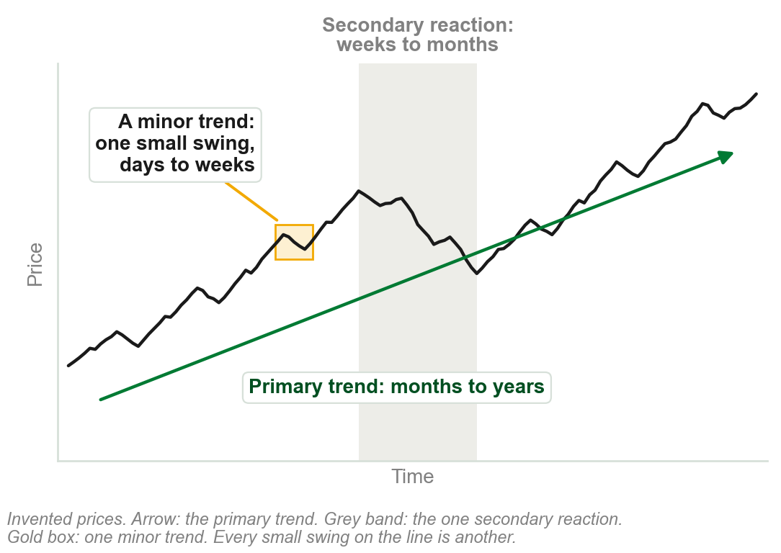
5.1 Dow sorts trends by how long they last
Primary, or major, trends are longer term: months to years.
Secondary trends, or reactions, are medium term: weeks to months.
Minor trends are shorter term: days to weeks.
Dow sorts the three by duration and extent: how long a trend lasts, and how far it runs.
Chapter 2 taught all three, with one extent: a secondary reaction retraces a third to two thirds. Here the book lists durations only.
Chart A - FIN1209 teaching chart, drawn for this course. Illustrative data, not a real instrument.
Part 1 of 11 - 5.1 Definitions | 1 of 21
Book p.125: 'classified and defined by their duration and extent'. The chart is ours, on invented prices: this chapter has no figure of the three together.

Slide 5
An uptrend: higher highs and higher lows
An uptrend is a series of successively higher highs, the peaks, and higher lows, the troughs.
HH: a rally carries above the last peak. HL: a dip holds above the last trough.
Right of the figure: the highs and lows stop rising. By the definition, the uptrend has technically ended.
FIGURE 5.1
A rising bar chart with every peak marked HH and every trough HL, labelled an uptrend as a sequence of higher highs and higher lows, and a flat stretch at the end where the uptrend has technically ended.
The artwork is copyrighted and is not in the public repository. Build with assets/figures/ present to place it here.
The same definition as Chapter 2: Dow's peak and trough analysis.
A share peaks at PHP 50, dips to 46, peaks at 54, dips to 49: higher highs and higher lows.
Figure 5.1 - Lim, The Handbook of Technical Analysis (Wiley, 2016)
Part 1 of 11 - 5.1 Definitions | 2 of 21
Book p.126 and Figure 5.1. The pesos in the small print are our example.

Slide 6
A downtrend: lower highs and lower lows
A downtrend is represented by a series of successively lower highs and lows. The figure starts from a first peak, H, and a first trough, L.
Each rally stops below the last peak: a lower high, LH.
Each decline carries below the last trough: a lower low, LL.
FIGURE 5.2
A falling bar chart labelled a downtrend unfolding, with its first peak marked H, its first trough L, and after them three lower highs marked LH and three lower lows marked LL.
The artwork is copyrighted and is not in the public repository. Build with assets/figures/ present to place it here.
Peak and trough analysis is the most popular definition of a trend.
Figure 5.2 - Lim, The Handbook of Technical Analysis (Wiley, 2016)
Part 1 of 11 - 5.1 Definitions | 3 of 21
Book p.126 and Figure 5.2.

Slide 7
Where the definition runs out
Scenarios 1 and 2 show higher highs and higher lows: uptrends under Dow.
Scenario 3 has one high, H, and one low, L, then runs to B: no second peak or trough to compare. Scenario 4 never turns.
Under the definition neither is an uptrend. Yet in all four, price went from A to B.
FIGURE 5.3
Four paths from a point A up to a point B. The first two zigzag through higher highs and higher lows and are labelled uptrend. The third has one high and one low, the fourth is a straight line, and both are labelled uptrend with a question mark.
The artwork is copyrighted and is not in the public repository. Build with assets/figures/ present to place it here.
All definitions impose limitations: an actual trend may go unrecognized.
So many practitioners prefer an absolute measure: the distance traversed, not how price behaved on the way.
Figure 5.3 - Lim, The Handbook of Technical Analysis (Wiley, 2016)
Part 1 of 11 - 5.1 Definitions | 4 of 21
Book pp.126-127 and Figure 5.3.

Slide 8
Three other ways to call a trend intact
Left: price stays above an overlay indicator: here a trendline. A moving average is another.
Middle: price stays above an arbitrarily chosen price level.
Right: no reversal of a specified amount. Each grey box is one such amount, as on a Point and Figure or Renko chart.
FIGURE 5.4
Three rising prices, each labelled trend still intact: one remaining above a dotted trendline, one remaining above a chosen level, and one climbing through stacked boxes with the minimum reversal amount not breached.
The artwork is copyrighted and is not in the public repository. Build with assets/figures/ present to place it here.
While the condition holds, the trend is still intact.
For a downtrend, below. Trendlines: 5.6. Moving averages, met in Chapter 4: Chapter 11. Point and Figure, Renko: Chapter 3.
Figure 5.4 - Lim, The Handbook of Technical Analysis (Wiley, 2016)
Part 1 of 11 - 5.1 Definitions | 5 of 21
Book pp.127-128 and Figure 5.4.

Slide 9
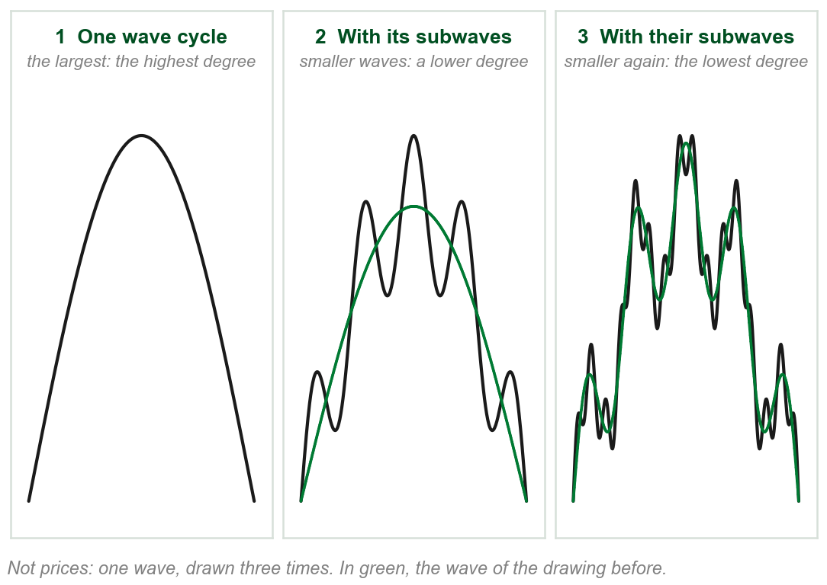
What a wave degree is
Price swings up and back down. A run of swings of one size is a wave: the book's wave cycle.
Small swings ride inside bigger ones. The smaller wave is a subwave of the bigger.
Degree is the rank of a wave by size: the bigger wave is of a higher degree, its subwaves of a lower one.
The book: any trend or consolidation can be described in wave cycles, at various wave degrees.
Chapters 3 and 4 said wave cycle and cycle degree in passing. The book defines neither; this reading is from its figures.
Chart B - FIN1209 teaching chart, drawn for this course. Illustrative data, not a real instrument.
Part 1 of 11 - 5.1 Definitions | 6 of 21
Book p.128 says wave cycle, wave degree and subwave and defines none of them. The reading and the chart are ours, from its Figures 5.5 to 5.9.

Slide 10
NEW TERM
Wave cycles: HWC, MWC and LWC
IN PLAIN WORDS
Three wave degrees on one chart, named by size against each other.
FIGURE 5.5
A wave of three degrees: one thick line rising and falling, the higher wave cycle; a dotted line weaving around it, the medium wave cycle; and a thin jagged line weaving around that, the lower wave cycle.
The artwork is copyrighted and is not in the public repository. Build with assets/figures/ present to place it here.
FOR EXAMPLE
In the figure: HWC thick, MWC dotted, LWC thin. Three degrees here; the minimum in any trend is two.
THE FORMAL DEFINITION
HWC, the higher wave cycle: the highest wave degree. MWC, the medium wave cycle: a subwave of the HWC, of a lower degree. LWC, the lower wave cycle: a subwave of both, at the lowest degree.
Figure 5.5 - Lim, The Handbook of Technical Analysis (Wiley, 2016)
Part 1 of 11 - 5.1 Definitions | 7 of 21
Book pp.128-129 and Figure 5.5. It gives the minimum of two degrees as a note, with no reason.

Slide 11
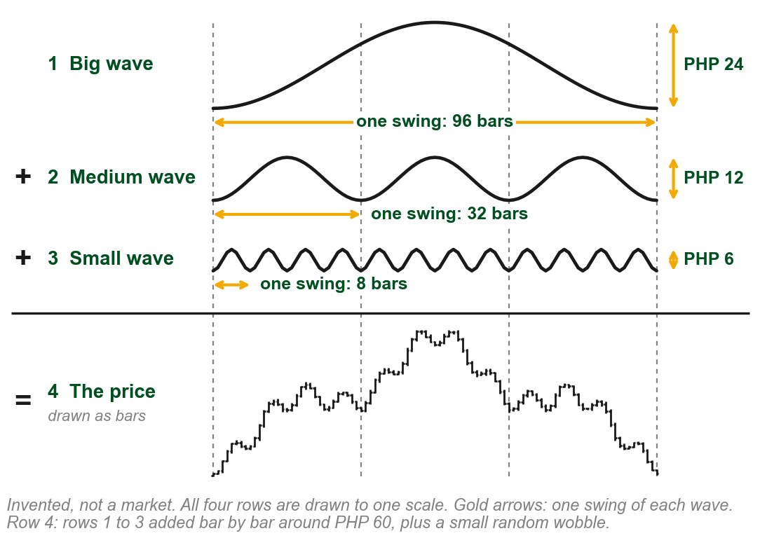
Our example: one price, built from three waves
Figure 5.5 is a sketch with no prices. To see wave cycles on price bars, we built a price.
Rows 1 to 3: a big, a medium and a small wave. Gold arrows measure one swing of each, up and back down.
Row 4: at every bar the three are added, around PHP 60, plus a small wobble: the price.
The sizes are ours. A real chart carries none.
Why these sizes: so that three medium swings fit in the big one, and four small swings in each medium one.
Chart C - FIN1209 teaching chart, drawn for this course. Illustrative data, not a real instrument.
Part 1 of 11 - 5.1 Definitions | 8 of 21
Ours, to put the book's Figure 5.5 (p.129) on a price chart. Every number here is one we chose; none is the book's or a market's.

Slide 12
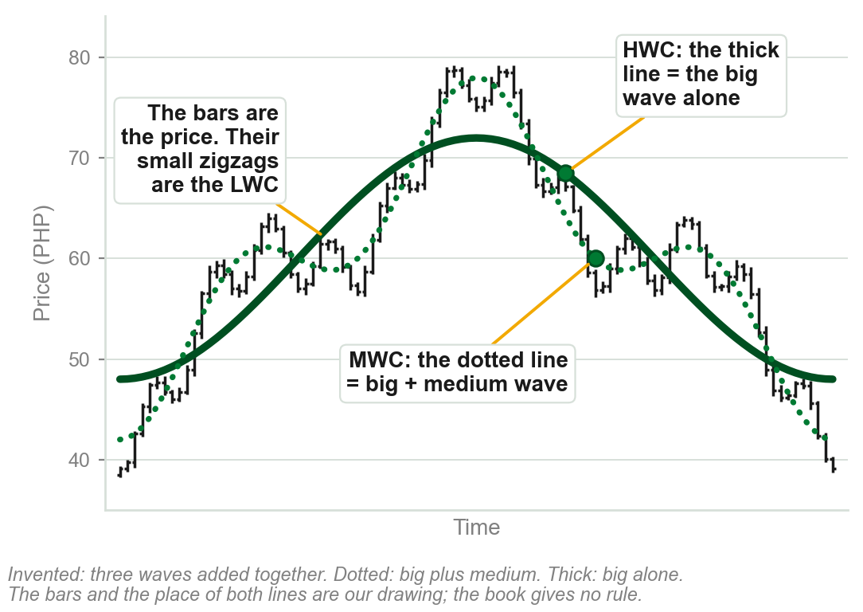
How the three cycles are drawn
LWC: the small zigzags of the price bars.
MWC: the dotted line, the big wave plus the medium, through the middle of the zigzags.
HWC: the thick line, the big wave alone, through the middle of the dotted line's swings.
The book gives no rule for placing either line. We can place ours because we built the price.
They look like moving averages. The book does not say they are.
Moving averages: met in Chapter 4, taught in Chapter 11.
Chart D - FIN1209 teaching chart, drawn for this course. Illustrative data, not a real instrument.
Part 1 of 11 - 5.1 Definitions | 9 of 21
The book's (pp.128-129, Figure 5.5): thin, dotted and thick lines, and no formula, indicator or number of bars. Ours: the bars, and where both lines sit.

Slide 13
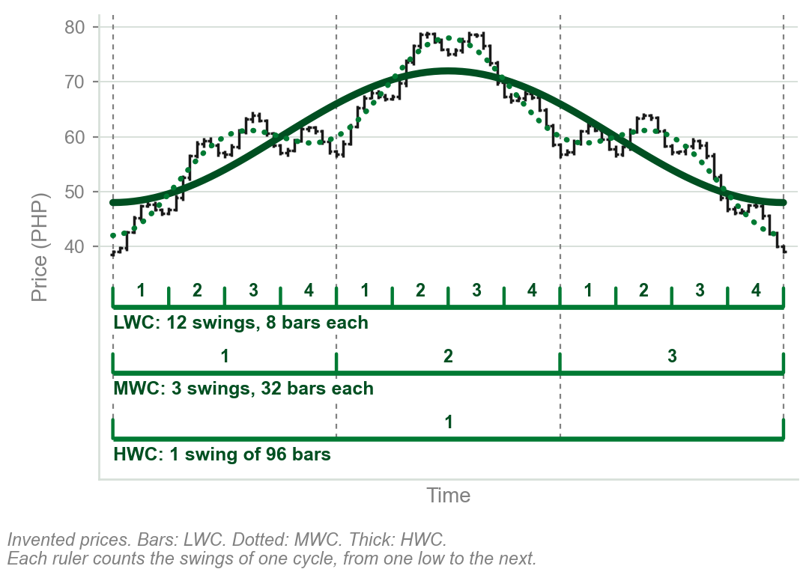
Telling the three cycles apart
Each ruler counts the swings of one wave cycle, low to low.
Four LWC swings fit inside each MWC swing, and three MWC swings inside the HWC swing. That is what subwave means.
A real chart gives no sizes and the book fixes none. So compare: the smallest swings in view are the LWC, the swings they ride on the MWC, the biggest the HWC.
A degree is a rank, never a fixed size.
Four and three are this chart's numbers, not a rule.
Chart E - FIN1209 teaching chart, drawn for this course. Illustrative data, not a real instrument.
Part 1 of 11 - 5.1 Definitions | 10 of 21
Ours, on the book's pp.128-129, which fix no size, duration or timeframe for a wave cycle. The counts are of our invented chart.

Slide 14
Know which wave cycle you are trading
Without knowing which wave cycle is traded, a trader may be unable to:
select consistent breakout levels or effective stoploss levels, or apply effective stopsizing;
tell trend from consolidation mode, or find the direction of the predominant trend.
The figure labels one rise three ways: [1] on the HWC, 1 to 3 on the MWC, i to v and a to c on the LWC.
FIGURE 5.6
One rise labelled at three wave degrees: i to v and a to c at the lowest degree, 1 to 3 at the medium degree, and [1] at the highest, under the heading Elliott wave in terms of wave degrees.
The artwork is copyrighted and is not in the public repository. Build with assets/figures/ present to place it here.
The labels, question marks included, are Elliott's, Chapter 18: not needed here. Stoploss, a stop loss order: 5.4. Stopsizing: 5.5.
Figure 5.6 - Lim, The Handbook of Technical Analysis (Wiley, 2016)
Part 1 of 11 - 5.1 Definitions | 11 of 21
Book p.129 and Figure 5.6. The book lists the five with no reasons; p.130 explains modes and breakout levels, which follow here.

Slide 15
Trending and consolidating at once
Chapter 4: a market is either trending or consolidating.
Chapter 5 adds: it may be both at once, depending on the wave cycle being observed.
Figure: the LWC climbs swing after swing, then falls: trend mode. The MWC swings across one level: ranging. The HWC is flat: flatline.
FIGURE 5.7
A flat thick arrow, the higher wave cycle in flatline mode; a dashed wave swinging above and below it, the medium wave cycle in ranging mode; and a thin jagged line climbing each swing, the lower wave cycle in trend mode.
The artwork is copyrighted and is not in the public repository. Build with assets/figures/ present to place it here.
Ask at which wave degree before asking whether it is trending.
Ranging and flatline are the figure's words; the text says only trend and consolidation mode. Both are consolidation.
Figure 5.7 - Lim, The Handbook of Technical Analysis (Wiley, 2016)
Part 1 of 11 - 5.1 Definitions | 12 of 21
Book p.130 and Figure 5.7. The Chapter 4 line is this course's Chapter 4 deck.

Slide 16
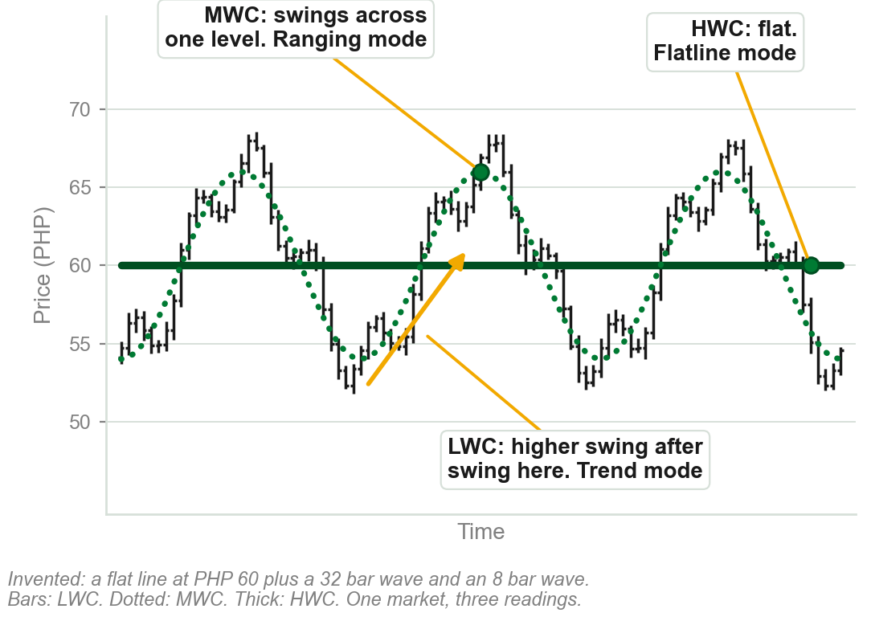
One market, three modes, on price bars
LWC, the small zigzags of the bars: swing after swing they climb, then fall. Trend mode, up and then down.
The dotted MWC swings between about PHP 54 and PHP 66 and gets nowhere: ranging mode.
The thick HWC stays at PHP 60: flatline mode.
One chart. Whether it is trending depends on which wave is read.
The three modes are the book's. The bars and the pesos are our invented chart.
Chart F - FIN1209 teaching chart, drawn for this course. Illustrative data, not a real instrument.
Part 1 of 11 - 5.1 Definitions | 13 of 21
Ours: the book's Figure 5.7 (p.130) on price bars. Built from a flat line at PHP 60, a 32 bar wave PHP 12 tall and an 8 bar wave PHP 4 tall, so each mode shows.

Slide 17
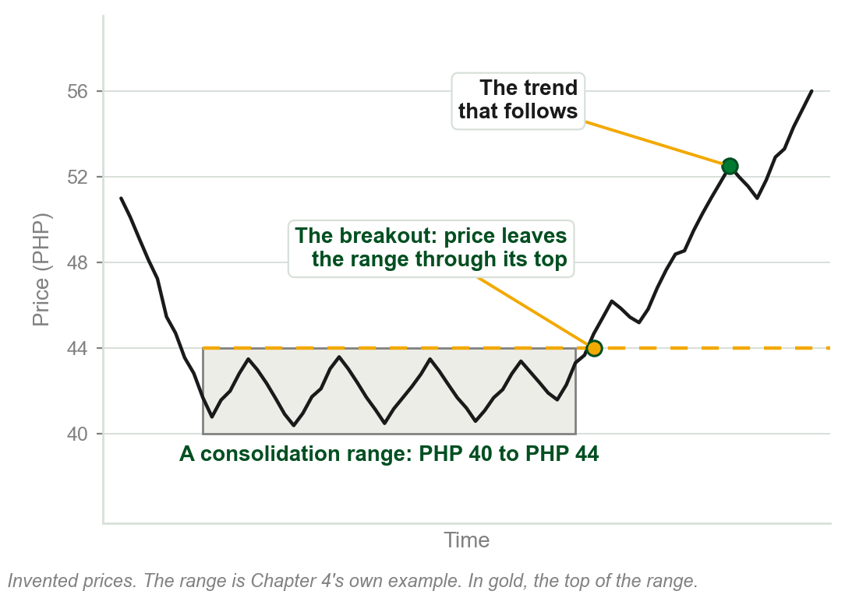
Breakout, as Chapters 2 and 4 used it
Chapter 2: a line, a narrow sideways range, usually results in a strong breakout.
Chapter 4: most call a consolidation over on a clear breakout from the range. The trend phase follows.
In both, price leaves a sideways range through its top or its bottom.
The breakout taught so far: price getting out of a range.
Earlier chapters also said breakout, in passing, of a pattern, a neckline and a level. None defined it.
Chart G - FIN1209 teaching chart, drawn for this course. Illustrative data, not a real instrument.
Part 1 of 11 - 5.1 Definitions | 14 of 21
A recall of this course's Chapters 2 and 4. The chart is Chapter 4's own example, a range from PHP 40 to PHP 44.

Slide 18
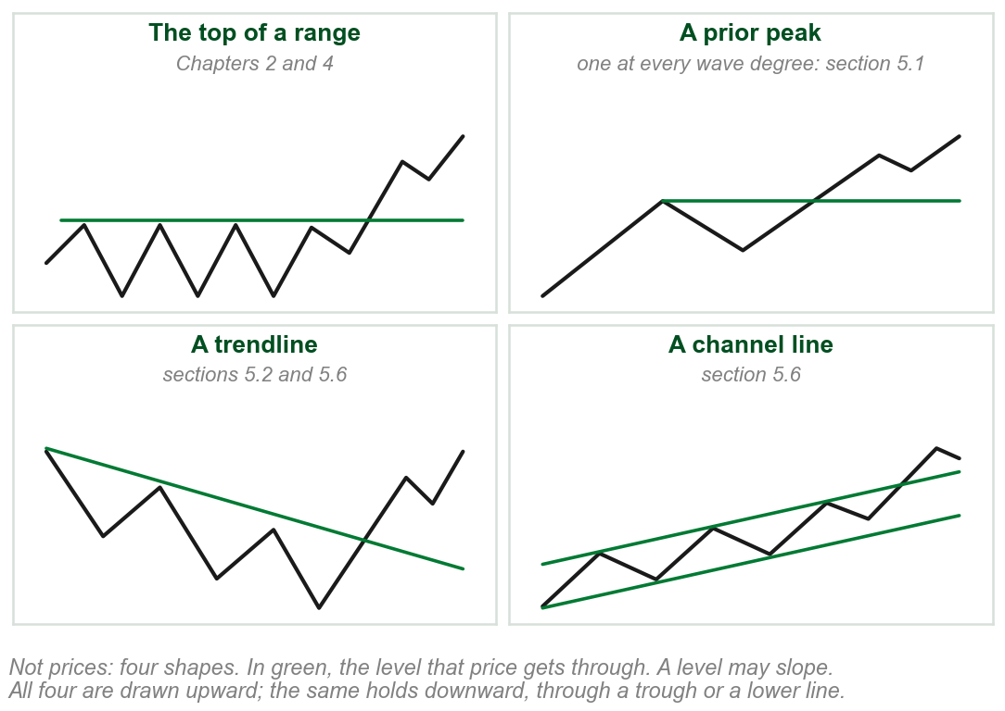
Chapter 5: a breakout is through a level
The edge of a range is one kind of level. Chapter 5 uses breakout of every kind:
a prior peak or trough, a trendline, a channel line, any overlay such as a moving average.
Each time, a level holds price and then price gets through it. A level may slope, as a trendline does.
One word for all of them: the level need not be the edge of a range.
The book never defines breakout. Chapter 2 called price going through a previous peak or trough a penetration.
Chart H - FIN1209 teaching chart, drawn for this course. Illustrative data, not a real instrument.
Part 1 of 11 - 5.1 Definitions | 15 of 21
Our reading of how the book uses the word: pp.130, 143, 148, 158 to 161. It defines breakout nowhere.

Slide 19
A breakout for every wave degree
Breakouts can be defined by wave degree: the level depends on the degree traded.
Each B/OUT LEVEL in the figure sits on a prior peak: five peaks, five levels.
Knowing the degree, a trader can size the stoploss to its average wave amplitude and volatility.
FIGURE 5.8
One price path with breakout levels drawn at three sizes: short LWC breakout levels on the small swings, two MWC breakout levels on the medium swings, and one HWC breakout level across the top of the whole move.
The artwork is copyrighted and is not in the public repository. Build with assets/figures/ present to place it here.
Volatility at one wave degree may not manifest at a higher or lower degree.
Our words: a stop sized for the thin line's zigzags is too small for the thick line's one swing. Amplitude: 5.2. Stop sizing: 5.5.
Figure 5.8 - Lim, The Handbook of Technical Analysis (Wiley, 2016)
Part 1 of 11 - 5.1 Definitions | 16 of 21
Book p.130 and Figure 5.8. The gold line is the only reason the book gives for sizing the stoploss by degree.

Slide 20
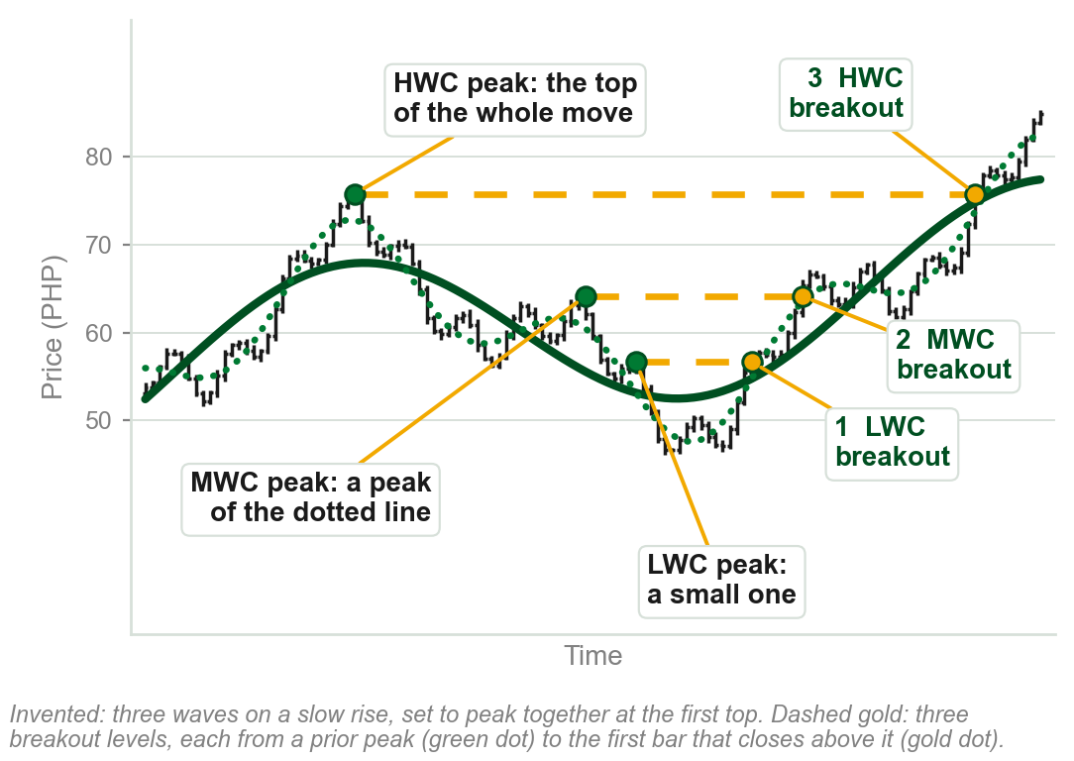
One price passes three breakout levels
Each dashed gold line is a breakout level: the highest price at a prior peak.
1 LWC breakout: past a small peak, about PHP 57.
2 MWC breakout: past a peak of the dotted line, about PHP 64.
3 HWC breakout: past the top of the whole move, about PHP 76.
One price, three breakouts: one for each wave degree.
Chart I - FIN1209 teaching chart, drawn for this course. Illustrative data, not a real instrument.
Part 1 of 11 - 5.1 Definitions | 17 of 21
Ours: the book's Figure 5.8 (p.130) on price bars. Each level is the highest bar at a peak, where price was, not the height of the smooth line.

Slide 21
NEW TERM
Wave-degree convergence
IN PLAIN WORDS
When the biggest wave turns, every smaller wave turns with it. That is why bigger turning points matter more.
FIGURE 5.9
The three wave cycles rising to one peak and turning down together, with the peak labelled all subwaves reversing in sync with the highest wave degree.
The artwork is copyrighted and is not in the public repository. Build with assets/figures/ present to place it here.
FOR EXAMPLE
At a major top the HWC, the MWC and the LWC all turn down together.
THE FORMAL DEFINITION
When a large wave cycle reverses, all the wave cycles of lower degrees reverse in sync with it. Waves of higher degrees need not reverse when waves of lower degrees reverse.
Figure 5.9 - Lim, The Handbook of Technical Analysis (Wiley, 2016)
Part 1 of 11 - 5.1 Definitions | 18 of 21
Book p.130, and Figure 5.9 on p.131. The book states this as a rule and gives no reason for it.

Slide 22
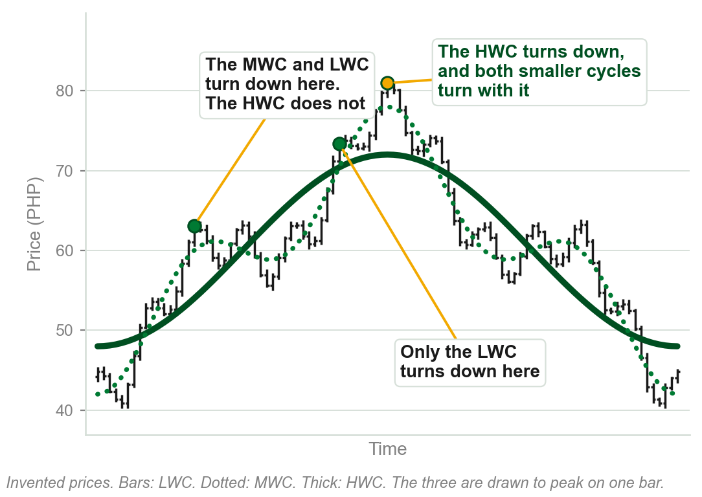
Lower degrees turn alone. The highest does not.
On the way up the LWC turns down again and again, and the rise goes on.
The MWC turns down as well, with the LWC, and the HWC still rises.
At the top the HWC turns down, and the MWC and the LWC turn with it.
A turn of the largest wave is a turn of every wave: the significant one.
The book gives no reason. Our waves are set to peak on one bar. Chapter 3's convergence, futures meeting spot, was a different thing.
Chart J - FIN1209 teaching chart, drawn for this course. Illustrative data, not a real instrument.
Part 1 of 11 - 5.1 Definitions | 19 of 21
Ours: the book's Figure 5.9 (pp.130-131) on price bars. The three invented waves are set to peak on one bar, so the one turn shows.

Slide 23
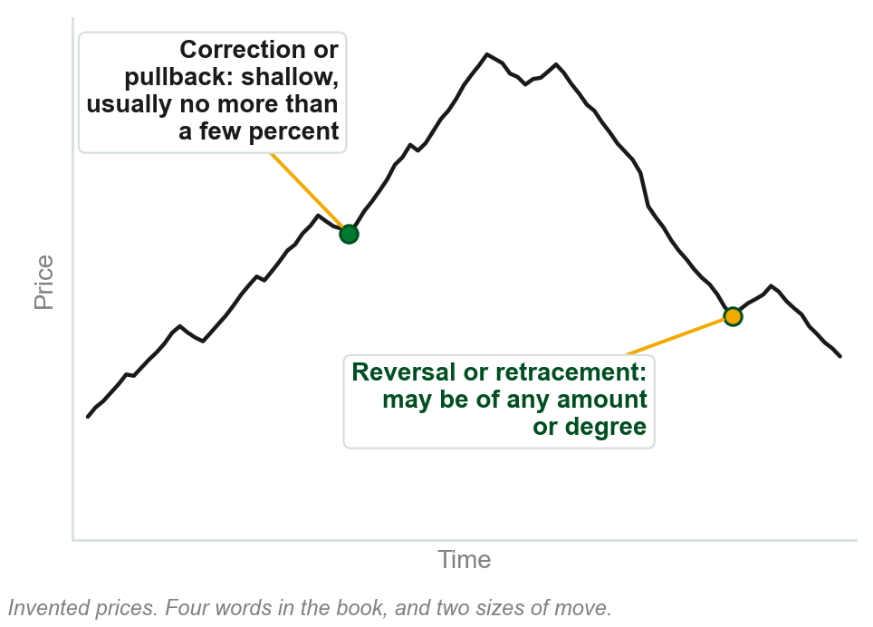
NEW TERM
Correction and pullback
IN PLAIN WORDS
A small move against the trend: shallow, usually no more than a few percent.
FOR EXAMPLE
A share at PHP 50 dips to PHP 49: 2 percent of its price. A correction, or pullback.
THE FORMAL DEFINITION
Reversals and retracements imply a turnaround in prices, and may be of any amount or degree. Corrections and pullbacks tend to imply a more shallow reversal or retracement, usually no more than a few percent.
Chart K - FIN1209 teaching chart, drawn for this course. Illustrative data, not a real instrument.
Part 1 of 11 - 5.1 Definitions | 20 of 21
Book p.131. It puts no number on 'a few percent' and does not say percent of what; our example measures against the price. The chart is ours.

Slide 24
A trend in the highs, the lows or the closes
Trend may also be defined on individual open, high, low and close data.
Top row: the same bars are an uptrend in their highs and a downtrend in their lows.
Middle: the bars' highs and lows stay level, yet the closes rise bar after bar. An uptrend in the closes: Chapter 3's line chart.
Bottom: the mark at the middle of each bar stays level. By that mark, no trend.
FIGURE 5.10
Three rows of bars under the heading OHLC-based trend: bar highs rising while bar lows fall, bar closes rising steadily and labelled equivalent to a line chart, and flatline action based on typical and midprices.
The artwork is copyrighted and is not in the public repository. Build with assets/figures/ present to place it here.
The figure calls that mark the mid or typical price. The book defines neither here, nor the pivot point moving average, the CCI or Floor Trader's Pivot Points.
Figure 5.10 - Lim, The Handbook of Technical Analysis (Wiley, 2016)
Part 1 of 11 - 5.1 Definitions | 21 of 21
Book pp.131-132 and Figure 5.10.

Slide 25
5.2 Sixteen price characteristics
1 Cycle amplitude. 2 Cycle period. 3 Bar retracement symmetry.
4 Average bar range. 5 Price persistence. 6 Average bar stochastic ratio.
7 Real body to range ratio. 8 Angular symmetry and momentum.
9 Barrier proximity. 10 Frequency and depth of oscillations.
11 Size and duration of a consolidation. 12 Third gap exhaustion.
13 Average period range. 14 Overextension. 15 Volume spread. 16 Divergence.
Each is taught in this order on the slides that follow. Variations in these may impact future price activity. The book calls reading pure price action the highest skill any trader can aspire to.
Part 2 of 11 - 5.2 Quality of trend | 1 of 28
Book p.132. For most of the sixteen the book states what a change signals and gives no reason. Where it gives one, the slide gives it.

Slide 26
NEW TERM
1 Cycle amplitude
IN PLAIN WORDS
The height of each leg of a swing, as the figure marks it.
FIGURE 5.11
A rising wave between two converging dashed lines, each swing smaller than the last, with the up cycle amplitudes and the down cycle amplitudes measured by vertical arrows, labelled gradually decreasing up and down cycle amplitudes.
The artwork is copyrighted and is not in the public repository. Build with assets/figures/ present to place it here.
FOR EXAMPLE
Rallies of PHP 6, then 4, then 2: decreasing amplitude.
THE FORMAL DEFINITION
Decreasing cycle amplitude is an early indication of potential underlying weakness in an uptrend, and a bullish indication in a downtrend. In an uptrend the up cycle amplitudes must, on average, be larger than the down ones; the converse in a downtrend. The change in successive amplitudes matters most.
Figure 5.11 - Lim, The Handbook of Technical Analysis (Wiley, 2016)
Part 2 of 11 - 5.2 Quality of trend | 2 of 28
Book p.132 and Figure 5.11. It gives no reason why a shrinking amplitude means weakness. The pesos are our example.

Slide 27
Contracting, even and expanding amplitude
Contracting formations are bearish in an uptrend and bullish in a downtrend.
Expanding formations, with both boundary lines pointing upward, are generally bullish in an uptrend; the converse in a downtrend.
Steady, consistent amplitude is bullish in an uptrend and bearish in a downtrend.
FIGURE 5.12
Three idealized uptrends side by side: contracting price action between converging lines, labelled bearish; even price action between parallel lines, labelled neutral or bullish; and expanding price action between diverging lines, labelled bullish or volatile.
The artwork is copyrighted and is not in the public repository. Build with assets/figures/ present to place it here.
The steady trend is regarded as the most reliable in extent and duration.
The figure labels even Neutral / Bullish and expanding Bullish / Volatile; the book does not reconcile them.
Figure 5.12 - Lim, The Handbook of Technical Analysis (Wiley, 2016)
Part 2 of 11 - 5.2 Quality of trend | 3 of 28
Book p.133 and Figure 5.12. The book states these readings and gives no reason for them.

Slide 28
NEW TERM
2 Cycle period
IN PLAIN WORDS
How long each swing takes, as the figure marks it: across, from one peak to the next.
FIGURE 5.13
A rising wave between two converging lines whose peaks come closer and closer together, with the horizontal distance between peaks marked by arrows that shorten, labelled gradually decreasing cycle periods.
The artwork is copyrighted and is not in the public repository. Build with assets/figures/ present to place it here.
FOR EXAMPLE
An uptrend's peaks come 30 bars apart, then 20, then 12: a decreasing cycle period.
THE FORMAL DEFINITION
Decreasing cycle periods are also an early indication of potential weakness in a trend. A gradual reduction in the cycle period during an uptrend: there may be underlying weakness in the uptrend. During a downtrend: a bullish indication.
Figure 5.13 - Lim, The Handbook of Technical Analysis (Wiley, 2016)
Part 2 of 11 - 5.2 Quality of trend | 4 of 28
Book p.133 and Figure 5.13. It gives no reason. The bar counts 30, 20 and 12 are our example.

Slide 29
NEW TERM
3 Bar retracement symmetry
IN PLAIN WORDS
In a strong trend each retracement takes about the same number of bars. Count them.
FIGURE 5.14
A rising channel in which three retracements of 28, 30 and 26 bars are labelled consistent symmetry indicates strong trend action, then a retracement of only 14 bars circled as symmetry broken, a trend behavior change, before price leaves the channel upward at a point A.
The artwork is copyrighted and is not in the public repository. Build with assets/figures/ present to place it here.
FOR EXAMPLE
In the figure three retracements take 28, 30 and 26 bars: consistent symmetry. The next takes 14: symmetry broken, and a strong upside move follows, at A.
THE FORMAL DEFINITION
A change in the number of bars in a retracement is an early indication of a potential change in trend behavior.
Figure 5.14 - Lim, The Handbook of Technical Analysis (Wiley, 2016)
Part 2 of 11 - 5.2 Quality of trend | 5 of 28
Book p.134 and Figure 5.14: the bar counts 28, 30, 26 and 14 are printed on the figure. It gives no reason.

Slide 30
NEW TERM
4 Average bar range
IN PLAIN WORDS
The average height of the bars, low to high.
FIGURE 5.15
A rising run of candlesticks, each shorter than the one before, labelled gradually decreasing bar range, over a lower panel in which the ATR declines.
The artwork is copyrighted and is not in the public repository. Build with assets/figures/ present to place it here.
FOR EXAMPLE
Daily ranges average PHP 3.00 one month, 2.40 the next, 1.80 the next: a decreasing average bar range.
THE FORMAL DEFINITION
A decrease in the average bar range is an early indication of potential weakness in an uptrend, and a bullish indication in a downtrend. The bar range can be tracked using the average true range, ATR.
Figure 5.15 - Lim, The Handbook of Technical Analysis (Wiley, 2016)
Part 2 of 11 - 5.2 Quality of trend | 6 of 28
Book p.134, Figure 5.15, whose lower panel is the ATR: next slide. Its text fixes no number of bars to average; its real charts print ATR(14) unexplained. Pesos ours.

Slide 31
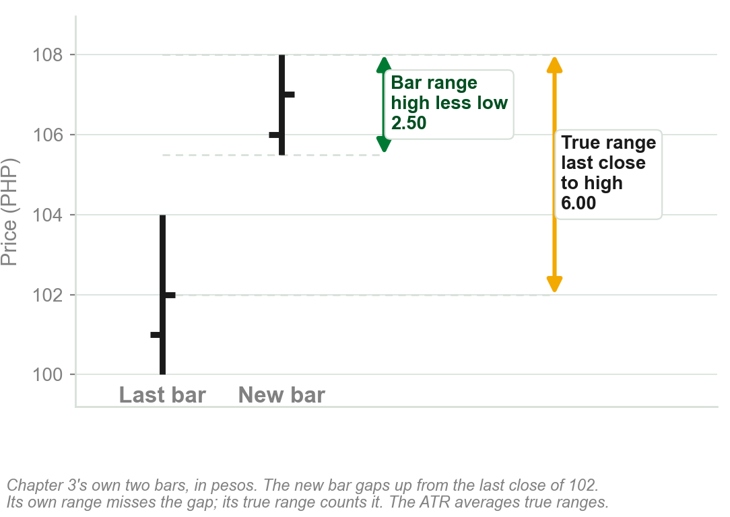
The ATR: a bar range that counts the gaps
Chapter 3: a bar's true range is the greater of its own range and the distance from the last close to its high or low.
On Chapter 3's two bars: bar range 2.50, true range 6.00.
The ATR is the average of the true ranges.
Unlike average bar range, the ATR accounts for gaps between the bars as well.
Chapter 3 met it with the Type 4 gap. The book calls the ATR an oscillator: that, and how it is averaged, is Chapter 8.
Chart L - FIN1209 teaching chart, drawn for this course. Illustrative data, not a real instrument.
Part 2 of 11 - 5.2 Quality of trend | 7 of 28
Book p.134: the gold sentence is the book's own; counting gaps is its only given reason. Recall: Chapter 3's slide "The true range, and the Type 4 gap". The chart is ours.

Slide 32
A declining ATR in a steady uptrend
GLD, the SPDR Gold Trust Shares, weekly: a steady uptrend, the figure's strong uptrend, while the ATR in the bottom panel declines.
Volume, the bars under the price, rises: bullish. But the ATR is indicating otherwise.
FIGURE 5.16
The weekly GLD chart in three panels: price in a strong uptrend to a circled pair of candlesticks at the top, volume increasing beneath it, and the ATR declining all the way up before turning.
The artwork is copyrighted and is not in the public repository. Build with assets/figures/ present to place it here.
Price declined after the volume climax.
Volume climax: the book's phrase, undefined here; the burst of volume near the top. It adds that a large bearish candlestick, circled at the top, completes the picture: too small to see here, and not needed. The ATR's turn up at the end goes without comment.
Figure 5.16 - Lim, The Handbook of Technical Analysis (Wiley, 2016)
Part 2 of 11 - 5.2 Quality of trend | 8 of 28
Book pp.134-135 and Figure 5.16.

Slide 33
5 Price persistence
A trend persists for longer when price is of high quality: relatively small, and approximately equal, bar ranges.
Price then moves predictably. Trends and reversals are clear and decisive, and volatility is relatively low.
Left box: long, clean moves, greater persistence. Right box: short, choppy moves, lesser persistence.
FIGURE 5.17
An hourly GBPJPY chart with two boxes: higher quality price action with greater persistence, where the swings are long and clean, and lower quality price action with lesser persistence, where they are short and choppy.
The artwork is copyrighted and is not in the public repository. Build with assets/figures/ present to place it here.
Persistence, Chapter 1: price behavior persists. Low volatility here: small bars, not small moves, in our reading. The bars are too small to see: the next slide draws them.
Figure 5.17 - Lim, The Handbook of Technical Analysis (Wiley, 2016)
Part 2 of 11 - 5.2 Quality of trend | 9 of 28
Book pp.135-136, Figure 5.17: hourly GBPJPY. The book does not say what low volatility is measured by, or name the curved bands.

Slide 34
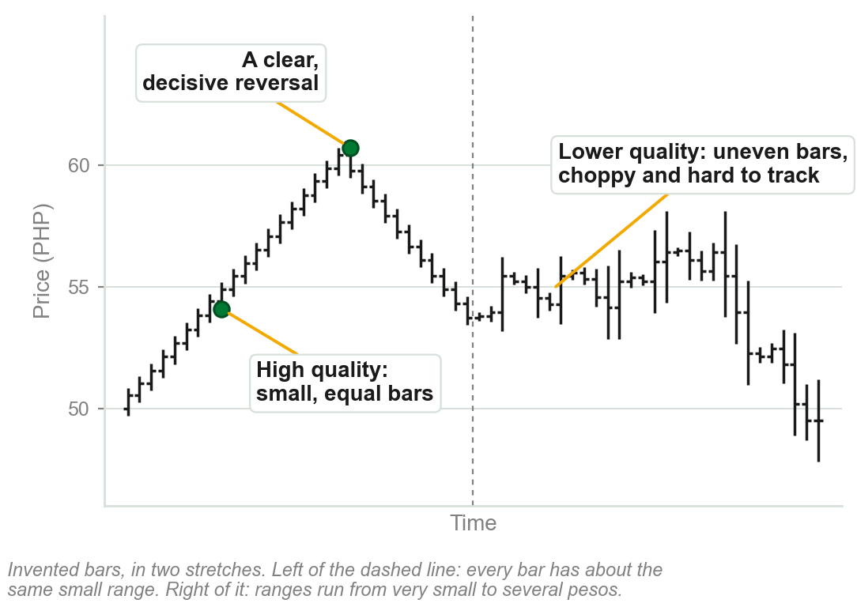
High and lower quality price, on bars
Left, high quality: every bar's range is relatively small, and about equal to the last.
Price moves predictably: a clean trend up, and a clear, decisive reversal.
Right, lower quality: bar ranges uneven, small then large. Moves are short and choppy, and hard to track.
Small, equal bars: the trend persists.
Characteristic 4 watched the bar range shrink. This one asks whether the bars are small and alike. The book does not relate the two.
Chart M - FIN1209 teaching chart, drawn for this course. Illustrative data, not a real instrument.
Part 2 of 11 - 5.2 Quality of trend | 10 of 28
Ours: the book's two tests for high quality price (p.135) on invented bars, because the bars of its Figure 5.17 cannot be seen. It gives no reason for either test.

Slide 35
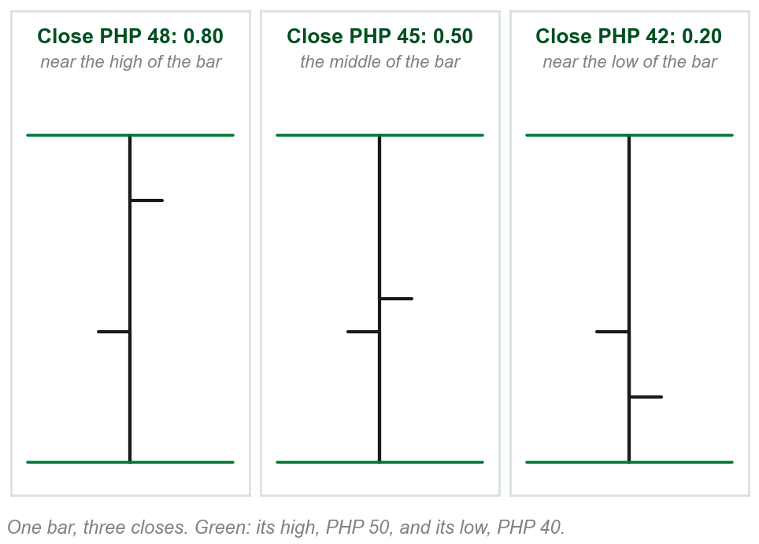
NEW TERM
Bar stochastic
IN PLAIN WORDS
Where a bar closed inside its own range: near the top, the middle or the bottom.
FOR EXAMPLE
A bar with a low of PHP 40, a high of PHP 50 and a close of PHP 48: (48 - 40) / (50 - 40) = 0.80. It closed near its high.
THE FORMAL DEFINITION
The relative position of the closing price within the bar itself, measured as a ratio: (C - L) / (H - L). The book calls it essentially a one-period %K, and does not explain %K here.
Chart N - FIN1209 teaching chart, drawn for this course. Illustrative data, not a real instrument.
Part 2 of 11 - 5.2 Quality of trend | 11 of 28
Book p.135; the formula is printed on its Figure 5.18 (p.136). The pesos and the chart are ours, picked to give 0.80, 0.50 and 0.20.

Slide 36
6 The average bar stochastic ratio
In an uptrend, a gradual decline in closes with respect to the bar is an early indication of potential weakness.
In a downtrend, a gradual increase is an early indication of potential bullishness.
FIGURE 5.18
A rising run of bars whose closes sit lower and lower within each bar, labelled declining closing prices with respect to the bar range, with the formula bar stochastic = (C - L) / (H - L) and a lower panel in which the bar stochastic declines.
The artwork is copyrighted and is not in the public repository. Build with assets/figures/ present to place it here.
In the figure the bars climb while each close sits lower within its bar.
Average: the ratio is watched through a moving average of it, on the next slide.
Figure 5.18 - Lim, The Handbook of Technical Analysis (Wiley, 2016)
Part 2 of 11 - 5.2 Quality of trend | 12 of 28
Book p.135, and Figure 5.18 on p.136. It gives no reason for the sign.

Slide 37
The ratio, averaged, on a real chart
The ratio is monitored with a simple moving average, SMA. Lower panel: a 3-period SMA, the average of the last three bars' ratios.
The book: it accurately identifies bearish divergences in uptrends and bullish ones in downtrends, which the figure labels.
The panel cannot be read at this size. The next slide draws one bearish divergence.
FIGURE 5.19
A weekly EURUSD chart over a lower panel carrying a 3-period SMA of the bar stochastic, with three tops labelled bearish divergence and three bottoms labelled bullish divergence.
The artwork is copyrighted and is not in the public repository. Build with assets/figures/ present to place it here.
Weekly EURUSD. Moving averages: Chapter 11. Divergence, bullish and bearish: Chapter 9.
Figure 5.19 - Lim, The Handbook of Technical Analysis (Wiley, 2016)
Part 2 of 11 - 5.2 Quality of trend | 13 of 28
Book pp.136-137 and Figure 5.19. It does not say why the average is of three periods.

Slide 38
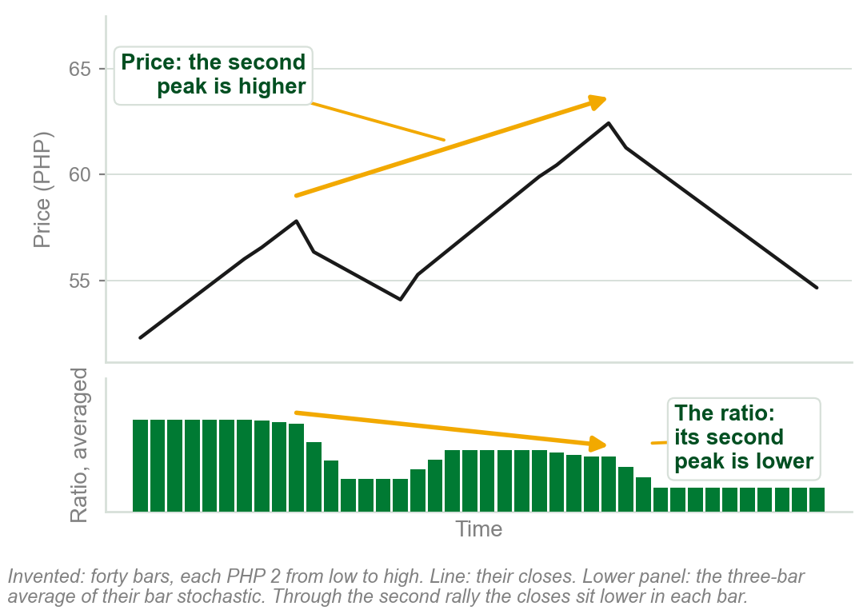
One bearish divergence, drawn
Top: price makes a peak, pulls back, then makes a higher peak.
Bottom: the three-bar average of the bar stochastic. Its second peak is lower.
Price higher, ratio lower: bearish divergence. In the second rally each bar closed lower in its range.
Closes sinking within their bars while price still rises.
Chapter 4 showed the same shape on the MACD. Bullish divergence, at bottoms, is left to Chapter 9.
Chart O - FIN1209 teaching chart, drawn for this course. Illustrative data, not a real instrument.
Part 2 of 11 - 5.2 Quality of trend | 14 of 28
Ours: one of Figure 5.19's bearish divergences (book p.136) on invented bars. Divergence as Chapter 4 showed it; the book explains it in Chapter 9.

Slide 39
NEW TERM
7 Real body to range ratio, BRR
IN PLAIN WORDS
How much of a candlestick is real body: the open-to-close move as a share of the whole bar.
FIGURE 5.20
A rising run of candlesticks whose real bodies shrink while their ranges do not, labelled declining BRR, with the formula body to range ratio (BRR) = (C - O) / (H - L) and a lower panel in which the BRR declines.
The artwork is copyrighted and is not in the public repository. Build with assets/figures/ present to place it here.
FOR EXAMPLE
Open 42, close 48, low 40 and high 50, in pesos: (48 - 42) / (50 - 40) = 0.60.
THE FORMAL DEFINITION
BRR = (C - O) / (H - L). A gradual decrease in the real body to candlestick range is an early indication of potential weakness in an uptrend, and a bullish indicator in a downtrend. A simple moving average of the ratio is used to monitor it.
Figure 5.20 - Lim, The Handbook of Technical Analysis (Wiley, 2016)
Part 2 of 11 - 5.2 Quality of trend | 15 of 28
Book p.136; the formula is printed on Figure 5.20 (p.137). It gives no reason, and does not say how to treat a falling candle, where C - O is negative. The pesos are ours.

Slide 40
NEW TERM
8 Angular symmetry and momentum
IN PLAIN WORDS
A trend rising or falling at a steady angle.
FIGURE 5.21
A three year chart of 3M Co. with many trendlines, labelled all lines are rising at the same angle and underlying angular symmetry in 3M Co., two of them dotted and numbered 1 and 2, a point 3 above the second, and a box marked bullish indication.
The artwork is copyrighted and is not in the public repository. Build with assets/figures/ present to place it here.
FOR EXAMPLE
3M Co.: every long line rises at one angle, consistent angular symmetry. Dotted lines 1 and 2 are parallel to each other: a strong predictor of bullishness.
THE FORMAL DEFINITION
Any change in angular symmetry is an early indication of potential bullishness or bearishness. Generally an increase in the angle of ascent is bullish, and a decrease bearish.
Figure 5.21 - Lim, The Handbook of Technical Analysis (Wiley, 2016)
Part 2 of 11 - 5.2 Quality of trend | 16 of 28
Book pp.137-138, Fig. 5.21. Its reason: line 1 was followed by a steady rise. Point 3: where it expects a minor correction first. Momentum is never explained.

Slide 41
Acceleration and deceleration
Upside acceleration in price is bullish. Upside deceleration is bearish.
Downside acceleration is bearish. Downside deceleration is bullish.
Upside and downside acceleration is normally parabolic in nature.
FIGURE 5.22
Four curves. Uptrends: one bending upward, upside acceleration, bullish; one flattening, upside deceleration, bearish. Downtrends: one bending downward, downside acceleration, bearish; one flattening, downside deceleration, bullish.
The artwork is copyrighted and is not in the public repository. Build with assets/figures/ present to place it here.
An uptrend may not be self-sustaining if its rate of ascent was excessive.
Such rises usually end in a blow-off or buying climax, Chapter 4; downside acceleration may end in a selling climax. The book gives no measure of excessive.
Figure 5.22 - Lim, The Handbook of Technical Analysis (Wiley, 2016)
Part 2 of 11 - 5.2 Quality of trend | 17 of 28
Book p.138 and Figure 5.22.

Slide 42
Deceleration with a diminishing bar range
An even more potentially bearish scenario in an uptrend.
Two characteristics at once: a deceleration in price, and a diminishing bar range.
FIGURE 5.23
A run of candlesticks rising along a curve that flattens out, each candlestick shorter than the last, labelled gradually decreasing bar range and flattening out action.
The artwork is copyrighted and is not in the public repository. Build with assets/figures/ present to place it here.
The trend flattens out, and each bar covers less ground than the last.
Figure 5.23 - Lim, The Handbook of Technical Analysis (Wiley, 2016)
Part 2 of 11 - 5.2 Quality of trend | 18 of 28
Book pp.138-139 and Figure 5.23.

Slide 43
A change in the trend rate
Trend rate: dollars risen per day along a leg. Gold's is consistent, leg after leg.
Once the rate changes, the market enters a new regime: greater volatility, larger swings.
The new rate of $10.30 a day may be unsustainable over the longer term.
FIGURE 5.24
A daily Gold chart headed trend rate analysis on Gold: five rising legs each drawn at an uptrend rate of $3.80 a day, labelled previous market behavior, then steeper legs at $10.30 a day, an approximately 270 percent increase, labelled new market behavior, more volatile.
The artwork is copyrighted and is not in the public repository. Build with assets/figures/ present to place it here.
Gold in fact declined rapidly thereafter, not shown on the chart.
The old rate is about $3.30 a day in the book's text, $3.80 on its figure. $10.30 is 2.7 times $3.80, a rise of about 170 percent; the figure prints 'approx. 270% increase'.
Figure 5.24 - Lim, The Handbook of Technical Analysis (Wiley, 2016)
Part 2 of 11 - 5.2 Quality of trend | 19 of 28
Book p.139 and Figure 5.24. The dollar rates are the book's, and it does not show how they were measured.

Slide 44
NEW TERM
9 Barrier proximity
IN PLAIN WORDS
How near a trend is to a strong price barrier: a support below or a resistance above. The nearer, the likelier a turn.
FIGURE 5.25
A daily chart of iShares MSCI Emerging Markets: a strong downtrend falls to a support barrier drawn from an earlier low and price rebounds, with the cycle-tuned stochastic below circled at oversold.
The artwork is copyrighted and is not in the public repository. Build with assets/figures/ present to place it here.
FOR EXAMPLE
iShares MSCI Emerging Markets rebounds at strong support, a line across an earlier low, with the oscillator below at its low: oversold.
THE FORMAL DEFINITION
There is always a high probability that a trend may reverse as it approaches a strong and significant price barrier.
Figure 5.25 - Lim, The Handbook of Technical Analysis (Wiley, 2016)
Part 2 of 11 - 5.2 Quality of trend | 20 of 28
Book pp.139-140, Figure 5.25. No measure of strong is given. What support and resistance are, and why they hold: 5.6. The cycle-tuned stochastic, oversold: Chapter 8.

Slide 45
10 Frequency and depth of oscillations
An uptrend is more reliable with a reasonable number of oscillations, its dips and rallies: fairly frequent, not too shallow or too deep.
That indicates healthy profit taking. With little profit taken, more unrealized profit is at risk, and traders exit rapidly at the slightest hint of bearishness.
FIGURE 5.26
Two uptrends. On the left a large number of deep price oscillations, with less chance of a severe retracement because more profit is taken along the way. On the right a smaller number of shallow oscillations, with a high probability of a more severe retracement.
The artwork is copyrighted and is not in the public repository. Build with assets/figures/ present to place it here.
Few oscillations: a trend potentially more bearish at higher prices.
The figure calls the healthy trend's oscillations deep. The book does not say how deep is too deep.
Figure 5.26 - Lim, The Handbook of Technical Analysis (Wiley, 2016)
Part 2 of 11 - 5.2 Quality of trend | 21 of 28
Book pp.140-141 and Figure 5.26. The reason on the slide, profit taking, is the book's.

Slide 46
Oscillations on the Apple chart
Apple first oscillates in a steady, rising channel: the two parallel dotted lines (5.6).
Then price rises rapidly, with the minimum of oscillations and little profit taking.
Between time lines 1 and 2 the ATR declines as prices rise: a bearish indication, which the figure labels bearish divergence.
FIGURE 5.27
A daily Apple chart: a relatively healthy trend with deep oscillations inside a rising channel, then a rapidly rising trend with little price oscillation, an eventual sell-off, and an ATR panel displaying bearish divergence between two dotted time lines.
The artwork is copyrighted and is not in the public repository. Build with assets/figures/ present to place it here.
Apple prices decline substantially thereafter.
Profit-taking oscillations also occur at various wave degrees within a trend.
Figure 5.27 - Lim, The Handbook of Technical Analysis (Wiley, 2016)
Part 2 of 11 - 5.2 Quality of trend | 22 of 28
Book p.141 and Figure 5.27.

Slide 47
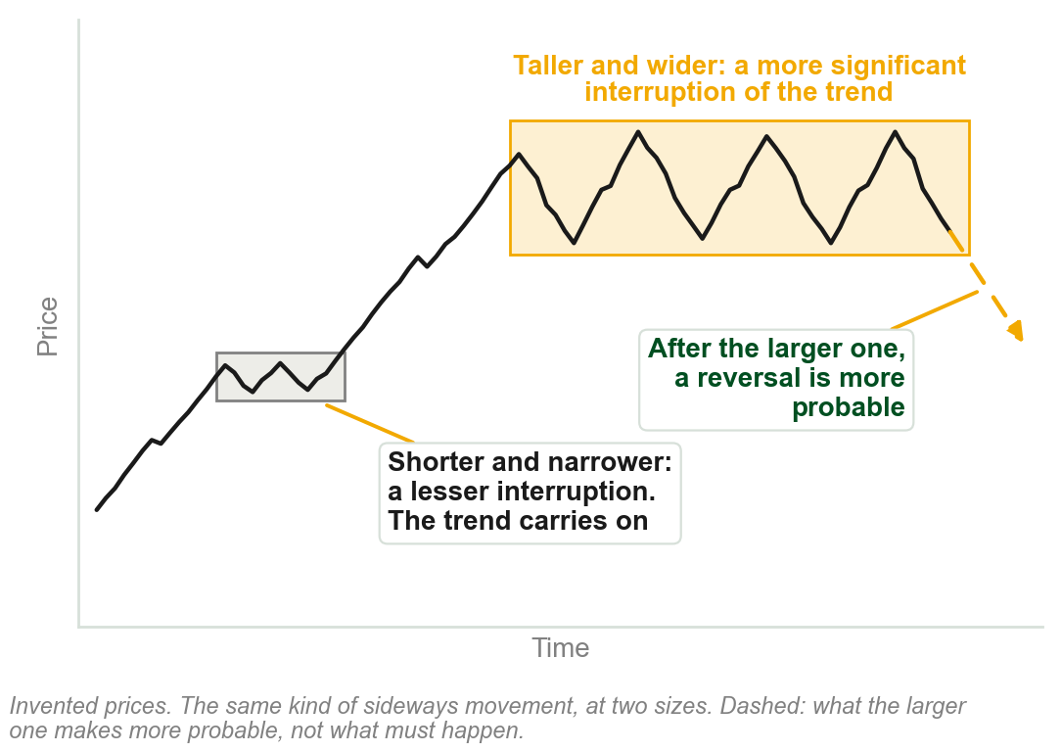
11 Size and duration of a consolidation
A trend interruption, Chapter 4's consolidation, is more significant the greater its magnitude, a taller chart pattern, and the longer it takes, a wider one.
Larger trend interruptions normally lead to a greater probability of a reversal.
In short, size takes precedence over form.
Form: which pattern. A larger head and shoulders is more bearish in an uptrend; a larger rounding bottom more bullish in a downtrend.
Chart P - FIN1209 teaching chart, drawn for this course. Illustrative data, not a real instrument.
Part 2 of 11 - 5.2 Quality of trend | 23 of 28
Book p.141. The chart is ours, on invented prices: the book has no figure for this point.

Slide 48
NEW TERM
12 Third gap exhaustion
IN PLAIN WORDS
Count the gaps in a trend. Watch the third.
FIGURE 5.28
A daily chart of the SPDR Dow Jones Industrial Average ETF: a breakaway, a runaway and an exhaustion gap numbered 1, 2 and 3 on the way up, the same three numbered on the way down, and a cycle-tuned stochastic indicating overextension at both third gaps.
The artwork is copyrighted and is not in the public repository. Build with assets/figures/ present to place it here.
FOR EXAMPLE
The SPDR Dow Jones Industrial Average ETF tops after gap 3 of its uptrend, and bottoms after gap 3 of the downtrend that follows. The oscillator in the lower panel is at its high, overbought, at the top, and at its low, oversold, at the bottom.
THE FORMAL DEFINITION
The appearance of a third gap in a trend is an indication of potential trend exhaustion and a possible reversal.
Figure 5.28 - Lim, The Handbook of Technical Analysis (Wiley, 2016)
Part 2 of 11 - 5.2 Quality of trend | 24 of 28
Book pp.141-142 and Figure 5.28. It gives no reason why the third, and does not say which gaps to count; the figure numbers the three that 5.8 names.

Slide 49
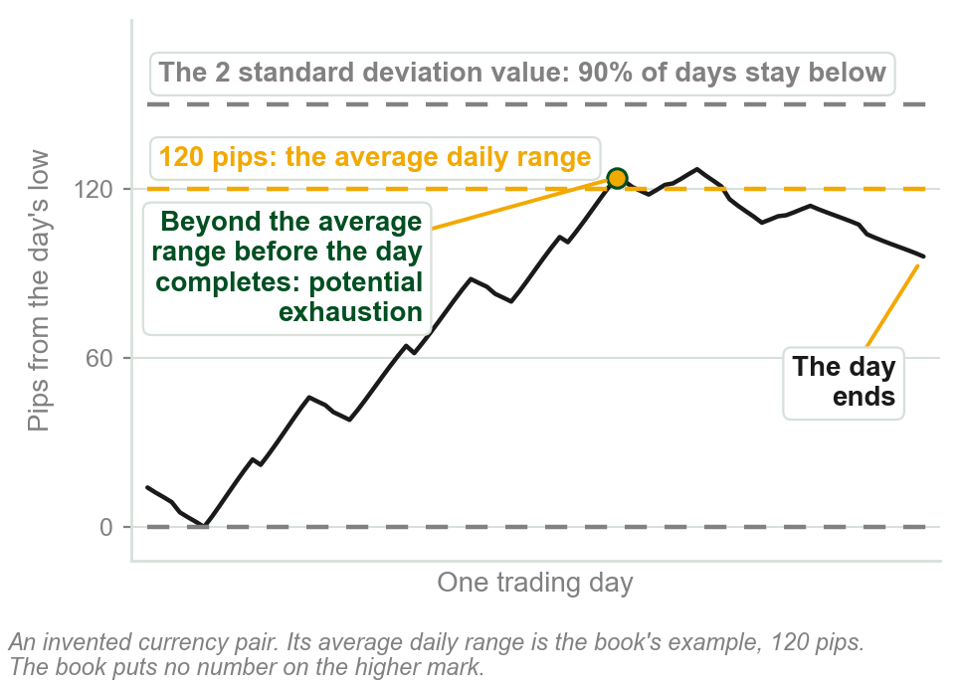
NEW TERM
13 Average period range
IN PLAIN WORDS
The usual range of price in one period.
FOR EXAMPLE
A foreign exchange (FOREX) pair averages 120 pips a day, a pip being the smallest price step a forex quote moves in. Price beyond that, either way, before the day completes: potential exhaustion.
THE FORMAL DEFINITION
One of the most reliable characteristics of price activity. The average is found with the ATR. A higher mark, the 2 standard deviation value of bar range (twice how far ranges typically spread from that average): ninety percent of period ranges stay below it.
Chart Q - FIN1209 teaching chart, drawn for this course. Illustrative data, not a real instrument.
Part 2 of 11 - 5.2 Quality of trend | 25 of 28
Book p.142: 120 pips and ninety percent are its numbers. A breach of the higher mark is a greater overextension.

Slide 50
14 Overextension past an overlay barrier
A price penetration above an uptrending line, or below a downtrending one, is generally regarded as a potential sign of exhaustion, with a reversal expected.
Short term penetrations below an uptrending line, or above a downtrending one, are usually regarded as false breakouts.
FIGURE 5.29
Four small charts. Top: price spiking above an uptrending line, and price spiking below a downtrending line, each circled as price exhaustion. Bottom: price dipping below an uptrending line, and price poking above a downtrending line, each circled as a false breakout.
The artwork is copyrighted and is not in the public repository. Build with assets/figures/ present to place it here.
With the line's slope: exhaustion. Against it: a false breakout.
The line is the heading's overlay barrier: a line drawn over price (5.6). False breakout, in the figure: price pokes through and comes straight back.
Figure 5.29 - Lim, The Handbook of Technical Analysis (Wiley, 2016)
Part 2 of 11 - 5.2 Quality of trend | 26 of 28
Book pp.142-143 and Figure 5.29. It gives no reason for either reading, and does not say how short is short term.

Slide 51
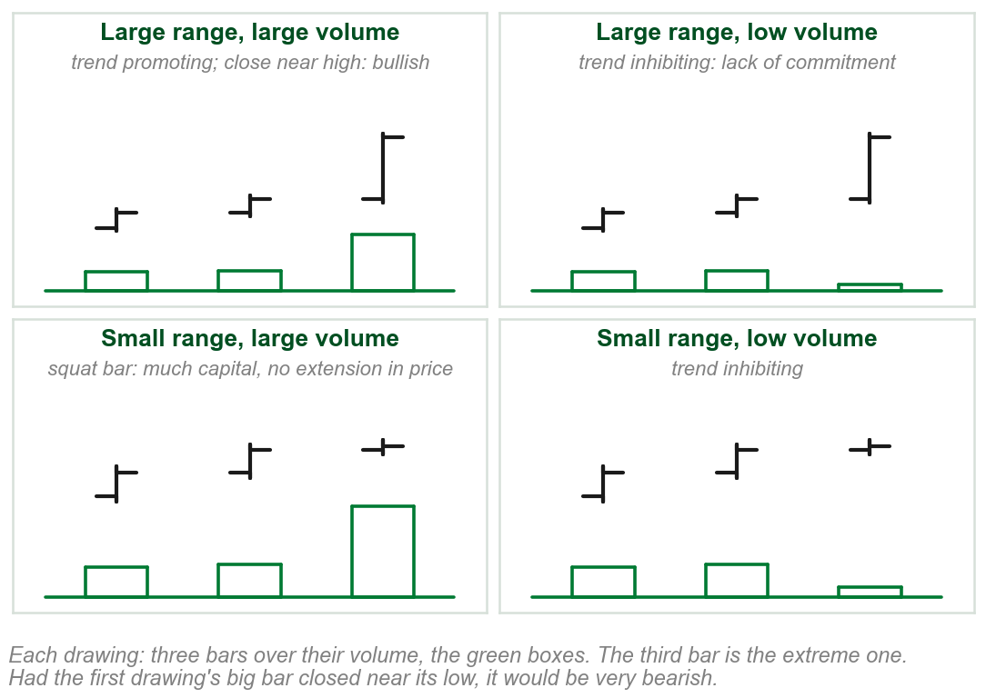
15 Volume spread action
Large range, large volume: trend promoting. Close near the high: bullish. Near the low: very bearish.
Large range, low volume: trend inhibiting. A lack of commitment.
Small range, large volume, the squat bar: inhibiting, and a much stronger reversal sign.
Small range, low volume: trend inhibiting.
Price and volume matter most together when both are extreme.
Chart R - FIN1209 teaching chart, drawn for this course. Illustrative data, not a real instrument.
Part 2 of 11 - 5.2 Quality of trend | 27 of 28
Book p.143; the chart is ours. The heading says spread, the text says bar range: not Chapter 3's bid-ask spread. The squat bar's reason is on the chart.

Slide 52
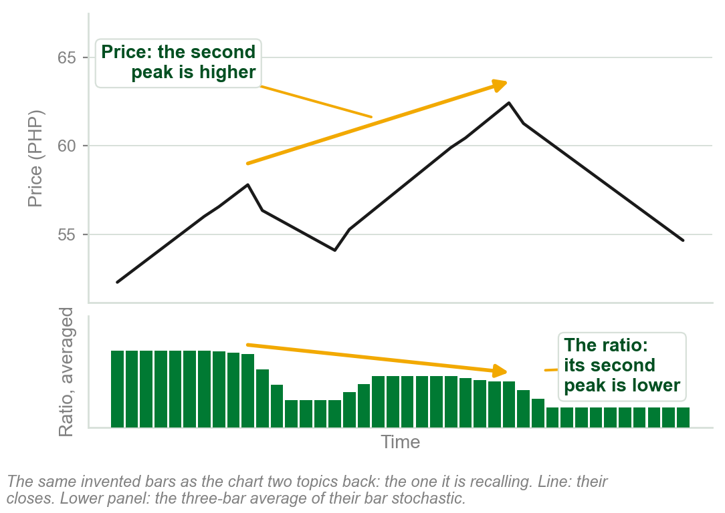
16 Volume and oscillator divergence
Standard divergence, price and volume or price and any oscillator, may signal a potential reversal or continuation.
As Chapter 4 showed: price makes a higher peak while the MACD makes a lower one. Recalled on the right, characteristic 6's own example.
The book names a second kind, reverse divergence, but gives it no sentence of its own here.
Reverse divergence, and how either kind signals a continuation, are left to Chapter 9.
Chart S - FIN1209 teaching chart, drawn for this course. Illustrative data, not a real instrument.
Part 2 of 11 - 5.2 Quality of trend | 28 of 28
Book p.143, one sentence, then Chapter 9. MACD: Chapter 4. Chart recalls Chart O, a few slides back.

Slide 53
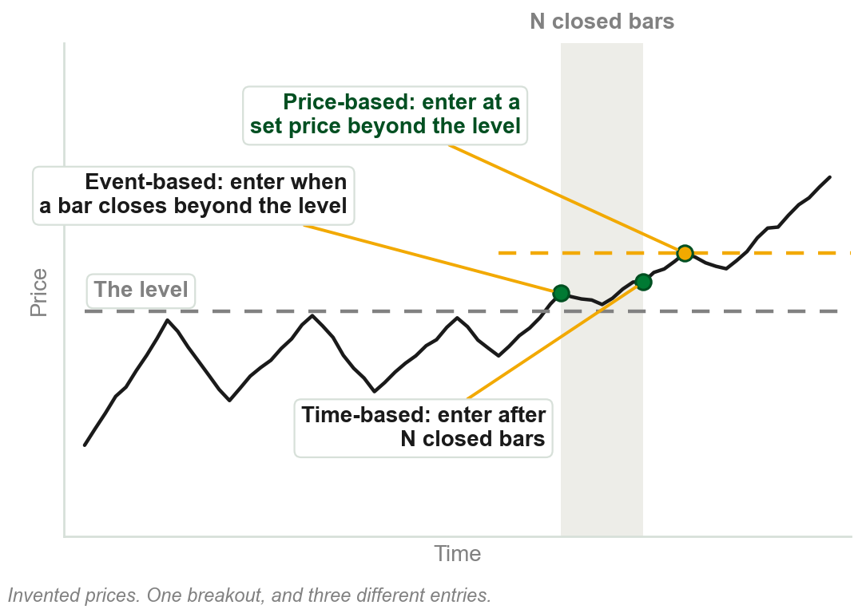
5.3 Three categories of filter
Price-based filters indicate the exact price of entry, but not when.
Time-based filters indicate the exact time of entry, but not the price.
Event-based filters indicate neither, until an event has occurred.
The type of filter, and the extent to which it is employed, sets the exact point of entry and exit.
Chapter 1: filters validate breakouts. Unfiltered, they cannot be backtested, run against past prices to see how they would have performed, the book says.
Chart T - FIN1209 teaching chart, drawn for this course. Illustrative data, not a real instrument.
Part 3 of 11 - 5.3 Filters | 1 of 3
Book p.144; backtest glossed in the caption, ours. The chart is ours: the book's own figure lists the filters and does not show the three entries.

Slide 54
The filters, one level down
Price-based. Absolute: a fixed price excursion. Relative: a percentage of the breakout price. Volatility: multiples of ATR or of standard deviation, how far a bar's range typically varies.
Time-based: a duration of N closed bars, N being however many the trader chooses.
Event-based. Algorithmic: a specific sequence of closed bars, several in a row closing the same way, or of new highs or lows. Event-based measure: a closing violation, or a retest, price returning to touch a broken level.
FIGURE 5.30
A price falling through an uptrend line after a failure swing, with a question mark on how far below the line it must go, beside the full list: (A) price-based filters, absolute, relative and volatility measures; (B) time-based filters; (C) event-based filters, algorithmic filters and event-based measures.
The artwork is copyrighted and is not in the public repository. Build with assets/figures/ present to place it here.
How far past the line, the ?, before the break counts? Chapter 1 calls the third family algorithmic; here it is a branch of event-based.
Figure 5.30 - Lim, The Handbook of Technical Analysis (Wiley, 2016)
Part 3 of 11 - 5.3 Filters | 2 of 3
Book pp.144-145, Figure 5.30. N, a sequence, a retest and standard deviation are glossed in one line each; the book gives no number for any of them.

Slide 55
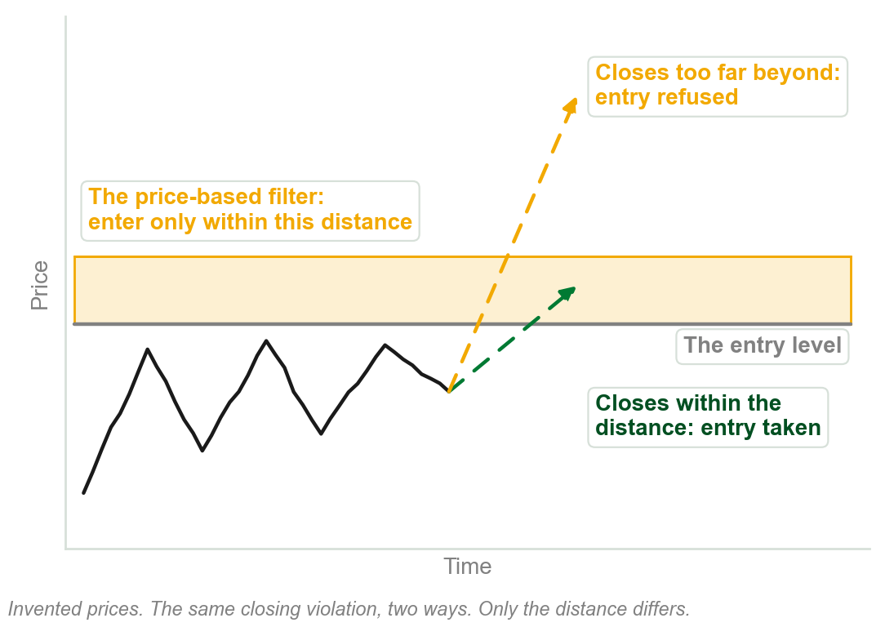
Two-stage filtering
Stage one: a closing violation triggers entry. But price may close too far beyond the entry level.
Stage two: a price-based filter limits entry to within a set distance: a maximum here, where Chapter 1's was a minimum.
Time and event filters do not specify the entry price, so controlling risk is ineffective, if not impossible.
So price-based filters are preferred.
Chart U - FIN1209 teaching chart, drawn for this course. Illustrative data, not a real instrument.
Part 3 of 11 - 5.3 Filters | 3 of 3
Book pp.144-145; the chart is ours. Its reason: with no cap on the risk of a single trade a system may meet risk of ruin, a phrase it does not define.

Slide 56
5.4 Four ways into and out of the market
To go long: buying to open a new position.
To go short: selling to open a new position.
To liquidate: selling to close an old long position.
To cover: buying to close an old short position.
FIGURE 5.31
One price swing with the four orders marked on it: go long, buy to open at a low price of $50; liquidate, sell to close at a higher price of $70; go short, sell to open at a high price of $70; cover, buy to close at a lower price of $40. A box works out the long profit as $20 and the short profit as $30.
The artwork is copyrighted and is not in the public repository. Build with assets/figures/ present to place it here.
In the figure: long from $50 to $70 is $20. Short from $70 to $40 is $30.
Chapter 1's four terms. In cash: no open positions. To square: to exit. To hedge: equal and opposite positions.
Figure 5.31 - Lim, The Handbook of Technical Analysis (Wiley, 2016)
Part 4 of 11 - 5.4 Participation | 1 of 9
Book pp.145-146 and Figure 5.31: the dollar amounts are printed on the figure.

Slide 57
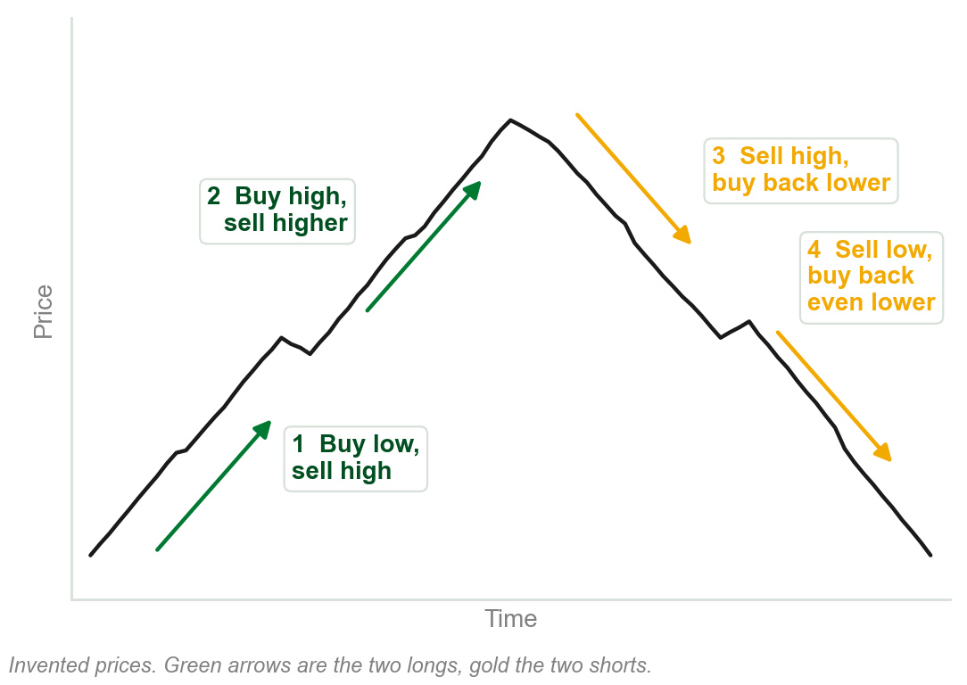
Four scenarios, one principle
1 Buying low and selling high.
2 Buying high and selling higher.
3 Selling high and buying back lower.
4 Selling low and buying back even lower.
Two longs, two shorts. In every one, the selling price is above the buying price.
The book here files all four under 'the principle of buying low and selling high'. By name only the first is buy low, sell high, as Chapter 1 said.
Chart V - FIN1209 teaching chart, drawn for this course. Illustrative data, not a real instrument.
Part 4 of 11 - 5.4 Participation | 2 of 9
Book pp.145-146. The chart is ours, on invented prices.

Slide 58
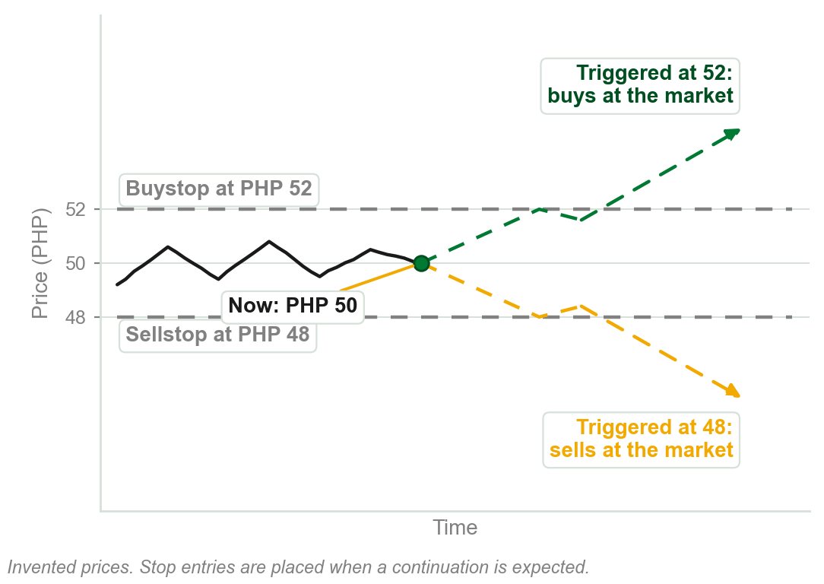
Stop orders: execution, but not the price
A stop order waits at a set price. Once triggered there, it turns into a market order: enter or exit immediately, at any price.
A buystop or sellstop entry is placed when a continuation in price is expected.
A stop exit closes a position that moves adversely: the stoploss order.
It can guarantee execution, but not the fill price.
Chapter 1 taught stop and limit entries. New: the exits, and that a gap can fill a stop away from its price.
Chart W - FIN1209 teaching chart, drawn for this course. Illustrative data, not a real instrument.
Part 4 of 11 - 5.4 Participation | 3 of 9
Book p.146. The chart is ours, on invented prices.

Slide 59
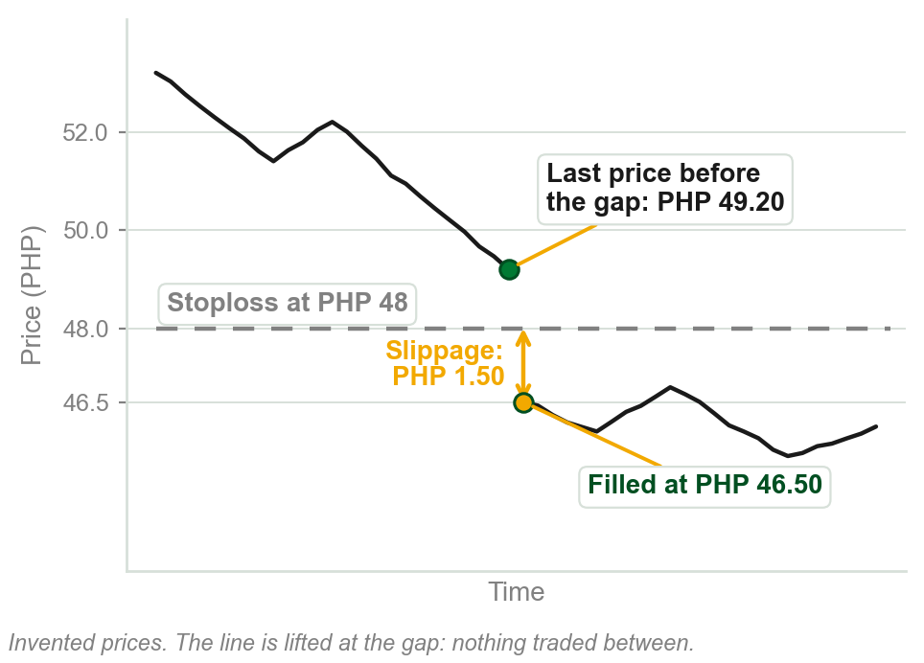
NEW TERM
Slippage
IN PLAIN WORDS
Filled at a price other than the one you asked for. Negative: worse for you. Positive: better.
FOR EXAMPLE
A stoploss waits at PHP 48. Price gaps down and the order is filled at PHP 46.50: negative slippage of PHP 1.50 a share.
THE FORMAL DEFINITION
The difference between the specified order price and the actual filled price. Stoploss orders may experience additional loss under gapping price action, due to negative slippage.
Chart X - FIN1209 teaching chart, drawn for this course. Illustrative data, not a real instrument.
Part 4 of 11 - 5.4 Participation | 4 of 9
Book p.146. The pesos and the chart are our example: PHP 48.00 less PHP 46.50 is PHP 1.50.

Slide 60
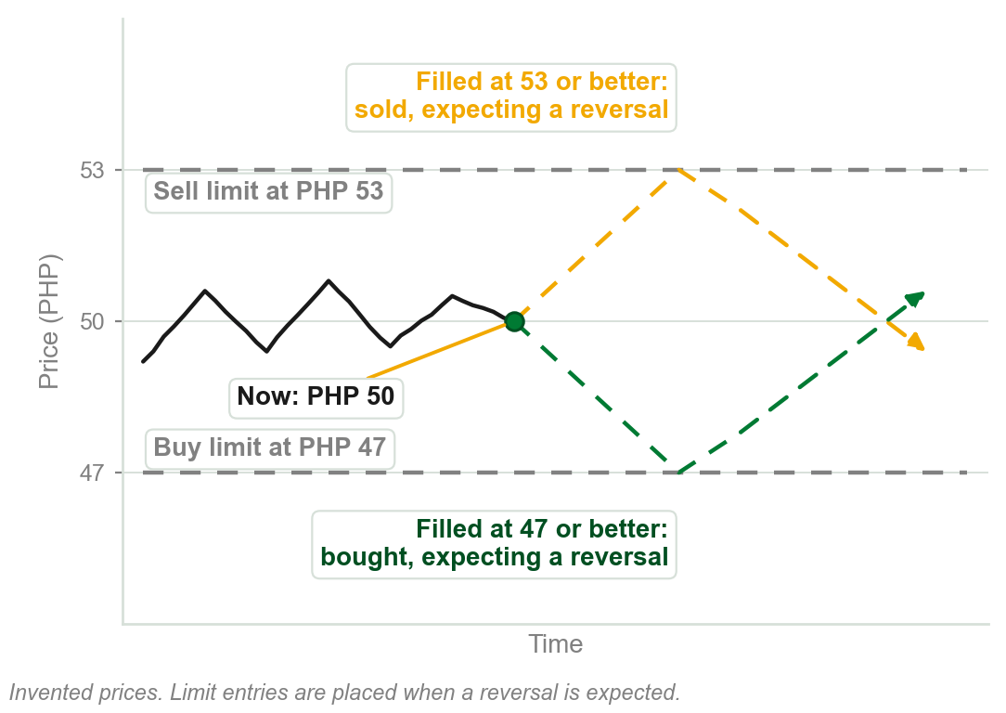
Limit orders: the price, but not execution
Instructions to enter or exit a market at a specified price, or better.
If the broker cannot fill it at that price or better, it is not executed.
A buy limit or sell limit entry is placed when a reversal in price is expected.
Placed only as a pending order. Only positive slippage is possible.
It can guarantee the intended price or better, but not execution.
Chart Y - FIN1209 teaching chart, drawn for this course. Illustrative data, not a real instrument.
Part 4 of 11 - 5.4 Participation | 5 of 9
Book pp.146-147. The chart is ours, on invented prices.

Slide 61
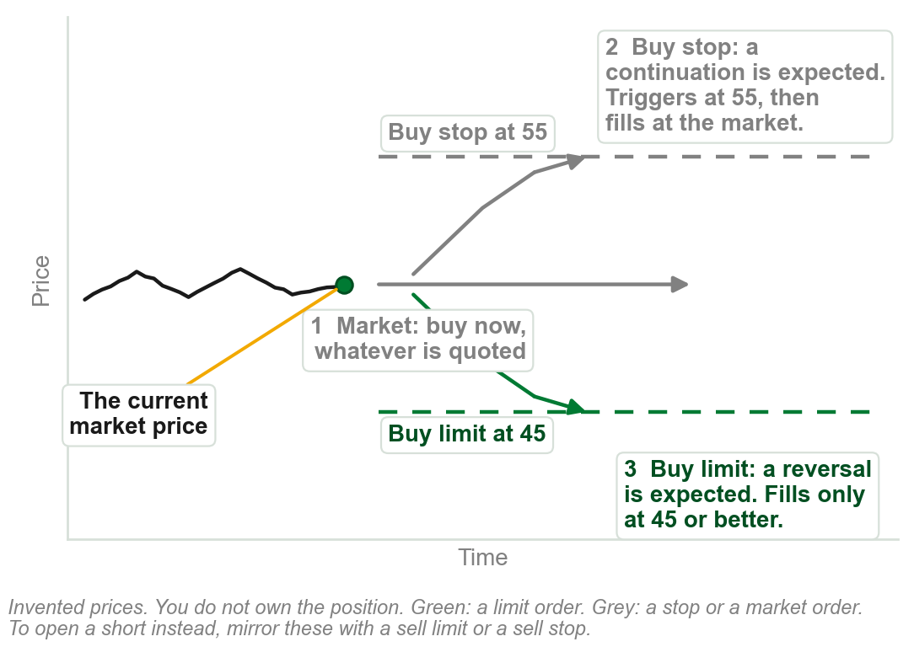
You do not own it: orders to enter
A market order: buy now, at whatever price is quoted. Instant, but the price is not guaranteed.
A buy stop: buy at a set price or higher, placed when a continuation up is expected.
A buy limit: buy at a set price or lower, placed when a reversal down is expected.
To open a short instead, the mirror is a sell limit or a sell stop; this pp.146-148 stretch works only the buy side.
Going short itself was taught earlier, in 5.4 Trend Participation; the book does not pair it with these orders here.
Chart Z - FIN1209 teaching chart, drawn for this course. Illustrative data, not a real instrument.
Part 4 of 11 - 5.4 Participation | 6 of 9
Book pp.146-147. The chart is ours, recalling the stop and limit entry slides before, numbered to its own arrows.

Slide 62
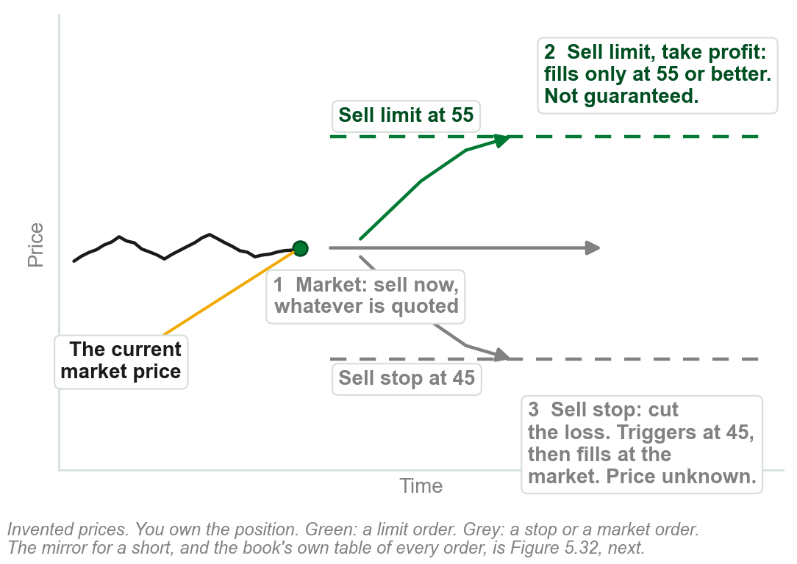
You own it: orders to exit
A market order: sell now, at whatever price is quoted. Instant, but the price is not guaranteed.
A sell limit: the profit-take order, above the market. Fills only at that price or better.
A sell stop: the stoploss, below the market. Triggers there, then fills at the market, price unknown.
A limit exit is not guaranteed. A stop exit is guaranteed, but not its price.
The book says 'or better, that is, higher' of every limit order; for a buy limit on the other slide, better reads lower.
Chart AA - FIN1209 teaching chart, drawn for this course. Illustrative data, not a real instrument.
Part 4 of 11 - 5.4 Participation | 7 of 9
Book pp.147-148. The chart is ours, numbered the same way as the entry slide before it.

Slide 63
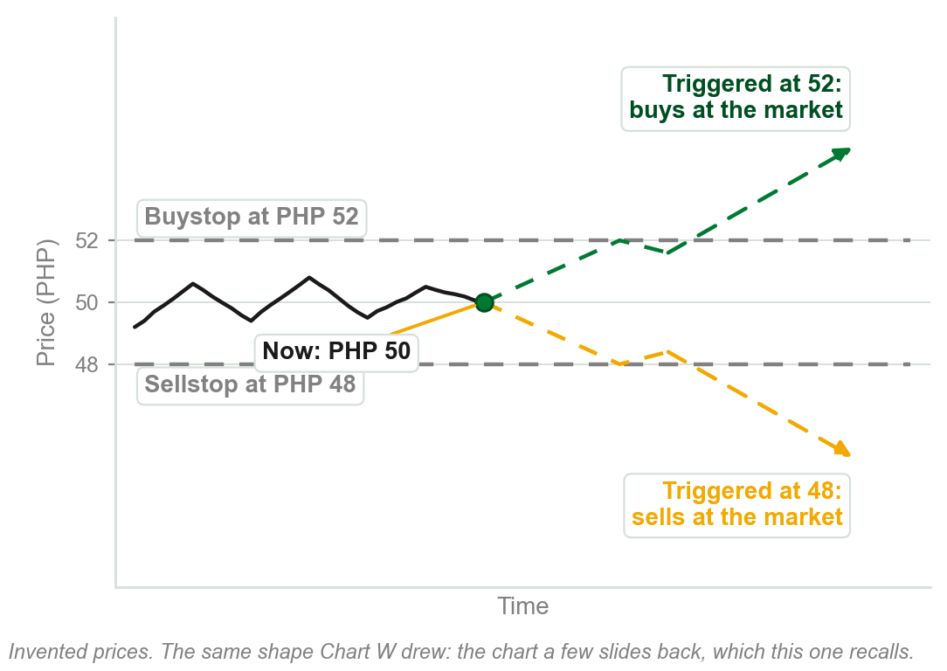
Other orders the book names
Market if Touched, MIT: sells above the market, buys below it, with a stop order. Same shape as the recall, right.
Day orders stay pending only until the end of the trading day.
Good till Cancelled orders stay active until further notice.
Market on Close orders fill in the last minutes, at or near the close.
OCO places two opposite orders and cancels whichever does not fill. OTO places a second order once a first fills.
Chart AB - FIN1209 teaching chart, drawn for this course. Illustrative data, not a real instrument.
Part 4 of 11 - 5.4 Participation | 8 of 9
Book pp.147-148. The chart recalls Chart W, a few slides back: the same shape an MIT order uses.

Slide 64
The book's table: orders above and below the market
FIGURE 5.32
A table around the current market price. Orders allowable above the market: buy stop or limit entry, sell limit entry, MIT sell, buy stop to exit a loss, sell limit to exit with profit. Orders allowable under the market: sell stop or limit entry, buy limit entry, MIT buy, sell stop to exit a loss, buy limit to exit with profit.
The artwork is copyrighted and is not in the public repository. Build with assets/figures/ present to place it here.
Figure 5.32 - Lim, The Handbook of Technical Analysis (Wiley, 2016)
Part 4 of 11 - 5.4 Participation | 9 of 9
Book p.148, Figure 5.32. 'Stop /limit entry' is the figure's own wording: the book's text places a buystop above and a sellstop below, and explains no stop/limit order.

Slide 65
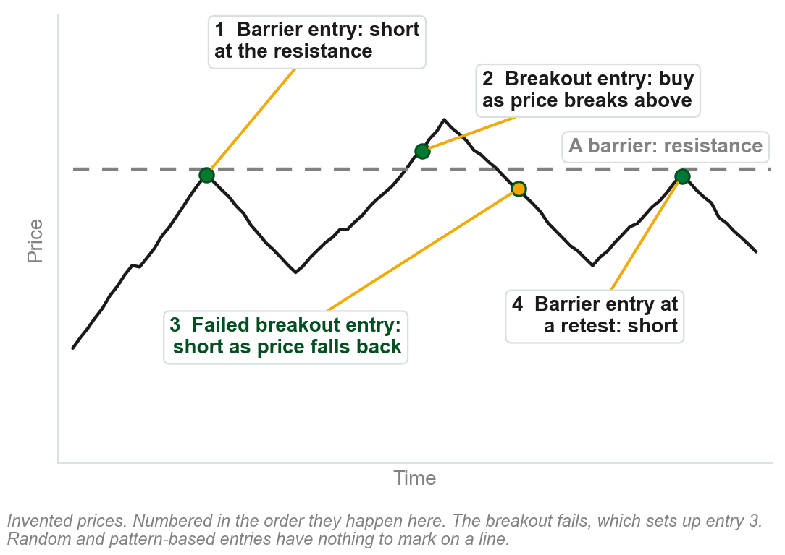
5.5 Ways of initiating an entry
Overlay breakout entries: on an upside or downside breakout of a price overlay.
Overlay barrier entries: buy at support, short at resistance, or at a retest of the barrier.
Failed breakout entries: in the opposite direction, after a failed breakout.
Random entries, and pattern or sequence-based entries.
The book announces four ways and lists five, each with or against the trend. Failed breakout: 5.2's false breakout. Pattern entries follow a set sequence of bars or a completed pattern; a random entry is taken with no technical signal at all, usually only to benchmark a strategy against chance.
Chart AC - FIN1209 teaching chart, drawn for this course. Illustrative data, not a real instrument.
Part 5 of 11 - 5.5 Inflection points | 1 of 13
Book pp.148-149; the chart is ours. Overlays it names: channels and trendlines (5.6), pivot points and price envelopes (not taught here).

Slide 66
Three variations of a top and a bottom
Failure swing: the second peak fails to penetrate the previous peak.
Double top: the second peak matches the level of the previous peak.
Non-failure swing: the second peak succeeds in penetrating the previous peak.
Bottoms are the mirror: a failure swing, a double bottom and a non-failure swing, read on the second trough.
FIGURE 5.33
Two rows of three drawings. Three basic variations of a top reversal: failure swing, double top and non-failure swing, each with its second peak and its sell signal marked. Three basic variations of a bottom reversal: the same three on the second trough, each with its buy signal.
The artwork is copyrighted and is not in the public repository. Build with assets/figures/ present to place it here.
All three were Chapter 2 terms, unchanged. More complex: a head and shoulders, a broadening formation, an island, a diamond, a rounding top or bottom.
Figure 5.33 - Lim, The Handbook of Technical Analysis (Wiley, 2016)
Part 5 of 11 - 5.5 Inflection points | 2 of 13
Book p.149 and Figure 5.33. The book says 'as we learned in Chapter 4'; in this course they were Chapter 2's terms.

Slide 67
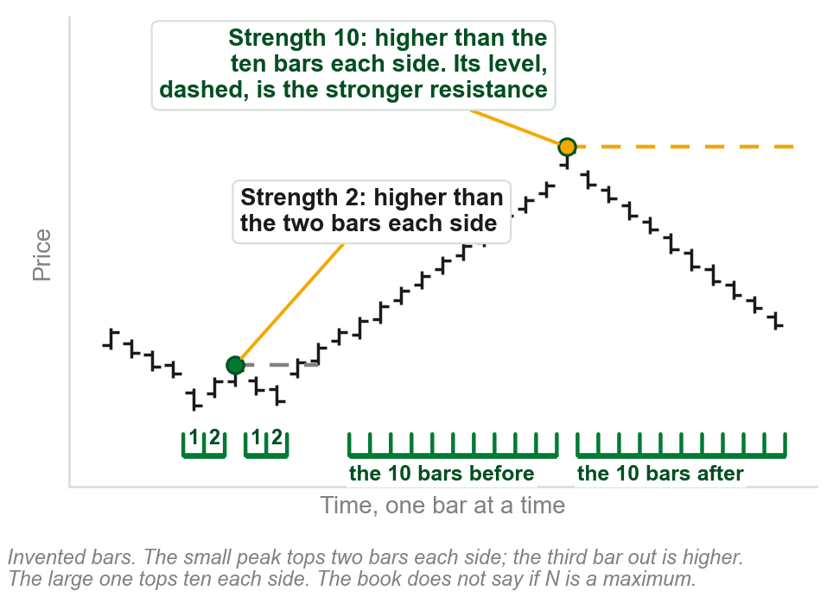
NEW TERM
Inflection point of strength N
IN PLAIN WORDS
An inflection point, a peak or trough, counts for more the more bars flank it. A peak acts as resistance, stopping a rally; a trough acts as support, stopping a decline.
FOR EXAMPLE
A peak whose highest bar is higher than the ten bars on either side is of strength 10. One that tops only two bars each side is of strength 2.
THE FORMAL DEFINITION
N bars on either side of the highest peak or lowest trough is an inflection point of strength N. More bars: a more significant peak or trough, and a stronger resistance or support level.
Chart AD - FIN1209 teaching chart, drawn for this course. Illustrative data, not a real instrument.
Part 5 of 11 - 5.5 Inflection points | 3 of 13
Book pp.149-150. It gives no reason, and does not say whether N is the most bars a peak tops. On the chart the small peak fails at the third bar. Strengths 2 and 10 are ours.

Slide 68
NEW TERM
Support and resistance role reversal
IN PLAIN WORDS
A breached barrier changes sides.
FIGURE 5.34
Four drawings in two columns, resistance turning into support and support turning into resistance: the top pair on horizontal levels, the bottom pair on a downtrend line and an uptrend line.
The artwork is copyrighted and is not in the public repository. Build with assets/figures/ present to place it here.
FOR EXAMPLE
A share holds at PHP 40, then falls through it. On the next rally PHP 40 stops it.
THE FORMAL DEFINITION
Price barriers change roles once breached: support turns into future resistance, and resistance into future support. All overlay barriers: channels, trendlines (5.6), pivot points and price envelopes, the last two not built in this course, named only as the book's others.
Figure 5.34 - Lim, The Handbook of Technical Analysis (Wiley, 2016)
Part 5 of 11 - 5.5 Inflection points | 4 of 13
Book p.150, Figure 5.34: top row flat levels, bottom row trendlines (5.6). No reason given here; pesos ours. Support and resistance: the slide just before this one.

Slide 69
Role reversal in a trend
In a downtrend, support turns into resistance, level after level.
In an uptrend, resistance turns into support, level after level.
FIGURE 5.35
A price chart falling and then rising, with short horizontal lines at the levels where support turned into resistance in the downtrend and where resistance turned into support in the uptrend.
The artwork is copyrighted and is not in the public repository. Build with assets/figures/ present to place it here.
Each horizontal line in the figure is one level, met first from one side and then from the other.
Figure 5.35 - Lim, The Handbook of Technical Analysis (Wiley, 2016)
Part 5 of 11 - 5.5 Inflection points | 5 of 13
Book p.150, Figure 5.35. The book gives this figure no sentence of its own.

Slide 70
Prior peaks, prior troughs and a channel
EURUSD, 30 minutes: support and resistance at prior peaks and troughs, and on the rising channel.
Resistance turning into support, again and again, in an uptrend.
FIGURE 5.36
A 30 minute EURUSD chart headed resistance turning into support in an uptrend: horizontal levels each marked resistance and then support, a rising channel around them, and a cycle-tuned stochastic below with arrows from its lows up to the support levels.
The artwork is copyrighted and is not in the public repository. Build with assets/figures/ present to place it here.
The same role reversal as the last two slides, on a real chart instead of an invented one.
The figure's lower panel carries an oscillator, the cycle-tuned stochastic, Chapter 8, too small to read here; this slide keeps only what the price panel itself shows.
Figure 5.36 - Lim, The Handbook of Technical Analysis (Wiley, 2016)
Part 5 of 11 - 5.5 Inflection points | 6 of 13
Book p.151 and Figure 5.36.

Slide 71
Trade in the direction of the trend
It means to buy in an uptrend and short in a downtrend. It is generally easier and safer.
Buying dips and selling rallies gets positions at the most advantageous prices, with the smallest stopsizes: the stop goes just beyond the dip or rally, close to the entry.
Positions taken with the trend can be held, and so extract greater profit from the markets.
FIGURE 5.37
Two drawings: buying dips in an uptrend, with arrows at each trough along a rising dotted trendline, and selling into rallies in a downtrend, with arrows at each peak along a falling one.
The artwork is copyrighted and is not in the public repository. Build with assets/figures/ present to place it here.
Buying a dip and selling a rally are retracement entries in the direction of the existing trend.
Stopsize: the distance from entry to stop. Trendlines or channels (5.6) time the entries; a cycle-tuned oscillator (Chapter 8) fine-tunes them.
Figure 5.37 - Lim, The Handbook of Technical Analysis (Wiley, 2016)
Part 5 of 11 - 5.5 Inflection points | 7 of 13
Book pp.151-152 and Figure 5.37. Both reasons on the slide are the book's.

Slide 72
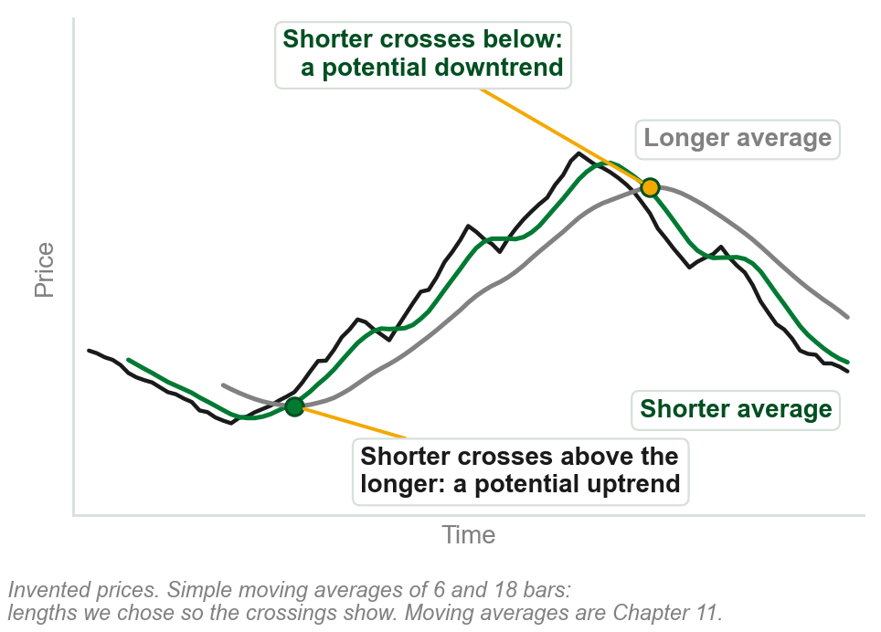
NEW TERM
Trend filter
IN PLAIN WORDS
Says whether a trend is on. Not 5.3's filters.
FOR EXAMPLE
A moving average: the average of a bar's own close and a set number before it, moving ahead one bar at a time. A double crossover compares a shorter one against a longer: shorter above, a potential uptrend; shorter below, a potential downtrend.
THE FORMAL DEFINITION
It helps to identify a trend amidst the market noise and price volatility. How a moving average is built in general is Chapter 11; this is only its crossing read. Two more: an oscillator crossing its signal line, and price contained above or below an overlay barrier.
Chart AE - FIN1209 teaching chart, drawn for this course. Illustrative data, not a real instrument.
Part 5 of 11 - 5.5 Inflection points | 8 of 13
Book p.152. No reason given for the crossover; signal line is not explained here. The chart is ours: 6 and 18 bar moving averages, chosen so the crossings show.

Slide 73
A filter and a trigger together
Bottom: the MACD, the filter, says which way. Middle: the stochastic, the trigger, says when.
Long: the stochastic crosses above its signal line with the MACD above zero. Short: the reverse.
Stops: below the previous trough for a long, trailing up to each higher trough. A short: the mirror.
FIGURE 5.38
A EURUSD chart with long entries, short entries and trailing stops marked on price, a stochastic panel with the entry crossovers circled, and a MACD panel with three divergences drawn on it.
The artwork is copyrighted and is not in the public repository. Build with assets/figures/ present to place it here.
Preview only, not examinable: the MACD, the stochastic and signal lines are not taught in this course until later chapters.
An illustration of one tool for direction, one for timing, shown here only because the book places it in this section. Nothing on this slide is assumed known or tested.
Figure 5.38 - Lim, The Handbook of Technical Analysis (Wiley, 2016)
Part 5 of 11 - 5.5 Inflection points | 9 of 13
Book pp.152-153 and Figure 5.38.

Slide 74
Where the stop goes, and how big it is
A stop is usually placed just below significant troughs for longs, just above significant peaks for shorts.
Entry too far from one: a stop some multiple of ATR or standard deviations away. A qualitative rule only; the book gives no actual multiple.
Barrier entries: stopsizes always about the same. The peak or trough is usually the point of entry itself.
Breakout entries: stopsizes vary. The peak or trough may be any distance from the entry.
FIGURE 5.39
Two columns. Breakout entries: go long at a breakout with the stoploss just below the trough, where the stopsize will vary with each entry. Barrier entries: go long at support with the stoploss just below the barrier, where the stopsize need not vary with each entry. Each is shown on a level and on a trendline.
The artwork is copyrighted and is not in the public repository. Build with assets/figures/ present to place it here.
Stopsize: the distance from entry to stop, the figure's brackets.
Figure 5.39 - Lim, The Handbook of Technical Analysis (Wiley, 2016)
Part 5 of 11 - 5.5 Inflection points | 10 of 13
Book pp.153-154 and Figure 5.39, which says only that a barrier entry's stopsize need not vary with each entry.

Slide 75
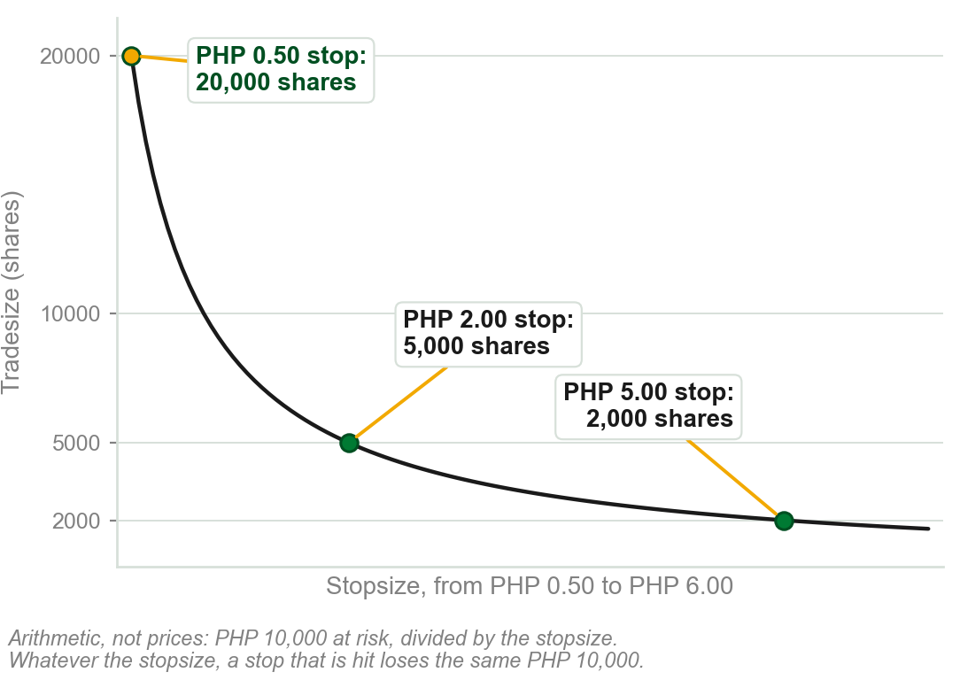
The trouble with a varying stopsize
Tradesize, the number of shares, is the risk per trade divided by the stopsize. So it varies with every stop.
The book's two worst cases: narrow stops taken out frequently, on a fixed percentage of current capital; or wide stops, on a fixed percentage of original capital.
Either way the result is significant loss.
Taken out: the stop is hit. Why each is bad, our reading: a narrow stop on current capital compounds, each loss shrinks the base the next is sized from; a wide stop on original capital stays large even after capital has shrunk.
Chart AF - FIN1209 teaching chart, drawn for this course. Illustrative data, not a real instrument.
Part 5 of 11 - 5.5 Inflection points | 11 of 13
Book p.153: 'risking a fixed percentage or fixed unit size per trade'. The chart is ours, and is arithmetic: PHP 10,000 at risk divided by each stopsize.

Slide 76
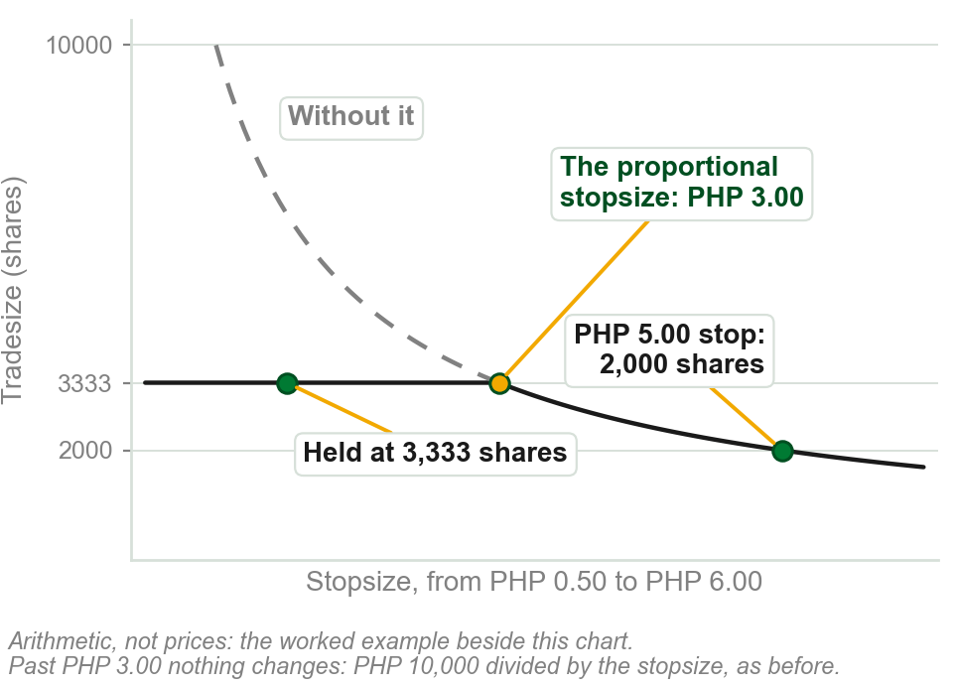
NEW TERM
Proportional stopsizing
IN PLAIN WORDS
One tradesize for every stop up to a threshold. For any wider stop, a smaller one, as before.
FOR EXAMPLE
Proportional stopsize, the threshold: PHP 3.00. Risk per trade PHP 10,000. Stops up to 3.00 trade 3,333 shares; a 5.00 stop, 2,000.
THE FORMAL DEFINITION
It limits the losses in either scenario by allocating a fixed percentage of original capital to narrow stops, and of current capital for stopsizes that exceed a fixed threshold size.
Chart AG - FIN1209 teaching chart, drawn for this course. Illustrative data, not a real instrument.
Part 5 of 11 - 5.5 Inflection points | 12 of 13
Book pp.153-154; pesos ours. Its sentence speaks of original and current capital; its five steps, next slide, use one risk per trade. Learn the steps.

Slide 77
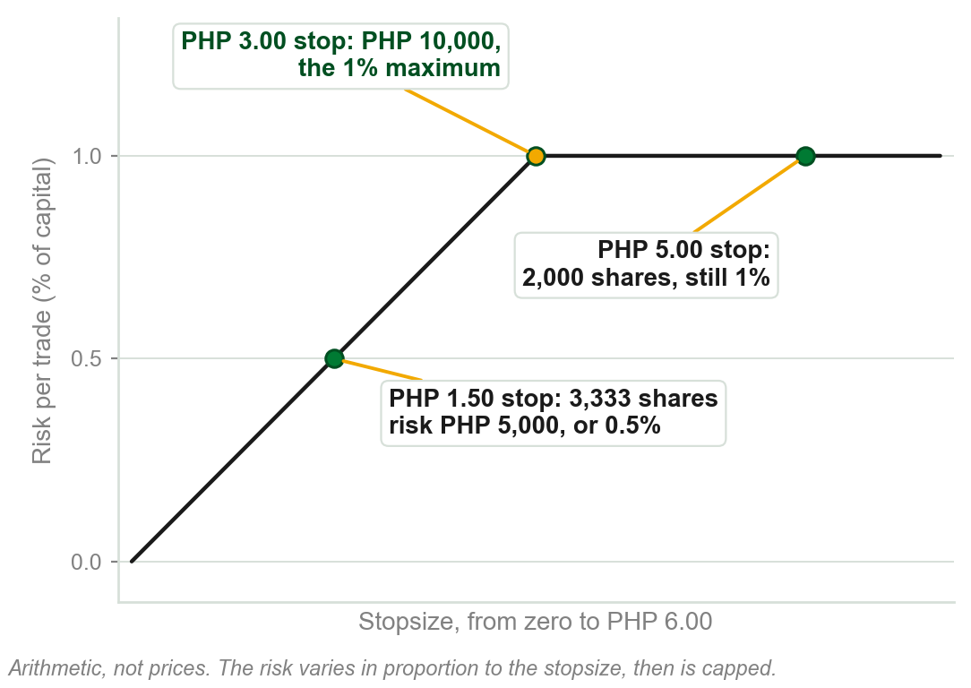
Five steps to the proportional tradesize
1 Backtest, run the system on past trades: the average stopsize of 300 to 500, to average out noise. Say PHP 2.00.
2 Their two standard deviation value: say PHP 1.00, the same cushion as 13's ninety percent mark.
3 Add: the proportional stopsize, PHP 3.00, wide enough for almost every stop seen.
4 Maximum risk per trade: 1 percent of current capital. Say PHP 10,000.
5 10,000 / 3.00 = 3,333 shares, the proportional tradesize.
Chart AH - FIN1209 teaching chart, drawn for this course. Illustrative data, not a real instrument.
Part 5 of 11 - 5.5 Inflection points | 13 of 13
Book p.154. No reason for 300 to 500 trades or step 3, beyond 13's 2 SD case. Backtest: 5.3. Pesos, 1 percent: ours.

Slide 78
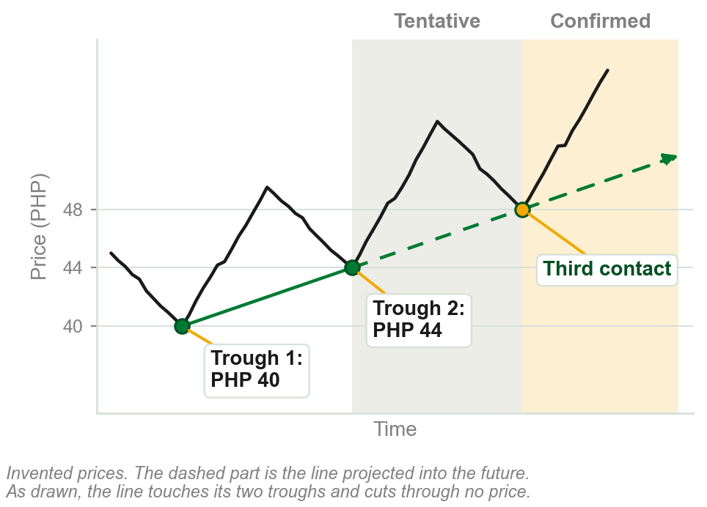
NEW TERM
5.6 Trendline
IN PLAIN WORDS
A straight line through two turning points, carried forward, cutting through no price.
FOR EXAMPLE
Join an uptrend's troughs at PHP 40 and PHP 44 and extend the line. A third touch confirms it.
THE FORMAL DEFINITION
A line projected forward into the future from two significant inflection points: troughs for an uptrend, peaks for a downtrend. Two points only fit a line to the past; a third touch is the first time it predicts, which is why it is tentative until then and confirmed, or valid, after. A line price cuts through has already broken it, so it could not still be holding.
Chart AI - FIN1209 teaching chart, drawn for this course. Illustrative data, not a real instrument.
Part 6 of 11 - 5.6 Trendlines | 1 of 24
Book p.155. No reason given for the third contact or the no-cutting rule beyond our own reading. Price crossing it later is a breach. Pesos and chart ours.

Slide 79
Short, medium and longer-term trendlines
A trendline is short, medium or longer term depending on the amount of price activity it contains above or below it.
Longer-term uptrend lines contain more price activity above them than shorter-term uptrend lines.
The converse is true for downtrend lines.
FIGURE 5.40
One rising price with three dotted uptrend lines fanning out from the same low: a steep short-term line, a medium-term line, and a shallow longer-term line that contains or supports more of the price action.
The artwork is copyrighted and is not in the public repository. Build with assets/figures/ present to place it here.
A longer-term trendline contains, or supports, more of the price action.
Point and Figure's bullish support and bearish resistance lines are drawn from one reference point, not two.
Figure 5.40 - Lim, The Handbook of Technical Analysis (Wiley, 2016)
Part 6 of 11 - 5.6 Trendlines | 2 of 24
Book p.155 and Figure 5.40.

Slide 80
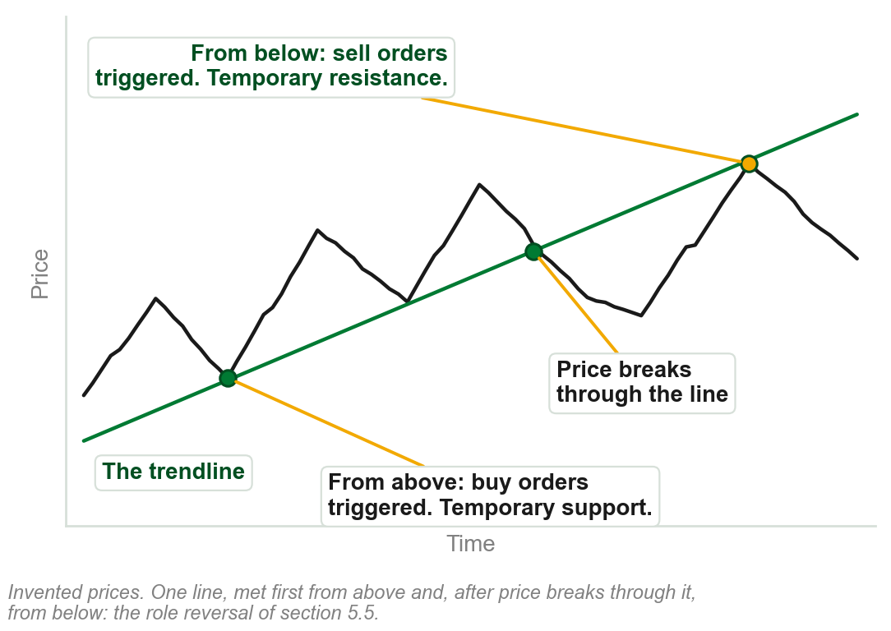
Why a trendline holds: behavior
All price overlays, trendlines included, are barriers. Most participants place buy orders above one and sell orders below it.
From above, price triggers the buy orders: an upside reaction, temporary support.
From below, it triggers the sell orders: a downside reaction, temporary resistance.
Support and resistance are behavioral: human psychology, biases and emotions.
Chapters 2 and 3 pointed here for support and resistance. This is the book's account of them.
Chart AJ - FIN1209 teaching chart, drawn for this course. Illustrative data, not a real instrument.
Part 6 of 11 - 5.6 Trendlines | 3 of 24
Book pp.155-156, reason included. The chart is ours, on invented prices.

Slide 81
NEW TERM
Internal line
IN PLAIN WORDS
A breached trendline: invalid, still usable.
FIGURE 5.41
A 30 minute EURUSD chart following one uptrend line: drawn from two troughs at points 1 and 2, confirmed or validated at its first retest, the third point on the line, then invalidated, and a new uptrend line redrawn between points 1 and 3.
The artwork is copyrighted and is not in the public repository. Build with assets/figures/ present to place it here.
FOR EXAMPLE
Figure: the line through 1 and 2 is confirmed at the circle, then breached: an internal line. A new line runs through 1 and 3.
THE FORMAL DEFINITION
Once breached, a trendline is invalidated and thereafter called an internal line. The new uptrend line runs from the original lower trough to the new significant trough; in a downtrend, from the original higher peak to the new peak.
Figure 5.41 - Lim, The Handbook of Technical Analysis (Wiley, 2016)
Part 6 of 11 - 5.6 Trendlines | 4 of 24
Book p.156, Figure 5.41. Its example of use: a head and shoulders neckline (Chapter 13), very frequently retested after the breach. It does not say why internal.

Slide 82
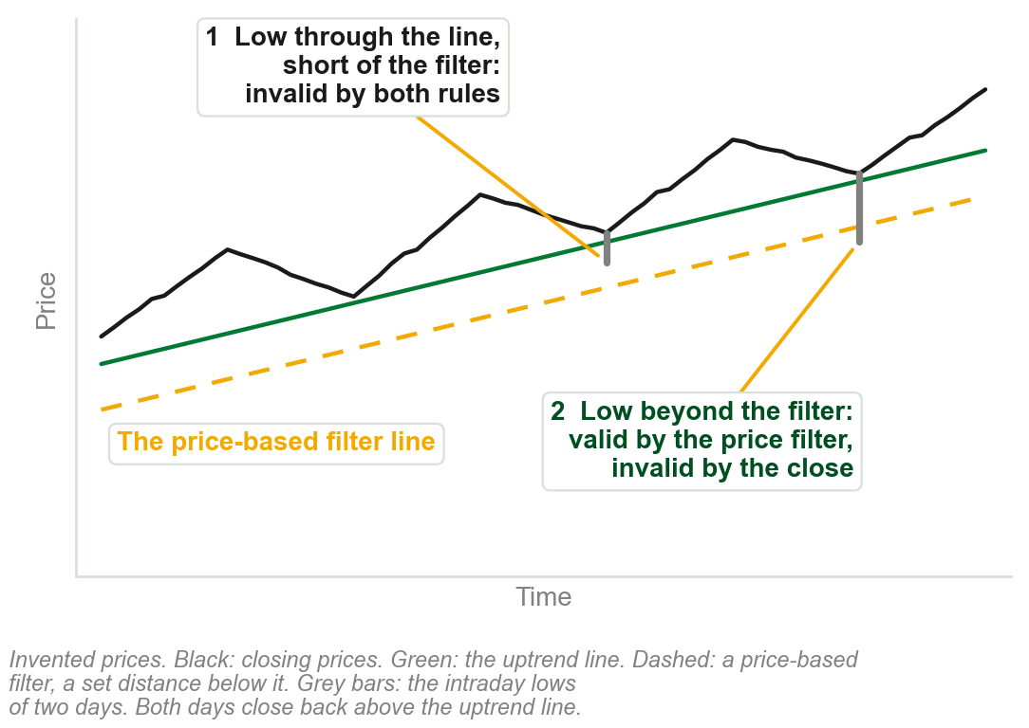
What counts as a valid penetration?
It depends on the filtering employed. Closing filter rule: valid only once price closes beyond the line.
So an intraday low well through an uptrend line, with a close back above it, is significant but invalid.
The book's answer: use a price-based filter. A penetration is then valid once price goes a set distance beyond the line, whatever the close.
With a time or event filter, the book adds the price filter as a second stage. Valid or not, a new trendline may still be drawn.
Chart AK - FIN1209 teaching chart, drawn for this course. Illustrative data, not a real instrument.
Part 6 of 11 - 5.6 Trendlines | 5 of 24
Book pp.156-157. The chart is ours, on invented prices.

Slide 83
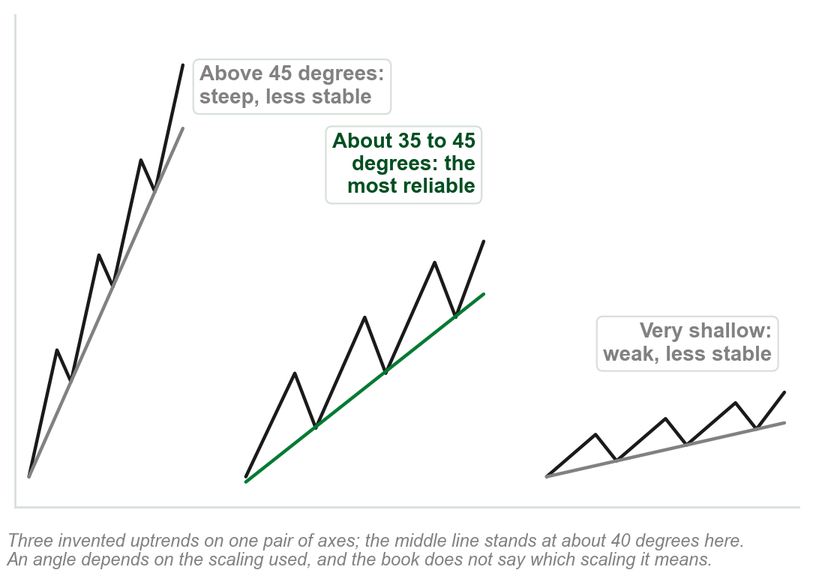
A reliable trendline: angle and duration
A reliable trendline gives consistent support and resistance. A lot of whipsaws, price crossing the line back and forth without a clean break: unreliable.
Angle, read on a linear price scale, Chapter 3: above 45 degrees a steep uptrend is less stable, and may not sustain itself. So is a very shallow one.
The most reliable uptrend line rises at approximately 35 to 45 degrees.
Duration: longer-term trendlines are generally more reliable than shorter-term ones.
A longer-term line is more obvious to all participants and attracts more and larger orders.
Chart AL - FIN1209 teaching chart, drawn for this course. Illustrative data, not a real instrument.
Part 6 of 11 - 5.6 Trendlines | 6 of 24
Book p.157. No reason given for 35 to 45 degrees or the scaling; our reading is linear, Chapter 3. The chart is ours.

Slide 84
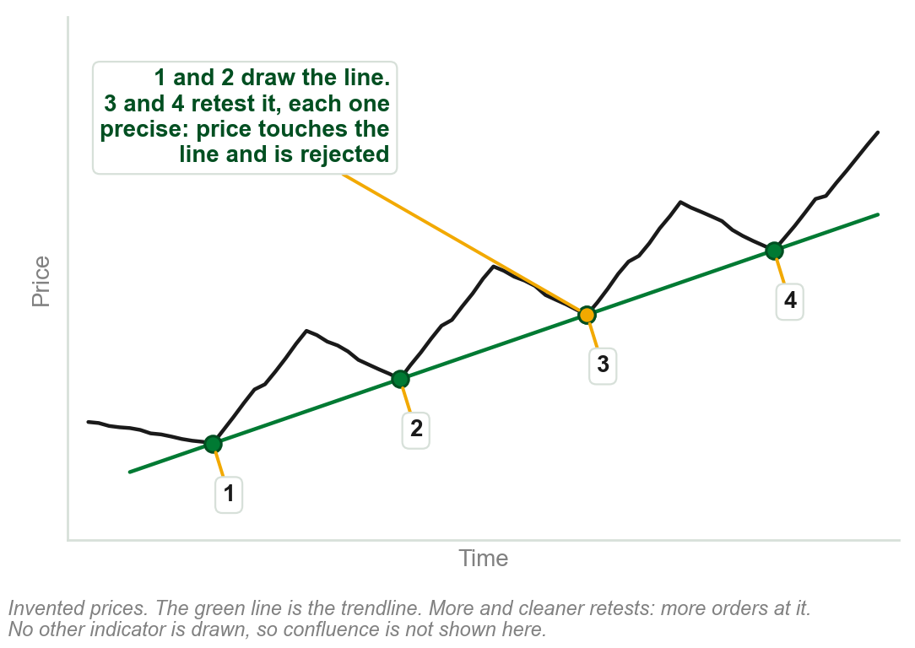
A reliable trendline: the other four
Number of retests: the more a line is retested, the more orders it attracts.
Clarity of the retests: the more precise, the more formidable the barrier.
Confluence: other bullish or bearish indicators agreeing at the point of contact. A stronger rejection of price.
Preceding action: contracting cycle amplitude, cycle period, bar range or body-to-range ratio makes a line suspect.
Retests show that traders are aware of the line and paying attention to it.
Chart AM - FIN1209 teaching chart, drawn for this course. Illustrative data, not a real instrument.
Part 6 of 11 - 5.6 Trendlines | 7 of 24
Book pp.157-158, reasons included. The chart is ours, on invented prices.

Slide 85
A trendline's minimum price target
Find the distance that price moved farthest from the trendline.
Apply a one-to-one projection of that distance from the breakout point.
Farthest distance PHP 6, breakout at PHP 50: the minimum target is 50 - 6 = PHP 44.
FIGURE 5.42
A 30 minute EURUSD chart: the maximum distance of price from the uptrend line measured as a vertical arrow, the same height projected one to one down from the breakout point, and profit-taking activity around the minimum target projection.
The artwork is copyrighted and is not in the public repository. Build with assets/figures/ present to place it here.
In the figure prices bottom very close to the minimum projected target.
Chapter 4's minimum measuring objective, from a trendline.
Figure 5.42 - Lim, The Handbook of Technical Analysis (Wiley, 2016)
Part 6 of 11 - 5.6 Trendlines | 8 of 24
Book p.158 and Figure 5.42. The pesos are our example of the one-to-one projection.

Slide 86
Strengths and weaknesses of trendline analysis
Strengths 1 and 2: straight lines catch any trend change, no need to identify price patterns.
Strengths 3 and 4: simple on any timeframe or market, viewable across them all.
Weakness 1: subject to whipsaws, the slide before's term; weaker in erratic markets.
Weakness 2: affected by the scaling used, Chapter 3's ratio or linear.
Weakness 3: a sideways consolidation drifts both ways, crossing a line without a real reversal's break.
Part 6 of 11 - 5.6 Trendlines | 9 of 24
Book pp.158-159: its own list. Weakness 3's reason is our reading.

Slide 87
NEW TERM
Continuation and reversal trendlines
IN PLAIN WORDS
Named by the breakout a trendline allows.
FIGURE 5.43
Two existing uptrends. In the first a falling dotted line over a pullback is broken upward: a continuation trendline, with the breakout in the direction of the existing trend. In the second a rising dotted line under the trend is broken downward: a reversal trendline.
The artwork is copyrighted and is not in the public repository. Build with assets/figures/ present to place it here.
FOR EXAMPLE
A falling line over a retracement in an uptrend, broken upward: a continuation trendline. For the retracement itself, a lower degree, a reversal.
THE FORMAL DEFINITION
Trendlines that allow a breakout in the direction of the existing trend are continuation trendlines; in the opposite direction, reversal trendlines. First ascertain which wave degree is being observed.
Figure 5.43 - Lim, The Handbook of Technical Analysis (Wiley, 2016)
Part 6 of 11 - 5.6 Trendlines | 10 of 24
Book p.159 and Figure 5.43. Why the wave degree matters is our reading; the book says only that it must be ascertained.

Slide 88
NEW TERM
Channel, and its return line
IN PLAIN WORDS
A trendline and a parallel across price.
FIGURE 5.44
A rising channel turning into a falling channel, headed channel transition: an uptrend line through points 1 and 2 with its channel or return line from point 3, then a downtrend line through points 4 and 5 with its channel or return line from point 6.
The artwork is copyrighted and is not in the public repository. Build with assets/figures/ present to place it here.
FOR EXAMPLE
Rising: an uptrend line on troughs 1 and 2, with a parallel from peak 3. Falling: a downtrend line on peaks 4 and 5, with a parallel from trough 6, which violates the uptrend line.
THE FORMAL DEFINITION
A line projected parallel to the trendline from a significant peak or trough is the channel, or return, line. Channels indicate potential entry, profit-taking, price target and stoploss levels.
Figure 5.44 - Lim, The Handbook of Technical Analysis (Wiley, 2016)
Part 6 of 11 - 5.6 Trendlines | 11 of 24
Book pp.159-160 and Figure 5.44.

Slide 89
NEW TERM
Nested channels
IN PLAIN WORDS
Channels inside a bigger channel.
FIGURE 5.45
A 4 hour Silver chart with one larger falling channel drawn across it and many smaller channels, rising and falling, nested within the larger one.
The artwork is copyrighted and is not in the public repository. Build with assets/figures/ present to place it here.
FOR EXAMPLE
Silver, 4 hour: price moves through smaller channels, rising and falling, inside one larger falling channel.
THE FORMAL DEFINITION
The smaller channels are contained, or nested, within the larger channel. Nesting can occur at multiple levels, with large channels comprised of ever-decreasing channel sizes. Channel nesting has fractal-like properties.
Figure 5.45 - Lim, The Handbook of Technical Analysis (Wiley, 2016)
Part 6 of 11 - 5.6 Trendlines | 12 of 24
Book p.160, Figure 5.45 (p.161). Fractal-like, unexplained by the book: the same shape at every size. It says nothing of the lines right of the larger channel.

Slide 90
Nested channels at Fibonacci levels
Nested channeling again, this time on a chart of the USDCAD.
The horizontal lines are Fibonacci retracement levels: set percentages of a prior move.
The book's own page, kept for completeness. Neither the channels nor the levels can be read at this size, so nothing here is asked to be verified from it; the next slide redraws the same idea so it can be.
FIGURE 5.46
A price chart with nested channels drawn in solid and dashed lines over a set of horizontal Fibonacci retracement levels, from 0.0 to 100.0, with the channel turns falling on those levels.
The artwork is copyrighted and is not in the public repository. Build with assets/figures/ present to place it here.
Retracement levels: 5.7, and Chapter 10. The book's printed caption repeats Figure 5.45's and says Silver; its text says USDCAD.
Figure 5.46 - Lim, The Handbook of Technical Analysis (Wiley, 2016)
Part 6 of 11 - 5.6 Trendlines | 13 of 24
Book p.160, and Figure 5.46 on p.161.

Slide 91
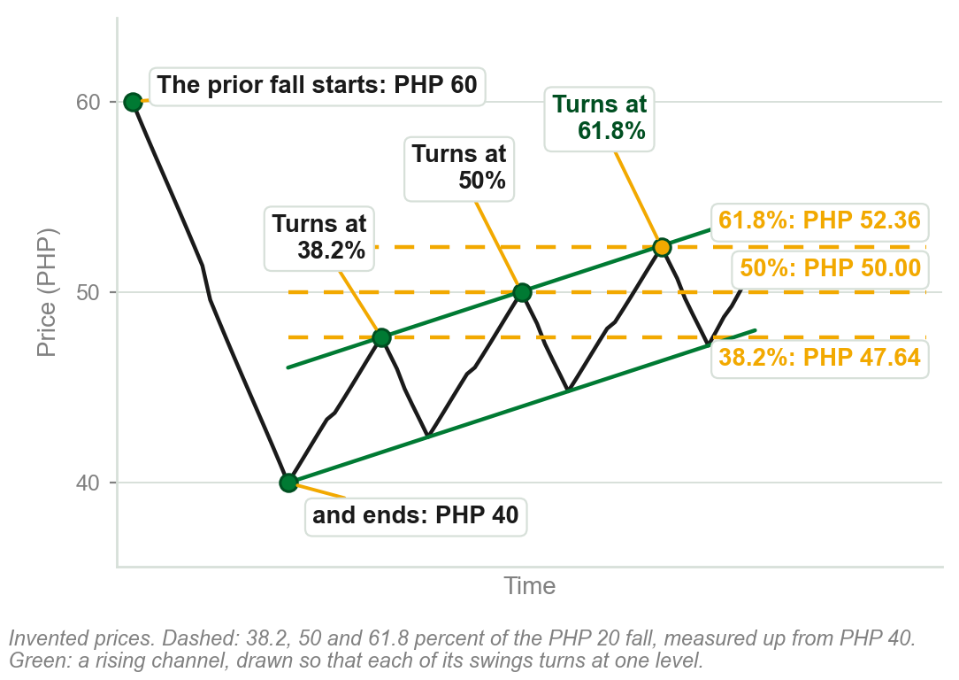
A channel turning at retracement levels
A prior fall: PHP 60 down to PHP 40, PHP 20 in all.
Levels, measured back up from PHP 40: 38.2 percent is PHP 47.64, 50 percent PHP 50.00, 61.8 percent PHP 52.36.
Each swing of the rising channel turns down at one of the levels: the reaction the book says to notice.
Two kinds of barrier: sloping channel lines, flat retracement levels.
Preview only, not examinable: 38.2, 50 and 61.8 percent are borrowed here for the book's channel point; where they come from is 5.7 and Chapter 10, not this slide.
Chart AN - FIN1209 teaching chart, drawn for this course. Illustrative data, not a real instrument.
Part 6 of 11 - 5.6 Trendlines | 14 of 24
Ours: what the book says of its Figure 5.46 (p.160), on invented prices, because the figure's levels cannot be read. Drawn so that each swing turns at a level.

Slide 92
Projecting a price target with a channel
The return line of a channel is a possible price target, providing resistance to price.
Solid: an uptrend line through troughs 1 and 2, and its parallel from peak 3, channel projection 1. Price meets it at 5.
Dotted: a new, steeper line from trough 2 to trough 4, and its parallel from 5, channel projection 2. Price meets it at 6.
FIGURE 5.47
A EURUSD chart: a rising line through troughs 1 and 2 carried on to trough 4, channel projection 1 drawn parallel to it from peak 3 and met by price at point 5, and channel projection 2 carried on to point 6.
The artwork is copyrighted and is not in the public repository. Build with assets/figures/ present to place it here.
The targets at 5 and 6 were forecast accurately.
The line slopes: the target price depends on when price arrives.
Figure 5.47 - Lim, The Handbook of Technical Analysis (Wiley, 2016)
Part 6 of 11 - 5.6 Trendlines | 15 of 24
Book p.160, and Figure 5.47 on p.162. The point by point reading of the figure is ours; the book gives it one sentence.

Slide 93
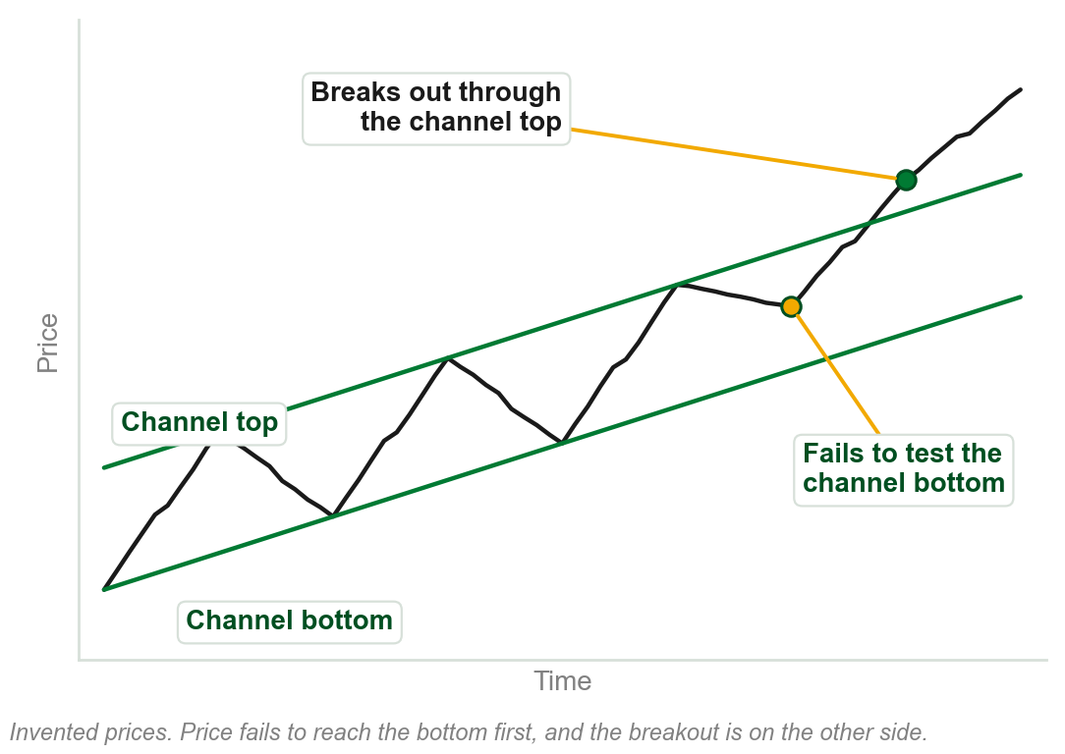
Anticipating a channel breakout
Price failing to test one of the channel boundaries may be an early indication of a breakout in the opposite direction.
A failure to test a channel bottom in an uptrend, or a channel top in a downtrend, is even stronger evidence of a continuation of the existing trend.
Especially so if the channel breakout bar is accompanied by large volume.
Not the same case as 5.2's single trendline, where piercing the line itself was exhaustion: here price never even reaches the near boundary, then clears the far one, which 5.2 never addressed.
Chart AO - FIN1209 teaching chart, drawn for this course. Illustrative data, not a real instrument.
Part 6 of 11 - 5.6 Trendlines | 16 of 24
Book pp.160-161. The chart is ours: the book makes the point on its Figure 5.14. Reconciled with 5.2's single-line exhaustion rule below, our reading.

Slide 94
NEW TERM
Sperandeo trendlines
IN PLAIN WORDS
Sperandeo's rule for which two points to join: a minor trough or peak is a small one, smaller than the move it sits inside.
FIGURE 5.48
Two drawings. A Sperandeo uptrend line from the lowest trough through the highest minor trough preceding the highest peak, and a Sperandeo downtrend line from the highest peak through the lowest minor peak preceding the lowest trough.
The artwork is copyrighted and is not in the public repository. Build with assets/figures/ present to place it here.
FOR EXAMPLE
An uptrend's lowest trough is PHP 40, and its highest minor trough before the PHP 60 peak is PHP 55: the line runs from the first through the second.
THE FORMAL DEFINITION
Uptrend line: from the lowest trough to the highest minor trough preceding the highest peak. Downtrend line: the mirror. The rule anchors the line on the most recent higher low before the top, as close under price as the rally allows. From Victor Sperandeo's Trader Vic: Methods of a Wall Street Master.
Figure 5.48 - Lim, The Handbook of Technical Analysis (Wiley, 2016)
Part 6 of 11 - 5.6 Trendlines | 17 of 24
Book p.162, Figure 5.48 (p.163). No reason given for the rule itself. It advises reading Sperandeo's book. Pesos ours.

Slide 95
NEW TERM
DeMark trendlines
IN PLAIN WORDS
DeMark's rule: join the two newest points.
FIGURE 5.49
A rising candlestick chart with three uptrend lines drawn from different pairs of troughs: the one through the two most recent troughs is marked correct and the two drawn from older troughs are marked wrong.
The artwork is copyrighted and is not in the public repository. Build with assets/figures/ present to place it here.
FOR EXAMPLE
Of three uptrend lines in the figure, only the one through the two most recent troughs is marked Correct.
THE FORMAL DEFINITION
Uptrend line: from the two most recent qualified troughs. Downtrend line: from the two most recent qualified peaks. From Thomas DeMark's The New Science of Technical Analysis, where the book sends the reader for how a point qualifies.
Figure 5.49 - Lim, The Handbook of Technical Analysis (Wiley, 2016)
Part 6 of 11 - 5.6 Trendlines | 18 of 24
Book p.162, Fig. 5.49. It calls the approach more responsive, not saying than what, or how a point qualifies. The troughs cannot be told apart here: next slide.

Slide 96
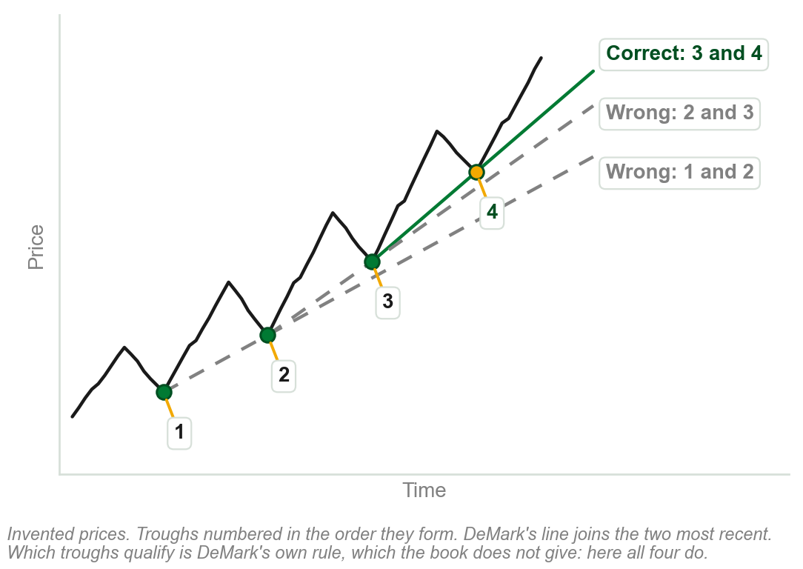
DeMark's line, on numbered troughs
An uptrend with four troughs, numbered in the order they form.
Correct, DeMark's line: through the two most recent troughs, 3 and 4.
Wrong: the lines through 2 and 3, and through 1 and 2. They use older troughs.
Only the two most recent troughs give DeMark's line.
Which troughs qualify is DeMark's own rule; the book sends the reader to his book for it. Here all four are taken to qualify.
Chart AP - FIN1209 teaching chart, drawn for this course. Illustrative data, not a real instrument.
Part 6 of 11 - 5.6 Trendlines | 19 of 24
Ours: the book's Figure 5.49 (p.163) redrawn on invented prices with the troughs numbered, because they cannot be told apart on it.

Slide 97
NEW TERM
Standard fan lines
IN PLAIN WORDS
Three trendlines fanning out from one point, each flatter than the last.
FIGURE 5.50
Two drawings: decelerating fan lines, three uptrend lines fanning out from one trough and numbered 1st, 2nd and 3rd as they flatten, and accelerating fan lines, three downtrend lines fanning out from one peak.
The artwork is copyrighted and is not in the public repository. Build with assets/figures/ present to place it here.
FOR EXAMPLE
Decelerating: from one significant trough, three uptrend lines to later troughs. Accelerating: three downtrend lines, from one peak.
THE FORMAL DEFINITION
They indicate a change in trend: violation of the third fan line is strong confirmation. They provide support and resistance, change roles when breached, and trade like any trendline.
Figure 5.50 - Lim, The Handbook of Technical Analysis (Wiley, 2016)
Part 6 of 11 - 5.6 Trendlines | 20 of 24
Book p.163, Fig. 5.50. No reason for three or the names. Its troughs and peaks are too small to read; the next slide redraws them.

Slide 98
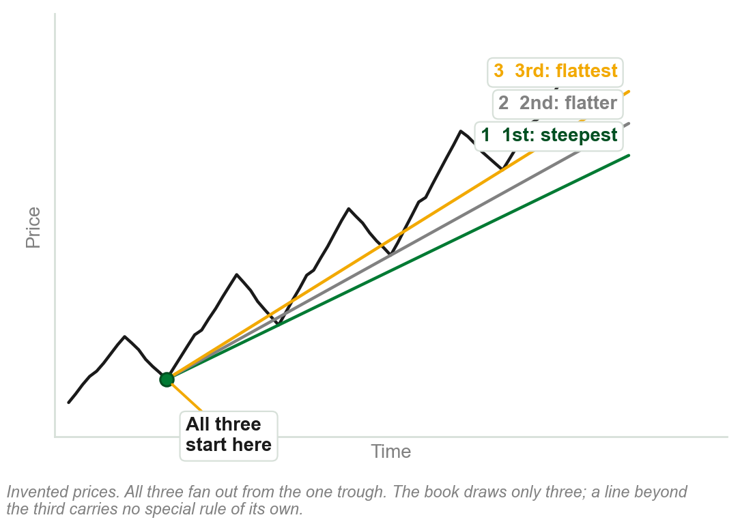
Standard fan lines, numbered
An uptrend, with three fan lines all starting from its first trough.
1st, steepest: to the next trough. 2nd, flatter: to the one after. 3rd, flattest: to the last.
Accelerating fan lines, from a peak instead, are the same shape mirrored down.
Each line is numbered in the order the book draws it.
The book says to draw only three of either; a line beyond the third carries no rule of its own.
Chart AQ - FIN1209 teaching chart, drawn for this course. Illustrative data, not a real instrument.
Part 6 of 11 - 5.6 Trendlines | 21 of 24
Ours: the book's Figure 5.50 (p.163) redrawn on invented prices, because its troughs and peaks are too small to read on it.

Slide 99
NEW TERM
Fibonacci fan lines
IN PLAIN WORDS
Fan lines through three Fibonacci levels.
FIGURE 5.51
A rise from a trough to a peak with a vertical line dropped from the peak to the base, divided at 38.2, 50.0 and 61.8 percent, and three lines projected from the trough through those three points.
The artwork is copyrighted and is not in the public repository. Build with assets/figures/ present to place it here.
FOR EXAMPLE
A rise from PHP 40 to PHP 60: the vertical line is PHP 20 tall. Measured down from the peak, the three marks are PHP 52.36, 50.00 and 47.64.
THE FORMAL DEFINITION
Bearish: identify a significant Fibonacci retracement range. Draw a vertical line from its peak to the trough's price level. Divide it at 38.2, 50 and 61.8 percent. Project three lines from the trough through those levels.
Figure 5.51 - Lim, The Handbook of Technical Analysis (Wiley, 2016)
Part 6 of 11 - 5.6 Trendlines | 22 of 24
Book p.164, Figure 5.51. It calls this one bearish and does not say why. The percentages are given, not derived: Fibonacci is Chapter 10, retracements 5.7. Pesos ours.

Slide 100
NEW TERM
Speed lines
IN PLAIN WORDS
Fibonacci fan lines, drawn with thirds.
FIGURE 5.52
A rise from a trough to a peak with a vertical line dropped from the peak to the base and divided into three thirds, and two lines projected from the trough through the division points: the 1/3 speed line and the 2/3 speed line.
The artwork is copyrighted and is not in the public repository. Build with assets/figures/ present to place it here.
FOR EXAMPLE
The same vertical line, divided into thirds: a 1/3 speed line and a 2/3 speed line.
THE FORMAL DEFINITION
Edson Gould's speed lines track the progress of a trend as it attempts to bottom or top. They are created in exactly the same way as Fibonacci fan lines, except that the retracement ratios are one-third and two-thirds.
Figure 5.52 - Lim, The Handbook of Technical Analysis (Wiley, 2016)
Part 6 of 11 - 5.6 Trendlines | 23 of 24
Book p.164, Figure 5.52 (p.165). No reason for thirds. What they are read for: as with all fan lines, support and resistance (p.163).

Slide 101
NEW TERM
Andrew's Pitchfork
IN PLAIN WORDS
Three parallel lines drawn from three points.
FIGURE 5.53
A daily Silver chart with a falling pitchfork: a significant peak, a retracement trough and a retracement peak, three parallel falling lines, and labels where prices react at the median line and tag the upper band.
The artwork is copyrighted and is not in the public repository. Build with assets/figures/ present to place it here.
FOR EXAMPLE
Daily Silver, in a downtrend: prices react at the median line and tag the upper band.
THE FORMAL DEFINITION
Bearish: find a significant peak, then an upside retracement that does not exceed it. The median line runs from the peak through the midpoint between the retracement trough and peak; parallels run from both. The lines give support and resistance. Bullish: the converse.
Figure 5.53 - Lim, The Handbook of Technical Analysis (Wiley, 2016)
Part 6 of 11 - 5.6 Trendlines | 24 of 24
Book p.165, Figure 5.53. No reason given. Its text calls both reactions support; at the upper band the figure shows price turning down, which is resistance.

Slide 102
5.7 Three ways to measure a retracement
Fibonacci retracements are based on ratios related to the Fibonacci Phi ratio: Chapter 10. Only the percentages matter here.
Dow paid particular attention to the one-third and two-thirds retracements. Gann employed one-third and one-eighth retracement ranges.
FIGURE 5.54
A table of retracement percentages in three columns. Fibonacci: 23.6, 38.2, 50 in brackets, 61.8 and 78.6. Dow: 33, 50 and 66. Gann: 12.5, 25.0, 37.5, 50.0, 62.5, 75.0 and 87.5.
The artwork is copyrighted and is not in the public repository. Build with assets/figures/ present to place it here.
Gann and Dow both regarded 50 percent as the most significant, with most major tops and bottoms forming around it.
Each is a percentage of the move retraced, as in Chapter 2. The table's Gann column is in eighths only, and it brackets Fibonacci's 50; the book explains neither.
Figure 5.54 - Lim, The Handbook of Technical Analysis (Wiley, 2016)
Part 7 of 11 - 5.7 Retracements | 1 of 2
Book p.166 and Figure 5.54. Nothing is derived here: the book leaves that to 'a subsequent chapter', unnamed. Its Chapter 10 is Fibonacci, its Chapter 19 Gann.

Slide 103
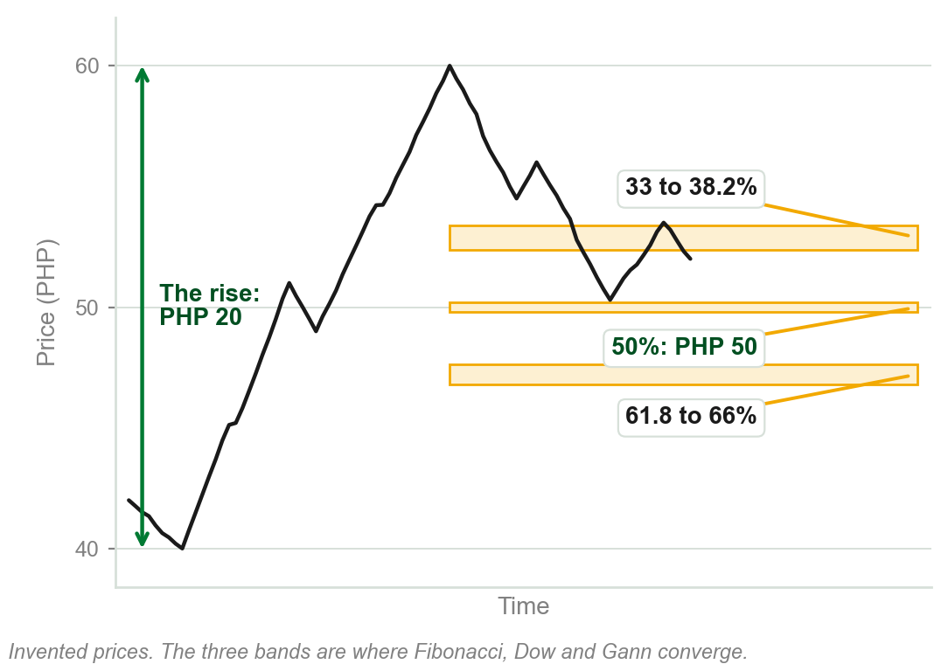
Where the three approaches agree
Set side by side, the retracement percentages converge strongly around specific ranges.
Between 33 and 38.2 percent.
At 50 percent.
Between 61.8 and 66 percent.
Probably the most important retracement percentage of all is the 50 percent level.
Chart AR - FIN1209 teaching chart, drawn for this course. Illustrative data, not a real instrument.
Part 7 of 11 - 5.7 Retracements | 2 of 2
Book p.166. The chart is ours: a rise from PHP 40 to PHP 60, chosen so that 50 percent falls on PHP 50.

Slide 104
NEW TERM
5.8 Common, breakaway, runaway and exhaustion gaps
IN PLAIN WORDS
Each is named for where it opens: in a range, or early, midway or late in a trend.
FIGURE 5.55
A weekly Wheat chart with each kind of gap boxed and named: common gaps inside the consolidation, then a breakaway gap, a runaway gap and an exhaustion gap up the trend, with arrows from the three trend gaps to later levels of support.
The artwork is copyrighted and is not in the public repository. Build with assets/figures/ present to place it here.
FOR EXAMPLE
Weekly Wheat shows all four.
THE FORMAL DEFINITION
Common: within a trading range, considered insignificant. Breakaway: as price breaks away from a consolidation or chart pattern. Runaway, measuring, midway or continuation: in a strong trend phase; there may be more than one. Exhaustion: at the end of a trend, before a consolidation or reversal.
Figure 5.55 - Lim, The Handbook of Technical Analysis (Wiley, 2016)
Part 8 of 11 - 5.8 Gaps | 1 of 4
Book p.166, Figure 5.55 (p.167), whose Support arrows mark the support each gap later gives. Chapter 3 named the four and left their meanings to this chapter.

Slide 105
Gaps forecasting trend exhaustion
Weekly Wheat: common gaps within the consolidation, then the trend-related gaps.
Prices top after the third gap: potential trend exhaustion.
The exhaustion is at a significant resistance level, created by a strong price rejection.
FIGURE 5.56
A weekly Wheat chart: a strong price rejection at an early high, a dashed line carrying that level across as prior resistance, an accumulation box holding a common gap, then a breakaway gap, a midway gap and an exhaustion gap rising into a distribution box at the resistance.
The artwork is copyrighted and is not in the public repository. Build with assets/figures/ present to place it here.
Gaps define the stages within a trend, indicating potential tops and bottoms.
Midway gap: the runaway gap by another name. The rejection is at a very bearish shooting star, a candlestick pattern: Chapter 14.
Figure 5.56 - Lim, The Handbook of Technical Analysis (Wiley, 2016)
Part 8 of 11 - 5.8 Gaps | 2 of 4
Book pp.166-167 and Figure 5.56.

Slide 106
Gaps become support and resistance
On the Wheat chart the gaps gave rise to later levels of support.
On this 15 minute chart of GLD, gaps give rise to areas of both support and resistance: the horizontal lines drawn from each gap.
FIGURE 5.57
A 15 minute chart of the SPDR Gold Trust Shares headed gaps as support and resistance: horizontal lines drawn from each gap, parallel dashed lines showing angular symmetry in GLD, and a cycle-tuned stochastic below with its extremes circled.
The artwork is copyrighted and is not in the public repository. Build with assets/figures/ present to place it here.
Gaps tend to create areas of potential support and resistance.
The gaps, and the figure's other two labels (angular symmetry in GLD, a cycle-tuned stochastic, both characteristics for a different chapter), cannot be read at this size, so nothing here is asked to be verified from them; the next slide draws the gap claim so it can be.
Figure 5.57 - Lim, The Handbook of Technical Analysis (Wiley, 2016)
Part 8 of 11 - 5.8 Gaps | 3 of 4
Book pp.167-168, Figure 5.57, kept for completeness; no reason given why a gap becomes a barrier.

Slide 107
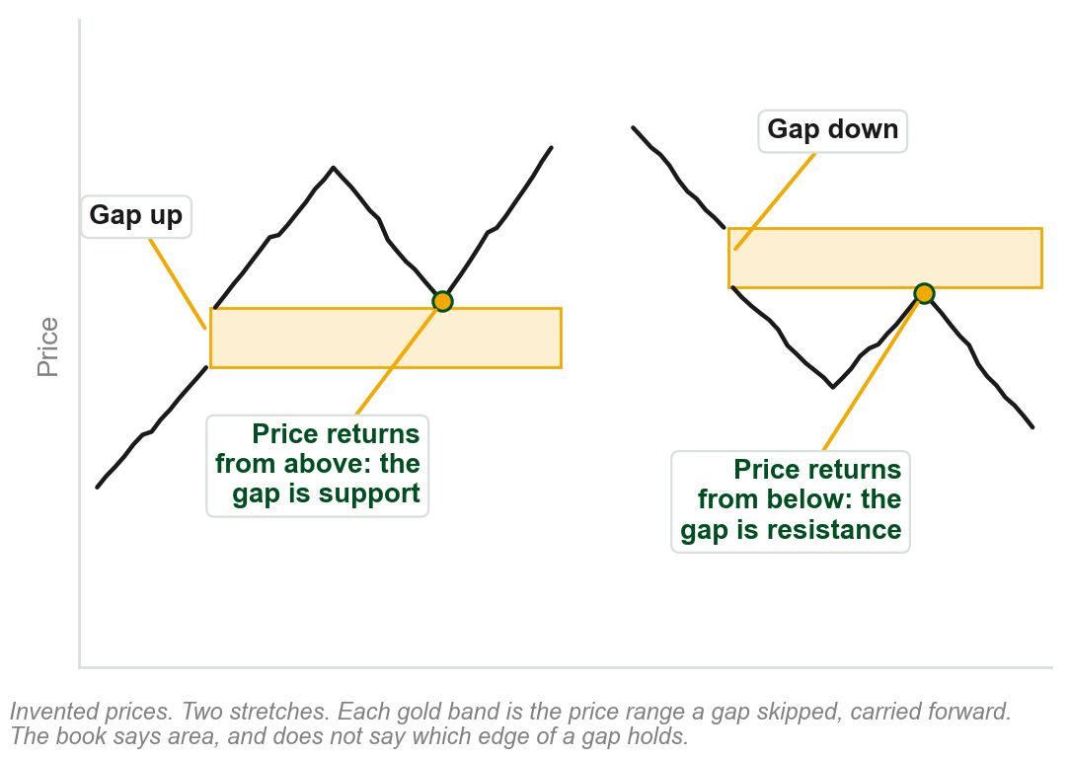
A gap as support, and a gap as resistance
Each gold band is the price range a gap skipped, carried forward in time.
Left: price gaps up and climbs. When it returns from above, the gap area holds it: support.
Right: price gaps down and falls. When it returns from below, the gap area stops it: resistance.
From above, a gap is support. From below, resistance.
The book says area, and does not say which edge of the gap holds.
Chart AS - FIN1209 teaching chart, drawn for this course. Illustrative data, not a real instrument.
Part 8 of 11 - 5.8 Gaps | 4 of 4
Ours: the book's sentence (p.167) on invented prices, because the gaps on its Figure 5.57 are too small to see. It gives no reason why a gap holds.

Slide 108
NEW TERM
5.9 Unidirectional and bidirectional entries
IN PLAIN WORDS
With the trend only, or whichever way price breaks.
FIGURE 5.58
A price rising and falling between two levels, with longs marked only on the way up and shorts only on the way down, labelled micro-unidirectional entries, over the words equivalent to a macro-bidirectional mechanism: a buy-sell straddle, buying above one line and selling below the other.
The artwork is copyrighted and is not in the public repository. Build with assets/figures/ present to place it here.
FOR EXAMPLE
A trader takes only breakouts with the trend: long in an uptrend, short in a downtrend. Trends turn, so over time that is trading both ways, if no called-for trade is skipped.
THE FORMAL DEFINITION
A unidirectional entry is a trade taken only in the direction of the existing trend, up or down. A bidirectional entry is a trade taken in either direction, depending on which way the breakout occurs.
Figure 5.58 - Lim, The Handbook of Technical Analysis (Wiley, 2016)
Part 9 of 11 - 5.9 Directionality | 1 of 1
Book pp.168-169, Fig. 5.58. Top: each swing traded with its short-term (micro) trend. Bottom: the same seen longer-term (macro): buy above, sell below, its straddle.

Slide 109
NEW TERM
5.10 Drummond geometry
IN PLAIN WORDS
A way to stay on the right side of the market.
FIGURE 5.59
A weekly EURUSD chart with a short moving average hugging price, labelled PLdot approximated by a 3-period SMA of typical price: price above the SMA is bullish, price below it is bearish, and buy when the SMA turns up and sell when it turns down.
The artwork is copyrighted and is not in the public repository. Build with assets/figures/ present to place it here.
FOR EXAMPLE
Price above the PLdot line: bullish. Below: bearish. Some buy when it turns up, sell when it turns down.
THE FORMAL DEFINITION
Charles Drummond's: a short-term moving average, the PLdot line, and inter-bar trendlines, which connect each bar's highs and connect each bar's lows, that forecast support and resistance. The PLdot is a simple three-period moving average of typical price, and may be forward shifted by one period.
Figure 5.59 - Lim, The Handbook of Technical Analysis (Wiley, 2016)
Part 10 of 11 - 5.10 Drummond | 1 of 2
Book p.169, Fig. 5.59, where the line hugs the bars too closely to see: next slide. Not explained: typical price, why three periods.

Slide 110
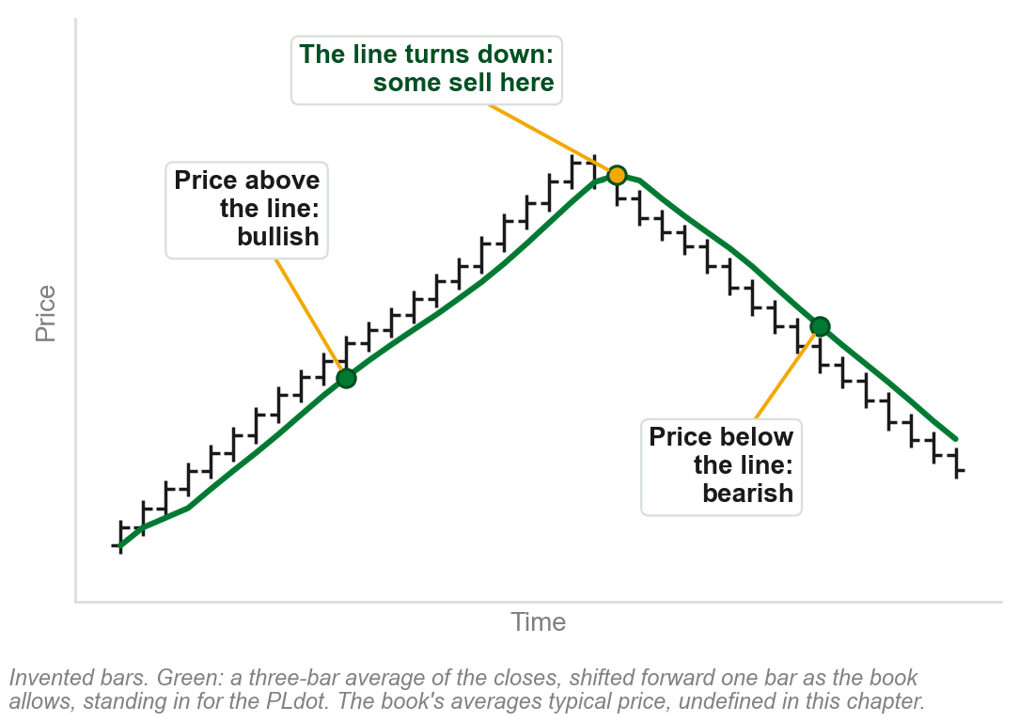
Reading a PLdot line
The green line is a three-bar moving average: at each bar, the average of the last three.
Price above the line: the market is regarded as bullish. Below it: bearish.
Some buy when the line turns up, and sell when it turns down.
It helps keep the trader on the right side of the market.
Ours averages closes, shifted forward one bar. The book's PLdot averages typical price, which this chapter does not define. Moving averages: Chapter 11.
Chart AT - FIN1209 teaching chart, drawn for this course. Illustrative data, not a real instrument.
Part 10 of 11 - 5.10 Drummond | 2 of 2
Ours: the book's three readings of the PLdot (p.169) on invented bars, because the line cannot be seen on its Figure 5.59.

Slide 111
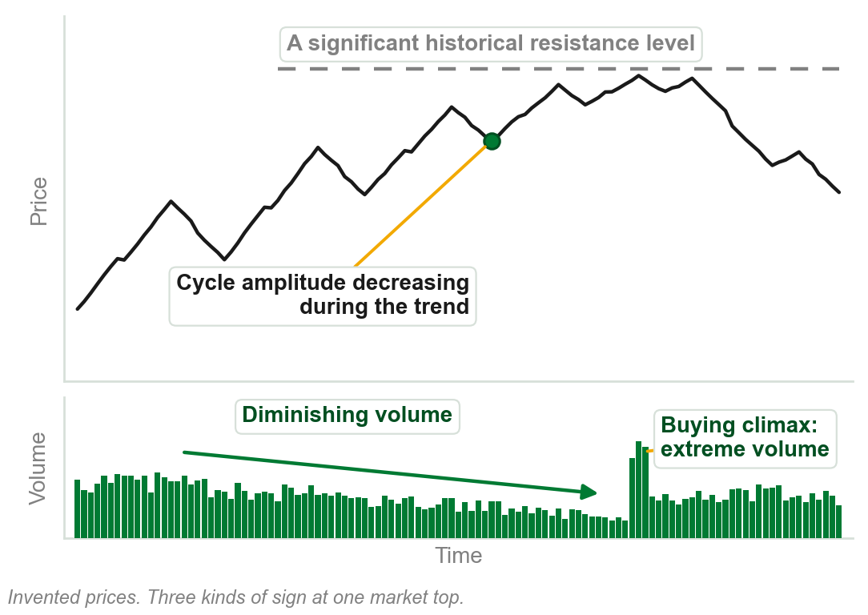
5.11 Signs that a trend may reverse
Volume: diminishing volume in a trend, or extreme volume in a buying or selling climax.
Chart patterns: bearish after a strong, prolonged uptrend, bullish after a downtrend.
Cycles: peaks at tops, troughs at bottoms, or decreasing cycle amplitude or period in a trend.
Tops at significant historical resistance levels, bottoms at significant historical support levels.
Also a chart pattern sign: the appearance of a large broadening, diamond or island formation.
Chart AU - FIN1209 teaching chart, drawn for this course. Illustrative data, not a real instrument.
Part 11 of 11 - 5.11 Reversals | 1 of 2
Book p.170. The chart is ours, on invented prices.

Slide 112
Reversal signs from tools taught later
Oscillators, Chapter 8: give overbought and oversold readings at tops and bottoms, by a method this chapter does not give.
Divergence, Chapter 9: bearish divergence with price at tops, bullish at bottoms.
Candlesticks, Chapter 14: bearish formations at tops, bullish at bottoms.
Intermarket, no chapter named: a reversal confirmed by what related or broader markets are doing at the same time, by a method this chapter does not give.
A summary, the book says: it explains none of these tools here. Know the names; the first three come with their own chapters. Signal line, equilibrium line and intermarket relationship: used here by name only, defined in none of this course's chapters, and added to the next slide's used-not-taught list for that reason.
Part 11 of 11 - 5.11 Reversals | 2 of 2
Book p.170. It does not say here what a signal line, an equilibrium line or an intermarket relationship is; this slide names each tool without claiming how it works.

Slide 113
Chapter 5 in five sentences
Dow defines a trend by its peaks and troughs, and every definition has limits.
Sixteen price characteristics show a trend's quality: watch each for a change.
Filters, orders, stops and tradesize settle how a trend is entered and exited.
Trendlines, channels and fan lines are barriers: support, resistance, targets.
Retracement levels, gaps and the signs in 5.11 help locate a reversal.
The book's own summary: pay particular attention to the 16 characteristics.
Chapter 5 - Wrap up
Book p.171: its summary is three sentences. These five are ours, of the whole chapter.

Slide 114
The review questions to prepare
What is a trend? Explain the disadvantages of defining market and price action.
What are the early indications of a potential reversal?
Briefly describe the ways in which price action may be understood.
How can channel analysis help pinpoint potential reversals and continuations?
What are the factors that impact trendline reliability?
The advantages of proportional sizing? Of price-based over time and algorithmic filters?
The book's eight questions, on six lines. Its question 4, line three here, says 12 ways; 5.2 lists 16.
Chapter 5 - Wrap up
Book p.171.

Slide 115
What the book uses, and where it says two things
Never defined here: breakout, wave cycle, wave degree, stopsize.
Used, not taught: typical price, overbought, oversold, signal line, equilibrium line, intermarket relationship, MACD.
Sent ahead, by chapter: oscillators 8, divergence 9, Fibonacci 10, moving averages 11, candlesticks 14, Elliott 18, Gann 19.
Two answers: 16 characteristics, taught, or 12; 5 ways to enter, listed, or 4; Gold's rate, $3.30 or $3.80.
Where the book disagrees with itself, the slide says so.
Chapter 5 - Wrap up
This course's own list of the main ones, drawn from the chapter's slides. The numbers after Sent ahead are the book's chapters.

