Slide 1
FIN1209 Technical Analysis in Investment
Chapter 2
Introduction to Dow Theory
Institute of Accounts, Business and Finance | Far Eastern University Manila
Benjamin C. Sotelo

Slide 2
What you will be able to do
Understand the basic concepts and assumptions of Dow Theory.
Apply the concepts of Dow Theory to forecast potential entry and exit points in the market.
Identify the strengths and weaknesses of applying Dow Theory.
Explain the importance of price and volume confirmation as a basis for determining potential market action.
Chapter 2 - Learning objectives

Slide 3
What you will be able to do, continued
Highlight the current challenges to Dow Theory.
Chapter 2 - Learning objectives

Slide 4
How today is laid out
Part 1 Where Dow Theory came from
Part 2 The six tenets, and the first one
Part 3 Three trends, and the primary one
Part 4 The secondary reaction and the minor trend
Part 5 Three phases, and when a trend reverses
Part 6 Confirmation, volume, and the challenges
Six parts, and a clean stop at every boundary.
Chapter 2 - Roadmap

Slide 5
Part 1 of 6
Where Dow Theory Came From
The four men whose writing became Dow Theory, and which one wrote it down.
The three assumptions Robert Rhea built it on.
Why Dow wanted an average of many stocks instead of one.
About 20 minutes

Slide 6
What this chapter is for
Dow Theory lays the basic foundation for modern day technical analysis.
Its premises underpin the very study of market action.
The book says they have withstood the test of time.
Almost everything in the rest of this course sits on top of today.
Part 1 of 6 - Origins | 1 of 13

Slide 7
NEW TERM
Dow Theory
IN PLAIN WORDS
A set of basic statements about how markets move, taken from what Charles H. Dow wrote and organized by the people who came after him.
FOR EXAMPLE
It is not a formula and there is nothing to compute. It is six statements, and we take them one at a time.
THE FORMAL DEFINITION
Dow Theory is the body of basic premises credited to Charles H. Dow and codified by later writers, which lays the basic foundation for modern day technical analysis.
Part 1 of 6 - Origins | 2 of 13

Slide 8
Charles H. Dow
Dow is credited for much of the early work that led to Dow Theory.
His writing was not a book. It was editorials in the Wall Street Journal.
They were published around the beginning of the twentieth century.
Dow wrote the ideas. Other people assembled them into a theory.
Part 1 of 6 - Origins | 3 of 13

Slide 9
The three who came after him
William P. Hamilton, Dow's successor. Book: The Stock Market Barometer.
S. A. Nelson, a close acquaintance of Dow's. Book: The ABC of Stock Speculation.
Robert Rhea, a student of Hamilton. Book: The Dow Theory.
Nelson was the first person to call the ideas the Dow Theory.
Part 1 of 6 - Origins | 4 of 13

Slide 10
What each of them actually did
Hamilton carried on developing and organizing Dow's original early writings.
Nelson published a book about Dow's work, and named the theory.
Rhea did the categorizing, the refining and the formal codification.
It was Rhea's work that really developed the theory and laid its foundation.
Part 1 of 6 - Origins | 5 of 13

Slide 11
Rhea built the theory on three assumptions
1. The primary trend is not susceptible to manipulation.
2. The averages discount everything. Price reflects all information.
3. Dow Theory is not perfect. It will not guarantee profitability.
At most, Rhea said, treat it as a set of guidelines for investing.
Part 1 of 6 - Origins | 6 of 13

Slide 12
NEW TERM
The primary trend is not susceptible to manipulation
IN PLAIN WORDS
Rhea's first assumption. The long movement of a market is too big for anyone to push around, though a shorter stretch of it might be.
FOR EXAMPLE
One large buyer can move a small listed company for a week. Rhea's claim is that nobody can hold a whole market up for two years.
THE FORMAL DEFINITION
Rhea's first assumption is that the primary trend is not susceptible to manipulation, although there is a possibility that manipulation could occur over the shorter term.
Part 1 of 6 - Origins | 7 of 13

Slide 13
NEW TERM
Dow Theory is not perfect
IN PLAIN WORDS
Rhea's third assumption. Investing by these principles will not guarantee that you make money.
FOR EXAMPLE
The theory can tell you the primary trend is up. It cannot tell you this particular trade will profit.
THE FORMAL DEFINITION
Rhea's third assumption is that Dow Theory itself is not perfect and that investing according to its principles will not guarantee profitability. At most it should be regarded as a set of guidelines for investing.
Part 1 of 6 - Origins | 8 of 13

Slide 14
1884: eleven stocks
In 1884 Dow published a stock market average of 11 stocks.
He later developed it into a 12 stock Industrial Index and a 20 stock Railroad Average.
He wanted a number for the market, not a number for one company.
Part 1 of 6 - Origins | 9 of 13

Slide 15
NEW TERM
A stock market average
IN PLAIN WORDS
One number that stands for a group of companies, so you can talk about what the market did rather than what one share did.
FOR EXAMPLE
The PSEi is the same idea: one number that moves with thirty listed companies at once.
THE FORMAL DEFINITION
A stock market average is an index of stocks created to better reflect the general action of the markets, instead of gauging market behavior through individual stock action.
Part 1 of 6 - Origins | 10 of 13

Slide 16
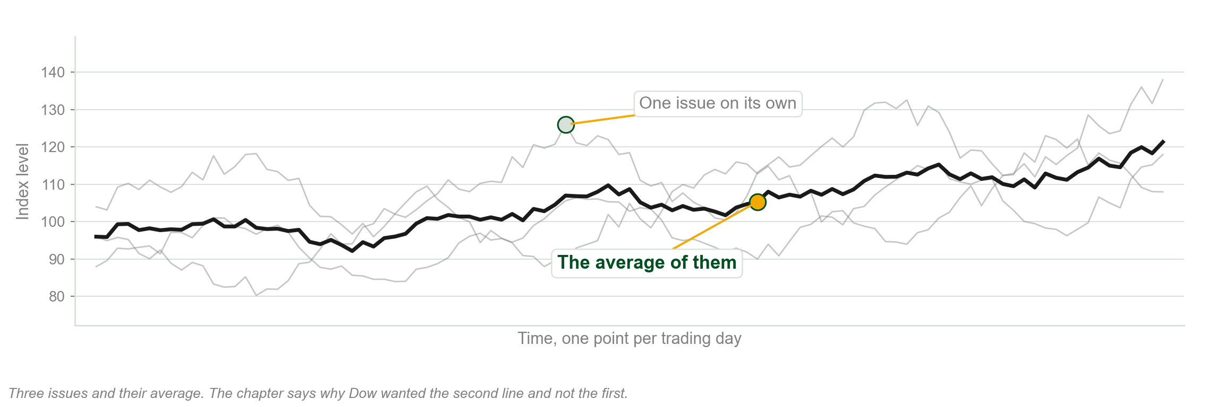
One share, and the average of several
Chart A - FIN1209 teaching chart, drawn for this course. Illustrative data, not a real instrument.
Part 1 of 6 - Origins | 11 of 13

Slide 17
Why Dow wanted the average
Individual stock action at the time was fairly erratic and open to manipulation.
The index was meant to average out or smooth those erratic price movements.
The action of the averages was meant to act as a barometer of the market environment.
Barometer is the word to hold on to. It reads the weather. It does not make it.
Part 1 of 6 - Origins | 12 of 13

Slide 18
What those two averages are called now
The 12 stock Industrial Index has gradually evolved into 30 stocks.
It is known today as the Dow Jones Industrial Average.
The Railroad Average is known today as the Dow Jones Transportation Average.
Two averages. In Part 6 they will have to agree with each other.
Part 1 of 6 - Origins | 13 of 13

Slide 19
You now know
▪ Dow Theory, and that Dow never published it
▪ Dow, Hamilton, Nelson and Rhea, and their three books
▪ Rhea's three assumptions
▪ A stock market average, and why Dow wanted one
▪ The Industrial Average and the Transportation Average
Part 1 of 6 - Origins | recap

Slide 20
Part 2 of 6
The Six Tenets, and the First One
The six basic tenets of Dow Theory, which is the list the paper asks for.
What it means to say the averages discount everything.
The one price Dow Theory keeps, and everything it throws away.
About 20 minutes

Slide 21
The six basic tenets of Dow Theory
1. The averages discount everything.
2. The market has three trends.
3. Primary trends have three phases.
4. A trend persists until its reversal is indicated.
5. The averages must confirm one another.
6. Volume must confirm the trend.
Learn this list. Parts 2 to 6 take them one at a time, in order. There is no gold line on this slide because all six of them matter.
Part 2 of 6 - Discounting | 1 of 12

Slide 22
And one more rule that is not on the list
In addition to the six basic tenets, only closing prices are recognized in Dow Theory.
Six tenets, plus that. The book states it separately, so we will too.
Part 2 of 6 - Discounting | 2 of 12

Slide 23
NEW TERM
The averages discount everything
IN PLAIN WORDS
The market has already priced in everything anybody knows. What you see is the sum of what every participant did about what they knew.
FOR EXAMPLE
By the time good results are on the evening news, the people acting on them have already bought. The price moved before the bulletin.
THE FORMAL DEFINITION
The first tenet: the market is the end result of all participatory action, which represents all information that may be known to the markets.
Part 2 of 6 - Discounting | 3 of 12

Slide 24
How information gets into the price
The mechanism is participation: somebody puts capital in, or takes it out.
Information nobody acts on has not reached the market at all.
The price is not what people think. It is what they did about what they think.
Part 2 of 6 - Discounting | 4 of 12

Slide 25
Four things discounting does not require
It need not be instantaneous.
It need not be driven by rational participants.
Participants need not act on all information all of the time.
They need not react in the same manner as each other.
This is a much weaker claim than it first sounds, and that is deliberate.
Part 2 of 6 - Discounting | 5 of 12

Slide 26
NEW TERM
Acts of God
IN PLAIN WORDS
The one thing the market cannot discount: an event nobody knew was coming.
FOR EXAMPLE
An earthquake at nine in the morning is not in yesterday's closing price. Nothing could have put it there.
THE FORMAL DEFINITION
The market discounts everything except acts of God, that is, unexpected events or unknown information. It can still absorb, react and adjust to such shocks fairly rapidly.
Part 2 of 6 - Discounting | 6 of 12

Slide 27
Prices before September 11, 2001
FIGURE 2.1
A daily chart of the Nasdaq 100 index through 2001, with prices already declining ahead of the September 11 event, and the question printed on the chart: is the market discounting unknown information?
The artwork is copyrighted and is not in the public repository. Build with assets/figures/ present to place it here.
Figure 2.1 - Lim, The Handbook of Technical Analysis (Wiley, 2016)
Part 2 of 6 - Discounting | 7 of 12

Slide 28
Gold, after the same event
FIGURE 2.2
A daily chart of spot gold around September 2001, with the price adjusting very rapidly once the information is known, annotated as the market discounting all information once it has become known.
The artwork is copyrighted and is not in the public repository. Build with assets/figures/ present to place it here.
Figure 2.2 - Lim, The Handbook of Technical Analysis (Wiley, 2016)
Part 2 of 6 - Discounting | 8 of 12

Slide 29
What the analyst does with that
Price is the ultimate reflection and embodiment of everything that is knowable.
So the technical analyst need not be concerned with the causes of market action.
Only with the effects of the underlying causes.
Effects, not causes. You met that in Chapter 1. Here it is again as a tenet.
Part 2 of 6 - Discounting | 9 of 12

Slide 30
NEW TERM
Only closing prices are recognized
IN PLAIN WORDS
Whatever the price did during the day, Dow Theory uses only the number it finished at.
FOR EXAMPLE
A share swings between 96 and 104 pesos and closes at 100. Dow Theory records 100. The eight peso swing is not recorded at all.
THE FORMAL DEFINITION
In Dow Theory only closing prices are recognized: regardless of how large the high and low price excursions may be on any one day, only the final closing price is used.
Part 2 of 6 - Discounting | 10 of 12

Slide 31
And the size of the move does not matter
It does not matter how miniscule the amount is.
A close one centavo above yesterday's close is a higher close.
A close one centavo below yesterday's close is a lower close.
The test is the close, and any amount above or below it counts.
Part 2 of 6 - Discounting | 11 of 12

Slide 32
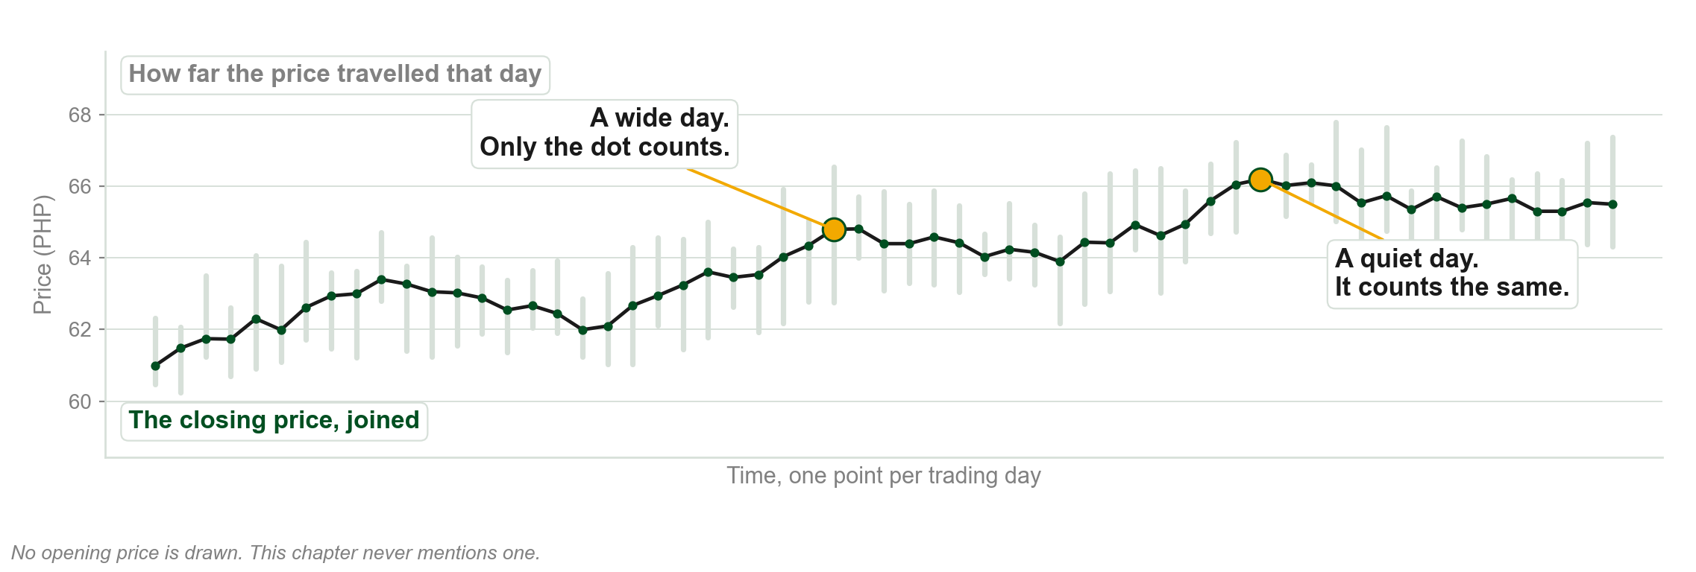
The day's whole excursion, and the one number kept
Chart B - FIN1209 teaching chart, drawn for this course. Illustrative data, not a real instrument.
Part 2 of 6 - Discounting | 12 of 12

Slide 33
You now know
▪ The six tenets, in order
▪ The averages discount everything
▪ How information reaches a price, and the four things discounting does not require
▪ Acts of God, the one exception
▪ Only closing prices are recognized
Part 2 of 6 - Discounting | recap

Slide 34
Part 3 of 6
Three Trends, and the Primary One
The three movements the book says are running at the same time.
What an uptrend actually is, and what ends one.
Why the signal always arrives late, and why Dow was content with that.
About 35 minutes

Slide 35
NEW TERM
The market has three trends
IN PLAIN WORDS
At any moment the market is doing three things at once: a long movement, a shorter movement against it, and daily noise.
FOR EXAMPLE
The ocean does all three at the same time as well. That is the picture Rhea used, and we will use it too.
THE FORMAL DEFINITION
The second tenet of Dow Theory is that the market comprises three trends: the primary trend, the secondary reaction and the minor trend.
Part 3 of 6 - Primary trend | 1 of 28

Slide 36
A definition worth writing down
"There are three movements of the averages, all of which may be in progress at one and the same time."
Robert Rhea, The Dow Theory, quoted in Lim, The Handbook of Technical Analysis
What it tells us
All three at once. Not one after the other.
Part 3 of 6 - Primary trend | 2 of 28

Slide 37
The three, named
1. Primary trend, the major trend. Months to years. Long term.
2. Secondary reaction, the intermediate trend. Weeks to months. Medium term.
3. Minor trend. Days to weeks. Short term.
Rhea called the primary the most important and the secondary the most deceptive.
Part 3 of 6 - Primary trend | 3 of 28

Slide 38
Tides, waves and ripples
The primary trend is sometimes called the tides of the ocean.
The secondary reaction is the waves on the tides.
The minor trend is the ripples on the waves.
A ripple never tells you whether the tide is coming in or going out.
Part 3 of 6 - Primary trend | 4 of 28

Slide 39
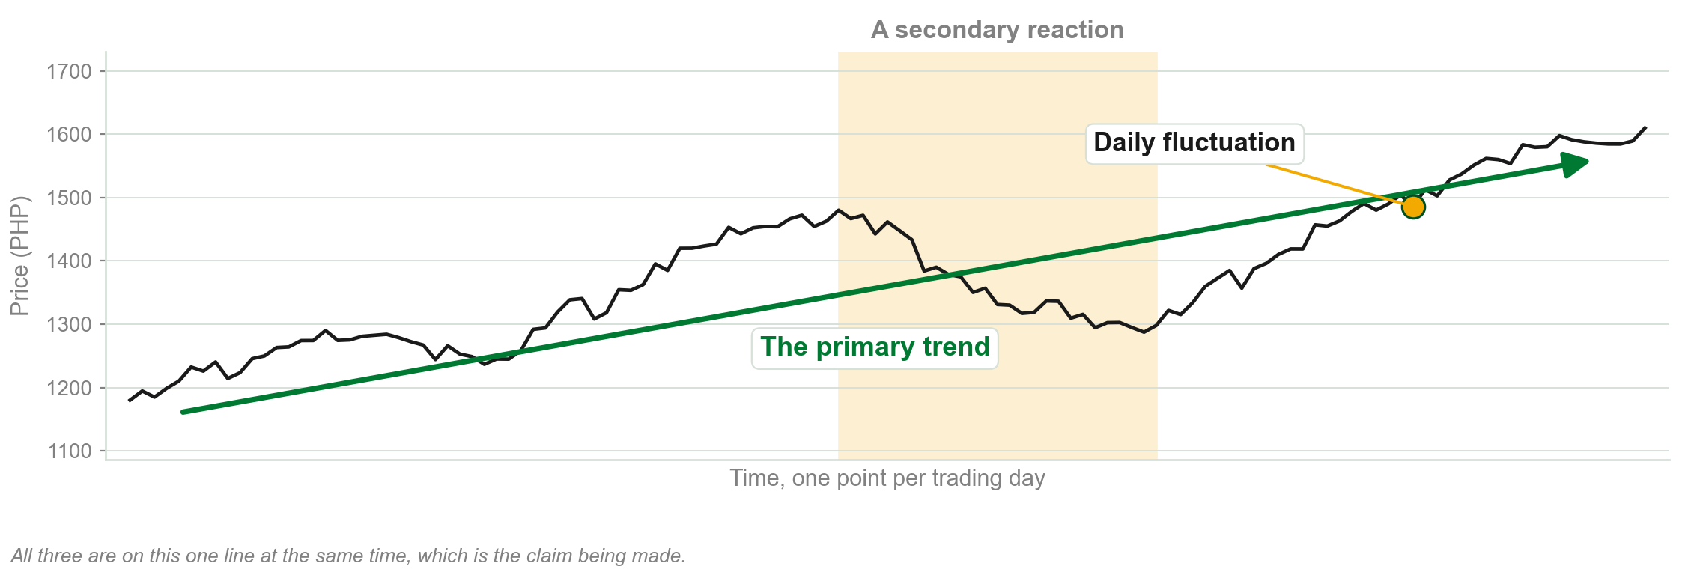
All three, on one line
Chart C - FIN1209 teaching chart, drawn for this course. Illustrative data, not a real instrument.
Part 3 of 6 - Primary trend | 5 of 28

Slide 40
All three trends on one index
FIGURE 2.3
A daily chart of the NYSE Composite Index with the primary trend, a secondary reaction and the minor trends all labelled on the same price action, and the primary trend resuming on a breakout of the secondary peak.
The artwork is copyrighted and is not in the public repository. Build with assets/figures/ present to place it here.
Figure 2.3 - Lim, The Handbook of Technical Analysis (Wiley, 2016)
Part 3 of 6 - Primary trend | 6 of 28

Slide 41
NEW TERM
Primary trend
IN PLAIN WORDS
The long movement, and the biggest one on the chart. Normally months to years.
FOR EXAMPLE
A share that goes from 40 pesos to 140 pesos over three years is in a primary bull trend, whatever it did in any given week.
THE FORMAL DEFINITION
The primary or major trend is the largest trend, normally expected to last from months to years, and the one Rhea held to be a more reliable barometer for investment decisions.
Part 3 of 6 - Primary trend | 7 of 28

Slide 42
Two kinds of primary trend
Primary bull trend, which is a bull market.
Primary bear trend, which is a bear market.
Rhea also said it is very difficult to forecast the extent or the duration of either.
Part 3 of 6 - Primary trend | 8 of 28

Slide 43
NEW TERM
Uptrend
IN PLAIN WORDS
Price makes a high, falls back to a low above the last low, then makes a high above the last high. Then it does it again.
FOR EXAMPLE
Peaks at 104, 116 and 128 pesos, with troughs at 98, 108 and 119 between them. Every peak beats the last peak and every trough beats the last trough.
THE FORMAL DEFINITION
In Dow Theory, an uptrend is defined primarily as successively higher peaks and troughs.
Part 3 of 6 - Primary trend | 9 of 28

Slide 44
NEW TERM
Downtrend
IN PLAIN WORDS
The same thing upside down. Each peak lower than the last, and each trough lower than the last.
FOR EXAMPLE
Peaks at 128, 116 and 104 pesos, with troughs at 119, 108 and 98 between them.
THE FORMAL DEFINITION
In Dow Theory, a downtrend is defined as successively lower peaks and troughs.
Part 3 of 6 - Primary trend | 10 of 28

Slide 45
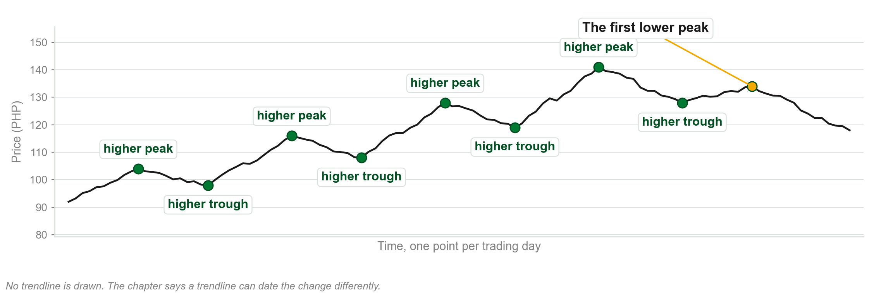
An uptrend, drawn as its own definition
Chart D - FIN1209 teaching chart, drawn for this course. Illustrative data, not a real instrument.
Part 3 of 6 - Primary trend | 11 of 28

Slide 46
An uptrend, and its first lower high
FIGURE 2.4
A rising price with successive higher highs and higher lows labelled HH and HL, the appearance of the first lower high circled, and the note that the uptrend has technically ended.
The artwork is copyrighted and is not in the public repository. Build with assets/figures/ present to place it here.
Figure 2.4 - Lim, The Handbook of Technical Analysis (Wiley, 2016)
Part 3 of 6 - Primary trend | 12 of 28

Slide 47
What the first lower peak means
The appearance of a lower high in an uptrend may be an early indication that the uptrend is coming to an end.
Nothing else had to change. The sequence changed.
A trend is a sequence of points, so a trend ends when the sequence breaks.
Part 3 of 6 - Primary trend | 13 of 28

Slide 48
NEW TERM
Penetration
IN PLAIN WORDS
Price going through a previous peak or a previous trough. That is the event Dow Theory watches for.
FOR EXAMPLE
The last peak was 141 pesos. Price closes at 143. The peak has been penetrated.
THE FORMAL DEFINITION
In Dow Theory, an indication of a trend continuation or reversal is signaled by the penetration of a previous peak or trough.
Part 3 of 6 - Primary trend | 14 of 28

Slide 49
The price of waiting for it
One of the main criticisms of Dow Theory is that its buy and sell signals arrive too late.
They usually miss out on one third or more of the entire trend.
You buy after the bottom, and you sell after the top. Always.
Part 3 of 6 - Primary trend | 15 of 28

Slide 50
Dow thought the trade was worth it
It is more important to participate once the trend has been confirmed.
Losing some potential profit for the added safety of a confirmed trend is well worth the sacrifice.
That is Dow's own position. The book reports it as his, not as a fact.
Part 3 of 6 - Primary trend | 16 of 28

Slide 51
Where the buy and the sell signals fall
FIGURE 2.5
An idealized primary trend with the buy signal marked well above the low and the sell signal well below the high, and the profit potential based on Dow's signals shaded against the maximum profit potential.
The artwork is copyrighted and is not in the public repository. Build with assets/figures/ present to place it here.
Figure 2.5 - Lim, The Handbook of Technical Analysis (Wiley, 2016)
Part 3 of 6 - Primary trend | 17 of 28

Slide 52
What Dow Theory says you may trade
All investment and trading decisions are based strictly on the primary trend alone.
The one exception is trading lines, which form out of the daily price fluctuations.
Two tradable things in the whole theory. We meet the second one in Part 4.
Part 3 of 6 - Primary trend | 18 of 28

Slide 53
A primary bull trend that ran twelve years
FIGURE 2.6
A long term chart of gold labelled as a primary bull trend lasting approximately twelve years.
The artwork is copyrighted and is not in the public repository. Build with assets/figures/ present to place it here.
Figure 2.6 - Lim, The Handbook of Technical Analysis (Wiley, 2016)
Part 3 of 6 - Primary trend | 19 of 28

Slide 54
A primary bear trend that ran twenty three years
FIGURE 2.7
A long term chart of the 30 year Treasury bond yield labelled as a primary bear trend lasting approximately twenty three years.
The artwork is copyrighted and is not in the public repository. Build with assets/figures/ present to place it here.
Figure 2.7 - Lim, The Handbook of Technical Analysis (Wiley, 2016)
Part 3 of 6 - Primary trend | 20 of 28

Slide 55
Two ways to define a trend, and they can disagree
One way is the sequence of rising or falling peaks and troughs, which is the definition we just learned.
The other way is a trendline violation.
The book says the two may date a change of trend differently.
Part 3 of 6 - Primary trend | 21 of 28

Slide 56
NEW TERM
Arithmetic scaling
IN PLAIN WORDS
A price axis where equal distances up the page mean equal amounts of money.
FOR EXAMPLE
The gap from 100 to 110 pesos is exactly the same height as the gap from 200 to 210 pesos.
THE FORMAL DEFINITION
An arithmetically scaled chart plots price in equal price increments. Arithmetically scaled charts tend to give slower trend change signals, as uptrend lines are violated much later.
Part 3 of 6 - Primary trend | 22 of 28

Slide 57
NEW TERM
Logarithmic scaling
IN PLAIN WORDS
A price axis where equal distances up the page mean equal percentage moves.
FOR EXAMPLE
The gap from 100 to 110 pesos is the same height as the gap from 200 to 220 pesos, because both are ten percent.
THE FORMAL DEFINITION
A logarithmically scaled chart plots price in equal proportional increments. Logarithmically scaled charts tend to give earlier trend change signals, since uptrend lines are violated sooner.
Part 3 of 6 - Primary trend | 23 of 28

Slide 58
Log scaling, the earlier signal
FIGURE 2.8
A logarithmically scaled chart of the Nasdaq 100 index through a bull market turning into a bear market, annotated with an earlier trend change signal.
The artwork is copyrighted and is not in the public repository. Build with assets/figures/ present to place it here.
Figure 2.8 - Lim, The Handbook of Technical Analysis (Wiley, 2016)
Part 3 of 6 - Primary trend | 24 of 28

Slide 59
Arithmetic scaling, the later signal
FIGURE 2.9
The same Nasdaq 100 index over the same period on an arithmetic scale, annotated with a slower trend change signal.
The artwork is copyrighted and is not in the public repository. Build with assets/figures/ present to place it here.
Figure 2.9 - Lim, The Handbook of Technical Analysis (Wiley, 2016)
Part 3 of 6 - Primary trend | 25 of 28

Slide 60
One stock, flattening out
FIGURE 2.10
A logarithmically scaled chart of Apple Inc. where the advance appears to be flattening out, which the book reads as more bearish behaviour.
The artwork is copyrighted and is not in the public repository. Build with assets/figures/ present to place it here.
Figure 2.10 - Lim, The Handbook of Technical Analysis (Wiley, 2016)
Part 3 of 6 - Primary trend | 26 of 28

Slide 61
The same stock, not flattening
FIGURE 2.11
The same period of Apple Inc. on an arithmetic scale, where the same price action appears as a stronger and steadier uptrend.
The artwork is copyrighted and is not in the public repository. Build with assets/figures/ present to place it here.
Figure 2.11 - Lim, The Handbook of Technical Analysis (Wiley, 2016)
Part 3 of 6 - Primary trend | 27 of 28

Slide 62
Two analysts, two habits, two readings
Sometimes it is hard to decide which scaling to use.
An analyst who always uses log charts may read the same price differently from one who always uses arithmetic charts.
Same prices, same period, different conclusion. Chapter 1 called that subjectivity.
Part 3 of 6 - Primary trend | 28 of 28

Slide 63
You now know
▪ The three trends, and that they run together
▪ The primary trend, and its two kinds
▪ Uptrend and downtrend, as sequences of peaks and troughs
▪ Penetration, and why the signal is always late
▪ Arithmetic and logarithmic scaling, and the two readings they produce
Part 3 of 6 - Primary trend | recap

Slide 64
Part 4 of 6
The Secondary Reaction and the Minor Trend
How far back a reaction against the primary trend usually comes.
The moment a reaction stops being a reaction.
The one small formation Dow Theory says you are allowed to trade.
About 25 minutes

Slide 65
NEW TERM
Secondary reaction
IN PLAIN WORDS
A move against the primary trend that is big enough to notice but not big enough to be a new primary trend.
FOR EXAMPLE
A market that has run from 4,000 to 5,200 and falls back to 4,400 is in a secondary reaction, not a bear market.
THE FORMAL DEFINITION
The secondary trend, also called the secondary reaction, moves in the opposite direction of the existing primary trend. It usually lasts from weeks to approximately three months, and frequently slightly longer.
Part 4 of 6 - Secondary and minor | 1 of 12

Slide 66
How far back a reaction usually comes
The secondary reaction usually retraces from one third to two thirds of the primary trend's range.
Any retracement beyond two thirds on high volume usually signifies it may in fact be a new primary bear market.
One third to two thirds is normal. Past two thirds, start worrying.
Part 4 of 6 - Secondary and minor | 2 of 12

Slide 67
And the level in the middle
Dow Theory stresses the importance and psychological significance of the 50 percent retracement level.
It is a view shared by another prominent technician, W. D. Gann.
Half back is the level people watch, and the book says so plainly.
Part 4 of 6 - Secondary and minor | 3 of 12

Slide 68
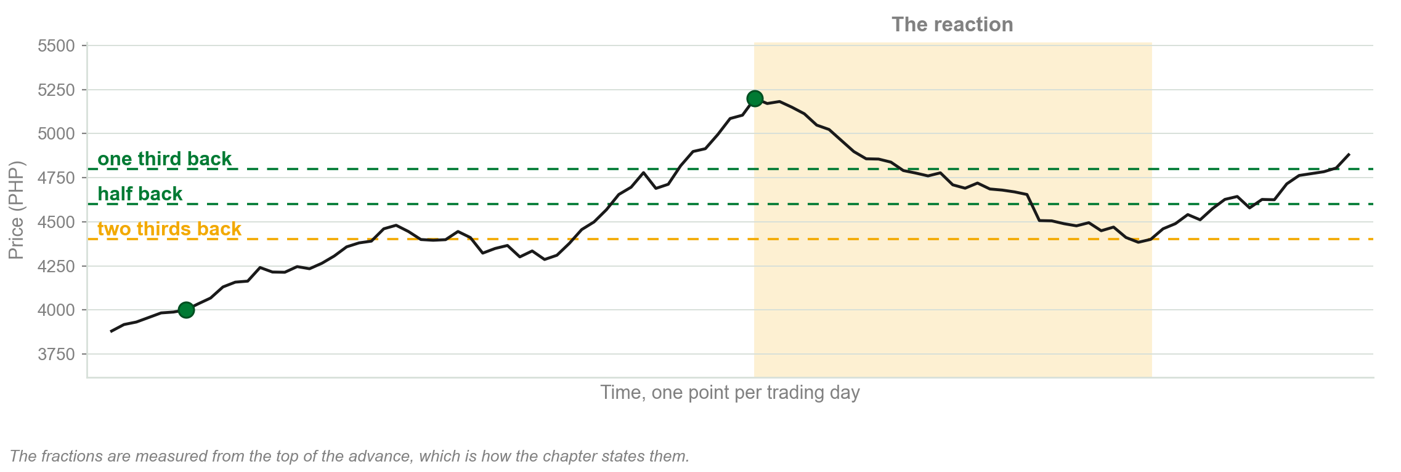
How far back a reaction comes
Chart E - FIN1209 teaching chart, drawn for this course. Illustrative data, not a real instrument.
Part 4 of 6 - Secondary and minor | 4 of 12

Slide 69
When the primary trend resumes
A primary bull trend resumes its uptrend once price breaches the highest peak formed by the secondary reaction.
A primary bear trend resumes its downtrend once price breaches the lowest trough formed by the secondary reaction.
The reaction is over when the peak it made is taken out.
Part 4 of 6 - Secondary and minor | 5 of 12

Slide 70
A reaction of 75 percent, and the resumption
FIGURE 2.12
The Dow Jones Industrial Average with a secondary reaction retracing about 75 percent of the primary trend's range, and the primary bull market resuming its uptrend on breaching the highest peak formed during the reaction.
The artwork is copyrighted and is not in the public repository. Build with assets/figures/ present to place it here.
Figure 2.12 - Lim, The Handbook of Technical Analysis (Wiley, 2016)
Part 4 of 6 - Secondary and minor | 6 of 12

Slide 71
Reactions of several depths on one chart
FIGURE 2.13
A daily chart of the EURUSD with several secondary reactions marked at roughly one third, one half and two thirds retracements.
The artwork is copyrighted and is not in the public repository. Build with assets/figures/ present to place it here.
Figure 2.13 - Lim, The Handbook of Technical Analysis (Wiley, 2016)
Part 4 of 6 - Secondary and minor | 7 of 12

Slide 72
NEW TERM
Minor trend
IN PLAIN WORDS
The day to day movement. Dow Theory does not regard it as important.
FOR EXAMPLE
A share closes up 40 centavos on Tuesday and down 30 centavos on Wednesday. Dow Theory calls that noise.
THE FORMAL DEFINITION
Minor trends usually last from days to weeks. Under Dow Theory the day's erratic fluctuations represent market noise, and no investment decision should be based on such activity, with the exception of lines being formed.
Part 4 of 6 - Secondary and minor | 8 of 12

Slide 73
A definition worth writing down
"The stock market is not logical in its movements from day to day."
William P. Hamilton, The Stock Market Barometer, quoted in Lim, The Handbook of Technical Analysis
What it tells us
Which is exactly why Dow Theory refuses to trade the daily movement.
Part 4 of 6 - Secondary and minor | 9 of 12

Slide 74
NEW TERM
Line
IN PLAIN WORDS
A narrow sideways range on the daily chart. The market stops going anywhere for a while.
FOR EXAMPLE
Price spends five weeks between 63 and 66 pesos ahead of an announcement, then breaks sharply out of that range.
THE FORMAL DEFINITION
Lines are narrow horizontal ranging formations on the daily chart. They are usually formed in anticipation of some significant news or economic announcement, and these narrow consolidations usually result in strong breakouts.
Part 4 of 6 - Secondary and minor | 10 of 12

Slide 75
Why the book lets you trade a line
Dow Theory recognizes lines as potentially profitable formations, even though they are essentially minor trends.
A line is the only tradable formation under Dow Theory other than inflection point breakouts in the primary trend.
So the whole theory gives you two things to trade: the primary trend, and lines.
Part 4 of 6 - Secondary and minor | 11 of 12

Slide 76
A line, and its breakout
FIGURE 2.14
A daily chart of the GBPUSD with a narrow horizontal range lasting 106 days and spanning about 4.2 percent of the midrange price, and the breakout out of it marked.
The artwork is copyrighted and is not in the public repository. Build with assets/figures/ present to place it here.
Figure 2.14 - Lim, The Handbook of Technical Analysis (Wiley, 2016)
Part 4 of 6 - Secondary and minor | 12 of 12

Slide 77
You now know
▪ The secondary reaction, and how long it lasts
▪ One third to two thirds, and the 50 percent level
▪ When a reaction stops being a reaction
▪ How a primary trend resumes
▪ The minor trend, market noise, and the line
Part 4 of 6 - Secondary and minor | recap

Slide 78
Part 5 of 6
Three Phases, and When a Trend Reverses
The three phases every primary trend passes through, and who is buying in each.
Why one phase always lasts longer than the other.
The three formations that say a trend has turned.
About 30 minutes

Slide 79
The third tenet: primary trends have three phases
1. Accumulation phase.
2. Trending phase.
3. Distribution phase.
Primary trends. Not all trends. That distinction is asked directly.
Part 5 of 6 - Phases and reversal | 1 of 22

Slide 80
NEW TERM
Accumulation phase
IN PLAIN WORDS
The quiet stretch after a bad fall, where informed buyers pick up shares cheaply from people who have given up.
FOR EXAMPLE
A share falls from 180 to 95 pesos on bad results. It then goes nowhere for a year while somebody quietly buys it.
THE FORMAL DEFINITION
Accumulation normally occurs after a deep and rapid decline in prices following companies releasing very negative data. The uninformed participants are extremely bearish and sell at any price available, while the better informed start accumulating at extremely cheap prices.
Part 5 of 6 - Phases and reversal | 2 of 22

Slide 81
Who is on each side during accumulation
The uninformed participants are usually extremely bearish, selling off whatever shares they have left at any price.
The better informed participants start accumulating shares at extremely cheap prices.
The sentiment is worst exactly where the informed money is buying.
Part 5 of 6 - Phases and reversal | 3 of 22

Slide 82
NEW TERM
Trending phase
IN PLAIN WORDS
The middle stretch, where the move becomes obvious and the public arrives.
FOR EXAMPLE
The share leaves 95 pesos, reaches 140, and only then starts appearing in the news as a good buy.
THE FORMAL DEFINITION
The trend phase consists of the uptrend and the downtrend phase. The uptrend phase is driven by participants expecting higher prices after an accumulation.
Part 5 of 6 - Phases and reversal | 4 of 22

Slide 83
The uptrend phase
The initial general sentiment tends to be slightly less bearish.
The public begins to participate as rising prices become obvious and more bullish news is reported.
At higher prices margin debt starts to increase as the public scrambles to invest.
It lasts longer than the downtrend phase, because there is less capital and profit at risk at lower prices.
Part 5 of 6 - Phases and reversal | 5 of 22

Slide 84
The downtrend phase
It normally accelerates as more companies report increasingly bearish news.
The uninformed begin to unload, and as prices fall unexpectedly the public liquidates.
Bearish sentiment intensifies as prices sink to new depths.
It is shorter lived than the uptrend phase, because more capital and unrealized profit is at risk at higher prices.
Part 5 of 6 - Phases and reversal | 6 of 22

Slide 85
NEW TERM
Distribution phase
IN PLAIN WORDS
The noisy stretch at the top, where informed holders sell gradually to a crowd that is certain prices will keep rising.
FOR EXAMPLE
Everyone is buying the share at 178 pesos and the headlines are all positive. That is when the early buyers are selling to them.
THE FORMAL DEFINITION
Distribution normally occurs after a prolonged and rapid rise in prices. The uninformed tend to be extremely optimistic, buying whatever is available at any price, a state normally referred to as irrational exuberance. The smart investors liquidate gradually so as not to drive prices down too rapidly.
Part 5 of 6 - Phases and reversal | 7 of 22

Slide 86
Why accumulation lasts longer than distribution
Accumulation happens at low prices, where less capital and less profit is at risk.
Distribution happens at the top, where much more capital and unrealized profit is at risk.
So there is more urgency to get out than there ever was to get in.
The reason is risk at the price, not sentiment. That is the answer the paper wants.
Part 5 of 6 - Phases and reversal | 8 of 22

Slide 87
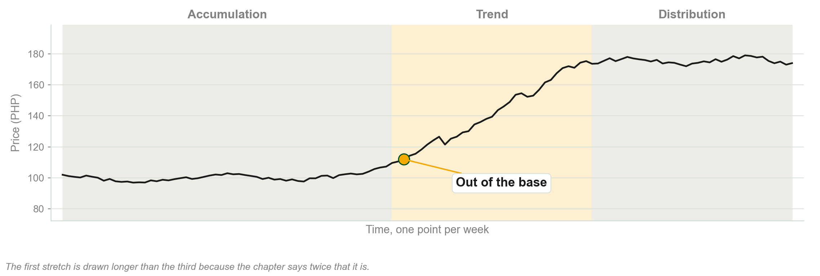
The three phases, and their relative lengths
Chart F - FIN1209 teaching chart, drawn for this course. Illustrative data, not a real instrument.
Part 5 of 6 - Phases and reversal | 9 of 22

Slide 88
The idealized three phases
FIGURE 2.15
A schematic primary bull trend with accumulation at the base, the trending stretch rising out of it, and distribution across the top.
The artwork is copyrighted and is not in the public repository. Build with assets/figures/ present to place it here.
Figure 2.15 - Lim, The Handbook of Technical Analysis (Wiley, 2016)
Part 5 of 6 - Phases and reversal | 10 of 22

Slide 89
The same three phases on a real chart
FIGURE 2.16
A real market example of the three phases of a primary bull trend, with a strong breakout out of the accumulation phase and stronger breakouts marked out of the wider distribution.
The artwork is copyrighted and is not in the public repository. Build with assets/figures/ present to place it here.
Figure 2.16 - Lim, The Handbook of Technical Analysis (Wiley, 2016)
Part 5 of 6 - Phases and reversal | 11 of 22

Slide 90
The longer the base, the bigger the move out of it
The longer the accumulation or the distribution lasts, the greater its subsequent breakout move will be.
A year of going nowhere is not nothing happening. It is the setup.
Part 5 of 6 - Phases and reversal | 12 of 22

Slide 91
NEW TERM
A trend persists until its reversal is indicated
IN PLAIN WORDS
The fourth tenet. You assume the trend you can see is still running until something tells you it is not.
FOR EXAMPLE
A market has been rising for two years. Until a previous significant peak or trough is penetrated, you assume it is still rising.
THE FORMAL DEFINITION
In Dow Theory a trend is assumed to persist until there is evidence to the contrary. Trend changes are identified by a penetration of a previous significant peak or trough.
Part 5 of 6 - Phases and reversal | 13 of 22

Slide 92
Until a level is breached, nothing has happened
Unless a prior support or resistance level is breached, the trend is assumed to be still intact.
The book uses those two words here and does not define them in this chapter.
Treat them for now as the previous trough and the previous peak.
Chapter 5 is where the book defines support and resistance properly.
Part 5 of 6 - Phases and reversal | 14 of 22

Slide 93
A primary bull trend ending on a breach
FIGURE 2.17
A chart of a primary bull trend terminated by a violation of a prior support level, with the accumulation, the trend and the distribution marked and the reversal signalled at the breach.
The artwork is copyrighted and is not in the public repository. Build with assets/figures/ present to place it here.
Figure 2.17 - Lim, The Handbook of Technical Analysis (Wiley, 2016)
Part 5 of 6 - Phases and reversal | 15 of 22

Slide 94
Three formations that signal a reversal
1. Failure swings.
2. Non failure swings.
3. Double tops and double bottoms.
Three shapes, one question: did the second attempt beat the first one?
Part 5 of 6 - Phases and reversal | 16 of 22

Slide 95
NEW TERM
Failure swing
IN PLAIN WORDS
The second peak fails to reach the first one. The market tried again and could not get there.
FOR EXAMPLE
Price makes a peak at 141 pesos, falls back, then rallies only to 134 and turns down again.
THE FORMAL DEFINITION
In a top reversal, a failure swing is the variation in which the second peak fails to penetrate the previous peak. A breach of the prior support then signals a potential change in the direction of the trend.
Part 5 of 6 - Phases and reversal | 17 of 22

Slide 96
NEW TERM
Non failure swing
IN PLAIN WORDS
The second peak does beat the first one, and the market still turns down afterwards.
FOR EXAMPLE
Price peaks at 141, falls back, rallies to 146, and then rolls over anyway.
THE FORMAL DEFINITION
In a non failure swing, the second peak succeeds in penetrating the previous peak. Because the formation was still making a higher peak, more evidence is required, so the conclusive sell signal comes at the penetration of the second and lower support level rather than the first.
Part 5 of 6 - Phases and reversal | 18 of 22

Slide 97
NEW TERM
Double top and double bottom
IN PLAIN WORDS
The second attempt matches the first one almost exactly. The market got back to the same level and stopped there twice.
FOR EXAMPLE
Price peaks at 141 pesos, falls back, and rallies to 141 again before turning down.
THE FORMAL DEFINITION
A double top is the top reversal variation in which the second peak matches the level of the previous peak. A double bottom is its mirror image, where the second trough matches the level of the previous trough.
Part 5 of 6 - Phases and reversal | 19 of 22

Slide 98
The three top reversal patterns
FIGURE 2.18
Three schematic top reversals side by side: a failure swing where the second peak does not reach the first, a double top where it matches, and a non failure swing where it exceeds it, each with its sell signal marked.
The artwork is copyrighted and is not in the public repository. Build with assets/figures/ present to place it here.
Figure 2.18 - Lim, The Handbook of Technical Analysis (Wiley, 2016)
Part 5 of 6 - Phases and reversal | 20 of 22

Slide 99
The three bottom reversal patterns
FIGURE 2.19
The same three formations inverted as bottom reversals, with the buy signal marked on each.
The artwork is copyrighted and is not in the public repository. Build with assets/figures/ present to place it here.
Figure 2.19 - Lim, The Handbook of Technical Analysis (Wiley, 2016)
Part 5 of 6 - Phases and reversal | 21 of 22

Slide 100
Why the non failure swing needs the lower level
The formation was still in the process of making a higher peak, so more evidence is needed.
The conclusive sell signal is the penetration of the second and lower support level.
Many traders scale out at the first, higher level and finish at the second.
A stronger looking top needs stronger evidence before you call it a top.
Part 5 of 6 - Phases and reversal | 22 of 22

Slide 101
You now know
▪ The three phases, and that they belong to primary trends
▪ Accumulation, and who is on each side of it
▪ The uptrend and downtrend phases, and why one is longer
▪ Distribution, and irrational exuberance
▪ A trend persists until its reversal is indicated
▪ Failure swings, non failure swings, double tops and bottoms
Part 5 of 6 - Phases and reversal | recap

Slide 102
Part 6 of 6
Confirmation, Volume, and the Challenges
Why one average is not allowed to call a trend on its own.
What volume has to do before a trend counts as healthy.
The seven arguments the book itself makes against Dow Theory.
About 35 minutes

Slide 103
NEW TERM
The averages must confirm one another
IN PLAIN WORDS
The fifth tenet. One average moving is not a signal. Two averages moving the same way is.
FOR EXAMPLE
If the Industrials clear their earlier peak in March and the Transportation Average does not clear its own until May, the signal is dated May.
THE FORMAL DEFINITION
In Dow Theory both the Industrials Average and the Railroad Average must extend beyond their secondary peaks in order for a trend to be established. The trend in one average must be confirmed by the other.
Part 6 of 6 - Confirmation and volume | 1 of 26

Slide 104
The signal is dated by the later average
One average penetrates its secondary peak at a time we will call T1.
The other penetrates its own secondary peak later, at T2.
As far as Dow Theory is concerned, the uptrend was not confirmed until T2.
The slower average sets the date. The faster one on its own proves nothing.
Part 6 of 6 - Confirmation and volume | 2 of 26

Slide 105
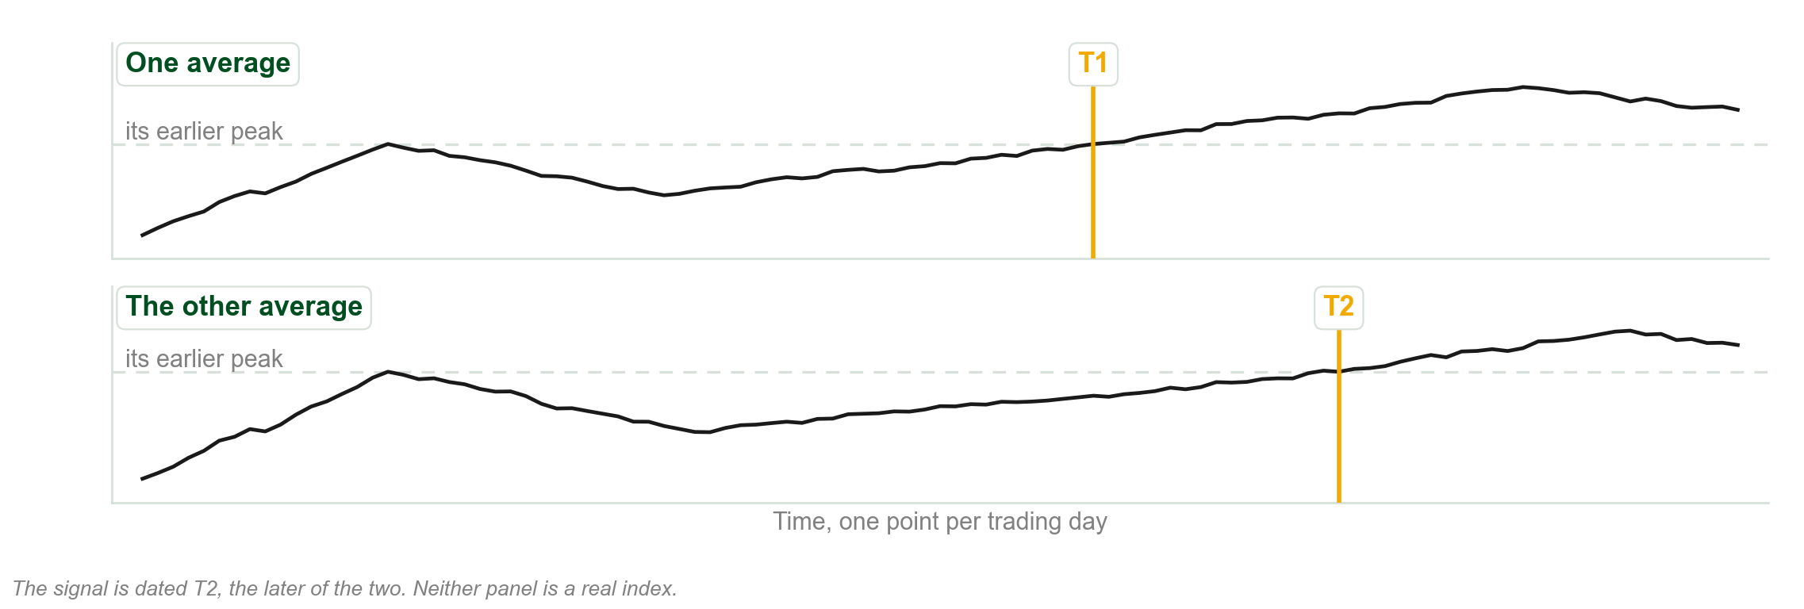
One average confirming the other
Chart G - FIN1209 teaching chart, drawn for this course. Illustrative data, not a real instrument.
Part 6 of 6 - Confirmation and volume | 3 of 26

Slide 106
Confirmation of the averages
FIGURE 2.20
A schematic of two averages, with the Industrials Average penetrating its secondary peak at T1 and the Railroad Average penetrating its own a little later at T2, at which point the uptrend is confirmed.
The artwork is copyrighted and is not in the public repository. Build with assets/figures/ present to place it here.
Figure 2.20 - Lim, The Handbook of Technical Analysis (Wiley, 2016)
Part 6 of 6 - Confirmation and volume | 4 of 26

Slide 107
The same thing on real averages
FIGURE 2.21
The Dow Jones Industrial Average breaching its secondary peak at T1 and the Dow Jones Transportation Average breaching its own at T2, with the secondary reaction marked on both.
The artwork is copyrighted and is not in the public repository. Build with assets/figures/ present to place it here.
Figure 2.21 - Lim, The Handbook of Technical Analysis (Wiley, 2016)
Part 6 of 6 - Confirmation and volume | 5 of 26

Slide 108
NEW TERM
Non confirmation
IN PLAIN WORDS
One average gives a signal and the other refuses to. Dow Theory then treats the signal as unproven.
FOR EXAMPLE
The Industrials give a sell signal, the Transportation Average does not, and the book reads that as a bullish indication rather than a bearish one.
THE FORMAL DEFINITION
Non confirmation occurs when a signal in one average is not confirmed by the other. A bearish signal that is not confirmed is regarded as a bullish indication, and the trend may simply resume.
Part 6 of 6 - Confirmation and volume | 6 of 26

Slide 109
A sell signal that was not confirmed
FIGURE 2.22
The Dow Jones Industrial Average making a weak non failure swing sell signal with support breached, while the Dow Jones Transportation Average does not breach its own support, after which the Industrials resume the uptrend.
The artwork is copyrighted and is not in the public repository. Build with assets/figures/ present to place it here.
Figure 2.22 - Lim, The Handbook of Technical Analysis (Wiley, 2016)
Part 6 of 6 - Confirmation and volume | 7 of 26

Slide 110
Confirmation between closely correlated markets
The concept may also be applied to closely correlated markets, not only to the two averages.
Practitioners also compare a large cap index with a small cap index.
The idea is general: one market alone is not evidence.
Part 6 of 6 - Confirmation and volume | 8 of 26

Slide 111
Two correlated markets disagreeing
FIGURE 2.23
Gold and silver side by side, with silver breaching its support while gold does not, which the book reads as either a bearish signal for gold or a bullish one for silver.
The artwork is copyrighted and is not in the public repository. Build with assets/figures/ present to place it here.
Figure 2.23 - Lim, The Handbook of Technical Analysis (Wiley, 2016)
Part 6 of 6 - Confirmation and volume | 9 of 26

Slide 112
A large cap index and a small cap index
FIGURE 2.24
The S&P500 large cap index showing sell signals that the Russell 2000 small cap index does not confirm, which the book construes as an oversold indication on the S&P500.
The artwork is copyrighted and is not in the public repository. Build with assets/figures/ present to place it here.
Figure 2.24 - Lim, The Handbook of Technical Analysis (Wiley, 2016)
Part 6 of 6 - Confirmation and volume | 10 of 26

Slide 113
NEW TERM
Volume must confirm the trend
IN PLAIN WORDS
The sixth tenet. Volume has to grow when price moves with the trend and shrink when it moves against it.
FOR EXAMPLE
A share rising on 3 million shares a day and pulling back on 1 million is behaving the way the tenet wants.
THE FORMAL DEFINITION
In Dow Theory, volume has to increase or expand in the direction of the existing trend. If volume does not expand in the direction of the existing trend, this is seen as a sign of weakness in the trend, and may potentially lead to a weakening or reversal of it.
Part 6 of 6 - Confirmation and volume | 11 of 26

Slide 114
The four conditions, in full
1. In an uptrend, volume should be increasing.
2. In an uptrend, volume should be decreasing during a downside retracement.
3. In a downtrend, volume should be increasing.
4. In a downtrend, volume should be decreasing during an upside retracement.
Volume grows with the trend and shrinks against it. All four say only that.
Part 6 of 6 - Confirmation and volume | 12 of 26

Slide 115
If any one of the four is not met
The existing trend may be potentially weaker than expected.
That may lead to a reversal in the existing trend.
May, and potentially. The book does not promise a reversal and neither should you.
Part 6 of 6 - Confirmation and volume | 13 of 26

Slide 116
And volume is only a secondary indicator
The book notes that volume is considered to be a secondary indicator.
Price first. Volume confirms or fails to confirm. It does not lead.
Part 6 of 6 - Confirmation and volume | 14 of 26

Slide 117
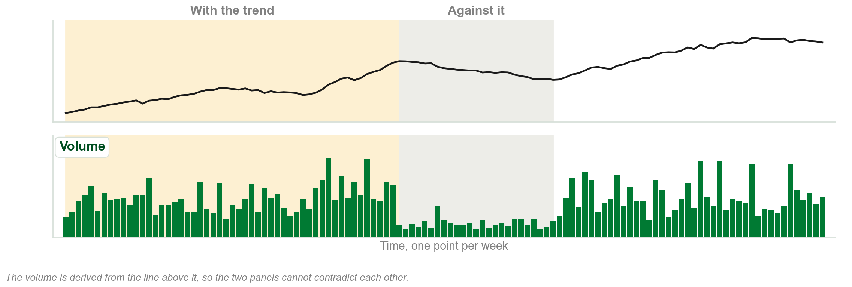
Volume expanding with the trend, and easing against it
Chart H - FIN1209 teaching chart, drawn for this course. Illustrative data, not a real instrument.
Part 6 of 6 - Confirmation and volume | 15 of 26

Slide 118
Volume expanding with a primary bull trend
FIGURE 2.25
A long term chart of gold with volume expanding in the direction of the existing primary bull trend in one marked area, and declining on average during the retracement in another.
The artwork is copyrighted and is not in the public repository. Build with assets/figures/ present to place it here.
Figure 2.25 - Lim, The Handbook of Technical Analysis (Wiley, 2016)
Part 6 of 6 - Confirmation and volume | 16 of 26

Slide 119
The same test, period by period
FIGURE 2.26
A weekly chart of the GLD SPDR Gold Trust Shares with ten numbered periods, volume expanding with the trend in the odd numbered ones and declining during each correction or retracement.
The artwork is copyrighted and is not in the public repository. Build with assets/figures/ present to place it here.
Figure 2.26 - Lim, The Handbook of Technical Analysis (Wiley, 2016)
Part 6 of 6 - Confirmation and volume | 17 of 26

Slide 120
There are many criticisms of Dow Theory
The book lists seven of the more significant arguments against it.
They are the book's own, not ours, and several attack Rhea's assumptions directly.
A textbook that argues with itself is worth reading carefully.
Part 6 of 6 - Confirmation and volume | 18 of 26

Slide 121
1. It suits the equity markets better than anything else
A commodity trader might wait months or years for a signal on the primary trend.
Hedgers would have few or no counterparties to take the other side.
The capital risk is astronomically high if the stop loss is set by the primary trend.
A twenty three year bear trend is not a trade anybody can actually hold.
Part 6 of 6 - Confirmation and volume | 19 of 26

Slide 122
2. The primary trend is susceptible to manipulation
Near zero interest rates over extended periods, colossal stimulus and quantitative easing.
Collective energy market rigging, and the Libor scandal.
This attacks Rhea's first assumption directly, and it is the book making the attack.
Part 6 of 6 - Confirmation and volume | 20 of 26

Slide 123
3. The averages are not a true barometer any more
Most indices are themselves tradable today, so they are open to manipulation.
The VIX was meant to reflect fear, and heavy speculative trading works against that.
Physical gold is at the mercy of shorting in its ETFs, futures and options.
Such products never existed in Dow's time.
Part 6 of 6 - Confirmation and volume | 21 of 26

Slide 124
4. Only closing prices are recognized
Recognizing only the close ignores potentially large intraday ranges.
Those important price rejection levels are totally disregarded.
And there is a conceptual conflict: one centavo on the close counts, a huge swing does not.
Part 6 of 6 - Confirmation and volume | 22 of 26

Slide 125
5. The signals on the primary trend are said to be safer
This may or may not be true.
Detractors argue such signals usually occur late in the trend and miss a large part of it.
Note the wording. The book does not settle this one either way.
Part 6 of 6 - Confirmation and volume | 23 of 26

Slide 126
6. Telling a new primary trend from a reaction
It is difficult to establish whether a retracement is part of a secondary reaction.
Or whether it is the inception of a new primary trend in the opposite direction.
Investing on the wrong reading runs a higher risk of losing capital.
This is why the secondary reaction is the most deceptive of the three movements.
Part 6 of 6 - Confirmation and volume | 24 of 26

Slide 127
7. The two averages no longer measure what they used to
The logic was that industry produces goods and the transports ship them.
But the Industrial Average today holds many companies that produce nothing needing shipping.
Many are in financial products, telecommunications and insurance.
Many practitioners prefer large cap against small cap, such as the S&P500 and the Russell 2000.
Part 6 of 6 - Confirmation and volume | 25 of 26

Slide 128
What the book still claims for Dow Theory
Dow Theory forms the basis for much of technical analysis in the twenty first century.
Many practitioners still regard it as one of the most reliable ways to confirm a trend exists.
Market phase and volume confirmation changed how investors participate.
More than a century after it was introduced, and after all seven of those criticisms.
Part 6 of 6 - Confirmation and volume | 26 of 26

Slide 129
You now know
▪ The averages must confirm one another, and the signal is dated by the later one
▪ Non confirmation, and why an unconfirmed sell signal reads as bullish
▪ Volume must confirm the trend, and the four conditions
▪ Volume is a secondary indicator
▪ The seven criticisms, two of which attack Rhea's own assumptions
▪ What the book still claims for the theory
Part 6 of 6 - Confirmation and volume | recap

Slide 130
Chapter 2 in five sentences
Dow Theory is six tenets, codified by Robert Rhea out of Charles Dow's editorials.
The averages discount everything, and only closing prices are recognized.
Three trends run at once, and only the primary one and lines may be traded.
A primary trend has three phases and persists until a peak or trough is penetrated.
The averages must confirm one another, and volume must confirm the trend.
If you can say those five, you can answer most of what this chapter is asked about.
Chapter 2 - Wrap up

Slide 131
The review questions to prepare
Describe the basic tenets of Dow Theory.
Give examples of the primary trend being manipulated.
Is Dow Theory still relevant today, and what are its main weaknesses?
Explain why volume should expand in the direction of the existing trend.
In what ways is accumulation similar to distribution?
Why is the secondary reaction more problematic than the primary trend?
Seven of the book's eight questions. The eighth is on the next slide.
Chapter 2 - Wrap up

Slide 132
The one question this chapter does not answer
Review question 8 asks for the differences between Dow's and Ralph N. Elliott's determination of a trend.
Chapter 2 never mentions Elliott. It gives you Dow's half and nothing else.
The book takes up Elliott properly in Chapter 4 and Chapter 18.
Answer the Dow half now, and finish the question when we reach Elliott.
Do not fill the gap from outside the book. The paper is set on the book.
Chapter 2 - Wrap up

Slide 133
Next: mechanics and dynamics of charting
Chapter 3 builds the chart itself: open, high, low and close, and how a bar is made.
Bring the closing price with you. Chapter 3 explains the other three you were told to ignore.
Before then: find a chart with a clear trend, mark its peaks and troughs, and say where the trend ended.
FIN1209 Technical Analysis in Investment | Institute of Accounts, Business and Finance

