Slide 1
FIN1209 Technical Analysis in Investment
Chapter 3
Mechanics and Dynamics of Charting
Institute of Accounts, Business and Finance | Far Eastern University Manila
Benjamin C. Sotelo

Slide 2
What you will be able to do
Understand chart construction and how technical data is incorporated and displayed.
Describe the process by which OHLC data is created and its relationship to various charts.
Identify and differentiate between contango and backwardation, and their connection with negative and positive roll yields.
Understand the adverse effects of the bid-ask spread on trading performance.
Chapter 3 - Learning objectives

Slide 3
What you will be able to do, continued
Construct various charts using constant measures of time, range, volatility, trade volume and number of transactions.
Set up a volatility neutral chart for consistent viewing of price action.
Chapter 3 - Learning objectives

Slide 4
How today is laid out
Part 1 From price to OHLC
Part 2 What the four prices mean, and four kinds of gap
Part 3 Five constant measures
Part 4 Chart scaling
Part 5 The bid-ask spread
Part 6 Futures contracts
Six parts, and a clean stop at every boundary.
Chapter 3 - Roadmap

Slide 5
Part 1 of 6
From Price to OHLC
What a chart is for, who reads one, and the four families of data behind it.
How a stream of trades is filtered into four prices: open, high, low and close.
How long bars are built from short ones, and why auto-scaling misleads.
About 25 minutes

Slide 6
What this chapter is for
Charting is a two dimensional matrix on which technical data is viewed.
It reveals repetitive price behaviour, volatility, price distortions and illiquidity.
It is where trendlines, channels, envelopes and chart patterns get drawn.
Chapter 2 kept only the close. This chapter brings back the other three prices.
Part 1 of 6 - OHLC | 1 of 18

Slide 7
NEW TERM
Chartist
IN PLAIN WORDS
Someone who studies the market by looking at charts of its data.
FOR EXAMPLE
Anyone in this room who opens a daily chart of a PSE listed share and reads its peaks and troughs is working as a chartist.
THE FORMAL DEFINITION
Analysts who use charts to study technical data are called chartists. They study classical chart patterns, trendlines, window oscillators, overlay indicators and other price formations.
Part 1 of 6 - OHLC | 2 of 18

Slide 8
NEW TERM
Price-time chart
IN PLAIN WORDS
The ordinary chart: price up the side, time along the bottom.
FOR EXAMPLE
On a daily chart of a share, each step to the right is one more trading day and each step up is more pesos.
THE FORMAL DEFINITION
The usual graphical form of technical data, where the vertical axis tracks the movement of price and the horizontal axis tracks the motion of time. The price axis may be scaled arithmetically (linear) or logarithmically (ratio).
Part 1 of 6 - OHLC | 3 of 18

Slide 9
When the time axis is only a counter
On some charts the time axis is not plotted in equal units of time.
It acts as a counter for each new block of data instead.
On such charts, time is regarded as implicit along the x axis.
Hold this. Part 3 is full of charts that work this way.
Part 1 of 6 - OHLC | 4 of 18

Slide 10
Four families of technical data
Price data: open, high, low and close.
Transaction related data: volume and open interest.
Market breadth data: advances, declines, new highs and new lows, and more.
Sentiment data: the put/call ratio, margin debt, implied volatility (VIX), and more.
The chapter lists all four families and works only with the first two.
The chapter names every breadth and sentiment item and defines none of them. Do not learn them from here.
Part 1 of 6 - OHLC | 5 of 18

Slide 11
NEW TERM
Quantization of price
IN PLAIN WORDS
Cutting a stream of trades into equal slices of time, one bar per slice.
FOR EXAMPLE
Take one trading morning and cut it into five minute slices: 9:30 to 9:35, 9:35 to 9:40, and so on. Each slice becomes one bar.
THE FORMAL DEFINITION
To create OHLC data, price activity is separated, or quantized, with respect to time, for each successive interval or period. An interval may be of any duration; the most popular are 1 minute, 5 minutes, 15 minutes, 1 hour, 4 hours, daily, weekly, monthly and yearly.
Part 1 of 6 - OHLC | 6 of 18

Slide 12
NEW TERM
OHLC data
IN PLAIN WORDS
The four numbers left once a slice of trading has been summarised: where it started, its highest point, its lowest point, and where it finished.
FOR EXAMPLE
In one five minute slice a share opens at 50.00 pesos, trades up to 50.80, down to 49.60, and ends at 50.40. Its OHLC is 50.00, 50.80, 49.60 and 50.40.
THE FORMAL DEFINITION
The price at the beginning and end of an interval is the opening (O) and closing (C) price; the highest and lowest prices within it are the high (H) and low (L). Price activity is summarized into these four pieces of information.
Part 1 of 6 - OHLC | 7 of 18

Slide 13
Four pieces of information
FIGURE 3.1
One five minute interval of jagged price filtered into four prices and drawn three ways: a 5 minute bar, a 5 minute candlestick and a 5 minute Gann bar, with the range marked.
The artwork is copyrighted and is not in the public repository. Build with assets/figures/ present to place it here.
Figure 3.1 - Lim, The Handbook of Technical Analysis (Wiley, 2016)
Part 1 of 6 - OHLC | 8 of 18

Slide 14
The range, and where the next bar opens
The range of a bar is the absolute difference between its high and low: range = |H - L|.
In most cases the close of one interval is also the open of the next, unless there is a gap.
OHLC data also builds bar charts, Gann bars and Japanese candlesticks.
High 50.80 and low 49.60 give a range of 1.20 pesos.
The chapter names Gann bars and draws one in Figure 3.1, but never says how to read one. Nothing is set on it.
Part 1 of 6 - OHLC | 9 of 18

Slide 15
NEW TERM
Higher timeframe bar
IN PLAIN WORDS
A longer bar built out of several shorter ones, by summarising them all at once.
FOR EXAMPLE
Three five minute bars. The first opens at 50.00, the highest high of the three is 50.90, the lowest low is 49.40, and the third closes at 50.30. The fifteen minute bar is 50.00, 50.90, 49.40, 50.30.
THE FORMAL DEFINITION
To create OHLC data over a longer period, take the opening price of the first period, the closing price of the last period, and the highest and lowest prices between them. Such composite bars are referred to as higher timeframe bars and candlesticks.
Part 1 of 6 - OHLC | 10 of 18

Slide 16
Three short bars make one long one
FIGURE 3.2
Fifteen minutes of price, three five minute intervals, summarised as one 15 minute bar and one 15 minute candlestick carrying the first open, the last close, and the extreme high and low.
The artwork is copyrighted and is not in the public repository. Build with assets/figures/ present to place it here.
Figure 3.2 - Lim, The Handbook of Technical Analysis (Wiley, 2016)
Part 1 of 6 - OHLC | 11 of 18

Slide 17
Quantization, bar by bar
FIGURE 3.3
Eight successive five minute intervals of unfiltered price action, with the bar each interval produces drawn beneath it and the equivalent Japanese candlestick beneath that.
The artwork is copyrighted and is not in the public repository. Build with assets/figures/ present to place it here.
Figure 3.3 - Lim, The Handbook of Technical Analysis (Wiley, 2016)
Part 1 of 6 - OHLC | 12 of 18

Slide 18
Most charts start from OHLC
FIGURE 3.4
A family tree with OHLC data feeding the line, bar, candlestick, point and figure, three line break, Renko, Kagi and Gann swing charts, and a branch adding volume for the equivolume chart.
The artwork is copyrighted and is not in the public repository. Build with assets/figures/ present to place it here.
Figure 3.4 - Lim, The Handbook of Technical Analysis (Wiley, 2016)
Part 1 of 6 - OHLC | 13 of 18

Slide 19
The one chart that needs a fifth number
Most charts are created from OHLC data alone.
The equivolume chart also needs volume, so the book says it requires OHLCV data.
Kagi charts and Gann swing charts appear on the family tree and nowhere else in the chapter.
OHLC plus V. That is the one exception.
The chapter never explains Kagi or Gann swing charts. Nothing is set on them.
Part 1 of 6 - OHLC | 14 of 18

Slide 20
Three pictures of the same prices
FIGURE 3.5
The same sequence of OHLC data drawn three ways: as a line chart, as a bar chart and as a candlestick chart.
The artwork is copyrighted and is not in the public repository. Build with assets/figures/ present to place it here.
Figure 3.5 - Lim, The Handbook of Technical Analysis (Wiley, 2016)
Part 1 of 6 - OHLC | 15 of 18

Slide 21
NEW TERM
Auto-scaling
IN PLAIN WORDS
A chart setting that stretches or squeezes the price axis so that whatever is on the screen fills the screen.
FOR EXAMPLE
Scroll a flat, quiet month into view and its bars suddenly look tall and wild. Scroll a strong trend into the same window and those same bars shrink.
THE FORMAL DEFINITION
Auto-scaling attempts to fill the entire screen with price activity, so the heights of bars and candlesticks keep changing with whether price is ranging or trending. The vertical scaling is not preserved or constant, and volatility is misrepresented.
Part 1 of 6 - OHLC | 16 of 18

Slide 22
Why the book says switch it off
When prices are flat, auto-scaling makes low volatility activity look more volatile.
When prices trend, it makes volatile activity look less volatile.
Switching it off normalizes volatility on the charts, for more accurate price visualization.
It is always best to turn auto-scaling off. That is the book's instruction.
The learning objectives ask for a volatility neutral chart. The text never uses that phrase; this is the nearest it comes.
Part 1 of 6 - OHLC | 17 of 18

Slide 23
The same stretch of price, magnified and shrunk
FIGURE 3.6
Four panels of the same prices: with auto-scaling on, an encircled quiet stretch looks volatile and then shrinks when a trend comes into view; with it off, the stretch keeps its true height.
The artwork is copyrighted and is not in the public repository. Build with assets/figures/ present to place it here.
Figure 3.6 - Lim, The Handbook of Technical Analysis (Wiley, 2016)
Part 1 of 6 - OHLC | 18 of 18

Slide 24
You now know
▪ Chartists, and the price-time chart
▪ A time axis that is only a counter
▪ The four families of technical data
▪ Quantization, OHLC data and the range
▪ Higher timeframe bars
▪ Auto-scaling, and why to switch it off
Part 1 of 6 - OHLC | recap

Slide 25
Part 2 of 6
What the Four Prices Mean, and Four Kinds of Gap
Why the high and the low carry more weight than the open and the close.
The three conditions that make the open and the close matter more.
The four ways to measure a gap, and which ones need the next bar to close.
About 25 minutes

Slide 26
Not all four prices are equal
The open and the close are merely a function of time stamping.
They mark where an arbitrary interval happened to start and stop.
The high and the low are created by actual market forces of supply and demand.
Two of the four are set by the clock. Two are set by traders.
The book's figure labels the high a function of supply and the low a function of demand.
Part 2 of 6 - Significance and gaps | 1 of 14

Slide 27
NEW TERM
Price rejection
IN PLAIN WORDS
The high and low are where the market tried to go further and was pushed back.
FOR EXAMPLE
A share trades up to 52 pesos and sellers meet it there; it trades down to 49 and buyers meet it there. Both prices were set by people risking money, not by the clock.
THE FORMAL DEFINITION
The highs and lows represent areas of price rejection, caused by the responsive actions of market participants, who react to high and low prices by risking capital. This makes them more significant than the open and close, and the longer the interval, the more significant the high and low formed.
Part 2 of 6 - Significance and gaps | 2 of 14

Slide 28
What sets each of the four
FIGURE 3.7
One period of price with the open and the close each labelled a function of an arbitrary time stamp, the high labelled a function of supply and the low a function of demand, both as market forces.
The artwork is copyrighted and is not in the public repository. Build with assets/figures/ present to place it here.
Figure 3.7 - Lim, The Handbook of Technical Analysis (Wiley, 2016)
Part 2 of 6 - Significance and gaps | 3 of 14

Slide 29
When the open and the close gain importance
1. The durations between active trading sessions are longer.
2. The open and close belong to a higher timeframe bar or candlestick.
3. There is a larger gap between the previous close and the new open.
Any of the three makes the open and close more reliable and actionable.
Part 2 of 6 - Significance and gaps | 4 of 14

Slide 30
Sessions separated by no trading
FIGURE 3.8
Three trading sessions, each with its own open, high, low and close, separated by stretches of no trading, annotated that longer breaks raise the significance of the open and close.
The artwork is copyrighted and is not in the public repository. Build with assets/figures/ present to place it here.
Figure 3.8 - Lim, The Handbook of Technical Analysis (Wiley, 2016)
Part 2 of 6 - Significance and gaps | 5 of 14

Slide 31
Daily against intraday, and markets that never close
The daily open and close draw more interest than the opens and closes between morning and afternoon sessions.
The break overnight is longer than the break between the two sessions of one day.
In markets that trade continuously, such as spot foreign exchange, the open and close matter less than the high and low.
The longer the market has been shut, the more its opening price means.
Part 2 of 6 - Significance and gaps | 6 of 14

Slide 32
NEW TERM
Gap
IN PLAIN WORDS
A stretch of prices where nothing traded at all. Price jumped over it.
FOR EXAMPLE
A share closes at 102 pesos and opens the next morning at 106. Nobody traded at 103, 104 or 105 in between.
THE FORMAL DEFINITION
A gap is represented by a range of prices where no trading activity takes place. There are essentially four ways to define one, Types 1 to 4.
Part 2 of 6 - Significance and gaps | 7 of 14

Slide 33
NEW TERM
Type 1 and Type 2 gaps
IN PLAIN WORDS
Both are measured to the new bar's open, so both exist the moment it opens.
FOR EXAMPLE
The last bar had a high of 104 and closed at 102. The new bar opens at 106. The Type 1 gap, close to open, is 4 pesos. The Type 2 gap, high to open, is 2 pesos.
THE FORMAL DEFINITION
Type 1 is measured from the close of the previous bar to the open of the next or current bar. Type 2 is measured from the high or low of the previous bar to the open of the next or current bar. Both are created instantaneously at the open, with no trading within that range.
Part 2 of 6 - Significance and gaps | 8 of 14

Slide 34
NEW TERM
Type 3 and Type 4 gaps
IN PLAIN WORDS
Both are measured to the new bar's high or low, so both wait for it to close.
FOR EXAMPLE
The new bar's low turns out to be 105.50. Type 3, high 104 to low 105.50, is 1.50 pesos. Type 4, close 102 to low 105.50, is 3.50 pesos.
THE FORMAL DEFINITION
Type 3 is measured from the highs or lows of the previous bar to the highs or lows of the current bar, and is the gap usually called a window in candlestick and bar charts. Type 4 is measured from the close of the previous bar to the high or low of the next. Both are created only after the current bar has closed.
Part 2 of 6 - Significance and gaps | 9 of 14

Slide 35
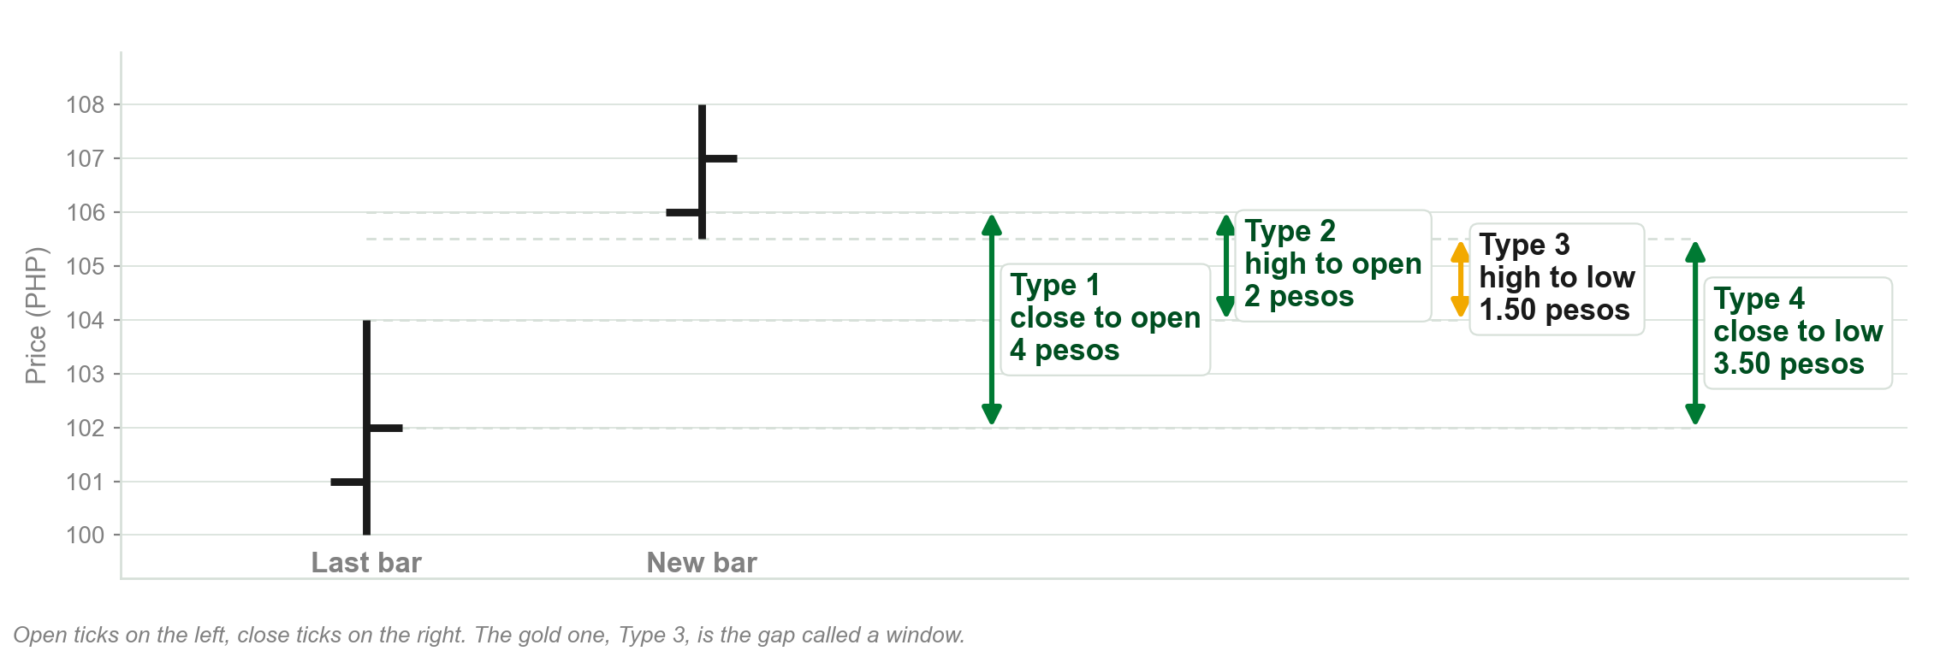
The four gaps, measured on one pair of bars
Chart A - FIN1209 teaching chart, drawn for this course. Illustrative data, not a real instrument.
Part 2 of 6 - Significance and gaps | 10 of 14

Slide 36
Four definitions of a gap
FIGURE 3.9
Four schematic pairs of bars, Types 1 to 4, each gap marked by an arrow; Types 1 and 2 grouped as created when the next bar opens, Types 3 and 4 as needing the next bar to close.
The artwork is copyrighted and is not in the public repository. Build with assets/figures/ present to place it here.
Figure 3.9 - Lim, The Handbook of Technical Analysis (Wiley, 2016)
Part 2 of 6 - Significance and gaps | 11 of 14

Slide 37
What a gap usually does afterwards
A gap normally represents an area of support or resistance, depending on whether price is above or below it.
This is especially so for a Type 3 gap, and larger gaps are more significant.
Prices are generally expected to return and fill the gap later, although often they do not.
Expected to fill, and often does not. The book says both.
The chapter uses support and resistance without defining them. Chapter 5 is where the book defines them.
Part 2 of 6 - Significance and gaps | 12 of 14

Slide 38
The true range, and the Type 4 gap
The book notes that the average true range (ATR) is somewhat related to a Type 4 gap.
The true range is the greater of the new bar's range and the distance from the last close to its high or low.
In the example, last close 102 to new high 108 is 6 pesos, more than the new range of 2.50.
The chapter gives the true range, not the average. The averaging is taught in Chapter 8.
Part 2 of 6 - Significance and gaps | 13 of 14

Slide 39
Four market gaps, named for later
Chapter 5 analyses gaps in relation to market phase.
The four it covers are common gaps, breakaway gaps, runaway gaps and exhaustion gaps.
Runaway gaps are also called continuation or midway gaps.
Names only today. Types 1 to 4 are ways to measure a gap, not kinds of gap.
Part 2 of 6 - Significance and gaps | 14 of 14

Slide 40
You now know
▪ The open and close as time stamps, the high and low as price rejection
▪ The three conditions that raise the open and close
▪ Daily against intraday, and continuous markets
▪ A gap, and Types 1 to 4
▪ What a gap usually does afterwards, and the true range
Part 2 of 6 - Significance and gaps | recap

Slide 41
Part 3 of 6
Five Constant Measures
The five things that can decide when a bar is finished.
The four constant time charts, and what each one keeps or loses.
The charts that ignore the clock, and the one chart with no constant at all.
About 40 minutes

Slide 42
The five constant measures
1. Constant time: the bar closes when a set interval of time is met.
2. Constant range: the bar closes when a set excursion in price is met.
3. Constant volume: the bar closes when a set volume is met.
4. Constant transaction, or tick: the bar closes when a set number of trades is met.
5. Constant volatility: the bar closes when a set amount of standard deviation or ATR is met.
Every bar has a range, a duration, a volume, a number of transactions and a volatility. Each chart holds one of them constant.
Part 3 of 6 - Constant measures | 1 of 26

Slide 43
NEW TERM
Constant time chart
IN PLAIN WORDS
Every bar covers the same length of time, whatever happened in it.
FOR EXAMPLE
On a daily chart, a quiet day and a wild day each get exactly one bar, and each takes up the same width.
THE FORMAL DEFINITION
Constant time charts quantize price activity into units of time, so each bar is complete once a specified amount of time has elapsed; they are also called interval charts. The bar duration is constant, and the range, volume, transactions per bar and volatility are variable.
Part 3 of 6 - Constant measures | 2 of 26

Slide 44
Why constant time is the default
Constant time charts work with both numerically and geometrically based overlay indicators.
Charts that are not constant time should use numerical and horizontal overlays only.
Their time axis is not linear, which affects trendlines, channels and chart pattern analysis.
Constant time charts are the most popular form of chart construction.
The book sorts overlays into numerical, geometrical and horizontal ones and treats them fully in Chapter 8.
Part 3 of 6 - Constant measures | 3 of 26

Slide 45
NEW TERM
Bar chart
IN PLAIN WORDS
Each interval drawn as one vertical line from high to low, with a small tick on the left for the open and on the right for the close.
FOR EXAMPLE
A day that opened at 50, ran up to 52, fell to 49 and closed at 51 is one line from 49 to 52, with a tick on the left at 50 and a tick on the right at 51.
THE FORMAL DEFINITION
A bar chart is created by the quantization of price into specified time intervals. Bar charts clearly depict levels of supply and demand in the market, but the open and close markers are hard to read from a distance when the chart holds many bars.
Part 3 of 6 - Constant measures | 4 of 26

Slide 46
NEW TERM
Line chart
IN PLAIN WORDS
Just the closing prices, joined up. Everything else in each bar is thrown away.
FOR EXAMPLE
Five days closing at 50, 51, 50.50, 52 and 53 pesos are five dots joined by a line. The highs and lows of those days do not appear anywhere.
THE FORMAL DEFINITION
Line charts are created by connecting all of the closing prices. They give little information about levels of supply and demand, since they ignore the high and low prices, which are the true indicators of market force. They are used as a trend identifier or a simple summary of price activity.
Part 3 of 6 - Constant measures | 5 of 26

Slide 47
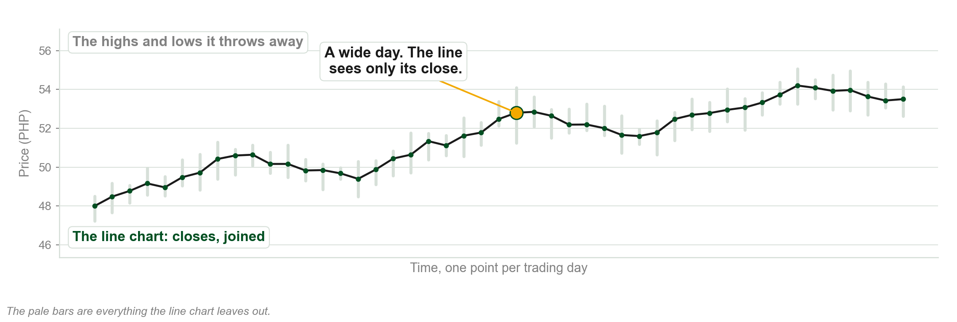
What a line chart keeps
Chart B - FIN1209 teaching chart, drawn for this course. Illustrative data, not a real instrument.
Part 3 of 6 - Constant measures | 6 of 26

Slide 48
NEW TERM
Japanese candlestick
IN PLAIN WORDS
A bar with the stretch between the open and the close drawn as a box.
FOR EXAMPLE
Open 50, close 51: the box runs from 50 up to 51 and is hollow, or white. Open 51, close 50: the same box, filled, or black.
THE FORMAL DEFINITION
Japanese candlesticks are created in essentially the same manner as price bars. The only difference is that the space between the opening and closing price is boxed up and referred to as the real body, which may be filled or hollow, black or white, depending on where the open lies relative to the close.
Part 3 of 6 - Constant measures | 7 of 26

Slide 49
A bullish and a bearish candlestick
FIGURE 3.10
A white bullish candlestick and a black bearish one labelled part by part: real body, open, close, and the upper and lower shadows, also called tails or wicks, running to the high and low.
The artwork is copyrighted and is not in the public repository. Build with assets/figures/ present to place it here.
Figure 3.10 - Lim, The Handbook of Technical Analysis (Wiley, 2016)
Part 3 of 6 - Constant measures | 8 of 26

Slide 50
NEW TERM
Equivolume chart
IN PLAIN WORDS
Each bar's width shows how much traded: a busy day wide, a quiet day narrow.
FOR EXAMPLE
Two days with the same high and low. One traded 3 million shares and the other 1 million. The first is drawn as the wider bar.
THE FORMAL DEFINITION
Equivolume charts are based on constant time bars, displaying volume over the interval as bar width rather than height. They are constructed using high and low prices, and open and close prices are disregarded. Larger volume results in a wider bar.
Part 3 of 6 - Constant measures | 9 of 26

Slide 51
Equivolume: constant time, non linear axis, two accounts
Every equivolume bar still covers one interval of time, so it is a constant time chart.
But because the widths vary, its time axis is not plotted in a linear fashion.
The book says equivolume needs OHLCV data, and also that its open and close are disregarded.
What the bar actually draws on is the high, the low and the volume.
The book says both things about its data. Learn both, and know which prices the bar uses.
Part 3 of 6 - Constant measures | 10 of 26

Slide 52
Candlestick and equivolume, same stock
FIGURE 3.11
The same daily prices of Apple Inc. as a candlestick chart with a linear time axis and as an equivolume chart with a non linear one, the trendline on each ending at a different price.
The artwork is copyrighted and is not in the public repository. Build with assets/figures/ present to place it here.
Figure 3.11 - Lim, The Handbook of Technical Analysis (Wiley, 2016)
Part 3 of 6 - Constant measures | 11 of 26

Slide 53
NEW TERM
Constant range chart
IN PLAIN WORDS
A chart that draws a new bar only when price has moved a set amount, however long that takes.
FOR EXAMPLE
Set the size at 1 peso. A share that drifts 40 centavos all week draws nothing. A share that moves 3 pesos in a morning draws three.
THE FORMAL DEFINITION
On constant range charts each bar, box or brick is complete once a specified excursion in price is met. The bar range and the bar volatility are constant; the duration, volume and transactions per bar are variable.
Part 3 of 6 - Constant measures | 12 of 26

Slide 54
NEW TERM
Point and figure chart
IN PLAIN WORDS
Columns of X's while price rises and O's while it falls, one box per set move.
FOR EXAMPLE
Box size 1 peso, reversal size 3 boxes. Price must move 1 peso to add a box, and at least 3 pesos against the column before a new column starts.
THE FORMAL DEFINITION
The most popular form of constant range charting. A continuation box is the minimum excursion for a new box in the trend's direction; the reversal size is the number of boxes needed to plot a reversal. The box size is arbitrarily chosen, and closing prices are normally used, though many use the high and low.
Part 3 of 6 - Constant measures | 13 of 26

Slide 55
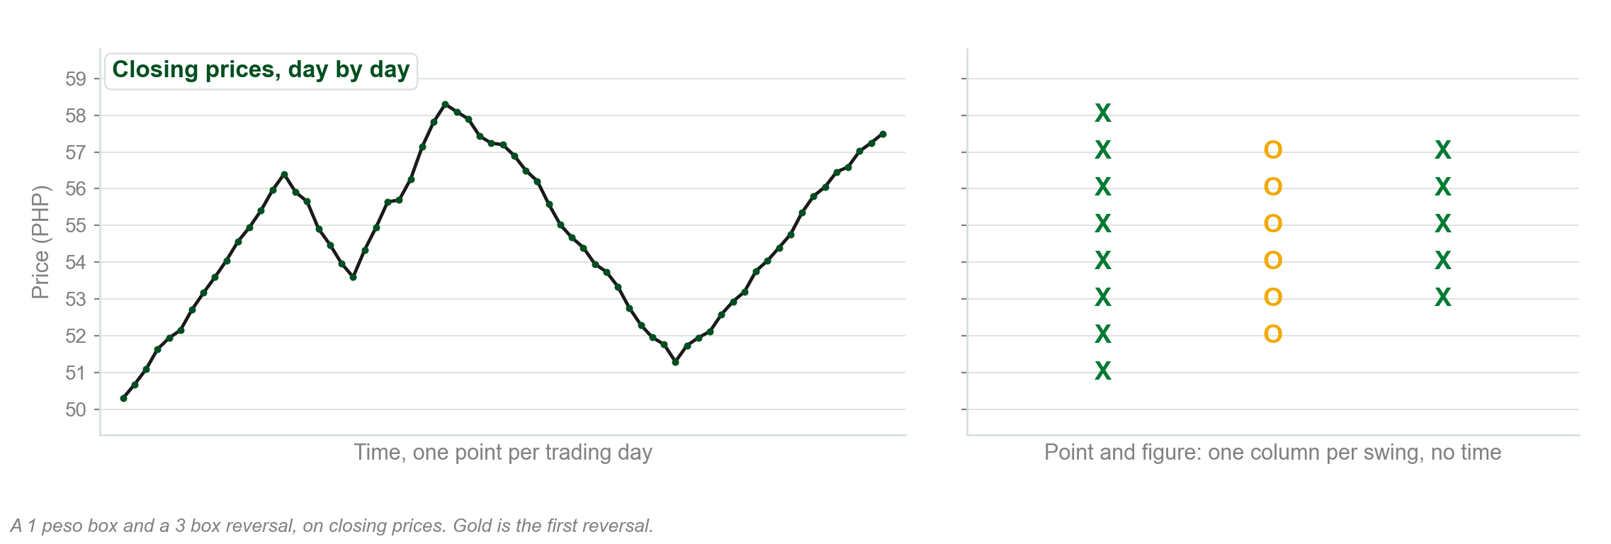
Point and figure, one box at a time
Chart C - FIN1209 teaching chart, drawn for this course. Illustrative data, not a real instrument.
Part 3 of 6 - Constant measures | 14 of 26

Slide 56
Why point and figure draws its lines at 45 degrees
As a constant range chart, point and figure has a non linear time axis.
So geometrically based overlays would give inconsistent readings on it.
Its trendlines need only one point, and rise and fall along 45 and minus 45 degree angles.
Point and figure uses bullish support and bearish resistance lines in place of conventional trendlines.
Part 3 of 6 - Constant measures | 15 of 26

Slide 57
Point and figure on Google
FIGURE 3.12
A point and figure chart of Google Inc. in columns of X's and O's, with a plus 45 degree line under the rise and a minus 45 degree line over the decline, and the note that the time axis is non linear.
The artwork is copyrighted and is not in the public repository. Build with assets/figures/ present to place it here.
Figure 3.12 - Lim, The Handbook of Technical Analysis (Wiley, 2016)
Part 3 of 6 - Constant measures | 16 of 26

Slide 58
NEW TERM
Renko chart
IN PLAIN WORDS
White bricks for each set rise, black for each set fall, one column per brick.
FOR EXAMPLE
Brick size 1 peso. From 50, a rise to 52.40 adds two white bricks. For a black brick, price must now move at least two bricks, 2 pesos, the other way.
THE FORMAL DEFINITION
A form of constant range charting whose bars are bricks, bullish white and bearish black, each plotted in a new column once the minimum price excursion is met. All reversals require price to move at least two bricks the other way, so Renko charts are essentially two brick reversal charts. Brick size is arbitrary.
Part 3 of 6 - Constant measures | 17 of 26

Slide 59
A Renko chart
FIGURE 3.13
A Renko chart of the iPath Dow Jones-AIG Coffee Total Return Sub-Index in white and black bricks, with the note that its time axis is non linear.
The artwork is copyrighted and is not in the public repository. Build with assets/figures/ present to place it here.
Figure 3.13 - Lim, The Handbook of Technical Analysis (Wiley, 2016)
Part 3 of 6 - Constant measures | 18 of 26

Slide 60
NEW TERM
Constant volume chart
IN PLAIN WORDS
A new bar every time a set number of shares has traded, however long that takes.
FOR EXAMPLE
Set 100,000 shares a bar. A busy morning might draw ten bars; a slow afternoon might draw one.
THE FORMAL DEFINITION
In constant volume charts a new bar is plotted once the minimum volume traded is met. The bar volume is constant; the range, duration, transactions per bar and volatility are variable. Since a new bar is not time dependent, the time axis is plotted in a non linear fashion.
Part 3 of 6 - Constant measures | 19 of 26

Slide 61
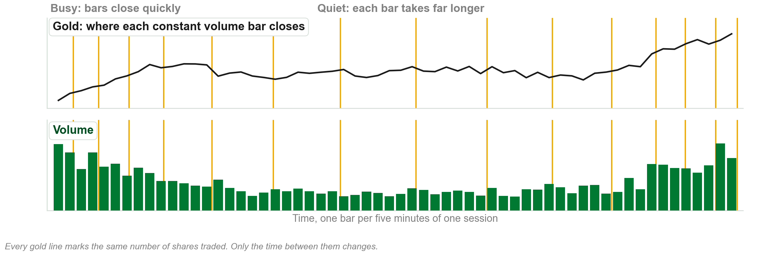
Where a constant volume bar closes
Chart D - FIN1209 teaching chart, drawn for this course. Illustrative data, not a real instrument.
Part 3 of 6 - Constant measures | 20 of 26

Slide 62
NEW TERM
Constant transaction chart
IN PLAIN WORDS
A new bar after every set number of trades. Also called a tick chart.
FOR EXAMPLE
Set 50 trades a bar. Fifty trades of 100 shares and fifty trades of 10,000 shares each make exactly one bar.
THE FORMAL DEFINITION
In constant transaction or tick charts a new bar is plotted once the minimum number of transactions is met. Each transaction is represented by one tick, and the volume per transaction is unspecified. The transactions per bar are constant; everything else is variable, and the time axis is non linear.
Part 3 of 6 - Constant measures | 21 of 26

Slide 63
NEW TERM
Constant volatility chart
IN PLAIN WORDS
Like constant range, but volatility sets the size of move each bar needs.
FOR EXAMPLE
Set each bar at 2 x ATR. If the ATR is 0.50 pesos a bar needs a 1 peso move; if the ATR widens to 1.50, it needs 3 pesos.
THE FORMAL DEFINITION
A new bar is plotted once a minimum price excursion determined by volatility is met, for example 2 x ATR. The bar volatility is constant; range, duration, volume and transactions are variable. It is objective, as volatility sets the size, and subjective in the choice of the ATR multiple.
Part 3 of 6 - Constant measures | 22 of 26

Slide 64
ATR box sizing against standard box sizing
FIGURE 3.14
Two point and figure charts of one market: box size set to 1 x ATR on the left, less volatile and more directional; standard box sizing on the right, more volatile and less directional.
The artwork is copyrighted and is not in the public repository. Build with assets/figures/ present to place it here.
Figure 3.14 - Lim, The Handbook of Technical Analysis (Wiley, 2016)
Part 3 of 6 - Constant measures | 23 of 26

Slide 65
NEW TERM
Three line break chart
IN PLAIN WORDS
No fixed measure at all: a new line only when price closes beyond the last one.
FOR EXAMPLE
After three white lines in a row, price has to fall to the low of those last three lines before a black line can be drawn.
THE FORMAL DEFINITION
Three line break charts possess no measures of constancy. Once price closes above the previous high or below a previous low, a new line is created. After three successive lines, a reversal may only be plotted if price meets or exceeds the low, or in an upside reversal the high, of the last three.
Part 3 of 6 - Constant measures | 24 of 26

Slide 66
Three line break against Renko
FIGURE 3.15
The same period of the Currency Shares Euro Trust drawn as a Renko chart and as a three line break chart side by side.
The artwork is copyrighted and is not in the public repository. Build with assets/figures/ present to place it here.
Figure 3.15 - Lim, The Handbook of Technical Analysis (Wiley, 2016)
Part 3 of 6 - Constant measures | 25 of 26

Slide 67
Which one each chart holds constant
Constant time: the duration.
Constant range: the range, and the volatility.
Constant volume: the volume.
Constant transaction: the number of transactions per bar.
Constant volatility: the volatility.
Three line break: nothing at all.
The book lists volatility as constant for both constant range and constant volatility charts. What separates them is how the size is set.
Part 3 of 6 - Constant measures | 26 of 26

Slide 68
You now know
▪ The five constant measures
▪ Constant time: bar, line, candlestick and equivolume charts
▪ Constant range: point and figure and Renko
▪ Constant volume, constant transaction and constant volatility
▪ Three line break, with nothing constant
▪ Why a non linear time axis bends trendlines
Part 3 of 6 - Constant measures | recap

Slide 69
Part 4 of 6
Chart Scaling
Three ways to scale a price axis, and what each one preserves.
Which overlays scaling changes, and which it leaves alone.
Why the same prices can look bullish on one scale and bearish on the other.
About 25 minutes

Slide 70
Three ways to scale a price axis
1. Linear, or arithmetic, scale.
2. Ratio, or logarithmic, scale.
3. Square root scale.
Linear and ratio are the common two. Square root lies between them and is rarely offered.
Part 4 of 6 - Scaling | 1 of 19

Slide 71
NEW TERM
Linear scaling
IN PLAIN WORDS
Equal distances up the chart mean equal amounts of money.
FOR EXAMPLE
A rise from 10 to 20 pesos and a rise from 90 to 100 pesos are drawn the same height: 10 pesos each. But the first is a 100 percent rise and the second only 11.1 percent.
THE FORMAL DEFINITION
In linear or arithmetic scaling, equal distances on the chart represent equal price changes: the change P(N) minus P(N-1) is constant for every equal distance moved on the chart. The percentage change is not preserved for equal units of price change.
Part 4 of 6 - Scaling | 2 of 19

Slide 72
NEW TERM
Ratio scaling
IN PLAIN WORDS
Equal distances up the chart mean equal percentage moves.
FOR EXAMPLE
A rise from 10 to 20 pesos is 100 percent. On a ratio scale it is drawn the same height as a rise from 90 to 180 pesos, which is also 100 percent but a 90 peso move.
THE FORMAL DEFINITION
In ratio or logarithmic scaling, equal distances on the chart represent equal percentage changes: (P(N) minus P(N-1)) divided by P(N-1) is constant for every equal distance moved, which is also what is called stock returns. The price change is not preserved per equal unit of percentage change.
Part 4 of 6 - Scaling | 3 of 19

Slide 73
One sentence in the book says the opposite
The book defines ratio scaling as equal distances for equal percentage changes.
Two sentences later it says equal distances on the chart do not equate to equal percentage changes.
That sentence contradicts the definition just given, which the book states twice and draws twice.
Learn the definition. Equal distance on a ratio scale is equal percentage change.
Part 4 of 6 - Scaling | 4 of 19

Slide 74
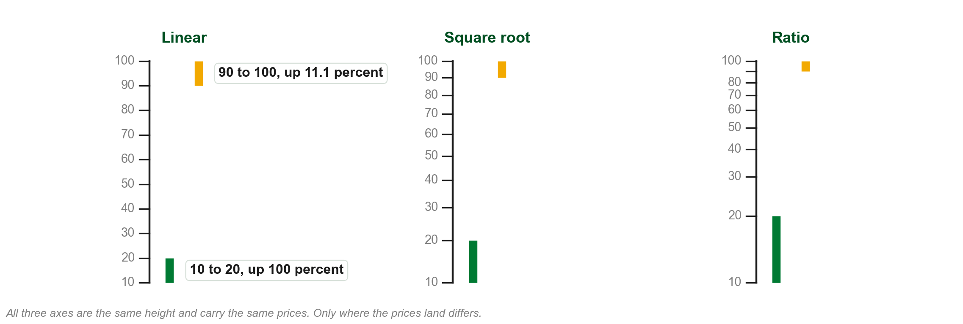
One price axis, three scales
Chart E - FIN1209 teaching chart, drawn for this course. Illustrative data, not a real instrument.
Part 4 of 6 - Scaling | 5 of 19

Slide 75
Linear scaling
FIGURE 3.16
A price axis from 0 to 6 dollars with each 1 dollar step the same height, annotated that the price changes are constant from level to level and are of equal distances on the chart.
The artwork is copyrighted and is not in the public repository. Build with assets/figures/ present to place it here.
Figure 3.16 - Lim, The Handbook of Technical Analysis (Wiley, 2016)
Part 4 of 6 - Scaling | 6 of 19

Slide 76
Ratio scaling, and where the halfway point falls
FIGURE 3.17
A ratio scaled axis from 10 to 100 with the log of each level beside it: 55, the arithmetic halfway point, sits well above the middle, and prices are compressed at the upper end.
The artwork is copyrighted and is not in the public repository. Build with assets/figures/ present to place it here.
Figure 3.17 - Lim, The Handbook of Technical Analysis (Wiley, 2016)
Part 4 of 6 - Scaling | 7 of 19

Slide 77
Ratio scaling, in equal percentage steps
FIGURE 3.18
A ratio scaled axis doubling from 1 to 64 dollars, every doubling the same height and 0.3 apart in logs, annotated that equal distances are equal percentage changes.
The artwork is copyrighted and is not in the public repository. Build with assets/figures/ present to place it here.
Figure 3.18 - Lim, The Handbook of Technical Analysis (Wiley, 2016)
Part 4 of 6 - Scaling | 8 of 19

Slide 78
Compressed at the top, expanded at the bottom
The ratio scale compresses price action at higher prices and expands it at lower prices.
Linear scaling represents price evenly across the whole range.
So linear gives better definition at the upper end, and ratio gives better definition at the lower end.
Each scale is clear at one end and poor at the other.
Part 4 of 6 - Scaling | 9 of 19

Slide 79
Which scale to use
Use linear when the price range under observation is relatively small.
For stock price ranges exceeding 100 dollars ratio may be more appropriate, and it is best for very long term equity charts.
For futures, foreign exchange and anything traded on very low margin, use linear.
Ratio would compress those highly leveraged markets too much at higher prices.
The book gives the 100 dollar threshold without saying whether it means the price or the distance from low to high.
Part 4 of 6 - Scaling | 10 of 19

Slide 80
NEW TERM
Square root scale
IN PLAIN WORDS
A third way to scale the axis, lying between linear and ratio.
FOR EXAMPLE
Equal price steps get shorter as price rises, but not as much shorter as they do on a ratio scale.
THE FORMAL DEFINITION
The square root scale lies somewhere between the linear and ratio scales with respect to its scale increments, and is not commonly used on most platforms. It indicates an uptrend line penetration later than ratio scaling but earlier than linear scaling.
Part 4 of 6 - Scaling | 11 of 19

Slide 81
What scaling changes, and what it does not
Geometric overlays are affected: trendlines, channels and chart patterns. Change the scale and every angle changes.
Numerical overlays are not affected: moving averages and price envelopes.
Horizontal overlays are not affected: prior support and resistance, Fibonacci levels, and Gann retracements and Square of Nine projections.
Geometry moves with the scale. Computed values and horizontal levels do not.
The chapter only names these overlays. Each one is taught later in the book.
Part 4 of 6 - Scaling | 12 of 19

Slide 82
Trendlines break at different times
On ratio charts, uptrend lines are penetrated sooner and downtrend lines later.
On linear charts, uptrend lines are penetrated later and downtrend lines sooner.
Chapter 2 gave you the uptrend half. This is the whole rule.
Part 4 of 6 - Scaling | 13 of 19

Slide 83
Uptrend lines on the two scales
FIGURE 3.19
The SPDR Dow Jones Industrial Average on an arithmetic and on a logarithmic scale side by side, with the uptrend line penetrated later on the arithmetic chart and sooner on the logarithmic one.
The artwork is copyrighted and is not in the public repository. Build with assets/figures/ present to place it here.
Figure 3.19 - Lim, The Handbook of Technical Analysis (Wiley, 2016)
Part 4 of 6 - Scaling | 14 of 19

Slide 84
Downtrend lines on the two scales
FIGURE 3.20
The U.S. Natural Gas Fund on an arithmetic and on a logarithmic scale side by side, with the downtrend line penetrated sooner on the arithmetic chart and later on the logarithmic one.
The artwork is copyrighted and is not in the public repository. Build with assets/figures/ present to place it here.
Figure 3.20 - Lim, The Handbook of Technical Analysis (Wiley, 2016)
Part 4 of 6 - Scaling | 15 of 19

Slide 85
The same prices can look bullish or bearish
Rising, ratio chart: decelerating, concave, a rounding top. Bearish.
Falling, ratio chart: accelerating, convex, a parabolic decline. Bearish.
Rising, linear chart: accelerating or even, convex, parabolic. Bullish.
Falling, linear chart: decelerating, concave, a rounding bottom. Bullish.
Ratio makes both directions look bearish. Linear makes both look bullish.
Part 4 of 6 - Scaling | 16 of 19

Slide 86
A123 Systems on both scales
FIGURE 3.21
The same decline in A123 Systems Inc. on a semilog scale, where it takes a convex, parabolic and bearish appearance, and on a linear scale, where it takes a concave and more bullish appearance.
The artwork is copyrighted and is not in the public repository. Build with assets/figures/ present to place it here.
Figure 3.21 - Lim, The Handbook of Technical Analysis (Wiley, 2016)
Part 4 of 6 - Scaling | 17 of 19

Slide 87
Apple on both scales
FIGURE 3.22
The same advance in Apple Inc. on a ratio chart, where it appears to flatten out with a bearish appearance, and on a linear chart, where it does not flatten and appears bullish.
The artwork is copyrighted and is not in the public repository. Build with assets/figures/ present to place it here.
Figure 3.22 - Lim, The Handbook of Technical Analysis (Wiley, 2016)
Part 4 of 6 - Scaling | 18 of 19

Slide 88
Channels drawn on both scales
FIGURE 3.23
Energy Services of America Corp. on semilog and linear charts: channels drawn from the same inflection points land in different places, while the moving average reads the same on both.
The artwork is copyrighted and is not in the public repository. Build with assets/figures/ present to place it here.
Figure 3.23 - Lim, The Handbook of Technical Analysis (Wiley, 2016)
Part 4 of 6 - Scaling | 19 of 19

Slide 89
You now know
▪ Linear, ratio and square root scaling
▪ What each scale preserves, and where each is clearer
▪ Which scale for which market
▪ Geometric overlays move with the scale; numerical and horizontal ones do not
▪ Trendline penetration on each scale
▪ Four appearances of the same prices
Part 4 of 6 - Scaling | recap

Slide 90
Part 5 of 6
The Bid-Ask Spread
Why most charts are drawn on the bid, and what that does to a buyer.
Expensive longs, early longs and late longs.
How the spread bends the reward to risk ratio, and how to shrink its cost.
About 20 minutes

Slide 91
NEW TERM
Bid-ask spread
IN PLAIN WORDS
The gap between the price you can sell at, the bid, and the higher price you must pay to buy, the ask.
FOR EXAMPLE
Bid 10.00 pesos, ask 10.20 pesos. The spread is 20 centavos, and every trade that buys and then sells pays it.
THE FORMAL DEFINITION
The bid-ask spread is the price difference between the bid and the ask price. A buy must accept the ask price and a sell is made at the bid. Since a trade consists of a buy and a sell, the bid-ask spread affects all trades.
Part 5 of 6 - Bid-ask spread | 1 of 14

Slide 92
Charts are usually drawn on the bid
Charts are typically drawn on bid prices, though many platforms can also draw the ask or the mid price.
On a bid-based chart, performance is adversely affected when initiating long entries and executing long exits.
The book says it does not specifically affect short entries or short exits.
Selling happens at the bid, which is the price the chart shows. Buying does not.
The book defines shorting here as selling to open or close a position. Read long the same way, as any buy, or its rule contradicts its own example.
Part 5 of 6 - Bid-ask spread | 2 of 14

Slide 93
Shorting resistance at the bid
FIGURE 3.24
A price rising to a 10.00 dollar resistance level on a bid-based chart, the ask 20 cents above at 10.20, and the short entered at the bid at exactly the level intended.
The artwork is copyrighted and is not in the public repository. Build with assets/figures/ present to place it here.
Figure 3.24 - Lim, The Handbook of Technical Analysis (Wiley, 2016)
Part 5 of 6 - Bid-ask spread | 3 of 14

Slide 94
NEW TERM
Expensive longs
IN PLAIN WORDS
You buy at exactly the right moment on the chart, and still pay more than the chart showed.
FOR EXAMPLE
The breakout level is 10.00 and you plan to buy at 10.05. Price touches 10.05 on the bid chart, you buy at market, and you are filled at the ask, 10.25.
THE FORMAL DEFINITION
The problem of the expensive longs: a long initiated with a market order at precisely the right time on a bid-priced chart is nevertheless bought at a higher price than intended, because a buy must accept the ask price.
Part 5 of 6 - Bid-ask spread | 4 of 14

Slide 95
Going long at the breakout
FIGURE 3.25
A price breaking up through a 10.00 dollar resistance level, with the long entered as price reaches 10.05 on the bid chart and filled at the ask of 10.25, twenty cents above.
The artwork is copyrighted and is not in the public repository. Build with assets/figures/ present to place it here.
Figure 3.25 - Lim, The Handbook of Technical Analysis (Wiley, 2016)
Part 5 of 6 - Bid-ask spread | 5 of 14

Slide 96
NEW TERM
Early longs
IN PLAIN WORDS
You use a pending buy order so the price is exact, and it fills before the breakout has really happened on the chart.
FOR EXAMPLE
A buy stop at 10.05 fills at 10.05, which is the ask. At that moment the bid is 9.85, still below the 10.00 breakout level.
THE FORMAL DEFINITION
The problem of the early longs: a buy stop entry order is filled at the intended price, the ask, while the bid is still below the breakout level, so the trader has bought into the position before the breakout on the bid-priced chart.
Part 5 of 6 - Bid-ask spread | 6 of 14

Slide 97
NEW TERM
Late longs
IN PLAIN WORDS
You try to buy at support with a pending order, and it fills only after the bid has already broken below support.
FOR EXAMPLE
Support is at 10.00. A pending order to buy at 10.00 fills at the ask of 10.00, but the bid is then 9.80: support had already been breached.
THE FORMAL DEFINITION
The problem of the late longs: a pending order to buy at a support level is filled at the intended price, the ask, only when the bid is already below the support level on the bid-priced chart.
Part 5 of 6 - Bid-ask spread | 7 of 14

Slide 98
Two ways to buy support, and both cost
Buy at market as price tests support at 10.00, and you are filled at the ask, 10.20: expensive longs again.
Use a pending order instead, and you get 10.00, but only after support has broken on the bid chart: late longs.
At a breakout the pending order is early. At support it is late.
Figure 3.26 labels its level a resistance level. Its own title and the text call it support. Read it as support.
Part 5 of 6 - Bid-ask spread | 8 of 14

Slide 99
Going long at support
FIGURE 3.26
Price falling back to a 10.00 dollar level, ask 10.00 and bid 9.80, the long filled at the ask by a pending order once the bid is below the level. The figure labels the level resistance.
The artwork is copyrighted and is not in the public repository. Build with assets/figures/ present to place it here.
Figure 3.26 - Lim, The Handbook of Technical Analysis (Wiley, 2016)
Part 5 of 6 - Bid-ask spread | 9 of 14

Slide 100
The spread and the reward to risk ratio
The spread increases the probability of exiting at the stop loss: loss promoting.
It reduces the probability of exiting at the profit target: profit restricting.
With a market order it is deducted from the profit and added to the loss, and shows in the account.
Bid 1.00, spread 0.20, bought at 1.20. Target 1.50 and stop 0.50 give 0.30 against 0.70: an R/r of 0.43, not 1.
Part 5 of 6 - Bid-ask spread | 10 of 14

Slide 101
Market order long entries
FIGURE 3.27
A long bought when the bid was 1.00 dollar and filled at the ask of 1.20, stop 0.50 and target 1.50: expected R/r of 0.50/0.50 = 1 against a spread adjusted 0.30/0.70 = 0.43.
The artwork is copyrighted and is not in the public repository. Build with assets/figures/ present to place it here.
Figure 3.27 - Lim, The Handbook of Technical Analysis (Wiley, 2016)
Part 5 of 6 - Bid-ask spread | 11 of 14

Slide 102
With a pending order the cost is hidden
The spread is not deducted from the profit or added to the loss, and does not show in the account.
Instead price has to travel further to reach the profit, and less far to reach the stop.
The expected R/r ratio is unchanged, but the probability of a winning trade falls.
Same ratio on paper. Worse odds in the market.
Part 5 of 6 - Bid-ask spread | 12 of 14

Slide 103
Pending order long entries
FIGURE 3.28
A long bought at the ask of 1.00 dollar by pending order while the bid is 0.80, stop 0.50 and target 1.50: R/r stays 1, but price must rise 0.70 to win and fall only 0.30 to lose.
The artwork is copyrighted and is not in the public repository. Build with assets/figures/ present to place it here.
Figure 3.28 - Lim, The Handbook of Technical Analysis (Wiley, 2016)
Part 5 of 6 - Bid-ask spread | 13 of 14

Slide 104
How to shrink the spread's cost
Increase the size of the target and the stop relative to the spread.
The obvious way is to trade a higher timeframe, or a larger wave cycle.
Scalpers need to buy at the bid and sell at the ask, which a standard level one (L1) platform will not allow.
The spread hurts the short term trader most, and the scalper above all.
Part 5 of 6 - Bid-ask spread | 14 of 14

Slide 105
You now know
▪ The bid-ask spread, and the bid-based chart
▪ Expensive longs, early longs and late longs
▪ Loss promoting and profit restricting
▪ The spread adjusted R/r ratio, and the hidden cost of a pending order
▪ Why the spread hurts the scalper most
Part 5 of 6 - Bid-ask spread | recap

Slide 106
Part 6 of 6
Futures Contracts
Why futures exist, why they expire, and which contract to trade.
Rolling over at a premium or a discount, contango and backwardation.
Three ways to chart a string of contracts, and what each one costs you.
About 35 minutes

Slide 107
What futures were created for
Futures were originally created to let commodity producers hedge against falling prices.
By shorting an equal amount in the futures market, a producer locks in costs and profit before harvest.
So the book calls futures essentially a bearish mechanism.
Unlike shares, every futures contract eventually expires.
The chapter describes what futures are for and how they behave. It never defines a futures contract itself.
Part 6 of 6 - Futures | 1 of 31

Slide 108
NEW TERM
Rollover
IN PLAIN WORDS
Swapping an expiring contract for a later one, so you can keep holding the position.
FOR EXAMPLE
You hold the June contract. Before June expires you sell it and buy September.
THE FORMAL DEFINITION
Unlike the equity markets, all futures contracts eventually expire, requiring a trader who intends to hold a position to roll over into the next available contract. Expiration months are usually quarterly, in March, June, September and December, often extending beyond a year.
Part 6 of 6 - Futures | 2 of 31

Slide 109
When a contract is liquid
A futures contract is normally fairly illiquid until the last three to six months before expiry.
Volume and open interest are greatest about two to three months before expiry.
As expiry approaches, volume subsides as traders roll into the next contract.
Trade the contract with the largest volume and open interest. It may not be the nearby one.
Part 6 of 6 - Futures | 3 of 31

Slide 110
Volume on two silver contracts
FIGURE 3.29
Daily charts of the July and September 2011 silver futures side by side: volume contracting on the expiring July contract while it expands on the September contract, which has become the nearby one.
The artwork is copyrighted and is not in the public repository. Build with assets/figures/ present to place it here.
Figure 3.29 - Lim, The Handbook of Technical Analysis (Wiley, 2016)
Part 6 of 6 - Futures | 4 of 31

Slide 111
Read volume on a continuous chart
Falling volume toward expiry can lead an analyst to believe a trend is weak.
A quick look at the next contract will normally show volume rising over the same period.
To gauge true volume and open interest across rollover points, use a continuous chart.
Falling volume on an expiring contract is traders leaving, not the trend weakening.
Part 6 of 6 - Futures | 5 of 31

Slide 112
Volume on the continuous silver chart
FIGURE 3.30
The continuous daily chart of silver with its volume, giving one balanced view of volume action across multiple contracts and marking a volume blow off.
The artwork is copyrighted and is not in the public repository. Build with assets/figures/ present to place it here.
Figure 3.30 - Lim, The Handbook of Technical Analysis (Wiley, 2016)
Part 6 of 6 - Futures | 6 of 31

Slide 113
NEW TERM
Front month contract
IN PLAIN WORDS
The contract that expires soonest. Also called the nearby or nearest contract.
FOR EXAMPLE
It is March and the March contract has just expired. June is now the front month.
THE FORMAL DEFINITION
The contract with the closest expiry is the nearby, nearest or front month contract. It has the expiration date closest to the current date, the narrowest bid-ask spread, the narrowest spread with respect to the spot price, and it is the most liquid contract.
Part 6 of 6 - Futures | 7 of 31

Slide 114
Next month, back months, and the month codes
The next contract is the second one out, with the expiry closest to the nearby contract.
Contracts further out than that are back month contracts.
Codes: F Jan, G Feb, H Mar, J Apr, K May, M Jun, N Jul, Q Aug, U Sep, V Oct, X Nov, Z Dec.
The quarterly four are H, M, U and Z.
A trader may also hold one contract closer and one further out at once. The book calls that a calendar spread.
Part 6 of 6 - Futures | 8 of 31

Slide 115
Front, next and back months
FIGURE 3.31
Quarterly contracts over twelve months, March to March, showing for each starting point which contract is the nearby or front month, which is the next month and which is the back month.
The artwork is copyrighted and is not in the public repository. Build with assets/figures/ present to place it here.
Figure 3.31 - Lim, The Handbook of Technical Analysis (Wiley, 2016)
Part 6 of 6 - Futures | 9 of 31

Slide 116
NEW TERM
Negative roll yield
IN PLAIN WORDS
The loss from rolling into a new contract that costs more than the old one.
FOR EXAMPLE
You sell March at 11 pesos and must buy June at 12. You pay 1 peso to stay in the trade.
THE FORMAL DEFINITION
When the new contract trades at a higher price, it is trading at a premium to the previous contract, and rolling over at a premium causes the trader to experience negative roll yields. It is possible to lose money being long in a rising or sideways market if the rollover premiums are large enough.
Part 6 of 6 - Futures | 10 of 31

Slide 117
Rolling over at a premium
FIGURE 3.32
A long bought in March at 10 dollars and sold at 11 when March expires, then rolled into the June contract at 12, paying a 1 dollar premium: a negative roll yield.
The artwork is copyrighted and is not in the public repository. Build with assets/figures/ present to place it here.
Figure 3.32 - Lim, The Handbook of Technical Analysis (Wiley, 2016)
Part 6 of 6 - Futures | 11 of 31

Slide 118
NEW TERM
Positive roll yield
IN PLAIN WORDS
The gain from rolling into a new contract that costs less than the old one.
FOR EXAMPLE
You sell March at 12 pesos and buy June at 11. You collect 1 peso for staying in the trade.
THE FORMAL DEFINITION
When the new contract trades at a lower price, it trades at a discount to the previous contract, and rolling over at a discount causes the trader to experience positive roll yields. It is possible to make a profit being long in a declining or sideways market if the rollover discounts are large enough.
Part 6 of 6 - Futures | 12 of 31

Slide 119
Rolling over at a discount
FIGURE 3.33
A long bought in March at 10 dollars and sold at 12 when March expires, then rolled into the June contract at 11, collecting a 1 dollar discount: a positive roll yield.
The artwork is copyrighted and is not in the public repository. Build with assets/figures/ present to place it here.
Figure 3.33 - Lim, The Handbook of Technical Analysis (Wiley, 2016)
Part 6 of 6 - Futures | 13 of 31

Slide 120
NEW TERM
Normal contango
IN PLAIN WORDS
Contracts further out cost successively more than the price the market is expected to be at when they expire.
FOR EXAMPLE
The spot price is expected to be 100 at expiry, and the contracts further out trade at 101, 102, 103 and 104.
THE FORMAL DEFINITION
When further out contracts are trading at successively higher prices compared to the expected spot price at expiry, the market is in normal contango.
Part 6 of 6 - Futures | 14 of 31

Slide 121
NEW TERM
Normal backwardation
IN PLAIN WORDS
The mirror image: contracts further out cost successively less than the expected spot price.
FOR EXAMPLE
The spot price is expected to be 100 at expiry, and the contracts further out trade at 99, 98, 97 and 96.
THE FORMAL DEFINITION
If further out contracts are trading at successively lower prices compared to the expected spot price at expiry, the market is in normal backwardation.
Part 6 of 6 - Futures | 15 of 31

Slide 122
Contango without the word normal
Traders often drop the word normal and compare further out contracts with the nearby contract or the current spot price.
The book calls that an informal use of the terms, but common practice among futures traders.
Simple contango can be read off a chart. Normal contango needs the expected spot price at expiry.
The book does not say how to estimate the expected spot price at expiry. It says only that you need some knowledge of it.
Part 6 of 6 - Futures | 16 of 31

Slide 123
Gold in simple contango
FIGURE 3.34
A daily chart of 2012 gold futures, with the further out contracts stacked beneath it trading at successively higher prices than the nearby December contract.
The artwork is copyrighted and is not in the public repository. Build with assets/figures/ present to place it here.
Figure 3.34 - Lim, The Handbook of Technical Analysis (Wiley, 2016)
Part 6 of 6 - Futures | 17 of 31

Slide 124
NEW TERM
Convergence
IN PLAIN WORDS
At expiry, the futures price and the spot price become the same price.
FOR EXAMPLE
The spot stays at 100. A contango contract at 104 has to fall to 100 by expiry; a backwardated one at 96 has to rise to 100.
THE FORMAL DEFINITION
Futures prices always converge to the spot price at expiry. With the spot price constant, a contract in contango will eventually decline, experiencing negative yields, and a contract in backwardation will eventually rise, experiencing positive yields.
Part 6 of 6 - Futures | 18 of 31

Slide 125
Futures and spot converge at expiry
FIGURE 3.35
Contracts converging on a spot price assumed to stay at 100 dollars: backwardated prices of 99 to 96 rising to it with a positive yield, contango prices of 101 to 104 falling with a negative yield.
The artwork is copyrighted and is not in the public repository. Build with assets/figures/ present to place it here.
Figure 3.35 - Lim, The Handbook of Technical Analysis (Wiley, 2016)
Part 6 of 6 - Futures | 19 of 31

Slide 126
Rising gas, falling fund
Natural gas rallied strongly through 2009.
The U.S. Natural Gas Fund, which tracks gas through futures, rolled at large premiums and lost money.
Very short term traders who never roll are not affected by roll yields either way.
Contango can take a whole rally away from a holder who has to roll.
Part 6 of 6 - Futures | 20 of 31

Slide 127
Natural gas against the fund that tracks it
FIGURE 3.36
The continuous daily chart of natural gas, in contango and rallying, beside the U.S. Natural Gas Fund over the same months.
The artwork is copyrighted and is not in the public repository. Build with assets/figures/ present to place it here.
Figure 3.36 - Lim, The Handbook of Technical Analysis (Wiley, 2016)
Part 6 of 6 - Futures | 21 of 31

Slide 128
The fund's underperformance
FIGURE 3.37
A relative strength chart of the U.S. Natural Gas Fund against spot natural gas, falling steadily and labelled as the effect of negative roll yield.
The artwork is copyrighted and is not in the public repository. Build with assets/figures/ present to place it here.
Figure 3.37 - Lim, The Handbook of Technical Analysis (Wiley, 2016)
Part 6 of 6 - Futures | 22 of 31

Slide 129
NEW TERM
Unadjusted nearest futures chart
IN PLAIN WORDS
Join the nearest contracts end to end and leave the jumps between them in.
FOR EXAMPLE
March expires at 110 and June is trading at 120. The chart simply jumps 10 at the roll.
THE FORMAL DEFINITION
Connecting the nearest contracts without accounting for the spread between them. It preserves the actual sequence of nearby prices and is an accurate record of historical prices, but technical analysis cannot be applied to it meaningfully, and back and forward testing are impossible because of the gaps.
Part 6 of 6 - Futures | 23 of 31

Slide 130
An unadjusted nearest futures chart
FIGURE 3.38
A price series made of successive contracts joined end to end without adjustment, with a price gap distortion at every rollover.
The artwork is copyrighted and is not in the public repository. Build with assets/figures/ present to place it here.
Figure 3.38 - Lim, The Handbook of Technical Analysis (Wiley, 2016)
Part 6 of 6 - Futures | 24 of 31

Slide 131
NEW TERM
Back-adjusted continuous chart
IN PLAIN WORDS
Shift the old contract's history to meet the new contract's price.
FOR EXAMPLE
March expires at 110 while June trades at 120. Every March price is raised by 10, so its troughs at 80 and 90 become 90 and 100.
THE FORMAL DEFINITION
Back adjusting raises or lowers the previous contract price at expiry, or N days before, to match the new contract, removing the spread and creating a continuous flow of prices. It always displays the current market price and allows technical analysis and back and forward testing.
Part 6 of 6 - Futures | 25 of 31

Slide 132
How back adjusting is done
FIGURE 3.40
A March contract expiring at 110 dollars while June trades at 120; March prices are adjusted up by the 10 dollar spread, lifting its troughs at 80 and 90 to 90 and 100.
The artwork is copyrighted and is not in the public repository. Build with assets/figures/ present to place it here.
Figure 3.40 - Lim, The Handbook of Technical Analysis (Wiley, 2016)
Part 6 of 6 - Futures | 26 of 31

Slide 133
The price of back adjusting
Past prices no longer reflect what the contracts actually traded at.
At every roll the history shifts again, so past peaks and troughs keep changing.
If newer contracts keep trading at a discount, past prices may even become negative.
Historical prices end up adjusted to the net accumulated spread.
Part 6 of 6 - Futures | 27 of 31

Slide 134
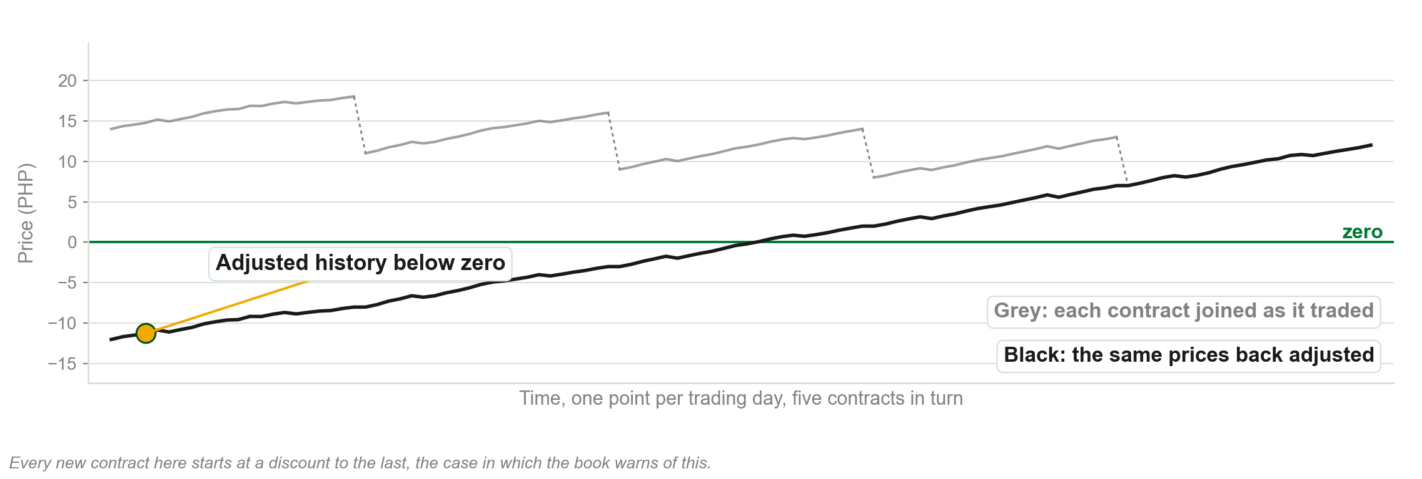
Back adjusting through several rolls
Chart F - FIN1209 teaching chart, drawn for this course. Illustrative data, not a real instrument.
Part 6 of 6 - Futures | 28 of 31

Slide 135
Continuous gold against the contract itself
FIGURE 3.39
The continuous, spread adjusted daily chart of gold above the December 2013 gold contract over the same period, with the OHLC readings for 7 November 2011 boxed on each and differing between the two.
The artwork is copyrighted and is not in the public repository. Build with assets/figures/ present to place it here.
Figure 3.39 - Lim, The Handbook of Technical Analysis (Wiley, 2016)
Part 6 of 6 - Futures | 29 of 31

Slide 136
NEW TERM
Perpetual contract
IN PLAIN WORDS
It never rewrites history, and it shows an estimated price, not the real one.
FOR EXAMPLE
Between two expiries, a perpetual series blends the nearby and further out contract prices by a weighting, so the value on the chart is not a price anyone traded at.
THE FORMAL DEFINITION
Perpetual contracts are not back shifted with each new front month contract. They display an estimated price rather than the current market price, interpolated between expiration dates by a weighting factor. That makes them useless for trading, but useful as a basis for constructing relative strength charts.
Part 6 of 6 - Futures | 30 of 31

Slide 137
Which chart for which job
Trading, and back or forward testing: the back-adjusted continuous chart.
An accurate record of what actually traded: the unadjusted nearest futures chart.
Relative strength charts: perpetual contracts, because back adjusting keeps shifting the ratio.
None of the three does every job.
Part 6 of 6 - Futures | 31 of 31

Slide 138
You now know
▪ Why futures exist and why they must be rolled
▪ When a contract is liquid, and reading volume on a continuous chart
▪ Front, next and back months, and the month codes
▪ Negative and positive roll yields
▪ Normal contango, normal backwardation and convergence
▪ Unadjusted, back-adjusted and perpetual charts
Part 6 of 6 - Futures | recap

Slide 139
Chapter 3 in five sentences
A chart filters each interval into four prices: open, high, low and close.
Supply and demand set the high and low; the clock sets the open and close.
A bar can close on time, range, volume, transactions or volatility.
Scaling moves every trendline, and the spread moves every entry.
Futures expire, each roll costs or pays, and no futures chart does every job.
Say those five and you can answer most of this chapter.
Chapter 3 - Wrap up

Slide 140
The review questions to prepare
How is OHLC data derived, and what increases its significance?
Why should traders normalize their charts for volatility?
Describe the five measures of constancy in charting.
How does chart scaling affect the use of overlay indicators?
How does the bid-ask spread affect the reward to risk ratio?
Link contango to negative roll yields; describe back-adjusted charts.
All eight of the book's questions, on six lines. Every one is answerable from this chapter.
Chapter 3 - Wrap up

Slide 141
What this chapter names and does not teach
Gann bars, Kagi charts and Gann swing charts.
The breadth and sentiment data items.
How the average true range is averaged, and how to estimate the expected spot price.
What a futures contract is, formally.
Nothing on this slide is examinable from Chapter 3.
Do not fill these from outside the book. Where the book takes one up later, we will too.
Chapter 3 - Wrap up

Slide 142
Next: market phase analysis
Chapter 4 studies the structure and behaviour of the three market phases.
Its objectives include reading a potential change of market regime from volume.
Before then: switch one chart between linear and ratio scaling and see which trendline breaks first.
FIN1209 Technical Analysis in Investment | Institute of Accounts, Business and Finance

