Slide 1
FIN1209 Technical Analysis in Investment
Chapter 9
Divergence Analysis
Institute of Accounts, Business and Finance | Far Eastern University Manila
Benjamin C. Sotelo

Slide 2
Part 1 of 7
Sample slides for approval
divergence
main data series
supporting data series
confirmation
price confirmation

Slide 3
Divergence: price and an indicator telling different stories
In Chapter 8 you met four kinds of divergence: standard and reverse, bullish and bearish. This chapter is the whole story behind them. Lim says divergence, used with other indicators, is one of the most effective ways of forecasting a reversal or a continuation in price (p. 267).
The idea is a comparison of two data series. The main data series is usually price, and the supporting data series is usually an oscillator or another indicator (p. 268). We ask whether the two agree. The oldest example is Dow Theory: the Industrials against the Transports (p. 267).
Divergence analysis: does the supporting series agree with price?
Part 1 of 7 - Chapter 9 samples | 1 of 10
Lim (2016), pp. 267 to 268; Chapter 8, "Divergence: when price and the oscillator disagree". The chart on the next slide is ours.

Slide 4
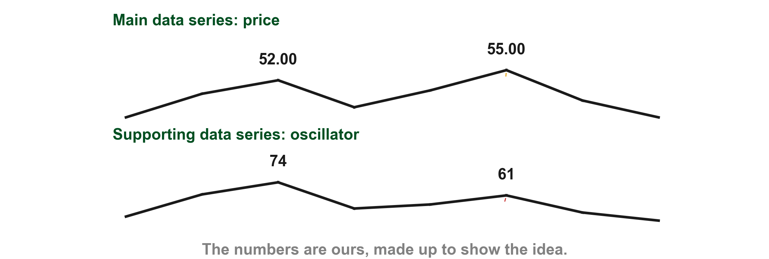
Here is a main and a supporting series that disagree
Numbers of ours, made up to show the idea. The main data series, price, makes a higher peak (1) while the supporting data series, an oscillator, makes a lower peak (2). Price alone looks strong, and the oscillator does not agree. That disagreement is what divergence analysis looks for.
1
2
Chart A - FIN1209 teaching chart, drawn for this course. Illustrative data, not a real instrument.
Part 1 of 7 - Chapter 9 samples | 2 of 10
FIN1209 teaching chart A. The numbers are invented for teaching.

Slide 5
Direction comes from comparing two adjacent peaks
To say two series disagree we first need each one's direction. Lim's test here compares two adjacent peaks, the next peak against the one before it (p. 270). Higher, as in the first pair (1), means the direction is up. Lower (2) means down. Level (3) means sideways.
Troughs work the same way (Figure 9.2). Lim uses this two-peak test only to find the current larger trend at the point of non-confirmation (p. 271).
1
FIGURE 9.1
Figure 9.1: three pairs of adjacent peaks. The second peak is higher than the first, so the direction is up. It is lower, so the direction is down. It is level, so the direction is sideways.
2
3
Higher peak: up. Lower peak: down. Equal peaks: sideways.
Figure 9.1 - Lim, The Handbook of Technical Analysis (Wiley, 2016)
Part 1 of 7 - Chapter 9 samples | 3 of 10
Lim (2016), pp. 269 to 271, Figure 9.1. The marks are ours, added for teaching.

Slide 6
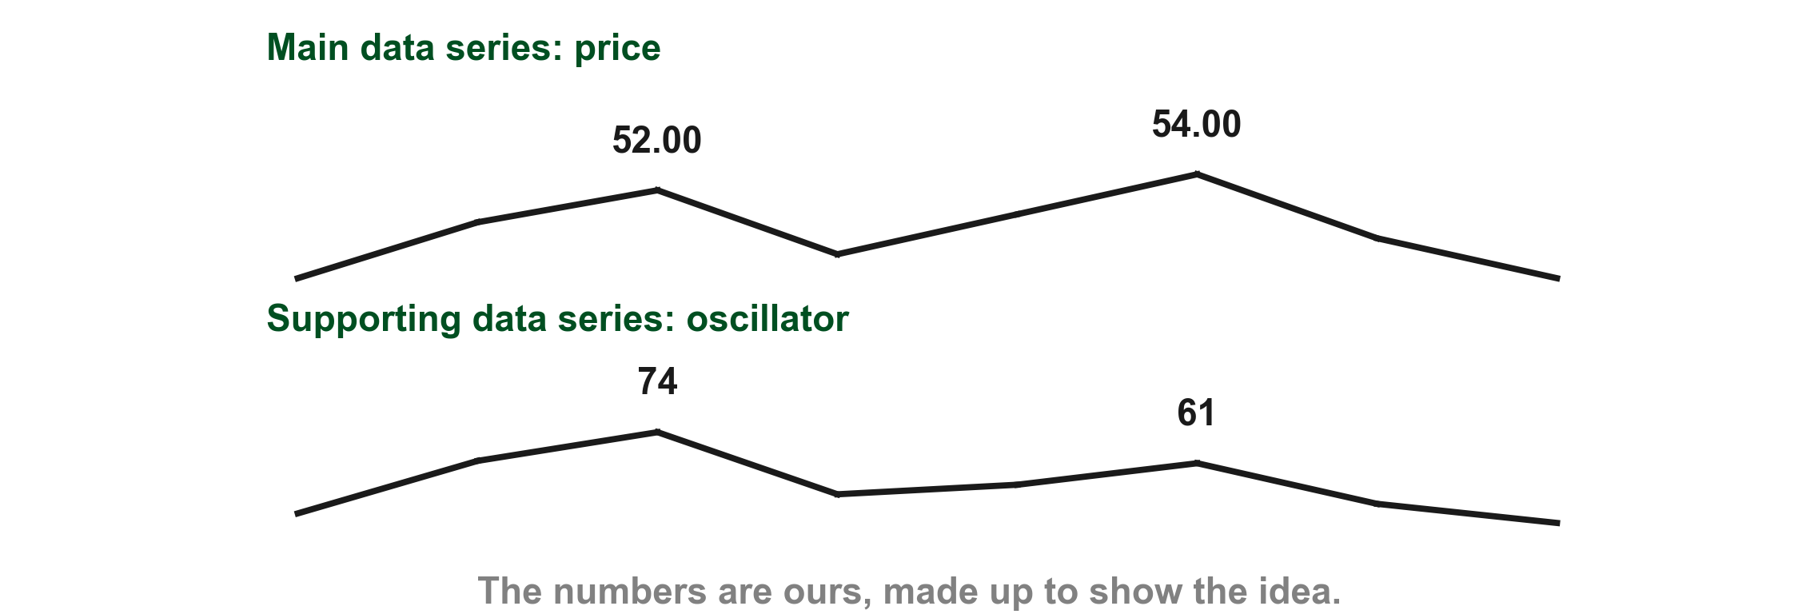
Let's find the direction of each series on our own numbers
Numbers of ours, made up to show the idea. Our price peaks at PHP 52.00 and then at PHP 54.00, so by the adjacent peak test its direction is up (1). The oscillator beside it peaks at 74 and then at 61, so its direction is down (2). One series is going up while the other goes down. Lim calls that non-confirmation (p. 273).
1
2
Chart B - FIN1209 teaching chart, drawn for this course. Illustrative data, not a real instrument.
Part 1 of 7 - Chapter 9 samples | 4 of 10
FIN1209 teaching chart B. The numbers are invented for teaching.

Slide 7
Let's find the direction of each series on our own numbers
A higher price peak against a lower oscillator peak is the standard bearish divergence from Chapter 8 (p. 291).
Chart B - FIN1209 teaching chart, drawn for this course. Illustrative data, not a real instrument.
Part 1 of 7 - Chapter 9 samples | 5 of 10
FIN1209 teaching chart B. The numbers are invented for teaching.

Slide 8
Confirmation and price confirmation are not the same thing
Lim uses both words in a very specific way (p. 273). Confirmation is about the two data series: it says whether the main and the supporting series agree in direction. Price confirmation is about price alone: it says price has broken through some barrier, which proves a setup is working.
We take them one at a time, each on its own chart.
Confirmation: the two series agree. Price confirmation: price breaks a barrier.
Part 1 of 7 - Chapter 9 samples | 6 of 10
Lim (2016), p. 273.

Slide 9
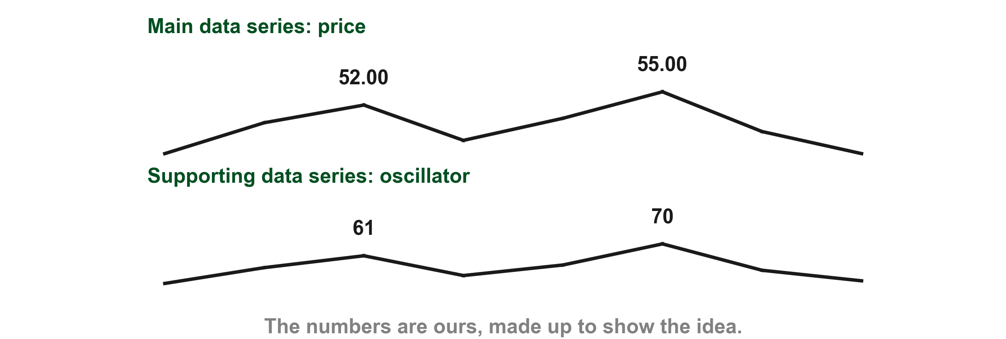
Confirmation: the two series agree
Numbers of ours, made up to show the idea. Price peaks at 52.00 and then at 55.00, direction up (1). The oscillator peaks at 61 and then at 70, direction up as well (2). The two agree, so Lim says there is confirmation, which suggests the current larger trend continues (pp. 273 to 274).
1
2
Chart C - FIN1209 teaching chart, drawn for this course. Illustrative data, not a real instrument.
Part 1 of 7 - Chapter 9 samples | 7 of 10
FIN1209 teaching chart C. The numbers are invented for teaching.

Slide 10
Figure 9.5 shows non-confirmation, price against an oscillator
This is the left half of Lim's figure. The price pair of peaks (1) goes up, because the second peak is higher. The oscillator pair (2) goes down, because its second peak is lower. The two series disagree.
Lim calls that non-confirmation, and says it implies a potential reversal or a weakening of the current larger trend (p. 274).
1
FIGURE 9.5
Figure 9.5, its left half: price above, with a higher second peak, and the oscillator below it, with a lower second peak. Mark 1 is the pair of price peaks and mark 2 the pair of oscillator peaks.
2
Non-confirmation: the two series disagree in direction.
Figure 9.5 - Lim, The Handbook of Technical Analysis (Wiley, 2016)
Part 1 of 7 - Chapter 9 samples | 8 of 10
Lim (2016), p. 274, Figure 9.5. The marks are ours, added for teaching.

Slide 11
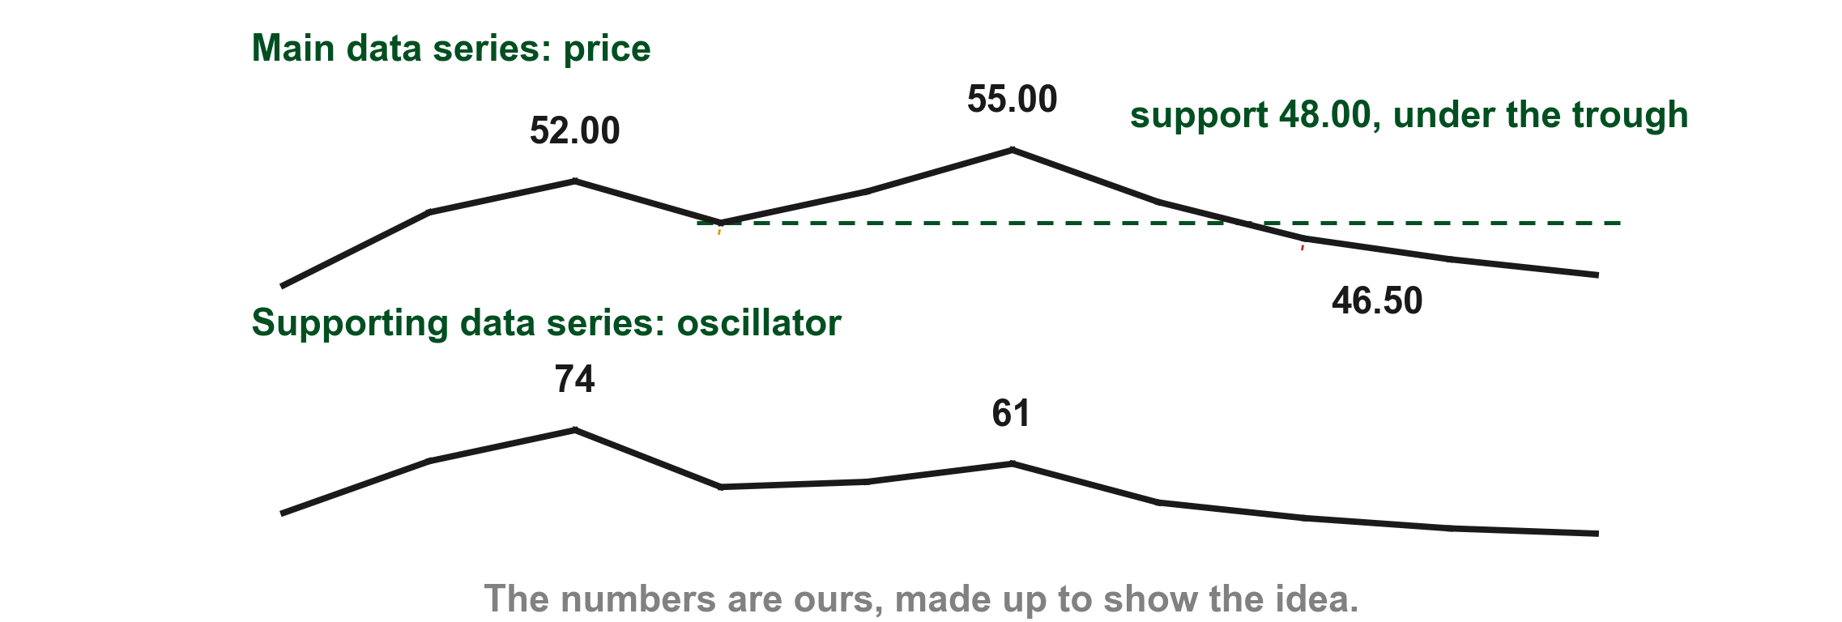
Price confirmation: price itself breaks a barrier
Numbers of ours, made up to show the idea. Take the divergence from the last chart: price peaks at 52.00 and 55.00 while the oscillator peaks at 74 and 61. The trough between the two price peaks, 48.00, is a support (1). Lim says the divergence is only a signal. Price confirmation is the trigger, and it comes when price alone breaks a significant barrier (p. 323).
1
Chart D - FIN1209 teaching chart, drawn for this course. Illustrative data, not a real instrument.
Part 1 of 7 - Chapter 9 samples | 9 of 10
FIN1209 teaching chart D. The numbers are invented for teaching.

Slide 12
Price confirmation: price itself breaks a barrier
Here price falls to 46.50, below the support (2). No indicator can confirm a divergence; only price can (p. 323).
2
Chart D - FIN1209 teaching chart, drawn for this course. Illustrative data, not a real instrument.
Part 1 of 7 - Chapter 9 samples | 10 of 10
FIN1209 teaching chart D. The numbers are invented for teaching.

