Slide 1
FIN1209 Technical Analysis in Investment
Chapter 9
Divergence Analysis
Institute of Accounts, Business and Finance | Far Eastern University Manila
Benjamin C. Sotelo
Notes:
- Chapter 9 is the full story of divergence, which Chapter 8 introduced in four kinds.
- It defines the terms, shows the figures and then looks at examples across markets.

Slide 2
Part 1 of 7
Sample slides for approval
divergence
main data series
supporting data series
confirmation
price confirmation
Notes:
- Say we are starting Part 1 of 7.
- Read the five terms, then move. Do not linger here.

Slide 3
Divergence: price and an indicator telling different stories
In Chapter 8 you met four kinds of divergence: standard and reverse, bullish and bearish. This chapter is the whole story behind them. Lim says divergence, used with other indicators, is one of the most effective ways of forecasting a reversal or a continuation in price (p. 267).
The idea is a comparison of two data series. The main data series is usually price, and the supporting data series is usually an oscillator or another indicator (p. 268). We ask whether the two agree. The oldest example is Dow Theory: the Industrials against the Transports (p. 267).
Divergence analysis: does the supporting series agree with price?
Part 1 of 7 - Chapter 9 samples | 1 of 10
Lim (2016), pp. 267 to 268; Chapter 8, "Divergence: when price and the oscillator disagree". The chart on the next slide is ours.
Notes:
- Open by saying what the chapter is: the full story of divergence, which Chapter 8 introduced in four kinds.
- Then show the picture of the claim on the next slide.

Slide 4
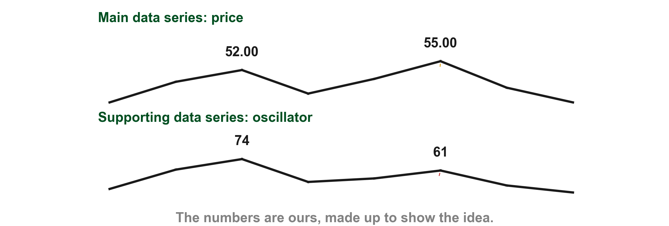
Here is a main and a supporting series that disagree
Numbers of ours, made up to show the idea. The main data series, price, makes a higher peak (1) while the supporting data series, an oscillator, makes a lower peak (2). Price alone looks strong, and the oscillator does not agree. That disagreement is what divergence analysis looks for.
1
2
Chart A - FIN1209 teaching chart, drawn for this course. Illustrative data, not a real instrument.
Part 1 of 7 - Chapter 9 samples | 2 of 10
FIN1209 teaching chart A. The numbers are invented for teaching.
Notes:
- Gold 1 the second price peak, 55.00 after 52.00. Red 2 the second oscillator peak, 61 after 74.

Slide 5
Direction comes from comparing two adjacent peaks
To say two series disagree we first need each one's direction. Lim's test here compares two adjacent peaks, the next peak against the one before it (p. 270). Higher, as in the first pair (1), means the direction is up. Lower (2) means down. Level (3) means sideways.
Troughs work the same way (Figure 9.2). Lim uses this two-peak test only to find the current larger trend at the point of non-confirmation (p. 271).
1
FIGURE 9.1
Figure 9.1: three pairs of adjacent peaks. The second peak is higher than the first, so the direction is up. It is lower, so the direction is down. It is level, so the direction is sideways.
2
3
Higher peak: up. Lower peak: down. Equal peaks: sideways.
Figure 9.1 - Lim, The Handbook of Technical Analysis (Wiley, 2016)
Part 1 of 7 - Chapter 9 samples | 3 of 10
Lim (2016), pp. 269 to 271, Figure 9.1. The marks are ours, added for teaching.
Notes:
- Gold 1 two peaks, the second higher: up. Red 2 the second lower: down. Blue 3 level: sideways.
- Lim says this two-peak test is used only for the current larger trend at the point of non-confirmation.

Slide 6
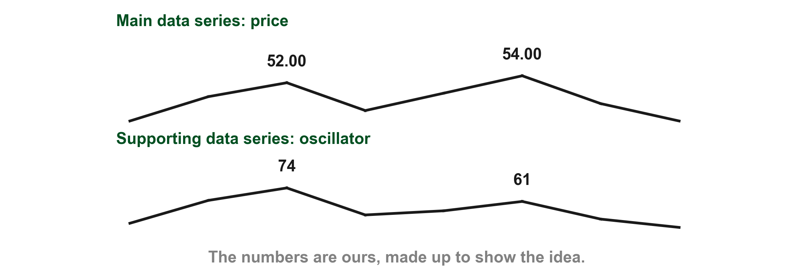
Let's find the direction of each series on our own numbers
Numbers of ours, made up to show the idea. Our price peaks at PHP 52.00 and then at PHP 54.00, so by the adjacent peak test its direction is up (1). The oscillator beside it peaks at 74 and then at 61, so its direction is down (2). One series is going up while the other goes down. Lim calls that non-confirmation (p. 273).
1
2
Chart B - FIN1209 teaching chart, drawn for this course. Illustrative data, not a real instrument.
Part 1 of 7 - Chapter 9 samples | 4 of 10
FIN1209 teaching chart B. The numbers are invented for teaching.
Notes:
- Gold 1 the price peaks, 52.00 then 54.00: up. Red 2 the oscillator peaks, 74 then 61: down.

Slide 7
Let's find the direction of each series on our own numbers
A higher price peak against a lower oscillator peak is the standard bearish divergence from Chapter 8 (p. 291).
Chart B - FIN1209 teaching chart, drawn for this course. Illustrative data, not a real instrument.
Part 1 of 7 - Chapter 9 samples | 5 of 10
FIN1209 teaching chart B. The numbers are invented for teaching.
Notes:
- Gold 1 the price peaks, 52.00 then 54.00: up. Red 2 the oscillator peaks, 74 then 61: down.

Slide 8
CHECK 1 OF 2
Direction from adjacent peaks
1
Q1
FIGURE 9.1
Figure 9.1: three pairs of adjacent peaks. The second peak is higher than the first, so the direction is up. It is lower, so the direction is down. It is level, so the direction is sideways.
In the figure, mark 2 is a pair of peaks with a lower second peak. What direction does Lim's test give it?
A. Down
B. Up
C. Sideways
D. No direction
2
Q2
Two adjacent peaks are at exactly the same height. What direction is that?
3
A. Up
B. Down
C. Sideways
D. Confirmation
Figure 9.1 - Lim, The Handbook of Technical Analysis (Wiley, 2016)
Part 1 of 7 - Chapter 9 samples | Check 1
Notes:
- Both answers come from the slides on the adjacent peak test.

Slide 9
ANSWERS
Direction from adjacent peaks
Q1 In the figure, mark 2 is a pair of peaks with a lower second peak. What direction does Lim's test give it?
1
FIGURE 9.1
Figure 9.1: three pairs of adjacent peaks. The second peak is higher than the first, so the direction is up. It is lower, so the direction is down. It is level, so the direction is sideways.
A. Down
A lower second peak means the direction is down (p. 270).
2
Q2 Two adjacent peaks are at exactly the same height. What direction is that?
C. Sideways
Equal peaks mean the direction is sideways, as in mark 3 (p. 270).
3
Figure 9.1 - Lim, The Handbook of Technical Analysis (Wiley, 2016)
Part 1 of 7 - Chapter 9 samples | Check 1
Notes:
- Both answers come from the slides on the adjacent peak test.

Slide 10
Confirmation and price confirmation are not the same thing
Lim uses both words in a very specific way (p. 273). Confirmation is about the two data series: it says whether the main and the supporting series agree in direction. Price confirmation is about price alone: it says price has broken through some barrier, which proves a setup is working.
We take them one at a time, each on its own chart.
Confirmation: the two series agree. Price confirmation: price breaks a barrier.
Part 1 of 7 - Chapter 9 samples | 6 of 10
Lim (2016), p. 273.
Notes:
- Two words that sound alike. Take the first alone, then the second.

Slide 11
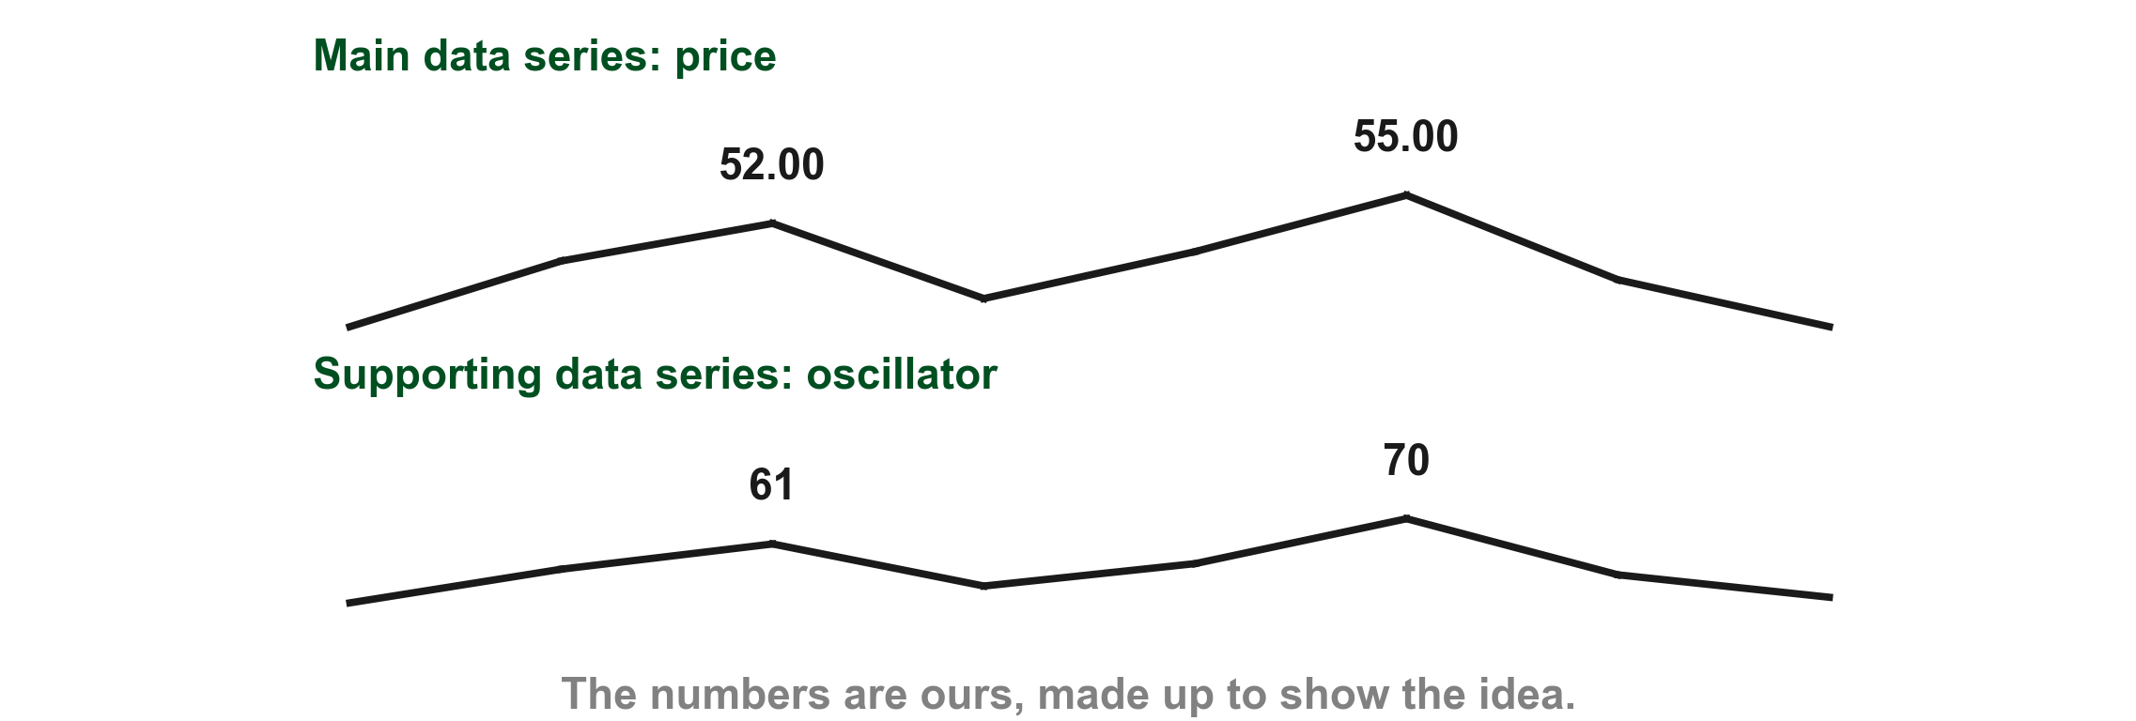
Confirmation: the two series agree
Numbers of ours, made up to show the idea. Price peaks at 52.00 and then at 55.00, direction up (1). The oscillator peaks at 61 and then at 70, direction up as well (2). The two agree, so Lim says there is confirmation, which suggests the current larger trend continues (pp. 273 to 274).
1
2
Chart C - FIN1209 teaching chart, drawn for this course. Illustrative data, not a real instrument.
Part 1 of 7 - Chapter 9 samples | 7 of 10
FIN1209 teaching chart C. The numbers are invented for teaching.
Notes:
- Gold 1 the price peaks, 52.00 then 55.00. Red 2 the oscillator peaks, 61 then 70. Both up.

Slide 12
Figure 9.5 shows non-confirmation, price against an oscillator
This is the left half of Lim's figure. The price pair of peaks (1) goes up, because the second peak is higher. The oscillator pair (2) goes down, because its second peak is lower. The two series disagree.
Lim calls that non-confirmation, and says it implies a potential reversal or a weakening of the current larger trend (p. 274).
1
FIGURE 9.5
Figure 9.5, its left half: price above, with a higher second peak, and the oscillator below it, with a lower second peak. Mark 1 is the pair of price peaks and mark 2 the pair of oscillator peaks.
2
Non-confirmation: the two series disagree in direction.
Figure 9.5 - Lim, The Handbook of Technical Analysis (Wiley, 2016)
Part 1 of 7 - Chapter 9 samples | 8 of 10
Lim (2016), p. 274, Figure 9.5. The marks are ours, added for teaching.
Notes:
- Gold 1 the price peaks, the second higher. Red 2 the oscillator peaks, the second lower.
- Lim: non-confirmation implies a potential reversal or weakening of the current larger trend.

Slide 13
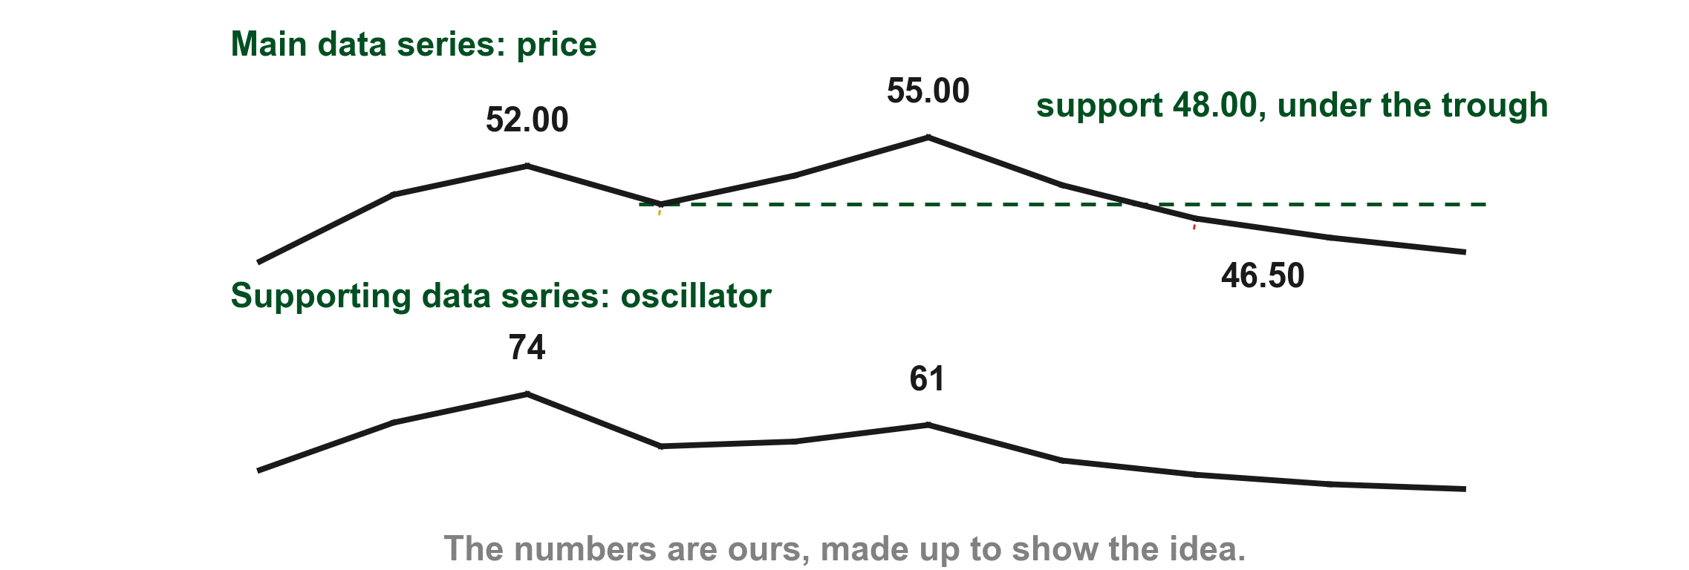
Price confirmation: price itself breaks a barrier
Numbers of ours, made up to show the idea. Take the divergence from the last chart: price peaks at 52.00 and 55.00 while the oscillator peaks at 74 and 61. The trough between the two price peaks, 48.00, is a support (1). Lim says the divergence is only a signal. Price confirmation is the trigger, and it comes when price alone breaks a significant barrier (p. 323).
1
Chart D - FIN1209 teaching chart, drawn for this course. Illustrative data, not a real instrument.
Part 1 of 7 - Chapter 9 samples | 9 of 10
FIN1209 teaching chart D. The numbers are invented for teaching.
Notes:
- Gold 1 the support at 48.00, the trough between the price peaks. Red 2 price at 46.50, below it.

Slide 14
Price confirmation: price itself breaks a barrier
Here price falls to 46.50, below the support (2). No indicator can confirm a divergence; only price can (p. 323).
2
Chart D - FIN1209 teaching chart, drawn for this course. Illustrative data, not a real instrument.
Part 1 of 7 - Chapter 9 samples | 10 of 10
FIN1209 teaching chart D. The numbers are invented for teaching.
Notes:
- Gold 1 the support at 48.00, the trough between the price peaks. Red 2 price at 46.50, below it.

Slide 15
CHECK 2 OF 2
Confirmation and price confirmation
Q1
1
In the figure, price peaks rise and oscillator peaks fall. What does Lim call that?
FIGURE 9.5
Figure 9.5, its left half: price above, with a higher second peak, and the oscillator below it, with a lower second peak. Mark 1 is the pair of price peaks and mark 2 the pair of oscillator peaks.
A. Confirmation
B. Non-confirmation
C. Price confirmation
D. Sideways direction
2
Q2
A setup shows non-confirmation. What proves it is working?
A. The oscillator turns back up
B. A second indicator agrees
C. The two series move together
D. Price breaks a significant barrier
Figure 9.5 - Lim, The Handbook of Technical Analysis (Wiley, 2016)
Part 1 of 7 - Chapter 9 samples | Check 2
Notes:
- Both answers come from the slides on direction, confirmation and price confirmation.

Slide 16
ANSWERS
Confirmation and price confirmation
Q1 In the figure, price peaks rise and oscillator peaks fall. What does Lim call that?
1
FIGURE 9.5
Figure 9.5, its left half: price above, with a higher second peak, and the oscillator below it, with a lower second peak. Mark 1 is the pair of price peaks and mark 2 the pair of oscillator peaks.
B. Non-confirmation
One series is going up and the other down, so they disagree. Lim calls that non-confirmation (p. 273).
Q2 A setup shows non-confirmation. What proves it is working?
2
D. Price breaks a significant barrier
That is price confirmation: only price, never an indicator, confirms a divergence (p. 323).
Figure 9.5 - Lim, The Handbook of Technical Analysis (Wiley, 2016)
Part 1 of 7 - Chapter 9 samples | Check 2
Notes:
- Both answers come from the slides on direction, confirmation and price confirmation.

