Slide 1
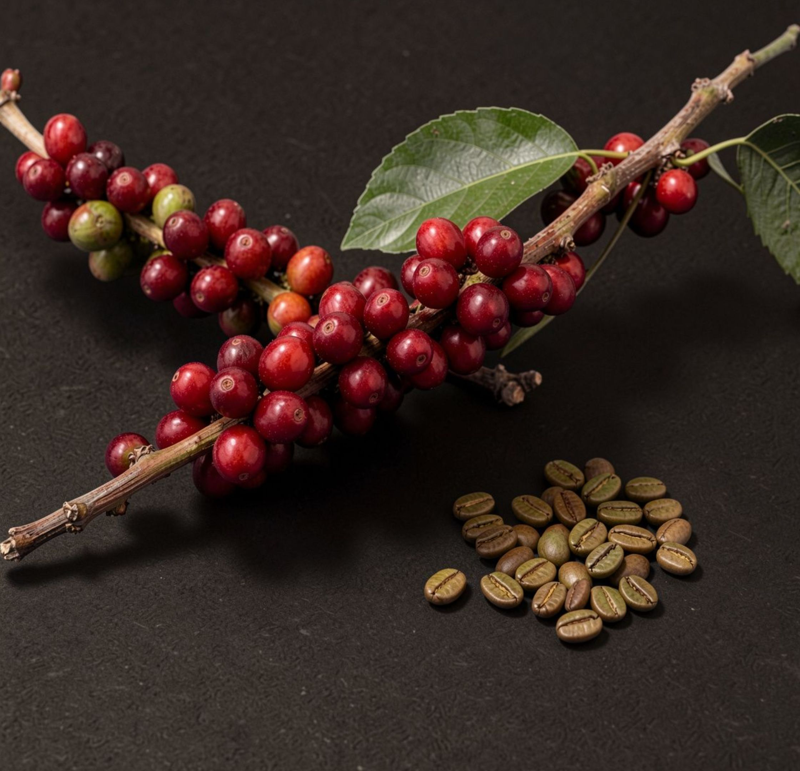
WEEK 3 · PROJECT 1
COFFEE LAND vs PRICE
EDA & SQL PROJECT PRESENTATION
BY RIZKI FIRDAUS
2 OCTOBER 2026
Notes:
Introduce the project as a comparison between coffee land, yield, and price across the upstream part of the coffee trade.

Slide 2
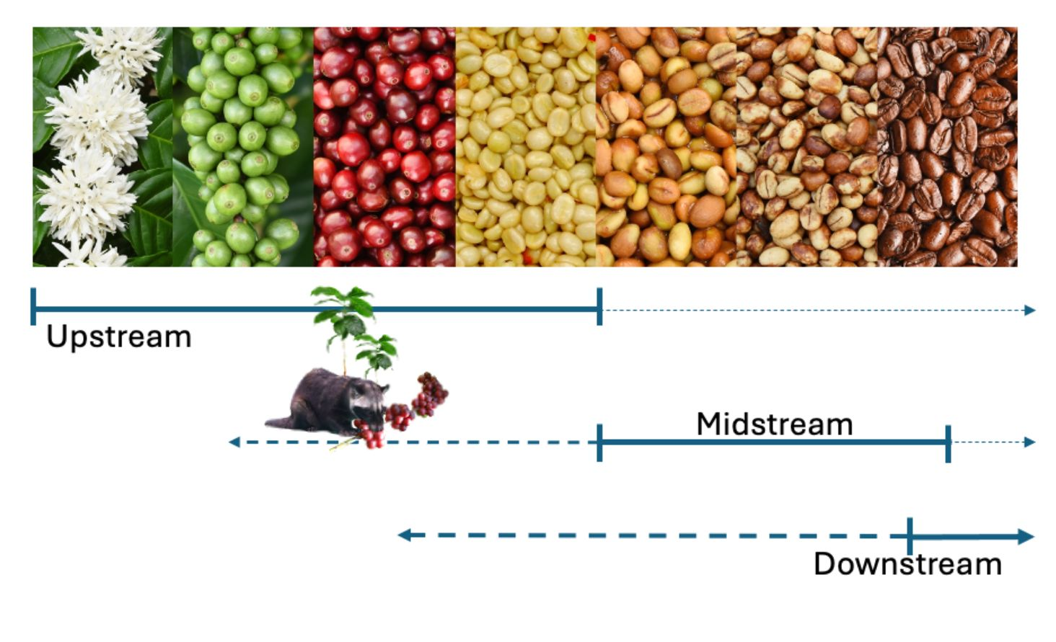
- COFFEE LAND VS PRICE -
THE COFFEE CHAIN
FROM FARM TO CUP
What drives coffee’s export price?
Do bigger, more efficient growers sell cheaper?
Do buyers pay more than sellers actually get?
IRONHACK | WEEK 3 | PROJECT 1
2 OCTOBER 2026
EDA & SQL PROJECT PRESENTATION by RIZKI FIRDAUS
Notes:
Use this flow to orient the audience: the project follows coffee from production and export through trade movement to roasting, retail, and the final cup, while the analysis stays upstream.

Slide 3
- COFFEE LAND VS PRICE -
THREE OFFICIAL RECORDS :
GREEN COFFEE PRODUCTION, PROCESSED GREEN BEANS, AND TRADE
64
203
41,179
IRONHACK | WEEK 3 | PROJECT 1
2 OCTOBER 2026
years
1961–2024
countries
represented in the coffee chain
official values
8,082 production rows
33,097 trade rows
SOURCE: FAOSTAT ANALYTICAL DATA.
EDA & SQL PROJECT PRESENTATION by RIZKI FIRDAUS
Notes:
The dataset combines a long historical range with broad country coverage and separate production and trade records.

Slide 4
- COFFEE LAND VS PRICE -
SOURCE DOWNLOAD
DATA QUALITY
IGNORE
KEEP
RESULT
Estimated or unverified values
Officially verified values
Processed dataset
IRONHACK | WEEK 3 | PROJECT 1
2 OCTOBER 2026
Inputs that do not meet the verification rule.
Inputs that remain comparable across the analysis.
Two usable data records inputs remained after filtering.
EDA & SQL PROJECT PRESENTATION by RIZKI FIRDAUS
Notes:
The filter is deliberately strict. Verified values stay; estimated or unverified values are ignored; the processed dataset is reduced to two usable inputs.

Slide 5
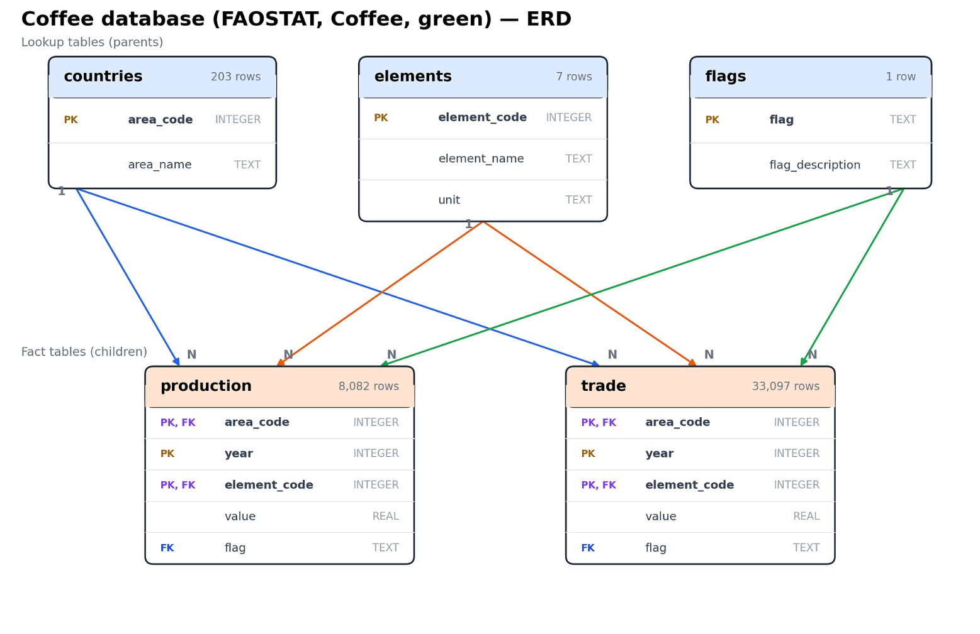
- COFFEE LAND VS PRICE -
DATA MODEL
HOW THE COFFEE DATA CONNECTS
Reference tables hold countries, measurements, and data-quality flags.
Record tables hold production and import/export price observations.
Linked keys connect each observation to its country, year, measurement, and source.
IRONHACK | WEEK 3 | PROJECT 1
2 OCTOBER 2026
ENTITY RELATIONAL DIAGRAM (ERD)
SOURCE: SUPPLIED POWERPOINT CONTENT
EDA & SQL PROJECT PRESENTATION by RIZKI FIRDAUS
Notes:
Read the ERD as the traceability layer behind the analysis. The image is the supplied coffee database diagram; do not infer entities or relationships beyond what it shows.

Slide 6
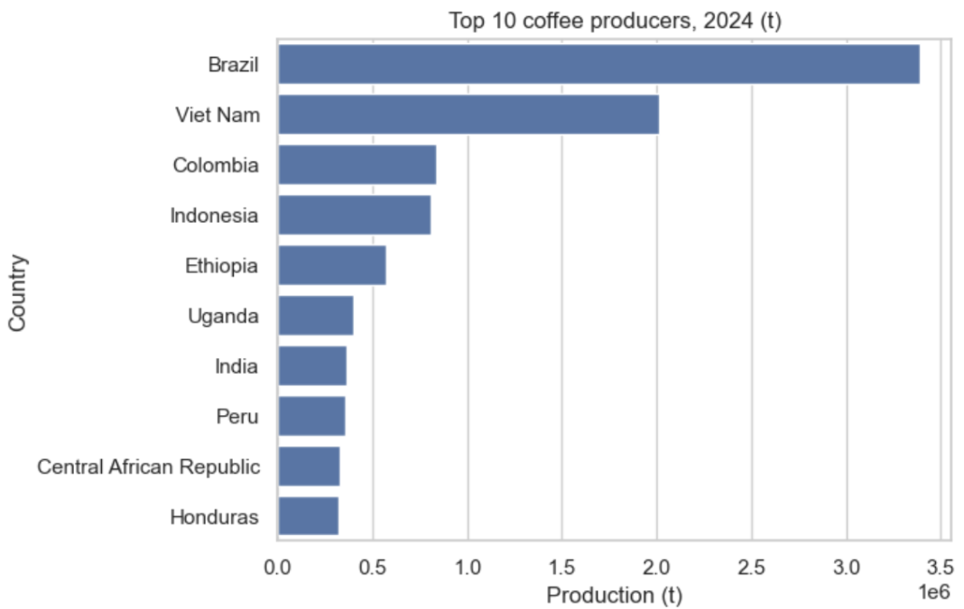
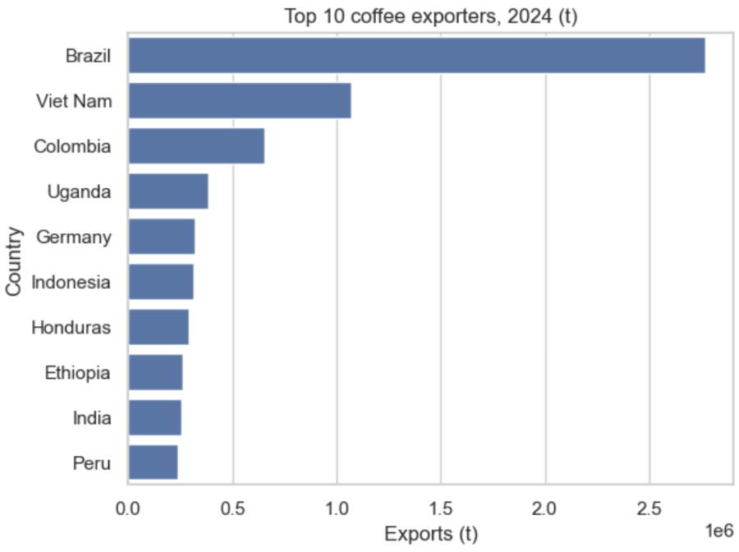
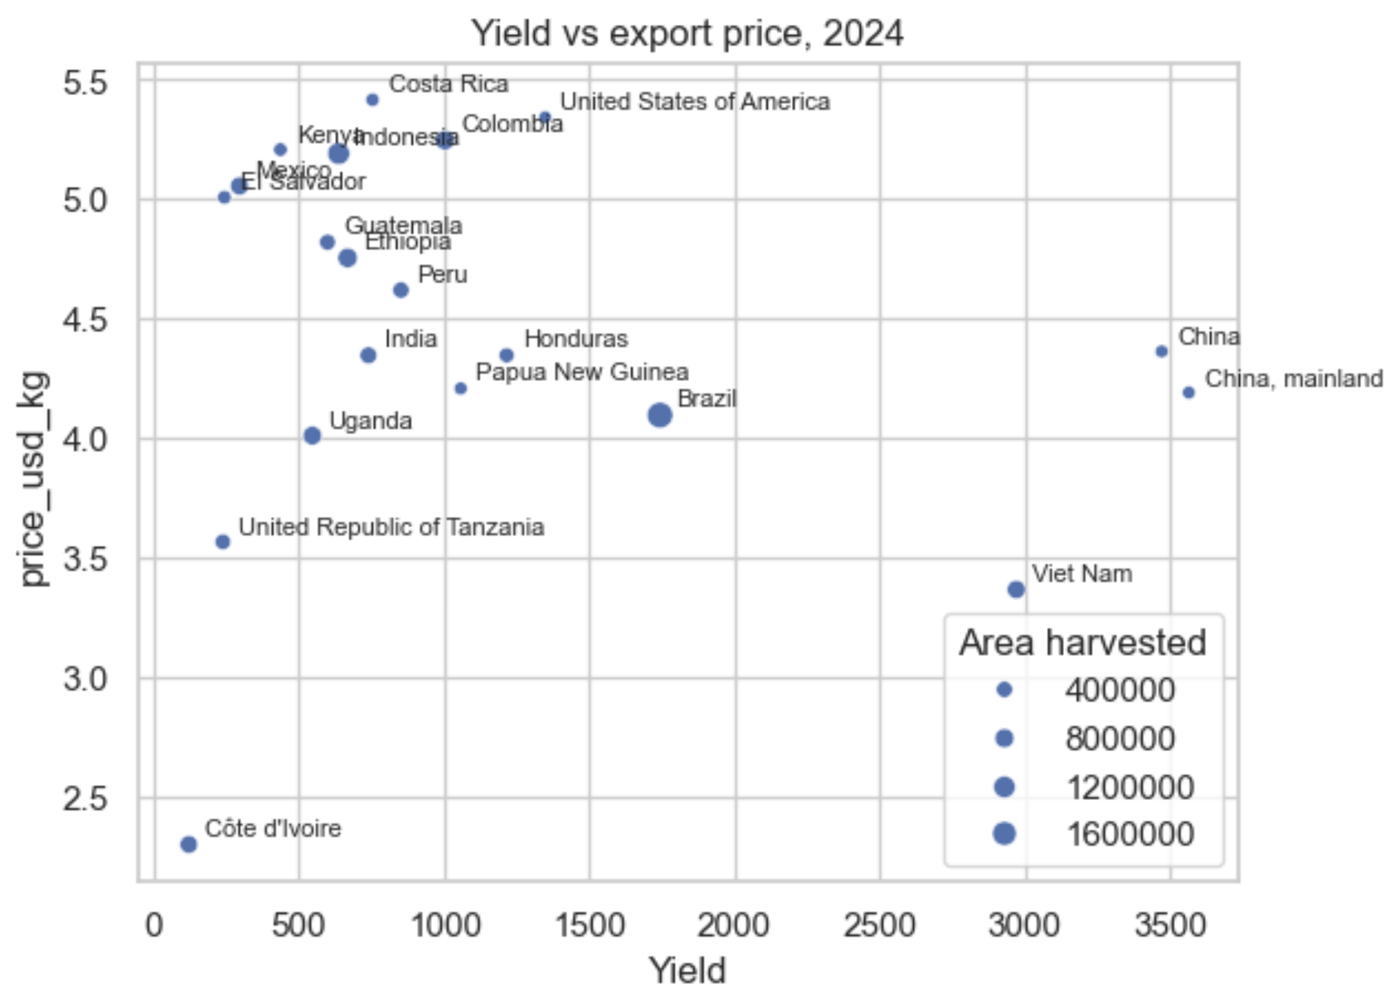
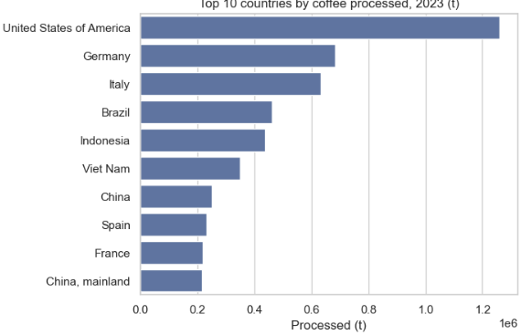
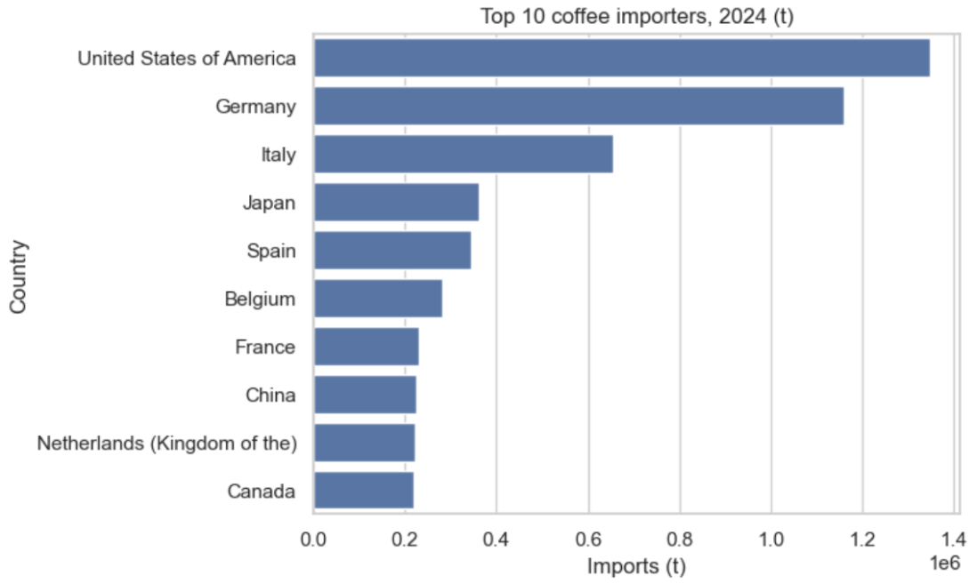
- COFFEE LAND VS PRICE -
FINDINGS
Top 10 coffee producers, 2024 (tonnes)
Top 10 coffee exporters, 2024 (tonnes)
Yield vs export price, 2024 (tonnes)
Top 10 processed-green beans volume , 2024 (tonnes)
Top 10 coffee importers, 2024 (tonnes)
IRONHACK | WEEK 3 | PROJECT 1 | EDA & SQL PROJECT PRESENTATION by RIZKI FIRDAUS | FRIDAY, 2 OCTOBER 2026

Slide 7
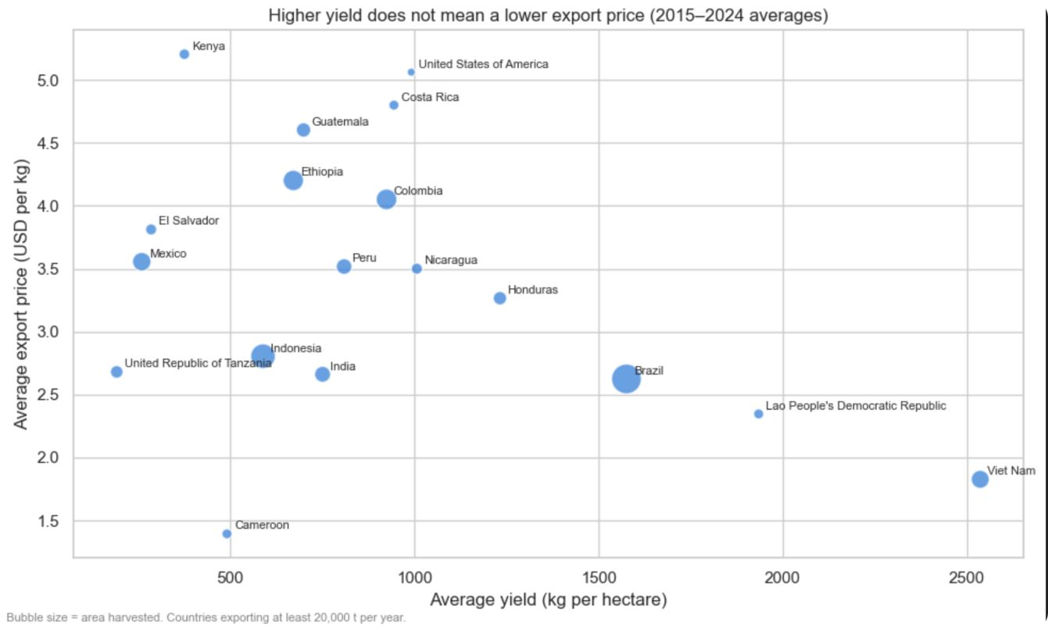
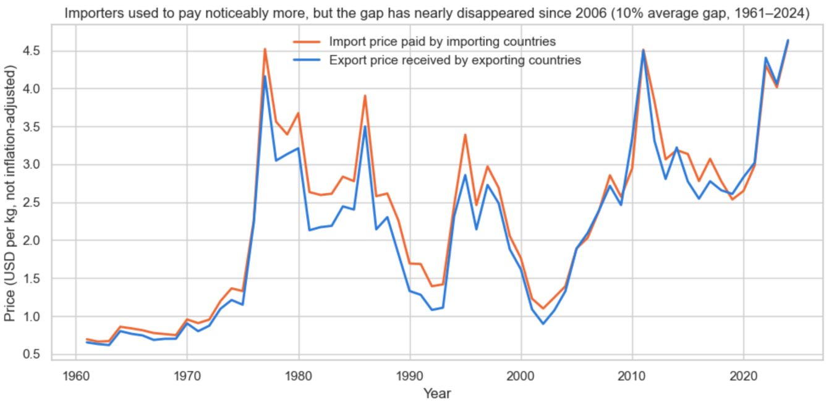
- COFFEE LAND VS PRICE -
CONCLUSIONS
Do more land or higher yield mean a lower export price?
Weakly supported. Larger, higher-yield producers tend to sell a little cheaper, but the relationship is weak and inconsistent across all 18 countries.
Area correlation: −0.16 · Yield correlation: −0.26
Viet Nam: highest yield 2,536 kg/ha, cheapest price $1.83/kg. Kenya: lowest yield 376 kg/ha, highest price $5.21/kg.
Do importers pay more per kg than exporters receive?
Partly supported. Importers paid more in 54 of 64 years (84%), but the gap did not grow.
The gap peaked around 1990 at +27% and nearly disappeared by 2024 at −0.5%.
• FAIR TRADE
• DIRECT TRADE
• FARM TO TABLE
IRONHACK | WEEK 3 | PROJECT 1 | EDA & SQL PROJECT PRESENTATION by RIZKI FIRDAUS | FRIDAY, 2 OCTOBER 2026

Slide 8
- COFFEE LAND VS PRICE -
WHATS NEXT
IRONHACK | WEEK 3 | PROJECT 1
2 OCTOBER 2026
• Arabica vs. robusta is not distinguished in the data.
• Build a tech-access index and re-run the yield–price test against the total yield of coffee farmers with ‘better tech’.
EDA & SQL PROJECT PRESENTATION by RIZKI FIRDAUS

Slide 9

T H A N K Y O U .
IRONHACK | WEEK 3 | PROJECT 1 | COFFEE LAND VS PRICE | EDA & SQL PROJECT PRESENTATION by RIZKI FIRDAUS | FRIDAY, 2 OCTOBER 2026

