Slide 1
From Green Bean to Cup Score
Predicting the cupping score of green coffee with machine learning
Project 2 · Machine Learning: From Data to Predictions
Ironhack · Data Science & Machine Learning
Rizki Firdaus · October 2026

Slide 2
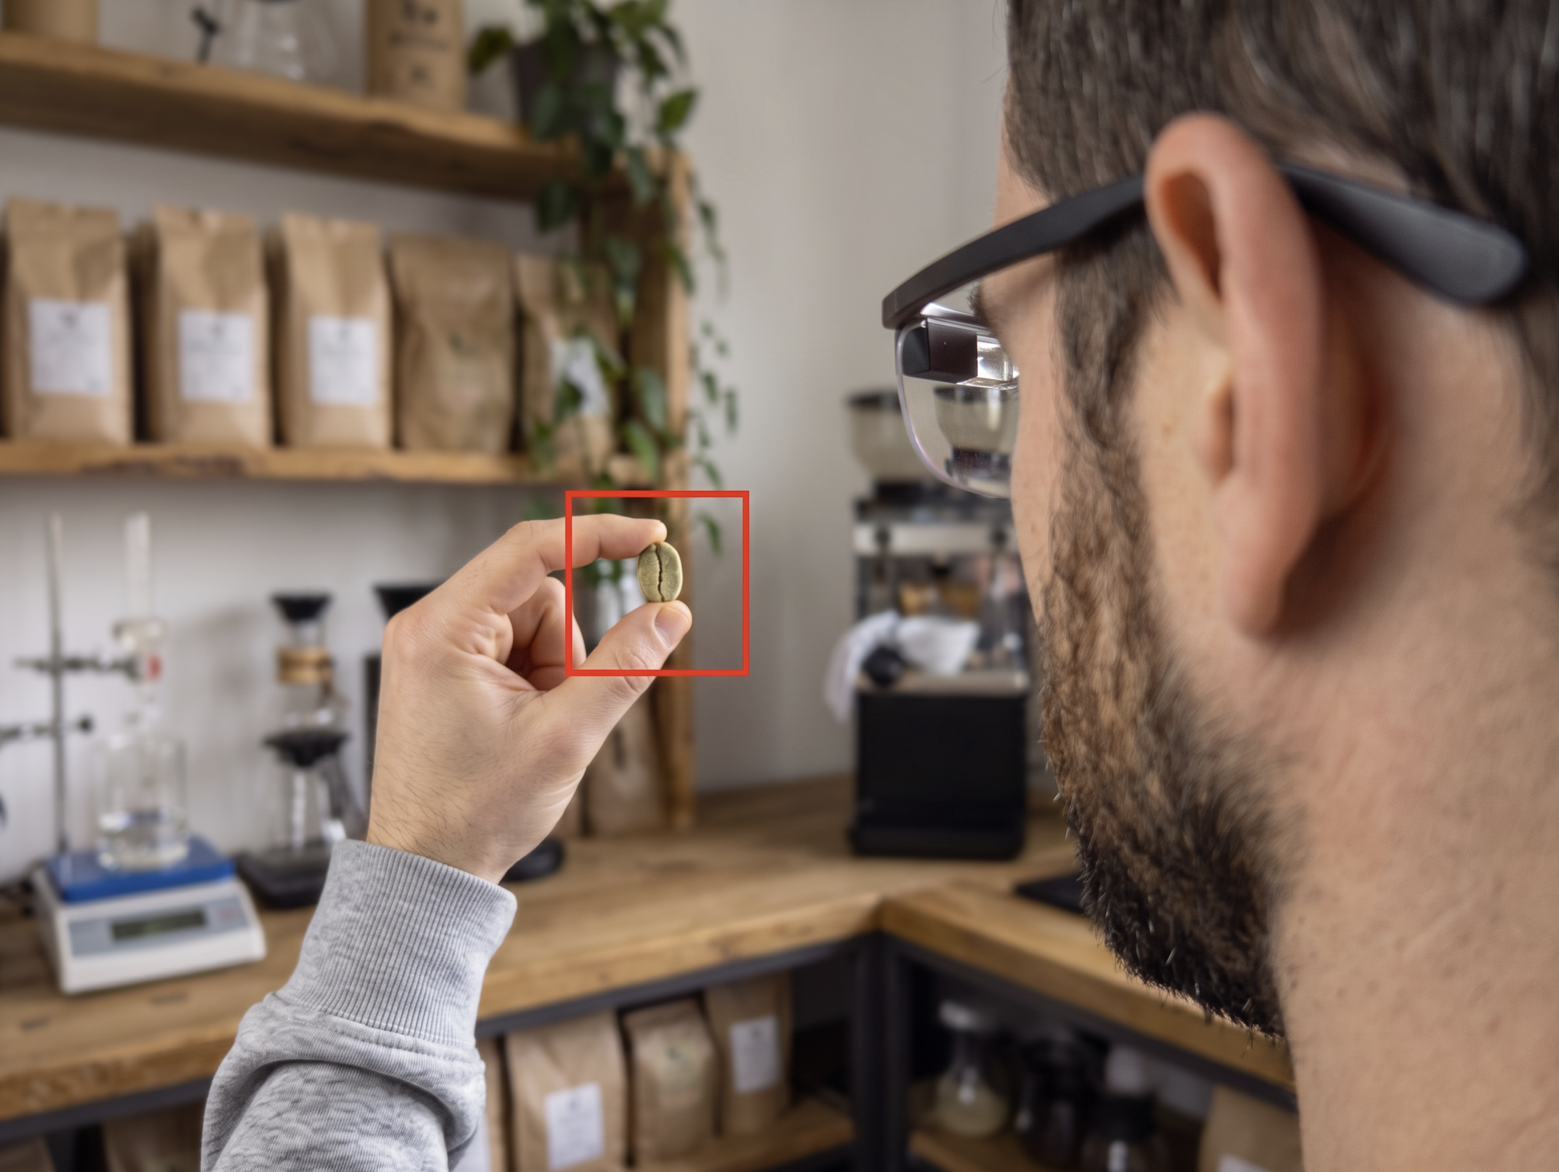

Slide 3
Identity and origin:
country,
altitude,
region,
species,
variety or cultivar,
+ farm or lot, harvest year
+ total coffee harvested
Composition:
caffeine,
chlorogenic acids,
trigonelline,
protein,
lipids,
sugars,
+ other measured chemistry
Processing technology:
washed, natural, honey, wet-hulled, anaerobic and fermentations, carbonic maceration, civet (luwak) processing, drying method

Slide 4
Identity and origin:
country,
altitude,
region,
species,
variety or cultivar,
+ farm or lot, harvest year
+ total coffee harvested
Composition:
caffeine,
chlorogenic acids,
trigonelline,
protein,
lipids,
sugars,
+ other measured chemistry
Processing technology:
washed, natural, honey, wet-hulled, anaerobic and fermentations, carbonic maceration, civet (luwak) processing, drying method
Final Cup Score:
93

Slide 5
Visual Identification
  Size
  Colour

Slide 6
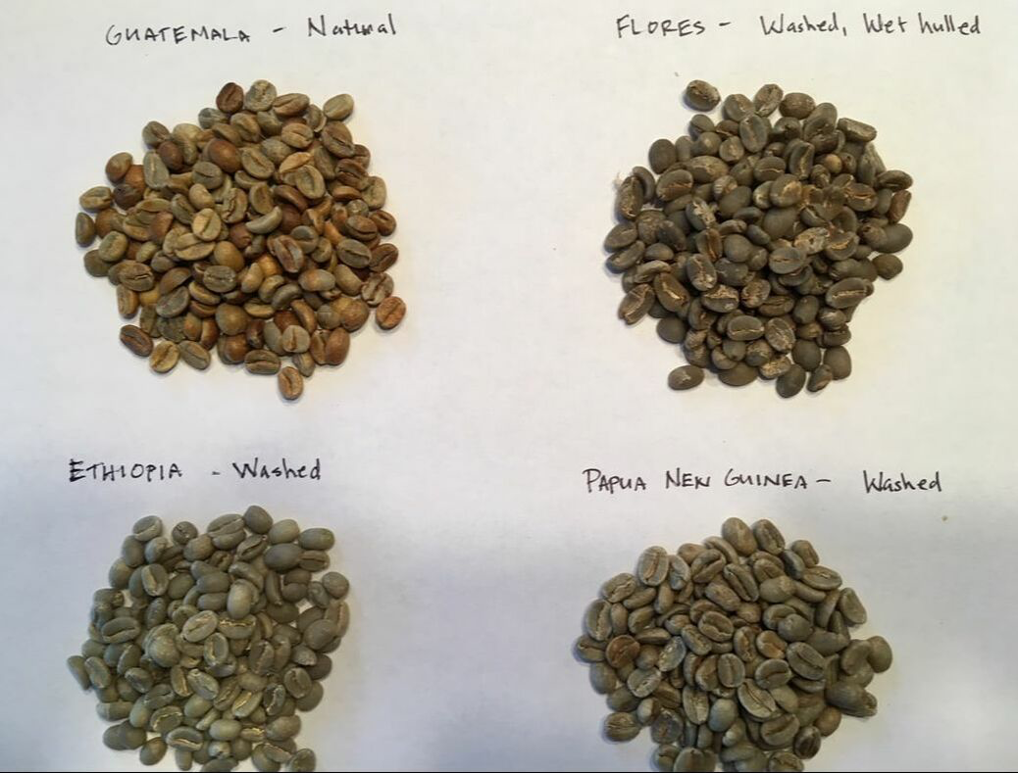
Visual Identification
  Size
  Colour

Slide 7
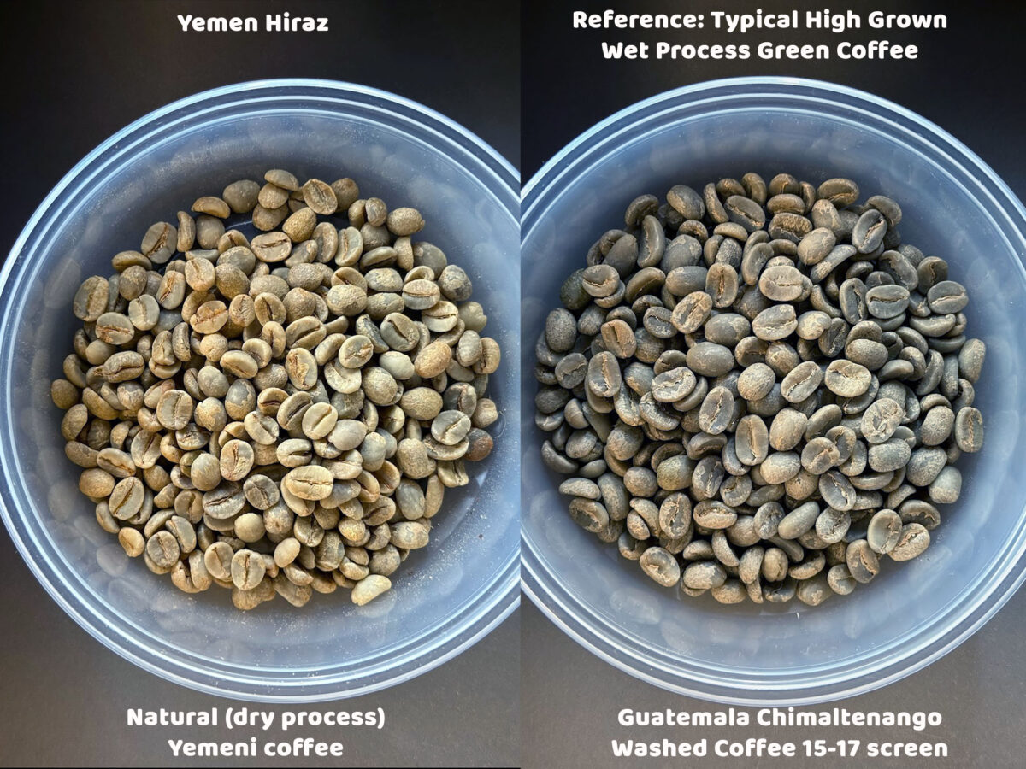
Visual Identification
  Size
  Colour

Slide 8
Final Cup Score:
__

Slide 9
Identity and origin:
country,
altitude,
region,
species,
variety or cultivar,
+ farm or lot, harvest year
+ total coffee harvested
Composition:
caffeine,
chlorogenic acids,
trigonelline,
protein,
lipids,
sugars,
+ other measured chemistry
Processing technology:
washed, natural, honey, wet-hulled, anaerobic and fermentations, carbonic maceration, civet (luwak) processing, drying method
Final Cup Score:
__

Slide 10
Identity and origin:
country,
altitude,
region,
species,
variety or cultivar,
+ farm or lot, harvest year
+ total coffee harvested
Composition:
caffeine,
chlorogenic acids,
trigonelline,
protein,
lipids,
sugars,
+ other measured chemistry
Processing technology:
washed, natural, honey, wet-hulled, anaerobic and fermentations, carbonic maceration, civet (luwak) processing, drying method
Final Cup Score:
__

Slide 11
The Data

