Slide 1
Writing Recursive Queries
Retrieving Hierarchy Data from Relational Tables
Ben Lis
PostgresConf US 2019

Slide 2
Is this Talk Right for You?
What we will cover
What you should know
Why we need recursive queries
How they work
How to write them
Basic knowledge of SQL through outer joins
General programming concepts
Slides and SQL:
https://github.com/benjlis/talk-writing-recursive-queries

Slide 3
About ME
Data Engineer at LEI Smart
Writes recursive queries on corporate hierarchy data
Initially found recursive SQL a bit confusing
Using PostgreSQL since 2015
Started working with Oracle databases in 1988!
Adjunct Associate Faculty in Applied Analytics at Columbia University
Held various technical, product, and management roles on Wall Street
LinkedIn and Twitter

Slide 4
Agenda
Motivation
Understanding Recursive SQL
Writing Recursive Queries
Next Steps
Questions & Discussion

Slide 5
Motivation
Why we need recursive SQL

Slide 6

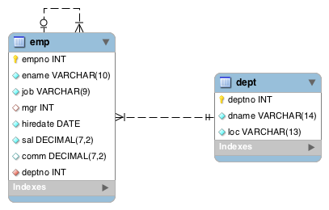
HR Database
hrex-create.sql

Slide 7
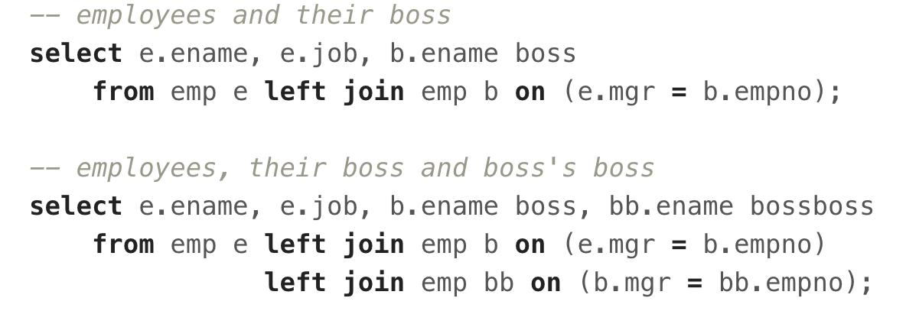
Let’s QUERY EMPLOYEEs, THEIR BOSS & THE Boss's Boss
boss-queries.sql

Slide 8


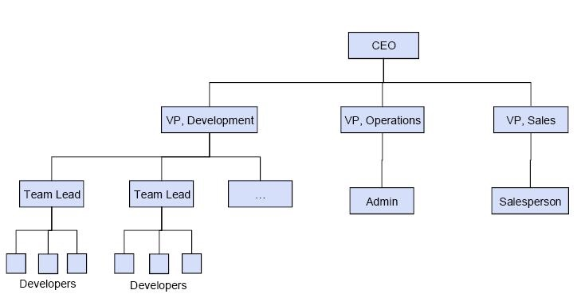
Let’s Query EMPLOYEES’ Entire Reporting Line
Hmmm… how do we do that?

Slide 9
Idea 1: extend current approach
“Add a few more JOINs”
Need to know the number of hierarchy levels in advance
Not realistic or robust!

Slide 10
Idea 2: Write a Program
Use Python, Java, PL/pgSQL, etc.
Query all employees
For each employee get their boss’s record and then their boss’s boss’s record, etc. until you get a NULL
Complex and resource consumptive!

Slide 11
Shouldn’t we be able to write this Query in SQL?

Slide 12
we SHOULD be able to Write this Query in SQL
In the early days (decades) of SQL & relational databases we couldn’t
Writing a program (Idea 2) was the only solution
Other names for the hierarchy problem:
Transitive Closure
Bill of Materials
Parts Explosion
Good news: We can write this query in modern SQL using recursive SQL!

Slide 13
Understanding Recursive SQL
Key Ideas, CTE, Syntax, structure & Evaluation

Slide 14
Recursive SQL Support
Part of ISO Standard SQL
Introduced in SQL:1999 (aka SQL 3)
Supported in
PostgreSQL
Oracle
SQL Server
DB2

Slide 15
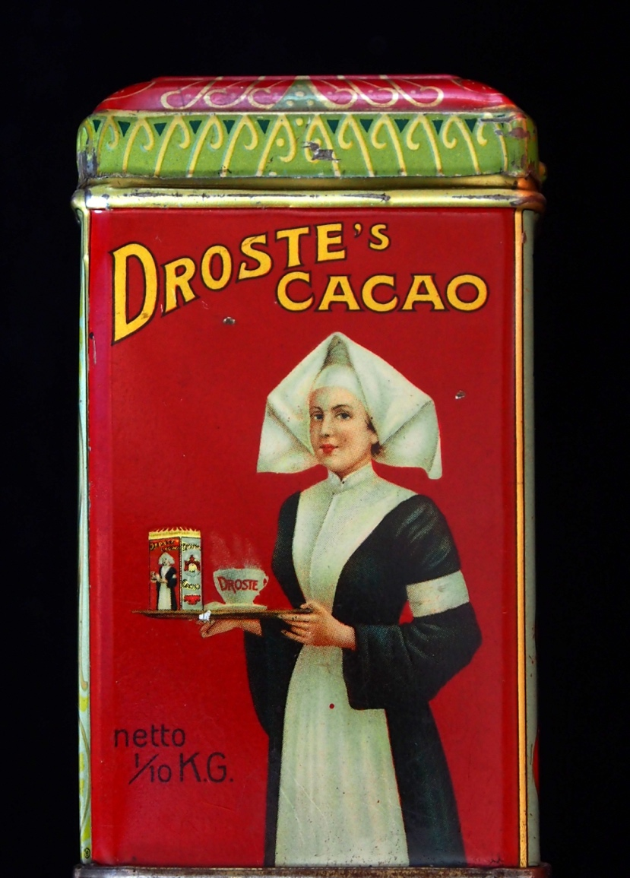
Key Ideas
re·cur·sive /rəˈkərsiv/: a program or routine of which a part requires the application of the whole, so that its explicit interpretation requires in general many successive executions
Self-referencing
Your Bosses = Your Manager + Your Manager’s Bosses
Recursive SQL is an iterative process
Think while loops
But SQL is declarative!!!!
Tip: Put aside knowledge of recursion in programming
Recursive SQL uses Common Table Expressions (CTEs)

Slide 16
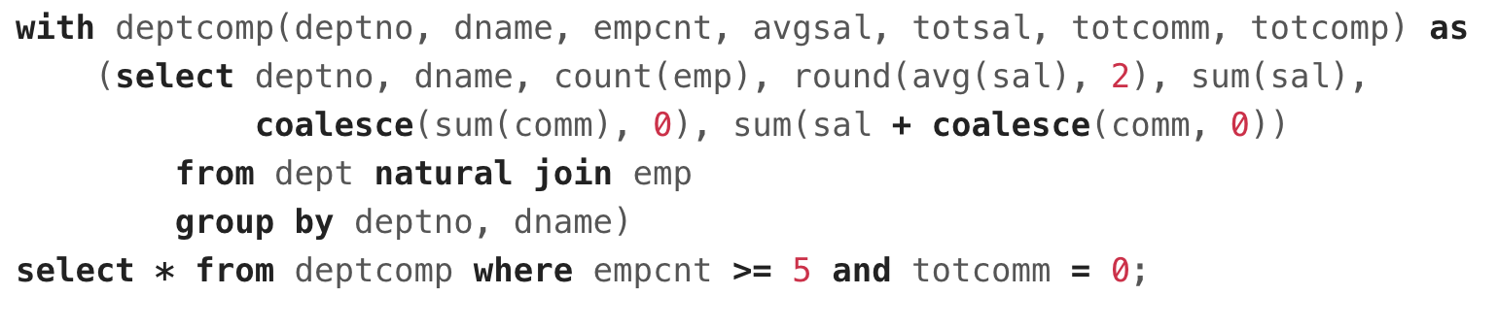
Common Table expression (CTE) Example
cte.sql
Primarily used to simplify queries
Think of as inline view(s)

Slide 17
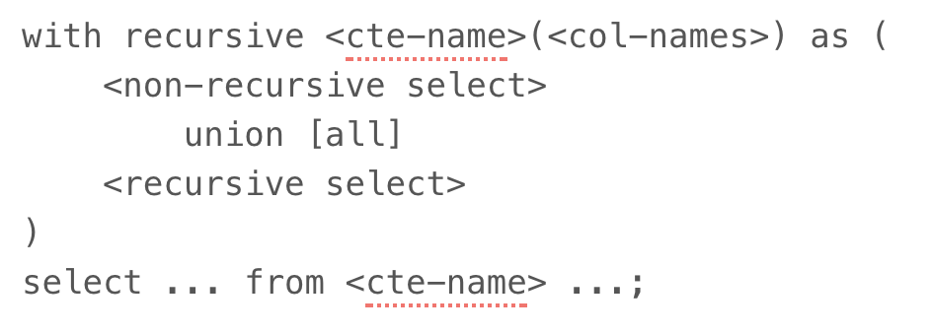
RECURSIVE CTE Structure
Keyword: recursive
Always a UNION or UNION ALL of
Non-recursive select
Recursive select

Slide 18
Non-recursive select
Evaluated 1st - where we start
FROM clause:
Must not refer to <cte-name>
Refers to table containing hierarchy

Slide 19
recursive select
Evaluated 2..N times
FROM clause:
Must reference <cte-name>
Join of the <cte-name> and table containing hierarchy
N is a function of the data and the recursive select’s where clause
Think of DB engine dynamically adding correct # of joins to FROM

Slide 20
RECURSIVE CTE EVALUATION
QR = Query Results; WT = Working Table
Both initially empty
Execute <non-recursive select>
Add results to QR and WT
Repeat until WT is empty
Execute <recursive select> using WT data for <cte-name>
Add results to QR
Replace WT with results

Slide 21
WRITING Recursive Queries
Let’s Get down to it!

Slide 22
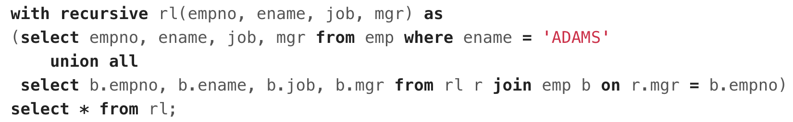
What is ADAMS REPORTING LINE?
rl.sql

Slide 23
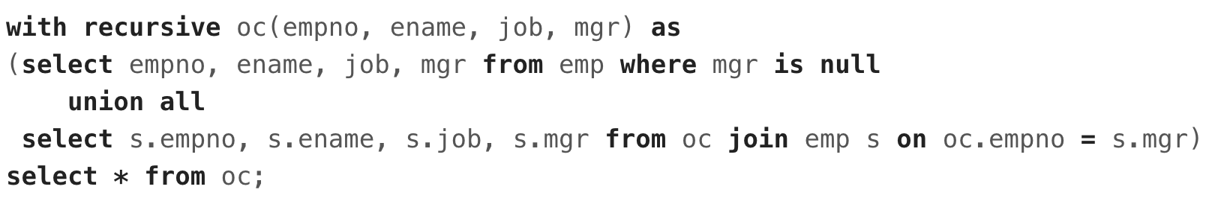
All Employees from CEO to Entry level
oc.sql

Slide 24
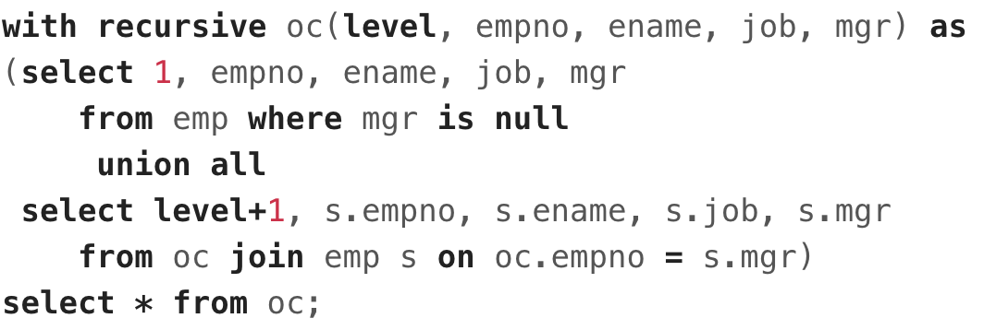
Include a Level
oc-level.sql

Slide 25
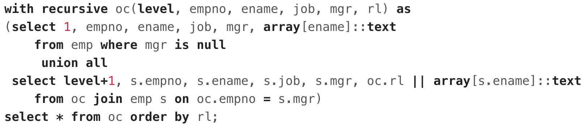
Include A Path
oc-path.sql

Slide 26
Next steps
Recommended Readings & Beyond Hierarchy

Slide 27
recommended Readings
PostgreSQL documentation
Fun with SQL: Recursive CTEs in Postgres – Craig Kerstiens
Modern SQL in Open Source and Commercial Databases (slides 45-60) – Markus Winand
Exporting a Hierarchy in JSON: with recursive queries - Dmitri Fontaine
Joe Celko’s Trees and Hierarchies in SQL for Smarties (Book)

Slide 28
Beyond Hierarchy
Hierarchy queries are the most common application of recursive SQL, but not the only application!
Pretty wild recursive SQL queries:
Solving the Traveling Salesman Problem with Postgres Recursive CTEs - Periscope Data
Mandelbrot Set
tic-tac-toe
My views:
Can doesn’t mean should
Worth studying for learning advanced techniques

Slide 29
Questions

