Slide 1


Computed Organ Segmentation with Generative Adversarial Neural Network
D
Y
L
BE
COS-GANN
T
E
P
H
E
N
N
ECE 431 – Biomedical Signals and Image Processing

Slide 2

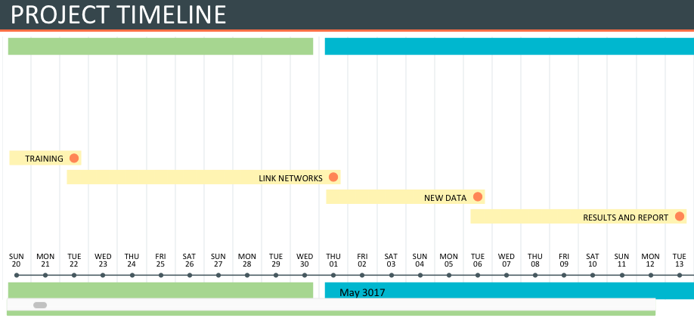

Slide 3

AlexNet
  Trained on 1.2 million images
  23 Layers
  Great at patterns, shading, lines, etc.
Transfer Learning
  Total Images
    57 Correct
    40 Incorrect

Slide 4

