Slide 1
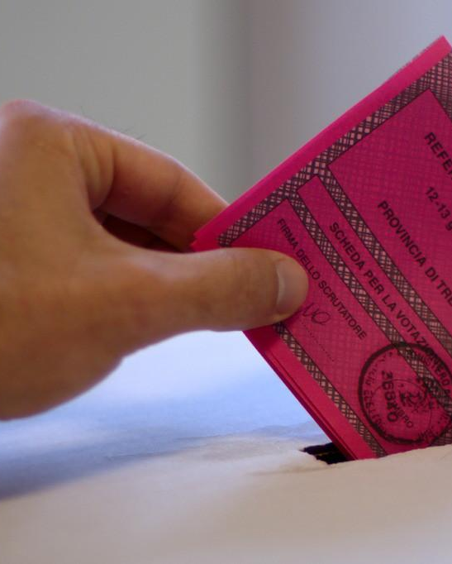
Referendum in Haiti : What people think about it
Are Haitian citizens informed enough about the referendum ?

Slide 2
Definition of a referendum
“It’a procedure leading to the submission of a text, a question, a draft drafted in these broad lines to the vote of the citizens” (Francis HARMON)
it is an instrument of direct democracy, that is to say a voting procedure (by yes or no) making it possible to directly consult the people on a project (of governmental origin) or a proposal. parliamentary constitutional review.

Slide 3
Context
There is a disagreement between our Haitian constituents around the notion of referendum, it is crucial to ask the question whether the population knows what a referendum is. Our work here is to highlight what could push Haitian citizens to make use of the referendum procedure

Slide 4
2017-2022 is and will remain a difficult period for Haiti. The Haitian government set itself the ultimate goal of implementing a single agenda after presenting its draft constitution to the Haitian people. This agenda is as follows: The constitutional referendum and the presidential and legislative elections of 2022.

Slide 5
Purpose
Our purpose study is to determine at what level the Haitian citizen is informed about the concept of “referendum”
What could push the Haitian citizen to make use of the referendum procedure

Slide 6
Since 1804 until today, Haiti has known eleven (11) referendums.
The constitutional referendum is the most common because it is most often used to amend a constitution or to extend a presidential term as you can see in the chart below.

Slide 7
Année | Président | Procédure | Motifs | Résultat (Pour/Contre/Participants)
1918 | Sudre Dartiguenave | Référendum constitutionnel | Réformes constitutionnelles | 99% | 1% | 99,063
1922 | Louis Borno | Référendum constitutionnel | Réformes constitutionnelles | --- | ---
1928 | Louis Borno | Plébiscite | Réformes constitutionnelles | 97% | 3% | 184,287
1935 (Février) | Sténio Vincent | Référendum populaire | Fin de l'Occupation Américaine | 100% | 0% | 455,529

Slide 8
Année | Président | Procédure | Motifs | Résultat (Pour/Contre/Participants)
1935 (Juin) | Sténio Vincent | Référendum constitutionnel | Réformes constitutionnelles | 100% | 0% | 614,514
1939 | Sténio Vincent | Référendum constitutionnel | Réformes constitutionnelles | 100% | 0% | 231,515
1961 | François Duvalier | Référendum constitutionnel | Prolongation de mandat | 100% | 0% | 1,320,748
1964 | François Duvalier | Référendum populaire | Instauration de la Présidence à vie | 99.90% | 0.1% | 2,803,235

Slide 9
Année | Président | Procédure | Motifs | Résultat (Pour/Contre/Participants)
1971 | François Duvalier | Référendum constitutionnel | Ratification de Jean-Claude Duvalier à la présidence à vie | 100% | 0% | 2,239,917
1985 | Jean-Claude Duvalier | Référendum constitutionnel | Amendement constitutionnel | 99.98% | 0.02% | 2,375,459
1987 | Henry Namphy | Référendum constitutionnel | Nouvelle Constitution | 99.80% | 0.20% | 1,261,334
2021 | Jovenel Moise | Référendum constitutionnel | Nouvelle Constitution | --- | --- | ---

Slide 10
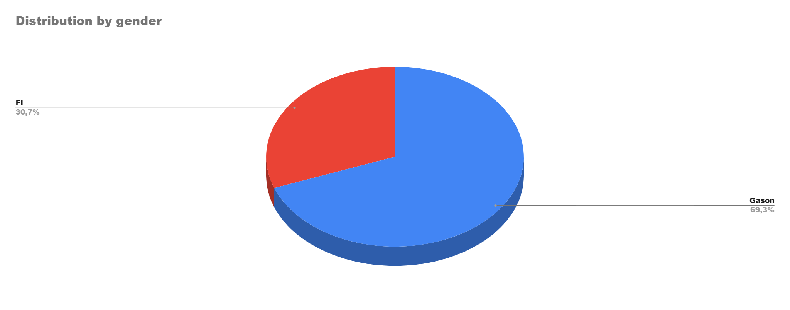
During this survey, we used social networks (Facebook, Linkedin, whatsapp, Instagram).
137 People responded to the questionnaire, among them:
69,7% Men
37,3% Women

Slide 11
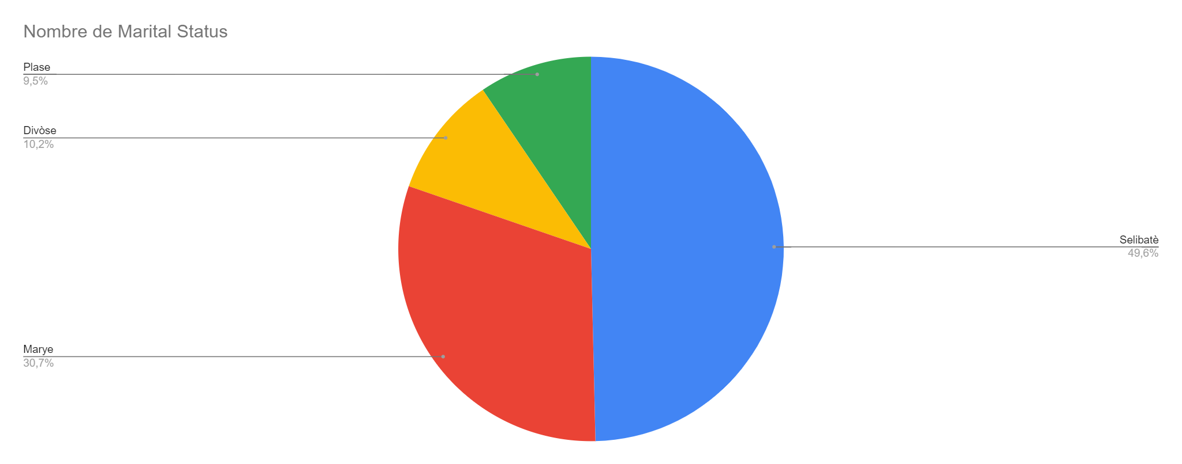
the population involved in the survey, is predominantly young:
48.2% are between 25 and 34 years old
17.25% are between 34 and 44 years old
10.2% are between 18 and 24 years old
10.25% are between 45 and 24 years old
7.2% are between 65 and over
6.6% are between 55 and 64 years old

Slide 12
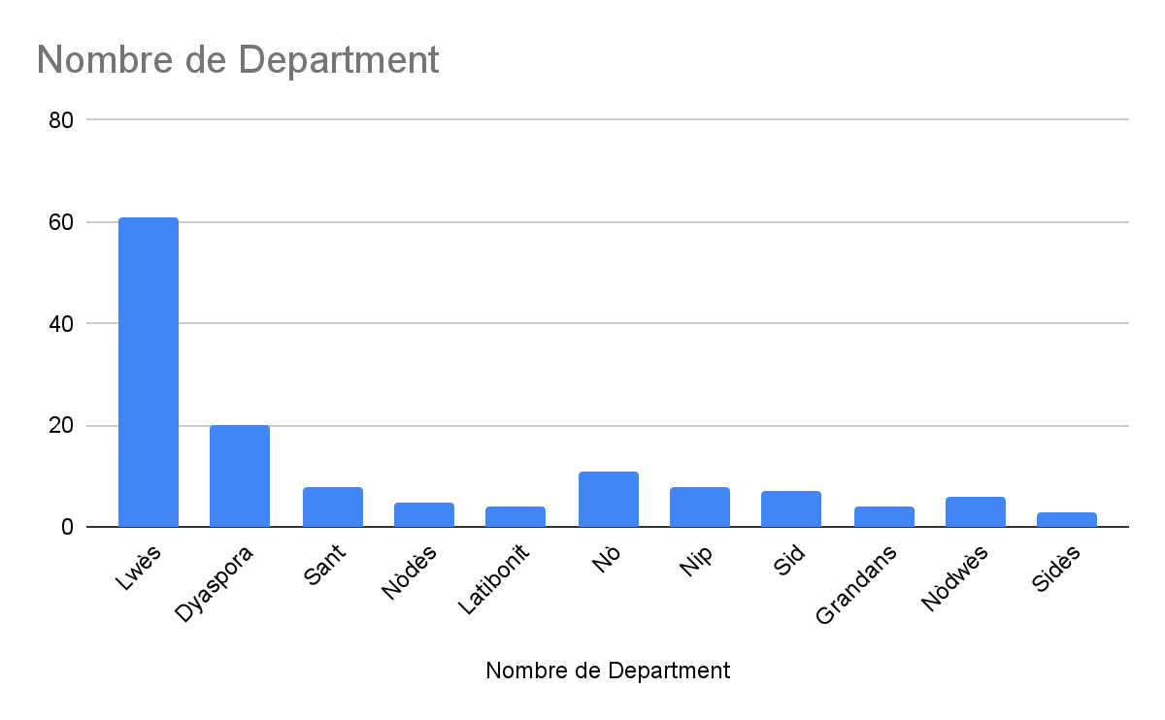
44.5% live in the west department
14.6% abroad
8% in the Noth department

Slide 13
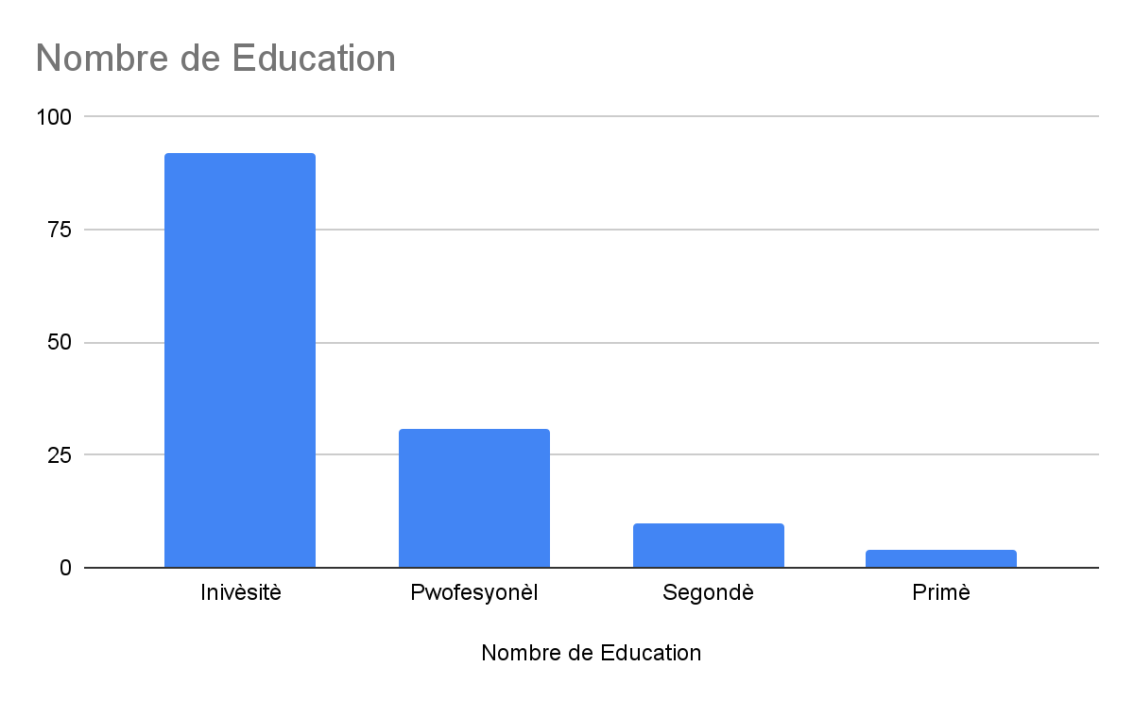
67.2 % have a university education
22.6% have a professional education
7.3% have a secondary school level
2.9% have a primary school level

Slide 14
Eske w konn tande pale de referandòm deja ? | Eske ou swiv deba sou avan-pwojè konstitisyon an deja ? | Selon ou menm, nan ki fason ou panse ou ka sèvi ak referandòm antanke zouti demokratik?
Non | Non | 13,14%
 | Wi | 1,46%
Total pour Non |  | 14,60%
Wi | Non | 37,96%
 | Wi | 47,45%
Total pour Wi |  | 85,40%
Total général |  | 100,00%

Slide 15
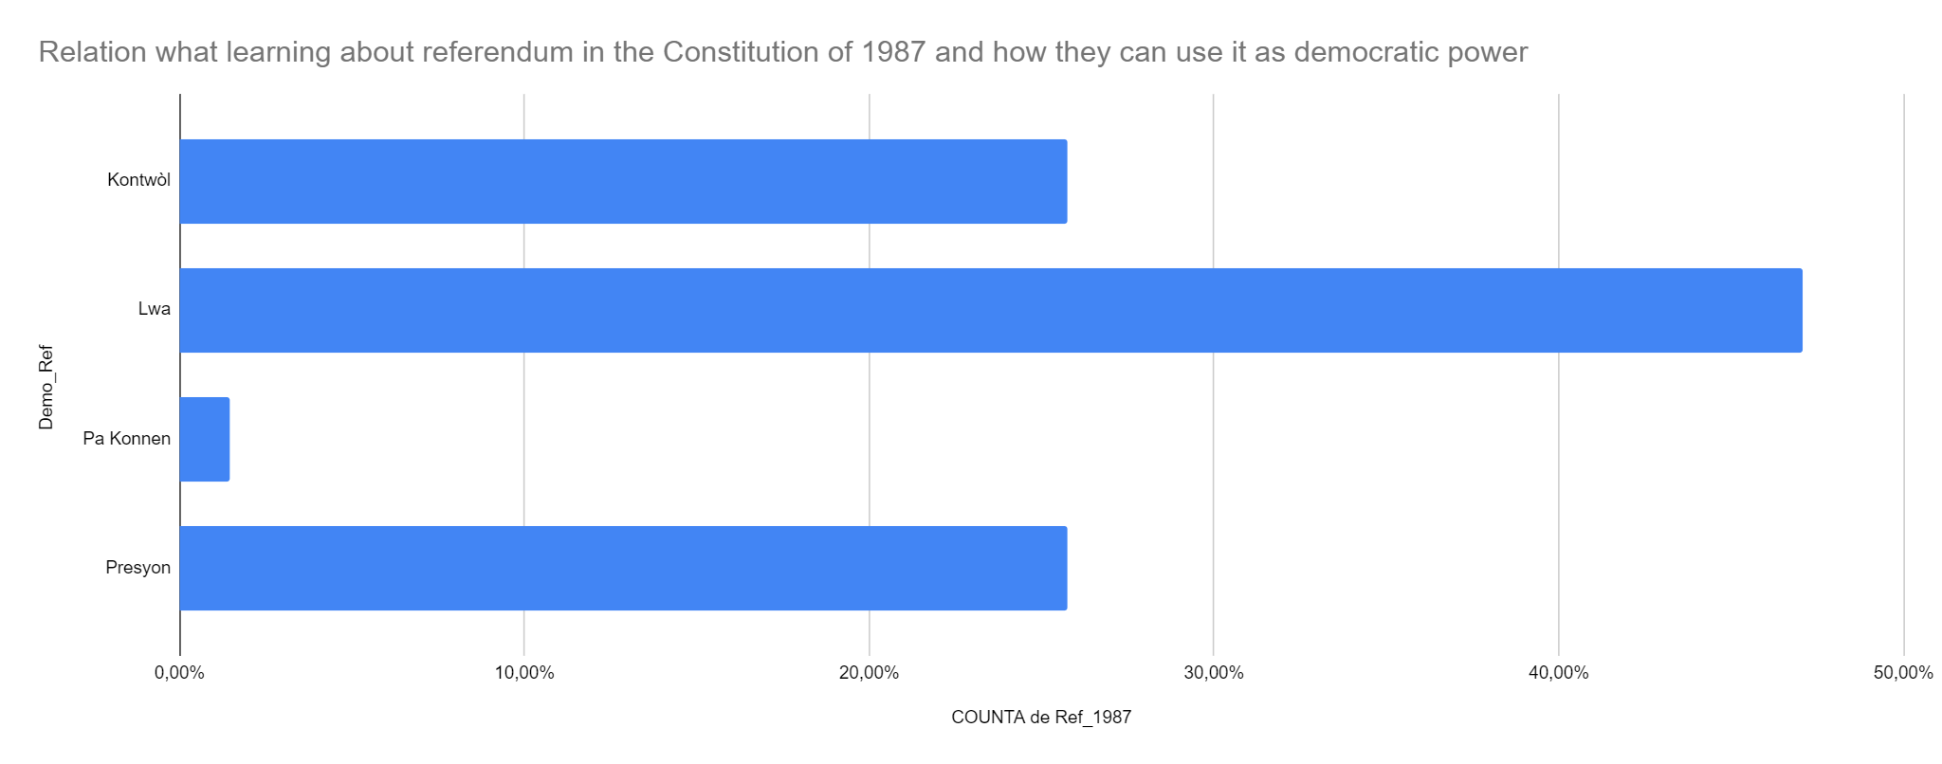

Slide 16
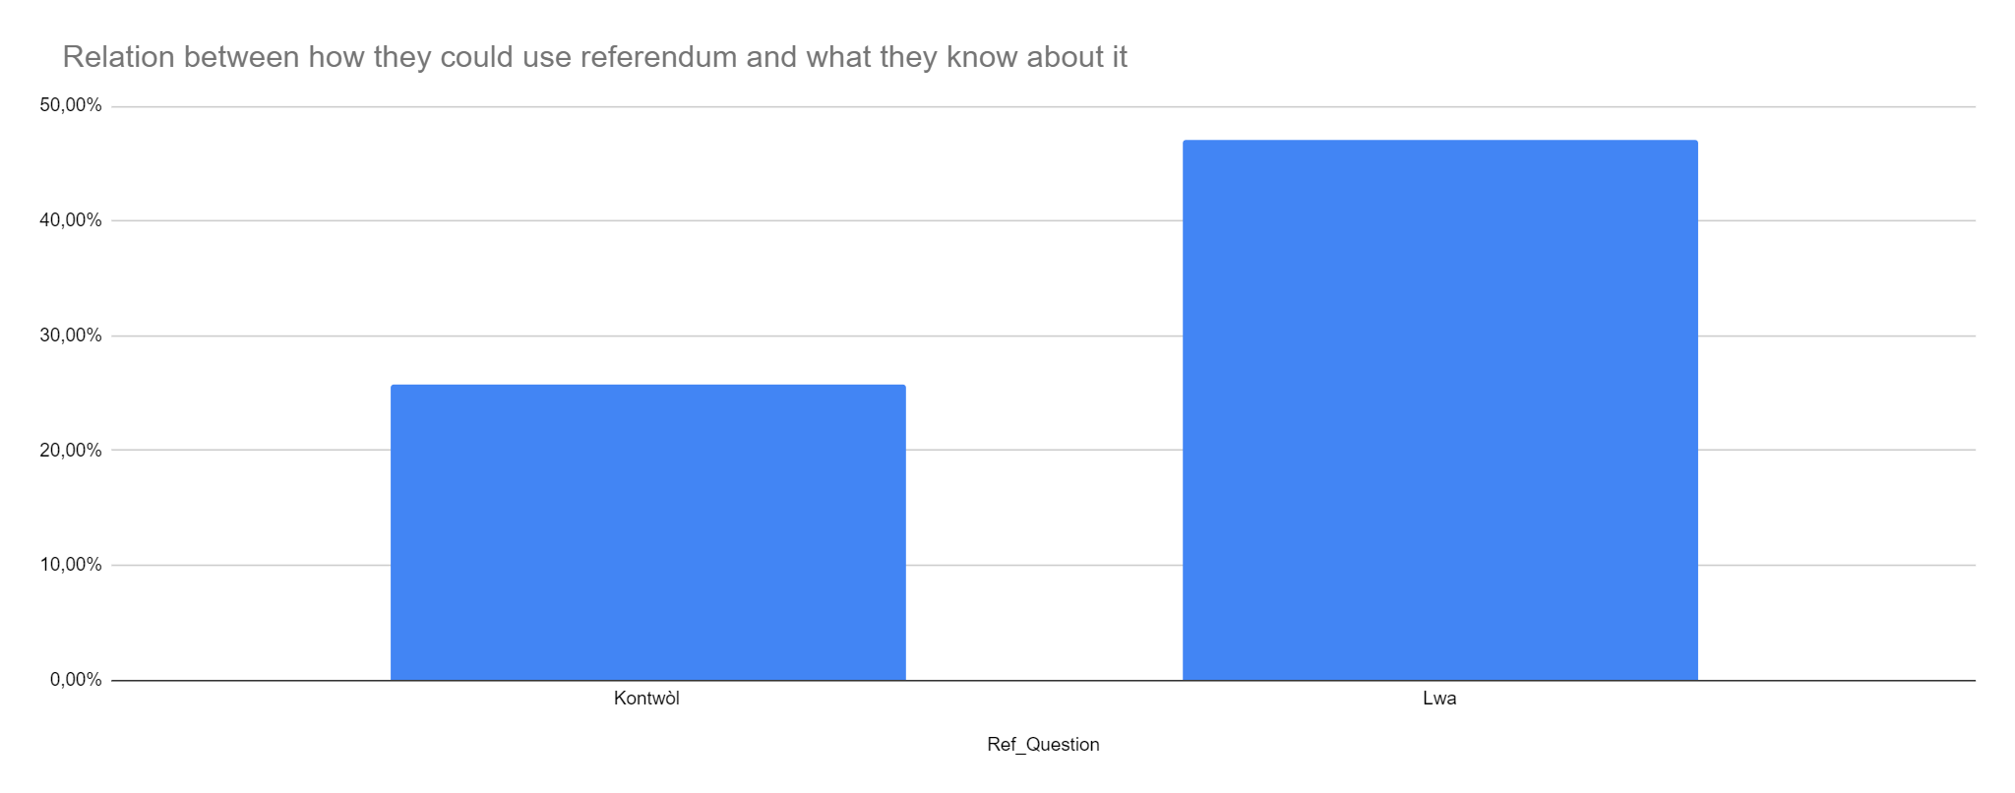

Slide 17
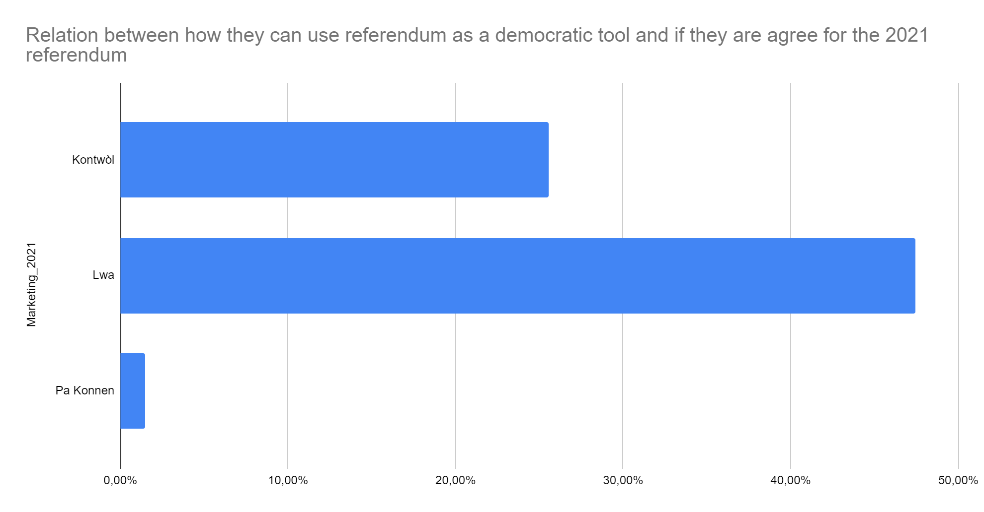

Slide 18
Results
This survey reveals that 85,40% know what a referendum is, of which 47.45% have heard about the 2021 constitution.
47.06% of those who know that the referendum is prohibited in the 1987 constitution say they want to use it to pass laws
25.74% say they want to use it as a control tool
25.74% say they want to use it as a lobbying tool
The rest do not know

Slide 19
Recommandations
People are not informed enough, it is important to clarify the following concepts: constitutional referendum, popular referendum and plebiscite
Include mock referendums in the National Awareness Program (NAP) to better guide participants in their decisions
Broadcast more advertisements on the radio, social networks, etc.

Slide 20
MERCI !!!!!!!!!!!

