Slide 1
Internship PROJECT
Benjamin Vandenbussche, 13152

Slide 2
Main POINTS
About Vasco
The SDTF
Internship: goals & Achievements
Personal Experience

Slide 3

About Vasco
Data Security:
Mobile App Security
Fraud Prevention
Transaction Signing
Identity & Access
Document eSignatures
Authentication:
COMPUTING
the process or action of verifying the identity of a user or process.

Slide 4
The SDTF
IAS
Identikey Authentication Server
SDTF: software Deployment & Testing Framework
Launches virtual environments
Installs IAS and launches tests in said environments

Slide 5
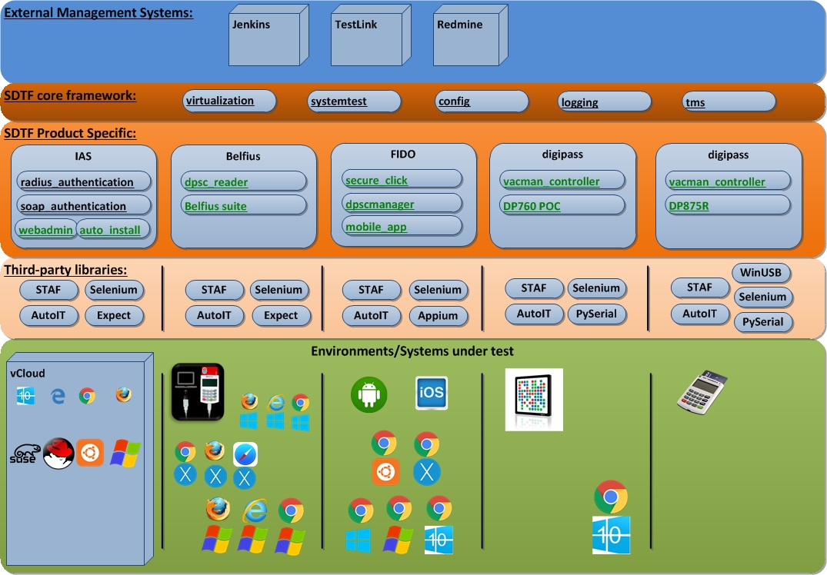
SDTF Test Automation

Slide 6
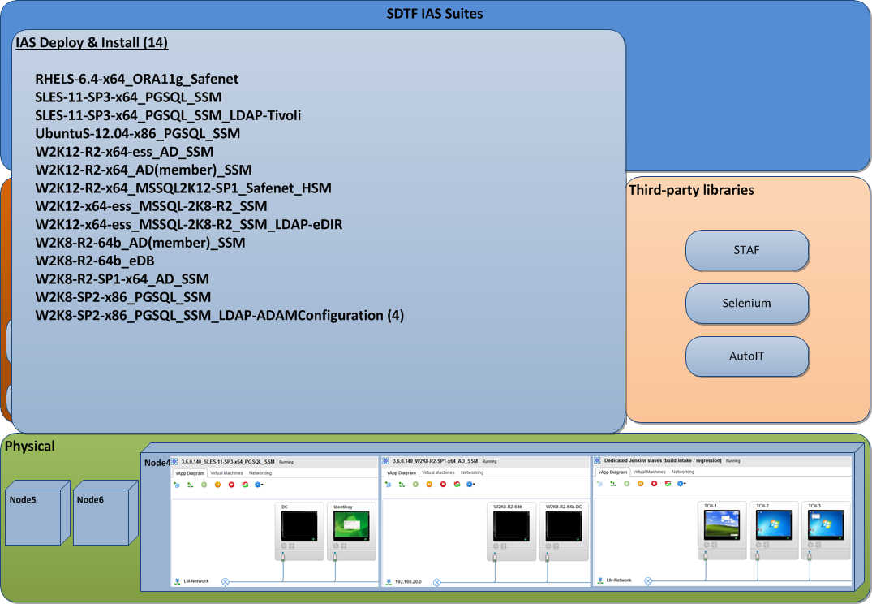
SDTF – IAS Deploy & Install

Slide 7
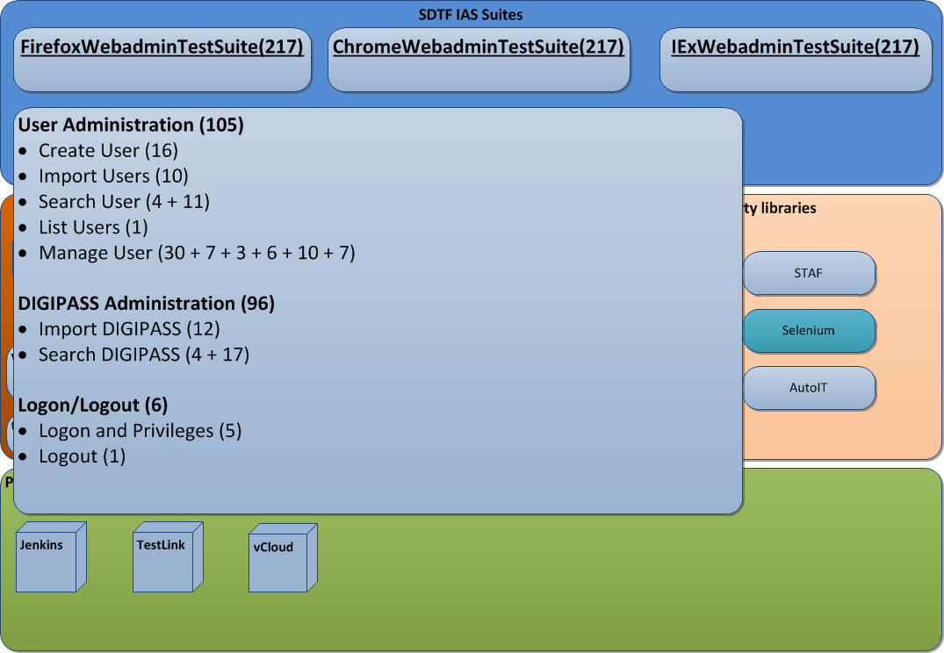
SDTF – IAS WebAdmin

Slide 8
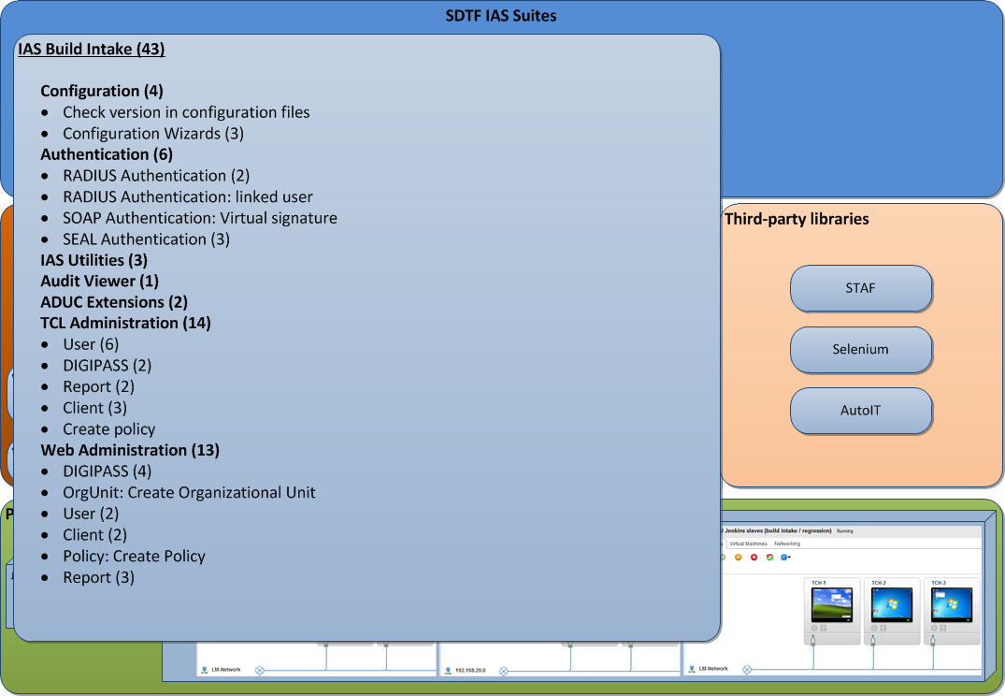
QA – IAS Build Intake

Slide 9
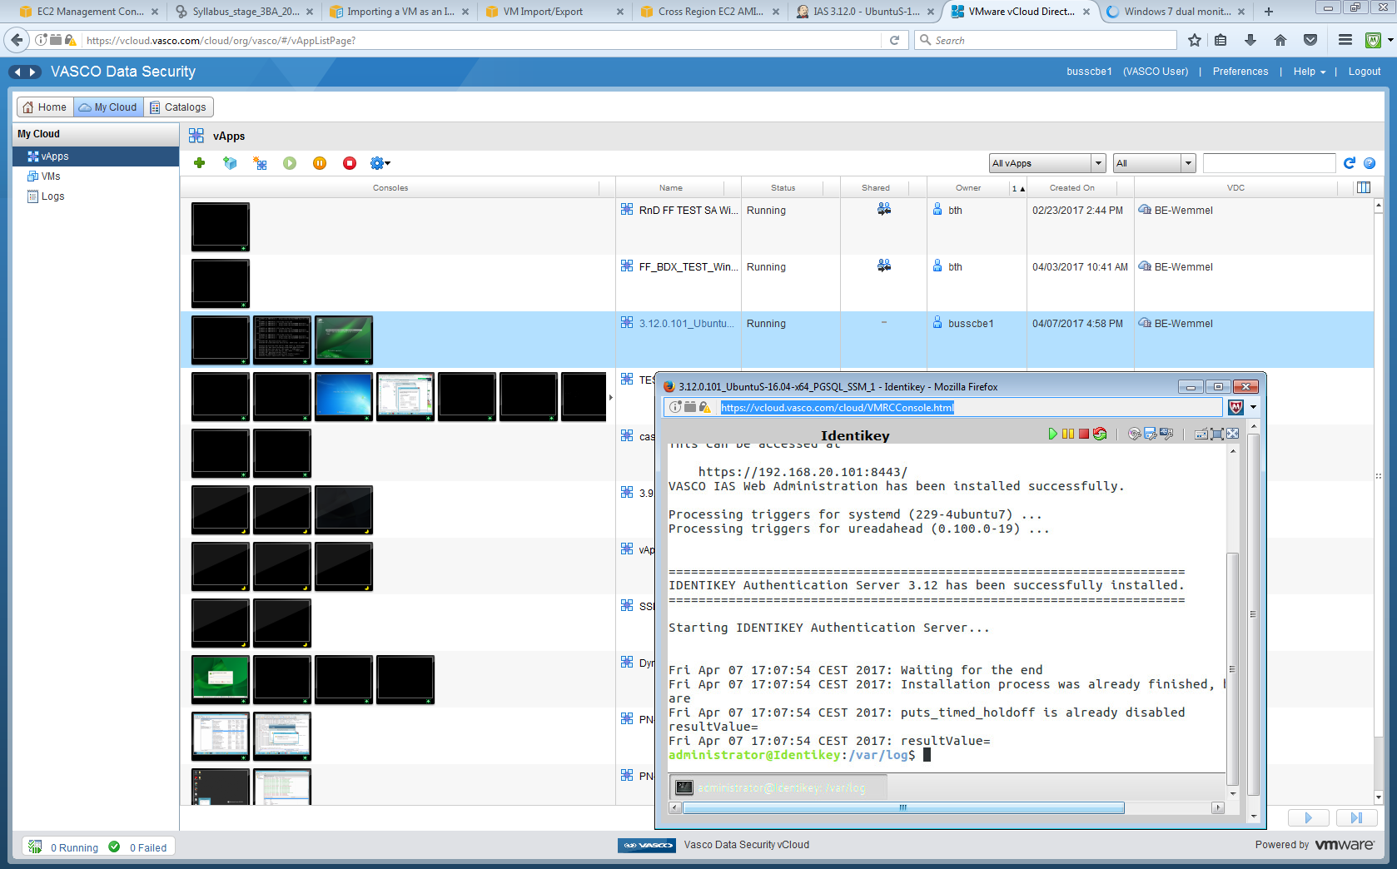

Slide 10
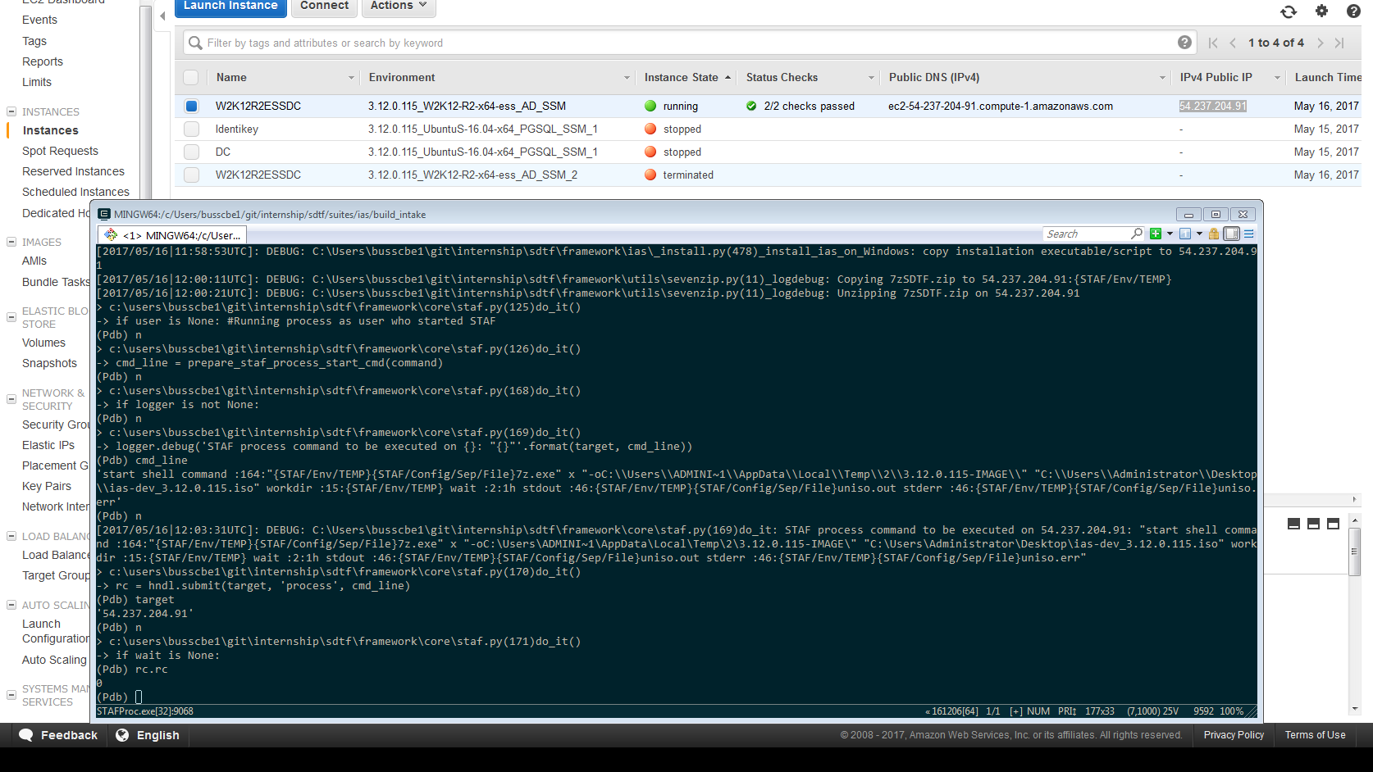

Slide 11
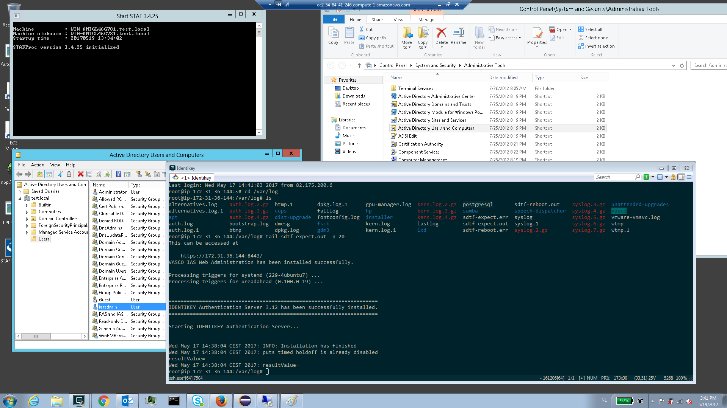

Slide 12
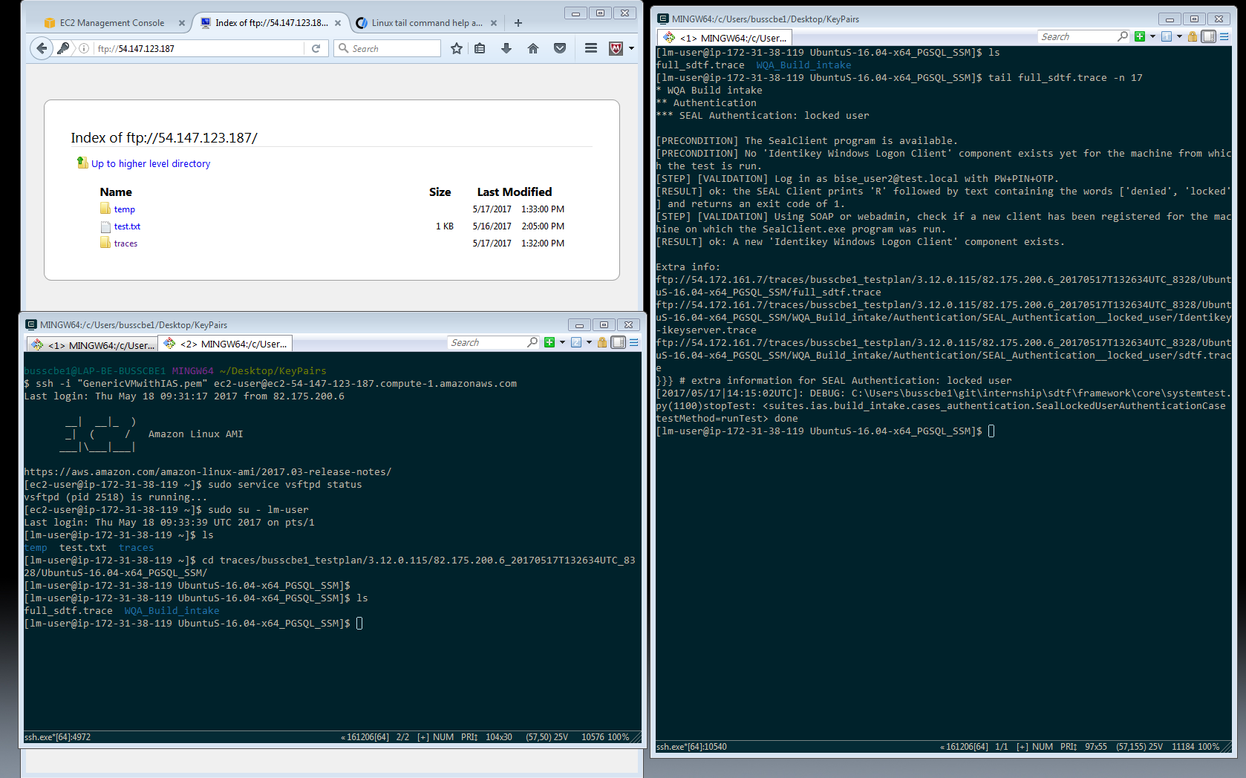

Slide 13
Internship Goals
Recreate existing environments for AWS
Successful Installation
Successful Build Intake
Successful Regression

Slide 14
Results
Environments: imported Ubuntu ( + Windows Server 2012 R2 )
Installation successful on Ubuntu
Successful Build Intake
Dropped Regression

Slide 15
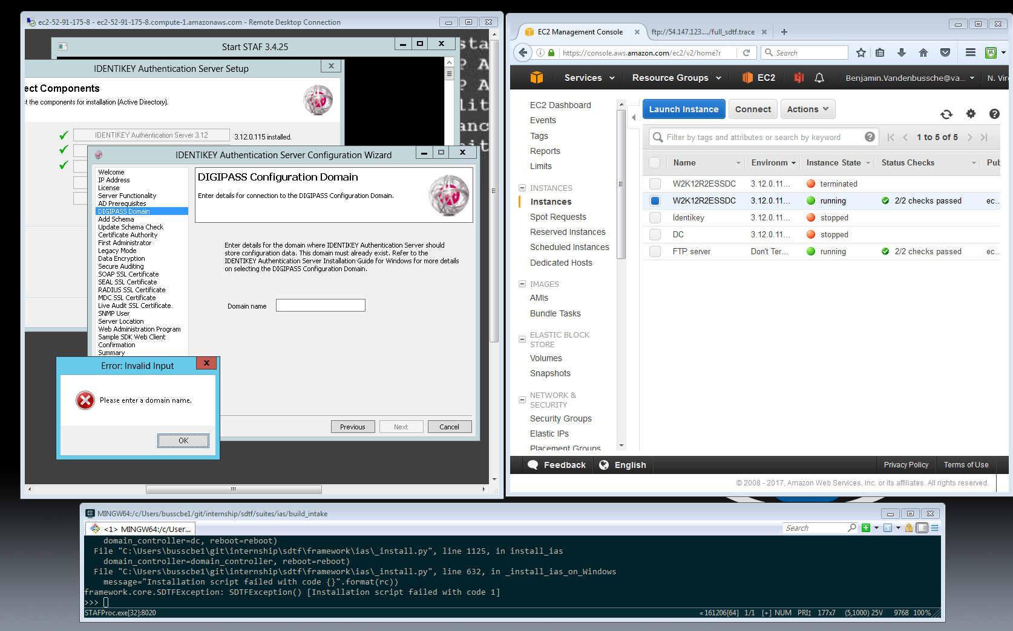

Slide 16
Personal Experience
Communication
Comprehension
Teamwork
Objectives and Holdups

Slide 17
Questions

