Slide 1
Literature review
EMG signals combined with a neuromuscular reflex model has been used to control a robotic ankle prosthetic reliably [1]
Future research consider using machine learning algorithms with EMG signals [1]
Robotic prosthetics with IMUs exist [2] but could not find a direct application of EMG signals being used
Notes:
Script guidance: Its been shown that EMG signals, when combined with a neuromuscular reflex model, is a viable and reliable way to control a prosthetic. Most research points to considering the use of machine learning to process the EMG signals, with this become increasingly viable. Due to issues with EMG placement and issues with long term viability due to sweat and natural shifting with movement no commercial or research prosthetic has been yet created.
What has been done
And then another slide for the "research gap", how our research fills the gap in existing work There has been research into using Existing research into using EMG signals with a neuromuscular model to control ankle prosthetics[1] there is also research on using IMUs for robotic prosthesis[2]

Slide 2
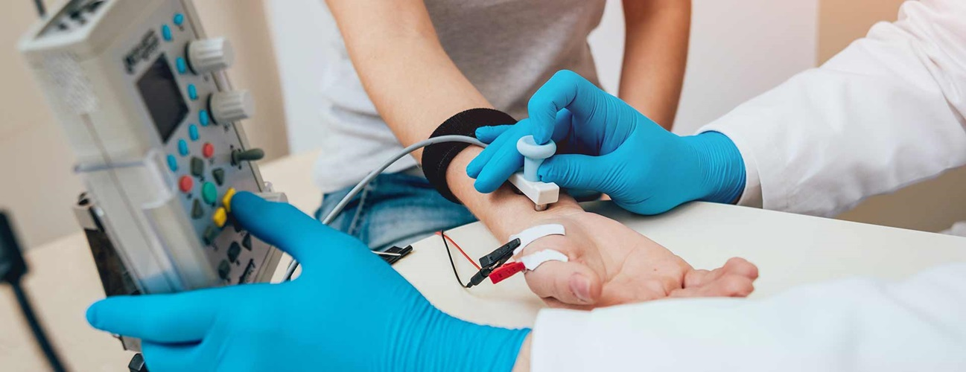





EMG signals may provide accurate predictions of muscle forces that can be used to design new approaches to robotic therapy that surpass traditional therapy efficacy [6]
LSTMs have been used for gait classification and prediction successfully with suggested applications in exoskeletons [3]
LSTMs are the best contender with CNNs being the worst performing machine learning algorithm [4]
LSTM-CNN models however have been shown to be very successful at gait prediction with very high accuracy [5]
Current research
Notes:
Script guidance: Current research shows that LSTMs are successful at predicting and classifying gait trajectory. CNN models generally tend to perform poorly with trajectory prediction but okay with classification, although research on this is mixed and conflicting. A combination LSTM-CNN model has been demonstrated to be highly successful and both tasks achieving a high accuracy in both. EMG signals provide accurate prediction of muscle forces and it is hoped that they can be used to design new approaches to robotic therapy that surpasses traditional methods.

Slide 3
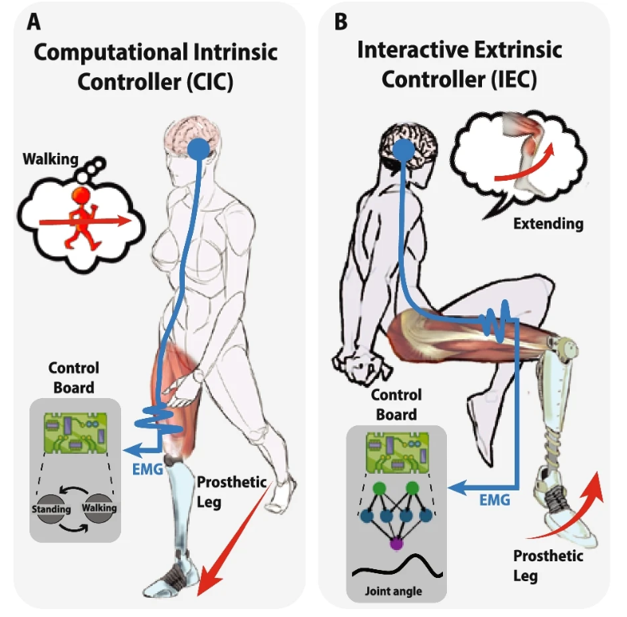
Context and Motivation
Where will this be used in prosthetics?
The idea is to create a Machine Learning model that would be integrated into a bionic prosthetic, learning the user’s style of gait and replicating it.
It would use EMG, accelerometer and goniometer readings as input and replicate the natural movement of the foot throughout various movements
This will allow for more accurate assistive robotic prosthetics to aid with walking
Validates and expands upon current research on the viability of a predictive model in this context
Will help allow engineers to develop the first useable and commercial robotic prosthetics using EMG data
Will help end users due to improved usability and comfort over neural interface technology
See [8], [C]
Notes:
Script guidance: The project aims to implement the machine learning algorithms for classifying and predicting gait using as minimal data as possible. The limited current research relies heavily on very complicated and specific set ups and use cases to predict the gait trajectory. The idea is that if successful, a simple EMG setup could be used as the input for the robotic prosthetic, improving reliability and accuracy when walking, validating current research, and help allow engineers to develop the first useable and commercially viable robotic prosthetic using EMG data as the sole input.

