Slide 1
MSc ADVANCED COMPUTING · INDIVIDUAL PROJECT · STATUS BRIEFING
Agentic AI for Open
Data Maturity
Assessment
Status snapshot and next steps for supervisor review
Benjy Bream · King's College London · 14 May 2026

Slide 2
CAPABILITY SNAPSHOT
What is built
PAIRS FINALISED
GROUND-TRUTH COVERAGE
ACCURACY VS ODMI
TOTAL LLM SPEND
71
5,148
79%
£8.11 Equivalent
113 Researcher · 111 Verifier · 9 Adjudicator.
ODMI answers loaded (36 countries × 143 questions).
56 / 71 match against ODMI 2025.
Via CLIProxyAPI on Claude Max.
Three-agent swarm, end-to-end
Live dashboard with ODMI ground truth
Researcher proposes, Verifier tries to disprove, Adjudicator steps in when retries are exhausted. Average runtime ~86s.
Streamlit app over SQLite. Every LLM call logs tokens, latency, cost, prompt version. Each finalised swarm pair is compared to ODMI's recorded answer automatically (5,148 ground-truth rows loaded).
ODMI Agent Swarm · Benjy Bream · King's College London · 2 / 8

Slide 3
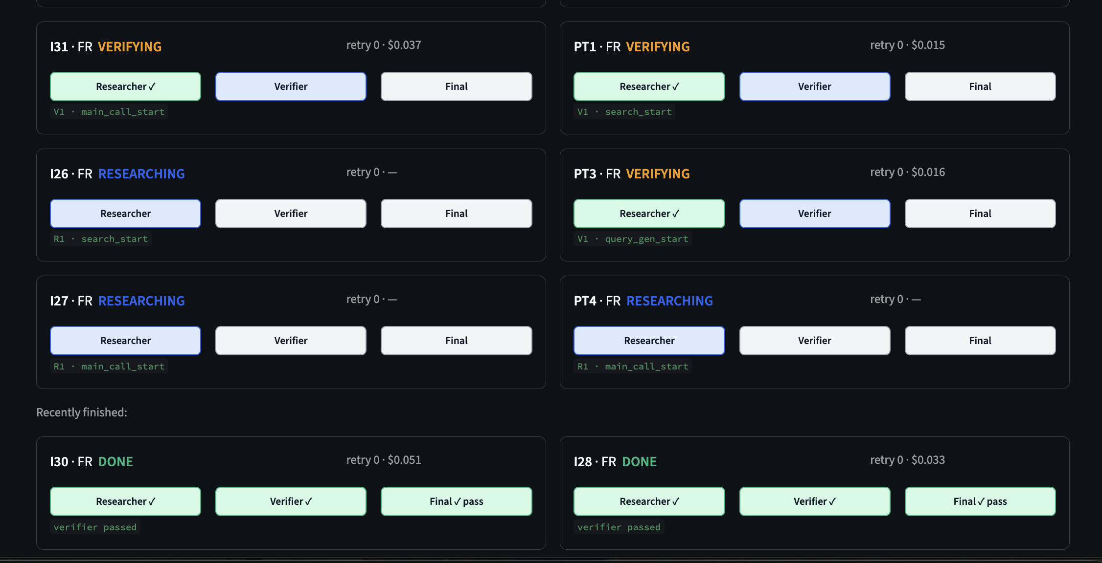
SWARM IN ACTION
Run Console — live view while the swarm runs
ODMI Agent Swarm · Benjy Bream · King's College London · 7 / 8

Slide 4
COORDINATOR STATE MACHINE
How the swarm answers one question
RESEARCHER
VERIFIER
ADJUDICATOR
Tavily search → fetch URL → reason → return {answer, source_url, evidence_quote, confidence}.
Substring-checks the Researcher's quote, runs an independent search, and reasons adversarially (default strategy: find a way to disprove the claim). Returns pass / fail with counter-evidence.
Fires only on retry exhaustion. Reads the full history. Picks a winner or escalates to a human queue.
TERMINATION RULE
DATA-LEAKAGE GUARDRAIL (D24)
Researcher retries up to 3× on Verifier rejection. After that, Adjudicator decides. Confidence below 0.6 escalates to a human queue.
ODMI publications (data.europa.eu and mirrors) banned at five layers: search, fetch, validator, prompts, audit. An audit script catches anything that slips through.
ODMI Agent Swarm · Benjy Bream · King's College London · 3 / 8

Slide 5
FINALISED PAIRS · SUCCESS VS FAILURE
Results so far, per country
62
61
60
59
58
57
56
55
54
53
52
51
50
49
48
47
46
45
44
43
42
41
40
39
38
37
36
35
34
33
32
31
30
29
28
27
26
25
24
23
22
21
20
19
18
17
16
15
14
13
12
11
10
9
8
7
6
5
4
3
2
1
0
DE
FR
NL
RO
3 / 3
48 / 62
3 / 3
2 / 2
Matches ODMI 2025
Differs from ODMI 2025
Comparison is to ODMI's 2025 merged_responses. The current sample is small and Policy-dimension heavy. ODMI's assessments are one cycle old, so where the swarm differs that does not automatically mean the swarm is wrong: the country may have changed since the assessment. Each disagreement is worth a human glance.
ODMI Agent Swarm · Benjy Bream · King's College London · 5 / 8

Slide 6
WHAT I'LL DEMO LIVE
Best bits of the dashboard
▶
Run Console
📋
Results · Cards view with ODMI side-by-side
Multiselect questions × countries, pick the Verifier strategy and the model triple, dispatch a batch. Cost is estimated before the run starts.
One card per finalised pair: question, swarm answer with evidence quote, clickable source URL, plus ODMI's recorded answer and explanation. Match / differ badge at a glance.
📊
Accuracy chart vs ODMI
💷
Cost tracking and rolling budget
Per-country stacked bar of pairs that match ODMI 2025 versus those that differ. Headline accuracy KPI is read straight off the comparison.
Costs page shows the 5-hour rolling spend, per-model breakdown, and per-strategy averages. Rate-limit hits and soft-limit progress on every page's sidebar.
ODMI Agent Swarm · Benjy Bream · King's College London · 6 / 8

Slide 7
SHORT TERM AND LONG TERM
Where this goes next
NEXT TWO WEEKS
JUNE AND JULY
Scale to harder questions
Scale to all six countries
Run the swarm beyond Policy on the easy four countries: Portal, Quality, and Impact dimensions. Track where accuracy starts to fall.
Run all 143 questions across FR, DE, NL, RO, HU and EE — the full Phase B matrix.
Add the lower-resource countries
Model cost-effectiveness experiments
Bring Hungary and Estonia into the regular sweep. Country-language fetch is the biggest unknown.
Compare Haiku, Sonnet and Opus on accuracy and cost across the matrix. Build the cost-accuracy surface and identify the optimal strategy.
Verifier strategy comparison
July — dissertation write-up
Run experiments on different adversarial verifier strategies, testing:
Hallucination catch rate, false rejection rate, tokens per Verifier run.
Analyse results, write methodology and findings chapters. Submission deadline: 2 August 2026.
ODMI Agent Swarm · Benjy Bream · King's College London · 8 / 8

