Slide 1
MSC ADVANCED COMPUTING · KING'S COLLEGE LONDON · 2026
AI researchers that
do not make things up
Building and stress-testing an agent swarm that answers only what a source supports. The EU Open Data Maturity Index is the testbed.
36 countries · 5,148 question-country pairs
Benjamin Bream · Progress review, June 2026

Slide 2
A confident answer is not a correct one
Ask a language model a factual question and it returns a fluent answer whether or not the evidence exists. For an assessment like ODMI, much of it self-reported and across 20+ languages, a fabricated "yes" is worse than no answer at all.
The failure modes we fight
Fabrication
THE RESEARCH QUESTION
!
The model fills a gap with plausible text instead of evidence.
How do you build an agent that asserts only what a source supports, abstains when it cannot, and how do you prove it is not bluffing?
!
Overconfidence
A wrong answer arrives sounding as certain as a right one.
!
No receipts
A bare label cannot be audited, traced, or trusted.
ODMI is a hard testbed: 5,148 pairs, self-reported answers to check, 36 countries.

Slide 3
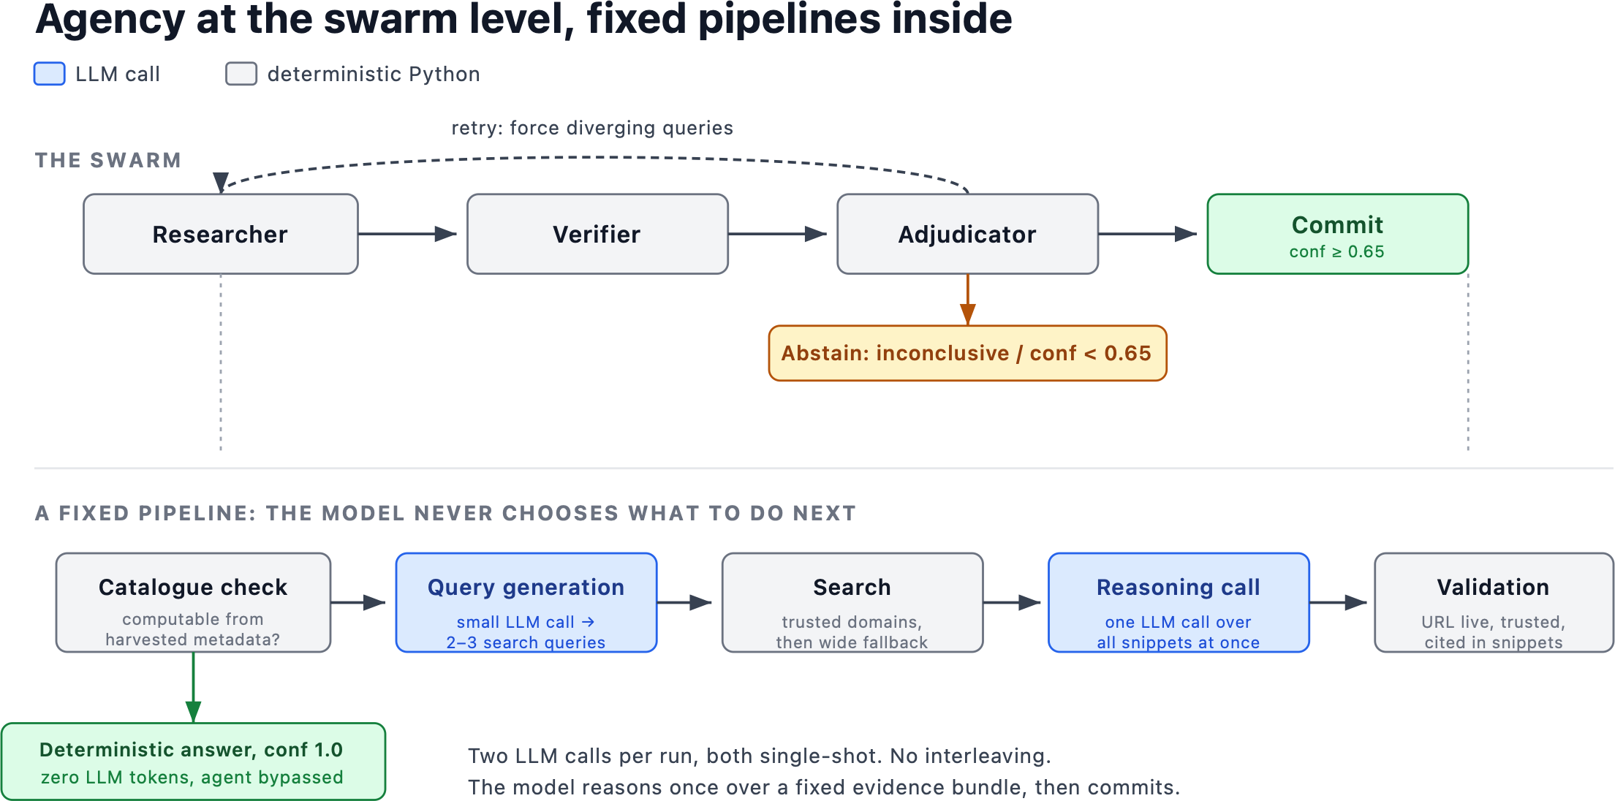
The Researcher: constrained so it cannot invent
Deterministic where possible (zero-LLM catalogue answers) · trusted-domain search with the answer key deny-listed · one reasoning pass over a fixed evidence bundle

Slide 4
How the system checks it did not make it up
✓
Grounded in what it read
The cited source must be one the Researcher actually retrieved; the evidence quote is checked against those snippets. It cannot cite what it never saw.
✓
The source must be real
URL is live (HEAD request), on a trusted domain, and the answer fits the allowed shape for that question.
✓
An adversary checks the claim
A second agent, the Verifier, is set against the evidence to disprove the answer before it is allowed to stand.
✓
Abstain over guess
Below a 0.65 confidence floor the system returns an honest "inconclusive" instead of committing to an answer.
✓
Retry before giving up
A weak first pass triggers retries with forced diverging queries, then abstention if it is still unsure.

Slide 5
Measuring it honestly: the accuracy trap
THE TRAP
THE FIX: A BALANCED TESTBED
98%
of France's binary answers are "yes"
Test on Malta: English is official, so a miss is not a translation artefact. A frozen 60-pair set, 30 "no" / 30 "yes".
Score with metrics that catch fabrication: false-positive rate, true-negative recall, Youden's J, not raw accuracy.
France's gold is 121 "yes" and a single "no" (124 binary questions).
A model that always answers "yes" scores 98% and never exposes one false positive. Raw accuracy here measures fluency, not honesty.
EXPERIMENTS RUNNING TO FIND THE BEST CONFIG
Verifier strategies
how hard to push the Verifier to disprove a claim.
Retry chaining
recover more answers without committing more false positives.
Cost vs quality
how much accuracy a deeper search actually buys.

Slide 6
What the balanced test shows
Malta, 60-pair base-rate-balanced baseline.
0.87
true-negative recall
only 3 false positives in 23 committed "no" answers
17 / 60
abstained, did not guess
an honest "inconclusive" over a forced answer
recall, not precision
failures are "could not find it", not "made it up"
THE UPSIDE
Where it finds independent evidence it can beat the self-report. France claimed >90% on licence coverage and metadata conformance; the recompute reads ~38% and ~32%.
Next: lock the balanced held-out set, finish the Verifier and chaining experiments, then scale across countries.
It would rather say "I do not know" than make something up.

