Slide 1
MSc ADVANCED COMPUTING · INDIVIDUAL PROJECT · STATUS BRIEFING
Agentic AI for Open
Data Maturity
Assessment
Status snapshot and next steps for supervisor review
Benjy Bream · King's College London · 02 June 2026

Slide 2
CAPABILITY SNAPSHOT
What is built
PAIRS FINALISED
GROUND-TRUTH COVERAGE
ACCURACY VS ODMI
TOTAL LLM SPEND
164
5,148
63%
£42.29
307 Researcher · 304 Verifier · 34 Adjudicator.
ODMI answers loaded (36 countries × 143 questions).
103 / 164 match against ODMI 2025.
Via CLIProxyAPI on Claude Max.
Three-agent swarm, end-to-end
Live dashboard with ODMI ground truth
Researcher proposes, Verifier tries to disprove, Adjudicator steps in when retries are exhausted. Average runtime ~113s.
Streamlit app over SQLite. Every LLM call logs tokens, latency, cost, prompt version. Each finalised swarm pair is compared to ODMI's recorded answer automatically (5,148 ground-truth rows loaded).
ODMI Agent Swarm · Benjy Bream · King's College London · 2 / 8

Slide 3
COORDINATOR STATE MACHINE
How the swarm answers one question
RESEARCHER
VERIFIER
ADJUDICATOR
Tavily search → fetch URL → reason → return {answer, source_url, evidence_quote, confidence}.
Substring-checks the Researcher's quote, runs an independent search, and reasons adversarially (default strategy: find a way to disprove the claim). Returns pass / fail with counter-evidence.
Fires only on retry exhaustion. Reads the full history. Picks a winner or escalates to a human queue.
TERMINATION RULE
DATA-LEAKAGE GUARDRAIL (D24)
Researcher retries up to 3× on Verifier rejection. After that, Adjudicator decides. Confidence below 0.6 escalates to a human queue.
ODMI publications (data.europa.eu and mirrors) banned at five layers: search, fetch, validator, prompts, audit. An audit script catches anything that slips through.
ODMI Agent Swarm · Benjy Bream · King's College London · 3 / 8

Slide 4
DATA-LEAKAGE CONTROLS · D24
Why ODMI publications are banned
The swarm is validated against ODMI's published merged_responses. Any URL that hosts, mirrors, or summarises ODMI's own answers leaks the signal we are predicting, so it must never reach the agents. Five layers enforce this:
1. SEARCH
2. FETCH
3. VALIDATOR
4. PROMPTS
5. AUDIT
Tavily exclude_domains · Brave −site: · post-filter drops any blocked URL before it reaches an agent.
fetch_text and head_ok refuse blocked URLs with failure_mode="blocked_data_leakage". No network call.
trust_score forced to 0.0 for blocked URLs. data.europa.eu removed from the trusted domain seed list.
Researcher V2, all four Verifier V2 strategies, and Adjudicator V2 carry an explicit forbidden_odmi_source rule.
scripts/check_data_leakage.py scans every URL column in the swarm tables. Exits non-zero on any hit. --purge deletes tainted pair_runs.
Each layer fails in a different way. The audit catches whatever the four runtime layers miss; 30 historical violations were purged when D24 landed.
ODMI Agent Swarm · Benjy Bream · King's College London · 4 / 8

Slide 5
FINALISED PAIRS · SUCCESS VS FAILURE
Results so far, per country
129
128
127
126
125
124
123
122
121
120
119
118
117
116
115
114
113
112
111
110
109
108
107
106
105
104
103
102
101
100
99
98
97
96
95
94
93
92
91
90
89
88
87
86
85
84
83
82
81
80
79
78
77
76
75
74
73
72
71
70
69
68
67
66
65
64
63
62
61
60
59
58
57
56
55
54
53
52
51
50
49
48
47
46
45
44
43
42
41
40
39
38
37
36
35
34
33
32
31
30
29
28
27
26
25
24
23
22
21
20
19
18
17
16
15
14
13
12
11
10
9
8
7
6
5
4
3
2
1
0
DE
EE
FR
NL
RO
3 / 3
5 / 22
90 / 129
3 / 3
2 / 2
Matches ODMI 2025
Differs from ODMI 2025
Comparison is to ODMI's 2025 merged_responses. The current sample is small and Policy-dimension heavy. ODMI's assessments are one cycle old, so where the swarm differs that does not automatically mean the swarm is wrong: the country may have changed since the assessment. Each disagreement is worth a human glance.
ODMI Agent Swarm · Benjy Bream · King's College London · 5 / 8

Slide 6
WHAT I'LL DEMO LIVE
Best bits of the dashboard
▶
Run Console
📋
Results · Cards view with ODMI side-by-side
Multiselect questions × countries, pick the Verifier strategy and the model triple, dispatch a batch. Cost is estimated before the run starts.
One card per finalised pair: question, swarm answer with evidence quote, clickable source URL, plus ODMI's recorded answer and explanation. Match / differ badge at a glance.
📊
Accuracy chart vs ODMI
💷
Cost tracking and rolling budget
Per-country stacked bar of pairs that match ODMI 2025 versus those that differ. Headline accuracy KPI is read straight off the comparison.
Costs page shows the 5-hour rolling spend, per-model breakdown, and per-strategy averages. Rate-limit hits and soft-limit progress on every page's sidebar.
ODMI Agent Swarm · Benjy Bream · King's College London · 6 / 8

Slide 7
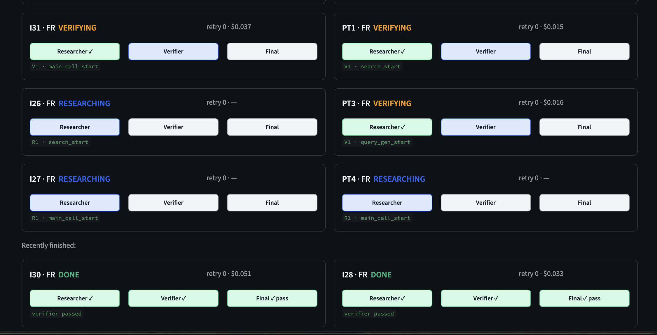
SWARM IN ACTION
Run Console — live view while the swarm runs
ODMI Agent Swarm · Benjy Bream · King's College London · 7 / 8

Slide 8
SHORT TERM AND LONG TERM
Where this goes next
NEXT TWO WEEKS
JUNE AND JULY
Scale to harder questions
Scale to all six countries
Run the swarm beyond Policy on the easy four countries: Portal, Quality, and Impact dimensions. Track where accuracy starts to fall.
Run all 143 questions across FR, DE, NL, RO, HU and EE — the full Phase B matrix.
Add the lower-resource countries
Model cost-effectiveness experiments
Bring Hungary and Estonia into the regular sweep. Country-language fetch is the biggest unknown.
Compare Haiku, Sonnet and Opus on accuracy and cost across the matrix. Build the cost-accuracy surface and identify the optimal strategy.
Verifier strategy comparison
July — dissertation write-up
Four strategies on the same Researcher rows. Hallucination catch rate, false rejection rate, tokens per Verifier run.
Analyse results, write methodology and findings chapters. Submission deadline: 2 August 2026.
ODMI Agent Swarm · Benjy Bream · King's College London · 8 / 8

