Slide 1
Object Oriented Programming with C++ Iterators, Containers and Generic Algorithms
Dr. Neil Buckley FML 408

Slide 2
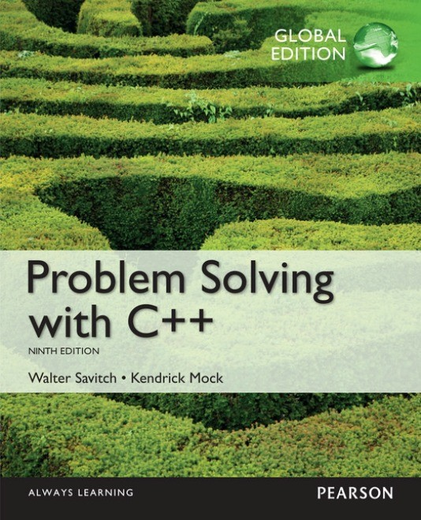
Required Reading
Product details
Paperback: 1088 pages
Publisher: Pearson; 9th Edition
Language: English
ISBN-10: 1292018240
ISBN-13: 978-1292018249
This lecture is based on Chapter 18.
Acknowledgement:
Original Slides provided by Pearson

Slide 3
What we have done
Discussed Computer Systems, Programming and Problem Solving, Introduced C++, Testing and Debugging
Covered Variables and Assignments, Input and Output, Data Types and Expressions, Simple Flow of Control and Program Style
Using Boolean Expressions, Multiway Branches, More about C++ Loop Statements and Designing Loops
Looked at a Top-Down Design approach for creating programs, discussed functions (predefined and programmer defined. Discussed procedural abstraction, Local Variables and Overloading Functions.
Explained the use of void Functions and how we can Call-By-Reference. Discussed the use of using Procedural Abstraction. Then explained how to Test and Debug using General Debugging Techniques

Slide 4
What we have done
Examined Streams and Basic File I/O, discussed some tools for Stream I/O, looked at Character I/O
Introduced Arrays, discussed how to pass an array to a function. How to program an array. The difference between an array and a two dimensional array. Finished by looking at searching and sorting algorithms.
Looked at an Array Type for Strings, The Standard string Class and Vectors
Discussed Pointers and Dynamic Arrays
Explained Structures and Classes with explanation of Abstract Data Types and an Introduction to Inheritance
Discussed how we can use friend functions to access private member variables. Introduced a non-member function as a way to mediate between two or more classes.

Slide 5
What we have done
Overloaded binary operators such as: < == and <<
Discussed ADTs and keeping our classes separate using an interface (header) and an implementation file (cpp).
Explained how we can implement dynamic data structures using pointers and linked lists.
Discussed recursion with three examples.
Discussed Inheritance and Polymorphism
Examined Exception-Handling Basics and the Programming Techniques for Exception Handling
Looked at Templates for Algorithm Abstraction and Templates for Data Abstraction

Slide 6
Aims of the Presentation
18.1 Iterators
18.2 Containers
18.3 Generic Algorithms

Slide 7
18.1
Iterators

Slide 8
Without Iterators
Output
c[0] == A
c[1] == B
vector<char> c;
c.push_back('A');
c.push_back('B');
for (int i = 0; i < 2; i++)
cout << "c[" << i << "] == " << c[i] << endl;
return 0;

Slide 9
Iterators
STL has containers, algorithms and Iterators
Containers hold objects, all of a specified type
Generic algorithms act on objects in containers
Iterators provide access to objects in the containers yet hide the internal structure of the container

Slide 10
Using Declarations
Using declarations allow use of a function or name defined in a namespace:
using ns::fun( );
using ns::iterator;
using std::vector;
using std::vector<int>::iterator;

Slide 11
Iterator Basics
An iterator is a generalization of pointer
Not a pointer but usually implemented using pointers
The pointer operations may be overloaded for behavior appropriate for the container internals
Treating iterators as pointers typically is OK.
Each container defines an appropriate iterator type.
Operations are consistent across all iterator types.

Slide 12
Basic Iterator Operations
Basic operations shared by all iterator types
++ (pre- and postfix) to advance to the next data item
== and != operators to test whether two iterators point to the same data item
* dereferencing operator provides data item access
c.begin( ) returns an iterator pointing to the first element of container c
c.end( ) returns an iterator pointing past the last element of container c. Analogous to the null pointer. Unlike the null pointer, you can apply -- to the iterator returned by c.end( ) to get an iterator pointing to last element in the container.

Slide 13
More Iterator Operations
-- (pre- and postfix) moves to previous data item Available to some kinds of iterators.
*p access may be read-only or read-write depending on the container and the definition of the iterator p.
STL containers define iterator types appropriate to the container internals.
Some containers provide read-only iterators`

Slide 14
With Iterators
Output
B
A
vector<char> c;
c.push_back('A');
c.push_back('B');
vector<char>::iterator i = c.begin();
cout << c[1] << endl;
cout << *(i) << endl;
return 0;

Slide 15
Kinds of Iterators
Forward iterators provide the basic operations
Bidirectional iterators provide the basic operations and the -- operators (pre- and postfix) to move to the previous data item.
Random access iterators provide
The basic operations and –
Indexing p[2] returns the third element in the container
Iterator arithmetic p + 2 returns an iterator to the third element in the container

Slide 16
With Iterators
vector<char> c;
for (int i=65; i<65+26; i++)
c.push_back(i);
vector<char>::iterator i;
for (i = c.begin(); i != c.end(); i++)
cout << *(i) << ",";
return 0;
Output
A,B,C,D,E,F,G,H,I,J,K,L,M,N,O,P,Q,R,S,T,U,V,W,X,Y,Z,

Slide 17
Constant and Mutable Iterators
Categories of iterator divide into constant and mutable iterator.
Constant Iterator cp does not allow assigning element at p
using std::vector<int>::const_iterator;
const_iterator cp = v.begin( );
*cp = something; // illegal
Mutable iterator p does allow changing the element at p.
using std::vector<int>::iterator;
iterator p = v.begin( );
*p = something; // OK

Slide 18
Using auto
The C++11 auto keyword can simplify variable declarations for iterators, e.g. instead of:
vector<int>::iterator p = v.begin();
We simply use:
auto p = v.begin();

Slide 19
Reverse Iterators
A reverse iterator enables cycling through a container from the end to the beginning. Reverse iterators reverse the more usual behavior of ++ and –
rp-- moves the reverse iterator rp towards the beginning of the container.
rp++ moves the reverse iterator rp towards the end of the container.
reverse_iterator rp;
for(rp = c.rbegin( ); rp != c.rend( ); rp++)
process_item_at (rp);
Object c is a container with bidirectional iterators

Slide 20
Reverse Iterators
vector<char> c;
for (int i=65; i<65+26; i++)
c.push_back(i);
for (auto i = c.rbegin(); i != c.rend(); i++)
cout << *(i) << ",";
return 0;
Output
Z,Y,X,W,V,U,T,S,R,Q,P,O,N,M,L,K,J,I,H,G,F,E,D,C,B,A,

Slide 21
Other Kinds of Iterators
Two other kinds of (weaker) iterator –
An input iterator is a forward iterator that can be used with input streams.
An output iterator is a forward iterator that can be used with output streams.

Slide 22
18.2
Containers

Slide 23
Containers
The STL provides three kinds containers:
Sequential Containers are containers where the ultimate position of the element depends on where it was inserted, not on its value.
Container Adapters use the sequential containers for storage, but modify the user interface to stack, queue or other structure.
Associative Containers maintain the data in sorted order to implement the container’s purpose. The position depends on the value of the element.

Slide 24
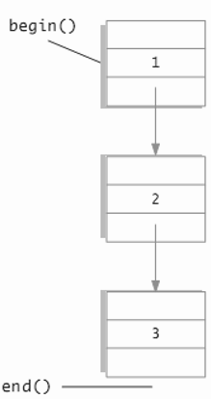
Sequential Containers
The STL sequential containers are the list, vector and deque. (The slist is not in the STL.)
Sequential means the container has a first element, a second element and so on.
An STL list is a doubly linked list.
An STL vector is essentially an array whose allocated space can grow while the program runs.
An STL deque (“d-que” or “deck”) is a “double ended queue”. Data can be added or removed at either end and the size can change while the program runs.

Slide 25
Common Container Members
The STL sequential containers each have different characteristics, but they all support these members:
container( ); creates empty container
~container( ); destroys container, erases all members
c.empty( ) true if there are no entries in c
c.size( ) const; number of entries in container c
c = v; replace contents of c with contents of v

Slide 26
More Common Container Members
c.swap(other_container);
swaps contents of c and other_container.
c.push_back(item);
appends item to container c
c.begin( );
returns an iterator to the first element in container c
c.end( );
returns an iterator to a position beyond the end of the container c.
c.rbegin( );
returns an iterator to the last element in the container. Serves to as start of reverse traversal.

Slide 27
More Common Container Members
c.rend( );
returns an iterator to a position beyond the of the container.
c.front( );
returns the first element in the container (same as *c.begin( );)
c.back( );
returns the last element in the container same as *(--c.end( ));
c.insert(iter, elem);
insert copy of element elem before iteIr
c.erase(iter);
removes element iter points to, returns an iterator to element following erasure. returns c.end( ) if last element is removed.

Slide 28
More Common Container Members
c.clear( );
makes container c empty
c1 == c2
returns true if the sizes equal and corresponding elements in c1 and c2 are equal
c1 != c2
returns !(c1==c2)
c.push_front(elem)
insert element elem at the front of container c. NOT implemented for vector due to large run-time that results

Slide 29
PITFALL: Iterators and Removing Elements
Removing elements will invalidates some iterators.
erase member returns an iterator pointing to the next element past the erased element.
With list we are guaranteed that only iterators pointing to the erased element are invalidated.
With vector and deque, treat all operations that erase or insert as invalidating previous iterators.

Slide 30
Operation Support
Operation | Function | vector | List | deque
Insert at front | push_front(e) | - | X | X
Insert at back | push_back(e) | X | X | X
Delete at front | pop_front( ) | - | X | X
Delete at back | pop_back( ) | X | X | X
Insert in middle | insert(e) | (X) | X | (X)
Delete in middle | erase(iter ) | (X) | X | (X)
Sort | sort( ) | X | - | X
(X) Indicates this operation is significantly slower.

Slide 31
The Container Adapters stack and queue
Container Adapters use sequence containers for storage but supply a different user interface.
A stack uses a Last-In-First-Out discipline.
A queue uses a First-In-First-Out discipline.
A priority queue keeps its items sorted on a property of the items called the priority, so that the highest priority item is removed first.
The deque is the default container for both stack and queue.
A vector cannot be used for a queue as the queue requires operations at the front of the container.

Slide 32
Container Adapter stack
Declarations:
stack<T> s; // uses deque as underlying store
stack<T, underlying_container> t ; //uses the specified container as underlying container for stack
Stack<T> s (sequence_container); // initializes stack to elements in sequence_container.
Header:
#include <stack>
Defined types:
value_type, size_type
No iterators are defined.

Slide 33
stack Member Functions
Sample Member Functions
Member function | Returns
s.size( ) | number of elements in stack
s.empty( ) | true if no elements in stack else false
s.top( ) | reference to top stack member
s.push(elem) | void Inserts copy of elem on stack top
s.pop( ) | void function. Removes top of stack.
s1 = = s2 | true if sizes same and corresponding pairs of elements are equal, else false

Slide 34
Container Adapter queue
Declarations:
queue<T> q; // uses deque as underlying store
queue<T, underlying_container> q ; //uses the specified container as underlying container for queue
Stack<T> s (sequence_container); // initializes queue to elements in sequence_container.
Header:
#include <queue>
Defined types:
value_type, size_type
No iterators are defined.

Slide 35
queue Member Functions
Sample Member Functions
Member function | Returns
q.size( ) | number of elements in queue
q.empty( ) | true if no elements in queue else false
q.front( ) | reference to front queue member
q.push(elem) | void adds a copy of elem at queue rear
q.pop( ) | void function. Removes front of queue.
q1 == q2 | true if sizes same and corresonding pairs of elements are equal, else false

Slide 36
Associative Containers set and map
Associative containers keep elements sorted on a some property of the element called the key.
Only the first insertion of a value into a set has effect.
The order relation to be used may be specified:
set<T, OrderRelation> s;
The default order is the < relational operator for both set and map.

Slide 37
The set Associative Container
Declarations:
set<T> s; // uses deque as underlying store
set<T, Ordering> s ; //uses the specified order relation to sort elements in the set uses < if no order is specified.
Header:
#include <set>
Defined types:
value_type, size_type
Iterators: iterator, const_iterator, reverse_iterator, const_reverse_iterator

Slide 38
set Member Functions
function | Returns
s.size( ) | number of elements in set
s.empty( ) | true if no elements in set else false
s.insert(el) | Insert elem in set. No effect if el is a member
s.erase(itr) | Erase element to which itr refers
s.erase(el) | Erase element el from set. No effect if el is not a member
s.find(el) | Mutable iterator to location of el in set if present, else returns s.end( )
s1 == s2 | true if sizes same and corresponding pairs of elements are equal, else false

Slide 39
The map associative container
A map is a function given as a set of ordered pairs <first, second>
For each first in an ordered pair <first, second> there is at most one value, second, that appears in an ordered pair in the map.
First and second can be different data types, so for example you could map an integer to a string
The STL provides a template class pair<T1,T2> defined in the utility header file.
You may wish to read about the multiset and multimap. See Josuttis, The C++ Standard Library Addison Wesley.

Slide 40
Maps as associative arrays
An alternative interpretation is that a map is an associative array. For example, numbermap["c++"] = 5 associates the integer 5 with the string "c++"
The easiest way to add and retrieve data from a map is to use the [] operator
However, if you attempt to access map[key] and key is not already in the map, then a new entry with the default value will be added!

Slide 41
map Member Functions
Function | Returns
m.size( ) | number of pairs in the map
m.empty( ) | true if no pairs are in the map else false
m.insert(el) el is a pair <key, T> | Inserts el into map. Returns <iterator, bool>. If successful, bool is true, iterator points to inserted pair. Otherwise bool is false
m.erase(key) | Erase element with key value key from map.
m.find(el) | Mutable iterator to location of el in map if present, else returns m.end( )
m1 = = m2 | true if maps contain the same pairs, else false
m[target] | Returns a reference to the map object associated to a key of target.

Slide 42
Efficiency
The STL was designed with efficiency as an important consideration.
STL requires compliant implementations to guarantee a maximum running time.
STL implementations strive to be optimally efficient.
Sorting is usually specified to be O(N*log(N)) where N is the number of items being sorted
Search is usually specified to be O(log(N)) where N is the number of items being searched.

Slide 43
Tip: Use ranged-for, auto with containers
C++11 ranged-for loop and auto keyword make it easier to iterate through containers. Consider the following map and set:
map<int, string> personIDs = {{1,"Walt"}, {2,"Kenrick"}};
set<string> colors = {"red","green","blue"};
We can iterate through each container conveniently with a ranged for loop and auto:
for (auto p : personIDs) cout << p.first << " " << p.second << endl; for (auto p : colors) cout << p << " ";

Slide 44
18.3
Generic Algorithms

Slide 45
Generic Algorithms
“Generic Algorithm” are a template functions that use iterators as template parameters.
This chapter will use Generic Algorithm, Generic function, and STL function template to mean the same thing.
Function interface specifies task, minimum strength of iterator arguments, and provides run-time specification.

Slide 46
Running Times and Big-O Notation
To be useful, running times for an algorithm must specify time as a function of the problem size.
We can time a program with a stop watch or instrument the code with calls to the system clock to empirically determine running time.
What problems do you see there?
There is a better way.

Slide 47
Worst case running time
In the rest of the chapter we will always mean “worst case running time” when we specify a running time.
How do we proceed? Do we count “steps” or “operations”?
What is a step? What is an operation?
Disagreement abounds, but mostly we agree to count =, <, &&, !, [ ], ==, and ++
This simplifying assumption works well in practice.

Slide 48
An example
int i = 0;
bool found = false;
while (( i < N ) && !(found))
if (a[i] == target)
found = true;
else
i++;
Assume target is not in array.
Loop runs N times, 6 operations per iteration. <, &&, ! , [i] , ==, ++
After N iterations, Boolean expression adds 3 operations, <, &&, and !
Total of 6N + 3 operations.

Slide 49
Objections
Not all operations take the same time
A given operation takes different time on different machines
We ignores some operations that might be significant.
What we are really interested in is the growth rate of the running time as a function of the problem size, not precise computations for a particular architecture.

Slide 50
Big-O Notation
Estimates of running time are usually expressed with the Big-O notation.
We pronounce this “Big-Oh.” The O is the letter Oh, not the digit zero, 0.
We say that our loop in a previous slide runs in O(6N + 3).
This means that the actual running time will be less than or equal to c(6N+3)
We say the code runs in O(6N+3)

Slide 51
Large Coefficients Do Not Matter
Big-O estimates do not distinguish 5N + 5 and 100N
These all have Big-O estimates of O(N3)
N3 + 4000N2 – N + 1
8N3 + 5N – 1000
1000N3 + 4N2 – 100000N + 1
Regardless of the coefficient, the largest exponent “rules”

Slide 52
Some generic terminology
T(N) means runnning time.
Linear running time
T(N) = aN + b
Quadratic running time
T(N) has highest term N2
O(log N) A function with this running time is very fast
O(N log N) A function with this running time is slower than linear, but much faster than quadratic.

Slide 53
Container Access Time 1
vector: push_back(el), pop_back( ) have O(1) (constant upper bound) running time
deque: push_back(el), push_front(el), pop_back( ), push_back(el) are all O(1)
list: insert anywhere is O(1)
Finding the location of an element in a list has O(N) running time.

Slide 54
Container Access Time 2
vector, deque insert in the middle is O(N)
vector insert at the front is O(N)
Most set and map operations are O(log N) Other set and map operations are O(1).

Slide 55
Generic Algorithm Classification
Algorithms are classified into
Nonmodifying Sequence Algorithms
Modifying Sequence Algorithms
Sorting and Related Algorithms
Numeric Algorithms
We will deal with nonmodifying, modifying and sorting algorithms.
See Josuttis for more information on algorithms.

Slide 56
Nonmodifying Sequence Algorithms
Nonmodifying algorithms that do not modify the container they operate upon.
The declaration of the generic function find algorithm:
template<class InputIterator, class T> InputIterator find (InputIterator first, InputIterator last, const T& value);
The declaration tells us find works with any container that provides an iterator at least as strong as an input iterator.
Type T objects must be equality comparable.

Slide 57
Iter find(Iter first, Iter last, const T& value);
The generic algorithm find( ) locates an element within a sequence. It takes three arguments.
The first two specify a range: [start, end), the third specifies a target value for the search.
If requested value is found, find( ) returns an iterator that points to the first element that is identical to the sought-after value.
If the requested value is not found, find( ) returns an iterator pointing one element past the final element in the sequence (that is, it returns the same value as end( ) does).

Slide 58
More nonmodifying Algorithms
count Counts occurrences of a value in a sequence
equal Asks are elements in two ranges equal?
search Looks for the first occurrence of a match sequence within another sequence
binary_search Searches for a value in a container sorted using less. If the container was sorted using another predicate, this predicate must be supplied to binary_search. This is an efficient search for sorted sequences with random access iterators.

Slide 59
Container Modifying Algorithms
Container modifying algorithms change the content of the elements or their order.
copy Copies from a source range to a destination range. This can be used to shift elements in a container to the left provided that the first element in the source range is not contained in the destination range.
remove Removes all elements from a range equal to the given value
random_shuffle shuffles the elements of a sequence. Argument 1 is an iterator pointing to the first of the sequence. Argument 2 points one position past the last element of the sequence.

Slide 60
Sorting Algorithms
Algorithm analysis tells us that the runtime of the most efficient sort algorithms that depend on swapping elements is O(N log(N)). N is the number of elements being sorted.
All the STL sorting algorithms are required to be O(N log(N)), so these algorithms (up to a multiplicative constant) as fast as possible.
sort Sorts elements in a range in nondescending order, or in an order determined by a user-specified binary predicate.
merge Merges two sorted source ranges into a single destination range.

Slide 61
Chapter Summary 1
An iterator is a generalization of pointer. Iterators allow cycling through containers without compromising the container structure.
Most iterators have operations ++ and dereferencing * defined.
Main kinds of iterators are:
Forward, where ++ works but -- does not
Bidirectional where ++ and -- work
Random access where ++ -- indexing and iterator arithmetic all work.

Slide 62
Chapter Summary 2
Kinds of container classes are
Sequence containers: vector, deque, list
Adapters: stack, queue, priority queue
Deque is the default underlying container
User can select an underlying container
Stack discipline is last-in-first-out
Queue discipline is first-in-first-out
Priority queue keeps largest key on top.

Slide 63
Chapter Summary 3
Associative containers: set, map, multiset, multimap
Associative containers store elements in sorted order
Map is a set of <key, value> pairs, allowing retrieval on key.
Multiset and multiset allow single key for multiple entries

Slide 64
Chapter Summary 4
Containers with iterators also provide member functions begin( ) and end( ) that return iterator types useful to traverse the container:
for (p = c.begin( ); p != c.end( ); p++)
process(*p ); // *p is the current item
Dereferencing a constant iterator *const_p provides read only access.
Dereferencing a mutable iterator produces a read-write access: *mutable_p

Slide 65
Chapter Summary 5
The sequence container list provides mutable bidirectional iterators.
The sequence containers vector and deque provides mutable random access iterators.
The STL provides template functions (sometimes called generic algorithms or template functions) that provide very guarantees on maximum running time.

Slide 66
Chapter 18 -- End
There are further slides that show examples of implementation for independent study

Slide 67
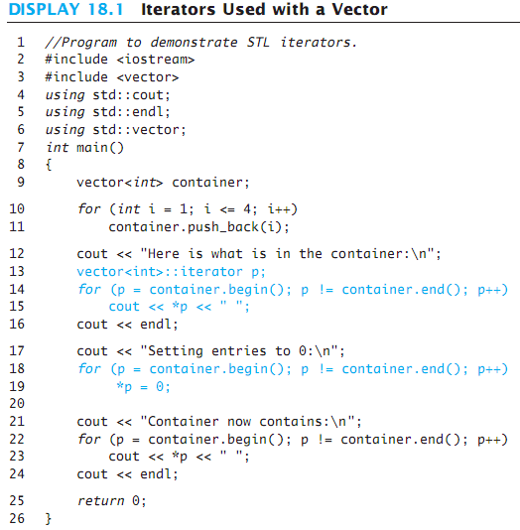
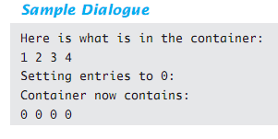
Display 18.1
Back
Next

Slide 68
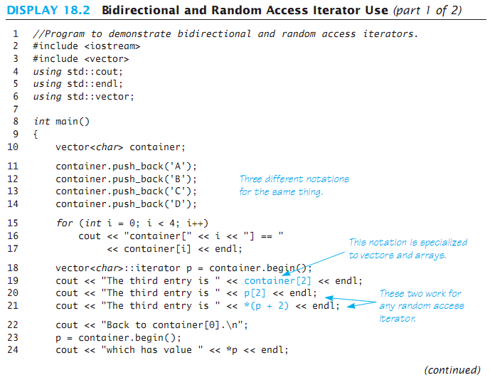
Display 18.2 (1/2)
Back
Next

Slide 69
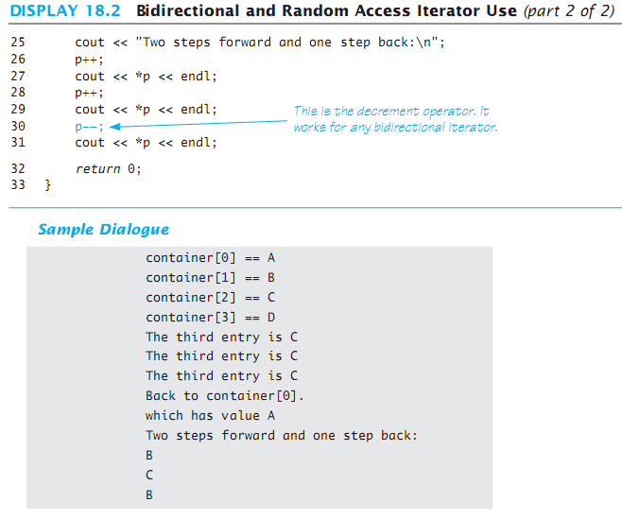
Display 18.2 (2/2)
Back
Next

Slide 70
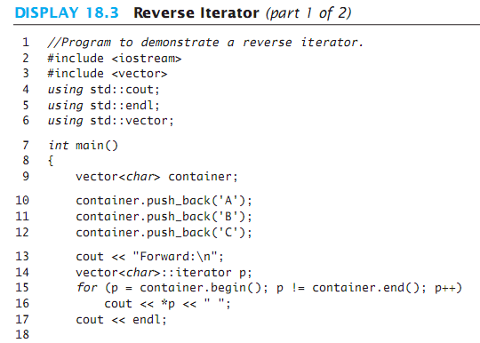
Display 18.3 (1/2)
Back
Next

Slide 71
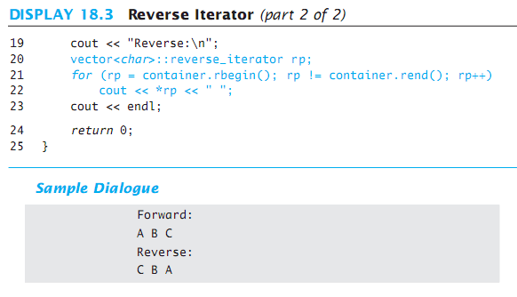
Display 18.3 (2/2)
Back
Next

Slide 72
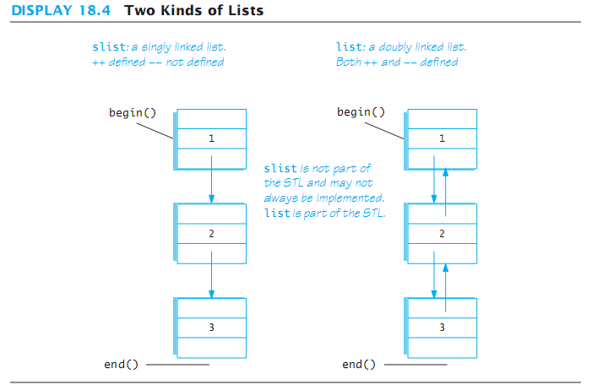
Display 18.4
Back
Next

Slide 73
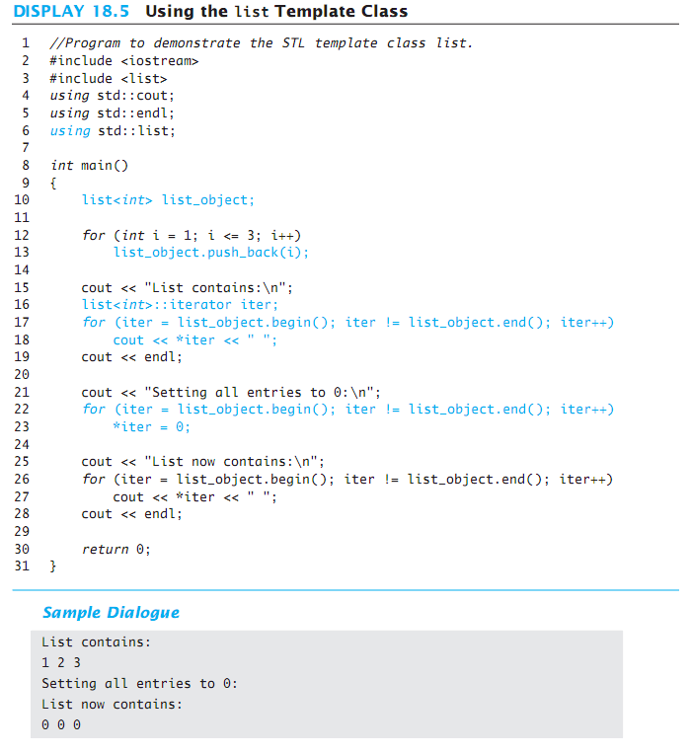
Display 18.5
Back
Next

Slide 74
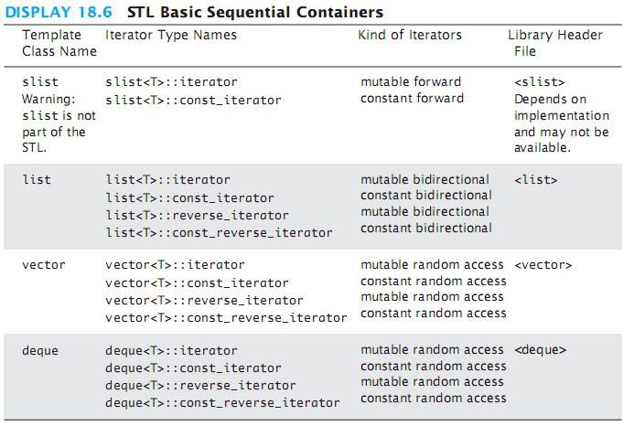
Display 18.6
Back
Next

Slide 75
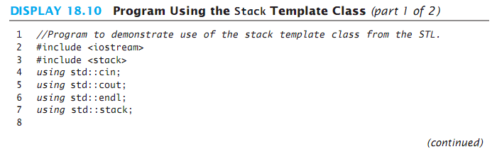
Display 18.10 (1/2)
Back
Next

Slide 76
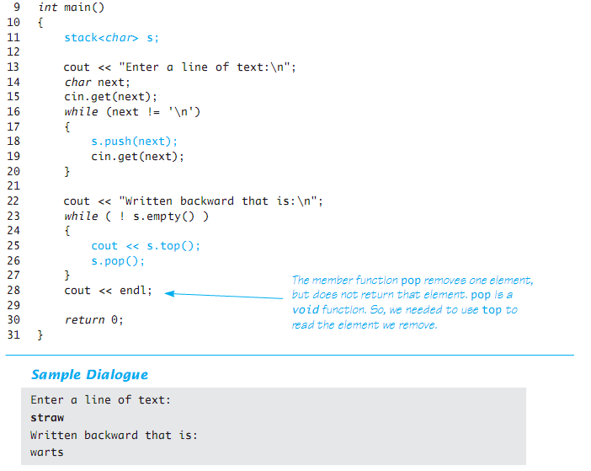
Display 18.10 (2/2)
Back
Next

Slide 77
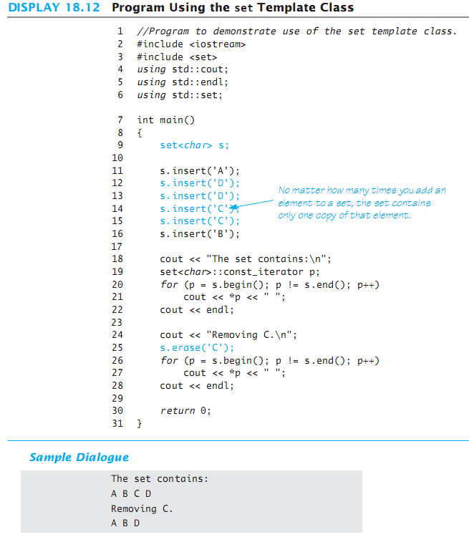
Display 18.12
Back
Next

Slide 78
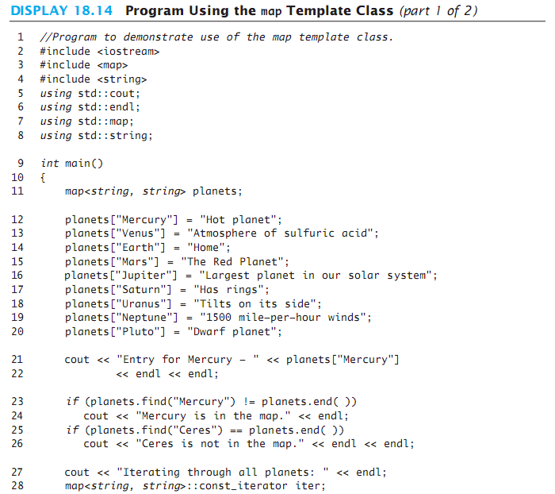
Display 18.14 (1/2)
Back
Next

Slide 79
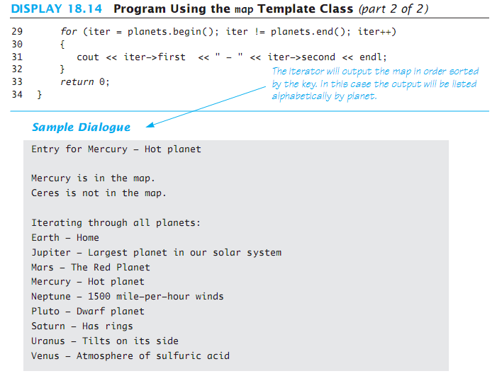
Display 18.14 (2/2)
Back
Next

Slide 80
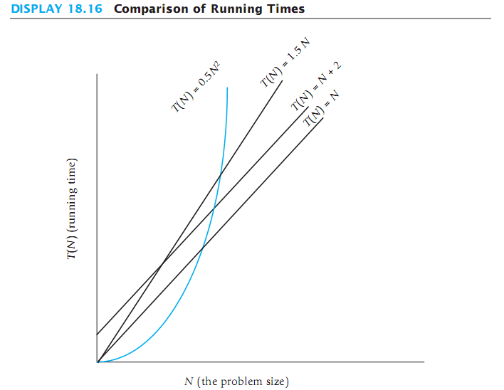
Display 18.16
Back
Next

