Slide 1

Prediction of Home Value Using XGBoost Regression
Ben Karabinus
University of Denver, COMP 4442, Fall Quarter 2021

Slide 2
Data sources and definitions explained
Value – Seasonally adjusted and smoothed measure of typical home values in the United States. Obtained from the Zillow Home Value Index (ZHVI) data set available for download from Zillow.com.
Region – City, State combinations or metropolitan statistical areas (MSAs) representing regions in the United States having at least one urbanized area with a population of 50,000 or more people.
POP – Population for a given region. Obtained from the U.S. Bureau of Economic Analysis (BEA.gov)
Size – Factor representing home size for a given record in the data set. Levels (condo, one, two, three, four, five +)
Income – Per capita personal income for a given region. Obtained form the U.S. Bureau of Economic Analysis (BEA.gov)
UnEmpRate – Unemployment rate for a given region. Obtained form the U.S. Census Bureau (Census.gov)
RPP – Measure of the difference in price level for consumer goods across U.S. regions for a given year. Expressed as a percentage of the national price level.
Notes:
Data used for the analysis was collected from multiple sources and then combined into a single data set prior to the application of XGBoost regression. All data used in the analysis was collected in 2019.
Value – calculated using Zillow’s proprietary zestimate
Region – Factor 368 levels
Pop
Size – ZHVI indicator converted to factor for purpose of analysis
Per cap income calculated as total personal income divided by population
UnEmp
Expressed as percentage of national price level

Slide 3
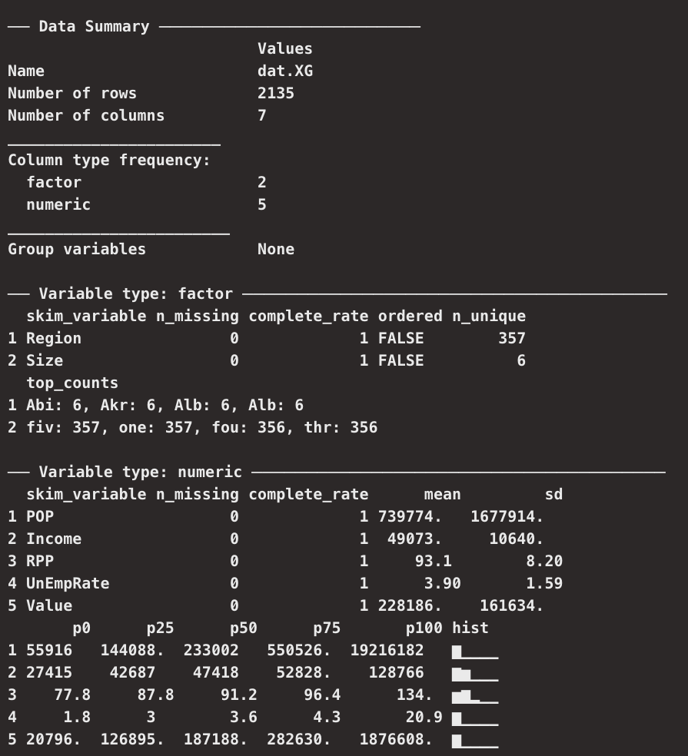
Exploratory Data analysis
Notes:
High dimensionality of categorical variables – Region
Distribution of home value and population effected by presence of extreme outliers

Slide 4
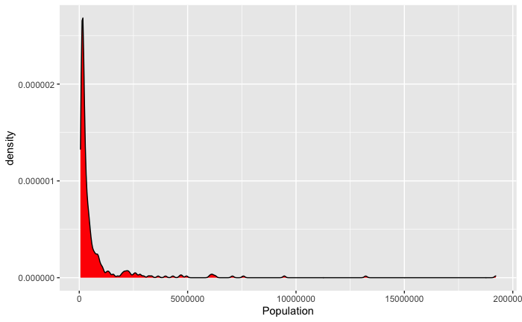
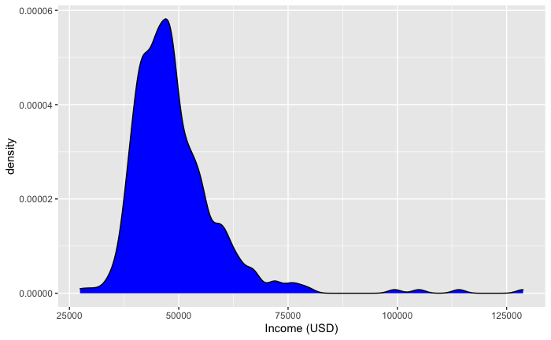
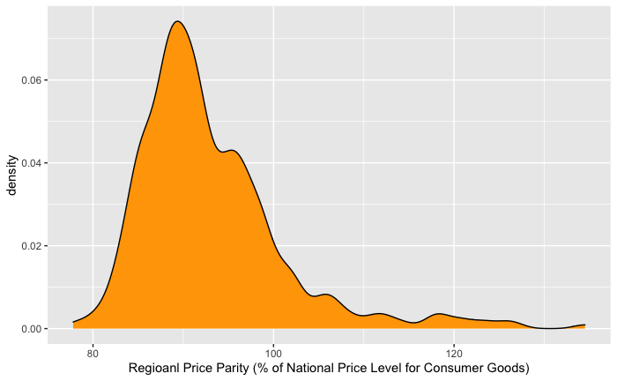
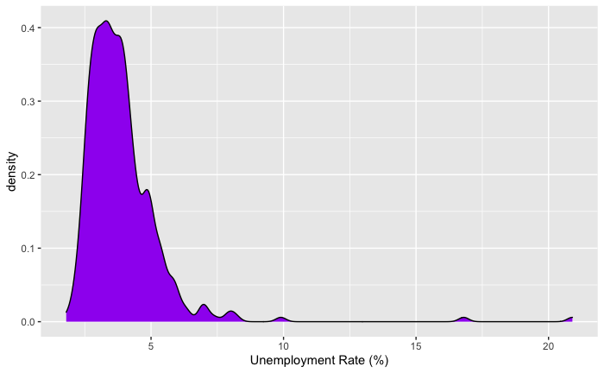
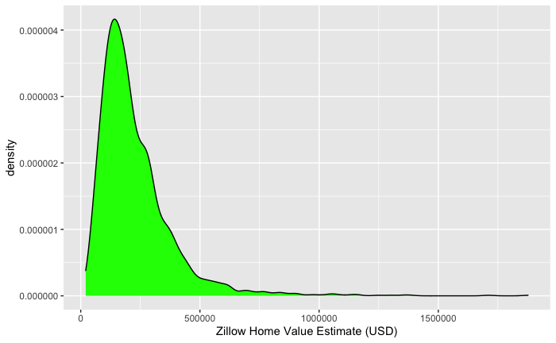
Exploratory Data Analysis - Distribution of continuous variables
Notes:
Each of the continuous variables in the data set is exhibit the presence of extreme outliers
Population in particular is extremely left skewed. Majority of regions below 250,000 people, yet mean of population predictor is 739000 and sd is1.7 million

Slide 5
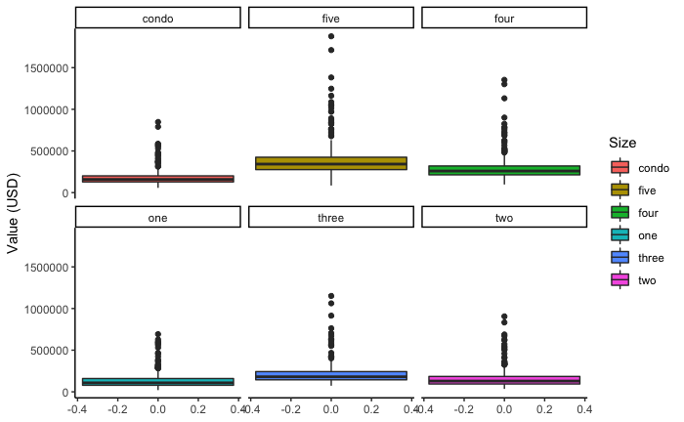
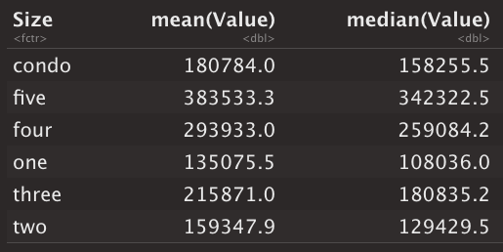
Exploratory Data Analysis - Distribution of Home Values by size
Notes:
Each home size is affected by the presence of extreme outliers
This confirms the density plots in the previous slides

Slide 6
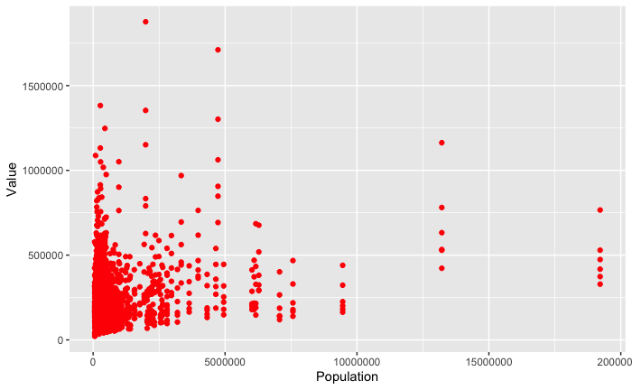
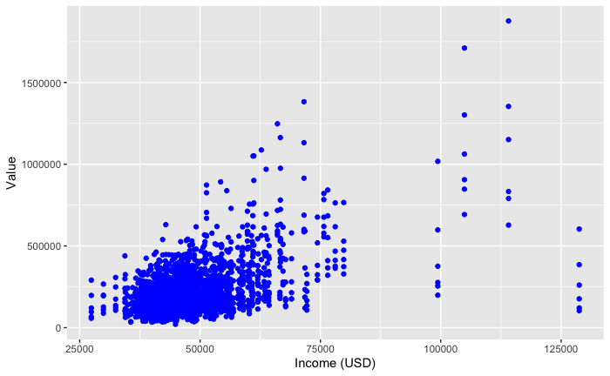
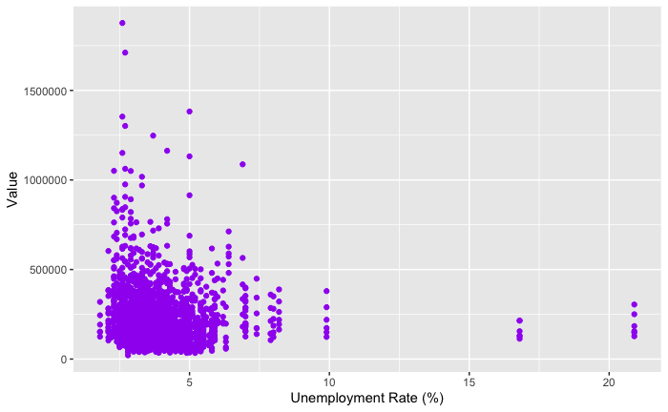
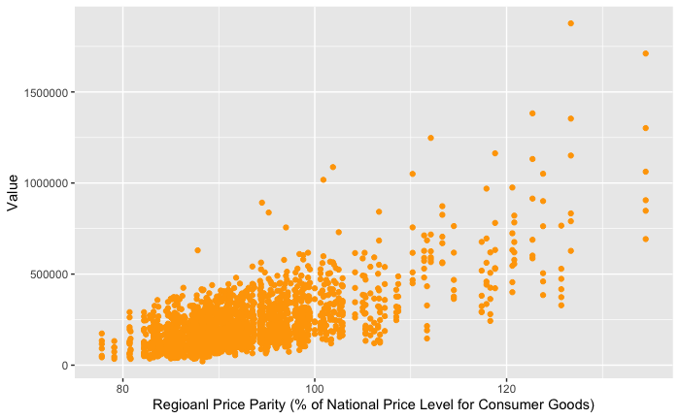
Exploratory Data Analysis – affects of continuous predictors on outcome
Notes:
There is a significant

Slide 7
Primary Research Question(s)
Can Region, Population, Size, Income, Regional Price Parity and Unemployment Rate be used to predict the Zillow Home Value estimate for a given Region in the United States?
How robust is XGBoost regression to skewed data?
Notes:
Cam the

Slide 8
Supervised machine learning: Gradient Boosted machines
Data
Error
Error
Model 0
Model 1
Train
Test
Train
Test
Error
Model 2
Model N
Train
Test
Test
Final Prediction

Slide 9
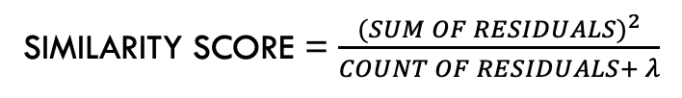

Primary Method for Analysis – XGBoost regression
SIMILARITY SCORE = $\frac{{(SUM OF RESIDUALS)}^{2}}{COUNT OF RESIDUALS+ λ}$
REGULARIZATION PARAMETER - $λ$
Initial prediction
Residuals
SIMILARITY SCORE = 0
Notes:
The XGBoost algorithm has become extremely popular in the field of Data science in recent years.
Built for large complicated datasets
Robust against overfitting

Slide 10


Primary Method for Analysis – XGBoost regression (categorical Predictors)
ROOT NODE
SIMILARITY SCORE = ${Left}_{Similarity}$
LEFT LEAF
RIGHT LEAF
SIMILARITY SCORE = ${Right}_{Similarity}$
GAIN = ${Left}_{Similarity}+{Right}_{Similarity} − {Root}_{Similarity}$

Slide 11
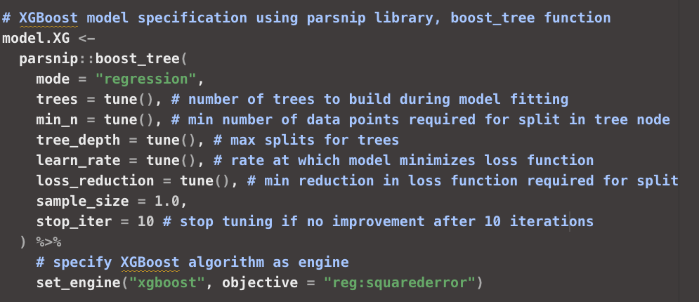
XGBoost regression with tidy models: Specify parameters for model tuning

Slide 12
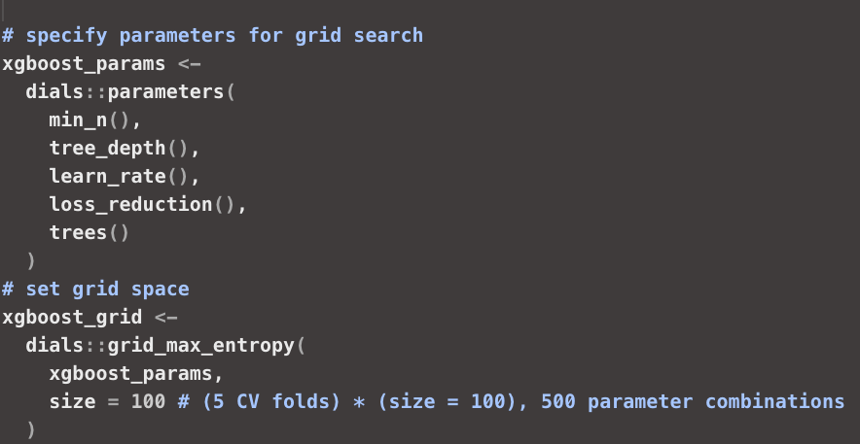
XGBoost regression with tidy models: Create training grid

Slide 13
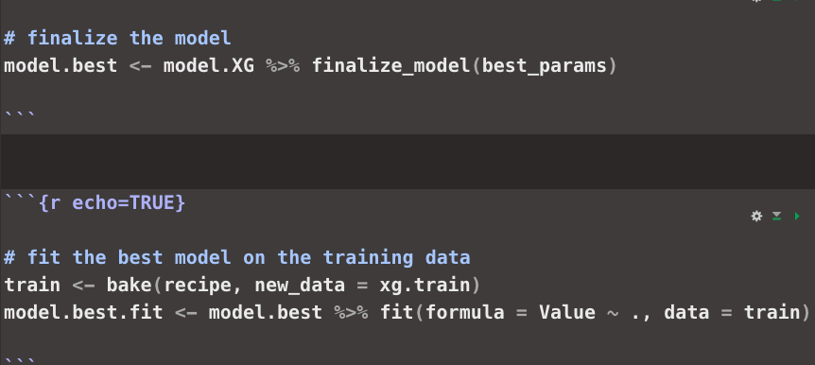
XGBoost regression with tidy models: extract Best Parameters and fit final model

Slide 14
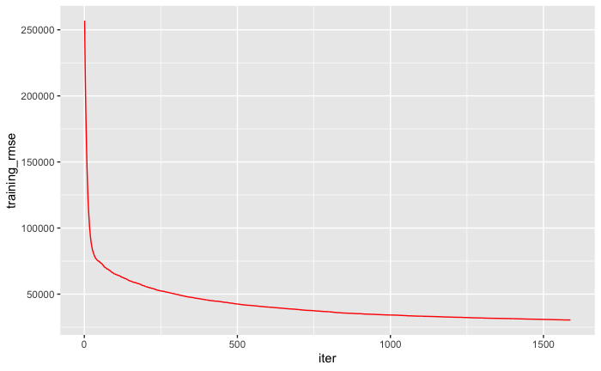
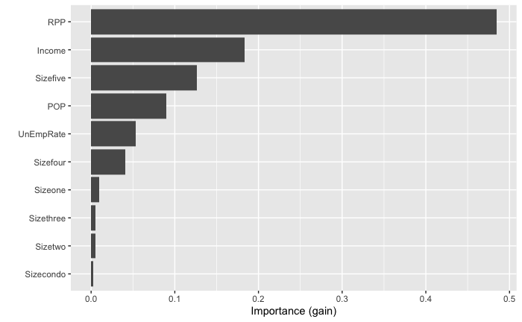
XGBoost regression with tidy models: Visual Assessment of Best fit
Notes:
1598 trees

Slide 15
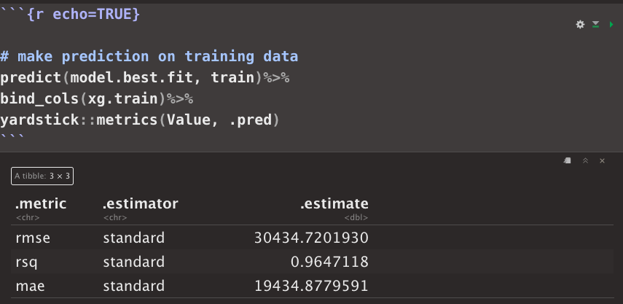
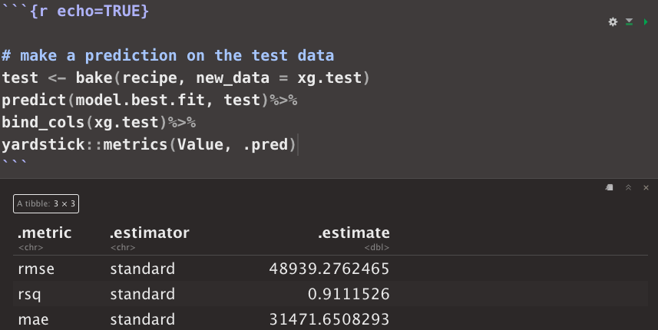
XGBoost regression with tidy models: Visual Assessment of Best fit
Training data
Test Data
Notes:
Mean: 228186
SD: 161634

