Slide 1
Week 2
Working with data

Slide 2

Roadmap:
Week 1: data types, lists, loops, statements
Week 2: functions, dictionaries, numpy, advanced loops
Week 3 and 4: working with data – numpy and pandas + plotting
Week 5 : advanced pandas and plotting
Week 6: basics of modelling + preprocessing
Week 7: advanced modelling

Slide 3
Summary for Week 2
Loading Data
DataTypes: csv / excel / numpy
to dictionary
to numpy
to pandas
Intro to Pandas
Intro to Matplotlib

Slide 4
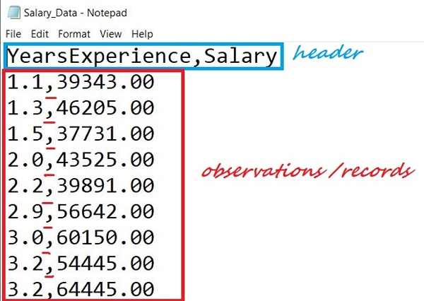

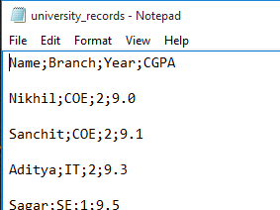
Data Types: CSV (comma separated values)

Slide 5
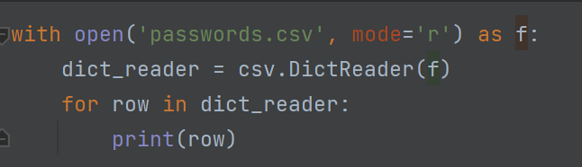
Reading csv data as dictionaries:
Notes:
+ use variable row.items() to get key, values and assign to dictionary

Slide 6
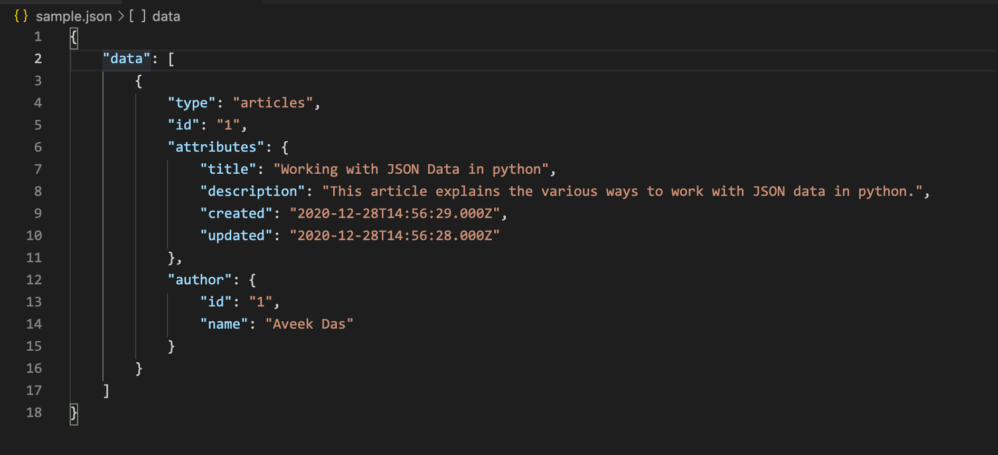
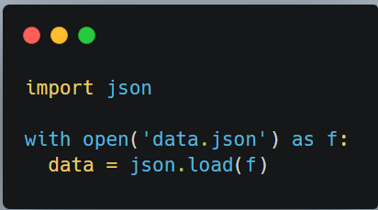
Data Types: json
Good blog post:
https://www.sqlshack.com/working-with-json-data-in-python/

Slide 7
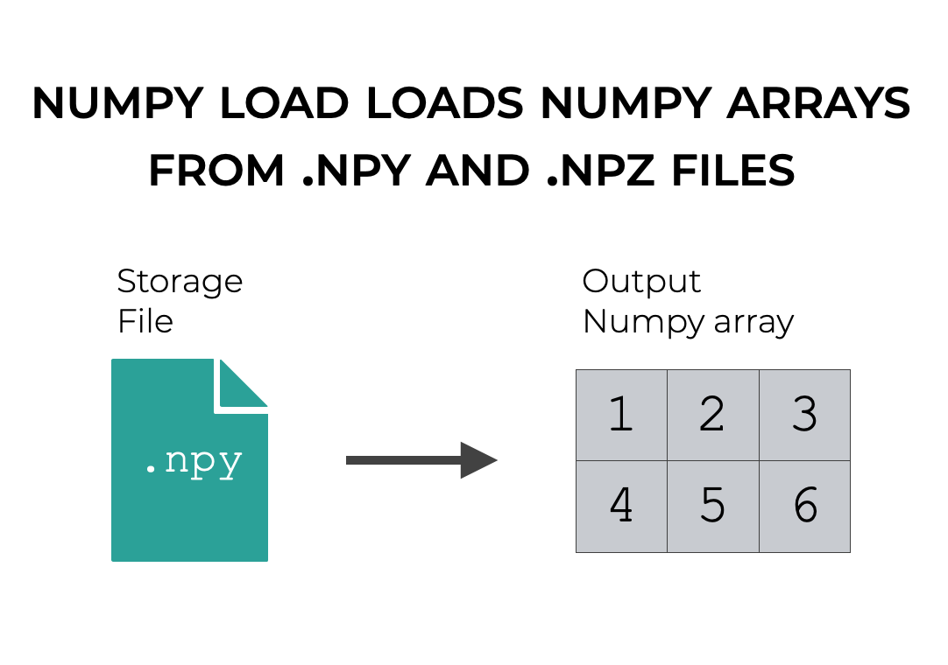
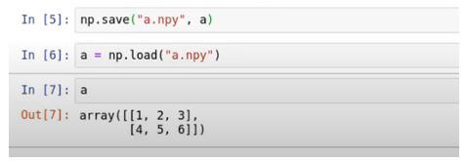
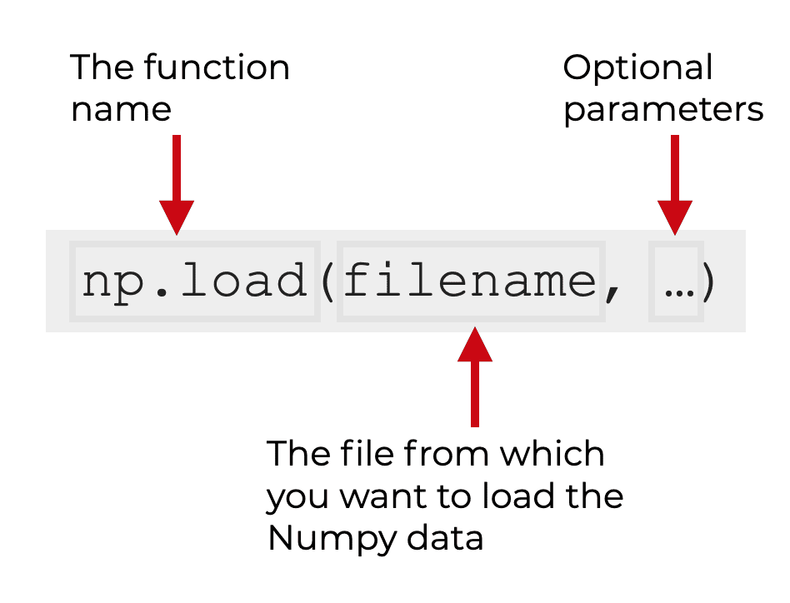
Data Types: NumPy

Slide 8


Introduction to
https://pandas.pydata.org/docs/
Online tutorial with extra info
https://www.datacamp.com/tutorial/pandas

Slide 9
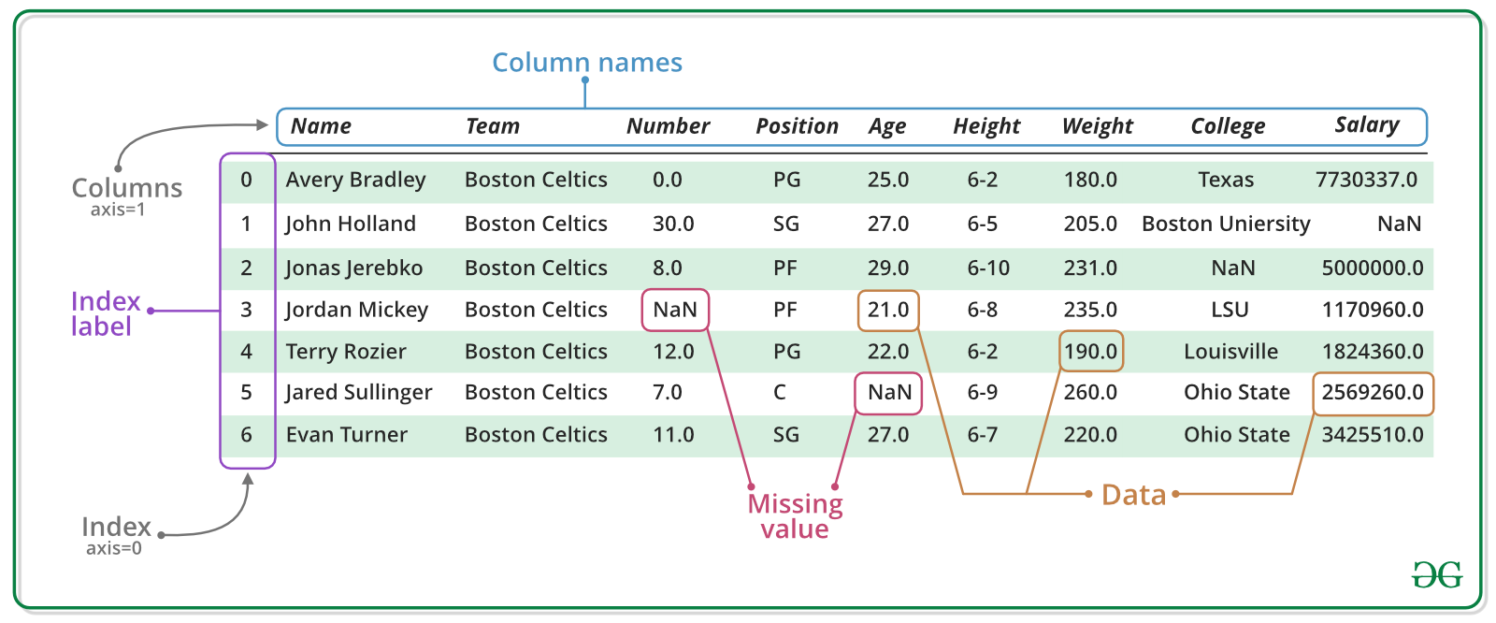
‘the’ tabular data analysis and manipulation Python library
built using the NumPy library
core structure: DataFrames: a 2D data table similar to a spreadsheet.
DataFrames can store and manipulate various data types, including numerical, categorical, and text data.
Loads of functions for manipulation, cleaning, filtering, sorting, aggregating
Integrates well with plotting libraries (matplotlib / seaborn)

Slide 10
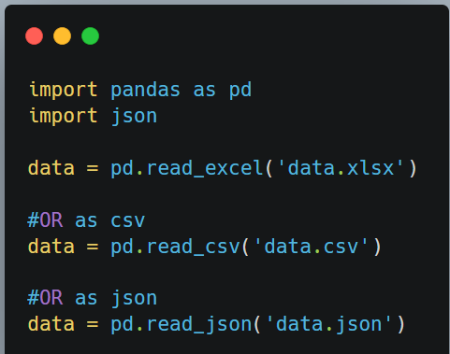
Load data into Pandas

Slide 11
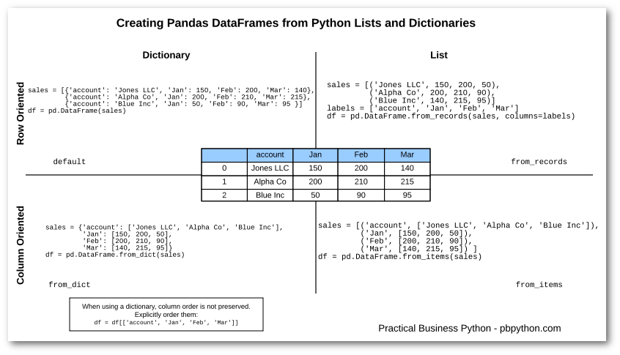

Slide 12
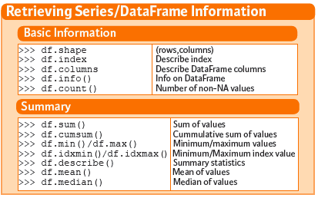
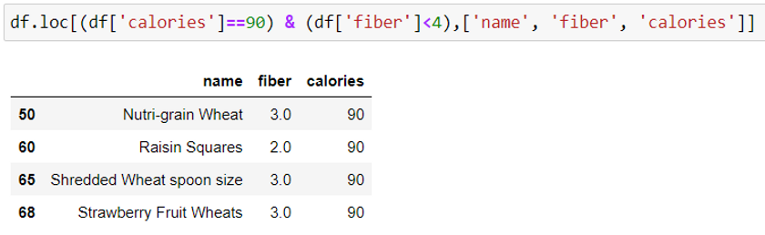
Filtering:

Slide 13
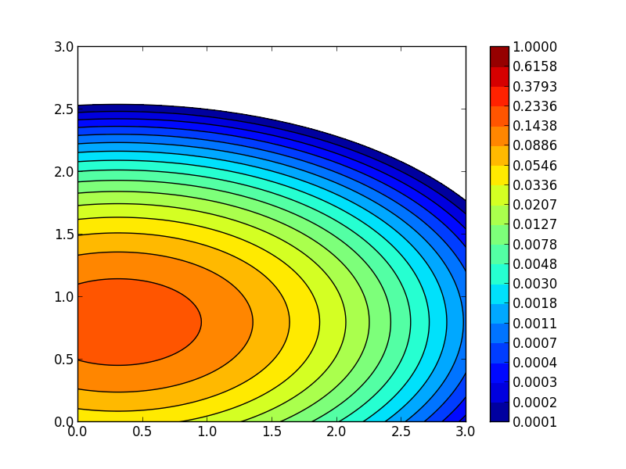
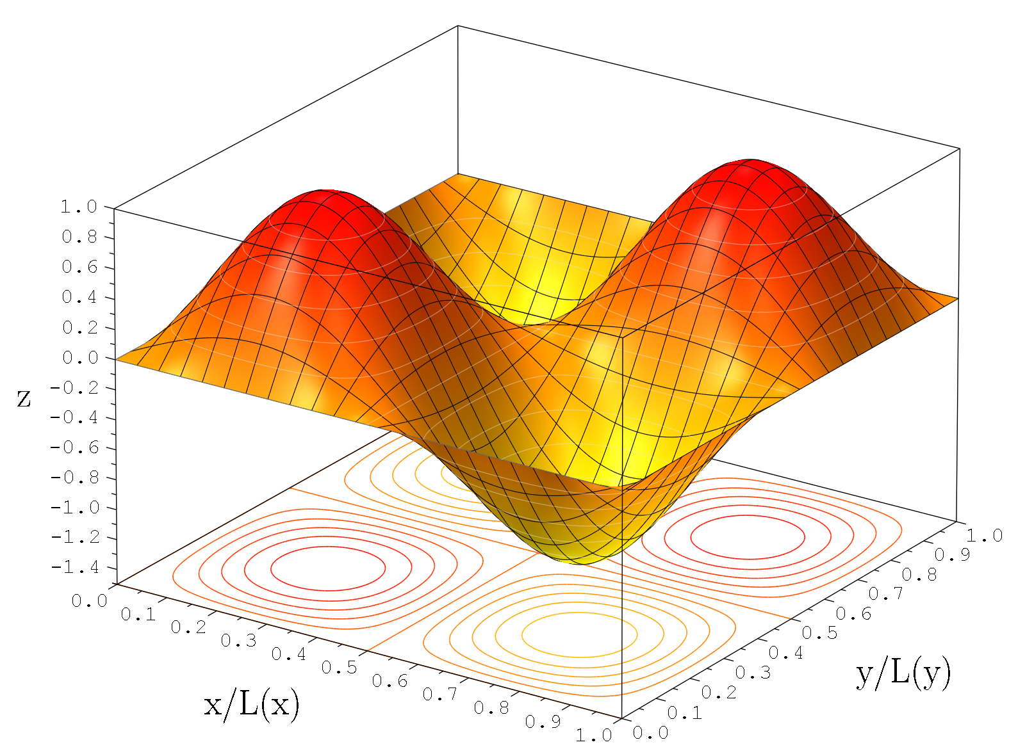

Introduction to
Documentation:
Online tutorial with extra info:
https://matplotlib.org/stable/index.html
https://www.datacamp.com/tutorial/matplotlib-tutorial-python

Slide 14
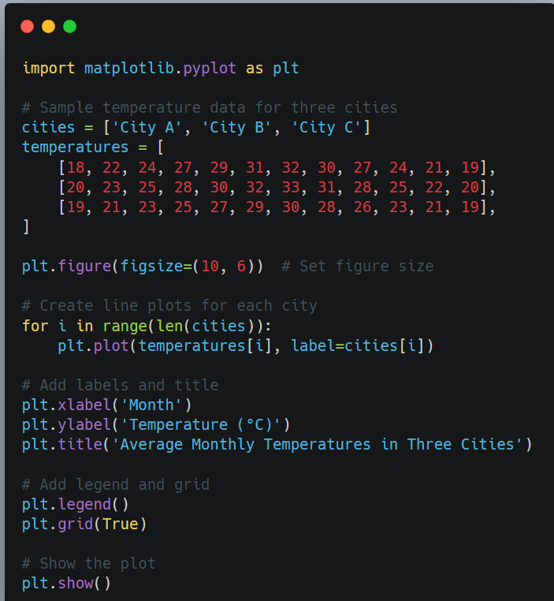
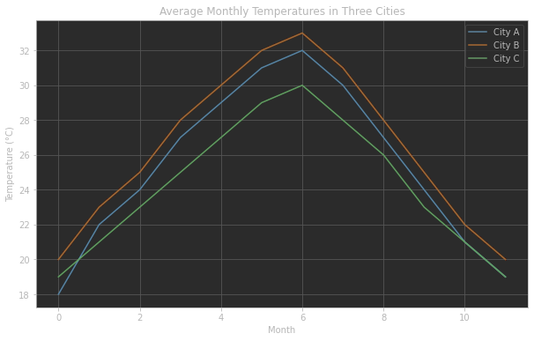
Introduction example
(or) retrieve data from pandas as list or numpy or dictionary
annotations

Slide 15
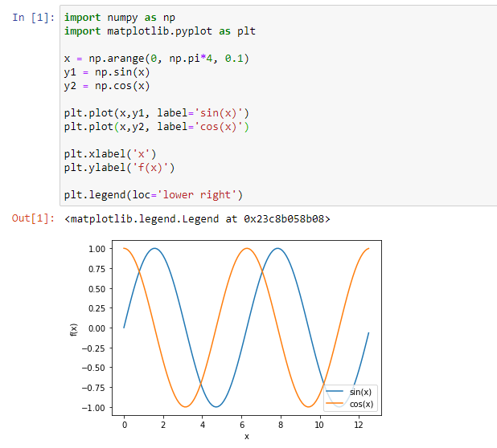
A comprehensive 2D plotting library in Python for visualising data and results
Variety of Plots:
line graphs,
scatter plots,
bar charts,
box plots,
histograms (and more)

Slide 16
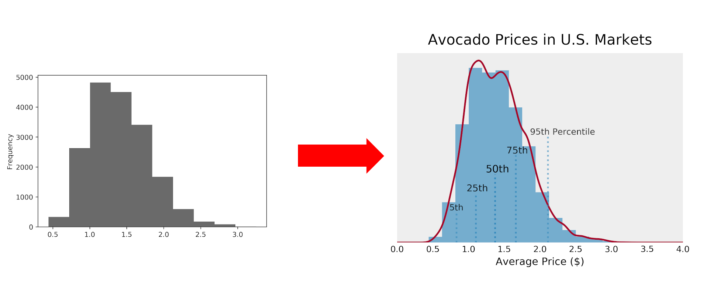
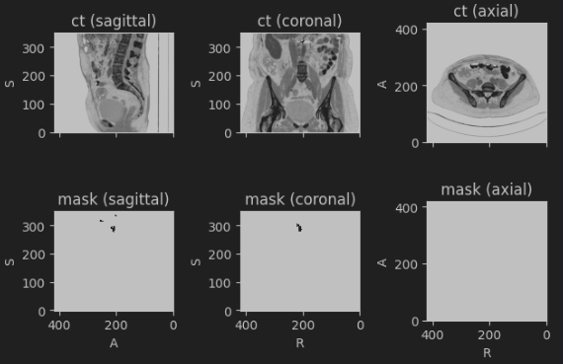
Lots of customisation options:
to fine tune appearance of plots
Size, colours, styles, axis, plot annotations.
Subplots

Slide 17

Any Questions?
Notes:
Using Git?
[How to install git
How to pull ]

