Slide 1
Week 2
More basics of Python

Slide 2

Roadmap:
Weeks 1: data types, lists, loops, statements
Week 2: functions, dictionaries, numpy, advanced loops
Week 3 and 4: working with data – numpy and pandas + plotting
Week 5 : advanced pandas and plotting
Week 6: basics of modelling + preprocessing
Week 7: advanced modelling

Slide 3
Summary for Week 2
More Python:
Dictionaries
Numpy arrays
Loops and nesting
Functions
How to launch jupyter notebook in your environment (terminal)
Installing packages (pip/conda)

Slide 4
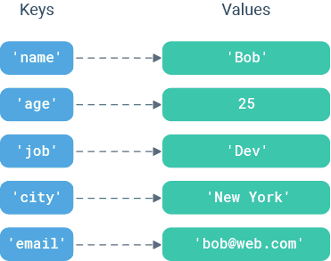
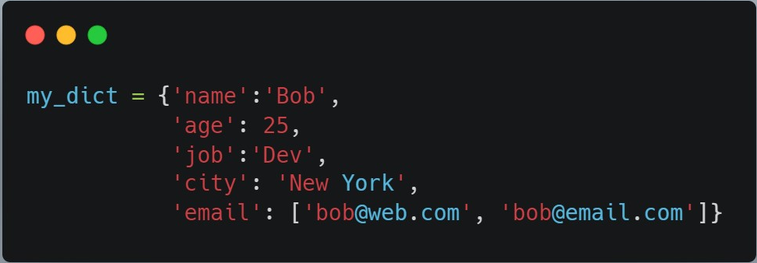
Dictionaries:
a collection of key-value pairs
Start and end with {
key: value
key can be strings (str) or numbers (int/float),
value can be any object (e.g. str, int, float, list, numpy array, dict etc.)
Other stuff:
Can add more keys/edit values, iterate through them

Slide 5
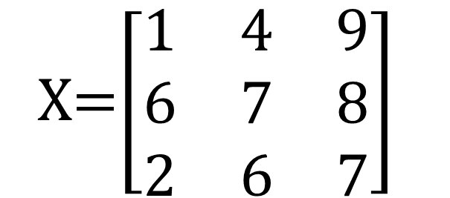
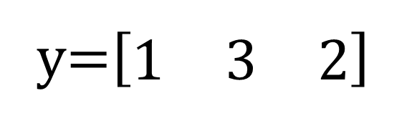
Numpy Arrays:
Data structure with lots of methods for scientific computing
Easier / much more efficient than lists
X=$\left[\begin{matrix}1 & 4 & 9 \\ 6 & 7 & 8 \\ 2 & 6 & 7\end{matrix}\right]$
y=$\left[\begin{matrix}1 & 3 & 2\end{matrix}\right]$
Single dimensional array
Two-dimensional array
y=np.array([1,3,2] )
X= np.array([[1,4,9],
[6,7,8],
[2,6,7]])
https://numpy.org/devdocs/user/absolute_beginners.html

Slide 6
Function Name | Description
np.sum | Compute sum of elements
np.prod | Compute product of elements
np.mean | Compute mean of elements
np.std | Compute standard deviation
np.var | Compute variance
np.min | Find minimum value
np.max | Find maximum value
np.argmin | Find index of minimum value
np.argmax | Find index of maximum value
np.median | Compute median of elements
np.percentile | Compute rank-based statistics of elements
np.any | Evaluate whether any elements are true
np.all | Evaluate whether all elements are true
Numpy Functions:
Python for Data Science Handbook (Jake VanderPlas)
Notes:
In the python for data science handbook you can see a bunch different functions that you can use in numpy.
https://jakevdp.github.io/PythonDataScienceHandbook/02.04-computation-on-arrays-aggregates.html

Slide 7
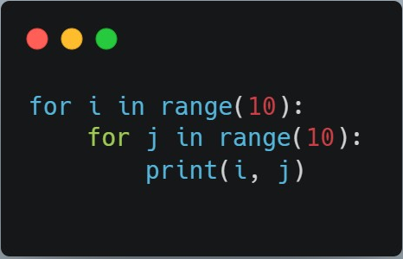
Nesting loops:
What are i and j here?

Slide 8
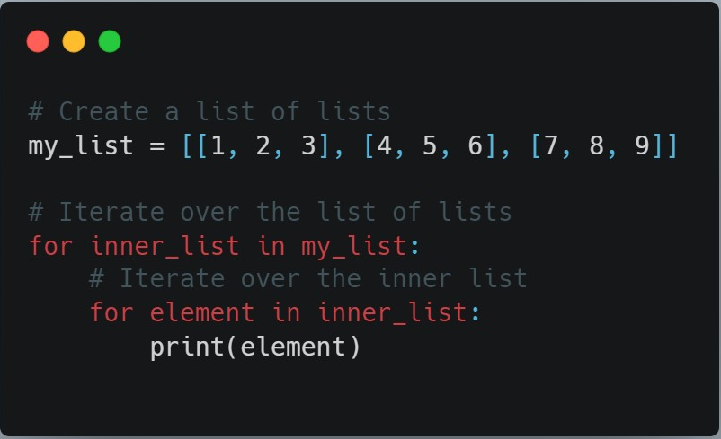

Slide 9
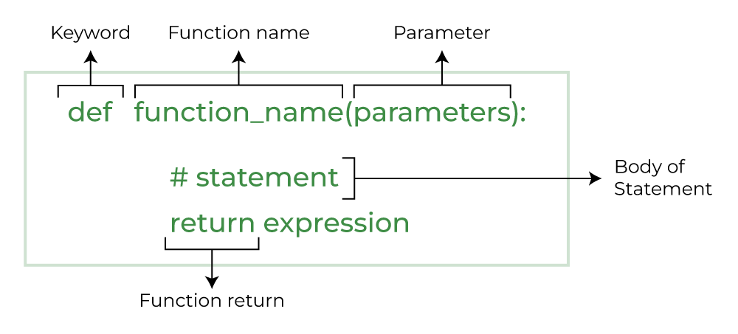
Python Functions

Slide 10
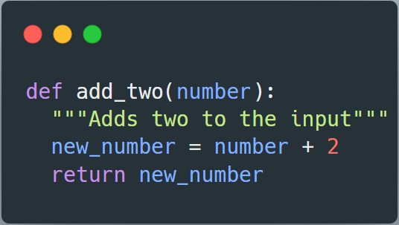

Slide 11
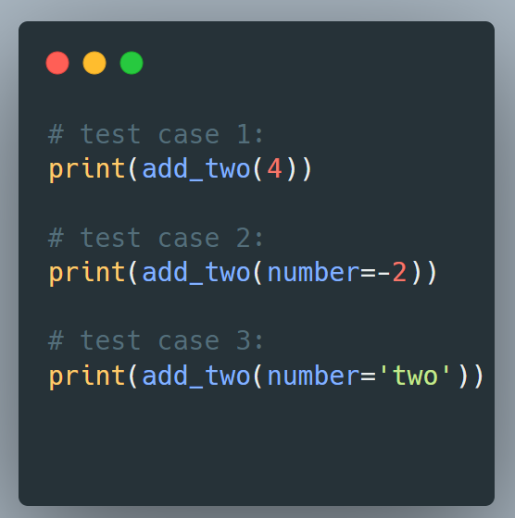

Slide 12
Lab Notebook Setup

Slide 13


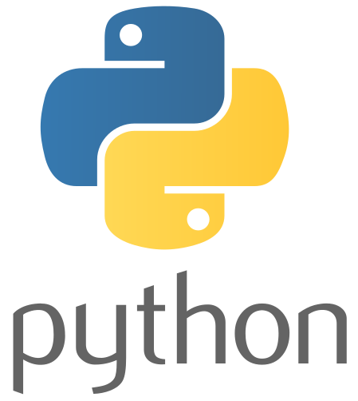
Opening Jupyter Notebook with environment
Mac/Linux users: Open a Terminal
Windows users: Open Anaconda prompt
Then run the following command:
conda activate hestia
jupyter notebook

Slide 14
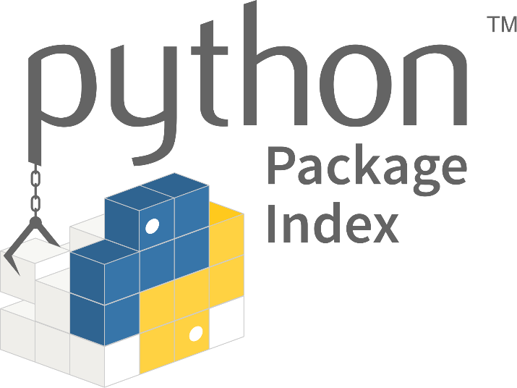
Python Modules
When you need 3rd party modules, we can install them using a package manager.
In terminal
conda install pandas OR pip install pandas
In python
import pandas as pd

Slide 15

Any Questions?
Notes:
Using Git?
[How to install git
How to pull ]

