Slide 1
Reassessing LaGuardia’s perimeter rule
Ben Kenigsberg
December 8, 2016

Slide 2
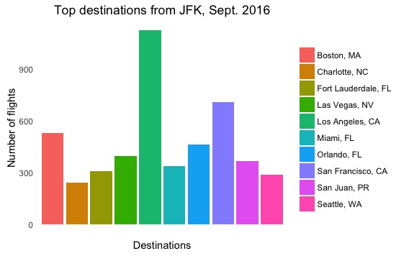

Slide 3
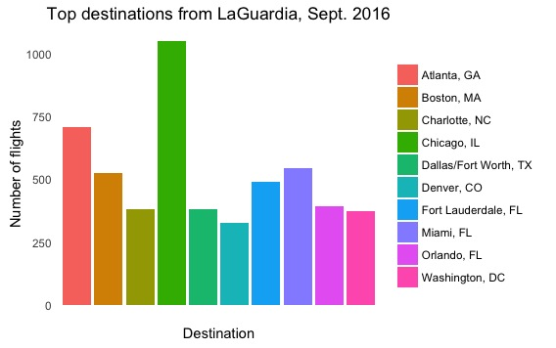

Slide 4
