Slide 1
Azure Data Factory ♡ Bicep
Data Saturday Oslo, 2022-09-10
Alpa Buddhabhatti Azure Consultant Cluster Reply, UK
Benjamin Kettner CTO ML!PA Consulting GmbH, Germany

Slide 2









Slide 3
Agenda
What is ADF
What is Bicep
Linked Services
Dataset
Activities
Pipelines

Slide 4
Azure Data Factory
1. Quick overview of Azure Data Factory (ADF)

Slide 5
What is Azure Data Factory?
A cloud-based data integration service that orchestrates and automates the movement and transformation of data
Azure Platform as a Service (PaaS)
It is Serverless
Only pay for what you have use
Low-code and no-code Solutions

Slide 6

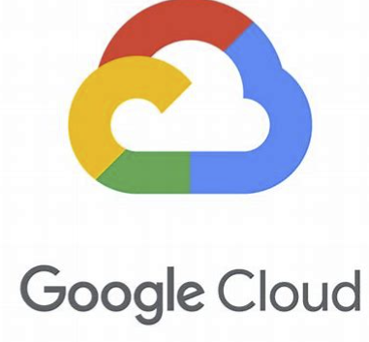


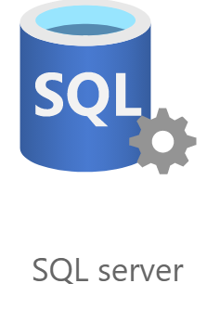
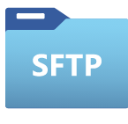






What can you do in ADF?
Data Movement
COPY DATA
~100
Copy activity - Azure Data Factory & Azure Synapse | Microsoft Docs

Slide 7

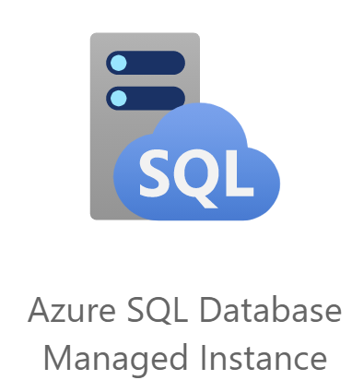
What can you do in ADF?
Data Transformation
TRANSFORMATION
~18
Source transformation in mapping data flow - Azure Data Factory & Azure Synapse | Microsoft Docs

Slide 8

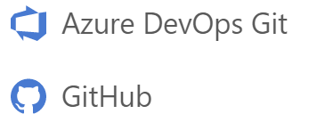


What can you do in ADF?
Pipelines are JSON, ready for Source Control
Git Integration built in
Monitor
Manage

Slide 9
What are Key Components of ADF?
1
Linked services

Slide 10



What are Key Components of ADF?
1
Linked services
2
Datasets

Slide 11




What are Key Components of ADF?
1
Linked services
2
Datasets
3
Activities

Slide 12
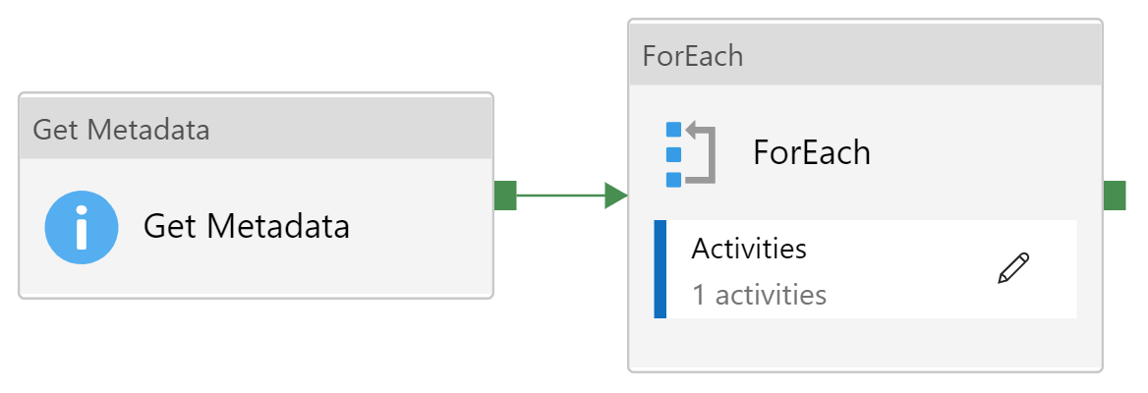
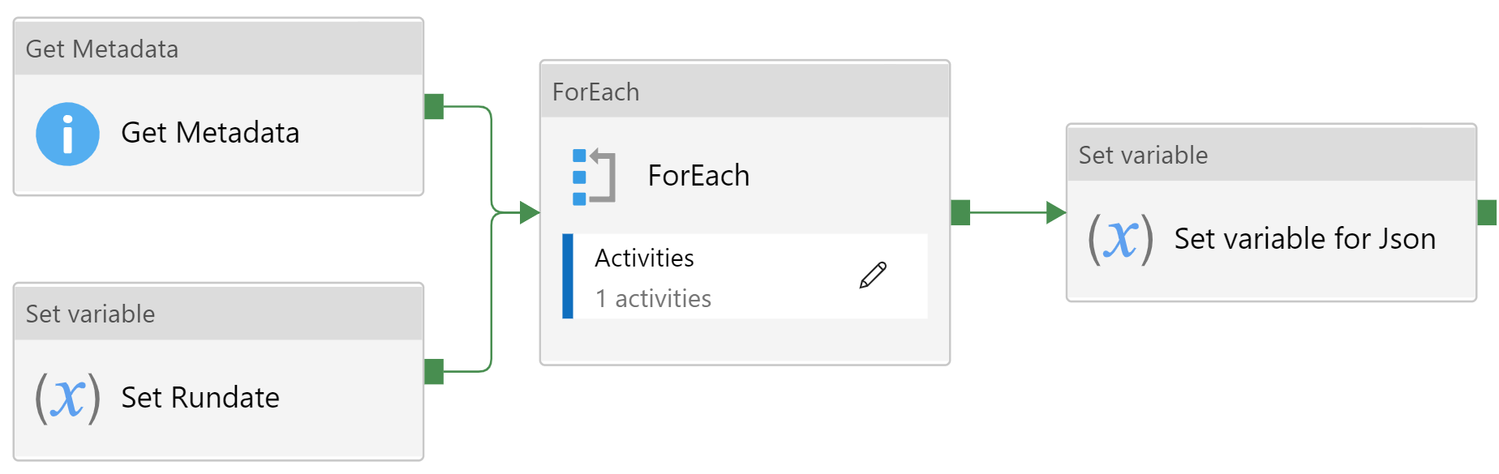
What are Key Components of ADF?
1
Linked services
2
Datasets
3
Activities
4
Pipelines

Slide 13
What are Key Components of ADF?
1
Linked services
2
Datasets
3
Activities
4
Pipelines
5
Triggers

Slide 14
Bicep

Slide 15
What is Bicep?
Domain specific language
Deploying Azure resouces declaratively
Define Infrastructure as Code and deploy
Advantages over ARM:
Better readability
Easier development
Good VS Code integration

Slide 16
Why infrastructure as code?
Controlable (version control, code reviews, CI/CD)
Auditing
History of changes
Repeatable (for different environments)
Enforce naming conventions
Reduce errors
Disaster recovery
Documentation

Slide 17
Demo-Time
Does ADF really ♡ Bicep?

Slide 18
Conclusion
Thank you for your attention
ADF is great. Use it!
Bicep is great too. Use it too!
Combining two great things is also great.
Do it, if you have a use case for it!
Alpa:
a.buddhabhatti@reply.eu
Ben:
benjamin.kettner@ml-pa.com

