Slide 1
Running Jupyter Notebooks automagically in the cloud
Ben Kettner, Microsoft AI and ML Meetup,
2020-11-03

Slide 2
Disclaimer
I am about to talk about running Jupyter-Notebooks in a „Production“ environment.
Is this a good idea? Certainly not.
Will I do it anyways? Definitely.
Do I have a reason to do it? Yes, I do.

Slide 3

Basics for the Non-DataScientists I
Notebooks are built into many modern applications
➔ For Notebooks for DB-Guys check out the Talks by Rob Sewell
Notebooks allow for interactive work, embedding code and results in documentation.

Slide 4

Basics for the Non-DataScientists II
Jupyter Notebooks are very popular among Data Scientists
Jupyter refers to the languages Julia, Python und R
Usually used in an interactive way to explore and wrangle data
Usually executed „by the Data Scientist“

Slide 5
Consequences
Since Jupyter Notebooks contain Visualizations, Result sets, Documentation and Code, they can be quite large.
As an interactive means of working, they are not production ready.
If you want to transfer code to production, you need
The data scientist who understands the code
A developer who can transfer the code to a deployable form
An Operations guy to handle deployment

Slide 6

An introduction
I…
… am from Berlin.
… am CTO and co-founder of ML!PA Consulting.
… did a PhD in applied mathematics (a long time ago in a galaxy far away).
… am a Microsoft MVP since June 2020.
… leader of our local PASS chapter.
… music and data nerd and father.

Slide 7
The need
How can we productionalize the results our data scientists achieve without blocking our developers?
Customer has two data scientists but only one developer (and no Ops guys).
➔Manually transforming the notebooks not an option.

Slide 8
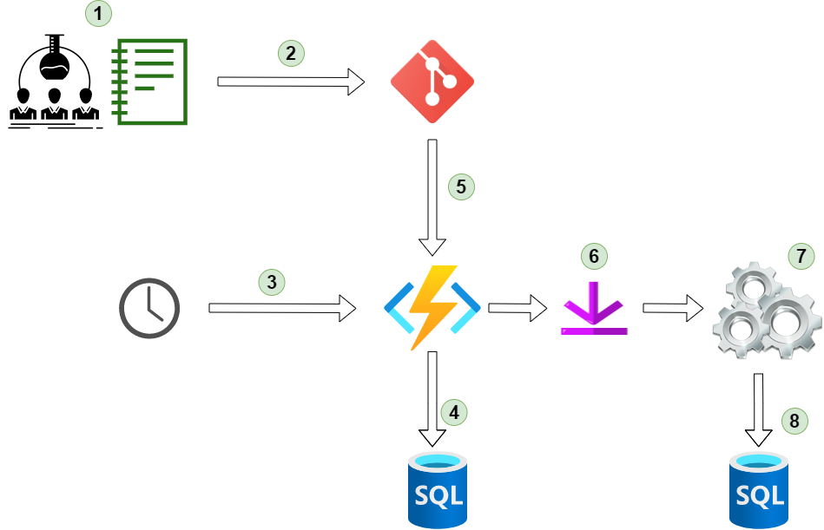
The process
Data Scientists writes Jupyter Notebook
Commits to new branch in special Git repo
Function triggered (by daily load e.g.)
Look up active notebooks in DB
Pull Notebook and requirements.txt from Git
Install requirements
Execute Notebook
Save results to DB

Slide 9

CODE TIME!

Slide 10






Stack for execution
Jupyter Notebook
aka the culprit
Git Repo on Azure DevOps
for storage
Azure SQL DB for storing
meta data on notebooks
Azure function implemented in python to do the magic with papermill for notebook execution
Azure SQL DB for storing
results and serialized models

Slide 11
Summary
Is it ideal? No.
Does it work? Yes!
Is the customer happy? Yes!
Do I like doing this in production? Definitely not.
Do I know a better solution? Unfortunately not.
Questions? Comments? Please get in touch:
benjamin.kettner@ml-pa.com | @DataMonsterBen

