Slide 1
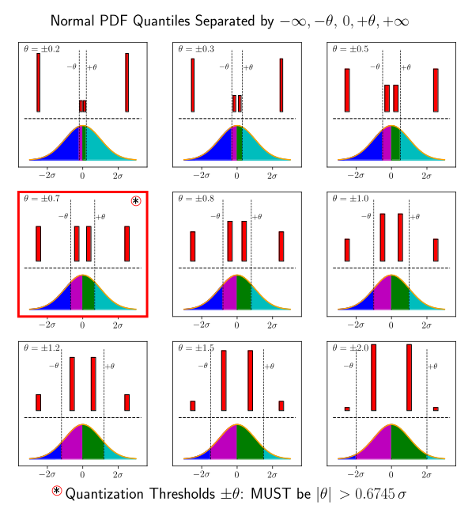
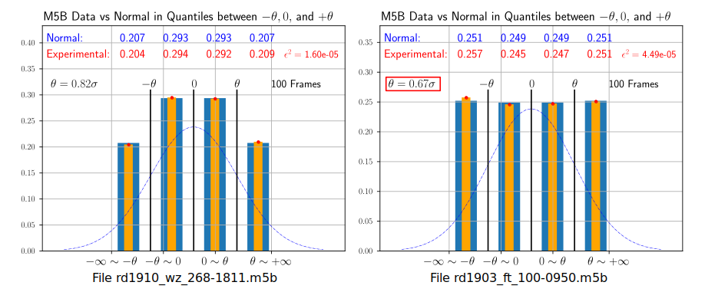
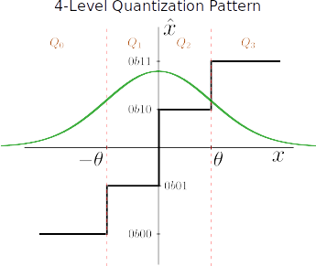


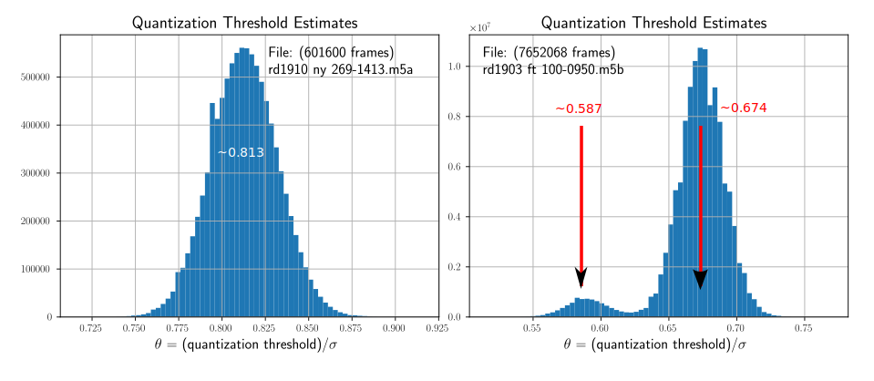
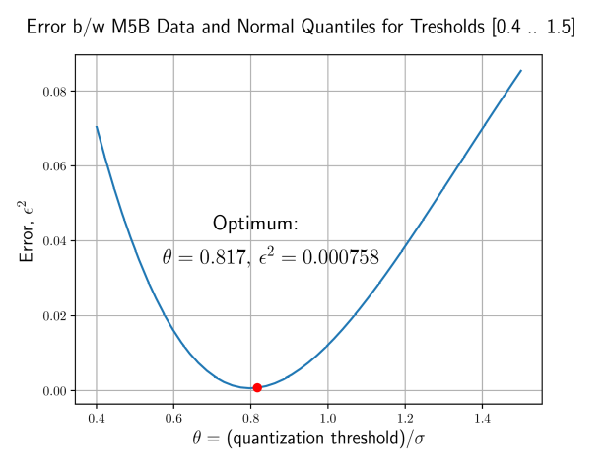
Detection of Non-Gaussian Data in Mark5 (M5B) Files
The radio astronomy data stored in M5B files are Gaussian white noise. Channel data streams are 4-level quantized to have only 2 binary digits per sample.
Problem: detect damaged fragments with non-Gaussian distribution. Do it before the correlation on GPU because of high data volumes.
Solution: estimating quantization thresholds from data may indicate non-Gaussianity
1. Data quantization uses 3 thresholds, -θ, 0, +θ, so the only statistics are quantiles, Q0, Q1, Q2, and Q3, the quantities of data that fall into intervals (including infinities) between them.
2. Below one can see the limitations on q-threshold values. The four red bars show relative values or the standard Normal probability density function.
4. Two examples of finding the optimal q-threshold. The bars give values of quantiles: blue – Normal, yellow – M5B data.
Good data (Normal distribution)
GARBAGE (Uniform distribution?)
3. The q-thresholds are not strictly specified and can be varied during operation. It is possible to find the optimal θ that minimizes the error between the standard Normal quantiles and those from data:
5. SOLUTION. Statistics of optimal q-threshold estimates. One threshold is found for each 2500 samples in one channel.
Good data (θ > 0.67)
Bad, non-Gaussian data (θ > 0.67)

