Slide 1
Computational Thinking & Systems Design Assembly and Machine Languages
Ben Koo
September 3, 2020

Slide 2
Audience
4th grade
Advanced curriculum
18 students

Slide 3
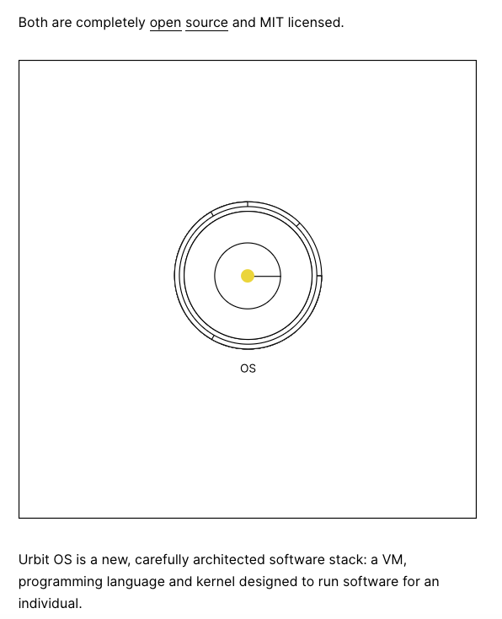
Objective
A New Operating System Designed by Curtis Yarvin.

Slide 4
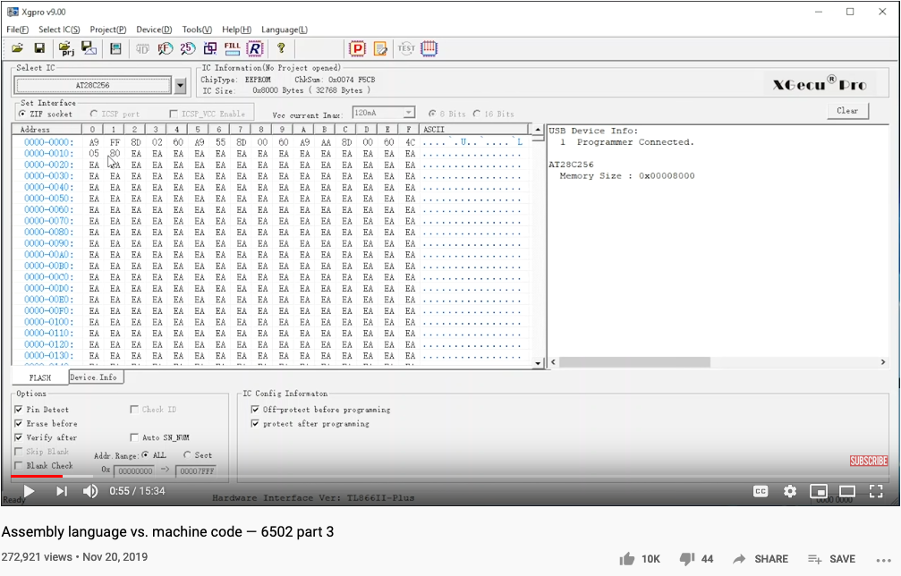
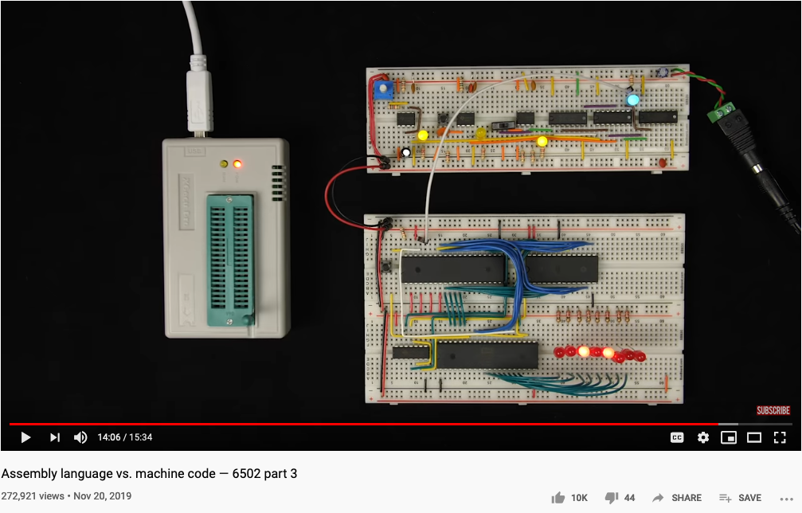
Ben Eater’s 6502 Assembly to Machine Code

