Slide 1
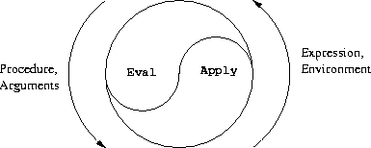
Computational Thinking & Systems Design Lecture 9: Application Programming
Ben Koo
November 9, 2020

Slide 2
Where we are at:
Human
Abstract design
Software
Thought
abstract interface
hierarchy
Chapters 9, 12
H.L. Language
Compiler
&
abstract interface
Operating Sys.
Chapters 10 - 11
Virtual
VM Translator
Machine
abstract interface
Chapters 7 - 8
Assembly
Language
Assembler
Chapter 6
abstract interface
Computer
Machine
Architecture
Language
abstract interface
Chapters 4 - 5
Gate Logic
Hardware
abstract interface
Platform
Chapters 1 - 3
Electrical
Hardware
Chips &
Engineering
Logic Gates
Physics
hierarchy

Slide 3
Some milestones in the evolution of programming languages
Machine language (binary code)
Assembly language (low-level symbolic programming)
Simple procedural languages, e.g. Fortran, Basic, Pascal, C
Simple object-based languages (without inheritance), e.g. early versions of Visual Basic, JavaScript
Fancy object-oriented languages (with inheritance): C++, Java, C#
Jack

Slide 4
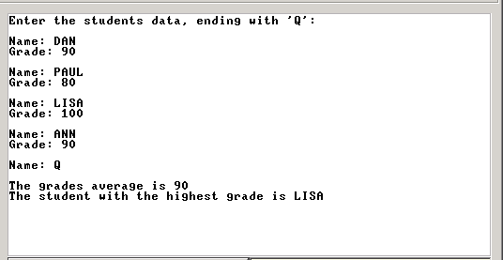
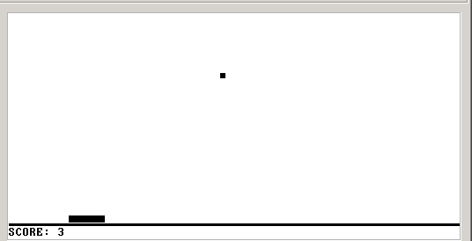
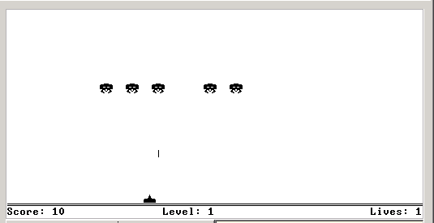
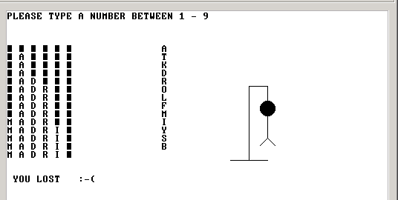
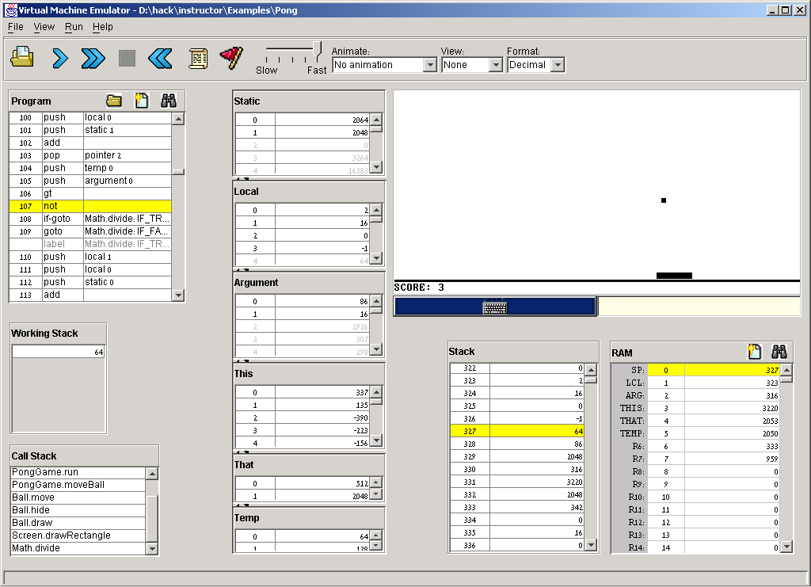
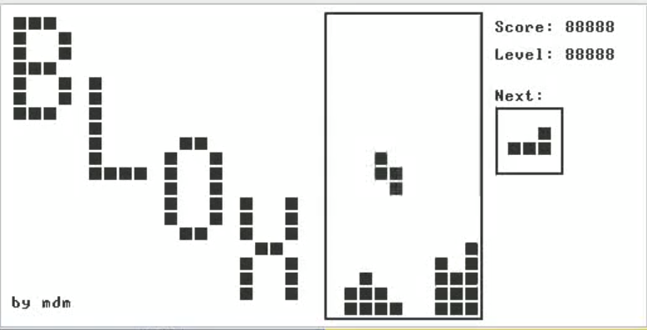
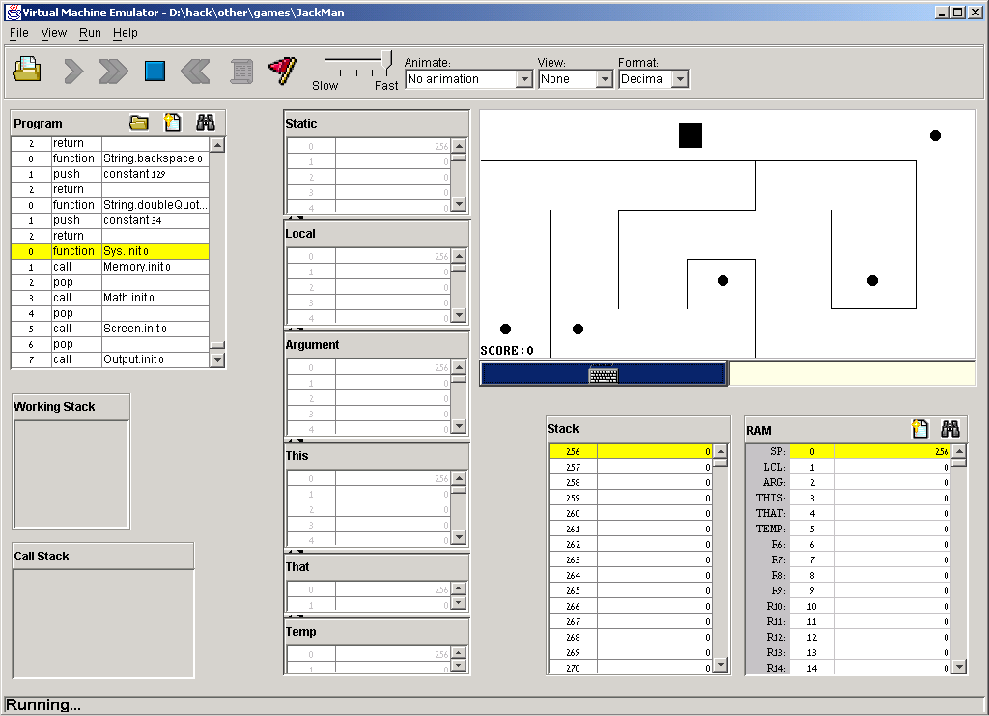


The Jack programming language
Jack: a simple, object-based, high-level language with a Java-like syntax
Some sample applications written in Jack:
procedural
programming
Pong game
Space Invaders
Tetris

Slide 5
Disclaimer
Although Jack is a real programming language, we don’t view it as an end
Rather, we use Jack as a means for teaching:
How to build a compiler
How the compiler and the language interface with the operating system
How the topmost piece in the software hierarchy fits into the big picture
Jack can be learned (and un-learned) in one hour.

Slide 6
Hello world
/** Hello World program. */
class Main {
function void main () {
// Prints some text using the standard library
do Output.printString("Hello World");
do Output.println(); // New line
return;
}
}
Some observations:
Java-like syntax
Typical comments format
Standard library
Language-specific peculiarities

Slide 7
Typical programming tasks in Jack
Jack can be used to develop any app that comes to my mind, for example:
Procedural programming: a program that computes 1 + 2 + ... + n
Object-oriented programming: a class representing bank accounts
Abstract data type representation: a class representing fractions (like 2/5)
Data structure representation: a class representing linked lists
Etc.
We will now discuss the above app examples
As we do so, we’ll begin to unravel how the magic of a high-level object-based language is delivered by the compiler and by the VM
These insights will serve us in the next lectures, when we build the Jack compiler.

Slide 8
Procedural programming example
Jack program = a collection of one or more classes
Jack class = a collection of one or more subroutines
Execution order: when we execute a Jack program, Main.main() starts running.
Jack subroutine:
method
constructor
function (static method)
(the example on the left has functions only, as it is “object-less”)
Standard library: a set of OS services (methods and functions) organized in 8 supplied classes: Math, String. Array, Output, Keyboard, Screen, Memory, Sys (OS API in the book).
class Main {
/** Sums up 1 + 2 + 3 + ... + n */
function int sum (int n) {
var int sum, i;
let sum = 0;
let i = 1;
while (~(i > n)) {
let sum = sum + i;
let i = i + 1;
}
return sum;
}
function void main () {
var int n;
let n = Keyboard.readInt("Enter n: ");
do Output.printString("The result is: ");
do Output.printInt(sum(n));
return;
}
}

Slide 9
Object-oriented programming example
The BankAccount class (skeletal)
/** Represents a bank account.
A bank account has an owner, an id, and a balance.
The id values start at 0 and increment by 1 each
time a new account is created. */
class BankAccount {
/** Constructs a new bank account with a 0 balance. */
constructor BankAccount new(String owner)
/** Deposits the given amount in this account. */
method void deposit(int amount)
/** Withdraws the given amount from this account. */
method void withdraw(int amount)
/** Prints the data of this account. */
method void printInfo()
/** Disposes this account. */
method void dispose()
}

Slide 10
Object-oriented programming example (continues)
/** Represents a bank account. */
class BankAccount {
// class-level variable
static int newAcctId;
// Private variables (aka fields / properties)
field int id;
field String owner;
field int balance;
/** Constructs a new bank account */
constructor BankAccount new (String owner) {
let id = newAcctId;
let newAcctId = newAcctId + 1;
let this.owner = owner;
let balance = 0;
return this;
}
// More BankAccount methods.
}
// Code in any other class:
var int x;
var BankAccount b;
let b = BankAccount.new("joe");
1
3
Explain return this
The constructor returns the RAM base address of the memory block that stores the data of the newly created BankAccount object
Explain b = BankAccount.new("joe")
Calls the constructor (which creates a new BankAccount object), then stores in variable b a pointer to the object’s base memory address
Behind the scene (following compilation):
// b = BankAccount.new("joe")
push "joe" call BankAccount.new pop b
Explanation: the calling code pushes an argument and calls the constructor; the constructor’s code (not shown above) creates a new object, pushes its base address onto the stack, and returns;
The calling code then pops the base address into a variable that will now point to the new object.
2

Slide 11
Object-oriented programming example (continues)
class BankAccount {
static int nAccounts;
field int id;
field String owner;
field int balance;
// Constructor ... (omitted)
/** Handles deposits */
method void deposit (int amount) {
let balance = balance + amount;
return;
}
/** Handles withdrawls */
method void withdraw (int amount){
if (~(amount > balance)) {
let balance = balance - amount;
}
return;
}
// More BankAccount methods.
}
...
var BankAccount b1, b2;
...
let b1 = BankAccount.new("joe");
let b2 = BankAccount.new("jane");
do b1.deposit(5000);
do b1.withdraw(1000);
...
Explain do b1.deposit(5000)
In Jack, void methods are invoked using the keyword do
(a compilation artifact)
The object-oriented method invocation style b1.deposit(5000) is a fancy way to express the procedural semantics deposit(b1,5000)
Behind the scene (following compilation):
// do b1.deposit(5000)
push b1
push 5000
call BankAccount.deposit

Slide 12
Object-oriented programming example (continues)
class BankAccount {
static int nAccounts;
field int id;
field String owner;
field int balance;
// Constructor ... (omitted)
/** Prints information about this account. */
method void printInfo () {
do Output.printInt(id);
do Output.printString(owner);
do Output.printInt(balance);
return;
}
/** Disposes this account. */
method void dispose () {
do Memory.deAlloc(this);
return;
}
// More BankAccount methods.
}
// Code in any other class:
...
var int x;
var BankAccount b;
let b = BankAccount.new("joe");
// Manipulates b...
do b.printInfo();
do b.dispose();
...
Explain do Memory.deAlloc(this)
This is a call to an OS function that knows how to recycle the memory block whose base-address is this. We will write this function when we develop the OS (project 12).
Explain do b.dispose()
Jack has no garbage collection; The programmer is responsible for explicitly recycling memory resources of objects that are no longer needed. If you don’t do so, you may run out of memory.

Slide 13
Abstract data type example
The Fraction class API (method signatures)
/** Represents a fraction data type.
A fraction consists of a numerator and a denominator, both int values */
class Fraction {
/** Constructs a fraction from the given data */
constructor Fraction new(int numerator, int denominator)
/** Reduces this fraction, e.g. changes 20/100 to 1/5. */
method void reduce()
/** Accessors
method int getNumerator()
method int getDenominator()
/** Returns the sum of this fraction and the other one */
method Fraction plus(Fraction other)
/** Returns the product of this fraction and the other one */
method Fraction product(Fraction other)
/** Prints this fraction */
method void print()
/** Disposes this fraction */
method void dispose()
}

Slide 14
Abstract data type example (continues)
/** Represents a fraction data type.
A fraction consists of a numerator and a denominator, both int values */
class Fraction {
field int numerator, denominator;
constructor Fraction new (int numerator, int denominator) {
let this.numerator = numerator;
let this.denominator = denominator;
do reduce() // Reduces the new fraction
return this
}
/** Reduces this fraction */
method void reduce () {
// Code omitted
}
// A static method that computes the greatest common denominator of a and b.
function int gcd (int a, int b) {
// Code omitted
}
method int getNumerator () {
return numerator;
}
method int getDenominator () {
return denominator;
}
// More Fraction methods follow.
// Code in any other class:
...
var Fraction a, b;
let a = Fraction.new(2,5);
let b = Fraction.new(70,210);
do b.print() // prints "1/3"
...
// (print method in next slide)

Slide 15
Abstract data type example (continues)
/** Represents a fraction data type.
A fraction consists of a numerator and a denominator, both int values */
class Fraction {
field int numerator, denominator;
// Constructor and previously defined methods omitted
/** Returns the sum of this fraction the other one */
method Fraction plus (Fraction other) {
var int sum;
let sum = (numerator * other.getDenominator()) +
(other.getNumerator() * denominator());
return Fraction.new(sum , denominator * other.getDenominator());
}
// Similar fraction arithmetic methods follow, code omitted.
/** Prints this fraction */
method void print () {
do Output.printInt(numerator);
do Output.printString("/");
do Output.printInt(denominator);
return
}
}
// Code in any other class:
var Fraction a, b, c;
let a = Fraction.new(2,3);
let b = Fraction.new(1,5);
// computes c = a + b
let c = a.plus(b);
do c.print(); // prints "13/15"

Slide 16
Data structure example
/** Represents a sequence of int values, implemented as a linked list.
The list consists of an atom, which is an int value,
and a tail, which is either a list or a null value. */
class List {
field int data;
field List next;
/* Creates a new list */
constructor List new (int car, List cdr) {
let data = car;
let next = cdr;
return this;
}
/* Disposes this list by recursively disposing its tail. */
method void dispose() {
if (~(next = null)) {
do next.dispose();
}
do Memory.deAlloc(this);
return;
}
...
} // class List.
v
5
v
2
3
5
// Code in any other class:
...
// Creates a list holding the numbers 2,3, and 5:
var List v;
let v = List.new(5 , null);
let v = List.new(2 , List.new(3,v));
...

Slide 17
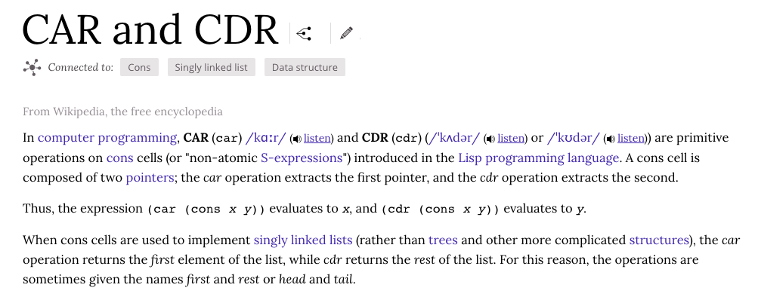
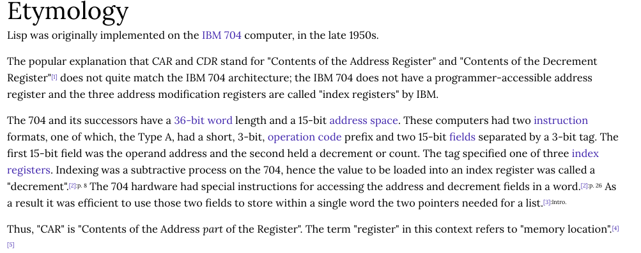
car and cdr
/** Represents a sequence of int values, implemented as a linked list.
The list consists of an atom, which is an int value,
and a tail, which is either a list or a null value. */
class List {
field int data;
field List next;
/* Creates a new list */
constructor List new (int car, List cdr) {
let data = car;
let next = cdr;
return this;
}
/* Disposes this list by recursively disposing its tail. */
method void dispose() {
if (~(next = null)) {
do next.dispose();
}
do Memory.deAlloc(this);
return;
}
...
} // class List.

Slide 18
Jack language specification
Syntax
Data types
Variable kinds
Expressions
Statements
Subroutine calling
Program structure
Standard library
(for complete language specification, see the book).

Slide 19
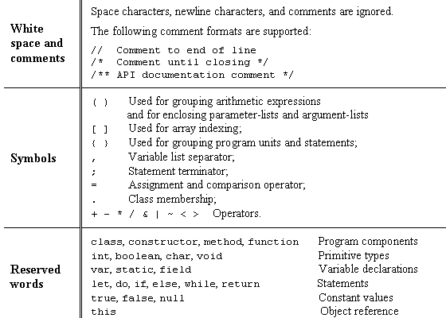
Jack syntax

Slide 20
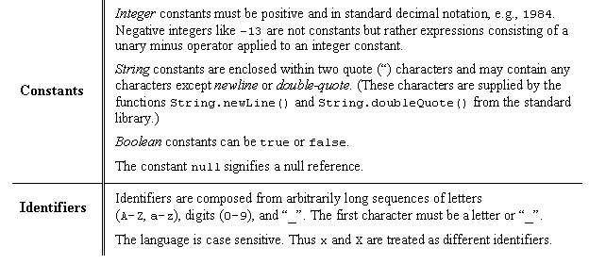
Jack syntax (continues)

Slide 21
Jack data types
Primitive types (Part of the language; Realized by the compiler):
int 16-bit 2’s complement (from -32768 to 32767)
boolean 0 and –1, standing for true and false
char unicode character (‘a’, ‘x’, ‘+’, ‘%’, ...)
Abstract data types (Standard language extensions; Realized by the OS / standard library):
String
Array
... (extensible)
Application-specific types (User-defined; Realized by user applications):
BankAccount
Fraction
List
Bat / Ball
. . . (as needed)

Slide 22
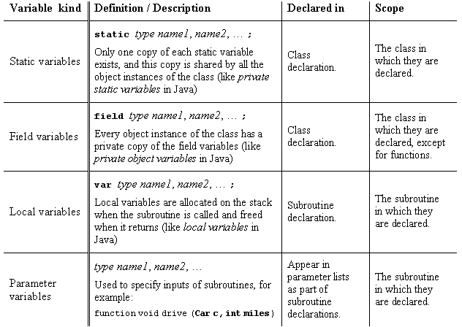
Jack variable kinds and scope

Slide 23
Jack expressions
A Jack expression is any one of the following:
A constant
A variable name in scope (the variable may be static, field, local, or a parameter)
The keyword this, denoting the current object
An array element using the syntax arrayName[expression], where arrayNname is a variable name of type Array in scope
A subroutine call that returns a non-void type
An expression prefixed by one of the unary operators – or ~ :
-expression (arithmetic negation)
~expression (logical negation)
An expression of the form expression op expression where op is one of the following:
+ - * / (integer arithmetic operators)
& | (boolean and and or operators, bit-wise)
< > = (comparison operators)
( expression ) (an expression within parentheses)

Slide 24
Jack Statements
let varName = expression;
or
let varName[expression] = expression;
if (expression) {
statements
}
else {
statements
}
while (expression) {
statements
}
do function-or-method-call;
return expression;
or
return;

Slide 25
Jack subroutine calls
General syntax: subroutineName(arg0, arg1, …)
where each argument is a valid Jack expression
Parameter passing is by-value (primitive types) or by-reference (object types)
Example 1:
Consider the function (static method): function int sqrt(int n)
This function can be invoked as follows:
sqrt(17)
sqrt(x)
sqrt((b * b) – (4 * a * c))
sqrt(a * sqrt(c - 17) + 3)
Etc. In all these examples the argument value is computed and passed by-value
Example 2:
Consider the method: method Matrix plus (Matrix other);
If u and v were variables of type Matrix, this method can be invoked using: u.plus(v)
The v variable is passed by-reference, since it refers to an object.

Slide 26
Noteworthy features of the Jack language
The (cumbersome) let keyword, as in let x = 0;
The (cumbersome) do keyword, as in do reduce();
No operator priority:
1 + 2 * 3 yields 9, since expressions are evaluated left-to-right;
To effect the commonly expected result, use 1 + (2 * 3)
Only three primitive data types: int, boolean, char; In fact, each one of them is treated as a 16-bit value
No casting; a value of any type can be assigned to a variable of any type
Array declaration: Array x; followed by x = Array.new();
Static methods are called function
Constructor methods are called constructor; Invoking a constructor is done using the syntax ClassName.new(argsList)
Q: Why did we introduce these features into the Jack language?
A: To make the writing of the Jack compiler easy!
Any one of these language features can be modified, with a reasonable amount of work, to make them conform to a more typical Java-like syntax.

Slide 27
Jack program structure
About this spec:
Every part in this spec can appear 0 or more times
The order of the field / static declarations is arbitrary
The order of the subroutine declarations is arbitrary
Each type is either int, boolean, char, or a class name.
class ClassName {
field variable declarations;
static variable declarations;
constructor type { parameterList ) {
local variable declarations;
statements
}
method type { parameterList ) {
local variable declarations;
statements
}
function type { parameterList ) {
local variable declarations;
statements
}
}
A Jack program:
Each class is written in a separate file (compilation unit)
Jack program = collection of one or more classes, one of which must be named Main
The Main class must contain at least one method, named main()

Slide 28
Jack standard library aka language extensions aka Jack OS
class Math {
function void init()
function int abs(int x)
function int multiply(int x, int y)
function int divide(int x, int y)
function int min(int x, int y)
function int max(int x, int y)
function int sqrt(int x)
}
Class String {
constructor String new(int maxLength)
method void dispose()
method int length()
method char charAt(int j)
method void setCharAt(int j, char c)
method String appendChar(char c)
method void eraseLastChar()
method int intValue()
method void setInt(int j)
function char backSpace()
function char doubleQuote()
function char newLine()
}
Class Array {
function Array new(int size)
method void dispose()
}
class Output {
function void moveCursor(int i, int j)
function void printChar(char c)
function void printString(String s)
function void printInt(int i)
function void println()
function void backSpace()
}
Class Screen {
function void clearScreen()
function void setColor(boolean b)
function void drawPixel(int x, int y)
function void drawLine(int x1, int y1, int x2, int y2)
function void drawRectangle(int x1, int y1, int x2, int y2)
function void drawCircle(int x, int y, int r)
}
class Memory {
function int peek(int address)
function void poke(int address, int value)
function Array alloc(int size)
function void deAlloc(Array o)
}
Class Keyboard {
function char keyPressed()
function char readChar()
function String readLine(String message)
function int readInt(String message)
}
Class Sys {
function void halt():
function void error(int errorCode)
function void wait(int duration)
}

Slide 29
Perspective
Jack is an object-based language: no inheritance
Primitive type system (3 types)
Standard library
Our hidden agenda: gearing up to learn how to develop the ...
Compiler (projects 10 and 11)
OS (project 12).

Slide 30
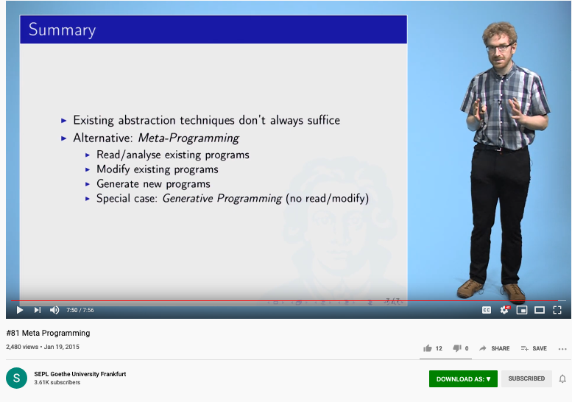
Meta Programming according to Reichenbach

Slide 31
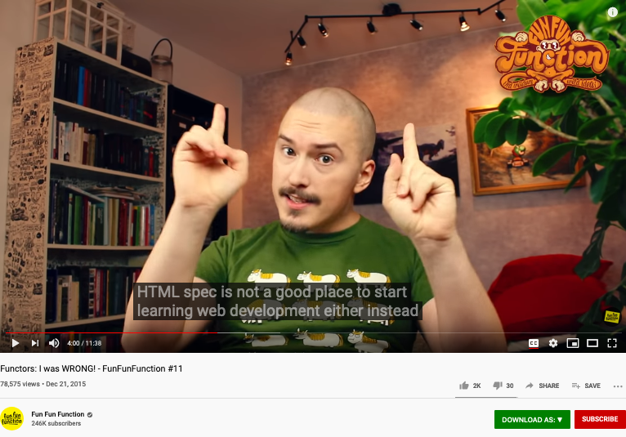
A cool video on Functors
https://youtu.be/DisD9ftUyCk?t=240

Slide 32
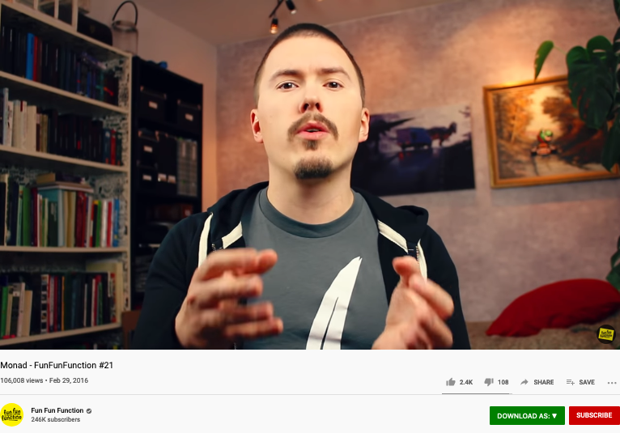
A cool video on Monad
https://youtu.be/9QveBbn7t_c

Slide 33
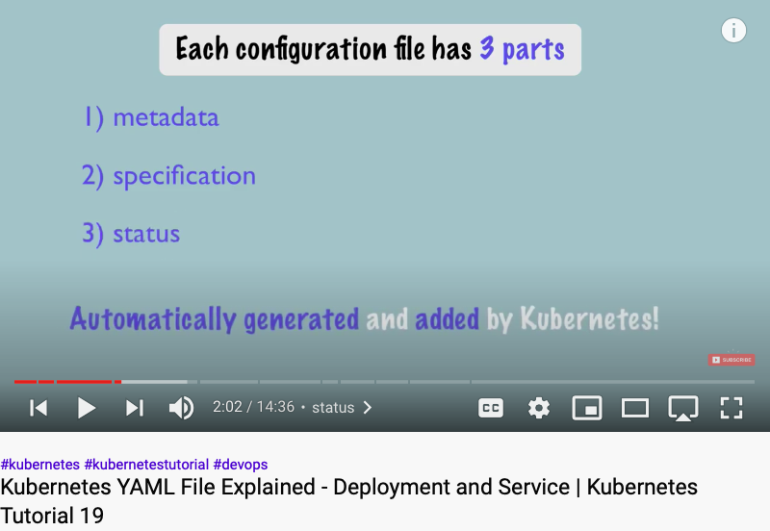
Executable Contract for Kubernetes
Video URL: https://youtu.be/qmDzcu5uY1I?t=122

Slide 34
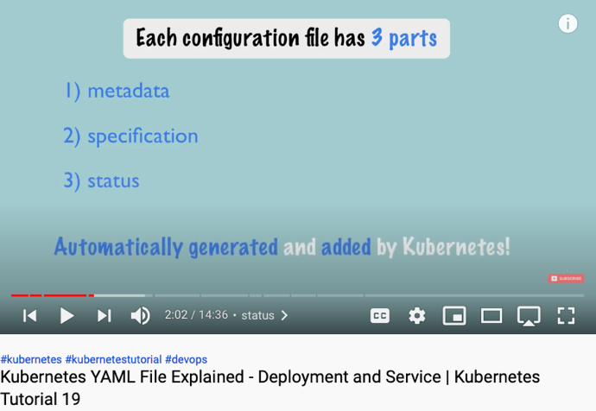
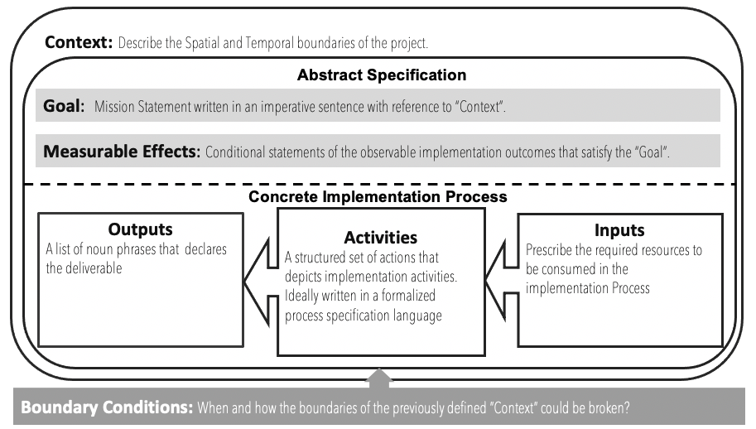
Logic Model and Config File
Contextualized data
Goal Expr
Criteria Expr
𝜆
Input
Output Spec
( )
Exception Handling

Slide 35
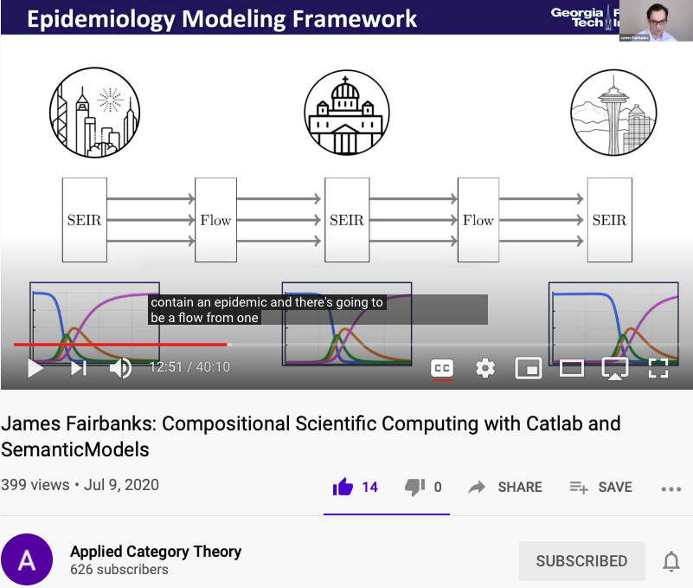
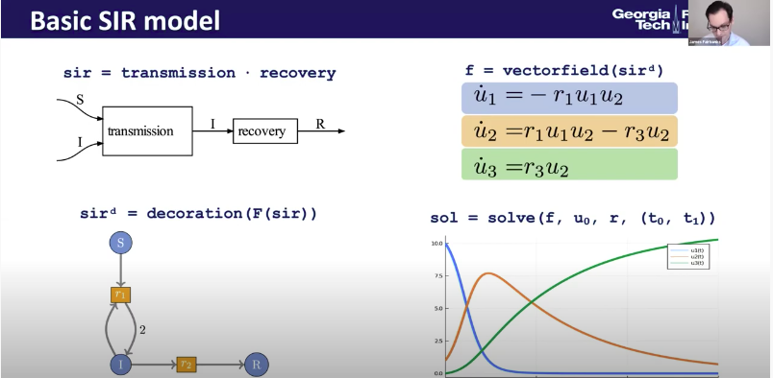
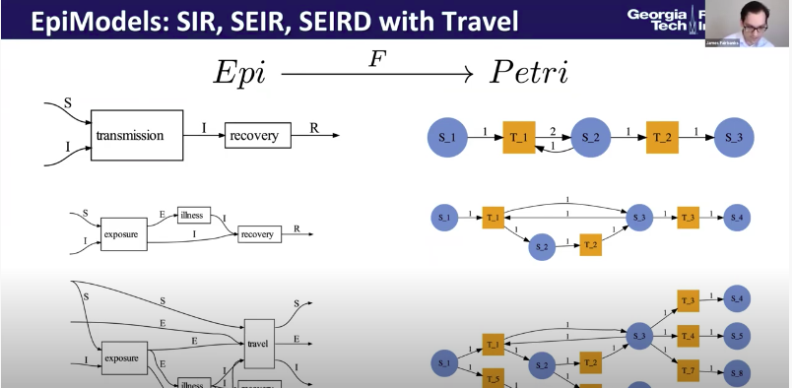
Applying Functional Programming to solve City-scale Problems
Keynote talk at the Applied Category Theory 2020 Conference

Slide 36
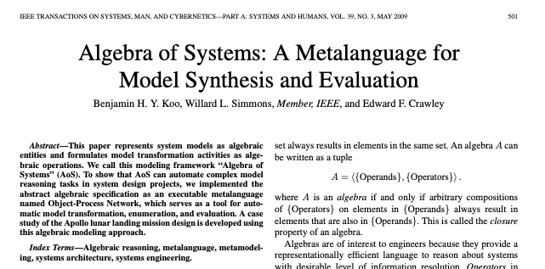
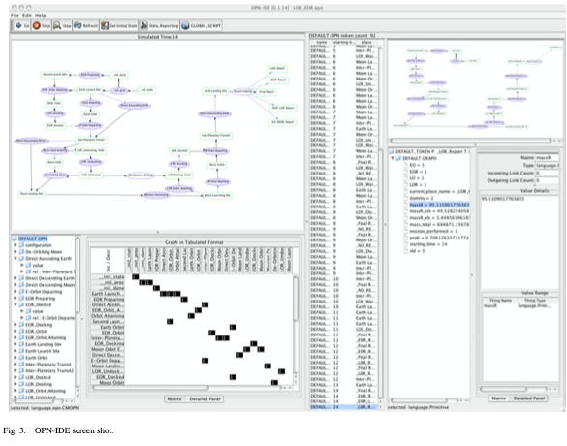
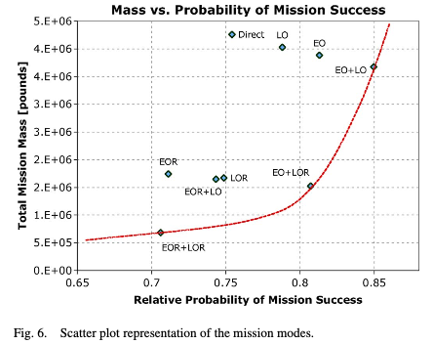
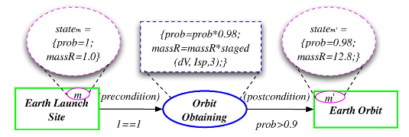
Applying Functional Programming to solve Planetary-scale Problems
2009 paper on IEEE’s Systems, Man, and Cybernetics Journal

