Slide 1

Quantum Disentanglement Eraser
M. Suhail Zubairy
(with G. S. Agarwal and M. O. Scully)
Department of Physics, Texas A&M University, College Station, TX 77843

Slide 2

Quantum Eraser
Marlan O. Scully
Girish S. Agarwal
Herbert Walther
M. Suhail Zubairy
Texas A&M University
Institute for
Quantum Studies

Slide 3
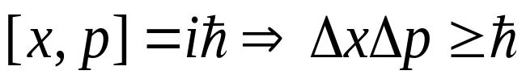
COMPLEMENTARITY
(N. BOHR, 1927)
Two observables are “COMPLEMENTARY” if precise knowledge of one of them implies that all possible outcomes of measuring the other one are equally probable
  POSITION-MOMENTUM
  SPIN COMPONENTS
  POLARIZATION
TRADITIONALLY
Complementarity in quantum mechanics is associated with “Heisenberg’s uncertainty relations”
However it is a more general concept!!!
Scully, Englert, Walther, Nature 351, 111 (1991).

Slide 4
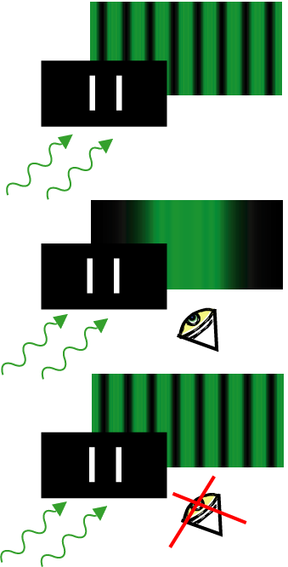
Newsweek, June 19, 1995, p. 68
Erasing Knowledge!
As Thomas Young taught us two
Hundred years ago, photons interfere.
But now we know that:
Knowledge of path (1 or 2) is the reason
why interference is lost. Its as if the photon
knows it is being watched.
But now we discover that:
Erasing the knowledge of photon path
brings interference back.
“No wonder Einstein was confused.”

Slide 5
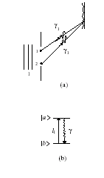
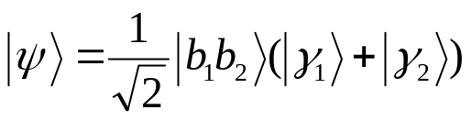
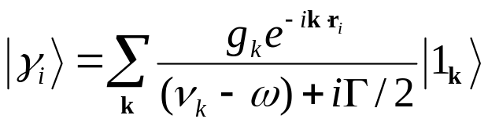

Photon correlation experiment
Light impinging on atoms at sites 1 and 2. Scattered photons γ₁ and γ₂ produce interference pattern on screen.
Two-level atoms are excited by laser pulse and emit γ photons in the a → b transition (Fig. b).
Atom-scattered field system:
The state vector for the scattered photon from the i^{th} atom:
______________________________
M. O. Scully and K. Druhl, PRA 25, 2208 (1982)

Slide 6
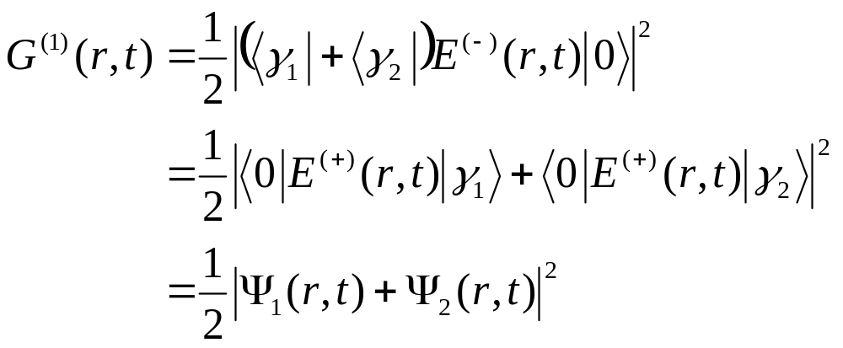
Correlation function for the scattered field:
This is just the interference pattern associated with a
Young’s double-slit experiment generalized to the
present scattering problem. Note that when the γ₁ and
γ₂ photons arrive at the detector at the ‘same time’,
interference fringes are present.

Slide 7
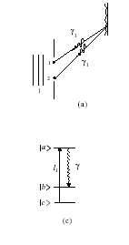
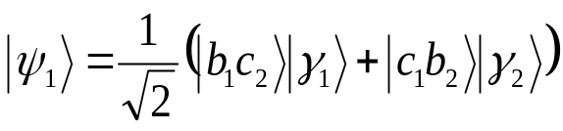
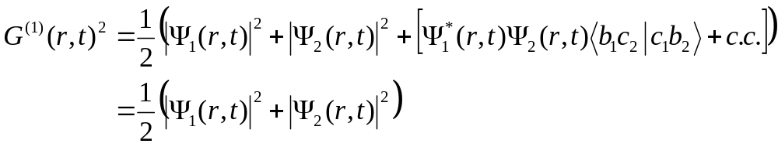
Three-level atoms excited by a pulse l₁ from |c> → |a> followed by emission of γ-photons in the |a> → |b> transition (Fig. c).
State of the coupled atom-field system:
Field correlation function:
Which path information available - No fringes

Slide 8
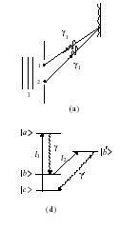
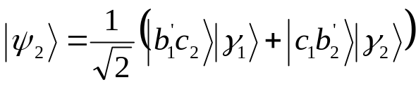
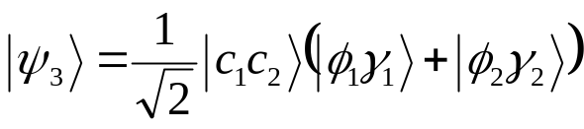
Can we erase the information (memory) locked in our atoms and thus recover fringes?
Four-level system: a second pulse l₂ takes atoms from |b> → |b’>. Decay from |b’> → |c> results in emission of Φ-photons.
The second laser pulse l_{2 ,} resonant with |b>→ |b’> transition, transfers 100 percent of the population from |b> to |b’> (second laser pulse - π pulse).
State of the system after interacting with the l₂ pulse is
The i^{th} atom decays to the |c> state via the emission of |Φ_{i}> photon. State vector after Φ-emission:

Slide 9
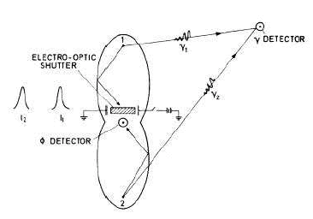
Scattered photons γ and γ result from a → b transition.
Decay of atoms from b′→ c results in Φ photon emission
Elliptical cavities reflect Φ photons onto a common photodetector.
Electrooptic shutter transmits Φ photons only when switch is open.
Choice of switch position determines whether we emphasize particle (shutter open) or wave (shutter
closed) nature of γ photon.
“Delayed choice” quantum eraser!!!

Slide 10
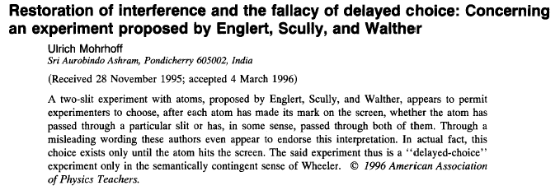
U. Mohrhoff, Am. J. Phys. 64, 1468 (1996)

Slide 11
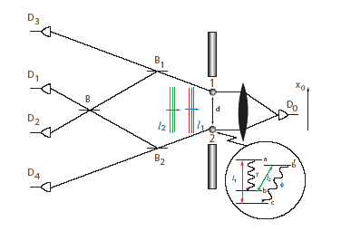
“Delayed choice” quantum eraser - experimental demonstration ª
Pair of entangled photons is emitted from either atom A or atom B by atomic cascade emission.
‘Clicks’ at D₃ or D₄ provide which path information (No interference fringes!!)
‘Clicks’ at D₁ or D₂ erase the which path information (Fringes!!)
absence or restoration of interference can be arranged via an appropriately contrived photon correlation experiment.
_______________________________________________
ª Kim, Yu, Kulik, Shih, and Scully, PRL 84, 1 (2000)

Slide 12
Experimental considerations
Distance L_{A}, L_{B} between atoms A, B and detector D₀ << distance between atoms A,B and the beam splitter BSA and BSB where the which path or both paths choice is made randomly by photon 2
When photon 1 triggers D₀, photon 2 is still on its way to BSA, BSB
After registering of photon 1 at D₀, we look at the subsequent detection events at D₁, D₂, D₃, D₄ with appropriate time delay
Joint detection events at D₀ and D_{i} must have resulted from the same photon pair
Interference pattern as a function of D₀’ s position for joint counting rates R₀₁ and R₀₂
No interference pattern for R₀₃ and R₀₄

Slide 13
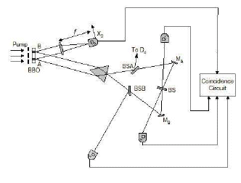
Experimental setup ª
The delayed choice to observe either wave or particle behavior of the signal photon is made randomly by the idler photon about 7.7 ns after the detection of the signal photon
ª Kim, Yu, Kulik, Shih, and Scully, PRL 84, 1 (2000)

Slide 14
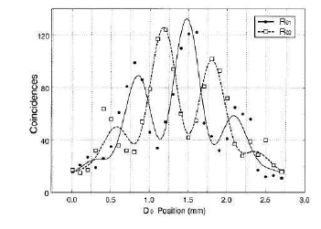
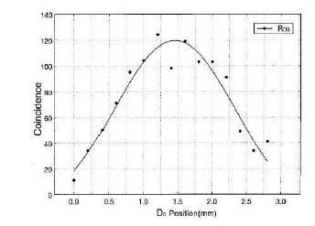
Experimental results ª
ª Kim, Yu, Kulik, Shih, and Scully, PRL 84, 1 (2000)

Slide 15
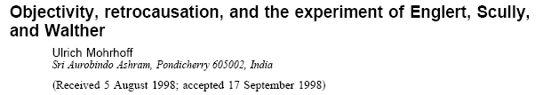
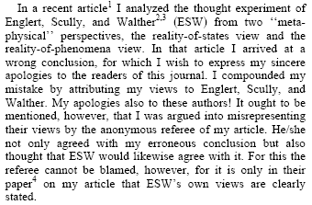
U. Mohrhoff, Am. J. Phys. 67, 330 (1999)

Slide 16
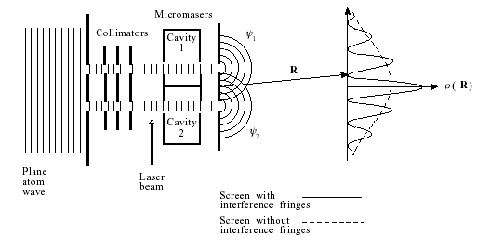
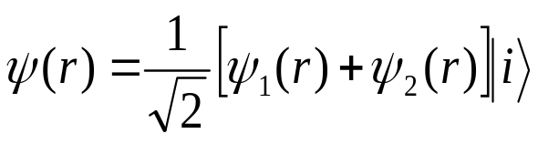
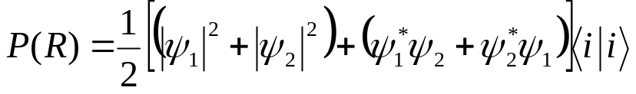
Double-slit experiment with atoms
In the absence of laser-cavity system:
r is the center-of-mass coordinate and i denotes the
internal state of the atom.
The probability density for particles on the screen:
Fringes!!

Slide 17
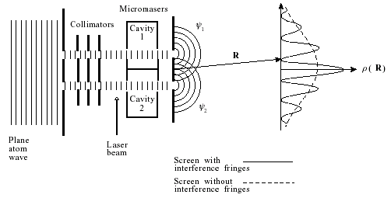
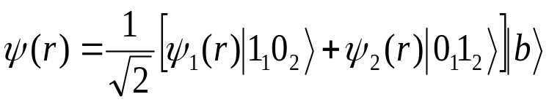
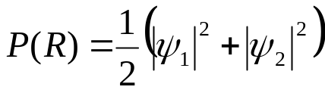
Micromaser Which-Path Detector
State of the correlated atomic beam-maser system:
Probability density at the screen:
Because <1₁0₂|0₁1₂> vanishes,
No fringes!!

Slide 18
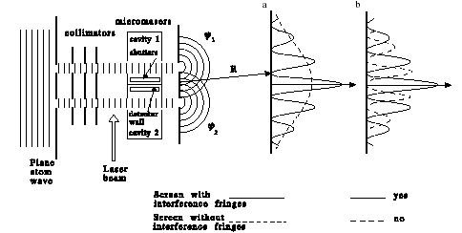
Quantum Eraser ª
Is it possible to retrieve the coherent interference cross-terms by removing (‘erasing’) the which-path information contained in the detectors?
The answer is yes, but how can that be? The atom is now far removed from the micromaser cavities and so there can be no thought of any physical influence on the atom’s center-of-mass wave function.
ª Scully, Englert and Walther, Nature 351, 111 (1991)

Slide 19
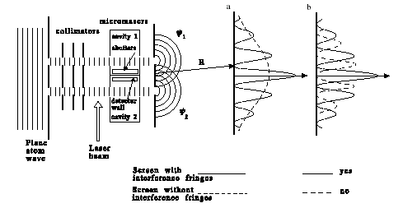
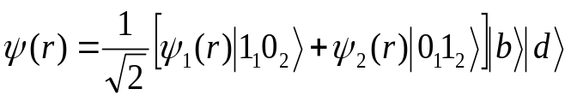

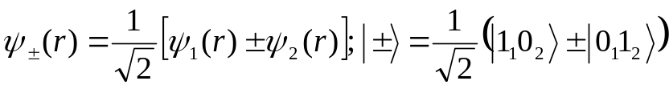
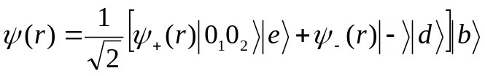
After absorbing a photon, the detector atom, initially in state |d> would be excited to state |e>.
with
Detector produces
i.e., the symmetric interaction couples only to the symmetric radiation state |+>; the antisymmetric state |-> remains unchanged.

Slide 20
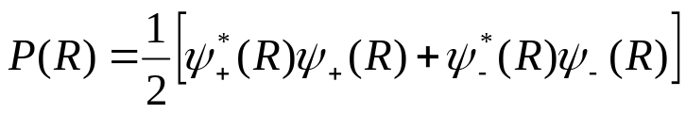
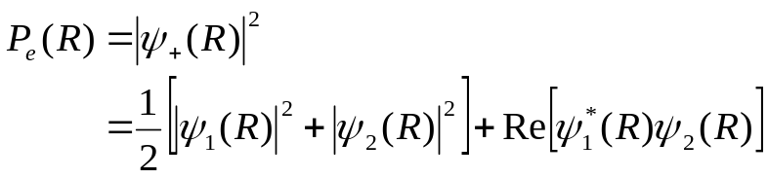
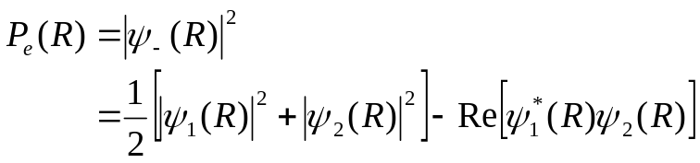
Atomic probability density at the screen:
No interference fringes if the final state of the detector is unknown!!
Probability density P_{e}(R) for finding both the detector excited and the atom at R on the screen:
Fringes → solid lines!!
Probability density P_{d}(R) for finding both the detector deexcited and the atom at R on the screen:
Antifringes → broken line!!

Slide 21
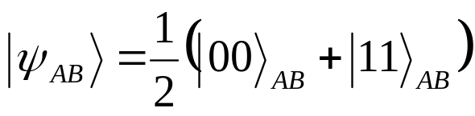
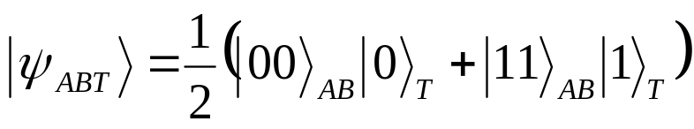
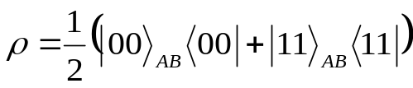
Quantum disentanglement erasersª
Involves at least three-subsystems A, B, T.
Entangled state of the AB subsystem:
Wave function of whole system:
State of the AB subsystem:
Entanglement of subsystem AB is lost!
However if one erases the tag information, then the entanglement is restored.
Thus entanglement of any two particles that do not interact (directly or indirectly) never disappears but is encoded in the ancilla of the system. A projective measurement that seems to destroy such entanglement could always in principle be erased by uitable manipulation of the ancilla.
ªR. Garisto and L. Hardy, PRA 60, 827 (1999)

Slide 22
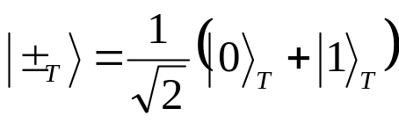
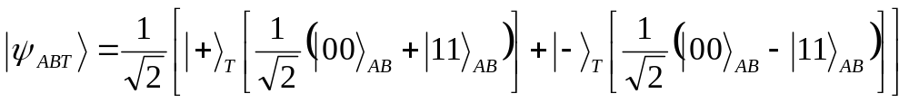
Entangled state of the AB subsystem:
Wave function of whole system:
Define
Thus
Measurement of the tagging qubit realizes the entangled state.

Slide 23
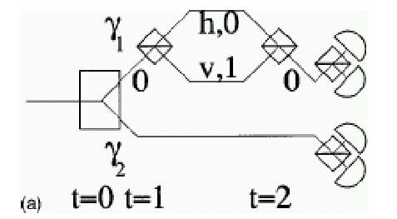

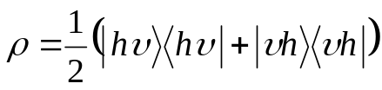
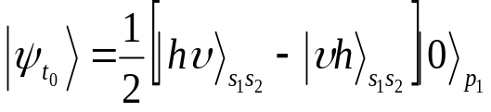
AB system is given by the polarization, T is given by the path of particle 1.
At t₀
After passage through polarizing beam splitter (PBS)
If we measure the spin of photons at this point, we obtain mixed state
No entanglement!!
To reversibly erase the tagging information at t = 2, we perform the reverse of the operation of t=1.
Entanglement is restored!!

Slide 24
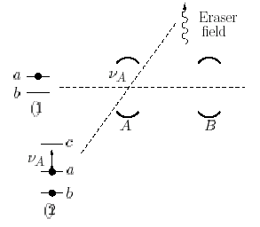
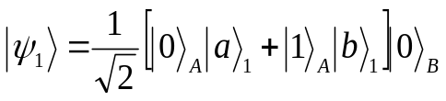
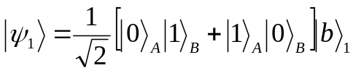
Cavity QED Implementation
Consider cavities A and B with |0> state and an atom 1 in excited state |a> passes through the two cavities
After passage through cavity A with interaction time corresponding to π/2 pulse:
After passage through cavity B with interaction time corresponding to π pulse:
Entangled state!!!
Atom 2 (tagging qubit) now passes through cavity A

Slide 25
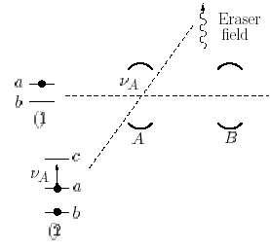



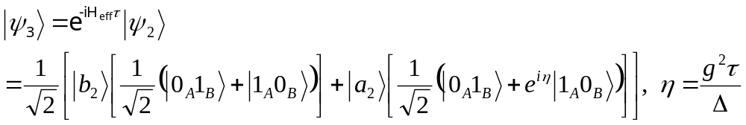
Atom 2 has dispersive coupling with cavity A,
Effective Hamiltonian:
Initially atom 2 is in state
After passage through cavity A, a quantum phase gate is made
_____________________________________
A. Rauschenbeutal et. al PRL 83, 5166 (1999).

Slide 26
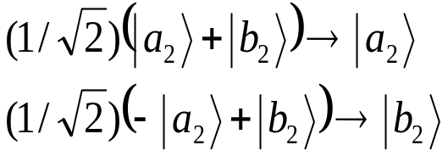
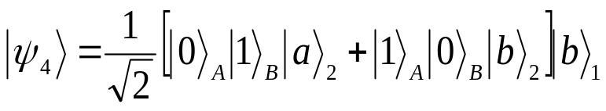
Pass atom through classical field with
Resulting state
(with η=π):
Entanglement between
cavities A and B is
controlled by atom 2!!

Slide 27
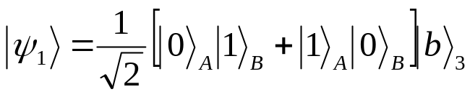




Initial state:
After passage through
cavity A:
Phase shift:
After passage through cavity B:

Slide 28


Detection probabilities:
Haroche et. al, Nature (2000)

Slide 29




Quantum Eraser
Initial state:
After passage through cavity A:
Phase shift:

Slide 30








After passage through cavity B:
Detection probabilities:
Restoration of fringes:

Slide 31



Quantum teleportation
Initial state is an entangled
state between cavities A
and B along with the tagged
qubit T:
We want to teleport the state of qubit C:
to cavity B

Slide 32



State of combined system ABCT is
where
A Bell-basis measurement of reduces the BT state to

Slide 33


Induced coherence without induced emission
Recall we produced:
Interference terms are only partially erased in the reduced two-cavity density matrix ρ_{AB}, given by

Slide 34


Probabilities for finding the atom 3 in the excited and ground states:
For η≠π, we have the control of the interferences in unconditional measurements on atom 2.
Visibility of the fringes is equal to |sin(η/2)|.

Slide 35
Brian Greene in The Fabric of the Cosmos (2004)
These experiments are a magnificent affront to our conventional notions of space and time. . . . . . . . . .For a few days after I learned of these experiments, I remember feeling elated. I felt I'd been given a glimpse into a veiled side of reality.

Slide 36
Table of Contents
Quantum Disentanglement Eraser
Quantum Eraser
Complementarity (Bohr)
Erasing Knowledge
Photon Correlation Experiment
Correlation Function
Three-Level Atom
Can we erase?
Particle or Wave
Restoration of Interference (Mohrhoff)
Delayed Choice
Experimental Considerations
Experimental Set-up
Experimental Results
Objectivity, retrocausation (Mohrhoff II)
Double-Slit Experiment
Micromaser Which-Path Detector
Quantum Eraser
Interference Fringes
Atomic Probability
Quantum Disentanglement
Entangled State
AB System
Cavity QED
Eraser Field
Classical Field
Initial State
Detection Probabilities
Quantum Eraser
After Passage
Quantum Teleportation
ABCT
Induced coherence
Probabilities
Fabric of the Cosmos

