Slide 1

Computational Thinking & Systems Design Functions in VM
Image source: INSTANA
Ben Koo
November 3, 2020

Slide 2
Where we are at:
Human
Abstract design
Software
Thought
abstract interface
hierarchy
Chapters 9, 12
H.L. Language
Compiler
&
abstract interface
Operating Sys.
Chapters 10 - 11
Virtual
VM Translator
Machine
abstract interface
Chapters 7 - 8
Assembly
Language
Assembler
Chapter 6
abstract interface
Computer
Machine
Architecture
Language
abstract interface
Chapters 4 - 5
Gate Logic
Hardware
abstract interface
Platform
Chapters 1 - 3
Electrical
Hardware
Chips &
Engineering
Logic Gates
Physics
hierarchy

Slide 3
VM programming (example)
High-level code
VM code (first approx.)
VM code
function mult (x,y) {
int result, j;
result = 0;
j = y;
while ~(j = 0) {
result = result + x;
j = j - 1;
}
return result;
}
function mult(x,y)
push 0
pop result
push y
pop j
label loop
push j
push 0
eq
if-goto end
push result
push x
add
pop result
push j
push 1
sub
pop j
goto loop
label end
push result
return
function mult 2
push constant 0
pop local 0
push argument 1
pop local 1
label loop
push local 1
push constant 0
eq
if-goto end
push local 0
push argument 0
add
pop local 0
push local 1
push constant 1
sub
pop local 1
goto loop
label end
push local 0
return

Slide 4
VM to Assembly (One to Many replacement)
Assembly program
VM code
// Computes 1+...+RAM[0]
// And stores the sum in RAM[1].
@i
M=1 // i = 1
@sum
M=0 // sum = 0
(LOOP)
@i // if i>RAM[0] goto WRITE
D=M
@0
D=D-M
@WRITE
D;JGT
@i // sum += i
D=M
@sum
M=D+M
@i // i++
M=M+1
@LOOP // goto LOOP
0;JMP
(WRITE)
@sum
D=M
@1
M=D // RAM[1] = the sum
(END)
@END
0;JMP
function mult 2
push constant 0
pop local 0
push argument 1
pop local 1
label loop
push local 1
push constant 0
eq
if-goto end
push local 0
push argument 0
add
pop local 0
push local 1
push constant 1
sub
pop local 1
goto loop
label end
push local 0
return
VM code
pop local 0
push argument 1
pop local 1

Slide 5
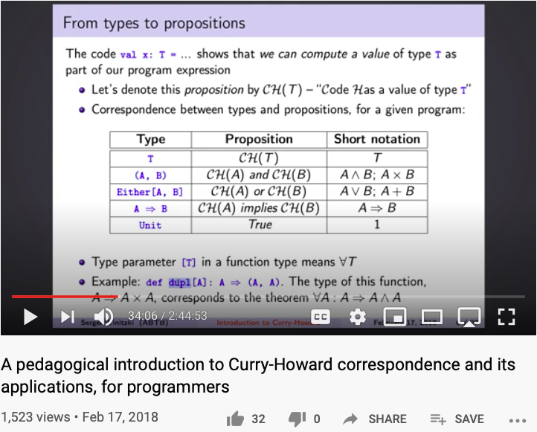
Curry-Howard Correspondence
Last Accessed: October 27, 2020

Slide 6
The big picture
. . .
. . .
Jack
Some
Some Other
language
language
language
Jack
Chapters 9-13
Some
Some Other
compiler
compiler
compiler
Implemented in Projects 7-8
VM language
VM
VM imp.
implementation
VM imp.
VM
over the Hack
Chapters 7-8
over CISC
over RISC
emulator
platform
platforms
platforms
A Java-based emulator is included in the course software suite
CISC
RISC
. . .
written in
Hack
machine
machine
a high-level
machine
language
language
language
language
. . .
. . .
Chapters 1-6
CISC
RISC
other digital platforms, each equipped
Any
Hack
machine
machine
with its VM implementation
computer
computer
Notes:
6

Slide 7
Goal: Complete the specification and implementation of the VM model and language
Arithmetic / Boolean commands
add
sub
neg
eq
gt
lt
and
or
not
Memory access commands
pop x (pop into x, which is a variable)
push y (y being a variable or a constant)
Program flow commands
label (declaration)
goto (label)
if-goto (label)
Function calling commands
function (declaration)
call (a function)
return (from a function)
previous lecture
this lecture
Method: (a) specify the abstraction (model’s constructs and commands) (b) propose how to implement it over the Hack platform.
Notes:
7

Slide 8
The compilation challenge
Source code (high-level language)
Target code
class Main {
static int x;
function void main() {
// Inputs and multiplies two numbers
var int a, b, c;
let a = Keyboard.readInt(“Enter a number”);
let b = Keyboard.readInt(“Enter a number”);
let c = Keyboard.readInt(“Enter a number”);
let x = solve(a,b,c);
return;
}
}
// Solves a quadratic equation (sort of)
function int solve(int a, int b, int c) {
var int x;
if (~(a = 0))
x=(-b+sqrt(b*b–4*a*c))/(2*a);
else
x=-c/b;
return x;
}
}
0000000000010000
1110111111001000
0000000000010001
1110101010001000
0000000000010000
1111110000010000
0000000000000000
1111010011010000
0000000000010010
1110001100000001
0000000000010000
1111110000010000
0000000000010001
0000000000010000
1110111111001000
0000000000010001
1110101010001000
0000000000010000
1111110000010000
0000000000000000
1111010011010000
0000000000010010
1110001100000001
0000000000010000
1111110000010000
0000000000010001
...
Our ultimate goal:
Translate high-level programs into executable code.
Compiler
Notes:
8

Slide 9
The compilation challenge / two-tier setting
Jack source code
VM (pseudo) code
Machine code
if (~(a = 0))
x = (-b+sqrt(b*b–4*a*c))/(2*a)
else
x = -c/b
push a
push 0
eq
if-goto elseLabel
push b
neg
push b
push b
call mult
push 4
push a
call mult
push c
call mult
call sqrt
add
push 2
push a
call mult
div
pop x
goto contLable
elseLabel:
push c
neg
push b
call div
pop x
contLable:
0000000000010000
1110111111001000
0000000000010001
1110101010001000
0000000000010000
1111110000010000
0000000000000000
1111010011010000
0000000000010010
1110001100000001
0000000000010000
1111110000010000
0000000000010001
0000000000010000
1110111111001000
0000000000010001
1110101010001000
0000000000010000
1111110000010000
0000000000000000
1111010011010000
0000000000010010
1110001100000001
0000000000010000
1111110000010000
0000000000010001
0000000000010010
1110001100000001
...
Compiler
VM translator
We’ll develop the compiler later in the course
We now turn to describe how to complete the implementation of the VM language
That is -- how to translate each VM command into assembly commands that perform the desired semantics.
Notes:
9

Slide 10
The compilation challenge
Typical compiler’s source code input:
// Computes x = (-b + sqrt(b^2 -4*a*c)) / 2*a
if (~(a = 0))
x = (-b + sqrt(b * b – 4 * a * c)) / (2 * a)
else
x = - c / b
program flow logic (branching)
Boolean expressions
function call and return logic
arithmetic expressions
(this lecture)
(previous lecture)
(this lecture)
(previous lecture)
How to translate such high-level code into machine language?
In a two-tier compilation model, the overall translation challenge is broken between a front-end compilation stage and a subsequent back-end translation stage
In our Hack-Jack platform, all the above sub-tasks (handling arithmetic / Boolean expressions and program flow / function calling commands) are done by the back-end, i.e. by the VM translator.
Notes:
10

Slide 11
Lecture plan
Arithmetic / Boolean commands
add
sub
neg
eq
gt
lt
and
or
not
Memory access commands
pop x (pop into x, which is a variable)
push y (y being a variable or a constant)
Program flow commands
label (declaration)
goto (label)
if-goto (label)
Function calling commands
function (declaration)
call (a function)
return (from a function)
previous lecture
Notes:
11

Slide 12
Program flow commands in the VM language
VM code example:
In the VM language, the program flow abstraction is delivered using three commands:
function mult 1
push constant 0
pop local 0
label loop
push argument 0
push constant 0
eq
if-goto end
push argument 0
push 1
sub
pop argument 0
push argument 1
push local 0
add
pop local 0
goto loop
label end
push local 0
return
label c // label declaration
goto c // unconditional jump to the // VM command following the label c
if-goto c // pops the topmost stack element; // if it’s not zero, jumps to the // VM command following the label c
How to translate these three abstractions into assembly?
Simple: label declarations and goto directives can be effected directly by assembly commands
More to the point: given any one of these three VM commands, the VM Translator must emit one or more assembly commands that effects the same semantics on the Hack platform
How to do it? see project 8.
Notes:
12

Slide 13
Lecture plan
Arithmetic / Boolean commands
add
sub
neg
eq
gt
lt
and
or
not
Memory access commands
pop x (pop into x, which is a variable)
push y (y being a variable or a constant)
Program flow commands
label (declaration)
goto (label)
if-goto (label)
Function calling commands
function (declaration)
call (a function)
return (from a function)
previous lecture
Notes:
13

Slide 14
Subroutines
// Compute x = (-b + sqrt(b^2 -4*a*c)) / 2*a
if (~(a = 0))
x = (-b + sqrt(b * b – 4 * a * c)) / (2 * a)
else
x = - c / b
Subroutines = a major programming artifact
Basic idea: the given language can be extended at will by user-defined commands ( aka subroutines / functions / methods ...)
Important: the language’s primitive commands and the user-defined commands have the same look-and-feel
This transparent extensibility is the most important abstraction delivered by high-level programming languages
The challenge: implement this abstraction, i.e. allow the program control to flow effortlessly between one subroutine to the other
“A well-designed system consists of a collection of black box modules, each executing its effect like magic” (Steven Pinker, How The Mind Works)
Notes:
14

Slide 15
Subroutines in the VM language
Calling code (example)
Called code, aka “callee” (example)
...
// computes (7 + 2) * 3 - 5
push constant 7
push constant 2
add
push constant 3
call mult
push constant 5
sub
...
function mult 1
push constant 0
pop local 0 // result (local 0) = 0
label loop
push argument 0
push constant 0
eq
if-goto end // if arg0 == 0, jump to end
push argument 0
push 1
sub
pop argument 0 // arg0--
push argument 1
push local 0
add
pop local 0 // result += arg1
goto loop
label end
push local 0 // push result
return
VM subroutine call-and-return commands
The invocation of the VM’s primitive commands and subroutines follow exactly the same rules:
The caller pushes the necessary argument(s) and calls the command / function for its effect
The called command / function is responsible for removing the argument(s) from the stack, and for popping onto the stack the result of its execution.
Notes:
15

Slide 16
Function commands in the VM language
function g nVars // here starts a function called g, // which has nVars local variables
call g nArgs // invoke function g for its effect; // nArgs arguments have already been pushed onto the stack
return // terminate execution and return control to the caller
Q: Why this particular syntax?
A: Because it simplifies the VM implementation (later).
Notes:
16

Slide 17
Function call-and-return conventions
Calling function
called function aka “callee” (example)
function demo 3
...
push constant 7
push constant 2
add
push constant 3
call mult
...
function mult 1
push constant 0
pop local 0 // result (local 0) = 0
label loop
... // rest of code omitted
label end
push local 0 // push result
return
Although not obvious in this example, every VM function has a private set of 5 memory segments (local, argument, this, that, pointer)
These resources exist as long as the function is running.
Call-and-return programming convention
The caller must push the necessary argument(s), call the callee, and wait for it to return
Before the callee terminates (returns), it must push a return value
At the point of return, the callee’s resources are recycled, the caller’s state is re-instated, execution continues from the command just after the call
Caller’s net effect: the arguments were replaced by the return value (just like with primitive commands)
Behind the scene
Recycling and re-instating subroutine resources and states is a major headache
Some agent (either the VM or the compiler) should manage it behind the scene “like magic”
In our implementation, the magic is VM / stack-based, and is considered a great CS gem.
Notes:
17

Slide 18
The function-call-and-return protocol
function g nVars
call g nArgs
return
The caller’s view:
Before calling a function g, I must push onto the stack as many arguments as needed by g
Next, I invoke the function using the command call g nArgs
After g returns:
The arguments that I pushed before the call have disappeared from the stack, and a return value (that always exists) appears at the top of the stack
All my memory segments (local, argument, this, that, pointer) are the same as before the call.
Blue = VM function writer’s responsibility
Black = black box magic, delivered by the VM implementation
Thus, the VM implementation writer must worry about the “black operations” only.
The callee’s (g ‘s) view:
When I start executing, my argument segment has been initialized with actual argument values passed by the caller
My local variables segment has been allocated and initialized to zero
The static segment that I see has been set to the static segment of the VM file to which I belong, and the working stack that I see is empty
Before exiting, I must push a value onto the stack and then use the command return.
Notes:
18

Slide 19
The function-call-and-return protocol:
the VM implementation view
When function f calls function g, the VM implementation must:
Save the return address within f ‘s code: the address of the command just after the call
Save the virtual segments of f
Allocate, and initialize to 0, as many local variables as needed by g
Set the local and argument segment pointers of g
Transfer control to g.
function g nVars
call g nArgs
return
When g terminates and control should return to f, the VM implementation must:
Clear g ’s arguments and other junk from the stack
Restore the virtual segments of f
Transfer control back to f (jump to the saved return address).
Q: How should we make all this work “like magic”?
A: We’ll use the stack cleverly.
Notes:
19

Slide 20
The implementation of the VM’s stack on the host Hack RAM
Global stack: the entire RAM area dedicated for holding the stack
Working stack: The stack that the current function sees
At any point of time, only one function (the current function) is executing; other functions may be waiting up the calling chain
Shaded areas: irrelevant to the current function
The current function sees only the working stack, and has access only to its memory segments
The rest of the stack holds the frozen states of all the functions up the calling hierarchy.
Notes:
20

Slide 21
Implementing the call g nArgs command
call g nArgs
// In the course of implementing the code of f
// (the caller), we arrive to the command call g nArgs.
// we assume that nArgs arguments have been pushed
// onto the stack. What do we do next?
// We generate a symbol, let’s call it returnAddress;
// Next, we effect the following logic:
push returnAddress // saves the return address
push LCL // saves the LCL of f
push ARG // saves the ARG of f
push THIS // saves the THIS of f
push THAT // saves the THAT of f
ARG = SP-nArgs-5 // repositions SP for g
LCL = SP // repositions LCL for g
goto g // transfers control to g
returnAddress: // the generated symbol
None of this code is executed yet ... At this point we are just generating code (or simulating the VM code on some platform)
Implementation: If the VM is implemented as a program that translates VM code into assembly code, the translator must emit the above logic in assembly.
Notes:
21

Slide 22
Implementing the function g nVars command
function g nVars
// to implement the command function g nVars,
// we effect the following logic:
g:
repeat nVars times:
push 0
Implementation: If the VM is implemented as a program that translates VM code into assembly code, the translator must emit the above logic in assembly.
Notes:
22

Slide 23
Implementing the return command
return
// In the course of implementing the code of g,
// we arrive to the command return.
// We assume that a return value has been pushed
// onto the stack.
// We effect the following logic:
frame = LCL // frame is a temp. variable
retAddr = *(frame-5) // retAddr is a temp. variable
*ARG = pop // repositions the return value
// for the caller
SP=ARG+1 // restores the caller’s SP
THAT = *(frame-1) // restores the caller’s THAT
THIS = *(frame-2) // restores the caller’s THIS
ARG = *(frame-3) // restores the caller’s ARG
LCL = *(frame-4) // restores the caller’s LCL
goto retAddr // goto returnAddress
Implementation: If the VM is implemented as a program that translates VM code into assembly code, the translator must emit the above logic in assembly.
Notes:
23

Slide 24
Bootstrapping
A high-level jack program (aka application) is a set of class files. By a Jack convention, one class must be called Main, and this class must have at least one function, called main.
The contract: when we tell the computer to execute a Jack program, the function Main.main starts running
Implementation:
After the program is compiled, each class file is translated into a .vm file
The operating system is also implemented as a set of .vm files (aka “libraries”) that co-exist alongside the program’s .vm files
One of the OS libraries, called Sys.vm, includes a method called init. The Sys.init function starts with some OS initialization code (we’ll deal with this later, when we discuss the OS), then it does call Main.main
Thus, to bootstrap, the VM implementation has to effect (e.g. in assembly), the following operations:
SP = 256 // initialize the stack pointer to 0x0100
call Sys.init // call the function that calls Main.main
Notes:
24

Slide 25
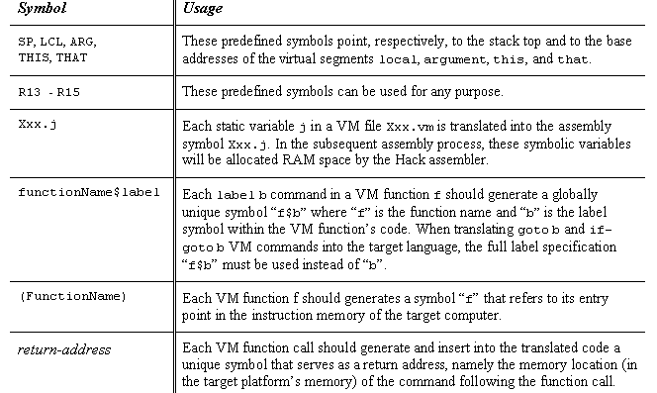

VM implementation over the Hack platform
Extends the VM implementation described in the last lecture (chapter 7)
The result: a single assembly program file with lots of agreed-upon symbols:
Notes:
25

Slide 26
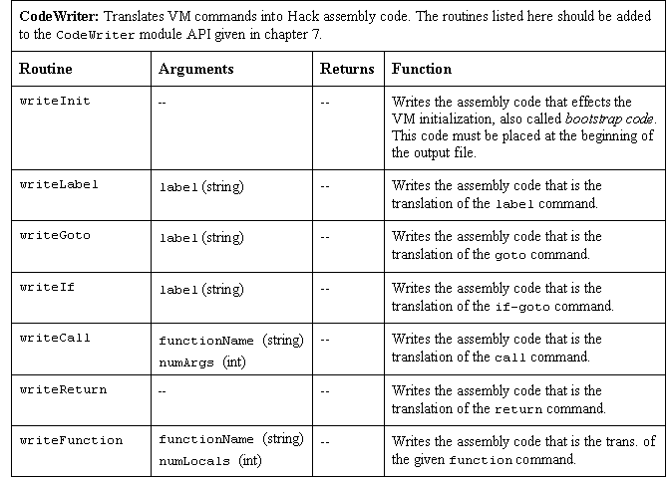
Proposed API
Notes:
26

Slide 27
Perspective
Benefits of the VM approach
Code transportability: compiling for different platforms requires replacing only the VM implementation
Language inter-operability: code of multiple languages can be shared using the same VM
Common software libraries
Code mobility: Internet
Some virtues of the modularity implied by the VM approach to program translation:
Improvements in the VM implementation are shared by all compilers above it
Every new digital device with a VM implementation gains immediate access to an existing software base
New programming languages can be implemented easily using simple compilers
Benefits of managed code:
Security
Array bounds, index checking, …
Add-on code
Etc.
VM Cons
Performance.
Notes:
27

