Slide 1
Computational Thinking & Systems Design Lecture 10: Syntax Analysis
Variable
Expression1
Expression2
𝜆
Variable
Expression
( )
Expression
Ben Koo
November 17, 2020

Slide 2
Course map
Human
Abstract design
Software
Thought
abstract interface
hierarchy
Chapters 9, 12
H.L. Language
Compiler
&
abstract interface
Operating Sys.
Chapters 10 - 11
Virtual
VM Translator
Machine
abstract interface
Chapters 7 - 8
Assembly
Language
Assembler
Chapter 6
abstract interface
Computer
Machine
Architecture
Language
abstract interface
Chapters 4 - 5
Gate Logic
Hardware
abstract interface
Platform
Chapters 1 - 3
Electrical
Hardware
Chips &
Engineering
Logic Gates
Physics
hierarchy

Slide 3
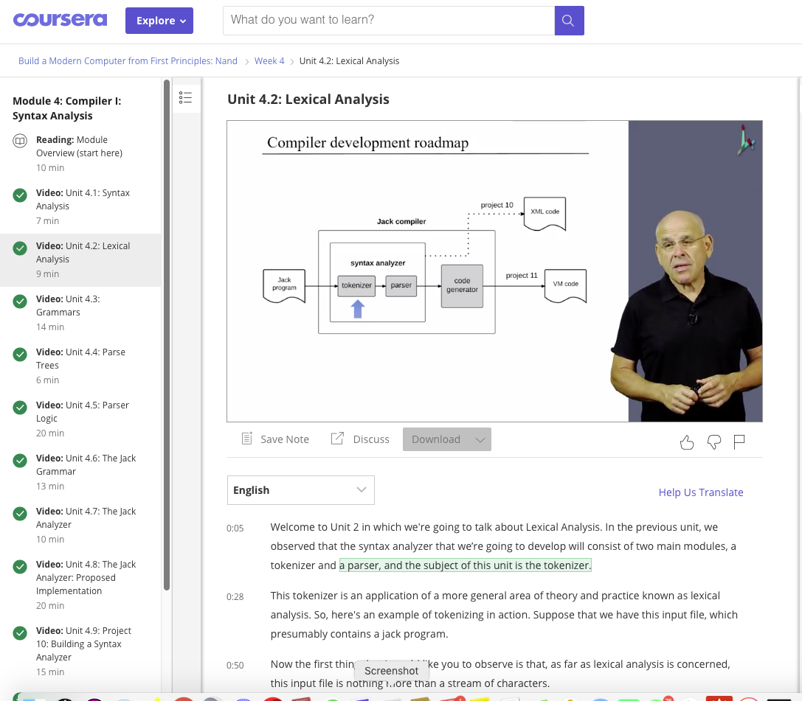
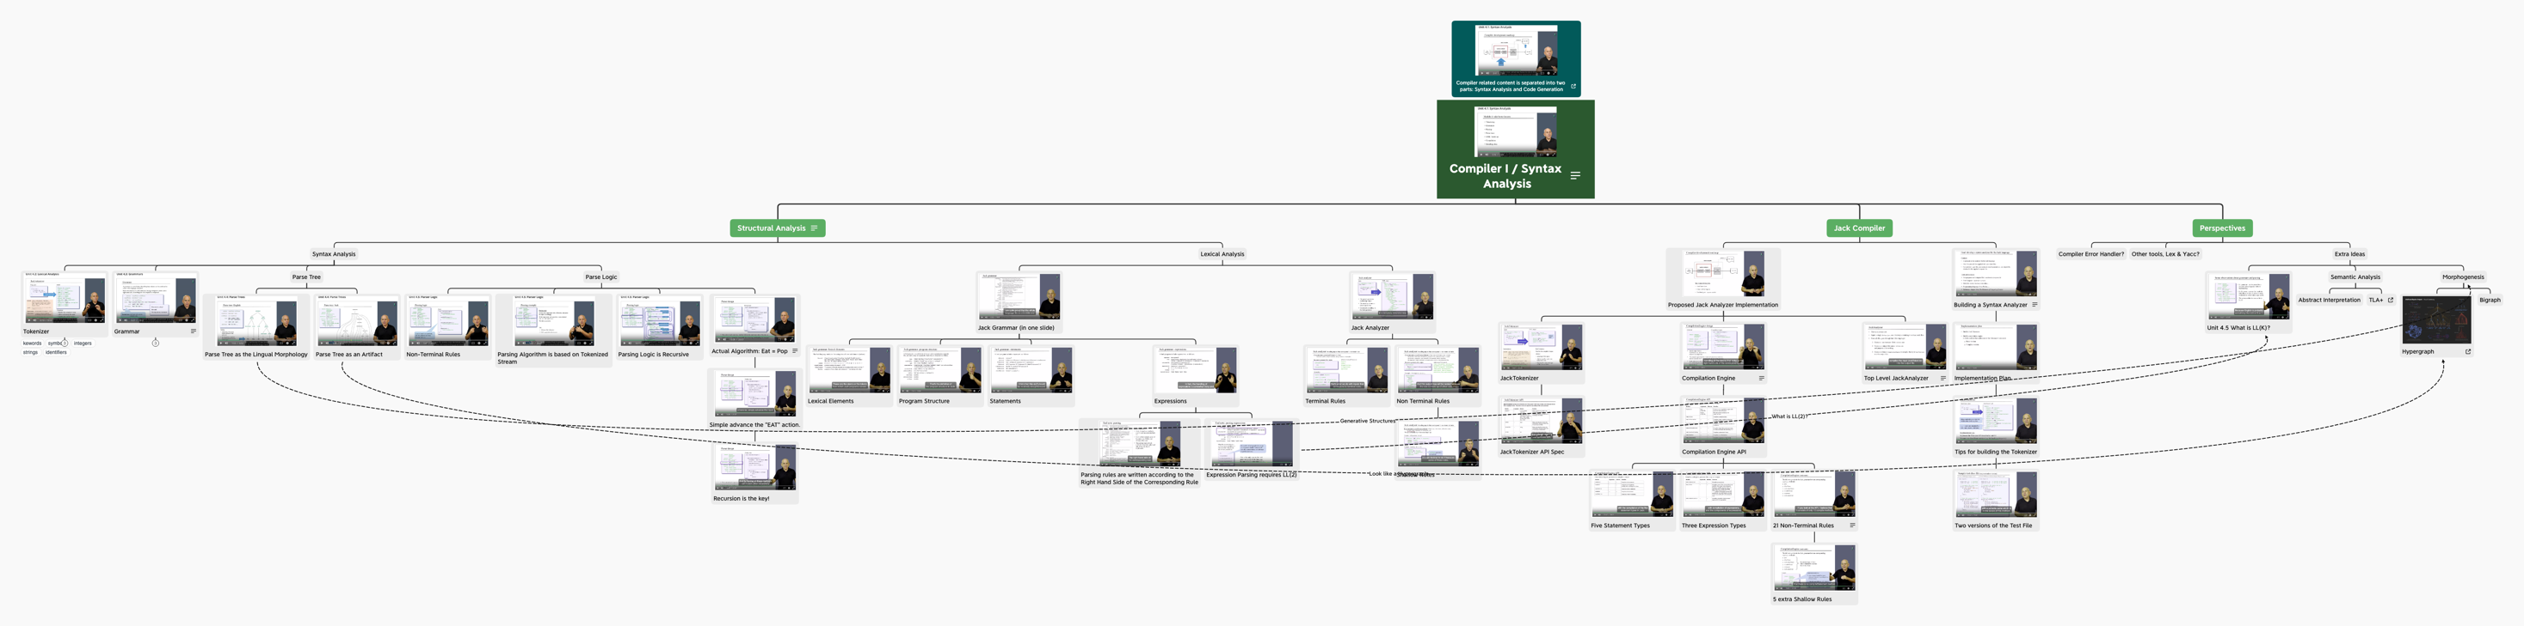
Video Course Content

Slide 4
Motivation: Why study about compilers?
Because Compilers …
Are an essential part of applied computer science
Are very relevant to computational linguistics
Are implemented using classical programming techniques
Employ important software engineering principles
Train you in developing software for transforming one structure to another (programs, files, transactions, …)
Train you to think in terms of ”description languages”.

Slide 5
The big picture
Modern compilers are two-tiered:
Front-end: from high-level language to some intermediate language
Back-end: from the intermediate language to binary code.
. . .
. . .
Some
Some Other
Jack
language
language
language
Compiler
lectures
Some
Some Other
Jack
(Projects 10,11)
compiler
compiler
compiler
Intermediate code
VM
VM
implementation
VM imp.
VM imp.
lectures
over CISC
over RISC
VM
over the Hack
platforms
platforms
emulator
platform
(Projects 7-8)
CISC
RISC
. . .
written in
Hack
machine
machine
a high-level
machine
language
language
language
language
HW
lectures
. . .
. . .
(Projects 1-6)
CISC
RISC
other digital platforms, each equipped
Any
Hack
machine
machine
with its VM implementation
computer
computer

Slide 6

Compiler architecture (front end)
(source)
(target)
Syntax analysis: understanding the semantics implied by the source code
Code generation: reconstructing the semantics using the syntax of the target code.
Tokenizing: creating a stream of “atoms”
Parsing: matching the atom stream with the language grammar
XML output = one way to demonstrate that the syntax analyzer works

Slide 7
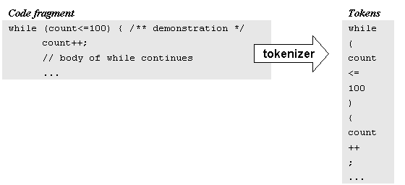
Tokenizing / Lexical analysis
Remove white space
Construct a token list (language atoms)
Things to worry about:
Language specific rules: e.g. how to treat “++”
Language-specific classifications: keyword, symbol, identifier, integerCconstant, stringConstant,...
While we are at it, we can have the tokenizer record not only the token, but also its lexical classification (as defined by the source language grammar).

Slide 8
Jack Tokenizer
Source code
if (x < 153) {let city = ”Paris”;}
Tokenizer’s output
<tokens>
<keyword> if </keyword>
<symbol> ( </symbol>
<identifier> x </identifier>
<symbol> &lt; </symbol>
<integerConstant> 153 </integerConstant>
<symbol> ) </symbol>
<symbol> { </symbol>
<keyword> let </keyword>
<identifier> city </identifier>
<symbol> = </symbol>
<stringConstant> Paris </stringConstant>
<symbol> ; </symbol>
<symbol> } </symbol>
</tokens>
Tokenizer

Slide 9
Parsing
The tokenizer discussed thus far is part of a larger program called parser
Each language is characterized by a grammar. The parser is implemented to recognize this grammar in given texts
The parsing process:
A text is given and tokenized
The parser determines weather or not the text can be generated from the grammar
In the process, the parser performs a complete structural analysis of the text
The text can be in an expression in a :
Natural language (English, …)
Programming language (Jack, …).

Slide 10
Parsing examples
Jack
English
(5+3)*2 – sqrt(9*4)
she discussed sex with her doctor
parse 1
parse 2
discussed
with
discussed
she
sex
her doctor
she
with
sex
her doctor

Slide 11
More examples of challenging parsing
Time flies like an arrow
We gave the monkeys the bananas because they were hungry
We gave the monkeys the bananas because they were over-ripe
I never said she stole my money
I never said she stole my money
I never said she stole my money
I never said she stole my money
I never said she stole my money
I never said she stole my money
I never said she stole my money
I never said she stole my money

Slide 12
A typical grammar of a typical C-like language
Grammar
Code sample
program: statement;
statement: whileStatement
| ifStatement
| // other statement possibilities ...
| '{' statementSequence '}'
whileStatement: 'while' '(' expression ')' statement
ifStatement: simpleIf
| ifElse
simpleIf: 'if' '(' expression ')' statement
ifElse: 'if' '(' expression ')' statement 'else' statement
statementSequence: '' // null, i.e. the empty sequence | statement ';' statementSequence
expression: // definition of an expression comes here
// more definitions follow
while (expression) {
if (expression)
statement;
while (expression) {
statement;
if (expression)
statement;
}
while (expression) {
statement;
statement;
}
}
if (expression) {
statement;
while (expression)
statement;
statement;
}
if (expression)
if (expression)
statement;
}
Simple (terminal) forms / complex (non-terminal) forms
Grammar = set of rules on how to construct complex forms from simpler forms
Highly recursive.

Slide 13
Parse tree
program: statement;
statement: whileStatement
| ifStatement
| // other statement possibilities ...
| '{' statementSequence '}'
whileStatement: 'while'
'(' expression ')'
statement
...

Slide 14
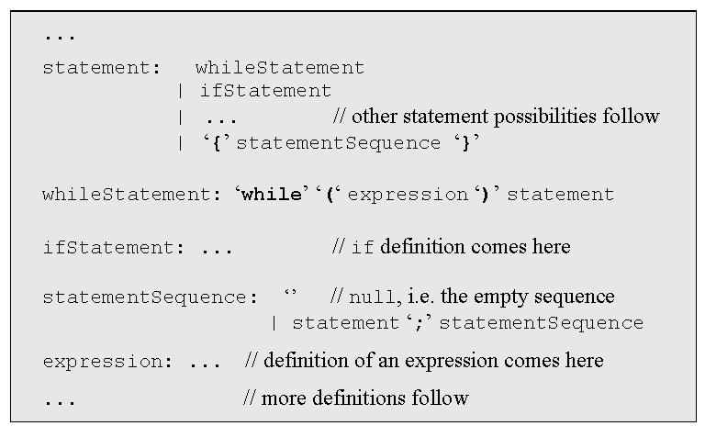
Recursive descent parsing
code sample
while (expression) {
statement;
statement;
while (expression) {
while (expression)
statement;
statement;
}
}
Highly recursive
LL(0) grammars: the first token determines in which rule we are
In other grammars you have to look ahead 1 or more tokens
Jack is almost LL(0).
Parser implementation: a set of parsing methods, one for each rule:
parseStatement()
parseWhileStatement()
parseIfStatement()
parseStatementSequence()
parseExpression().

Slide 15
A linguist view on parsing
Parsing:
One of the mental processes involved in sentence comprehension, in which the listener determines the syntactic categories of the words, joins them up in a tree, and identifies the subject, object, and predicate, a prerequisite to determining who did what to whom from the information in the sentence.
(Steven Pinker, The Language Instinct)

Slide 16
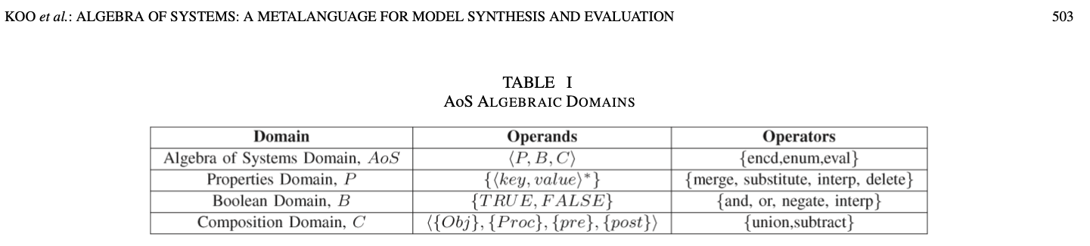
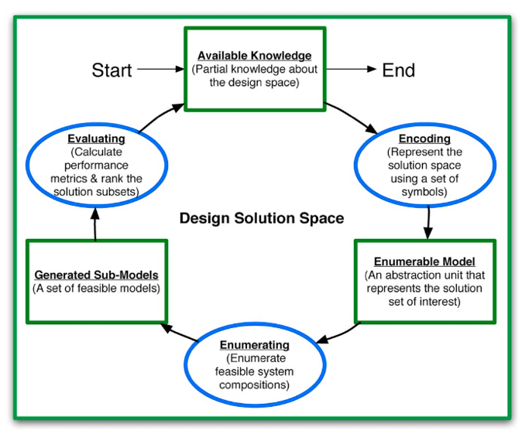
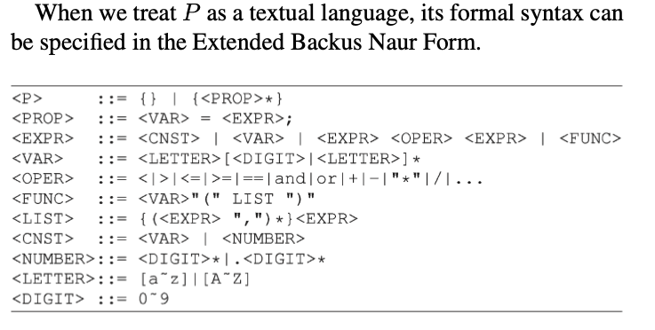
Computable Multi-level Abstractions

Slide 17
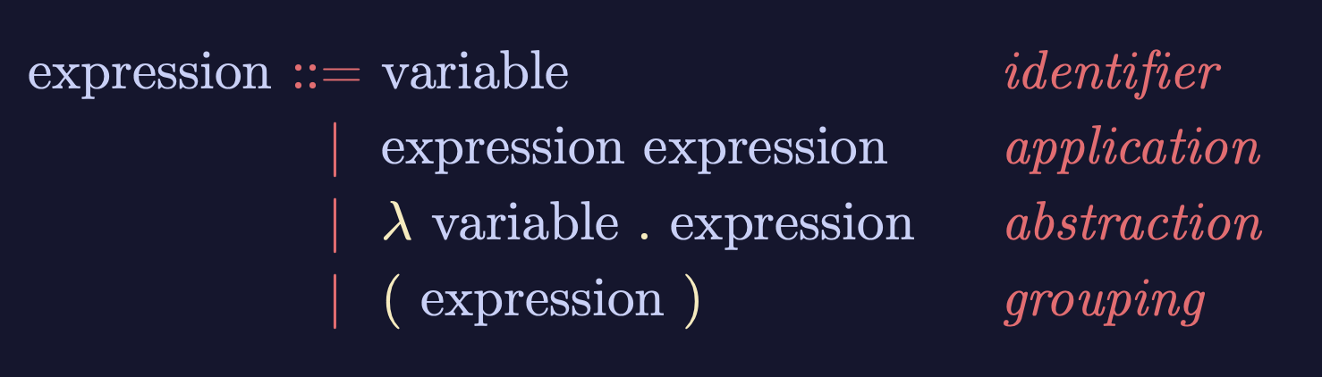
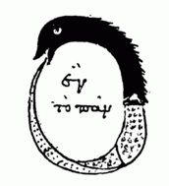

Lambda-Calculus is an Ouroboros
Variable
Expression1
Expression2
𝜆
Variable
Expression
( )
Expression
Lambda calculus as an executable rewrite process is a Lattice/Poset.
Paradigm shifting concepts
and
incommensurable terms
Normal Science
Model
Drift
Model Crisis
Model Revolution
Paradigm
Change
Learning as a vocabulary acquisition process!
Early alchemical ouroboros illustration with the words ἓν τὸ πᾶν ("The All is One") from the work of Cleopatra the Alchemist in MS Marciana gr. Z. 299. (10th Century)
Image and Text: Wikipedia
Backus-Naur Form provides a way to customize the “concrete syntax” of formal languages.

Slide 18
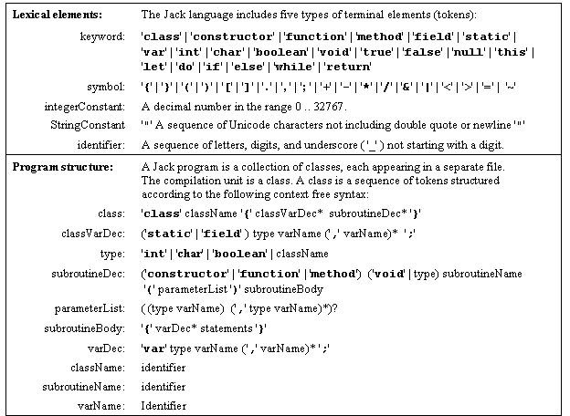
The Jack grammar
’x’: x appears verbatim
x: x is a language construct
x?: x appears 0 or 1 times
x*: x appears 0 or more times
x|y: either x or y appears
(x,y): x appears, then y.

Slide 19
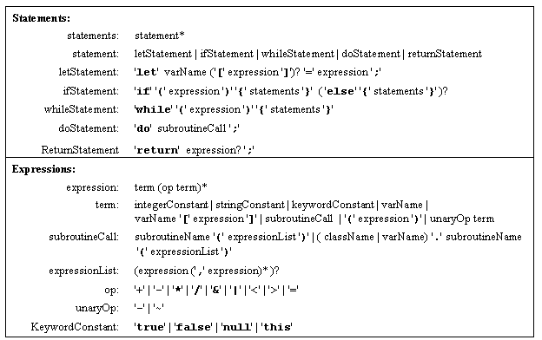
The Jack grammar (cont.)
’x’: x appears verbatim
x: x is a language construct
x?: x appears 0 or 1 times
x*: x appears 0 or more times
x|y: either x or y appears
(x,y): x appears, then y.

Slide 20
Jack syntax analyzer in action
Class Bar { method Fraction foo(int y) { var int temp; // a variable let temp = (xxx+12)*-63; ...
...
<varDec>
<keyword> var </keyword>
<keyword> int </keyword>
<identifier> temp </identifier>
<symbol> ; </symbol>
</varDec>
<statements>
<letStatement>
<keyword> let </keyword>
<identifier> temp </identifier>
<symbol> = </symbol>
<expression>
<term>
<symbol> ( </symbol>
<expression>
<term>
<identifier> xxx </identifier>
</term>
<symbol> + </symbol>
<term>
<int.Const.> 12 </int.Const.> </term>
</expression>
...
Syntax analyzer
Syntax analyzer
Using the language grammar, a programmer can write a syntax analyzer program (parser)
The syntax analyzer takes a source text file and attempts to match it on the language grammar
If successful, it can generate a parse tree in some structured format, e.g. XML.
The syntax analyzer’s algorithm shown in this slide:
If xxx is non-terminal, output:
<xxx>
Recursive code for the body of xxx
</xxx>
If xxx is terminal (keyword, symbol, constant, or identifier) , output:
<xxx>
xxx value
</xxx>

Slide 21
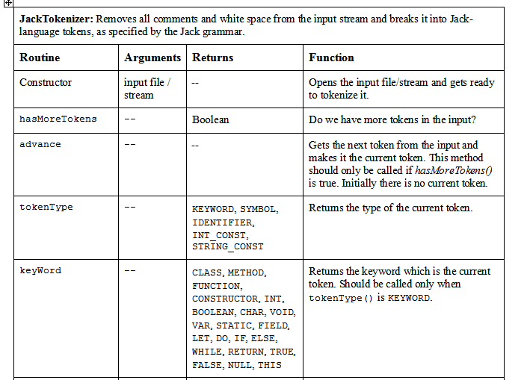
JackTokenizer: a tokenizer for the Jack language (proposed implementation)

Slide 22
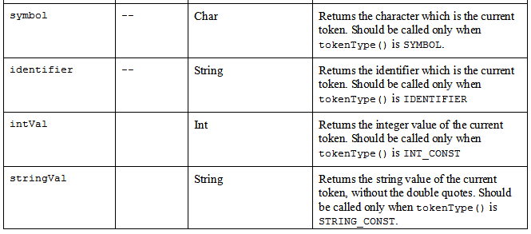
JackTokenizer (cont.)

Slide 23
CompilationEngine: a recursive top-down parser for Jack
The CompilationEngine effects the actual compilation output.
It gets its input from a JackTokenizer and emits its parsed structure into an output file/stream.
The output is generated by a series of compilexxx() routines, one for every syntactic element xxx of the Jack grammar.
The contract between these routines is that each compilexxx() routine should read the syntactic construct xxx from the input, advance() the tokenizer exactly beyond xxx, and output the parsing of xxx. Thus, compilexxx()may only be called if indeed xxx is the next syntactic element of the input.
In the first version of the compiler, which we now build, this module emits a structured printout of the code, wrapped in XML tags (defined in the specs of project 10). In the final version of the compiler, this module generates executable VM code (defined in the specs of project 11).
In both cases, the parsing logic and module API are exactly the same.

Slide 24
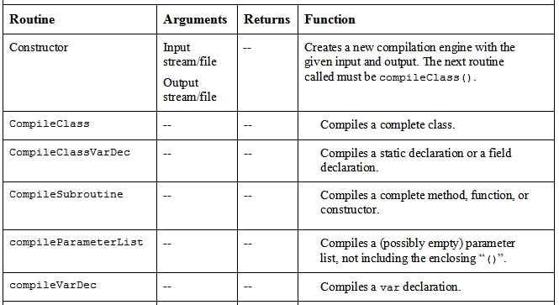
CompilationEngine (cont.)

Slide 25
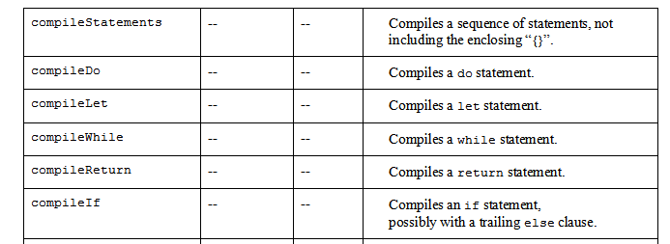
CompilationEngine (cont.)

Slide 26
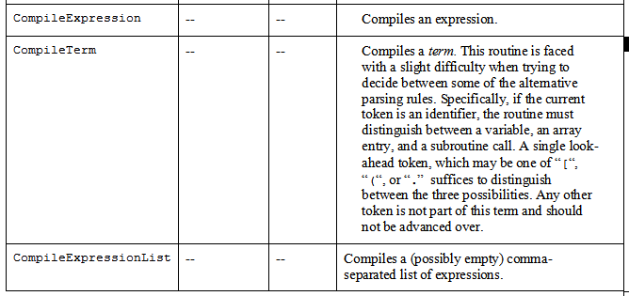
CompilationEngine (cont.)

Slide 27
Summary and next step
Syntax analysis: understanding syntax
Code generation: constructing semantics
The code generation challenge:
Extend the syntax analyzer into a full-blown compiler that, instead of generating passive XML code, generates executable VM code
Two challenges: (a) handling data, and (b) handling commands.

Slide 28
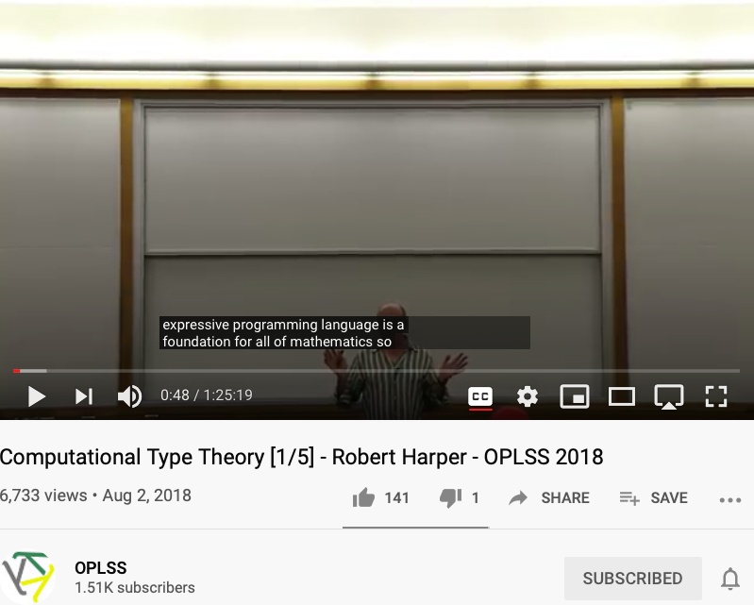
The foundation of math as programming languages
Prof. Robert Harper

Slide 29
Perspective
The parse tree can be constructed on the fly
Syntax analyzers can be built using:
Lex tool for tokenizing
Yacc tool for parsing
Do everything from scratch (our approach ...)
The Jack language is intentionally simple:
Statement prefixes: let, do, ...
No operator priority
No error checking
Basic data types, etc.
Richer languages require more powerful compilers
The Jack compiler: designed to illustrate the key ideas that underlie modern compilers, leaving advanced features to more advanced courses
Industrial-strength compilers:
Have good error diagnostics
Generate tight and efficient code
Support parallel (multi-core) processors.

