Slide 1
A Plan to make cities Intelligent
Ben Koo
benkoo@tsinghua.edu.cn
April 7th，2020
Notes:
今天的主题是“区块链启发的新产业范式”

Slide 2
10 things to make cities smart
Data is the foundation
The network is the Structure
Facilitating IoT Connectivity
Modular Infrastructure
Security
Privacy from the ground up
Sensor and Data Capture
Distributed Data Processing
Focus on Small Wins First
A Smart city is De-Siloed
https://www.coxblue.com/10-things-to-consider-in-planning-and-building-a-smart-city/

Slide 3
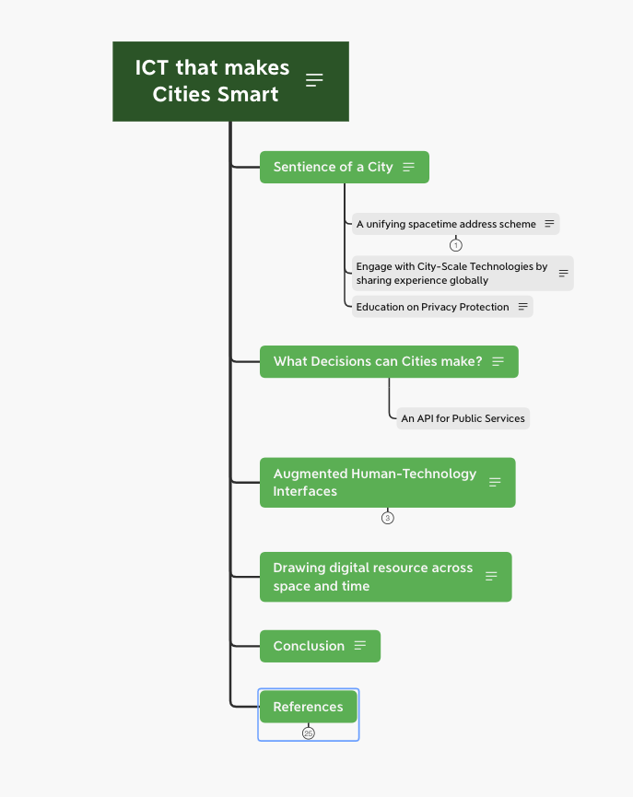
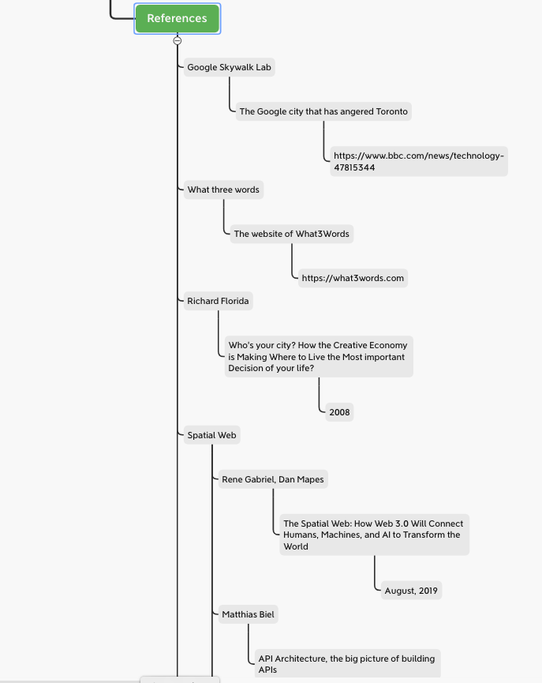
Outline from last week

Slide 4
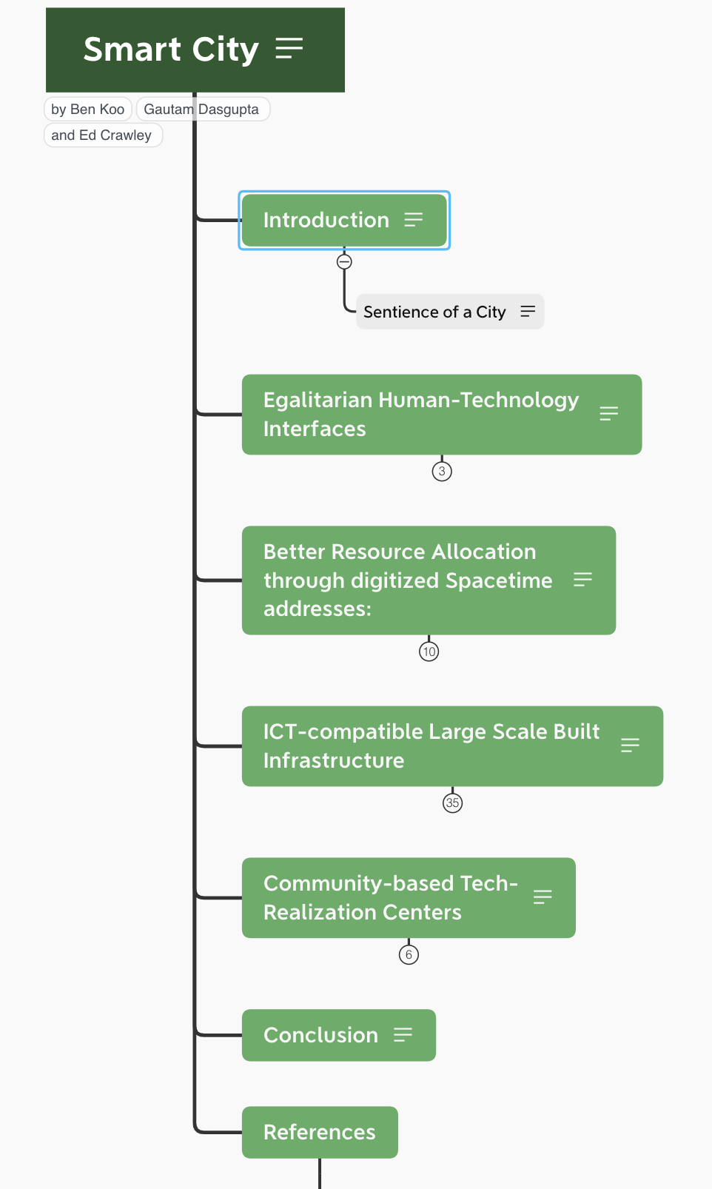
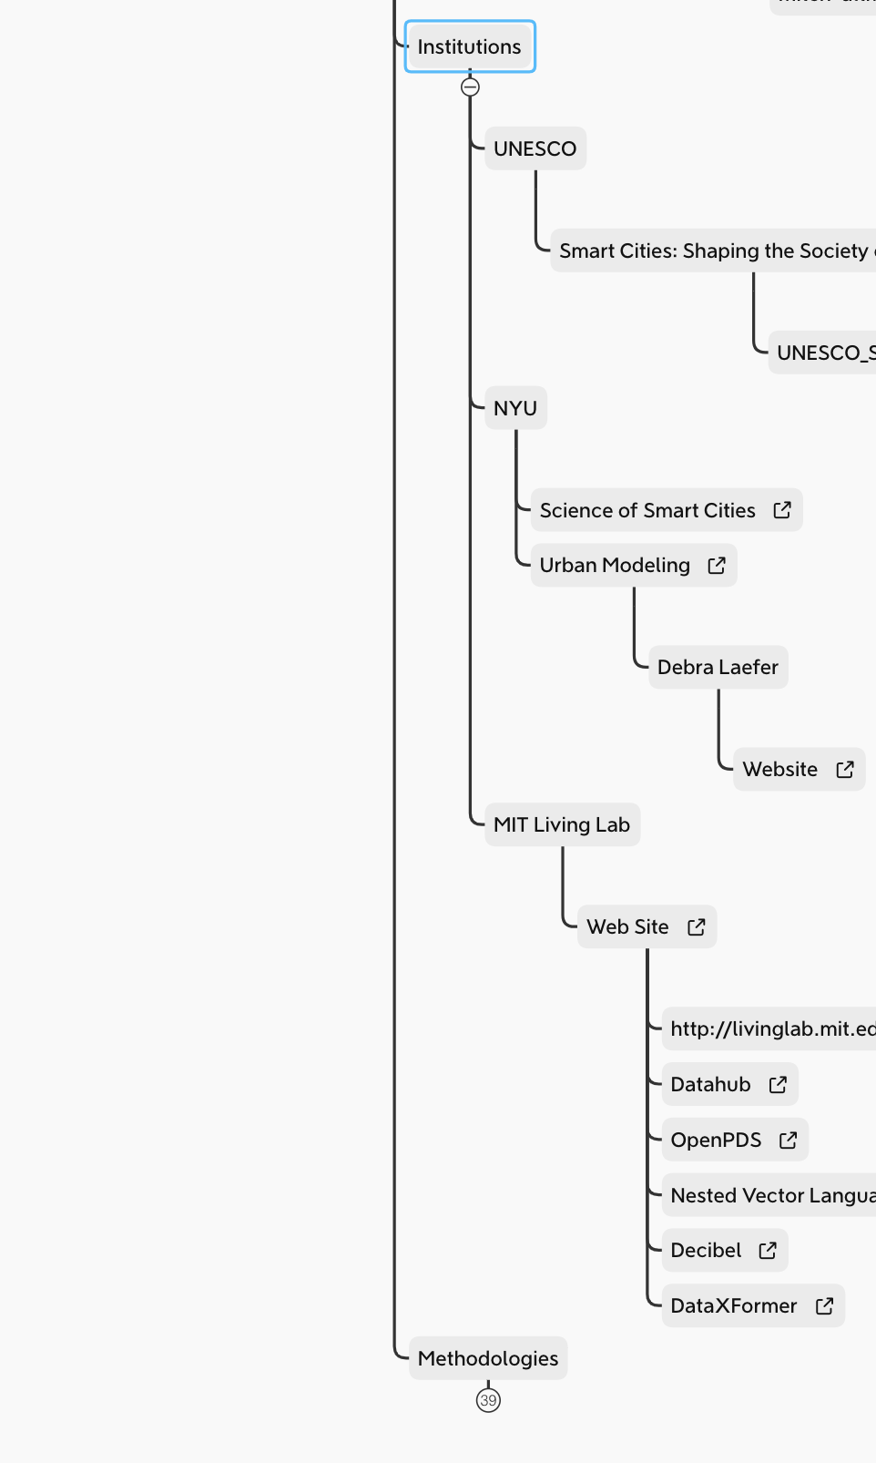
An Updated Outline

