Slide 1
A Case Study:
Based on China RX
Ben Koo
benkoo@tsinghua.edu.cn
March 24th，2020
Notes:
今天的主题是“区块链启发的新产业范式”

Slide 2

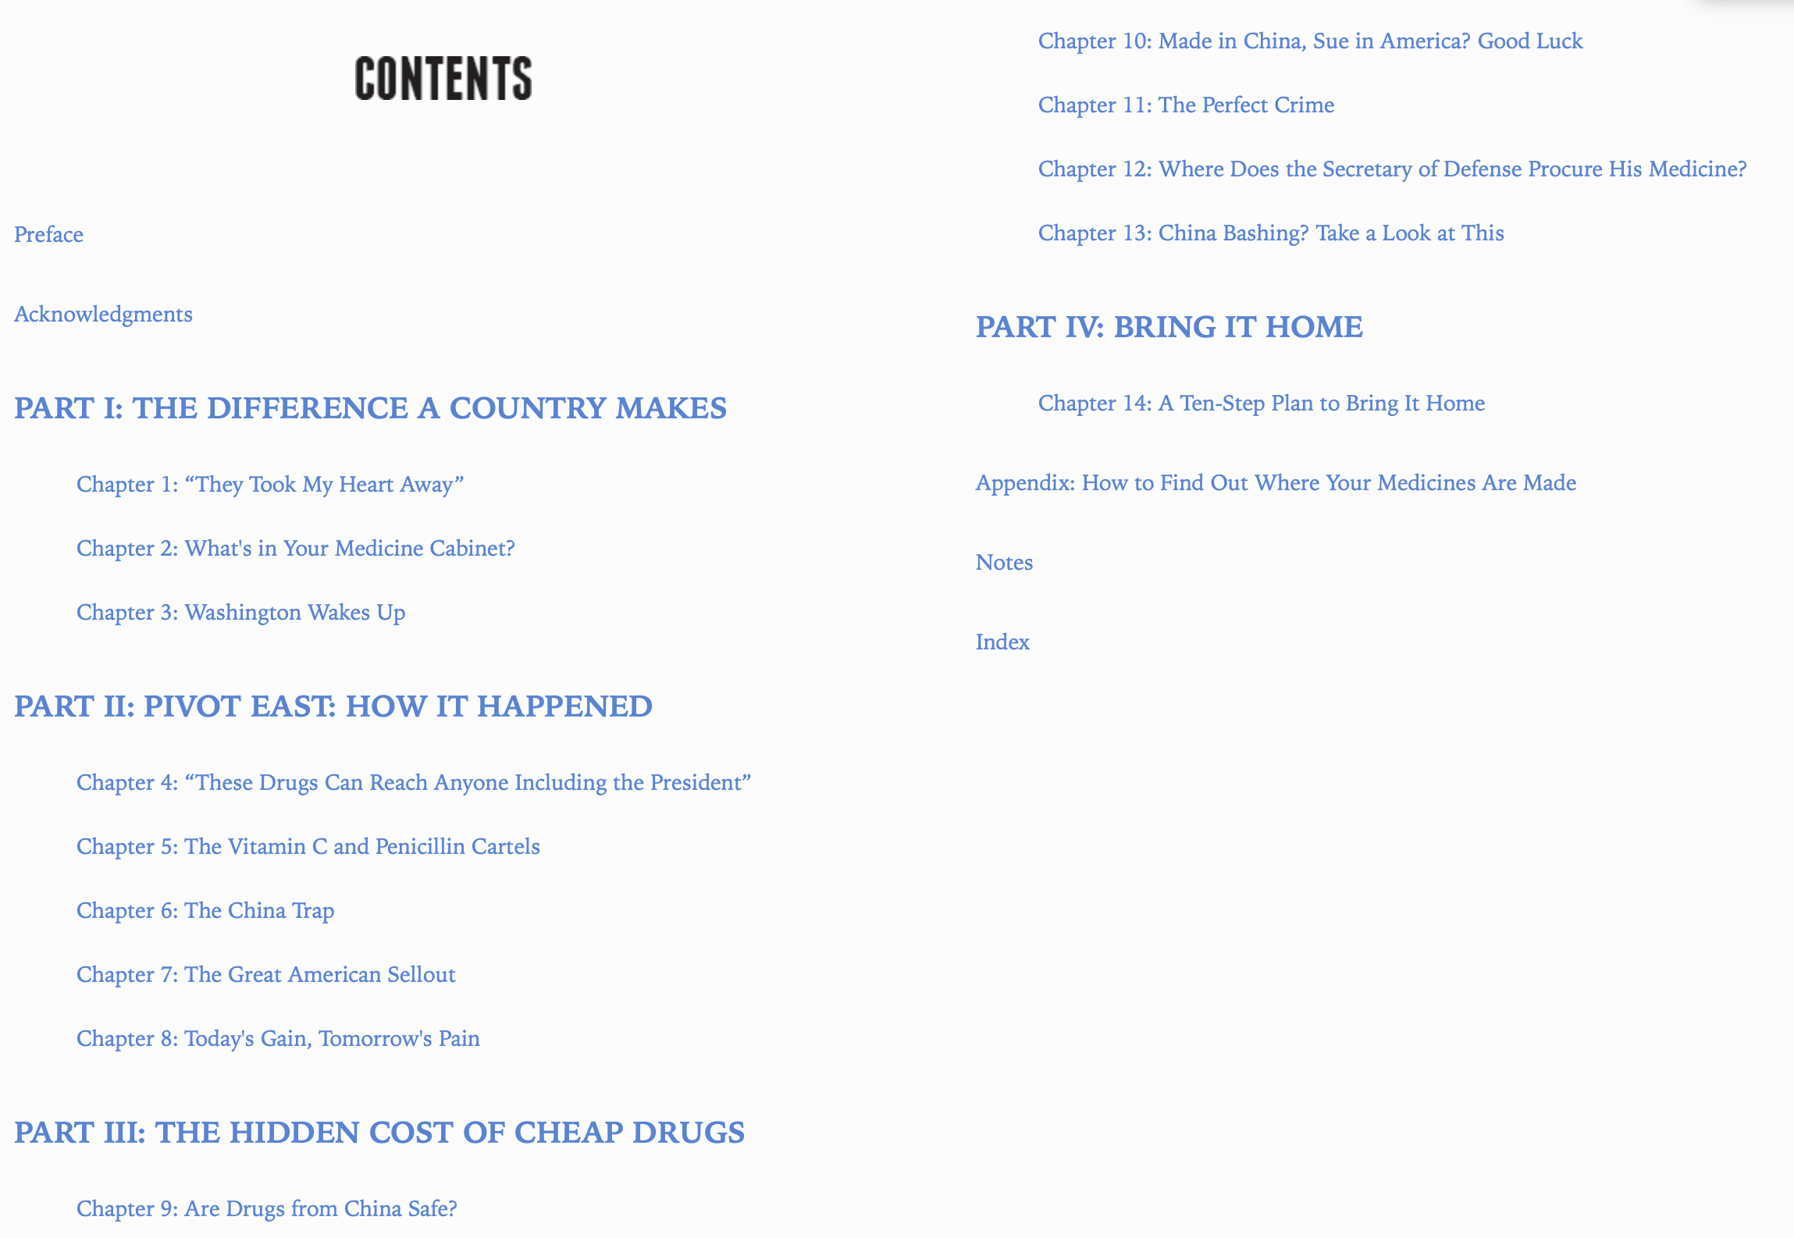
The book on The New Urban Crisis

Slide 3
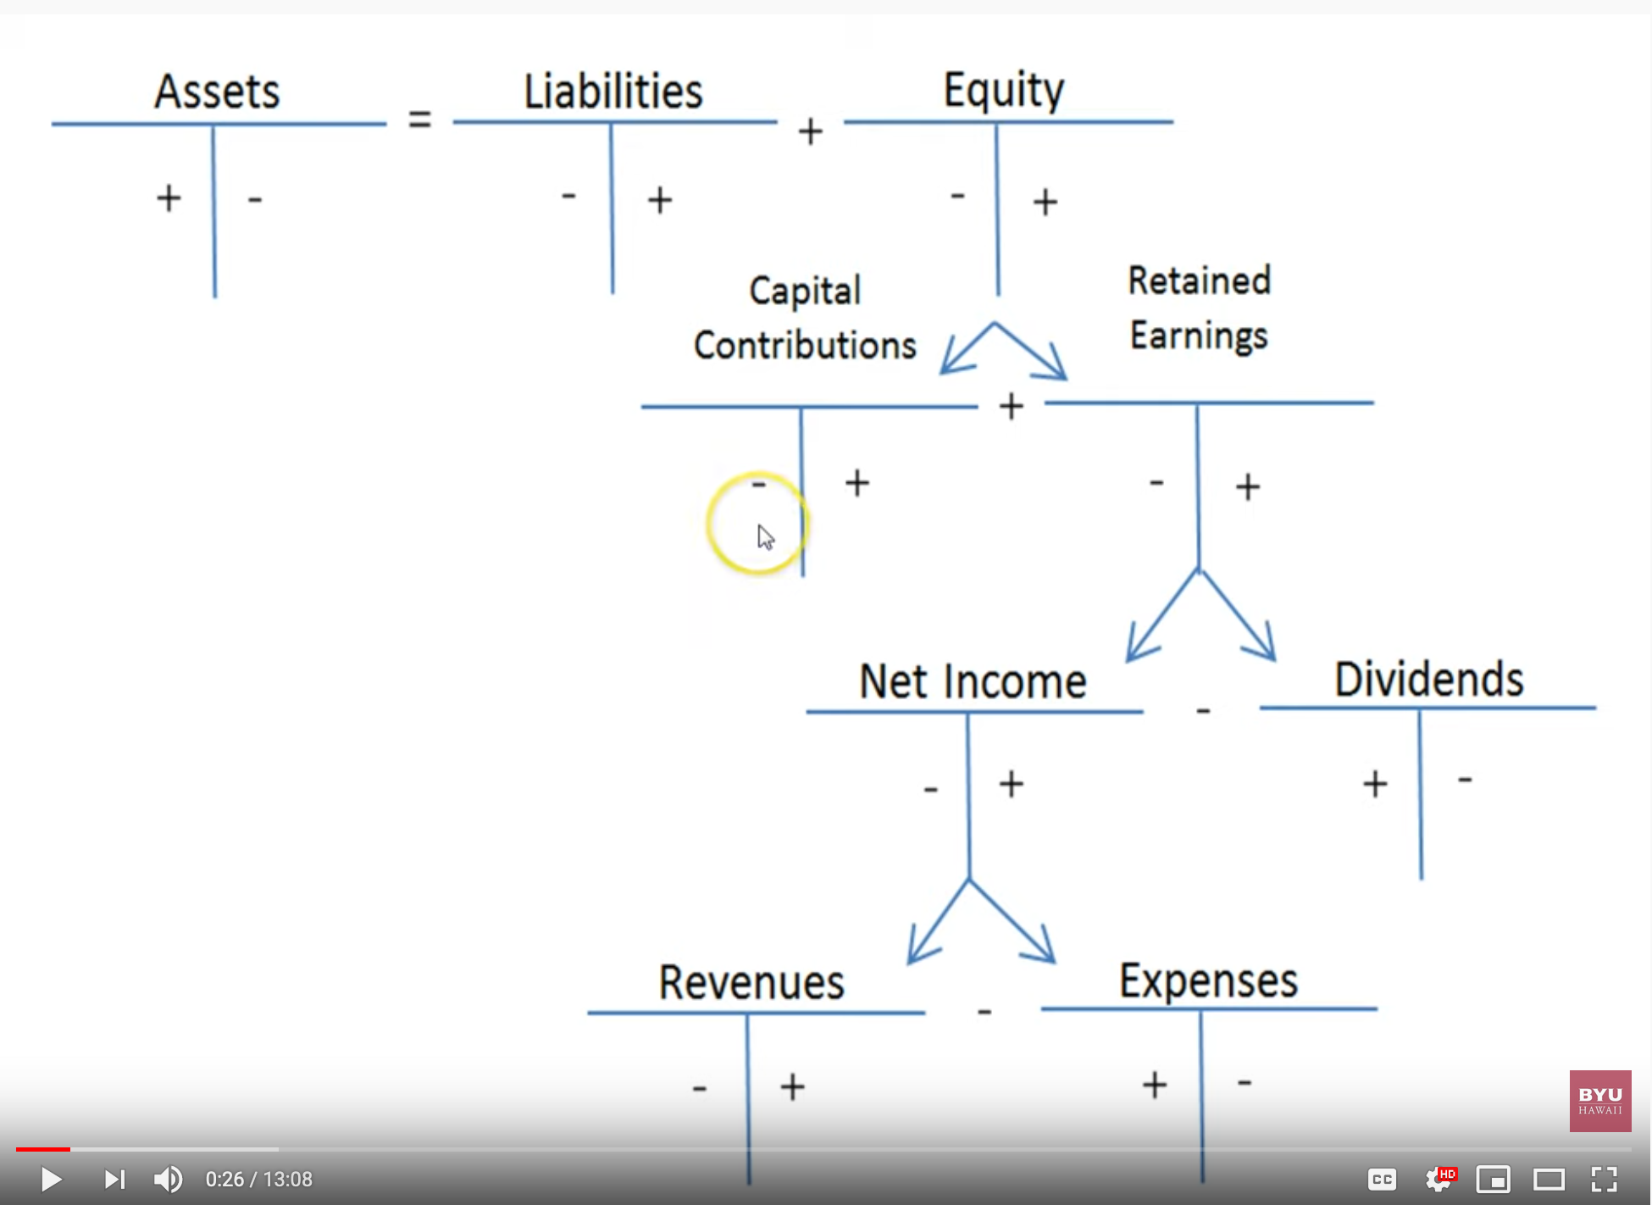
Debits and Credits and the Expanded Accounting Equation
Image source: https://youtu.be/gIWmPrUDj_M

