Slide 1
A Globalized Local View of the World
Ben Koo
benkoo@tsinghua.edu.cn
March 31st，2020
Notes:
今天的主题是“区块链启发的新产业范式”

Slide 2

Recover from Current Crisis

Slide 3

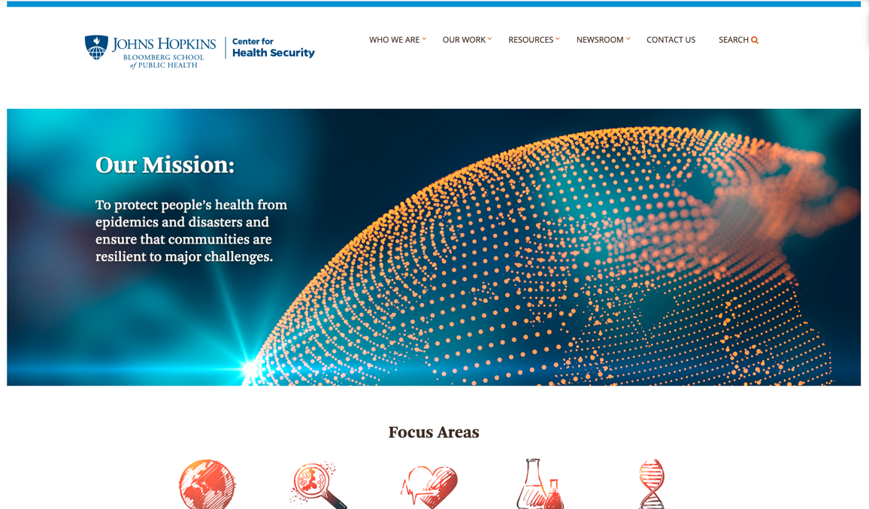
Outbreak Science
http://www.centerforhealthsecurity.org/

Slide 4
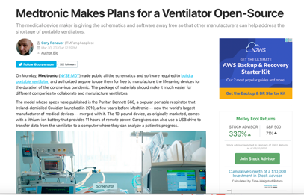
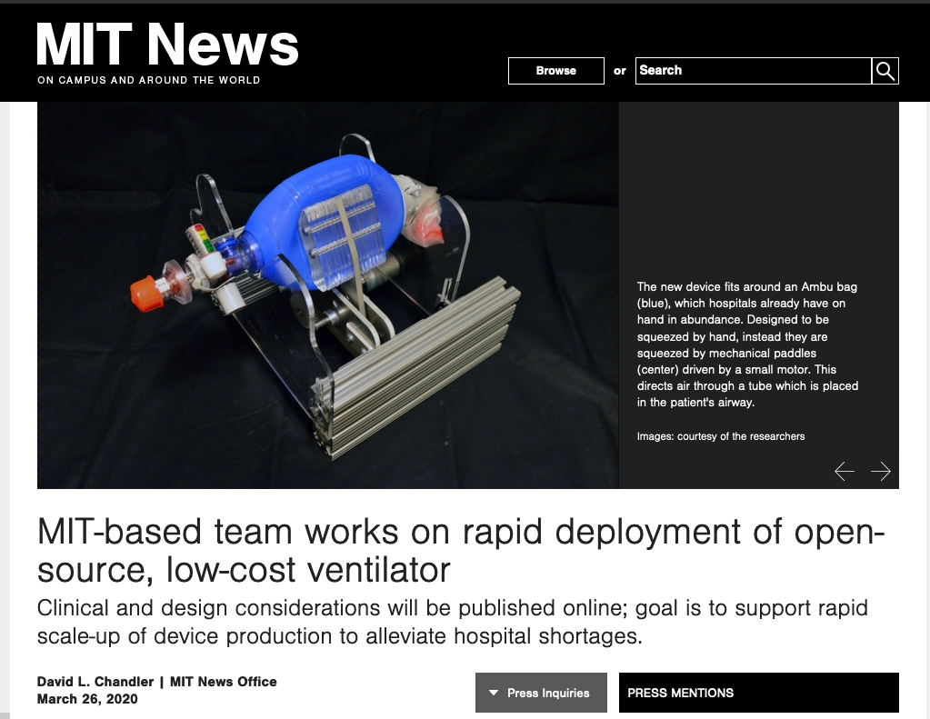
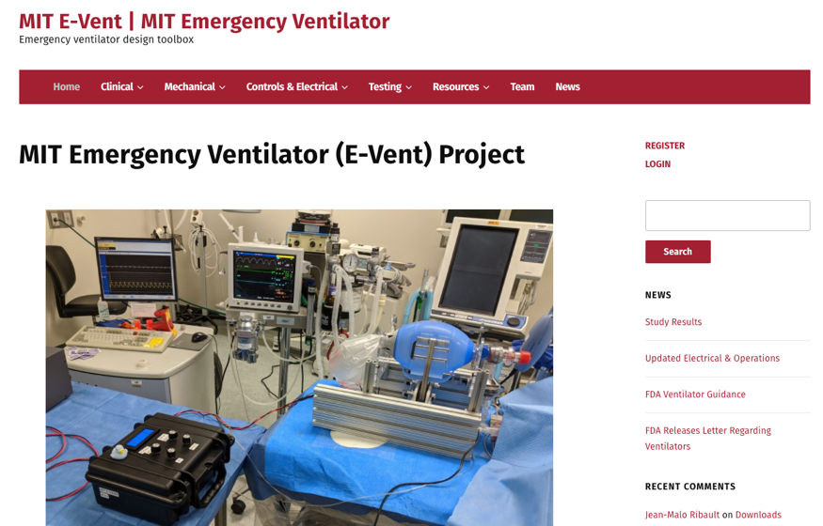
Open Source Ventilator Design
https://e-vent.mit.edu/
http://news.mit.edu/2020/ventilator-covid-deployment-open-source-low-cost-0326

Slide 5
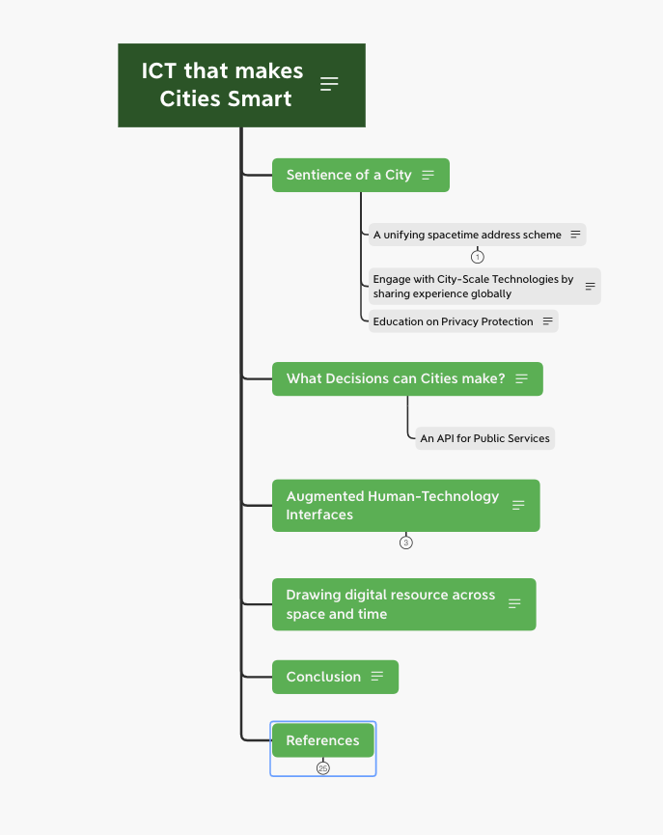
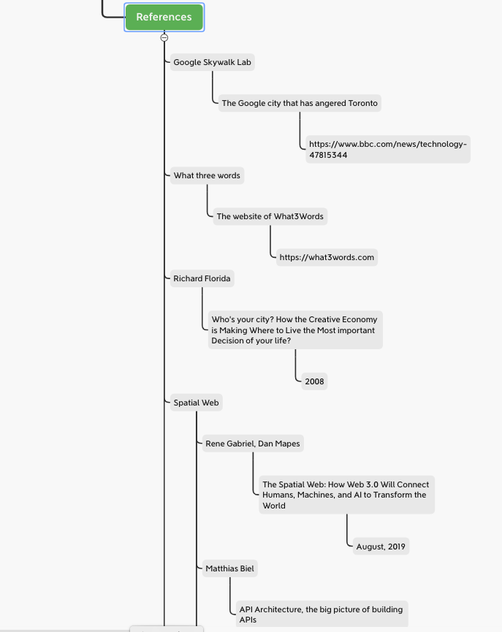
An Outline of my proposal

