Slide 1


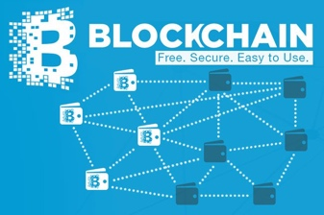
Transaction Records on Blockchain
Traders
Miners
Coders
Version Upgrade
Production Code
Function Requests
Customer Crisis
Feature Revolution
Emerging cases or
systematic attacks
Perform Checking
receive confirmation
commit transaction

Slide 2
Pre-Science
Normal Science
Model Drift
Model Crisis
Model Revolution
Paradigm Shift
Image Source: https://www.thwink.org/sustain/glossary/KuhnCycle.htm

Slide 3
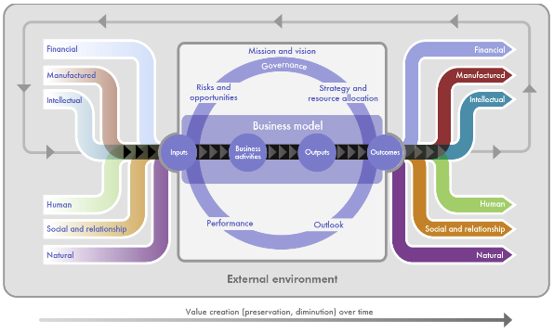
Normal Science
Model Drift
Model Crisis
Model Revolution
Paradigm Shift
Input
Acitivites/Outputs
Outcomes
Value Creation over time
Modified from International <IR> Framework. Figure 2, p.13
http://www.theiirc.org/international-ir-framework/, accessed July 2020.

Slide 4
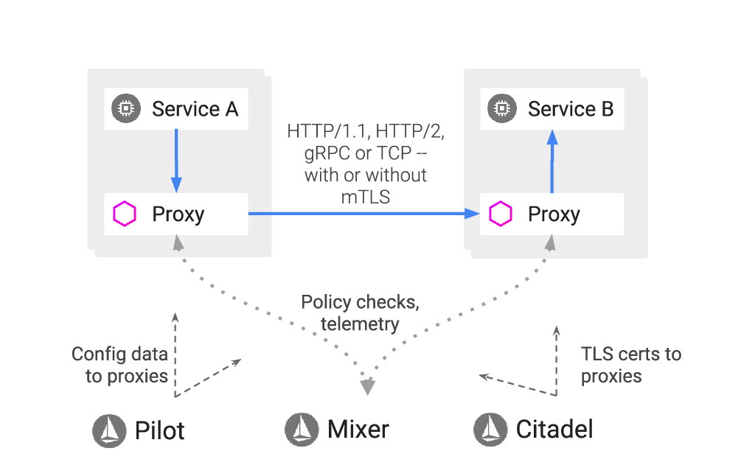
Data Plane
Control Plane
Modified from Getting Started with Istio on Amazon EKS
https://aws.amazon.com/blogs/opensource/getting-started-istio-eks/, accessed July 2020.

Slide 5
Syntax Verification
Semantic Verification
Test-case Generation
Deductuve Program Verifier
Parser
OCA-compliant Domain-Specific Language Definitions
OCA-IS, OCA-DL, OCA-NS
Using K-Framework
Model Checker
Interpreter
Symbolic Execution
Compiler
Debugger

Slide 6
