Slide 1


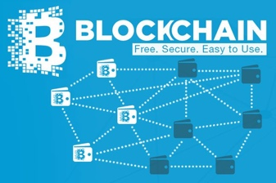
Transaction Records on Blockchain
Traders
Coders
Miners
Emerging cases or
systematic attacks
Version Upgrade
Production Code
Function Requests
User Crisis
Feature Revolution
Perform Checking
receive confirmation
commit transaction

Slide 2
Pre-Science
Normal Science
Model Drift
Model Crisis
Model Revolution
Paradigm Shift
Image Source: https://www.thwink.org/sustain/glossary/KuhnCycle.htm

Slide 3
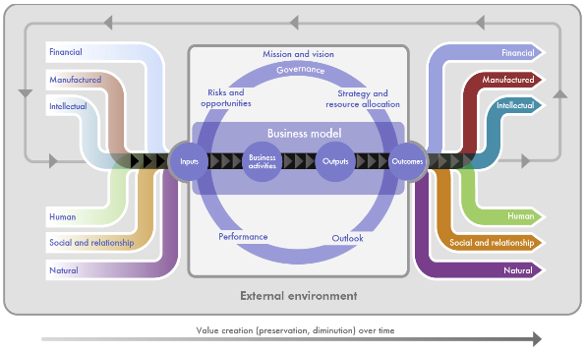
Normal Science
Model Drift
Model Crisis
Model Revolution
Paradigm Shift
Input
Acitivites/Outputs
Outcomes
Value Creation over time
Modified from International <IR> Framework. Figure 2, p.13
http://www.theiirc.org/international-ir-framework/, accessed July 2020.

Slide 4
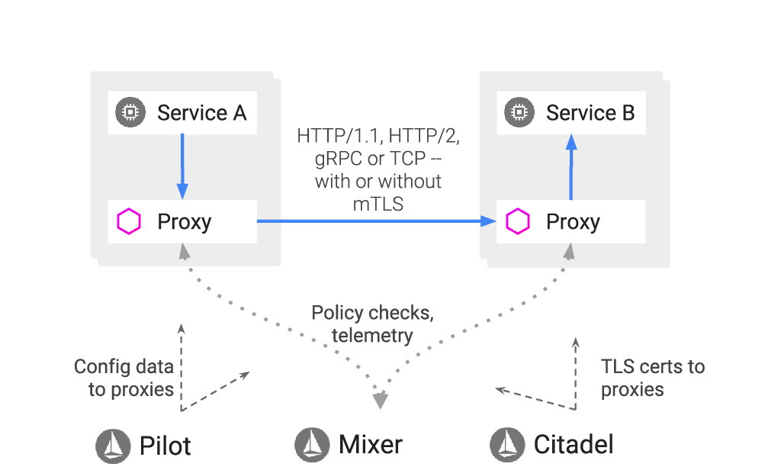
Data Plane
Control Plane
Modified from Getting Started with Istio on Amazon EKS
https://aws.amazon.com/blogs/opensource/getting-started-istio-eks/, accessed July 2020.

Slide 5
Syntax Verification
Semantic Verification
Test-case Generation
Deductuve Program Verifier
Parser
OCA-compliant Domain-Specific Language Definitions
OCA-IS, OCA-DL, OCA-NS
Using K-Framework
Model Checker
Interpreter
Symbolic Execution
Compiler
Debugger

Slide 6
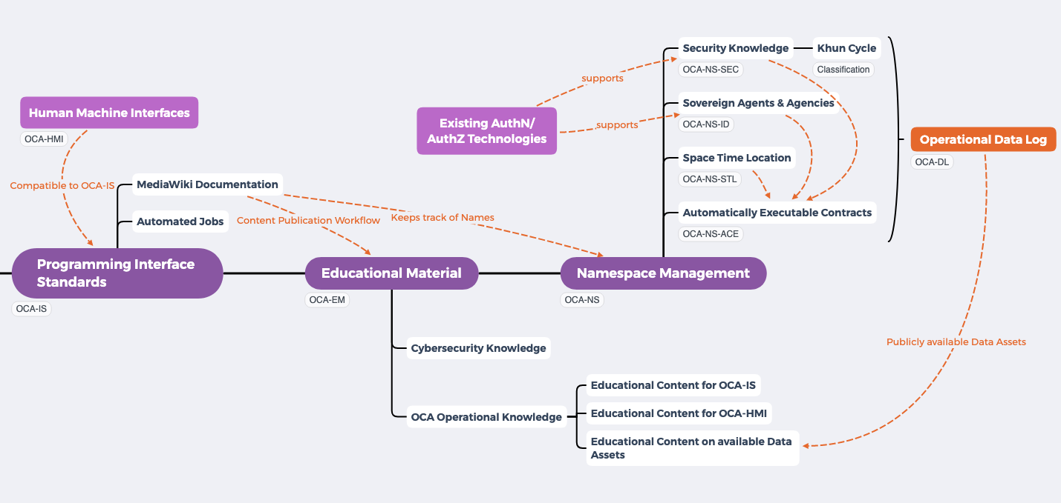
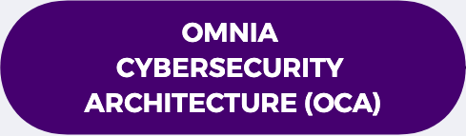



Slide 7
Source
Private Communication Channel
Destination
Pass Phrase
Decrypted
by
Pass Phrase
Pass Phrase
Source created Pass Phrase, so that it must be transmitted to Destination for Decryption.
Original Data Content
Encrypted
by
Original Data Content
Public Communication Channel
Pubic Key
Pubic Key
Encrypted
by Public Key
PKI Namespace
Decrypted
by Private Key
Original Data Content
Original Data Content
Public Keys can be retrieved from Open Namespaces
Pubic Key
Public/Private Key pair is created on Destination so that private key never have to be exposed
Pubic Key
Pubic Key
Private Key
Notes:
https://youtu.be/q9vu6_2r0o4

Slide 8
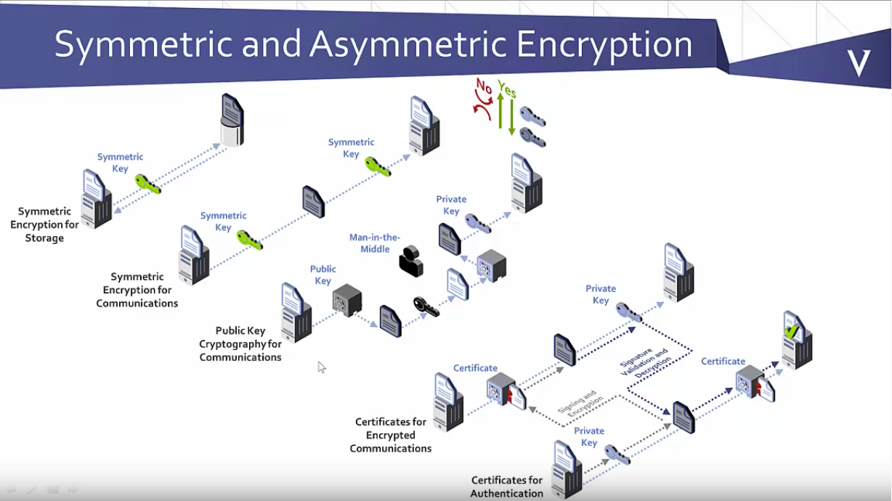
Image Source: https://youtu.be/q9vu6_2r0o4

Slide 9
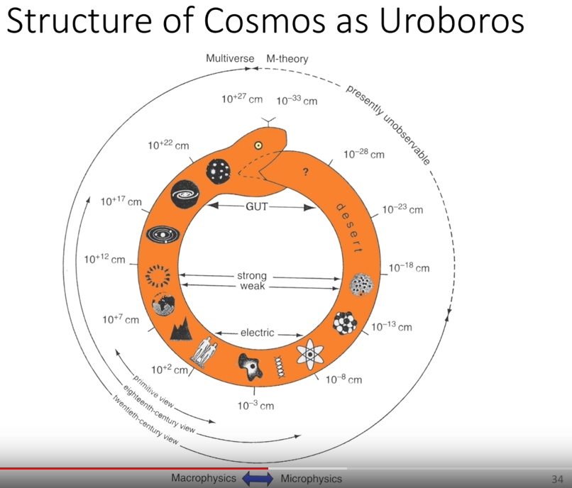
A Geometry of Consciousness -- The Pribram Bohm Hypothesis

