Slide 1
Stacks
Based on Koffmann and Wolfgang
Chapter 5

Slide 2
Chapter Outline
The Stack<E> data type and its four methods:
  push(E), pop(), peek(), and empty()
How the Java libraries implement Stack
How to implement Stack using:
  An array
  A linked list
Using Stack in applications
  Finding palindromes
  Testing for balanced (properly nested) parentheses
  Evaluating arithmetic expressions

Slide 3

The Stack<E> Abstract Data Type
A stack can be compared to a Pez dispenser
  Only the top item can be accessed
  Can only extract one item at a time
A stack allows access only to the top element
A stack’s storage policy is Last-In, First-Out
Carl
push Carl ...
Barb
Barb
Alex
Alex

Slide 4
Specification of Stack<E>
As An Abstract Data Type
Since only the top element of a stack is visible ...
  There are only a few operations
Need the ability to
  Inspect the top element: peek()
  Retrieve & remove the top element: pop()
  Push a new element on the stack: push(E)
  Test for an empty stack: empty()

Slide 5
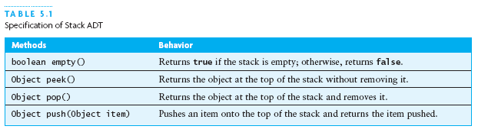
API for Stack<E> (old)

Slide 6
Stack Applications
Text studies two client programs using stacks
  Palindrome finder
  Parenthesis (bracket) matcher
A palindrome is a string that is the same in either direction
  “Able was I ere I saw Elba”
  “A man, a plan, a canal: Panama”
  Abba

Slide 7
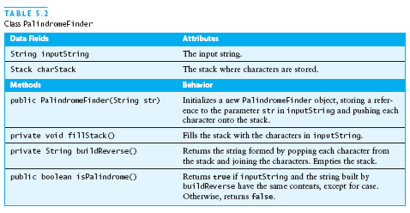
Stack Applications (continued)

Slide 8
Palindrome Code
public class Palindrome {
private String input;
private Stack<Character> charStack =
new Stack<Character>();
public Palindrome (String input) {
this.input = input;
fillStack();
}
...
}

Slide 9
Palindrome Code (2)
// pushes chars of input String, such
// that last ends up on top, and they
// can be popped in reverse order
private void fillStack () {
for (int i = 0, len = input.length();
i < len;
++i) {
charStack.push(input.charAt(i));
}
}

Slide 10
Palindrome Code (3)
// adds chars, in reverse order, to result
// uses a StringBuilder to reduce allocation
// that would happen with String +
private String buildReverse () {
StringBuilder result = new StringBuilder();
while (!charStack.empty()) {
result.append(charStack.pop());
}
return result.toString();
}

Slide 11
Palindrome Code (4)
public boolean isPalindrome () {
return input.equalsIgnoreCase(buildReverse());
}
Testing this class:
Single character, empty string: both always palindromes
Multiple characters, one word
Multiple words
Different cases (upper/lower)
Both even- and odd-length strings

Slide 12
Stack Applications: Balancing Brackets
Arithmetic expressions should balance parentheses:
    (a+b*(c/(d-e)))+(d/e)
Not too hard if limited to parentheses only:
  Increment depth counter on (
  Decrement depth counter on )
  If always ≥ 0, then balanced properly
Problem harder if also use brackets: [] {}
  A stack provides a good solution!

Slide 13
Balancing Brackets: Overview
Start with empty stack of currently open brackets
Process each char of an expression String
If it is an opener, push it on the stack
If it is a closer, check it against the top stack element
  If stack empty, or not a matching bracket:
    not balanced, so return false
  Otherwise, it matches: pop the opener
If stack is empty at the end, return true
If not empty, then some bracket unmatched: false

Slide 14
isBalanced Code
public static boolean isBalanced (String expr) {
Stack<Character> s = new Stack<Character>();
try {
for (int idx = 0, len = expr.length();
idx < len;
idx++) {
... process each char of expr ...
}
} catch (EmptyStackException ex) {
return false;
}
return s.empty();
}

Slide 15
isBalanced Code: Loop Body
// process each char of expr:
char ch = expr.charAt(idx);
if (isOpen(ch)) {
s.push(ch);
} else if (isClose(ch)) {
char top = s.pop();
if (!matches(ch, top)) {
return false;
}
}

Slide 16
isBalanced Code: Helper Routines
private static final String OPEN = “([{“;
private static final String CLOSE = “)]}”;
private static boolean isOpen (char ch) {
return OPEN.indexOf(ch) >= 0;
}
private static boolean isClose (char ch) {
return CLOSE.indexOf(ch) >= 0;
}
private static boolean matches (char open,
char close) {
return OPEN .indexOf(open) ==
CLOSE.indexOf(close);
}

Slide 17
Testing isBalanced
Expressions without brackets
Expressions with just one level
Expressions with multiple levels, same kind
Expressions with multiple levels, different kinds
Expressions with same # open/close, but bad order:
  ) (
Expressions with open/close order ok, wrong bracket:
  ( ]
Expressions with too many openers
Expressions with too many closers

Slide 18
Implementing Stack as Extension of Vector
Collection hierarchy includes java.util.Stack
The Vector class offers a growable array of objects
Elements of a Vector accessed by index
Size can grow or shrink as needed
That is: Vector is just like ArrayList

Slide 19
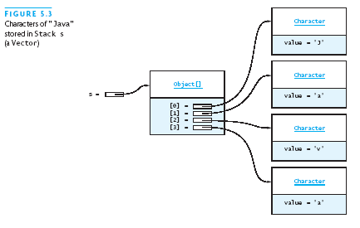
Implementing Stack as Extension of Vector (2)
Top element of the Stack is at the highest index

Slide 20
Stack Code
public class Stack<E> extends Vector<E> {
public E push (E e) {
add(e);
return e;
}
public E pop () throws EmptyStackException {
try {
return remove(size()-1);
} catch (ArrayIndexOutOfBoundsException ex) {
throw new EmptyStackException();
}
}
...

Slide 21
Stack Code (2)
public class Stack<E> extends Vector<E> {
...
public E peek () throws EmptyStackException {
try {
return get(size()-1);
} catch (ArrayIndexOutOfBoundsException ex) {
throw new EmptyStackException();
}
}
public boolean empty () {
return size() == 0;
}
}

Slide 22
Implementing Stack with a List
Can use ArrayList, Vector, or LinkedList:
  All implement the List interface
Name of class illustrated in text is ListStack
ListStack is an adapter class
  Adapts methods of another class to ...
  Interface its clients expect by ...
  Giving different names to essentially the same operations

Slide 23
ListStack Code
public class ListStack<E>
implements StackInterface<E> {
private List<E> list;
public ListStack () {
list = new ArrayList<E>();
// or new Vector<E> or new LinkedList<E>
}
public E push (E e) {
list.add(e);
return e;
}
...

Slide 24
ListStack Code (2)
public E peek () {
if (empty())
throw new EmptyStackException();
return list.get(list.size()-1);
}
public E pop () {
if (empty())
throw new EmptyStackException()
return list.remove(list.size()-1);
}
public boolean empty () {
return list.size() == 0;
}

Slide 25
Implementing Stack Using an Array
Must allocate array with some default capacity
Need to keep track of the top of the stack
Have no size method, so must track size
Similar to growable PhoneDirectory

Slide 26
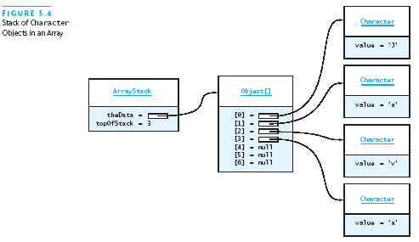
Implementing Stack Using an Array (2)

Slide 27
ArrayStack Code
public class ArrayStack<E>
implements StackInterface<E> {
private static final int INITIAL_CAPACITY = 10;
private E[] data =
(E[]) new Object[INITIAL_CAPACITY];
private int top = -1;
public ArrayStack () { }
public boolean empty () { return top < 0; }
...
}

Slide 28
ArrayStack Code (2)
public E push (E e) {
if (++top == data.length) reallocate();
return data[top] = e;
}
public E pop () {
if (empty()) throw new EmptyStackException();
return data[top--];
}
public E peek () {
if (empty()) throw new EmptyStackException();
return data[top];
}

Slide 29
ArrayStack Code (3)
private reallocate () {
E[] newData = (E[]) new Object[data.length*2];
System.arraycopy(data, 0, newData, 0,
data.length);
data = newData;
}

Slide 30
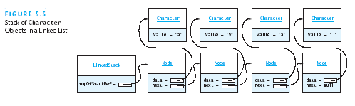
Implementing Stack as a Linked Structure
We can implement Stack using a linked list:

Slide 31
LinkedStack Code
public class LinkedStack<E>
implements StackInterface<E> {
private Node<E> top = null;
public LinkedStack () { }
public boolean empty () { return top == null; }
public E push (E e) {
top = new Node<E>(e, top);
return e;
}
...
}

Slide 32
LinkedStack Code (2)
public E pop () {
if (empty()) throw new EmptyStackException();
E result = top.data;
top = top.next;
return result;
}
public E peek () {
if (empty()) throw new EmptyStackException();
return top.data;
}

Slide 33
LinkedStack Code (3)
private static class Node<E> {
private E data;
private Node<E> next;
Node (E data, Node<E> next) {
this.data = data;
this.next = next;
}
}

Slide 34
Comparison of Stack Implementations
Vector is a poor choice: exposes Vector methods
Likewise, extending other List classes exposes
Using a List as a component avoid exposing
  LinkedStack operations are O(1)
    But Node objects add much space overhead
  ArrayList component is perhaps easiest
    Still some space overhead (Stack+ArrayList)
  Array as a component best in space and time
    But somewhat harder to implement

Slide 35
Additional Stack Applications:
Evaluating Arithmetic Expressions
Expressions normally written in infix form
  Binary operators appear between their operands:
    a + b c * d e * f - g
A computer normally scans in input order
  One must always compute operand values first
  So easier to evaluate in postfix form:
    a b + c d * e f * g -

Slide 36
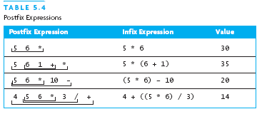
Postfix Expression Evaluation Examples

Slide 37
Advantages of Postfix Form
No need to use parentheses for grouping
No need to use precedence rules:
  Usual meaning of a + b * c is a + (b * c)
  * takes precedence over + ... or ...
  * has higher precedence than +
  Postfix: a b c * +
  For (a+b)*c, postfix is: a b + c *

Slide 38
Program: Evaluating Postfix Expressions
Input: String with integers and operators separated by spaces (for StringTokenizer)
Operators: + - * / (all binary, usual meaning)
Strategy:
  Use stack for input integers, evaluated operands
  Operator pops operands, computes, pushes result
  At end, last item on stack is the answer

Slide 39
Program: Evaluating Postfix Expressions (2)
Create empty Stack<Integer>
For each token of the expression String do:
If the token is an Integer (starts with a digit)
Push the token’s value on the stack
Else if the token is an operator
Pop the right (second) operand off the stack
Pop the left (first) operand off the stack
Evaluate the operation
Push the result onto the stack
Pop the stack and return the result

Slide 40
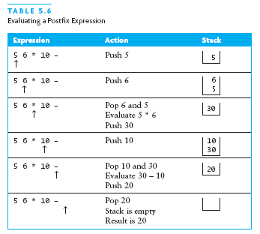
Program: Evaluating Postfix Expressions (3)

Slide 41
Program: Evaluating Postfix Expressions (4)
import java.util.*;
public class PostfixEval {
public static class SyntaxErrorException
extends Exception {
SyntaxErrorException (String msg) {
super(msg);
}
}
private final static String
OPERATORS = “+-*/”;

Slide 42
Program: Evaluating Postfix Expressions (5)
private Stack<Integer> operandStack =
new Stack<Integer>();
private int evalOp (char op) {
int rhs = operandStack.pop();
int lhs = operandStack.pop();
int result = 0;
switch (op) {
case ‘+’: result = lhs + rhs; break;
case ‘-’: result = lhs - rhs; break;
case ‘*’: result = lhs * rhs; break;
case ‘/’: result = lhs / rhs; break;
}
return result;
}

Slide 43
Program: Evaluating Postfix Expressions (6)
private boolean isOperator (char ch) {
return OPERATORS.indexOf(ch) >= 0;
}
public int eval (String expr)
throws SyntaxErrorException {
operandStack.reset();
StringTokenizer tokens =
new StringTokenizer(expr);
...;
}

Slide 44
Program: Evaluating Postfix Expressions (7)
try {
while (tokens.hasMoreTokens()) {
String token = tokens.nextToken();
... loop body ...
}
... after loop ...
} catch (EmptyStackException exc) {
throw new SyntaxErrorException(
“Syntax Error: The stack is empty”);
}

Slide 45
Program: Evaluating Postfix Expressions (8)
// loop body: work done for each token
if (Character.isDigit(token.charAt(0))) {
int value = Integer.parseInt(token);
operandStack.push(value);
} else if (isOperator(token.charAt(0))) {
int result = evalOp(token.charAt(0));
operandStack.push(result);
} else {
throw new SyntaxErrorException(
“Invalid character encountered”);
}

Slide 46
Program: Evaluating Postfix Expressions (9)
// Work after loop completes
int answer = operandStack.pop();
if (operandStack.empty()) {
return answer;
} else {
throw new SyntaxErrorException(
“Syntax Error: Stack not empty”);
}

Slide 47
Converting Infix to Postfix
Need to handle precedence
Need to handle parentheses
  First implementation handles only precedence
Input: Infix with variables, integers, operators
  (No parentheses for now)
Output: Postfix form of same expression

Slide 48
Converting Infix to Postfix (2)
Analysis:
  Operands are in same order in infix and postfix
  Operators occur later in postfix
Strategy:
  Send operands straight to output
  Send higher precedence operators first
  If same precedence, send in left to right order
  Hold pending operators on a stack

Slide 49
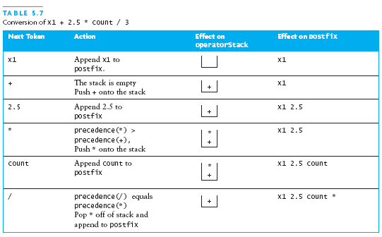
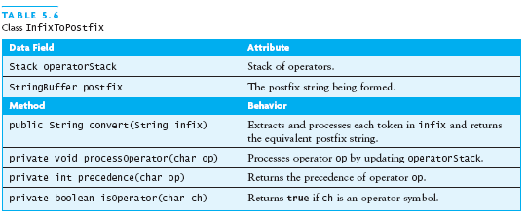
Converting from Infix to Postfix: Example

Slide 50
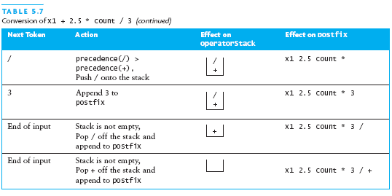
Converting from Infix to Postfix: Example (2)

Slide 51
Converting Infix to Postfix: convert
Set postfix to an empty StringBuilder
Set operator stack to an empty stack
while more tokens in infix string
Get the next token
if the token is an operand
Append the token to postfix
else if the token is an operator
Call processOperator to handle it
else
Indicate a syntax error
Pop remaining operators and add them to postfix

Slide 52
Converting Infix to Postfix: processOperator
while the stack is not empty & prec(new) ≤ prec(top)
pop top off stack and append to postfix
push the new operator

Slide 53
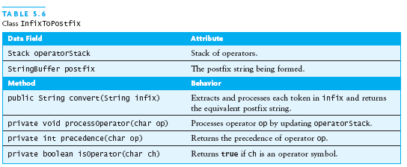
Converting Infix to Postfix

Slide 54
Infix toPostfix: Code
import java.util.*;
public class InfixToPostfix {
private Stack<Character> opStack;
private static final String OPERATORS = “+-*/”;
private static final int[] PRECEDENCE =
{1, 1, 2, 2};
private StringBuilder postfix;
private boolean isOperator (char ch) {
return OPERATORS.indexOf(ch) >= 0;
}
private int precedence (Character ch) {
return (ch == null) ? 0 :
PRECEDENCE[OPERATORS.indexOf(ch)];
}

Slide 55
Infix toPostfix: Code (2)
public String convert (String infix)
throws SyntaxErrorException {
opStack = new Stack<Character>();
postfix = new StringBuilder();
StringTokenizer tokens =
new StringTokenizer(infix);
try {
while (tokens.hasMoreTokens()) { loop body }
... after loop ...
} catch (EmptyStackException exc) {
throw new SyntaxErrorException(...);
}
}

Slide 56
Infix toPostfix: Code (3)
// loop body
String token = tokens.nextToken();
Character first = token.charAt(0);
if (Character.isJavaIdentifierStart(first) ||
Character.isDigit(first)) {
postfix.append(token);
postfix.append(‘ ‘);
} else if (isOperator(first)) {
processOperator(first)
} else {
throw new SyntaxErrorException(...);
}

Slide 57
Infix toPostfix: Code (4)
// after loop
while (!opStack.empty()) {
char op = opStack.pop();
postfix.append(op);
postfix.append(‘ ‘);
}
return postfix.toString();

Slide 58
Infix toPostfix: Code (5)
private Character top () {
return opStack.empty() ? null : opStack.peek();
}
private void processOperator (Character op) {
while (precedence(op) <= precedence(top())) {
postfix.append(opStack.pop());
postfix.append(‘ ‘);
}
opStack.push(op);
}

Slide 59
Infix toPostfix: Handling Parentheses
private static final String OPERATORS = “+-*/()”;
private static final int[] PRECEDENCE =
{2, 2, 3, 3, 1, 1};
private int precedence (Character ch) {
return (ch == null) ? 0 :
PRECEDENCE[OPERATORS.indexOf(ch)];
}

Slide 60
Infix toPostfix: Handling Parentheses (2)
private void processOperator (Character op) {
if (op.charValue() != ‘(‘) {
while (precedence(op) <= precedence(top())) {
char top = opStack.pop();
if (top == ‘(‘) break;
postfix.append(top);
postfix.append(‘ ‘);
}
}
if (op.charValue() != ‘)’) {
opStack.push(op);
}
}

Slide 61
Infix toPostfix: Handling Parentheses (3)
// in convert, after token loop:
while (!opStack.empty()) {
char op = opStack.pop();
if (op == ‘(‘)
throw new SyntaxErrorException(...);
// because ( is unmatched
postfix.append(op);
postfix.append(‘ ‘);
}

Slide 62
Infix to Postfix: Making It Even Cleaner
Can push a special “open bracket” first
  Stack is never empty
  This will not pop off: we give it very low precedence
Push the same special bracket at the end:
  Will cause other operators to pop off
Make bracket/parenthesis handling less special
  Add notion of left and right precedence
  Left value is for already scanned operator (on left)
  Right value is for not yet pushed operator (on right)

Slide 63
Infix to Postfix: Making It Even Cleaner (2)
Operator | + | * | ( | )
Left Precedence | 3 | 4 | 1 | ---
Right Precedence | 3 | 4 | 5 | 2
while (leftPred(top) >= rightPred(newer))
pop(top);
if (top == ‘(‘)
pop(top);
else
push(newer);

