Slide 1
BK
Bayandabenkosi Khumalo
Full Stack Developer | 1-3 years experience
I build fast, responsive websites that help small businesses look professional and win customers online.
Live portfolio: https://personal-portfolio-af5c7f.netlify.app

Slide 2
01 ABOUT ME
Developer, problem solver, builder.
I am a Full Stack Developer who enjoys turning a business idea into a working, polished product. My work so far has focused on local businesses — a logistics company, a sneaker cleaning service and a laundry room — where a good website directly means more bookings and more trust from customers.
My training in Full Stack Development and the FNB App Academy gave me a strong foundation in programming fundamentals, problem solving and building applications end to end. I am comfortable owning a project from the first conversation with a client through design, development and deployment.
I am currently looking for an internship or junior developer role where I can contribute to a team, learn from experienced engineers and keep growing as a developer.
LOCATION
South Africa
EXPERIENCE
1-3 years
QUALIFICATION
Full Stack Development
CERTIFICATION
FNB App Academy
PHONE
069 827 5896

Slide 3
02 SKILLS
Technical & soft skills
Languages
Web Development
Full Stack
Tools
JavaScript (ES6+)
Python
HTML5
CSS3
SQL
Responsive design
DOM manipulation
REST APIs
Forms & validation
SEO basics
Front-end & back-end development
Databases
Mobile app fundamentals
Deployment & hosting
Git & GitHub
VS Code
Netlify
Chrome DevTools
Figma
SOFT SKILLS
Communication with clients • Problem solving • Teamwork & collaboration • Time management • Attention to detail • Adaptability & fast learning

Slide 4
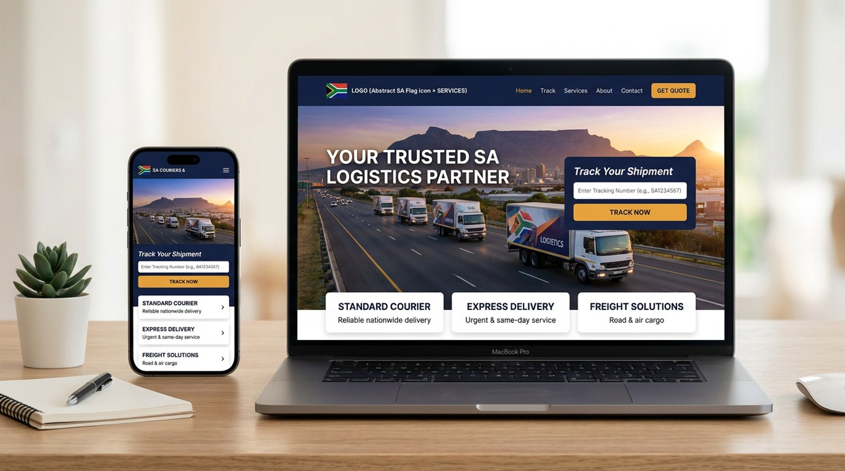
03 PROJECT 1 — LOGISTICS & COURIER
Dlokovu Logistics
A professional business website for a logistics company, presenting its transport and delivery services and making it easy for customers to request a quote.
Service pages for freight, courier and delivery offerings
Quote request and contact forms that go straight to the business
Mobile-first layout so customers can reach the team on the go
TECHNOLOGIES
HTML5 • CSS3 • JavaScript • Responsive design

Slide 5
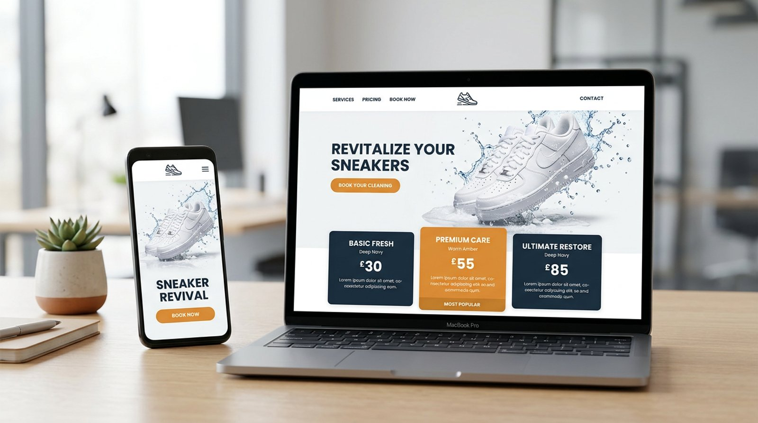
03 PROJECT 2 — SNEAKER CARE SERVICE
Zakhele Sneaker Clean
A bold, modern website for a sneaker cleaning business that showcases before-and-after results, lists service packages and drives bookings.
Pricing cards for each cleaning and restoration package
Gallery that shows off the quality of the work
Booking call-to-action with WhatsApp and phone links
TECHNOLOGIES
HTML5 • CSS3 • JavaScript • UI/UX design

Slide 6
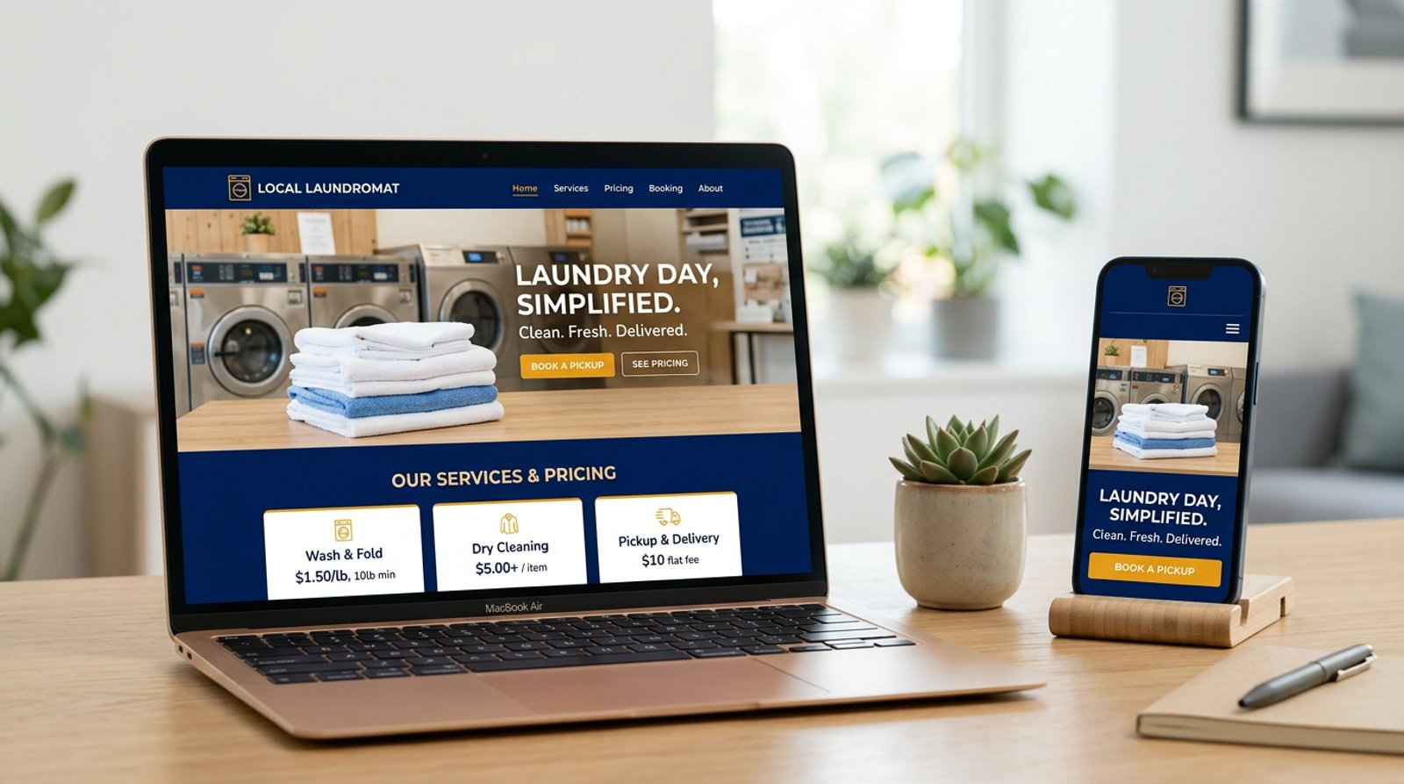
03 PROJECT 3 — LAUNDRY SERVICE
Thabethe Laundry Room
A clean, friendly website for a local laundry business with a clear price list, opening hours and a simple way to book a wash or pickup.
Easy-to-read service and price list
Location, hours and contact details on every device
Lightweight pages that load quickly on mobile data
TECHNOLOGIES
HTML5 • CSS3 • JavaScript • Responsive design

Slide 7
04 WORK EXPERIENCE
Where I've been building.
Freelance Full Stack Developer
Self-employed | South Africa | 1-3 years
Designed, built and launched websites for local businesses including Dlokovu Logistics, Zakhele Sneaker Clean and Thabethe Laundry Room.
Gathered requirements directly from business owners and turned them into clear, responsive page designs.
Wrote clean, maintainable HTML, CSS and JavaScript and deployed sites to the web.
Provided ongoing updates and support after launch.

Slide 8
05 EDUCATION & CERTIFICATIONS
Qualified and certified.
QUALIFICATION
CERTIFICATION
Full Stack Development
FNB App Academy
Institution name | Year - Year
First National Bank (FNB)
Qualification covering front-end and back-end development, databases, programming with JavaScript and Python, and deploying complete web applications.
Coding and app development programme by FNB covering programming fundamentals, problem solving and building real applications.

Slide 9
06 THE PORTFOLIO WEBSITE
How this portfolio was built
Responsive
Easy navigation
Contact form
Mobile-first layout that adapts to desktop, tablet and phone screens.
Sticky header with section links, active-section highlighting and a mobile menu.
Messages are delivered through Netlify Forms with spam protection.
Downloadable CV
Fast images
Modern stack
One-click PDF CV plus a printable online CV page.
Images are resized and converted to WebP on the fly by the Netlify Image CDN.
React, TypeScript, TanStack Start and Tailwind CSS, deployed on Netlify.

Slide 10
Thank you.
Let's work together — open to internships and junior developer roles.
PHONE / WHATSAPP 069 827 5896
EMAIL bayandabenkosi.khumalo@example.com
GITHUB github.com/your-github-username
LINKEDIN linkedin.com/in/your-linkedin-handle
PORTFOLIO personal-portfolio-af5c7f.netlify.app

