Slide 1

GitHub SDK Demo Presentation
Demo Presentation
Get Started →
GitHub
March 2026

Slide 2
⚡
GitHub Copilot SDK
Build an agent into any app — now in Technical Preview
What is it?
What Can You Build?
The same production-tested agentic core that powers GitHub Copilot CLI, packaged as a programmable SDK you can embed in any application.
🎨 Custom GUIs for AI agents🎬 YouTube chapter generators🎙️ Speech-to-command workflows🏢 Enterprise internal agents🎮 AI-powered games📝 Summarizing & productivity tools
Key Capabilities
Plan, invoke tools, edit files & run commands
Multi-turn execution loop with context management
Multiple AI model support & model routing
Full MCP server integration
Custom tool definitions & agent skills
GitHub authentication & real-time streaming
Get started → github.com/github/copilot-sdk
Source: GitHub Blog • Jan 2026 • Technical Preview

Slide 3
>_
GitHub CLI
Take GitHub to the command line — Free and open source
What is it?
gh is GitHub on the command line. It brings pull requests, issues, and other GitHub concepts to the terminal — right next to where you already work with git and your code.
Popular Commands
$ gh issue list
View & filter open issues
Key Features
$ gh pr create
Create a new pull request
$ gh pr status
Check status of your PRs
Your entire GitHub workflow
Issues, PRs, checks, releases & more
$ gh pr checks
View CI/CD check results
Script and customize
GitHub API access & custom aliases
$ gh release create
Create a new release
$ gh repo view
View repository READMEs
Enterprise-ready
Supports GitHub.com & Enterprise Server
$ gh alias set
Create command shortcuts
Open source & community-driven
Contributions welcome at github.com/cli/cli
Install → brew install gh
Source: cli.github.com • v2.88.1 • Free & Open Source

Slide 4
✦
GitHub Copilot CLI
Less // TODO: more done — A GitHub-native agent in your terminal
Overview
Key Capabilities
Run a GitHub-native agent in your terminal that works directly with your issues and PRs, executes across a /fleet of parallelized subagents, and carries you from /plan to merged code.
/model
Switch between Anthropic, Google & OpenAI models per task
/mcp
Native GitHub integration — issues, branches & PRs
Core Workflow
/agent
Shape behavior with AGENTS.md & custom skills
1
/plan your approach
Outline work, compare models
/resume
Persistent memory & session compaction across turns
2
/fleet to parallelize
/fleet
Parallelize work across multiple subagents
Run subagents in parallel
3
/IDE to refine
/experimental
Early access to preview features as they ship
Open in VS Code to edit code
/delegate to ship
🔒
Works inside your existing guardrails — branch protections, required checks & org policies apply automatically.
4
Branch, implement, open a PR
Install → npm install -g @github/copilot
Included in Copilot Free, Pro, Pro+, Business & Enterprise

Slide 5
{ }
GitHub Copilot SDK — Setup Guide
Embed Copilot's agentic runtime in your application • Technical Preview • MIT License
Architecture
Setup Steps
Your Application
1
Install Copilot CLI
↓
SDK Client (JSON-RPC)
curl -fsSL https://gh.io/copilot-install | bash
↓
Copilot CLI (server mode)
2
Install your preferred SDK
Authentication Options
Node.js
npm install @github/copilot-sdk
Python
pip install github-copilot-sdk
👤
GitHub signed-in user
Stored OAuth credentials from CLI login
Go
go get github.com/.../copilot-sdk/go
.NET
dotnet add package GitHub.Copilot.SDK
🔑
OAuth GitHub App
Pass user tokens from your GitHub OAuth app
Java
com.github:copilot-sdk-java
🌐
Environment variables
COPILOT_GITHUB_TOKEN / GH_TOKEN
3
Authenticate
Use GitHub OAuth, env tokens, or BYOK keys — see left column
🔓
BYOK (Bring Your Own Key)
Use your own OpenAI / Anthropic / Azure keys
Build your agent!
4
Define agent behavior — Copilot handles planning, tool invocation, file edits & more
Docs → github.com/github/copilot-sdk
Technical Preview • Python, TypeScript, Go, .NET, Java • MIT License

Slide 6
GitHub Copilot for Office — Setup Guide
CLI tools, SDK packages & Office Add-in registration • github.com/patniko/github-copilot-office
INSTALL THESE FIRST
CLONE, INSTALL & RUN
N
Node.js 20+
nodejs.org
1
Clone & Install Dependencies
nodejs.org — required runtime for CLI & SDK
git clone github.com/patniko/
github-copilot-office.git
cd github-copilot-office
npm install
G
Git
git-scm.com
git-scm.com — clone the repository
Installs @github/copilot-sdk, @github/copilot, React, Express & more
gh
GitHub CLI (gh)
brew install gh
2
Authenticate with GitHub
cli.github.com — provides GH_TOKEN for auth
gh auth login # GitHub CLI
copilot /login # Copilot CLI
export GH_TOKEN=<pat> # env var
C
GitHub Copilot CLI
npm i -g @github/copilot
Agent runtime — SDK communicates via JSON-RPC
3
Register Add-in
trusts SSL cert & registers manifest
$
Copilot Subscription
github.com/copilot
./register.sh
macOS
.\register.ps1
Win
Free tier available — or BYOK with own API keys
4
Start Tray App
npm run start:tray
O
Microsoft Office
M365 / 2019+
Word, PowerPoint, or Excel — M365 / 2019+
Copilot icon appears in system tray (Win) or menu bar (Mac)
5
Load in Office & Go!
Open Word / PPT / Excel → Insert → Add-ins → My Add-ins → select "GitHub Copilot"
Architecture:
Architecture: Office Add-in → React + Express → WebSocket Proxy → @github/copilot-sdk → Copilot CLI (JSON-RPC) → GitHub API
github.com/patniko/github-copilot-office
Word • PowerPoint • Excel | macOS & Windows

Slide 7
GitHub Copilot for Office — Setup Guide
CLI tools, SDK packages & Office Add-in registration • github.com/patniko/github-copilot-office
INSTALL THESE FIRST
CLONE, INSTALL & RUN
N
Node.js 20+
nodejs.org
1
Clone & Install Dependencies
nodejs.org — required runtime for CLI & SDK
git clone github.com/patniko/
github-copilot-office.git
cd github-copilot-office
npm install
Installs @github/copilot-sdk,
@github/copilot, React, Express & more
G
Git
git-scm.com
git-scm.com — clone the repository
GitHub CLI (gh)
2
Authenticate with GitHub
gh
brew install gh
gh auth login
copilot /login
export GH_TOKEN=<pat>
# GitHub CLI
# Copilot CLI
# env var
cli.github.com — provides GH_TOKEN for auth
C
GitHub Copilot CLI
npm i -g @github/copilot
3
Register Add-in
trusts SSL cert & registers manifest
Agent runtime — SDK communicates via JSON-RPC
./register.sh
.\register.ps1
S
Copilot SDK
npm i @github/copilot-sdk
macOS
Win
@github/copilot-sdk — Node.js bridge to Copilot CLI
4
Start Tray App
$
Copilot Subscription
github.com/copilot
npm run start:tray
Copilot icon appears in system tray (Win) or menu bar (Mac)
Free tier available — or BYOK with own API keys
5
Load in Office & Go!
O
Microsoft Office
M365 / 2019+
Open Word / PPT / Excel → Insert → Add-ins → My Add-ins → select "GitHub Copilot"
Word, PowerPoint, or Excel — M365 / 2019+
Architecture: Office Add-in → React + Express → WebSocket Proxy → @github/copilot-sdk → Copilot CLI (JSON-RPC) → GitHub API
github.com/patniko/github-copilot-office
Word • PowerPoint • Excel | macOS & Windows

Slide 8
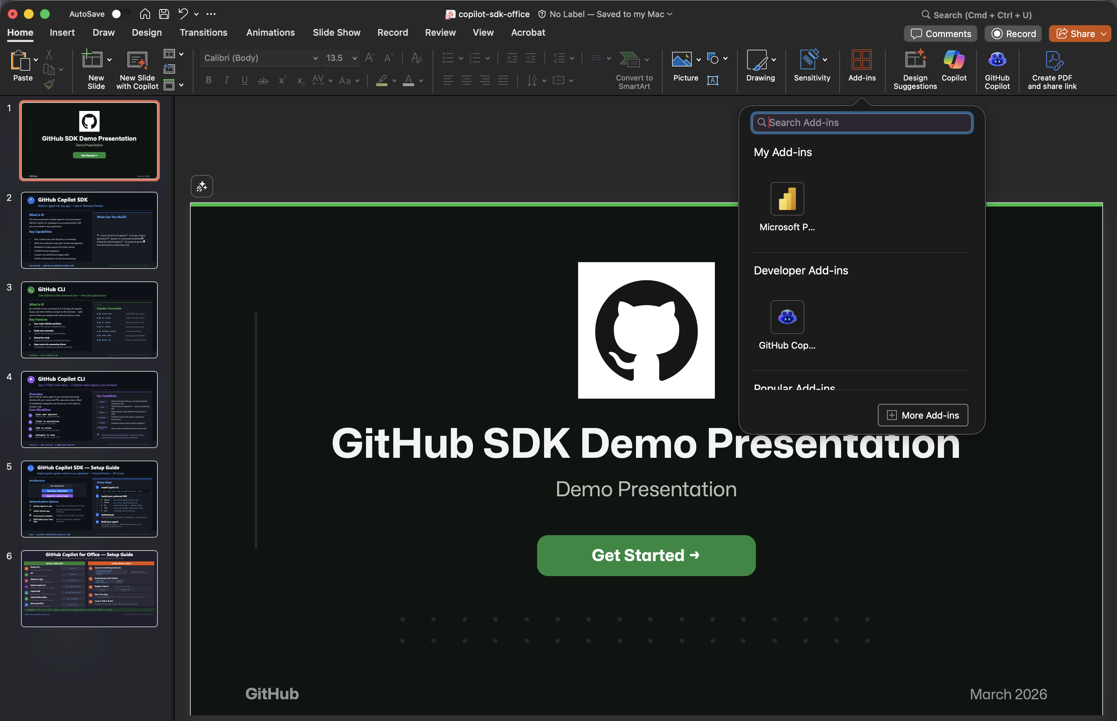
Add the GitHub Copilot Plugin
[ Insert screenshot here ]

