Slide 1

CSS
Cascading Style Sheets

Slide 2
Goal
Review some overarching concepts in CSS
Demonstrate some modern practices in CSS including Grids and Flexbox with some tips
Overall make CSS a more approachable task in development

Slide 3
Creation of CSS
Proposed by Hakon Wium Lie in 1994 and he co-created it with Bert Bos
Published in 1996
A style sheet language used for describing the presentation of a document written in a markup language such as HTML
HTML had a growing number of stylistic capabilities, but this was causing the markup to get more complex

Slide 4
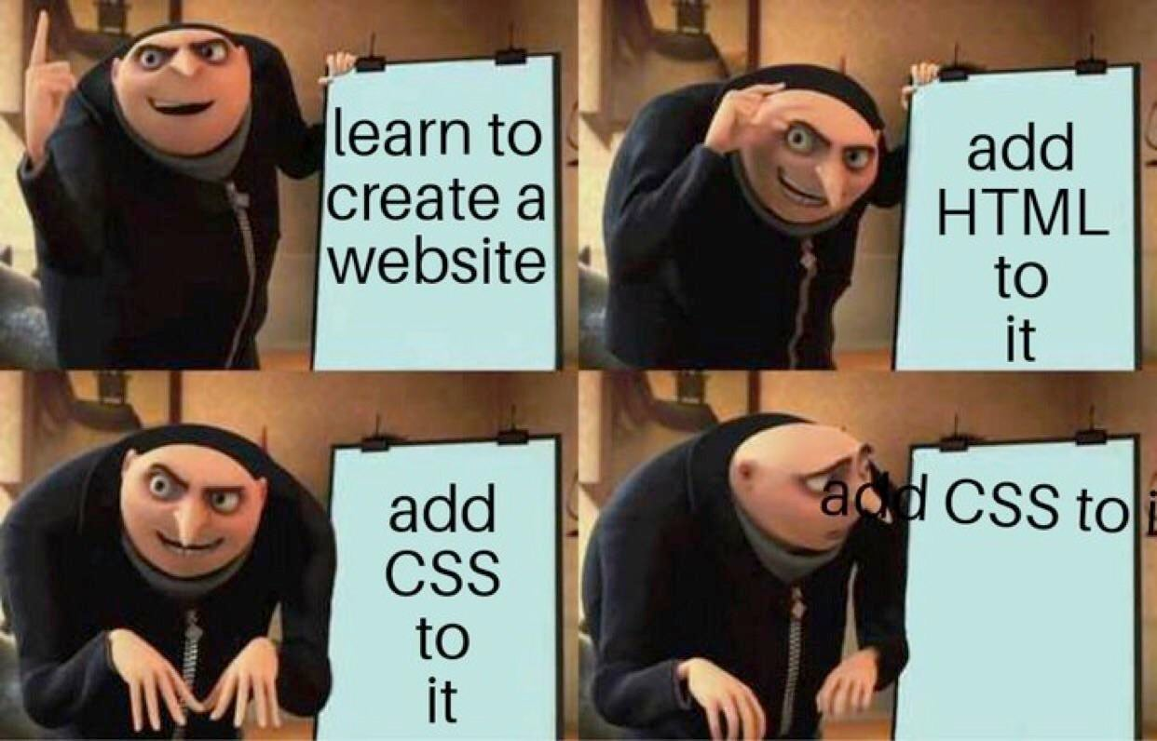

Slide 5
Syntax
selector {
property: value;
property: value;
}
Selectors can be element types (ie. h1, div), ids or classes
A CSS rule consists of a selector, and it's set of CSS properties

Slide 6
Specificity
Refers to the relative weights of various rules
id > class > element type
Be careful choosing selectors as not to change all global styles unless purposefully
Following a property value with !important can be used to overrule the specificity but should not be used lightly

Slide 7
Inheritance
Controls what happens when no value is specified for a property on an element
Some properties cascade down while others don’t
Inherited properties vs non-inherited properties
When debugging CSS remember specificity and inheritance

Slide 8
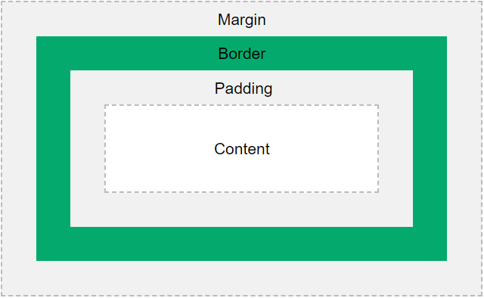
Box model
Calculates the size of the element
By default, includes margin, border,
padding and content
ie. width=200px, left + right padding = 20px, left + right border = 10px
width = 230px
box-sizing: border-box;
Forces all to fit within defined width and height
ie. width=200px, left + right padding = 20px, left + right border = 10px
width = 200px content is forced into 170px width

Slide 9
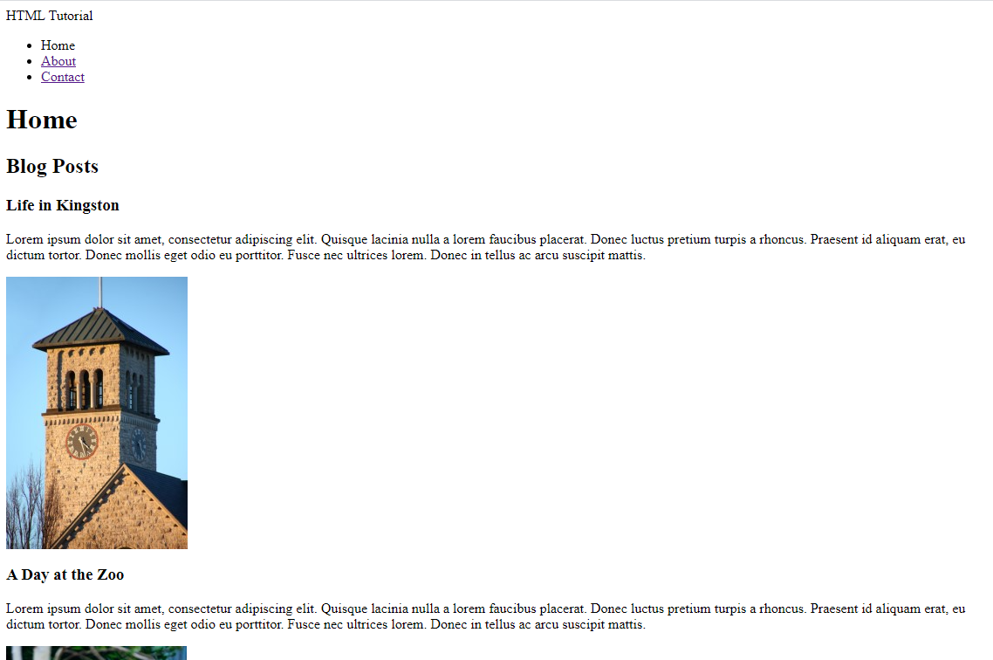
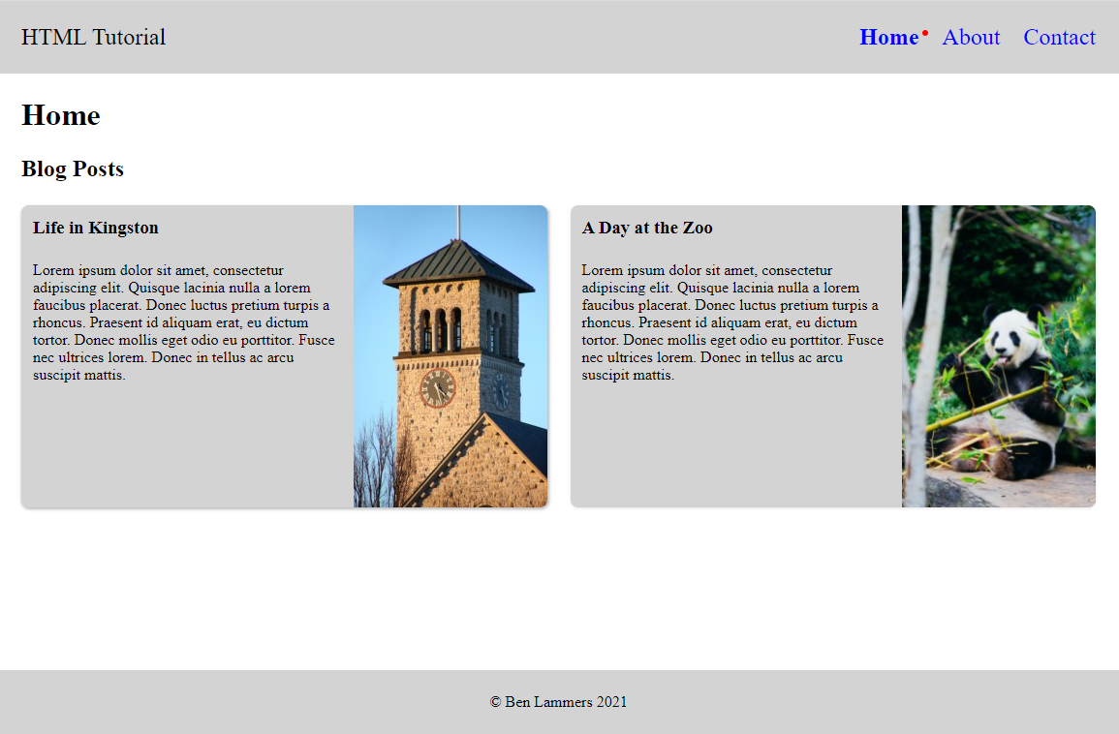


Slide 10
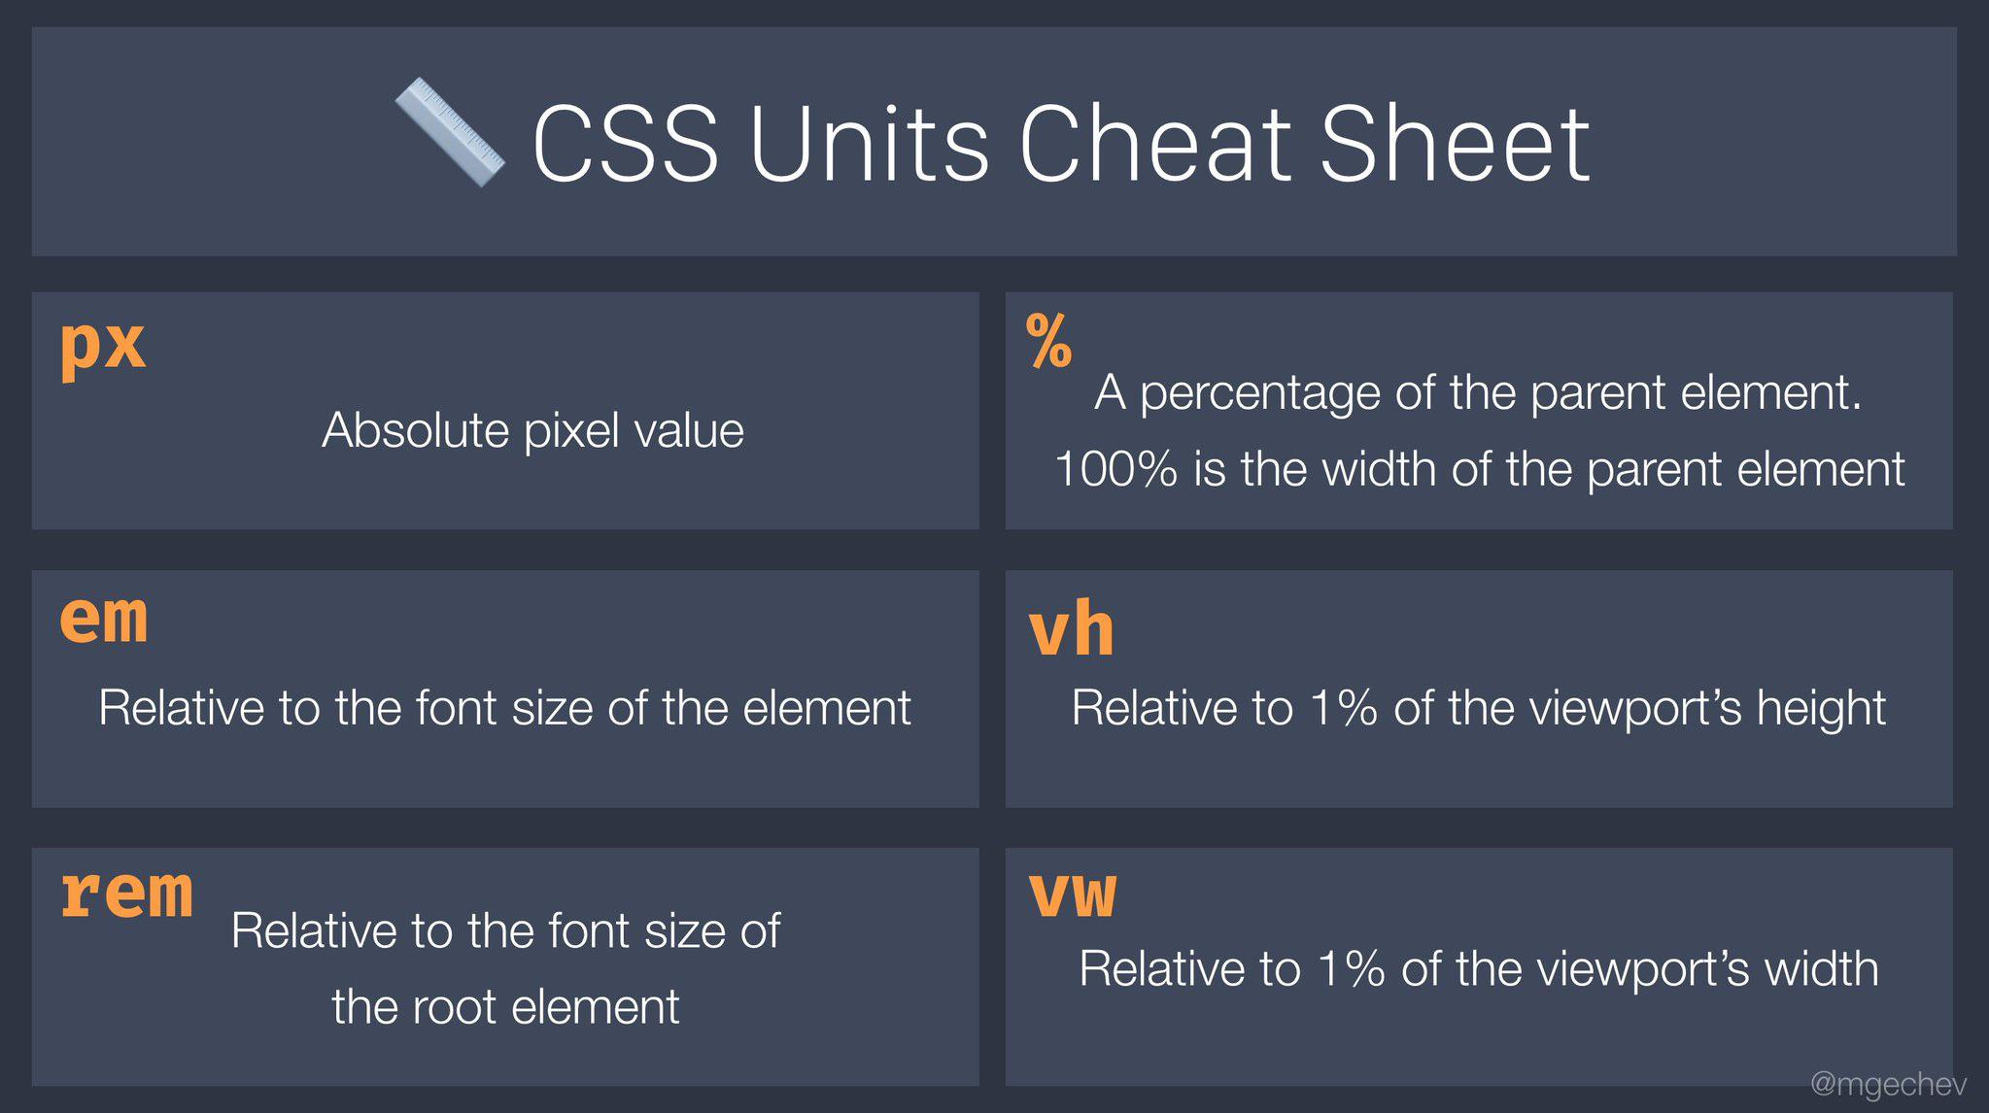

Slide 11
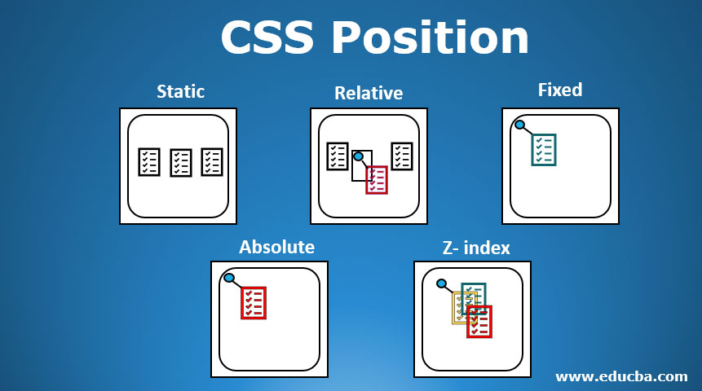

Slide 12
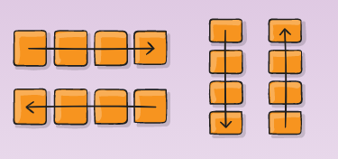
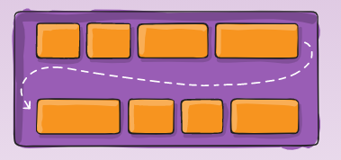
Flexbox
For aligning all elements within a container in one direction
A Guide to Flexbox

Slide 13
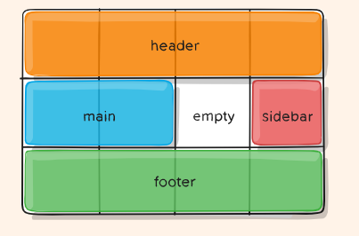
Grids
A grid-based layout system with rows and columns, and numerous properties making it easier to design layouts in CSS
A Guide to Grids

Slide 14

Breakpoints & Responsiveness
With the vast range of devices and screen sizes available it is important to cater to as many as possible
Breakpoints can be set to effect styling at different screen sizes
Can apply styles using max-width or min-width breakpoints among other options

Slide 15
More Features
Custom Properties
Animations

Slide 16
Image Sources
Box Model: https://www.w3schools.com/css/css_boxmodel.asp
CSS Units: https://www.reddit.com/r/webdev/comments/fngh3z/heres_a_cheat_sheet_for_css_units/
Positioning: https://www.educba.com/css-position/
Flexbox: https://css-tricks.com/snippets/css/a-guide-to-flexbox/
Grid: https://css-tricks.com/snippets/css/complete-guide-grid/
Responsive: https://brolik.com/blog/responsive-web-design-examples-with-css-tips-and-tricks/

